Slide 1


AirNow - Providing the Public with Easy Access to National Air Quality Information
NC Teachers Workshop
July 10th, 2019
John E. White

Slide 2
Introduction
Two major kinds of air quality reporting
Attainment status
Air Quality Index (Real-Time and Daily)
Reporting for attainment status designation is based on official, verified, reviewed, and multi-year data (required)
Air Quality Index (AQI) reporting is based on unofficial, partially quality-controlled, and hourly data.
Solely for the purpose of protecting public health now
Voluntary (real-time reporting)

Slide 3
Air Quality Index (AQI)
An air quality index (AQI) is a number used by government agencies to communicate to the public how polluted the air currently is or how polluted it is forecast to become
Makes it easy for public communication and understanding
Aids in government transparency
Develops good will
Makes data and information easy and understandable
Can catalyze political will and action - gain support for controls and regulations to protect health
As the AQI increases, an increasingly large percentage of the population is likely to experience increasingly severe adverse health effects
Different countries have their own air quality indices, corresponding to different national air quality standards

Slide 4

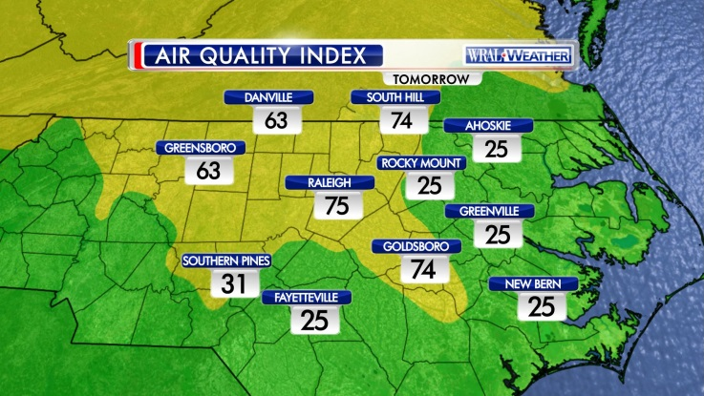
Air Quality Index (AQI)
Purpose
Communicate air quality to the public
Protect people’s health
Reduce people’s exposure to poor air quality, especially sensitive groups (people with heart or lung disease, older adults, and children)
Same AQI scale and color are used for all pollutants and across the U.S.

Slide 5
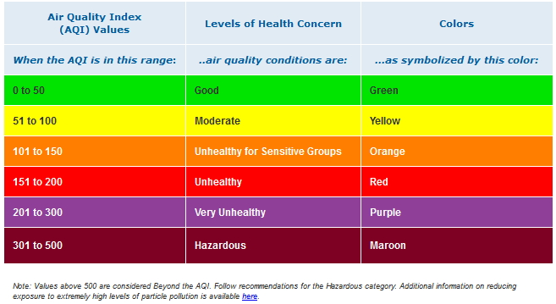
Air Quality Index (AQI)
Air Quality Index (AQI) creates national consistency
Links concentrations to health effects and actions
Ranges from 1 to 500; 101+ is unhealthy
Notes:
Pollutant-specific health effects and cautionary statements address question “who will be affected”
Advisories based on health information supporting the NAAQS
Controlled human exposure, epidemiological studies exposure/risk assessments used to set breakpoints
Epidemiological studies useful for identifying risk factors and more serious effects
Controlled human exposure studies useful for identifying proportion of healthy population affected, symptoms, mechanisms of effects, genetic variability
Exposure assessments help identify at-risk groups
Dose = Concentration x Ventilation rate x Time
C - be active outdoors when air quality is better
V - take it easier when active outdoors
T - spend less time being active outdoors
PAY ATTENTION TO SYMPTOMS!

Slide 6
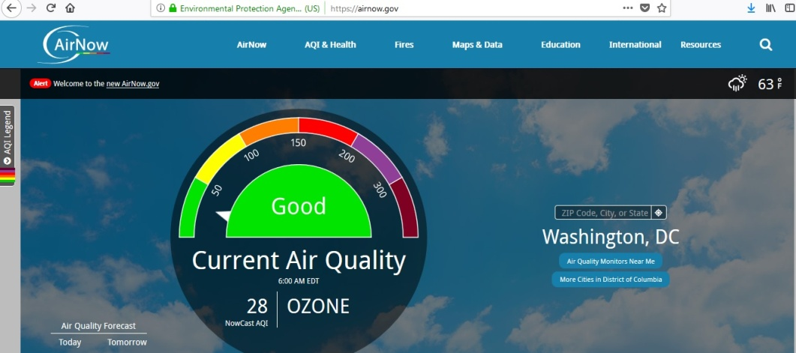
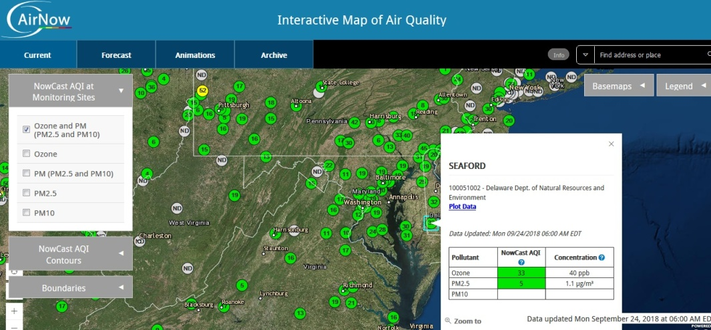
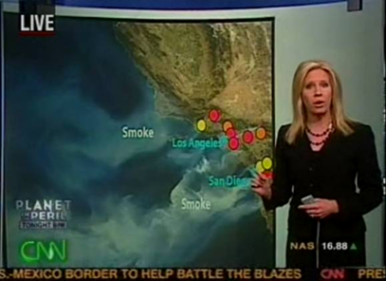
AirNow Program
AirNow is the national framework for acquiring and distributing air quality information (AQI)
Gathers and quality assures data provided by 150+ federal, state, tribal, and local air quality agencies
Real-time and forecasted air quality information to the public
U.S. Embassy data worldwide
Canada, Mexico
Next-day AQI forecasts for nearly 500 cities
Public/private partnerships with The Weather Channel, USA Today, CNN, weather service providers, NOAA National Weather Service
Educates public on air quality and health
America’s “go to” resource for current and forecasted air quality information

Slide 7
AirNow Program
Public
Website: Averages 5 million views each year
During 2018 November wildfires we were the #2 website in the entire federal government (USPS #1)
New website crashed after 25k concurrent users…old site in place now until relaunched in the cloud
iPhone App: more than 50,000 installed (needs to be updated!)
State/local/tribal agencies
300,000+ EnviroFlash email alert subscribers
210 million people in areas that have AQI forecasts
Emergency response
Public and states used AirNow to convey info about BP oil spill, Katrina, and wildfires
Others
Epi studies, researchers, other federal agencies

Slide 8
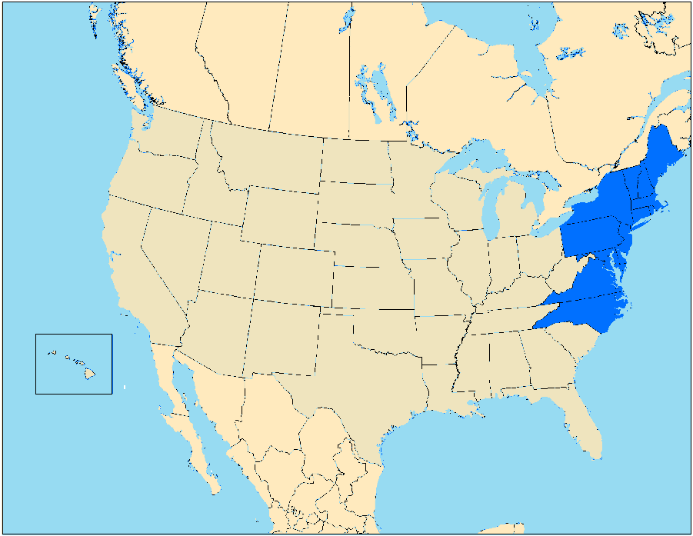
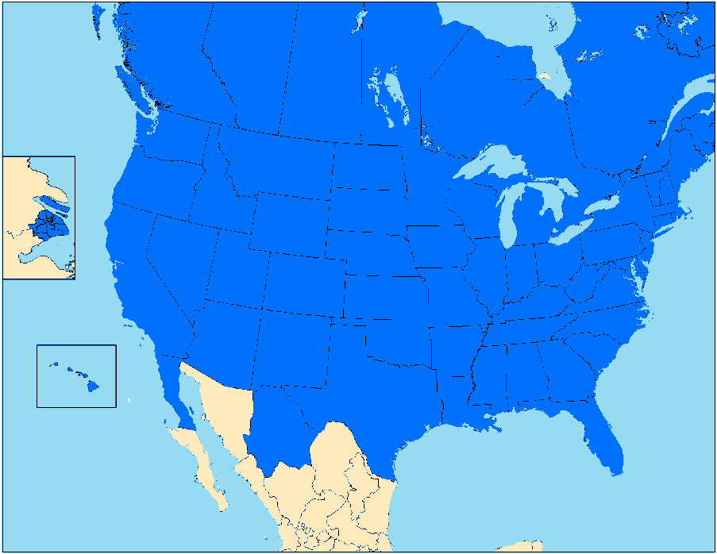
AirNow History
1997
2019
Started with 14 US States…
50 US States, 12 Provinces in Canada, 4 states in Mexico, Taiwan, Japan, Thailand and 43 Embassy Posts

Slide 9
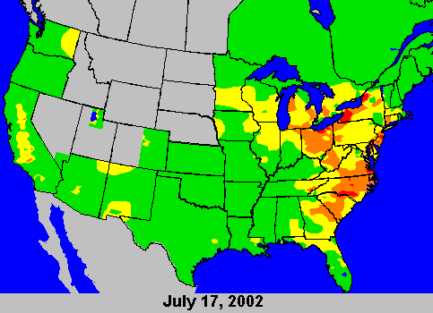
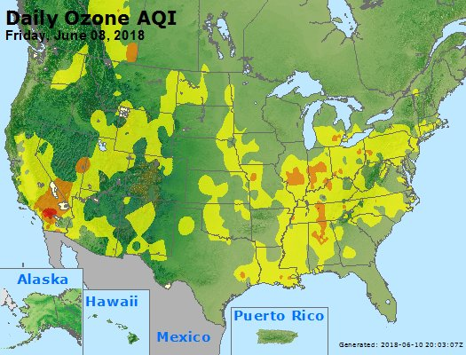
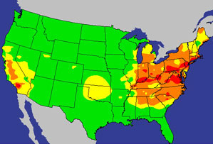
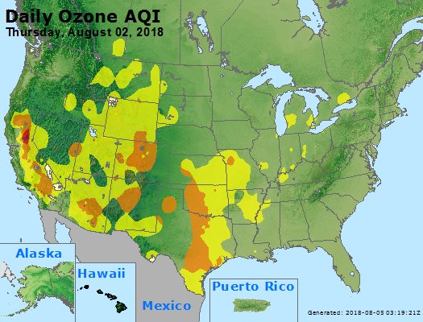
Much Progress in Last Decade…
Typical Summer Day in early 2000’s
(Ozone standard – 80ppb)
Worse Days in 2018
(Ozone standard – 70ppb)
Notes:
Started in 1995 in the state of Maryland
Today, the AirNow provides (read the slide)
• Since 1997, funded by U.S. EPA, but stakeholder involvement is voluntary
Non-regulatory program
• Standardized Air Quality Index (AQI)

Slide 10
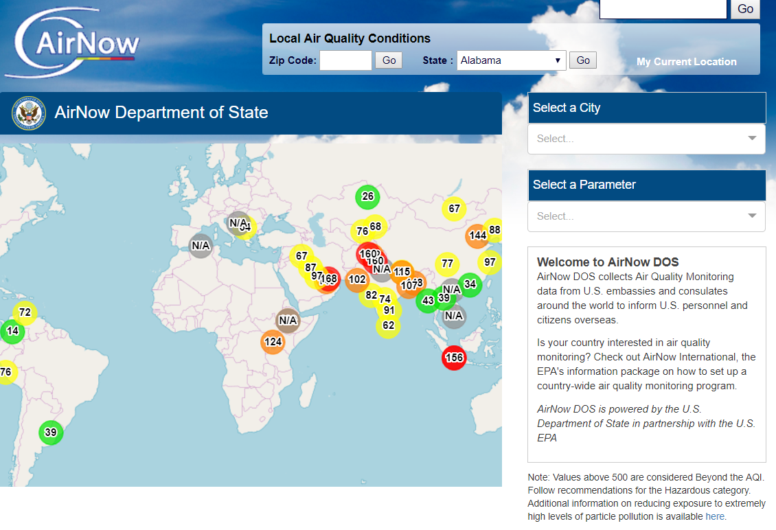
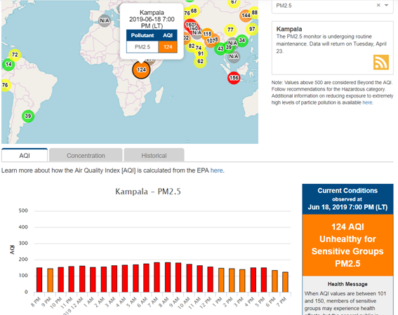
Department of State/EPA Program
Agreement between USEPA and DoS
DoS has 43 monitors around the world – more coming
https://airnow.gov/index.cfm?action=airnow.global_summary

Slide 11
New Website Coming Soon
Originally launched in September 2018
California Wildfires in November brought the site down
EPA moving to a cloud/scaling environment
Evaluated and improved the application as well
More comprehensive load testing
Will do a soft launch later this year
Keep current site as front and center with link to new one
When satisfied after extensive testing of cloud then switch to the new website

Slide 12
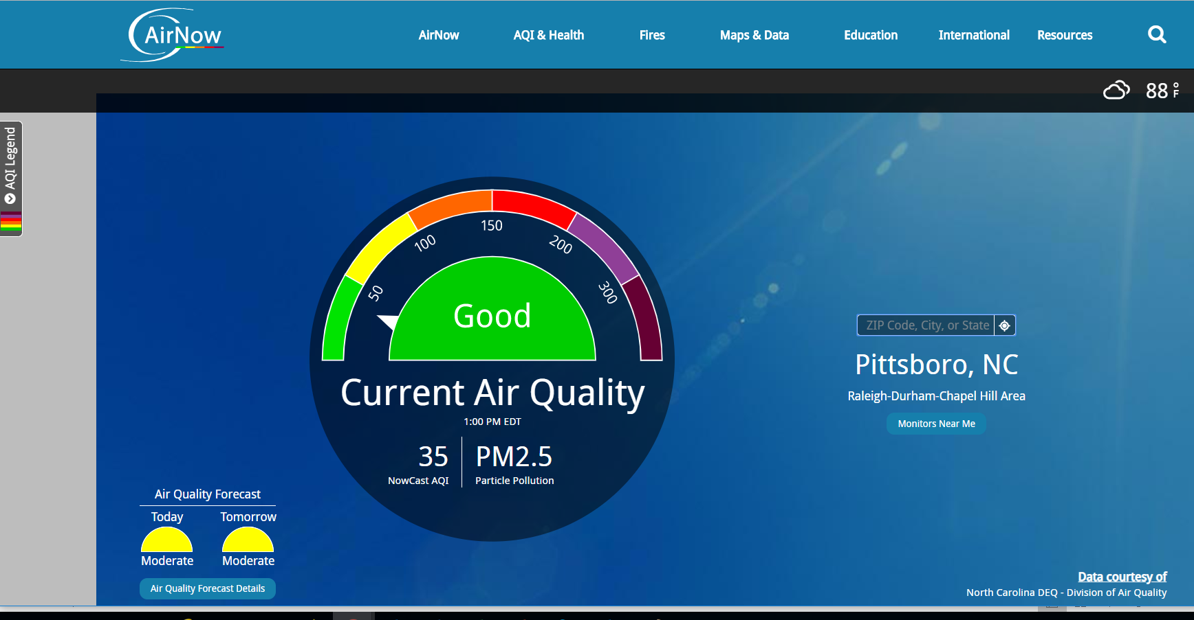
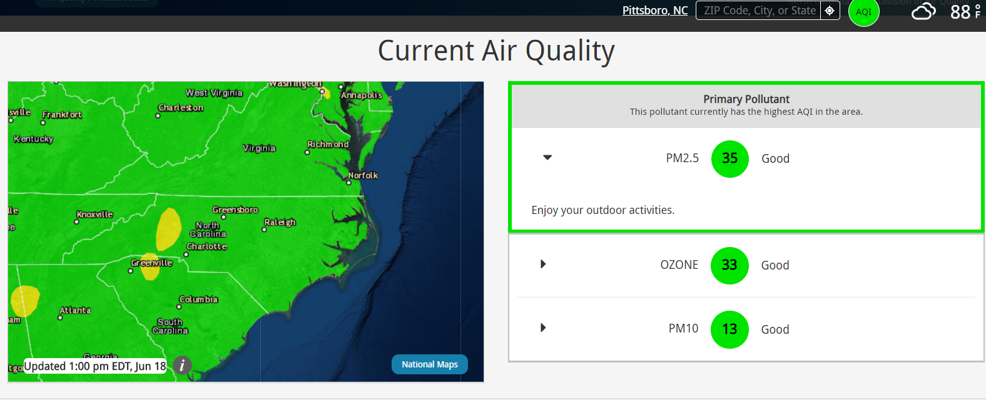
AirNow Web Site
All Information is provided by state, local, tribal and federal agencies

Slide 13
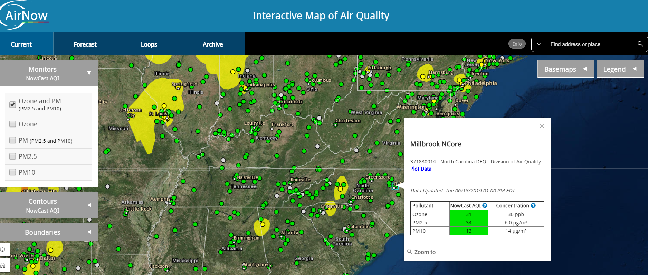
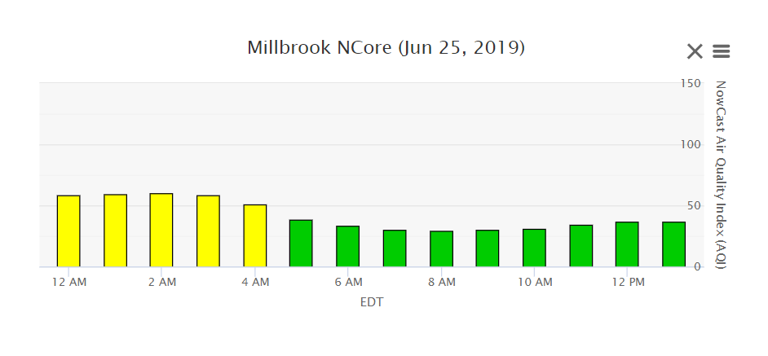
AirNow Web Site
New Interactive Map
Click on individual monitors and get data/charts!
Will be the first time the public can get data from AirNow

Slide 14
Tips about the Information You See
What does this AQI mean/represent?
Reporting Areas are designated by these various agencies
Highest of measured pollutants at given time
Highest can be from just one monitor or many
Each pollutant has its own AQI (different averaging times and breakpoints but same color scale)
AirNow doesn’t report AQI’s for SO2, NO2, or CO (yet)
Nowcast? What is it?
Data received every hour, EPA doesn’t have a 1-hr AQI for ozone or PM
EPA uses statistical modeling to estimate the AQI based on recent hourly data trends to reflect short term air quality
Forecasts
Issued for maximum 8-hr ozone for a day, or the 24-hr average for PM for the day
Forecasters aim for the max value for ozone, average for the day for PM
Often differs from short peaks that you may see

Slide 15
Quick Demo
http://airnowgovit4qj7irj3.devcloud.acquia-sites.com/

Slide 16


Contacts
John E. White
white.johne@epa.gov
Phil Dickerson
dickerson.phil@epa.gov
Lourdes Morales
morales.lourdes@epa.gov

