Slide 1


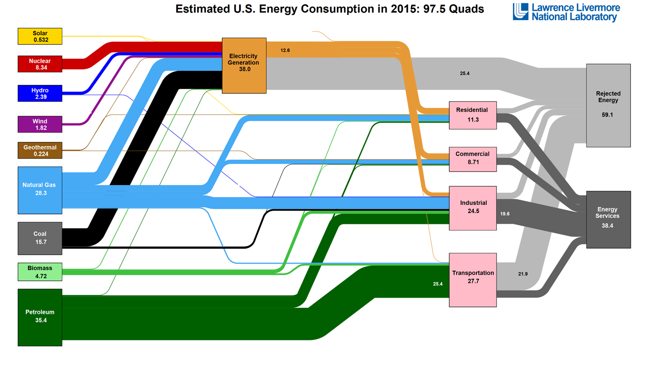
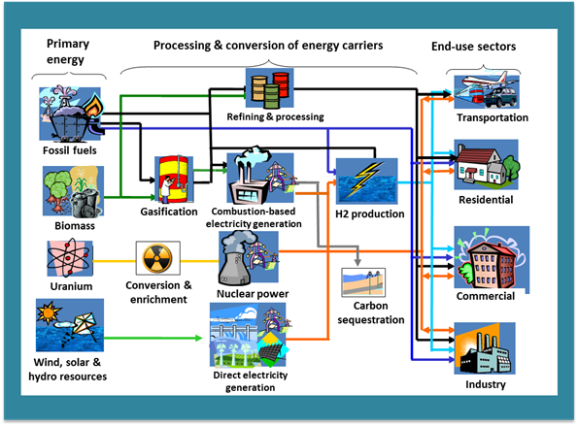
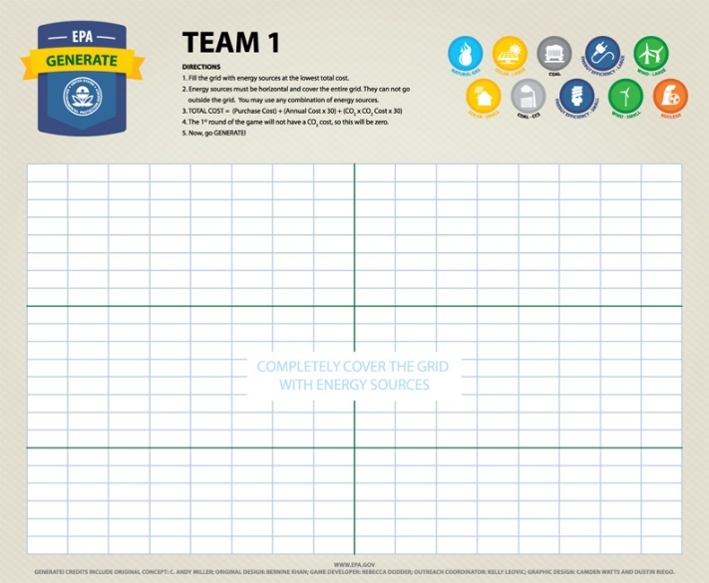
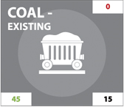
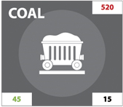





Generate: The Game of Energy Choices

Slide 2
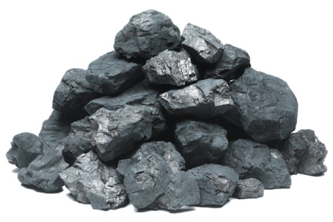
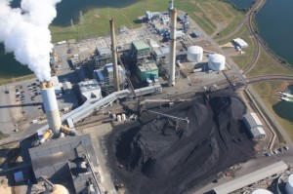
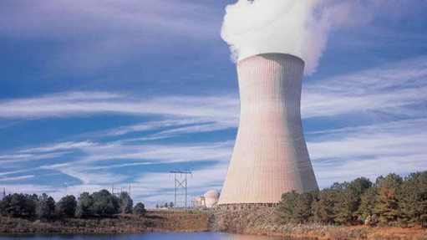
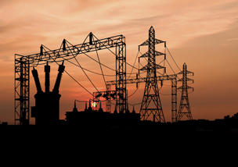



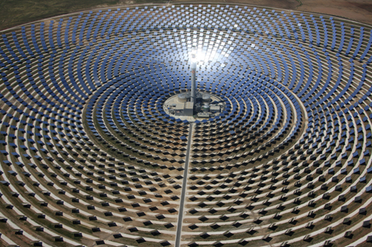
The big picture: What is the energy system?
Primary energy resources
Fossil: coal, natural gas, petroleum
Uranium
Renewable: wind, solar, hydro, geothermal, biomass
Technologies to convert primary resources to useable energy like electricity, gasoline, …
Petroleum Refineries
Electric Power Generation
End-use sectors
Residential
Commercial
Industrial
Transportation
Energy services – What people actually need and want: For example, mobility (vehicle miles of travel), lighting (lumens of light), comfort (space heating and cooling). Energy is a “derived demand”

Slide 3

Connecting the dots: where we use what energy
U.S Energy Flows from Resource to End Uses
1
2
Electricity
3
Rejected Energy
Residential
4
5
Commercial
6
Industrial
Used Energy
7
8
Transportation
9
Coal
Natural Gas
Petroleum (Crude Oil)
Solar
Wind
Hydropower
Biomass
Geothermal
Nuclear

Slide 4
Connecting the dots: where we use what energy
U.S Energy Flows from Resource to End Uses
1
2
Electricity
3
Rejected Energy
Residential
4
5
Commercial
6
Industrial
Used Energy
7
8
Transportation
9
Coal = 7
Natural Gas = 6
Petroleum (Crude Oil) = 9
Solar = 1
Wind = 4
Hydropower = 3
Biomass = 8
Geothermal = 5
Nuclear = 2

Slide 5

Energy and our environment: why it matters
Energy-system related impacts
Criteria air pollutants (EPA 2016)*
NO_{X} – 93%
CO – 61%
SO₂ – 81%
PM_{2.5} – 63% (excl. misc.)
Greenhouse gases (GHG EI 2015)**
CO₂ – 95%
Methane – 42%
Nitrous oxide – 13%
Water use (USGS 2010 data) 51% of total surface freshwater withdrawals are used for electric power
*includes fuel combustion (elec., ind. & other), petroleum & related industries, highway & off-highway from 2016 Air Pollutant Emissions Trends Data
**includes fossil fuel combustion & natural gas and petroleum systems
Notes:
GHG Emissions Inventory, 2015
CO2 from fossil fuel combustion for elec, res/com, ind = 5049.8
Natural gas systems = 42.4, petrochemical production = 28.1, petrochemical systems = 3.6
Total CO2 emissions= 5411.4 MMT CO2-eq
CH4 from natural gas systems, coal mining, petroleum systems, stationary combustion, mobile combustion, petrochemical combustion = 272.4
Total CH4 emissions = 655.7 MMT CO2-eq
N2O from stationary combustion, mobile combustion, electrical transmission and dist. = 42.4
Total N2O = 334.8

Slide 6
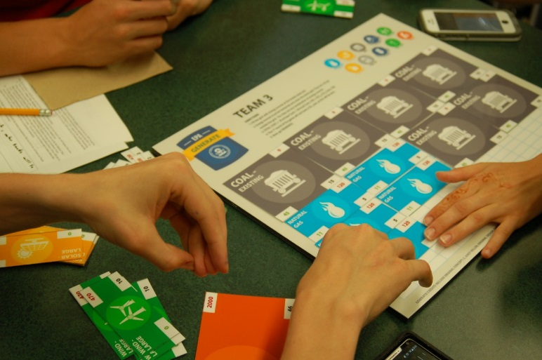
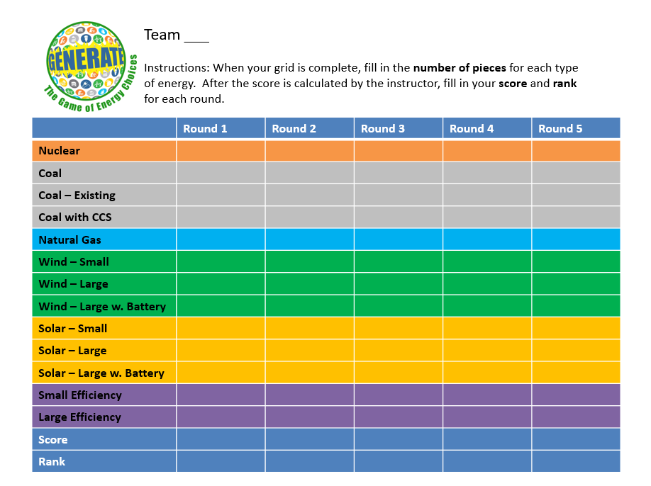
Generate: The Game of Energy Choices
A simple “simulation” of an energy system
Helps us to see some of the challenges and tradeoffs involved in making energy choices
Each team has roughly the same total energy (area of available pieces)
Each team does not have the same mix of energy pieces
Goal is to fill the game board with energy types to achieve the lowest total score
Score = purchase cost + operating cost + CO₂ cost

Slide 7
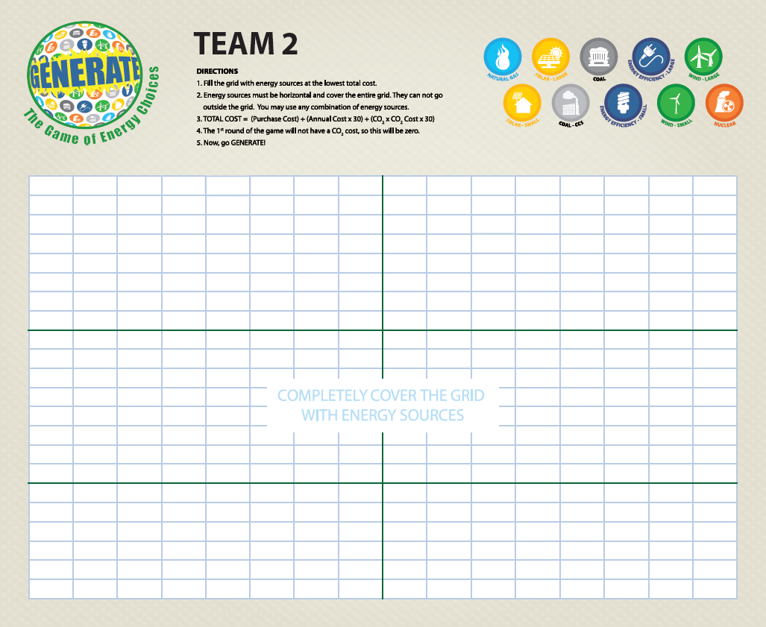
The game board = the “grid”
Students teams are the decision makers for how they want to produce energy
They will use this board for multiple rounds of game play
Each team can be thought of as a town, state, region or country

Slide 8
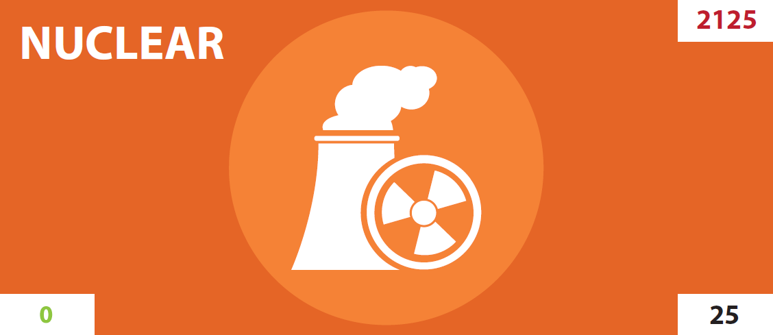
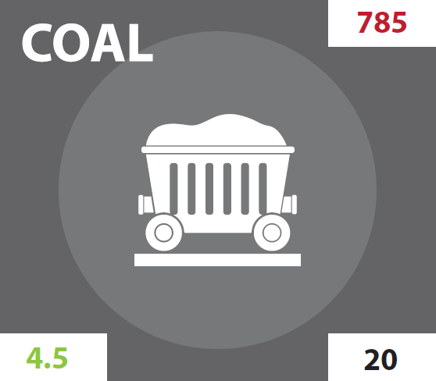
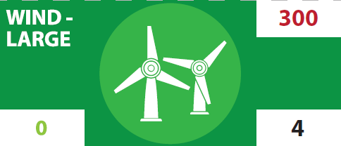
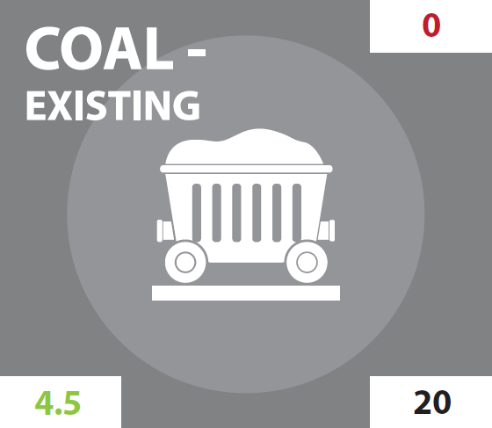
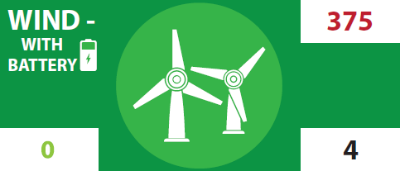
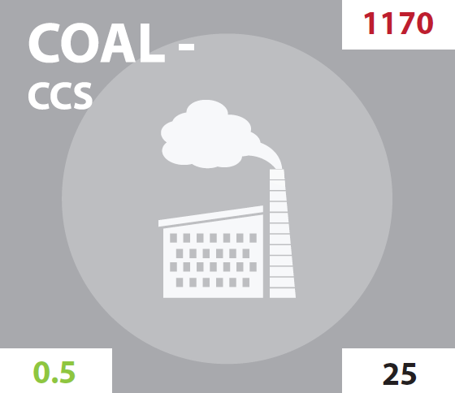
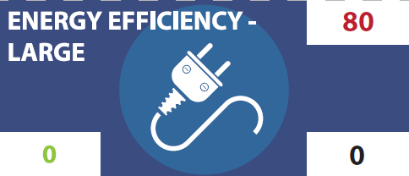
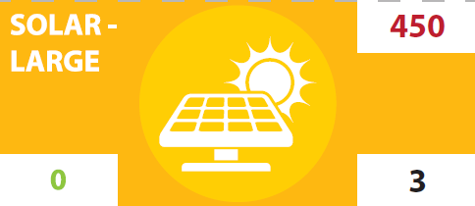
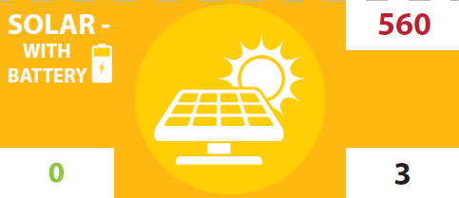
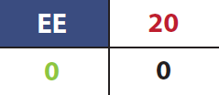
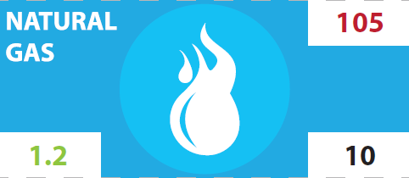

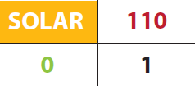
Types of energy pieces (each team will have a different mix)

Slide 9

Parts of the energy pieces
Type:
What primary energy resource does it use?
Purchase Cost:
How much does it cost up front to build/purchase?
Size: How much energy does it produce?
CO₂ emissions:
How much CO₂ does it produce each year?
Annual Cost:
How much does it cost each year to run/operate?
Lifetime: All energy pieces will last 30 years
Cost per piece = 785 + (20 * 30) + (4.5 * 30) * CO₂ cost
(for 30 years) = 1385 (if CO₂ cost is zero)

Slide 10
Now, let’s play a few rounds of Generate!

Slide 11
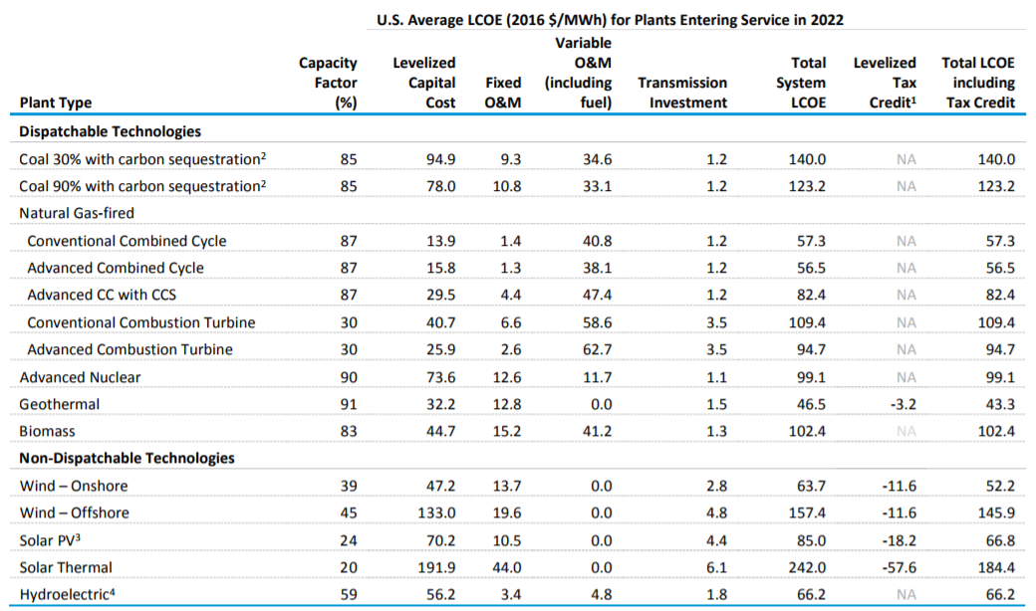
Levelized Cost of Electricity (LCOE) for projected plants
https://www.eia.gov/outlooks/aeo/pdf/electricity_generation.pdf

Slide 12
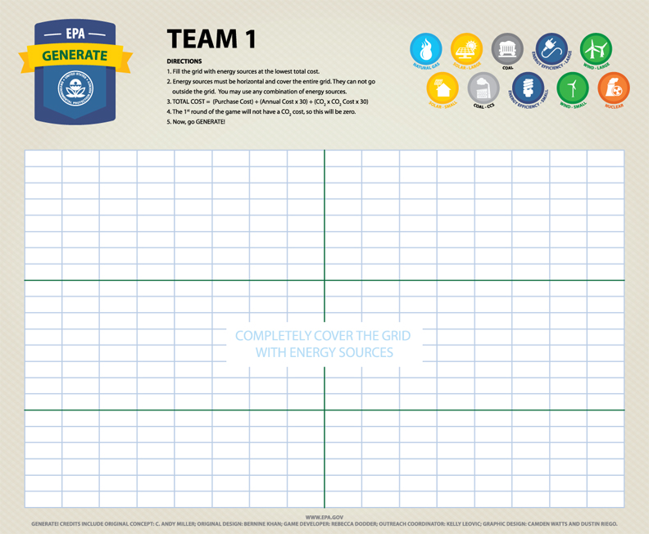
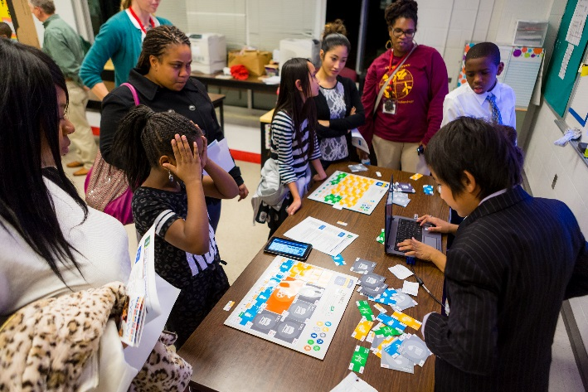
It’s all fun and games…
Scientific models are approximations of the objects, systems or phenomena that they represent.
In a basic way, games do the same thing.
Evolving modes of outreach
Working with directly with students (EPA RTP)
Working with teachers and informal educators
Teacher’s trainings (OAQPS, ORD, UNC Chapel Hill)
2017 NSTA STEM Forum Workshop
Development of online materials
2014 NSTA Webinar
2014 and 2017 web accessible versions of game
100’s of teachers/educators are using it and 1000’s of students have played
Used in K-12 classrooms, museums, afterschool programs/clubs.
Across the U.S., high level of use in NC, mostly high school
Used at universities, community colleges, public events, faith groups
Interest from Jordan, Australia, U.K., Lebanon
Scaling up user base
“This is the best science board game EVER!”
6th grader
“It was cool, funny and angering at times!” 6th grader

Slide 13
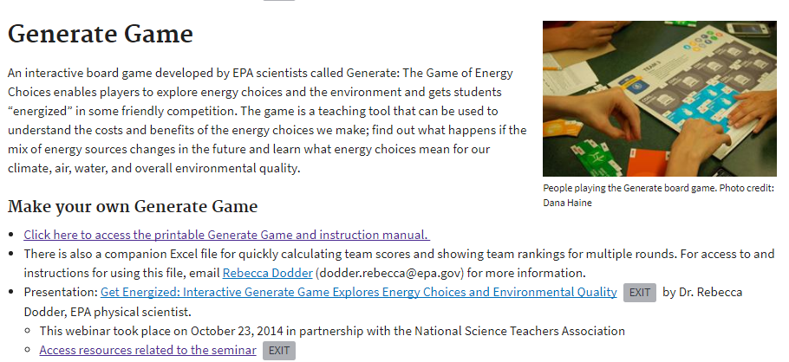
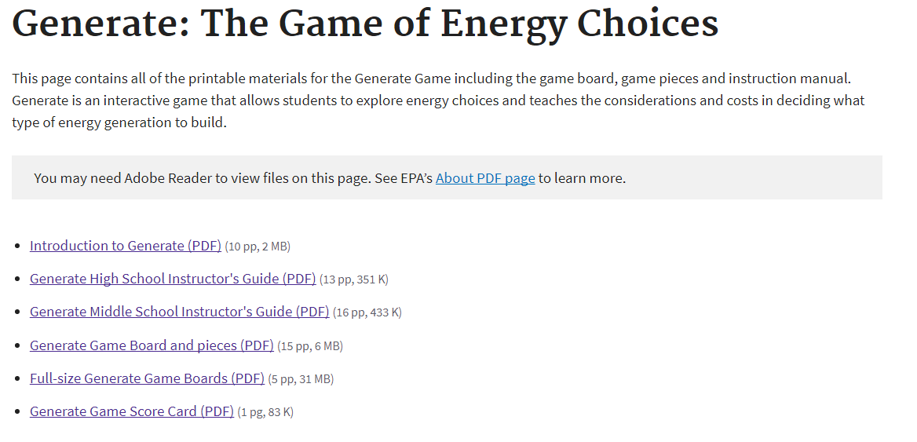
Online resources
https://www.epa.gov/air-research/air-quality-and-energy-choice-stem-activities-educators
https://www.epa.gov/climate-research/generate-game-energy-choices

