Slide 1
2016 Platform EGU Small Group
3/14/2019

Slide 2
Future year IPM Processing for 2016 Beta Platform
Background
When IPM is run and used for air quality modeling, the data are parsed from regional to unit-level and then converted into flat files that can be input to SMOKE
A cross reference from NEEDS to NEI units is used during flat file creation
In 2011 and previous platforms, units with certain fuels were not included in the flat files, e.g.:
Landfill gas, Municipal Solid Waste, Non-fossil Waste
Gap filling of emissions
IPM computes some but not all pollutants for these previously not-included sources – base year data can help us to compute future emissions
Fuel Type | Missing Pollutants | Base Year Heat Input Coverage
Land Fill Gas | All but NOx | None
MSW | All but NOx and SO2 | None
Non-Fossil Waste | All | None

Slide 3
Gapfilling
We can use base year emissions and generation to compute missing future year emissions
Emissions can be estimated by projecting base year emissions using growth of generation or heat input.
Most of these units do not have CEMS and so do not have base year heat input from CAMD.
2016 BY generation is available from EIA Form 923
Contains monthly generation by unit
Method only valid for units that have BY emissions and BY generation/heat input

Slide 4
Fuel Types for Gapfilling
The non-fossil waste, MSW, and landfill gas fuel types have the highest amount of gap-filled emissions.
Non-fossil waste is a catch-all fuel that includes pulp and paper waste at cogeneration facilities, dairy waste, calciners, biomethane, and other fuels that may have poorly defined emissions factors.
The gapfilled emissions are a small portion of total future year emissions
Natural gas units are assumed to have zero SO2 emissions and are not gap-filled
This is a difference between IPM and ERTAC

Slide 5
EGU Gapfilling Implementation
Method:
FY emis = base year emis. (tons) * proportion of base year emissions at IPM unit * (FY generation (MWhr) / BY generation (MWhr))
Challenges
Projecting emissions from EIS flat file to IPM flat file requires one to many unit splitting for some units (first factor in equation)
Projection requires applying IPM to EIS generation fractions to process-level emissions, not unit-level
Assumed that no new controls came online
EIA 923 unit level generation not available for all units (facility level projections used in these cases)
Some units operated in IPM but are not matched to base year inventory (see summary spreadsheets of these)

Slide 6
2030 Gapfilled Emissions by Fuel Type
Total EGU Annual Emissions
Pollutant | Sum of 2016beta | Sum of 2023 IPM | Sum of 2030 IPM
NOX | 1,317,450 | 836,987 | 809,974
PM25-PRI | 133,350 | 112,537 | 109,827
SO2 | 1,565,797 | 907,762 | 906,437
VOC | 33,644 | 29,505 | 29,269
Gapfilled emissions
Fuel | 7439976 (Hg) | 7647010 (HCl) | CO | NH3 | NOX | PM10-PRI | PM25-PRI | SO2 | VOC
Biomass | 0.03 | 75
Fwaste | 0.01
LF Gas | 0.00 | 15 | 3,549 | 14 | IPM | 305 | 270 | 501 | 429
MSW | 0.35 | 1,081 | 5,952 | 243 | IPM | 1,032 | 908 | IPM | 390
Non-Fossil | 0.01 | 143 | 13,455 | 0 | 7,059 | 1,769 | 1,565 | 3,880 | 407
Oil |  |  |  |  | IPM |  |  | 0.15
Tires |  |  | 20 | 0 |  | 10 | 4 |  | 1
Grand Total | 0.40 | 1,314 | 22,976 | 257 | 7,059 | 3,116 | 2,748 | 4,382 | 1,226

Slide 7
Recap of Base Year Temporal Allocation Approach for EGUs
Units with CEMS
CEMS data are used where they are matched to NEI (NOx and SO2 directly, and heat input for rest of pollutants)
CEMS data are preprocessed to remove spikes from non-measured values
Known partial year reporters (e.g., summer only) receive special treatment allocating the total of NEI-CEMS emissions to winter months
Units without CEMS
Emissions allocated to months based on average pollutant and fuel-specific season-to-month factors for each region derived from base year CEMS data
Peaking and non-peaking profiles are available for each region
Heat input is used to allocate emissions from months to days in each region based on pollutant and fuel-specific factors
Cross-reference applied by SCC and FIPS
Diurnal profiles for winter and summer derived from base year CEMS data for each region and fuel based on heat input
Most MWCs and co-gens given flat emissions for each day and hour

Slide 8
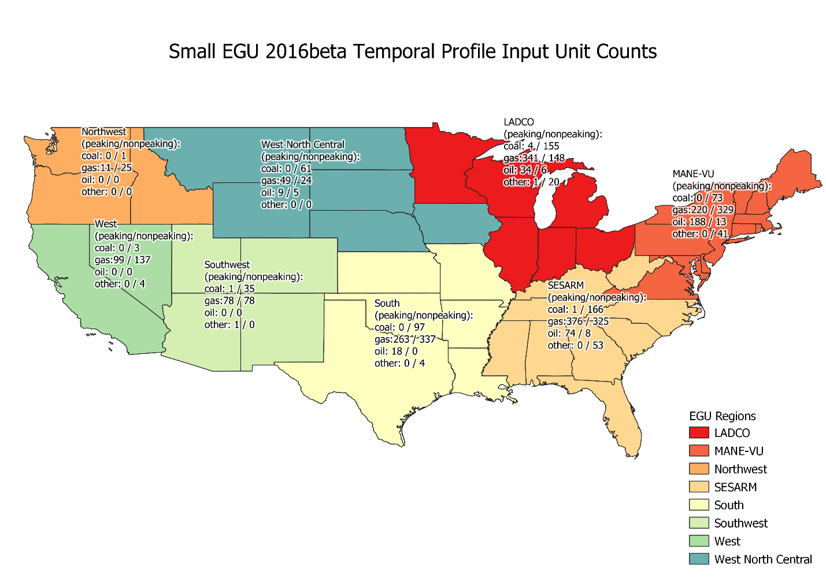

Slide 9
Temporal Cross Reference
To support the assignment of profiles by region and peaking vs non-peaking, the cross reference in SMOKE had to be implemented at the unit-level rather than by FIPS-SCC as it was in 2011 platform
Note that units that switched fuels or were added since the base year need to be handled

Slide 10
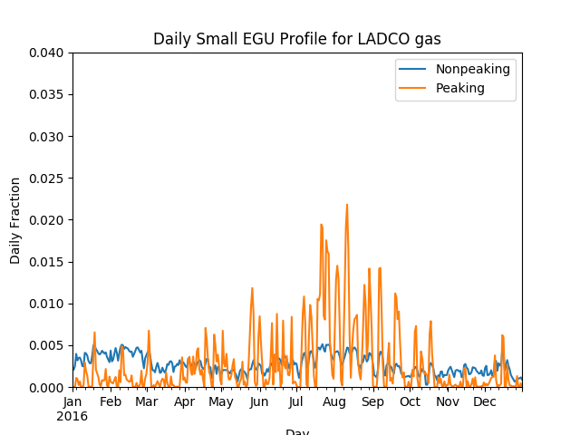
Example Small EGU profiles for LADCO

Slide 11
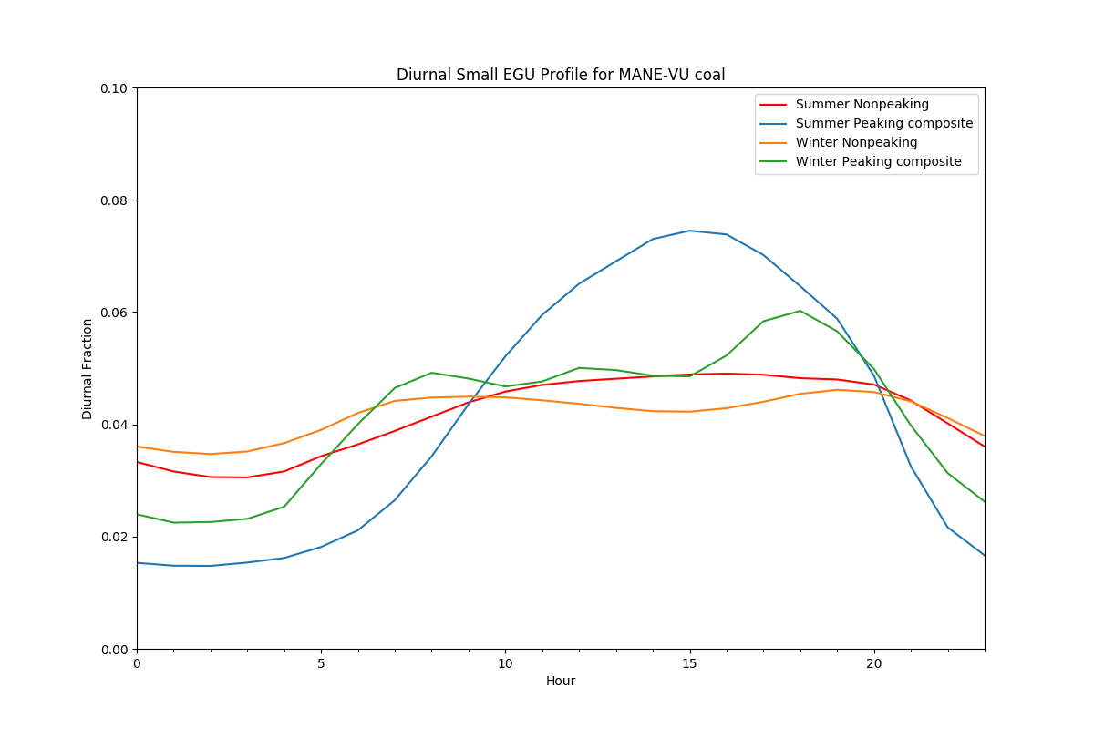
Daily and diurnal profiles
- Base year diurnal profiles are already differentiated between summer and winter.
- The daily and diurnal profiles are exactly the same as the base year.

Slide 12
Future Year Temporal Allocation
Larger units temporalized by CEM data where a unit match is made to the BY CEM data.
Smaller units temporalized by region-fuel profiles.
Caveat: IPM is processed seasonally not monthly or annually. Patterns should reflect winter/summer seasonal weighting from the model
Pseudo-CEMS data represent hourly emissions
Hourly CEM NOX and SO2 values are scaled using ratio of seasonal FY IPM FF10 values to BY FF10 values.
Hourly heat input is scaled using ratio of seasonal FY IPM heat input to BY CEM heat input.

Slide 13
Monthly profiles
IPM outputs are available by season
To get monthly emissions without over or under-allocating the annual emissions to a season the inventory is split into summer (May-Sep) and winter (Jan-Apr, Oct-Dec).
Annual monthly profiles are renormalized into seasonal monthly profiles to make sure that emissions output from SMOKE match the totals from IPM

Slide 14
Handling hourly “Excesses”
The CEMQuery tool identifies units where a pseudo CEM hourly value exceeds the maximum seasonal hourly emissions based on the NOX or SO2 emissions rate and the nameplate unit generation capacity from IPM parsed file
Hours that exceed the maximum are capped at the 4 year (2014 to 2017) hourly emissions maximum for that unit
The excess emissions from the capped hour(s) are redistributed to all other hours that were emitting for that unit in the 2016 CEM data
The redistribution may take multiple passes.

Slide 15
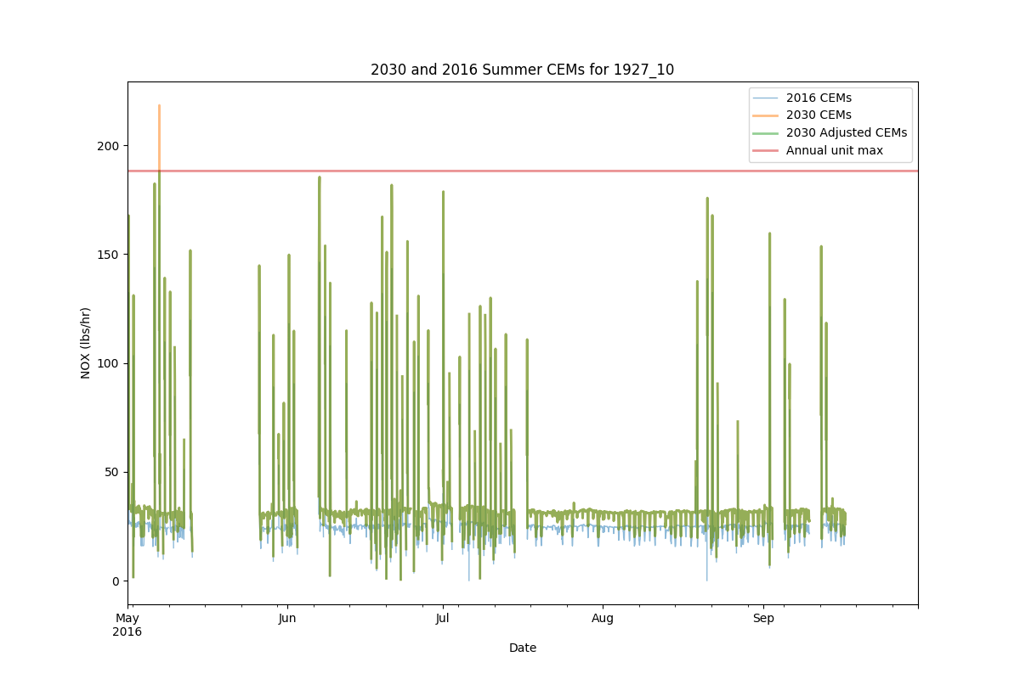
Adjusted Pseudo CEMS Emissions

Slide 16
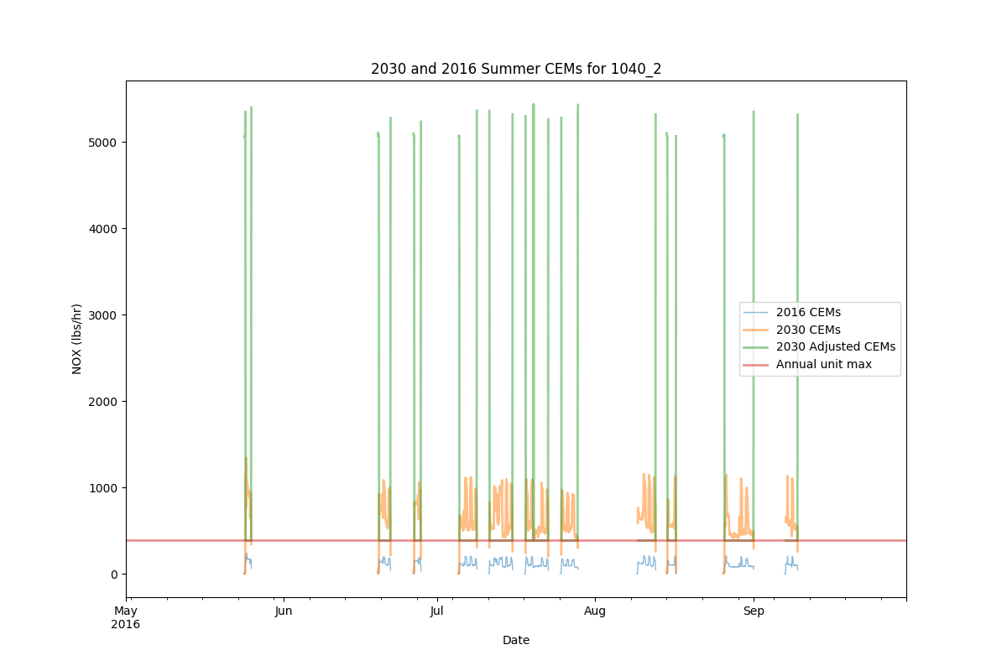
Example where Emissions cannot be fit Under the Maximum

Slide 17
For Units that Cannot fit under the Maximum
Use Region-fuel profiles from base year
Eight multi-state regions and four fuel categories (same as base year)
Differentiate between peaking and non-peaking
MWCs and cogens get flat profiles
We do not try to fit the emissions allocated with the regional profile under the historic maximum

Slide 18
Additional summary requests
Attendees from the small group call asked about having some summaries / plots of daily total emissions by profile type
EPA created a spreadsheet with columns: state, region, FIPS, fuel, profile type, pollutant, Julian Day, and tons/day of NOx, SO2 and PM
Find updated reports here: ftp://newftp.epa.gov/air/emismod/2016/beta/reports/EGU/
(more to be added soon)

