Slide 1
Emission Modeling Profiles Updates for 2020 Platform
11/17/2023

Slide 2
Background
A number of updates to speciation, temporal allocation, and spatial surrogates were made for 2020 and 2021 platforms and those are summarized here
For more information on methods used for 2020 including additional plots, see the TSD available here:
https://www.epa.gov/air-emissions-modeling/2020-emissions-modeling-platform

Slide 3
Speciation Updates in 2020 Platform
Profiles are based on SPECIATE 5.2
For PM2.5:
The profile for grass fires was updated to profile 95809.
The profile for hydrogen boilers were updated to a gas combustion profile.
Assignments for new PM2.5 SCCs in the 2020 point and nonpoint inventories were developed.
For VOC:
The profile for wildfires and prescribed fires was updated to profile 95861.
Assignments for new VOC SCCs in the 2020 point and nonpoint inventories were included (e.g., agricultural silage and asphalt paving).
Several point and nonpoint SCCs which were previously assigned the overall average profile were reassigned to more appropriate profiles.
Speciation is now done outside of MOVES instead of MOVES generating EF tables with speciated pollutants

Slide 4
Onroad Speciation Outside of MOVES
Some speciation is done inside MOVES for “integrated species” – species of gases and particulate matter which are calculated directly by MOVES. In many cases, these integrated species have effects like temperature or fuel effects which are not always well captured by external speciation profiles.
For total organic gases, MOVES calculates 15 integrated species, such as methane and benzene, and the remainder is called NonHAPTOG which is speciated outside MOVES. [starting in 2020 platform]
There are fewer PM integrated species, such as elemental carbon (EC), sulfate, organic carbon, and non-carbon organic matter but the concept is the same. The remaining unspeciated particulate mass is called Residual PM and is also speciated outside MOVES [starting in 2021 platform]
In MOVES, speciation profiles for both gaseous and PM emissions are assigned by emission process, fuel subtype, regulatory class, and model year. Each of these dimensions are available in MOVES output except for fuel subtype, which is aggregated as part of each fuel type.
To apply speciation outside of MOVES and make it compatible with the needs of SMOKE, we need to determine the speciation profile mapping by SMOKE process (aggregation of MOVES emission processes) and SMOKE Source Classification Code (SCC), which are defined by fuel type, source type, and road type
MOVES runs were performed in inventory mode for each representative county to get NonHAPTOG and Residual PM output by emission process, fuel type, regulatory class, and model year. Emissions were then disaggregated by fuel subtype using the market share of each fuel blend in each county, so that speciation profiles can be accurately assigned.
After this step, emissions are normalized and aggregated to calculate the percentage of total NonHAPTOG and Residual PM emissions that should be speciated by each profile for each SMOKE SCC and process.
Finally, these percentages are applied in SMOKE_MOVES to all counties based on their representative county

Slide 5
Temporal Allocation Highlights in 2020 Platform
Profiles for small-EGUs without CEMS reflect 2020
Year-specific profiles are used for oil and gas sources
Fugitive dust emissions have reductions based on hour / grid-cell specific meteorological data for soil moisture and snow cover (not a new method) and also transport fraction
Airport temporal profiles (diurnal, month to day, and annual to month) reflect pandemic impacts with airport-specific for major airports and state defaults (see TSD for plots)
Nonroad temporal allocation was unchanged be we wondered if LADCO profiles for agricultural equipment may be applicable in other places
Biogenic emissions are based on year-specific meteorological data
Onroad temporal profiles are based on 2020 data
For 2021, EPA used statewide 2021 volume counts from FHWA (TMAS) to derive annual to month, month to day, and diurnal profiles for four groups of vehicle types; speeds were carried over from December 2020
We recommend a similar approach for 2022v1, but hope for better data in 2022v2
Ammonia profiles are based on year-specific meteorological data

Slide 6
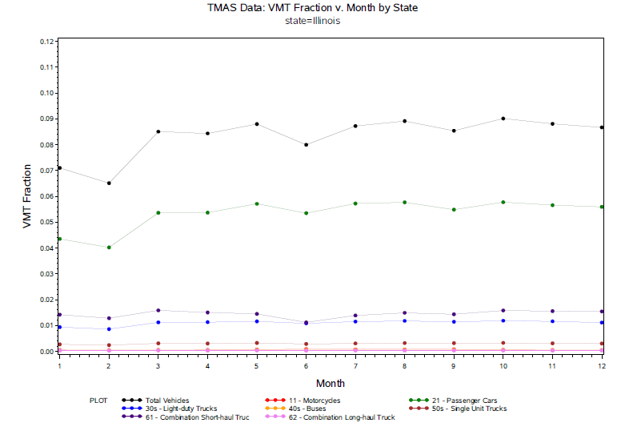
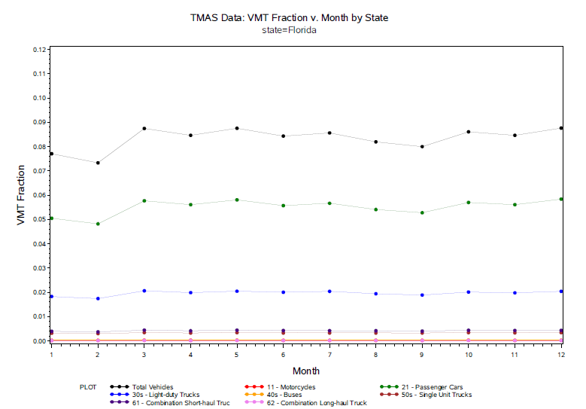
Examples of 2021 TMAS Data (monthly)

Slide 7
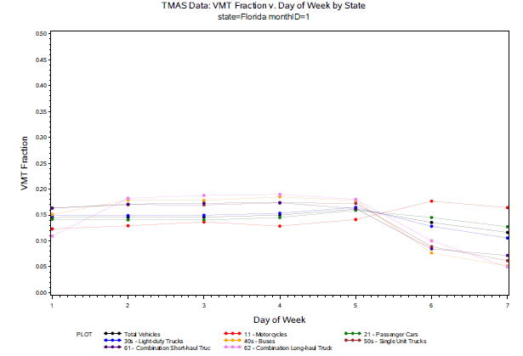
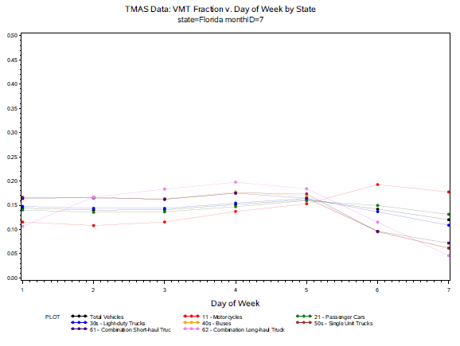
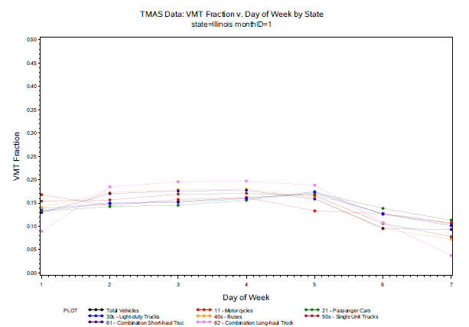
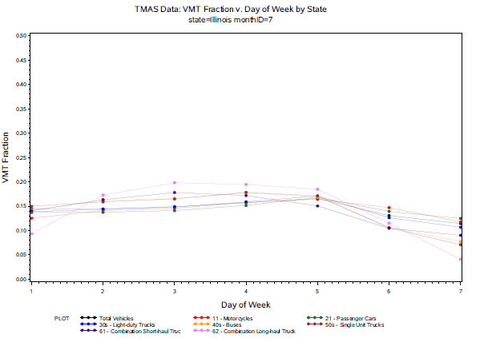
Examples of 2021 TMAS Data (day of week)

Slide 8
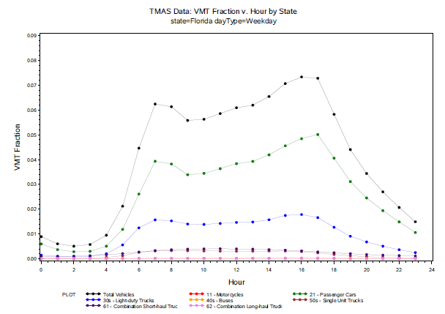
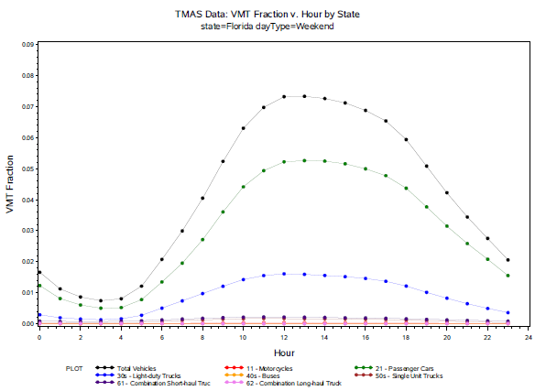
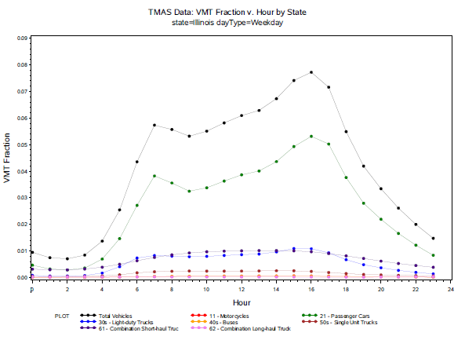
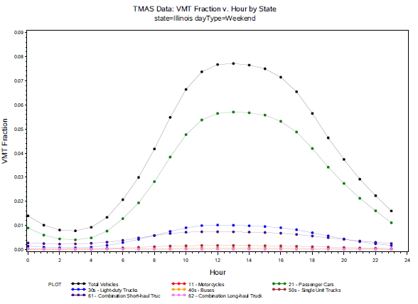
Examples of 2021 TMAS Data (hour of day)

Slide 9
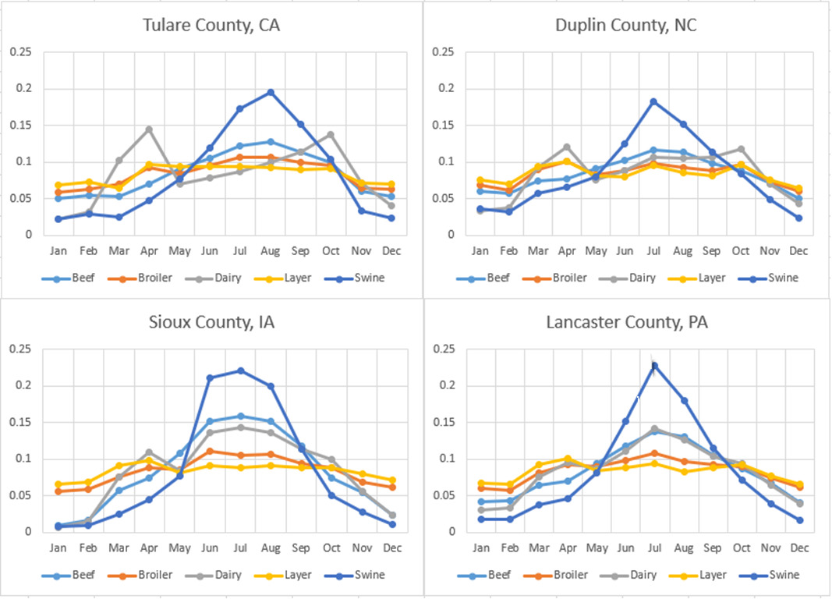
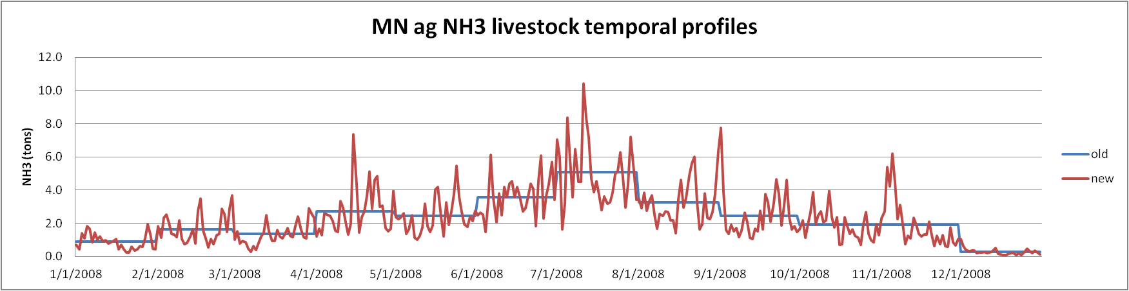
Examples of 2020 Agricultural Livestock Profiles

Slide 10
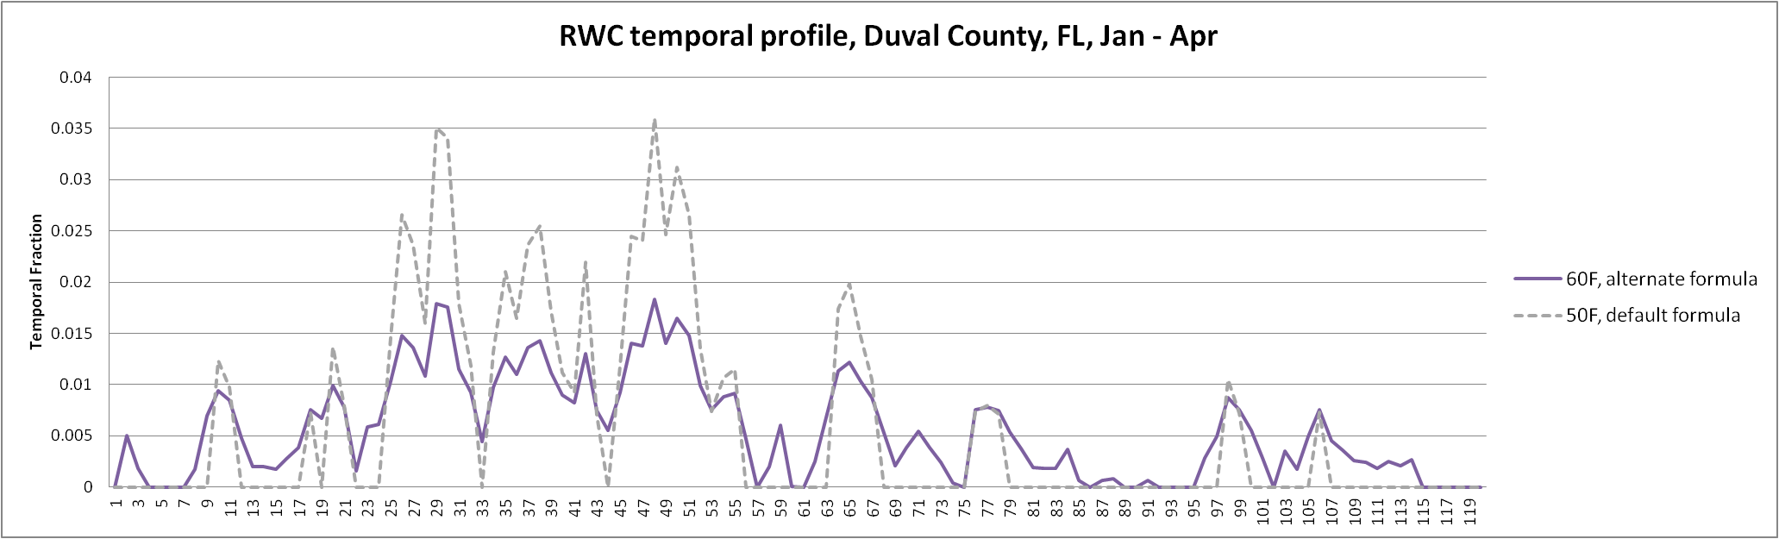
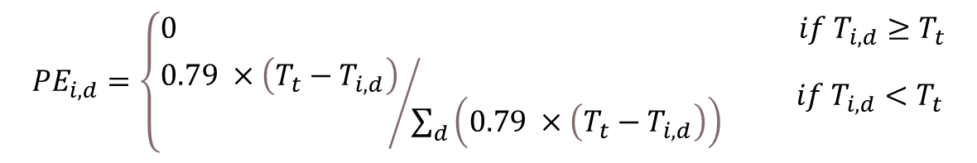
RWC Temporal Profiles
RWC annual to day profiles are based on year-specific meteorology
A new annual-to-day approach to allocate recreational wood burning emissions (e.g., firepits) was implemented: emissions are allocated only to days in which the temperature falls within a range of 50°F and 80°F at some point during the day.
Recent studies show that the formula used to attribute most RWC emissions to specific days of year may need to be refined (Tt is 50°F in most states and 60°F in southern states)
$${PE}_{i,d}=\left\{\begin{aligned}&0 if T_{i,d}≥T_{t} \\ &{0.79 ×\left(T_{t}−T_{i,d}\right)}/{\sum_{d}{\left(0.79 ×\left(T_{t}−T_{i,d}\right)\right)}} if T_{i,d}<T_{t}\end{aligned}\right.$$

Slide 11
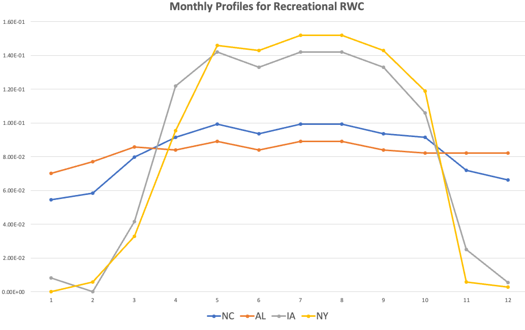
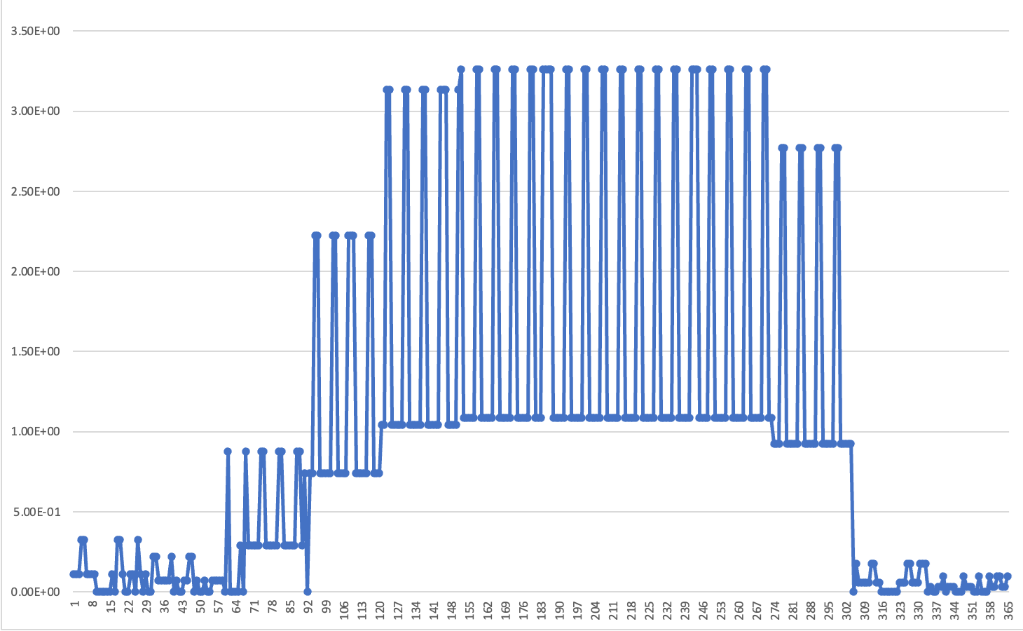
Recreational Wood Burning Profiles (new in 2020)
Annual to day output based on meteorology
0.16
3.5
0.0
0.0
Day of year
Northern states now have more emissions in the warmer months
All profiles are county-specific and incorporate day-of-week variations with higher emissions on weekends (33% each weekend day)

Slide 12
Spatial Surrogate Updates in 2020 Platform
County boundaries used for all surrogates were updated to use the 2020 TIGER boundaries.
Oil and gas surrogates were updated to represent 2020.
American Community Survey-based surrogates were updated to use the 2020 ACS from 2016.
Updated surrogates for residential wood combustion were developed based on ACS data.
NLCD-based surrogates were updated to use NLCD 2019 from 2011.
Animal specific livestock waste surrogates were derived from National Pollutant Discharge Elimination System (NPDES) animal operation water permits and Food and Agriculture Organization (FAO) gridded livestock count data.
New surrogates for fuel stations, asphalt surfaces, and unpaved roads were created using data from the OpenStreetMap database and corresponding cross reference updates were made.
Gravel and lead mines were split out to their own surrogates from the more general United States Geological Survey mining surrogate and corresponding cross reference updates were made.
RWC SCCs now use ACS Detached Housing and Single and Dual Unit Housing instead of NLCD Low Intensity Dev. (but we think further improvements could be made to better reflect structure locations)
Canadian surrogates were updated with circa 2020 data, but Mexico surrogates are old (looking into updates)

Slide 13
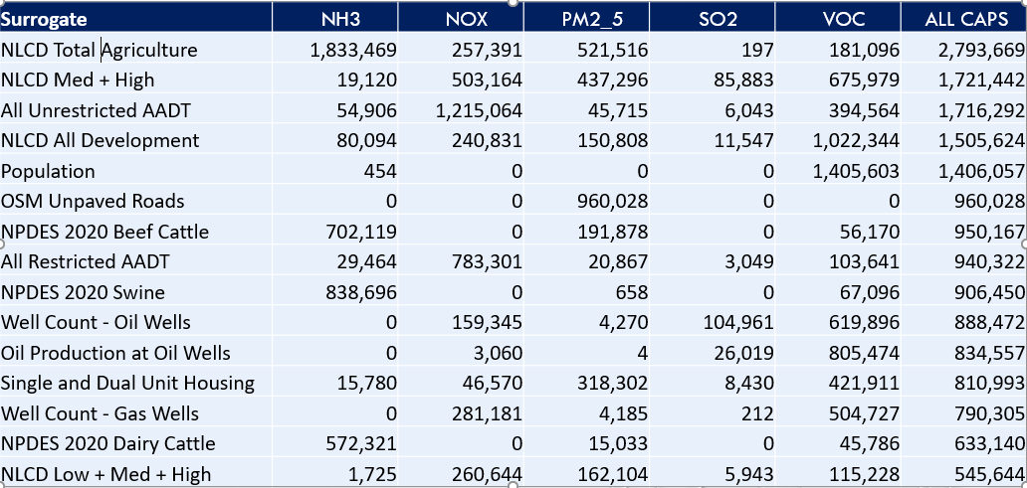
Top 15 surrogates for Total CAPs

Slide 14
Surrogates 15-30 for Total CAPs
Surrogate | NH3 | NOX | PM2_5 | SO2 | VOC | ALL CAPS
NPDES 2020 Chicken | 426,996 | 0 | 5,069 | 0 | 34,157 | 466,222
Gas Production at Gas Wells | 0 | 42,067 | 228 | 1,120 | 400,686 | 444,101
NTAD Class 1 2 3 Railroad Density | 269 | 400,799 | 9,861 | 336 | 18,552 | 429,817
Detached Housing (rwc) | 7,054 | 29,363 | 213,791 | 6,359 | 143,793 | 400,360
NLCD Water | 203 | 115,290 | 4,502 | 112 | 258,398 | 378,505
Total Road Miles | 0 | 0 | 333,425 | 0 | 41,753 | 375,178
OSM Asphalt Surfaces | 0 | 0 | 0 | 0 | 339,778 | 339,778
FAO 2010 Large Cattle Operations | 0 | 0 | 0 | 0 | 295,993 | 295,993
Residential Heating - Natural Gas | 44,524 | 214,626 | 2,669 | 1,436 | 12,680 | 275,935
OSM Fuel | 0 | 0 | 0 | 0 | 209,354 | 209,354
NLCD Recreational Land | 80 | 12,898 | 5,082 | 35 | 185,202 | 203,297
NPDES 2020 Turkey | 83,001 | 0 | 1,959 | 0 | 6,640 | 91,600
Refineries and Tank Farms | 0 | 0 | 0 | 0 | 90,120 | 90,120
NLCD Open + Low + Med | 133 | 21,682 | 1,301 | 64 | 50,114 | 73,294
Produced water at oil wells | 0 | 0 | 0 | 0 | 69,418 | 69,418

Slide 15
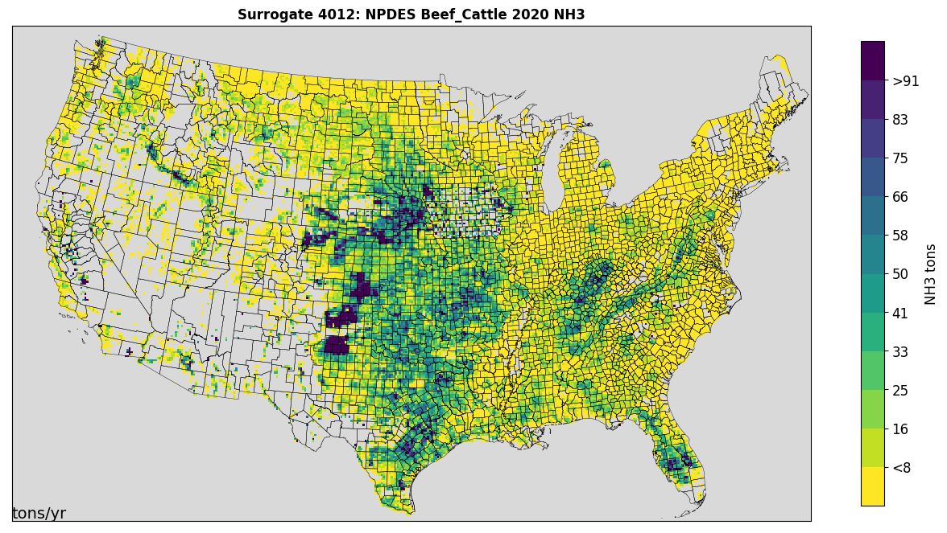
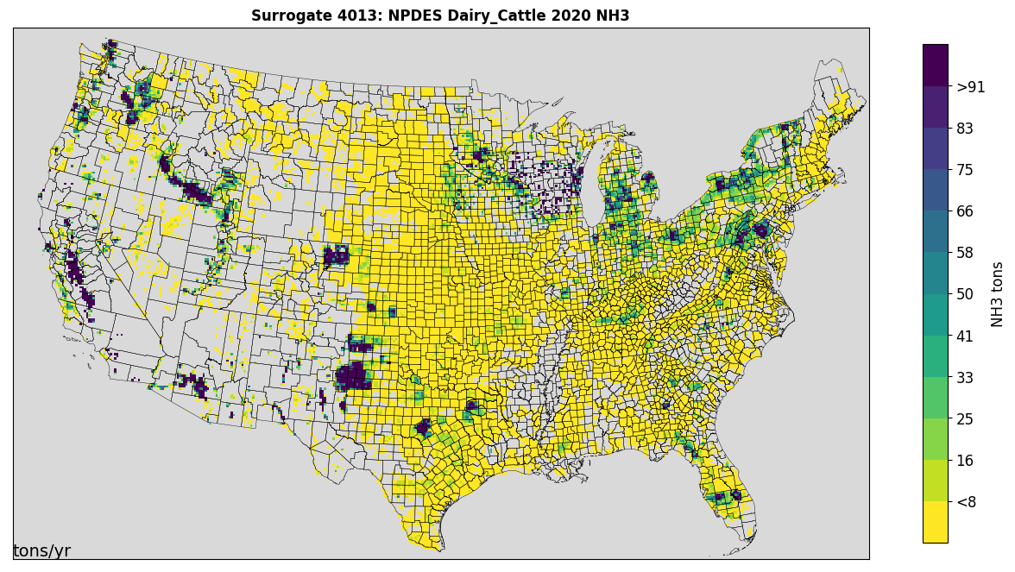
Livestock Surrogates
2010 Animal-specific FAO raster data at ~10 km resolution
Masked with NLCD agriculture areas to improve spatial resolution for fine scales
NPDES water waste animal feedlot (AFO) permits for states where available
IA, NC, SC, MN, WI, CA have public datasets with varying coverage by animal type
Animal types: beef cattle, dairy cattle, chicken, swine, sheep, horse, turkey
Notes:
The livestock surrogates are unique in that they were developed with multiple levels of spatial data to provide as specific as possible livestock surrogates across the entire US
Livestock farm locations and operations are often obfuscated and, to our knowledge, there is no public central database of animal counts across the entire US
The global animal-specific FAO dataset used remote-sensed imagery and machine learning techniques to provide gridded livestock counts. However, this data was only created for 2010 and is provided at a 10 km resolution – a resolution that is larger than EPA’s finescale modeling domains
To improve the resolution the FAO raster was divided down to the NLCD resolution and then masked with NLCD agricultural areas
Some states do provide livestock operation locations with animal counts in the form of NPDES water waste permits for feedlots. IA, NC, SC, MN, WI, and CA all had recent state-wide coverage for at least one type of animal in their NPDES permit data. This data is considered higher quality than the FAO data and gets preference in the surrogate where available.

Slide 16
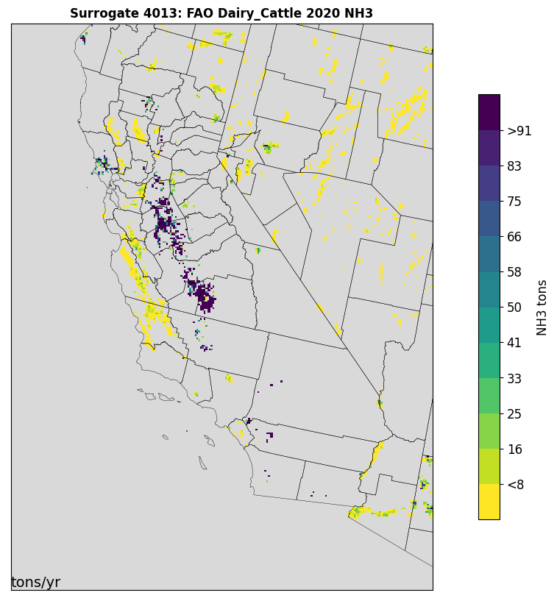
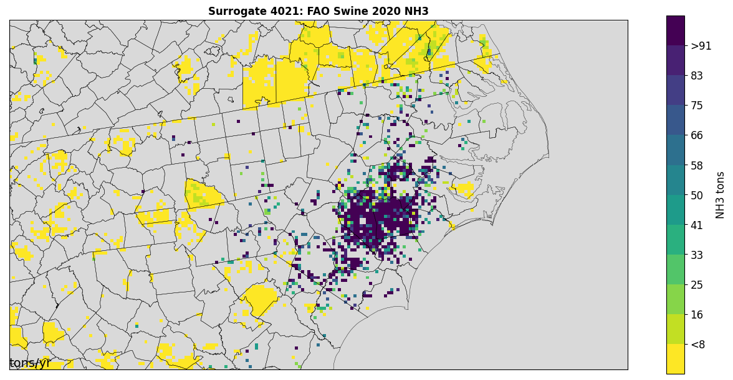
NPDES Impact on Livestock Surrogates
NPDES point data improves allocation at 4 km
NC Swine
CA Dairies
Notes:
Spatial accuracy of livestock distribution using the NPDES data comes into focus at 4 km.
Individual swine farms can be identified in NC and gaps are shown around towns and waterbodies.
In CA’s central valley the large compact dairy cattle operations are well defined

Slide 17
2020 livestock emissions by surrogate (CONUS 12km)
ID | Description | NH3 | NOX | PM2_5 | SO2 | VOC
310 | FAO 2010 Horse | 31,969 | 0 | 0 | 0 | 2,558
405 | FAO 2010 Sheep | 19,235 | 0 | 0 | 0 | 1,539
406 | NPDES 2020 Beef Cattle | 702,119 | 0 | 0 | 0 | 56,170
4012 | NPDES 2020 Dairy Cattle | 572,321 | 0 | 0 | 0 | 45,786
4013 | NPDES 2020 Swine | 838,696 | 0 | 0 | 0 | 67,096
4031 | NPDES 2020 Chicken | 426,996 | 0 | 0 | 0 | 34,157
4041 | NPDES 2020 Goat | 19,231 | 0 | 0 | 0 | 1,538
4071 | NPDES 2020 Turkey | 83,001 | 0 | 0 | 0 | 6,640
* NPDES surrogates are also used for dust emissions (shown later)
Notes:
Livestock waste is a significant source of NH3 in the 2020 NEI. This table shows the primary surrogates used for livestock waste, including the largest emitting animal types.
The surrogates are also used for livestock associated fugitive dust emissions: “dust kicked up by hooves”

Slide 18
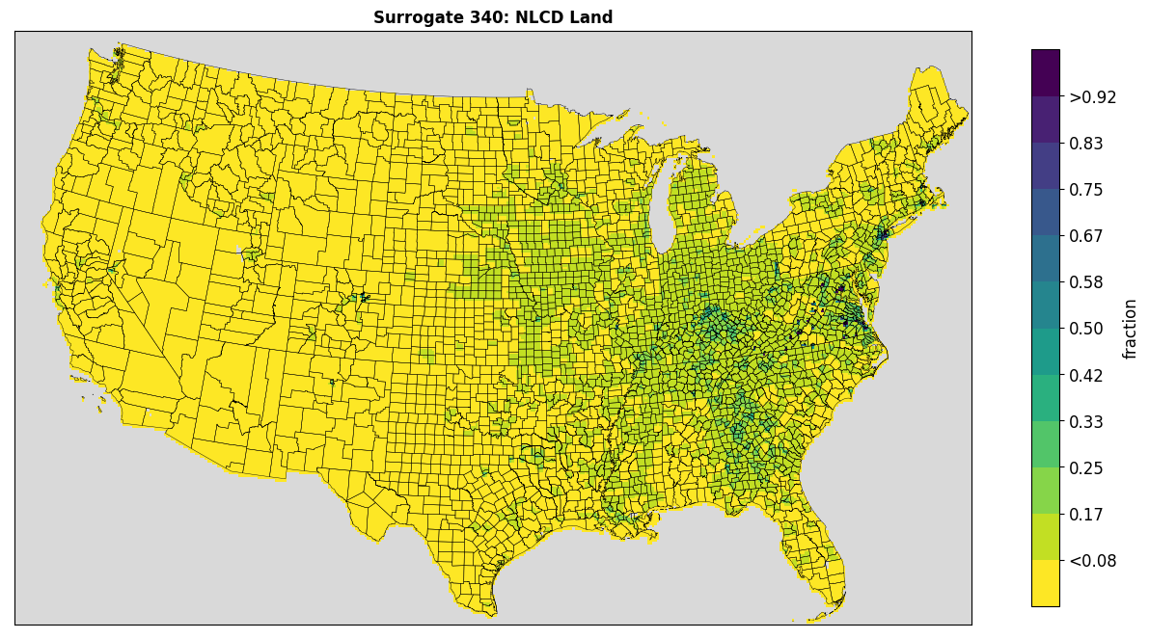
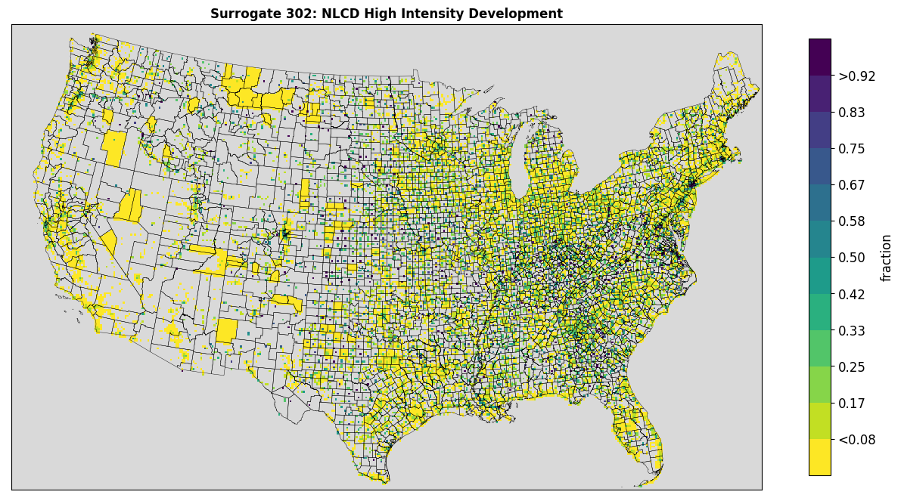
NLCD Surrogates
National Land Cover (NCLD) data were updated to 2019 from 2011
Land use with percent developed impervious surface
Used to define land area, water, and development related surrogates
NLCD surrogates commonly used as a gapfiller for other surrogates
Downscaled to 250 m from 30 m using NN approach
Notes:
The NLCD defines land cover with broad categories based on the amount of impervious surface and general use clasifications
The surrogates are often used as a gapfiller for other surrogates because they have a wide national coverage and offer “catch-all” type groupings
The NLCD rasters are supplied at 30 m which is more detailed than necessary for emissions surrogates and add to processing time. They are downscaled to 250 m using a NN approach.

Slide 19
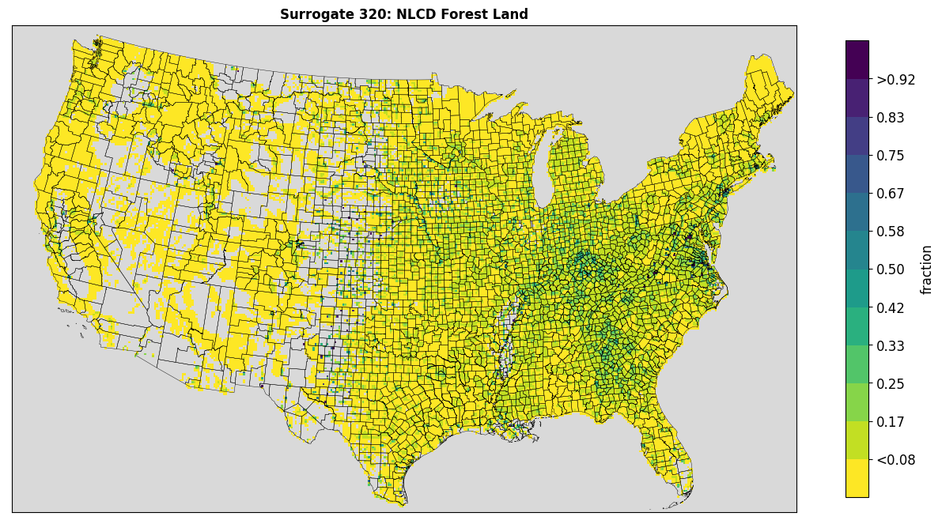
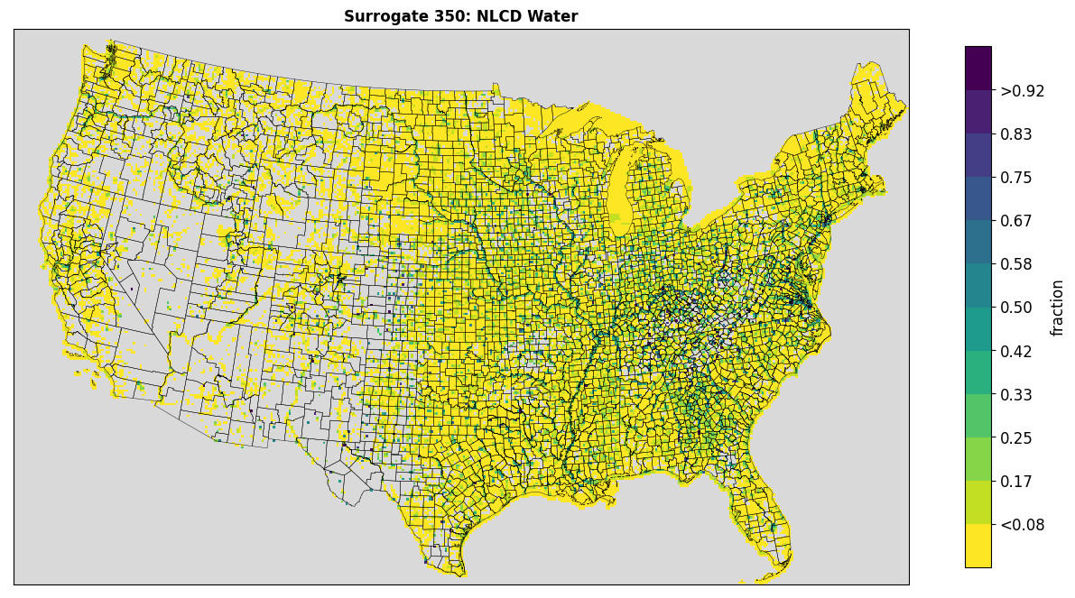
Available NLCD Surrogates
Open Space (< 20% impervious)
Low Development (20-49% impervious)
Med Development (50-79% impervious)
High Development (80%+ impervious)
Combinations of Open, Low, Med, and High
Total Agriculture (pasture, hay, row crops)
Forest Land (all tree types)
Recreational Land
All Land
All Water
Notes:
Many different combinations of NLCD attributes are used to create NLCD platform surrogates. Some surrogates may use only one land cover type, such as water or open space, while others that try to capture urban and suburban areas may include both Med and High development

Slide 20
NLCD Surrogate Uses in 2020 Platform
Most off-network onroad emissions
Almost all nonroad emissions
All fertilizer emissions are assigned to NLCD Total agriculture
They are also used for 650K tons of fugitive dust PM2.5
About 800K tons of solvent emissions use NLCD surrogates
They are used for significant amounts of other nonpoint NOx and VOC
Totals by CAP: 1.4M tons of NOx, 2M tons of NH3, 1.3M tons PM2.5, 2.6M tons VOC and 104K tons of SO2
Notes:
NLCD surrogates are used for many different source types representing a significant emissions total
Some have the potential for more source specific surrogate replacement if quality spatial weighting data can be found

Slide 21
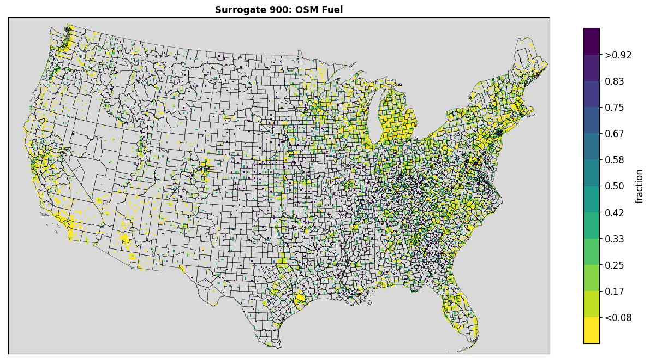
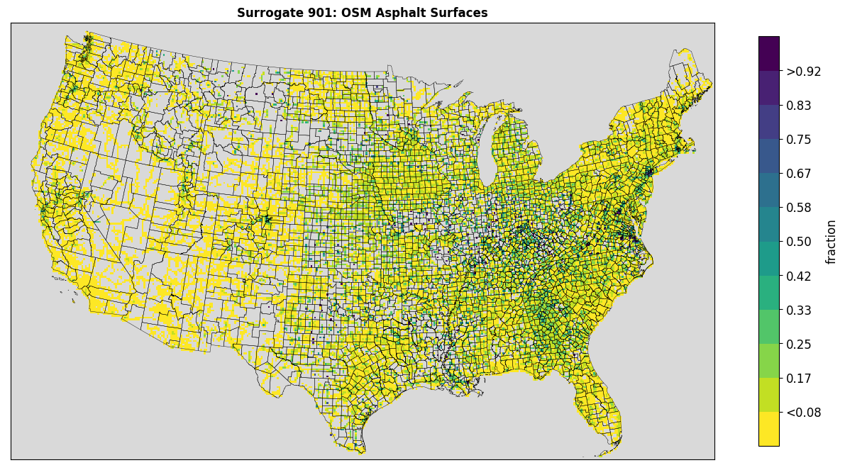
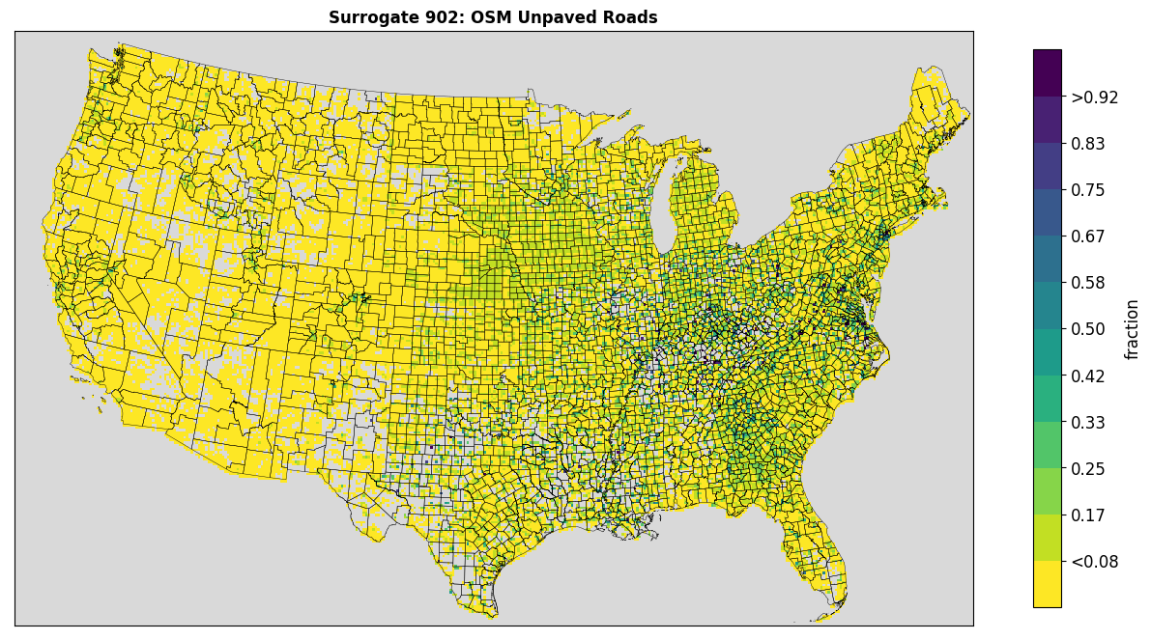
OpenStreetMap (OSM) Surrogates
Crowd-sourced open geographic database
Network of nodes, lines, and polygons
Contains attributes indicating
Road amenities such as fueling stations
Surface types of roads and parking areas
Fuel stations, asphalt surfaces, unpaved roads
Notes:
As previously mentioned OSM is a crowd-source open geospatial database including many different geometry types with detailed attributes
Pertinent to emissions surrogates in the 2020 platform are fueling stations and surface types such as asphalt and unpaved surfaces
Plots of surrogates 900, 901, and 902 show the national distribution of each of those attributes

Slide 22
Uses of OpenStreetMap Surrogates in 2020 Platform (CONUS 12km grid)
Sector | ID | Description | NH3 | NOX | PM2_5 | SO2 | VOC
afdust | 902 | OSM Unpaved Roads | 0 | 0 | 960,028 | 0 | 0
nonpt | 900 | OSM Fuel | 0 | 0 | 0 | 0 | 209,354
np_solvents | 901 | OSM Asphalt Surfaces | 0 | 0 | 0 | 0 | 339,778
Notes:
The new unpaved roads surrogate is assigned to a large amount of PM coming from unpaved road fugitive dust
Type 1 gas and diesel tank refueling represents a significant source of VOC that is now assigned to the fuel station surrogate
And various types of asphalt paving are assigned to the asphalt surfaces surrogate which contains roads, parking lots, and other asphalt surfaces
Previously these used NLCD surrogates that put these emissions in locations based on land cover/impervious surface type. This often spread emissions out over areas unliked to have these sources.

Slide 23
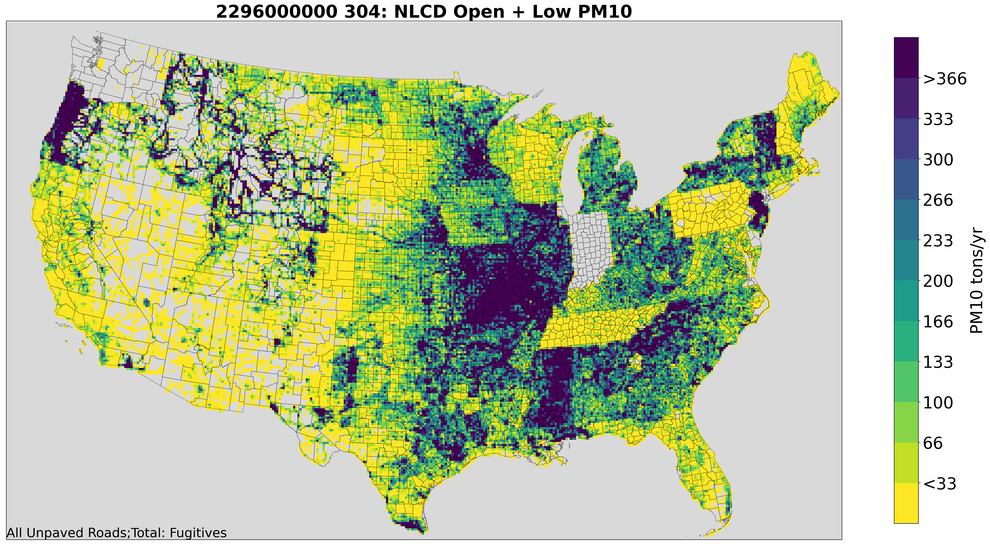
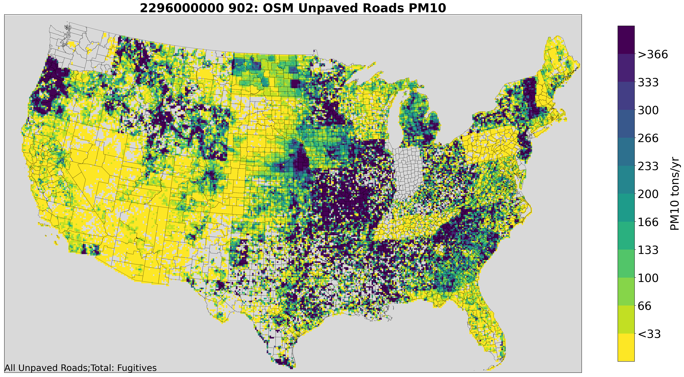
OpenStreetMap Surrogates (ctd.)
Unpaved roads are a key source of fugitive dust (PM)
Previous platforms used NLCD Open Space and Low Development surrogate
New surrogate uses lines/roads with unpaved surface types
Notes:
On the last slide unpaved roads were shown to contribute nearly 1M tpy of PM2.5 over the Conterminous United States
In the 2017 platform and other previous platforms the NLCD open space surrogate was used to spatially allocate unpaved road emissions
In 2020 actual unpaved road lines are used to allocate the fugitive dust emissions, drastically changing the spatial distribution in many states
Note that some states may have incomplete coverage of unpaved road fugitive dust emissions, such as IN and WA

Slide 24
2020 fugitive dust emissions by surrogate (CONUS 12km)
ID | Description | NH3 | NOX | PM2_5 | SO2 | VOC
240 | Total Road Miles | 0 | 0 | 333,425 | 0 | 0
306 | NLCD Med + High | 0 | 0 | 41,167 | 0 | 0
308 | NLCD Low + Med + High | 0 | 0 | 122,726 | 0 | 0
310 | NLCD Total Agriculture | 0 | 0 | 502,702 | 0 | 0
861 | Sand and Gravel Mines | 0 | 0 | 271 | 0 | 0
863 | Crushed Stone Mines | 0 | 0 | 291 | 0 | 0
902 | OSM Unpaved Roads | 0 | 0 | 960,028 | 0 | 0
4012 | NPDES 2020 Beef Cattle | 0 | 0 | 191,878 | 0 | 0
4013 | NPDES 2020 Dairy Cattle | 0 | 0 | 15,033 | 0 | 0
4021 | NPDES 2020 Swine | 0 | 0 | 658 | 0 | 0
4031 | NPDES 2020 Chicken | 0 | 0 | 5,069 | 0 | 0
4071 | NPDES 2020 Turkey | 0 | 0 | 1,959 | 0 | 0
Notes:
Unpaved roads and livestock-related activity are a major contributor of fugitive dust, both received new more specific surrogates
NLCD surrogates and road miles make up the bulk of the remaining fugitive dust emissions

Slide 25
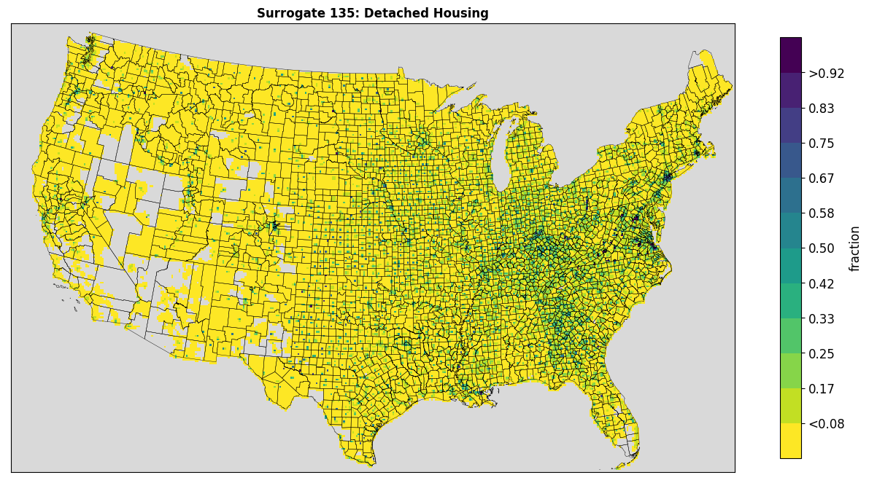
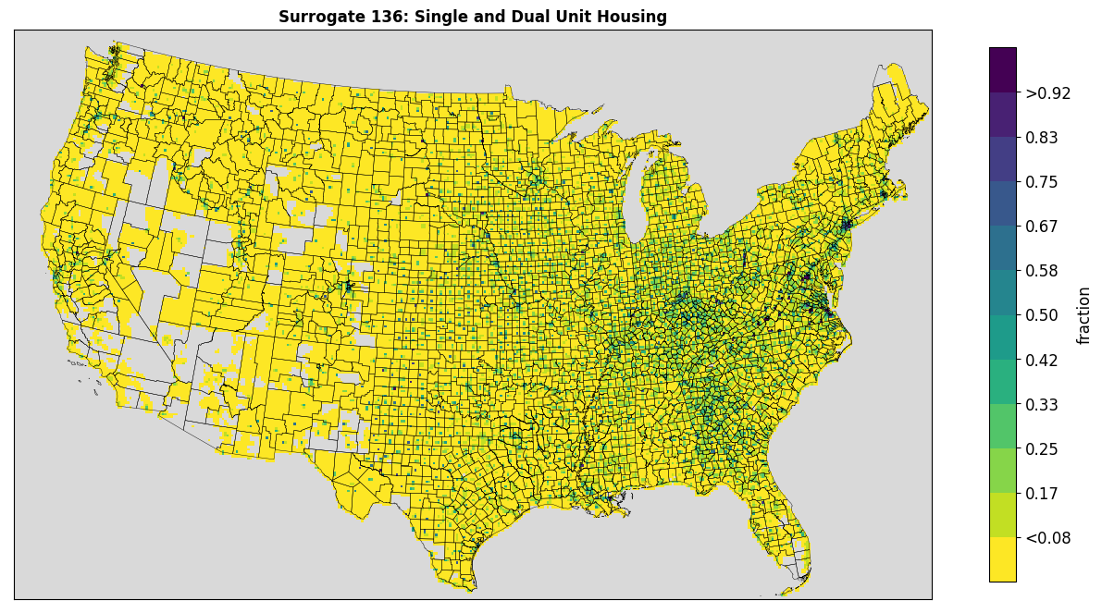
American Community Survey (ACS) Surrogates
2020 release of 5-year data
Data by census block group
Population, housing, primary home heating
Detached homes and single/dual units
New and can be used for residential wood combustion sources
Notes:
The Census releases the ACS data every year using statistics from the five preceding years
It contains census block group level data on population, housing, and related properties such as primary home heating and families per housing unit
The data has been used in the past to derive population and home heating surrogates but two new surrogates were created this year to identify detached and single family housing
Residential wood combustion sources are currently assigned to these new housing related surrogates, replacing the use of broader NLCD surrogates that include all impervious surface areas by grouping including commercial areas, industrial areas, and hard infrastructure

Slide 26
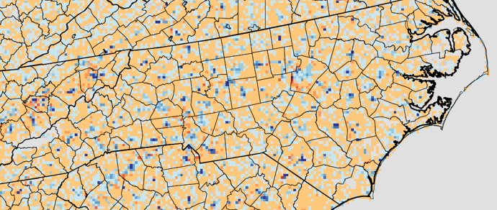
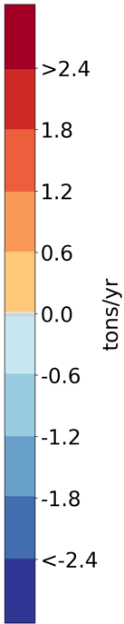
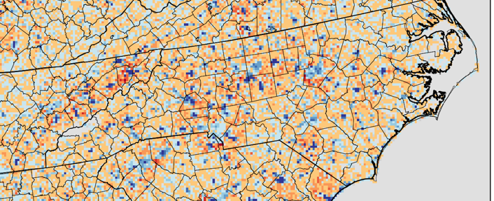
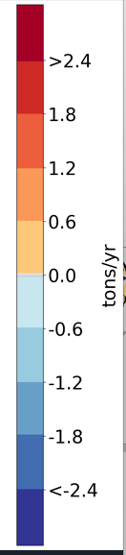
Onroad Surrogate updates
2019 NOx at 4km with new-old surrogates
Onroad uses updated surrogates from the new NLCD
Shifts in emissions are noticeable in areas where suburbs are growing
More VOC is spatially allocated with NLCD than for NOx (which uses more AADT)
2019 VOC at 4km with new-old surrogates
Notes:
The onroad sector uses NLCD surrogates for off-network processes such as evaporative emissions from parked vehicles
The grid cell weighting within each county changed as the NLCD was updated from 2011 to 2019. The fraction of VOC emissions from the off-network processes shifted more to the areas of growth within a given county, such as SW Wake, East Durham, etc.

Slide 27
2020 Onroad Emissions by Surrogate
ID | Description | NH3 | NOX | PM2_5 | SO2 | VOC
205 | Extended Idle Locations | 290 | 33,058 | 750 | 14 | 3,717
242 | All Restricted AADT | 29,464 | 783,301 | 20,867 | 3,049 | 103,641
244 | All Unrestricted AADT | 54,906 | 1,215,064 | 45,715 | 6,043 | 303,973
259 | Transit Bus Terminals | 42 | 1,539 | 37 | 1 | 476
304 | NLCD Open + Low |  | 510 | 13 | 0 | 2,811
306 | NLCD Med + High | 914 | 91,100 | 2,823 | 67 | 26,456
307 | NLCD All Development | 3,519 | 182,771 | 7,802 | 578 | 559,726
308 | NLCD Low + Med + High | 179 | 18,151 | 535 | 32 | 29,126
508 | Public Schools | 13 | 1,589 | 72 | 1 | 440
Notes:
The single largest share of onroad VOC is assigned to the NCLD All Development surrogate which is used for off-network processes
On-network emissions uses the HPMS AADT surrogates and represent the vast majority of NOx from this sector

Slide 28
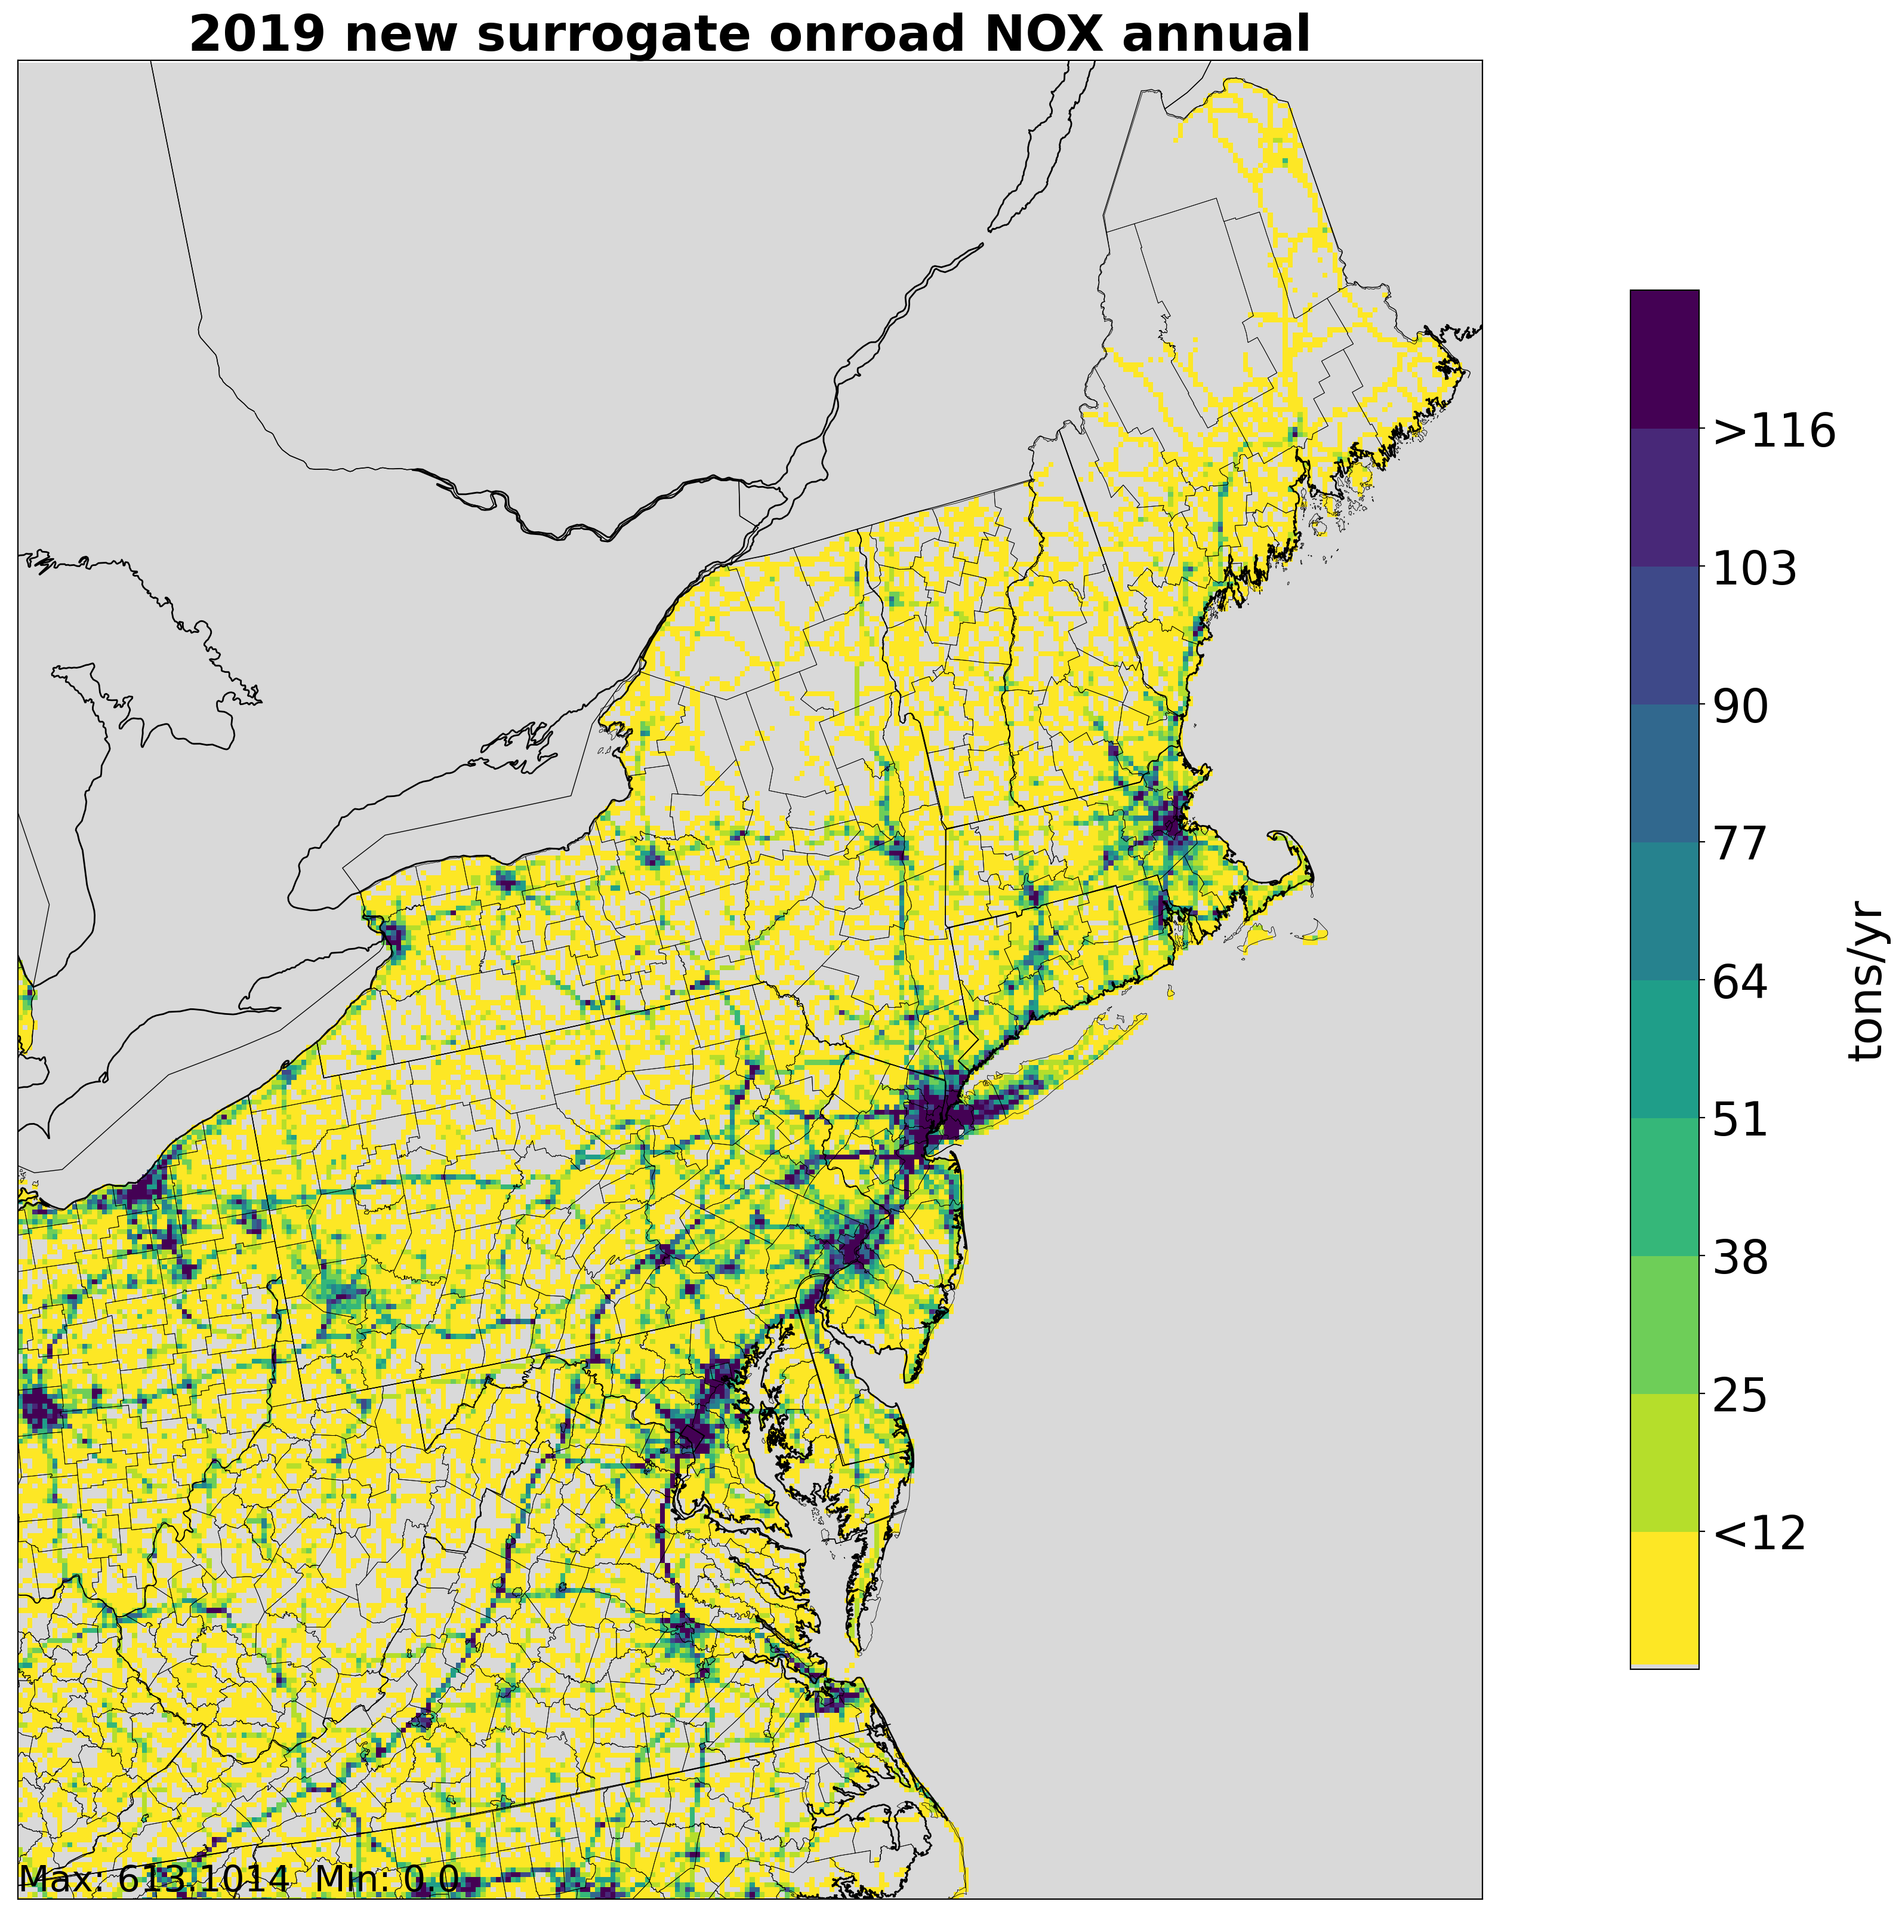
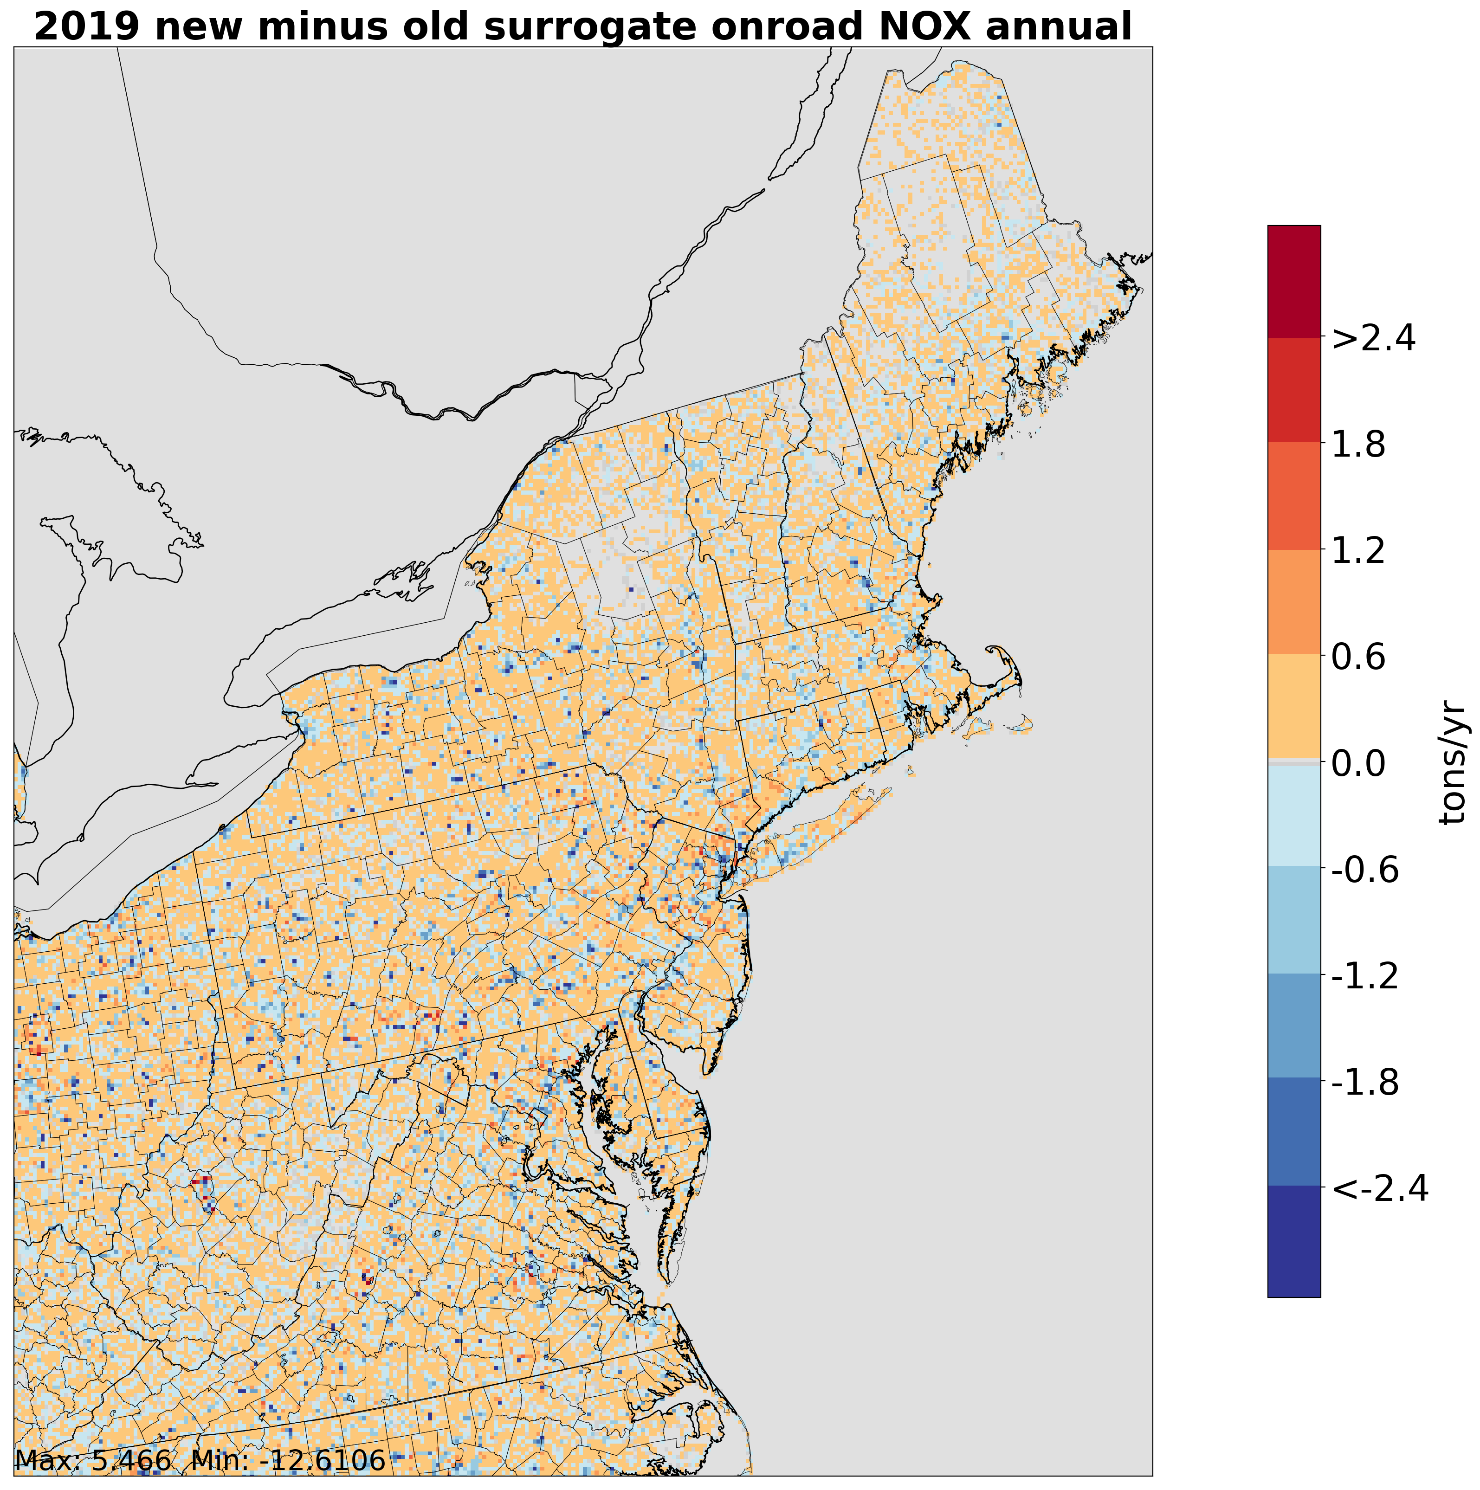
2019 Onroad NOx emissions over Northeast at 4km and Impact of New Surrogates
Notes:
Similar to NC there is a shift of some NOx emissions in the mobile sector to suburban and exurban areas within the NE US. NOx spatial allocation in the mobile sector is primarily driven by AADT which follows the road networks

Slide 29
Gapfilling of Spatial Surrogates
Surrogates may be gap-filled using other surrogates as generalized fallbacks when the weighting spatial data has incomplete coverage
This helps ensure emissions are not dropped if there is no data in a county for the primary weight surrogate
Tools support up to four levels of gapfilling
Example, the Beef Cattle surrogate is gap-filled by the NLCD Agriculture surrogate
NLCD Land or Population are used to gapfill many surrogates
Notes:
Spatial surrogates and their underlying weighting data sometimes don’t completely align with the regions in the emissions inventory
More generalized surrogates can be used as fillers where these gaps in the spatial data exist, ensuring that no emissions are dropped from the inventory
Gapfilling is usually done from the least to most generalized surrogate for the target source type such as NLCD Agriculture acting as a filler for the Beef Cattle surrogate
Very broad surrogates with near total national coverage such as NLCD Land or Population may be used as final gapfillers

Slide 30
Possible Future Updates
Recreational waters surrogate
Currently uses all NLCD all water, not necessarily representative of activity
Parking (on/off street)
Exhaust and evaporative off-network emissions
Currently uses NLCD all-development which includes all impervious surfaces
Airport areas
Used for av-gas refueling, largest airport by area in a county may not have highest GA activity
Rail activity
About 10 years old, current data source not updated with line specific activity
Notes:
Other updates were considered or discussed but were tabled due to time, data availability, and relative importance
The NLCD Water surrogate is currently used for recreational water emissions which are likely to occur closer to a shoreline than throughout an entire water body
A large fraction of the emissions assigned to the NLCD All Development surrogate come from off-network mobile processes, a parking surrogate was investigated and could theoretically be created using OSM data
Most airport emissions are point sources but Av-Gas stage 1 refueling does use the airport area surrogate, the problem with this surrogate is that the largest airport by area within a county does not necessarily use the most Av-Gas. Weighting by GA activity could be a fix
The rail activity is about 10 years old and the legacy data source has not been updated with activity since then even while the rail lines have. There are proprietary data sources available for this and many other source types. Proprietary data is a common issue that is encountered in creating surrogates

Slide 31
Appendix A. Updated Cross-reference Entries for 2020

Slide 32
Appendix A. Updated Cross-reference for 2020 cont.

