Slide 1
Geospatial Gridding Surrogate Updates for the 2020 Emissions Modeling Platform
April 2023
James Beidler and Alison Eyth

Slide 2
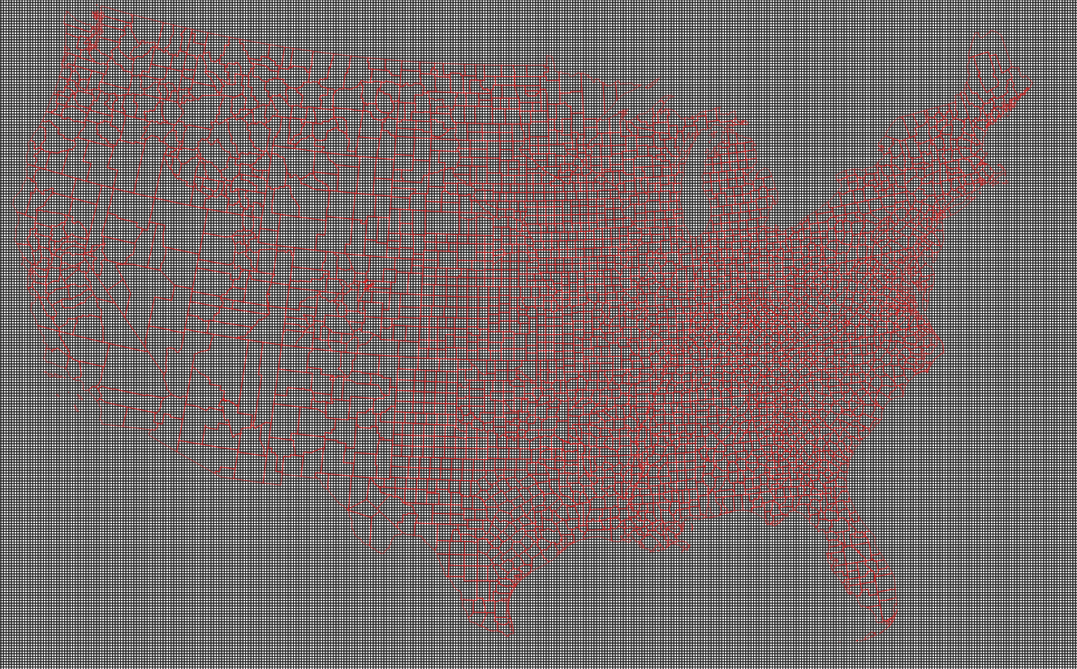
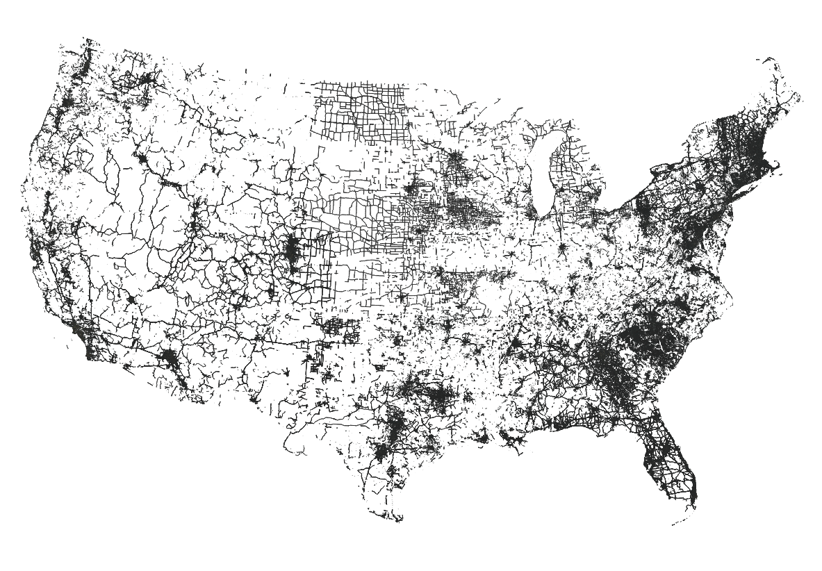
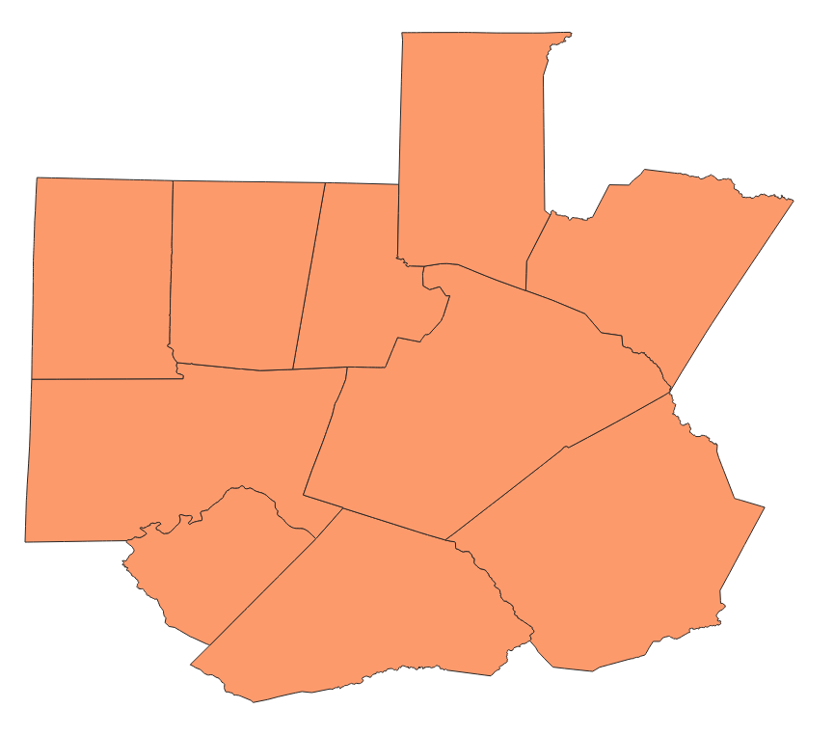
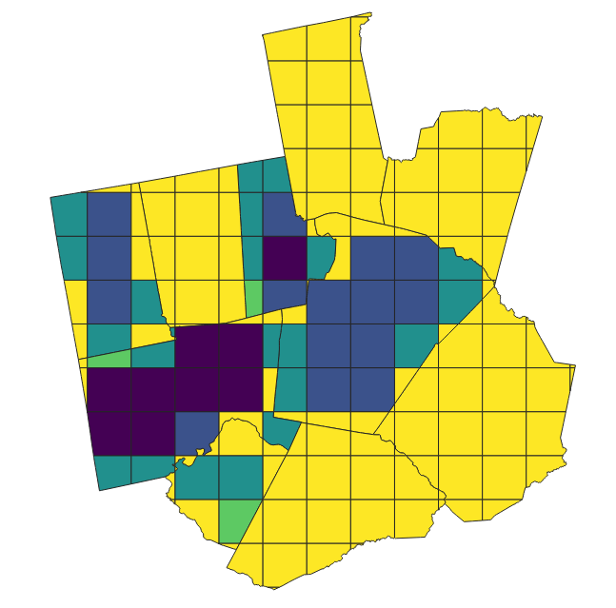
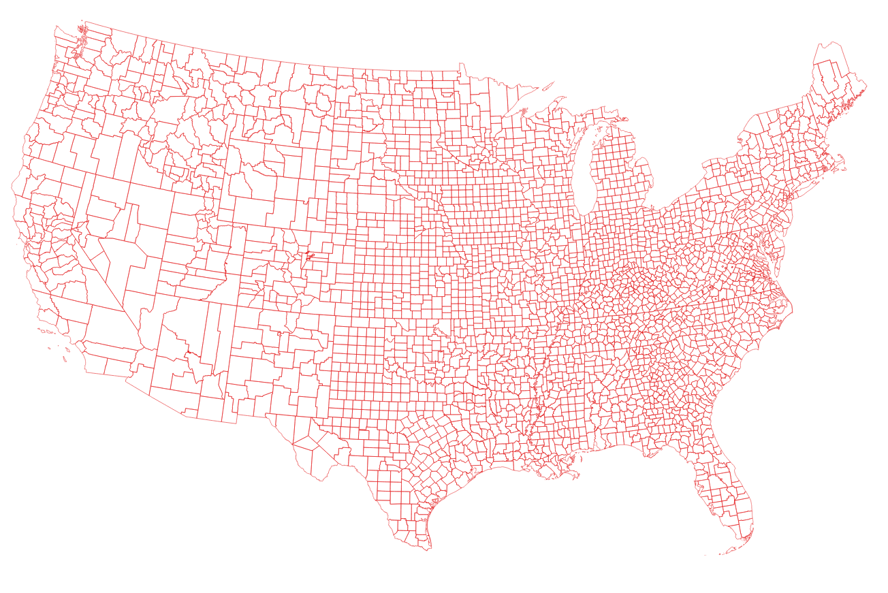
Spatial Surrogates
Processed with Surrogate Tool Using
Map county emissions to an air quality modeling grid
A modeling grid
Weighting Attributes
Spatial Unit Data (Counties)
The weighting and spatial unit data are “Shapefiles”

Slide 3
Updated Year-specific Shapes and Weighting Data
The last significant gridding surrogate update coincided with the 2017NEI cycle and platform
New versions of previously used datasets available since the 2017 platform
2019 NLCD replaces the 2011 NLCD
2020 ACS/Census release replaces the 2016 release
New datasets for improved sector and SCC-specific approaches
Livestock surrogates associated with specific animals
Fugitive dust for unpaved roads
Updated selection of properties from legacy datasets
Detached, single, and dual unit homes from ACS
National Land Cover Database (NLCD)
High resolution land cover data
American Community Survey (ACS)
Census statistics over a five year period related to housing and population
Food and Agriculture Organization (FAO) and National Pollutant Discharge Elimination System (NPDES)
FAO remote-sensed animal specific rasters and NPDES water permits for AFOs
OpenStreetMap (OSM)
Crowd-sourced attributes for road and parking surfaces, locations of fueling stations
USGS Mineral Resources Data System (MRDS)
Locations and types of mines and quarries

Slide 4
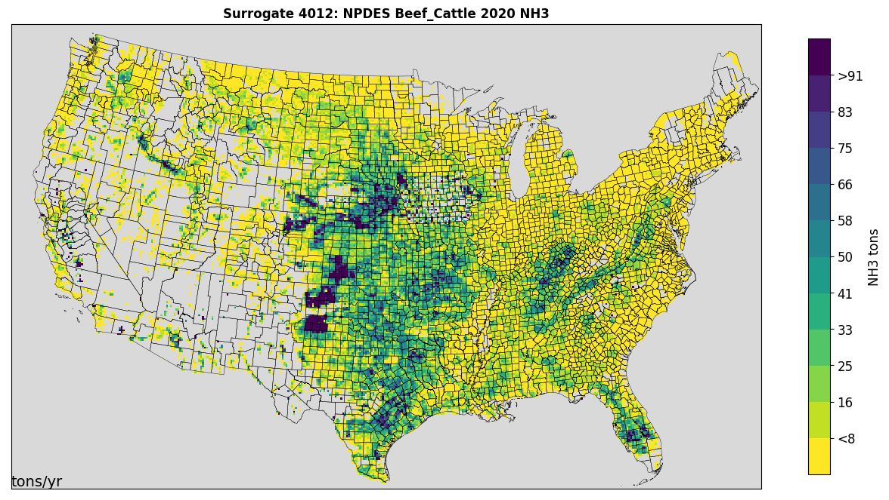
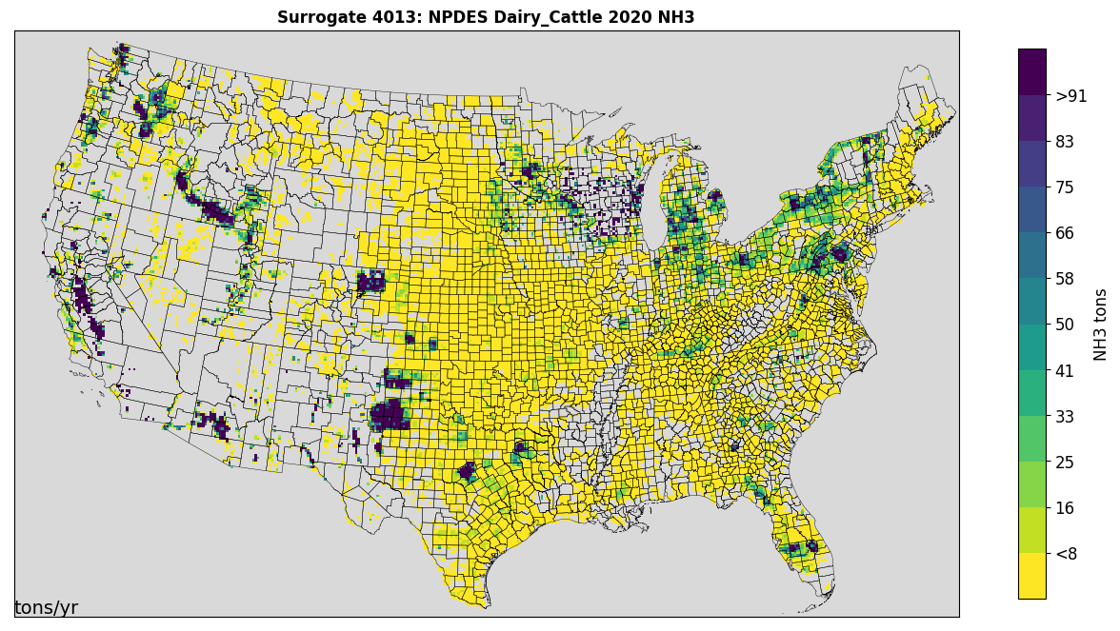
Livestock Surrogates
2010 Animal-specific FAO raster data at ~10 km resolution
Masked with NLCD agriculture areas to improve spatial resolution for fine scales
NPDES water waste animal feedlot (AFO) permits for states where available
IA, NC, SC, MN, WI, CA have public datasets with varying coverage by animal type
Animal types: beef cattle, dairy cattle, chicken, swine, sheep, horse, turkey

Slide 5
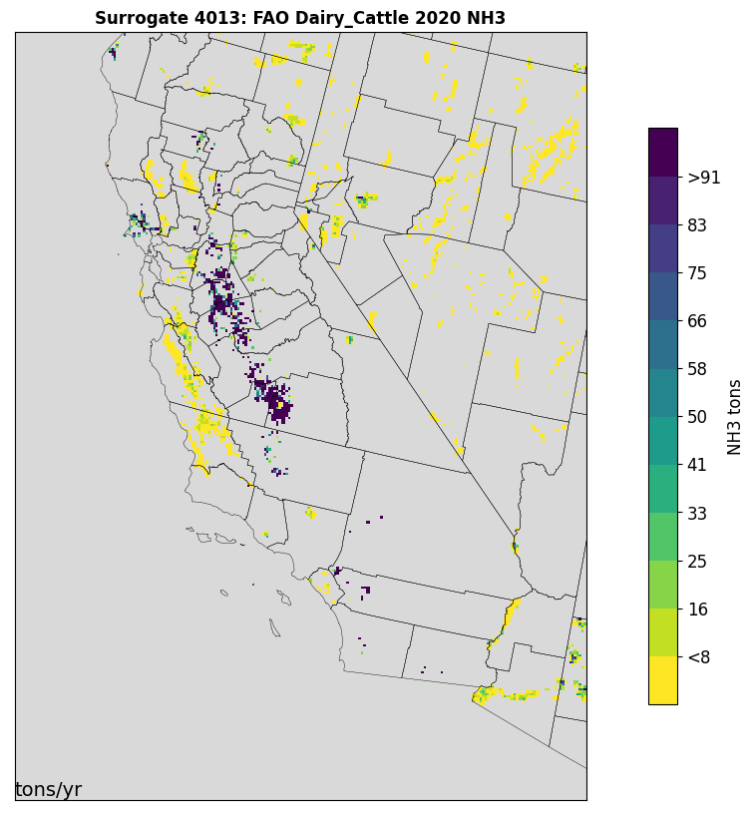
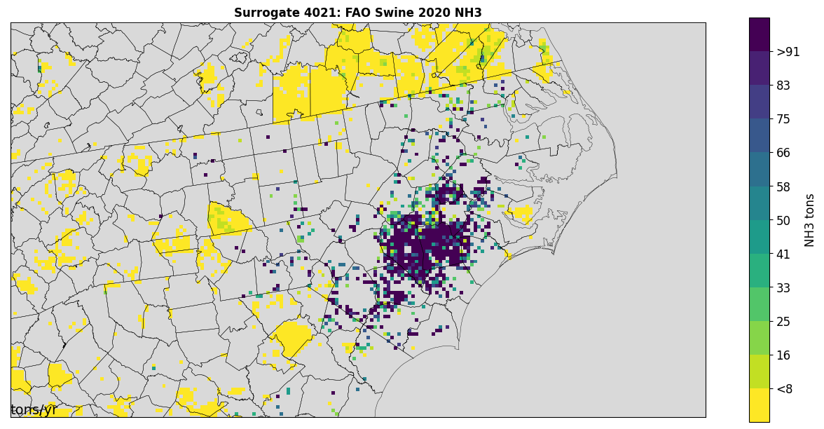
NPDES Impact on Livestock Surrogates
NPDES point data improves allocation at 4 km
NC Swine
CA Dairies

Slide 6
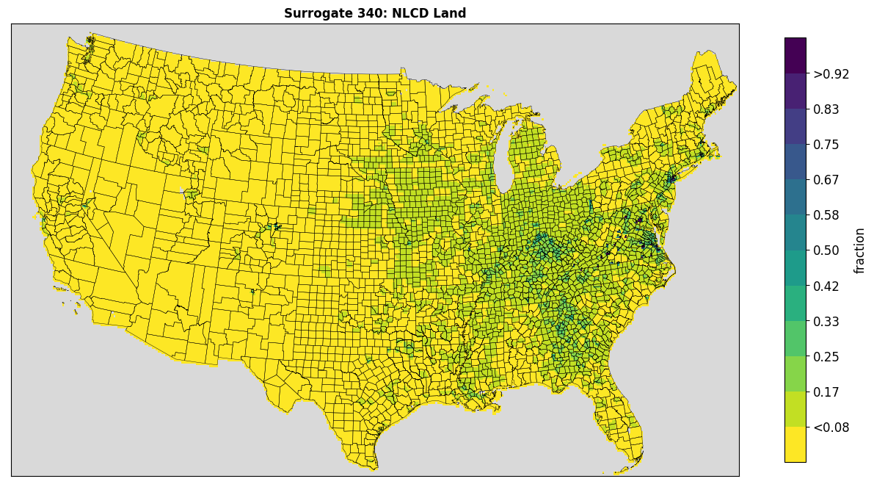
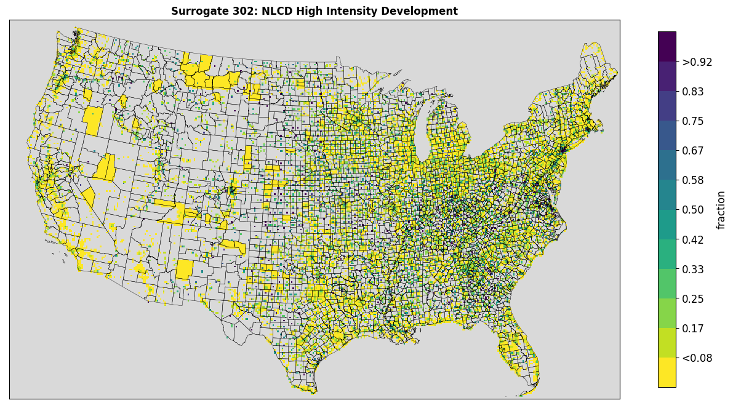
NLCD Surrogates
National Land Cover (NCLD) data were updated to 2019 from 2011
Land use with percent developed impervious space
Used to define land area, water, and development related surrogates
NLCD surrogates commonly used as a gapfiller for other surrogates
Downscaled to 250 m from 30 m using NN approach

Slide 7
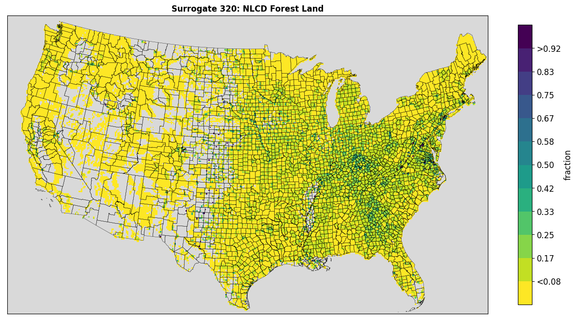
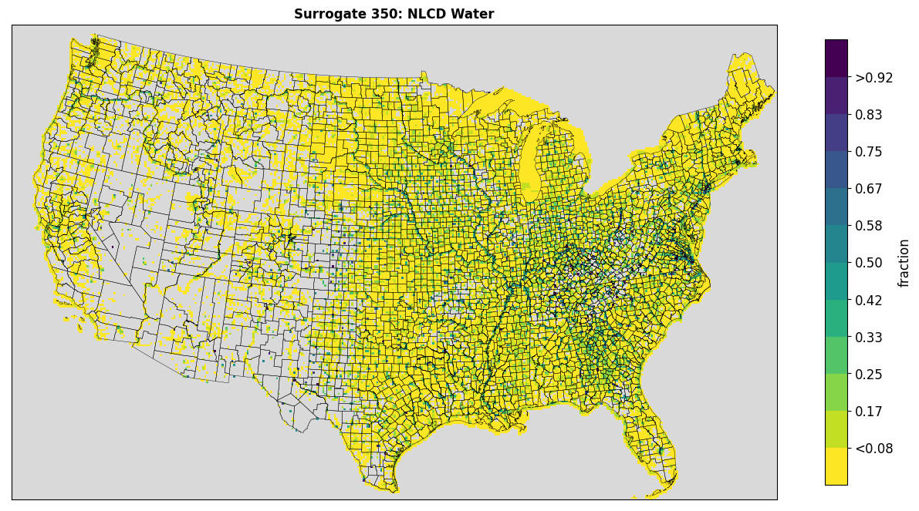
Available NLCD Surrogates
Open Space (< 20% impervious)
Low Development (20-49% impervious)
Med Development (50-79% impervious)
High Development (80%+ impervious)
Total Agriculture (pasture, hay, row crops)
Forest Land (all tree types)
Recreational Land
All Land
All Water

Slide 8
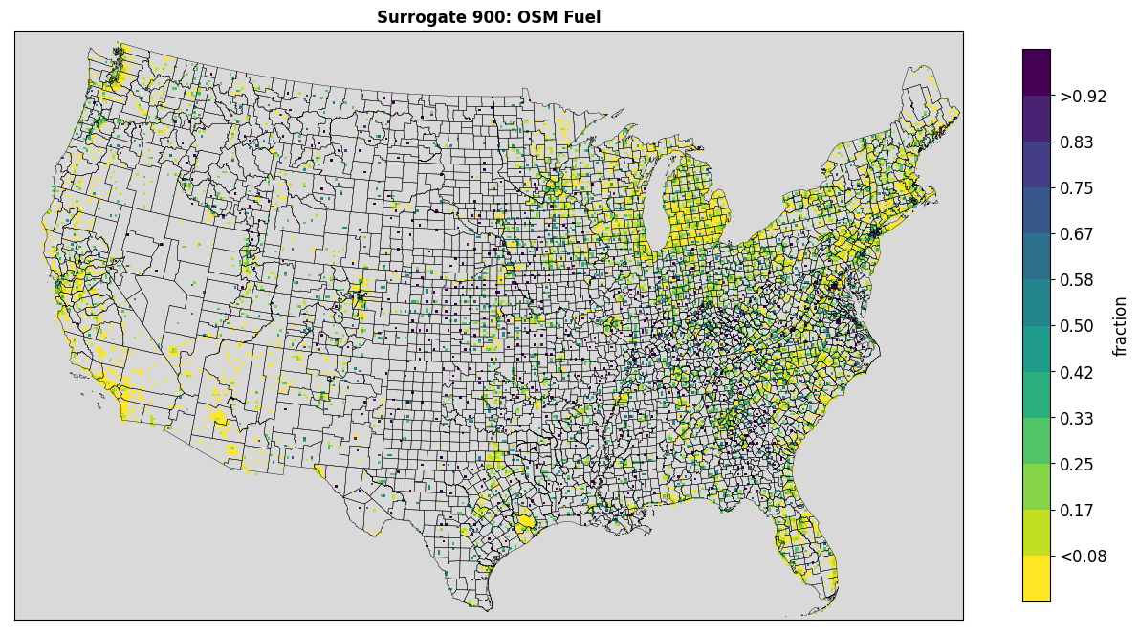
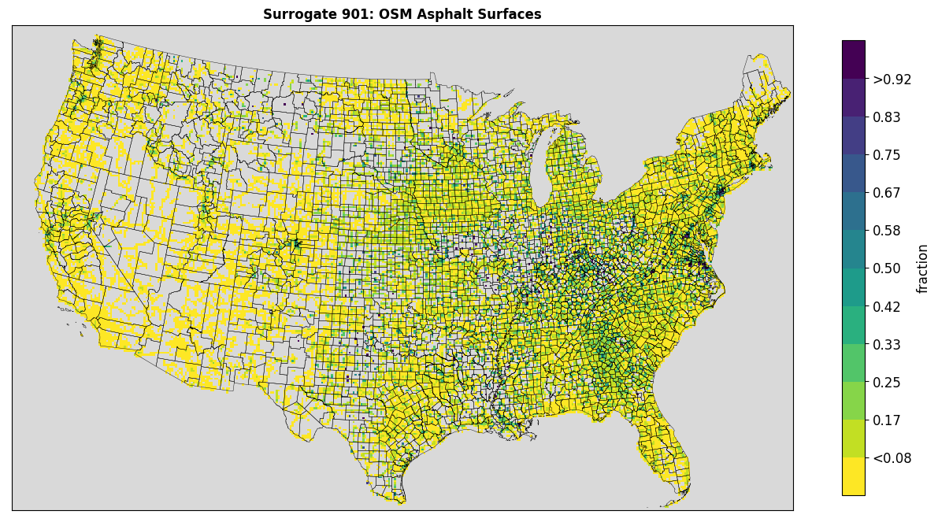
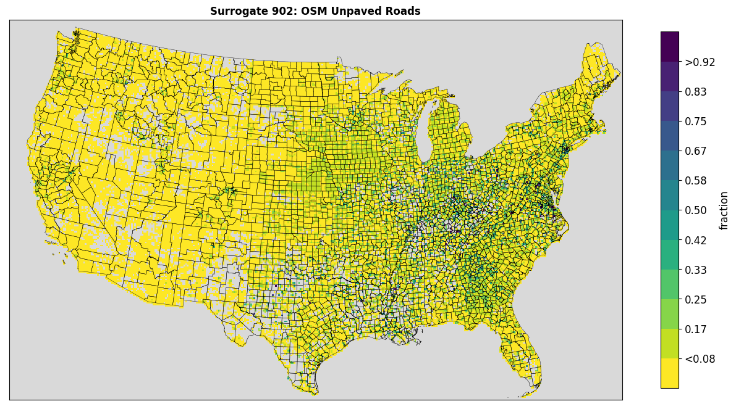
OpenStreetMap Surrogates
Crowd-source open geographic database
Network of nodes, lines, and polygons
Contains attributes indicating
Road amenities such as fueling stations
Surface types of roads and parking areas
Fuel stations, asphalt surfaces, unpaved roads

Slide 9
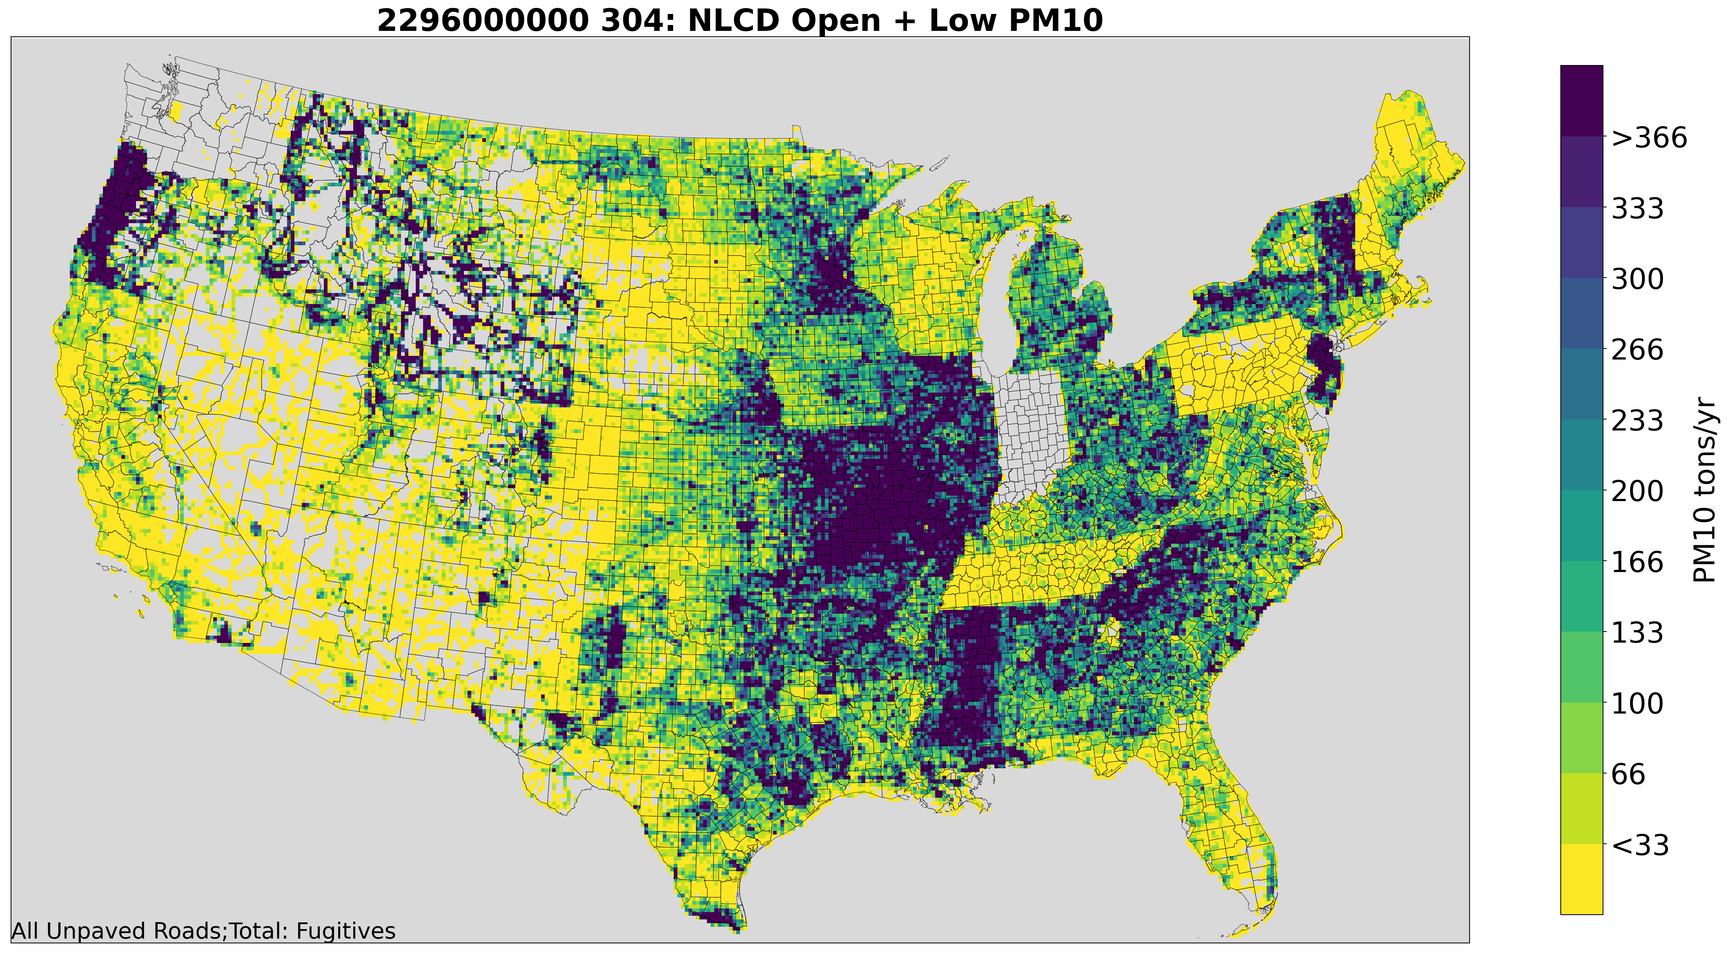
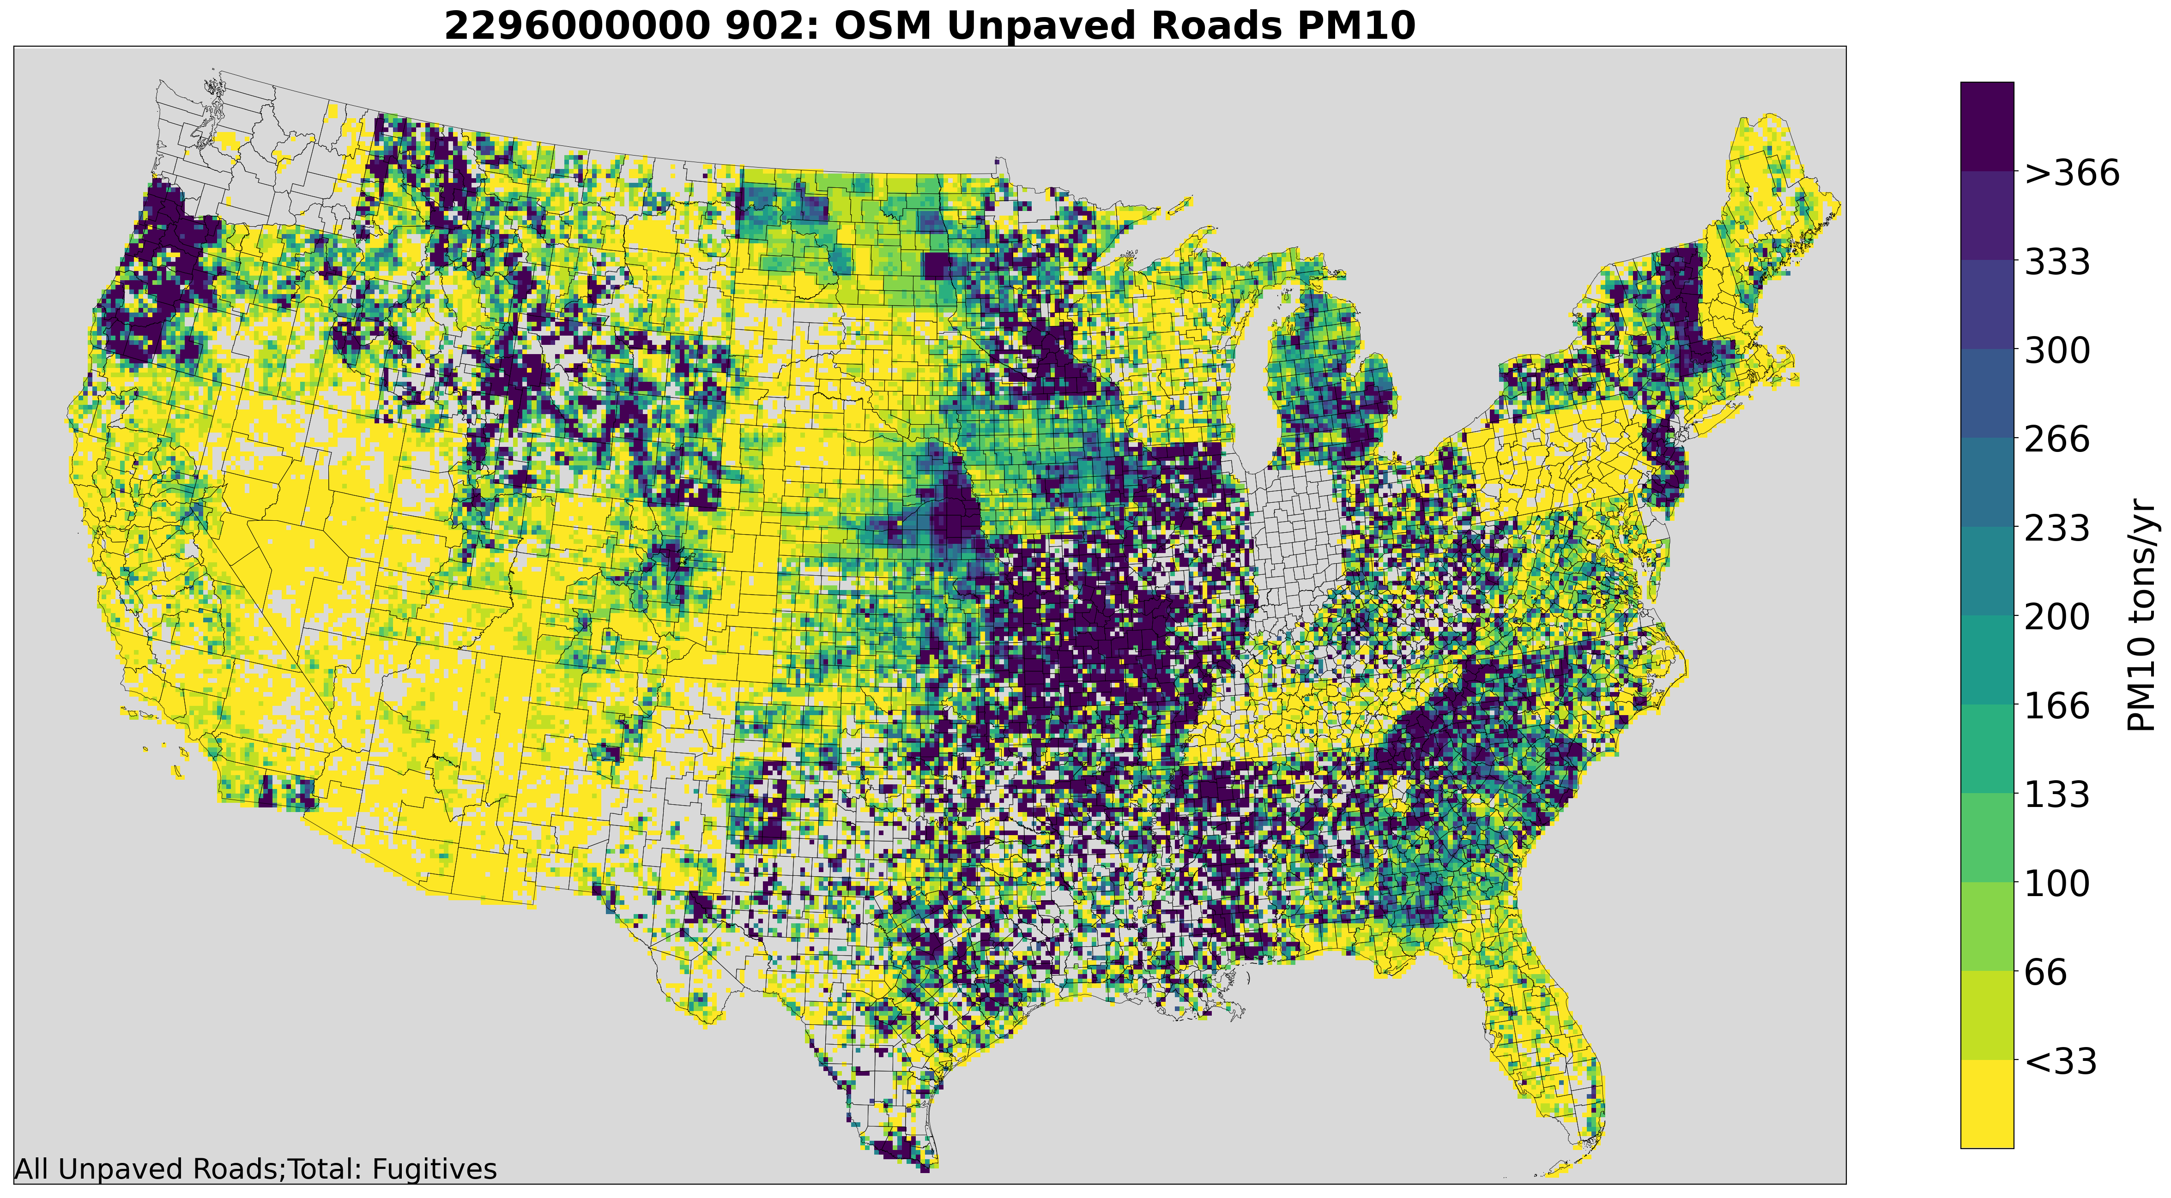
OpenStreetMap Surrogates (ctd.)
Unpaved roads are a key source of fugitive dust (PM)
Previous platforms used NLCD Open Space and Low Development surrogate
New surrogate uses lines/roads with unpaved surface types

Slide 10
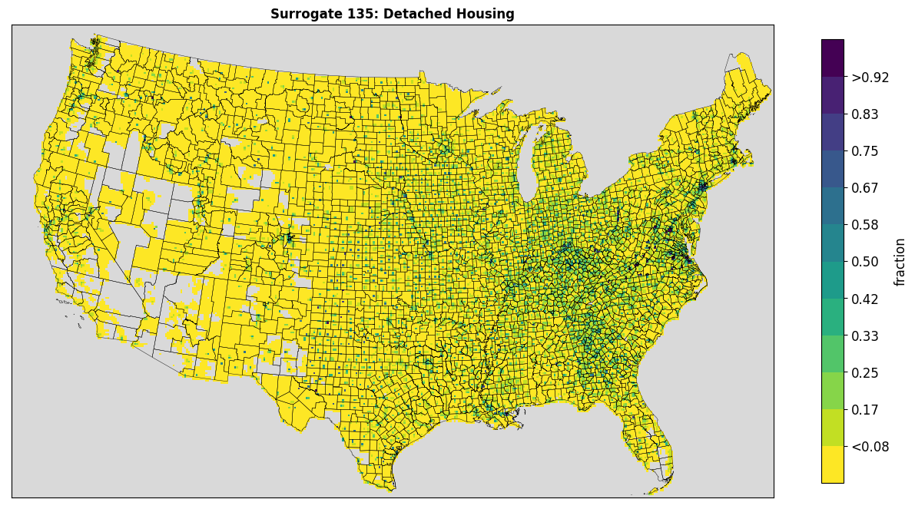
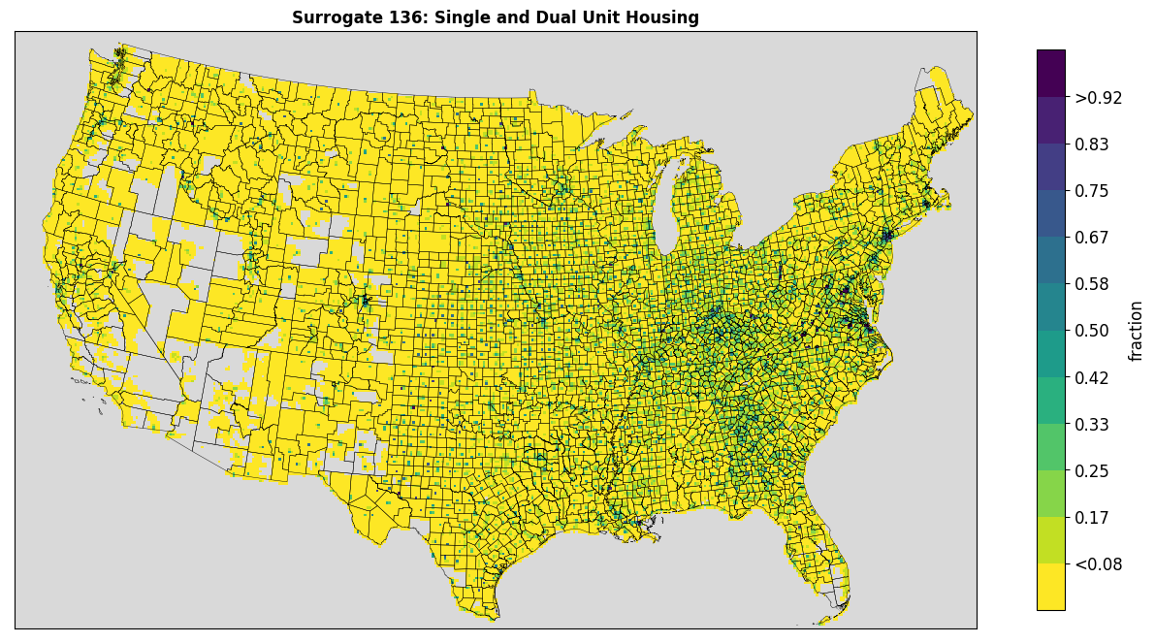
American Community Survey Surrogates
2020 release of 5-year data
Data by census block (sub-county) level
Population, housing, primary home heating
Detached homes and single/dual units
New and can be used for residential wood combustion sources

Slide 11
Other Aspects of Spatial Surrogates
Spatial surrogates are mapped to inventory data using a gridding cross-reference
Mappings typically done using source category code (SCC) but can also be done using the state or state and county FIPS code with or without the SCC
When quality weighting data are available mappings can be specific (ie. Sand and Gravel Quarries SCC to Sand and Gravel Quarry surrogate)
Many sources have broad mappings (i.e. Automobile surface coating SCCs to NLCD Low + Med + High surrogate)
Updates were made in 2020 platform for livestock, afdust, rwc, and a couple SCCs in nonpt, nonroad, and solvents
Surrogates may be gap-filled using other surrogates as generalized fallbacks when the weighting spatial data has incomplete coverage
Example, the Beef Cattle surrogate is gap-filled by the NLCD Agriculture surrogate

Slide 12
Other Surrogates
Oil and gas surrogates updated with 2020 year-specific data
Onroad surrogates use 2017 HPMS, same as 2017 platform
Have not been updated with available 2018 data
NTAD rail uses 2014 data
Updated rail lines available, but no new activity for proper weighting
Split USGS mines into lead and crushed stone types
Last Mineral Resources Data System (MRDS) update is 2016
Airport areas, port areas, golf courses, extended idle locations are not updated
Smaller sources, did not check for new shapefiles

Slide 13
Possible Future Updates
Recreational waters surrogate
Currently uses all NLCD all water, not necessarily representative of activity
Parking (on/off street)
Exhaust and evaporative off-network emissions
Currently uses NLCD all-development
Airport areas
Used for av-gas refueling, weigh by general aviation activity?
Research other data sources for rail activity

Slide 14
Appendix A. Updated Cross-reference Entries

Slide 15
Appendix A. Updated Cross-reference cont.

