Slide 1
2021 vs 2022 CMV Emissions
April 2024

Slide 2
Development of 2022 CMV Emissions
Data were requested from US Coastguard for larger boxes than were used for 2020 NEI – they cover our 36US3 grid AK, HI, and PR+VI
Data were processed by EPA with C1C2 separated from C3
ERG developed C1C2 emissions using methods similar to 2020 NEI
EPA developed C3 emissions using methods similar to 2020 NEI
Unique issue in 2022: there were some missing data in May and June
Updates since 2021 to C3 processing:
EPA previously identified ships as Tier 3 based on their keel-laid date alone; therefore, all new ships were assigned Tier 3 emission factors.
We now understand that Tier 3 ships operating outside the ECA turn off their aftertreatment as a cost saving measure.
As a result, we now assume that the lowest NOx emission rates calculated outside the ECA will correspond to Tier 2.

Slide 3
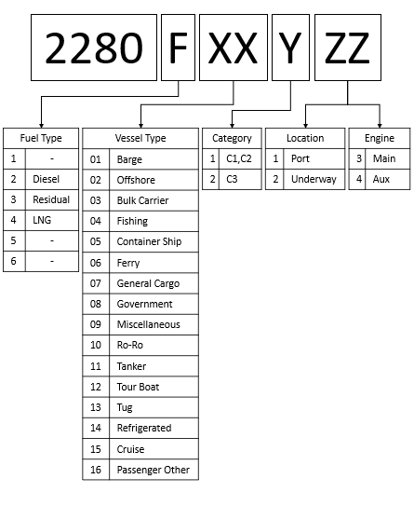
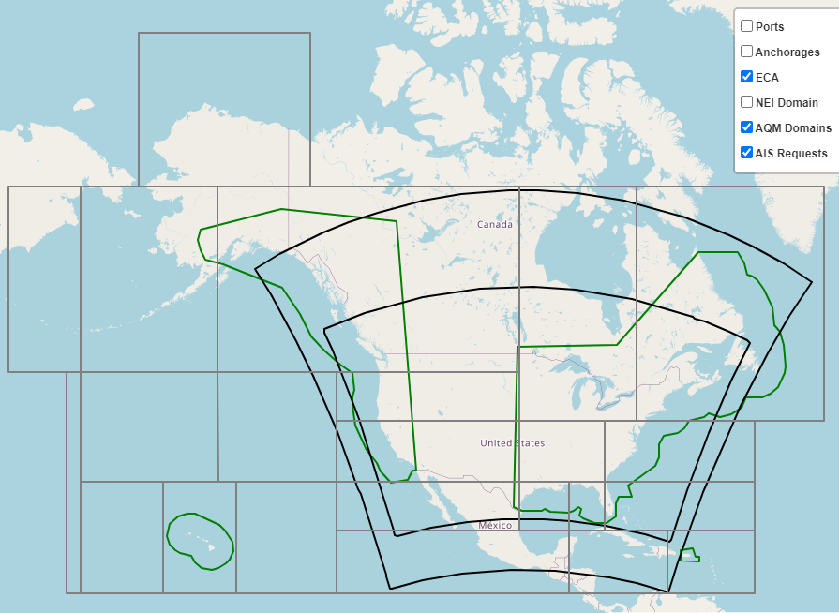
Expanded area covered by 2022 request boxes
Decoder for new SCCs

Slide 4
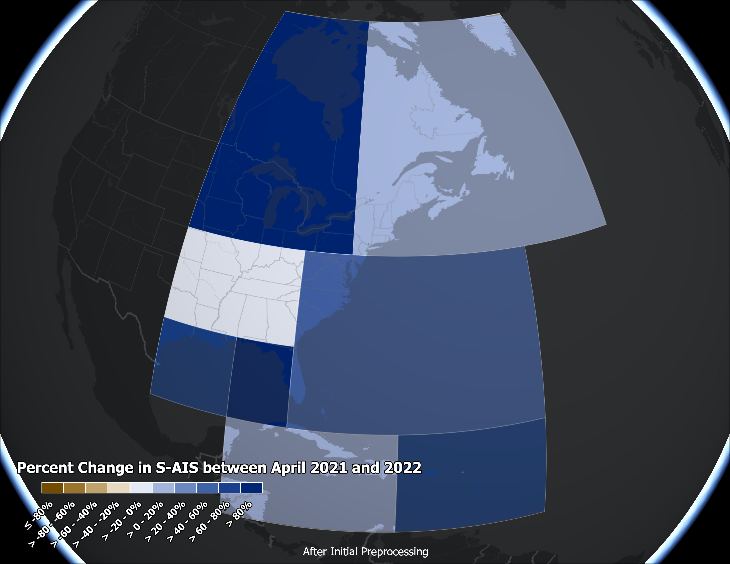
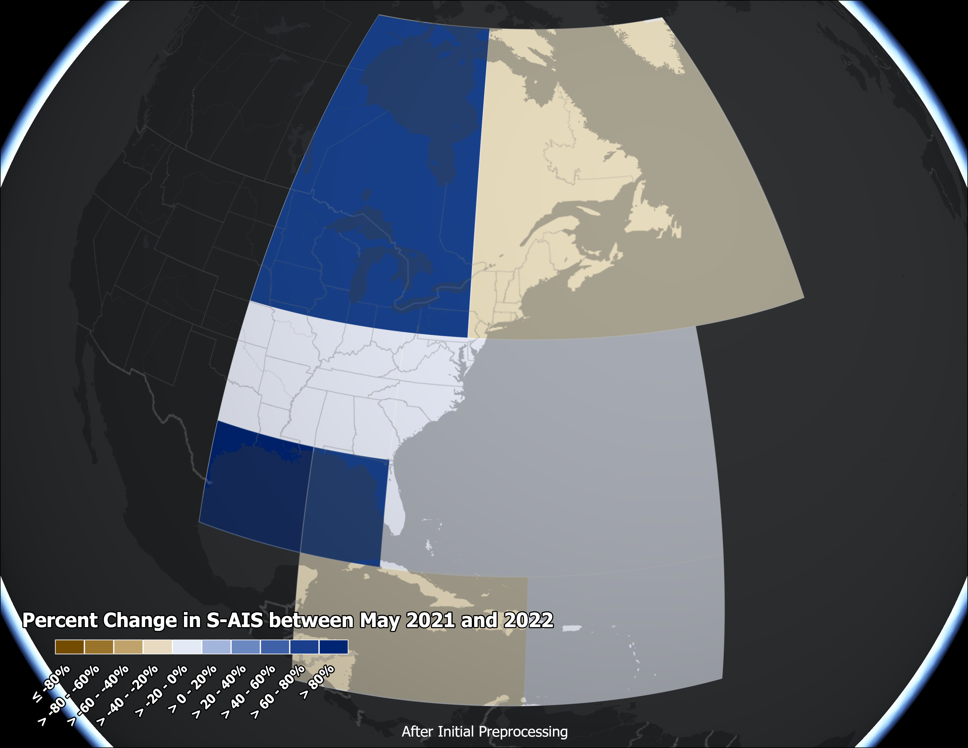
C1C2 Satellite AIS Record Counts

Slide 5
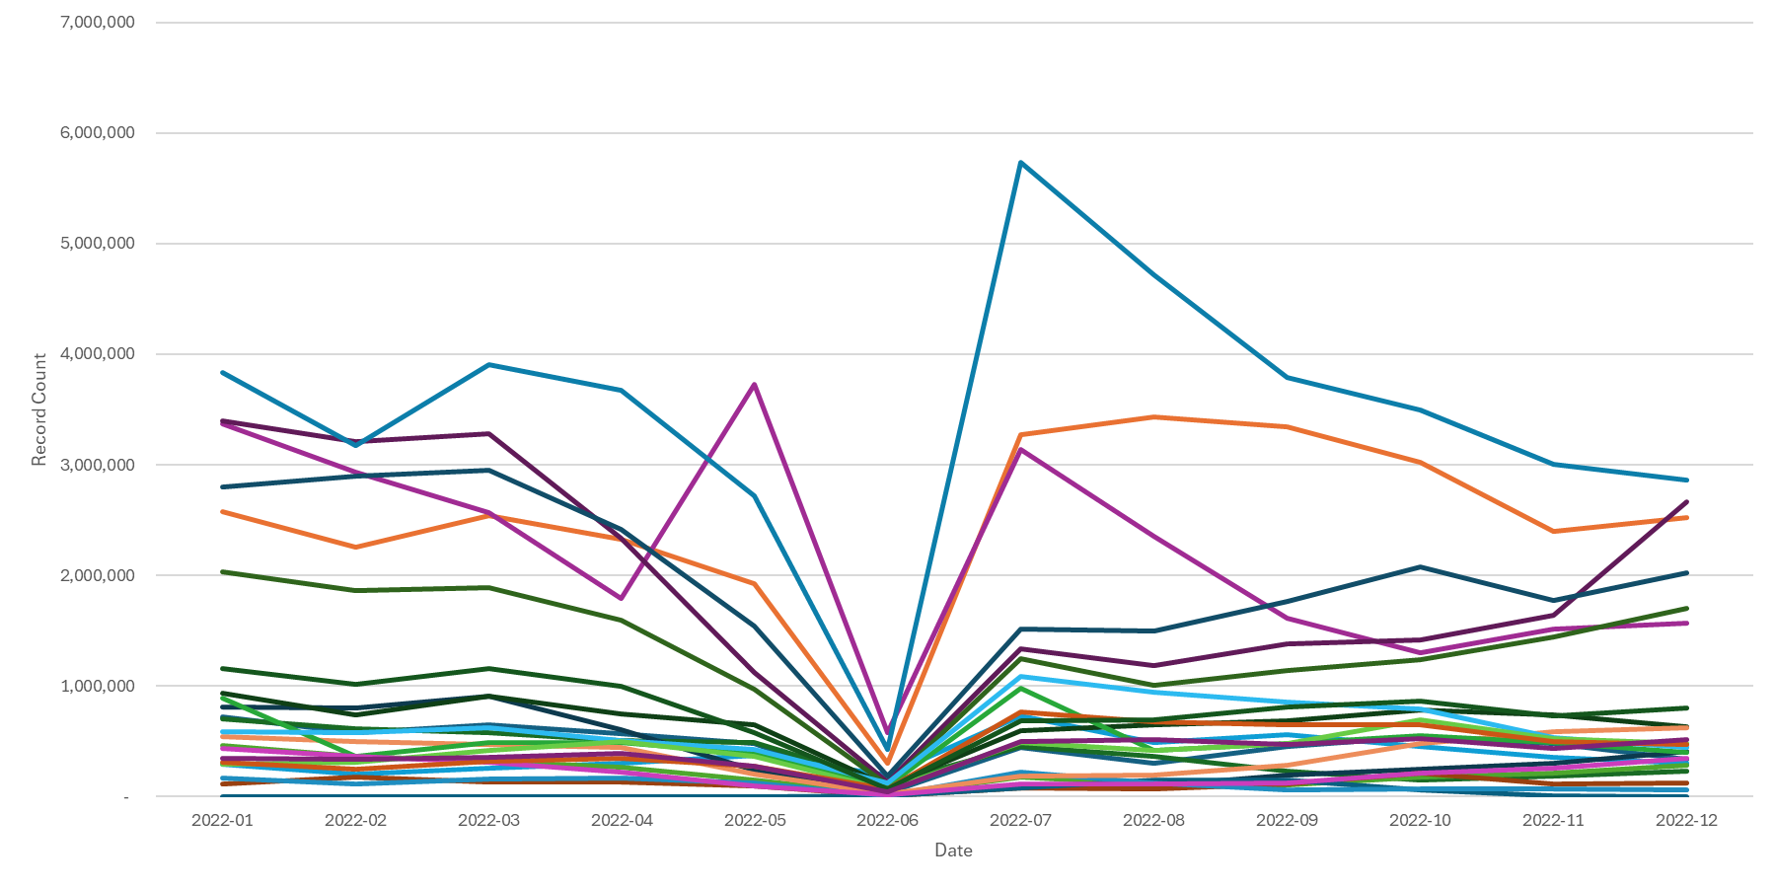
Initially Processed C1C2 S-AIS Record Counts

Slide 6
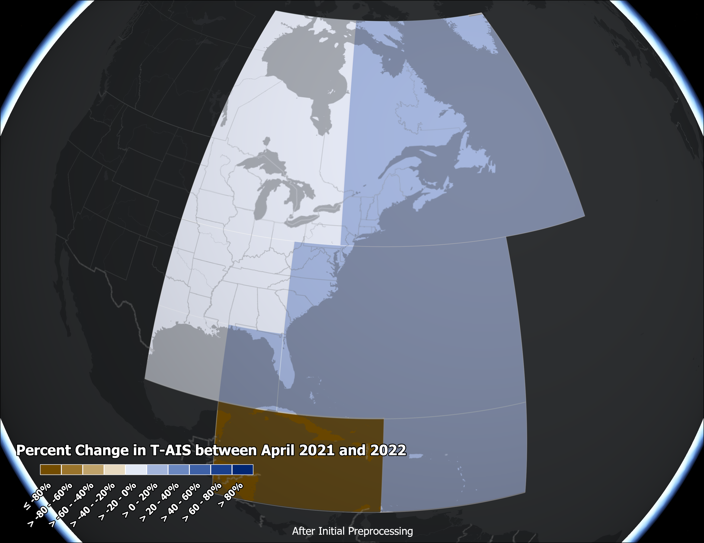
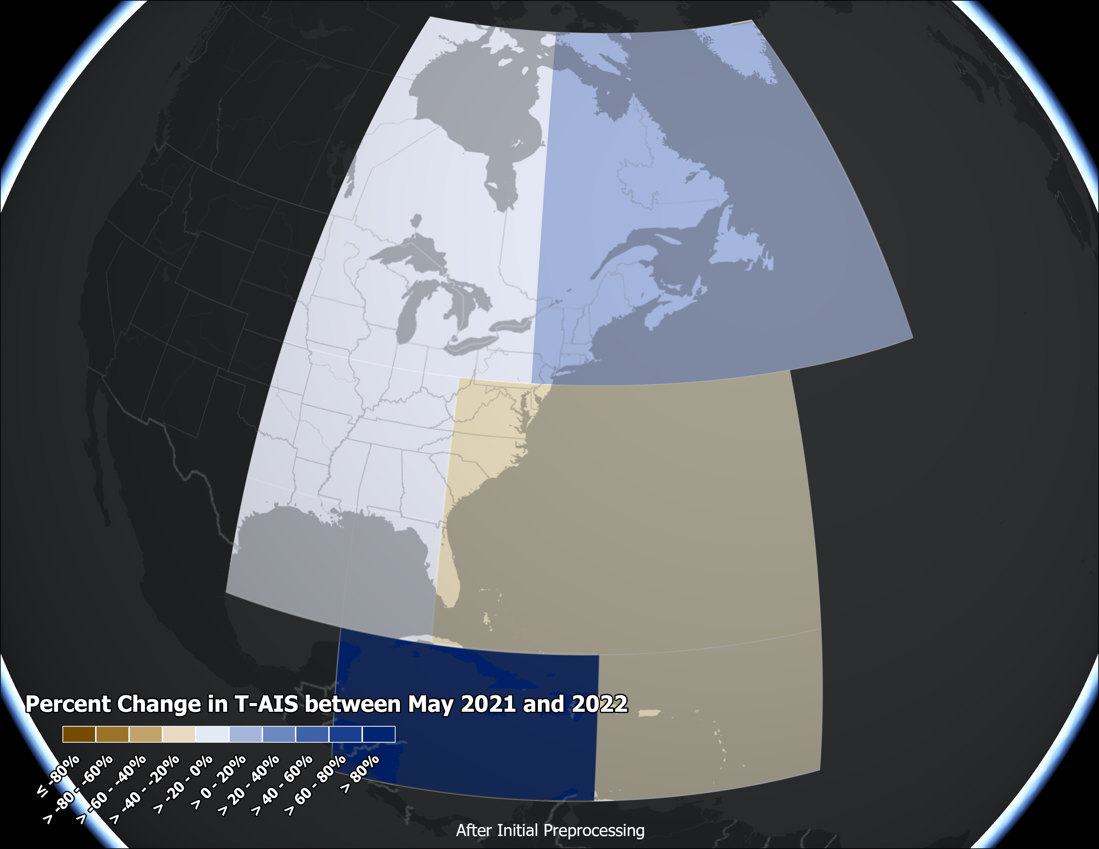
Terrestrial-AIS C1C2 Record Counts

Slide 7
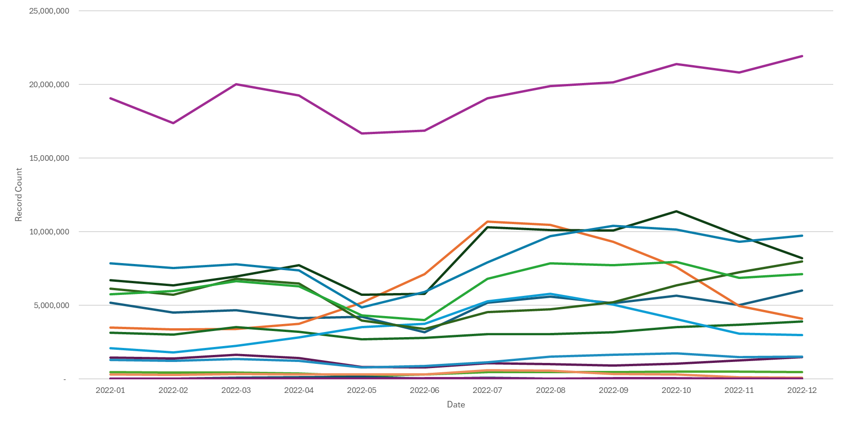
Initially Processed C1C2 T-AIS Record Counts
West Gulf of Mexico
New England (orange)
Southeast Alaska (blue)

Slide 8
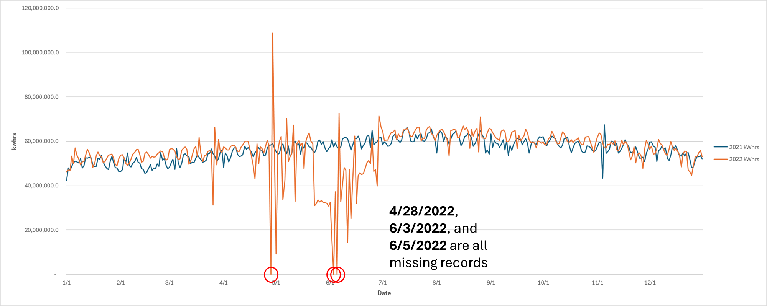
Some dates have no records

Slide 9
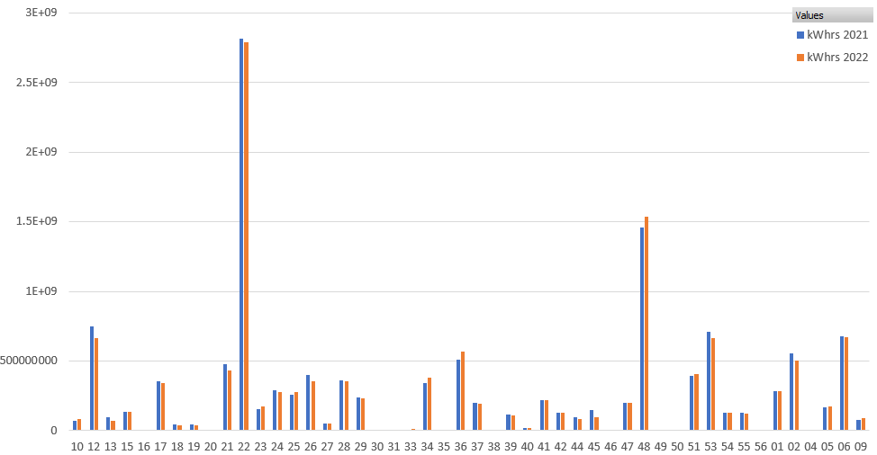
C1C2 KWhrs by State: 2021 vs 2022

Slide 10
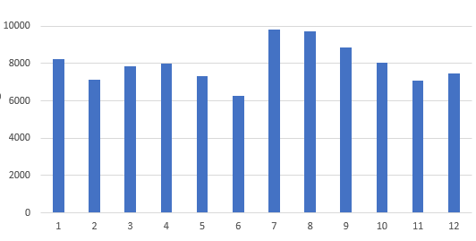
2022 C3 NOx Emissions in State Waters by Month

Slide 11
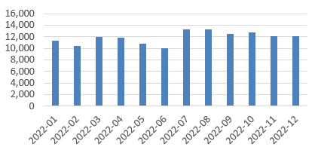
2022 C1C2 NOx Emissions in State Waters by Month

Slide 12
2021 and 2022 CONUS Emissions in State Waters
Pollutant | C3 2021 | C3 2022 | 2022-2021 | % change
CO | 10,252 | 9,919 | -334 | -3.3%
CO2 | 6,859,059 | 6,530,341 | -328,719 | -4.8%
NOX | 81,846 | 81,879 | 33 | 0.0%
PM10 | 2,507 | 1,780 | -727 | -29.0%
PM25 | 2,307 | 1,638 | -669 | -29.0%
SO2 | 5,767 | 4,018 | -1,750 | -30.3%
VOC | 4,687 | 4,344 | -344 | -7.3%
* Excludes AK, HI, PR, VI because they are not included in the 2021 numbers
Pollutant | C1C2 2021 | C1C2 2022 | 2022-2021 | % change
CO | 19,892 | 19,780 | -112 | -0.6%
CO2 | 9,518,291 | 9,469,870 | -48,421 | -0.5%
NOX | 134,167 | 133,801 | -366 | -0.3%
PM10 | 3,662 | 3,661 | -1 | 0.0%
PM25 | 3,548 | 3,547 | -1 | 0.0%
SO2 | 615 | 615 | -1 | -0.1%
VOC | 5,116 | 5,155 | 39 | 0.8%

Slide 13
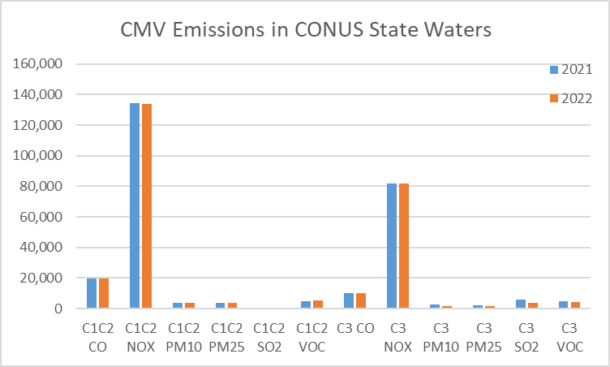

Slide 14
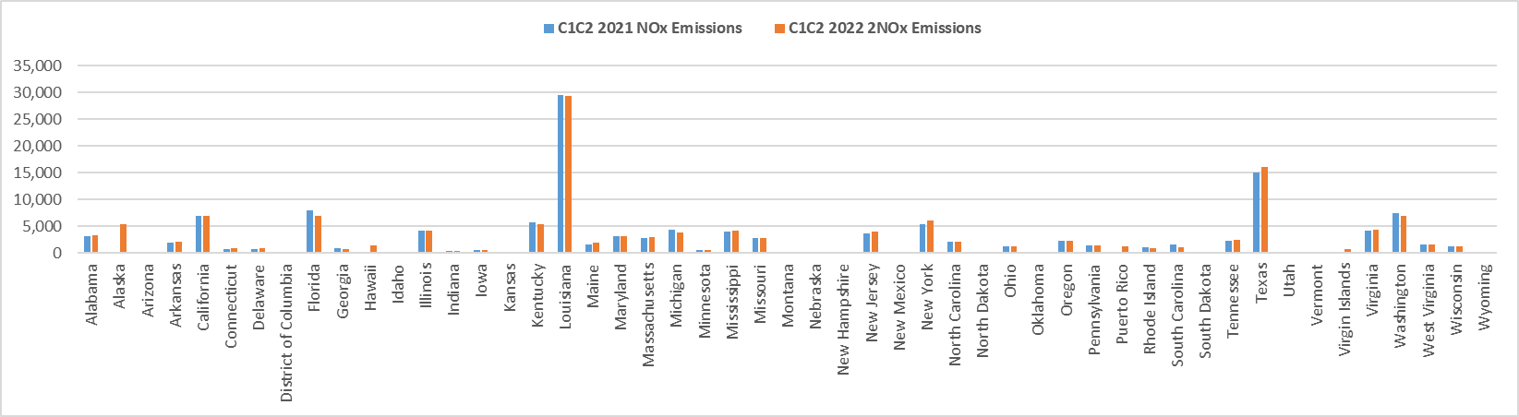
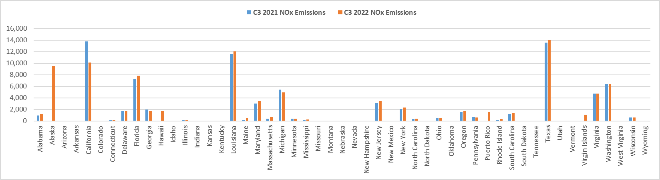
2021 and 2022 CMV Emissions by State

Slide 15
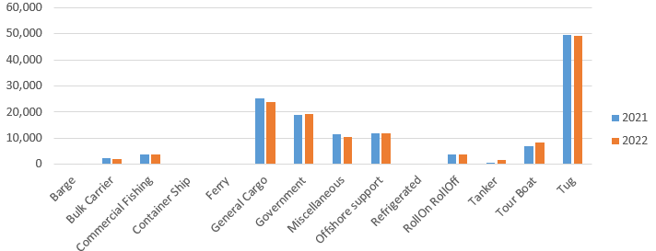
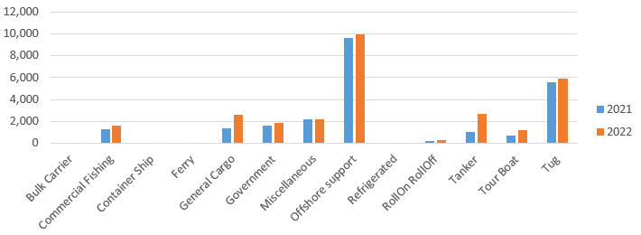
CONUS C1C2 NOx in State Waters by Ship Type
C1C2 NOx in Federal Waters by Ship Type

Slide 16
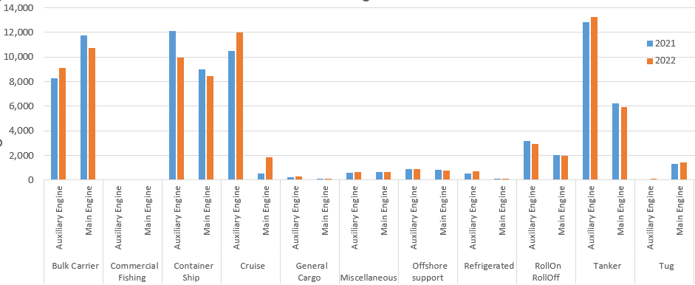
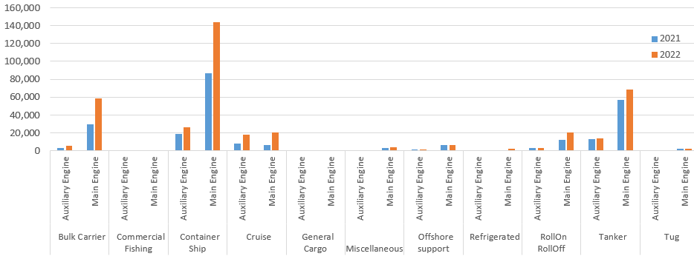
C3 NOx in State Waters by Ship and Engine Type
C3 NOx in Federal Waters by Ship and Engine Type

Slide 17
“County”+SCCs with most C1C2 NOx Emissions
County | SCC Description | Pollutant | 2021 | 2022
Gulf Coast EEZ | Diesel Offshore support;C1C2 Underway emissions: Auxiliary Engine | NOX | 5,132 | 5,457
Gulf Coast EEZ | Diesel Offshore support;C1C2 Underway emissions: Main Engine | NOX | 3,157 | 3,284
Gulf Coast EEZ | Diesel Tug;C1C2 Underway emissions: Main Engine | NOX | 2,350 | 2,290
Lafourche | Diesel Offshore support;C1C2 Port Emissions: Auxiliary Engine | NOX | 2,124 | 2,800
East Coast EEZ | Diesel Tug;C1C2 Underway emissions: Main Engine | NOX | 1,737 | 1,704
Lafourche | Diesel Offshore support;C1C2 Underway emissions: Auxiliary Engine | NOX | 1,396 | 1,512
Anne Arundel | Diesel Government;C1C2 Underway emissions: Auxiliary Engine | NOX | 1,310 | 1,280
Harris | Diesel General Cargo;C1C2 Underway emissions: Auxiliary Engine | NOX | 1,083 | 1,186
South Pacific EEZ | Diesel Tug;C1C2 Underway emissions: Main Engine | NOX | 938 | 840
Harris | Diesel Tug;C1C2 Underway emissions: Main Engine | NOX | 770 | 808
Gulf Coast EEZ | Diesel Miscellaneous;C1C2 Underway emissions: Auxiliary Engine | NOX | 748 | 736
Harris | Diesel Tug;C1C2 Underway emissions: Auxiliary Engine | NOX | 721 | 739
Plaquemines | Diesel Tug;C1C2 Underway emissions: Main Engine | NOX | 614 | 615
San Diego | Diesel Government;C1C2 Port Emissions: Auxiliary Engine | NOX | 610 | 513
Galveston | Diesel Tug;C1C2 Underway emissions: Main Engine | NOX | 594 | 706
East Coast EEZ | Diesel Government;C1C2 Underway emissions: Auxiliary Engine | NOX | 594 | 637
Non-US SECA C3 | Diesel Government;C1C2 Underway emissions: Auxiliary Engine | NOX | 593 | 0
Plaquemines | Diesel General Cargo;C1C2 Underway emissions: Auxiliary Engine | NOX | 578 | 515
King | Diesel RollOn RollOff;C1C2 Underway emissions: Main Engine | NOX | 566 | 537
Non-US SECA C3 | Diesel Tanker;C1C2 Underway emissions: Main Engine | NOX | 563 | 0
Terrebonne | Diesel Offshore support;C1C2 Underway emissions: Auxiliary Engine | NOX | 557 | 575
East Coast EEZ | Diesel Offshore support;C1C2 Underway emissions: Auxiliary Engine | NOX | 542 | 248
Jefferson | Diesel Tug;C1C2 Underway emissions: Main Engine | NOX | 533 | 577
East Coast EEZ | Diesel Commercial Fishing;C1C2 Underway emissions: Auxiliary Engine | NOX | 515 | 519
Kitsap | Diesel RollOn RollOff;C1C2 Underway emissions: Main Engine | NOX | 501 | 539

Slide 18
C3 SCC+”Counties” with the most NOx Emissions in Federal Waters
County | SCC | SCC Description | Pollutant | 2021 | 2022
East Coast EEZ | 2280205323 | Diesel Container Ship;C3 Underway emissions: Main Engine | NOX | 40,968 | 38,930
Gulf Coast EEZ | 2280211323 | Diesel Tanker;C3 Underway emissions: Main Engine | NOX | 30,025 | 28,281
South Pacific EEZ | 2280205323 | Diesel Container Ship;C3 Underway emissions: Main Engine | NOX | 23,622 | 16,735
East Coast EEZ | 2280211323 | Diesel Tanker;C3 Underway emissions: Main Engine | NOX | 10,759 | 9,967
Gulf Coast EEZ | 2280205323 | Diesel Container Ship;C3 Underway emissions: Main Engine | NOX | 9,793 | 9,837
Gulf Coast EEZ | 2280203323 | Diesel Bulk Carrier;C3 Underway emissions: Main Engine | NOX | 9,601 | 8,346
Gulf Coast EEZ | 2280211324 | Diesel Tanker;C3 Underway emissions: Auxiliary Engine | NOX | 8,515 | 8,309
East Coast EEZ | 2280205324 | Diesel Container Ship;C3 Underway emissions: Auxiliary Engine | NOX | 8,399 | 12,641
South Pacific EEZ | 2280205324 | Diesel Container Ship;C3 Underway emissions: Auxiliary Engine | NOX | 7,231 | 3,726
East Coast EEZ | 2280305323 | Residual Container Ship;C3 Underway emissions: Main Engine | NOX | 6,877 | 9,338
East Coast EEZ | 2280210323 | Diesel RollOn RollOff;C3 Underway emissions: Main Engine | NOX | 6,797 | 5,982
East Coast EEZ | 2280203323 | Diesel Bulk Carrier;C3 Underway emissions: Main Engine | NOX | 6,487 | 5,714
East Coast EEZ | 2280311323 | Residual Tanker;C3 Underway emissions: Main Engine | NOX | 5,978 | 7,700
South Pacific EEZ | 2280211323 | Diesel Tanker;C3 Underway emissions: Main Engine | NOX | 5,017 | 5,023
South Pacific EEZ | 2280203323 | Diesel Bulk Carrier;C3 Underway emissions: Main Engine | NOX | 4,969 | 4,346
Gulf Coast EEZ | 2280311323 | Residual Tanker;C3 Underway emissions: Main Engine | NOX | 4,275 | 5,199
East Coast EEZ | 2280303323 | Residual Bulk Carrier;C3 Underway emissions: Main Engine | NOX | 3,740 | 4,616
East Coast EEZ | 2280215324 | Diesel Cruise;C3 Underway emissions: Auxiliary Engine | NOX | 3,330 | 7,636
South Pacific EEZ | 2280305323 | Residual Container Ship;C3 Underway emissions: Main Engine | NOX | 3,228 | 11,028
Gulf Coast EEZ | 2280202323 | Diesel Offshore support;C3 Underway emissions: Main Engine | NOX | 3,025 | 2,691

Slide 19
C3 County + SCC combinations with most NOx
County | SCC | SCC Description | Pollutant | 2021 | 2022
Los Angeles | 2280215324 | Diesel Cruise;C3 Underway emissions: Auxiliary Engine | NOX | 2,845 | 1,551
Harris | 2280211314 | Diesel Tanker;C3 Port Emissions: Auxiliary Engine | NOX | 2,374 | 2,302
Los Angeles | 2280205314 | Diesel Container Ship;C3 Port Emissions: Auxiliary Engine | NOX | 2,309 | 1,852
Miami-Dade | 2280215314 | Diesel Cruise;C3 Port Emissions: Auxiliary Engine | NOX | 2,209 | 1,195
Plaquemines | 2280203323 | Diesel Bulk Carrier;C3 Underway emissions: Main Engine | NOX | 1,818 | 1,631
Los Angeles | 2280205324 | Diesel Container Ship;C3 Underway emissions: Auxiliary Engine | NOX | 1,443 | 540
Galveston | 2280211324 | Diesel Tanker;C3 Underway emissions: Auxiliary Engine | NOX | 1,222 | 1,258
Plaquemines | 2280211323 | Diesel Tanker;C3 Underway emissions: Main Engine | NOX | 1,096 | 1,028
Galveston | 2280211323 | Diesel Tanker;C3 Underway emissions: Main Engine | NOX | 1,039 | 964
San Diego | 2280215324 | Diesel Cruise;C3 Underway emissions: Auxiliary Engine | NOX | 883 | 910
Plaquemines | 2280203324 | Diesel Bulk Carrier;C3 Underway emissions: Auxiliary Engine | NOX | 830 | 718
San Francisco | 2280205324 | Diesel Container Ship;C3 Underway emissions: Auxiliary Engine | NOX | 818 | 425
Broward | 2280215314 | Diesel Cruise;C3 Port Emissions: Auxiliary Engine | NOX | 814 | 768
Miami-Dade | 2280215324 | Diesel Cruise;C3 Underway emissions: Auxiliary Engine | NOX | 792 | 715
Clallam | 2280205323 | Diesel Container Ship;C3 Underway emissions: Main Engine | NOX | 715 | 601
Jefferson | 2280211324 | Diesel Tanker;C3 Underway emissions: Auxiliary Engine | NOX | 698 | 748
Chatham | 2280205323 | Diesel Container Ship;C3 Underway emissions: Main Engine | NOX | 675 | 524
Orange | 2280205324 | Diesel Container Ship;C3 Underway emissions: Auxiliary Engine | NOX | 637 | 50
Plaquemines | 2280205323 | Diesel Container Ship;C3 Underway emissions: Main Engine | NOX | 593 | 491
Keweenaw | 2280203323 | Diesel Bulk Carrier;C3 Underway emissions: Main Engine | NOX | 568 | 485
Harris | 2280211324 | Diesel Tanker;C3 Underway emissions: Auxiliary Engine | NOX | 523 | 517

Slide 20
Next Steps
Post the summaries on the FTP site (county + state + county + SCC):
https://gaftp.epa.gov/Air/emismod/2022/v1/draft/cmv/
https://www.epa.gov/air-emissions-modeling/2022v1-emissions-modeling-platform
Strip records from inland states / counties
For C3, develop and apply a mask file to remove interpolated values over land
Gapfill the emissions in the months / days that are missing AIS data
Prepare gridded emissions and plots
Address any comments that come in from the data review
Finalize the inventories in June

