Slide 1
Emissions Inventory Preparation for Air Quality Modeling (Base Year)
July 29, 2019
Alison Eyth, Jeff Vukovich, Caroline Farkas
EPA Office of Air Quality Planning and Standards
Emission Inventory and Analysis Group

Slide 2
Goals of Class
To introduce you to the various tasks involved with preparing emissions inputs to air quality models
Focus is on the steps and data involved, not the details of running the scripts
To answer commonly asked questions about emissions modeling
Note: presentation is available for download: ftp://newftp.epa.gov/Air/emismod/training/
US EPA OAQPS, Emission Inventory and Analysis Group

Slide 3
Course Outline and Schedule
8:00 Background, Inventories, Tools, and QA
8:40 Emissions Modeling and Plume Rise
9:10 Break
9:20 Temporal Allocation
9:40 Spatial Allocation
10:00 Speciation
10:20 Break
10:30 Fugitive Dust, Biogenics, and Fires
10:55 Onroad and Commercial Marine Vessels
11:20 Final processing and QA steps
11:35 LUNCH
US EPA OAQPS, Emission Inventory and Analysis Group

Slide 4
Background: Purpose and Contents of a Modeling Platform
Air quality modeling platforms are used to support air quality studies
Use technically sound data and state-of-the-science tools
Major components of a modeling platform:
Meteorological models (WRF) and met. data
Boundary conditions (GEOS-Chem/Hemispheric CMAQ)
Air quality models (CMAQ, CAMx)
Emissions: base year (NEI)+NonUS, future year projections
Other: ancillary data for emissions modeling, projections data, emissions modeling tools (SMOKE, etc) and scripts
US EPA OAQPS, Emission Inventory and Analysis Group
Notes:
Describe why we create modeling platforms and what they contain.

Slide 5
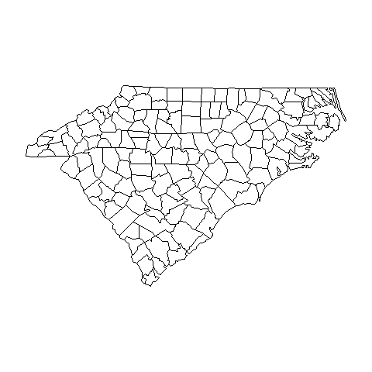
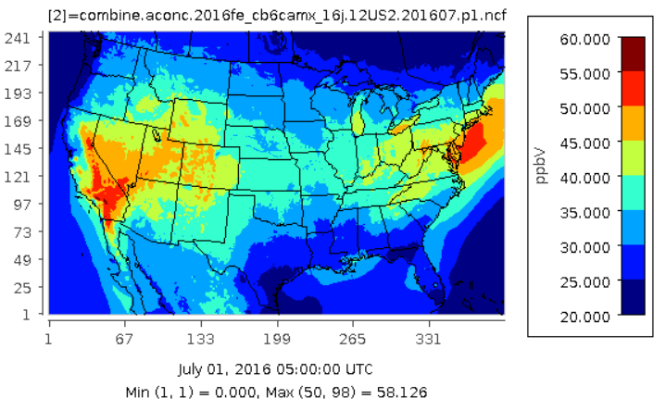
Air Quality Modeling Platform Components
Air Quality Model
Pollutant Concentrations
Meteorological Model: wind,
temperature,
precipitation,
radiation, …
These are hourly
and in 3-D
Boundary Conditions Concentrations of species at boundaries
Emissions
Ground level and elevated
Notes:
Shows how air quality model takes data from meteorological model, boundary conditions, and emissions, models the atmosphere in 3-D grid cells to create 3-D pollutant concentrations

Slide 6
Why do Air Quality Modeling?
Regulatory Impact Assessments (RIAs)
Model a base year focused on Criteria Air Pollutants (CAPs)
Model a future year base case with on-the-books rules
Model one or more cases that represent the rule
Estimate costs and benefits of rule
National Air Toxics Assessment (NATA)
Model a base year including as many Hazardous Air Pollutants (HAPs) as possible
Compute risk based on CMAQ and AERMOD concentrations
Transport and Regional Haze Modeling
Model a base year and a future year base case
Perform source apportionment modeling to determine contribution of states and/or sectors to air quality issues
US EPA OAQPS, Emission Inventory and Analysis Group
Notes:
These are common studies – there are others

Slide 7
Performing Emissions Modeling
We use the Sparse Matrix Operator Kernel Emissions (SMOKE) modeling system and associated tools to process our emissions into air quality model-ready files (http://www.cmascenter.org/smoke)
The input emission inventories (e.g., NEI) can be annual, monthly, daily, or hourly
“Ancillary” data files help process inventories into gridded hourly emissions of the chemical species (e.g., NO, NO₂, ISOP) used by the air quality model
Meteorological data such as temperature, precipitation, and radiation are needed to compute emissions and for some sectors temporalization (e.g., onroad mobile, biogenic, res. wood, agricultural)
Quality assurance steps and data summaries ensure data is properly transformed and mass is not lost
US EPA OAQPS, Emission Inventory and Analysis Group
Notes:
SMOKE modeling system the main tool to generate air quality modeling input data. SMOKE uses emissions inventories, meteorological data and other data.

Slide 8
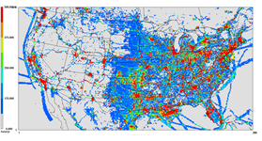
Emissions Modeling Schematic
Hourly, speciated
point and gridded
emissions
Meteorological Data: humidity,
temperature,
radiation, …
SMOKE
Emission
Inventories
Quality Assurance Logs and Summaries
Ancillary Data Speciation and Temporal Profiles, Spatial Surrogates, cross-references, etc.
Notes:
Meteorological data consisting of humidity, temperature, and radiation flows into SMOKE along with emission inventories and ancillary data such as speciation and temporal profiles, spatial surrogates, and cross references. SMOKE produces quality assurance logs and summaries along with hourly, speciated, point and gridded emissions.

Slide 9
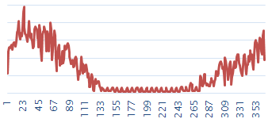

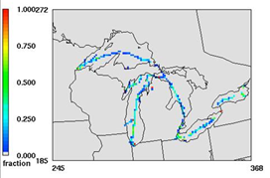
Emissions Modeling Process
Steps and data needed to convert emissions inventories into the resolution and formats needed by air quality models
Temporal Allocation
Temporal Profiles
Emission Inventories (annual/ monthly/daily)
+ Meteorology
day of year
Speciation Profiles
Speciation
Spatial Allocation
Hourly, speciated, gridded emissions for air quality modeling
Spatial Surrogates
Note: Plume rise is typically handled within the AQM
US EPA OAQPS, Emission Inventory and Analysis Group
Notes:
Emissions modeling starts with Emission Inventories, which can be annual, monthly or daily plus meteorology. The inventories go through the steps of temporal allocation (to hours), speciation (to air quality model species), and spatial allocation (to grid cells). The outputs are hourly, speciated, gridded emissions input to air quality models. Note that plume rise is typically handled in the air quality model.

Slide 10


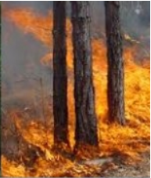
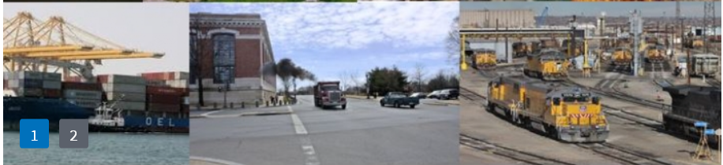

Base Year Emissions from the National Emissions Inventory (NEI)
Data are submitted by states, locals, tribes (S/L/T) and EPA into the Emissions Inventory System (EIS)
Five NEI data categories - all annual totals except events
Point/Facility Inventory (lat-lon locations): EGUs, airports, point oil and gas sources, commercial and industrial facilities
Nonpoint (county-based) – fugitive dust, agricultural, residential, industrial/commercial fuel comb., gas stations, biogenic
Onroad mobile sources (county): cars and trucks driving on roads
Nonroad mobile sources (county): mobile sources not on roads including rec. marine, construction equip., lawn/garden, tractors
Events (lat-lon, day): wildland and prescribed fires
US EPA OAQPS, Emission Inventory and Analysis Group
Notes:
The five NEI data categories are illustrated by the pictures at the bottom of the page.

Slide 11
NEI Compilation and Schedule
EPA and S/L/T data are blended to create the NEI
Full NEI produced every third year (e.g., 2011, 2014, 2017, 2020)
NEI Submissions due by end of the following year
2014 NEI data due end of 2015; 2017 data due end of 2018
EPA compiles the inventory within about a year of submission
2014NEIv1 released September, 2016
2017NEI to be released as data categories are ready starting summer 2019 through spring 2020 (no v2 planned)
“Type A” (large) point sources submitted every year
2016 sources due 12/31/17 (plus 2 week grace period)
See https://www.epa.gov/air-emissions-inventories
Notes:
Discuss how the NEI is compiled in stages every three years, with steps by the states, locals, and tribes, and steps by EPA.

Slide 12
Emissions Modeling Platforms
Contents:
Starting point is a version of the National Emissions Inventory (e.g., 2014 NEI version 2)
Related data sets needed for processing are also included
Software and scripts that process inventories into AQM inputs
Typically have a historic or “base” year and one or more future years
Historic platform development process:
Base and future year inventories and met. data developed by EPA
Data and software needed to process the inventories for AQM developed by EPA
Platform released for public comment
EPA incorporates comments into a new version of the platform
Now applying a more collaborative process
REPEAT
Notes:
Emissions modeling platforms start with version of the National Emissions Inventory and related data sets, software, and scripts. In recent platforms EPA has developed them and released them for comment. EPA has then incorporated comments into a new version of the platform that may later be released for comment. This is a slow process. We are now working on a more collaborative process.

Slide 13
Origins of the 2016 Platform Inventory Collaborative
There were several versions of the 2011 platform created over multiple years (2013-2017)
A new platform was needed based on 2014NEIv2
Needed for State Implementation Plans, Federal analyses
However, the year 2014 did not have much ozone
The 2016 base year was selected for air quality modeling via a collaborative process among EPA, regional modeling groups and states
Regional modeling organizations and states asked to be more involved in developing the next emissions platform
They wanted more input into the methods used, especially related to the “projections” of emissions to future years
In fall of 2017, regional modeling leaders and EPA worked together to prepare an 18 page development plan that laid the groundwork for the Inventory Collaborative effort
Notes:
Criteria pollutant-focused

Slide 14
Organizational Structure
Coordination co-leads: Zac Adelman (LADCO) and Alison Eyth (EPA OAQPS)
Developed process and communication structures, facilitate discussions, help resolve issues, documentation requirements, coordinate distribution of data to stakeholders
12 Sector-specific Workgroups: each led by one regional/state staff and one EPA staff (where possible)
Prepare emissions estimates for 2016 and future years
Workgroups meet monthly; improve how the sectors are modeled
Include participants from EPA/states/locals/regions
Coordination committee: regional, state, EPA leaders
Includes overall and workgroup co-leads plus MJO directors
Define processes, resolve issues, co-lead workgroups

Slide 15
Collaborative Workgroups (co-chairs)
EGUs: Julie McDill (MARAMA), Serpil Kayin (CAMD), Alison Eyth
Non-EGU Point: Caroline Farkas, Tammy Manning (NC)
Nonpoint: Caroline Farkas, Jennifer Snyder (EIAG)
Oil and gas sources: Jeff Vukovich, Tom Richardson (OK)
Onroad: Alison Eyth, Julie McDill (MARAMA)
Nonroad: Sarah Roberts (OTAQ)
Rail: Mark Janssen (LADCO)
Commercial Marine Vessels: Mark Janssen, NEI CMV leads
Fires: Jeff Vukovich, past co-chair was Tom Moore (WESTAR)
Biogenics: Jeff Vukovich, Doug Boyer (TCEQ)
International: Alison (not a full-fledged workgroup)
Modeling: Zac Adelman (LADCO), Eric Zalewsky (NY)
Wiki has information about, and notes from, each workgroup
http://views.cira.colostate.edu/wiki/wiki/9169
Notes:
Stress that people are involved from EPA, states, and regional modeling groups

Slide 16
2016 Platform Schedule
Several versions of 2016 platform were planned
Alpha: preliminary version based on 2014NEIv2 for some and 2016 for other key sectors (released Spring, 2018)
For initial testing of 2016 model runs
Beta: improved and/or new version of 2016 emissions for all sectors (March 2019) including inputs from states
Preliminary projected emissions for 2023 and 2028 (April)
See http://views.cira.colostate.edu/wiki/wiki/10197
V1.0: fully updated 2016 emissions and complete projected emissions for 2023 and 2028 (late Summer 2019)
Can use some data available due to 2017 NEI

Slide 17
Recent Emission Modeling Platforms and Naming Convention
2011v6.3 platform is based on updated 2011NEIv2
2011v6.3
Emission modeling platforms have base years and can have future years that go with them (e.g., 2023, 2028)
2014v7.1 was the 2014 NATA modeling platform based on 2014NEIv2
2016 Platform is currently under development and uses another nomenclature: alpha=7.1, beta=7.2, v1.0=7.3)
Base year being modeled
Specific NEI year (e.g., 6 means 2011 NEI was used)
Iteration of platform
(e.g., 3 is the third platform for 2011)
US EPA OAQPS, Emission Inventory and Analysis Group
Notes:
Describes how emissions modeling platforms are numbered. The NEI base year is first (2011 here) followed by v, then a major version that corresponds to the NEI version (6 in this case) followed by a 3, meaning the 3rd iteration of the 2011 platform. This comes together into 2011v6.3

Slide 18
Emissions Modeling Case Abbreviations
A “case” is a specific set of AQM-ready emissions inputs and has an abbreviation or nickname
2016 f f
Additional information can follow the main abbreviation and differs by case
Speciation, control case, sensitivity adjustments, meteorological model configuration (e.g., 11g)
Such as cb6, ctl, nox50 (e.g., 2011ek_cb6_11g)
Year being modeled
Configuration of emissions inputs
(e.g., f is the 6th version of platform)
NEI base year (e.g., e=2011 NEI, f=2014 NEI)
US EPA OAQPS, Emission Inventory and Analysis Group
Notes:
This slide describes how the 6 character case abbreviation is comprised of the year being modeled, a letter corresponding to the NEI version, followed by a letter that defines the iteration of the case.

Slide 19
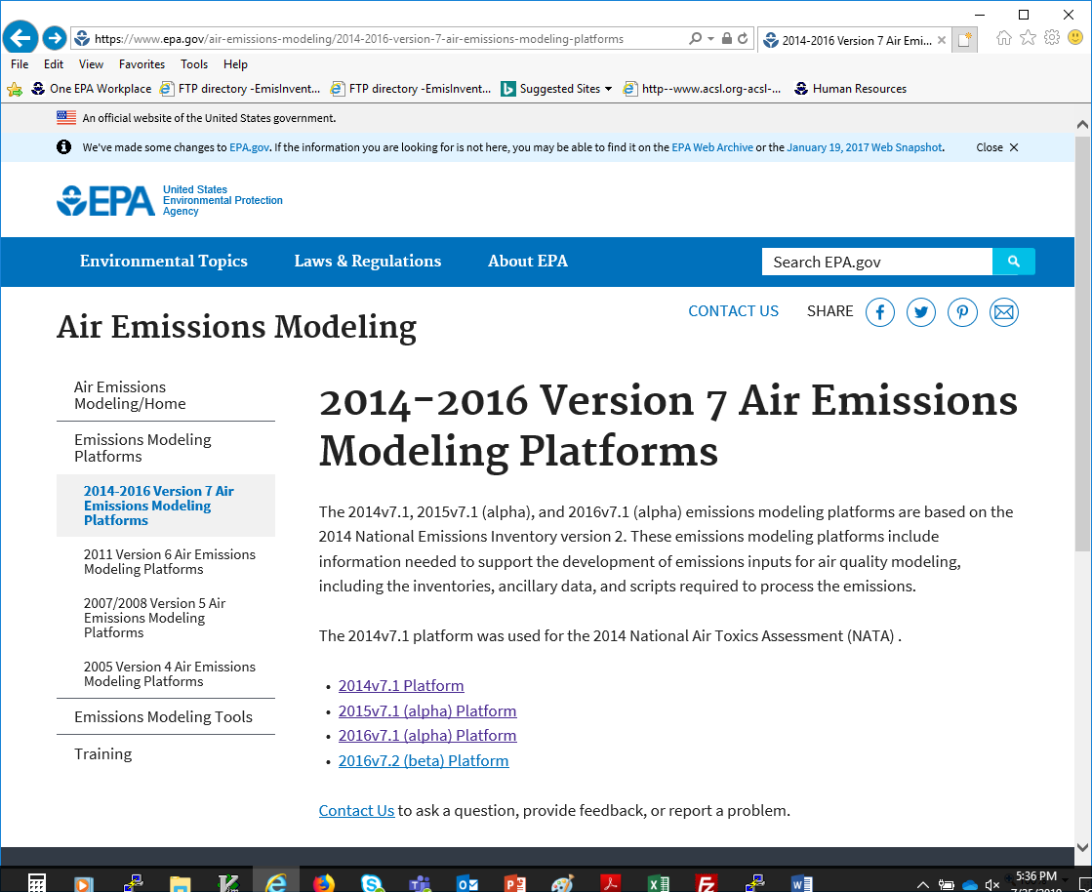
2014-16 Platforms Web Page
Case names appear on the web and FTP sites and in input file names
Notes:
Note that ek comes before el which comes before en; not all versions are released – because sometimes they are for special studies, so the letters of released versions aren’t necessarily sequential.

Slide 20
EPA US 12km Modeling Platform Domains
US domains / grids use consistent map projections (Lambert)
Other domains also exist (e.g., 36km, 4km, hemispheric)
Many US domains include parts of Canada and/or Mexico
US EPA OAQPS, Emission Inventory and Analysis Group
Notes:
Describe that we use multiple domains at different resolutions, and some of the recent 12km domains are shown on top of the Continental U.S. map.

Slide 21
Non-US emissions in the emissions modeling platform
Canada emissions & ancillary data (e.g., surrogates)
Courtesy Environment and Climate Change Canada
Most recent inventory is 2015 plus projection factors
Fire emissions provided for 2016 and other years
Mexico 2008 emissions and projections of these
Based on Inventario Nacional de Emisiones de Mexico, 2008
MOVES-Mexico data was developed for key years
Base year fire emissions for Mexico derived from Fire INventory from NCAR (FINN):
A daily fire emissions product for atmospheric chemistry models [also used for winter in Canada]
Hemispheric Transport of Air Pollution (HTAP) version 2 inventories used outside of North America in hemispheric runs
US EPA OAQPS, Emission Inventory and Analysis Group
Notes:
Platforms consist of data from outside the U.S., including data for Canada and Mexico. Hemispheric cases need data for areas outside of North America.

Slide 22
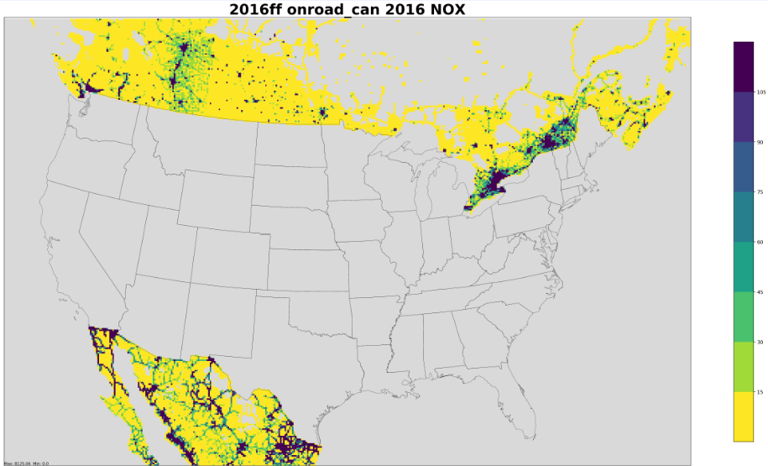
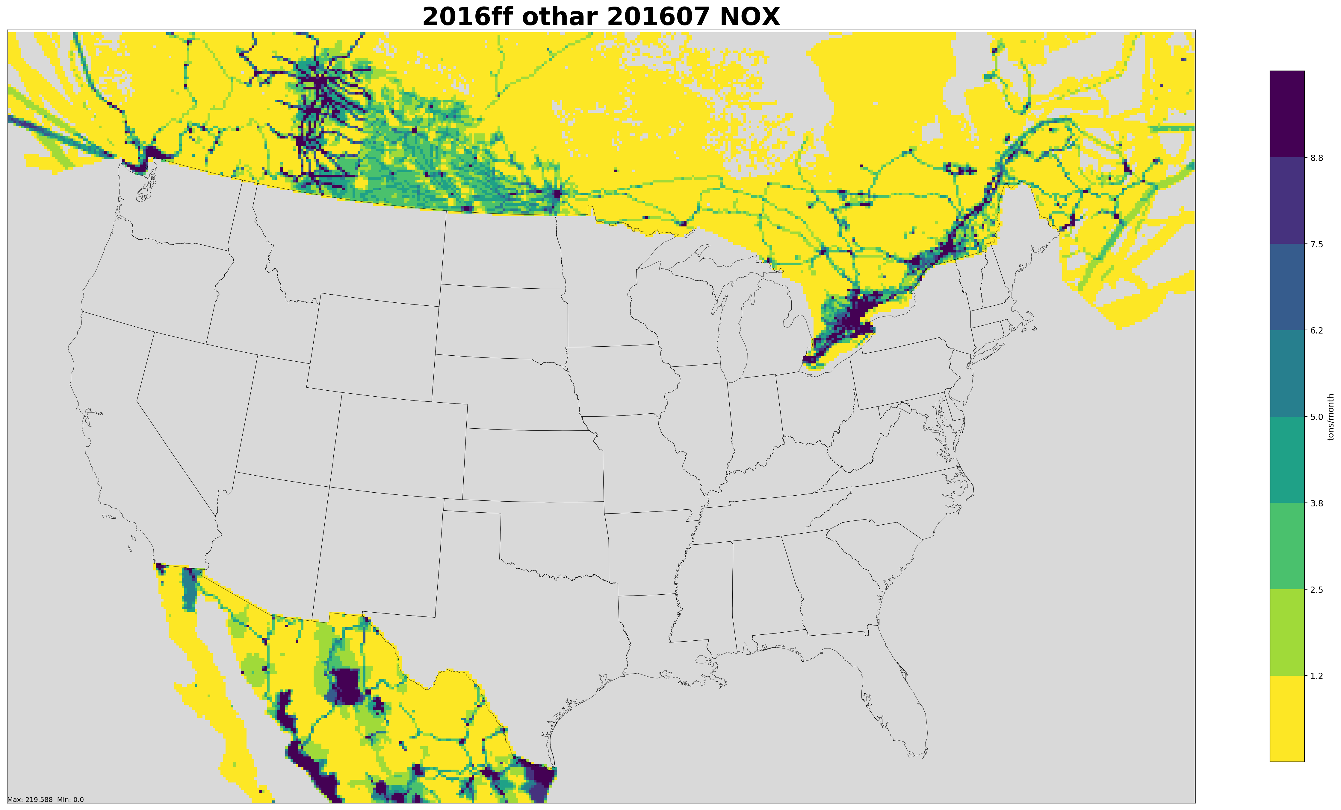
2016ff NOx Emissions Outside of the United States
Top: Onroad NOx emissions in Canada and Mexico
Bottom: Othar (area) source
NOx emissions in Canada and Mexico
US EPA OAQPS, Emission Inventory and Analysis Group
Notes:
Emissions outside of the U.S. are important to accurately estimating air quality within the U.S. Examples of onroad emissions in Canada and Mexico, and shipping lane emissions are shown.

Slide 23
Emissions Modeling Platform Sectors
Emission inventories are broken down into “sectors” used to prepare AQM-ready emissions for different parts of the inventory
Each sector has unique processing or inventory characteristics and a lowercase name (e.g., rwc)
Specific sectors vary by modeling platform but cover all sources in the inventory
Point source sectors keep their specific latitude-longitude locations throughout the processing
Nonpoint sectors are allocated to grid cells using spatial surrogates
EPA processes emissions separately for each sector then merges the ground-level emissions together to create final AQM-ready files for a case
Notes:
Emissions modeling platform sectors are broken up into two (2) types: point source and non-point source sectors.

Slide 24
2016 Platform Sectors: Point and Non-U.S. (EPA platform)
Point and non-US Sectors | Sector Description
ptegu | Point sources that are Electric generating units (EGUs)
pt_oilgas | Point sources related to oil and gas production
ptnonipm | Point sources that are not EGUs nor related to oil and gas
ptagfire | Point source day-specific agricultural fires (was agfire)
ptfire | Point source day-specific wild and prescribed fires
ptfire_othna | Non-US point source day-specific fires in North America
cmv_c3 | Category 3 (large) Commercial Marine Vessels as points
othar | Non-US area (i.e., nonpoint) sources
othafdust | Non-US area fugitive dust sources (Canada only)
othptdust | Non-US point fugitive dust sources (Canada only)
othpt | Non-US point sources
onroad_can | Onroad mobile sources for Canada (was othon)
onroad_mex | Onroad mobile sources for Mexico (was othon)
US EPA OAQPS, Emission Inventory and Analysis Group
Notes:
The point sector differ slightly for modeling that uses ERTAC for future years.

Slide 25
2016 Platform Sectors: Ground-level
Nonpoint Sectors | Sector Description
afdust_adj | Met.-adjusted area fugitive dust emissions
ag | Agricultural emissions (primarily ammonia)
beis | Biogenic emissions based on the BEIS model
cmv_c1c2 | C1&C2 Commercial marine vessels (nonpoint)
nonpt | Nonpoint sources not in other nonpint sectors
nonroad | Mobile sources that do not drive on roads or railroads, including recreational pleasurecraft
np_oilgas | Nonpoint oil and gas production-related sources
onroad | On-land mobile sources that drive on roads
onroad_ca_adj | Onroad mobile sources in California
rail | Locomotive sources on railroads
rwc | Residential wood combustion sources
US EPA OAQPS, Emission Inventory and Analysis Group
Notes:
Our job as emissions modelers is to ensure there are quality inventories and ancillary data going into all of these sectors…

Slide 26

Questions?
Any questions on basic concepts of emissions modeling?
Notes:
Next: Jeff

Slide 27
How do we Start Building a New Platform?
When a new NEI version becomes available, flat files (a .csv format) are output from EIS
Point and nonpoint inventories are split into sectors
Onroad, nonroad, and biogenic are inputs to the NEI release
Update ancillary files to account for new source classification codes (SCCs) and updated data
Perform quality assurance as needed (temporal, speciation, gridding)
Compare the inventories and results to a previous platform
Create difference reports by state, county, and/or SCC
Create charts and maps
Example: 2016 platform development
Notes:
Key inventory fields are FIPS code, pollutant, source classification code (SCC), and stack parameters

Slide 28
2014 vs 2016 Comparison
First, prepare excel workbook by sector, state, pollutant, case 1, case 2, absolute and percent changes; then apply filters to prioritize (e.g. > 1500)
sector | state | poll | ann_emis_ 2014fb | ann_emis_ 2016fc | diff_tons | percent diff
ptagfire | Arkansas | PM2_5 | 1,706 | 2,745 | 1,039 | 61%
ptagfire | California | PM2_5 | 3,596 | 5,689 | 2,093 | 58%
ptagfire | Florida | PM2_5 | 3,632 | 3,676 | 44 | 1%
ptagfire | Georgia | PM2_5 | 2,090 | 1,587 | -503 | -24%
ptagfire | Kansas | PM2_5 | 10,861 | 18,385 | 7,525 | 69%
ptagfire | Missouri | PM2_5 | 1,640 | 2,368 | 728 | 44%
ptagfire | North Dakota | PM2_5 | 1,969 | 3,241 | 1,272 | 65%
ptagfire | Oklahoma | PM2_5 | 6,124 | 9,545 | 3,421 | 56%
ptagfire | Texas | PM2_5 | 4,401 | 5,815 | 1,413 | 32%
ptagfire | Washington | PM2_5 | 1,694 | 1,334 | -359 | -21%
Notes:
Note the substantial changes in the two years: some increases, some decreases…

Slide 29
2014-2016 EGU comparison
State | 2014 SO2 | 2016 SO2 | % diff SO2 | 2014 NOx | 2016 NOx | % diff NOx
Alabama | 119,919 | 25,337 | -79% | 50,489 | 28,674 | -43%
Arkansas | 76,046 | 46,706 | -39% | 38,626 | 26,968 | -30%
Florida | 99,628 | 40,453 | -59% | 73,740 | 62,611 | -15%
Illinois | 143,261 | 67,096 | -53% | 48,196 | 32,147 | -33%
Indiana | 294,339 | 89,911 | -69% | 110,290 | 83,170 | -25%
Kentucky | 201,871 | 76,290 | -62% | 86,816 | 57,586 | -34%
Louisiana | 76,774 | 45,851 | -40% | 46,285 | 47,462 | 3%
Michigan | 154,855 | 85,354 | -45% | 59,625 | 41,541 | -30%
Mississippi | 90,790 | 3,187 | -96% | 23,643 | 16,022 | -32%
Missouri | 134,326 | 100,798 | -25% | 74,883 | 57,335 | -23%
Ohio | 302,698 | 107,532 | -64% | 88,177 | 56,137 | -36%
Oklahoma | 76,791 | 49,439 | -36% | 39,450 | 25,130 | -36%
Pennsylvania | 278,498 | 98,839 | -65% | 129,423 | 83,300 | -36%
Texas | 346,244 | 247,044 | -29% | 124,892 | 108,655 | -13%
West Virginia | 101,586 | 42,515 | -58% | 72,631 | 52,307 | -28%
Notes:
Note the large decreases of SO2 and NOx emissions for EGUs in just 2 years…

Slide 30
2014 vs 2016 County-level Comparisons
sector | state | county | poll | ann_emis_2014fb | ann_emis_2016fc | diff | pdiff
beis | Alabama | Autauga Co | CO | 2,458 | 2,756 | 298 | 12.1%
beis | Alabama | Autauga Co | NOX | 157 | 167 | 10 | 6.2%
beis | Alabama | Autauga Co | VOC_INV | 21,332 | 23,829 | 2,496 | 11.7%
beis | Alabama | Baldwin Co | CO | 7,276 | 8,206 | 930 | 12.8%
beis | Alabama | Baldwin Co | NOX | 399 | 433 | 34 | 8.6%
beis | Alabama | Baldwin Co | VOC_INV | 57,200 | 63,835 | 6,635 | 11.6%
beis | Alabama | Barbour Co | CO | 3,417 | 3,918 | 501 | 14.7%
beis | Alabama | Barbour Co | NOX | 151 | 164 | 14 | 9.0%
beis | Alabama | Barbour Co | VOC_INV | 30,439 | 35,010 | 4,572 | 15.0%
Biogenic changes mainly due to meteorology; ptnonipm due to leap year
sector | state | county | poll | ann_emis_2014fb | ann_emis_2016fc | diff | pdiff
ptnonipm | Alabama | Autauga Co | CO | 2,475 | 2,482 | 7 | 0.3%
ptnonipm | Alabama | Autauga Co | NH3 | 71 | 72 | 0 | 0.3%
ptnonipm | Alabama | Autauga Co | NOX | 2,530 | 2,537 | 7 | 0.3%
ptnonipm | Alabama | Autauga Co | PM10 | 536 | 538 | 1 | 0.3%
ptnonipm | Alabama | Autauga Co | PM2_5 | 428 | 429 | 1 | 0.3%
ptnonipm | Alabama | Autauga Co | SO2 | 3,692 | 3,702 | 10 | 0.3%
ptnonipm | Alabama | Autauga Co | VOC_INV | 901 | 903 | 2 | 0.3%
Notes:
County level comparisons can be used to better understand changes in emissions from year to year.

Slide 31
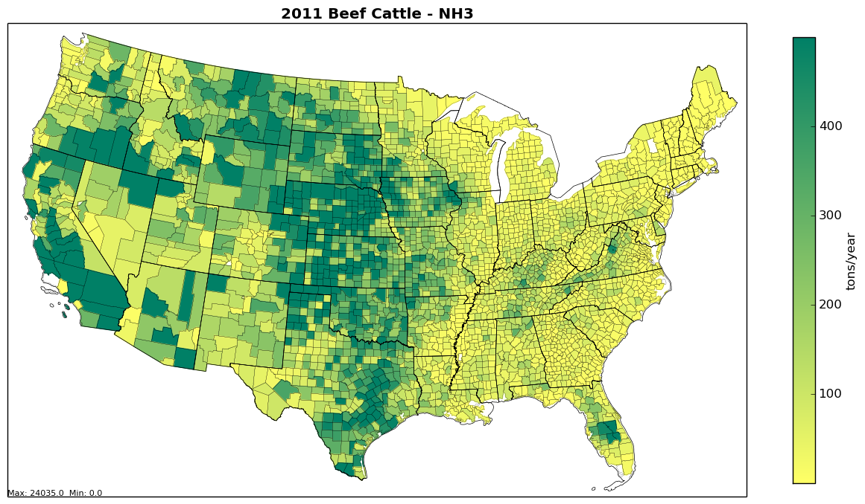
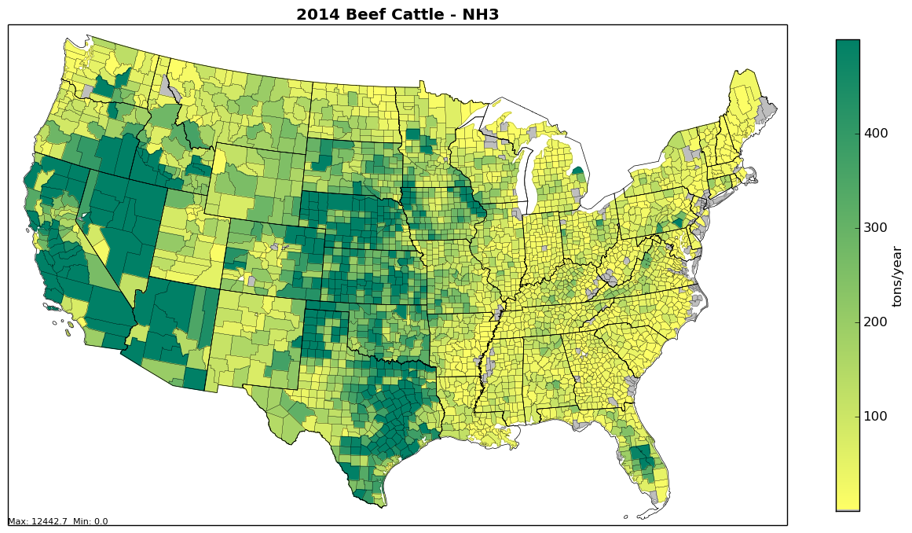
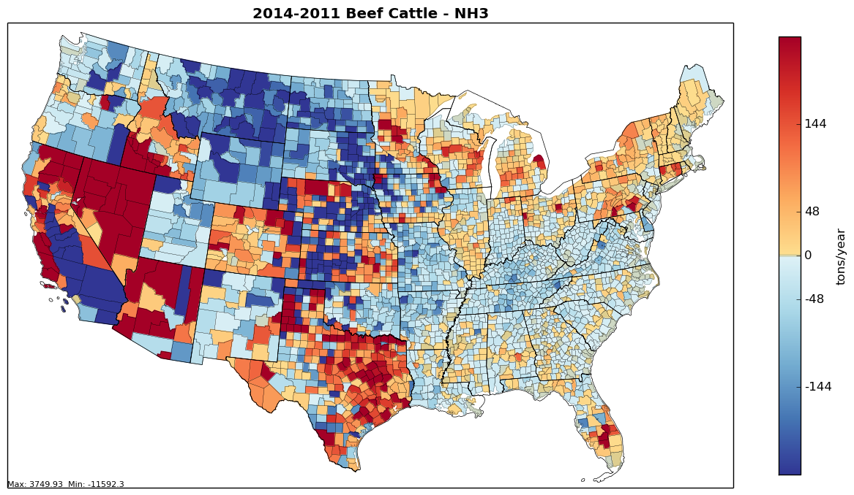
County-level Base and Difference Maps: Beef Cattle NH₃
2011
2014
Maps help us see spatial variation and hot spots
Most of our county-level maps are created with Python
Notes:
There is a difference in methods used to compute ag. ammonia in 2014 and 2011, which changed the distribution of emissions. between the inventories. Maps help us see these changes more easily than tables.

Slide 32
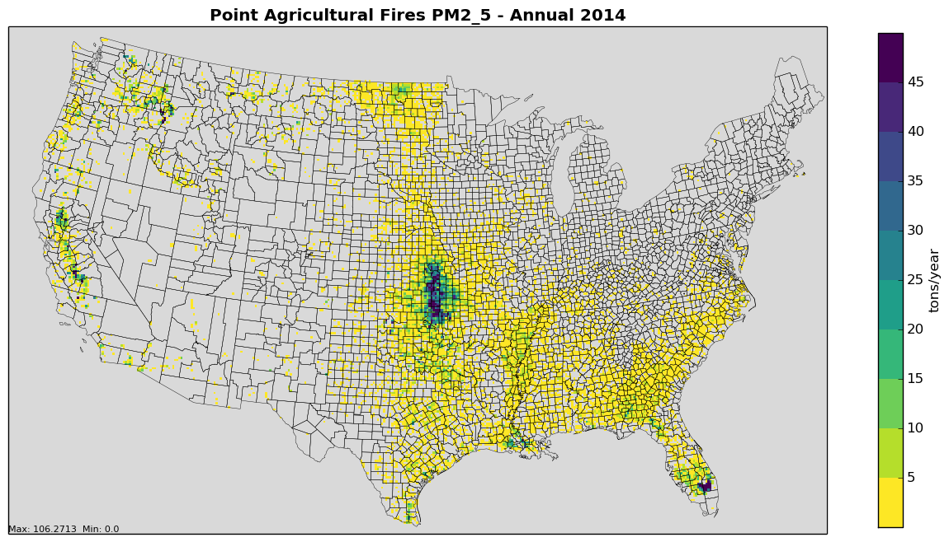
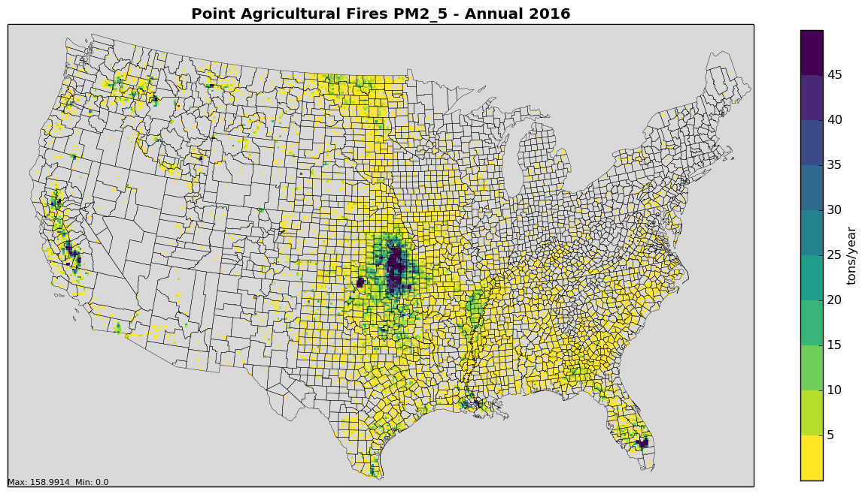
Gridded Maps: Ptagfire Example
2014 PM_{2.5}
Gridded maps can be created with VERDI, PAVE, etc.
2016 PM_{2.5}
For some sectors (e.g., fires, biogenics) we create monthly maps
Notes:
Gridded maps allow us to see data at the same resolution the air quality model sees it and helps identify low and high areas of emissions.

Slide 33
Modeling Platform Data is not always the same as the NEI
Some modeling platform data are not the same as what is in the NEI
Corrections to issues found after the NEI release
New data becomes available after NEI release
More detailed data is available than is stored in NEI
Continuous Emissions Monitoring System (CEMS) data for EGUs are hourly by unit
Nonroad data are computed monthly (summed in the NEI)
Onroad and biogenics data computed as hourly emissions and then aggregated & summed for the NEI
NEI uses average meteorological adjustments for afdust, but the modeling platform emissions are adjusted based on hourly, gridded met. data
For 2016 platform, lots of 2016-specific data are used and updated methods were developed

Slide 34

Questions?
Questions on new platform development or quality assurance?
Notes:
Jeff continues

Slide 35
Emissions Modeling with SMOKE
We use the Sparse Matrix Operator Kernel Emissions (SMOKE) modeling system and associated tools to process emissions into air quality model-ready files
Smkinven: reads in the emission inventories
Grdmat: computes gridding matrix using lat-lon locations and spatial surrogates
Spcmat: computes speciation matrix using speciation profiles
Temporal: temporally allocates emissions to hours using temporal profiles
Elevpoint: Splits ground-level and elevated point sources
Smkmerge: merges all matrices and temporalized emissions to create AQM-ready data for a sector
Mrggrid: merges ground-level emissions from different sectors together into a complete ground-level file
Notes:
SMOKE consists of core programs which are used process inventory, meteorological data and ancillary data.

Slide 36
SMOKE Data Flow for a Generic Emissions Modeling Sector
Emission Inventory
Temporal profiles
Smkinven
SMOKE inventory
SpeciationProfiles
Spatial Surrogates
Spcmat
Temporal
Grdmat
These emissions are for one sector
Speciation Matrix
Hourly Emissions
Gridding Matrix
AQM-formatted emissions
Smkmerge
Notes:
Inputs to SMOKE include emission inventory, speciation profiles, temporal profiles, and spatial surrogates. They are input to the main SMOKE programs of Smkinven, Spcmat, Temporal, Grdmat, and Smkmerge. The final output is air quality model-formatted emissions.

Slide 37
Special Emissions Models
Biogenic Emission Inventory System (BEIS): part of SMOKE and CMAQ that creates air quality model-ready biogenic emissions
SMOKE programs: Normbeis3, Tmpbeis3
Motor Vehicle Emission Simulator (MOVES):
For onroad mobile sources: generates emission factors that can be combined with activity data (e.g., Vehicle miles traveled, speed) within SMOKE
SMOKE programs: Met4moves, Movesmrg
For nonroad mobile sources: generates county-level emission inventories for each month
Previously done with National Mobile Inventory Model (NMIM) and NONROAD model
Notes:
BEIS estimates emissions from vegetation and soils. MOVES estimate emissions from onroad and nonroad sources.

Slide 38
Other Emissions Modeling Tools
Surrogate Tool: creates spatial surrogates from Shapefiles to put county emissions into grid cells
Speciation Tool: creates chemical speciation profiles from SPECIATE database profiles (e.g., NOx->NO+ NO₂, PM2.5->EC+OC+..., VOC->…)
Gentpro: SMOKE program that creates meteorology-based temporal profiles
Python: helps with QA, creates reports and maps
Emissions Modeling Framework: graphical user interface that manages inventories and related data and modeling cases; creates summaries for QA and analysis; includes Control Strategy Tool
Notes:
More tools that are used to assist in generating an emissions modeling platform.

Slide 39
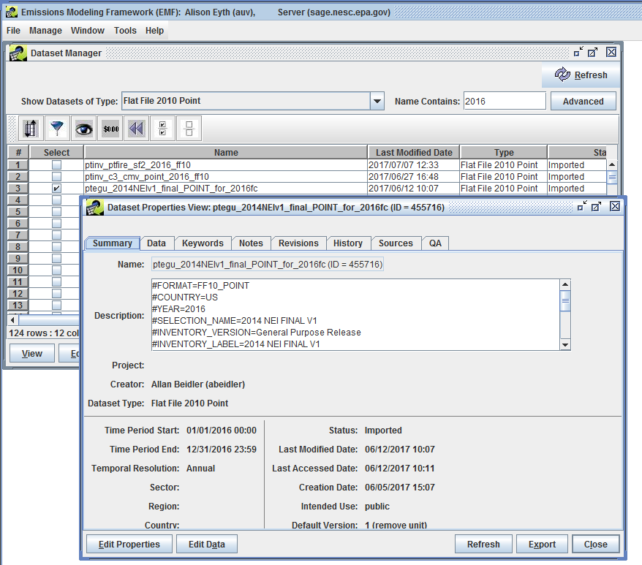
Emissions Modeling Framework
Emission
inventories
are stored as
Datasets in the
Emissions Modeling
Framework
Notes:
The EMF Dataset Manager shows a table of available datasets and their key attributes (e.g., Name, last modified date, type), and the dataset properties viewer, which has tabs for each of the types of information stored for the dataset: summary, data, keywords, notes, revisions, history, sources, data.

Slide 40
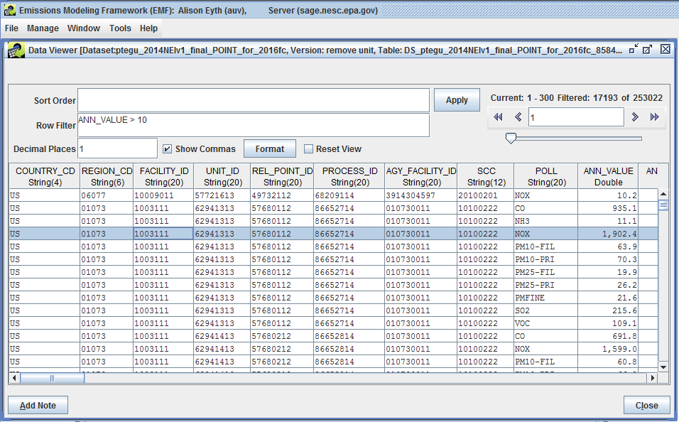
EMF Showing Point Inventory (FF10)
Filter records using SQL
Notes:
The EMF Data Viewer has input fields for a sort order and row filter, and an Apply button to make those take effect. The data is shown in a table with columns from an inventory: country_cd, region_cd, facility_id, ..., poll, ann_value.

Slide 41
Emissions Modeling Steps for Ground-level Sectors
Platform sector | Spatial | Speciation | Inventory resolution
afdust_adj | Surrogates | Yes | annual + met data
ag | Surrogates | Yes | annual or monthly
beis | Pre-gridded land use | in BEIS 3.6.1 | computed hourly
cmv_c1c2 | Surrogates | Yes | annual
nonpt | Surrogates | Yes | annual
nonroad | Surrogates | Yes | monthly
np_oilgas | Surrogates | Yes | annual
onroad, onroad_ca_adj | Surrogates | in MOVES 2014 | monthly activity, computed hourly
onroad_can | Surrogates | Yes | monthly
onroad_mex | Surrogates | in MOVES | monthly
rail | Surrogates | Yes | annual
rwc | Surrogates | Yes | annual
Notes:
Highlight the differences in inventory resolution and speciation

Slide 42
Emissions Modeling Steps for Non-U.S. and Point Sectors
Platform sector | Spatial | Speciation | Inventory resolution | Plume rise
othafdust | Surrogates | Yes | annual
othar | Surrogates | Yes | annual
othpt | Point | Yes | annual | in-line*
othptdust | Point | Yes | monthly | in-line
ptfire_mxca | Point | Yes | daily | in-line
pt_oilgas | Point | Yes | annual | in-line
ptegu | Point | Yes | annual & hourly CEMS | in-line
ptfire | Point | Yes | daily | in-line
ptagfire | Point | Yes | daily | in-line
ptnonipm | Point | Yes | annual | in-line
cmv_c3 | Point | Yes | Annual | in-line
* in-line means the plume rise can be done in CMAQ
Notes:
Point out sectors with plume rise

Slide 43
Plume Rise
Plume rise allows for sources to go vertically above the first layer of the air quality model (AQM has up to 35 layers)
The SMOKE Elevpoint program selects elevated or plume-in-grid point sources using the Briggs algorithm
Most sources with plume height > 20m as elevated
Sometimes we want all sources to have plume rise
Plume rise can be done with the SMOKE Laypoint program to compute layer fractions for each elevated point source
For hemispheric applications, 3-D emissions are developed
Notes:
Sectors that would all get plume rise include ptegu, cmv_c3, othpt, ptnonipm, pt_oilgas, fires and other point sectors.

Slide 44
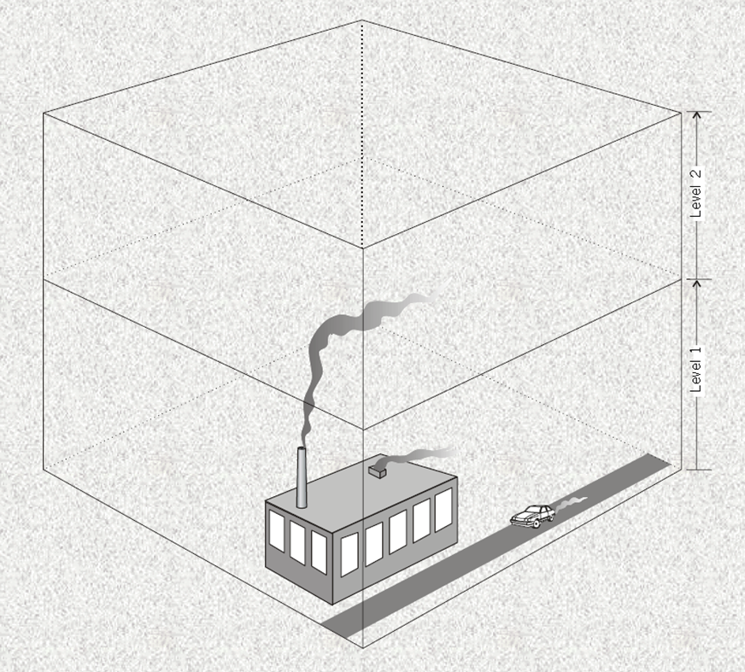
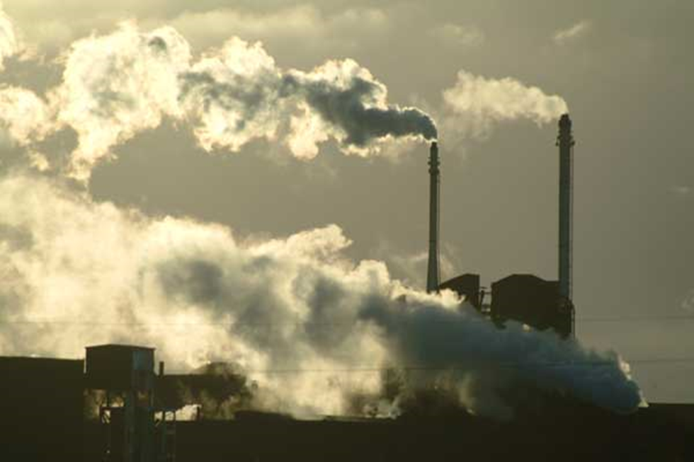
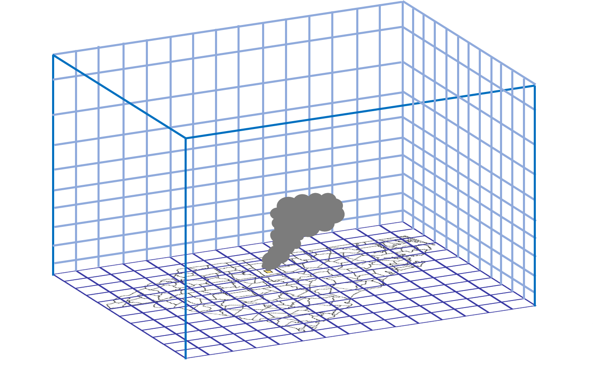
Plume rise: Vertical allocation
Notes:
These pictures illustrate the concept of plume rise from smoke stacks

Slide 45
Plume Rise Formula
Stack parameters for point sources affect plume rise
Height, diameter, velocity / flow, temperature
F = 0.25 x G x V_{S} x D_{S}² x (T_{S} - T)/T_{S}
For F < 55, Plume rise = H_{S} + 21.313 x F^{0.75}/U otherwise: Plume rise = H_{S} + 38.878 x F^{0.6}/U where
H_{S} = Physical stack height (m)
F = Buoyancy flux (m⁴/s³)
G = Mean gravitational acceleration (9.80665 m/s²)
V_{S} = Stack gas exit velocity (m/s)
D_{S} = Inside stack diameter (m)
T_{S} = Stack gas temperature (K)
T = Default ambient air temperature (293 K)
U = Default wind speed (2 m/s)
Notes:
The equation is used to compute the buoyancy of emissions from a fire.

Slide 46
Plume Rise Requirements for AQMs Differ
3-D emissions files can be really big!
CMAQ can do “in-line” plume rise
Provide CMAQ with hourly emissions with locations and stack parameters for any elevated sources
Compute plume rise with hourly meteorological data
A special plume rise treatment is used for fires that considers acres burned and heat flux
CAMx supports an in-line format for plume rise but does not have the same algorithm for fire plume rise
We run SMOKE Laypoint to compute 3-D fires
Point sources are then converted to CAMx format

Slide 47
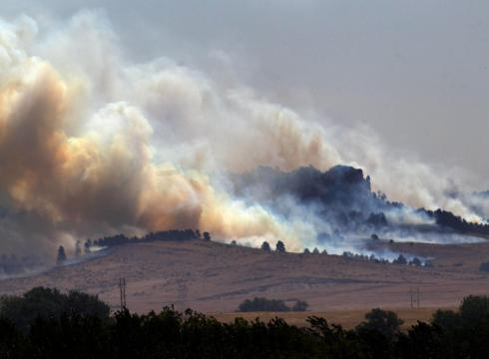
Allocation to Layers for AQ Modeling
Layer number
Emissions
Notes:
Emissions from fires are allocated into vertical layers of the air quality model according to the degree of heat flux.

Slide 48

Questions?
Any questions on SMOKE or plume rise?
Notes:
BREAK, then Caroline

Slide 49
Temporal Allocation
Temporal allocation is the process of allocating inventory emissions to hourly emissions
Hierarchy of temporal allocation steps: annual -> month -> day of week -> hour of day
There are many types of temporal profiles for each resolution and each has a unique code
Typically, SCCs are used to map temporal profiles to inventory sources
Cross reference may also use FIPS, pollutant, etc.
More control with the format in SMOKE 3.6+
e.g., Monday diurnal profile vs Friday diurnal profile
Database-friendly – no “packets” like old format
Notes:
Inventories can be on annual, monthly or day-specific scale. Air quality models need emissions at hourly time scale.

Slide 50
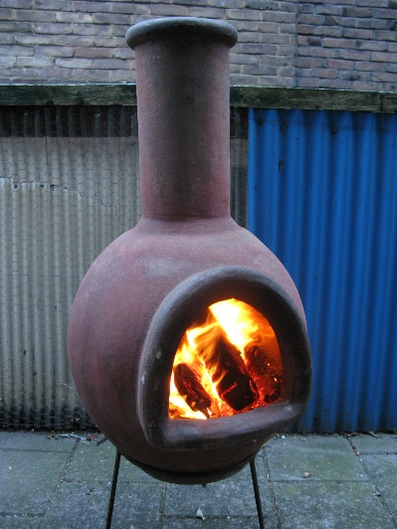

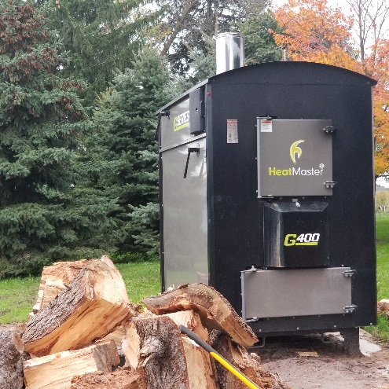
Temporal Profile Examples
Chimenea
Fire Pit
Outdoor Hydronic Heater

Slide 51
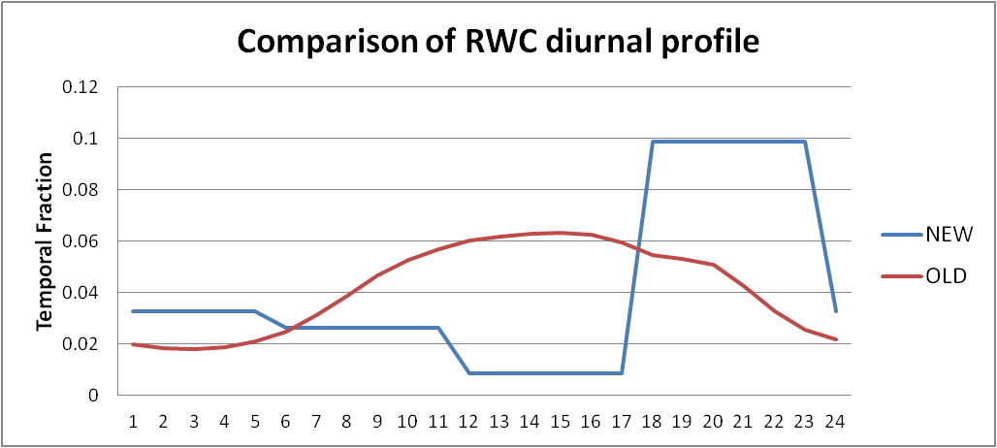
Diurnal Temporal Profile Examples
Outdoor Hydronic Heater Heat Load (BTU/hr)
(generate a temporal profile from this)
Notes:
Two residential wood-related profiles: one for fireplaces, which peaks in evening hours after people get home from work, and one for outdoor hydronic heaters which is more consistent throughout the day and has a minimum around noon. Note that temporal profiles have values of between 0 and 1 but units of source data vary.

Slide 52
Excerpt from Temporal Cross Reference and Profile Files
SCC | FIPS | Facility | Unit | Releasept | process | Pollutant | Profile Type | Profile Num | Comment
2104009000 | 56045 |  |  |  |  | 0 | MONTHLY | 17001
2104009000 | 56045 |  |  |  |  | 0 | DAILY | 56045
2104009000 | 56045 |  |  |  |  | 0 | ALLDAY | 600
2104008700 |  |  |  |  |  | 0 | MONTHLY | 17750 | “Fire pit"
2104008700 |  |  |  |  |  | 0 | WEEKLY | 61500 | “Fire pit"
2104008700 |  |  |  |  |  | 0 | ALLDAY | 600 | “Fire pit"
2104008610 |  |  |  |  |  | 0 | MONTHLY | 17751 | “Hydronic heater”
2104008610 |  |  |  |  |  | 0 | WEEKLY | 7 | “Hydronic heater"
2104008610 |  |  |  |  |  | 0 | ALLDAY | 1500 | “hydronic heater"
Profiles
MonthID | Jan | Feb | Mar | Apr | May | June | July | Aug | Sept | Oct | Nov | Dec
17750 | 0.01 | 0.01 | 0.02 | 0.05 | 0.12 | 0.14 | 0.15 | 0.13 | 0.15 | 0.11 | 0.08 | 0.03
17751 | 0.14 | 0.13 | 0.14 | 0.12 | 0.02 | 0.01 | 0.01 | 0.01 | 0.02 | 0.12 | 0.13 | 0.15
WeekID | Sun | Mon | Tue | Wed | Thu | Fri | Sat
7 | 0.14 | 0.14 | 0.14 | 0.14 | 0.14 | 0.14 | 0.14 | Equal | all days
61500 | 0.07 | 0.07 | 0.07 | 0.07 | 0.07 | 0.33 | 0.33 | Fire pit | higher | weekends
HourID | hr0 | hr1 | hr2 | hr3 | hr4 | hr5 | hr6 | hr7 | hr8 | hr9 | hr10 | hr11
600 | 0.03 | 0.03 | 0.03 | 0.03 | 0.03 | 0.03 | 0.03 | 0.03 | 0.03 | 0.03 | 0.03 | 0.01
1500 | 0.04 | 0.05 | 0.05 | 0.05 | 0.05 | 0.05 | 0.05 | 0.05 | 0.04 | 0.04 | 0.04 | 0.03
Notes:
The cross reference table by SCC, FIPS, etc is mapped to the profiles table for monthly, day of week, and diurnal profiles. Simplified examples of profiles are given for fire pits and hydronic heaters.

Slide 53
Temporal Settings by Sector
Platform sector short name | Inventory resolutions | Monthly profiles used? | Daily temporal approach | Merge processing approach | Process Holidays as separate days
afdust_adj | Annual | Yes | week | all | Yes
ag | Annual and Daily | Yes | all, hourly met | all | Yes
ptagfire | Daily | No | all | all | Yes
beis | Hourly | No | n/a | all | No
cmv | Annual | Yes | aveday | aveday | No
rail | Annual | Yes | aveday | aveday | No
nonpt | Annual | Yes | week | week | Yes
nonroad | Monthly | No | mwdss | mwdss | Yes
np_oilgas | Annual | Yes | Week | week | Yes
onroad | Annual & monthly¹ | No | All | All | Yes
onroad_ca_adj | Annual & monthly¹ | No | All | All | Yes
othafdust_adj | Annual | Yes | Week | All | No
othptdust | Monthly | No | mwdss | mwdss | No
othar | Annual & monthly | Yes | Week | week | No
onroad_can & mex | Monthly | No | Week | week | No
othpt | Annual | Yes | mwdss | mwdss | No
pt_oilgas | Annual | Yes | mwdss | mwdss | Yes
ptegu | Daily & hourly | No | all | all | Yes
ptnonipm | Annual | Yes | mwdss | mwdss | Yes
ptfire and ptfire_othna | Daily | No | all | all | Yes
rwc | Annual | No | met-based | all | Yes
Notes:
Note that there are different inventory resolutions: annual, monthly daily, hourly; also different types of daily temporal profile approaches: all, week, average day, mwdss, met-based (merge approach is correlated to this), also whether holidays are treated differently

Slide 54
Temporal Profile Data Sources
Some temporal profiles have been used for a while
We look for data sources that can be used to update temporal profiles
Sometimes temporal profile updates happen as a result of reviewing model performance issues
Recently, EGU profiles for municipal waste combustors and nonroad profiles for construction and lawn and garden sources have been updated
To update profiles, we use studies or data when possible (e.g., rwc), otherwise we try to apply common sense knowledge of the source sector

Slide 55
Airport Temporalization (1/2)
Airport diurnal temporal profiles updated for 2014v7.0 platform based on Aviation System Performance Metrics (ASPM) Airport Analysis
https://aspm.faa.gov/apm/sys/AnalysisAP.asp
Notes:
The diurnal profile for aircraft emissions at airports is low after midnight and peaks from 9AM to about 7PM.

Slide 56
Airport Temporalization (2/2)
Weekly and monthly profiles based on FAA Operations Network Air Traffic Activity System
http://aspm.faa.gov/opsnet/sys/Terminal.asp
Notes:
The temporal profile for aircraft emissions at airports shows emissions are a little higher Tuesday-Friday and lower on Saturday and Sunday. The monthly temporal profile for aircraft at airports is relatively flat, but emissions are lowest in the winter months adn a bit higher in March through October.

Slide 57
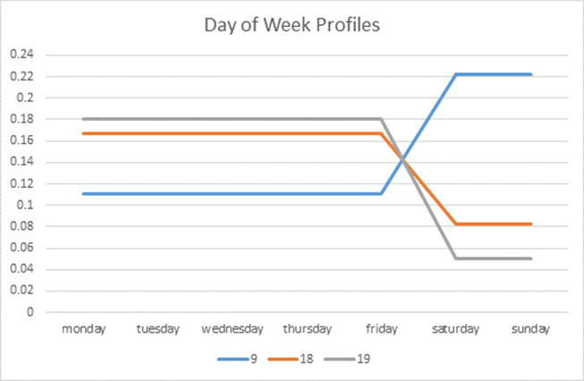
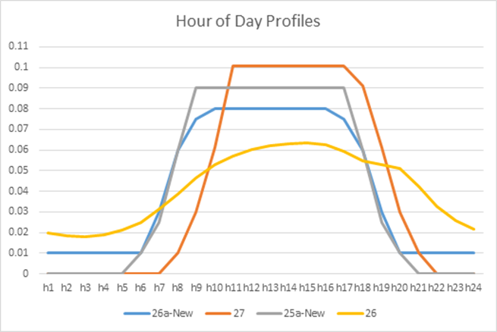
Nonroad Temporal Profile Updates
Non-Road Category | Old Day of Week | New Day of Week | Old Hour of day | New Hour of Day
Construction | 18 | 19 | 26 | 26a
Commercial Lawn and Garden | 18 | 19 | 26 | 25a
Residential Lawn and Garden | 9 | 9 | 26 | 27
Agriculture | 18 | 18 | 26 | 25a
Construction and Comm. Lawn & Gdn lower on weekends in New
New Res. L & G
New ag +
comm L&G
New diurnal profiles have lower overnight emissions
Old
Notes:
The new temporal profile used for construction and lawn and garden emissions is lower on Saturday and Sunday than the previous profile. The new diurnal temporal profile 25 used for agricultural and commercial lawn and garden emissions is basically zero overnight and a bit higher than the old profile during daylight hours. The new diurnal profile 27 is used for residential lawn and garden sources. It is essentially zero overnight and the emissions are concentrated into the hours of 9AM to 8PM.

Slide 58
Meteorology-based Temporalization
Some sectors have a significant temporal variation based on changes in the meteorology
GenTPRO
SMOKE program that reads gridded meteorology and spatial surrogates
Produces county-specific meteorology based profiles
Used for platform sectors: ag (month->hour) and rwc (annual->day of year)
Other sectors influenced by meteorology
Area fugitive dust (afdust)
Biogenic emissions
Onroad (discussed later)
EGUs (indirectly)
Notes:
Meteorological data is used in processing of many different emissions sectors.

Slide 59
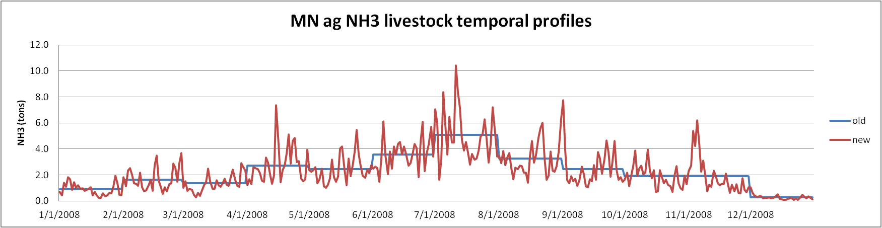
GenTpro: ag livestock
Meteorological fields used: temperature, wind speed, and aerodynamic resistance
Allocate monthly emissions to hour of month
Notes:
The ag. livestock profiles are done by county. The plot Shows daily variation of ag livestock ammonia emissions in Minnesota for 2008.

Slide 60
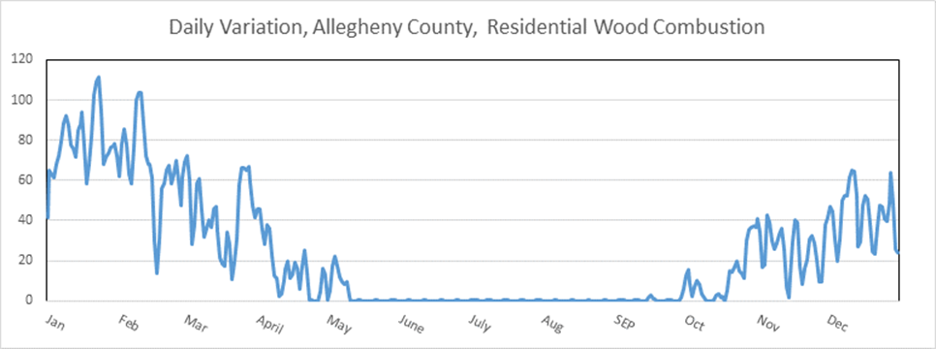
Residential Wood Day-specific Temporal Allocation with GenTpro
Daily minimum temperature used to help allocate annual emissions to days of year
If min temp. above 50 degrees, no emissions
Southern states use 60 degrees threshold
Note in summer RWC near 0
Notes:
This temporal allocation method puts more RWC emissions on colder days based on daily minimum T
Threshold: if min T > threshold, 0 emissions that day
In this plot also get influence of non-met based RWC, eg. firepits that show up in the summer
Total annual emissions are preserved

Slide 61
Special Steps Taken for EGUs
Future year emissions generated using Integrated Planning Model (IPM)
Separate EGUs from nonEGUs in EIS flat file based on whether IPM_YN column in flat file is non-blank
Download latest CEMS data for base year of interest
Review the assignments to ORIS IDs (used for CEMS) in the flat file and how they match up to the CEMS data
Identify partial year CEMS reporters; plus sources that should not use CEMS-based profiles (e.g., MWCs, cogens)
Run cemcorrect program to remove non-measured anomalies in CEMS data
Generate region/fuel-specific average temporal profiles for temporalization of sources without CEMS
Generate region/fuel-specific hourly profiles for winter and summer [and for peaking and non-peaking]
Notes:
– Introduce IPM, EGU sources without CEMs, #4 – mention difference between NEI partial year and sources that do not follow CEMS data

Slide 62
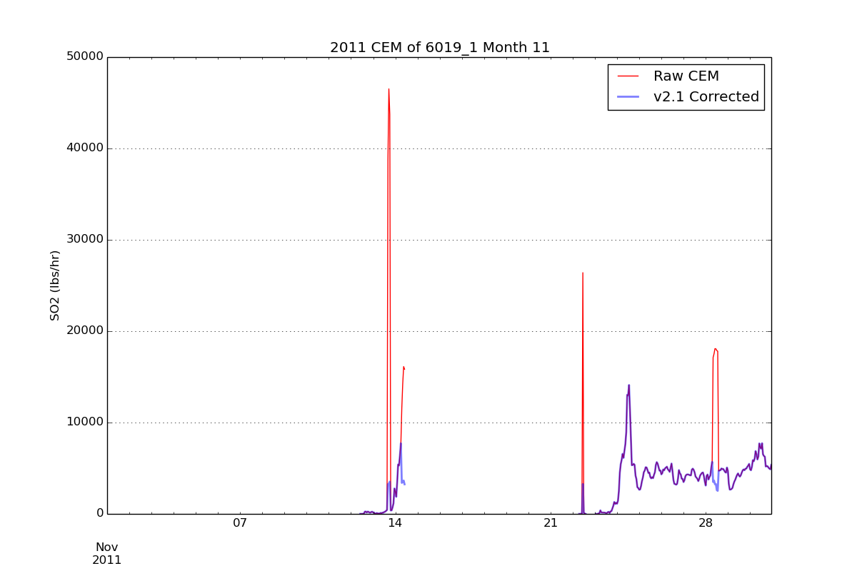
Outputs from UNC’s CEMS Data Correction Tool
Removes spikes
Emissions spikes adjusted to average values when they are not flagged as measured in CEMS data flags
Notes:
The plot shows CEMS emissions before and after correction with the UNC tool. Spikes are removed after running the tool.

Slide 63
EGU Temporal Profiles and Matching
Removed non-measured data values from CEMS data to ignore emission spikes
Hierarchy of CEMS assignments:
Use CEMS for all months (units with complete CEMS data) <-- Note: CEMS data replace the annual inventory
Partial year reporters use CEMS for months where there are measurements but use regional averages for periods without measurements [Note: sources can differ by year]
Use regional averages (for units without CEMS)
Regional average profiles for sources without CEMS
Region and fuel-specific average profiles used: peaking and non-peaking
Different winter and summer versions of hourly profiles
Matching of CEMS database units and future year units with EIS/platform point sources is key to success

Slide 64
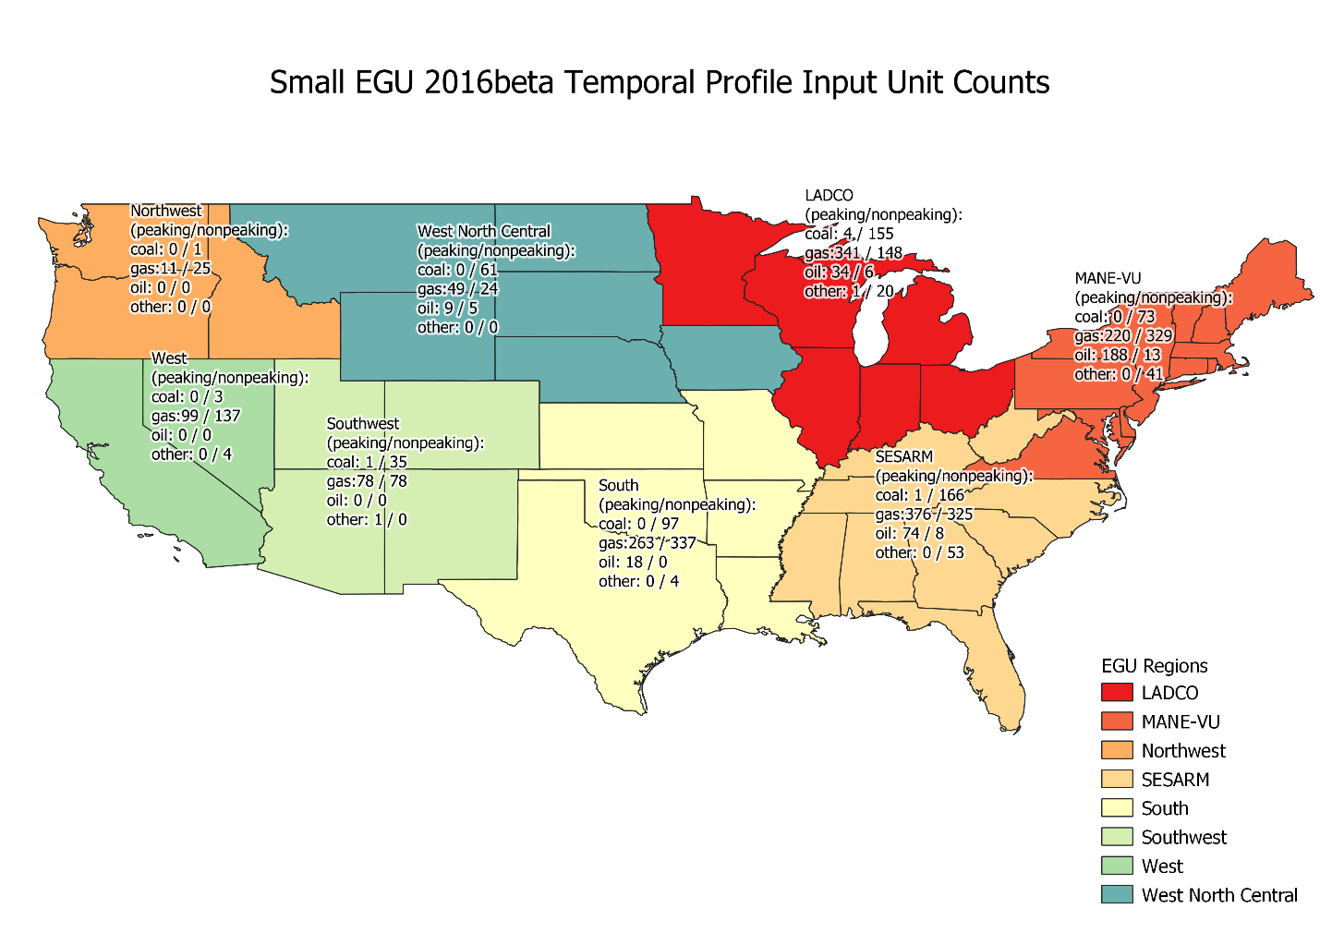
Map of EGU Temporal Regions
* Regions in the East based on work by MARAMA Regions in the West based on climate regions
Notes:
Used to use IPM regions, now using broader regions (product of EGU workgroup)

Slide 65
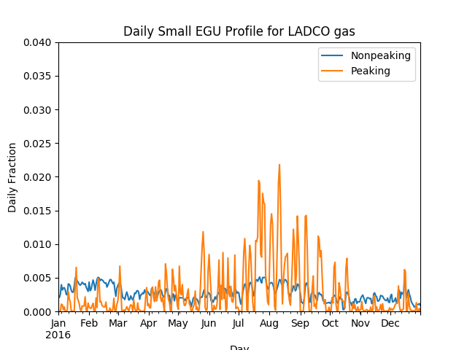
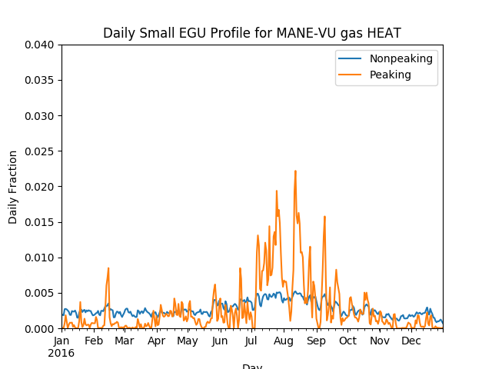
Average Month-day Profiles: Region- and fuel-specific
Profiles differ between regions
(orange=peaking, blue=non-peaking)
LADCO gas profiles
MARAMA gas profiles
Note: for 2016, profiles assigned by unit, not SCC
Notes:
Now peaking and non-peaking profiles, assigned by unit

Slide 66
Identifying Peaking Units
Peaking units have an annual capacity factor of less than 0.2 and a multiyear capacity factor of less than 0.1 or less than 20% utilization in the base year and less than 10% utilization across a 3-year period, where:
Base year (2016) annual capacity factor:
(annual unit output MWh) / (unit capacity MW * 8760 h)
Multiyear (2014-2016) capacity factor:
(3 year unit output MWh) / (unit capacity MW * 3 * 8760 h + 24 h)
Note: the extra 24 h is for the leap day in 2016
Unit outputs were summed from the CEMS data

Slide 67
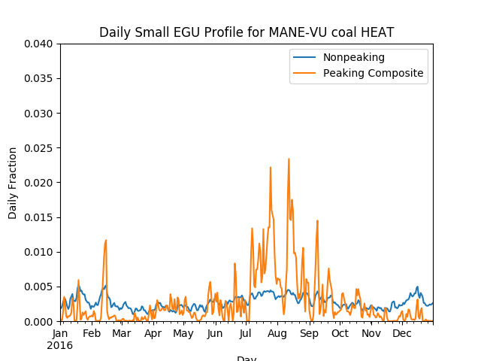
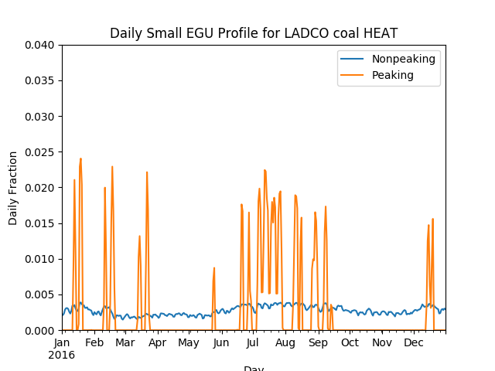
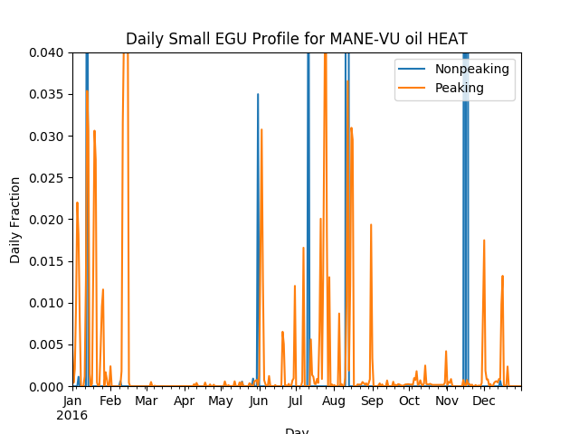
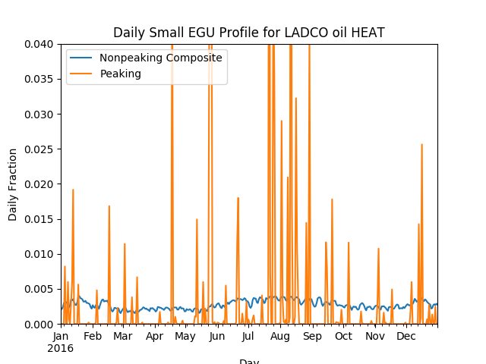
MANE-VU and LADCO Daily Profiles for Coal and Oil
Notes:
Discuss the differences between fuel and region – peaks happen on different days in different regions. Most oil units are “peaking”

Slide 68
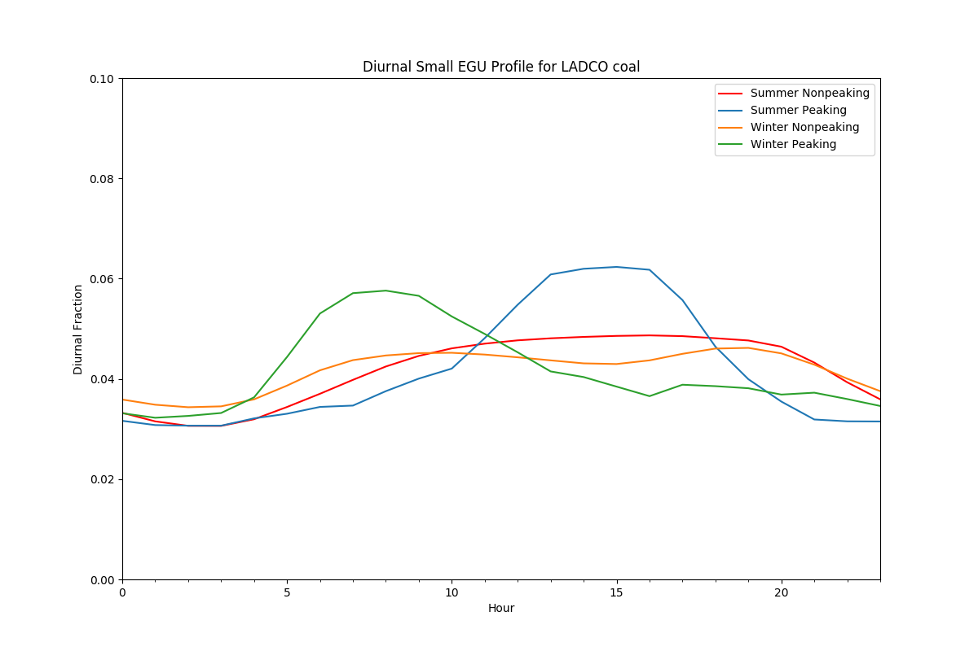
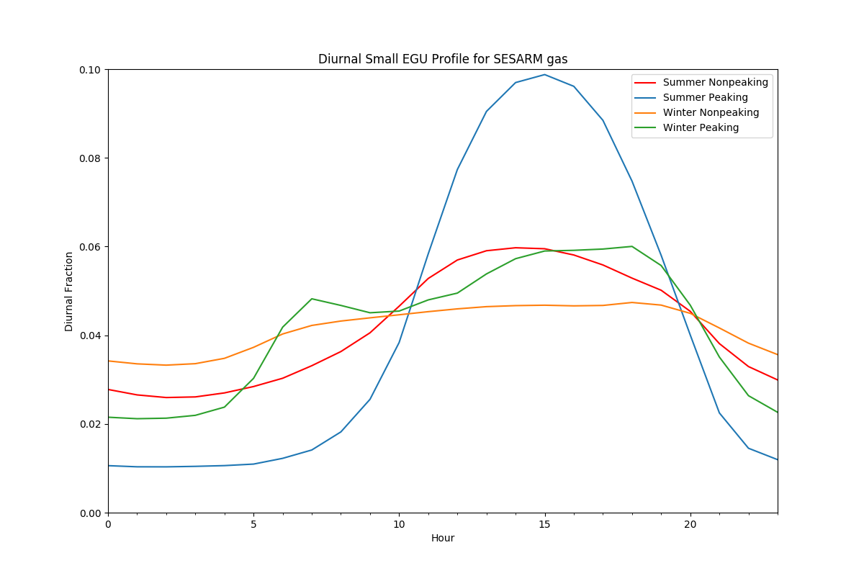
Diurnal Profiles
LADCO coal
Diurnal profiles are created
for each region and fuel
for peaking and non-peaking
Profiles differ by region and
season
SESARM gas
Red: summer nonpeaking
Blue: summer peaking
Orange: winter nonpeaking
Green: winter peaking
Notes:
Plot of EGU temporal profiles for based on data from winter and summer months. The summer has a mid-day peak while winter has morning and evening peaks.

Slide 69
QA of Temporal Allocation
Check SMOKE Temporal logs to ensure all sources are mapped to temporal profiles
Sum post-SMOKE daily emissions by sector to compare back to annual for inventory comparison
Perform various specialized analysis of EGUs (partial year reporters, spikes in CEMS data)
Check the PTSUP files to confirm that sources are using the correct temporal profiles (x-ref application)
Create monthly gridded plots
Compare daily Smkmerge reports for rwc and ag for two different Tuesdays (for example) in the same month as they should be different (except NH3_FERT) due to the Gentpro temporalization

Slide 70

Questions?
Does anyone have questions on temporal allocation?
Notes:
Next: Alison

Slide 71
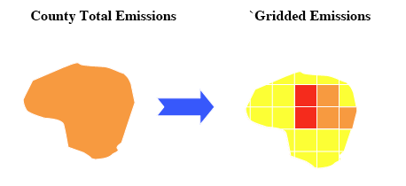
Spatial Allocation
Spatial allocation is the process of mapping inventory emissions to modeling grid cells
We do this using spatial surrogates; there are many types and each has a unique code (ID)
Population (100), Total agriculture (310), Railroad Density (261), Offshore shipping (806), Urban unrestricted daily VMT (222), Gas well count (698)
A cross reference maps inventory SCCs to surrogate codes
Notes:
Instead of assuming the emissions are uniformly distributed spatially, we use an attribute from another dataset to allocate the emissions to grid cells.

Slide 72
Surrogate Tool
Java program that takes .csv files as input
Runs the Spatial Allocator to prepare surrogates
Download from http://www.cmascenter.org
Performs gapfilling of surrogates
When attributes used to compute a surrogates do not exist for a county, another surrogate is used
Outputs quality assurance products
Sum of surrogate for each county (=1.0?), gapfilling
Some GIS datasets are too large to process with the Spatial Allocator (e.g., new roads, CMV))
NEW: PostgreSQL tool with PostGIS can also compute surrogates: https://github.com/CMASCenter/Spatial-Allocator

Slide 73
Data Used to Create a Spatial Surrogate with Surrogate Tool
Weight Shapefile: an attribute is selected from this spatial dataset to “weight”/apportion the emissions in a county into the model grid cells
Population at the census tract block level (polygon)
Lines representing railroads
Point locations of oil and gas wells
Data Shapefile: spatial dataset that represents boundaries on which inventory is computed (e.g., U.S. counties, Canadian provinces)
Output grid: modeling grid cells

Slide 74
Spatial Surrogate values
Value = sum of weight attribute in grid cell
sum of weight attribute in data polygon
Values sum to 1 for each county / province
Surg ID | County | Col | Row | Ratio | Comment*
806 | 01003 | 345 | 207 | 0.2 | 200/1000
806 | 01003 | 346 | 207 | 0.3 | 300/1000
806 | 01003 | 346 | 208 | 0.5 | 500/1000
806 | 01005 | 355 | 210 | 0.4 | 800/2000
806 | 01005 | 355 | 209 | 0.6 | 1200/2000
* Surrogates created using the Spatial Allocator include a comment that shows how the ratio was computed

Slide 75
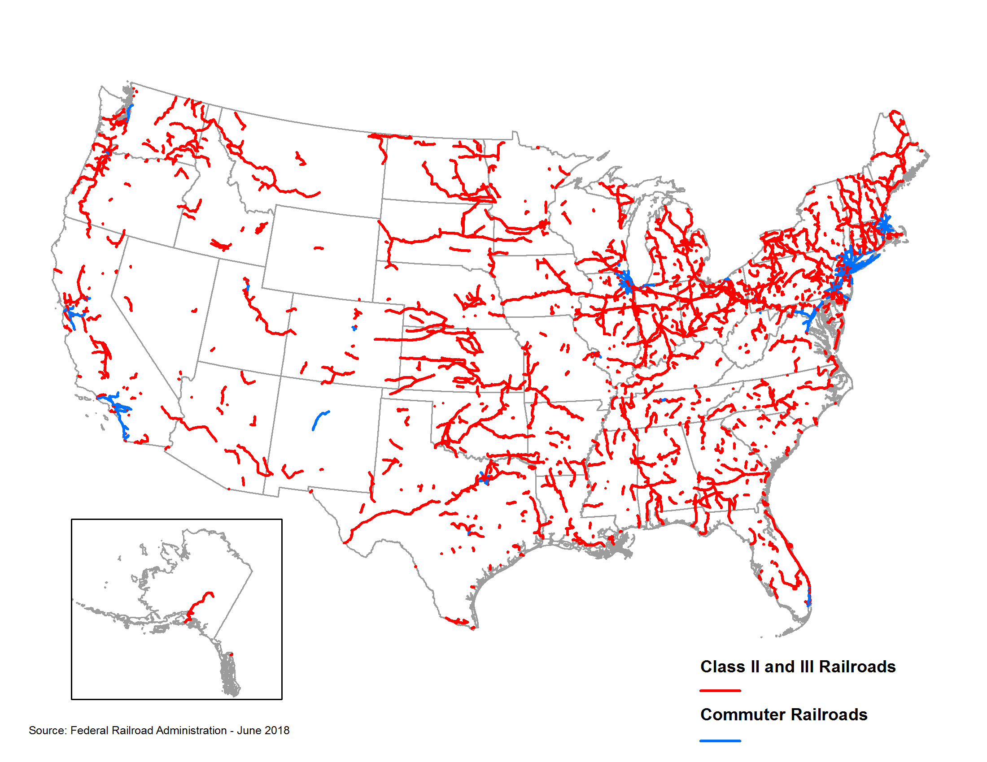
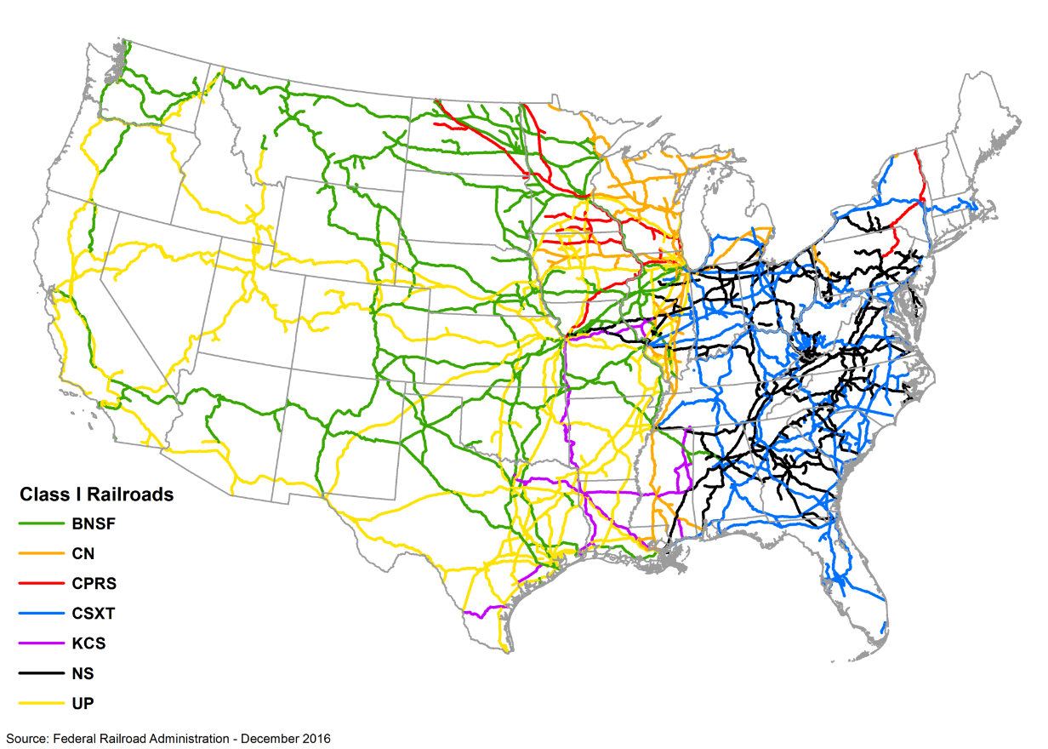
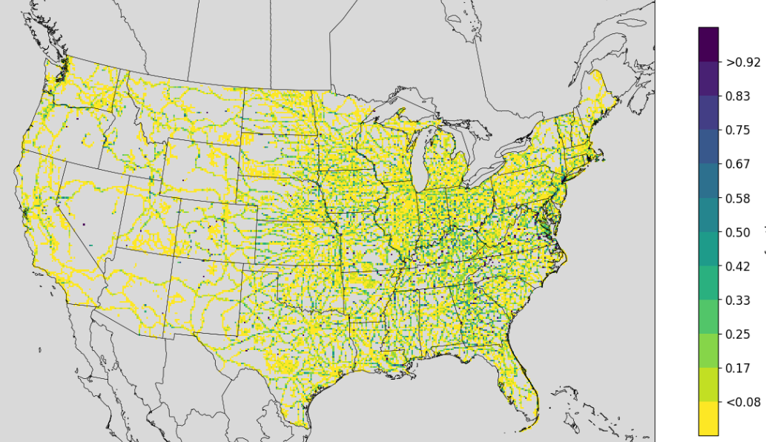
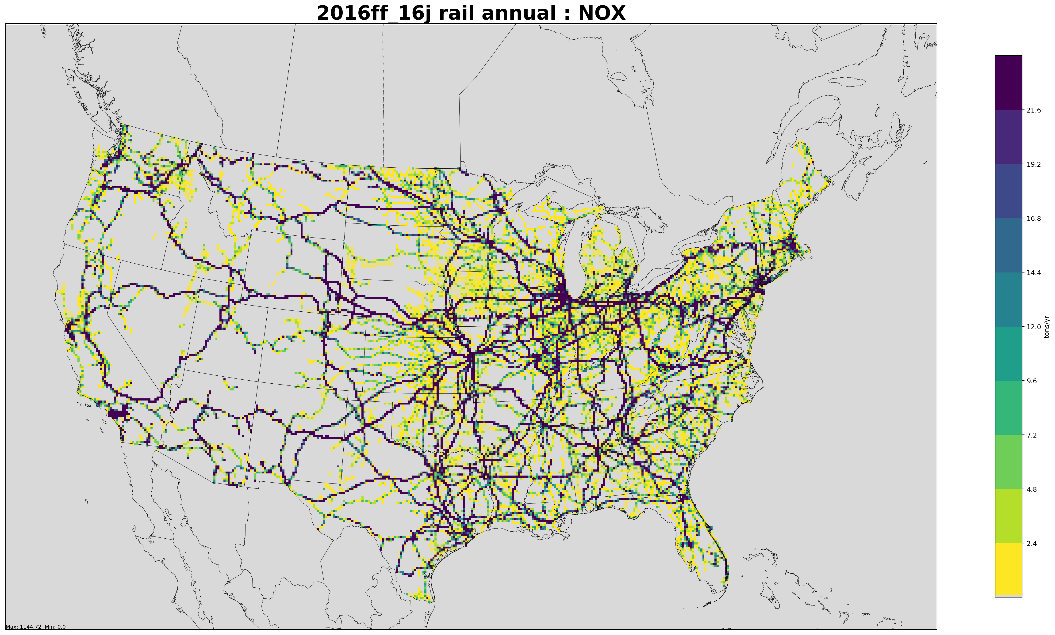
Creating a Surrogate for Railroad Miles
Class 2+3 Railroads
Class 1 Railroads
Weight = Railroad miles
Data = US. Counties
Output = US 12km grid
Surrogate Fractions
NOx Emissions (tons/yr)
22
Notes:
Railroad Shapefile is converted to gridded surrogate fractions, which are then multiplied by the county-level inventory to get gridded emissions.

Slide 76
Using Cross-references and Profiles (Generically)
Cross-references and profiles are used in emissions modeling to apportion wholes into parts:
X-REF table
Profiles table (sum to 1)
SCC, Surg. ID
ID, Grid cell 1, 2, 3
2505020121, 15 2505020122, 15
2294000000, 16
2296000000, 17
13 0.2, 0.3, 0.5
14 0.4, 0.4, 0.2
15 0.4, 0.3, 0.3
16 0.4, 0.5, 0.1
17 0.4, 0.4, 0.2
Notes:
A simplified example of a cross reference table with SCCs and surrogate IDs mapped to a profiles table of surrogate IDs with their values in three grid cells.

Slide 77
Spatial Surrogate Cross reference
FIPS ST/CTY* | SCC** | Surrogate ID | Comments
000000 | 0040600241 | 801 | ! All counties
000000 | 0040600242 | 801 | ! All counties
000000 | 2505020121 | 801 | ! All counties
008000 | 2520100102 | 689
048243 | 2520100102 | 693 | ! Replaced 698
048243 | 2520100102 | 693 | ! Replaced 698
*A surrogate can be applied to all counties using code 000000 or to specific states using state FIPS+”000”, or to specific counties ** Specific SCC assignments are always used (no hierarchy assumed)

Slide 78
Some Spatial Surrogate Data Sources
National Land Cover Database (NLCD)
U.S. Census American Community Survey
U.S. Census Topologically Integrated Geographic Encoding and Referencing (TIGER) data
U.S. DOT Highway Performance Monitoring System (HPMS) – Annual Average Daily Travel (AADT)
National Transportation Atlas Database (NTAD)
Oil and Gas Activity Data

Slide 79
Key Spatial Surrogates for CAPs (2014fa tons by sector)
Sector | ID | Description | NH3 | NOX | PM2_5 | VOC
ag | 310 | NLCD Total Agriculture | 3,135,285
onroad | 307 | NLCD All Development |  | 560,112 | 12,560 | 1,142,592
onroad | 222 | Urban Unrestricted AADT | 42,001 | 1,223,593 | 54,345 | 376,209
nonpt | 306 | NLCD Med + High | 22,268 | 239,863 | 290,187 | 864,662
onroad | 232 | Rural Unrestricted AADT | 25,027 | 987,683 | 33,882 | 201,764
nonpt | 100 | Population | 32,222 | 0 | 0 | 1,137,409
afdust | 310 | NLCD Total Agriculture |  |  | 1,169,400
afdust | 304 | NLCD Open + Low |  |  | 1,116,883
np_oilgas | 694 | Oil Production at Oil Wells | 0 | 4,375 | 0 | 1,104,120
np_oilgas | 698 | Well Count - Gas Wells | 15 | 388,677 | 6,726 | 623,925
onroad | 202 | Urban Restricted AADT | 24,687 | 790,075 | 30,439 | 149,645
rail | 271 | NTAD Class 1 2 3 Railroad Density | 362 | 767,307 | 22,868 | 39,121

Slide 80
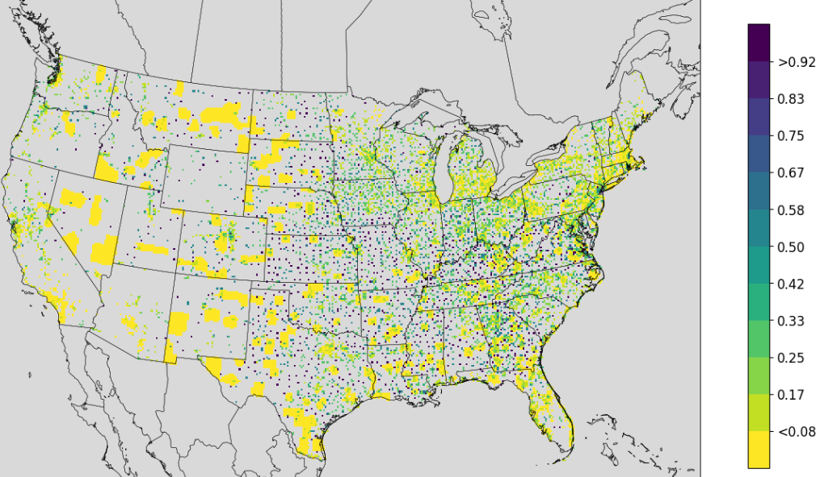
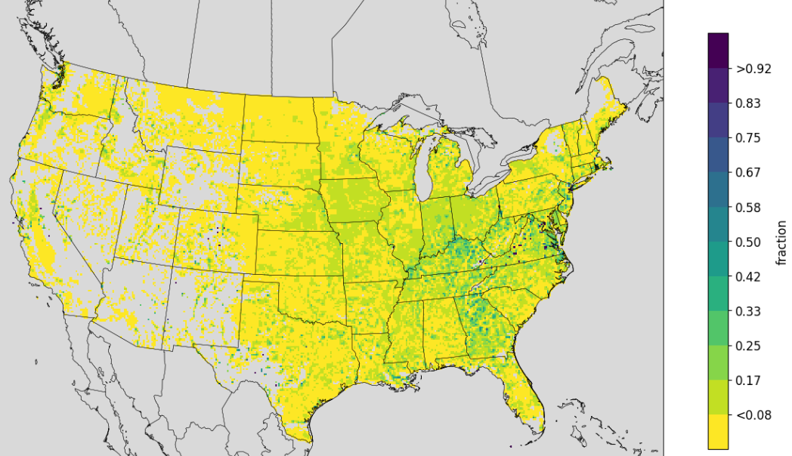
Agriculture and Golf Course Surrogates
The golf course surrogate
is based on a point
Shapefile and is gapfilled* with
housing ( polygon surrogate)
* Gapfilling means values from another
surrogate are used when the primary
surrogate has no data in a county
The agriculture surrogate
is based on raster data
converted to polygons,
gapfilled with Rural Housing
US EPA OAQPS, Emission Inventory and Analysis Group
Notes:
These spatial surrogates are examples of a point surrogate for golf courses and a polygon surrogates for agriculture

Slide 81
Quality Assurance of Spatial Allocation
Check SMOKE Grdmat logs to ensure all SCCs are mapped to spatial allocation profiles and only emissions outside the domain are not allocated to grid cells (do not want to drop emissions)
Review gridded emission plots by sector to ensure spatial patterns are reasonable (US sources are all in US, onshore emissions are all on land)
Compare post-SMOKE emissions to the inventory also helps to ensure that no emissions are dropped due to gridding
For point sources: check that inventory coordinates fall within county boundaries

Slide 82
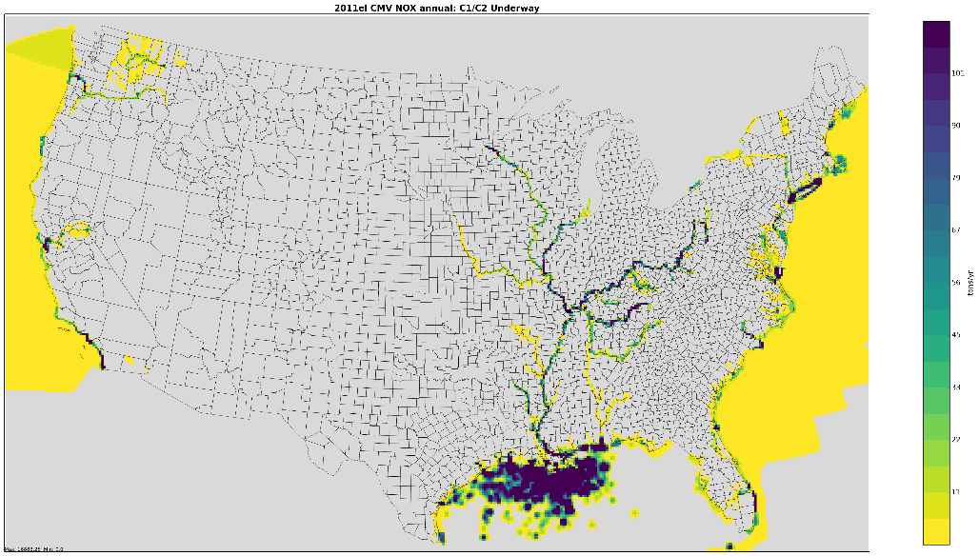
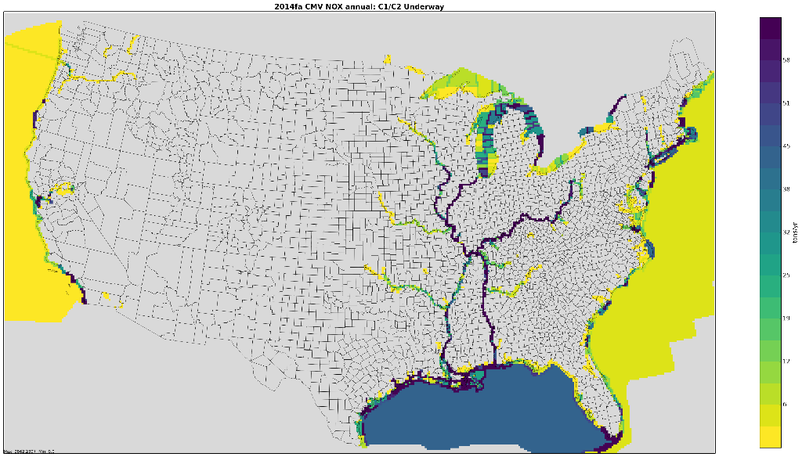
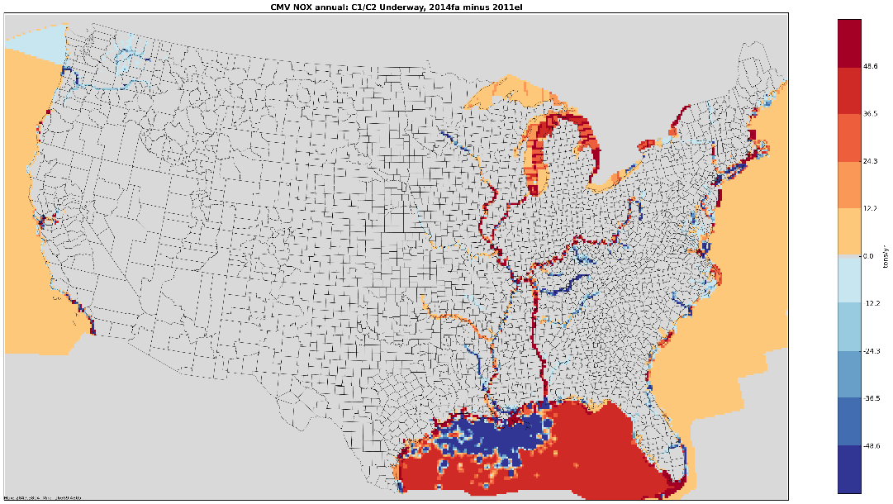
Maps Help us to QA Spatial Allocation: cmv_c1c2 Example
2011el cmv_c1c2 NOx
2014fa cmv_c1c2 NOx
101
58
0
2014fa-2011el cmv_c1c2 NOx
Comparing
gridded
emissions
shows issues
with surrogates
48.6
Great Lakes
and Gulf of
Mexico have
different
treatment
-48.6
Notes:
Gridded maps show the 2011 and 2014 spatial surrogates for CMV emissions and a difference in CMV NOx emissions computed as 2014-2011. There are slightly higher emissions off the Atlantic and Pacific in 2014. The Great Lakes have emissions in 2014 but not 2011, and in the Gulf emissions near the oil platforms are lower in 2014 but away from the platforms emissions are higher.

Slide 83

Questions?
In this section we’ve covered some details on spatial allocation
Notes:
Next: Caroline

Slide 84
Speciation
Mapping inventory pollutants to model species
Model species are used in the air quality model (AQM)
NOx, VOC (TOG), and PM are speciated
There are many types of speciation profiles and each has a unique code
Typically use SCC and pollutant to X-ref speciation profile to inventory sources
Cross reference may also use FIPS, facility, etc.
Different chemical mechanisms:
Emissions should match chemical mechanism of AQM
Different mechanisms have different list of model species
Examples: CB05, CB6, SAPRC07
Notes:
Caroline: Model species are either individual chemical compounds are groups of compounds

Slide 85
Obtaining Speciation Profiles
SPECIATE database
Source of most speciation profiles in the platform
SPECIATE 5.0 is the most recent version: https://www.epa.gov/air-emissions-modeling/speciate
Includes basin-specific profiles for oil and gas sources
Speciation Tool
Processes profiles from the SPECIATE database into the chemical mechanisms used by air quality models
Written in PostgreSQL and Perl
Available from http://cmascenter.org
Notes:
SPECIATE is the main source of speciation profiles used in the emissions modeling platforms.

Slide 86
Speciation Overview
Speciated (mass)
Profile (%)
MW1
Inventory Poll
Model species 1
Model species 2
Model species 3
Model species 4
Model species 1
Model species 2
Model species 3
Model species 4
MW2
MW3
MW4
Conversion to moles
Notes:
Speciation converts mass of inventory pollutants to moles of model species and conserves mass. The speciation profiles map inventory pollutants to model species via percentages. Mass * percent model species gives mass of the model species. The mass of each model species is then multiplied by the molecular weight of that species to get moles of the model specie.

Slide 87
NOx Speciation
NOx is converted to following model species:
NO
NO2
HONO
Example profiles:
profile | pollutant | species | massfrac
WHONO | NOX | NO2 | 0.092
WHONO | NOX | NO | 0.900
WHONO | NOX | HONO | 0.008
NHONO | NOX | NO2 | 0.100
NHONO | NOX | NO | 0.900

Slide 88
PM_{2.5} Speciation
Older versions of CMAQ used “simplified” PM model species (AE5)
Recent versions of CMAQ use the aerosol module ISORROPIA v2 that requires additional PM model species (AE6)
species name | species description | AE5 | AE6
POC | organic carbon | Y | Y
PEC | elemental carbon | Y | Y
PSO4 | sulfate | Y | Y
PNO3 | nitrate | Y | Y
PMFINE | unspeciated PM2.5 | Y | N
PNH4 | ammonium | N | Y
PNCOM | non-carbon organic matter | N | Y
PFE | iron | N | Y
PAL | aluminum | N | Y
PSI | silica | N | Y
PTI | titanium | N | Y
PCA | calcium | N | Y
PMG | magnesium | N | Y
PK | potassium | N | Y
PMN | manganese | N | Y
PNA | sodium | N | Y
PCL | chloride | N | Y
PH2O | water | N | Y
PMOTHR | unspeciated PM2.5 | N | Y
Prescribed Burning Composite Prof. (91109)
pollutant | species | massfrac
PM2_5 | POC | 0.5019
PM2_5 | PEC | 0.1093
PM2_5 | PSO4 | 0.0033
PM2_5 | PNO3 | 0.0107
PM2_5 | PNH4 | 0.0034
PM2_5 | PAL | 0.0005
PM2_5 | PCA | 0.0007
PM2_5 | PCL | 0.0024
PM2_5 | PFE | 0.0004
PM2_5 | PK | 0.0014
PM2_5 | PMN | 0.0001
PM2_5 | PMOTHR | 0.0125
PM2_5 | PNA | 0.0014
PM2_5 | PNCOM | 0.3513
PM2_5 | PSI | 0.0001
PM2_5 | PTI | 0.0007
Notes:
First four species (EC, OC, SO4, NO3) are in both; treatment of “the rest” differs; table on right is specific example for prescribed burns

Slide 89
VOC Speciation
Inventory VOC is converted to Total Organic Gas (TOG)
Example for Gas Exh E10: VOC * 1.199 = TOG (also includes methane)
TOG is then speciated according to the mechanism (species sum to 1.0):
Different model species depending on the chemical mechanism (e.g., CB05, CB6)
Model Species | Description
ALD2 | Acetaldehyde
ALDX | Propionaldehyde and higher aldehydes
BENZENE | Benzene*
CH4 | Methane*
ETH | Ethene
ETHA | Ethane
ETOH | Ethanol
FORM | Formaldehyde
IOLE | Internal olefin carbon bond
ISOP | Isoprene
MEOH | Methanol
OLE | Terminal olefin carbon bond
PAR | Paraffin carbon bond
TOL | Toluene and other monoalkyl aromatics
XYL | Xylene and other polyalkyl aromatics
Gasoline Exhaust – E10 (8751a)
pollutant | species | massfrac
TOG | ALD2 | 0.0145
TOG | ALDX | 0.0023
TOG | CH4 | 0.1416
TOG | ETH | 0.0596
TOG | ETHA | 0.0234
TOG | ETOH | 0.0157
TOG | FORM | 0.0145
TOG | IOLE | 0.0130
TOG | OLE | 0.0457
TOG | PAR | 0.3860
TOG | TOL | 0.1044
TOG | UNR | 0.0563
TOG | XYL | 0.1229
Notes:
Note model species molecular weights will vary with profile
Some of the model species are lumped, e.g. for CB05 “PAR”

Slide 90
VOC Integration Overview
Integration
Process of taking select VOC HAPs from the inventory as “true” and then speciating the remaining VOC
Want to avoid double counting of pollutants
Want to speciate the remaining VOC, while taking into account HAPs that were removed
NBAFM taken from inventory as “explicit HAPs”
Naphthalene, Benzene, Acetaldehyde, Formaldehyde, Methanol
NONHAPTOG
Remaining TOG after removing explicit VOC HAPs
NONHAPTOG = TOG – Total of NBAFM species

Slide 91
VOC Integration Example
Gasoline Exhaust – E10 (8751a)
No integrate (CB05)
Integrate (CB05)
pollutant | species | massfrac
TOG | ALD2 | 0.0145
TOG | ALDX | 0.0023
TOG | CH4 | 0.1416
TOG | ETH | 0.0596
TOG | ETHA | 0.0234
TOG | ETOH | 0.0157
TOG | FORM | 0.0145
TOG | IOLE | 0.0130
TOG | OLE | 0.0457
TOG | PAR | 0.3860
TOG | TOL | 0.1044
TOG | UNR | 0.0563
TOG | XYL | 0.1229
pollutant | species | massfrac
NONHAPTOG | ALD2 | 0.0019
NONHAPTOG | ALDX | 0.0025
NONHAPTOG | CH4 | 0.1519
NONHAPTOG | ETH | 0.0639
NONHAPTOG | ETHA | 0.0251
NONHAPTOG | ETOH | 0.0169
NONHAPTOG | FORM | 0.0010
NONHAPTOG | IOLE | 0.0139
NONHAPTOG | OLE | 0.0491
NONHAPTOG | PAR | 0.4067
NONHAPTOG | TOL | 0.1119
NONHAPTOG | UNR | 0.0234
NONHAPTOG | XYL | 0.1318
Notes:
Total massfrac = 1 for both profiles
Still have FORM and ALD2 b/c of secondary formation, note much smaller
Note NONHAPTOG, i.e. need to go from NONHAPVOC -> NONHAPTOG
So have 2 sets of profiles: integrate and no integrate

Slide 92
VOC Integration by Sector
Platform Sector | Approach for integrating in 2016ff
ptegu | No integration (i.e., integrated species in inventory ignored)
ptnonipm | No integration
pt_oilgas | No integration
ptfire, ptagfire | Partial integration
ptfire_othna | No integration
othar | No integration
othpt | No integration
onroad_can | No integration
onroad_mex | Full integration (MOVES-Mexico)
ag | Partial integration
afdust, othafdust, othptdust | N/A – sectors contain no VOC
beis | N/A – contains specific VOC model species
nonpt | Partial integration (NBAFM)
np_oilgas | Partial integration (NBAFM)
rwc | Partial integration (NBAFM)
rail | Full integration (NBAFM)
nonroad | Full integration (calculated in MOVES2014b)
cmv_c1c2 | Full integration (NBAFM)
cmv_c3 | Full integration (NBAFM)
onroad | Full integration (calculated in the MOVES2014 model)
Notes:
Partial integration: means some sources are integrated and others aren’t
Biog – beis creates model species explicitly
Onroad: MOVES2014 doing integration within model (next slide)

Slide 93
Onroad speciation
MOVES2014b does most of the needed speciation
Has different profiles for different vehicle model years, regulatory classes, fuel types, and emission processes
Previously used COMBO files or weighted profiles to approximate, but it was a coarse approach
Can do an explicit mapping of profiles to sources if doing speciation within MOVES
PM2.5
AE6 species coming directly from MOVES (as mass)
VOC
16 pollutants are explicit, i.e. integrated
Model species (moles) and inventory pollutants (mass) come directly from MOVES
Need to specify chemical mechanism in the MOVES run
Notes:
PM2.5: previous inventory polls from MOVES didn’t map cleanly to AE5 species

Slide 94
QA of Speciation
Check Spcmat SMOKE logs to ensure that all sources have references to VOC and PM speciation profiles.
Sum model species to compare to VOC and PM2.5 inventory totals.
Compare integrated species to inventory for full and partial integration sectors.
Do a quick manual calculation of a species for a specific FIPS/SCC to ensure that the post-SMOKE value is using the correct profile (or profiles in the case of GSPRO_COMBO).
Check SMOKE logs for warnings or errors. For example:
NBAFM but no VOC for an integrate source
No TOG conversion factor
Skipping pollutant [X] for other than PM₁₀ and *_NOI pollutants
Look at the output species to make sure all of the expected species are there for the specific mechanism (CB05 vs CB6 vs …).
Notes:
Another Spcmat log message we look for is "Skipping pollutant [X]", which means that an inventory pollutant is being dropped. We expect to see this for PM10 (we speciate PM2.5 and pass through PMC instead) and _NOI pollutants (no-integrate NBAFM, which we want to drop to avoid double counting speciated VOC), but if we see anything else getting skipped, that's a problem.

Slide 95
Questions?
Any questions on speciation?
Notes:
BREAK; then Jeff

Slide 96
Area Fugitive Dust Adjustments
AQ models tend to overestimate the impact of fugitive dust emissions
Paved and unpaved roads, construction, mining, hooves
Prior to modeling, afdust emissions are reduced according to a gridded transport fraction
Transport fraction reduction factors depend on land use
Forested areas will have a lower transport fraction (higher reduction)
Wide open areas will have a higher transport fraction (lower reduction)
Additional meteorologically-based reductions for rain and snow-cover are applied to fugitive dust emissions later in the process
Notes:
Forest areas can have a higher reduction on fugitive dust emissions than more open areas (e.g. grasslands).
Rain and snow-covered areas will see a reduction in fugitive dust emissions.

Slide 97
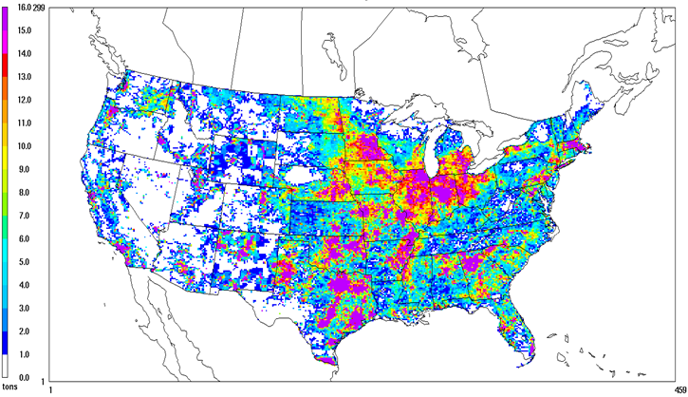
Unadjusted Fugitive Dust PM_{2.5} Emissions
Note: in NEI, dust emissions are adjusted
Notes:
Gridded map of unadjusted fugitive dust emissions. Dust is highest in the midwest and in Texas and states north of Texas.

Slide 98
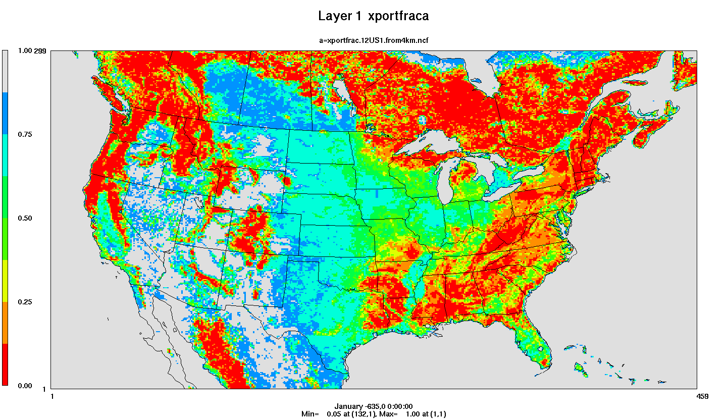
Transport Fraction Plot
Red = high level of reduction; Gray = little reduction
Notes:
Map shows the transport fraction factors. Red values have the biggest reduction (in southeast and in Canada). Areas shaded in red are heavily forested areas.

Slide 99



Impact of afdust Adjustments
Transport fraction
Precipitation adjustment
Zero out hourly emissions when rain (> 0.01 inches) or there is snow)
Apply
Transport
Fraction
Precipitation
adjustment
Unadjusted emissions
Notes:
Emissions are reduced through transport fraction adjustments which reduce dust in more wooded areas. Dust emissions are further reduce after the meteorological adjustment which is based on snow and soil moisture as predicted by the meteorological model (which differs temporally and spatially). The final emissions are much lower than the unadjusted emissions.

Slide 100
BEIS 3.6.1: Updated Biogenic Emissions
Updated leaf temperature algorithm in v3.6.1
Leaf temperature calculated using canopy model rather than 2 meter temperature
Biogenic Emissions Landcover Database (BELD) 4.1 land use based on:
U.S. National Land Cover Database (NLCD) 2011
Moderate Resolution Imaging Spectroradiometer (MODIS) for Canada and Mexico
Forest areas constrained by canopy coverage
2011 USDA Cropland Data Layer
Tree species from USFS Forest Inventory and Analysis (FIA) data
Selected surveys from 2001 to 2014 to get a complete decadal US survey that bounds the years being modeled
SMOKE programs used:
Normbeis3: normalized biogenic emissions
Tmpbeis3: outputs gridded, speciated, hourly emissions
Notes:
BEIS v3.6.1 consists of two programs: Normbeis3 and Tmpbeis3. BELD4.1 is the gridded landuse dataset input into Normbeis3.

Slide 101
Meteorological Variables Needed for BEIS 3.6.1
Variable | Description
LAI | leaf-area index
PRSFC | surface pressure
Q2 | mixing ratio at 2 m
RC | convective precipitation per met TSTEP
RGRND | solar radiation reaching surface
RN | nonconvective precipitation per met TSTEP
RSTOMI | inverse of bulk stomatal resistance
SLYTP | soil texture type by USDA category
SOIM1 | volumetric soil moisture in top cm
SOIT1 | soil temperature in top cm
TEMPG | skin temperature at ground
USTAR | cell averaged friction velocity
RADYNI | inverse of aerodynamic resistance
TEMP2 | temperature at 2 m
Notes:
There 14 different meteorological variables used in the biogenic emissions modeling process. These meteorological variables are used in the Tmpbeis3 program in BEISv3.6.1.

Slide 102
Species Produced by BEIS
Carbon Monoxide (CO), Nitrogen Oxide (NO)
Acetaldehyde (ALD2)
Higher acetaldehyde (ALDX)
Formaldehyde (FORM)
Isoprene (ISOP)
Terpene (TERP)
Sesquiterpene (SESQ)
Ethene (ETH), Ethane (ETHA)
Internal (IOLE) and terminal olefins (OLE)
Ethanol (ETOH), Methanol (MEOH)
Paraffins (PAR)
No PM species…
Notes:
List of output emissions species from BEIS.

Slide 103


2014 Annual Biogenic Emissions
Top: NO from soil (depends on temperature, precipitation, and fertilizer)
Bottom: Isoprene (produced during photosynthesis)
Notes:
Gridded map of 2014 biogenic NOx emissions. These are highest in the Mississippi valley and states north of Texas and are from processes dependent on fertilizer, temperature, and precipitation. Gridded map of 2014 biogenic isoprene emissions. These are highest in Texas and states east of Texas and are produced from certain plant / tree species during photosynthesis.

Slide 104
Future Directions and Questions?
Continue examining alternative biogenic model Model of Emissions of Gases and Aerosols from Nature (MEGAN) version 3 biogenic emissions estimates
MEGAN used for global and hemispheric modeling and for regional modeling by some agencies
Continue examining new Canadian BELD4-compatible data
Updated BELD(5?) coming soon
Any questions on fugitive dust or biogenic emissions?

Slide 105
NEI Fire Inventory Details
Includes daily “point” emissions from wildfires and prescribed fires
Emissions were estimated for PM_{2.5}, PM₁₀, CO, CO₂, CH₄, NO_{x}, NH₃, SO₂, VOC, and 34 hazardous air pollutants (HAPs). PM_{2.5} emissions were further broken down into EC, OC, SO₄, NO₃, and PM fine
HAPs emission factors and fractions of PM_{2.5} components were provided by EPA
2014NEI made flaming and smoldering emissions available (to allow for differentiated treatment of plume rise and potentially speciation)
Fire Inventory from NCAR (FINN) is used for Puerto Rico
Notes:
Prescribed fires and wildfires are treated as point sources. Emissions can be broken up into the flaming and smoldering phases.

Slide 106
Data Sources for NEI Fires
Data Sources included for NEI fire inventory development (non-NEI years typically use only data in red)
State/local/tribal data
National Association of State Foresters (NASF) WF data
NOAA’s Hazard Mapping System (HMS) data
Incident Status Summary (ICS-209) data (wild vs prescribed)
Geospatial Multi-Agency Coordination (GeoMAC) fire perimeter Shapefiles
Monitoring Trends in Burn Severity (MTBS)
USDA Forest Service Activity Tracking System (FACTS) Rx fire perimeter data
U.S. Fish and Wildlife Service (USFWS) data
U.S. Department of Interior (DOI) Rx data
Ancillary data sources
Fuel moisture data from the USFS Weather Information Management System
Fuel Characteristic Classification System (FCCS) fuel loading database
Notes:
There are many different type of historical fire information used to generate the fire inventories for the NEI.
Fire information is acquired from various government agencies including US Forest Service, NOAA, US DOI, and USDA.

Slide 107


NEI Fire Development Overview
Notes:
A flow chart of input data and processing steps used to prepare a fire inventory. Order: input data sets, data preparation, data aggregation and reconciliation to produce daily fire locations with fire size and type. Then Smoke modeling with BlueSky Framework (this requires fuel moisture and fuel loading data) which results in daily smoke emissions for each fire. The emissions data are then postprocessed to create the final wildland fire emissions inventory. The BlueSky Framework takes fire location, dates, type, and size information, uses fuel and moisture information to produce fuel consumption data. Emission factors are then applied to create emissions.

Slide 108


2014 and 2016 Annual PM2.5 from Wild and Prescribed Fires
Top: 2014
Bottom: 2016
Some aspects of fires are similar
between years:
Prairie, gulf coast, South Florida
Locations of large fires vary –
particularly noticeable in West, MN
Notes:
Gridded map of 2014 prescribed fires over continental US. Emissions are highest along the Gulf coast and in Kansas and surrounding states. There are also some emissions in West coast states. The pattern of emissions is similar in 2014 and 2016 but there are more emissions in northern Minnesota in 2016 than 2014.

Slide 109

Agricultural Fires
EPA estimates day-specific point-based agricultural fires based on satellite detects (Pouliot, 2017)
2014 PM_{2.5}
2016 PM_{2.5}
Notes:
When states provide data for NEI at annual resolution, it's different than what we use for modeling; day specific supplement is helpful. Gridded maps of 2014 and 2016 PM2.5 from agricultural fires shows emissions in the southeast states and the Mississippi valley. The patterns are very similar in the two years except that the Kansas fires are no longer in the ag fire sector.

Slide 110

Questions?
Notes:
Next: Alison

Slide 111
Onroad Emissions Modeling
Met. Data from WRF
Meteorological Preprocessor (Met4Moves)
MOVES
Temperature ranges,
rel. humidity
Run MOVES to get emission factors (EF) for representative counties for each temperature and speed needed
Gridded met
EF tables
Use representative EFs and county/ grid-specific activity data and meteorology to create emissions for all counties
Activity Data
SMOKE
AQ model-ready files
Notes:
This schematic shows the data flow used to create an onroad emissions inventory. The meteorological data output from SMOKE is processed by met4moves to extract temperature ranges and humidity needed by MOVES and the gridded met data needed by SMOKE. MOVES is run to create emission factor tables that are input to SMOKE. SMOKE combines emission factors with activity data to compute emissions.

Slide 112

Representative Counties
3000+ counties are mapped to approx. 300 representative counties according to: state, fuels, light duty age distribution, ramp fraction, I/M programs, emissions standards
Notes:
Note that county-specific activity data and grid-specific meteorological data are used to compute the emissions for each county.

Slide 113
Onroad Emission Processes and Inputs
On-roadway emissions
Exhaust, evaporative, evaporative permeation, refueling, brake and tire wear (Rate-per-distance)
Primary inputs: vehicle miles traveled (VMT), average speeds, speed profiles, and temperature (gridded, hourly)
Off-network emissions (i.e. parked vehicles)
Exhaust from starts, evaporative, evaporative permeation, refueling, hot soak (right after a trip) (Rate-per-vehicle)
Evaporative fuel vapor venting and diurnal (when vehicles are parked for a long period) (Rate-per-profile)
Primary inputs: vehicle population (VPOP) and Temperature (gridded, hourly, daily min/max)
Hoteling:
Extended idle and auxiliary power units (APU) for combination long-haul trucks (Rate-per-hour)
Primary inputs: Hoteling hours and Temp. (gridded, hourly)
Notes:
VMT and HOTELLING are temporalized, others aren’t

Slide 114
Running MOVES
MOVES runs on Windows, but SMOKE runs on Linux so a translation step is required
For info on running MOVES to create emission factors for SMOKE-MOVES see: https://github.com/CEMPD/SMOKE-MOVES
runspecgenerator.pl creates MOVES configuration files
moves2smkEF.pl reads the MOVES output databases and converts them into a form that runs SMOKE

Slide 115

On-roadway Processing (RPD)
Uses Standard SMOKE programs + Movesmrg
Input “inventory” is VMT and SPEED data
Notes:
Flow diagram for on-roadway SMOKE processing. VMT and Speed are read by Smkinven which produces outputs used by grdmat, spcmat, and temporal plus a speed file used by Movemrg. Movesmrg reads the speed file, the hourly VMT output from temporal, and the speciation and gridding matrices output by Grdmat and Spcmat, the hourly gridded temperatures from MCIP, and the MOVES emission factor tables to create the AQM-ready emissions for on-roadway processes. Although most speciation is done by MOVES, Spcmat is still used to keep track of which EFs are model species vs inventory.

Slide 116

Onroad Hoteling
Hoteling = Overnight truck idling: extended idle and APU
States can submit hoteling hours by county
EPA uses combination long-haul truck VMT on urban + rural restricted roads to distribute hoteling hours to counties
Temporal profile is opposite of the driving profile
Spatial surrogate is based on truck parking spaces
Notes:
Map of interstates and truck parking spaces is shown. Note that onroad hoteling does not include idling at ports or bus stops – it’s really about the requirement to hotel for the long-haul trucks. Note that some trucks use auxiliary processing units to cut down on idling and MOVES models these plus standard hoteling.

Slide 117


Onroad NOx Changes 2011-2014
2011
2014
2016
Although VMT typically
increases with time, emissions
decrease as newer cleaner vehicles penetrate the market
Notes:
NOx emissions decreased in most counties from 2011 (5.7M tons) to 2014 (4.5M tons). There are moderate increases in some counties in PA, ND, UT, NM, TX, LA and some minor increases in some other counties. Emissions continue to decrease from 2014 (4.5M tons) to 2016 (4M tons).

Slide 118
Improved MOVES Inputs used in 2016
States provided inputs for the 2016 platform
Activity data, other MOVES inputs
Coordinating Research Council (CRC) sponsored a project to decode year 2017 registration VINs into MOVES vehicle types by model year for both light-duty and heavy-duty vehicles
Impacts age distributions and vehicle populations
Includes data for populations of alternative fuel light-duty vehicles (i.e., diesel, CNG, E-85, electric)
EPA derived VMT data based on the new VPOP data

Slide 119
Input Data Updates from the CRC A-100 Study
Sponsored by the Coordinating Research Council (CRC)
Main data source: StreetLight Data, Inc.
5 Billion observations over continental U.S.
Passenger cars, commercial truck fleet management systems
Sub-minute level data for 12 consecutive months
Grouped by light-duty (LD), medium-duty (MD), and heavy-duty (HD); no car/truck split or age info available for LD vehicles
5m spatial precision, 16 speed bins
Used data to derive
VMT temporal distributions for MOVES and SMOKE temporal profiles
Road type distributions supplemental to those from FHWA
Speed distributions for MOVES plus speed inputs to SMOKE
Populating all speed bins by road type, month, day, hour, vehicle type was a challenge outside of urban areas
Notes:
Coordinating Research Council (CRC) A-100 is one source of data used to improve onroad mobile emissions.

Slide 120
CRC A-100 Geographic Scale
18,644,352 road segments over the Continental U.S.
3,601 polygons of urban areas / clusters from the U.S. Census
* CRC A-100 plots courtesy ERG
Notes:
In CRC A-100, road data was collected on more than 18 million road segments over the continental U.S.. These data were classified as urban or rural based on 3600 polygons of urban areas from the U.S. Census.

Slide 121
Spatial Groups Used
Example of Passenger Vehicles on Urban Unrestricted Roads
Counties for
which MOVES
inputs could be
populated shown in red;
others are based
on data for
the region and
urban/rural
Notes:
The map shows which counties used individual county-specific data versus regional averages.

Slide 122
Speed Results by City
Compared Atlanta, Chicago, and Las Vegas
Patterns differed by city and from MOVES defaults
Weekday patterns for passenger vehicles on urban restricted roads (highways) and unrestricted local roads shown below
Note scales differ
Notes:
Speeds are shown on urban restricted roads in Las Vegas, Atlanta, and Chicago versus the national default. Las Vegas speeds are a bit higher than Atlanta which are a bit higher than Chicago. Speeds are slowest during AM and PM rush hours. The same relative relationships exist on unrestricted roads but unrestricted road speeds are slower than restricted road speeds with an average speed around 30mph vs the 60mph on restricted roads.

Slide 123
Speed by Vehicle Type
Found speed differences between LD, MD, and HD
MD/HD speeds higher than LD in many cases
Different areas have different patterns esp. on interstates
Chicago examples shown below – note scales differ
Notes:
Speeds on urban restricted roads by vehicle type show that heavy duty vehicles actually travel a little faster than medium duty, which travel a bit faster the light duty vehicles. Speeds on urban restricted roads by vehicle type show that heavy duty vehicles actually travel a little faster than light duty, which travel a bit faster the medium duty vehicles.

Slide 124
Diurnal VMT Distributions by Vehicle Type – Chicago example
Note the differences in patterns weekdays vs weekends and LD/MD/HD
Data put into formats to support MOVES (weekday/weekend) and SMOKE (day-specific)
Notes:
Chicago light-duty VMT diurnal profiles show very low overnight activity with a weekday peak around 8-9AM a drop off during mid-day hours and another peak around 5PMthe n dropping off from there. On weekends there is a single mid-day peak. Chicago medium-duty VMT diurnal profiles show low (but not zero) overnight activity with a peak around 7AM until about 5PM and a steady drop off from there. Chicago heavy-duty VMT diurnal profiles show a single mid-day peak and higher overnight activity than medium and light-duty.

Slide 125




Day of Week Temporal Profiles
A-100 data was prepared into MOVES dayVMTFraction and SMOKE day-of-week temporal profiles (SMOKE shown here)
Urban GA LD vehicles
RURAL GA LD vehicles
Urban GA MD trucks
Urban GA combination trucks
Notes:
Urban GA light-duty vehicle day-of-week profiles show that weekdays have similar emissions and weekends a little less, except for interstates which have higher emissions Friday and on weekends. Rural GA light-duty day-of-week profiles show that emissions are similar Monday-Thursday and a bit higher Friday-Sunday. Urban GA medium-duty truck day-of-week profiles show that activity are similar on weekdays and lower on weekends. Urban GA combination truck day-of-week profiles show that activity is similar Monday-Friday and lower on weekends.

Slide 126


Hoteling and On-roadway NOx by County
Hoteling follows interstates and has 190K tons NOx (blue=500tpy) ->
Rate per Distance 3.2M tons of 4.1M tons total exists in all counties blue=6000tpy)
Notes:
Onroad NOx from on-roadway processes show higher values in urban areas and somewhat along interstates. County map of NOx from hoteling shows emissions along interstates in most states, but some states have low emissions in all counties. Highest emissions are in the northeast and in the large Western counties.

Slide 127


Off-network Emissions by County
RPV VOC is 1.05M of 2M tons VOC (blue=2000) -> (NOx=642K of 4.1M tons)
Rate per Profile VOC 180K of 2M tons onroad VOC (blue=370)
Onroad | NOX | VOC
RPD | 3,233,411 | 720,732
RPH | 189,889 | 35,101
RPP |  | 179,371
RPV | 642,240 | 1,050,560
Total | 4,065,540 | 1,985,763

Slide 128
Onroad Changes 2011 to 2016

Slide 129
Questions?
Any questions on onroad emissions processing?
Notes:
Alison continues

Slide 130
Commercial Marine Vessels
CMV in the NEI is split into two broad categories:
Category 3 (C3) (i.e., large) vessels with engine displacement above 30 liters that primarily use residual fuel blends
C1 and C2 vessels that primarily use distillate fuels
Recreational marine vessels are part of nonroad
Inventories computed for emissions in state waters (3-10 nautical miles) and federal waters out to 200 nautical miles from the U.S. coastline
Port emissions are separated from underway
Areas outside of 200 n.m. filled in from non-NEI data sources
“Modes” indicate what ships are doing and different emission factors are used for each
M=maneuvering, H=hoteling, C=cruise, Z=reduced speed zone
EPA data is used except for states that submitted
Notes:
Commercial marine vessels are typically broken up into two categories: 1) Category 3/Large vessels that use residual fuel bends and 2) Category 1 and 2 that use distillate fuels.

Slide 131
Commercial Marine Data Sources and Modeling
Data sources for CMV in the 2014NEI
Entrance and clearance data (2012)
About 11,000 vessels linked to routes from origin port to destination port
Hours of operation computed based on route and vessel type (e.g., bulk carrier, container, oil tanker) with reduced speed zones factored in
Army corps of engineers waterborne commerce data for tugs and barges, bulk carriers, tankers, and other vessels
2007 category 1 and 2 vessel study
See 2014NEI TSD for more details
Modeling
CMV modeling sectors now cmv_c1c2 and cmv_c3 and include all U.S. waters
Plume rise computed for cmv_c3 (pseudo-point sources which also help us represent shipping routes)
Temporal allocation is mostly flat every hour (except Great Lakes by month)
Notes:
Various data sources are used to estimate CMV emissions in US waters. C3 vessels can be treated as point sources and receive plume-rise treatment.

Slide 132

U.S. State and Federal Waters
Notes:
This map shows the state waters (3-10 miles from the coast) and federal waters that extend up to about 200n.m. from the coast.

Slide 133

New 12km CMV Spatial Surrogate based on marinecdaster data
Notes:
Gridded map of new commercial marine vessel spatial surrogate shows shipping lanes close to the coasts and various tracks through the Gulf of Mexico.

Slide 134

2016 CMV C3 SO2 Emissions

Slide 135
Updates to CMV: 2016v1/2017NEI
CMV for 2016v1 and 2017 NEI are being created based on Automated Identification System (AIS) data
Ships have transponders that send signals multiple times per minute
AIS data has been obtained for 2017 at 5 minute intervals for U.S. and some Canadian and Mexico Coastal waters
Emissions have been computed for 2017 NEI based on ship information and emission factors
For modeling, emissions are aggregated by hour and grid cell

Slide 136

July C3 emissions at 12km

Slide 137

July C1C2 Emissions at 12km
Note much lower scale than C3

Slide 138
Questions on CMV?
Notes:
Next: Caroline

Slide 139
Modeling Ramp-up Period
For regional CAP-focused modeling, we typically have a ramp-up period of 10 days (i.e., starting on December 22 of the previous year)
For most sectors, emissions from December of the modeled year are repeated during the ramp-up
For biogenic emissions, data based on actual prior year meteorology are used
For hemispheric modeling, the ramp-up is longer – six to eight months
Prior year fire emissions used for ramp-up
Notes:
Air quality models typically need a ramp-up period. The ramp-up period will vary based on model resolution.
The ramp-up period allows for the air quality model to be closer to initial conditions at the beginning of time period of interest.

Slide 140
Final Merging and QA
After all sectors have been processed through SMOKE programs, the ground-level emissions are merged using the SectorMerge script
Runs the mrggrid program based on the Sector list file
Only one input for ground-level but point sources can be given to CMAQ by sector without merging
cmv_c3, ptegu, ptnonpim, pt_oilgas, ptagfire, ptfire, ptfire_othna, othpt
If CAMx is to be run instead of CMAQ, then CAMx conversion scripts must be run
CAMx requires point files to be merged
Notes:
The Mrggrid program is used to merge all emissions sectors.

Slide 141
Final Layer 1 Merging
All ground-level files must be merged for both CMAQ and CAMx
Biogenic emissions can be optionally computed within CMAQ
Considers both day-specific and representative day emissions
afdust_adj
ag
cmv_ c1c2
nonpt
non-road
np_ oilgas
on-road
rwc
rail
othar
onroad_mex
oth afdust_adj
onroad_can
onroad_ca_adj
oth ptdust_adj
pt_oilgas
ptnonipm
Merged 2D emissions for each day
Ptegu and fire sectors are all elevated
Notes:
Low-level emissions are merged together prior to air quality modeling to create a full set of merged low-level emissions for each day. Elevated emissions are still passed separately to the AQM.

Slide 142
Example Sector List for 2016 Alpha Case
sector | sectorcase | Sectbaseyr | mrgapproach | prevyrspinup | endzip | mergesector
afdust_adj | 2016fd_cb6_16j | 2016 | all | SectBaseYr | Y | Y
ag | 2016fd_cb6_16j | 2016 | all | SectBaseYr | Y | Y
nonroad | 2016fd_cb6_16j | 2016 | mwdss_Y | SectBaseYr | N | Y
rail | 2014fd_cb6_16j | 2014 | aveday_N | SectBaseYr | N | Y
nonpt | 2014fd_cb6_16j | 2014 | week_Y | SectBaseYr | N | Y
np_oilgas | 2016fd_cb6_16j | 2016 | week_Y | SectBaseYr | N | Y
rwc | 2016fd_cb6_16j | 2016 | all | SectBaseYr | Y | Y
ptegu | 2016fd_cb6_16j | 2016 | all | SectBaseYr | Y | Y
ptnonipm | 2016fd_cb6_16j | 2016 | mwdss_Y | SectBaseYr | N | Y
pt_oilgas | 2016fd_cb6_16j | 2016 | mwdss_Y | SectBaseYr | N | Y
ptagfire | 2016fd_cb6_16j | 2016 | all | SectBaseYr | Y | N
ptfire | 2016fd_cb6_16j | 2016 | all | SectBaseYr | Y | N
cmv_c1c2 | 2014fd_cb6_16j | 2014 | aveday_N | SectBaseYr | N | Y
ptfire_othna | 2016fd_cb6_16j | 2016 | all | SectBaseYr | Y | N
onroad | 2016fd_cb6_16j | 2016 | all | SectBaseYr | Y | Y
onroad_ca_adj | 2016fd_cb6_16j | 2016 | all | SectBaseYr | Y | Y
othafdust_adj | 2016fd_cb6_16j | 2016 | all | SectBaseYr | N | Y
othar | 2016fd_cb6_16j | 2016 | week_N | SectBaseYr | N | Y
onroad_can | 2016fd_cb6_16j | 2016 | week_N | SectBaseYr | N | Y
onroad_mex | 2016fd_cb6_16j | 2016 | week_N | SectBaseYr | N | Y
othpt | 2016fd_cb6_16j | 2016 | mwdss_N | SectBaseYr | N | N
* Some sectors may come from another case
Notes:
Mention that emissions from earlier cases can be merged into the same case
Also mention about how low-level emissions are merged but elevated are not

Slide 143
QA of Merged Emissions
Look at the mrggrid logs to ensure that the correct case/sector files are merging and all sectors with ground-level emissions are included
Generate domain totals of the 2D and inline files and compare back to the sum of the sector-specific SMOKE annual reports
Check the size of the 2D merged emissions files to make sure that the file size is the same for each day (corrupted files will be smaller)
Sometimes compare day-specific or annual total gridded emissions to a previous run
Notes:
Quality assurance of final merged emissions consists of many steps.

Slide 144
U.S. Base Year Anthropogenic Emissions in 2011, 2014, and 2016
Notes:
Bar chart of 2011, 2014, and 2016 anthropogenic emissions shows that NH3, NOx, and VOC are all trending moderately down from 2011 to 2014. SO2 is trending steeply down. PM 2.5 is flat and PM20 is slightly increasing.

Slide 145
2014 National Emissions by Sector
Biogenic emissions comprise 71% of VOCs and fires 8%
Notes:
Bar chart of annual tons of PM2.5 by sector for 2011, 2014, and 2016 shows the significant sectors are ptfire, afdust. Moderate sectors are nonpt, rwc, and ptnonipm. Bar chart of annual tons of NH3 by sector shows that the dominant sector is ag and emissions are decreasing from 2011 to 2016. Ptfire has a moderate contribution and other sectors are much lower. Bar chart of annual tons of NOx by sector for 2011, 2014, and 2016 shows the dominant sector is onroad. Moderate sectors are ptegu, nonroad, and ptnonipm. Other contributing sectors are biogenics, CMV, nonpt, oil and gas, ptnonipm, and rail. Onroad, ptegu, and nonroad emissions are decreasing. Bar chart of annual tons of SO2 by sector for 2011, 2014, and 2016 shows the dominant sector is ptegu. Ptnonipm is a moderate sector. Contributing sectors are CMV and ptfire.

Slide 146

2016beta PM2.5 Emissions by Region

Slide 147

2016beta SO2 Emissions by Region

Slide 148

State-Sector Totals Report
State totals by sector before and after SMOKE
Notes:
Spreadsheet of state totals by sector before and after SMOKE shows CAP emissions and AQM species emissions by state.

Slide 149
CAMx Conversion
EPA always prepares the emissions files initially using CMAQ’s netCDF format
Scripts are provided to convert to CAMx:
Map species from CMAQ model ready names to CAMx names
Convert Merged gridded 2D emissions are from netCDF (IOAPI) format to CAMx model ready format “emis2d” files
Merge gridded CAMx emissions with met-based surf zone sea-salt emissions files
Convert inline CMAQ model ready emissions to CAMx point “ptsr” emissions for each sector
This step requires that fires have been processed in 3D
Merge the CAMx point “ptsr” emissions into a single point “mrgpt” file for the CAMx model
Notes:
Software exists that takes the CMAQ-ready emissions and converts them to the CAMx format. CAMx is another air quality model.

Slide 150
Source apportionment
Source apportionment (SA) is used for transport and sector-based analyses
Evaluate significant contribution by states
Understand which sectors contribute to AQ issues
Source apportionment requires that all sectors have been tagged and written as CAMx ptsr emissions files
For most sectors, SMOKE can prepare both SA and non-SA outputs simultaneously
Onroad for SA takes a lot of RAM and we run in shorter time chunks than our typical 7 days
Scripts are available for source apportionment runs
A standalone 2-D sea-salt file is read by CAMx (all others are in CAMx ptsr format)

Slide 151
Emissions Modeling Platform Data Availability
EPA’s modeling platform data, documentation, scripts available from
https://www.epa.gov/air-emissions-modeling
Version 6 platforms include:
2011v6.3: January 2017 NODA (2011el/2023el), Final Cross-State Air Pollution Rule (CSAPR) Update (2011ek/2017ek), hemispheric case
Version 7.0 platform for NATA based on 2014NEIv1
2016 alpha platform with compatible 2014 and 2015
Spatial surrogates available for 4km, 12km, 36km
Speciation data for CB05, CB6, SAPRC07TB
Temporal profiles for all sectors

Slide 152

Emissions Modeling FTP site
Several versions of the 2011 platform plus versions of 2014,2015, and 2016 are available on the FTP site:
ftp://newftp.epa.gov/air/emismod
Notes:
Tree of FTP site organization shows the various platforms organized according to the base year.

Slide 153


2016 Beta Emissions and Summary Reports on EPA FTP site
Additional information
is available on the 2016 beta Wiki page:
http://views.cira.colostate.edu/wiki/wiki/10197
Notes:
The 2016 beta FTP has emissions, maps, and reports (i.e., summaries).
Under the emissions section, inputs to SMOKE are organized by NEI data category.
Ancillary data are up a couple of levels parallel to the 2016fd directory.

Slide 154

Final Questions before lunch?
Any final questions on the base year part of the training?
Contacts: eyth.alison@epa.gov, farkas.caroline@epa.gov, Vukovich.jeffrey@epa.gov

