Slide 1
Projecting Emissions Inventories for Air Quality Modeling of Future Years
July 29, 2019
Alison Eyth, Jeff Vukovich, Caroline Farkas
EPA Office of Air Quality Planning and Standards
Emission Inventory and Analysis Group

Slide 2
Future Year Projections Course Outline and Schedule
1:25 Introduction to projections
1:40 Control Strategy Tool overview
2:00 Nonpoint projections
2:20 EGU projections
2:35 Break
2:45 Oil and gas projections
3:05 Airports, Non-EGU point
3:20 Onroad and Nonroad projections
3:45 Commercial marine vessel and rail
4:00 Wrap up and final questions
Notes:
Alison: Intro, EGU, Onroad
Caroline: CoST, nonEGU point, Ag, fugitive dust, Aviation
Jeff: O&G, RWC, CMV

Slide 3
Future Year Projections
Overview
Projections require inventories and ancillary data
Strive for consistency in methods when there are multiple future years
Estimate changes between base and future years
Activity changes
Rules / technology changes in intervening years
Facility and unit closures
Interpolation / extrapolation often difficult
Projection techniques
Apply factors and/or percent reductions that account for activity change and controls to a set of sources
Add or replace a sector inventory or portion thereof
Use a model to compute the future year inventory
Notes:
Estimating growth and controls applied to an emissions sector are the typical steps used in future year projections.

Slide 4
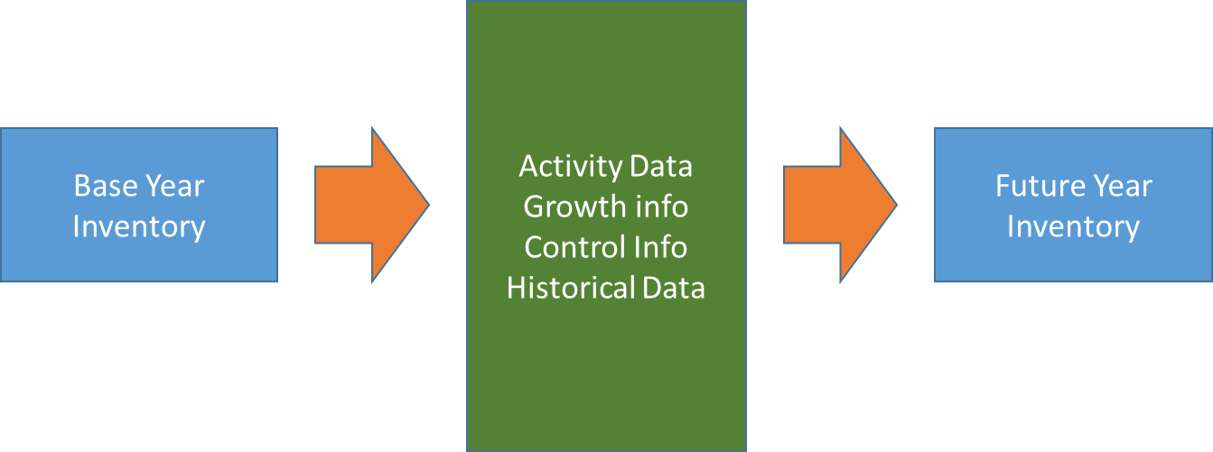
Future Year Projections Overview
Once created, the future year inventory is then processed by SMOKE in a similar way as if it were a base year inventory
Notes:
Start with base year inventories; incorporate activity data, growth and control info, and historical data; then create future year inventory

Slide 5
Why Develop Projected Emission Inventories?
Near-term projections to historic years
The full NEI is developed every three years (2011, 2014, 2017, 2020 …) but we often need to do air quality modeling for years other than NEI years (e.g., 2016)
For years in the past, existing data can help inform the projection
Longer-term future projections (e.g., 2023, 2028, 2035)
We need to evaluate policy options and impacts of changing emissions and use the results in a relative sense
EPA develops Regulatory Impact Analyses (RIAs) for regulations
Describe the potential social benefits and social costs
Interstate transport: The Clean Air Act’s "good neighbor" provision requires EPA and states to address interstate transport of air pollution that affects downwind states' ability to attain and maintain National Ambient Air Quality Standards (NAAQS)
Other types of analyses: regional haze, etc.
Notes:
Future-year projected emission inventories are used in air quality models as one way to evaluate impacts of policy options.

Slide 6
Developing Projections (1/2)
Future year emission inventories are developed starting with the base-year inventory and modeling platform
Techniques vary by sector
For non-historic year projections, meteorology is kept the same as base year, so base year-specific fires and biogenic emissions are used in the future years

Slide 7
Developing Projections (2/2)
Factors to consider for each sector include:
Confidence in base year inventory data
Historical data available since base year
What sources of information are available for each sector
Databases (e.g. Annual Energy Outlook (AEO))
Models (e.g. Integrated Planning Model (IPM) for EGUs)
How can these sources of information be used for estimating emissions? (e.g., to update activity data)
Spatial and temporal resolution of information
Federal and state rules that go into effect in the intervening years are considered
Point sources: consent decrees, planned shutdowns, etc.
Notes:
Some emissions sectors require various data sources so that future-year projections can be better estimated.

Slide 8
Modeling Platforms with Projections
2011v6.3 platform
https://www.epa.gov/air-emissions-modeling/2011-version-63-platform
Based on 2011 NEI version 2 with updates (used 5+ years)
Supported the Final Cross-State Air Pollution Rule (CSAPR) Update with cases 2011ek and 2017ek, and 2017ek_cntl
Added 2011el and 2023el for a preliminary analysis of ozone transport with respect to the 2015 National Ambient Air Quality Standard (NAAQS) for ozone
2011en and 2023en provided updates
Added 2028el for regional haze
2016 Platform
2016 beta is now a real base year, not a projection
2016 Beta platform has draft projections but 2016v1 will have final projections
Notes:
Summary of future-year projection work done with the year 2011 emissions modeling platform.
Near-term projection work done with the year 2014 and 2016 emissions modeling platforms.

Slide 9
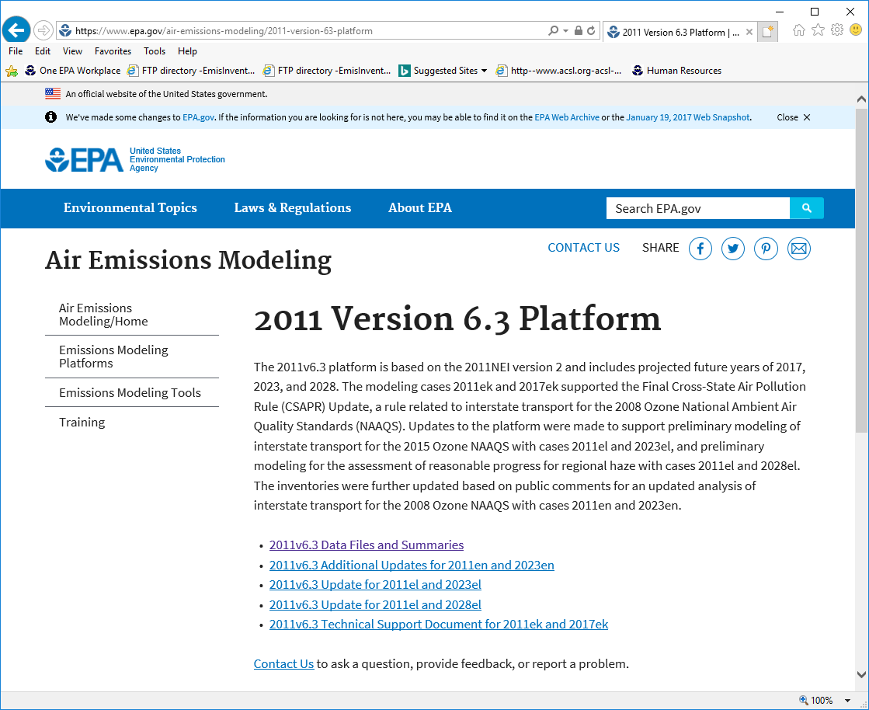
2011v6.3 Data on Web Site
https://www.epa.gov/air-emissions-modeling/2011-version-63-platform
Notes:
The 2011v6.3 FTP site has inventories, ancillary data and reports for several cases: 2011ek, 2017ek, 2011el, 2028el, 2011en, and 2023en

Slide 10
Projection Techniques
Inventory projection techniques differ for different modeling platform sectors
Some done using the Control Strategy Tool (CoST) within the Emissions Modeling Framework (EMF)
Others are taken as outputs from models
Sparse Matrix Operator Kernel Emissions (SMOKE) modeling system is used to prepare the emissions for air quality models (e.g. CMAQ, CAMx)
Notes:
CoST and SMOKE are two tools that can be used to project emissions to a future year.

Slide 11
Projections overview: Sectors projected based on NEI emissions
Sector(s) | Data sources and techniques used
Agricultural NH3 (ag) | USDA animal population growth estimates, livestock only.
Fugitive dust (afdust) | County-level VMT and population Annual Energy Outlook (AEO)-based projections to paved roads.
Residential Wood Combustion (rwc) | 2015 Wood heaters New Source Performance Standards (NSPS) with growth and appliance change-outs/retirement assumptions.
Class 1&2 CMV + trains (cmv_c1c2, rail) | Locomotive and Marine (RIA-based) rule growth and controls; California data scaled from CARB inventories.
Class 3 CMV (cmv_c3) | Regional-based growth factors + ECA-IMO engine and fuel controls, extending from ports (state), to near-offshore (EEZ) to global; California scaled from CARB data.
Oil and Gas (pt_oilgas, np_oilgas) | AEO production forecast and historical activity. Various NSPS impacts + local information.
Remaining non-EGUs (ptnonipm, nonpt) | AEO production, consumption fuel-based growth. Various NSPS impacts + local information. Numerous additional growth/control/closure information.

Slide 12
Projections overview: Sectors not projected from NEI base year emissions
Sector(s) | Data sources and techniques used
EGUs (ptegu) | Integrated Planning Model (IPM), Eastern Regional Technical Advisory Committee (ERTAC) EGU model
Onroad mobile (onroad) | MOVES2014b w/ projected activity, fuels, inspection and maintenance, controls, speciation; Include state inputs California magnitude from CARB but temporalized based on SMOKE-MOVES
Nonroad mobile (nonroad) | MOVES2014vb projected inventories (previously NMIM/NONROAD), except for California data provided by CARB
Canada/Mexico (othar, othpt, othon) | Canada: apply projection factors; sometimes adjust based on changes to U.S. inventories Mexico: Future-year inventories projected from 2008 base year inventory plus MOVES-Mexico
Biogenics & Fires (beis, agfire, ptfire) | No projections, same as base year in non-historc projections due to constant meteorology

Slide 13
Future-year Emissions Modeling Ancillary Data
Most ancillary (i.e., non-inventory) data stays the same in the base and future year modeling
Meteorology is held constant
Spatial surrogates are constant
Temporal profiles are constant for most sectors (except for EGUs)
Speciation profiles are constant for many sources
Updated in future year for mobile sources
Notes:
Meteorological data and spatial surrogates are two examples of data held constant when generating future-year projections.
Temporal and speciation profiles can change in future-year projections but doesn’t occur often and is limited to select sectors.

Slide 14
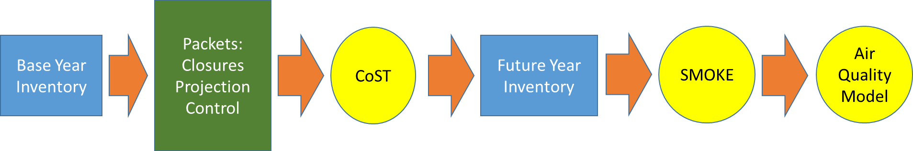
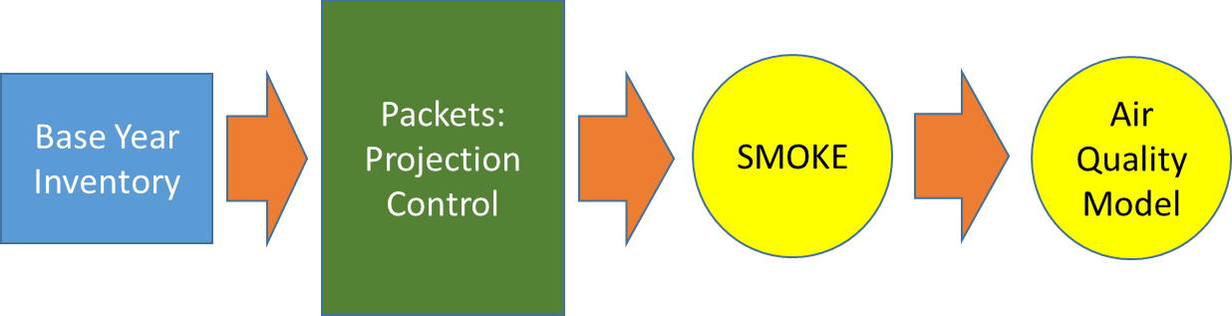
Available Tools for Projection of non-EGU Point/Nonpoint Projections
Control Strategy Tool (CoST) – a good organizational and reporting tool
SMOKE – traditional approach; good for simplified projection tasks
Notes:
When using CoST, start with base year inventory; compile closure, projection, and control packets; run CoST which outputs a future year inventory. This inventory goes into SMOKE and the outputs of SMOKE go into the air quality model. SMOKE can also do projections, but without the same level of tracability as CoST. This method is more likely used for simple sensitivity analyses. Still, you start with the base year inventory, develop projection and control factors, run SMOKE, and then run the AQM. Next: Jeff

Slide 15

Questions?
Any questions on the basic concepts of projections?
Notes:
Next: Jeff

Slide 16
Control Strategy Tool (CoST)
Part of the Emissions Modeling Framework (EMF)
https://cmascenter.org/cost/
Used to project most NEI non-EGU point and nonpoint inventories
Exceptions include stand-alone future year inventories (e.g., biodiesel and cellulosic plants, new cement kilns)
Has a hierarchy for how “packets” are applied
Tracks the impact of each packet on the inventory
Used for projections, but also includes algorithms for other analyses like maximum emissions reduction and least-cost
Notes:
CoST is part of the EMF and is a valuable tool that allows use to apply growth and controls to generate a resulting future year inventory.

Slide 17
Control Strategy Tool: Packet Types
CLOSURE
Facility, unit, stack and/or process-level
Effective date needed
July 1 cut-off (apply if before July 1 of target year)
PROJECTION
Scalars (e.g., 0.3 = 70% reduction, 2.0=100% increase)
All inventories: geographic (FIPS state / county), pollutant, source classification code (SCC)
Point only: target a facility/sub-facility / or North American Industry Classification System (NAICS)
CONTROL
Similar facility/geographic/SCC/pollutant applicability as PROJECTION packets
Percent reductions (0-100), optional rule effectiveness and rule penetration
Compliance date optional
July 1 cut-off
Notes:
Packet types include CLOSURE, PROJECTION and CONTROL packets.

Slide 18
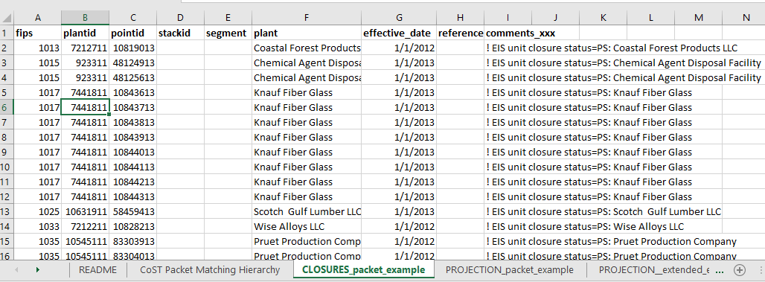
Closure Packet Example
region_cd
facility_id
unit_id
rel_point_id
process_id
faclity_name
effective_date
comment
Closures are applied for
a target year (e.g., 2020):
Records with effective
dates up to July 1 of target
year will be applied
Closures can be applied at multiple levels:
Region_cd (FIPS) - state & county code
Facility (plant)
Unit (point)
Release point (stack)
Process (segment)
New format: country_cd, tribal_cd, SCC
Notes:
Note that Plant Closure format uses older terminology of plant/point/stack/segment but Facility closure extended format uses the newer terms: facility/unit/release point process and we are working on updating to this

Slide 19
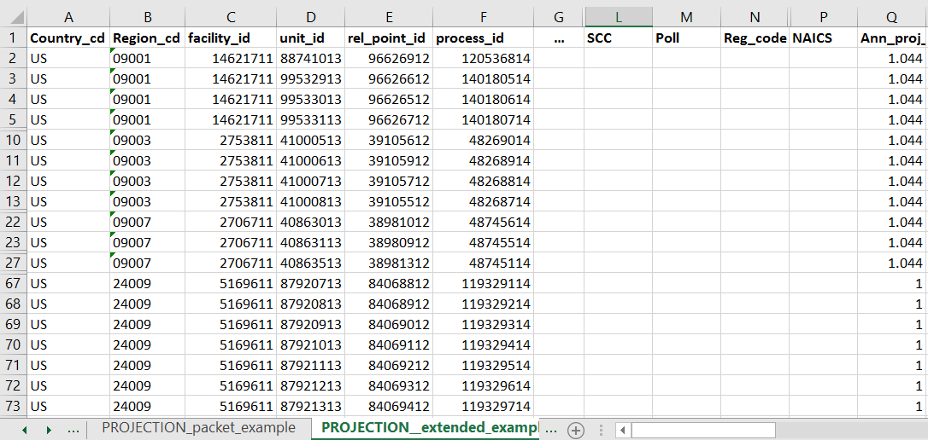
Projection Packet Example
Factors
to apply
are here
Projection entries can also be specified at multiple levels
An older / simpler version with only FIPS, SCC, proj_factor,
and POLL also exists

Slide 20
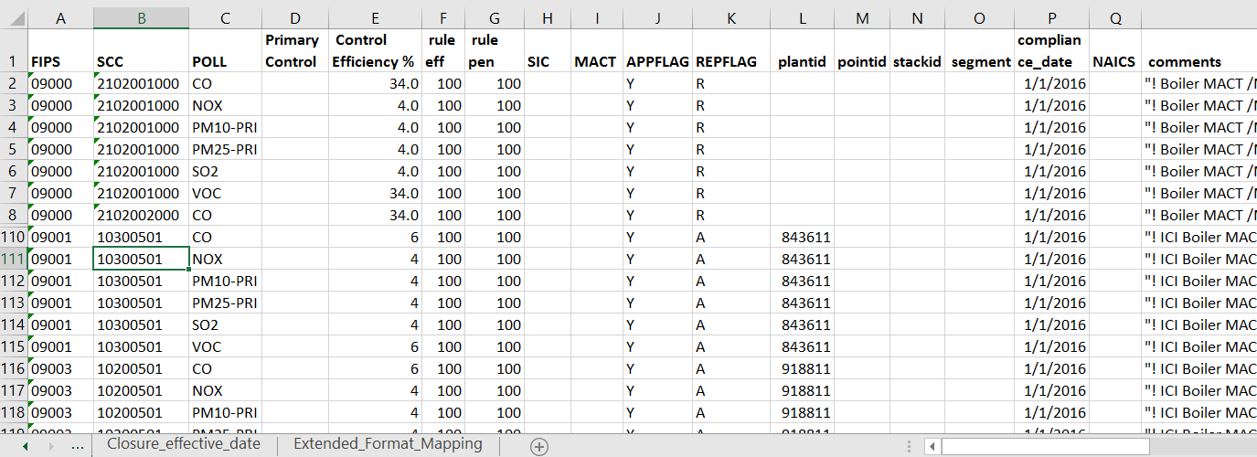
Control Packet Example
Ending FIPS with 000 applies to entire state
Rule effectiveness and penetration usually 100
APPFLAG of Y means to apply it
REPFLAG of R means replace existing controls, A means add on
Applied if compliance_date is before July 1 of target year
Note: A newer control format supports: country_cd, region_cd, facility_id, unit_id, rel_point_id, process_id, tribal_code, etc.
Notes:
Control efficiency is the key attribute, plus the setting of the attributes to specify what is controlled

Slide 21
Control Strategy Tool: Hierarchy
CLOSURES, PROJECTION, CONTROL packet types applied separately in a run
All packets for each type concatenated and QA’d
Most-specific applicable row (compliance date, application flag) supersedes more general entries
Care needed when there are overlapping consent decrees, comments, broad control programs
Need to be careful how you build packets
QA is very important to ensure output from strategy matches intentions – especially where the same sources are impacted by multiple packets
Notes:
The hierarchy used in CoST is important for tracking how growth and control information is applied to a base-year inventory to create a future-year inventory.

Slide 22
CoST Packet Priorities
Entries in packets that are more specific have higher priority than the more general ones
General <- Specific
Notes:
Matching hierarchy is used to apply priorities to various growth and control information in packets input into CoST.

Slide 23
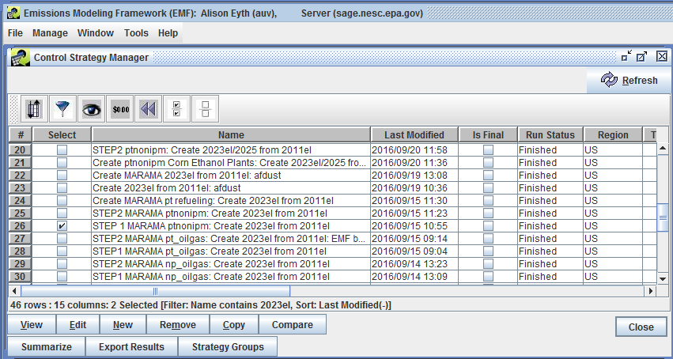
Control Strategies within the Emissions Modeling Framework
Notes:
The EMF allows the user to examine control strategies (series of packets).

Slide 24
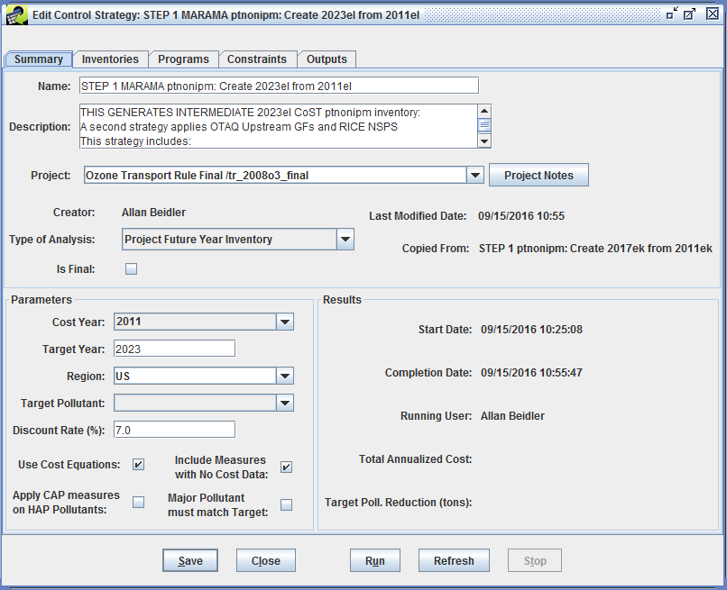
Editing a Control Strategy
Type of Analysis
and
Target Year are key parameters

Slide 25
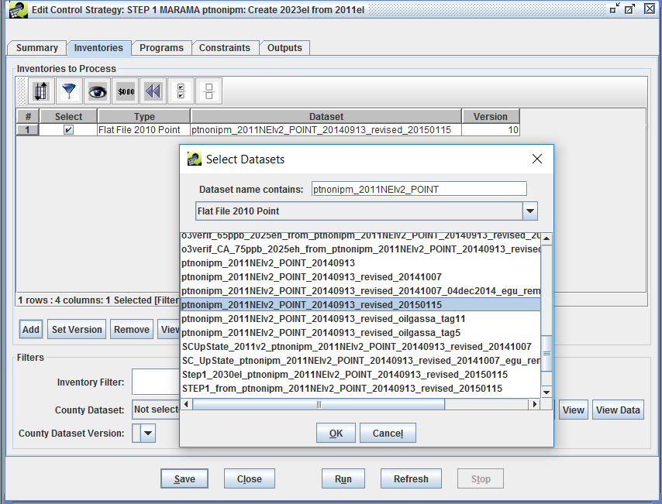
Select Inventories for Strategy
Select one
or more
inventories
to project

Slide 26
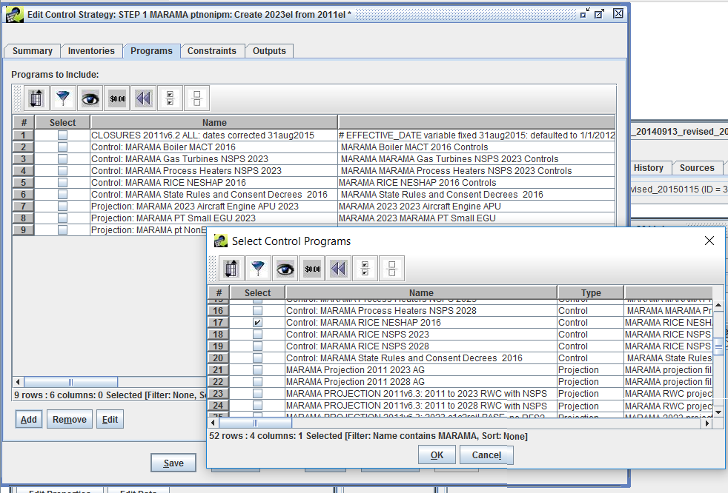
Select Control Programs to Apply
Select all
relevant
control
programs

Slide 27
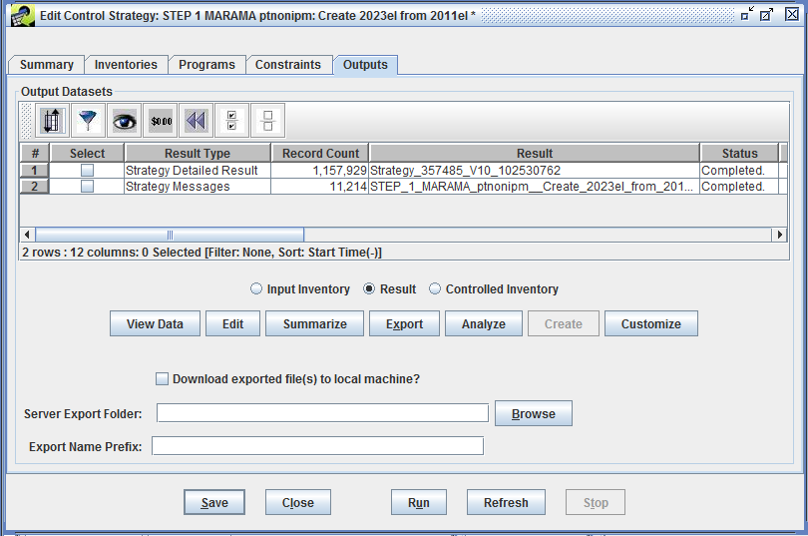
Control Strategy Tool: Outputs
After strategy
is run, Outputs
will appear: a
Detailed result
and Messages
It is important
to review these
outputs
Summaries of
detailed result
are also helpful
After QA, create
a controlled
inventory

Slide 28
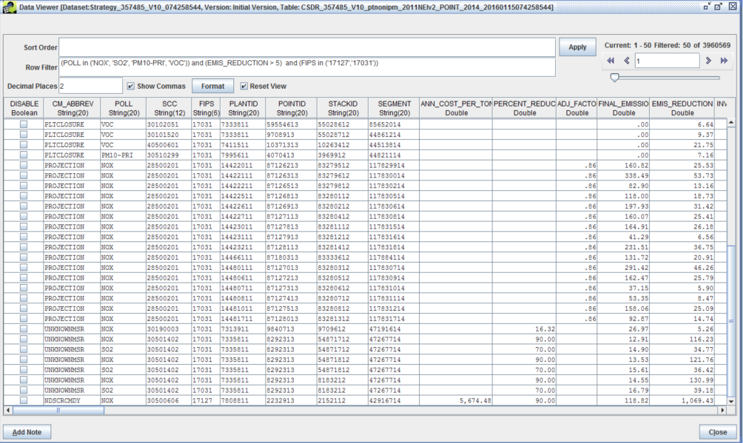




Example Detailed Result (only selected columns shown)
Notes:
Note the different types in CM_ABBREV: PTCLOSURE, PROJECTION, controls – known and unknown, then POLL, and attributes of affected point sources; also notice the specified adjustment factors, percent reductions, cost, final emissions, and emission reduction....

Slide 29
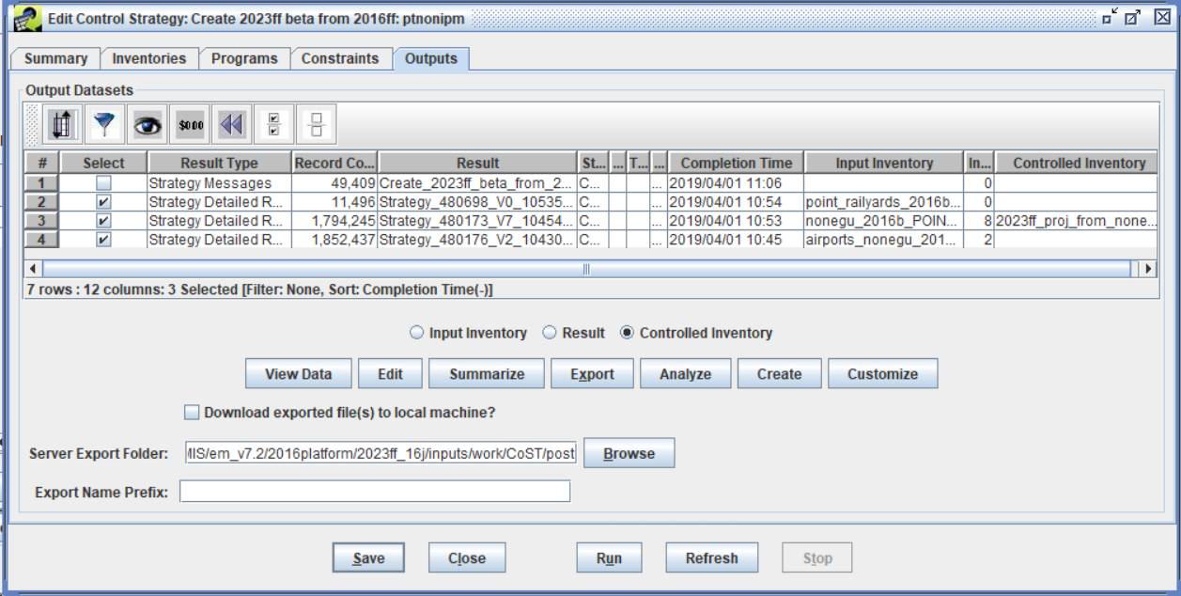
Create Controlled inventory
Once the detailed results are quality assured, create
Controlled inventories by selecting the results of interest and clicking Create to generate the controlled inventories

Slide 30
Control Strategy Tool: Sectors/ Relative Complexity
Some packets shared over multiple sectors, some packets contain several sources of data/programs
Simple sectors: afdust, ag, rwc, cmv_c1c2, cmv_c3, rail:
1 projection packet for each sector
Oil & gas nonpoint (np_oilgas):
3 packets
Remaining nonpoint (nonpt):
4 packets
Oil & gas point (pt_oilgas):
8 packets
Non-EGU point, not oil & gas (ptnonipm):
14 packets
Notes:
Some sectors require many different packets to estimate future-year emissions.

Slide 31
Projections: Quality Assurance
CoST detailed results
Review carefully to make sure the packets have been applied as you intended
Use Compare Datasets feature of EMF to review FIPS/SCC combinations in older and newer strategies
Do multiple levels of comparison depending on nature of the packets used: e.g., state, SCC, NAICS, poll, facility, unit
Use EMF to generate Structured Query Language (SQL)-based QA reports
By control program
Geography (e.g., state, county)
Source classification code (SCC)
Can limit pollutants in summary
Option to show “unaffected” sources
Create custom reports and summaries
Filter / sort in CoST then export to CSV

Slide 32

Questions?
Any questions on the Control Strategy Tool?
Notes:
Next: Caroline

Slide 33
Nonpoint Projections

Slide 34
Data Sources for Nonpoint Projections
Energy Information Administration/Annual Energy Outlook
Oil & gas, industrial sources
Data from multiple EPA offices
Office of Research and Development: animal NH3
Office of Air Quality Planning and Standards: RICE NESHAPs, regional haze, consent decrees, oil & gas, RWC
Office of Transportation and Air Quality: portable fuel containers (PFCs), upstream emissions
Office of Atmospheric Programs: oil & gas
Office of Enforcement and Compliance Assurance (OECA): consent decrees
Outside agencies
Federal: animal projections
State/local/regional: closures, projections, ICI boilers, fuel sulfur
Contractors: projections and controls for industrial sources including oil & gas, RWC
Collaboration needed to determine “most-appropriate” data for each source category
Notes:
Various data sources are used for non-point source future-year projections. One example of a data source is the Annual Energy Outlook (AEO).

Slide 35

Nonpoint Projections: Ag NH3
Animal-specific livestock only (no fertilizer approach: fertilizer future year = base year)
Based on national population estimates from the USDA and state submitted state- and county-based growth factors
Historical trends comparing number of animals vs production rates, net impact through 2028:
Slight increases for cows, turkey
Increases in pork, broilers, layers
and poultry
Notes:
USDA is typically one source of information used project emissions from livestock.

Slide 36

Nonpoint Projections: Ag NH3 Equations
Projection Factor:
$$\frac{Projection year value}{Base year value}$$
Example: Beef cows projected to 2023 from 2016
$\frac{31,411}{30,166}$ = 1.04
~
Notes:
Base year and future year activity information can be used to generate a projection factor.

Slide 37
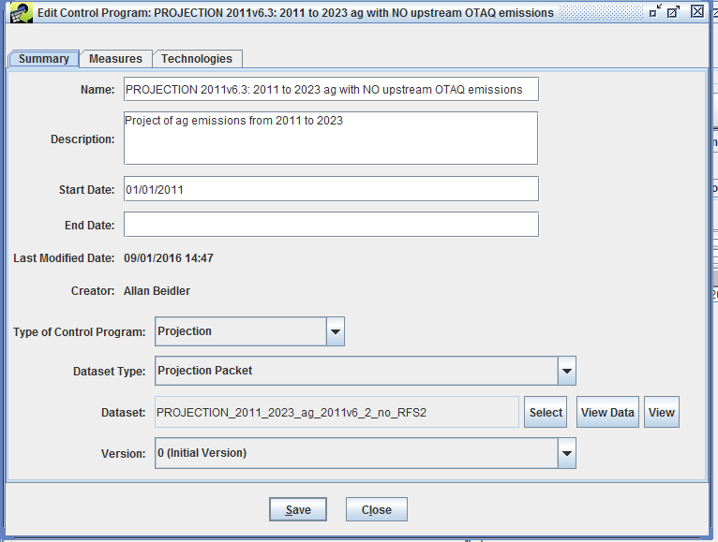
Ag Control Program
Select a dataset
for the control
program then
view the data…
Notes:
Edit control program window for ag projections. Includes strategy name, description, start date, end date, who created it, dataset type, dataset, and version.

Slide 38
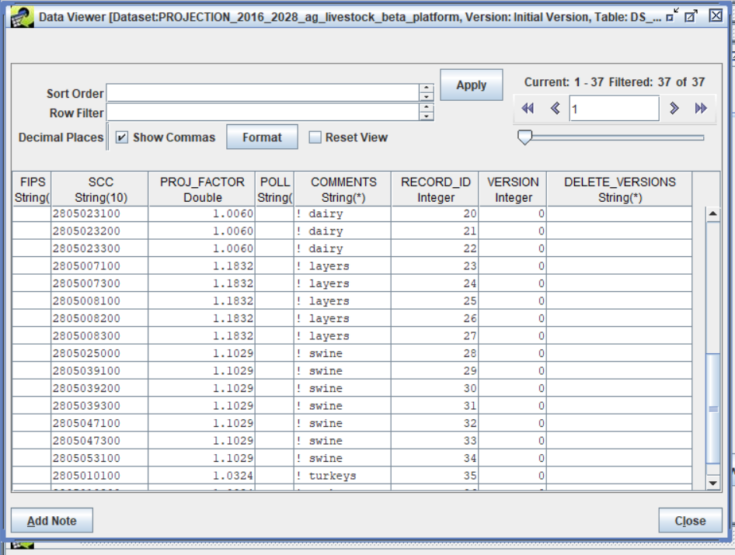
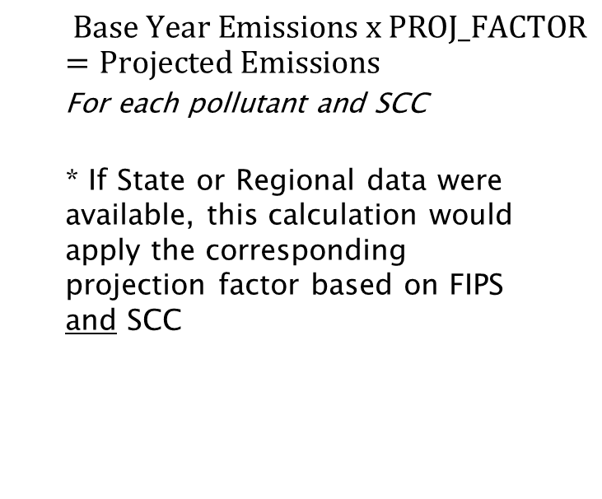
Nonpoint Projections: Ag NH3 (continued)
Ag Projection packet in EMF data viewer
(SCC-specific, but not FIPS or POLL-specific)
$$Base Year Emissions x \text{PROJ}\text{_}\text{FACTOR}=Projected Emissions$$
For each pollutant and SCC
* If State or Regional data were available, this calculation would apply the corresponding projection factor based on FIPS and SCC
Notes:
The base year emissions are multiplied by projection factors according to their SCCs.

Slide 39

Nonpoint Projections: Fugitive Dust
Impacts paved road dust only; unpaved road dust held constant for future years in 2016 platform
Function of VMT on roads
Onroad VMT projected to future year using AEO
County projection factor equation
PROJFAC = (Future-year total county VMT)
(Base-year total county VMT)
Future emis = PROJFAC * base emis
Notes:
Fugitive dust emissions are a function of VMT. Future year VMT estimates are used to project emissions for fugitive dust sector.

Slide 40
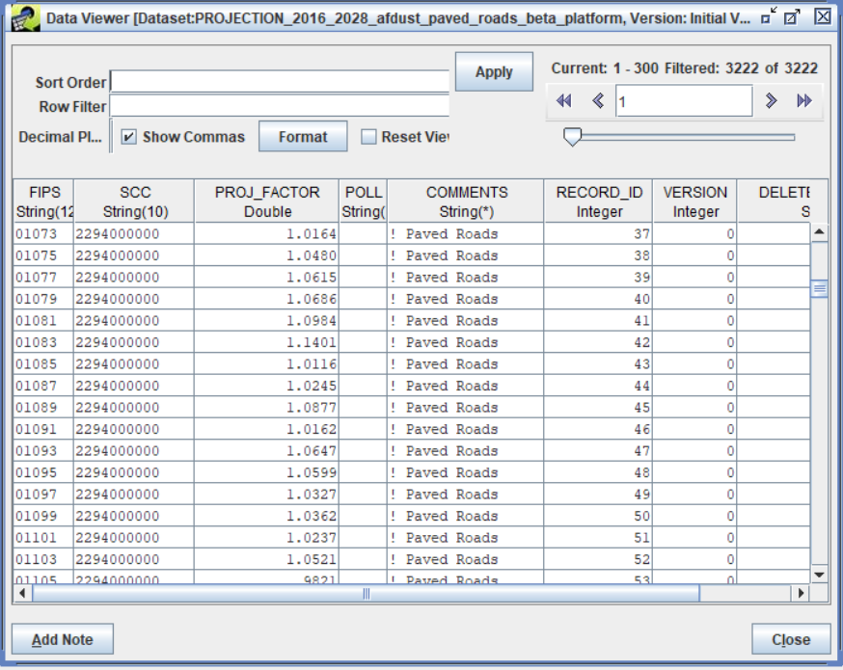
Example Fugitive Dust Packet
Projection
factors
are
specific
to each
county
the same
for each
pollutant
Notes:
Spreadsheet showing fugitive dust packet. Columns are FIPS, SCC, PROJFAC, and comment showing source type.

Slide 41
QA of ag/afdust Projections
Compare base and future year emissions to ensure that factors were properly applied
Create percent and absolute difference maps to make sure that results are as expected
Note: Future year fugitive dust inventories undergo meteorological and transport fraction reductions like the base year ones do

Slide 42
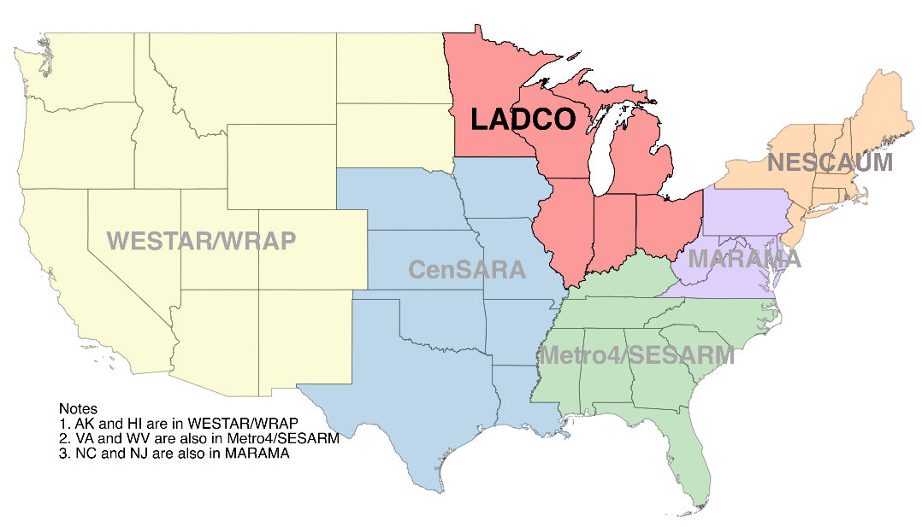
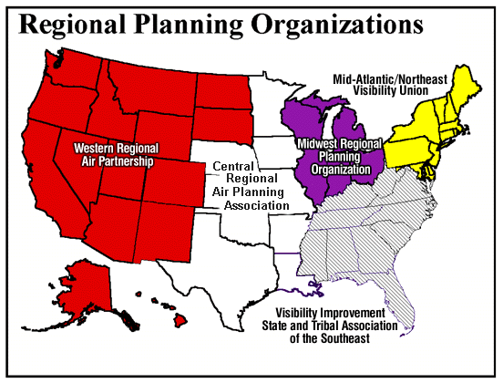
Regional Grouping for Bar Charts
Source: https://www.ladco.org/wp-content/uploads/Images/MJOs_Feb2019.png
Notes:
Map of regional planning organizations: WRAP, CenRAP, MWRPO, MidAtlantic/Northeast, VISTAS. These will be used in charts.

Slide 43
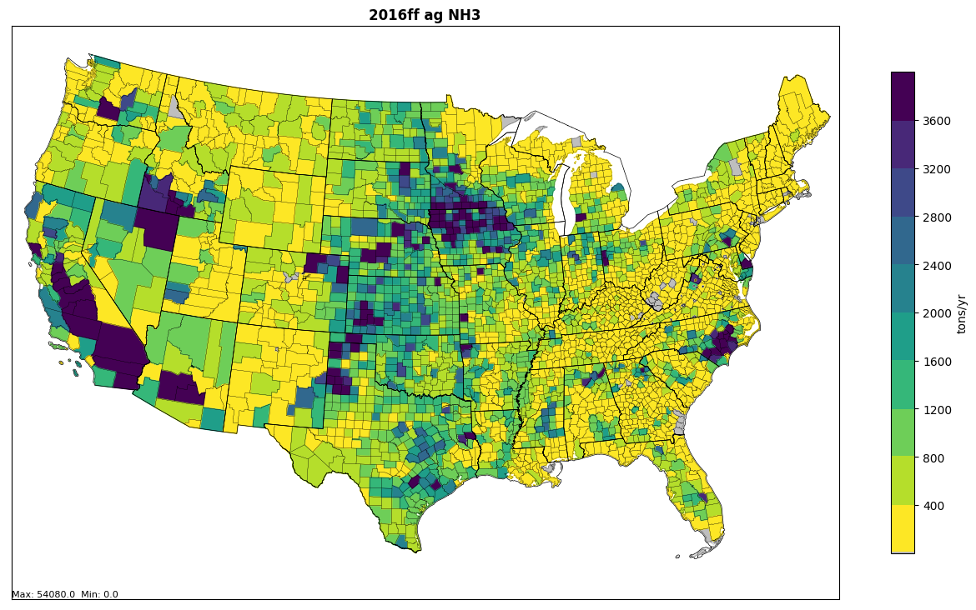
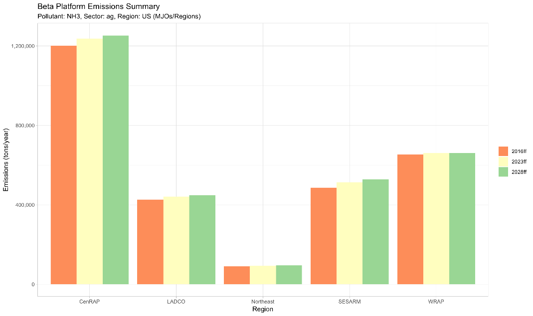
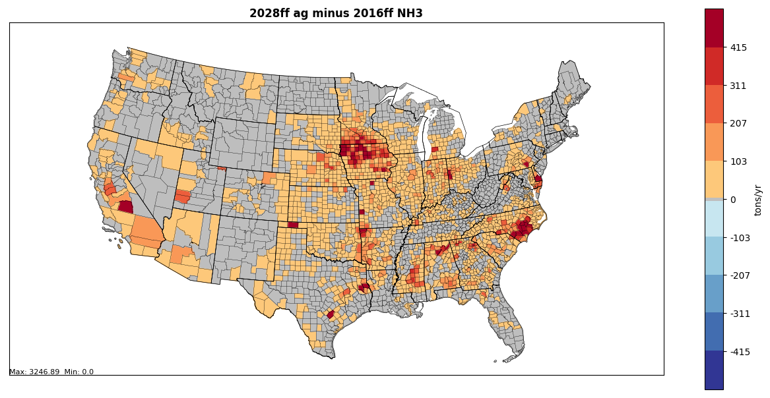
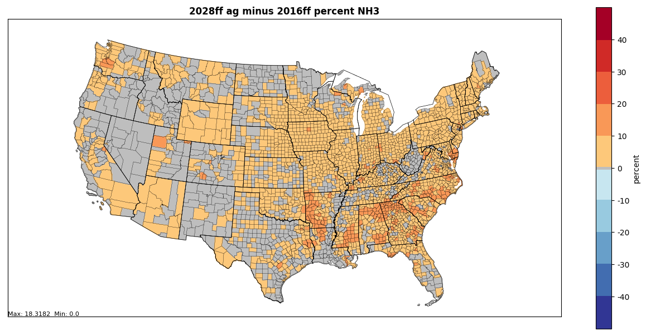
Changes in ag NH3 emissions 2016-2028
Orange= 2016ff
Yellow = 2023ff
Green = 2028ff
CENRAP LADCO Northeast SESARM WRAP
Difference in tons
Difference in percent
Notes:
State level map of agricultural NH3 emissions shows that NC, TX, CA, and IA are highest. NH3 is expected to increase moderately from 2016 to 2023 and 2028. The CENRAP region has more than twice as much ag NH3 emissions as any other regions. Percent change in VOC would look the same as NH3, but not the absolute difference.

Slide 44
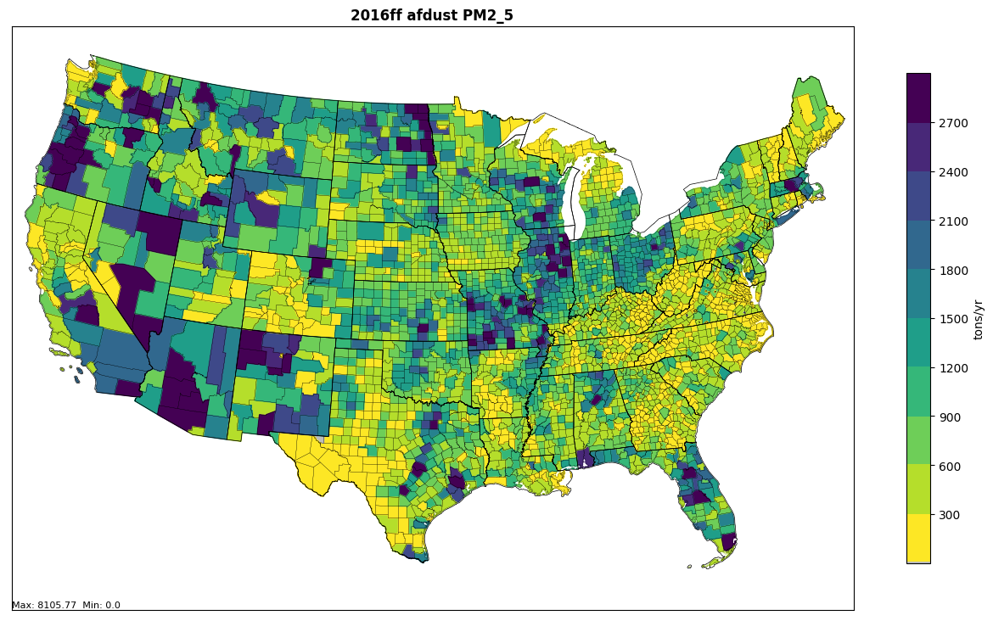
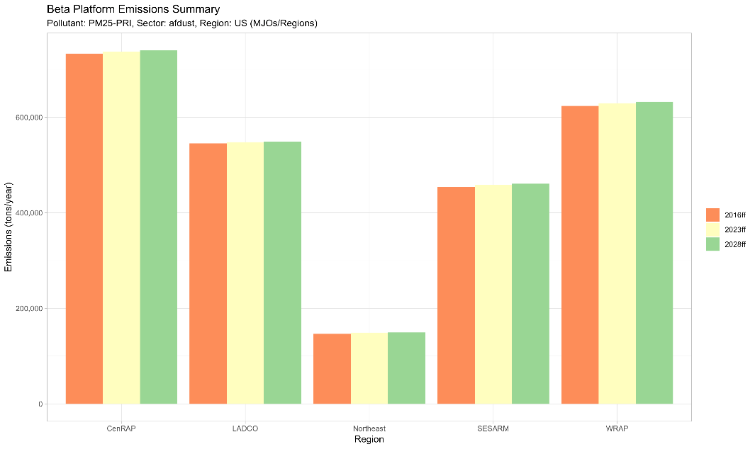
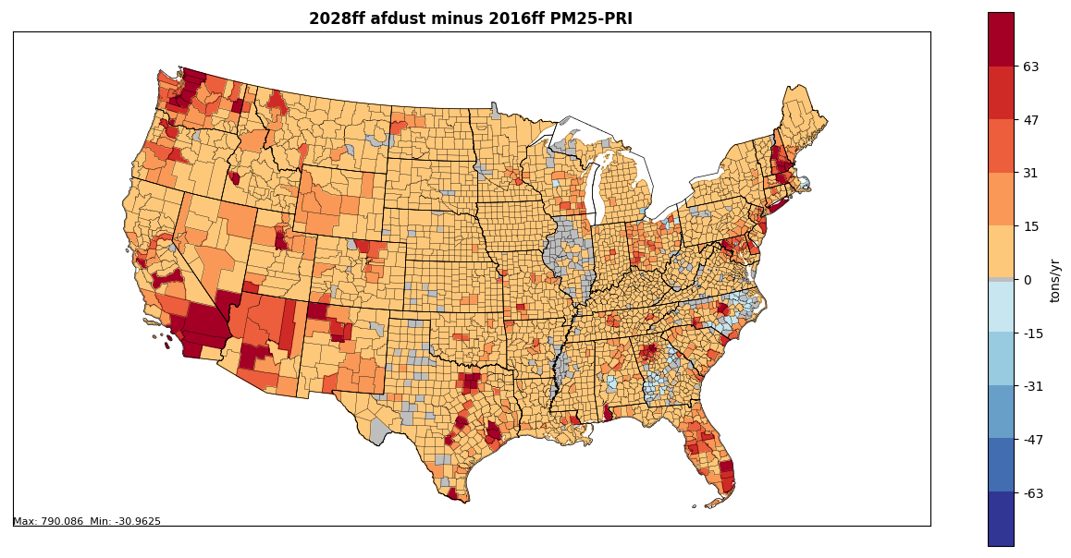
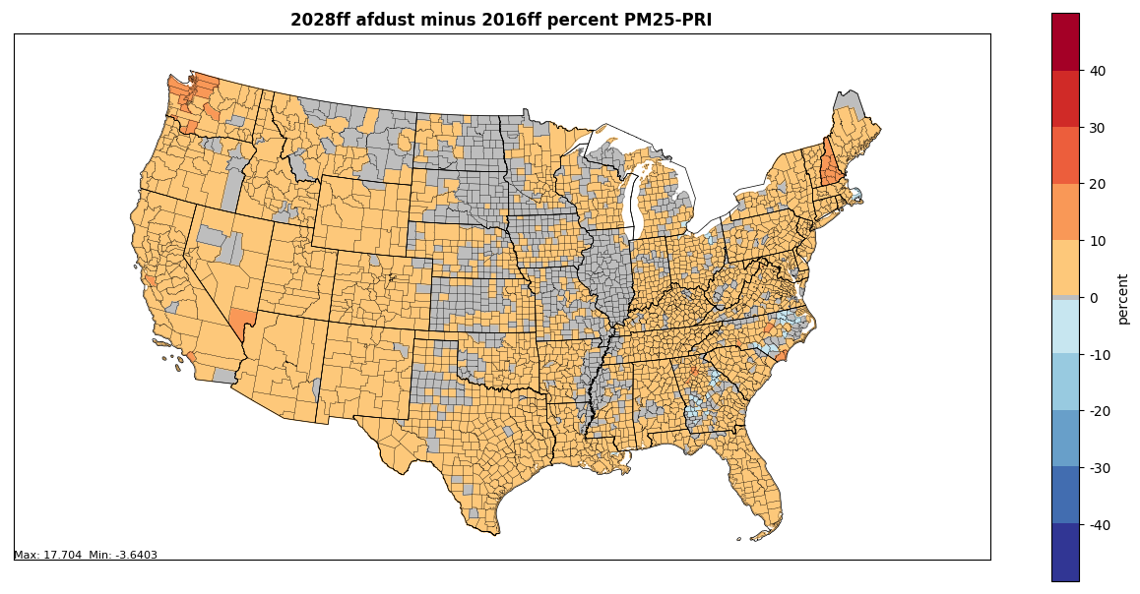
Changes in afdust PM2.5 2016-2028
Orange= 2016ff
Yellow = 2023ff
Green = 2028ff
CENRAP LADCO Northeast SESARM WRAP
3,000,000
Notes:
Map of fugitive dust emissions shows that TX, NM, KS and IL have the highest emissions. The CENRAP region more emissions than other areas. Emissions are expected to increase because paved road dust emissions are correlated to VMT increases in later years.

Slide 45
Nonpoint Projections: Residential Wood Combustion
Growth derived from year 2012 appliance shipments and revenue forecasts (e.g. US Bureau of Economic Analysis)
Updated to include the NSPS for ‘wood heaters’: https://www.epa.gov/residential-wood-heaters/final-2015-new-source-performance-standards-residential-wood-heaters
Net decrease rather than increase in RWC emissions vs business as usual approach in prior platform
Reflect year 2015 rulemaking and minor corrections
Appliance-specific retirement/replacement rates for most sources
“No-change” assumption used in western states: WA, OR, CA
Burn bans not addressed due to their unpredictable episodic nature
Notes:
Sometimes it is found best to assume “no-change” in emissions from base to future year (e.g. Western states in the residential wood combustion). However, each new modeling platform requires that assumptions be revisited.

Slide 46
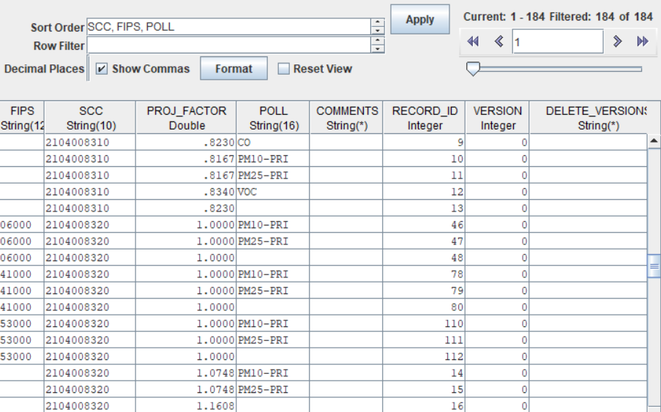
Packets for RWC projections
Different factors are applied by SCC (i.e., fireplaces, fireplace inserts, wood stoves), emissions held constant in CA, OR, WA

Slide 47
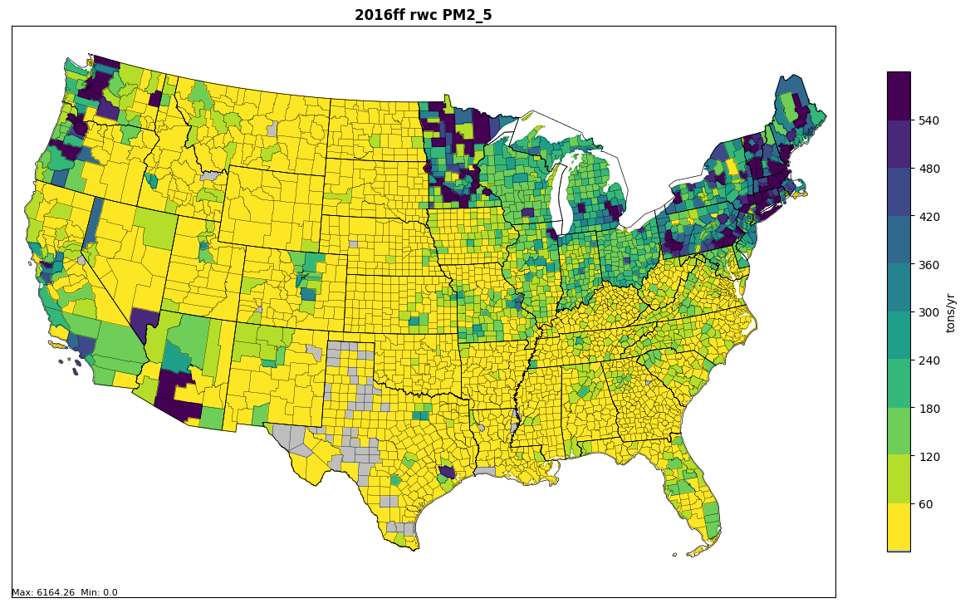
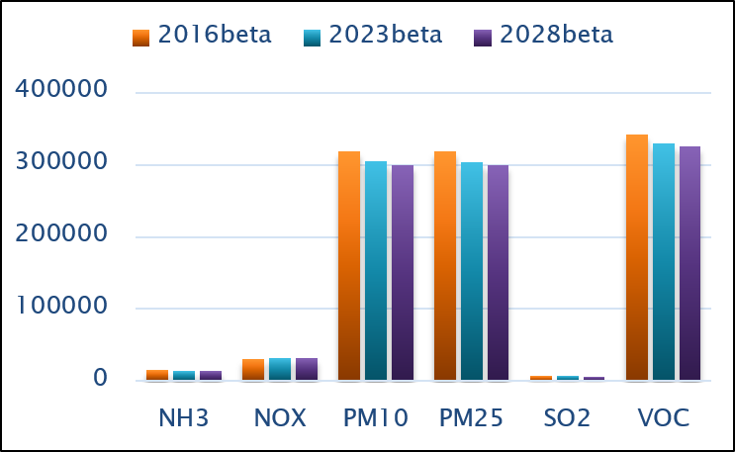
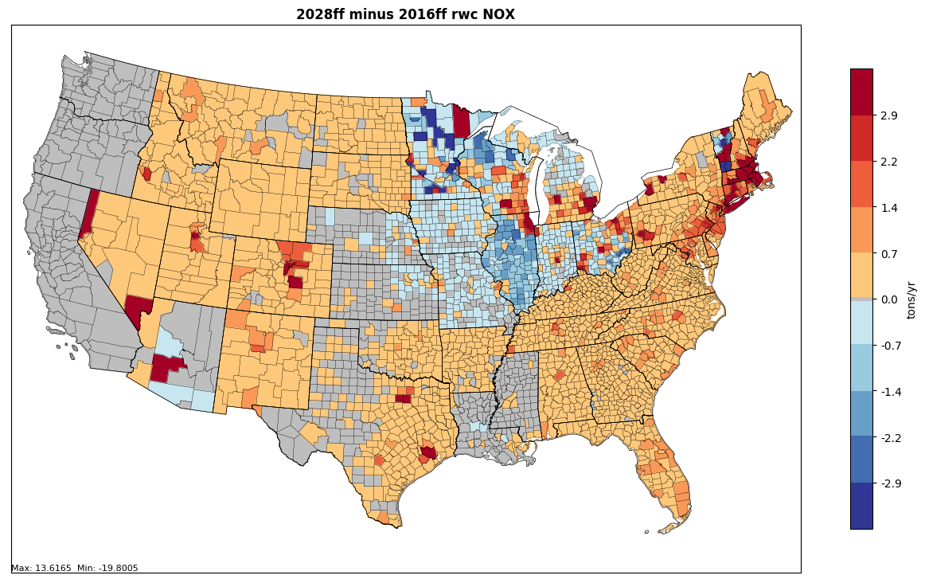
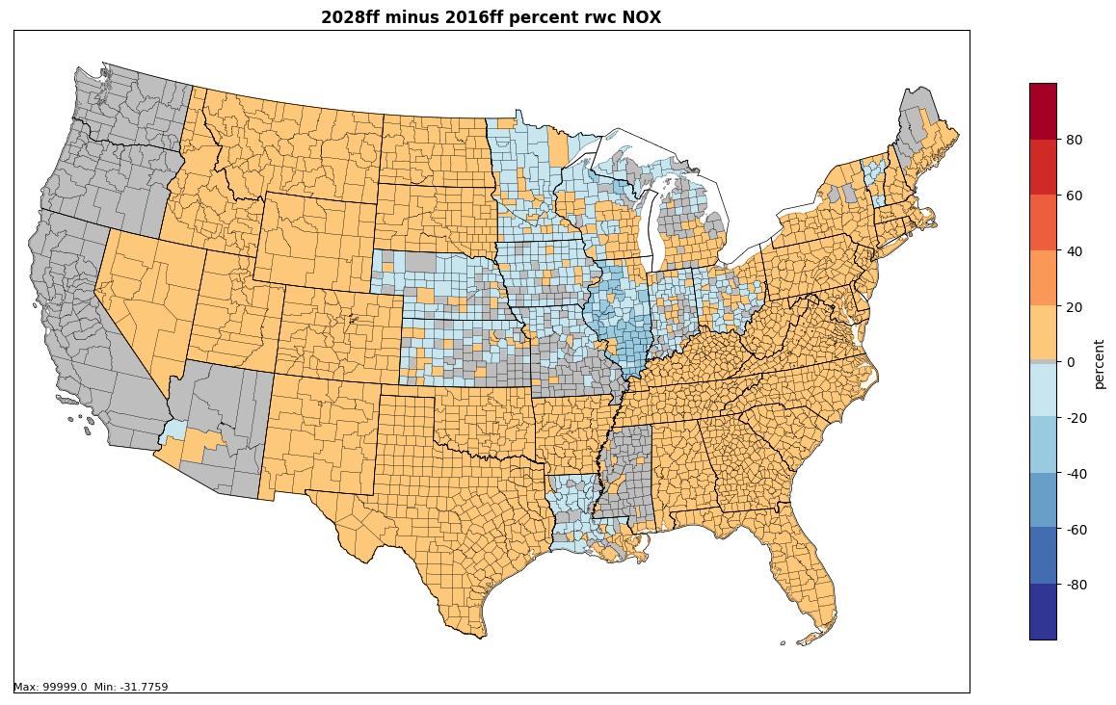
Changes in RWC Emissions 2016-2028
Notes:
Maps and a chart show how residential wood combustion emissions change from 2016 to 2028. States with the most RWC are MN, MI, and WI, followed by NY and PA. The LADCO and Northeast have the most PM2.5 emissions from RWC, but WRAP and CENRAP are close. Emissions are projected to decrease by 2028. Methods for estimating RWC emissions changed in 2014, so the emissions look different in 2014 and 2016 and projections off of 2014 may look different in nature.

Slide 48
Questions?
Any remaining questions on nonpoint sectors?

Slide 49
EGU Projection Methods
EPA primarily uses the Integrated Planning Model (IPM)
The National Electric Energy Data System (NEEDS) database defines the sources used in IPM
NEEDS is regularly updated to reflect announced retirements and planned controls
Data sources include EIA Form 860, Emissions Tracking System (ETS) / CAMD Data and stakeholder comments
IPM has been updated over time to account for new data, including energy supply, demand, and prices, from a variety of sources, including EIA’s Annual Energy Outlook
IPM output emissions are “dropped in” to replace ptegu emissions that were used in the base year
For the 2023en case, engineering analysis was used
Incorporated historic 2016 emissions and other known upcoming changes to project to 2023
ERTAC EGU model has been developed by MJOs
Used by many states and groups for planning purposes

Slide 50
EGU Projections with IPM
EGUs are identified in the NEI point inventory by filling in the IPM_YN column of the flat file
Populated from a set of alternate IDs stored in EIS
Sometimes there are not 1-1 matches between units in the NEI and the NEEDS database used by IPM
IPM reflects impacts of rules in intervening years
E.g., CSAPR, MATS, BART
IPM v6 produces outputs for these years:
2021, 2023, 2025, 2030, 2035, 2040, 2045, 2050
Updated inputs, assumptions, and features
More information on IPM is available here: https://www.epa.gov/airmarkets/clean-air-markets-power-sector-modeling
Notes:
Note: ACE is not included in the May, 2019 case but the impacts would be very small even if it were.

Slide 51
Flat Files Created from IPM Outputs
IPM regional, seasonal outputs are converted to a Flat File format that can be input to SMOKE
For a specific model output year, parse results to unit-level for each season (Pollutants = NO_{x}, SO₂, Hg, CO₂)
SMOKE-ready Flat file is created from parsed file
Cross reference from National Electric Energy Data System (NEEDS) to NEI units is used to assign NEI-compatible IDs, locations, stack parameters (improved with state review)
PM emissions are created as a postprocess based on emission factors, fuel, and control information
The base year EGU inventory is fully replaced by the flat file inventory output from IPM
IPM results not used in air quality modeling for geothermal, nuclear, wind, solar, or hydro

Slide 52
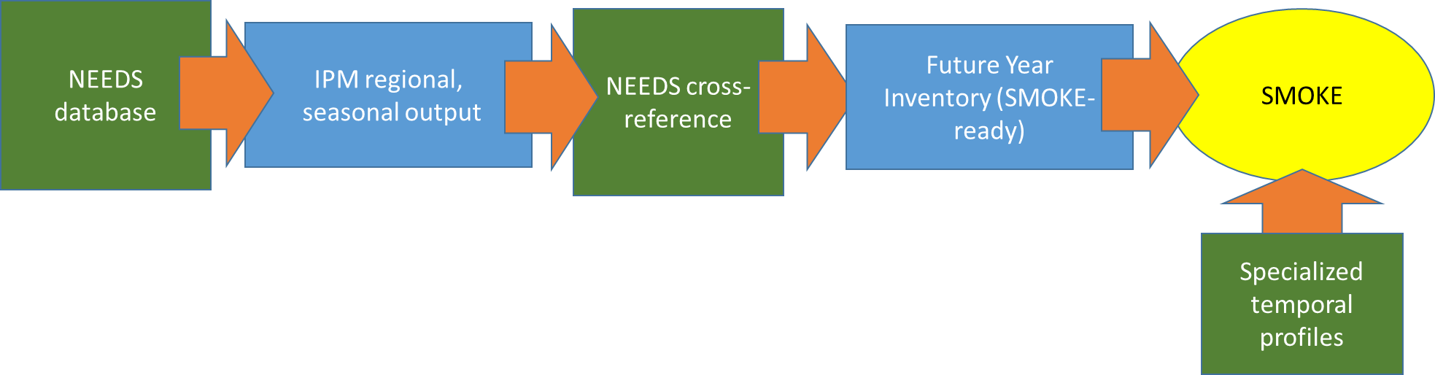
Future year EGU Processing with IPM
NEI to
Parsing to
unit-
level
Flat file
creation

Slide 53
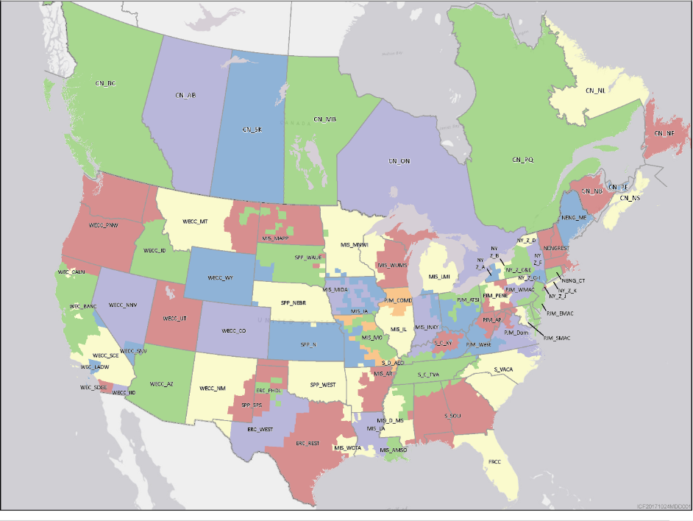
Map of 67 IPMv6 Output Regions
https://www.epa.gov/airmarkets/documentation-epa-platform-v6-november-2018-reference-case-chapter-3-power-system
Notes:
https://www.epa.gov/sites/production/files/2019-03/documents/chapter_3_0.pdf Figure 3-1

Slide 54
EGU Temporal Allocation for Future Years
For sources with CEMS that exist in both base and future years, allocate seasonal emissions to base year (2011 or 2016) hourly temporal pattern of CEMS data by pollutant (i.e., NOx, SO2)
Compute hourly ratio for each hour of season in base year and multiply that by the seasonal total to get the future year hourly emissions
Units not matched to CEMS data (aka “non-CEMS”) are temporalized using fuel- and pollutant-specific regional average profiles to allocate emissions to month, then day, then hour
Method is also used for new units, units with no base year emissions, units that change fuels from base to future, and units with large predicted increases in emissions

Slide 55
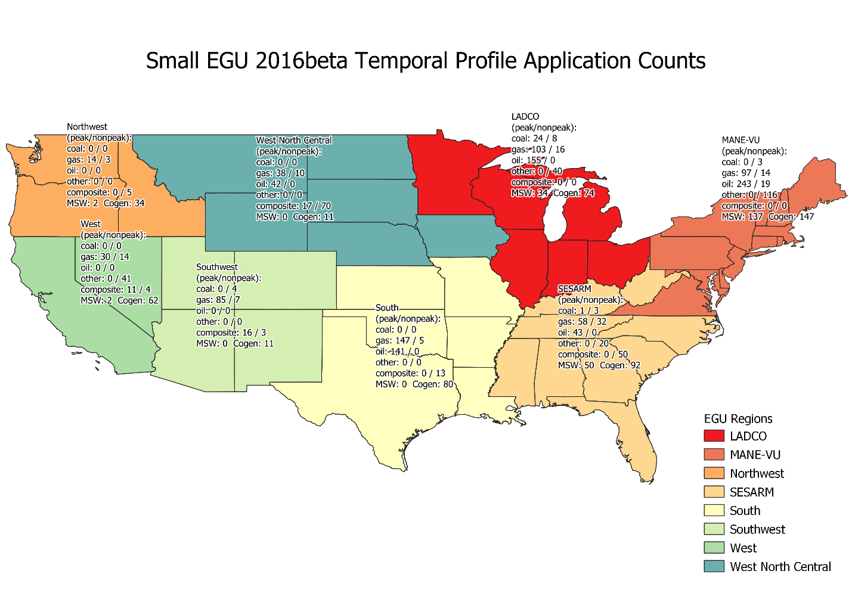
Temporal profile regions are Consistent with those used in base year

Slide 56
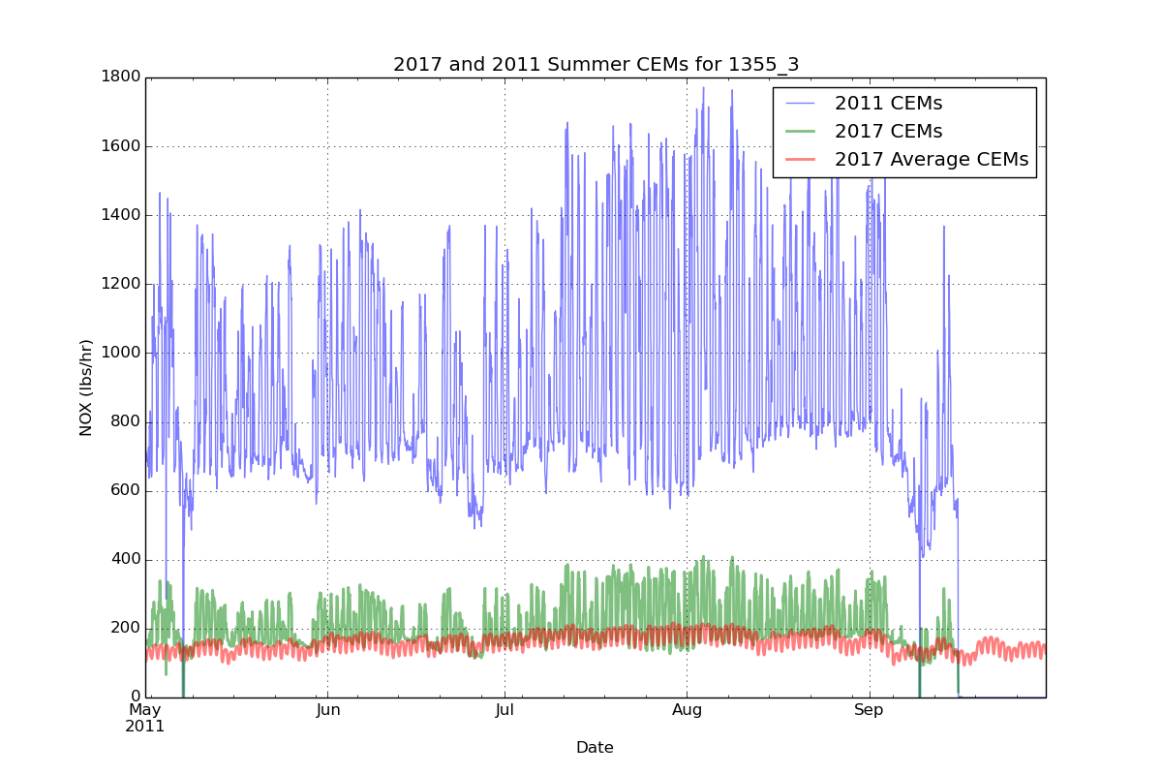
Example Temporal Plots: base year, unit-specific, regional
Compute fraction
of emissions @ each
hour of the season (winter/summer)
2. Future emissions @
each hour = seasonal
emissions * hourly factor
Seasonal emissions going down in
this example
CEMS-based profile (green) has service gaps
Regional average profile (red) does not include gaps

Slide 57
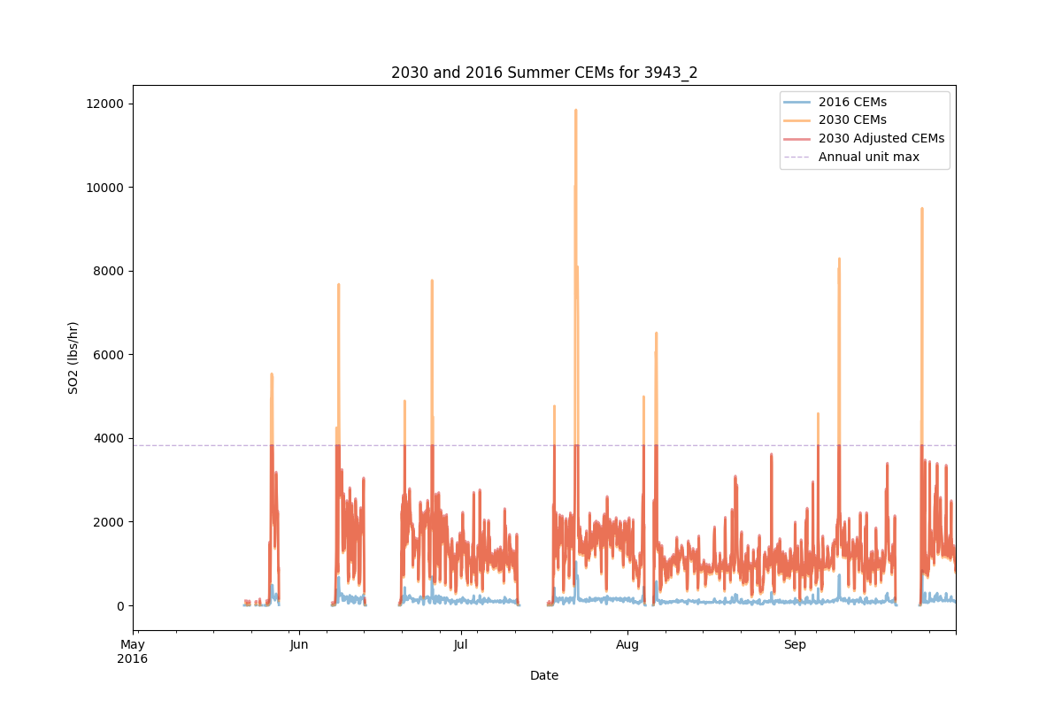
Adjust Emissions Below Historic Maximum
When emissions are found to go above the historic maximum, allocate the excess evenly to other hours
Notes:
For 2016 platform, historic maximum from 2014-2017 was computed and used. For 2011 platform, years were 2011-2016.

Slide 58
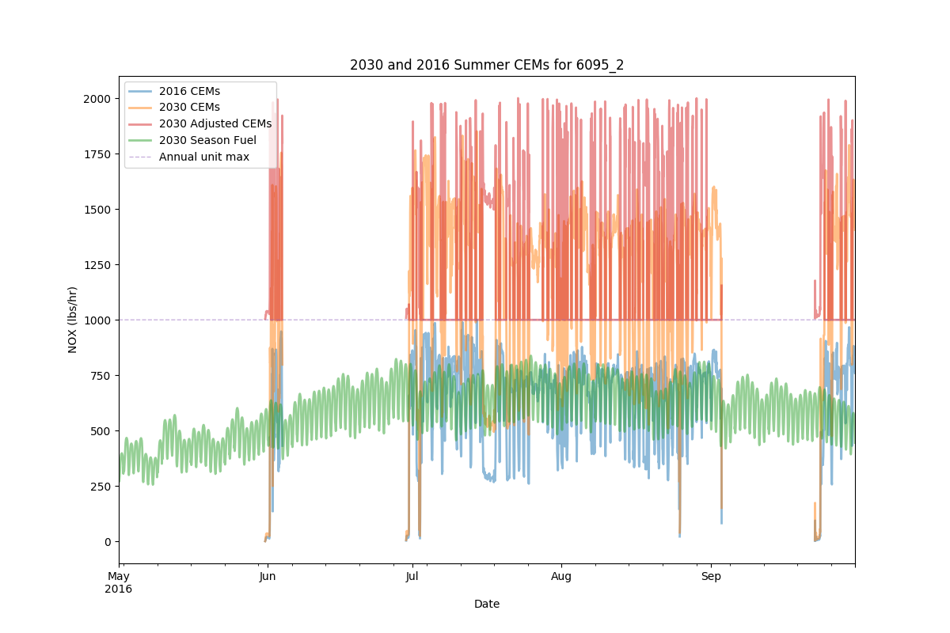
Use Regional Profile when Cannot Adjust below Historic Maximum
See 2023en emissions modeling TSD for more details

Slide 59
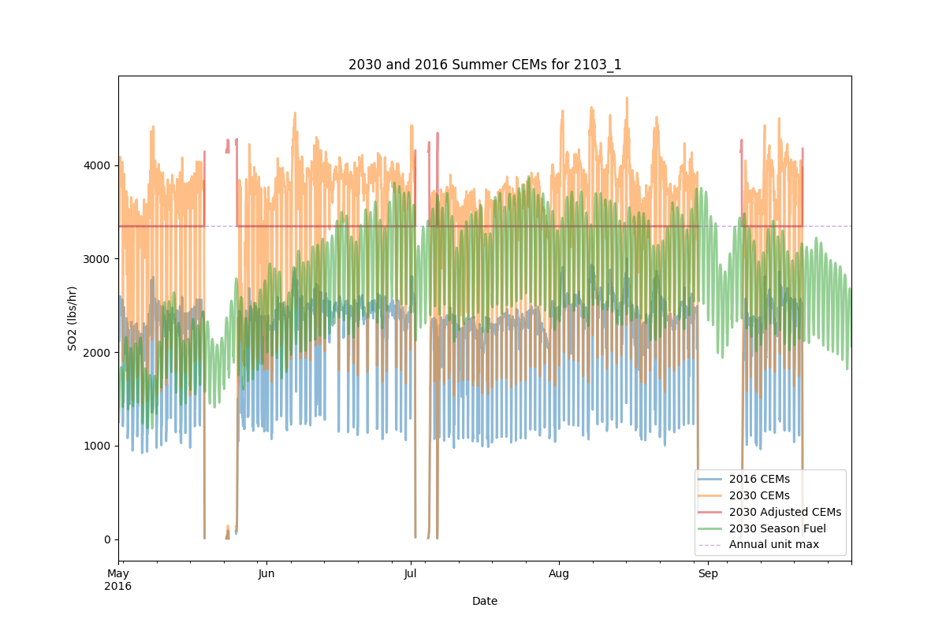
Regional Profile Applied but Exceeds Historic Maximum in Some Hours
Notes:
Sometimes even when we apply a regional profile, it can exceed the historic maximum in some hours.

Slide 60
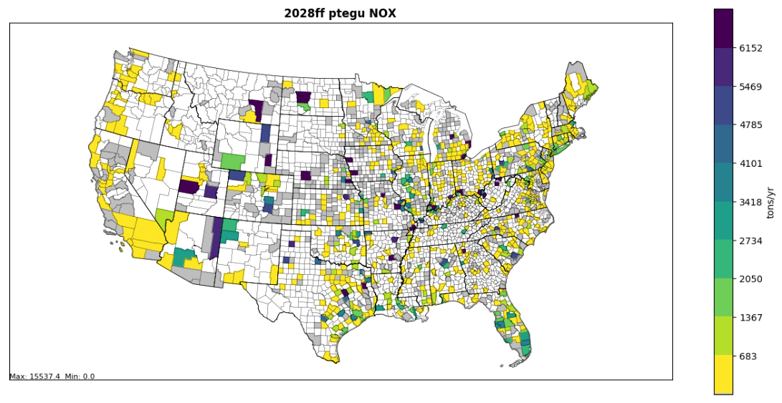
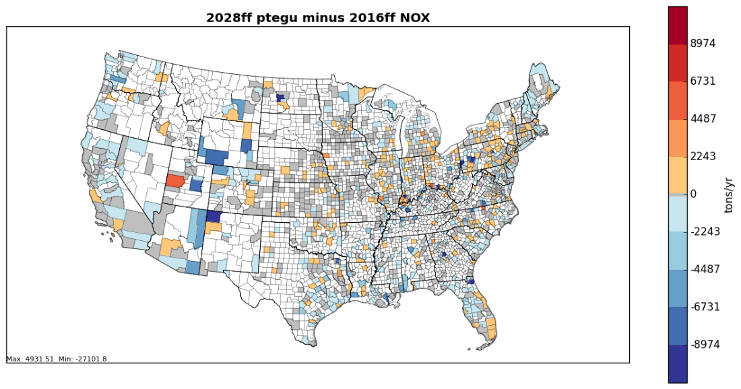
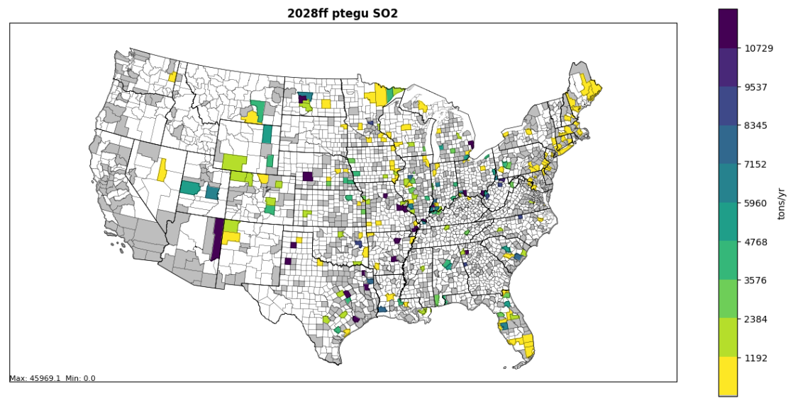
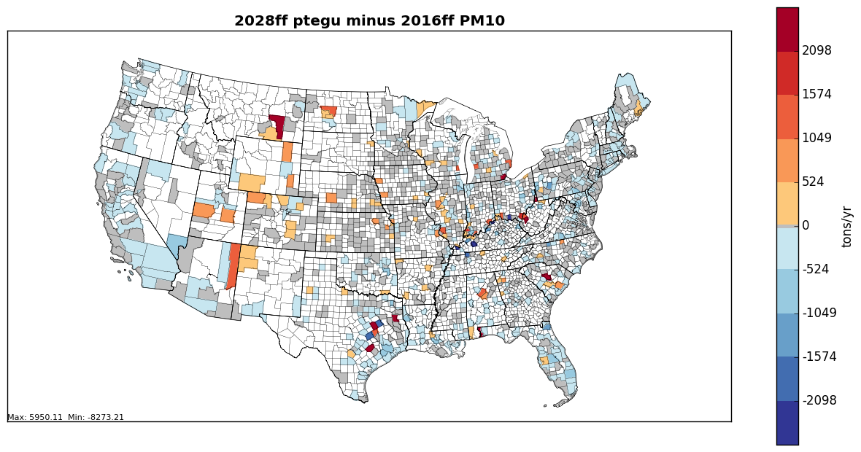
Changes in EGU emissions 2016-2028
500,000

Slide 61

Questions?
Any questions on EGU projections?
Notes:
Next: Jeff

Slide 62
Oil and Gas Projections
Volatile sector; industry changing frequently
Various data sources
State and county historical data
Annual Energy Outlook (AEO) tables
Various approaches are available

Slide 63
Oil and Gas Projections Overview
Data sources
Annual Energy Outlook (AEO) production forecast data from the Energy Information Administration (EIA) to estimate activity in future years
State historical production data to capture recent growth
County historical exploration data from recent years
New Source Performance Standards (NSPS) applications
Includes both point and nonpoint sources
Point: Production, Pipelines, other supporting activities
Nonpoint: Production and Exploration
Includes data and comments from states and regional planning organizations on the 2016 emissions platform
Notes:
AEO-forecasted and historical oil and gas production data can be use to estimate growth in this sector.

Slide 64
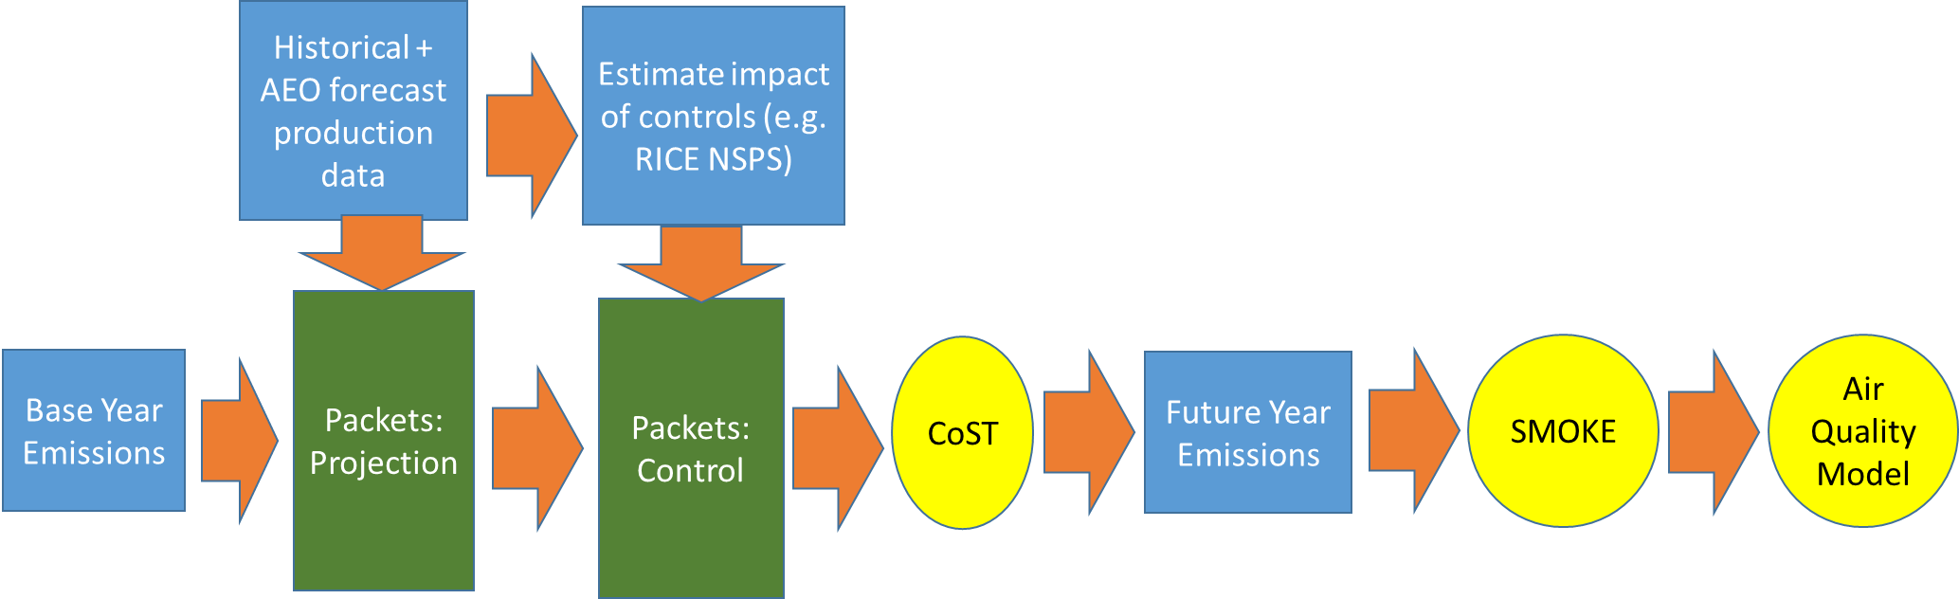
Applying Growth and Control Factors to Project Emissions
Notes:
The flowchart starts with the base year inventory. Projection packets are developed from historic and AEO forecast production data. Control packets are developed based on the projected production data and the impact of NSPS and other control programs. The packets are fed into CoST to create a future year inventory, which is then processed by SMOKE to create AQM-ready emissions.

Slide 65
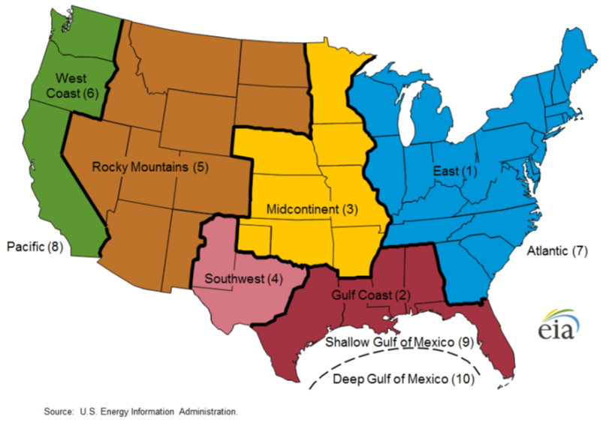
Oil and Gas Supply Regions: AEO2018
Notes:
Map of oil and gas supply NEMS regions. Consists of west coast, rocky mountains, midcontinent, east, gulf coast, and Southwest (western TX and eastern NM).

Slide 66
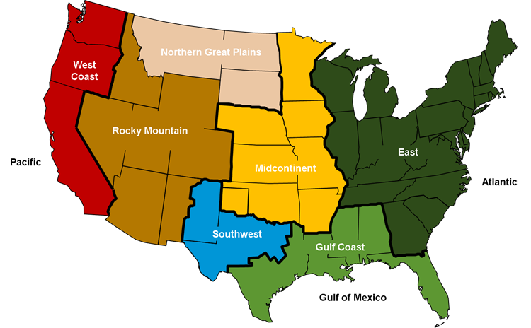
Oil and Gas Supply Regions: AEO2019
Rocky Mountain/Dakota
region in AEO2018 now broken up into 2 regions
Notes:
Map of oil and gas supply NEMS regions. Consists of west coast, rocky mountains, midcontinent, east, gulf coast, and Southwest (western TX and eastern NM).

Slide 67
Oil and Gas Projections: Supply Region-Level Forecasts Method
AEO Tables: Regional production
Table 60: lower 48 crude oil production
Table 61: lower 48 natural gas production
AEO Tables: national production
Table 14: Oil and gas supply
Coalbed methane production
Natural gas liquids production
Offshore production: state-owned sources only
Develop oil/gas/both cross-reference by source classification code (SCC) to apply regional/national factors
Notes:
Various tables from the AEO are used to support the development of projected future year emissions for oil and gas sources.

Slide 68
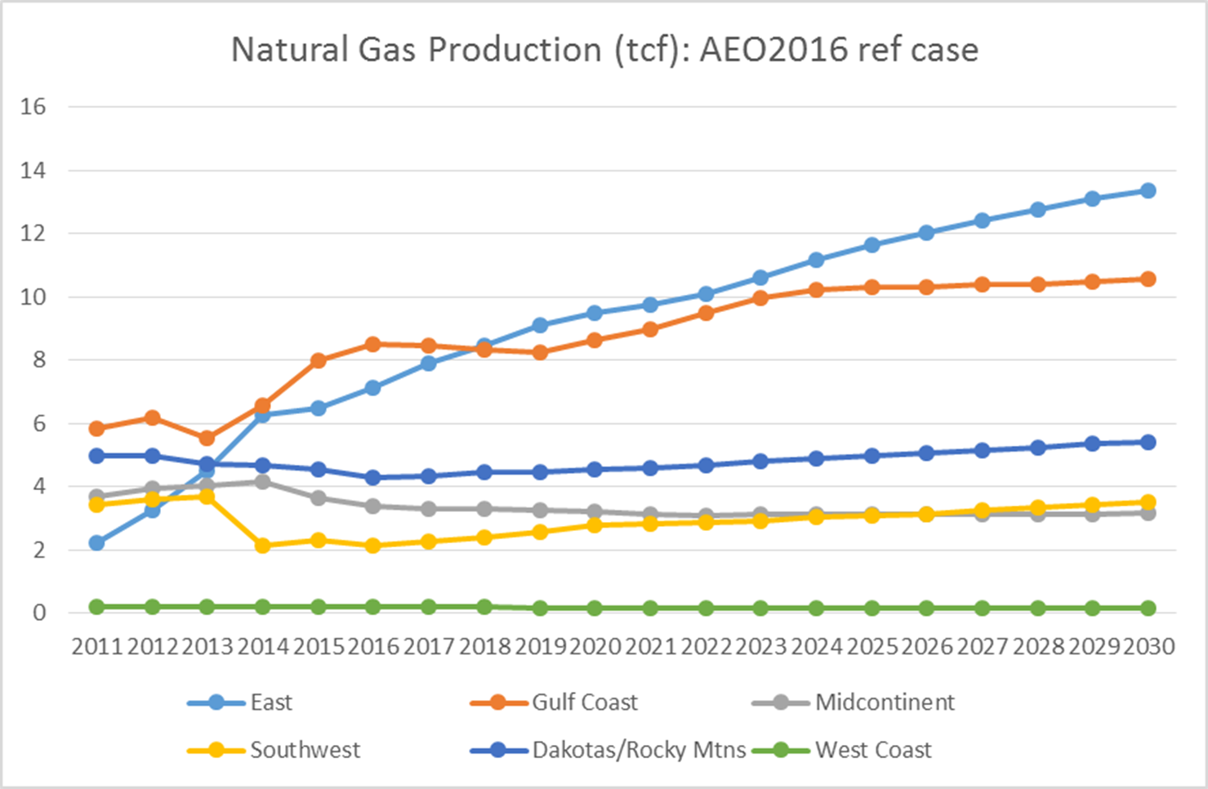
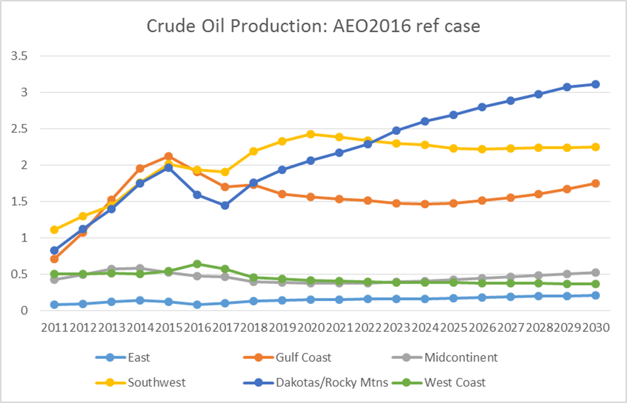
Oil and Gas Projections: Supply Region-level example used for 2011 platform
Applied this method for 2011v6.3 modeling platform along with state-specific factors supplied from MARAMA
Large regions where only 2-3 states make up the bulk of the production can cause issues with smaller-producing states in the region
Notes:
AEO forecasts oil and gas production in various supply regions. Growth can be quite different region to region.

Slide 69
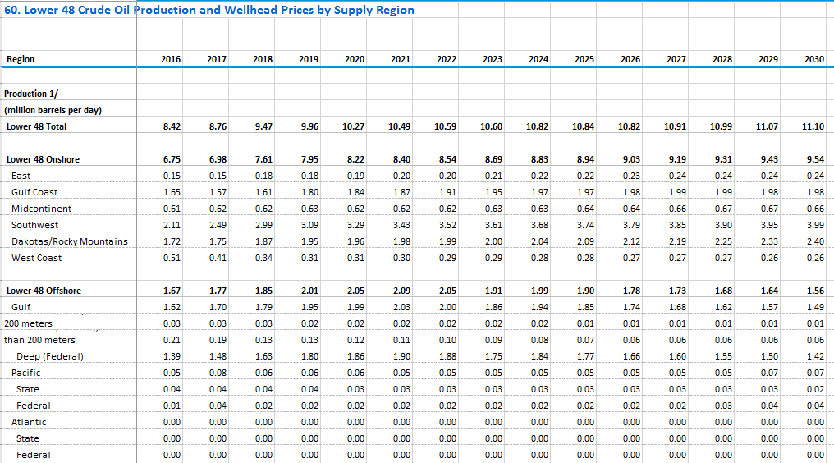
AEO Supply Region example
Notes:
Expected production levels from 2016-12030 is shown in the table for each year and NEMS region - both onshore and offshore in million barrels per day

Slide 70

AEO Supply Region Example (2)
Notes:
Projection factors are derived for teh east and Gulf Coast regions for each year starting with 2016 by dividing the future year by the 2016 production. The East factor for 2028 is 1.629 and the Gulf Coast is 1.2.

Slide 71

Oil and Gas Projections: Historical State Data + AEO Supply Region Method
Historical state change
AEO Supply Region change
X
Combined factors representing both historical state data and AEO supply region change for each state
Notes:
Historic factors from 2011-2016 multiplied by AEO factors from 2016 to the future year to compute a combined factor by state.

Slide 72
Oil and Gas Projections: Online Historical State Data
Historical state production data publicly available on EIA website used to project sources from a base year to a recent year (e.g. 2016 to 2017 or 2018)
Natural Gas http://www.eia.gov/dnav/ng/ng_sum_lsum_a_epg0_fgw_mmcf_a.htm
Crude Oil http://www.eia.gov/dnav/pet/pet_crd_crpdn_adc_mbbl_a.htm
Coalbed methane https://www.eia.gov/dnav/ng/ng_prod_coalbed_s1_a.htm
Notes:
Recent historical oil and gas production data at the state-level can be obtained and use to bridge the gap from base year (e.g. 2014) to a more recent year (e.g. 2016).

Slide 73
Oil and Gas Projections: Historical State Data Bridge to Supply Region-Level Forecast
Then use AEO Supply Region production forecasts to project from 2017 or 2018 to desired future year
Some adjustments based on historical trends for “low production” states may be needed
Combine factors to get a state-specific projection factor from base year to desired future year
For nonpoint sources use SCC-oil/gas/both cross-reference to apply state-specific factors
For point sources use a oil/gas/both cross-reference by SCCs and North American Industry Classification System (NAICS) codes to apply state-specific factors
Notes:
Recent historical oil and gas production data at the state-level can be obtained and use to bridge the gap from base year (e.g. 2014) to a more recent year (e.g. 2016).

Slide 74
Oil and Gas Projections: NSPS Controls
New Source Performance Standards applications
Oil and Gas (VOC)
Process Heaters (NOX)
Reciprocal Internal Combustion (IC) Engines (NOX, CO and VOC)
Natural Gas Turbines (NOX)
Point and nonpoint sources where applicable
Notes:
A control efficiency formula is one method that can be used to estimate a reduction of emissions due to NSPS controls.

Slide 75
Oil and Gas Projections: NSPS Controls
For future-year NSPS controls, we attempted to control only new sources/equipment
Accounts for growth and retirement of existing sources and the differences between the new and existing source emission rates
Control_Efficiency (%) = 100 * (1- [(P_{f}-1)*Fn + (1-Ri)^{t} + (1-(1-Ri)^{t})*Fn]/ P_{f})
P_{f} = growth rate expressed as ratio (e.g. 1.5=50% cumulative growth)
t = number of years between base and future years
Fn = emission factor ratio for new sources
Ri = retirement rate, expressed as decimal (e.g., 3.3%=0.033)
Notes:
A control efficiency formula is one method that can be used to estimate a reduction of emissions due to NSPS controls.

Slide 76




Changes in Nonpoint Oil/Gas 2016 to 2028 beta
NOx
NOx
300,000
100,000
VOC
1.5M
0.5M
Notes:
Changes in NOx emissions from base to future year can vary state-to-state or region-to-region.

Slide 77




Changes in Point Oil/Gas 2016 to 2028 beta
NOx
NOx
150,000
50,000
VOC
80,000
20,000
Notes:
States with largest point oil and gas NOx emissions are TX, OK, KS, CO, LA. Bar chart of VOC emissions shows that CENRAP and WRAP have the most emissions. Slight changes are projected by 2028 in CENRAP and significant increases in WRAP. 2014 is estimated quite differently in the WRAP region. Bar chart of VOC emissions shows that CENRAP and WRAP have the most emissions. Slight changes are projected by 2028 in CENRAP and significant increases in WRAP. 2014 is estimated quite differently in the WRAP region. Emissions are projected to decline in IA, MO, and KS, and increase in TX and CO.

Slide 78
Possible Future Work for Oil and Gas Projections
Continue to examine methods to take basin-level information into account where possible
Include more state or county historical data when possible
Better incorporate state and any updated federal regulations on emissions
Improve NAICS and SCC cross-references
Some states submit with different SCCs than others
Consider approaches for other non-production related point sources (e.g. pipelines and other supporting activities)

Slide 79
Questions on Oil and Gas Projections?
Notes:
Next: Caroline

Slide 80
Non-EGU Point Projections: Aviation
Aircraft emissions are in ptnonipm sector
Projected itinerant ITN (i.e., take off and landing) operations information available from the Federal Aviation Administration’s (FAA) Terminal Area Forecast (TAF) System:
https://www.faa.gov/data_research/aviation/taf/
Two sets of projections factors used:
State-level for low traffic airports
Airport-specific factors for larger airports
15,000 of 24,000 factors = 1.0 including most military aircraft; others could be less than or equal to 1.0
Notes:
Review source data for background info

Slide 81


Example Projection Factors for Aviation
Notes:
Table of projection factors for aircraft at airports has columns FIPS, SCC, pROJFAC, POLL and comments. Factors differ by county and SCC, but state-aggregates are also available

Slide 82
Non-EGU CoST Packets
Closures: 2016 beta platform
Control: 2016-2028 nonpt ptnonipm RICE NSPS beta platform
Control: 2016-2028 ptnonipm Natural Gas Turbines NSPS beta platform
Control: 2016-2028 ptnonipm Process Heaters NSPS beta platform
Control: 2016-202X ptnonipm AZ Regional Haze beta platform
Control: 2016-202X ptnonipm CISWI beta platform
Control: 2016-202X ptnonipm Consent Decrees and other comments
Control: 2016-202X ptnonipm NSPS Subpart Ja beta platform
Control: 2016-20XX MANEVU Sulfur beta platform
Control: 2016-20XX NC Boiler MACT beta platform
PROJECTION 2016-2028 industrial SCC beta platform
PROJECTION 2016-2028 industrial SCC-NAICS beta platform
PROJECTION 2016-2028 ptnonipm aircraft beta platform
PROJECTION 2016-2028 rail beta platform
Notes:
Set of non-EGU CoST packets: closures, control, projections.

Slide 83
Non-EGU Projections: Non-CoST
Some future-year sources do not exist in the NEI for the base year
Biodiesel and cellulosic ethanol plants
Other sources added based on comments
Take emissions for these sources as they are reported / provided
These are put into separate inventory files
Hard to project to additional future years

Slide 84



Non-EGU Projections: Petroleum Refineries – NSPS Subpart JA
Rule effective February 2016 – VOC reductions from controls at delayed coking units and storage vessels
Across-the-board control factor for impacted units
84% for delayed coking units; 49% for storage vessels

Slide 85

Non-EGU Projections: CISWI Units – NSPS and Emission Guidelines
Considers the MACT for incinerators, energy recovery units, waste-burning kilns, small, remote incinerators
All impacted units are to have control devices in place by 2018
Existing control devices and baseline emissions based on a 2008-2009 Information Collection Request
Floor emissions represent all units’ emissions after employing least-cost controls to meet MACT standard

Slide 86


Changes in Non-EGU Point 2016-2028
2016beta non-EGU Point SO2
300,000
2028-2016beta non-EGU Point SO2

Slide 87
Projections High-level impacts: ptnonipm sector NO_{X}
CoST can isolate the impact of each control/projection packet

Slide 88
Non-EGU Projections: Challenges/Limitations
Response to comments on prior platforms:
Many different sources of data – need to correctly layer these so appropriate controls/projections apply
State/Regional-submitted data
Some data provided for a complete range of years, but other data provided for 2023 but not for 2028
Promulgated vs proposed rules vs SIP inventories are confusing
Rapidly-changing world!
2019 AEO released + 2017 NEI being developed

Slide 89

Questions on Non-EGU Point?
Notes:
Next: Alison

Slide 90
Onroad Projections Overview
MOVES2014b is used to develop emission factors for light-duty and heavy-duty vehicles
Main components adjusted for projections:
Regulatory impacts (e.g., Tier-3, LD & HD GHG/CAFE standards, Modifications to Renewable Fuel Standard (RFS2), Mobile Source Air Toxics Rule (MSAT), California LEVIII)
Fuel composition changes
Inspection and Maintenance (I/M) programs
Vehicle age distributions (in some cases)
Vehicle Miles Traveled (VMT) and other activity data
Most of these changes are included in the approximately 300 representative county databases from which emission factors are computed
SMOKE combines activity data and emission factors
Notes:
CDB is where you update age distribution/fleet mix, I/M program. MOVES databases for LEV standards and regional fuel changes by year. Regulations are controlled by MOVES;

Slide 91

Onroad Projections Data Flow
County-specific
activity data
are used for
each county
MOVS is run for each
representative county
Notes:
Onroad mobile emissions are estimated using MOVES, activity data and the SMOKE modeling system.

Slide 92
Onroad Emission Processes and Inputs
On-roadway emissions [Rate per Distance]
Exhaust, evaporative, evaporative permeation, refueling, brake and tire wear
Primary inputs: vehicle miles traveled (VMT), average speeds, speed profiles, and temperature (gridded, hourly)
Off-network emissions (i.e. parked vehicles)
Exhaust from starts, evaporative, evaporative permeation, refueling, hot soak (after a trip) [rate-per-vehicle (RPV)]
Evaporative fuel vapor venting and diurnal (when vehicles are parked for a long period) [rate-per-profile (RPP)]
Primary inputs: vehicle population (VPOP) and Temperature
Hoteling:
Extended idle and auxiliary power units (APU) for combination long-haul trucks
Primary inputs: Hoteling hours and T (gridded, hourly) [rate-per-hour (RPH)]
Notes:
VMT and HOTELLING are temporalized, VPOP is not

Slide 93
Onroad Projections Details
Constant between base year and future year
Meteorology
Representative counties
If change representative counties, will create artificial spatial inconsistencies between base and future years
Spatial surrogates for gridding
Speeds
Temporal profiles
Speciation is not constant
Dependent on model year, fuel, etc.
Approaches differ for short-term vs. longer-term
MOVES CDBs updated and runs done for both
Notes:
CDB is where you update age distribution/fleet mix, I/M program. MOVES databases for LEV standards and regional fuel changes by year. Regulations are controlled by MOVES

Slide 94
Short-term Projection for 2016
FHWA provided urban / rural county-level VMT for 2016
By road type: interstate, freeways, arterials, collectors, local
2016 VMT projected from 2014NEIv2 using state+urban and state+rural factors derived from FHWA VM-2 tables
https://www.fhwa.dot.gov/policyinformation/statistics/2014/vm2.cfm
https://www.fhwa.dot.gov/policyinformation/statistics/2016/vm2.cfm
Use state overall factors when changes in urban/rural definitions between caused factors to be more different than they should be for two years of change
State DOT web sites can sometimes have different trends than FHWA
Preserved 2014v2 ratio of VMT/hoteling hour for long-haul combination trucks in 2016
Preserved 2014v2 ratio of VMT/vehicle was in the 2016 vehicle Population (VPOP)
QA: Compare original and projected activity data

Slide 95




Onroad NOx: 2016 vs 2014NEIv2
Notes:
Changes due to fleet turnover – newer vehicles more efficient; note ND VMT is going down

Slide 96

Longer-term VMT projections
Activity data for longer-term projections based on AEO
Light-Duty gas, diesel and E-85
Table 42: LD vehicle miles travelled by technology type
Motorcycles, cars, light-duty trucks
Heavy-Duty gas and diesel, Bus CNG
Table 50: Freight Transportation Energy Use
Heavy-Medium (Buses and Single Unit trucks)
Heavy (Combo Unit Trucks)
Light-duty Geographic variation using projected human population data
Notes:
Two different tables (one for light-duty and one for heavy-duty vehicles) from the AEO are typically used to project VMT to a future year.

Slide 97

AEO example: Light duty VMT
Notes:
Light-duty VMT table from AEO (Table 42).

Slide 98

AEO example: Growth Factors
AEO-specific categories are grouped to create growth factors
Notes:
This chart shows examples of AEO growth factors by technology type and fuel from 2014 through 2023. MOVES supports emissions of light-duty vehicles for gas, diesel, E-85, and electric but not the items below the line: natural gas, propane, or fuel cells. Factors for LD gas are 1.1 from 2014 to 2023.

Slide 99
VMT projections variation (1 of 2)
Use AEO to get magnitude of change nationally
Adjust light duty (LD) VMT projections geographically based on expected human population changes
Analysis indicated strong correlation between human population and LD VMT
Correlation between population and medium and heavy duty (MD/HD) VMT is not as strong
Use national factors for medium and heavy duty

Slide 100


VMT projections variation (2 of 2)
LD VMT projections for 2025 from 2011
With adjustment based on
human population changes
National projection
Notes:
There is variation even in the national projection b/c of difference mix of vehicle/fuels by state/county

Slide 101
Onroad Projection Details
Vehicle Population (VPOP) uses same projection factors as VMT
Hoteling
Calculate the total hoteling hours from future year combination long-haul restricted VMT
Split between auxiliary power units (APUs) and extended idling (EXT) changes in future years due to greater penetration of APUs
Speciation
Changes in model year and fuels impacts not only the emissions but the speciation
Speciation internal to MOVES2014 makes it possible to consider detailed model year, regulatory class, and fuel information

Slide 102




Changes in Onroad NOx and VOC emissions 2016-2028
Notes:
Top: NOx from 2016 and 2028 plotted on same scale – substantial reductions
Bottom: VOC for 2028 and percent reductions from 2016 – NOx reduction map shows even more reductions.

Slide 103
Nonroad Projection Overview
Nonroad sector = Exhaust, evaporative, and refueling emissions from nonroad engines (not including CMV, aircraft and locomotives)
Construction equipment, recreational marine, lawn & garden
Nonroad has been within MOVES since MOVES2014a
Previously used National Mobile Inventory Model (NMIM)
Regulatory programs included:
Nonroad spark-ignition engines
Locomotive & marine engines less than 30L/cylinder
Clean Air Nonroad Diesel Final Rule
Notes:
Nonroad emissions projections are done within the MOVES modeling system.

Slide 104
Nonroad Projection Details
Unlike onroad, can use the same input county databases as the base year
Run for future year with appropriate Meteorology (consistent with base year)
Fuels should be consistent with the future year and ideally with the onroad fuels
VOC speciation differs from base year to account for shift toward 10% ethanol fuels for nonroad
California-projected emissions used in CA
MOVES2014b included updated growth factors

Slide 105
Nonroad updates in MOVES2014b
MOVES2014b (released Aug. 2018) improves estimates of emissions from nonroad equipment
Updated Tier 4 engine technology categories to account for after-treatment configurations
Updated Tier 4 engine population fractions, emission factors, and speciation profiles
Updated nonroad marine diesel sulfur levels to be 15 ppm for 2014 and later (down from 55-56 ppm)
Harmonized nonroad diesel sulfur with onroad diesel for most calendar years since 2007 (up from 11 ppm)
Updated nonroad engine population growth rates with state-level, equipment sector-specific annual growth indices
This is the primary driver of differences in emissions between MOVES2014b and previous versions of the model

Slide 106

Nonroad sector-level national summary 2016 alpha vs beta
- Alpha produced with MOVES2014a include state inputs from 2014NEI
Beta produced with MOVES2014b; all emisisons in tons
See 2016 Wiki: http://views.cira.colostate.edu/wiki/wiki/9179
Note: emissions from Airport Support and Oil Field Equipment are excluded from nonroad inventories.
** Growth trends to future years also updated in MOVES2014b **
See MOVES2014b Nonroad Technical Reports (https://www.epa.gov/moves/nonroad-technical-reports)

Slide 107




Recreational and Commercial Nonroad NOx: 2016ff and Changes from 2016fe
Notes:
The spatial distribution of emissions varies by Nonroad sector, and the impacts from MOVES 2014b updates also vary.

Slide 108




Pleasure craft and Total Nonroad NOx 2016ff vs 2018ff

Slide 109
Questions on onroad or nonroad projections?

Slide 110
International Projections
Canada
Base year is 2015
Projection factors to various years provided by Environment and Climate Change Canada
Updated inventories computed by EPA based on factors
Mexico
Mexico point, nonpoint, nonroad inventories projected to years 2018, 2025 and 2030 and interpolate as needed – better data needed
Interpolate MOVES-Mexico outputs as needed between available years of 2014, 2017, 2020, 2023 and 2028
Notes:
Future year emissions inventories for Mexico and Canada are available for point and non-point sources.

Slide 111




2028 Canada Afdust PM2.5 and Onroad NOx emissions with changes from 2016 at 36km

Slide 112




Othar 2028 NOx and NH3 and changes from 2016

Slide 113




Othpt SO2 and NH3
Notes:
SO2 has some increases and decreases. Canada SO2 includes CMV-C3 in Canada in beta.
NH3: Note the waffle pattern in the base year that was corrected in the future year.

Slide 114
Questions?
Any questions on international emissions projections?
Notes:
Next: Jeff

Slide 115
CMV and rail Projections
Rail includes on-rail line locomotives
Yard Locomotives in point source inventory use different factors
The future year cmv and rail emissions account for increased fuel consumption based on Energy Information Administration (EIA) fuel consumption projections for freight
Regulatory programs:
Final Locomotive-Marine rule for engines less than 30L/cylinder, Clean Air Nonroad Diesel Rule
Category 3 marine diesel engines Clean Air Act and International Maritime Organization Standards
CMV Exclusive Economic Zone (EEZ) reductions: SO2 reductions in EEZ 200 nautical miles from state waters by 2015, and implemented globally by 2020
Notes:
Rules and standards in Regulatory programs must be understood and estimated in future-year emissions projections (e.g. Final Locomotive-Marine rule).

Slide 116


National Projections for Rail NOx
 | 2016-to-2023 | 2016-to-2028
Passenger trains | +8.8% | +16.2%
Freight and Yard Locomotives | +0.8% | +4.7%
Notes:
Note differences by pollutant and different factors for California

Slide 117
Regional Projections for CMV C3 2016beta
Region | 2016-to-2023 NOX | 2016-to-2023 other pollutants | 2016-to-2028 NOX | 2016-to-2028 other pollutants
US East Coast | -6.1% | 27.7% | -7.5% | 49.7%
US South Pacific | -24.8% | 20. 9% | -34.0% | 45.9%
US North Pacific | -3.4% | 22.6% | -4.1% | 41.3%
US Gulf | -6.9% | 20.8% | -12.4% | 36.4%
US Great Lakes | 8.7% | 14.6% | 19.8% | 28.3%
Other | 23.1% | 23.1% | 42.6% | 42.6%⁸

Slide 118
Regional CMV C3 emissions 2016, 2023 and 2028 beta
Region | Pollutant | SCC | SCC Description | 2016ff | 2023ff | 2028ff
US State Waters | CO | 2280003100 | Port Emissions | 2,624 | 3,295 | 3,829
US State Waters | CO | 2280003200 | Underway Emissions | 8,156 | 10,137 | 11,689
US Federal Waters | CO | 2280003200 | Underway Emissions | 45,047 | 55,954 | 65,536
US State Waters | NOX | 2280003100 | Port Emissions | 23,561 | 22,105 | 21,568
US State Waters | NOX | 2280003200 | Underway Emissions | 82,673 | 77,671 | 75,215
US Federal Waters | NOX | 2280003200 | Underway Emissions | 468,064 | 416,157 | 395,655

Slide 119
Regional Projections for CMV C1/C2 2016beta
Pollutant | 2014-to-2016 | 2014-to-2023 | 2014-to-2028
CO | -1.4% | -2.7% | -1.1%
NOX | -7.4% | -34.6% | -48.7%
PM10 | -11.0% | -36.2% | -49.6%
PM2.5 | -11.0% | -36.2% | -49.6%
SO2 | -60.3% | -86.2% | -86. 5%
VOC | -8.0% | -37.0% | -51.4%

Slide 120



Changes in CMV C3 NOx 2016-2028
Notes:
Maps and charts of CMV and rail NOx emissions are shown. The states with the most NOx emissions are TX, LA, FL, CA, and NE. Emissions are projected to decrease substantially by 2028. The methods for estimating CMV NOx changed in 2014 and those emissions are quite a bit lower than 2011 or the 2011-based projections .

Slide 121



Changes in CMV C1C2 NOx 2016-2028
Notes:
Maps and charts of CMV and rail NOx emissions are shown. The states with the most NOx emissions are TX, LA, FL, CA, and NE. Emissions are projected to decrease substantially by 2028. The methods for estimating CMV NOx changed in 2014 and those emissions are quite a bit lower than 2011 or the 2011-based projections .

Slide 122
Questions?
Any questions on CMV or rail projections?

Slide 123
Ongoing work and New Directions
2016 modeling platform
Workgroups wrapping up
Preparing emissions for version 1 for the years 2016, 2023, 2028
Beta platform for 2016 currently available
V1.0 platform coming soon
Possible New Directions
Projections of changes in land use/population
Surrogates, New sources, Biogenics, Ag fertilizer
Improve Mexico inventory
Incorporate WRAP oil and gas and EGU inventories
Fires: Impact on biogenics, future year modeling treatment

Slide 124
Emissions Modeling Software and Data Downloads
The CMAS Center distributes many tools (https://www.cmascenter.org/)
SMOKE, CMAQ, VERDI (visualization), the Surrogate Tool, Spatial Allocator, Speciation Tool, and the Control Strategy Tool which includes the Emissions Modeling Framework
SMOKE software and documentation is available from http://www.cmascenter.org/smoke
A WIKI for SMOKE that answers common questions about emissions modeling is here: https://www.airqualitymodeling.org/index.php

Slide 125
Emissions Modeling Platform Data Availability
EPA’s modeling platform data, documentation, scripts available from
https://www.epa.gov/air-emissions-modeling
Version 6 platforms include:
2011v6.3: January 2017 NODA (2011el/2023el), Final Cross-State Air Pollution Rule (CSAPR) Update (2011ek/2017ek), hemispheric case
Version 7.0 platform for NATA based on 2014NEIv1
2016 alpha platform with compatible 2014 and 2015
Spatial surrogates available for 4km, 12km, 36km
Speciation data for CB05, CB6, SAPRC07TB
Temporal profiles for all sectors

Slide 126

Emissions Modeling FTP site
Several versions of the 2011 platform plus versions of 2014,2015, and 2016 are available on the FTP site:
ftp://newftp.epa.gov/air/emismod
Notes:
Tree of FTP site organization shows the various platforms organized according to the base year.

Slide 127

2016 beta Release Documentation
http://views.cira.colostate.edu/wiki/wiki/9169
Specification Sheets
27 documents in a standardized format
Describe the sector, the SCCs/sources included in the sector, data sources, processing methods
Graphical and tabular summaries of the data

Slide 128

Downloading from IWDW
Once you log in with your account, select the components you need

Slide 129


IWDW Interactive map / chart

Slide 130


LADCO Example Stacked Bar Plot: National NOx Emissions by Sector
https://www.ladco.org/technical/modeling-results/2016-inventory-collaborative/
2011v6 2023₂₀₁₁ 2028₂₀₁₁ 2014 2016beta
Notes:
Overall the 2016beta NOx inventory is lower in 2016beta than both 2011 (-20.4%) and 2014 (-10.6%). Declining emissions from most sectors moving from 2011 to 2016; largest changes in onroad mobile (-28.8%), nonroad mobile (-33%), and EGU point (-34.6%); increasing emissions in nonpoint (5%) and biogenic NO (5.9%)

Slide 131

Also on LADCO: Gridded Plots e.g., 2016 Annual 12-km Gridded NOx (tons/year)
Notes:
Roadways and urban areas present NOx emission hotspots, can also see some fires and large point sources

Slide 132

Final Questions?
We hope that we have conveyed many of the consideration and complexities of emissions modeling
Any final questions for today?
Contacts: eyth.alison@epa.gov, vukovich.jeffrey@epa.gov, farkas.caroline@epa.gov

