Slide 1
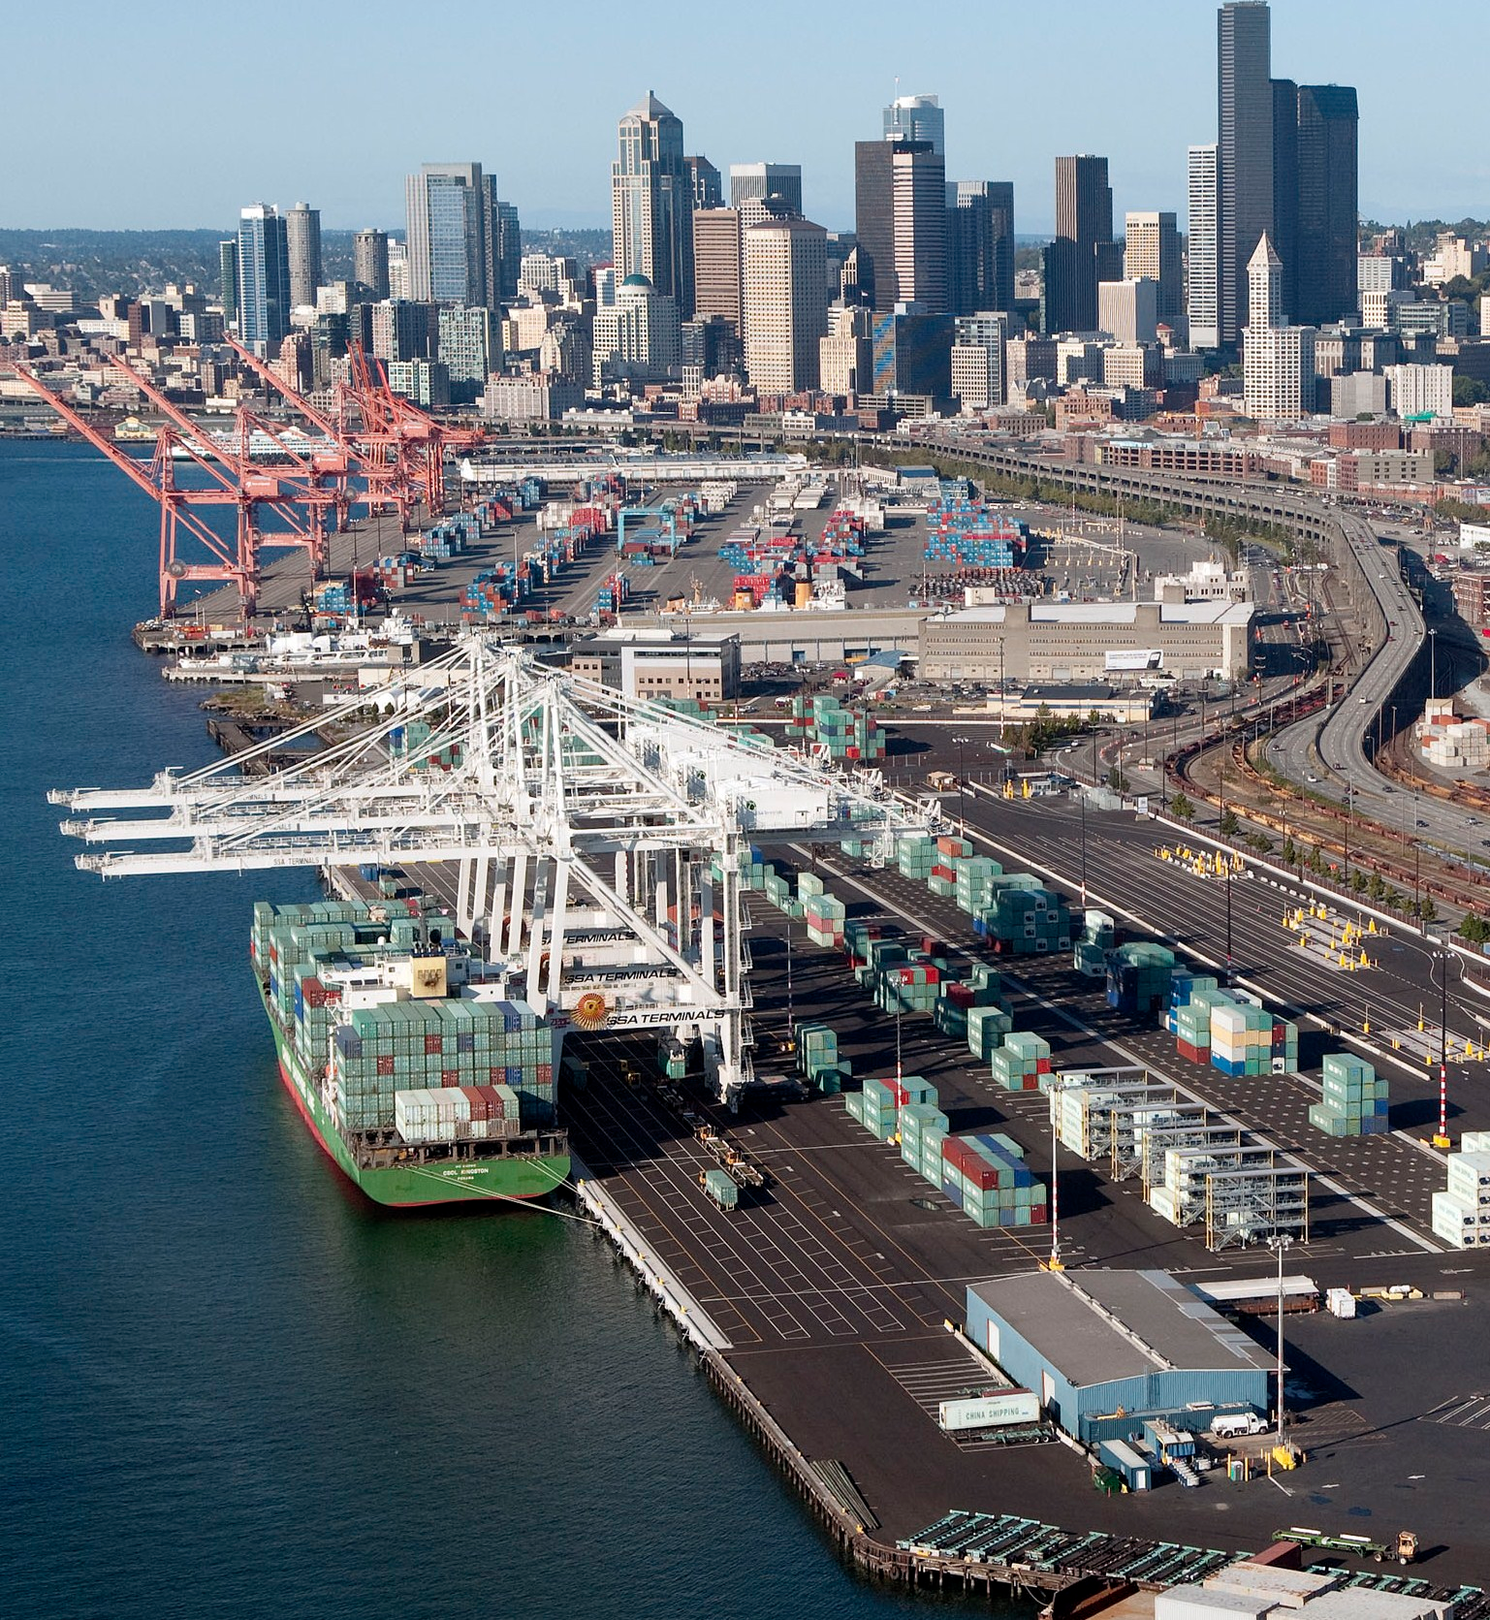

EPA CMV model
Richard Billings, ERG
Sarah Roberts, EPA
Michael Aldridge, EPA
Daniel Bizer-Cox, EPA
Jarrod Brown, EPA
Alison Eyth, EPA
Isabela Brown, ERG
Heather Perez, ERG
Roger Chang, ERG
James Beidler, GDIT
Notes:
I want to point out that I am just the presenter here
Most of the real work was done by Michael Aldridge and Isabela Brown with support from Daniel Bizer-Cox and Jarrod Brown from the EPA and Heather Perez and Roger Chang from ERG

Slide 2
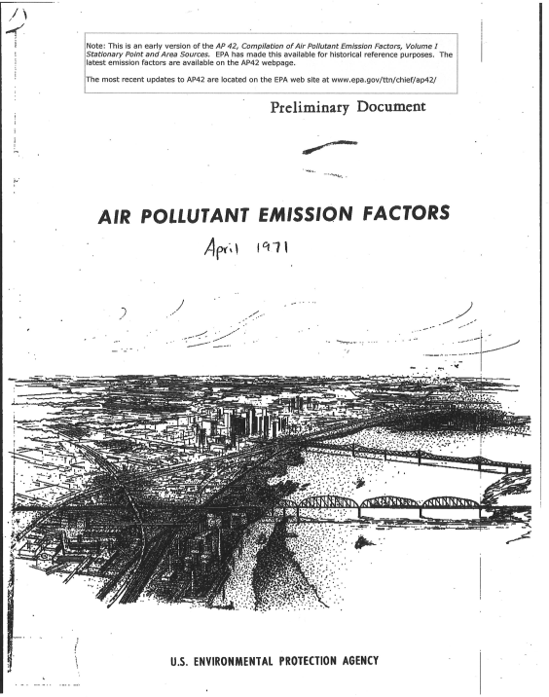
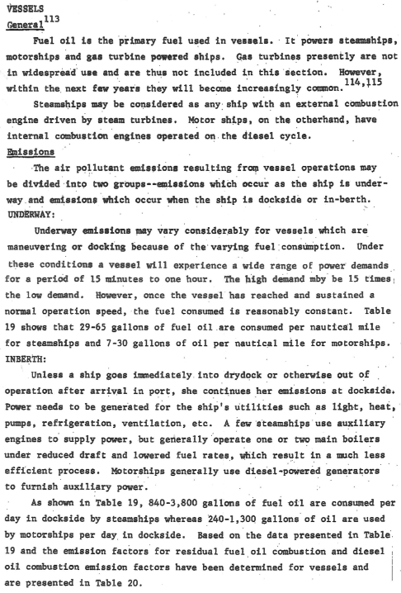
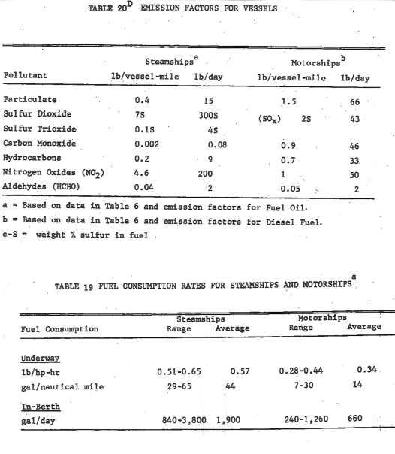
From Where we started…
Notes:
I think if you consider where we started from you will hopefully have an appreciation how significant this project is.
So let's look back to the beginning when we had things called steam ships.
This is what the guidance looked like back in 1971 ,
Really, one page of text and two tables
Not much changed from 71 to 92, when I was reviewing state 1990 SIP inventories

Slide 3
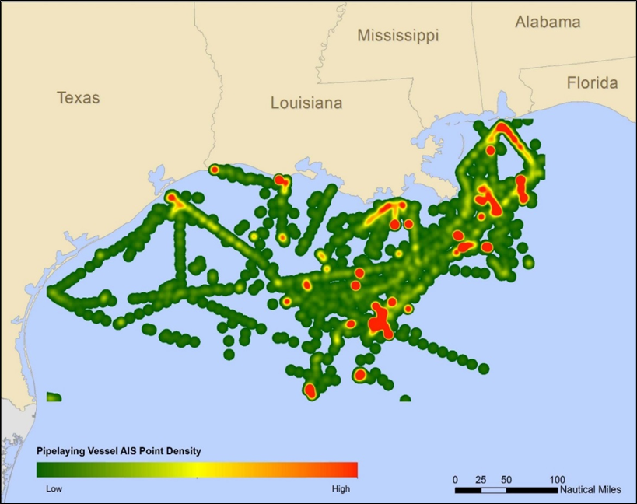
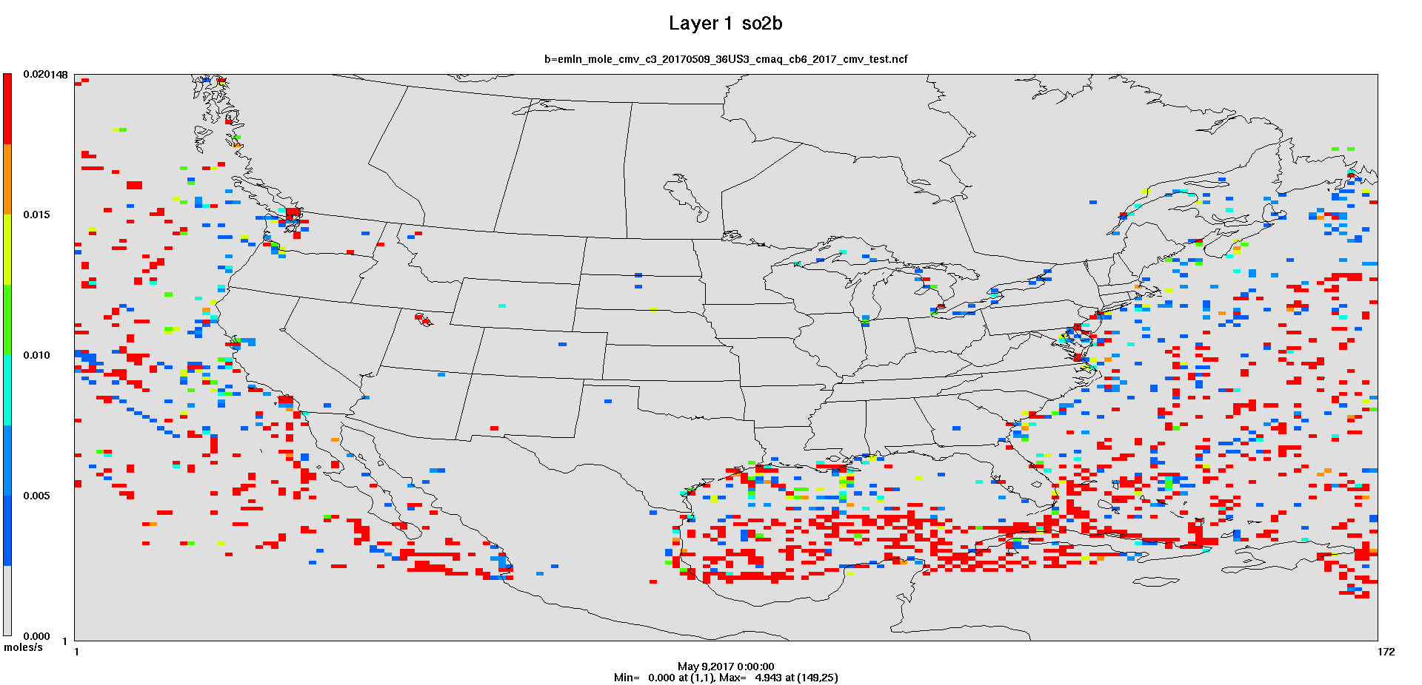
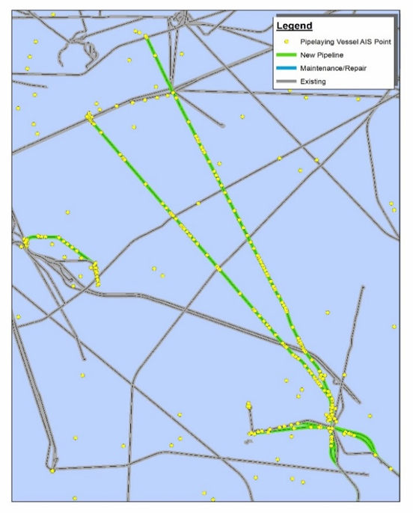
To Now…
Notes:
Big jump to NOW!!
Where emissions are calculated using electronic tracking systems for specific locations and times.
Adjustments are made for each vessel observation to account for operating load of the propulsion engines
Use of ECA and nonroad fuels can even be accounted for
Speciated into regulated HAPs
Initial use of electronic tracking data for BOEM
Mapping of pipelaying vessels (tracking data) to BOEM’s independent map of pipeline locations
Plus the data can be animated, showing impact of ECA compliant vs Global marine fuels.

Slide 4
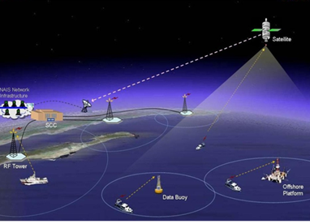
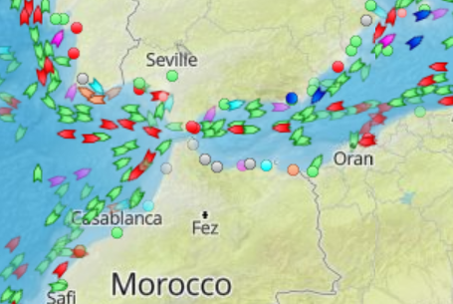
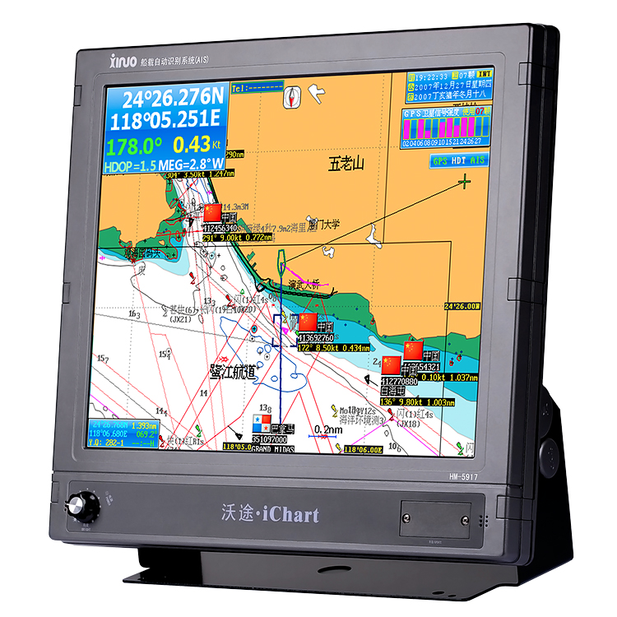
What is AIS?
Automatic Identification System (AIS) is a tracking
system to enhance navigation and prevent collision
with other AIS vessels.
Each participating vessel transmits a signal
that is picked up by a receiver:
VHF TV/radio towers
Offshore buoys
Oil and gas platforms
Satellites
Signals are returned to surrounding vessels and land Stations
Notes:
So what is electronic tracking – or as it is know “Automatic Identification System” of AIS
Vessel send signals every couple of seconds where they are received at VHF towers…
The vessel signal is returned to near by vessels and land stations on monitors such as the one shown here
All transmitting vessels appear on the screen in real time.
VHF towers have a range of approximately 20-30 nautical miles,
Plus there is a growing number of AIS satellites extending the range globally.

Slide 5
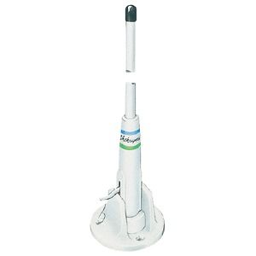
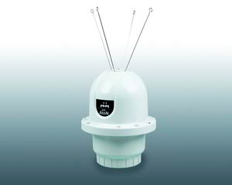
The International Maritime Organization’s International Convention for the Safety of Life at Sea requires AIS to be fitted aboard vessels
Involved in international trips
Greater than 300 gross tons
All passenger ships regardless of size
Smaller vessels can participate voluntarily
Currently large Category 3 vessels are equipped with Class A transmitters that operate at 20 watts
Class B transmitters operate at only 2 watts (viable option for smaller Category 1 & 2 commercial and recreational vessels).
Notes:
Two categories of participation in AIS:
1) Required for larger ships and passenger vessels
- Uses more powerful transmitter and sending more data
2) Voluntary – anyone else
- Smaller cheaper transmitters.

Slide 6

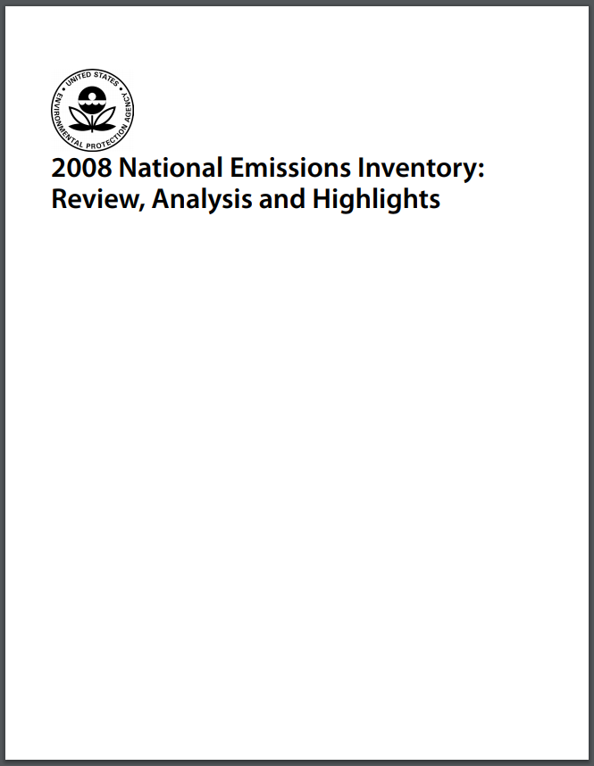
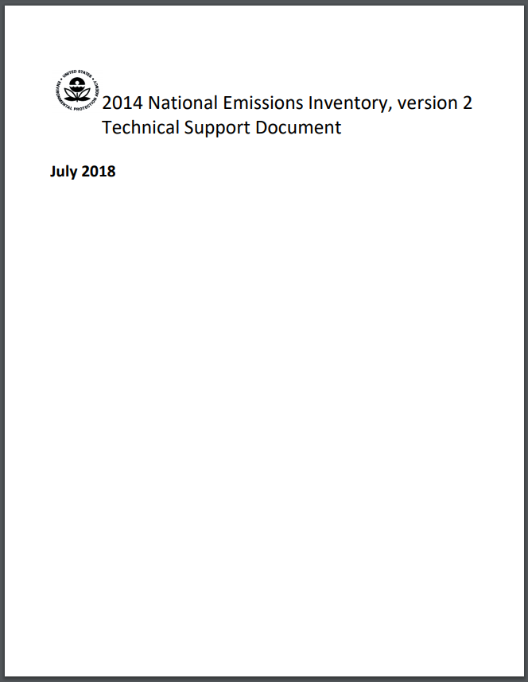
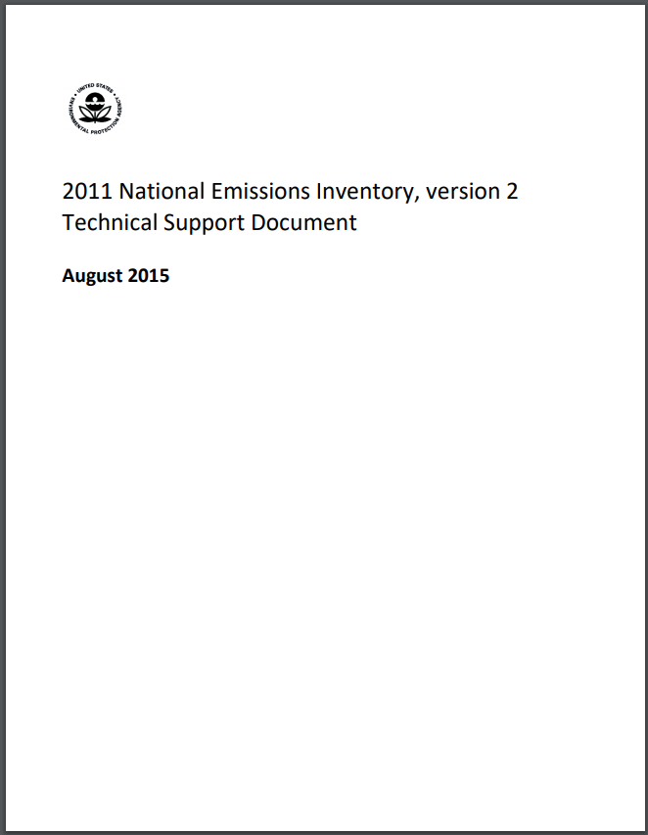
EPA CMV Model - Where it all Started
Notes:
On to the CMV model
EPA developed a detailed emission inventory of marine vessels for the 2009 Category 3 Regulatory Impact Analysis.
Preliminary data from this inventory was used in the 2008 NEI
And later adjusted for the 2011 NEI
For the 2014 NEI, a new inventory was developed based on the USACE Entrance and Clearance and Waterborne Commerce data
Since the development of these inventories, much has changed,
including the advent of AIS data as well as new GIS tools and shapefiles.
The development of a NEW AIS based inventory methodology in the form of a CMV model,
Has considerable value:
Direct applications for modelers
creating projected or back casted inventories
supporting regulatory and policy initiatives,
Evaluating fuel consumption across the sector and
Supporting the NEI
I need to clearly clarify what vessels are included in the CMV model.
Pretty much all vessels,
except for recreational vessels which are already included in the MOVE NONROAD model.
It was decided that the 2017 NEI data could be used as a test dataset for the new CMV model.

Slide 7
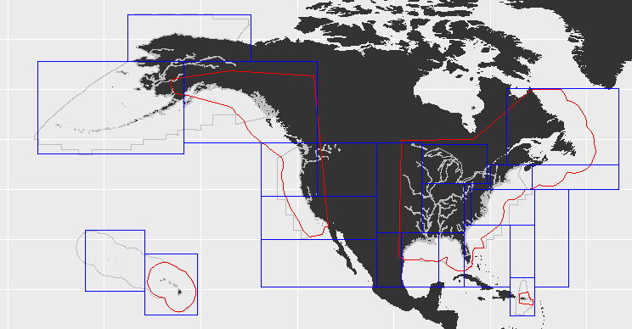
AIS CMV Model domain
AIS Data requested from US Coast Guard NAIS data set: https://www.navcen.uscg.gov/?pageName=NAISmain
5-minute intervals
Request broken into regions due to file size constraints
As received from USCG:
480 csv files (158 GB)
~1.3x10⁹ total records
Data request areas
N.A. ECA
2017 NEI modeling area
Notes:
The 2017 AIS data were provided by the USCG
This image presents the domain for data request
Including the NEI domain (grey box).
NA ECA zone (Red box) as well as
most NA waters (blue box)
The sampling time frame was 5-minute intervals
(note that the 2 second data are transmitted, but at that level of detail, the database would blow up, also any benefit of the additional data is questionable.)
Vessels do not move that quickly.
Still this dataset is large at 158 GB which includes 1.3 Billion records

Slide 8

AIS Data Elements
Participating vessels transmit a data string that includes “Static” data elements:
Unique identification codes (MMSI, IMO, vessel name)
Radio call signs
Vessel type
Dimensions including draft
Destination
“Dynamic” data elements are transmitted
every two seconds
Time and date
Position (latitude/longitude coordinates)
Course
Speed
Notes:
AIS is composed of two different data streams
1) Static: attributes that do not change frequently
These are manually entered by operator and can sometime be questionable.
Especially the vessel type attribute
Useful in identifying the vessel based in their vessel identifier codes which includes the IMO and MMSI (Marintime Mobile Service Identity)
2) Dynamic: automated elements that are constantly changing
Derived from the Vessels GPS
Higher quality
Useful in locating vessels in time and space and
Quantifying its operating speed

Slide 9
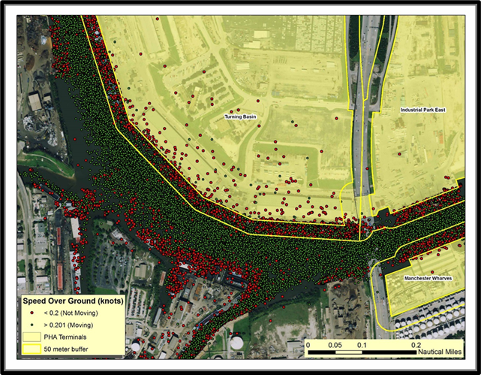
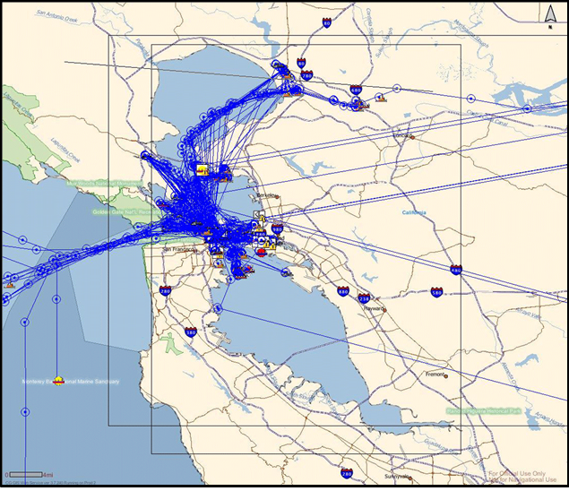
Geographic Information System Elements
Every observation has a latitude and longitude.
These data can be mapped to port shapefiles or shipping lanes to identify emission hotspots or traffic bottlenecks.
Sometimes vessel locations are on land - this is a known issue
Missed transmissions
Deliberate tampering,
Reduced accuracy due to high vessel speeds
Frequent bearing changes during a short period of time.
Notes:
One of the most important components of the AIS data is the locational data.
It allows the vessel’s exact location to be quantified .
Well mostly, there are some issues with it.
When you view the data as a vessel moving along a line,
the vessel may appear on land if:
Vessel transmissions are missing while the vessel moves around abend in the waterway
Tampering with the GPS system (rarely)
And there is a known accuracy issue if the vessel is moving quickly and changes direction a lot

Slide 10
Vector approach
Each observation is a point vector for a specific lat/long coordinate
Vessel Identifier
Day time stamp
Vessel speed
Duration (as fraction of hours)
Notes:
For this reason, the data were considered vectors rather than lines.
For example, each dot in the image includes the essential AIS data to estimate emissions.
A vessel identification code
Day time stamp
Latitude/Longitude Coordinate
Vessel speed
And duration since the last known location
This is a cool image
For this study, vessels were differentiated that come into or leave a specific port (purple dots)
vs those that travel past without enter the port (green dots) and are being excluded from the port inventory

Slide 11
Linking AIS vessel data to Individual vessel characteristics
Classification Societies
Lloyds/IHS Register of Ships ( half a million vessels – 100,000 are C3)
Bureau Veritas
Russian Maritime Register of Shipping
Data Elements
Vessel Name
ID codes
Radio call sign
Year of Manufacture (date the keel was laid)
Country where the vessel is registered
Vessel dimensions
Max design vessel speed
Engine type
Fuel type
Engine speed (RPM)
Cylinder dimensions (bore & stroke)
Propulsion power (kW)
Auxiliary power (kW)
Notes:
AIS Static vessel characteristics data such as:
Vessel type are frequently vague, erroneous, or incomplete.
In one Houston Tanker study. 50-75% of the tanker data were mislabeled.
To address this issue a variety of alternative data sources are considered including use of Classification Society data
Classification societies are central data sources for vessel attributes, that date back to the tea clipper ships.
Stakeholders (shipping agents, captains, & ship owners) met at Lloyds coffee shop to hammer out agreements for pending voyages.
In 1760 the first version of Lloyds register of ships was published rating the condition of individual vessels, to help backers underwrite the voyages – which has led to the Lloyds insurance company.
A French equivalent appeared in 1828. currently there are about 3 dozen classification societies. and the data they compile is way more detailed than the first ROS.
Classification Society data is important to the CMV model because it is possible to link the AIS vessels to its vessel and engine characteristics using the vessel identification codes
(IMO is the best; general you can match over 95% of IMO vessel IDs to Lloyds data for the Category 3 vessels)
Smaller non-IMO vessels it is more like 25%.
We like to use at least 3 data elements when matching a vessel to its attribute
Mostly we are after the power rating of each vessel for propulsion and auxiliary engines
To adjust the propulsion load the vessel speed and vessel dimensions are needed
To ensure we match the vessel to an appropriate EFs we use Country of registration, cylinder dimensions (to get the category) year of manufacture (to get the correct regulatory tier) and fuel type and engine speed.
Not all of the data fields are fully populated,
so it is necessary to gap fill with available surrogates or
Develop default values based on vessels that have been matched
But the real reason to link the data is to get the vessel power and speed!!!

Slide 12

Overview of Preliminary Data Parsing
Vessel Characteristics
Engine Bore
Engine Stroke
AIS Records
Latitude
Longitude
Speed
Matched on MMSI & IMO
Calculate Engine Displacement (L/cyl)
Category 3
(≥ 30 L/cyl)
Category 2
(≥ 7 and
< 30 L/cyl)
Category 1
(< 7 L/cyl)
Unknown
Category
~130 million AIS Records
~57 million AIS Records
+
~76 million AIS Records
+
~681 million AIS Records
~814 Million C1/C2/Unknown AIS Records
Notes:
After initial cleaning which will be cover in the next slide
the 1.3 billion records is reduced to
130 million records for C3
814 million records for C1/C2
98.9% of C3 observations had valid IDs
25% of C1/C2 vessels could be matched to vessel attributes

Slide 13
AIS data cleaning
As received, our AIS data has many records that are invalid for emissions estimates:
Known Category 3 vessels were flagged and handled separately from C1/C2 vessels
Fishing buoys, man over-board transmitters, rescue helicopters, and pleasure craft contribute a huge proportion of vessel IDs and messages
Messages with duplicate timestamps and different locations (or the same location)
Reported ship speeds > 1000 mph
Ghost Ships (Static data but no dynamic data)
Identify and Remove Unusable AIS Data
Flag Vessels with Valid ID unavailable in our ship registry dataset
Remove Duplicate Records
Flag Unreported Speeds
Flag Erroneous Speeds
Vessels without Valid ID
Filter for Category 3 Vessels
Remove Vessel Records with Duplicate Timestamp but Different Locations
Notes:
For the initial cleaning , vessels were identified with non-valid IDs: we considered alternative methods to match them sometimes a combination of call signs and vessel dimensions maybe year manufactured.
Using cylinder displacement the Category 3 vessels are identified – these tend to be well represented in the Classification Society Data, therefore what is left is like to be a C1/C2 vessel
Note that Category 3 vessels represent a little over 10% of the Original AIS data.
For the non Cat3 vessels there is the question if it is even a vessel.
AIS transmitter are used in a wide array of other applications such to track fishing buoys or for emergency rescue.
As noted earlier, smaller recreational vessels are starting to show up and for the NEI, these needed to be flagged and put aside
Considerable time was spent cleaning up the data, removing duplicate records or evaluating vessel speeds that were obviously incorrect
Ghost ships are signals that only have a static data field and no dynamic data elements. We have been advised by vendors and the USCG that these can be removed.
There could be a lot of these, but they are easy to identify and remove. A comparison of selected ports that had port call data was implemented – it was found that when the ghost ships were removed, the AIS vessel traffic matched the ports vessel call data.

Slide 14
General Approach to Estimate
Emissions for Each Observation
$$Emissions \left(g\right)=\sum_{Vessels}{Activity\left(hrs\right)∙Power\left(kW\right)∙Emission Factor\left(\frac{g}{kW∙h}\right)}$$
unique vessel observation
ROS vessel characteristics
C3 Hotrip & Mennen Equation
C1/C2 Propeller law
adjusted to account for compliance with standards
Data Sources
duration of AIS observation
Notes:
As many of you have considerable experience developing emission inventories this equation probably looks familiar
Generally speaking we need to have activity data in terms of kW-hrs to match the available emission factors
So the ROS power rating data were used which was adjusted for the propulsion operating load to get kWs
And the duration from the last known data point to get the duration which gives us KW-hrs.
Easy –this process was completed for each vessel and for every 5-minute observation.
So the data set can get large and if you add speciated HAPs then it can get really big.

Slide 15
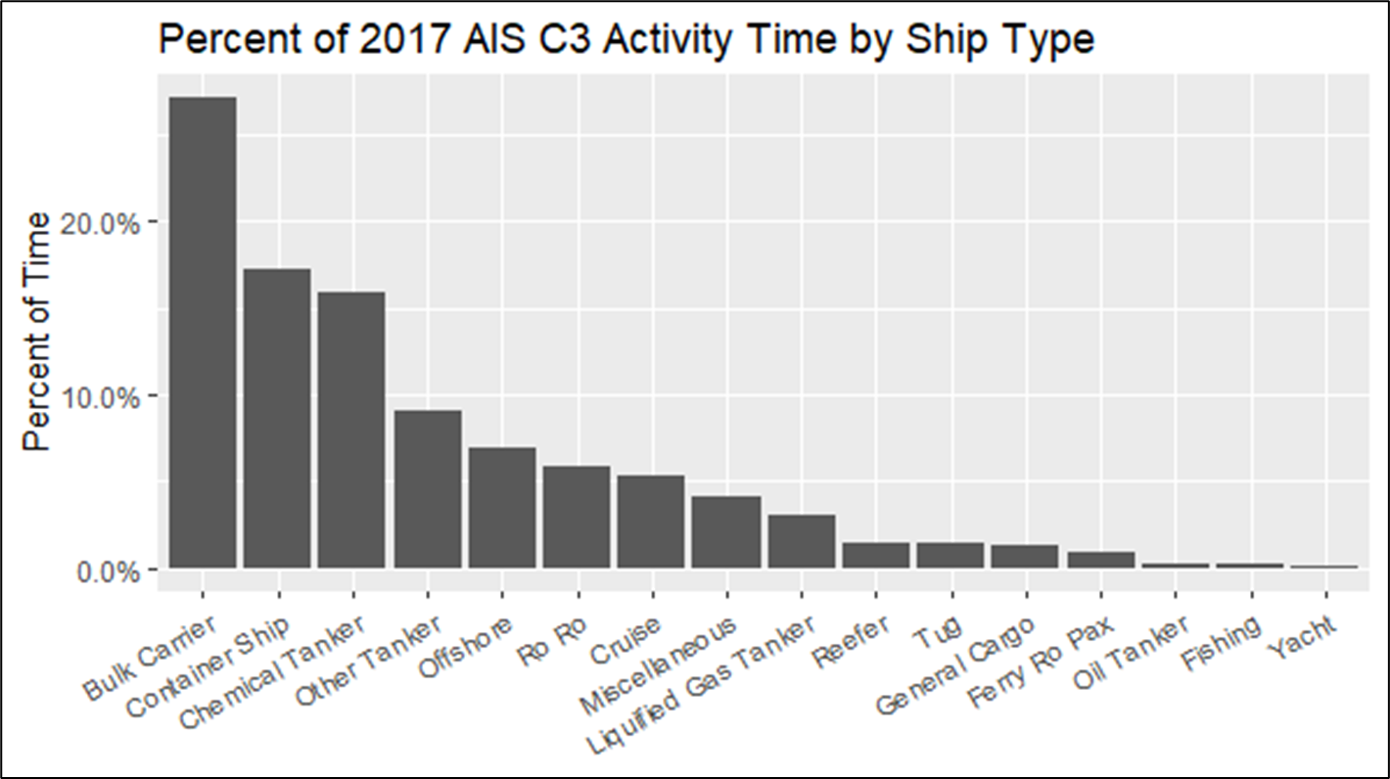
2017 Category 3 AIS Activity Data
11,248 vessels
1.3x10⁸ records
1.7x10⁷ hours of activity
Notes:
I need to explain an important distinction at this point
For the model the same approach is generally applied to both C3 and C1/2,
But there are some notable differences
So we will be jumping back and forth between the C3 and the C1/C2 methodologies.
Where the approach is specific for C3 the slide will have this orangy background and
for C1/2 a light green background will be used
to make it clear which approach each slide represents.
If the slide has a white background, there is no difference between the approaches..
So let's see what the C3 data look like:
130 million records
Account for 17 million hours of operation
As this table shows the dataset is dominated by bulk & container ships and chemical tankers,
(accounting for approximately 60% of hours of operation)
And yes there are some very large ocean-going tugs and yachts that have Category 3 engines.

Slide 16
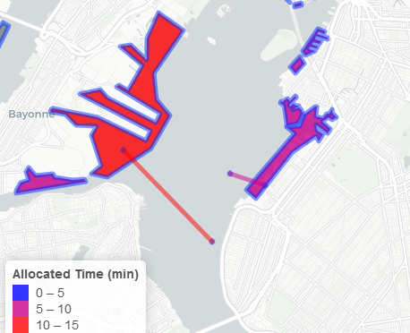
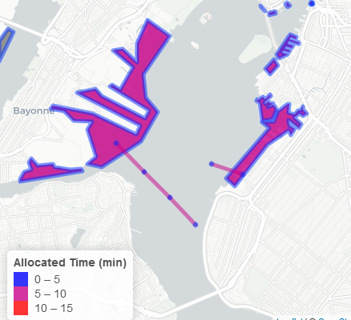
Temporal gap filling
In the model, emissions are allocated to AIS points (rather than lines)
Each point should represent a similar time-span, but as received data has time gaps
Missing points skew the spatial distribution of calculated emissions
Temporal gap filling corrects these issues
Notes:
As noted earlier, sometimes transmitted signals are missed
To address this issue for Category 3 vessels
The missing data between two known data points were interpolated to place the missing data.
As you can see in this example .
There are two data points that can be connected by a line
For which it can be assumed the vessel must travel
And as there are time stamps for the known data points,
the time and location for the missing data can be estimated

Slide 17
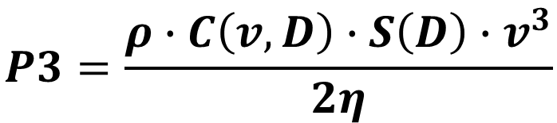
Category Propulsion Engine Operating Loads
For Propulsion Engines
Holtrip & Mennen equation used
$$P3=\frac{ρ∙C\left(v, D\right)∙S\left(D\right)∙v^{3}}{2η}$$
Models hull resistance at speed using estimated vessel shape and surface area
Uses vessel specific hull information
Uses AIS speed and draft data
P3 = Propulsion power for Category 3 vessels
P = Power rating of propulsion engines
V = speed
D = draft
ρ = seawater density
C = hull resistance coef.
S = hull wetted surface area
η = engine efficiency
Notes:
Obviously, vessels do not operate at 100% of their power through out the duration of the trip.
And there are a variety of ways to adjust the operating load.
For C3 the Holtrip & Mennen equation was used and
For C1/C2 the propeller law was used
The Holtrip & Mennen equation requires detailed information about vessel hull characteristics, vessel power and speed
to estimate resistance;
Primarily we are talking about the surface contact between the ship and the water it is moving through, The critical data element here is the draft of the vessel, adjustments can also be made to account for hull fouling and even water density (coastal salt waters vs Great Lakes fresh waters).

Slide 18
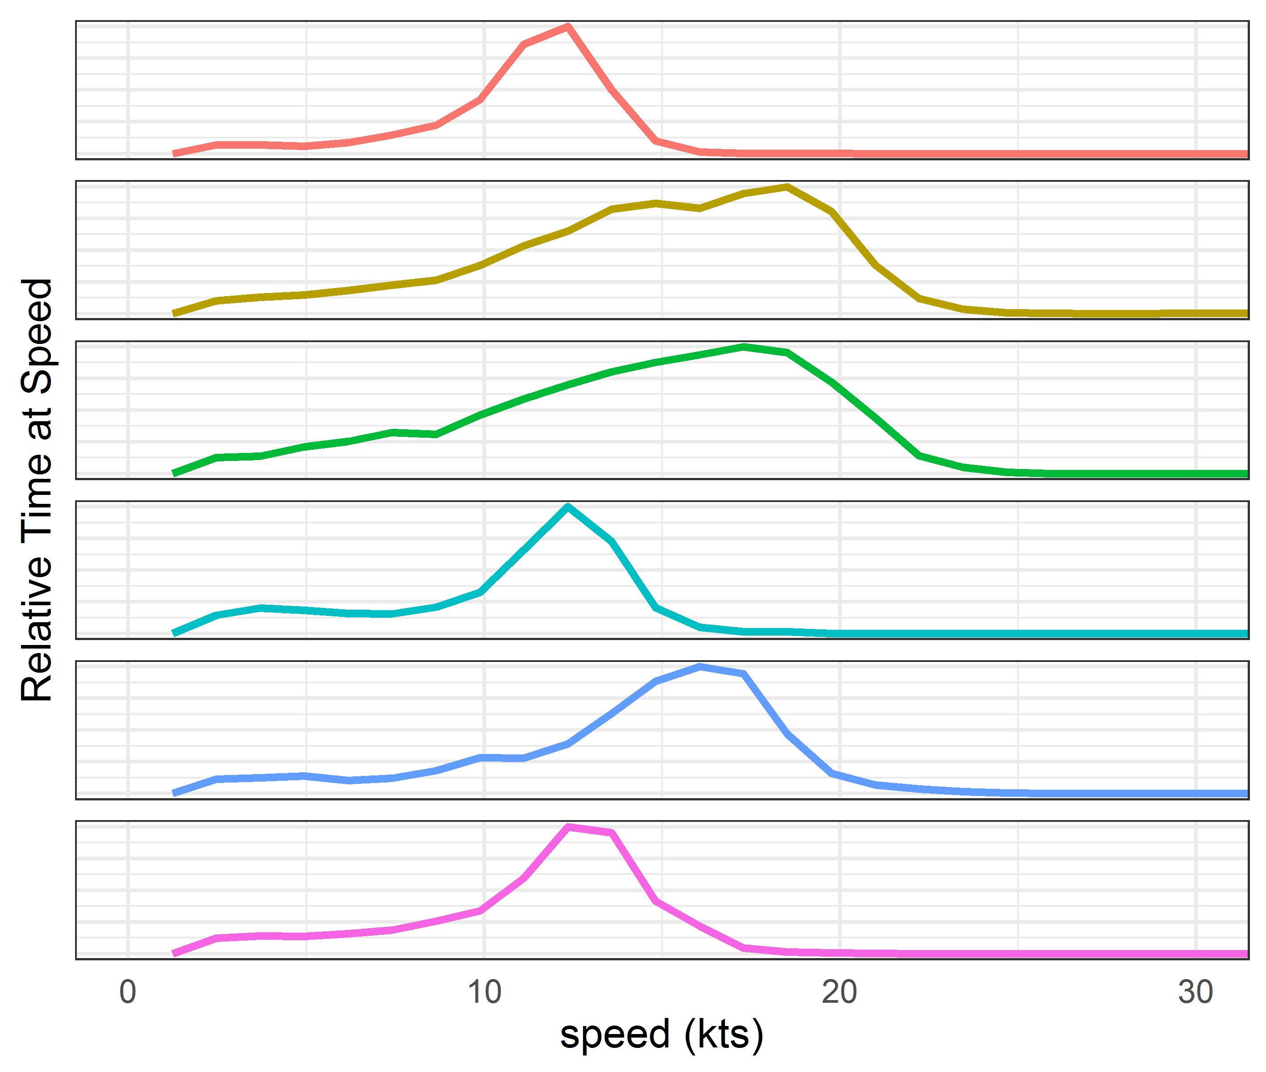
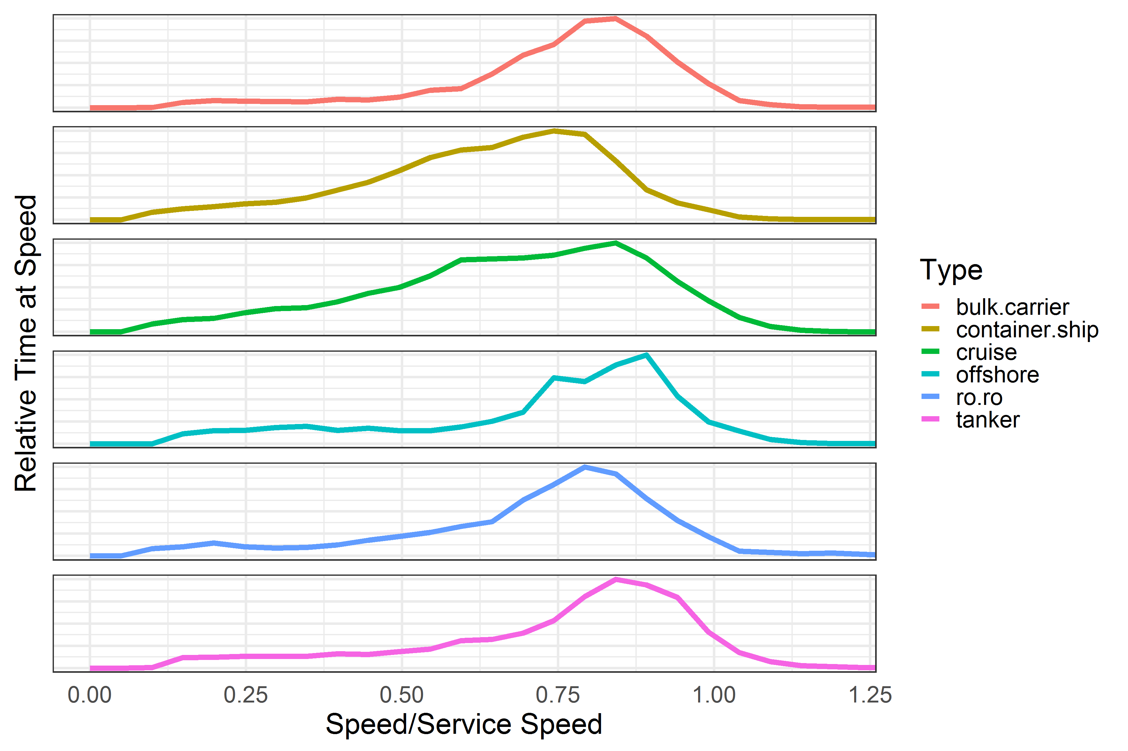
Category 3 Vessel speed distributions
Vessel Speed Distribution
Normalized Vessel Speed Distribution
Notes:
So let's look at some of the more significant data attributes
AIS speed data is interesting.
Not surprising that Container and Cruise ships have the fastest speeds
And tankers and bulkers have the slowest speeds.
Actual speed compare to the service speed ( which is typical underway speed)
which hovers around 80-85% - so vessels in general travel 15 to 20% slower than noted in previous EPA guidance
Note service speed is less than max speed so you can get ratios greater than 1.

Slide 19
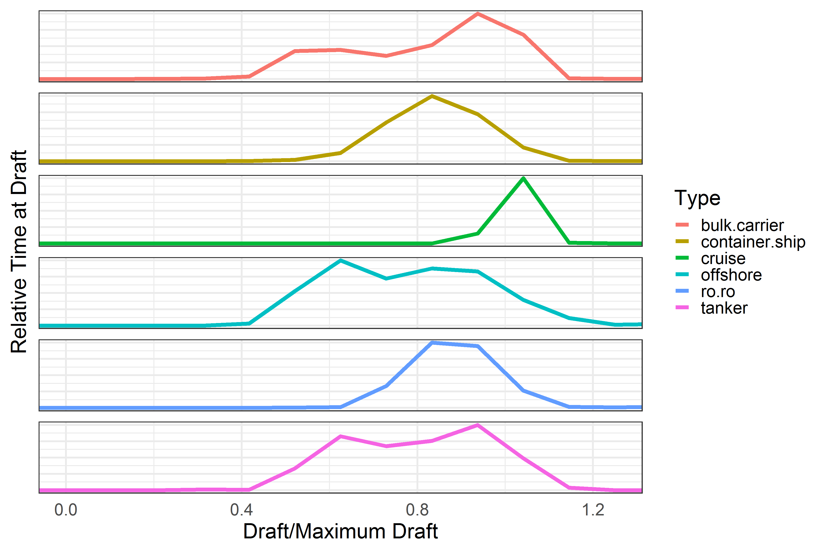
Category 3 Vessel draft distributions
Bulk goods (dry and liquid) are often only shipped one-way resulting in bi-modal draft distributions
Cruise ships stand out because their draft rarely changes
Notes:
Because the load factor adjustment accounts for the vessels draft
This is an important variable that is included in the AIS transmission
Bimodal distribution is interesting as it indicate movements where the vessel is empty.

Slide 20
Category 3 Regulations
Standard | Year | NO _{X} | Fuel Sulfur content
Global | 2000-2010 | Tier I (Engine-based controls) | 45,000 ppm
 | 2011-2015 | Tier II (Engine-based controls)
 | 2013-2019 |  | 35,000 ppm
 | 2020 and beyond |  | 5,000 ppm
North America Emission Control Area | 2012-2014 |  | 10,000 ppm
 | 2015 and beyond |  | 1,000 ppm
 | 2016 and beyond | Tier III (After treatment)
Notes:
For Category 3 vessels there are two sets of regulations
1) NOx Exhaust standards vessels equipped with category 3 engines must comply:
Tier 1 Standards promulgated in the 2003 and is applicable for vessels built after 2004.
Tier 2 Standards for vessels build after 2011 and require engine-based controls such as engine timing, cooling, electronic controls
(15-25 % reduction over Tier 1 engines)
Tier 3 Standards for vessels build after 2016 that requires after treatment such as Selective Catalytic Reduction (80% reduction over Tier 1)
These standards are derived from IMO MARPOL Annex 6 so they are applicable for all vessels, regardless where they are registered.’
2) North American Emission Control Area (NA ECA) which I have alluded to in earlier slides.
There are ECA in the Baltic and North Seas, new ECA are being considered for China, the Mediterranean and Mexico.
The US ECA went into affect in 2012 and includes all U.S. waters which matches to the NEI area of interest. But we still need to keep the global fuel standards and the Model extends beyond the NA ECA boundary.
An important thing to note, is if you reduce fuel sulfur you also reduce sulfate particulates.

Slide 21
Engine Type | Fuel Type | Tier | Sulfur % | EF (g/kWh)
 |  |  |  | CO | HC | NOx | BSFC | PM₁₀ | SO₂ | CO₂
Propulsion
SSD | MGO/MDO | Tier 0 | 1% | 1.4 | 0.6 | 17 | 185 | 0.45 | 3.62 | 593.11
MSD | MGO/MDO | Tier 0 | 1% | 1.1 | 0.5 | 13.2 | 205 | 0.48 | 4.01 | 657.23
ST | MGO/MDO | Tier 0 | 1% | 0.2 | 0.1 | 2 | 300 | 0.16 | 5.87 | 961.80
GT | MGO/MDO | Tier 0 | 1% | 0.2 | 0.1 | 5.7 | 300 | 0.01 | 5.87 | 961.80
SSD | MGO/MDO | Tier 1 | 1% | 1.4 | 0.6 | 16 | 185 | 0.45 | 3.62 | 593.11
MSD | MGO/MDO | Tier 1 | 1% | 1.1 | 0.5 | 12.2 | 205 | 0.48 | 4.01 | 657.23
SSD | MGO/MDO | Tier 2 | 1% | 1.4 | 0.6 | 14.4 | 185 | 0.45 | 3.62 | 593.11
MSD | MGO/MDO | Tier 2 | 1% | 1.1 | 0.5 | 10.5 | 205 | 0.48 | 4.01 | 657.23
SSD | MGO/MDO | Tier 3 | 1% | 1.4 | 0.6 | 3.4 | 185 | 0.45 | 3.62 | 593.11
MSD | MGO/MDO | Tier 3 | 1% | 1.1 | 0.5 | 2.6 | 205 | 0.48 | 4.01 | 657.23
Auxiliary
MSD | MGO/MDO | Tier 0 | 1% | 1.1 | 0.4 | 10.9 | 217 | 0.50 | 4.24 | 695.70
MSD | MGO/MDO | Tier 1 | 1% | 1.1 | 0.4 | 9.8 | 217 | 0.50 | 4.24 | 695.70
MSD | MGO/MDO | Tier 2 | 1% | 1.1 | 0.4 | 7.7 | 217 | 0.50 | 4.24 | 695.70
MSD | MGO/MDO | Tier 3 | 1% | 1.1 | 0.4 | 2 | 217 | 0.50 | 4.24 | 695.70
HSD | MGO/MDO | Tier 0 | 1% | 0.9 | 0.4 | 13.8 | 217 | 0.50 | 4.24 | 695.70
HSD | MGO/MDO | Tier 1 | 1% | 0.9 | 0.4 | 12.2 | 217 | 0.50 | 4.24 | 695.70
HSD | MGO/MDO | Tier 2 | 1% | 0.9 | 0.4 | 10.5 | 217 | 0.50 | 4.24 | 695.70
HSD | MGO/MDO | Tier 3 | 1% | 0.9 | 0.4 | 2.6 | 217 | 0.50 | 4.24 | 695.70
Boiler
Boiler | MGO/MDO | Tier 0 | 1% | 0.2 | 0.1 | 2 | 300 | 0.63 | 5.87 | 961.80
C3
Emission
Factors
Notes:
So now that you know the regulatory situation , I am hoping that the Category 3 emission factors make sense.
And here is the consolidated list of 2017 NEI emission factors for propulsion, auxiliaries and boilers.
As you can see the model assigns EF based on the engine speed (High speed diesel, medium and slow), tier level – and the assumption that for NEI waters, distillate ECA compliant fuel is being used.
Note the model includes EF for global waters which from the previous slide includes higher sulfur residual fuels
– I am just not showing them as this slide is already way too busy.

Slide 22
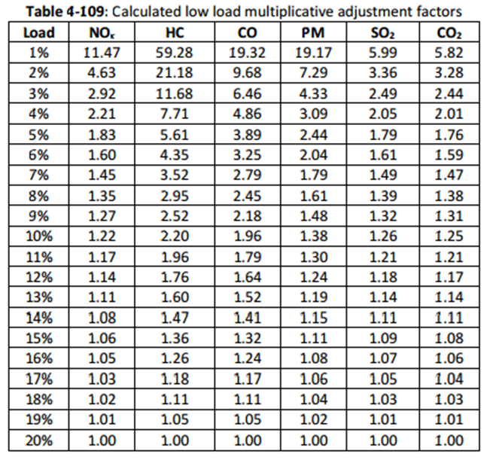
Adjusting Emission Factors to Account for Low Load Operations
Notes:
Another great feature of using AIS data is you know propulsion operating loads for every observation
And you can identify when the engines are operating outside their design range (typically below 20%)
During these low load operations when engine operations are less efficient, emissions can be higher ,
This table shows emission estimates were adjusted by pollutants for low operating loads.
At this point you have kw-hrs x emission factors, adjusted for regs and low operating loads – you are done! You now have emissions at each observation point.

Slide 23
Auxiliary and Boilers
AIS does not provide direct data to quantify the operation of auxiliary engines or boilers
Power and load assumptions were made based on the vessels operating modes
Transit > 3 kn >20% load
Maneuvering > 3 kn <20% load
Dockside < 1 kn 0 load
Anchorage >1 kn and <3 kn 0 load
Notes:
Note we need to repeat this process for Auxiliary engines and boilers.
AIS is less helpful regarding these components as their operations are somewhat independent of propulsion. Generally they are inversely related.
The power rating of auxiliary engines was extracted from ROS or the missing data were gapfilled
and to estimate the operating load of the auxiliary engines
we use EPA load factors based on the mode of operation – transit, maneuvering, dockside and anchorage.
The modes are defined based on the vessel speed and the estimated engine load –
mostly this is to differentiate Transit underway operations from maneuvering.
While stationary the propulsion engines are off
But what is stationary – AIS is so good it captures small vessel movement due to wind, wave and currents. For dockside it was assumed that a vessel is not moving if the detected speed is less than 1 kn and for offshore anchorage it could be up to 3 kns.

Slide 24
HAP Profiles for all vessels using distillate fuels
Notes:
As the NA ECA requires that the fuel sulfur content be less than 1,000 ppm
it is assumed that most vessels will be switching to a distillate blend rather than use higher sulfur fuels in conjunction with a scrubber.
Based on this assumption, it was decided that ECA fuels will be better represented by the distillate marine fuel speciation profile
Rather than the residual profile.
Note these profiles are fractions of either PM or VOC

Slide 25

Stretch break
Notes:
That wraps up the C3 calculations
Before we jump into C1/C2
How about a short stretch break
Or I can try to address any questions you may have about the Cat 3 approach.

Slide 26
General Approach to Estimating
Emissions for Each Observation
$$Emissions \left(g\right)=\sum_{Vessels}{Activity\left(hrs\right)∙Power\left(kW\right)∙Emission Factor\left(\frac{g}{kW∙h}\right)}$$
unique vessels in AIS data set
Propeller law
ROS vessel characteristics
account for compliance with standards
Data Sources
Duration of AIS messages
Notes:
As we venture into C1/C2 territory let me remind us of the primary equation
Duration is still calculated based on the last know data point.
Power is base on ROS data where matches can be made
And adjusted using the propeller law not the Holtrip & Mennen equation – more about that in a sec.
And the emission factors take into consideration the engine tier level based on year of manufacture when available.
Again the process is repeated to all vessels and each 5-minute observation

Slide 27
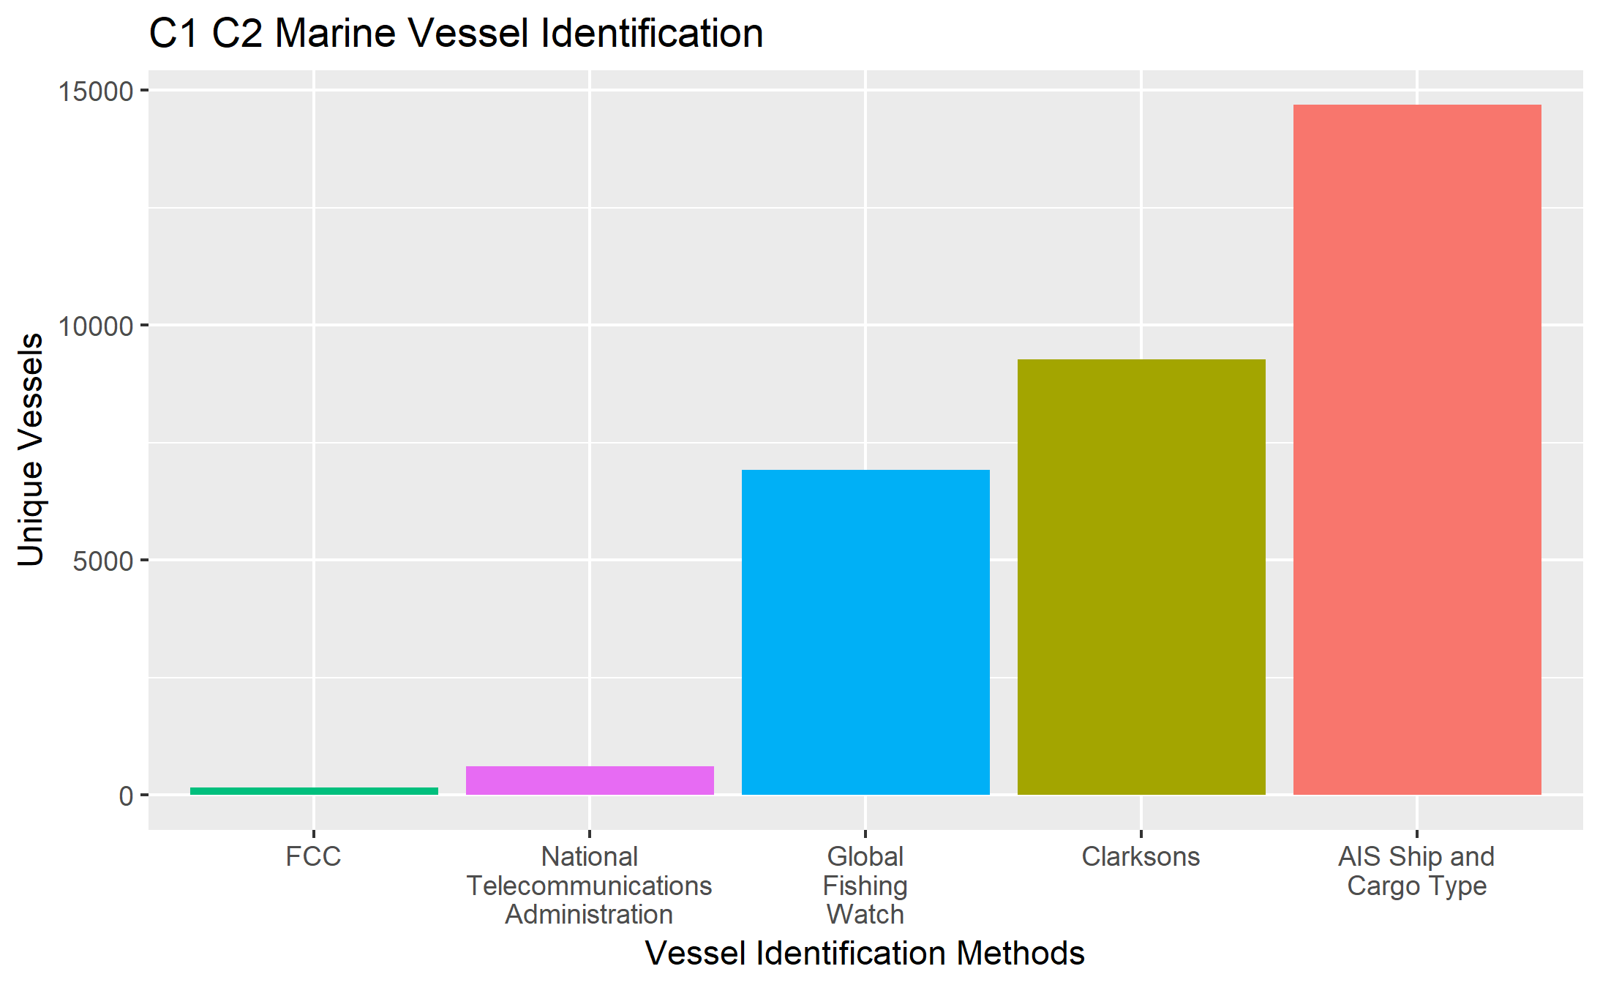
Category 1/2 Vessel type
Identification Process
Started with 814 million records – distilled down to 422 million
17,760 vessels
88 Million hours of operation
Clarksons
Match by IMO and MMSI
FCC
Match by Call Sign
NTA
Identify by MMSI pattern
Global Fishing Watch
AIS Ship & Cargo Type
Match by MMSI, Call Sign, Ship Name, IMO or a combination
Match to Marine Cadaster Vessel Type
Notes:
So we started with 814 million possible C1/C2 records which we were able to reduce to cut in half,
that included 17,760 vessels ( about 50% more than the C3 fleet)
that represented 88 million hours of operation ( about 5 time the hours than C3)
As ROS only accounted for 25% of C1/C2 vessels. Default power, and speed data were based on the vessel type.
To get the most accurate vessel type alternative data sources were considered
For example we matched to Clarkson’s data which accounted for more than half of the vessels
Next FCC data were used which represent commercial vessels that voluntarily participate in AIS based on radio licensing.
Note the match rate was low as the FCC is directly involved in issue MMSI codes to vessels involve in international movement of cargo, and that is not what C1/C2 generally do.
Then we matched to NTA data which includes all government vessels
A real plus was Global Fishing Watch, which helped us Identify commercial fishing boats.
For the remaining vessels, instead of using just the AIS vessel type data, the AIS cargo type code was also used to determine the vessel type.

Slide 28
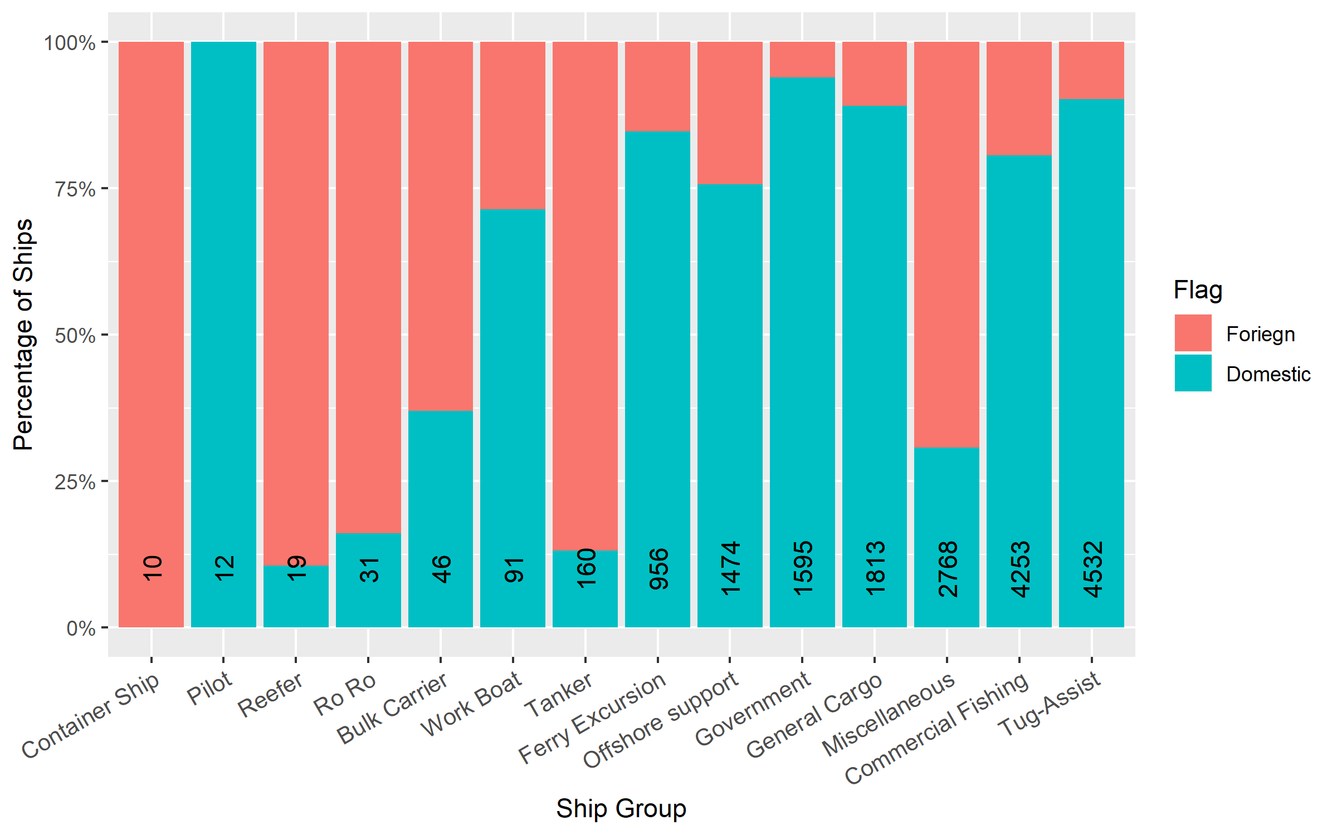
Category 1/2 Vessel Groups
Notes:
This figure shows how the size of the domestic fleet varies by vessel type.
The good news is it is possible to identify the country where the vessel is registered based on the MMSI identifier – the code includes a 3-digit sequence that notes the country of registration
In aggregate approximately, 75% of the C1/C2 fleet is U.S. flagged.
The Misc. category is our most challenging to characterize as it includes a mixture of vessel types. Including specialty vessels that operate globally.

Slide 29
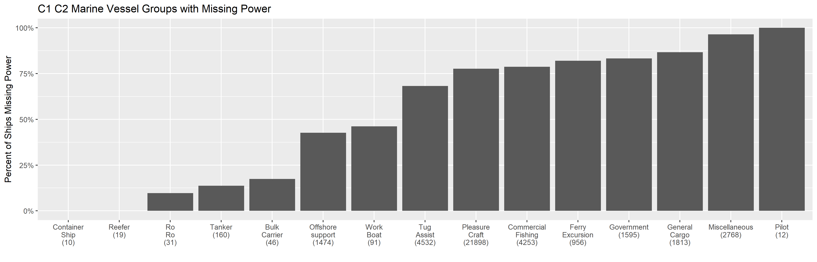
Category 1/2 Vessels Missing Power Data
Notes:
Not surprising that the need for surrogate power data to gap fill missing data is significant for C1/C2
given the lack of a central data source compared to Category 3 vessels.
Misc – very challenging given the diversity of the vessels
General Cargo
Government vessels
Ferries
Commercial fishing
Tugs

Slide 30
Default Category 1/2 Propulsion Power Assumptions
Vessel Group | Avg Build Year | Tier | Prop Power (kW)
Bulk Carrier | 1976 | 0 | 7505
Commercial Fishing | 1987 | 0 | 520
Container Ship | 1994 | 0 | 2700
Ferry Excursion | 1995 | 0 | 5322
General Cargo | 1986 | 0 | 2396
Government | 1998 | 0 | 2125
Miscellaneous | 1999 | 0 | 2337
Offshore support | 1999 | 0 | 3949
Pilot |  | 0 | 868
Reefer | 1992 | 0 | 5877
Ro Ro | 1985 | 0 | 3793
Tanker | 2003 | 0 | 6578
Tug | 1992 | 0 | 2395
Work Boat | 1989 | 0 | 3546
Notes:
So this is what has been developed based mostly on EPA data including the 2009 Port Guidance.
It is interesting that tankers tend to be newer
This is probably due to compliance with he Oil Pollution Act of 1990.
– which requires that all tankers have double hulls.
This was being phased-in starting in 1990 after the Exxon Valdez oil spill and was project to be completed by January 1, 2015.
Which accelerates typical vessel replacement from 45 years to 25 years.

Slide 31
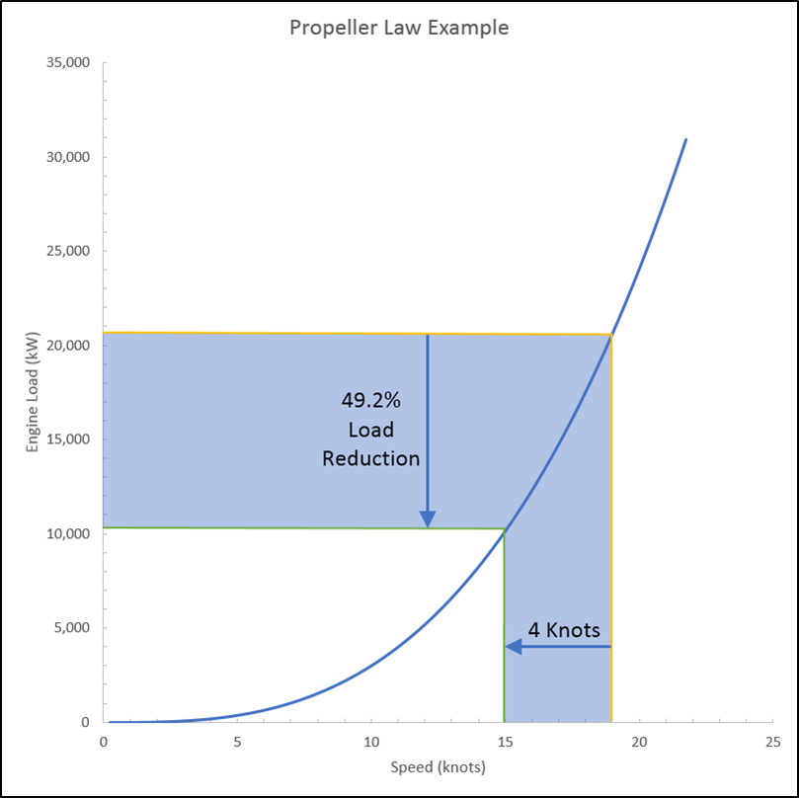
Propulsion Engine Operating Loads for Category 1/2
For Propulsion Engines
Propeller rule was used.
Requires data available for C1/C2
Holtrip & Mennen equation provides a more accurate estimate of operating load as it account for
Hull resistance
Water density
Draft
P12 = P(AS/MS)³
P12 = Propulsion power for Category 1/2 vessels
P = Power rating
of propulsion
engines
AS = Actual Speed
MS = Maximum
Speed (knts)
Both approaches assume speed is proportional to engine
operating load ignoring wave, wind and current effects
Notes:
As noted earlier, vessel operating power may vary from the maximum rated power,
particularly for C1/C2 vessels when traveling within a port or while going through locks.
So the power needs to be adjusted for the actual propulsion engine operating load.
Data for C1/C2 vessels is generally insufficient to use the Holtrip & Mennen equation
So the propeller law was used, which equates vessel speed reported in the AIS data to operating load.
To do this the vessel’s max speed is needed. If the max speed is not known,
then typical max speed values are used with the propeller law to get a rough approximation of the operating load.
The propeller law assumes that the operating load is the cube of the ratio of the actual speed over the max speed.

Slide 32
Category 1/2 Auxiliary and Boiler Power and Load Factors
Vessel Group | Avg Build Year | Tier | Aux Power (kW) | Aux Operating Load | Boiler (kW)
Bulk Carrier | 1976 | 0 | 1009 | 0.10 | 109
Commercial Fishing | 1987 | 0 | 567 | 0.56
Container Ship | 1994 | 0 | 594 | 0.19 | 506
Ferry Excursion | 1995 | 0 | 1385 | 0.56
General Cargo | 1986 | 0 | 1120 | 0.22 | 106
Government | 1998 | 0 | 2313 | 0.56
Miscellaneous | 1999 | 0 | 1069 | 0.56
Offshore support | 1999 | 0 | 1081 | 0.56
Pilot |  | 0 | 20 | 0.56
Reefer | 1992 | 0 | 2854 | 0.32 | 464
Ro Ro | 1985 | 0 | 695 | 0.26 | 109
Tanker | 2003 | 0 | 2399 | 0.26 | 346
Tug | 1992 | 0 | 162 | 0.56
Work Boat | 1989 | 0 | 1492 | 0.56
Notes:
As with C3, AIS is not helpful in estimating auxiliary and boiler operations. So EPA’s aggregated default data were used.
This table shows the auxiliary and boiler assumptions used by vessel type.

Slide 33
Category 1/2 Regulations
Tier | Year | CO | NOx | NOx + THC | NOx +HC | HC | PM
1 | 2003-2007 |  | X
2 | 2004-2014 | X |  | X |  |  | X
3 | 2009-2017 |  |  |  | X |  | X
4 | 2014 and beyond |  | X |  |  | X | X
Notes:
As with the Category 3 discussion it makes sense that we talk a little about the regulatory situation for Category 1 and 2 vessels, before we get to the emission factors..
Note these standards apply to all US flagged domestic vessels., so for foreign flagged vessels we have to assume they are uncontrol .
As you can see in this format the dates do not make a lot of sense, as the standards are phased in based on engine power and displacement.
I should also point out the nonroad fuel used by these smaller domestic vessels is 15 ppm – more stringent than then the ECA standard, which is 1000 ppm
Actually ECA is not a consideration for Category 1/2 vessels as the standards for these vessels are more stringent for Sulfur and NOx.

Slide 34
Category 1/2 Emission Factors
Main Engine Emission Factors
Model Year | Tier | NOX | VOC | CO | PM10 | PM25 | SO2 | CO2
Older than 2004 | Tier 0 | 13.36 | 0.14 | 2.48 | 0.21 | 0.20 | 0.00624 | 679.56
2004-2006 | Tier 1 | 10.55 | 0.14 | 2.48 | 0.21 | 0.20 | 0.00624 | 679.56
2007-2012 | Tier 2 | 8.33 | 0.14 | 2.03 | 0.31 | 0.30 | 0.00624 | 679.56
2013-2016 | Tier 3 | 6.35 | 0.08 | 2.03 | 0.20 | 0.19 | 0.00624 | 679.56
Newer than 2017 | Tier 4 | 1.30 | 0.02 | 2.03 | 0.11 | 0.11 | 0.00624 | 679.56
Updated with the New Port Methods and weighted vessel population to obtain average emission factors across different engine sizes
Auxiliary Engine Emission Factors
Tier | NOX | VOC | CO | PM10 | PM25 | CO2 | SO2 | HC | N2O | BC | BSFC
Tier 0 | 10.28 | 0.30 | 1.61 | 0.26 | 0.25 | 679.47 | 0.01 | 0.28 | 0.03 | 0.19 | 248.18
Tier 1 | 9.62 | 0.30 | 1.61 | 0.26 | 0.25 | 679.47 | 0.01 | 0.28 | 0.03 | 0.19 | 248.18
Tier 2 | 5.64 | 0.30 | 0.92 | 0.15 | 0.14 | 679.47 | 0.01 | 0.28 | 0.03 | 0.11 | 248.18
Tier 3 | 4.75 | 0.12 | 0.92 | 0.08 | 0.08 | 679.47 | 0.01 | 0.12 | 0.03 | 0.06 | 248.18
Tier 4 | 1.30 | 0.12 | 0.92 | 0.03 | 0.03 | 679.47 | 0.01 | 0.12 | 0.03 | 0.02 | 248.18
Boiler Engine Emission Factors
NOX | VOC | CO | PM10 | PM25 | CO2 | SO2 | Pb | N2O | CH4 | NH3
2 | 0.11 | 0.2 | 0.2 | 0.19 | 961.8 | 0.59 | 0.00005 | 0.08 | 0.002 | 0.0004
Notes:
Where vessel build date was known the appropriate Tier level was used to match vessels to their emission factors,
otherwise it was assumed that the vessel was Tier 0
Aux and boilers were assumed to have the same build date as the vessel.

Slide 35
New CMV SCCs
New SCC | Fuel | Category | Port/ Underway | Engine
2280002101 | Diesel | C1/C2 | Port | Main
2280002102 | Diesel | C1/C2 | Port | Aux
2280002201 | Diesel | C1/C2 | Underway | Main
2280002202 | Diesel | C1/C2 | Underway | Aux
2280002103 | Diesel | C3 | Port | Main
2280002104 | Diesel | C3 | Port | Aux
2280002203 | Diesel | C3 | Underway | Main
2280002204 | Diesel | C3 | Underway | Aux
2280003103 | Residual | C3 | Port | Main
2280003104 | Residual | C3 | Port | Aux
2280003203 | Residual | C3 | Underway | Main
2280003204 | Residual | C3 | Underway | Aux
Notes:
I probably should point out that the SCCs have been updated to differentiate between
Fuel
Engine Category
Whether it is a port or underway operations, and
Whether the estimates represents main or aux engine operations
It is hoped that these changes will help in assessing CMV impacts to local port areas, to support regulatory analysis and facilitate control assessments

Slide 36
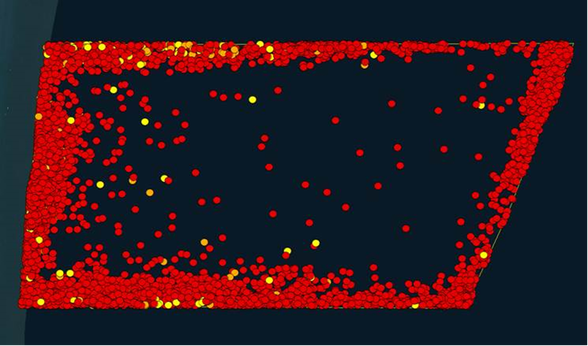
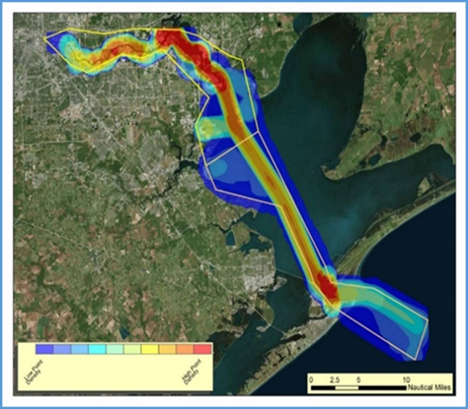
QA Checks
Check AIS data transfer (record count/ missing data/ file corruption)
Check boundary conditions – elevated duration
Check min/max/average power rating by vessel type
Check duration distribution by vessel type
(total per vessel is not greater than 8760)
Check calculated operating loads
Review Heat map of emissions
Compare with similar inventories
Compare with other similar ports
Notes:
I put this at the end but really it is critical that checks are implemented throughout the process:
For example, record counts are checked repeatedly to ensure that no data are accidentally lost in the process.
Duration errors at the boundary of a study area are not uncommon as vessels may leave the area for an extended period of time, when they come back the last known data may be months old. As shown the upper right image of a ports reduced speed zone, the red dots indicate long duration times and as you can see they cluster around the boundary.
We also look at vessel power ratings by vessel type, for instance if we have a fishing boat with 65,000 kWs or a Cruise ship with 700 kWs,, there may be an issue here.
Because we calculate all the durations for each observations, we can sum up the durations based on a vessels unique MMSI code to ensure that it is less than 8760 hours per year.
We also sort the calculated operating loads to make sure no value is unrealistically large
We also look at heat maps of activity or emissions to identify hot spots and evaluate whether the hot spots are reasonable.
Look at other similar AIS inventories for similar ports is also a good QA check, but you have to make sure the years are relatively close as coverage continues to get better every year.

Slide 37
Example Category 1/2 QA Check
Port | NEI Ranking Based on NOX Emissions for Port Shape files
Port Fourchon, LA | 1
NY/NJ | 2
Houston, TX | 3
Galveston, TX | 4
San Diego, CA | 5
Port of Plaquemines, LA | 6
Lake Charles, LA | 7
Corpus Christi, TX | 8
State | Million Domestic Tons (USACE) | % of Total Domestic
LA | 292.84 | 20.1
TX | 155.87 | 10.7
 | % of total | 30.8
Notes:
An example the type of checks performed on the 2017 NEI data concerns the observation that C1/C2 has a very large amount of activity in TX and LA -
of the top 8 areas for C1/C2 NOx emissions - 6 are in TX or LA
But when compared to USACE cargo data
these two states represent nearly 31% of domestic marine cargo movements .
This does not include offshore O&G support vessels or cruise ships which do not carry cargo.
So the elevated activity in this area are reasonable.

Slide 38
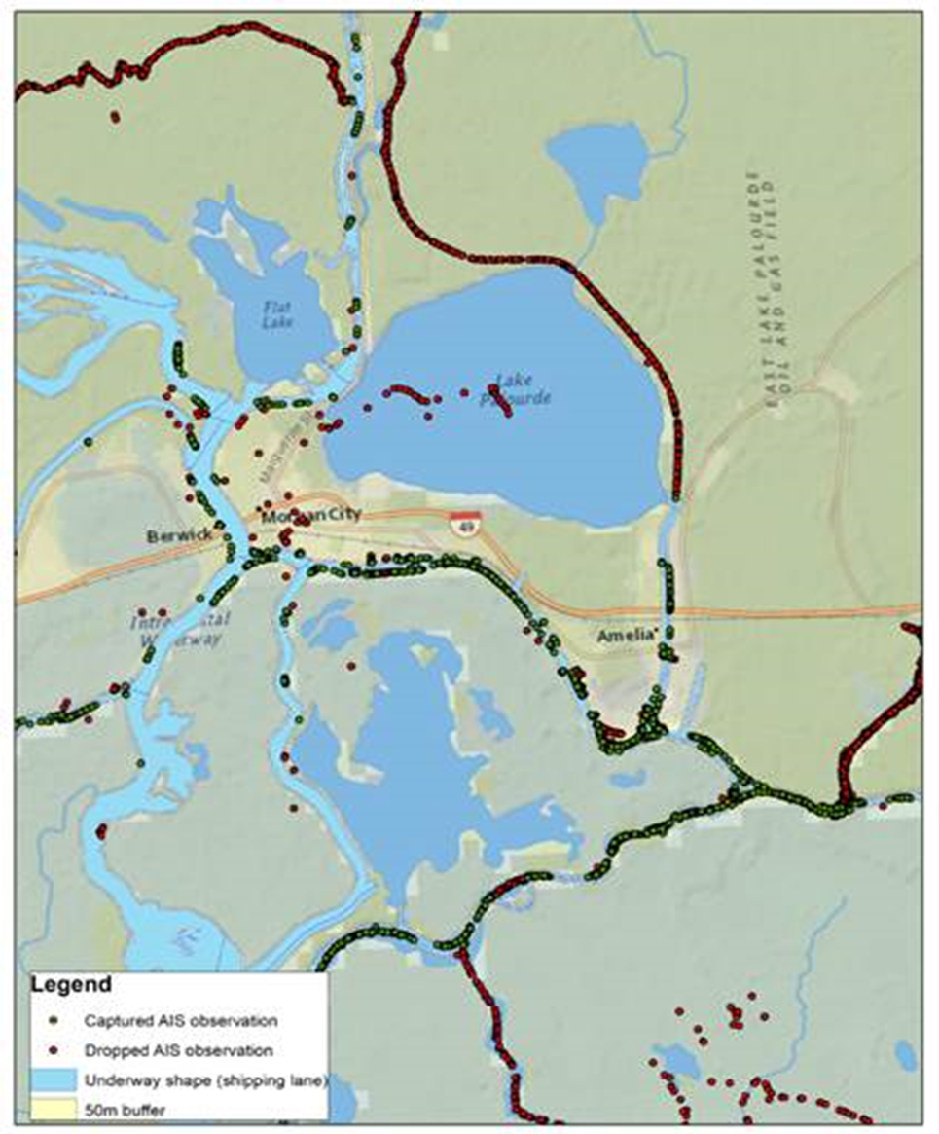
Spatial Aspects
Port Shape files – required for new SCCs
QA check noted underway operations along shipping lanes without shapefiles.
Underway - County FIPs
May need assistance from States to identify AIS anomalies
Notes:
AIS shows the exact location of the vessel,
but when the latitude and longitude coordinates were compared to pervious NEI underway shape files,
there were a large number of vessel movements outside the underway shapes.
So for 2017 the underway shapes were ignored and county boundaries (FIP codes) were used instead.
Also note that Port Shape files are still necessary to assign appropriate SCCs ( port vs Underway)

Slide 39
 | C3 2017 Annual Emissions (tons)
Shiptype | CO | CO2 | NOx | PM2.5 | PM10 | SO2 | VOC
Bulk carrier | 13,037 | 5,771,469 | 127,281 | 6,239 | 6,782 | 43,950 | 6,875
Containership | 26,956 | 10,993,733 | 256,050 | 12,207 | 13,269 | 86,508 | 14,225
Cruise | 4,505 | 2,954,470 | 44,752 | 1,033 | 1,123 | 4,708 | 1,849
Ferry/RoRo/pax | 103 | 57,720 | 1,031 | 22 | 24 | 94 | 57
General cargo | 328 | 167,231 | 2,894 | 79 | 86 | 403 | 189
Miscellaneous | 1,168 | 542,173 | 11,635 | 446 | 485 | 2,915 | 631
Offshore | 2,072 | 760,928 | 17,984 | 509 | 553 | 2,743 | 1,299
Reefer | 612 | 321,130 | 7,015 | 439 | 477 | 3,298 | 293
RoRo | 5,243 | 2,684,060 | 53,363 | 2,005 | 2,179 | 13,484 | 2,615
Tanker | 19,854 | 10,559,889 | 177,266 | 5,9891 | 6,509 | 35,193 | 11,524
Yacht | 3 | 1,757 | 29 | 1 | 1 | 2 | 2
TOTAL | 73,882 | 34,814,560 | 699,300 | 28,968 | 31,487 | 193,299 | 39,560
 | C1/C2 2017 Annual Emissions (tons)
Shiptype | CO | CO2 | NOx | PM2.5 | PM10 | SO2 | VOC
Bulk Carrier | 363 | 164,921 | 2,376 | 61 | 63 | 9 | 76
Commercial Fishing | 1,494 | 631,014 | 9,811 | 245 | 252 | 6 | 321
Container Ship | 62 | 31,780 | 411 | 11 | 11 | 4 | 13
Ferry Excursion | 3,323 | 1,433,040 | 22,498 | 575 | 592 | 13 | 844
General Cargo | 5,483 | 3,133,513 | 38,112 | 1,108 | 1,146 | 574 | 1,470
Government | 4,758 | 2,013,195 | 30,836 | 762 | 786 | 19 | 958
Miscellaneous | 1,427 | 608,594 | 9,825 | 253 | 261 | 6 | 382
Offshore support | 5,427 | 2,600,502 | 35,481 | 893 | 921 | 24 | 1,353
Reefer | 29 | 14,914 | 189 | 5 | 5 | 2 | 6
Ro Ro | 86 | 42,858 | 564 | 15 | 15 | 5 | 18
Tanker | 404 | 240,484 | 2,645 | 76 | 79 | 43 | 92
Tug | 7,992 | 3,523,258 | 57,924 | 1,548 | 1,596 | 32 | 2,706
Work Boat | 441 | 190,490 | 2,965 | 76 | 78 | 2 | 110
TOTAL | 31,290 | 14,628,561 | 213,637 | 5,628 | 5,807 | 738 | 8,348
Results
Notes:
Way too many numbers.
But just to put it into perspective
C3 represent the majority of CMV emissions.
More than double the CO2 emissions
More than triple the NOx, and
5 to 6 times the PM
Over C1/C2.

Slide 40
Comparison of NO_{X} Emissions by Engine Category
Notes:
For NOx, the differences between C3 and C1/C2 presented in these comparison pie charts make sense :
- C3 is mostly container ships, bulk carriers and tankers
Very few tugs, offshore vessels and general cargo,
- While the opposite is the case for C1/C2,
Mostly tugs, offshore support and general cargo
Very few container ships , bulk carrier and tankers

Slide 41
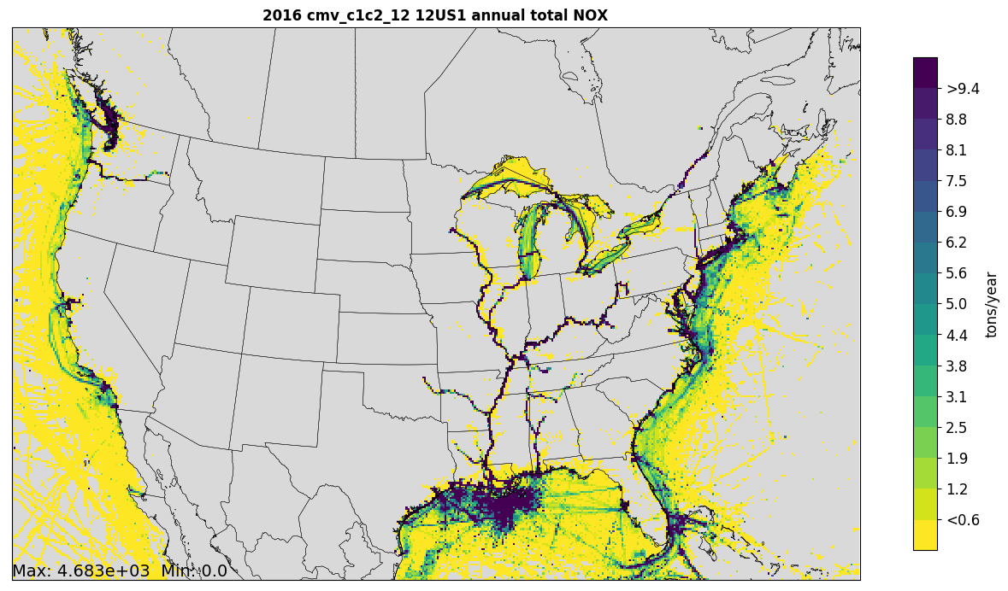
Notes:
Similarly for spatial aspects of the data
C1/C2 they operate inland,
close to the coast and
the Gulf of Mexico servicing the oil and gas platforms

Slide 42
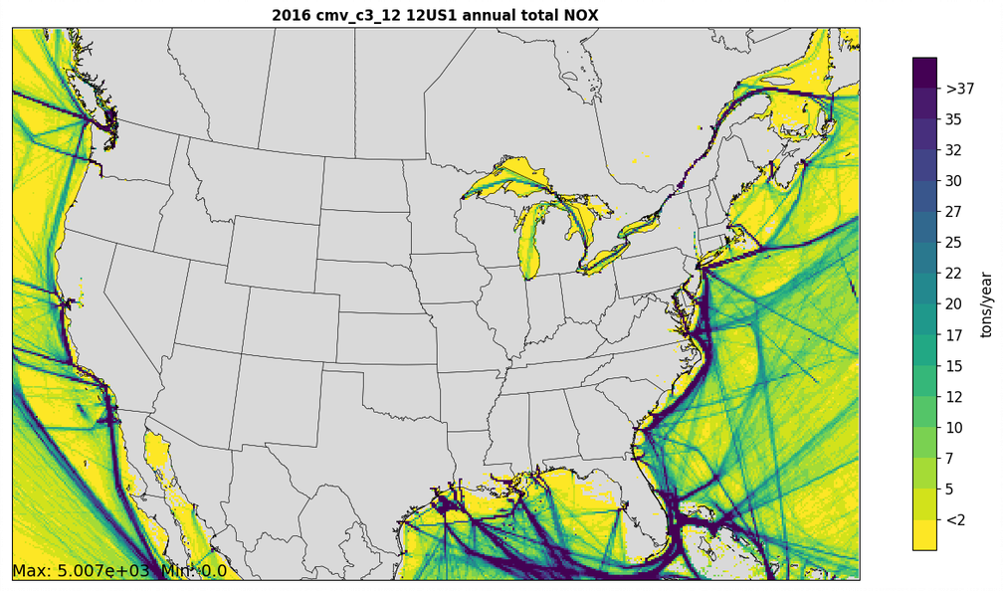
Notes:
While C3
do not operate inland and
tend to jump to international shipping lanes.

Slide 43
Data Aggregation for Air Quality Modeling (Part 1)
The same 5-minute resolution data used to create the NEI are being used to prepare data for air quality modeling
Step 1 “rasterization”:
Run an R script to aggregate the 5-minute data into hourly data for each grid cell,
This step adds up all of the 5-minute data within the “box” outlined by the grid cell + county combination and within a specific hour for each SCC
The county assignment can be important to place the emissions in the appropriate counties in certain areas, and example is the New York - New Jersey area
The release points used for the inventory are the center of each grid cell
Information on the ship type and port (where applicable) are retained

Slide 44
Data Aggregation for Air Quality Modeling (Part 2)
Step 2 create flat files with “cmv2ff10”:
Uses the output of the rasterization script and prepares for each country an annual and a set of hourly “flat files” that SMOKE can read and process for the AQM
Flat files are text files that include information for each source, SCC, pollutant, and time period (annual or hourly in this case)
Latitude and Longitude coordinates are included for each grid cell (aka source or release point)
Stack parameters for the release points (one per grid cell) are specified as:
C3: height = 65.62 ft, diameter = 2.625 ft, temperature = 539.6 °F, and velocity = 82.02 ft/s
C1C2: height = 1 ft, diameter = 1 ft, temperature = 70°F, and velocity = 0.1 ft/s.
For C3: remove data in grid cells that contain only interpolated values or are found in counties deemed to be not suitable for C3 emissions
For emissions in ports, set the county FIPS ID to match the FIPS of the NEI port shape

Slide 45
Adjustments to Model Other Base years
If the year to be modeled is not the same year as that of the activity data (e.g., we want to model 2016 but our emissions / activity are for the year 2017):
Step 1: apply adjustment factors to the make the emissions levels more representative of the desired year
The table shows the factor used to create 2016 emissions from 2017 emissions – these are based on entrance and clearance data for C3 vessels
For C1C2, 2017 emissions were multiplied by 0.98 to create 2016 emissions
Step 2: output the data so that the days of week and holidays in the year of the activity data match the days of week and holidays in the desired year
a date mapping table is used
Ship Type | Annual Ratio (2017->2016)ª
Barge | 1.551
Bulk Carrier | 1.067
Chemical Tanker | 1.031
Container Ship | 1.0345
Cruise | 1.008
Ferry Ro Pax | 1.429
General Cargo | 0.888
Liquified Gas Tanker | 1.192
Miscellaneous Fishing | 0.932
Miscellaneous Other | 1.015
Offshore | 0.860
Oil Tanker | 1.101
Other Tanker | 1.037
Reefer | 0.868
Ro Ro | 1.007
Service Tug | 1.074

Slide 46
Hoteling Adjustments and Quality Assurance
For stationary vessels (aka “hoteling”) – emissions should not appear in 1 hour for models:
Spread emissions assigned to the first hour over each hour the vessel was stationary. Script: scale_hoteling_mp_shp.py
If the vessel was stationary for over 400 hours, remove emission that occurred after hour 400
Quality assurance checks for any situations that result in emissions less than 0
This can occur when there is a grid misalignment between the hourly data and hoteling data
Other QA checks for CMV modeling files:
Hourly data values are scanned for high emissions that may need additional investigation / validation
Scripts compare the same emissions allocated to overlapping grids and unadjusted vs. adjusted emissions
Hourly emissions in the flat files are compared to values in the annual FF10 flat file

Slide 47
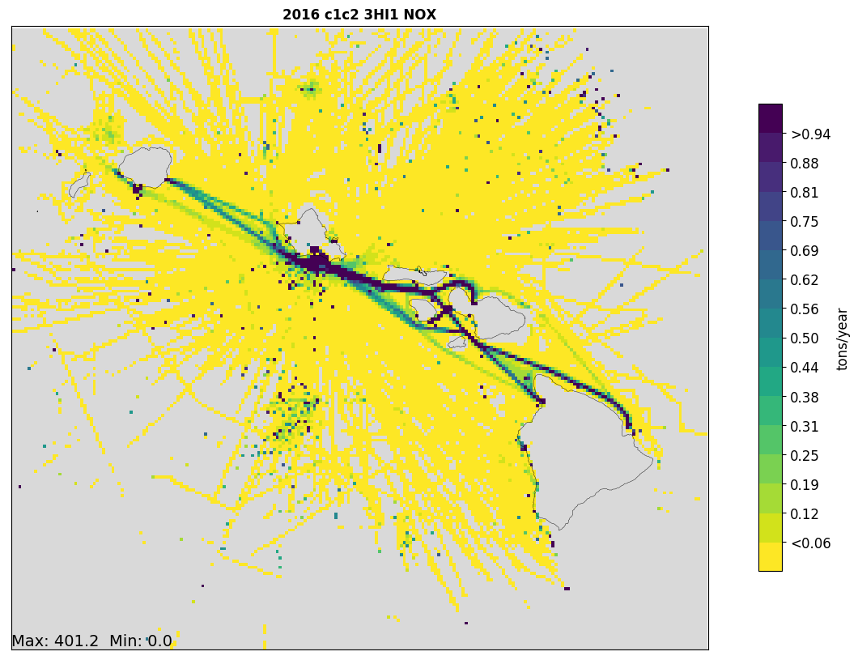
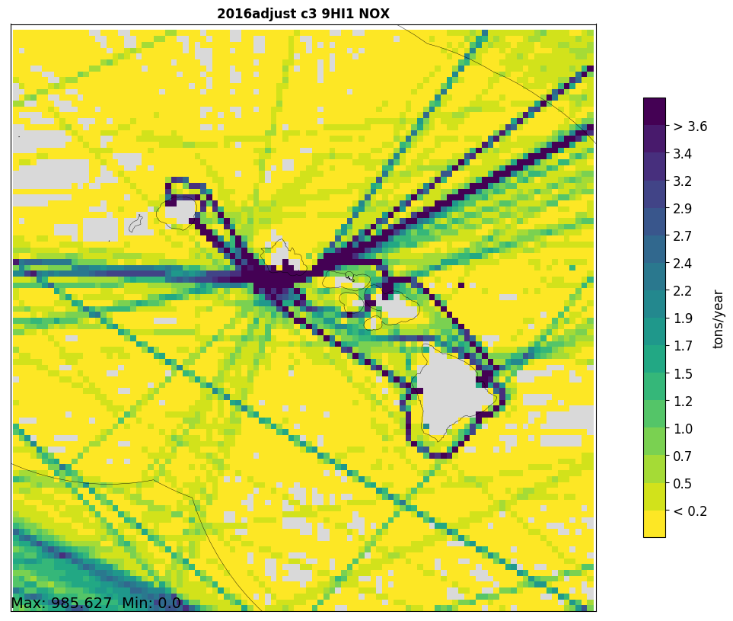
Hawaii CMV NOx at 3km and 9km Resolutions
C1C2 vessels go between and near the Islands (3km)
C3 ships go around and to/from islands (9km)
> 0.94
> 3.6

Slide 48
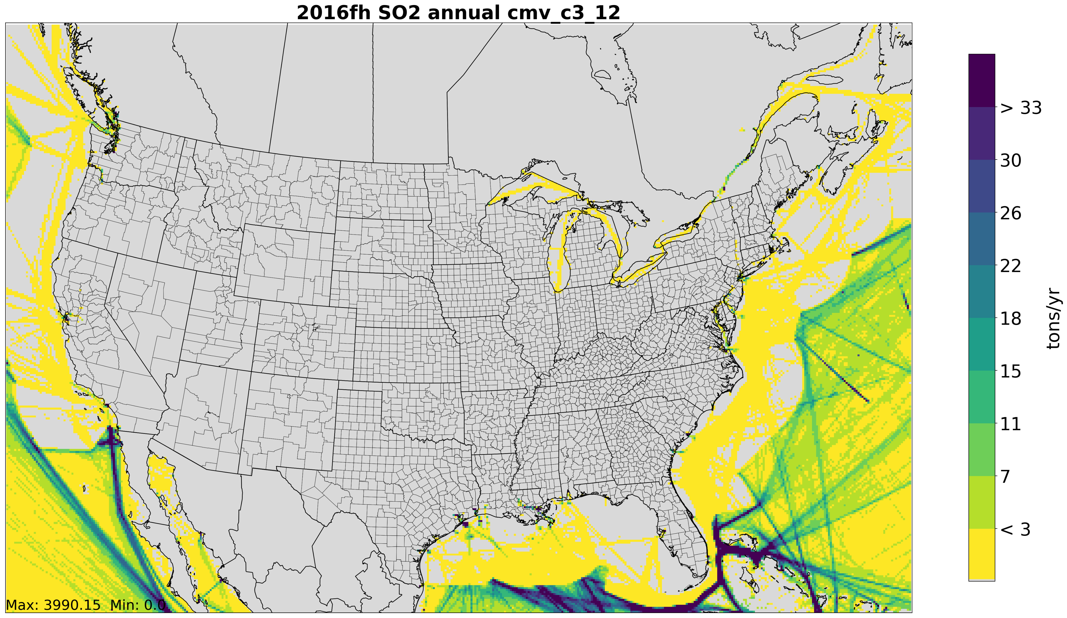
km
SO2 reductions in ECA region from cleaner fuels are captured
Notes:
SO2 emissions are reduced in the ECA region (aka “Federal Waters”)

Slide 49
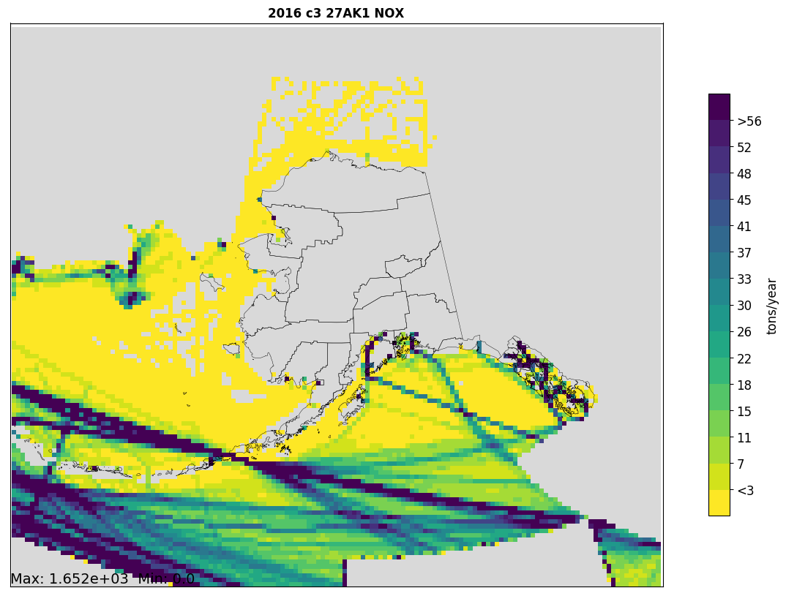
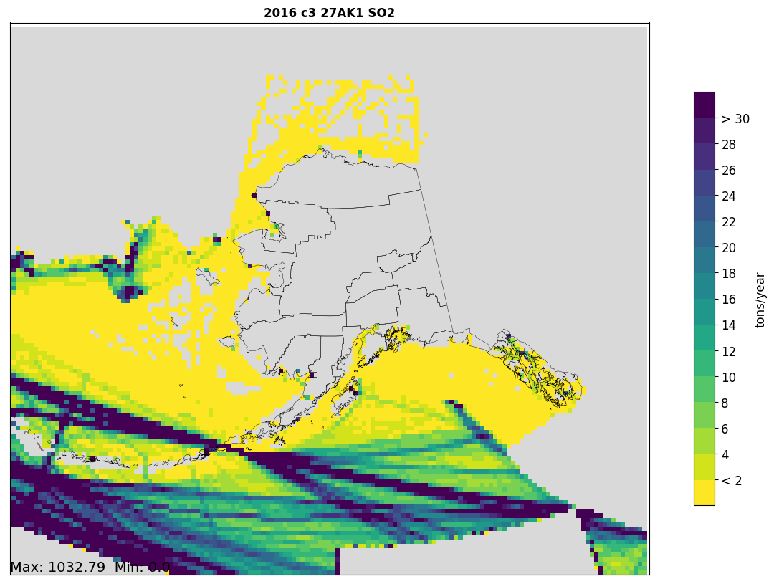
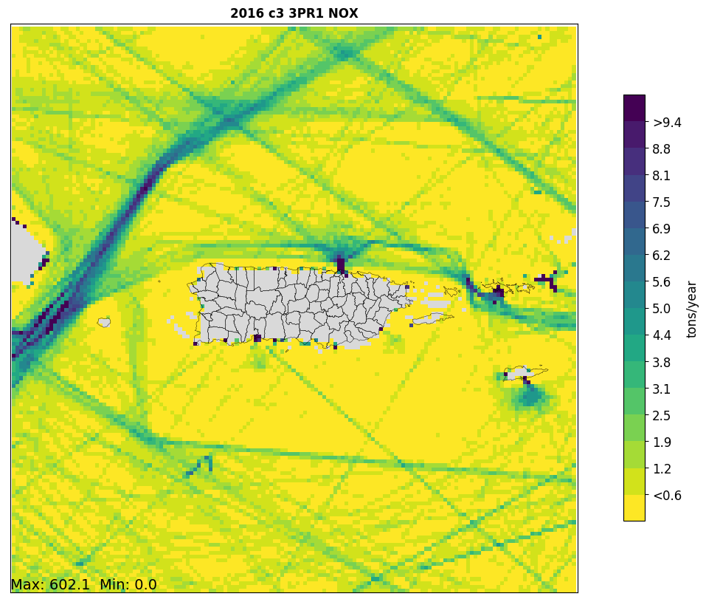
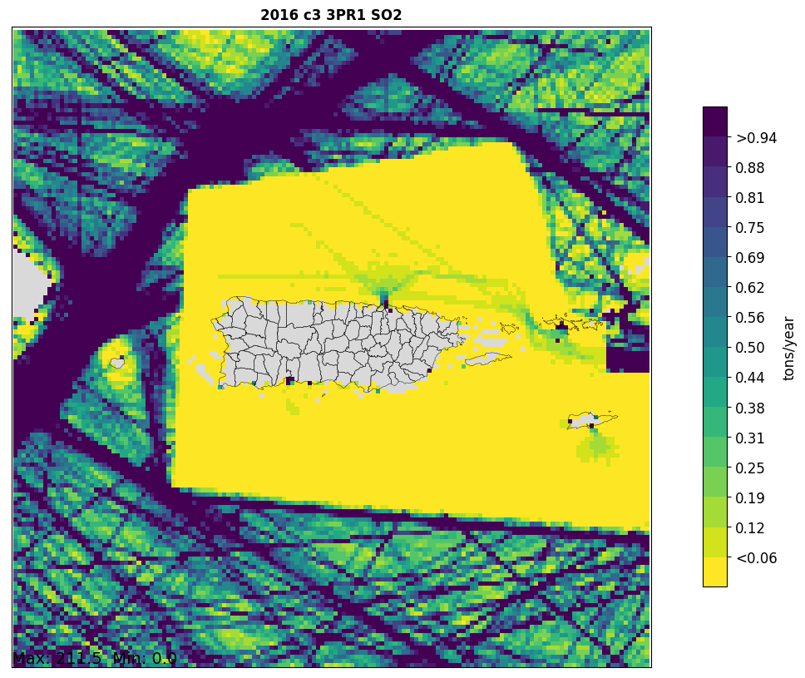
> 56
> 30
SO2 is
reduced in
Federal Waters
27km grid
around Alaska (9km also available)
3km grid around
Puerto Rico
(9km and 27km also available)
> 9.4
> 0.94

Slide 50
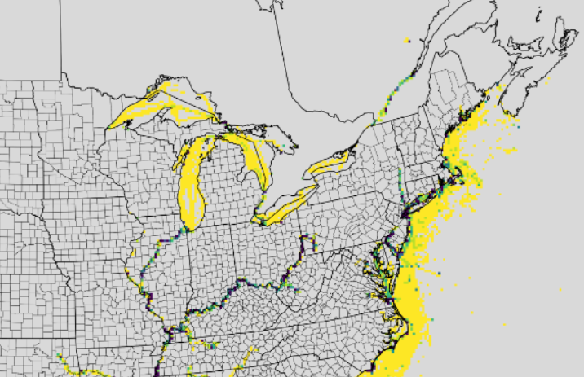
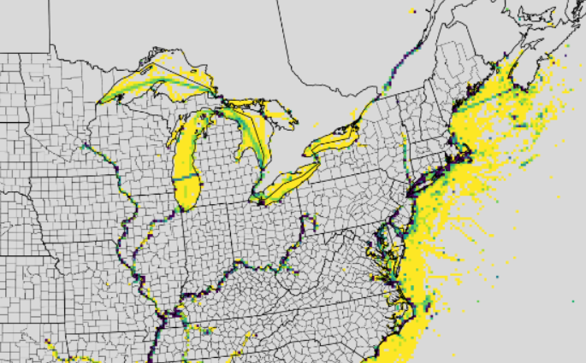
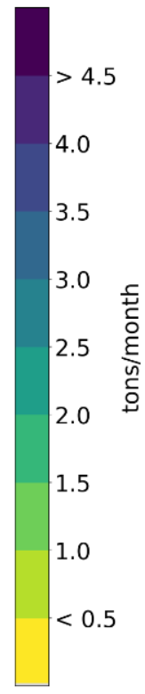
Seasonal Effects are Captured
January, 2017 NOx
July, 2017 NOx
You can see the ferry routes in the
Great Lakes and from Maine to
Nova Scotia in July but not January
There is also more traffic in the Great Lakes, Mississippi River, and St. Lawrence Seaway Traffic in July

Slide 51
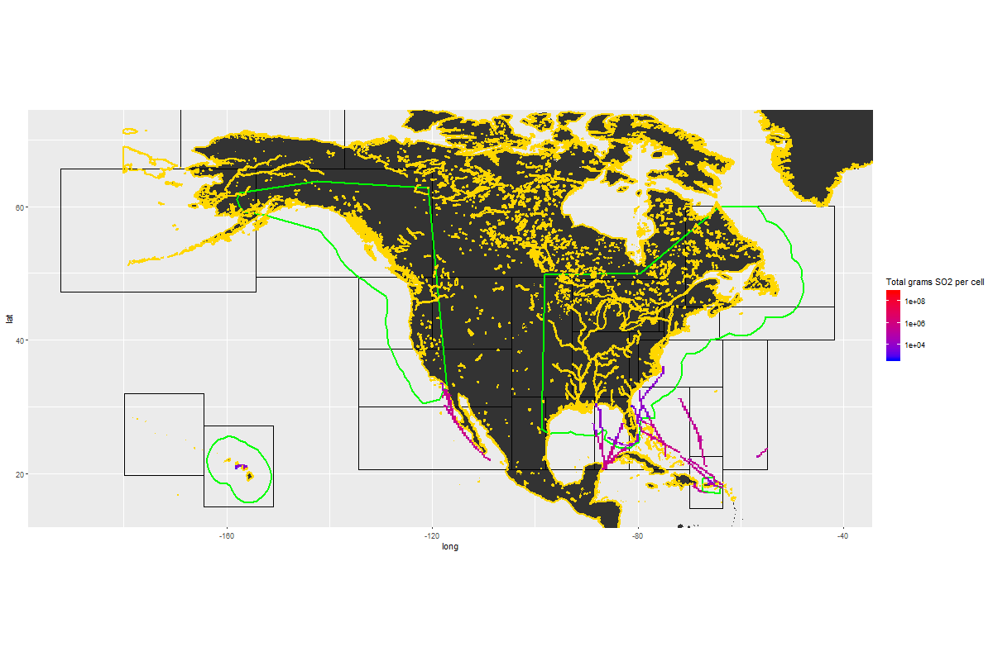
Time-resolved emissions
Animation of 2017 SO2 Emissions from Cruise Ships ≥ 100,000 GT (1 frame/day)
Notes:
And of course some cool
Cruise ship animation

Slide 52
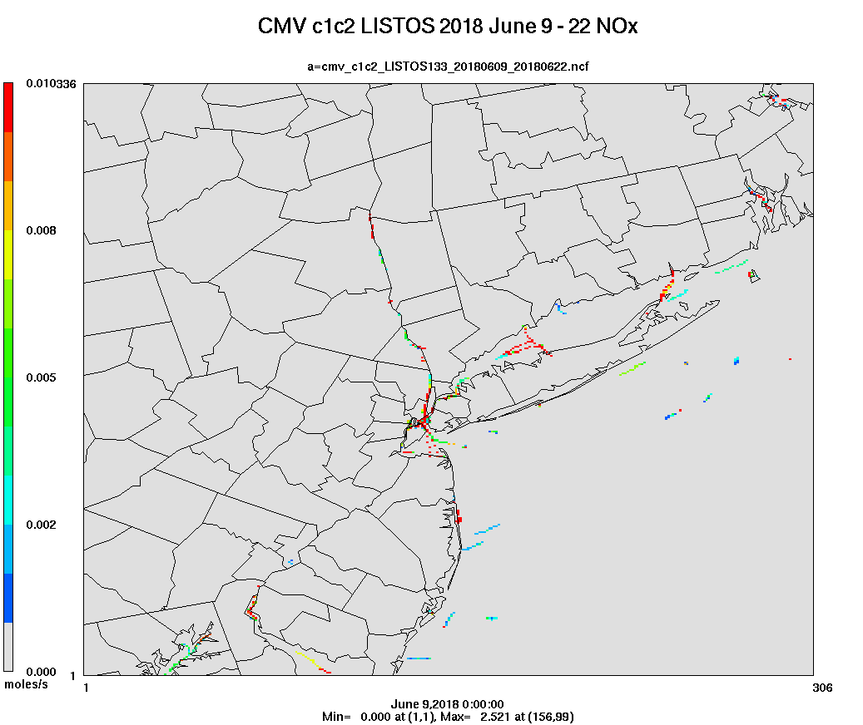
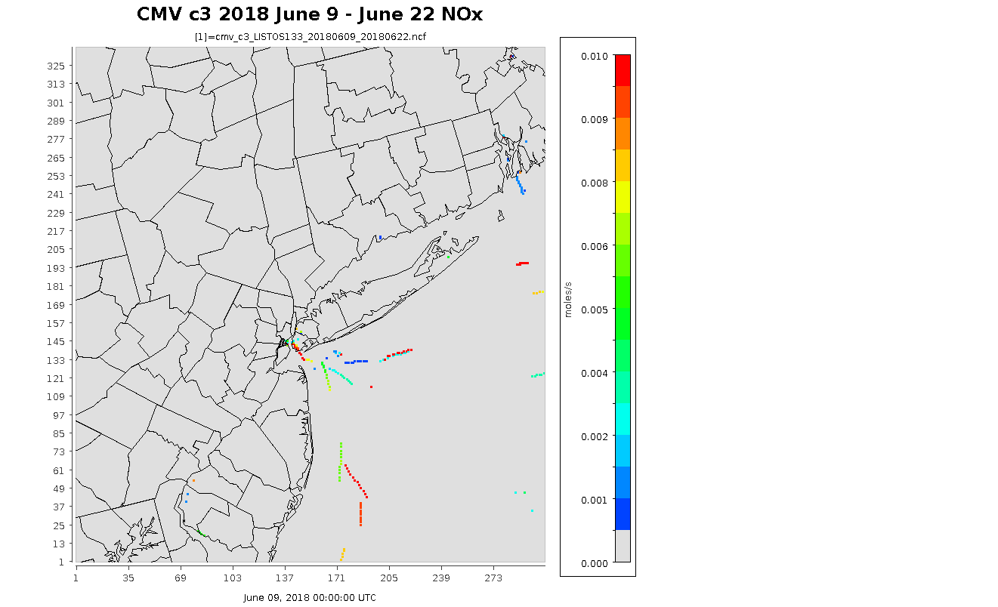
Hourly CMV Animation

Slide 53
C3 Projection Factors for Future Years
Federal Waters Region | 2016-to-2023 NOX | 2016-to-2023 other pollutants | 2016-to-2028 NOX | 2016-to-2028 other pollutants
US East Coast | -6.1% | 27.7% | -7.5% | 49.7%
US South Pacific* | -24.8% | 20.9% | -34.0% | 45.9%
US North Pacific | -3.4% | 22.6% | -4.1% | 41.3%
US Gulf | -6.9% | 20.8% | -12.4% | 36.4%
US Great Lakes | 8.7% | 14.6% | 19.8% | 28.3%
Other | 23.1% | 23.1% | 42.6% | 42.6%
Non-Federal Waters | 2016-to-2023 | 2016-to-2028
SO2 | -77.2% | -73.6%
PM (main engines) | -36.1% | -25.9%
PM (aux. engines) | -39.7% | -30.1%
Other pollutants | +23.1% | +42.6%
California Pollutant | 2016-to-2023 | 2016-to-2028
CO | 18.0% | 34.0%
NOx | 15.6% | 32.7%
PM₁₀ / PM_{2.5} | 20.5% | 38.1%
SO₂ | 18.3% | 33.2%
VOC | 24.2% | 46.1%
Notes:
Growth rates for cmv_c3 emissions from 2016 to 2023 and 2028 were developed using a forthcoming EPA report on projected bunker fuel demand. The report projects bunker fuel consumption by region out to the year 2030. Bunker fuel usage was used as a surrogate for marine vessel activity. To estimate future year emissions of CO, CO2, hydrocarbons, PM10, and PM2.5, the bunker fuel growth rate from 2016 to 2023, and 2028 were directly applied to the estimated 2016 emissions. Applied to annual files with Control Strategy Tool within EMF, and scripts update hourly files.
Growth factors for NOx emissions were handled separately to account for the phase in of Tier 3 vessel engines. To estimate these emissions, the NOx growth rates from the EPA C3 Regulatory Impact Assessment (RIA) were refactored to use the new bunker fuel usage growth rates. The assumptions of changes in fleet composition and emissions rates from the C3 RIA were preserved and applied to the new bunker fuel demand growth rates for 2023, and 2028 to arrive at the final growth rates https://nepis.epa.gov/Exe/ZyPURL.cgi?Dockey=P1005ZGH.TXT

Slide 54
C1C2 Projection Factors for Future Years
National Projection Factors
California Projection Factors
Pollutant | 2016-to-2023 | 2016-to-2028
CO | -2.67% | -1.11%
NOX | -34.6% | -48.7%
PM10 | -36.2% | -49.6%
PM2.5 | -36.2% | -49.6%
SO2 | -86.2% | -86.5%
VOC | -37.0% | -51.4%
Pollutant | 2016-to-2023 | 2016-to-2028
CO | 20.1% | 25.3%
NOX | -29.3% | -17.7%
PM10 | -29.9% | -33.5%
PM2.5 | -29.9% | -33.5%
SO2 | 24.1% | 48.7%
VOC | 1.5% | 1.9%
National C1C2 projection factors are derived from the Regulatory Impact Analysis (RIA) Control of Emissions of Air Pollution from Locomotive Engines and Marine Compression Ignition Engines Less than 30 Liters per Cylinder (US EPA, 2009).
California factors are based on data provided by CARB.

Slide 55
Summary
The New CMV emissions model framework derived from AIS data
AIS data allows the use of more refined propulsion power modeling
Geospatial approach allows more precise modeling of ECA emissions
Maintains high spatial and temporal resolution in output
Allows for projections and back casting
Notes:
In Summary.
There are notable benefits in associated with the EPA’s New AIS-Based CMV model.
Can estimate propulsion loads more accurately, allowing for better quantification of low load operations
Way better spatial refinement than even the 2014 inventory based on USACE data
Which allows for better modeling of ECA impacts
Plus the 5 minute sampling interval improves the temporal component of the model
We are currently working on methods to streamline the preprocessing of the AIS and vessel attribute data to be less burdensome.
At this point,
now that you are aware of the data and functionality of the CMV model ,
I hope you can appreciate just how far we have come since 1971…and with that thought I am done.

Slide 56
Additional Resources
2017 NEI CMV documentation (https://www.epa.gov/air-emissions-inventories/2017-national-emissions-inventory-nei-data),
2016v1 platform documentation https://www.epa.gov/air-emissions-modeling/2016v1-platform
2019 IEIC presentations (https://www.epa.gov/air-emissions-inventories/mobile-session-2019-eic), and
EPA draft ports inventory methodology (https://www.epa.gov/ports-initiative/port-and-goods-movement-emission-inventories)
IMO/international regs (https://www.epa.gov/regulations-emissions-vehicles-and-engines/international-standards-reduce-emissions-marine-diesel),
Notes:
If you need more details about the topics presented here, I have included a slide of additional resources you may want to consider
NEI Documentation
Documentation for the 2016 platform.
Two presentation made at last years EI conference in Dallas.
the recent Port EI methodologies, and
A link for the Annex 6 regulations.

