Slide 1

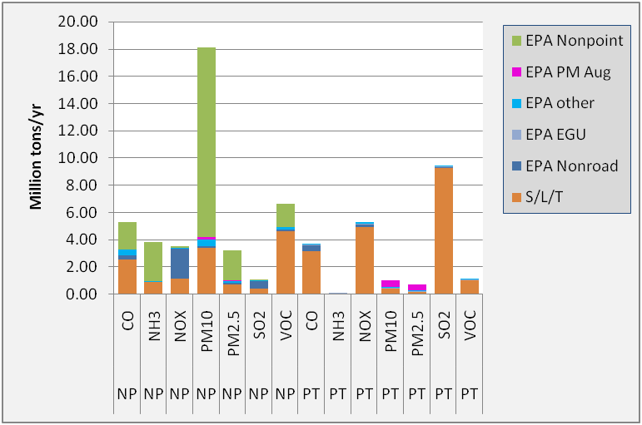
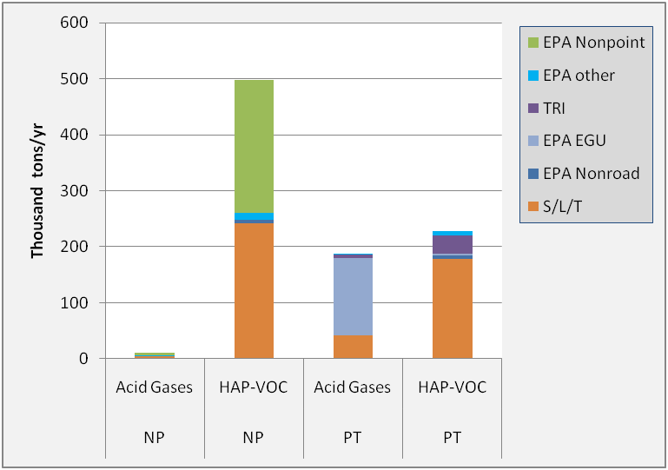
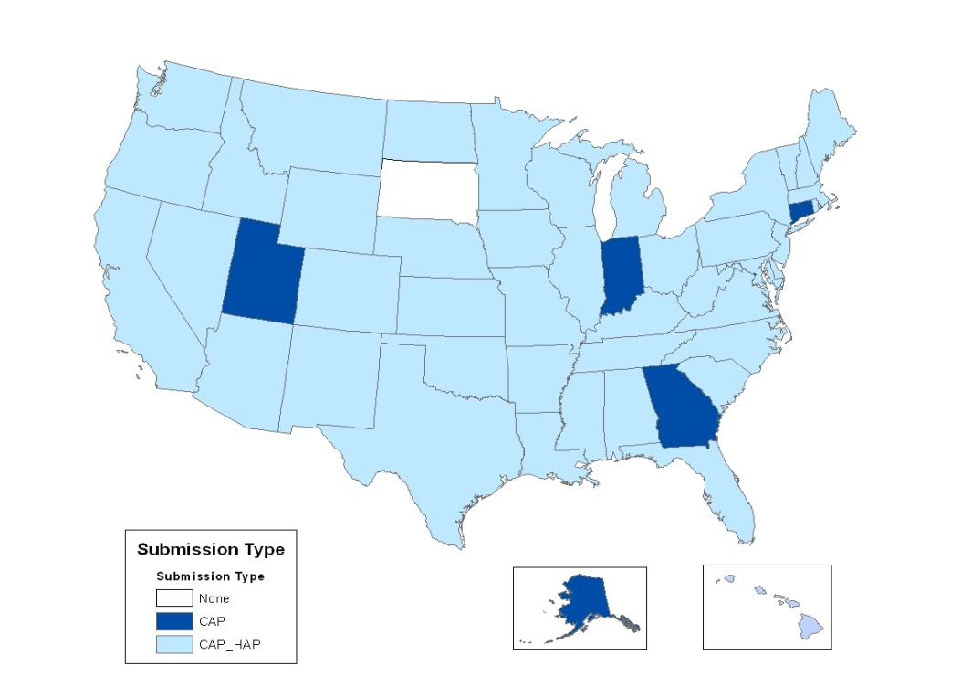
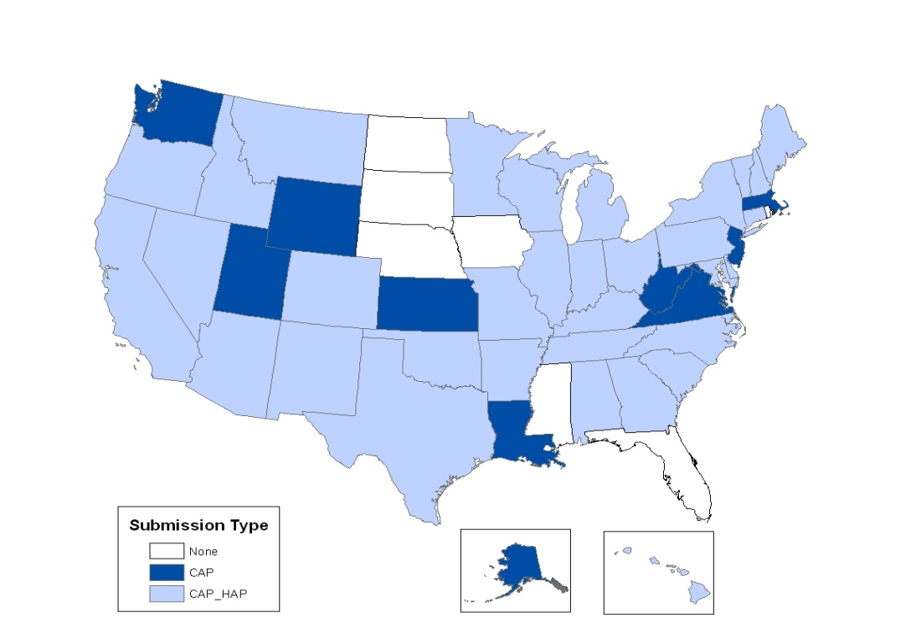
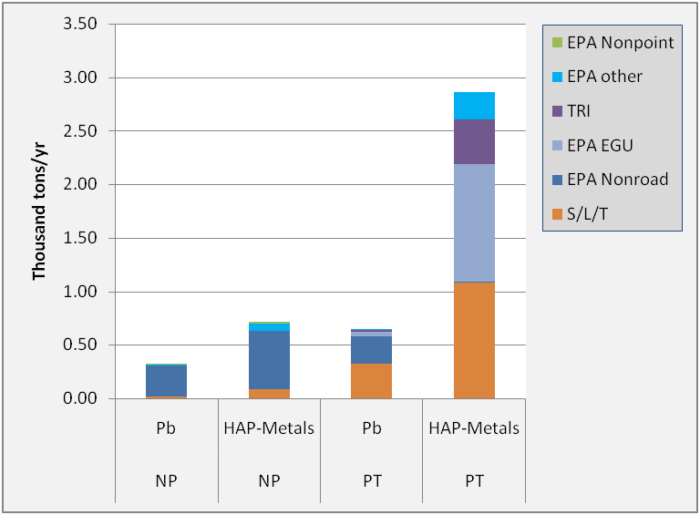
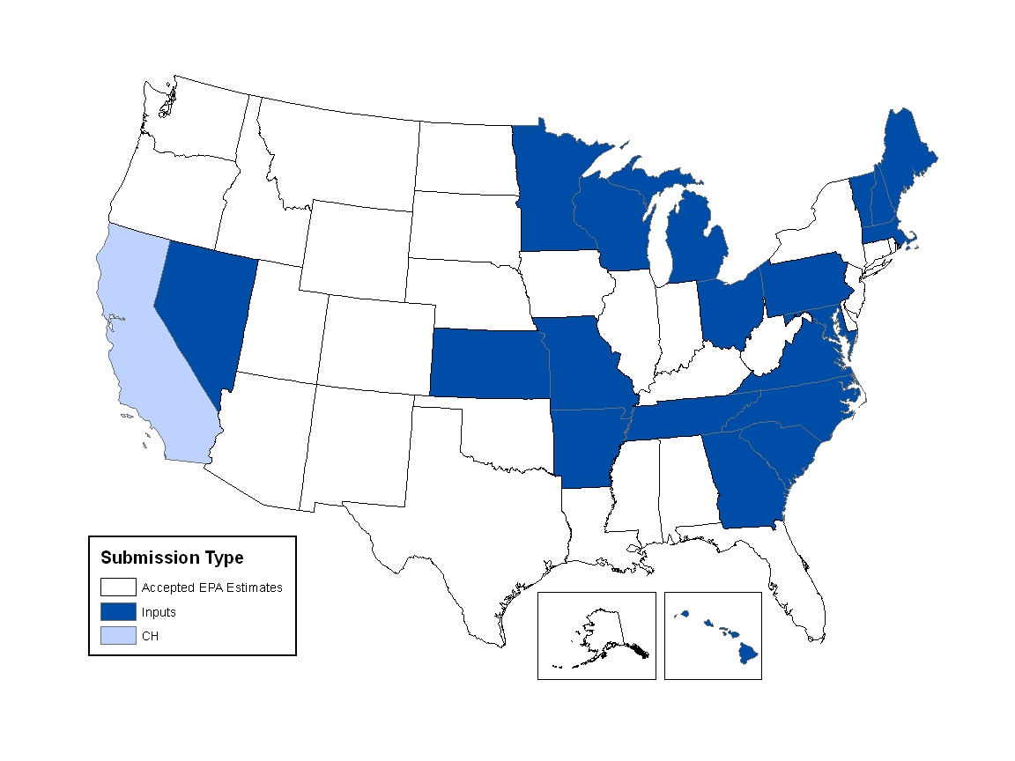
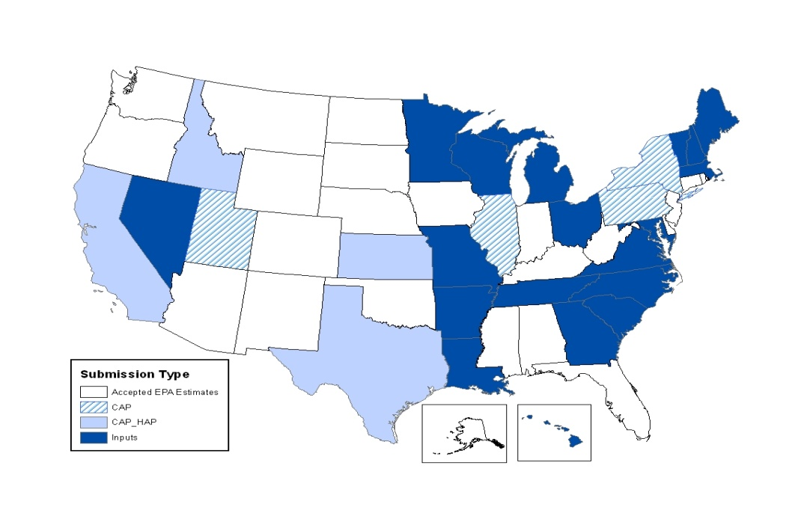
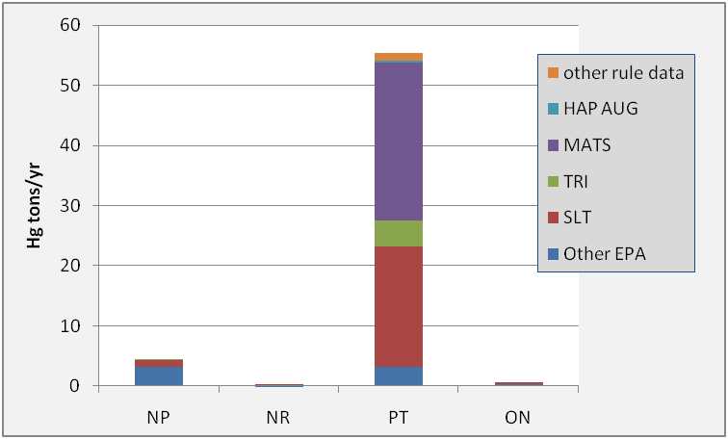
2008 v2 National Emission Inventory
Marc Houyoux, Madeleine Strum, Ron Ryan, Laurel Driver, Roy Huntley, Venkatesh Rao, and Sally Dombrowski, U.S. Environmental Protection Agency, Emission Inventory and Analysis Group
What data sources makeup the NEI?
Data in the NEI come from a variety of sources. The emissions are predominantly from S/L/T agencies for both CAP and HAP emissions. In addition, EPA quality assures and augments the data provided by states to assist with data completeness, particularly with the HAP emissions since the S/L/T HAP reporting is voluntary. Additional details on EPA’s augmentation datasets are available in the 2008 v2 Documentation.
What data are included in the 2008 NEI, version 2 General Public Release?
The 2008 National Emissions Inventory (NEI), version 2 General Public Release is a national compilation of emissions sources collected from state, local, and tribal air agencies as well as from emissions information from EPA emissions programs including the Toxics Release Inventory (TRI), emissions trading programs such as the Acid Rain Program, and data collected as part of EPA regulatory development for reducing emissions of air toxics. The NEI program develops datasets, blends data from these multiple sources, and performs quality assurance steps that further enhance and augment the compiled data. The emissions data in the NEI are generally provided for detailed emissions processes within a facility for large “point” sources or within a county for smaller “nonpoint” sources.
The pollutants included in the NEI are the pollutants related to implementation of the National Ambient Air Quality Standards (NAAQS), known as criteria air pollutants (CAPs), as well as hazardous air pollutants (HAPs) associated with EPA’s Air Toxics Program. The CAPs have ambient concentration limits or are precursors for pollutants with such limits from the NAAQS program. These pollutants include lead (Pb), carbon monoxide (CO), nitrogen oxides (NOX), volatile organic compounds (VOC), sulfur dioxide (SO2), ammonia (NH3), particulate matter 10 microns or less (PM10) and particulate matter 2.5 microns or less (PM2.5). The HAP pollutants include the 187 remaining HAP pollutants from the original 188 listed in Section 112(b) of the 1990 Clean Air Act Amendments. Key HAP emissions sources include mercury (Hg), hydrochloric acid (HCl) and other acid gases, heavy metals such as nickel and cadmium, and hazardous organic compounds such as benzene, formaldehyde, and acetaldehyde.
The current list of HAPs is available at http://www.epa.gov/ttn/atw/188polls.html.
Table 1: Percentage of emissions from different data sources in 2008 NEI by pollutant and EIS sector
 | CO |  |  | VOC |  |  | NOX |  |  | SO2 |  |  | PM2.5 |  |  | PM10 |  |  | NH3 |  |  | Total HAP |  |  |  | Acid Gases |  |  |  | HAP-VOC |  |  |  | HAP-Metals
Sector | S/L/T | EPA NP & Mob | EPA other | S/L/T | EPA NP & Mob | EPA other | S/L/T | EPA NP & Mob | EPA other | S/L/T | EPA NP & Mob | EPA other | S/L/T | EPA NP & Mob | EPA other | S/L/T | EPA NP & Mob | EPA other | S/L/T | EPA NP & Mob | EPA other | S/L/T | EPA NP & Mob | TRI | EPA other | S/L/T | EPA NP & Mob | TRI | EPA other | S/L/T | EPA NP & Mob | TRI | EPA other | S/L/T | EPA NP & Mob | TRI | EPA other
Agriculture - Crops & Livestock Dust |  |  |  |  |  |  |  |  |  |  |  |  | 13 | 78 | 9 | 14 | 77 | 9 |  |  |  | 0 | 0 | 0 | 100 |  |  |  |  |  |  |  |  | 0 | 0 | 0 | 100
Agriculture - Fertilizer Application |  |  |  |  |  |  |  |  |  |  |  |  |  |  |  |  |  |  | 23 | 77 | 0
Agriculture - Livestock Waste |  |  |  | 100 | 0 | 0 |  |  |  |  |  |  | 100 | 0 | 0 | 100 | 0 | 0 | 22 | 78 | 0 | 100 | 0 | 0 | 0 |  |  |  |  |  |  |  |  | 100 | 0 | 0 | 0
Bulk Gasoline Terminals | 100 | 0 | 0 | 100 | 0 | 0 | 100 | 0 | 0 | 100 | 0 | 0 | 3 | 0 | 97 | 28 | 0 | 72 | 100 | 0 | 0 | 97 | 0 | 3 | 0 | 0 | 0 | 100 | 0 | 97 | 0 | 3 | 0 | 4 | 0 | 81 | 15
Commercial Cooking | 33 | 67 | 0 | 42 | 58 | 0 | 100 | 0 | 0 | 100 | 0 | 0 | 34 | 66 | 0 | 39 | 61 | 0 |  |  |  | 22 | 78 | 0 | 0 |  |  |  |  | 22 | 78 | 0 | 0
Dust - Construction Dust | 100 | 0 | 0 | 100 | 0 | 0 | 100 | 0 | 0 | 100 | 0 | 0 | 31 | 69 | 0 | 28 | 72 | 0 | 0 | 0 | 100 | 2 | 0 | 0 | 98 |  |  |  |  | 54 | 0 | 0 | 46 | 0 | 0 | 0 | 100
Dust - Paved Road Dust |  |  |  |  |  |  |  |  |  |  |  |  | 21 | 67 | 12 | 41 | 49 | 10
Dust - Unpaved Road Dust |  |  |  |  |  |  |  |  |  |  |  |  | 11 | 89 | 0 | 13 | 87 | 0
Fires - Agricultural Field Burning | 46 | 0 | 54 | 50 | 0 | 50 | 40 | 0 | 60 | 31 | 0 | 69 | 39 | 0 | 61 | 40 | 0 | 60 | 100 | 0 | 0 | 100 | 0 | 0 | 0 | 0 | 0 | 0 | 0 | 100 | 0 | 0 | 0 | 98 | 0 | 0 | 2
Fires - Prescribed Burning | 16 | 0 | 84 | 4 | 0 | 96 | 20 | 0 | 80 | 10 | 0 | 90 | 16 | 0 | 84 | 16 | 0 | 84 | 4 | 0 | 96 | 36 | 0 | 0 | 64 |  |  |  |  | 36 | 0 | 0 | 64
Fires - Wildfires | 1 | 0 | 99 | 0 | 0 | 100 | 1 | 0 | 99 | 0 | 0 | 100 | 1 | 0 | 99 | 1 | 0 | 99 | 0 | 0 | 100 | 93 | 0 | 0 | 7 |  |  |  |  | 93 | 0 | 0 | 7
Fuel Comb - Comm/Institutional - Biomass | 100 | 0 | 0 | 100 | 0 | 0 | 100 | 0 | 0 | 100 | 0 | 0 | 74 | 0 | 26 | 83 | 0 | 17 | 96 | 0 | 4 | 86 | 0 | 3 | 12 | 0 | 0 | 0 | 22 | 86 | 0 | 4 | 10 | 88 | 0 | 0 | 12
Fuel Comb - Comm/Institutional - Coal | 100 | 0 | 0 | 100 | 0 | 0 | 100 | 0 | 0 | 100 | 0 | 0 | 52 | 0 | 48 | 73 | 0 | 27 | 100 | 0 | 0 | 80 | 0 | 18 | 3 | 0 | 0 | 18 | 2 | 96 | 0 | 2 | 3 | 70 | 0 | 0 | 30
Fuel Comb - Comm/Institutional - Natural Gas | 100 | 0 | 0 | 100 | 0 | 0 | 100 | 0 | 0 | 100 | 0 | 0 | 84 | 0 | 16 | 87 | 0 | 13 | 93 | 0 | 7 | 83 | 0 | 5 | 13 | 0 | 0 | 3 | 0 | 83 | 0 | 5 | 13 | 51 | 0 | 12 | 36
Fuel Comb - Comm/Institutional - Oil | 100 | 0 | 0 | 100 | 0 | 0 | 100 | 0 | 0 | 100 | 0 | 0 | 87 | 0 | 13 | 89 | 0 | 11 | 100 | 0 | 0 | 16 | 0 | 84 | 0 | 0 | 0 | 98 | 0 | 97 | 0 | 2 | 1 | 70 | 0 | 19 | 11
Fuel Comb - Comm/Institutional - Other | 100 | 0 | 0 | 100 | 0 | 0 | 100 | 0 | 0 | 100 | 0 | 0 | 59 | 0 | 41 | 72 | 0 | 28 | 100 | 0 | 0 | 98 | 0 | 1 | 0 | 0 | 0 | 0 | 0 | 97 | 0 | 3 | 0 | 96 | 0 | 1 | 3
Fuel Comb - Electric Generation - Biomass | 94 | 0 | 6 | 97 | 0 | 3 | 97 | 0 | 3 | 100 | 0 | 0 | 26 | 0 | 74 | 67 | 0 | 33 | 96 | 0 | 4 | 69 | 0 | 2 | 30 | 0 | 0 | 0 | 29 | 66 | 0 | 3 | 31 | 75 | 0 | 0 | 25
Fuel Comb - Electric Generation - Coal | 98 | 0 | 2 | 97 | 0 | 3 | 98 | 0 | 2 | 98 | 0 | 2 | 41 | 0 | 59 | 48 | 0 | 52 | 39 | 0 | 61 | 4 | 0 | 0 | 96 | 0 | 0 | 0 | 97 | 36 | 0 | 0 | 63 | 4 | 0 | 0 | 96
Fuel Comb - Electric Generation - Natural Gas | 92 | 0 | 8 | 97 | 0 | 3 | 99 | 0 | 1 | 100 | 0 | 0 | 52 | 0 | 48 | 56 | 0 | 44 | 56 | 0 | 44 | 51 | 0 | 1 | 48 | 0 | 0 | 3 | 95 | 57 | 0 | 0 | 43 | 46 | 0 | 0 | 54
Fuel Comb - Electric Generation - Oil | 99 | 0 | 1 | 99 | 0 | 1 | 99 | 0 | 1 | 99 | 0 | 1 | 43 | 0 | 57 | 44 | 0 | 56 | 56 | 0 | 44 | 16 | 0 | 0 | 84 | 0 | 0 | 0 | 93 | 48 | 0 | 0 | 52 | 6 | 0 | 0 | 94
Fuel Comb - Electric Generation - Other | 100 | 0 | 0 | 100 | 0 | 0 | 100 | 0 | 0 | 100 | 0 | 0 | 46 | 0 | 54 | 55 | 0 | 45 | 86 | 0 | 14 | 88 | 0 | 0 | 12 | 0 | 0 | 0 | 14 | 95 | 0 | 2 | 3 | 75 | 0 | 0 | 25
Fuel Comb - Industrial Boilers, ICEs - Biomass | 100 | 0 | 0 | 100 | 0 | 0 | 100 | 0 | 0 | 100 | 0 | 0 | 71 | 0 | 29 | 79 | 0 | 21 | 100 | 0 | 0 | 66 | 0 | 20 | 14 | 0 | 0 | 10 | 16 | 59 | 0 | 27 | 14 | 90 | 0 | 1 | 9
Fuel Comb - Industrial Boilers, ICEs - Coal | 100 | 0 | 0 | 100 | 0 | 0 | 100 | 0 | 0 | 100 | 0 | 0 | 49 | 0 | 51 | 65 | 0 | 35 | 72 | 0 | 28 | 71 | 0 | 12 | 18 | 0 | 0 | 11 | 18 | 60 | 0 | 32 | 8 | 53 | 0 | 5 | 42
Fuel Comb - Industrial Boilers, ICEs - Natural Gas | 82 | 0 | 18 | 98 | 0 | 2 | 92 | 0 | 8 | 100 | 0 | 0 | 58 | 0 | 42 | 60 | 0 | 40 | 79 | 0 | 21 | 63 | 0 | 7 | 31 | 0 | 0 | 41 | 39 | 65 | 0 | 5 | 30 | 57 | 0 | 13 | 30
Fuel Comb - Industrial Boilers, ICEs - Oil | 93 | 0 | 7 | 91 | 0 | 9 | 93 | 0 | 7 | 99 | 0 | 1 | 77 | 0 | 23 | 81 | 0 | 19 | 100 | 0 | 0 | 72 | 0 | 25 | 3 | 0 | 0 | 58 | 0 | 86 | 0 | 10 | 4 | 85 | 0 | 11 | 5
Fuel Comb - Industrial Boilers, ICEs - Other | 100 | 0 | 0 | 100 | 0 | 0 | 100 | 0 | 0 | 100 | 0 | 0 | 11 | 0 | 89 | 14 | 0 | 86 | 100 | 0 | 0 | 93 | 0 | 7 | 1 | 0 | 0 | 11 | 1 | 95 | 0 | 5 | 0 | 62 | 0 | 30 | 7
Fuel Comb - Residential - Natural Gas | 77 | 23 | 0 | 76 | 24 | 0 | 78 | 22 | 0 | 76 | 24 | 0 | 91 | 9 | 0 | 89 | 11 | 0 | 48 | 52 | 0 | 91 | 9 | 0 | 0 |  |  |  |  | 91 | 9 | 0 | 0 | 78 | 0 | 0 | 22
Fuel Comb - Residential - Oil | 78 | 22 | 0 | 75 | 25 | 0 | 81 | 19 | 0 | 80 | 20 | 0 | 50 | 50 | 0 | 51 | 49 | 0 | 65 | 35 | 0 | 42 | 58 | 0 | 0 |  |  |  |  | 43 | 57 | 0 | 0 | 37 | 60 | 0 | 3
Fuel Comb - Residential - Other | 45 | 55 | 0 | 48 | 52 | 0 | 52 | 48 | 0 | 50 | 50 | 0 | 38 | 42 | 20 | 38 | 43 | 19 | 35 | 65 | 0 | 34 | 66 | 0 | 0 | 0 | 76 | 0 | 0 | 50 | 50 | 0 | 0 | 35 | 62 | 0 | 3
Fuel Comb - Residential - Wood | 55 | 40 | 5 | 50 | 44 | 6 | 53 | 41 | 6 | 58 | 37 | 5 | 55 | 40 | 5 | 55 | 40 | 5 | 54 | 41 | 5 | 51 | 43 | 0 | 5 | 0 | 0 | 0 | 0 | 51 | 44 | 0 | 5 | 80 | 17 | 0 | 2
Gas Stations | 100 | 0 | 0 | 52 | 22 | 25 | 100 | 0 | 0 | 100 | 0 | 0 | 62 | 0 | 38 | 68 | 0 | 32 | 100 | 0 | 0 | 34 | 35 | 0 | 31 |  |  |  |  | 34 | 35 | 0 | 31 | 44 | 56 | 0 | 0
Industrial Processes - Cement Manuf | 100 | 0 | 0 | 100 | 0 | 0 | 100 | 0 | 0 | 100 | 0 | 0 | 46 | 0 | 54 | 48 | 0 | 52 | 100 | 0 | 0 | 91 | 0 | 9 | 0 | 0 | 0 | 9 | 0 | 93 | 0 | 7 | 0 | 81 | 0 | 11 | 7
Industrial Processes - Chemical Manuf | 100 | 0 | 0 | 100 | 0 | 0 | 100 | 0 | 0 | 100 | 0 | 0 | 26 | 0 | 74 | 46 | 0 | 54 | 100 | 0 | 0 | 78 | 0 | 22 | 0 | 0 | 0 | 3 | 0 | 77 | 0 | 23 | 0 | 57 | 0 | 33 | 10
Industrial Processes - Ferrous Metals | 100 | 0 | 0 | 100 | 0 | 0 | 100 | 0 | 0 | 100 | 0 | 0 | 13 | 0 | 87 | 36 | 0 | 64 | 100 | 0 | 0 | 65 | 0 | 32 | 3 | 0 | 0 | 27 | 0 | 66 | 0 | 34 | 0 | 50 | 0 | 38 | 12
Industrial Processes - Mining | 100 | 0 | 0 | 100 | 0 | 0 | 100 | 0 | 0 | 100 | 0 | 0 | 19 | 75 | 7 | 14 | 85 | 1 | 100 | 0 | 0 | 100 | 0 | 0 | 0 | 0 | 0 | 0 | 0 | 100 | 0 | 0 | 0 | 92 | 0 | 6 | 2
Industrial Processes - NEC | 100 | 0 | 0 | 100 | 0 | 0 | 100 | 0 | 0 | 100 | 0 | 0 | 41 | 0 | 59 | 61 | 0 | 39 | 100 | 0 | 0 | 88 | 0 | 11 | 1 | 0 | 0 | 8 | 7 | 86 | 0 | 14 | 0 | 69 | 0 | 20 | 11
Industrial Processes - Non-ferrous Metals | 100 | 0 | 0 | 100 | 0 | 0 | 100 | 0 | 0 | 100 | 0 | 0 | 19 | 0 | 81 | 39 | 0 | 61 | 100 | 0 | 0 | 73 | 0 | 27 | 0 | 0 | 0 | 17 | 0 | 54 | 0 | 46 | 0 | 80 | 0 | 16 | 4
Industrial Processes - Oil & Gas Production | 99 | 0 | 1 | 97 | 0 | 3 | 99 | 0 | 1 | 100 | 0 | 0 | 89 | 0 | 11 | 95 | 0 | 5 | 100 | 0 | 0 | 100 | 0 | 0 | 0 | 0 | 0 | 1 | 0 | 100 | 0 | 0 | 0 | 100 | 0 | 0 | 0
Industrial Processes - Petroleum Refineries | 100 | 0 | 0 | 100 | 0 | 0 | 100 | 0 | 0 | 100 | 0 | 0 | 44 | 0 | 56 | 55 | 0 | 45 | 100 | 0 | 0 | 86 | 0 | 13 | 0 | 0 | 0 | 10 | 0 | 86 | 0 | 14 | 0 | 88 | 0 | 9 | 3
Industrial Processes - Pulp & Paper | 100 | 0 | 0 | 100 | 0 | 0 | 100 | 0 | 0 | 100 | 0 | 0 | 27 | 0 | 73 | 49 | 0 | 51 | 100 | 0 | 0 | 84 | 0 | 16 | 0 | 0 | 0 | 17 | 0 | 84 | 0 | 16 | 0 | 78 | 0 | 19 | 3
Industrial Processes - Storage and Transfer | 100 | 0 | 0 | 68 | 32 | 0 | 100 | 0 | 0 | 100 | 0 | 0 | 27 | 0 | 73 | 58 | 0 | 42 | 100 | 0 | 0 | 64 | 29 | 7 | 0 | 0 | 0 | 1 | 0 | 62 | 31 | 7 | 0 | 49 | 0 | 48 | 3
Miscellaneous Non-Industrial NEC | 100 | 0 | 0 | 39 | 61 | 0 | 54 | 46 | 0 | 19 | 81 | 0 | 96 | 2 | 2 | 97 | 1 | 2 | 100 | 0 | 0 | 42 | 58 | 0 | 0 | 0 | 6 | 0 | 0 | 37 | 63 | 0 | 0 | 15 | 34 | 0 | 52
Mobile - Aircraft | 22 | 78 | 0 | 36 | 64 | 0 | 15 | 85 | 0 | 15 | 85 | 0 | 39 | 61 | 0 | 21 | 79 | 0 |  |  |  | 35 | 65 | 0 | 0 |  |  |  |  | 37 | 63 | 0 | 0 | 4 | 96 | 0 | 0
Mobile - Commercial Marine Vessels | 3 | 97 | 0 | 4 | 96 | 0 | 3 | 97 | 0 | 3 | 97 | 0 | 2 | 98 | 0 | 2 | 98 | 0 | 3 | 97 | 0 | 6 | 94 | 0 | 0 | 0 | 0 | 0 | 0 | 7 | 93 | 0 | 0 | 1 | 99 | 0 | 0
Mobile - Locomotives | 6 | 94 | 0 | 9 | 91 | 0 | 6 | 94 | 0 | 26 | 74 | 0 | 5 | 95 | 0 | 5 | 95 | 0 | 2 | 98 | 0 | 7 | 93 | 0 | 0 | 0 | 0 | 0 | 0 | 8 | 92 | 0 | 0 | 3 | 97 | 0 | 0
Mobile - Non-Road Equipment - Diesel | 34 | 66 | 0 | 39 | 61 | 0 | 35 | 65 | 0 | 28 | 72 | 0 | 29 | 71 | 0 | 30 | 70 | 0 | 9 | 91 | 0 | 23 | 77 | 0 | 0 |  |  |  |  | 23 | 77 | 0 | 0 | 14 | 80 | 6 | 0
Mobile - Non-Road Equipment - Gasoline | 29 | 71 | 0 | 24 | 76 | 0 | 31 | 69 | 0 | 49 | 51 | 0 | 24 | 76 | 0 | 26 | 74 | 0 | 14 | 86 | 0 | 8 | 92 | 0 | 0 |  |  |  |  | 8 | 92 | 0 | 0 | 62 | 38 | 0 | 0
Mobile - Non-Road Equipment - Other | 32 | 68 | 0 | 31 | 69 | 0 | 32 | 68 | 0 | 12 | 88 | 0 | 23 | 77 | 0 | 23 | 77 | 0 | 100 | 0 | 0 | 59 | 41 | 0 | 0 |  |  |  |  | 60 | 40 | 0 | 0 | 100 | 0 | 0 | 0
Mobile - On-Road Diesel Heavy Duty Vehicles | 10 | 90 | 0 | 10 | 90 | 0 | 11 | 89 | 0 | 0 | 100 | 0 | 6 | 94 | 0 | 7 | 93 | 0 | 1 | 99 | 0 | 17 | 83 | 0 | 0 |  |  |  |  | 18 | 82 | 0 | 0 | 14 | 86 | 0 | 0
Mobile - On-Road Diesel Light Duty Vehicles | 4 | 96 | 0 | 3 | 97 | 0 | 6 | 94 | 0 | 0 | 100 | 0 | 3 | 97 | 0 | 4 | 96 | 0 | 3 | 97 | 0 | 5 | 95 | 0 | 0 |  |  |  |  | 5 | 95 | 0 | 0 | 3 | 97 | 0 | 0
Mobile - On-Road Gasoline Heavy Duty Vehicles | 9 | 91 | 0 | 15 | 85 | 0 | 13 | 87 | 0 | 5 | 95 | 0 | 5 | 95 | 0 | 5 | 95 | 0 | 20 | 80 | 0 | 10 | 90 | 0 | 0 |  |  |  |  | 10 | 90 | 0 | 0 | 9 | 91 | 0 | 0
Mobile - On-Road Gasoline Light Duty Vehicles | 6 | 94 | 0 | 7 | 93 | 0 | 5 | 95 | 0 | 5 | 95 | 0 | 10 | 90 | 0 | 9 | 91 | 0 | 15 | 85 | 0 | 5 | 95 | 0 | 0 |  |  |  |  | 5 | 95 | 0 | 0 | 16 | 84 | 0 | 0
Solvent - Consumer & Commercial Solvent Use | 100 | 0 | 0 | 46 | 54 | 0 | 100 | 0 | 0 | 100 | 0 | 0 | 100 | 0 | 0 | 100 | 0 | 0 | 100 | 0 | 0 | 34 | 66 | 0 | 0 | 0 | 0 | 0 | 0 | 33 | 67 | 0 | 0 | 22 | 0 | 0 | 78
Solvent - Degreasing | 100 | 0 | 0 | 100 | 0 | 0 | 100 | 0 | 0 | 100 | 0 | 0 | 75 | 0 | 25 | 95 | 0 | 5 | 100 | 0 | 0 | 98 | 0 | 2 | 0 | 0 | 0 | 0 | 0 | 98 | 0 | 2 | 0 | 97 | 0 | 0 | 3
Solvent - Dry Cleaning | 100 | 0 | 0 | 66 | 0 | 34 |  |  |  | 100 | 0 | 0 | 93 | 0 | 7 | 100 | 0 | 0 | 100 | 0 | 0 | 100 | 0 | 0 | 0 | 0 | 0 | 0 | 0 | 100 | 0 | 0 | 0 | 69 | 0 | 0 | 31
Solvent - Graphic Arts | 100 | 0 | 0 | 100 | 0 | 0 | 100 | 0 | 0 | 100 | 0 | 0 | 49 | 0 | 51 | 64 | 0 | 36 | 100 | 0 | 0 | 95 | 0 | 5 | 0 | 0 | 0 | 0 | 0 | 95 | 0 | 5 | 0 | 99 | 0 | 0 | 1
Solvent - Industrial Surface Coating & Solvent Use | 100 | 0 | 0 | 96 | 4 | 0 | 100 | 0 | 0 | 100 | 0 | 0 | 43 | 0 | 57 | 71 | 0 | 29 | 100 | 0 | 0 | 86 | 8 | 6 | 0 | 0 | 0 | 5 | 0 | 85 | 9 | 6 | 0 | 56 | 0 | 16 | 28
Solvent - Non-Industrial Surface Coating |  |  |  | 60 | 40 | 0 |  |  |  |  |  |  |  |  |  |  |  |  | 100 | 0 | 0 | 27 | 73 | 0 | 0 |  |  |  |  | 28 | 72 | 0 | 0
Solvent - Industrial Surface Coating & Solvent Use | 30 | 70 | 0 | 58 | 42 | 0 | 64 | 36 | 0 | 91 | 9 | 0 | 31 | 63 | 6 | 33 | 62 | 5 | 99 | 1 | 0 | 58 | 41 | 0 | 0 | 0 | 32 | 0 | 1 | 53 | 46 | 0 | 0 | 85 | 0 | 2 | 13
All sectors | 17 | 59 | 24 | 37 | 36 | 27 | 41 | 57 | 2 | 90 | 7 | 2 | 19 | 44 | 36 | 19 | 67 | 14 | 25 | 68 | 7 | 45 | 43 | 1 | 11 | 0 | 2 | 3 | 70 | 46 | 46 | 1 | 7 | 33 | 25 | 9 | 32
Figure 1: Data sources for point and nonpoint emissions for criteria pollutants
Figure 2: Data sources for point and nonpoint emissions for acid gases and HAP VOCs
Who submitted what data?
Figure 3: Data sources for point and nonpoint emissions for Pb and HAP metals
Figure 5: Point Inventory
Figure 6: Nonpoint Inventory
Figure 4: Data sources of Hg emissions in the 2008 NEI, by data category
Figure 7: Onroad Inventory
Figure 8: Nonroad Inventory
2008 v2 Data and Documentation – http://www.epa.gov/ttn/chief/net/2008inventory.html

