Slide 1
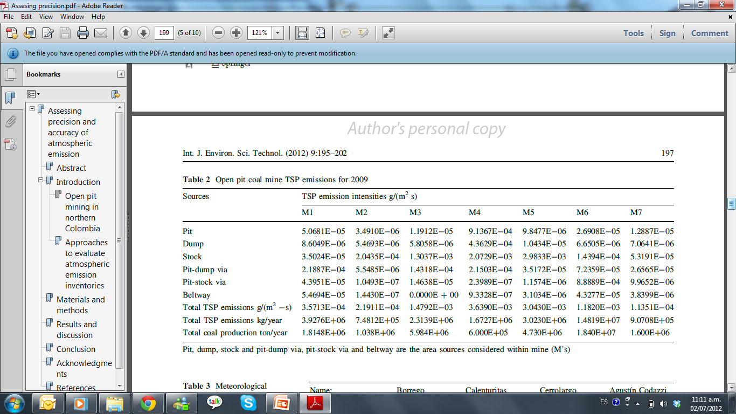
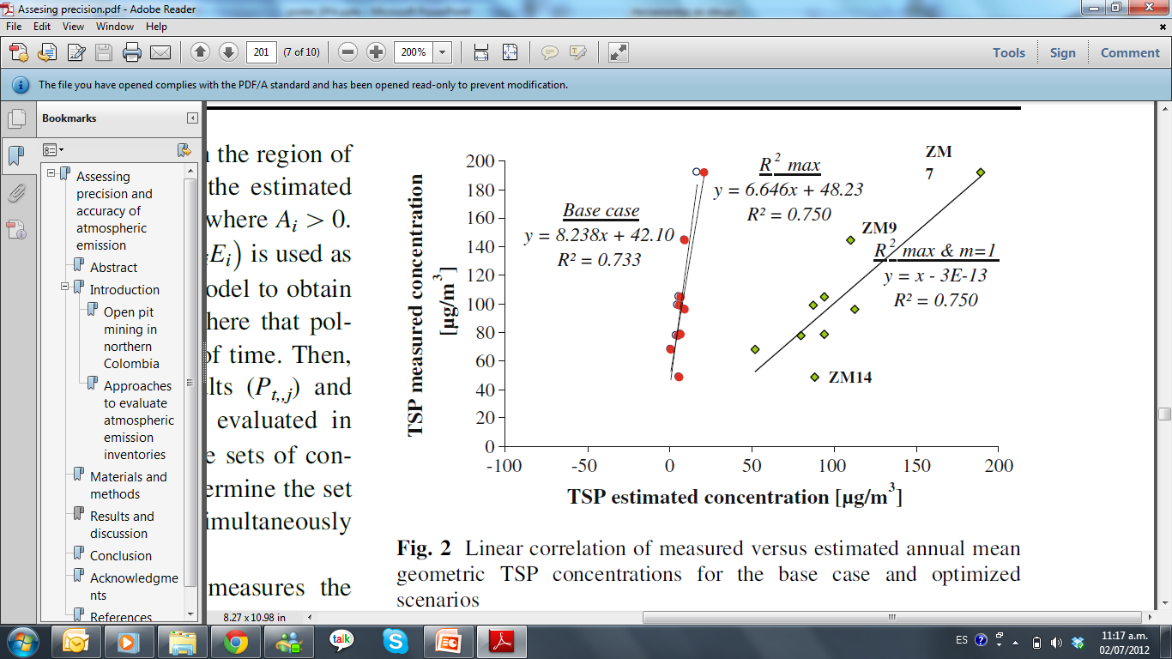
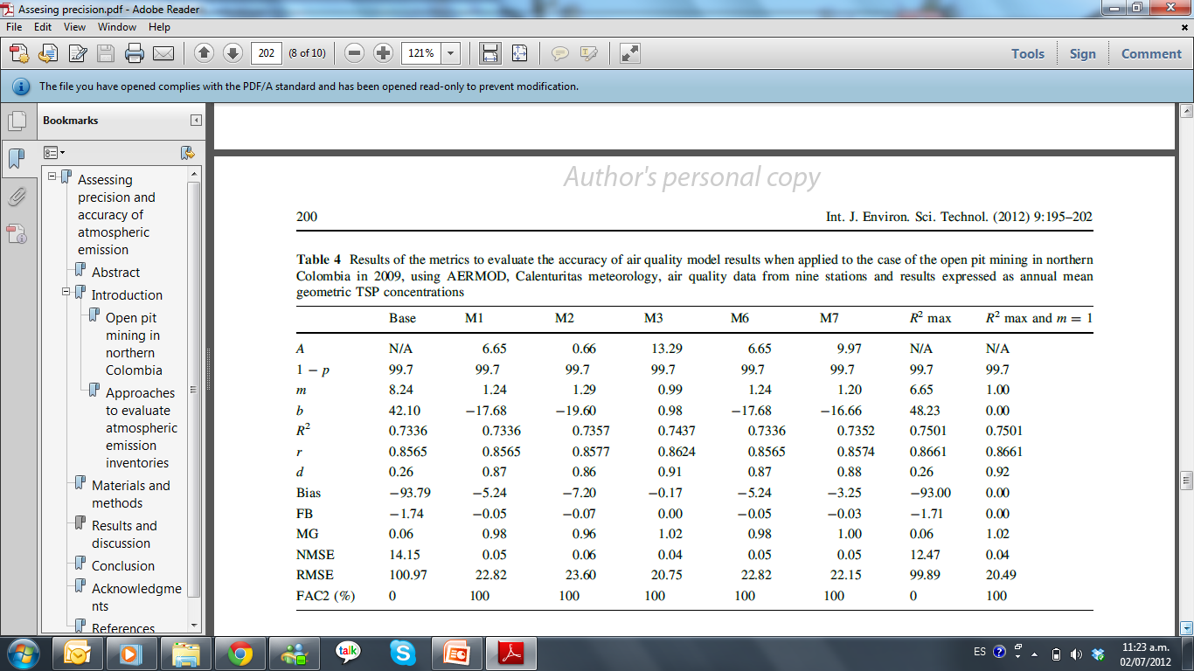
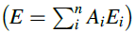
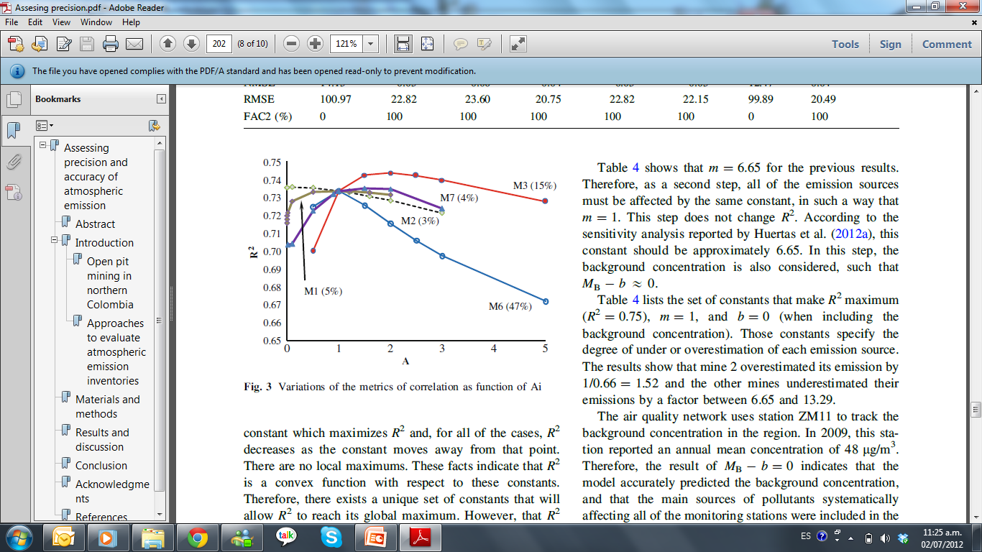
ASSESING PRECISION AND ACCURACY OF ATMOSPHERIC EMISSION INVENTORIES
Jose I. Huertas, Maria E. Huertas, Jenny Díaz
Automotive Engineering Research Center-CIMA, Tecnologico de Monterrey, Mexico
International Journal of Environmental Science and Technology
INTRODUCTION
The present work proposes a backward air quality simulation approach to assess the accuracy of emission inventories for these applications, with the goal of identifying sources that are over or underestimated. This approach consists of finding constants of the linear combination of the estimated emission that maximize R² and make the slope equal to one in the linear correlation analysis when the results from the air quality model are compared to the experimental measurements of air quality. This methodology was applied to the case of the mining region in northern Colombia. As one of the largest open pit coal mining regions in the world, this region consists of seven independent mines with no relevant additional sources of emission. Use of the proposed methodology allowed quantification of the amount by which companies over or underestimated their emission, as well as quantification of uncertainties due to sources not considered in the model but that locally affect each monitoring station.
Geography
Figure 1. Location of emission sources (M´s), air quality monitoring stations (ZM’s) and meteorological stations used for the modeling process. Altimetry is also shown.
Emissions
Table 1.
Open pit coal mine emissions for 2009
METHODOLOGY
The proposed methodology to assess the accuracy of emission inventories of a given pollutant compares experimental data of pollutant concentration with concentrations obtained through an air quality model that use emissions inventory in a backward modeling approach.
Let n be the number of emission sources in the region of interest. This method consists on affecting the estimated emission of each source Ei by a constant Ai, where Ai > 0. The resulting emission inventory is used as data input of a well-established air quality model to obtain the pollutant concentration at the j points where that pollutant has been measured for a long period of time. Then, the correlation between the numerical results (P_{t,j}) and experimental values (M_{t,j}) was statistically evaluated in terms of long-term averages (M_{j} vs. P_{j}). The sets of constants {Ai} are changed systematically to determine the set of constants {Ai}_{max} that maximizes R² and simultaneously makes the slope = 1.
RESULTS
CONCLUSIONS
The methodology was applied to the case of the mining region in northern Colombia, R² was determined to be an n-dimensional convex function with respect to the set of n constants that affect each emission source; thus, there existed a unique set of constants for which R² was a global maximum. R² moved from 0.73 in the base case scenario to 0.75 in the optimum scenario
Mine 2 was found to overestimate its emission by 1/0.66, and the other mines underestimated their emissions by a factor between 6.65 and 13.29. The result of 1 - R² = 25.0% indicated that there were relevant circumstances that locally affected each monitoring station and were not included in the air quality model.
Stations ZM9 and ZM14 exhibited the largest dispersion.
ACKNOWLEDGMENTS
Authors acknowledge the contribution of M.Sc. Sara Vera and Natalia Navarrete to the present work
REFERENCES
Huertas JI, Huertas ME, Izquierdo S, González ED. (2012a) Air quality impact assessment of multiple open pit coal mines in Northern Colombia. J Environ Manag 93:121–129
Huertas JI, Camacho D, Huertas ME (2012b) Standardized emissions inventory methodology for open pit mining areas. Environ Sci Pollut Res. doi: 10.1007/s11356-012-0778-3
USEPA (1994) Surface coal mine emission factor field study. EPA- 454/R-95-010
USEPA (2004) User’s guide for the AERMOD. US Environmental Protection Agency
USEPA (2005) Revision to the guideline on air quality models: adoption of a preferred general purpose (Flat and complex terrain) dispersion model and other revisions; Final Rule 40 CFR Part 51
USEPA (2006a) Revision of emission factors for AP-42. Miscellaneous source, Chap 13. Section 13.2.2: Unpaved Roads (Fugitive Dust Sources)
USEPA (2006b) Revision of emission factors for AP-42. Miscellaneous source, Chap 13. Section 13.2.4: Aggregate handling and storage piles (Fugitive dust sources)
.
Figure 3. Linear correlation of measured verus estimated annual mean geometric TSP comcemtratopm for the base case and optimized scenarios
Table 2. Results of the metrics to evaluate the accuracy of air quality model. Results expressed as annual mean geometric TSP concentration
Figure 2. Variation of the metrics of correlation as funtion of Ai

