Slide 1
U.S. Onroad Transportation CO₂ Emissions Analysis Comparing Highly-Resolved CO₂ Emissions and a National Average Approach: Mitigation Options and Uncertainty Reductions
Daniel Mendoza
Purdue University, University of South Florida
Kevin Gurney, Igor Razlivanov
Arizona State University
Sarath Geethakumar, Vandhana Chandrasekaran
CERIAS, Purdue University
Yuyu Zhou
Pacific Northwest Laboratory
EPA 2012 International Emission Inventory Conference

Slide 2
Motivation
Transportation sector is the second largest CO₂ emitting U.S. economic sector ~ 32.3%
CO₂ emissions for use in top-down/bottom-up carbon budget
Local ordinances independent of national policymaking
Notes:
Carbon dioxide (CO₂) is the most abundant anthropogenic greenhouse gas
Over 80% of the transportation sector is composed of onroad emissions
Need to more accurately predict CO₂ emissions for use in top-down/bottom-up carbon budget
Some states and localities have passed ordinances independent of national policymaking

Slide 3
Vulcan Project
High-resolution CO₂ emissions from fossil fuels
Native and gridded resolution
Point of emission (not sale, population)
Most developed 2002
Multi-year recently released

Slide 4
Previous work on spatial bias
Previous studies; national, small area, proxy
National level VMT, five vehicle classes and twelve road classes
VMT and CO₂ emissions for large metropolitan areas
Regional studies performed
Notes:
Local governance: California, Illinois

Slide 5
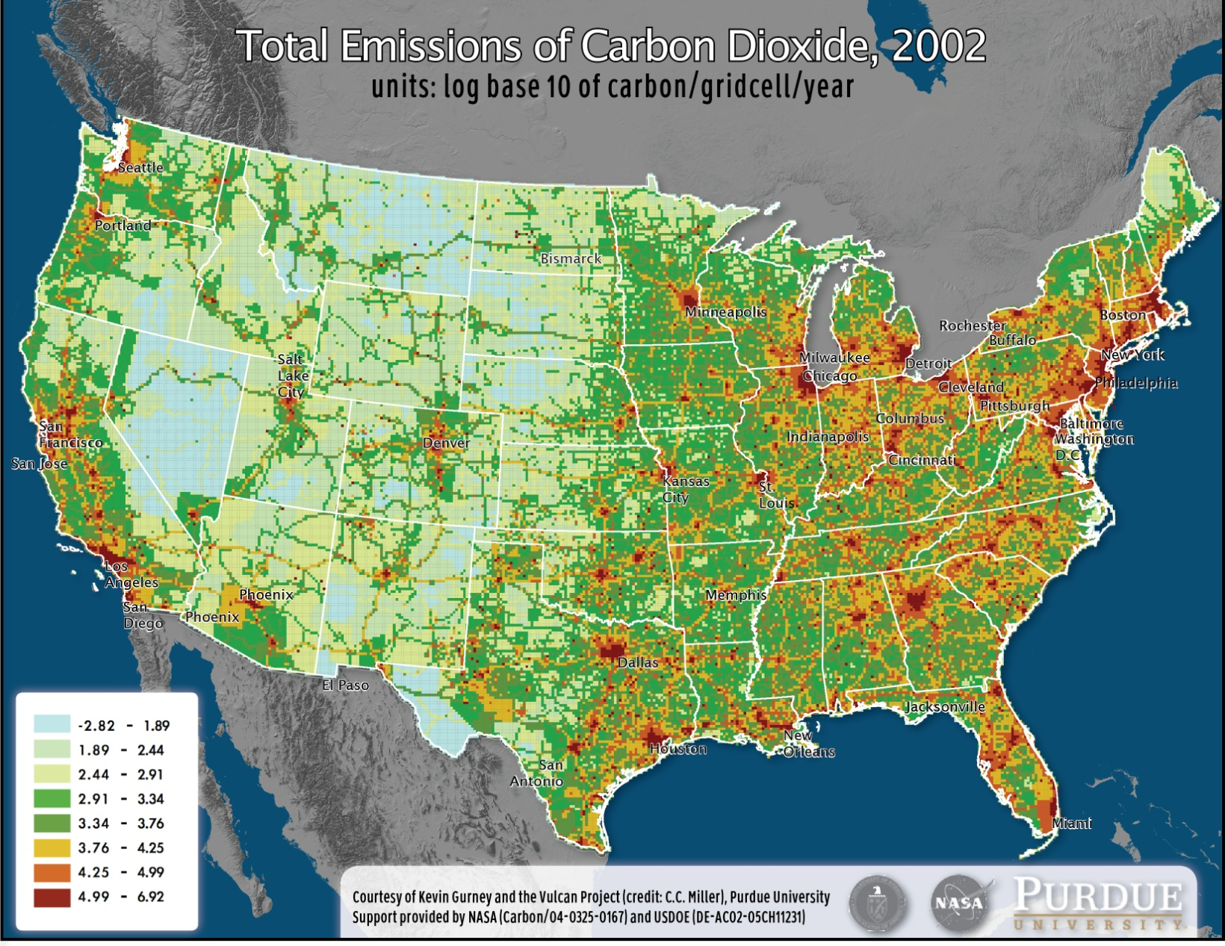
Vulcan Project Results
Notes:
- Metro areas (heating), interstates, agricultural

Slide 6
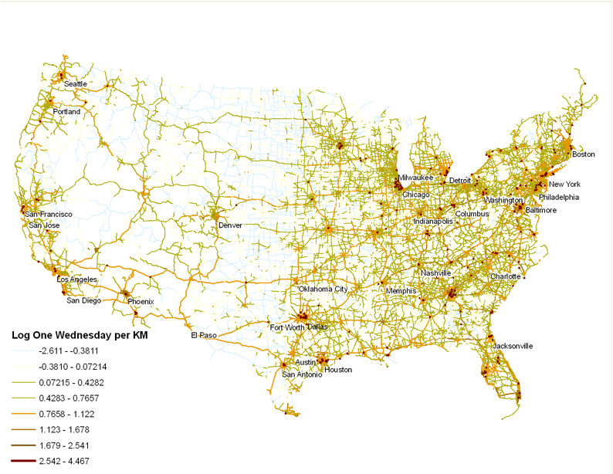
Static Map of Road Layer Output
Notes:
- Again metro areas, interstates, other roads

Slide 7
State specific biases
Light-duty vs. Urban
Heavy-duty vs. Rural
Notes:
Bias is defined as the percent difference between Vulcan group emissions total and national average group emissions total.
Positive bias therefore means that the national average approach would underestimate emissions from a particular group and viceversa.
On the left panel, for Washington State, Vulcan demonstrates a smaller amount of traffic performed by Light Duty vehicles and on Urban roads than predicted by the national average.
On the right panel, for Nevada, Vulcan demonstrates a larger amount of traffic on rural roads and performed by heavy duty vehicles.

Slide 8
State-specific Emissions Uncertainties
Notes:
Uncertainty estimates are calculated as the vehicle- and road-type specific variability taking into account the fleet/road distribution of a particular state. For example if a particular vehicle type within a group has a higher variability and it is a larger fraction it would be reflected in uncertainty.

Slide 9
Uncertainty Improvements
VMT
Review of variables
Sparse coverage
Age distribution uncertainty
Registration information
State-specific annual vehicle sales by class
Fuel efficiency
New regulations for HD
Revised CAFE standards LD
Age distribution accuracy improvement
5-cycle testing
Kyoto Protocol (7%) and California Senate (8-15%)
Notes:
- Noise is approximately 5x signal
VMT
- under-sampling large complicated road networks (not enough measuring stations)
downscaling from state to county level
counting stations look at lane-mile values, gap-filling, scope of influence – use odometer readings?

Slide 10
State and vehicle-specific emissions reductions
Light duty gas vehicle (LDGV) 10% reduction
Heavy duty diesel vehicle (HDDV8B) 10% reduction
Notes:
Red dot national average
Texas gas cars
California heavy trucks

Slide 11
Implication of Spatial Biases
Montgomery County, Maryland carbon tax: $5 per ton of CO₂
A 10% emissions reduction using national averages would cause California to be undercharged by nearly $800,000 due to its smaller fraction of HDDV8B vehicles
Conversely, Texas would overpay by $500,000 due to its larger fraction of LDGV vehicles
Notes:
Montgomery County, Maryland passed the first county-wide carbon tax in the U.S. in 2010 calling for payments of $5 per ton of CO₂

Slide 12
Conclusions
Vulcan provides a point of emissions approach
Web 2.0
LD and HD behave differently
Spatial biases range from 2-15%
Uncertainty is approximately 5 times bias
Estimates necessary: formulation/accountability
Other pollutants
Notes:
Uncertainty (New York) >> LD emissions of 20 states, total of 5 states

Slide 13
Acknowledgements
Vulcan Group
Yang Song, Chris Miller, Salvi Asefi-Najafabady, Jianhua Huang, Alexandra Garden
Past Vulcan Group Members
Mithun Vaidhyanathan, Broc Seib, William Ansley, Sullivan Peraino, Advait Godbole, Jaymee Binion, Warren Eckels
Paul Svercl, FHWA
Supported by NASA grant NNG05GG12G
Department of Energy
PCCRC
Rosen Center for Advanced Computing

Slide 14
Thank you!

