Slide 1
How to use eGRID for Carbon Footprinting Electricity Purchases in Greenhouse Gas Emission Inventories
2012 International Emission Inventory Conference
Session 3: Greenhouse Gases
8/14/2012

Slide 2
Outline
Summary of recommendations
eGRID background
Recommendations
What’s new in eGRID2012
Trends
Future eGRID updates
Conclusions
Questions and comments

Slide 3
Summary of
recommendations
EPA’s Emissions & Generation Resource Integrated Database (eGRID) is the de facto source of data for carbon footprinting electricity in the U.S.
  What level of data should I use? Electric Generating Company? State? NERC Region? U.S.? eGRID subregion level
  Which emission rate should I use? Input? Total Output? Non-baseload output? Total output emission rates
  What year data? Match years as best as possible
  How to account for line losses? Use equations presented in paper
  CO₂ only? Or also include methane (CH₄) and nitrous oxide (N₂O)? Conversion to CO₂ equivalent? Best practice to include CH₄ and N₂O. eGRID expresses the combined CO₂ CH₄ and N₂O output emission rates in CO₂ equivalent, for your use
Notes:
The GHG Protocol,
the old Climate Leaders program and
the vast majority of GHG inventory professionals in the U.S.
Also used by by other EPA tools :
Corp Calc,
Port folio Manager,
GHG Equivalency Calculator,
Green Power Calculator,
CHP Calculator,
Etc.

Slide 4
eGRID background
eGRID provides default greenhouse gas emission rates for use in scope 2 emission inventories in a transparent, credible, and consistent way.
Since 1998, eGRID is a comprehensive source of data on the environmental characteristics of U.S. power sector, uniquely integrating generation and emissions
  Sources: EPA, EIA, FERC, NERC
  Links electricity generation, air emissions and resource mix for virtually all U.S. power plants (5,400+ plants, 17,000+ generators, 5,500+ boilers)
    Data years: 2009, 2007, 2005, 2004, & 2000-1996
    GHG Emissions: CO2 (all years), CH4, N2O (2005 forward)
    Other Air Pollution: NOx, SO2 (all years), and Hg (1998-2000, 2004)
    Heat Input, net generation, resource mix
    Emissions rates data (total, non-baseload, fossil ):
      Input (lb/MMBtu), Output (lb/MWh)
    Various levels of aggregation: Plant, State, Electric Generating Company, Parent Company, Power Control Area, eGRID subregion, NERC region, US Total.
    State & U.S. import-export data (including grid gross loss factors)
Notes:
Emissions rates are generation based:
Do not include life-cycle emissions (e.g. extraction, processing and transportation of fuels)
Do not include transmission & distribution line losses

Slide 5
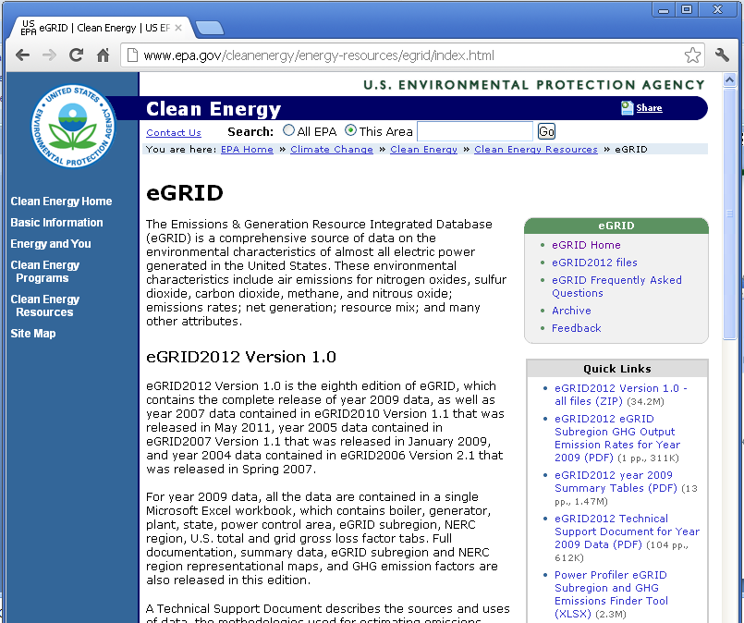
Accessing eGRID
epa.gov/egrid
Downloadable files:
  Microsoft Excel Workbook
  (in zip file)
    eGRID2012V1_0_year09_DATA.xls
  Adobe PDF documents:
    eGRID subregion GHG
    emission rates
    Summary Tables
      Emissions, output emission rates, resource mix, grid gross loss factors
      eGRID subregion, NERC Region, State levels E

Slide 6
What’s behind eGRID’s GHG emission factors
CO₂ emissions data reported to EPA per 40 CFR Part 75 (Acid Rain Program, Clean Air Interstate Rule, Regional Greenhouse Gas Initiative, etc.)
  About 96% of CO₂ emissions are sourced from monitored emissions reported to EPA:
    Continuous Emission Monitors (CEMS):
    CO₂ concentration, stack flow
    For some oil/gas units: fuel flow monitors and measured carbon content (or default carbon content)
CO₂ for other units, the same methodology for EPA's National GHG Inventory is applied to EIA-923 fuel use data
N₂O & CH₄ derived from EPA National GHG Inventory methodology and EPA or EIA sourced fuel use
See eGRID Technical Support Document for more details

Slide 7
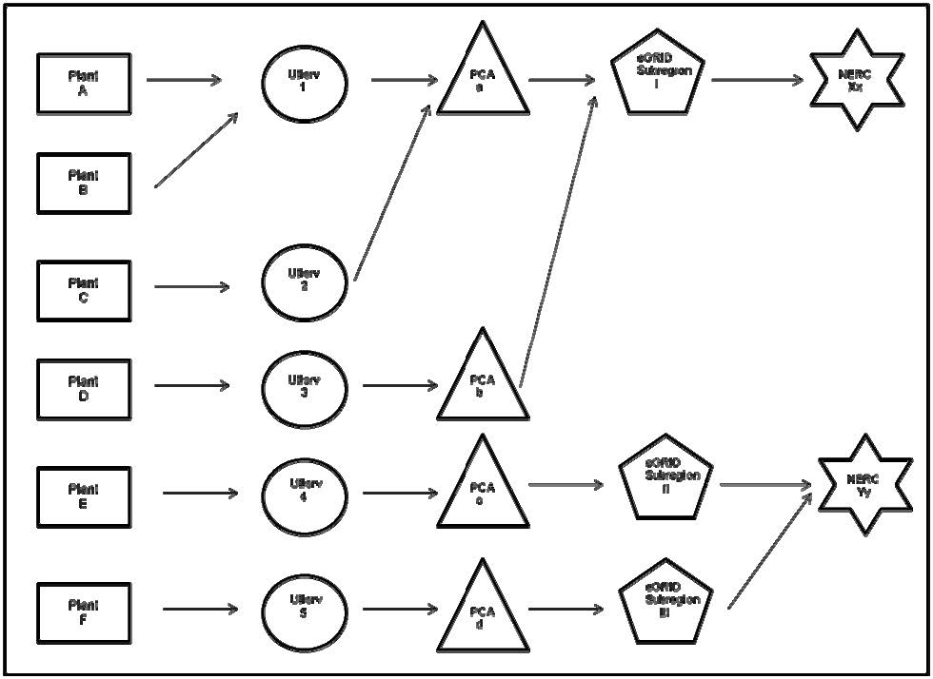
What’s behind eGRID’s GHG emission factors
Plant – utility service area (Utlserv) – power control area (PCA) –eGRID subregion – NERC region relationship
Notes:
eGRID aggregates the plant level data to utility service areas, power control areas, EPA assigned eGRID subregions, NERC regions, and U.S. Total

Slide 8
Which rates to use? Which aggregation level?
For carbon footprinting generic, grid-supplied electricity:
Use the total output emission rate (a.k.a. “system mix”)
    CO₂ in pounds per Megawatt-hour (MWh)
    N₂O and CH₄ in pounds per Gigawatt-hour (GWh)
Use the eGRID subregion aggregation level
  This level strikes a balance between areas that are too big and areas that are too small.
    U.S. level covers some irrelevant generation
    State level boundaries are unrelated to electric grid boundaries
    Power control area (PCA), a.k.a. balancing authority, level or Company (EGC) level may not address significant imported power
If purchasing directly from neighboring plant and transmission infrastructure is in place, then use plant specific rate
Notes:
State level data would be appropriate when examining the emissions that occur at generating plants within a certain state or states, but not the emissions associated with electricity consumption in a state.

Slide 9
How to determine
eGRID subregion
Power Profiler
  Online application www.epa.gov/powerprofiler
    Enter ZIP code
    Select from list of utilities
    Your eGRID subregion and selected eGRID data are shown
  Power Profiler eGRID subregion and GHG emission finder tool (spreadsheet)
    Available on eGRID page under quick links
    Decodes the eGRID subregion(s) for each ZIP code
    If more than one eGRID subregion
      Go to Power Profiler online application, OR
      Use the eGRID subregion of the predominant utility for the ZIP code
    Includes CO₂, CH₄, and N₂O eGRID subregion emission rates
Notes:
Useful for orgs with many buildings/facilities

Slide 10
Which data year to use?
Use the “best match” between inventory year and eGRID data year at time of inventory preparation
  More closely resembles emissions reflecting actual resource mix
Inventory Year | eGRID data year | eGRID edition to find data
1998 | 1998 | eGRID2002
1999 | 1999 | eGRID2002
2000 | 2000 | eGRID2002
2001 | 2000 | eGRID2002
2002 | 2000 | eGRID2002
2003 | 2000 | eGRID2002
2004 | 2004 | eGRID2012
2005 | 2005 | eGRID2012
2006 | 2005 | eGRID2012
2007 | 2007 | eGRID2012
2008 | 2007 | eGRID2012
2009 | 2009 | eGRID2012
2010 | 2009 (unless more recent exists at time of preparation) | eGRID2012
2011 | 2009 (unless more recent exists at time of preparation) | eGRID2012
2012 | 2009 (unless more recent exists at time of preparation) | eGRID2012
Notes:
eGRID subregion level data goes back to 1998.

Slide 11


How to address line losses
Line loss emissions estimate equation:
    For example 1,000 MWh purchased in CAMX eGRID subregion in year 2010
      eGRID subregion total output emission rate = 658.68 lb CO₂/MWh
      Grid gross loss factor = 8.21% = 0.0821
      Scope 3 line loss emissions =
      1000 MWh * 658.68 lb CO₂/MWh * 0.0821 / (1 – 0.0821) =
      58,914.5 lb CO₂
Notes:
Scope 3 emissions are more commonly reported in inventories
Usually reported in Metic tons, so you would need to convert lb to metric tons.

Slide 12
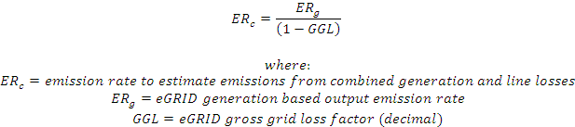
How to address line losses
Equation combining line losses with generation emissions:
    For example 1,000 MWh purchased in CAMX eGRID subregion in year 2010
      eGRID subregion total output emission rate = 658.68 lb CO₂/MWh
      Grid gross loss factor = 8.21% = 0.0821
      Emissions (including line losses) emissions =
      1000 MWh * 658.68 lb CO₂/MWh / (1 – 0.0821) =
      717,594.5 lb CO₂
Notes:
If you want to combine these together.
Again, you would need to convert lb to metric tons.

Slide 13
Including CH4 and N2O
-> CO2 equivalent
Including CH₄ and N₂O from electricity purchases adds less than 1% CO₂ equivalent (CO₂e)
Note that units for CH₄ and N₂O output emission rates in eGRID are in lbs per GWh, rather than lbs per MWh
To convert to CO₂e, consistent with EPA’s U.S. GHG Inventory, recommend using IPCC Second Assessment Report (SAR) Global Warming Potentials (See eGRID Technical Support Document for more details)
eGRID displays separate total output emission rates for each of these GHGs, and also combines into a CO₂e value in the spreadsheets and summary tables

Slide 14
What’s new in eGRID2012?
Data not presented at the company or parent company level
What used to be presented in three separate spreadsheets (PLANT, AGGREGATION, STIE_USGC) are now combined into one (DATA) with 10 tabs
Improved methodology for grid gross loss factors
  Used FERC-714 data for balancing authority interchanges rather than state based EIA estimates
Plant coordinate improvements

Slide 15
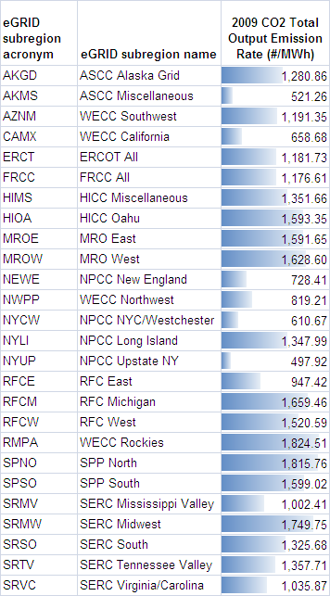
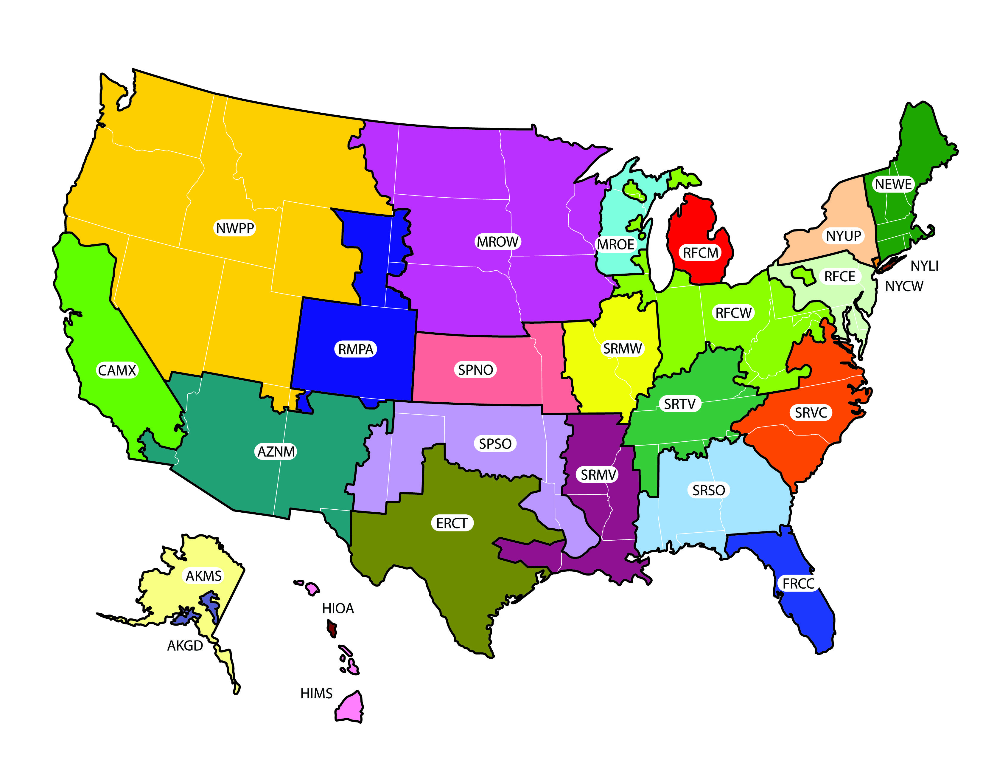
What’s new in eGRID2012?
This is a representational map; many of the boundaries shown on this map are approximate because they are based on companies, not on strictly geographical boundaries.
Notes:
Here’s the new eGRID subregion CO2 output emission rates, it’s probably a little difficult to read from the back of the room, but the bars show there is a lot of variation between subregions. What’s driving the differences is the resource mix of generation within each eGRID subregion. The more fossils fuels used, the higher the emission rates.

Slide 16
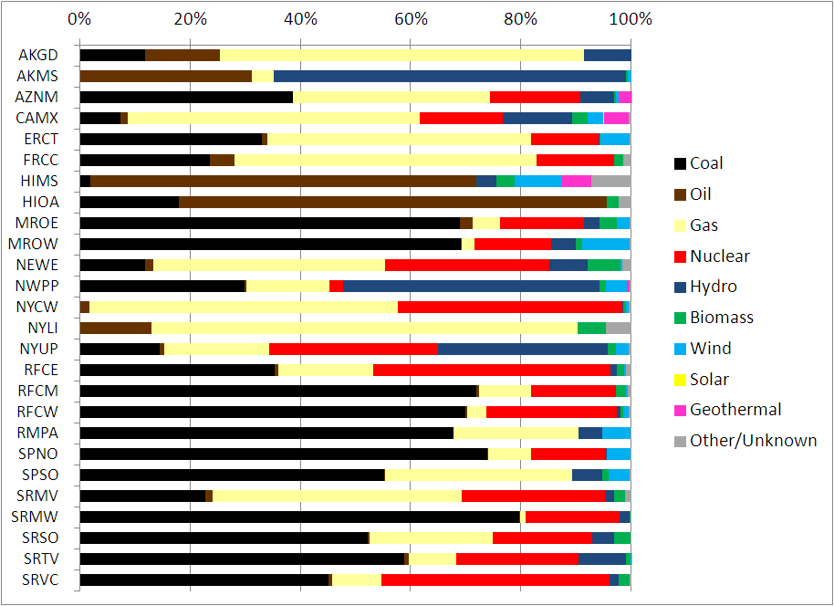
What’s new in eGRID2012?
Notes:
This chart shows the resource mix for each subregion. The black, brown, and yellow bars are the fossil fuels coal, oil and gas, everything else are nuclear and renewable resources.

Slide 17
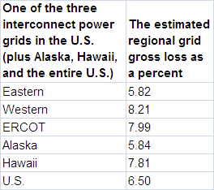
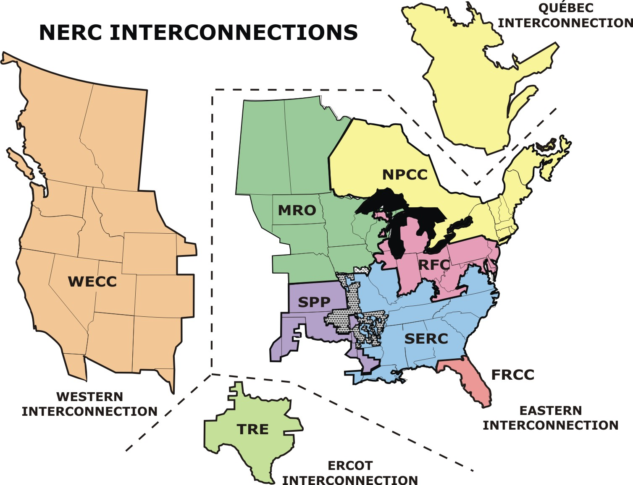
What’s new in eGRID2012?
Notes:
Here are the new grid loss factors.
They are developed by taking the consumption, generation, and power control area imports and exports external to each of these three interconnections. Data originates from FERC and EIA.
The Western interconnect correspond to the four eGRID subregions in WECC.
It’s pretty obvious which eGRID subregions belong to Hawaii, Alaska and ERCOT.
The rest of the eGRID subregions belong to the Eastern Interconnect.
There’s also a table in paper that shows which loss factor to use for each eGRID subregion.

Slide 18
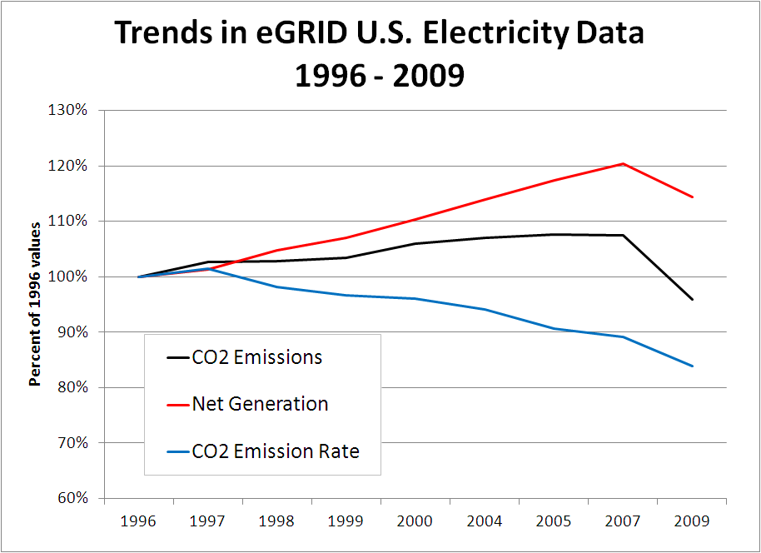
Trends
Notes:
Red line is generation, black line is emissions, blue line is average emission rate. All values are relative to 1996 values, the first year of eGRID data.
The overall CO2 output emission rate is gradually declining. The reason is due to the changes in the overall resource mix, however, some minor adjustments to methodologies over the years had very slight affects. The next slide …

Slide 19
Trends: Resource mix
Notes:
… shows a comparison of the resource mix from 1998 to 2009.
The proportion of generation from fossil fuels (black, brown and light yellow) are about the same.
However, there has been a shift away from coal and oil, toward the use of natural gas.

Slide 20
Trends: eGRID subregions
Notes:
We’ve seen the overall U.S. trends, what has happened on the eGRID subregion level?
There is a little more variability, but the overall trend is the same.
This chart is included in the paper, and you can examine it more caefully at your leisure, the next slide …

Slide 21
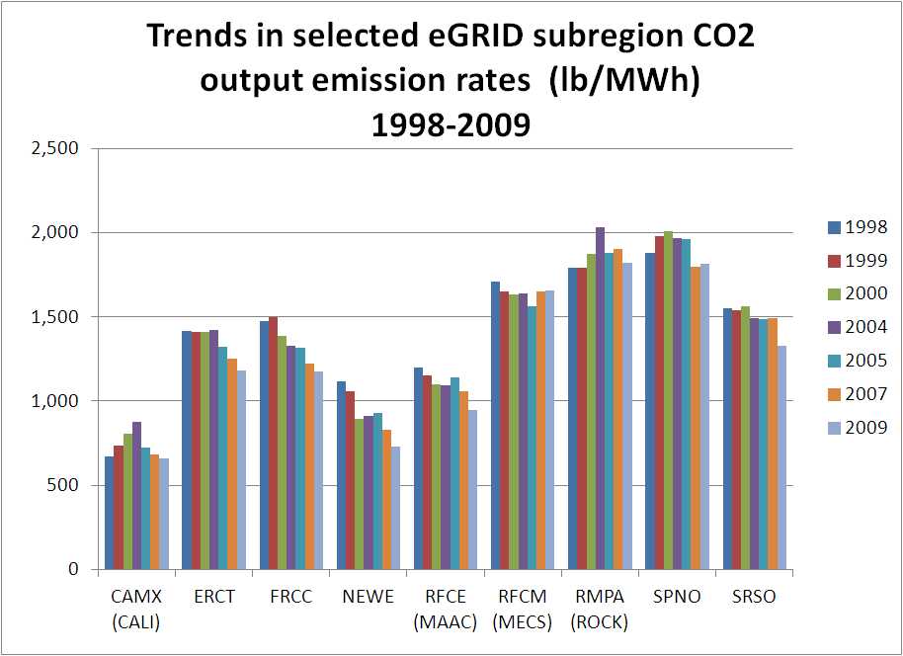
Trends: eGRID subregions
Notes:
… is a more clear for several selected eGRID subregions. The eGRID subregions on the left had greater reductions and greater changes in resource mix than the ones on the right side.

Slide 22
Future eGRID updates
Currently processing year 2010 data, to be issued in a new edition as soon as possible
  Rough estimate fall 2013
To stay informed when any eGRID update occurs, please fill out eGRID feedback form:
  www.epa.gov/cleanenergy/energy-resources/egrid/feedback.html
Notes:
If any significant issues arise with current data are discovered, a new version of eGRID2012 could be issued.

Slide 23
Conclusion
What level of data should I use? Electric Generating Company? State? NERC Region? U.S.? eGRID subregion level
Which emission rate should I use? Input? Total Output? Non-baseload output? Total output emission rates
What year data? Match years as best as possible
How to account for line losses? Use equations presented in paper
CO₂ only? Or also include methane (CH₄) and nitrous oxide (N₂O)? Conversion to CO₂ equivalent? Best practice to include CH₄ and N₂O. eGRID expresses the combined CO₂ CH₄ and N₂O output emission rates in CO₂ equivalent, for your use
Notes:
The GHG Protocol encourages transparency and completeness of GHG inventories so we usually recommend people include CH4 and N2O, especially since the data is there and it’s easy to do. eGRID has the information, and we’ve even done the math to convert the combined CO2, CH4 and N2O into CO2 equivalent. However, Recognizing that the CH4 and N2O numbers are small in comparison to the CO2 numbers, if you aren’t following a protocol, you can choose to consider these as de minimus and leave them out all

Slide 24
Questions and comments
epa.gov/egrid
Art Diem, Environmental Engineer
U.S. EPA
202-343-9340
diem.art@epa.gov
Cristina Quiroz
TranSystems|E.H. Pechan
703-245-4069
caquirozpacheco@transystems.com

