Slide 1



Top-down estimate of methane emissions in California using a mesoscale inverse modeling technique
Yu Yan Cui, Jerome Brioude, Stuart McKeen, Wayne Angevine, Si-Wan Kim, Gregory Frost, Jeff Peischl, Nicolas Bousserez, Zhen Liu, Thomas Ryerson, Steve Wofsy, Gregory Santoni, Eric Kort, Marc Fischer, Michael Trainer
NOAA/ESRL/CSD, CU-Boulder, Sandia NL, Harvard U, U of Michigan, LBNL
USEPA EI Conference
April 12-16, 2015 San Diego

Slide 2
Background
▪▪CH₄ has increased by factor of 2.5 at least since pre-industrial times (IPCC AR5)
▪▪Shorter lifetime than CO₂ but much higher global warming potential than CO₂
▪▪The change in CH₄ mixing ratio altered the concentrations of OH and ozone in the troposphere and water vapor in the stratosphere
▪▪In California, CH₄ emissions are regulated by Assembly Bill 32

Slide 3
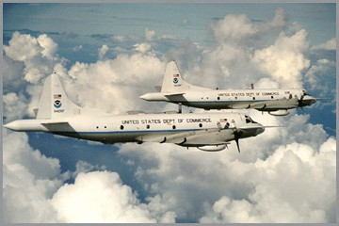
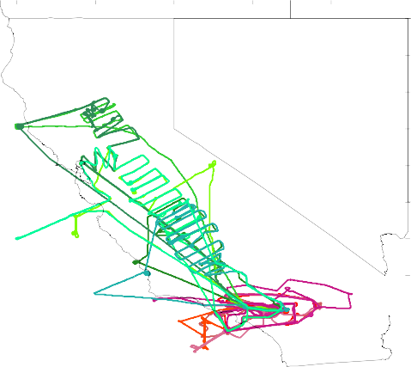


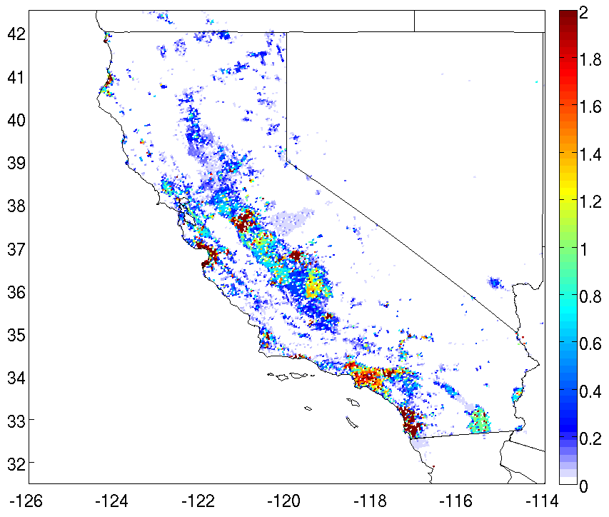





Airborne measurements, CalNex 2010
42
41
2.
40
39
38
37
36
1.
35
34
33
32
−126
−124
−122
−120
−118
−116
−114
b.
^{c.}Central Valley d.
e.
a.
SoCAB
_{µg m}-2 _{s}-1

Slide 4






















Lagrangian inverse system in Mesoscale
y=Hx +ε
y: mixing ratio (obs) x: surface fluxes
FLEXPART-WRF
Inverse model: reducing and balancing ε_{obs} and ε_{b.}
“H” matrix
Meteorology WRF
(Ensemble)
“y” vector
NOAA P@3
aircraB measurements
^{ε}obs
Mesoscale Bayesian Inversion
RegularizaTon α (Henze et al. 2009)
Clustering grids
FLEXPART v3.1
(24h transport)
Prior Info
Prior Inventory (EPA NEI)
ε_{b}
“x” vector
ε_{obs} : Obs + Model uncertainty ε_{b} : Prior uncertainty
3D & 4D VAR least square method
Posterior area emissions

Slide 5








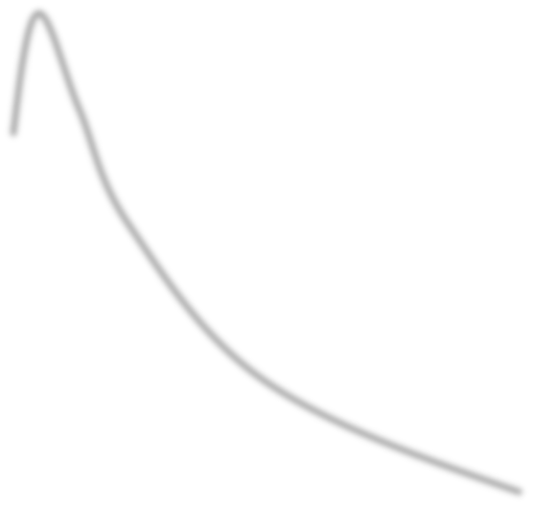
Bayesian formulaEon with lognormal distribuEon
1
1
! =
ln(!! ) − ln !"
! !!!
ln !!
— ln !"
+ (ln ! − ln (!! ))! !!!(ln ! − ln !!
)
2
2
Cost func*on
J obs
J prior
R and B are covariance matrices
3000
Background
2500
May 08 ﬂight
▪▪ For each ﬂight we give a background value, and a regularizaEon α to reach a good compromise in R and B
▪▪ Bootstrapping & Monte Carlo methods
▪▪ No negaEve ﬂuxes, obtain a minimum variance soluEon and not a likelihood
Brioude et al. 2011, Cui Y Y et al. 2014
# of obs
2000
Lognormal distribu:on
1500
1000
500
0
1800
1900 2000
2100
2200
observed CH₄ (ppbv)

Slide 6
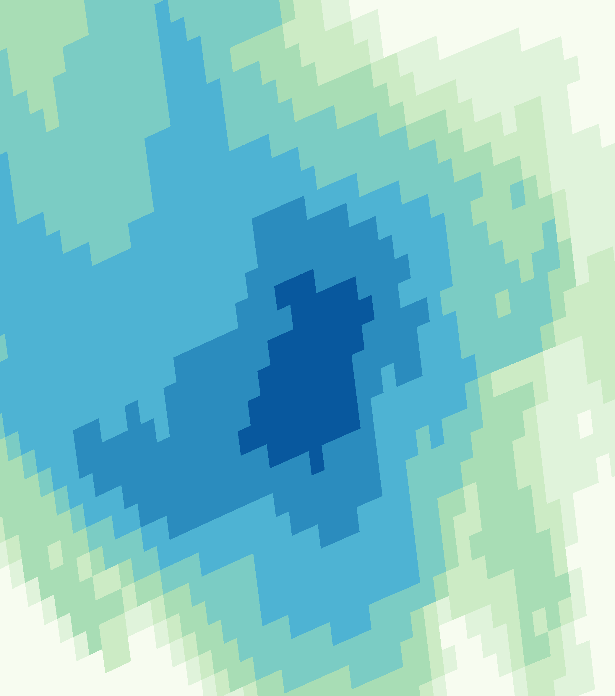
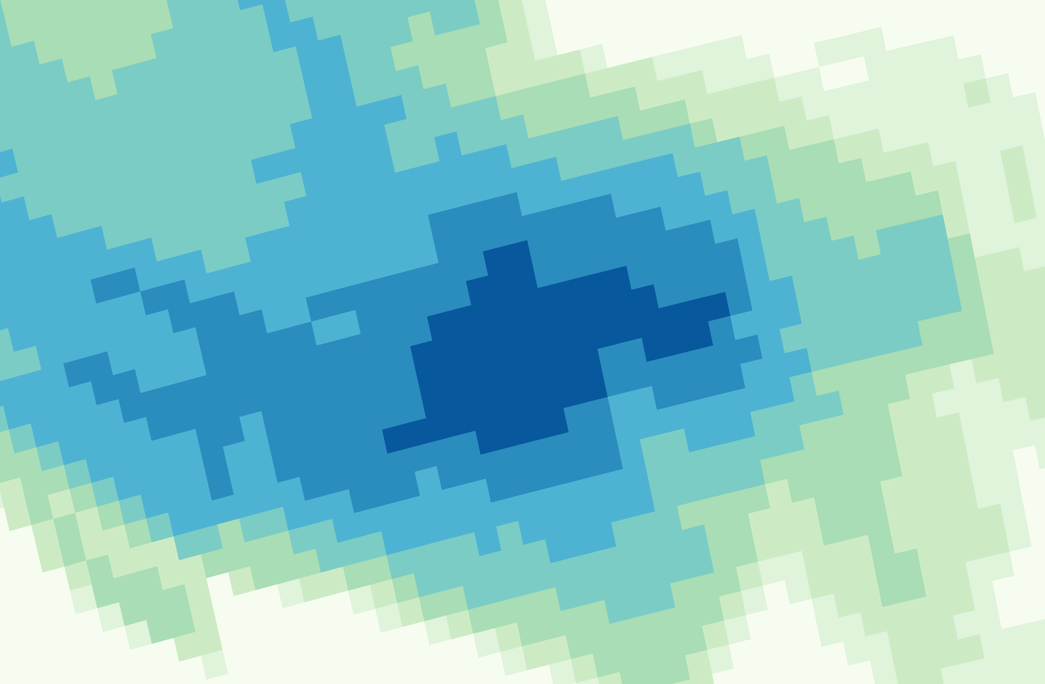
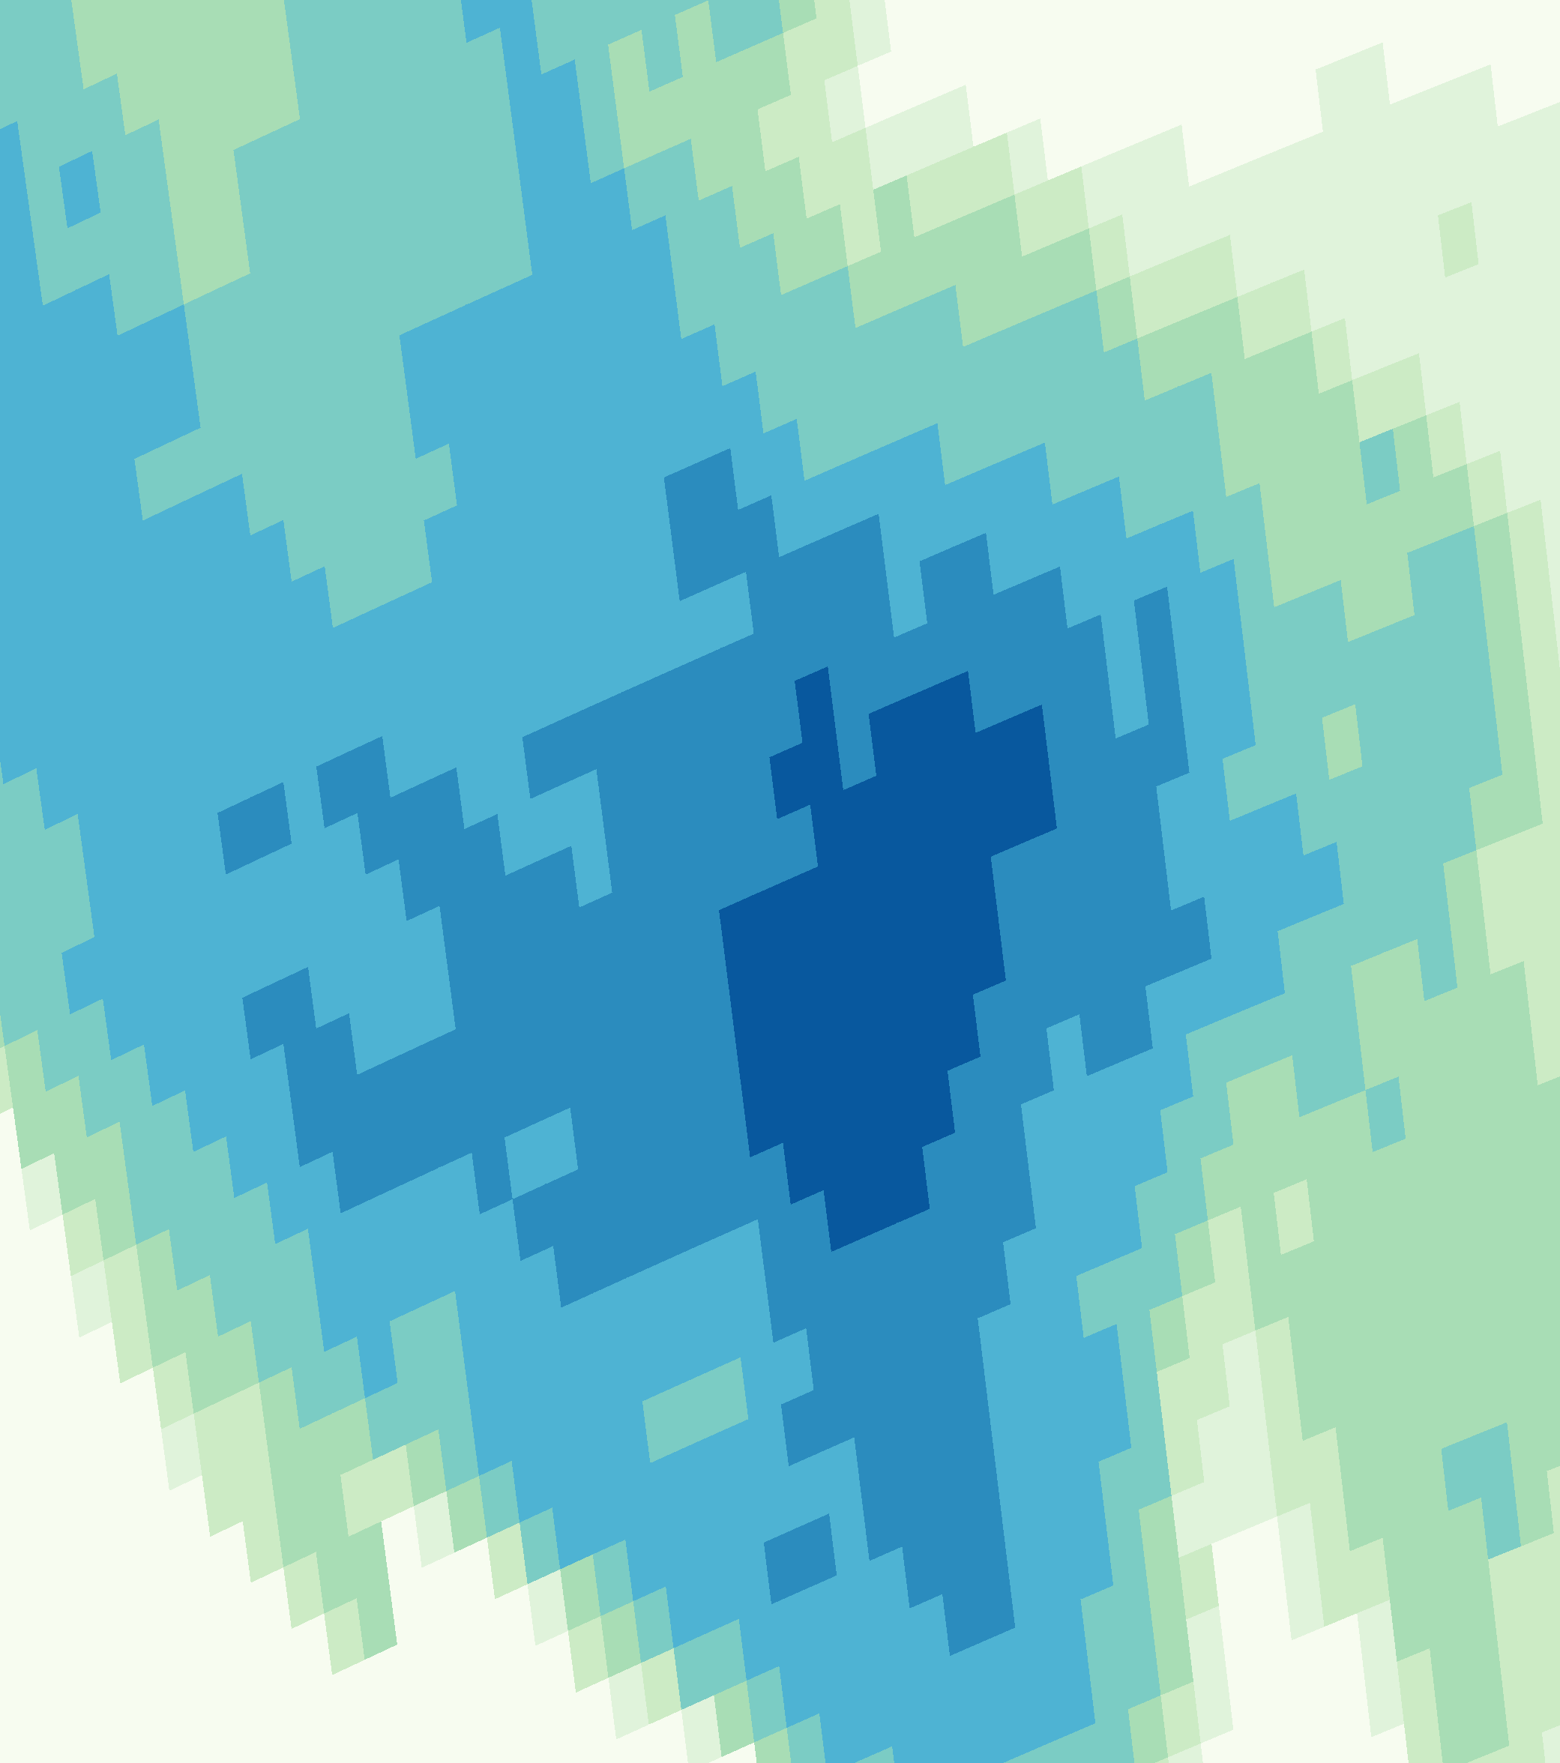
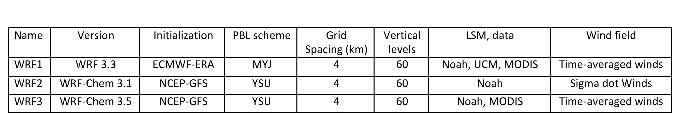
Three oﬀ-­‐line transport models (FLEXPART-­‐WRF)
WRF1
WRF1 WRF2 WRF3
WRF2
WRF3
unit: log₁₀ (s m³/kg)
35
35
35
1.5
1
34.5
34.5
34.5
0.5
34
34
34
0
-0.5
33.5
33.5
33.5
-1
33
33
33
-1.5
-120
-118
-116
-120
-118
-116
-120
-118
-116
Releasing 10,000 parEcles every 30 s and every 100 m along ﬂight tracks, backward 24 hrs

Slide 7
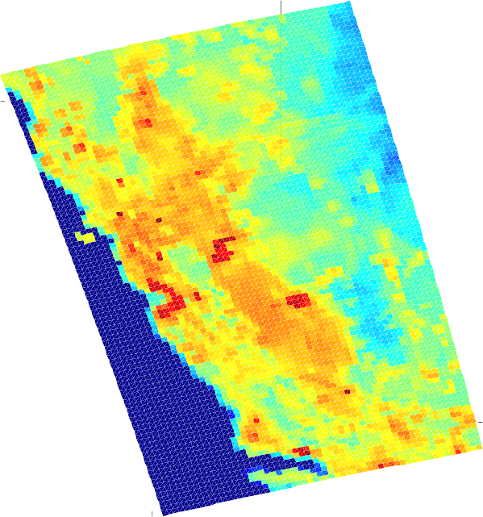
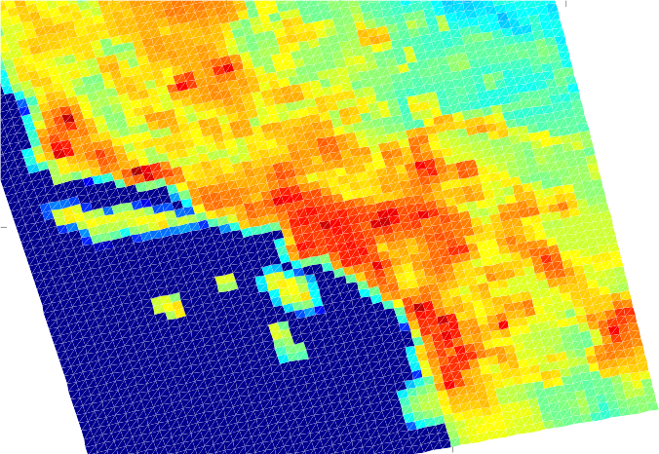
Clustering spatially grid cells
Based on Fisher information matrix, a criterion map is used to present the significance of each grid cell in constraining the CH₄ emissions.
J=Tr (BW^{T}R⁻¹W)
Central Valley
Log10
5
41
The SoCAB
40
0
Log10
36
5
39
−5
0
38
35
−10
−5
37
34
−10
36
−15
−15
35
33
−20
−20
34
32
−25
−124
−122
−120 −118
−25
−121
−120
−119
−118
−117
−116
−115
Bocquet el al. (2011)

Slide 8
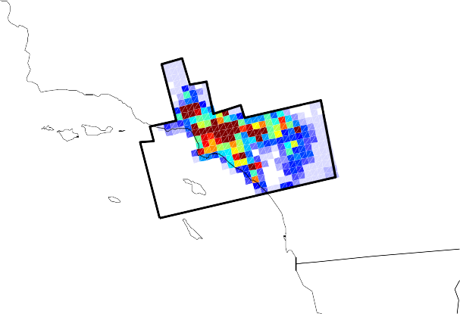
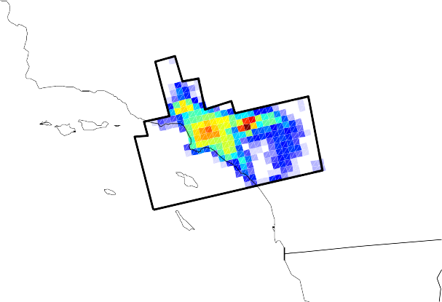
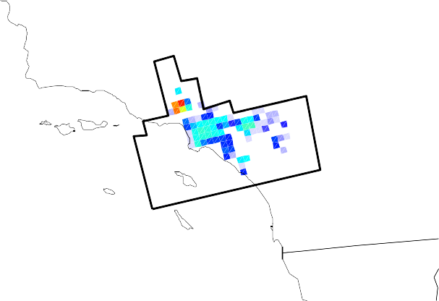
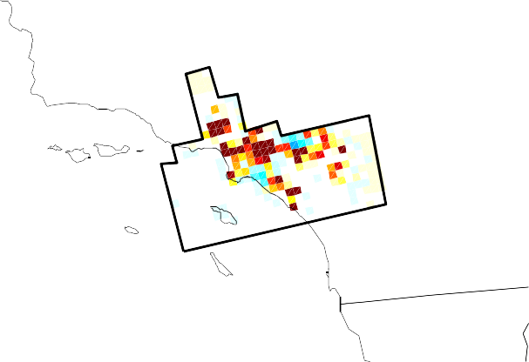
SoCAB Results
(a) The posterior map
(b) The prior map
(a) Posterior emissions
(b) Prior emissions
2
2
35
35
1.5
1.5
34
34
1
1
33
0.5
33
0.5
32
−120 −118 −116
0 32
−120 −118 −116
(d) The posterior minus the prior
0
(c) Uncertainties of the posterior map
(d) The poserior minus the prior
(c) Uncertain1es of posterior emissions
2
1
35
35
1.5
0.5
34
34
1
0
33
0.5
33
−0.5
32
−120
−118
−116
0 32
−120
−118
−116
−1
Cui, YY et al. submitted, 2014

Slide 9





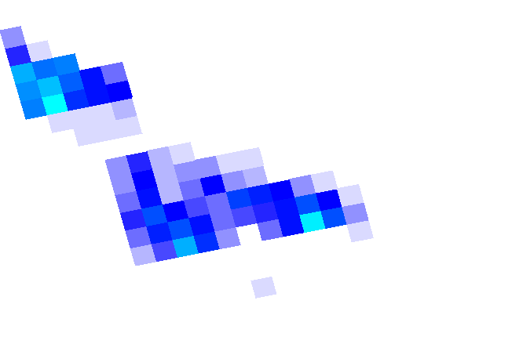
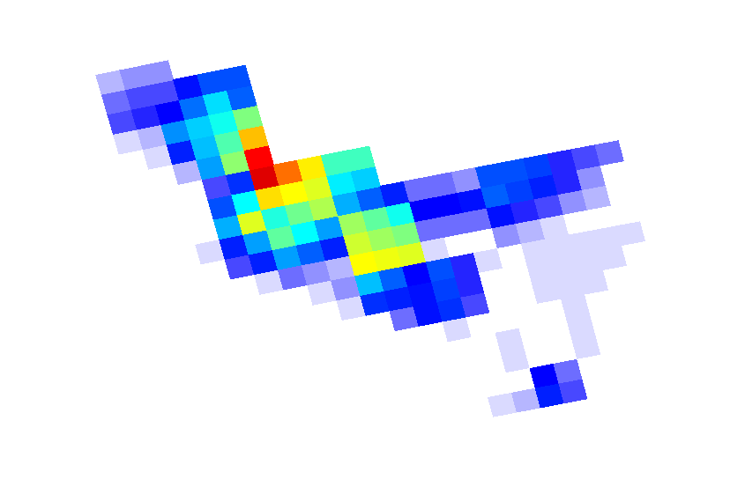

SoCAB Results (cont.)
Dairies
Landfills
35
35
1
0.5
0
1
34
34
33
33
-120
-118
OG Production
-116
-120
-118
OG Downstream
-116
0.5
35
35
34
34
0
33
-120 -118 -116
33
-120 -118 -116
We estimate that dairies contributed 52 ± 15 Gg CH₄/yr and the two sectors of oil and gas industry (production and downstream) and landfills together contributed 347
± 71 Gg CH₄/yr in the SoCAB.
Cui, YY et al. submitted, 2014

Slide 10

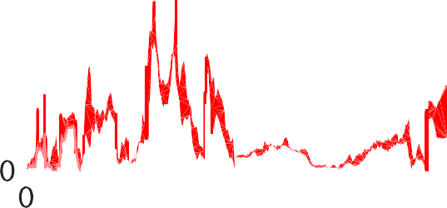

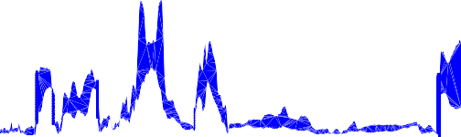
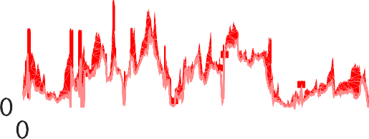

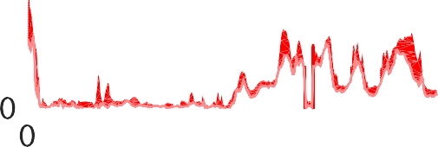
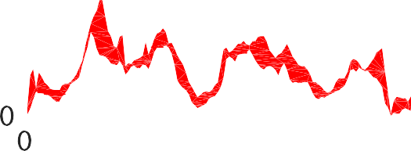
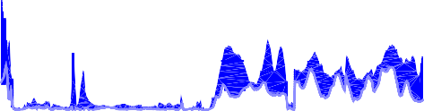

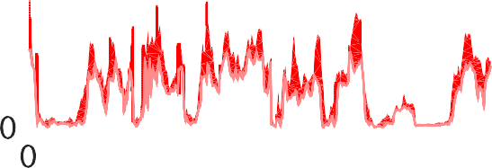
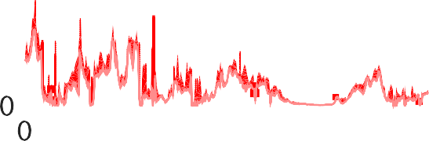
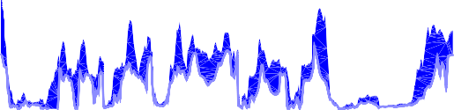
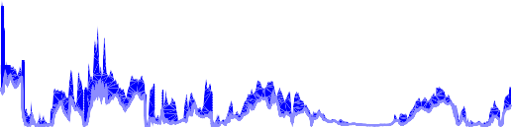
SoCAB Results (cont.)
ObservaEon Flexpart+prior Flexpart+post
CH₄ (ppbv)
The number of receptors
Cui, YY et al. submitted, 2014

Slide 11
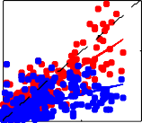
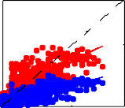
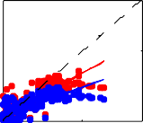
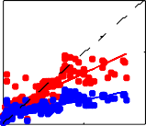
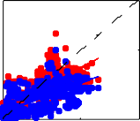
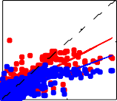
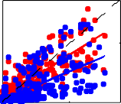
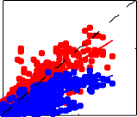
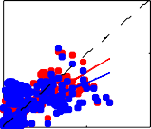
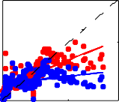
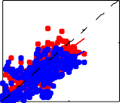
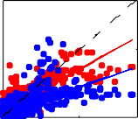
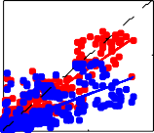
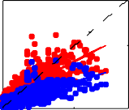
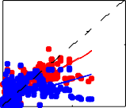
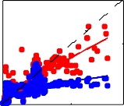
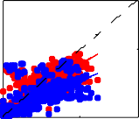
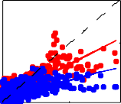
SoCAB Results (cont.)
0504 | 0508 | 0514 | 0516 | 0519 | 0620
r²: prior:0.3 post:0.7 | r²: prior:0.5 post:0.6 | r²: prior:0.7 post:0.8 | r²: prior:0.6 post:0.6 | r²: prior:0.5 post:0.7 | r²: prior:0.6 post:0.7
slope: prior:0.3 post:0.7 | slope: prior:0.3 post:0.6 | slope: prior:0.4 post:0.6 | slope: prior:0.2 post:0.5 | slope: prior:0.4 post:0.7 | slope: prior:0.4 post:0.6
WRF1
200
200
200
200
200
200
0
0
0
0
0
0
Model (ppbv)
WRF2
0 200 | 0 200 | 0 200 | 0 200 | 0 200 | 0 200
r²: prior:0.4 post:0.7 | r²: prior:0.6 post:0.6 | r²: prior:0.4 post:0.7 | r²: prior:0.1 post:0.5 | r²: prior:0.6 post:0.8 | r²: prior:0.4 post:0.7
slope: prior:0.5 post:0.7 | slope: prior:0.4 post:0.7 | slope: prior:0.5 post:0.7 | slope: prior:0.1 post:0.5 | slope: prior:0.7 post:0.8 | slope: prior:0.4 post:0.6
200
200
200
200
200
200
0
0
0
0
0
0
0 200 | 0 200 | 0 200 | 0 200 | 0 200 | 0 200
r²: prior:0.4 post:0.8 | r²: prior:0.5 post:0.6 | r²: prior:0.3 post:0.7 | r²: prior:0.2 post:0.6 | r²: prior:0.5 post:0.7 | r²: prior:0.4 post:0.7
slope: prior:0.4 post:0.8 | slope: prior:0.4 post:0.6 | slope: prior:0.3 post:0.7 | slope: prior:0.2 post:0.6 | slope: prior:0.5 post:0.7 | slope: prior:0.3 post:0.6
WRF3
200
200
200
200
200
200
0
0
200
0
0
200
0
0
200
Obs (ppbv)
0
0
200
0
0
200
0
0
200
Cui, YY et al. submitted, 2014

Slide 12


SoCAB Results (cont.)
WRF1
WRF2
WRF3
The posterior values range from 396 to 423 Gg CH₄/yr.
Vary by ~ 20% from a single flight’s data with current meteorological modeling of this summer period.
600
500
400
300
200
100
0
Gg CH / yr
4
May 4 May 8
May 14
May 16 May 19
June 20
Mean
600
The SoCAB area
600
Wecht et al. 2014
500
500
Gg CH₄/yr
Peischl et al. 2013
400
406± 81 Gg CH₄/yr
400
300
Wennberg
300
This study
et al. 2012
NEI 2005
Santoni et al. 2014
200
200
Cui, YY et al. submitted, 2014

Slide 13
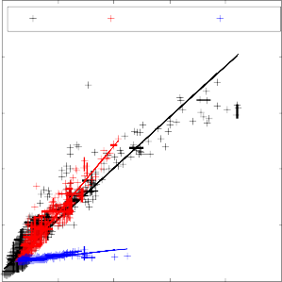
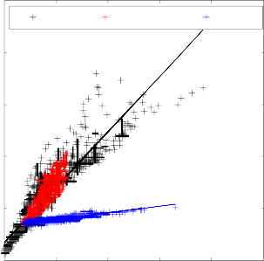
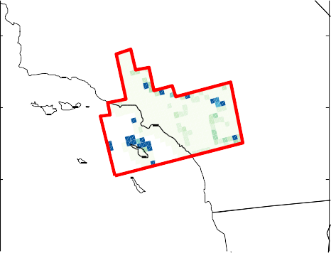
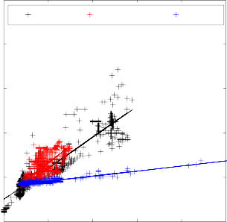
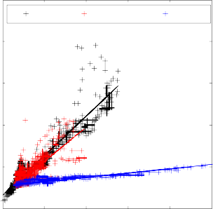
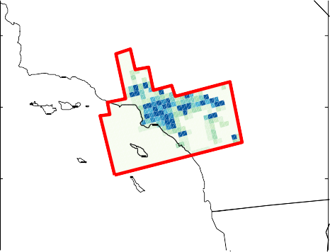


SoCAB Results (cont.)
2300
0504
Posterior
2300
0508
Posterior
Obs
Prior
Obs
Prior
2200
2200
Prior CH /CO
CH (ppbv)
CH (ppbv)
4
2100
2100
1
4
2000
4
2000
35
1900
1900
1800
100 200 300 400
CO (ppbv)
0514
500 600
1800
100 200 300 400
CO (ppbv)
0516
500 600
34
0.5
2300
2300
33
Obs Posterior
Prior
Obs Posterior
Prior
2200
2200
32
0
CH (ppbv)
2100
CH (ppbv)
2100
−120 −118 −116
4
2000
4
2000
Posterior CH /CO
1900
1900
4
1
1800
100 200 300 400
CO (ppbv)
0519
500 600
1800
100 200 300 400
CO (ppbv)
0620
500 600
35
2300
Obs Posterior
Prior
2300
Obs Posterior
Prior
34
0.5
2200
2200
CH (ppbv)
2100
CH (ppbv)
2100
33
4
2000
4
2000
32
0
1900
1900
−120
−118
−116
1800
100
1800
200 | 300 400 | 500 600 | 100 200 300 400 | 500 600
 | CO (ppbv) |  | CO (ppbv)
Cui, YY et al. submitted, 2014

Slide 14













Central Valley Results
San Joaquin Valley
(a)
May 07, 2010
(b)
June 16, 2010
ppbv
Sacramento Valley
May 12, 2010
ppbv
(a)
(b)
June 18, 2010
May 11, 2010
ppbv
(a)
(b)
June 14, 2010
Cui, YY et al. in prep, 2015

Slide 15



Central Valley Results (cont.)
Dairies
Mass Balance method (0512)
2
40
1.5
38
~70 Gg /yr
1
36
~90 Gg /yr
0.5
34
−124 −122 −120 −118
In this study: posterior emissions
0
Consistent with mass balance approach (530 Gg CH4/yr).
Higher by factor of ~7.5 in the posterior inventory in the Dairy sector
Cui, YY et al. in prep, 2015

Slide 16
Conclusions
A mesoscale inversion ensemble is used first to estimate CH4 emissions in CA.
The mesoscale inverse method improve simulations of CH₄ mixing ratios and the slopes of correlations between CH₄ and CO. And our uncertainty estimates include the uncertainty of the inversion method and also the uncertainty from the transport models.
Emission estimates are consistent with previous observation-based estimates.
Oil and gas industry emissions mostly explain differences between posterior and prior inventories in SoCAB. The CH₄ emissions of the dairy sector are highly underestimated by factor of ~7.5 in the Central Valley by the bottom-up inventory.

