Slide 1
Emissions Inventory Preparation for Air Quality Modeling (Base Year)
May 16, 2018
Alison Eyth, Jeff Vukovich, Caroline Farkas
EPA Office of Air Quality Planning and Standards
Emission Inventory and Analysis Group

Slide 2
Goals of Class
To introduce you to the various tasks involved with preparing emissions inputs to air quality models for base (historic) years
Focus is on the steps and data involved, not the details of running the scripts
To answer commonly asked questions about emissions modeling
Note: presentation is available for download: ftp://newftp.epa.gov/Air/nei/ei_training_may2018/emis_prep4aqm/
US EPA OAQPS, Emission Inventory and Analysis Group

Slide 3
Course Outline and Schedule
1:00 Background, Inventories, Tools, and QA
1:40 Emissions Modeling and Plume Rise
2:00 Spatial Allocation
2:25 Temporal Allocation
3:00 Break
3:15 Fugitive Dust, Biogenic, and Fire Emissions
3:45 Speciation
4:10 Onroad Mobile Sources
4:30 Final processing and QA steps
4:45 Any remaining questions
US EPA OAQPS, Emission Inventory and Analysis Group
Notes:
Alison: intro on emissions modeling and why we do it, Jeff modeling/plume rise, Alison spatial, Caroline temporal, Jeff fugitive dust/bio/fires...; Caroline speciation, Alison Onroad and wrap up

Slide 4
Background: Purpose and Contents of a Modeling Platform
Air quality modeling platforms are used to support air quality studies
Use technically sound data and state-of-the-science tools
Major components of a modeling platform:
Meteorological models (WRF) and met. data
Boundary conditions (GEOS-Chem/Hemispheric CMAQ)
Air quality models (CMAQ, CAMx)
Emissions: base year (NEI)+NonUS, future year projections
Other: ancillary data for emissions modeling, projections data, emissions modeling tools (SMOKE, etc) and scripts
US EPA OAQPS, Emission Inventory and Analysis Group

Slide 5
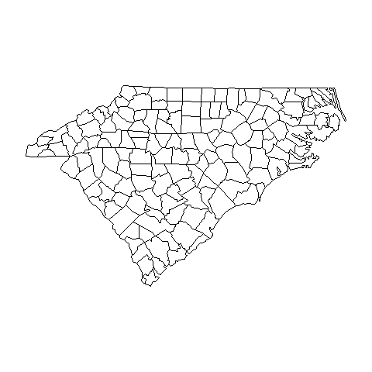
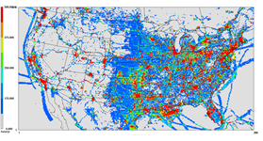
Air Quality Modeling Platform Components
Air Quality Model
Pollutant Concentrations
Meteorological Model: wind,
temperature,
precipitation,
radiation, …
These are hourly
and in 3-D
Boundary Conditions Concentrations of species at boundaries
Emissions
Ground level and elevated

Slide 6
Why do Air Quality Modeling?
Regulatory Impact Assessments (RIAs)
Model a base year focused on Criteria Air Pollutants (CAPs)
Model a future year base case with on-the-books rules
Model one or more cases that represent the rule
Estimate costs and benefits of rule
National Air Toxics Assessment (NATA)
Model a base year including as many Hazardous Air Pollutants (HAPs) as possible
Compute risk based on CMAQ and AERMOD concentrations
Transport and Regional Haze Modeling
Model a base year and a future year base case
Perform source apportionment modeling to determine contribution of states and/or sectors to air quality issues
US EPA OAQPS, Emission Inventory and Analysis Group
Notes:
These are common studies – there are others

Slide 7
Performing Emissions Modeling
We use the Sparse Matrix Operator Kernel Emissions (SMOKE) modeling system and associated tools to process our emissions into air quality model-ready files (http://www.cmascenter.org/smoke)
The input emission inventories (e.g., NEI) can be annual, monthly, daily, or hourly
“Ancillary” data files help process inventories into gridded hourly emissions of the chemical species (e.g., NO, NO₂, ISOP) used by the air quality model
Meteorological data such as temperature, precipitation, and radiation are needed to compute emissions and for some sectors temporalization (e.g., onroad mobile, biogenic, res. wood, agricultural)
Quality assurance steps and data summaries ensure data is properly transformed and mass is not lost
US EPA OAQPS, Emission Inventory and Analysis Group

Slide 8
Emissions Modeling Schematic
Hourly, speciated
point and gridded
emissions
Meteorological Data: humidity,
temperature,
radiation, …
SMOKE
Emission
Inventories
Quality Assurance Logs and Summaries
Ancillary Data Speciation and Temporal Profiles, Spatial Surrogates, cross-references, etc.

Slide 9
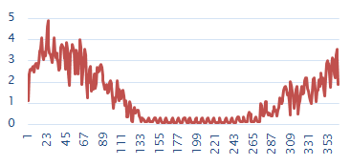

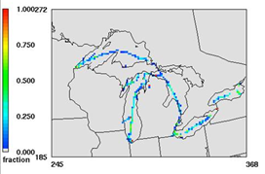
Emissions Modeling Process
Steps and data needed to convert emissions inventories into the resolution and formats needed by air quality models
Temporal Allocation
Temporal Profiles
Emission Inventories (annual/ monthly/daily)
+ Meteorology
Speciation Profiles
Speciation
Spatial Allocation
Hourly, speciated, gridded emissions for air quality modeling
Spatial Surrogates
Note: Plume rise is typically handled within the AQM
US EPA OAQPS, Emission Inventory and Analysis Group

Slide 10
Emissions Modeling Platforms
Contents:
Starting point is a version of the National Emissions Inventory (e.g., 2014 NEI version 2)
Related data sets needed for processing are also included
Software and scripts that process inventories into AQM inputs
Typically have a historic or “base” year and one or more future years
Historic platform development process:
Base and future year inventories and met. data developed by EPA
Data and software needed to process the inventories for AQM developed by EPA
Platform released for public comment
EPA incorporates comments into a new version of the platform
Now working on a more collaborative process
REPEAT

Slide 11


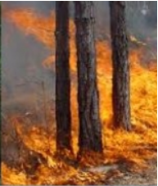
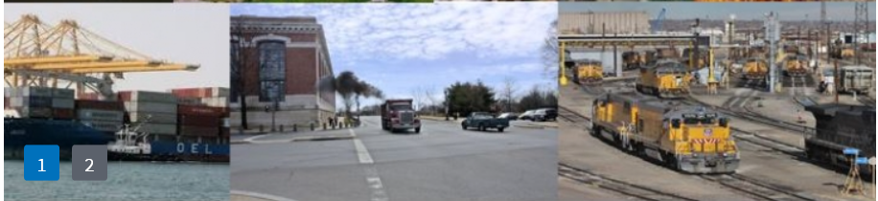

Base Year Emissions from the National Emissions Inventory (NEI)
Data are submitted by states, locals, tribes (S/L/T) and EPA into the Emissions Inventory System (EIS)
Five NEI data categories - all annual totals except events
Point/Facility Inventory (lat-lon locations): EGUs, airports, point oil and gas sources, commercial and industrial facilities
Nonpoint (county-based) – fugitive dust, agricultural, residential, industrial/commercial fuel comb., gas stations, biogenic
Onroad mobile sources (county): cars and trucks driving on roads
Nonroad mobile sources (county): mobile sources not on roads including rec. marine, construction equip., lawn/garden, tractors
Events (lat-lon, day): wildland and prescribed fires
US EPA OAQPS, Emission Inventory and Analysis Group

Slide 12
NEI Compilation and Schedule
EPA and S/L/T data are blended to create the NEI
Full NEI produced every third year (e.g., 2011, 2014, 2017)
NEI Submissions due by end of the following year
2014 NEI data due end of 2015; 2017 data due end of 2018
EPA compiles the inventory within about a year of submission
2014NEIv1 released September, 2016
2017NEIv1 to be released by March 2020 (no v2 planned)
“Type A” (large) point sources submitted every year
2016 sources due 12/31/17 (plus 2 week grace period)
2014 NEI version 2 released early 2018
See https://www.epa.gov/air-emissions-inventories

Slide 13
Recent and Upcoming Emissions Modeling Platforms
Multiple 2011 Platforms are available
Working on the 2014 NATA Platform
Based on 2014NEIv2 (2014 only, no future years)
Includes updated spatial surrogates, temporal profiles, and speciation profiles versus 2011 platforms
Focus is hazardous air pollutants (HAPs)
Collaborative Effort for a new base year
Not much ozone in the east in 2014
The year 2016 was selected through a collaborative process between states, regional organizations and EPA
States and MJOs wanted to be more involved in development of the next modeling platform
Notes:
HAP platform from NATA affects some inputs and scripts compared to CAP-platforms
Some files different than CAP-focused platforms

Slide 14
2016 Platform Schedule
Several versions of emissions will be developed
Alpha: preliminary version with 2016 emissions for some sectors and 2014 for the rest (March-April, 2018)
Beta: improved version of 2016 emissions and preliminary projected emissions to 2023 and 2028 (Summer-Fall, 2018)
V1.0: fully updated 2016 emissions and complete projected emissions for 2023 and 2028 (Winter, 2019)
Notes:
Timing of projections is uncertain

Slide 15
Recent Emission Modeling Platforms and Naming Convention
2011v6.3 platform is based on updated 2011NEIv2
2011v6.3
Emission modeling platforms have base years and can have future years that go with them (e.g., 2017, 2023)
2014v7.0 is the initial 2014 NATA modeling platform based on 2014NEIv1
2016 Platform is currently under development and uses a different nomenclature (i.e., alpha, beta, v1.0)
Base year being modeled
Specific NEI year (e.g., 6 means 2011 NEI was used)
Iteration of platform
(e.g., 3 is the third platform for 2011)
US EPA OAQPS, Emission Inventory and Analysis Group

Slide 16
Emissions Modeling Case Abbreviations
A “case” is a specific set of AQM-ready emissions inputs and has an abbreviation or nickname
2011ek
Additional information can follow the main abbreviation and differs by case
Speciation, control case, sensitivity adjustments, meteorological model configuration (e.g., 11g)
Such as cb6, ctl, nox50 (e.g., 2011ek_cb6_11g)
Year being modeled
NEI base year (e.g., e=2011 NEI, f=2014 NEI)
Configuration of emissions inputs
(e.g., k is the 11th version for 2011)
US EPA OAQPS, Emission Inventory and Analysis Group

Slide 17
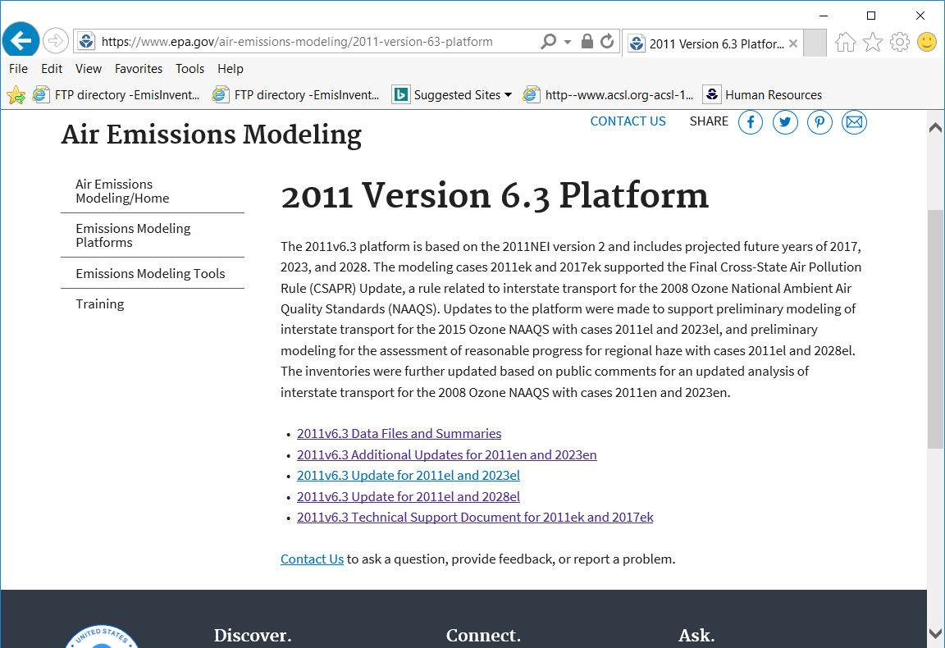
Case names appear on the web and FTP sites and in input file names
Notes:
Note that ek comes before el which comes before en; not all versions are released – sometimes they are special studies, so the letters aren’t sequential

Slide 18
EPA US 12km Modeling Platform Domains
US domains / grids use consistent map projections (Lambert)
Other domains also exist (e.g., 36km, 4km, hemispheric)
Many US domains include parts of Canada and/or Mexico
US EPA OAQPS, Emission Inventory and Analysis Group

Slide 19
Non-US emissions in the emissions modeling platform
Canada emissions & ancillary data (e.g., surrogates)
Courtesy Environment Canada
Used 2010 until 2013 and 2025 data provided in April, 2017
Fire emissions provided for summer 2011 and other years
Mexico 2008 emissions and projections of these
Based on Inventario Nacional de Emisiones de Mexico, 2008
MOVES-Mexico data was developed for key years
Base year fire emissions for Mexico derived from Fire INventory from NCAR (FINN):
A daily fire emissions product for atmospheric chemistry models [also used for winter in Canada]
Hemispheric Transport of Air Pollution (HTAP) version 2 inventories used outside of North America in hemispheric runs
US EPA OAQPS, Emission Inventory and Analysis Group

Slide 20
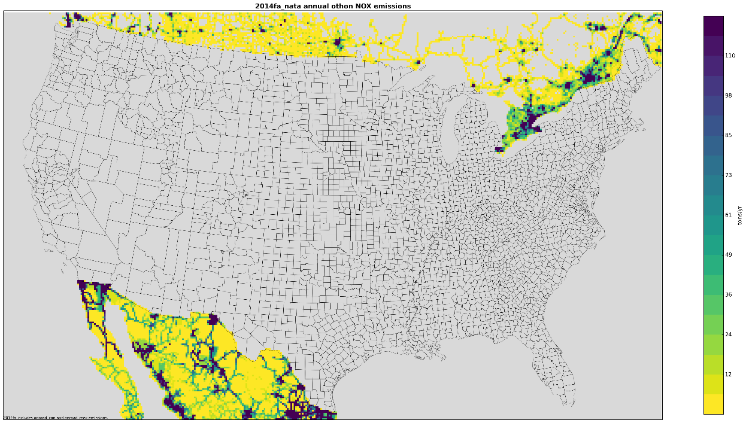
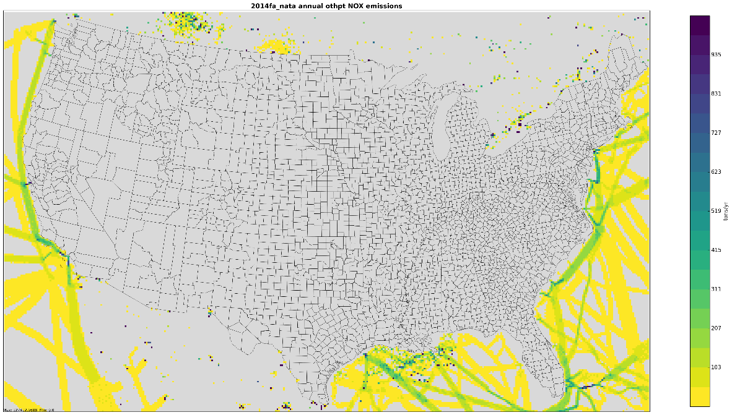
2014fa NOx Emissions Outside of the United States
Top: Onroad sources in Canada and Mexico
Bottom: Non-US point sources and Commercial marine vessels outside of state waters
US EPA OAQPS, Emission Inventory and Analysis Group

Slide 21
Emissions Modeling Platform Sectors
Emission inventories are broken down into “sectors” used to prepare AQM-ready emissions for different parts of the inventory
Each sector has unique processing or inventory characteristics and a lowercase name (e.g., rwc)
Specific sectors vary by modeling platform but cover all sources in the inventory
Point source sectors keep their specific latitude-longitude locations throughout the processing
Nonpoint sectors are allocated to grid cells using spatial surrogates
EPA processes emissions separately for each sector then merges the ground-level emissions together to create final AQM-ready files for a case

Slide 22
2016 Platform Sectors: Point and Non-U.S.
Point and non-US Sectors | Sector Description
ptegu | Point sources that are Electric generating units (EGUs)
pt_oilgas | Point sources related to oil and gas production
ptnonipm | Point sources that are not EGUs nor related to oil and gas
ptagfire | Point source day-specific agricultural fires (was agfire)
ptfire | Point source day-specific wild and prescribed fires
ptfire_othna | Non-US point source day-specific fires in North America
cmv_c3 | Category 3 (large) Commercial Marine Vessels as points
othpt | Non-US point sources
othafdust_adj | Non-US area fugitive dust sources (Canada only)
othar | Non-US area (i.e., nonpoint) sources
onroad_can | Onroad mobile sources for Canada (was othon)
onroad_mex | Onroad mobile sources for Mexico (was othon)
US EPA OAQPS, Emission Inventory and Analysis Group

Slide 23
2016 Platform Sectors: Ground-level
Nonpoint Sectors | Sector Description
afdust_adj | Met.-adjusted area fugitive dust emissions
ag | Agricultural ammonia sources
beis | Biogenic emissions based on the BEIS model
cmv_c1c2 | C1&C2 Commercial marine vessels (nonpoint)
nonpt | Nonpoint sources not in other sectors
nonroad | Mobile sources that do not drive on roads or railroads, including recreational pleasurecraft
np_oilgas | Nonpoint oil and gas production-related sources
onroad | On-land mobile sources that drive on roads
onroad_ca_adj | Onroad mobile sources in California
rail | Locomotive sources on railroads
rwc | Residential wood combustion sources
US EPA OAQPS, Emission Inventory and Analysis Group
Notes:
Our job as emissions modelers is to ensure there are quality inventories and ancillary data going into all of these sectors…

Slide 24

Questions?
Any questions on basic concepts of emissions modeling?
Notes:
Next: Jeff

Slide 25
How do we Start Building a New Platform?
When a new NEI version becomes available, flat files (a .csv format) are output from EIS
Point and nonpoint inventories are split into sectors
Onroad, nonroad, and biogenic are inputs to the NEI release
Update ancillary files to account for new source classification codes (SCCs) and updated data
Perform quality assurance as needed (temporal, speciation, gridding)
Compare the inventories and results to a previous platform
Create difference reports by state, county, and/or SCC
Create charts and maps
Example: 2016 platform development
Notes:
Key inventory fields are FIPS code, pollutant, source classification code (SCC), and stack parameters

Slide 26
2014 vs 2016 Comparison
First, prepare excel workbook by sector, state, pollutant, case 1, case 2, absolute and percent changes; then apply filters to prioritize (e.g. > 1500)
sector | state | poll | ann_emis_ 2014fb | ann_emis_ 2016fc | diff_tons | percent diff
ptagfire | Arkansas | PM2_5 | 1,706 | 2,745 | 1,039 | 61%
ptagfire | California | PM2_5 | 3,596 | 5,689 | 2,093 | 58%
ptagfire | Florida | PM2_5 | 3,632 | 3,676 | 44 | 1%
ptagfire | Georgia | PM2_5 | 2,090 | 1,587 | -503 | -24%
ptagfire | Kansas | PM2_5 | 10,861 | 18,385 | 7,525 | 69%
ptagfire | Missouri | PM2_5 | 1,640 | 2,368 | 728 | 44%
ptagfire | North Dakota | PM2_5 | 1,969 | 3,241 | 1,272 | 65%
ptagfire | Oklahoma | PM2_5 | 6,124 | 9,545 | 3,421 | 56%
ptagfire | Texas | PM2_5 | 4,401 | 5,815 | 1,413 | 32%
ptagfire | Washington | PM2_5 | 1,694 | 1,334 | -359 | -21%
Notes:
Note the substantial changes in the two years: some increases, some decreases…

Slide 27
2014-2016 EGU comparison
State | 2014 SO2 | 2016 SO2 | % diff SO2 | 2014 NOx | 2016 NOx | % diff NOx
Alabama | 119,919 | 25,337 | -79% | 50,489 | 28,674 | -43%
Arkansas | 76,046 | 46,706 | -39% | 38,626 | 26,968 | -30%
Florida | 99,628 | 40,453 | -59% | 73,740 | 62,611 | -15%
Illinois | 143,261 | 67,096 | -53% | 48,196 | 32,147 | -33%
Indiana | 294,339 | 89,911 | -69% | 110,290 | 83,170 | -25%
Kentucky | 201,871 | 76,290 | -62% | 86,816 | 57,586 | -34%
Louisiana | 76,774 | 45,851 | -40% | 46,285 | 47,462 | 3%
Michigan | 154,855 | 85,354 | -45% | 59,625 | 41,541 | -30%
Mississippi | 90,790 | 3,187 | -96% | 23,643 | 16,022 | -32%
Missouri | 134,326 | 100,798 | -25% | 74,883 | 57,335 | -23%
Ohio | 302,698 | 107,532 | -64% | 88,177 | 56,137 | -36%
Oklahoma | 76,791 | 49,439 | -36% | 39,450 | 25,130 | -36%
Pennsylvania | 278,498 | 98,839 | -65% | 129,423 | 83,300 | -36%
Texas | 346,244 | 247,044 | -29% | 124,892 | 108,655 | -13%
West Virginia | 101,586 | 42,515 | -58% | 72,631 | 52,307 | -28%
Notes:
Note the large decreases of SO2 and NOx emissions for EGUs in just 2 years…

Slide 28
2014 vs 2016 County-level Comparisons
sector | state | county | poll | ann_emis_2014fb | ann_emis_2016fc | diff | pdiff
beis | Alabama | Autauga Co | CO | 2,458 | 2,756 | 298 | 12.1%
beis | Alabama | Autauga Co | NOX | 157 | 167 | 10 | 6.2%
beis | Alabama | Autauga Co | VOC_INV | 21,332 | 23,829 | 2,496 | 11.7%
beis | Alabama | Baldwin Co | CO | 7,276 | 8,206 | 930 | 12.8%
beis | Alabama | Baldwin Co | NOX | 399 | 433 | 34 | 8.6%
beis | Alabama | Baldwin Co | VOC_INV | 57,200 | 63,835 | 6,635 | 11.6%
beis | Alabama | Barbour Co | CO | 3,417 | 3,918 | 501 | 14.7%
beis | Alabama | Barbour Co | NOX | 151 | 164 | 14 | 9.0%
beis | Alabama | Barbour Co | VOC_INV | 30,439 | 35,010 | 4,572 | 15.0%
Biogenic changes mainly due to meteorology; others due to # of days in year
sector | state | county | poll | ann_emis_2014fb | ann_emis_2016fc | diff | pdiff
ptnonipm | Alabama | Autauga Co | CO | 2,475 | 2,482 | 7 | 0.3%
ptnonipm | Alabama | Autauga Co | NH3 | 71 | 72 | 0 | 0.3%
ptnonipm | Alabama | Autauga Co | NOX | 2,530 | 2,537 | 7 | 0.3%
ptnonipm | Alabama | Autauga Co | PM10 | 536 | 538 | 1 | 0.3%
ptnonipm | Alabama | Autauga Co | PM2_5 | 428 | 429 | 1 | 0.3%
ptnonipm | Alabama | Autauga Co | SO2 | 3,692 | 3,702 | 10 | 0.3%
ptnonipm | Alabama | Autauga Co | VOC_INV | 901 | 903 | 2 | 0.3%

Slide 29
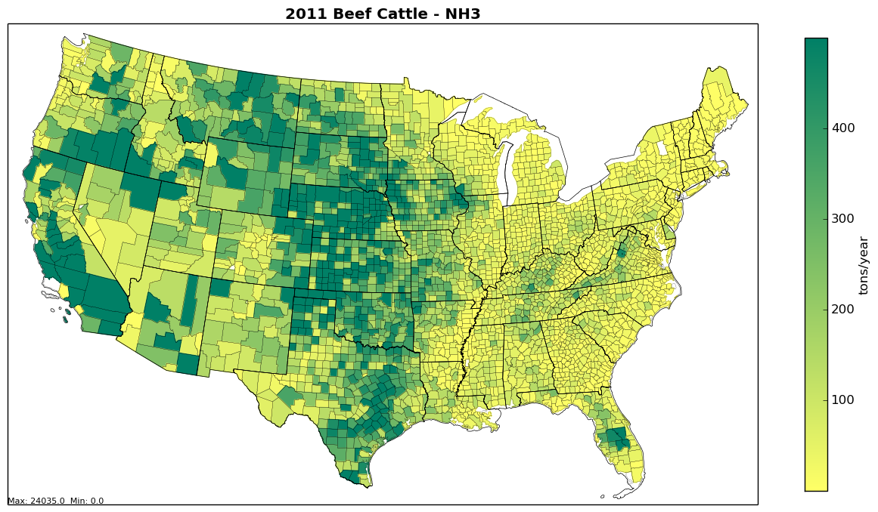
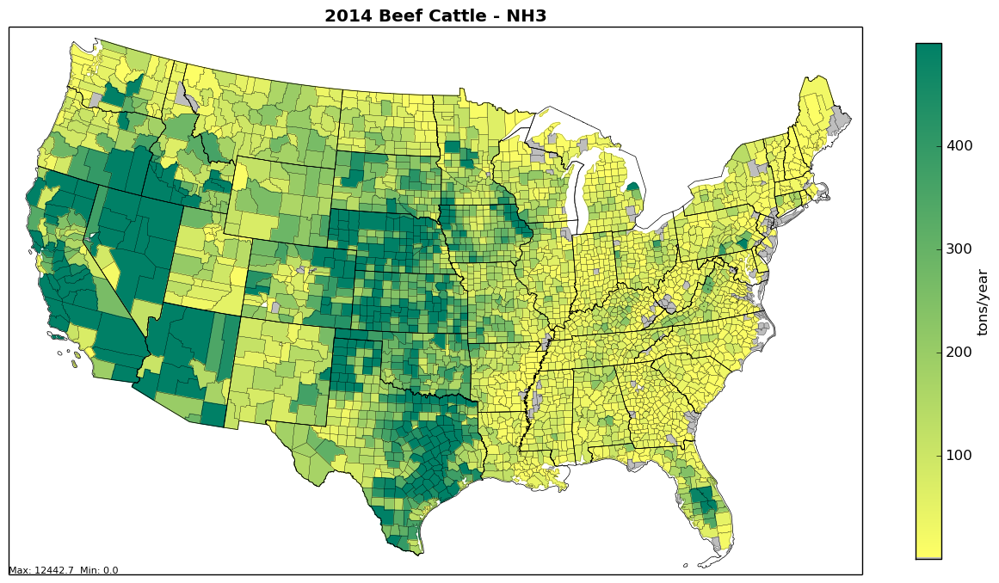
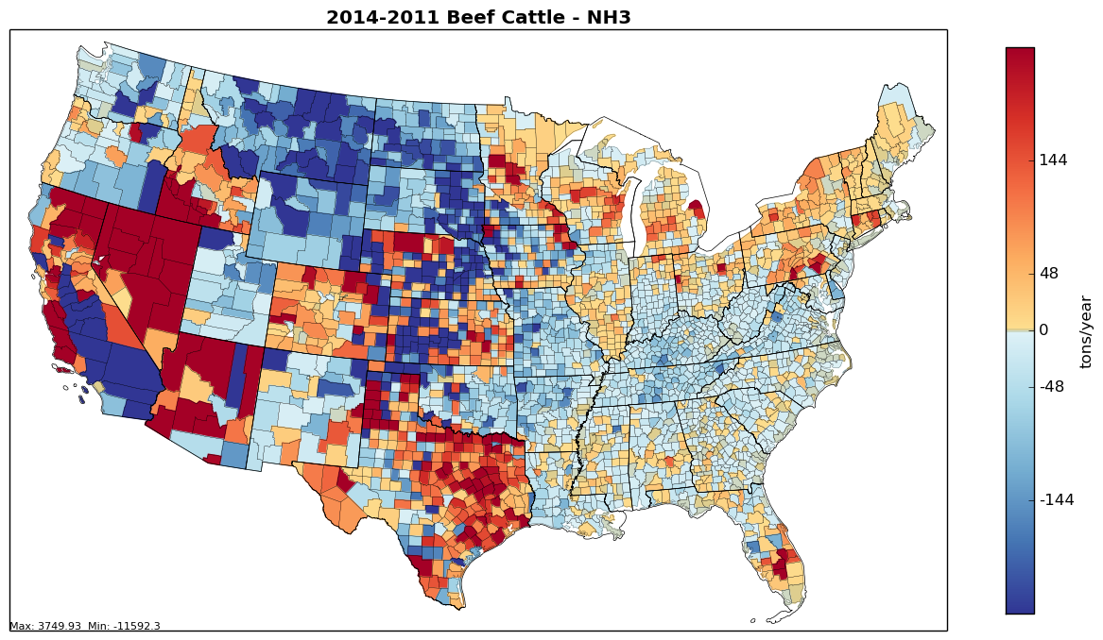
County-level Base and Difference Maps: Beef Cattle NH₃
2011
2014
Maps help us see spatial variation and hot spots
Most of our county-level maps are created with Python

Slide 30
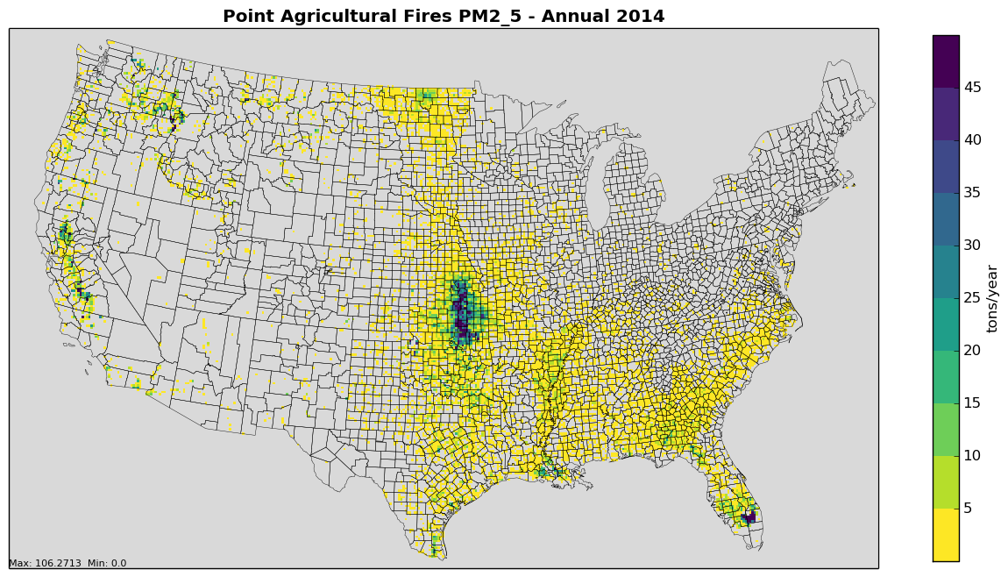
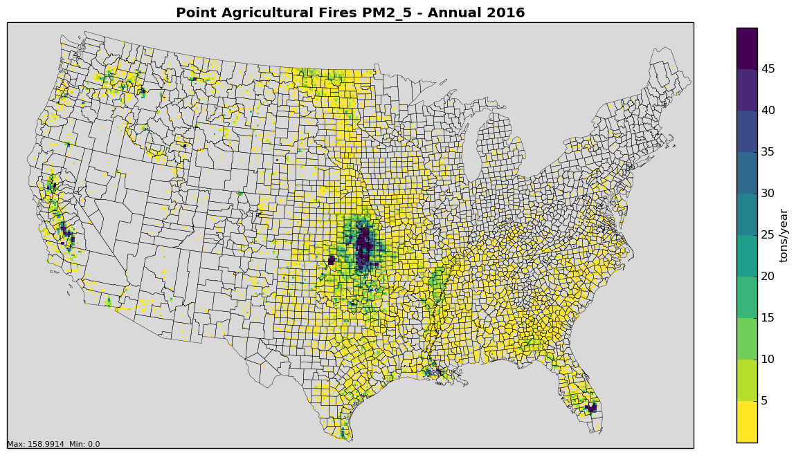
Gridded Maps: Ptagfire Example
2014 PM_{2.5}
Gridded maps can be created with VERDI, PAVE, etc.
2016 PM_{2.5}
For some sectors (e.g., fires, biogenics) we create monthly maps

Slide 31
Modeling Platform Data is not always the same as the NEI
Some modeling platform data are not the same as what is in the NEI
Corrections to issues found after the NEI release
New data becomes available after NEI release
More detailed data is available than is stored in NEI
Continuous Emissions Monitoring System (CEMS) data for EGUs are hourly by unit
Nonroad data are computed monthly (summed in the NEI)
Onroad and biogenics data computed as hourly emissions and then aggregated & summed for the NEI
NEI uses average meteorological adjustments for afdust, but the modeling platform emissions are adjusted based on hourly, gridded met. data

Slide 32

Questions?
Questions on new platform development or quality assurance?
Notes:
Jeff continues

Slide 33
Emissions Modeling with SMOKE
We use the Sparse Matrix Operator Kernel Emissions (SMOKE) modeling system and associated tools to process emissions into air quality model-ready files
Smkinven: reads in the emission inventories
Grdmat: computes gridding matrix using lat-lon locations and spatial surrogates
Spcmat: computes speciation matrix using speciation profiles
Temporal: temporally allocates emissions to hours using temporal profiles
Elevpoint: Splits ground-level and elevated point sources
Smkmerge: merges all matrices and temporalized emissions to create AQM-ready data for a sector
Mrggrid: merges ground-level emissions from different sectors together into a complete ground-level file

Slide 34
SMOKE Data Flow for a Generic Emissions Modeling Sector
Emission Inventory
Temporal profiles
Smkinven
SMOKE inventory
SpeciationProfiles
Spatial Surrogates
Spcmat
Temporal
Grdmat
These emissions are for one sector
Speciation Matrix
Hourly Emissions
Gridding Matrix
AQM-formatted emissions
Smkmerge

Slide 35
Special Emissions Models
Biogenic Emission Inventory System (BEIS): part of SMOKE and CMAQ that creates air quality model-ready biogenic emissions
SMOKE programs: Normbeis3, Tmpbeis3
Motor Vehicle Emission Simulator (MOVES):
For onroad mobile sources: generates emission factors that can be combined with activity data (e.g., Vehicle miles traveled, speed) within SMOKE
SMOKE programs: Met4moves, Movesmrg
For nonroad mobile sources: generates county-level emission inventories for each month
Previously done with National Mobile Inventory Model (NMIM) and NONROAD model

Slide 36
Other Emissions Modeling Tools
Surrogate Tool: creates spatial surrogates from Shapefiles to put county emissions into grid cells
Speciation Tool: creates chemical speciation profiles from SPECIATE database profiles (e.g., NOx->NO+ NO₂, PM2.5->EC+OC+..., VOC->…)
Gentpro: SMOKE program that creates meteorology-based temporal profiles
Python: helps with QA, creates reports and maps
Emissions Modeling Framework: graphical user interface that manages inventories and related data and modeling cases; creates summaries for QA and analysis; includes Control Strategy Tool

Slide 37
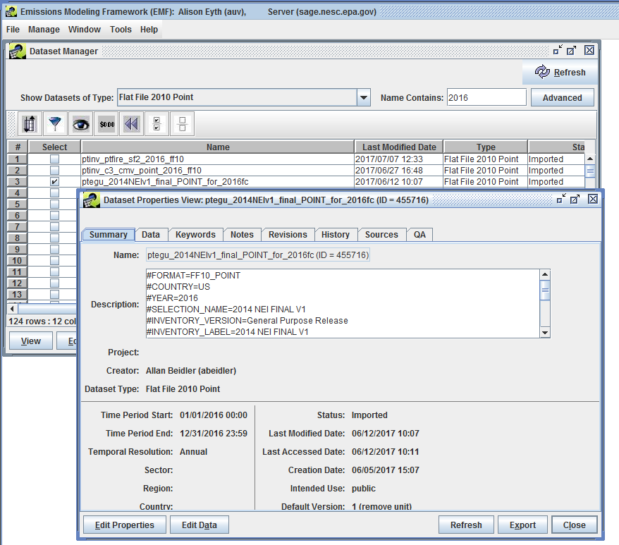
Emissions Modeling Framework
Emission
inventories
are stored as
Datasets in the
Emissions Modeling
Framework
Notes:
Mention the Dataset Manager

Slide 38
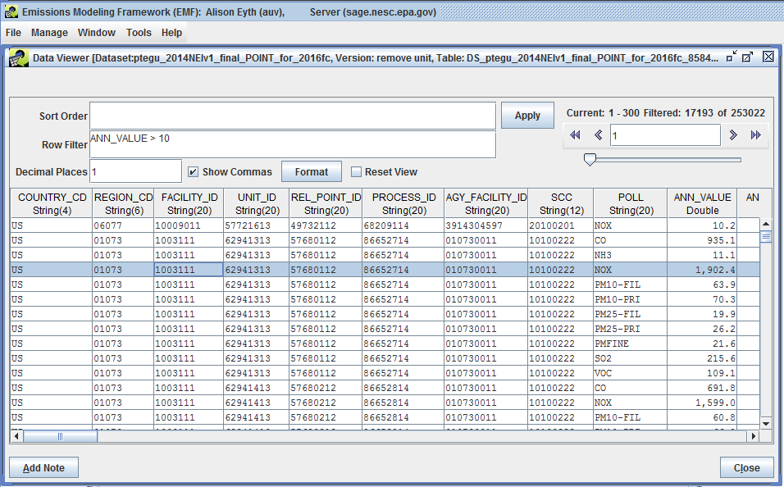
EMF Showing Point Inventory (FF10)
Filter records using SQL

Slide 39
Emissions Modeling Steps for Ground-level Sectors
Platform sector | Spatial | Speciation | Inventory resolution
afdust_adj | Surrogates | Yes | annual + met data
ag | Surrogates | Yes | annual or monthly
beis | Pre-gridded land use | in BEIS 3.6.1 | computed hourly
cmv_c1c2 | Surrogates | Yes | annual
nonpt | Surrogates | Yes | annual
nonroad | Surrogates | Yes | monthly
np_oilgas | Surrogates | Yes | annual
onroad, onroad_ca_adj | Surrogates | in MOVES 2014 | monthly activity, computed hourly
onroad_can | Surrogates | Yes | monthly
onroad_mex | Surrogates | in MOVES | monthly
rail | Surrogates | Yes | annual
rwc | Surrogates | Yes | annual
Notes:
Highlight the differences in inventory resolution and speciation

Slide 40
Emissions Modeling Steps for Non-U.S. and Point Sectors
Platform sector | Spatial | Speciation | Inventory resolution | Plume rise
othafdust | Surrogates | Yes | annual
othar | Surrogates | Yes | annual
othpt | Point | Yes | annual | in-line*
ptfire_mxca | Point | Yes | daily | in-line
pt_oilgas | Point | Yes | annual | in-line
ptegu | Point | Yes | annual & hourly CEMS | in-line
ptfire | Point | Yes | daily | in-line
ptagfire | Point | Yes | daily | in-line
ptnonipm | Point | Yes | annual | in-line
cmv_c3 | Point | Yes | Annual | in-line
* in-line means the plume rise can be done in CMAQ
Notes:
Point out sectors with plume rise

Slide 41
Plume Rise
Plume rise allows for sources to go vertically above the first layer of the air quality model (AQM has up to 35 layers)
The SMOKE Elevpoint program selects elevated or plume-in-grid point sources using the Briggs algorithm
Most sources with plume height > 20m as elevated
Sometimes we want all sources to have plume rise
Plume rise can be done with the SMOKE Laypoint program to compute layer fractions for each elevated point source
For hemispheric applications, 3-D emissions are developed
Notes:
Sectors that would all get plume rise include ptegu, cmv_c3, othpt

Slide 42
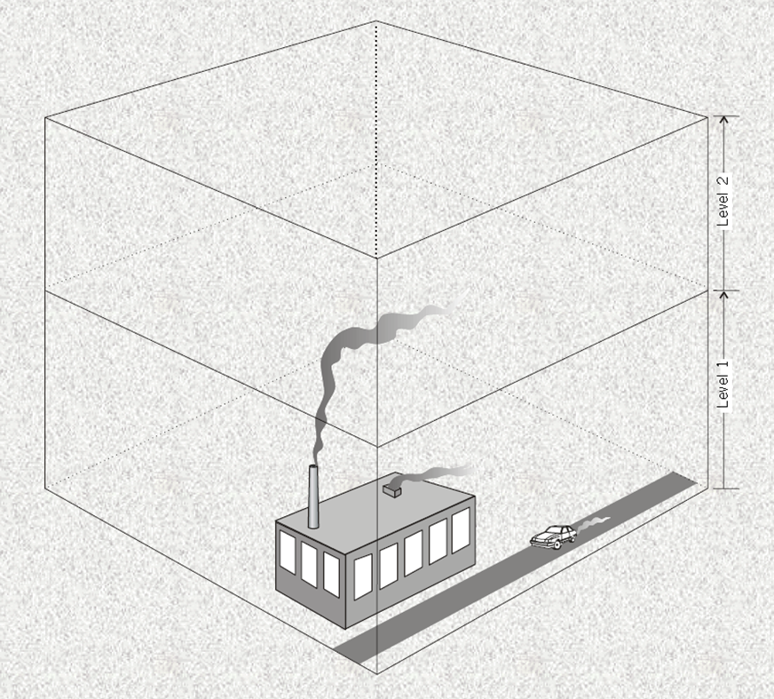
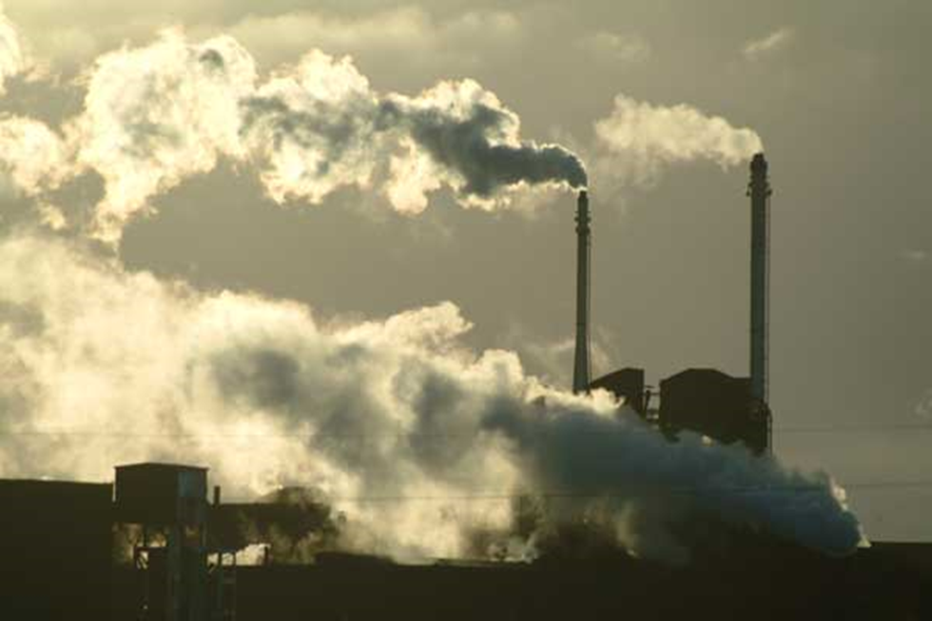
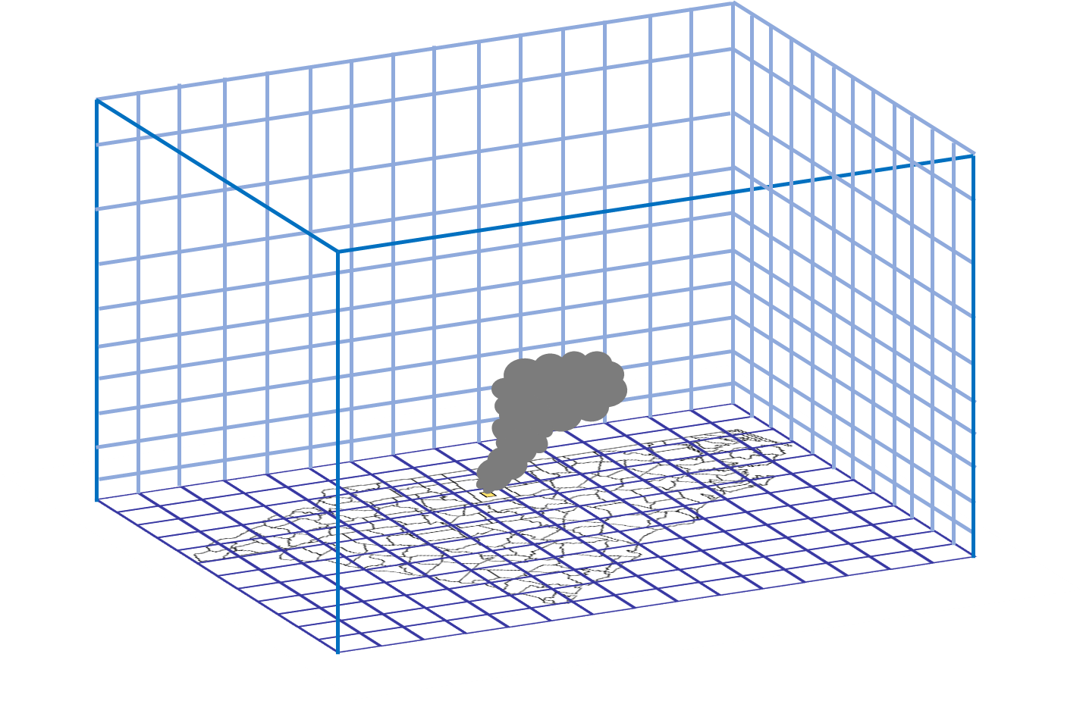
Plume rise: Vertical allocation

Slide 43
Plume Rise Formula
Stack parameters for point sources affect plume rise
Height, diameter, velocity / flow, temperature
F = 0.25 x G x V_{S} x D_{S}² x (T_{S} - T)/T_{S}
For F < 55, Plume rise = H_{S} + 21.313 x F^{0.75}/U otherwise: Plume rise = H_{S} + 38.878 x F^{0.6}/U where
H_{S} = Physical stack height (m)
F = Buoyancy flux (m⁴/s³)
G = Mean gravitational acceleration (9.80665 m/s²)
V_{S} = Stack gas exit velocity (m/s)
D_{S} = Inside stack diameter (m)
T_{S} = Stack gas temperature (K)
T = Default ambient air temperature (293 K)
U = Default wind speed (2 m/s)

Slide 44
Plume Rise Requirements for AQMs Differ
3-D emissions files can be really big!
CMAQ can do “in-line” plume rise
Provide CMAQ with hourly emissions with locations and stack parameters for any elevated sources
Compute plume rise with hourly meteorological data
A special plume rise treatment is used for fires that considers acres burned and heat flux
CAMx supports an in-line format for plume rise but does not have the same algorithm for fire plume rise
We run SMOKE Laypoint to compute 3-D fires
Point sources are then converted to CAMx format

Slide 45
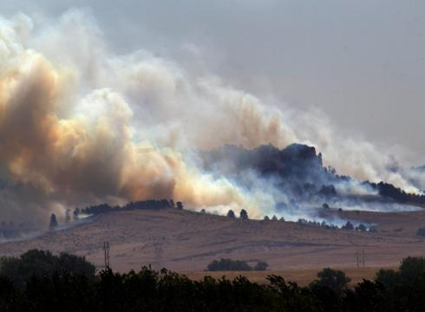
Allocation to Layers for AQ Modeling
Layer number
Emissions

Slide 46

Questions?
Any questions on SMOKE or plume rise?
Notes:
Next: Alison

Slide 47
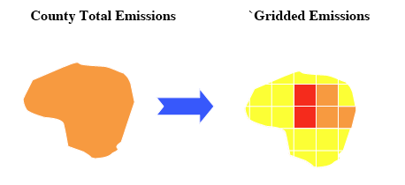
Spatial Allocation
Spatial allocation is the process of mapping inventory emissions to modeling grid cells
We do this using spatial surrogates; there are many types and each has a unique code (ID)
Population (100), Total agriculture (310), Railroad Density (261), Offshore shipping (806), Urban unrestricted daily VMT (222), Gas well count (698)
A cross reference maps inventory SCCs to surrogate codes
Notes:
Instead of assuming the emissions are uniformly distributed spatially, we use an attribute from another dataset to allocate the emissions to grid cells.

Slide 48
Surrogate Tool
Java program that takes .csv files as input
Runs the Spatial Allocator to prepare surrogates
Download from http://www.cmascenter.org
Performs gapfilling of surrogates
When attributes used to compute a surrogates do not exist for a county, another surrogate is used
Outputs quality assurance products
Sum of surrogate for each county (=1.0?), gapfilling
Some GIS datasets are too large to process with the Spatial Allocator (e.g., new roads, CMV))
Working on a PostgreSQL tool with PostGIS to process these

Slide 49
Data Used to Create a Spatial Surrogate with Surrogate Tool
Weight Shapefile: an attribute is selected from this spatial dataset to apportion values in a county into the model grid cells
Population at the census tract block level (polygon)
Lines representing railroads
Point locations of oil and gas wells
Data Shapefile: spatial dataset that represents boundaries on which inventory is computed (e.g., U.S. counties, Canadian provinces)
Output grid: modeling grid cells

Slide 50
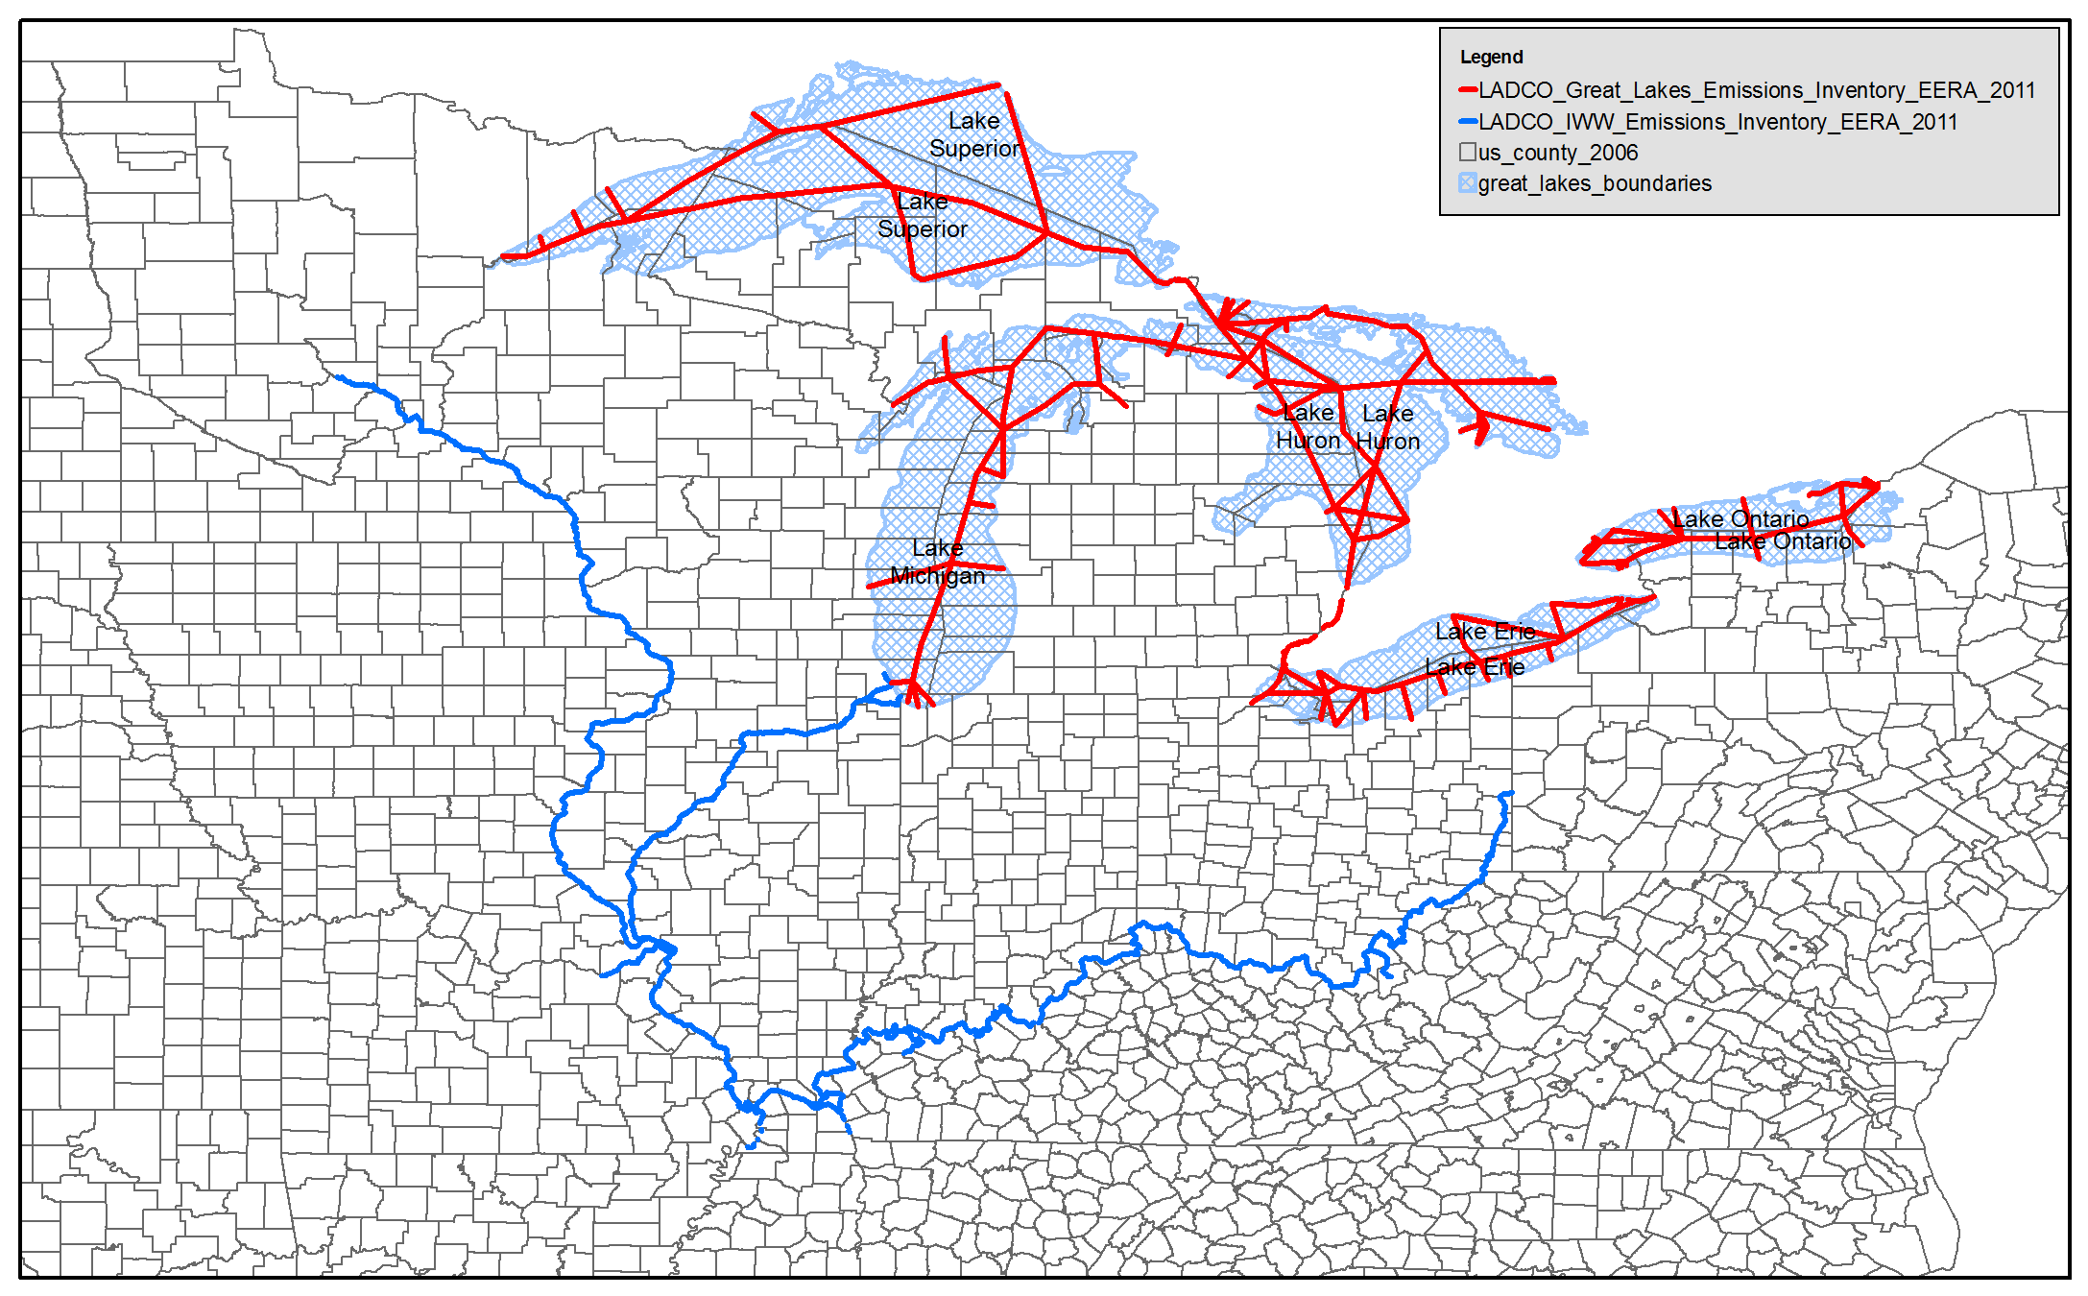
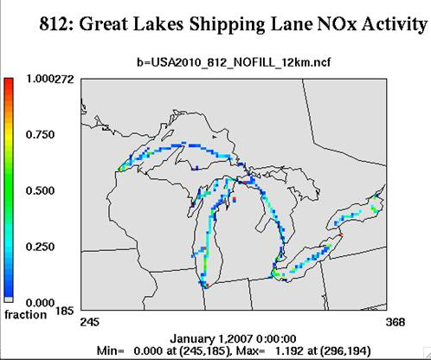
Creating a Surrogate for Commercial Marine Vessels
Data = US counties
Weight = NOx emissions on shipping lanes
Output is US 12km grid
Notes:
These spatial patterns are very different from what we would see if we assumed uniform distribution

Slide 51
Spatial Surrogate values
Value = sum of attribute in grid cell
sum of attribute in county
Values sum to 1 for each county / province
Surg ID | County | Col | Row | Ratio | Comment*
806 | 01003 | 345 | 207 | 0.2 | 200/1000
806 | 01003 | 346 | 207 | 0.3 | 300/1000
806 | 01003 | 346 | 208 | 0.5 | 500/1000
806 | 01005 | 355 | 210 | 0.4 | 800/2000
806 | 01005 | 355 | 209 | 0.6 | 1200/2000
* Surrogates created using the Spatial Allocator include a comment that shows how the ratio was computed

Slide 52
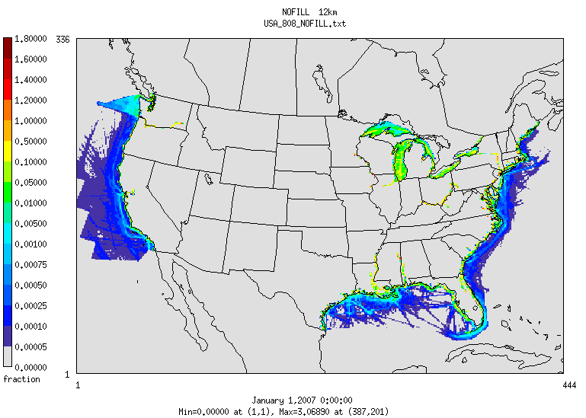
Updated CMV Surrogate
New spatial surrogate is based on 2013 data: https://www.marinecadastre.gov/data
US EPA OAQPS, Emission Inventory and Analysis Group
Notes:
Keep in mind the NEI boxes – Pacific, Atlantic, Gulf, Off Washington

Slide 53
Using Cross-references and Profiles (Generically)
Cross-references and profiles are used in emissions modeling to apportion wholes into parts:
X-REF table
Profiles table (sum to 1)
SCC, Surg. ID
ID, Grid cell 1, 2, 3
2505020121, 15 2505020122, 15
2294000000, 16
2296000000, 17
13 0.2, 0.3, 0.5
14 0.4, 0.4, 0.2
15 0.4, 0.3, 0.3
16 0.4, 0.5, 0.1
17 0.4, 0.4, 0.2

Slide 54
Spatial Surrogate Cross reference
FIPS ST/CTY* | SCC** | Surrogate ID | Comments
000000 | 0040600241 | 801 | ! All counties
000000 | 0040600242 | 801 | ! All counties
000000 | 2505020121 | 801 | ! All counties
008000 | 2520100102 | 689
048243 | 2520100102 | 693 | ! Replaced 698
048243 | 2520100102 | 693 | ! Replaced 698
*A surrogate can be applied to all counties using code 000000 or to specific states using state FIPS+”000”, or to specific counties ** Specific SCC assignments are always used (no hierarchy assumed)

Slide 55
Some Spatial Surrogate Data Sources
2011 National Land Cover Database (NLCD)
U.S. Census American Community Survey
U.S. Census Topologically Integrated Geographic Encoding and Referencing (TIGER) data
U.S. DOT Highway Performance Monitoring System (HPMS) – Annual Average Daily Travel (AADT)
National Transportation Atlas Database (NTAD)
2014 NEI Oil and Gas Activity Data
2014 NEI Ports and Shipping Lanes

Slide 56
Key Spatial Surrogates for CAPs
Sector | ID | Description | NH3 | NOX | PM2_5 | VOC
ag | 310 | NLCD Total Agriculture | 3,135,285
onroad | 307 | NLCD All Development |  | 560,112 | 12,560 | 1,142,592
onroad | 222 | Urban Unrestricted AADT | 42,001 | 1,223,593 | 54,345 | 376,209
nonpt | 306 | NLCD Med + High | 22,268 | 239,863 | 290,187 | 864,662
onroad | 232 | Rural Unrestricted AADT | 25,027 | 987,683 | 33,882 | 201,764
nonpt | 100 | Population | 32,222 | 0 | 0 | 1,137,409
afdust | 310 | NLCD Total Agriculture |  |  | 1,169,400
afdust | 304 | NLCD Open + Low |  |  | 1,116,883
np_oilgas | 694 | Oil Production at Oil Wells | 0 | 4,375 | 0 | 1,104,120
np_oilgas | 698 | Well Count - Gas Wells | 15 | 388,677 | 6,726 | 623,925
onroad | 202 | Urban Restricted AADT | 24,687 | 790,075 | 30,439 | 149,645
rail | 271 | NTAD Class 1 2 3 Railroad Density | 362 | 767,307 | 22,868 | 39,121

Slide 57
Quality Assurance of Spatial Allocation
Check SMOKE Grdmat logs to ensure all SCCs are mapped to spatial allocation profiles and only emissions outside the domain are not allocated to grid cells (do not want to drop emissions)
Review gridded emission plots by sector to ensure spatial patterns are reasonable (US sources are all in US, onshore emissions are all on land)
Compare post-SMOKE emissions to the inventory also helps to ensure that no emissions are dropped due to gridding
For point sources: check that inventory coordinates fall within county boundaries

Slide 58
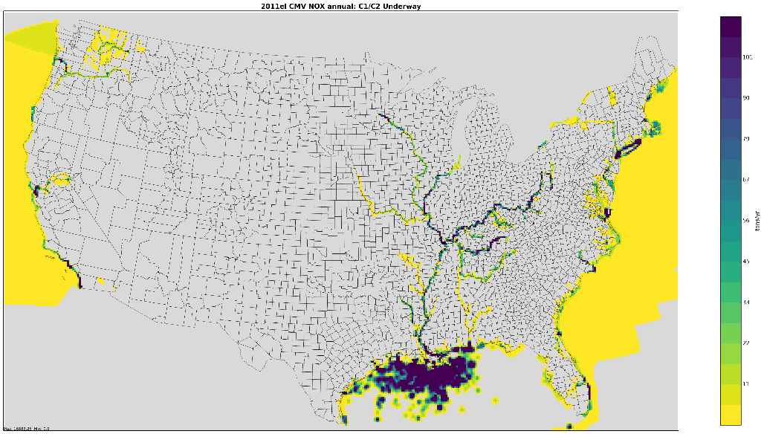
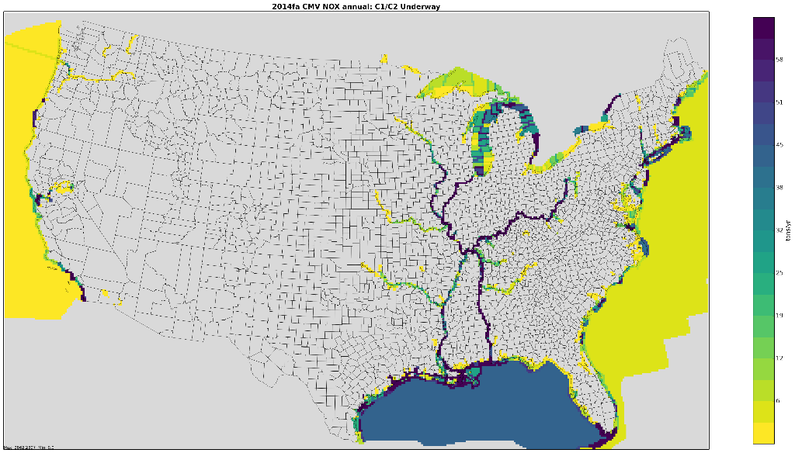
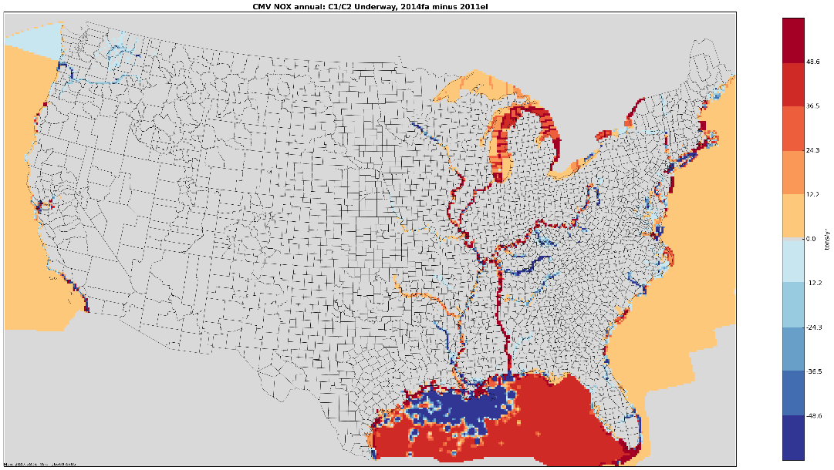
Maps Help us to QA Spatial Surrogates: cmv_c1c2 Example
2011el cmv_c1c2 NOx
2014fa cmv_c1c2 NOx
101
58
0
2014fa-2011el cmv_c1c2 NOx
48.6
-48.6

Slide 59

Questions?
In this section we’ve covered some details on spatial allocation
Notes:
Next: Caroline

Slide 60
Temporal Allocation
Temporal allocation is the process of allocating inventory emissions to hourly emissions
Hierarchy of temporal allocation steps: annual -> month -> day -> hour
There are many types of temporal profiles for each resolution and each has a unique code
Typically, SCCs are used to map temporal profiles to inventory sources
Cross reference may also use FIPS, pollutant, etc.
More control with the format in SMOKE 3.6+
e.g., Monday diurnal profile vs Friday diurnal profile
Database-friendly for use in EMF

Slide 61
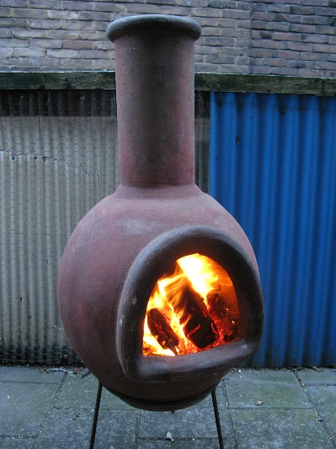

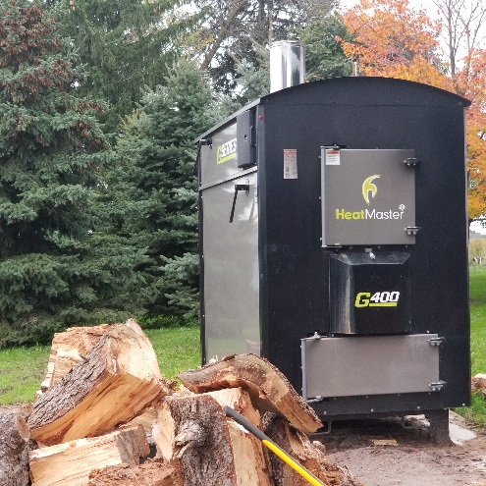
Temporal Profile Examples
Chimenea
Fire Pit
Outdoor Hydronic Heater

Slide 62
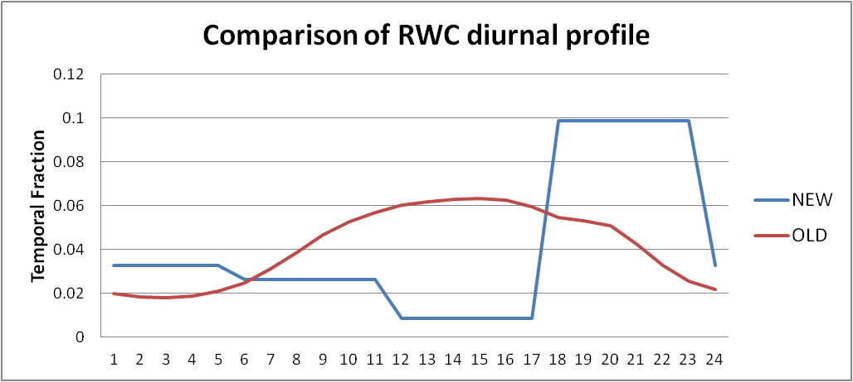
Diurnal Temporal Profile Examples
Notes:
Note that profiles are between 0 and 1 but units of source data vary

Slide 63
Excerpt from Temporal Cross Reference and Profile Files
SCC | FIPS | Facility | Unit | Releasept | process | Pollutant | Profile Type | Profile Num | Comment
2104009000 | 56045 |  |  |  |  | 0 | MONTHLY | 17001
2104009000 | 56045 |  |  |  |  | 0 | DAILY | 56045
2104009000 | 56045 |  |  |  |  | 0 | ALLDAY | 600
2104008700 |  |  |  |  |  | 0 | MONTHLY | 17750 | “Fire pit"
2104008700 |  |  |  |  |  | 0 | WEEKLY | 61500 | “Fire pit"
2104008700 |  |  |  |  |  | 0 | ALLDAY | 600 | “Fire pit"
2104008610 |  |  |  |  |  | 0 | MONTHLY | 17751 | “Hydronic heater”
2104008610 |  |  |  |  |  | 0 | WEEKLY | 7 | “Hydronic heater"
2104008610 |  |  |  |  |  | 0 | ALLDAY | 1500 | “hydronic heater"
Profiles
MonthID | Jan | Feb | Mar | Apr | May | June | July | Aug | Sept | Oct | Nov | Dec
17750 | 0.01 | 0.01 | 0.02 | 0.05 | 0.12 | 0.14 | 0.15 | 0.13 | 0.15 | 0.11 | 0.08 | 0.03
17751 | 0.14 | 0.13 | 0.14 | 0.12 | 0.02 | 0.01 | 0.01 | 0.01 | 0.02 | 0.12 | 0.13 | 0.15
WeekID | Sun | Mon | Tue | Wed | Thu | Fri | Sat
7 | 0.14 | 0.14 | 0.14 | 0.14 | 0.14 | 0.14 | 0.14 | Equal days
61500 | 0.07 | 0.07 | 0.07 | 0.07 | 0.07 | 0.33 | 0.33 | Fire pit/chimenea
HourID | hr0 | hr1 | hr2 | hr3 | hr4 | hr5 | hr6 | hr7 | hr8 | hr9 | hr10 | hr11
600 | 0.03 | 0.03 | 0.03 | 0.03 | 0.03 | 0.03 | 0.03 | 0.03 | 0.03 | 0.03 | 0.03 | 0.01
1500 | 0.04 | 0.05 | 0.05 | 0.05 | 0.05 | 0.05 | 0.05 | 0.05 | 0.04 | 0.04 | 0.04 | 0.03

Slide 64
Temporal Settings by Sector
Platform sector short name | Inventory resolutions | Monthly profiles used? | Daily temporal approach | Merge processing approach | Process Holidays as separate days
afdust_adj | Annual | Yes | week | all | Yes
ag | Annual and Daily | Yes | all, hourly met | all | Yes
agfire | Annual | Yes | mwdss | mwdss | Yes
ptagfire | Daily | No | all | all | Yes
beis | Hourly | No | n/a | all | No
cmv | Annual | Yes | aveday | aveday | No
rail | Annual | Yes | aveday | aveday | No
nonpt | Annual | Yes | week | week | Yes
nonroad | Monthly | No | mwdss | mwdss | Yes
np_oilgas | Annual | Yes | Week | week | Yes
onroad | Annual & monthly¹ | No | All | All | Yes
onroad_ca_adj | Annual & monthly¹ | No | All | All | Yes
othafdust_adj | Annual | Yes | Week | All | No
othar | Annual & monthly | Yes | Week | week | No
onroad_can & mex | Monthly | No | Week | week | No
othpt | Annual | Yes | Mwdss | mwdss | No
pt_oilgas | Annual | Yes | mwdss | mwdss | Yes
ptegu | Daily & hourly | No | all | all | Yes
ptnonipm | Annual | Yes | mwdss | mwdss | Yes
ptfire and ptfire_othna | Daily | No | all | all | Yes
rwc | Annual | No | met-based | all | Yes
Notes:
Note different inventory resolutions: annual, monthly daily, hourly; also different types of daily temporal profile approaches: all, week, average day, mwdss, met-based (merge approach is correlated to this), also whether holidays are treated differently

Slide 65
Temporal Profile Data Sources
Some temporal profiles have been around a while
We look for data sources that can be used to update temporal profiles
Sometimes temporal profile updates happen as a result of reviewing model performance issues
Recently EGU profiles for municipal waste combustors and nonroad profiles for construction and lawn and garden sources have been updated
To update profiles, we use studies or data when possible (e.g., rwc), otherwise we try to apply common sense knowledge of the source sector

Slide 66
Airport Temporalization (1/2)
Airport diurnal temporal profiles updated for 2014v7.0 platform based on Aviation System Performance Metrics (ASPM) Airport Analysis
https://aspm.faa.gov/apm/sys/AnalysisAP.asp

Slide 67
Airport Temporalization (2/2)
Weekly and monthly profiles based on FAA Operations Network Air Traffic Activity System
http://aspm.faa.gov/opsnet/sys/Terminal.asp

Slide 68
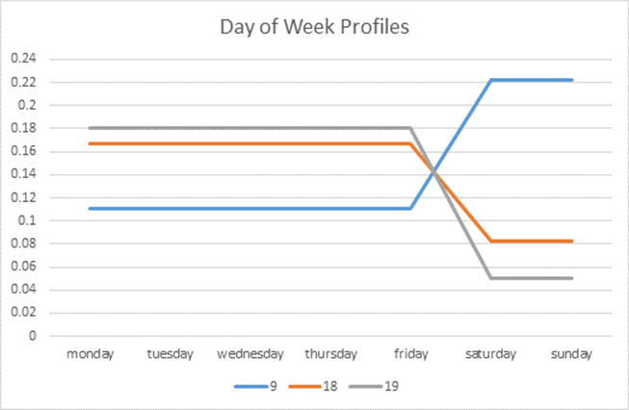
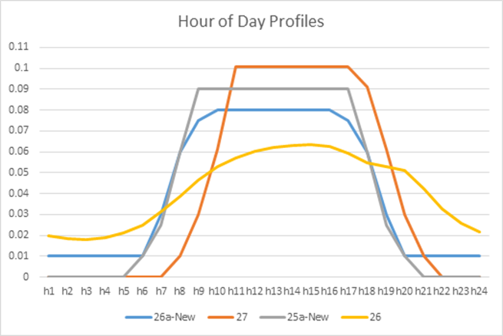
Nonroad Temporal Profile Updates
Non-Road Category | Old Day of Week | New Day of Week | Old Hour of day | New Hour of Day
Construction | 18 | 19 | 26 | 26a
Commercial Lawn and Garden | 18 | 19 | 26 | 25a
Residential Lawn and Garden | 9 | 9 | 26 | 27
Agriculture | 18 | 18 | 26 | 25a
Construction and Comm. Lawn & Gdn lower on weekends in New
New Res. L & G
New ag +
comm L&G
New diurnal profiles have lower overnight emissions
Old

Slide 69
Meteorology-based Temporalization
Some sectors have a significant temporal variation based on changes in the meteorology
GenTPRO
SMOKE program that reads gridded meteorology and spatial surrogates
Produces county-specific meteorology based profiles
Used for platform sectors: ag (month->hour) and rwc (annual->day of year)
Other sectors influenced by meteorology
Area fugitive dust (afdust)
Biogenic emissions
Onroad (discussed later)
EGUs (indirectly)

Slide 70
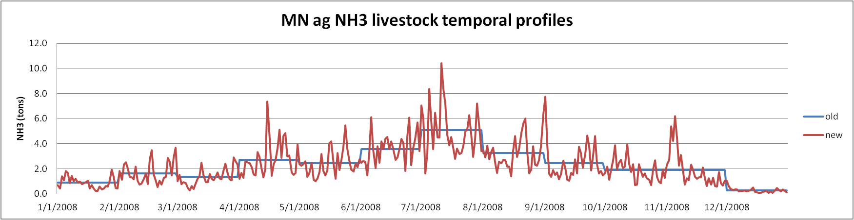
GenTpro: ag livestock
Meteorological fields used: temperature, wind speed, and aerodynamic resistance
Allocate monthly emissions to hour of month
Notes:
These profiles are done by county

Slide 71
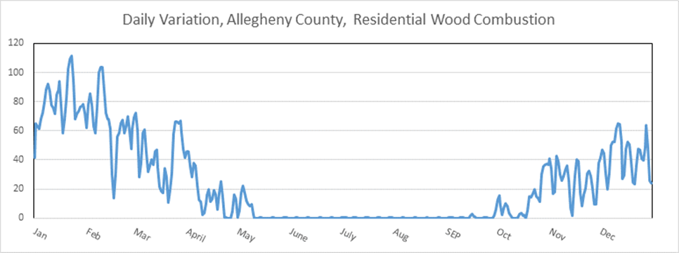
Residential Wood Day-specific Temporal Allocation with GenTpro
Daily minimum temperature used to help allocate annual emissions to days of year
If min temp. above 50 degrees, no emissions
Southern states use 60 degrees threshold
Note in summer RWC near 0
Notes:
Colder days have more emissions. Uses daily minimum T
Threshold: if min T > threshold, 0 emissions that day
In this plot also get influence of non-met based RWC, eg. firepits that show up in the summer
Total annual emissions are preserved

Slide 72
Special Steps for EGUs
Separate EGUs from nonEGUs in EIS flat file based on whether IPM_YN column is non-blank
Download latest CEMS data for base year of interest
Review the assignments to ORIS IDs in the flat file and how they match up to the CEMS data
Identify partial year CEMS reporters and sources that should not follow CEMS data at all (e.g., MWCs, cogens)
Run cemcorrect program to remove non-measured anomalies in CEMS data
Generate region/fuel-specific average temporal profiles for temporalization of sources without CEMS
Generate region/fuel-specific seasonal hourly profiles

Slide 73
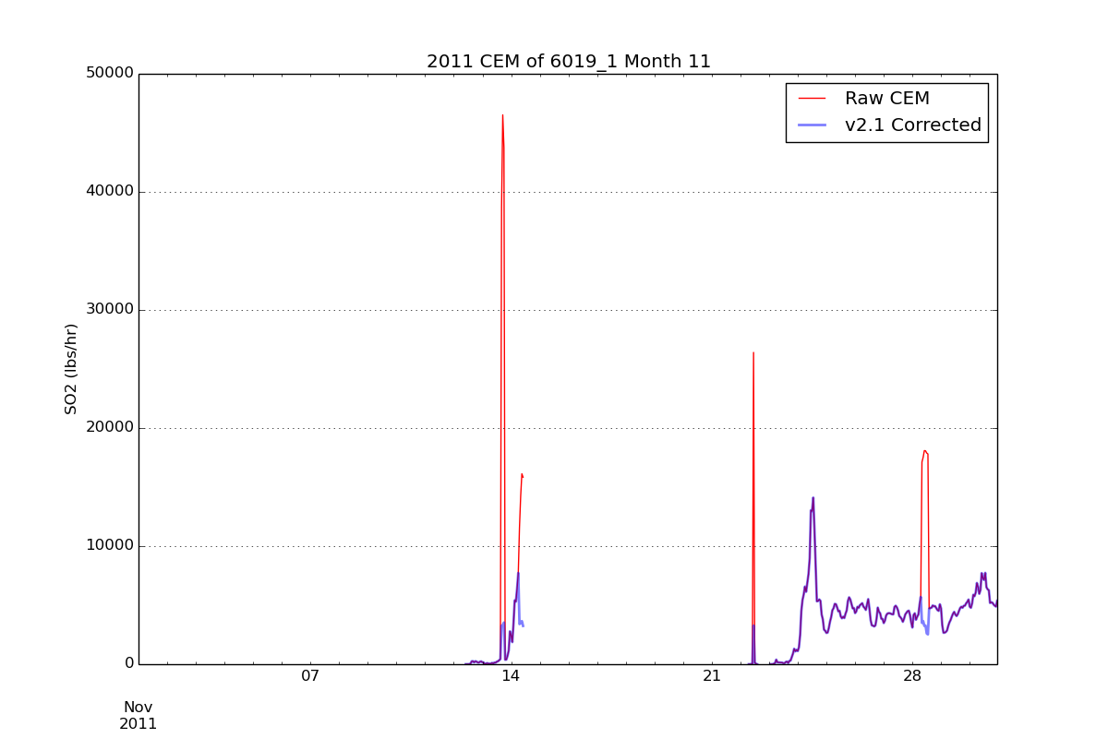
Outputs from UNC’s CEMS Data Correction Tool
Removes spikes
Emissions spikes adjusted to average values when they are not flagged as measured in CEMS data flags

Slide 74
EGU Temporal Profiles and Matching
Removed non-measured data values from CEMS data to ignore emission spikes
Hierarchy of CEMS assignments:
Use CEMS for all months (units with complete CEMS data) <-- Note: CEMS data replace the annual inventory
Use CEMS for months where there are measurements; use regional averages for periods without measurements (e.g., partial-year reporters)
Use regional averages (units without CEMS)
Regional average profiles
IPM region- and fuel-specific average profiles used
Different winter and summer versions of hourly profiles
Matching of CEMS database units and IPM units with EIS/platform point sources is key to success

Slide 75
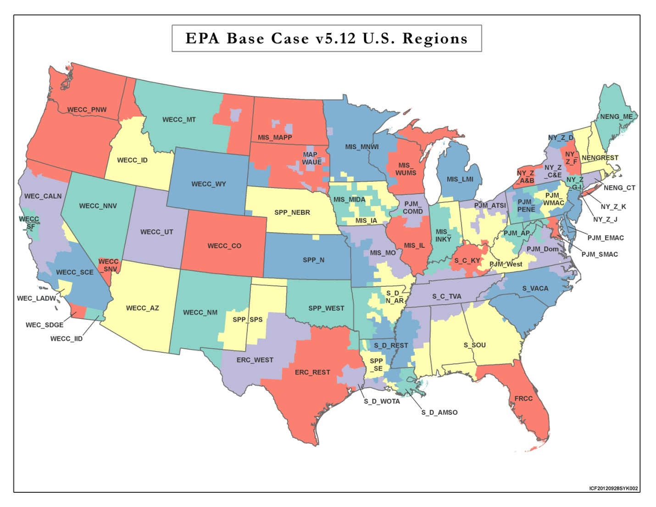
Map of EGU Profile Regions

Slide 76
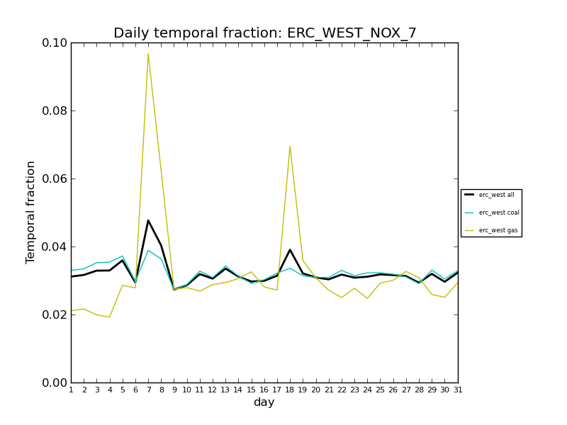
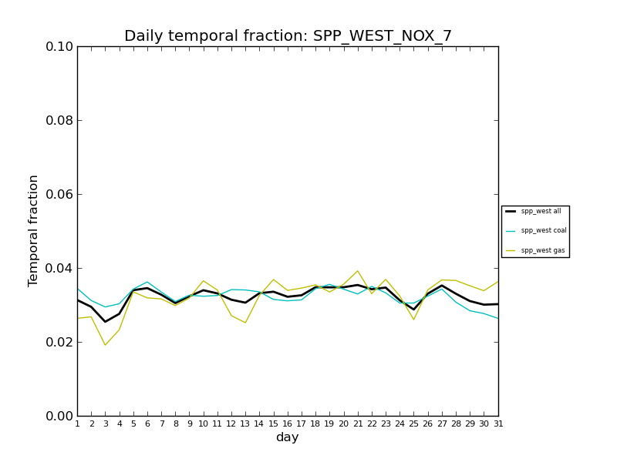
Average Month-day Profiles: Region- and fuel-specific
Profiles differ between regions
(yellow=gas, blue=coal, black=composite)
Region in W Texas
Region in E Oklahoma and W Arkansas
Notes:
ERC West gas is being used for base load but also more as a peaking
SPP West gas and coal both seem to be used as base load but off-setting each other

Slide 77
Mid-Atlantic CEMS Examples of Annual to Day-of-Year Allocation
10x larger
Notes:
2017 is projected from 2011

Slide 78
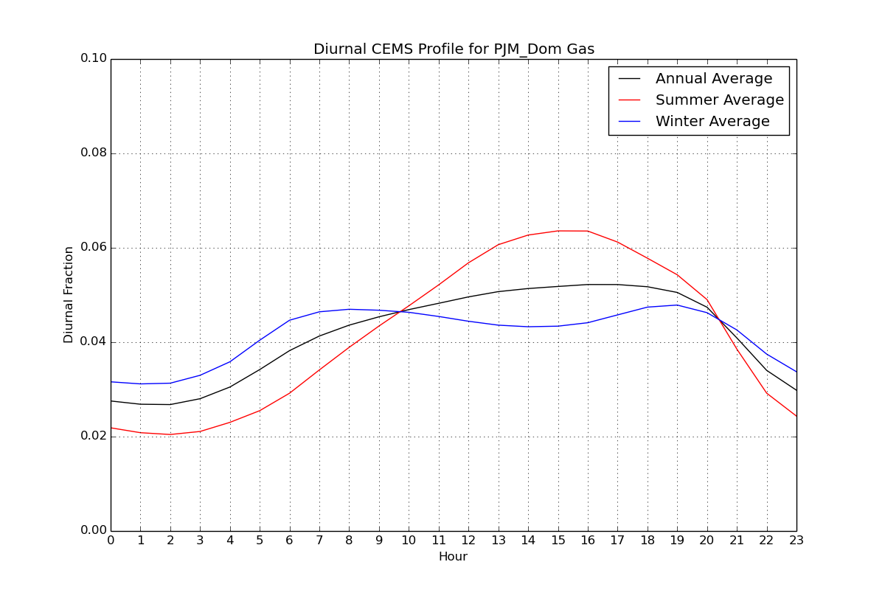
Dirunal Profiles: Winter vs. Summer
IPM region- and fuel-specific profile – mid-Atlantic

Slide 79
QA of Temporal Allocation
Check SMOKE Temporal logs to ensure all sources are mapped to temporal profiles
Sum post-SMOKE daily emissions by sector to compare back to annual for inventory comparison
Perform various specialized analysis of EGUs (partial year reporters, spikes in CEMS data)
Check the PTSUP files to confirm that sources are using the correct temporal profiles
i.e. that SMOKE is applying the xref correctly
Compare daily Smkmerge reports for rwc and ag for two different Tuesdays (for example) in the same month as they should be different (except NH3_FERT) due to the Gentpro temporalization

Slide 80

Questions?
Does anyone have questions on temporal allocation?
BREAK
Notes:
Next: Jeff

Slide 81
Area Fugitive Dust Adjustments
AQ models tend to overestimate the impact of fugitive dust emissions
Paved and unpaved roads, construction, mining, hooves
Prior to modeling, afdust emissions are reduced according to a gridded transport fraction
Transport fraction reduction factors depend on land use
Forested areas will have a lower transport fraction (higher reduction)
Wide open areas will have a higher transport fraction (lower reduction)
Additional meteorologically-based reductions for rain and snow-cover are applied to fugitive dust emissions later in the process

Slide 82
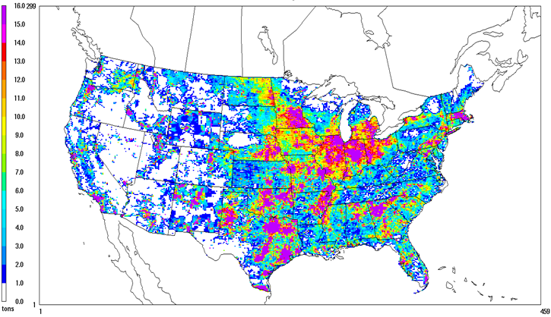
Unadjusted Fugitive Dust
In NEI and Platform, dust emissions are adjusted

Slide 83
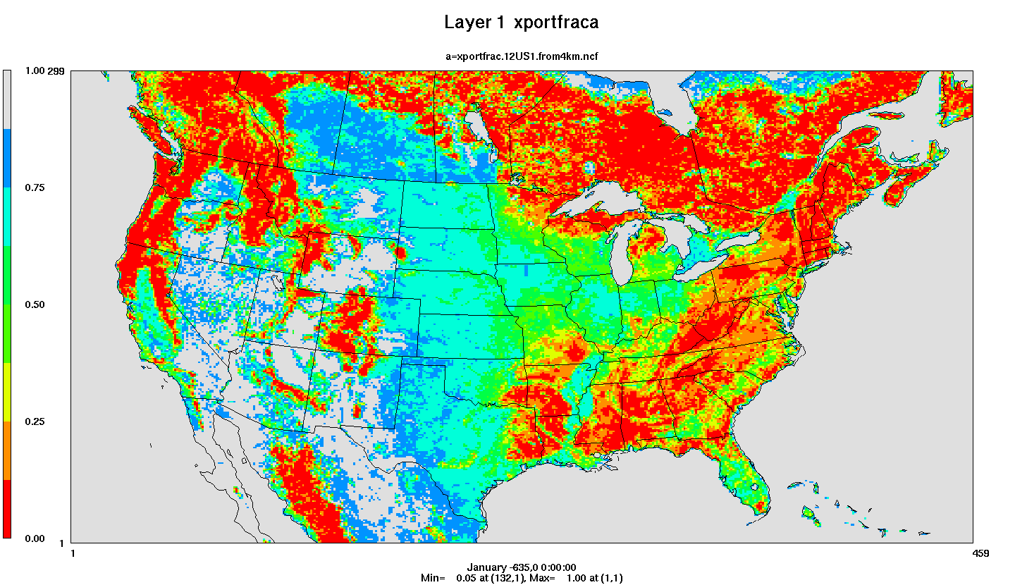
Transport Fraction Plot
Red = high level of reduction; Gray = little reduction

Slide 84
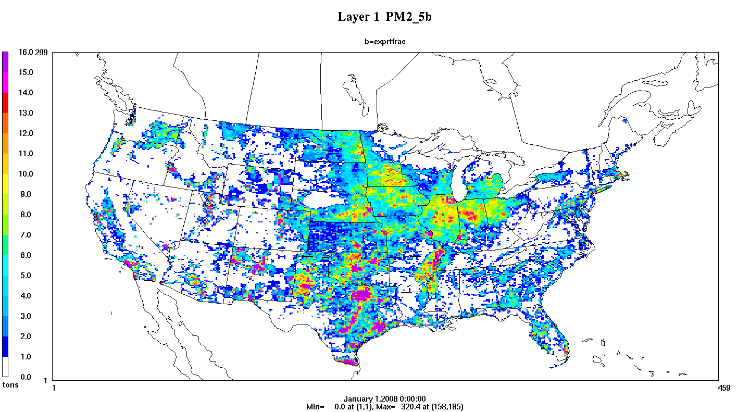
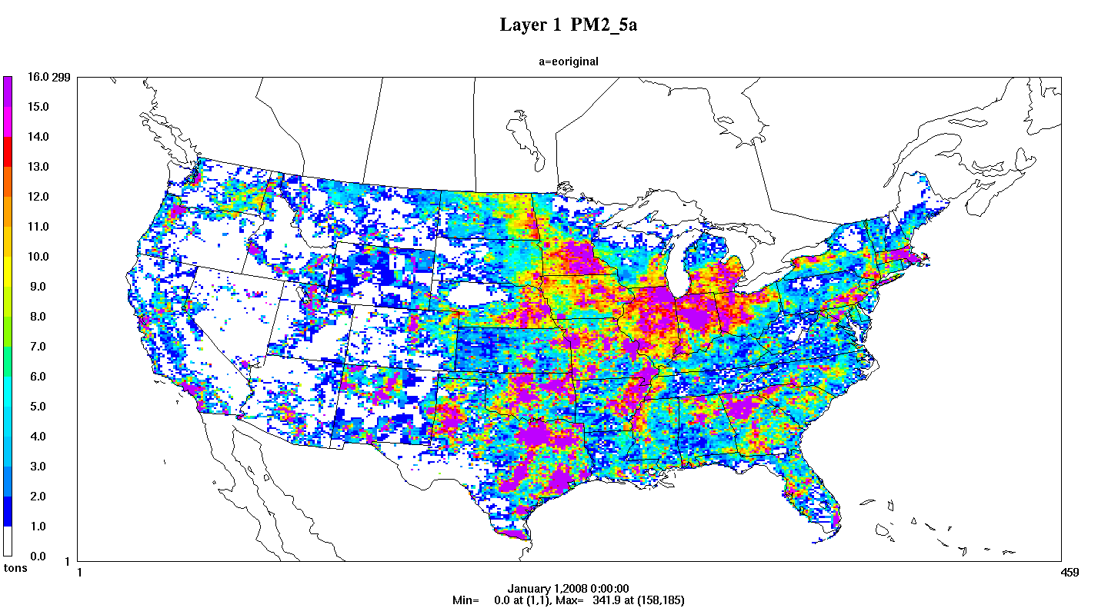
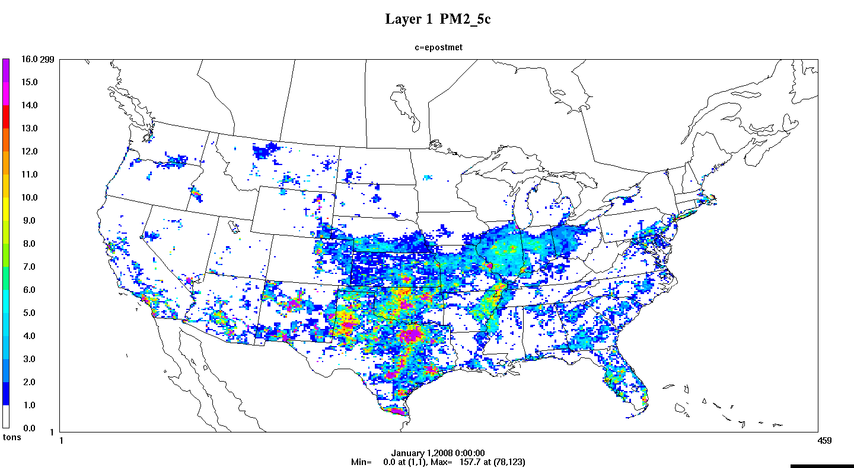
Impact of afdust Adjustments
Transport fraction
Precipitation adjustment
Zero out hourly emissions when rain (> 0.01 inches) or there is snow)
Apply
Transport
Fraction
Precipitation
adjustment
Unadjusted emissions
Notes:
Precipitation adjustment removes emissions so post-adjustment < annual inventory
Has a temporal and spatial aspect

Slide 85
BEIS 3.6.1: Updated Biogenic Emissions
Updated leaf temperature algorithm in v3.6.1
Leaf temperature calculated using canopy model rather than 2 meter temperature
BELD 4.1 land use based on:
U.S. National Land Cover Database (NLCD) 2011
Moderate Resolution Imaging Spectroradiometer (MODIS) for Canada and Mexico
Forest areas constrained by canopy coverage
2011 USDA Cropland Data Layer
Tree species from USFS Forest Inventory and Analysis (FIA) data
Selected surveys from 2001 to 2014 to get a complete decadal US survey that bounds the years being modeled
SMOKE programs used:
Normbeis3: normalized biogenic emissions
Tmpbeis3: outputs gridded, speciated, hourly emissions

Slide 86
Meteorological Variables Needed for BEIS 3.6.1
Variable | Description
LAI | leaf-area index
PRSFC | surface pressure
Q2 | mixing ratio at 2 m
RC | convective precipitation per met TSTEP
RGRND | solar radiation reaching surface
RN | nonconvective precipitation per met TSTEP
RSTOMI | inverse of bulk stomatal resistance
SLYTP | soil texture type by USDA category
SOIM1 | volumetric soil moisture in top cm
SOIT1 | soil temperature in top cm
TEMPG | skin temperature at ground
USTAR | cell averaged friction velocity
RADYNI | inverse of aerodynamic resistance
TEMP2 | temperature at 2 m

Slide 87
Species Produced by BEIS
Carbon Monoxide (CO), Nitrogen Oxide (NO)
Acetaldehyde (ALD2)
Higher acetaldehyde (ALDX)
Formaldehyde (FORM)
Isoprene (ISOP)
Terpene (TERP)
Sesquiterpene (SESQ)
Ethene (ETH), Ethane (ETHA)
Internal (IOLE) and terminal olefins (OLE)
Ethanol (ETOH), Methanol (MEOH)
Paraffins (PAR)
No PM species…

Slide 88
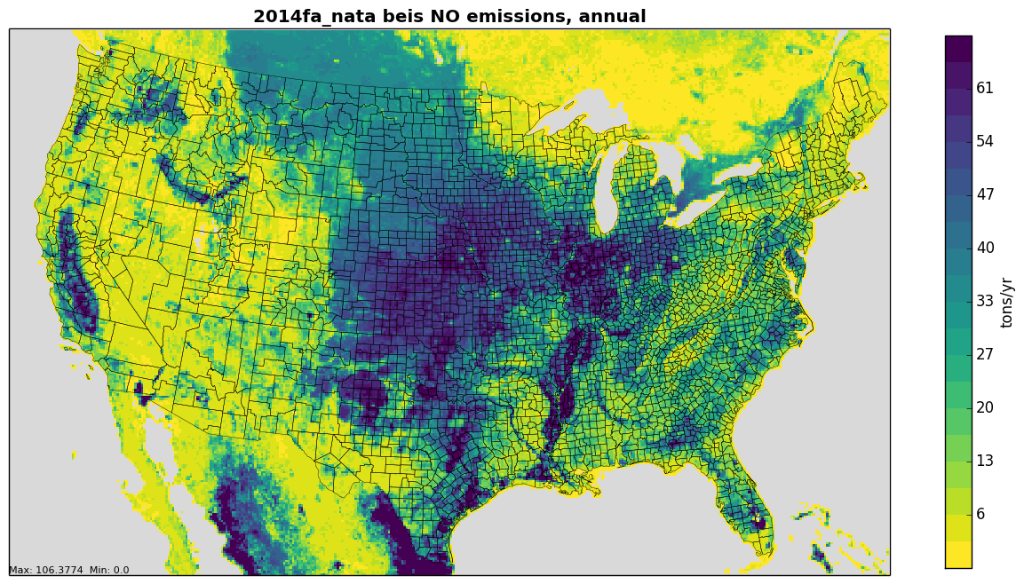
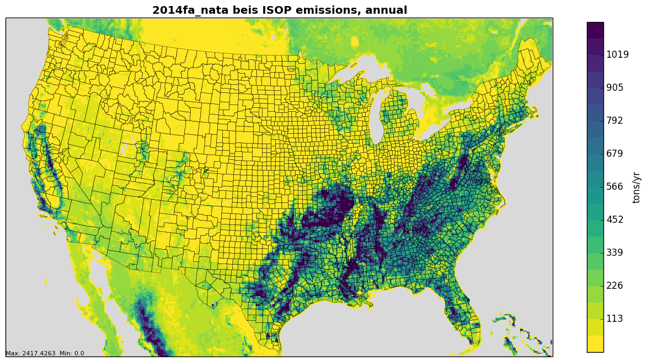
2014 Annual Biogenic Emissions
Top: NO from soil (depends on temperature, precipitation, and fertilizer)
Bottom: Isoprene (produced during photosynthesis)

Slide 89

Future Directions and Questions?
Examining MEGAN version 3 biogenic emissions estimates
Biogenic emissions modeling for Alaska
Possibly update land use used in transport fraction generation
Any questions on fugitive dust or biogenic emissions?
Notes:
Next: Jeff continues

Slide 90
NEI Fire Inventory Details
Includes daily “point” emissions from wildfires and prescribed fires
Emissions were estimated for PM_{2.5}, PM₁₀, CO, CO₂, CH₄, NO_{x}, NH₃, SO₂, VOC, and 34 hazardous air pollutants (HAPs). PM_{2.5} emissions were further broken down into EC, OC, SO₄, NO₃, and PM fine
HAPs emission factors and fractions of PM_{2.5} components were provided by EPA
2014NEI made flaming and smoldering emissions available (to allow for differentiated treatment of plume rise and potentially speciation)
Fire Inventory from NCAR (FINN) is used for Hawaii and Puerto Rico

Slide 91
Data Sources for NEI Fires
Data Sources included for NEI fire inventory development (non-NEI years typically use only data in red)
State/local/tribal data
National Association of State Foresters (NASF) WF data
NOAA’s Hazard Mapping System (HMS) data
Incident Status Summary (ICS-209) data (wild vs prescribed)
Geospatial Multi-Agency Coordination (GeoMAC) fire perimeter Shapefiles
USDA Forest Service Activity Tracking System (FACTS) Rx fire perimeter data
U.S. Fish and Wildlife Service (USFWS) data
U.S. Department of Interior (DOI) Rx data
Ancillary data sources
Fuel moisture data from the USFS Weather Information Management System
Fuel Characteristic Classification System (FCCS) fuel loading database

Slide 92
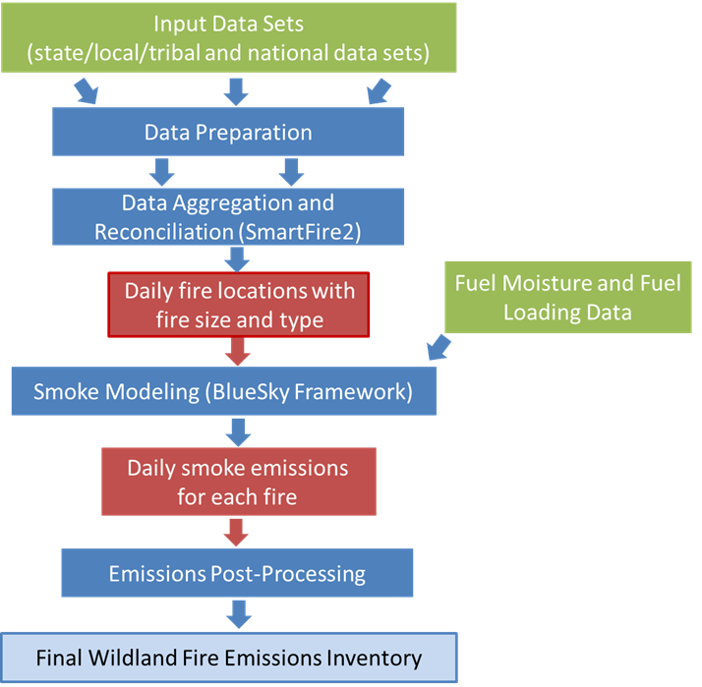
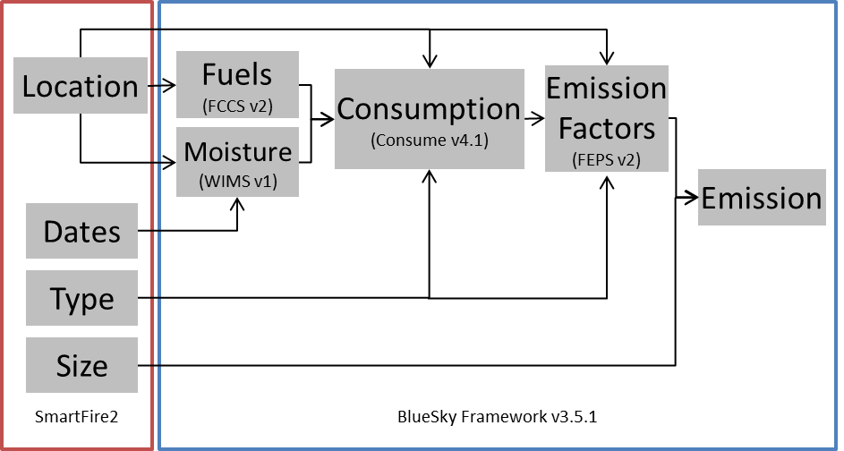
NEI Fire Development Overview

Slide 93
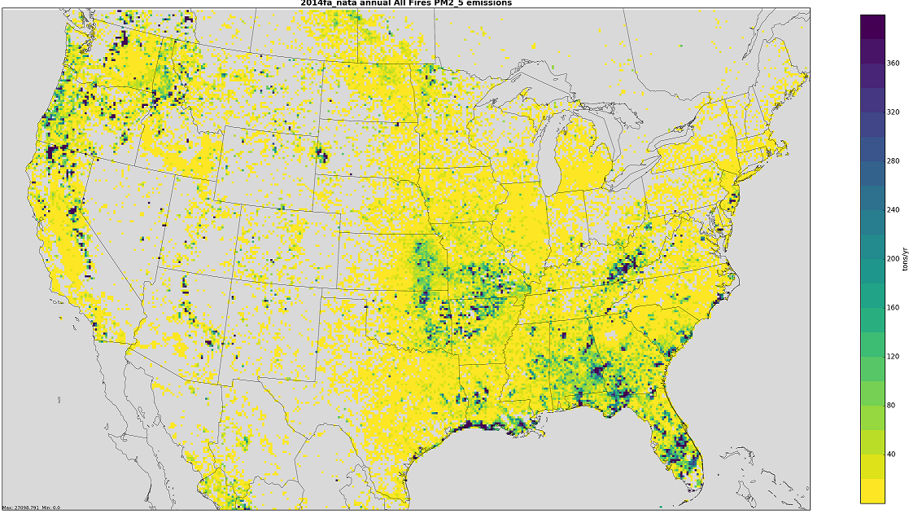
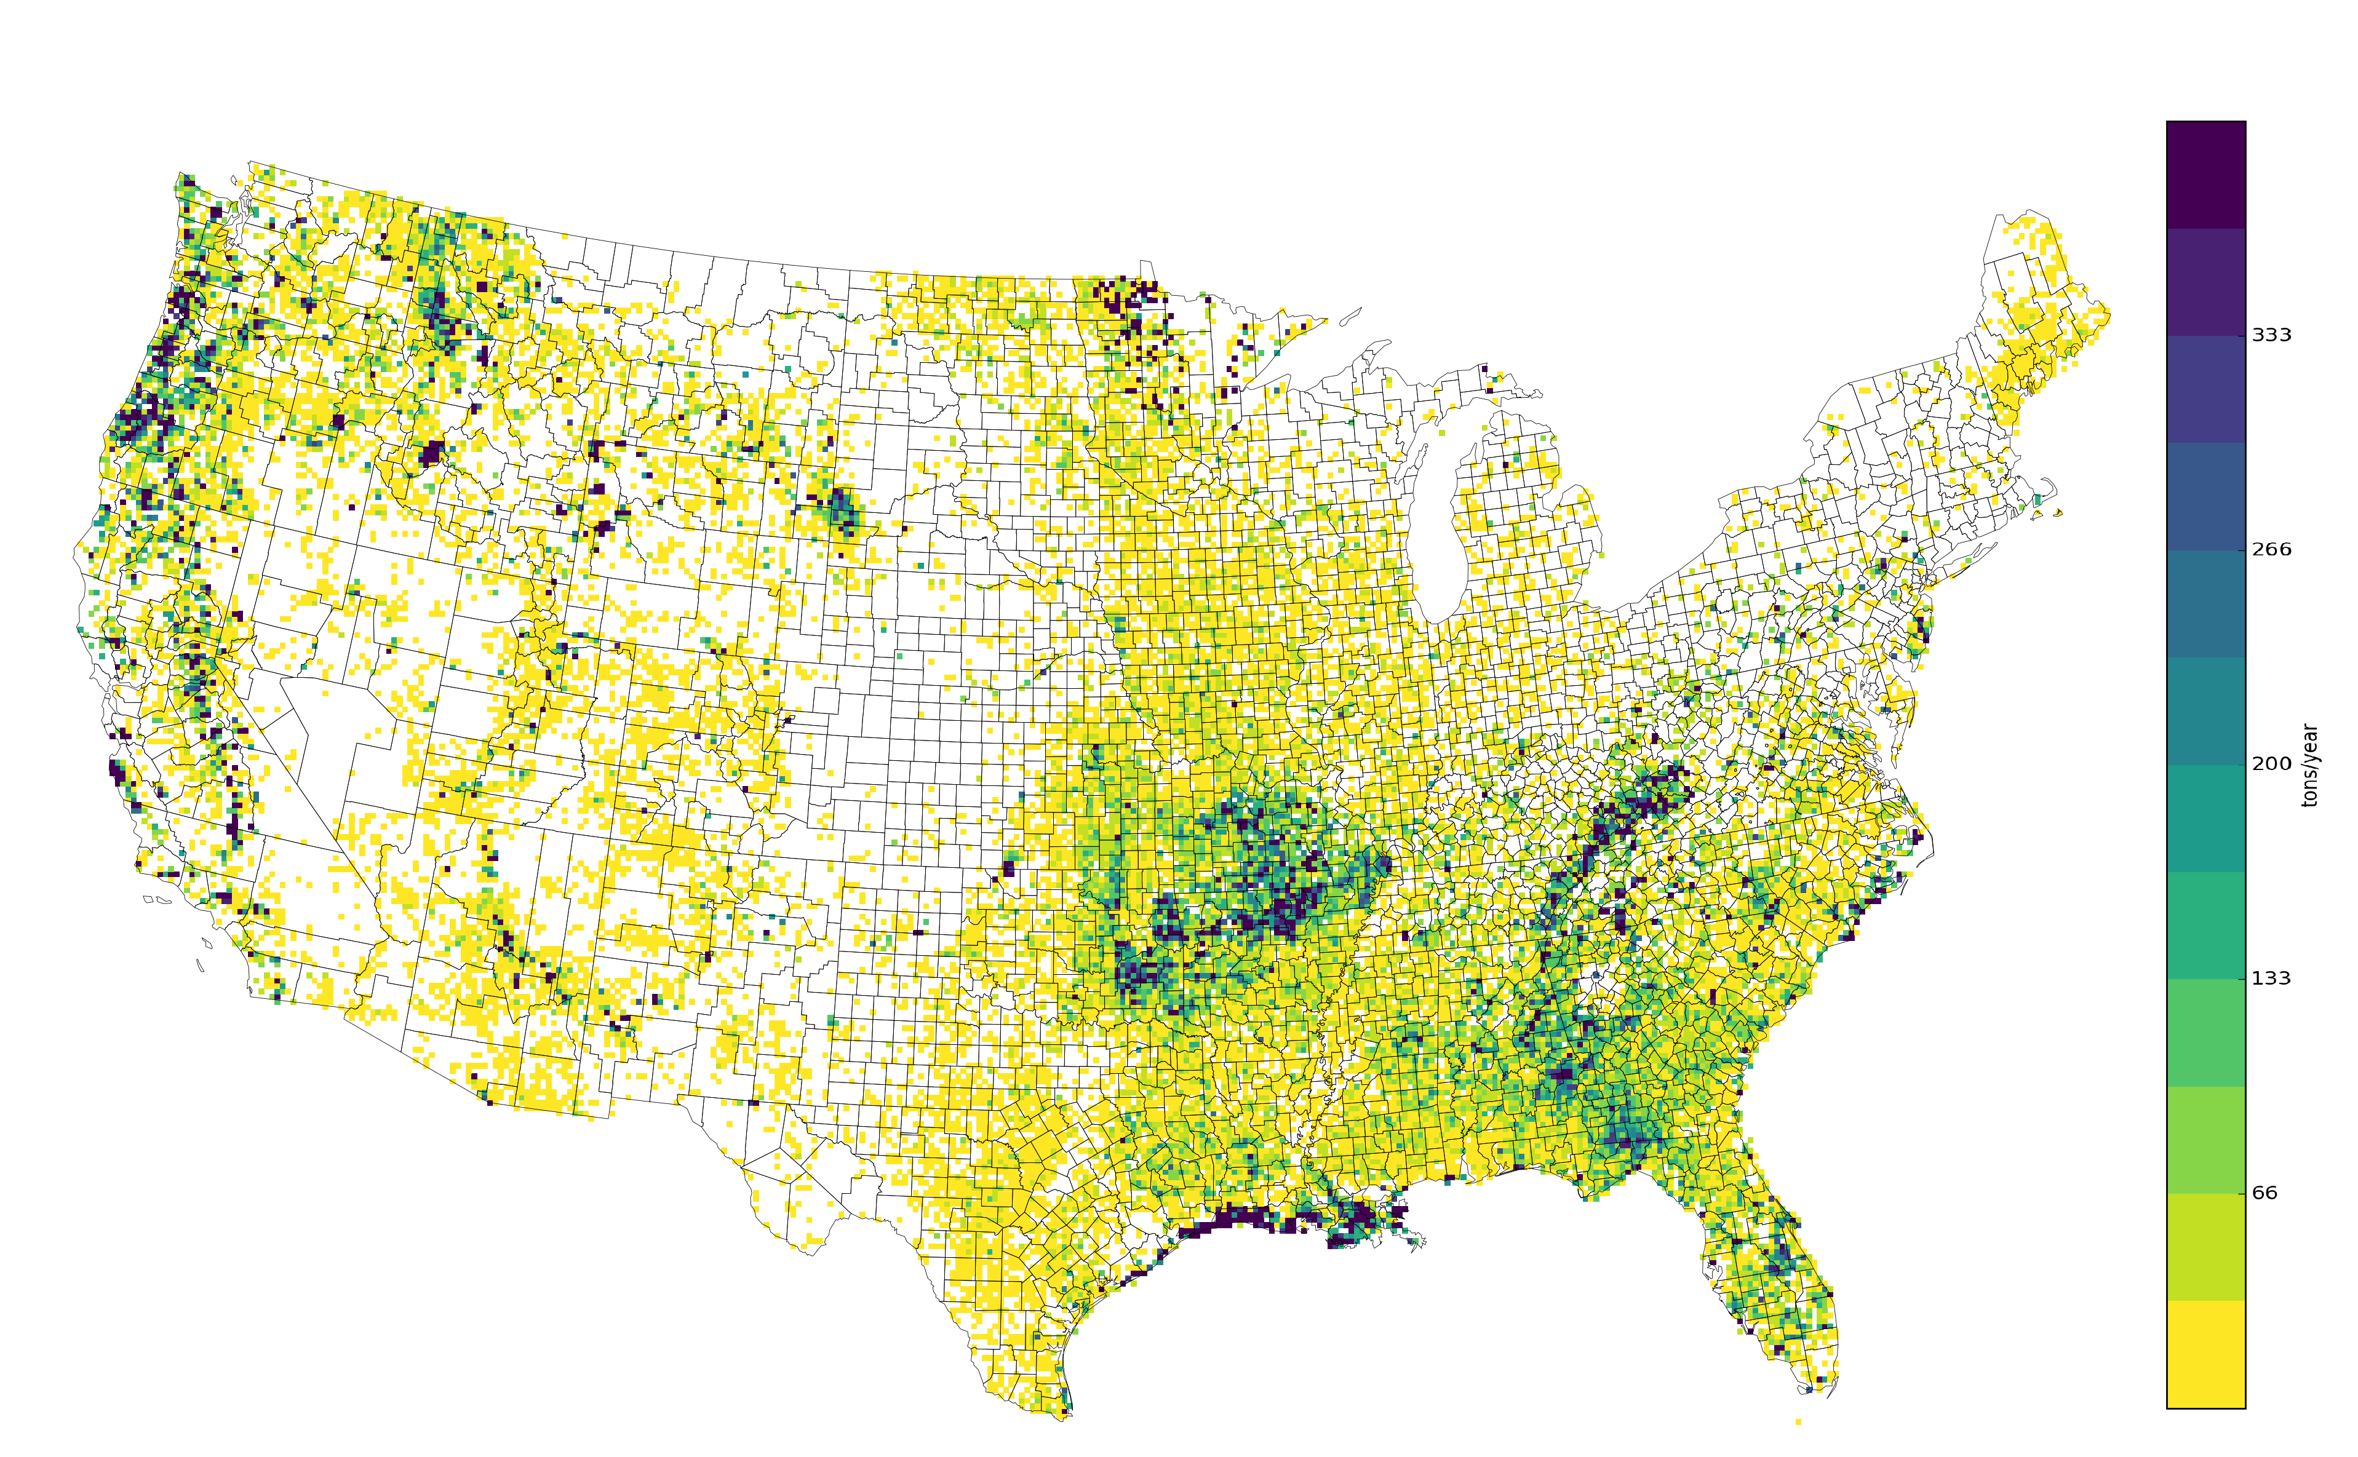
2014 and 2016 Annual PM2.5 from Wild and Prescribed Fires
Top: 2014
Bottom: 2016
Some aspects of fires are similar
between years:
Prairie, gulf coast, South Florida
Locations of large fires vary –
particularly noticeable in West, MN

Slide 94

Agricultural Fires
EPA estimates day-specific point-based agricultural fires based on satellite detects (Pouliot, 2017)
2014 PM_{2.5}
2016 PM_{2.5}
Any
questions
on
fires??
Notes:
Next: Caroline

Slide 95
Speciation
Mapping inventory pollutants to model species
Model species are used in the air quality model (AQM)
NOx, VOC (TOG), and PM are speciated
There are many types of speciation profiles and each has a unique code
Typically use SCC and pollutant to X-ref speciation profile to inventory sources
Cross reference may also use FIPS, facility, etc.
Different chemical mechanisms:
Emissions should match chemical mechanism of AQM
Different mechanisms have different list of model species
Examples: CB05, CB6, SAPRC07
Notes:
Model species are either individual chemical compounds are groups of compounds

Slide 96
Obtaining Speciation Profiles
SPECIATE database
Source of most speciation profiles in the platform
SPECIATE 4.5 is the most recent version: https://www.epa.gov/air-emissions-modeling/speciate-version-45-through-40
Includes basin-specific profiles for oil and gas sources
Speciation Tool
Processes profiles from the SPECIATE database into the chemical mechanisms used by air quality models
Written in PostgreSQL and Perl
Available from cmascenter.org
Separate training class for Speciation Tool

Slide 97
Speciation Overview
Speciated (mass)
Profile (%)
MW1
Inventory Poll
Model species 1
Model species 2
Model species 3
Model species 4
Model species 1
Model species 2
Model species 3
Model species 4
MW2
MW3
MW4
Conversion to moles
Notes:
Mass is conserved through speciation

Slide 98
NOx Speciation
NOx is converted to following model species:
NO
NO2
HONO
Example profiles:
profile | pollutant | species | massfrac
WHONO | NOX | NO2 | 0.092
WHONO | NOX | NO | 0.900
WHONO | NOX | HONO | 0.008
NHONO | NOX | NO2 | 0.100
NHONO | NOX | NO | 0.900

Slide 99
PM_{2.5} Speciation
Older versions of CMAQ used “simplified” PM model species (AE5)
Recent versions of CMAQ use the aerosol module ISORROPIA v2 that requires additional PM model species (AE6)
species name | species description | AE5 | AE6
POC | organic carbon | Y | Y
PEC | elemental carbon | Y | Y
PSO4 | sulfate | Y | Y
PNO3 | nitrate | Y | Y
PMFINE | unspeciated PM2.5 | Y | N
PNH4 | ammonium | N | Y
PNCOM | non-carbon organic matter | N | Y
PFE | iron | N | Y
PAL | aluminum | N | Y
PSI | silica | N | Y
PTI | titanium | N | Y
PCA | calcium | N | Y
PMG | magnesium | N | Y
PK | potassium | N | Y
PMN | manganese | N | Y
PNA | sodium | N | Y
PCL | chloride | N | Y
PH2O | water | N | Y
PMOTHR | unspeciated PM2.5 | N | Y
Prescribed Burning Composite Prof. (91109)
pollutant | species | massfrac
PM2_5 | POC | 0.5019
PM2_5 | PEC | 0.1093
PM2_5 | PSO4 | 0.0033
PM2_5 | PNO3 | 0.0107
PM2_5 | PNH4 | 0.0034
PM2_5 | PAL | 0.0005
PM2_5 | PCA | 0.0007
PM2_5 | PCL | 0.0024
PM2_5 | PFE | 0.0004
PM2_5 | PK | 0.0014
PM2_5 | PMN | 0.0001
PM2_5 | PMOTHR | 0.0125
PM2_5 | PNA | 0.0014
PM2_5 | PNCOM | 0.3513
PM2_5 | PSI | 0.0001
PM2_5 | PTI | 0.0007
Notes:
First four species (EC, OC, SO4, NO3) are in both; treatment of “the rest” differs; table on right is specific example for prescribed burns

Slide 100
VOC Speciation
Inventory VOC is converted to Total Organic Gas (TOG)
Example for Gas Exh E10: VOC * 1.199 = TOG (also includes methane)
TOG is then speciated according to the mechanism (species sum to 1.0):
Different model species depending on the chemical mechanism (e.g., CB6)
Model Species | Description
ALD2 | Acetaldehyde
ALDX | Propionaldehyde and higher aldehydes
BENZENE | Benzene*
CH4 | Methane*
ETH | Ethene
ETHA | Ethane
ETOH | Ethanol
FORM | Formaldehyde
IOLE | Internal olefin carbon bond
ISOP | Isoprene
MEOH | Methanol
OLE | Terminal olefin carbon bond
PAR | Paraffin carbon bond
TOL | Toluene and other monoalkyl aromatics
XYL | Xylene and other polyalkyl aromatics
Gasoline Exhaust – E10 (8751a)
pollutant | species | massfrac
TOG | ALD2 | 0.0145
TOG | ALDX | 0.0023
TOG | CH4 | 0.1416
TOG | ETH | 0.0596
TOG | ETHA | 0.0234
TOG | ETOH | 0.0157
TOG | FORM | 0.0145
TOG | IOLE | 0.0130
TOG | OLE | 0.0457
TOG | PAR | 0.3860
TOG | TOL | 0.1044
TOG | UNR | 0.0563
TOG | XYL | 0.1229
Notes:
Note model species molecular weights will vary with profile
Some of the model species are lumped, e.g. for CB05 “PAR”

Slide 101
VOC Integration Overview
Integration
Process of taking select VOC HAPs from the inventory as “true” and then speciating the remaining VOC
Want to avoid double counting of pollutants
Want to speciate the remaining VOC, while taking into account HAPs that were removed
BAFM treated as explicit HAPs
Benzene, Acetaldehyde, Formaldehyde, Methanol
NONHAPTOG
Remaining TOG after removing explicit VOC HAPs
NONHAPTOG = TOG – Total of BAFM species (moles)

Slide 102
VOC Integration Example
Gasoline Exhaust – E10 (8751a)
No integrate
Integrate
pollutant | species | massfrac
TOG | ALD2 | 0.0145
TOG | ALDX | 0.0023
TOG | CH4 | 0.1416
TOG | ETH | 0.0596
TOG | ETHA | 0.0234
TOG | ETOH | 0.0157
TOG | FORM | 0.0145
TOG | IOLE | 0.0130
TOG | OLE | 0.0457
TOG | PAR | 0.3860
TOG | TOL | 0.1044
TOG | UNR | 0.0563
TOG | XYL | 0.1229
pollutant | species | massfrac
NONHAPTOG | ALD2 | 0.0019
NONHAPTOG | ALDX | 0.0025
NONHAPTOG | CH4 | 0.1519
NONHAPTOG | ETH | 0.0639
NONHAPTOG | ETHA | 0.0251
NONHAPTOG | ETOH | 0.0169
NONHAPTOG | FORM | 0.0010
NONHAPTOG | IOLE | 0.0139
NONHAPTOG | OLE | 0.0491
NONHAPTOG | PAR | 0.4067
NONHAPTOG | TOL | 0.1119
NONHAPTOG | UNR | 0.0234
NONHAPTOG | XYL | 0.1318
Notes:
Total massfrac = 1 for both profiles
Still have FORM and ALD2 b/c of secondary formation, note much smaller
Note NONHAPTOG, i.e. need to go from NONHAPVOC -> NONHAPTOG
So have 2 sets of profiles: integrate and no integrate

Slide 103
VOC Integration by Sector
Platform Sector | Approach for integrating
ptegu | No integration (i.e., integrated species in inventory ignored)
ptnonipm | No integration
ptfire, ptagfire | No integration
othfire | No integration
othar | No integration
othpt | No integration
onroad_can | No integration
onroad_mex | Full integration (MOVES-Mexico)
ag | N/A – sector contains no VOC
afdust, othafdust | N/A – sector contains no VOC
beis | N/A – contains specific VOC model species
nonpt, rail | Partial integration (BAFM; EBAFM for future year PFC)
np_oilgas | Partial integration (BAFM)
pt_oilgas | Partial integration (BAFM)
rwc | Partial integration (BAFM)
nonroad | Full integration (BAFM) (i.e., integrated species used)
cmv_c1c2 | Full integration (BAFM)
cmv_c3 | Full integration (BAFM)
onroad | Full integration (calculated in the MOVES2014 model)*
Notes:
Partial integration: means some sources are integrated and others aren’t
Biog – beis creates model species explicitly
Onroad: MOVES2014 doing integration within model (next slide)

Slide 104
Additional Speciation Concepts
NBAFM = integration of BAFM + naphthalene
CMAQ CB6 has naphthalene as explicit species
Used for 2014-16 platforms
COMBO files
Method of combining 2 or more speciation profiles by pollutant/geography
Example: combine E0 and E10 fuel profiles for portable fuel containers
Speciation can be used to group/track interrelated pollutants e.g., PAH’s for NATA

Slide 105
Onroad speciaton
MOVES2014a does most of the needed speciation
Has different profiles for different vehicle model years, regulatory classes, fuel types, and emission processes
Previously used COMBO files or weighted profiles to approximate, but it was a coarse approach
Can do an explicit mapping of profiles to sources if doing speciation within MOVES
PM2.5
AE6 species coming directly from MOVES (as mass)
VOC
16 pollutants are explicit, i.e. integrated
Model species (moles) and inventory pollutants (mass) come directly from MOVES
Need to specify chemical mechanism in the MOVES run
Notes:
PM2.5: previous inventory polls from MOVES didn’t map cleanly to AE5 species

Slide 106
QA of Speciation
Check Spcmat SMOKE logs to ensure that all sources have references to VOC and PM speciation profiles.
Sum model species to compare to VOC and PM2.5 inventory totals.
Compare integrated species to inventory for full and partial integration sectors.
Do a quick manual calculation of a species for a specific FIPS/SCC to ensure that the post-SMOKE value is using the correct profile (or profiles in the case of GSPRO_COMBO).
Check SMOKE logs for warnings or errors. For example:
BAFM but no VOC for an integrate source
No TOG conversion factor
Skipping pollutant [X] for other than PM₁₀ and *_NOI pollutants
Look at the output species to make sure all of the expected species are there for the specific mechanism (CB05 vs CB6 vs …).
Notes:
Another Spcmat log message we look for is "Skipping pollutant [X]", which means that an inventory pollutant is being dropped. We expect to see this for PM10 (we speciate PM2.5 and pass through PMC instead) and _NOI pollutants (no-integrate BAFM, which we want to drop to avoid double counting speciated VOC), but if we see anything else getting skipped, that's a problem.

Slide 107
Questions?
Any questions on speciation?
Notes:
Next: Alison

Slide 108
Onroad Emissions Modeling
Met. Data from WRF
Meteorological Preprocessor (Met4Moves)
MOVES
Temperature ranges,
rel. humidity
Run MOVES to get emission factors (EF) for representative counties for each temperature and speed needed
Gridded met
EF tables
Use representative EFs and county/ grid-specific activity data and meteorology to create emissions for all counties
Activity Data
SMOKE
AQ model-ready files

Slide 109

Representative Counties
3000+ counties are mapped to approx. 300 representative counties according to: state, fuels, light duty age distribution, ramp fraction, I/M programs, emissions standards
Notes:
Emphasize the county specific activity and the grid specific meteorology is used even if using rep counties.

Slide 110
Onroad Emission Processes and Inputs
On-roadway emissions
Exhaust, evaporative, evaporative permeation, refueling, brake and tire wear (Rate-per-distance)
Primary inputs: vehicle miles traveled (VMT), average speeds, speed profiles, and temperature (gridded, hourly)
Off-network emissions (i.e. parked vehicles)
Exhaust from starts, evaporative, evaporative permeation, refueling, hot soak (right after a trip) (Rate-per-vehicle)
Evaporative fuel vapor venting and diurnal (when vehicles are parked for a long period) (Rate-per-profile)
Primary inputs: vehicle population (VPOP) and Temperature (gridded, hourly, daily min/max)
Hoteling:
Extended idle and auxiliary power units (APU) for combination long-haul trucks (Rate-per-hour)
Primary inputs: Hoteling hours and T (gridded, hourly)
Notes:
VMT and HOTELLING are temporalized, others aren’t

Slide 111
Running MOVES
MOVES runs on Windows, but SMOKE runs on Linux so a translation step is required
For info on running MOVES to create emission factors for SMOKE-MOVES see: https://github.com/CEMPD/SMOKE-MOVES
runspecgenerator.pl creates MOVES configuration files
moves2smkEF.pl reads the MOVES output databases and converts them into a form that runs SMOKE

Slide 112

On-roadway Processing (RPD)
Uses Standard SMOKE programs + Movesmrg
Input “inventory” is VMT and SPEED data
Notes:
Spcmat is still used, just to keep track of which EF are model species vs inventory.

Slide 113

Onroad Hoteling
Hoteling = Overnight truck idling: extended idle and APU
States can submit hoteling hours by county
EPA uses combination long-haul truck VMT on urban + rural restricted roads to distribute hoteling hours to counties
Temporal profile is opposite of the driving profile
Spatial surrogate is based on truck parking spaces
Notes:
Not idling at ports or bus stops, really about requirement to hotel for the long-haul trucks
Consider mentioning APU splits

Slide 114


2014NEIv1 Onroad NOx and Changes from 2011
2011
2014
2016
Although VMT typically
increases with time, emissions
decrease as newer cleaner vehicles penetrate the market

Slide 115
Improved MOVES Inputs used in 2014NEIv2
Some states provided updated inputs
9 agencies for onroad, 3 states for nonroad
EPA sponsored a project to decode year 2014 registration VINs into MOVES vehicle types by model year for both light-duty and heavy-duty vehicles
Impacts age distributions and vehicle populations
Includes data for populations of alternative fuel light-duty vehicles (i.e., diesel, CNG, E-85, electric)
EPA derived VMT data based on the new VPOP data
Coordinating Research Council (CRC) A-100
Used hourly telematics data to derive speed and VMT temporal distributions for lower 48 states for light-duty, medium-duty, and heavy-duty vehicles
EPA updated fuel properties data

Slide 116
Input Data Updates from the CRC A-100 Study
Sponsored by the Coordinating Research Council (CRC)
Main data source: StreetLight Data, Inc.
5 Billion observations over continental U.S.
Passenger cars, commercial truck fleet management systems
Sub-minute level data for 12 consecutive months
Grouped by light-duty (LD), medium-duty (MD), and heavy-duty (HD); no car/truck split or age info available for LD vehicles
5m spatial precision, 16 speed bins
Used data to derive
VMT temporal distributions for MOVES and SMOKE temporal profiles
Road type distributions supplemental to those from FHWA
Speed distributions for MOVES plus speed inputs to SMOKE
Populating all speed bins by road type, month, day, hour, vehicle type was a challenge outside of urban areas

Slide 117
CRC A-100 Geographic Scale
18,644,352 road segments over the Continental U.S.
3,601 polygons of urban areas / clusters from the U.S. Census
* CRC A-100 plots courtesy ERG

Slide 118
Spatial Groups Used
Example of Passenger Vehicles on Urban Unrestricted Roads
Counties for
which MOVES
inputs could be
populated shown in red;
others are based
on data for
the region and
urban/rural

Slide 119
Speed Results by City
Compared Atlanta, Chicago, and Las Vegas
Patterns differed by city and from MOVES defaults
Weekday patterns for passenger vehicles on urban restricted roads (highways) and unrestricted local roads shown below
Note scales differ

Slide 120
Speed by Vehicle Type
Found speed differences between LD, MD, and HD
MD/HD speeds higher than LD in many cases
Different areas have different patterns esp. on interstates
Chicago examples shown below – note scales differ

Slide 121
Diurnal VMT Distributions by Vehicle Type – Chicago example
Note the differences in patterns weekdays vs weekends and LD/MD/HD
Data put into formats to support MOVES (weekday/weekend) and SMOKE (day-specific)

Slide 122




Day of Week Temporal Profiles
A-100 data was prepared into MOVES dayVMTFraction and SMOKE day-of-week temporal profiles (SMOKE shown here)
Urban GA LD vehicles
RURAL GA LD vehicles
Urban GA MD trucks
Urban GA combination trucks

Slide 123


Hoteling and On-roadway NOx by County
Hoteling follows interstates 187K tons (blue=900tpy) ->
Rate per Distance 4.1M tons exists in all counties (blue=9900tpy)

Slide 124



Impacts of new Spatial Surrogates on 2011 Onroad NOx Emissions
Using 2011 surrogates
Using 2014 surrogates
Difference between 2011 and 2014 surrogates
On-network spatial surrogates now based on VMT
Many off-network surrogates are based on NLCD

Slide 125


Off-network VOC by County
RPV VOC is 1.3M of 2.4M tons (blue=3600) -> NOx=746K of 4.8M tons)
Rate per Profile VOC 200K of 2.4M tons onroad VOC (blue=540)

Slide 126
Questions?
Any questions on onroad emissions processing?

Slide 127
Commercial Marine Vessels
CMV in the NEI is split into two categories:
Category 3 (C3) (i.e., large) vessels with engine displacement above 30 liters that primarily use residual fuel blends
C1 and C2 vessels that primarily use distillate fuels
Recreational marine vessels are part of nonroad
Inventories computed for emissions in state waters (3-10 nautical miles) and federal waters out to 200 nautical miles from the U.S. coastline
Port emissions are separated from underway
Areas outside of 200 n.m. filled in from non-NEI data sources
“Modes” indicate what ships are doing and different emission factors are used for each
M=maneuvering, H=hoteling, C=cruise, Z=reduced speed zone
EPA data used except for states that submitted for 2014NEIv1: NH, NJ, IL, TX, CA, WA
More states submitted for 2014NEIv2 based on LADCO study

Slide 128
Commercial Marine Data Sources and Modeling
Data sources for CMV in the 2014NEI
Entrance and clearance data (2012)
About 11,000 vessels linked to routes from origin port to destination port
Hours of operation computed based on route and vessel type (e.g., bulk carrier, container, oil tanker) with reduced speed zones factored in
Army corps of engineers waterborne commerce data for tugs and barges, bulk carriers, tankers, and other vessels
2007 category 1 and 2 vessel study
See 2014NEI TSD for more details
Modeling
CMV modeling sectors were cmv (nonpoint) and othpt (point)
Now: cmv_c1c2 and cmv_c3 including all U.S. waters
Plume rise computed for cmv_c3 (pseudo-point sources which also help us represent shipping routes)
New spatial surrogate available May, 2017

Slide 129

U.S. State and Federal Waters

Slide 130

New 12km CMV Spatial Surrogate based on marinecdaster data

Slide 131
Modeling Ramp-up Period
For regional CAP-focused modeling, we typically have a ramp-up period of 10 days (i.e., starting on December 22 of the previous year)
For most sectors, emissions from December of the modeled year are repeated during the ramp-up
For biogenic emissions, data based on actual prior year meteorology are used
For hemispheric modeling, the ramp-up is longer – six to eight months
Prior year fire emissions used for ramp-up

Slide 132
Final Merging and QA
After all sectors have been processed through SMOKE programs, the ground-level emissions are merged using the SectorMerge script
Runs the mrggrid program based on the Sector list file
Only one input for ground-level but point sources can be given to CMAQ by sector without merging
cmv_c3, ptegu, ptnonpim, pt_oilgas, ptagfire, ptfire, ptfire_othna, othpt
If CAMx is to be run instead of CMAQ, then CAMx conversion scripts must be run
CAMx requires point files to be merged

Slide 133
Final Low-level Merging
All ground-level files must be merged for both CMAQ and CAMx
Biogenic emissions can be optionally computed within CMAQ
Considers both day-specific and representative day emissions
afdust_adj
ag
cmv_ c1c2
nonpt
non-road
np_ oilgas
on-road
rwc
rail
othar
onroad_mex
oth afdust_adj
onroad_can
onroad_ca_adj
pt_oilgas
ptnonipm
Merged 2D emissions for each day
Ptegu and fire sectors are all elevated

Slide 134
Example Sector List for 2016 Alpha Case
sector | sectorcase | Sectbaseyr | mrgapproach | prevyrspinup | endzip | mergesector
afdust_adj | 2016fd_cb6_16j | 2016 | all | SectBaseYr | Y | Y
ag | 2016fd_cb6_16j | 2016 | all | SectBaseYr | Y | Y
nonroad | 2016fd_cb6_16j | 2016 | mwdss_Y | SectBaseYr | N | Y
rail | 2014fd_cb6_16j | 2014 | aveday_N | SectBaseYr | N | Y
nonpt | 2014fd_cb6_16j | 2014 | week_Y | SectBaseYr | N | Y
np_oilgas | 2016fd_cb6_16j | 2016 | week_Y | SectBaseYr | N | Y
rwc | 2016fd_cb6_16j | 2016 | all | SectBaseYr | Y | Y
ptegu | 2016fd_cb6_16j | 2016 | all | SectBaseYr | Y | Y
ptnonipm | 2016fd_cb6_16j | 2016 | mwdss_Y | SectBaseYr | N | Y
pt_oilgas | 2016fd_cb6_16j | 2016 | mwdss_Y | SectBaseYr | N | Y
ptagfire | 2016fd_cb6_16j | 2016 | all | SectBaseYr | Y | N
ptfire | 2016fd_cb6_16j | 2016 | all | SectBaseYr | Y | N
cmv_c1c2 | 2014fd_cb6_16j | 2014 | aveday_N | SectBaseYr | N | Y
ptfire_othna | 2016fd_cb6_16j | 2016 | all | SectBaseYr | Y | N
onroad | 2016fd_cb6_16j | 2016 | all | SectBaseYr | Y | Y
onroad_ca_adj | 2016fd_cb6_16j | 2016 | all | SectBaseYr | Y | Y
othafdust_adj | 2016fd_cb6_16j | 2016 | all | SectBaseYr | N | Y
othar | 2016fd_cb6_16j | 2016 | week_N | SectBaseYr | N | Y
onroad_can | 2016fd_cb6_16j | 2016 | week_N | SectBaseYr | N | Y
onroad_mex | 2016fd_cb6_16j | 2016 | week_N | SectBaseYr | N | Y
othpt | 2016fd_cb6_16j | 2016 | mwdss_N | SectBaseYr | N | N
* Some sectors may come from another case
Notes:
Mention that emissions from earlier cases can be merged into the same case
Also mention about how low-level emissions are merged but elevated are not

Slide 135
QA of Merged Emissions
Look at the mrggrid logs to ensure that the correct case/sector files are merging and all sectors with ground-level emissions are included
Generate domain totals of the 2D and inline files and compare back to the sum of the sector-specific SMOKE annual reports
Check the size of the 2D merged emissions files to make sure that the file size is the same for each day (corrupted files will be smaller)
Sometimes compare day-specific or annual total gridded emissions to a previous run

Slide 136
Base Year Anthropogenic Emissions in 2011, 2014, and 2016

Slide 137
2014 National Emissions by Sector
Biogenic emissions comprise 71% of VOCs and fires 8%

Slide 138

State-Sector Totals Report
State totals by sector before and after SMOKE

Slide 139
CAMx Conversion
EPA always prepares the emissions files initially using CMAQ’s netCDF format
Scripts are provided to convert to CAMx:
Map species from CMAQ model ready names to CAMx names
Convert Merged gridded 2D emissions are from IOAPI format to CAMx model ready format “emis2d” files
Merge gridded CAMx emissions with met-based surf zone sea-salt emissions files
Convert inline CMAQ model ready emissions to CAMx point “ptsr” emissions for each sector
This step requires that fires have been processed in 3D
Merge the CAMx point “ptsr” emissions into a single point “mrgpt” file for the CAMx model

Slide 140
Source apportionment
Source apportionment is used for transport and sector-based analyses
Evaluate significant contribution by states
Understand which sectors contribute to AQ issues
Source apportionment requires that all sectors have been tagged and written as CAMx ptsr emissions files
For most sectors, SMOKE can prepare both SA and non-SA outputs simultaneously
Onroad for SA takes a lot of RAM and we run in shorter time chunks than our typical 7 days
Scripts are available for source apportionment runs
A standalone 2-D sea-salt file is read by CAMx (all others are in CAMx ptsr format)

Slide 141
Emissions Modeling Software and Data
The CMAS Center (https://www.cmascenter.org/) distributes SMOKE, CMAQ, VERDI (visualization), the Surrogate Tool, Spatial Allocator, Speciation Tool, and the Control Strategy Tool which includes the Emissions Modeling Framework
SMOKE software and documentation is available from http://www.cmascenter.org/smoke
A WIKI for SMOKE that answers common questions about emissions modeling is here: https://www.airqualitymodeling.org/index.php

Slide 142
Emissions Modeling Platform Data Availability
EPA’s modeling platform data, documentation, scripts available from
https://www.epa.gov/air-emissions-modeling
Version 6 platforms include:
2011v6.3: October 2017 transport analysis (2011en/2023en), January 2017 NODA (2011el/2023el), Final Cross-State Air Pollution Rule (CSAPR) Update (2011ek/2017ek), hemispheric case
Version 7.0 platform for NATA based on 2014NEIv1
2016 alpha platform with compatible 2014 and 2015
Spatial surrogates available for 4km, 12km, 36km
Speciation data for CB05, CB6, SAPRC07TB
Temporal profiles for all sectors

Slide 143

Emissions Modeling FTP site
Several versions of the 2011 platform and preliminary versions of 2014,2015, and 2016 are available on the FTP site:
ftp://newftp.epa.gov/air/emismod

Slide 144

Getting Started Running SMOKE
Scripts are available for the 2016 alpha platform on the FTP site, along with emissions, ancillary data, and summary reports

Slide 145


2016 Alpha Emissions and Summary Reports

Slide 146

Final Questions?
Any final questions on the base year part of the training?
Contacts: eyth.alison@epa.gov, farkas.caroline@epa.gov, Vukovich.jeffrey@epa.gov

