Slide 1
NEI Point Inventory
May 15, 2018
RTP, NC

Slide 2
Today’s Agenda
NEI and EIS Background Intro
EIS Gateway
Facility Inventory
Submitting Your Data to EIS
Lunch 12:45-1:45
Point Emissions
EPA Augmentation and Selection
EIS Data Reports

Slide 3
Components of the NEI
Five Emissions data categories
  Point Emissions (attached to Facility Inventory)
  Nonpoint Emissions
  Onroad Emissions
  Nonroad Emissions
  Event Emissions (wildfires and prescribed fires)
  No biogenic emissions, although these are part of EPA’s modeling files

Slide 4
Uses of the NEI
The NEI is one of the key inputs for :
  Modeling of national rules – NAAQS reviews, CSAPR, etc
  Non-attainment designations
  NATA Review – toxics risk modeling
  Trends reports and analyses
Notes:
Also used by S/L agencies to get emissions estimates for states on their borders, by RPOs, by academic researchers, and others.

Slide 5
POINT - S/L/T Reporting Requirement
Air Emissions Reporting Rule (AERR) https://www.epa.gov/air-emissions-inventories/air-emissions-reporting-requirements-aerr
Complete criteria pollutant inventory every 3 years (all data categories)
    All point sources with PTE > 100 Ton/year
    2017 Emissions due 12/31/2018
  Annual reporting for Type A facilities
      SO2, NOx, CO with PTE > 2,500 Ton/year
      VOC, PM, NH3 with PTE > 250 Ton/year
      Pb with Actual Emissions > a Half Ton/year
  HAPs are submitted voluntarily by many S/L/Ts and are encouraged as part of an integrated report
Notes:
The AERR pertains to criteria pollutants only which include SO2, NOx, CO, VOC, PM10-FIL and PM2.5-FIL, PM-CON, ammonia and lead.
Every three years, all point sources meeting the > 100tpy threshold, are to be reported.
The AERR requires S/L/Ts to report annually all Type A facilities with the “potential to emit” various criteria pollutants, at or above specified higher thresholds.
HAPs are on a voluntary basis, but we receive HAP emissions from the majority of our submitters. EPA adds HAPs from other data sources to complete coverage for HAPs, but would prefer to have S/L/T estimates.

Slide 6
Terminology - EIS or NEI?
Emission Inventory System (EIS)
  Data repository for air emissions data used to create the NEI
  Contains State, Local, Tribal and EPA-submitted data
  Can be multiple emissions values for the same unit/process
  Annual, monthly, ozone season, and daily data
  EIS Gateway interface https://eis.epa.gov/eis-system-web/welcome.html
National Emission Inventory (NEI)
  Snapshot in time from EIS
  Inventory version shared with the public
  One emissions value per process selected
  Annual emissions values
Notes:
EIS or NEI. Often used interchangeably, they are not the same.
The Emission Inventory System is a password protected database which receives and stores the State/Local/Tribal and EPA-submitted emission data used to create the NEI (National Emission Inventory).
The EIS is capable of holding multiple alternative emission estimate from different submitters for a single process. Both Annual emissions (at a minimum) and sub-annual emissions can be stored.
The National Emission Inventory is a snapshot in time of the selected emissions values for a specified inventory year. The NEI is shared with the public and contains one selected annual emissions value per process per pollutant.

Slide 7
EIS Gateway

Slide 8
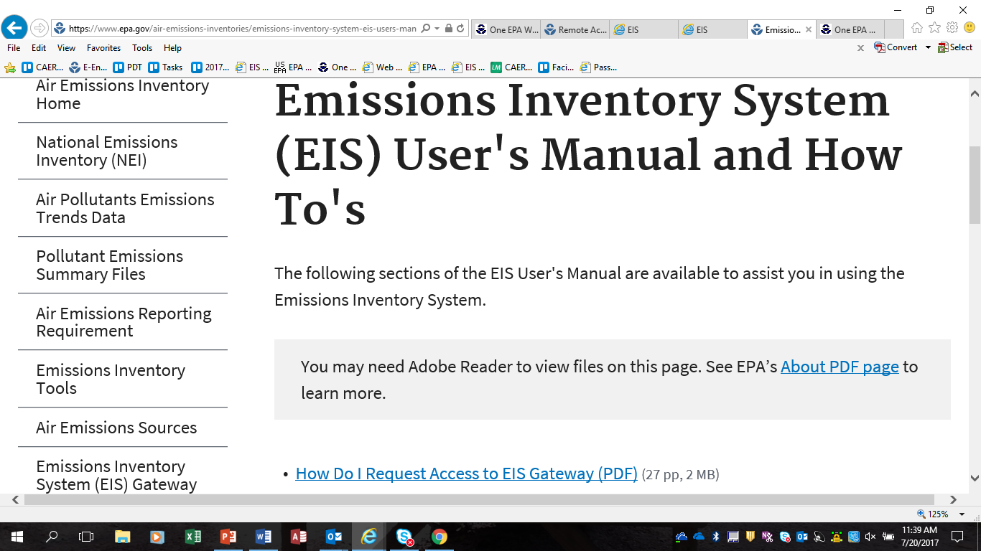
https://www.epa.gov/air-emissions-inventories/emissions-inventory-system-eis-users-manual-and-how-tos
Notes:
How you do you register for EIS? Detail instructions are located on the CHIEF website, under Emission Inventory Gateway. You will need to first register on the EPA Portal at https://waa.epa.gov/waa/login.jsp After registration, you will receive an approval email. Next you will complete your Profile in EIS at https://eis.epa.gov/eis-system-web/welcome.html Once this profile has been approved you will have full access to the system.

Slide 9
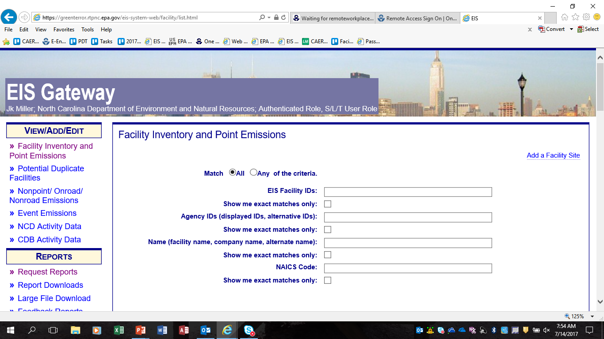
Notes:
This section can be used to filter for an individual facility by using EIS or Agency IDs, Facility Name, or NAICs Code.

Slide 10
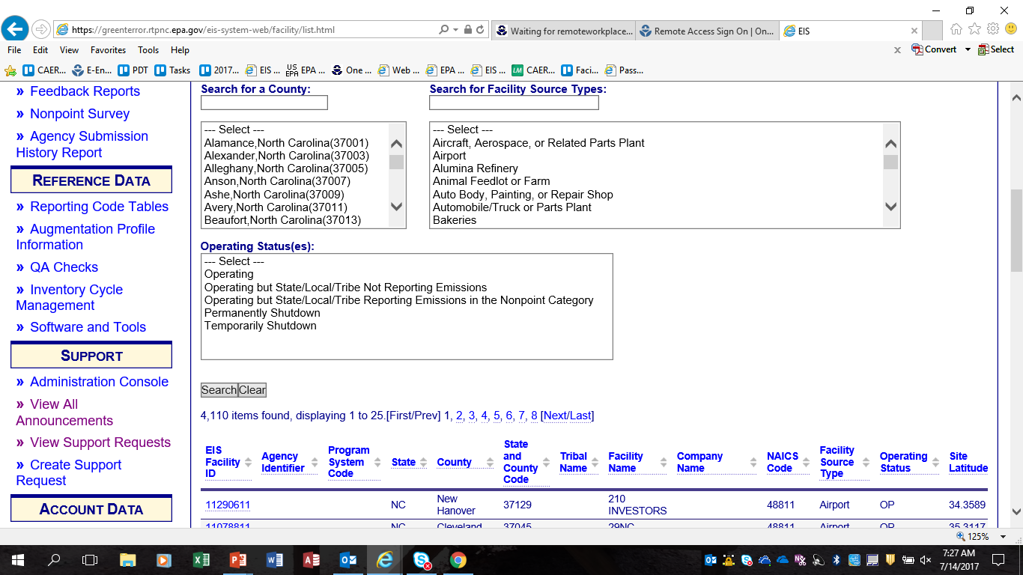
Notes:
Additional filters include County, Facility Type and the Operating Status. If you do not select any filters, all facilities in your jurisdiction will be listed at the bottom of the page. This list also includes facilities added by EPA such as airports, railyards and landfills.

Slide 11
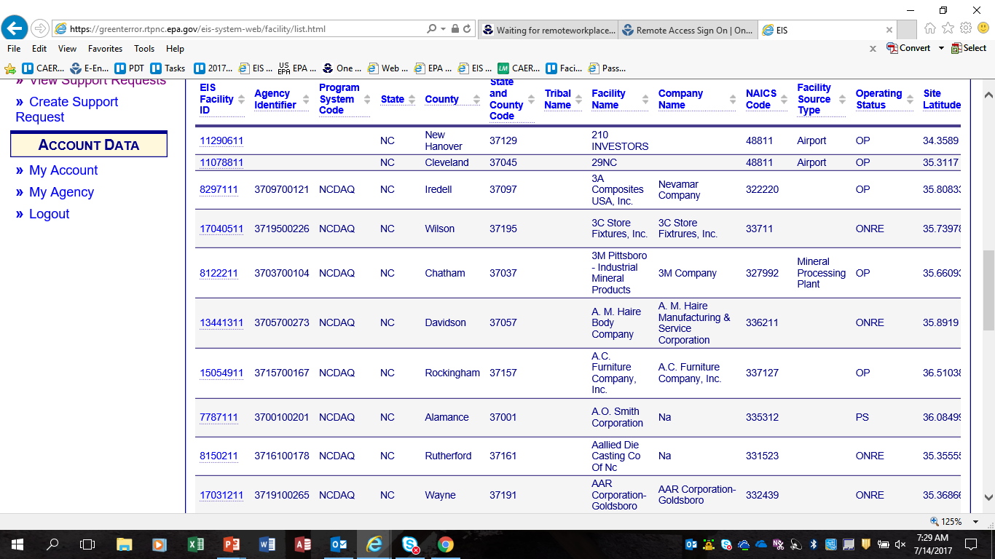
Notes:
Your agency facilities are identified by the existence of an Agency Identifier. Let’s select this one for 3M.

Slide 12
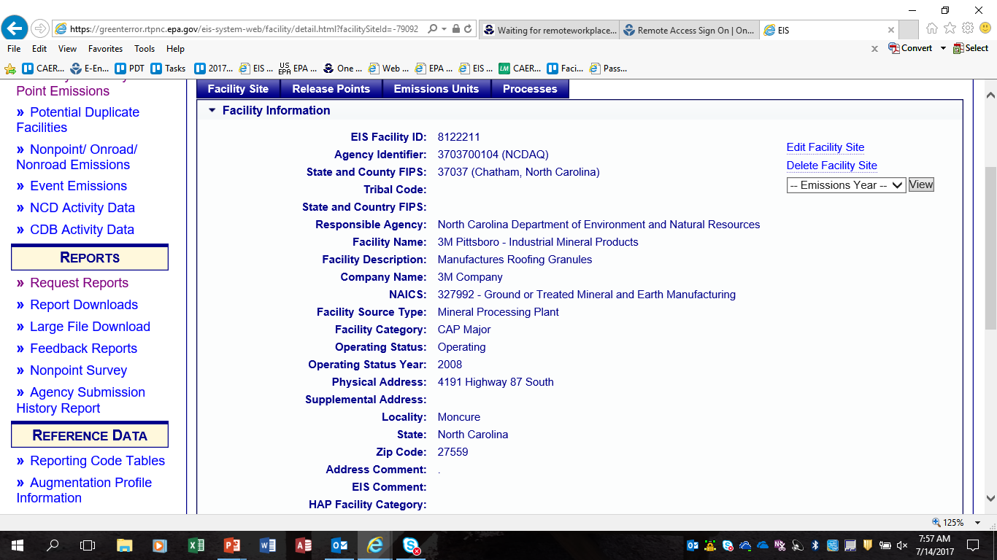
Notes:
From this page you can see the facility details contained in EIS. There are three action buttons on the right hand side. Edit Facility Site can be used to change the information in any data field. Delete Facility Site can be used to delete a facility from EIS. Word of caution though, EIS will not delete a facility that has emissions from any year tied to this facility ID.
You may also look at facility level emissions for this record by selecting the “Emissions Year” of interest. Each level: unit, process and release point will have a view emissions option for that particular level.

Slide 13
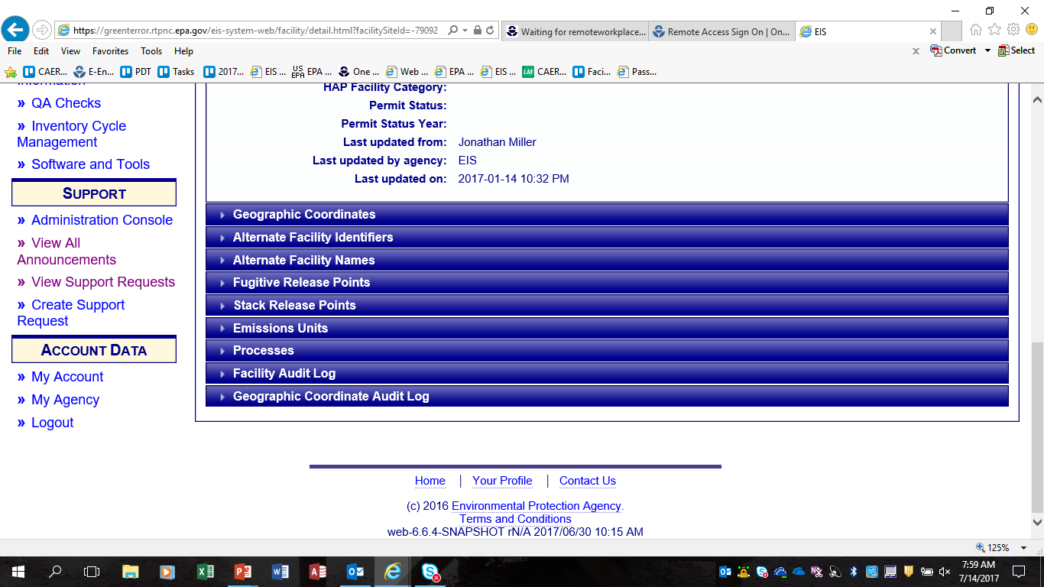
Notes:
Additional information includes:
Geographic Coordinates
Alternative Facility Identifiers – such as FRS ID, TRI ID, ids previously used by the SLT Agency
Fugitive Release Points
Stack Release Points
Emission Units
Processes
Also included are the Facility Audit Log and Geographic Coordinates Audit Log. These logs will tell you who and when an edit was made to this records.

Slide 14
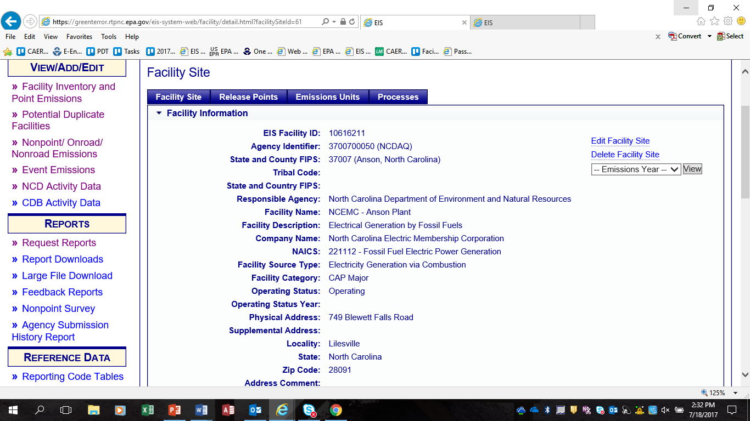
Notes:
You can use the tabs at the top of the page. Let’s look at the smallest granularity…processes.

Slide 15
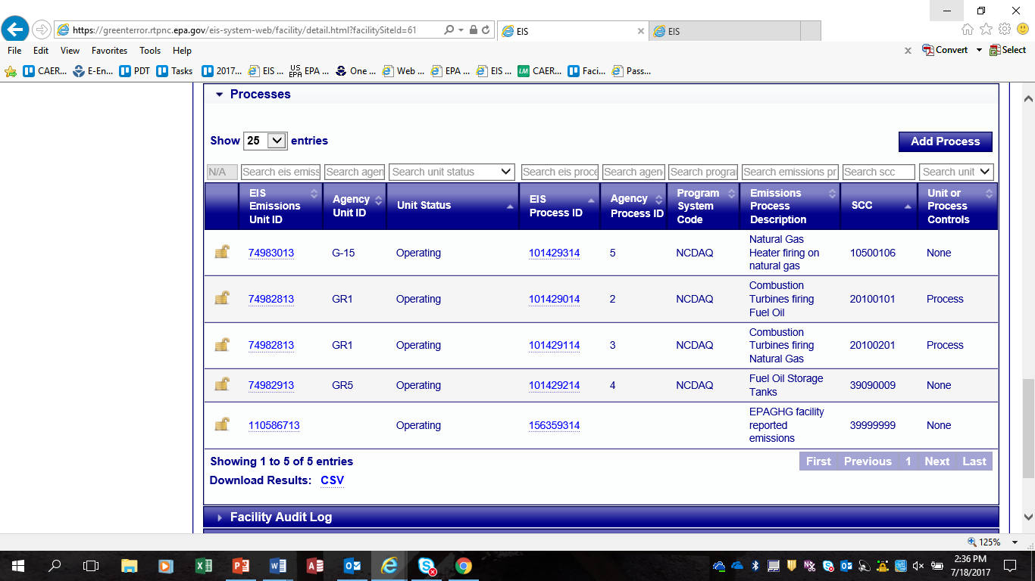
Notes:
The process component will open with the associated unit identifier first.. To see the process details click on the second linked identifier.

Slide 16
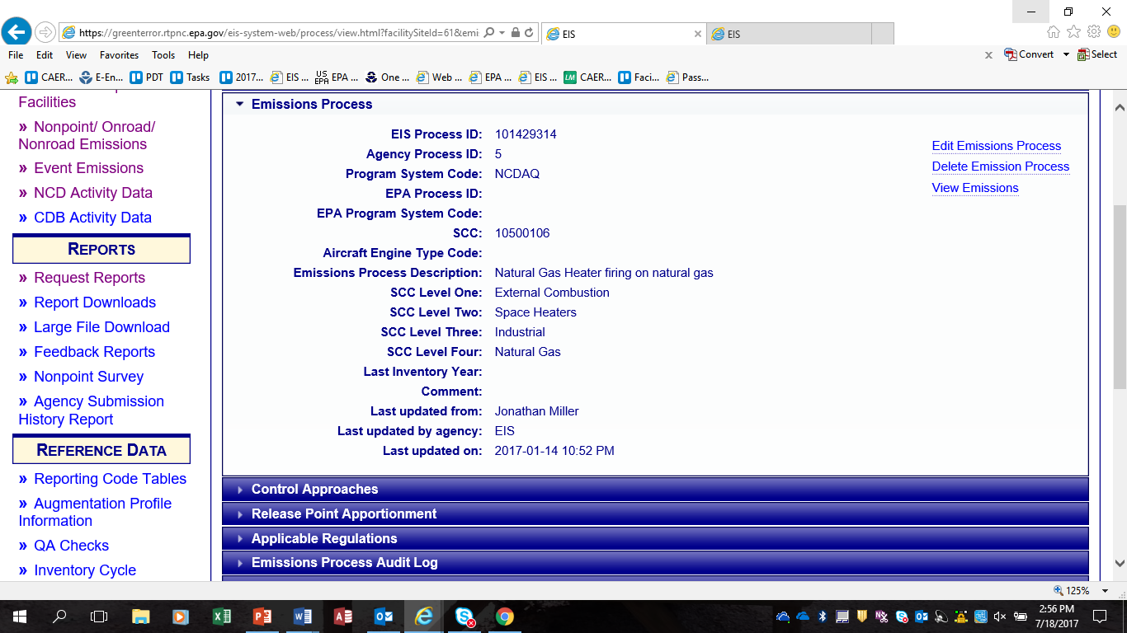
Notes:
Under the detailed process page, there is additional information for control approaches, release point apportionment and any applicable regulations.
There are also action buttons to edit and delete a process. Again, a process may not be deleted if there are emissions from any year associated with that process.
You may also view emissions for this process. Processes are the most detailed records in EIS. Let’s select View Emissions.

Slide 17
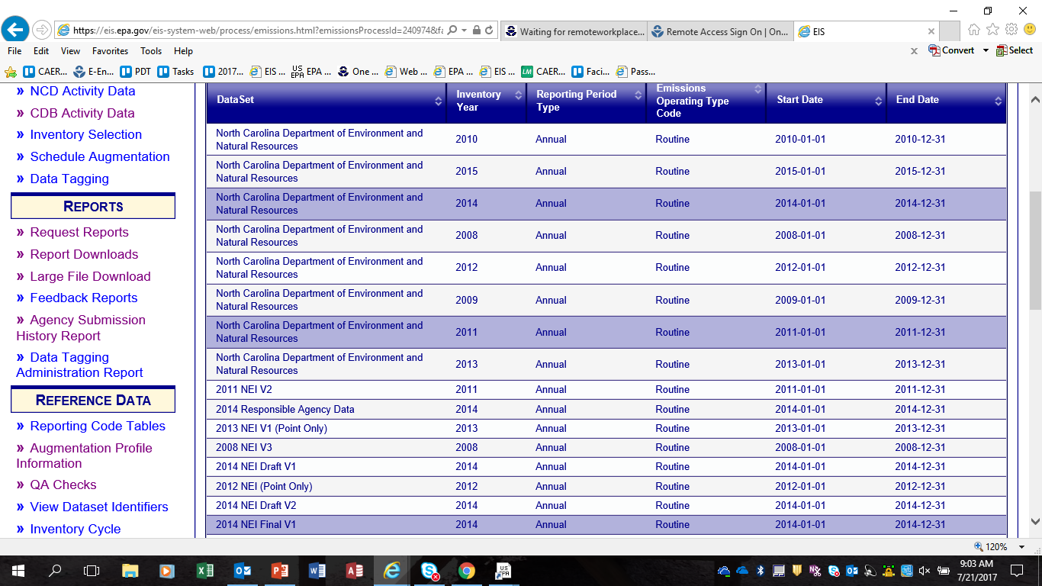
Notes:
First you must select a data set to view. In this case we have selected the NC 2014, NC 2011 and the 2014 NEI V1 data sets. Selection of multiple datasets is allowed.

Slide 18
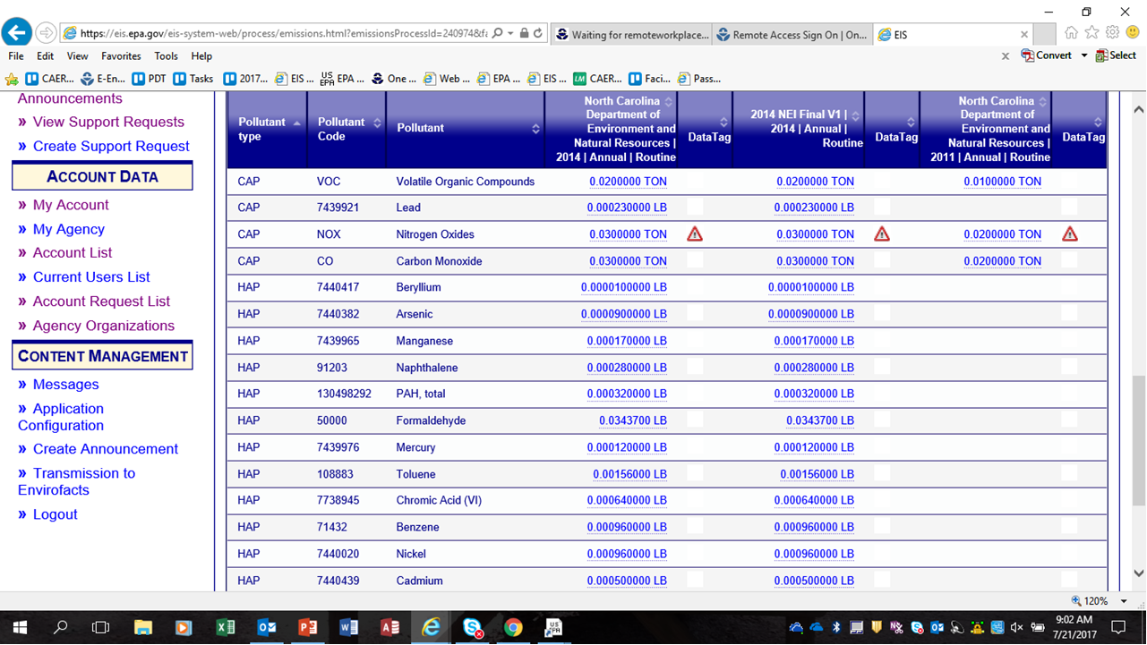
.
Notes:
The results from all three data sets are displayed. Notice the Data Tag column. The triangle icon in this column indicates that this particular pollutant/emission record will not be used in the selection of the NEI. Instead an EPA estimate may be used
Note that the emission values are links. Selecting this link will allow you to edit an emissions record, or see why the record was tagged. This is a convenient way to change one or two emissions. Batch submission should be used when you have numerous changes.

Slide 19
The Facility Inventory

Slide 20
The Facility Inventory
Information on the physical facility, as opposed to the annual throughputs and emissions. Provides the static framework to which point emissions can be reported each year.
  Site-level information and location
  Release point parameters and locations
  Emission unit information (unit type, design capacity)
  Emission process information (SCC)
  Control devices or measures
  Regulations
Only changes or additions from year to year need to be reported.
  EIS will recognize what the changes are if you maintain consistent facility/unit/process/release point IDs each year
The Facility Inventory provides the common framework between your Agency’s data system and USEPA’s for inventories
Notes:
The Facility Inventory in EIS should be up-to-date with your Agency’s facility data
Separating the facility inventory from the point emissions submittals reduces the burden of S/L/T’s reporting, and EPA reviewing, for completeness and errors each cycle for largely non-changing for facility data. You only need to submit changes from your previous submittal.
EIS will figure out what is a change if you maintain consistent IDs in your submittals from year to year. Without consistent identifiers, duplicates are introduced into the EIS system. We will talk about how you can change all of your identifiers at one time in the event that you change systems.

Slide 21
3
2
Release Points
1
Unit B, Processes 1 and 2,
are apportioned to
Release Point 1, 100%
Unit A
Unit B
Unit A, Process 2, is
apportioned to Release
Point 3 60% and Release
Point 2 40% (Must total 100%).
Unit A, Process 1, is
apportioned to Release
Point 1 100%.
Process 1
Process 1
Process 2
Process 2
Notes:
This is a graphical representation of how facilities are configured in the Emission Inventory System. In this example, a facility has 3 release points (2 stack and 1 fugitive) and 2 units, Unit A and Unit B. Each unit has 2 processes, 1 and 2. Notice the release point apportionment of processes to release points.
The Processes are apportioned to the Release Points. A single process may vent to one or many release points . Also several processes may vent to one release point. In the graphic above, you can see that Unit A, Process 2, is being vented to both Release Point 2 and Release Point 3. While process 1 uses only the fugitive release point 1.
Controls may be applied at either the unit level or the process level. If at the unit level it implies that all processes under that unit are controlled per the unit level information.
We will use this graphic as a “we are here” throughout this presentation. Our next section is on the facility data, which is circled in blue above.

Slide 22
Site-level Info Required for New Facility
    State and County FIPS or Tribal Code
    Facility Site Identifier (your Agency’s ID)
    Facility Site Identifier Program System Code
    Facility Site Name
    Facility Site Status Code (and Status Year if not=“OP”)
    NAICS
    4 Physical Address Fields : Street, City, State, Zip
    Site-level Latitude and Longitude
      must be Decimal Degrees (NOT Degrees.MinuteSecond)
Notes:
During this course we will cover how to add new items (facilities, units, release points, processes) and their attributes to the Facility Inventory, and how to change existing data for existing items. First let’s look at adding a new facility. A new facility may be added by submission by XML batch or manually in the EIS Gateway.
As items are received into EIS, an EIS facility identifier is assigned and does not change regardless of changes in agency identifiers. This is very important later on when we discuss how to change your IDs if you have a system change by manually changing in EIS Gateway or through a batch XML submission.
The Program System Code identifies that the ID submitted belongs to your agency’s data system, as opposed to the EIS IDs or USEPA IDs. Your Agency PSC is usually just a simple acronym for your agency name or it may be an acronym for your data system.
Facility Site Status Code consists of 5 codes : OP (operating); PS (permanently shutdown); TS (temporarily shutdown); ONP (operating but S/L/T includes its emissions under nonpoint). ONRE (operating but S/L/T does not report emissions).
All Facility Statuses except OP require a Facility Site Status Year. EIS interprets this year as meaning “As of Jan 1, the facility had this status”. So if you change status to PS with a status year of 2017, EIS will not accept any 2017 emissions. If a facility shuts down part way thru 2017, and you will have some 2017 emissions to report, the status year should be 2018. We prefer that you leave the status year for OP facilities null, but there is no QA check or other action by EIS that uses status year for OP facilities. If you entered 2017 as the status year for OP facilities during the 2017 reporting cycle, you can leave that as is, or update it if you want, but a point to remember is that you can’t delete by XML batch file, only manually in Gateway.

Slide 23
    Exceptions for Portable Facilities and Off-Shore Platforms
Portable Facilities
  State FIPS + 777
  Use “Portable Facility” for Facility Site Description
  Geographic Coordinates and Physical Address can not be reported.
Off-shore Platforms in State Waters
  Provide the 5-digit FIPS
  Use “Offshore Facility” for Facility Site Description
  Provide the Site-level Geographic Coordinates
  Use “N/A” for Physical Street Address and City
  Provide State Abbreviation
  Use “99999” for Zip Code
Off-shore Platforms in Federal Waters
  State and County FIPS = 85000
  USEPA loads emissions estimated by Dept of Interior to EIS
Notes:
There are some exceptions to the requirement list.
By nature, portable facilities do not have a permanent physical location and may even move from county to county. Therefore the FIPS code should consist of the 2-digit State FIPS plus “777” as the county code. You are then requested to provide a Facility Description of “Portable Facility”.
Since a portable facility is not at a fixed location, you can NOT provide a physical address or geographic coordinates. If you wish to provide a company mailing address, you can use the Supplemental address field.
For State water platforms, use the on-shore county FIPs. A site-level Lat-Lon for the actual platform location is required. You are requested to report a Facility Site Description of “Offshore Facility”. For the physical street address, City and zip code fields, use “N/A” and “99999” - do NOT put an on-shore company mailing address in the physical address fields. You can use the Supplemental address field if you wish to report mailing addresses.
Federal off-shore platforms are identified by a FIPS code of 85000 and will be reported by EPA.

Slide 24
Airports
Prior to 2008 NEI, reported by USEPA as nonpoint county sums
EPA has created 21,000 airport facilities in EIS. ALL airports, helipads, seaplane bases now in Facility/Point
  EPA provides estimates for LTOs and aircraft-related emissions, so only improved or missing local data need be reported
Nonpoint or nonroad emissions NOT accepted for aircraft engine exhaust, auxiliary power units or ground support equipment, even though NONROAD model calculates APU and GSE
  aviation gas distribution and filling emissions continue to be reported as nonpoint county sums
IF S/L/Ts report, use the existing EPA unit and process ID framework to place emissions at same processes as USEPA
  Units are aircraft types (military, commercial, general aviation, etc)
  Processes are aircraft make and engine type, indicated by aircraft engine type code. This is a required field
  Combinations of SCC plus aircraft engine type code that duplicate existing processes will NOT be accepted as new processes
Notes:
For the 2008 inventory year, EPA added ~21,000 airports to the EIS facility inventory using info received from the FAA. This data is updated for every tri-annual inventory. The FAA data includes international airports all the way down to unpaved airstrips, private heliports, and seaplane bases.
More details on the emissions reporting for these facilities will be discussed during the Point portion of this course.

Slide 25
Rail Yards
EPA has added 1240 largest facilities to EIS
There may be smaller rail yards.
  S/L/Ts may add these as Facility/Point or report in nonpoint
  Check Facility Inventory for duplication
Emissions from yard locomotives only.
Emissions from locomotives on rail lines are reported in nonpoint using line segment shapefiles
Notes:
The largest rail yard emissions should be reported at individual facilities, not as county nonpoint aggregates. Emissions from locomotives underway on rail lines should be reported to specific line segment or shapefiles in the nonpoint inventory. Reporting of the emissions from yard locomotives will be covered in more depth in the Point course, and emissions from locomotives on rail lines will be discussed in the Nonpoint course.

Slide 26

Notes:
Are there any questions so far?

Slide 27
3
2
Release Points
1
Unit B, Processes 1 and 2,
are apportioned to
Release Point 1, 100%
Unit A
Unit B
Unit A, Process 2, is
apportioned to Release
Point 3 60% and Release
Point 2 40% (Must total 100%).
Unit A, Process 1, is
apportioned to Release
Point 1 100%.
Process 1
Process 1
Process 2
Process 2
Notes:
Next we will discuss Release Points

Slide 28
Info Required for New Release Point
  State and County FIPS or Tribal Code
  Facility Site Identifier and Program System Code
  Release Point Identifier (your Agency’s ID)
  Release Point Identifier Program System Code
  Operating Status (and Status Year if not=“OP”)
      OP, PS, TS
  Release Point Type Code
      1 – Fugitive
      2 – Vertical
      3 – Horizontal
      4 – Goose Neck
      5 – Vertical with Rain Cap
      6 – Downward-Facing Vent
Notes:
Grey bullet text shows IDs and Program System Codes of the ‘parent” component in the XML or staging table file.
An EIS Release Point identifier is assigned to the record when initially received.
The Release Point Identifier Program System Code will be the same as the Facility Site Identifier Program System Code.

Slide 29
Required if Release Point is a Stack
  Height & Unit of Measure (FT)
  Diameter & Unit of Measure (FT)
  Exit Gas Velocity & Unit of Measure (FPS or FPM) AND/OR Exit Gas Flow Rate & Unit of Measure (ACFS or ACFM) or both
    Error 192 – consistency of Diameter, Velocity, and Flow
  Exit Gas Temperature (in Degrees F)
  Optional : Release Point Lat-Lon Coordinates
    must be Decimal Degrees (NOT Degrees.MinuteSecond)
Notes:
Release point parameters are required for all release points types except a release point type of 1, or Fugitive
Exit Gas Velocity and Exit Gas Flow Rate may both be reported, but at a minimum you must give us one or the other
Error 192 – EIS performs a consistency check on velocity, diameter, and flow by multiplying cross-sectional area (from the diameter) times velocity and comparing to flow. Must be within 5% tolerance, plus or minus.
Note that Lat-Lon is NOT required (but can be provided) for each release point in EIS.

Slide 30
Fugitive Releases
Fugitive parameters are optional
Height and Unit of Measure (FT)
Width and Unit of Measure (FT)
Length and Unit of Measure (FT)
Angle tilted from true North (in Degrees)
Notes:
Fugitive release point type parameters are not required.

Slide 31
Geo Coordinates - Lat & Lon
Required at Site Level
Optional at Release Point Level
Unless you have actual release point coordinates for some of your larger facilities, we suggest reporting Site level only
  Modeling files will use Site coords for any missing Release Point coords
  Site center or main emitting point coords preferred
    Use the Geo Reference Point Code to indicate that your measurement is the entrance or site center or other
Be careful with any conversions from your system’s data
  Decimal Degrees (NOT Degrees.MinuteSecond)
  Sum Longitude whole degrees and decimal portion correctly
  UTM zone errors
Notes:
Geographic Coordinates are required at the site level, but NOT for each individual release point, which is different than pre-2008 NIF submittals. It is important that geographic coordinates are accurate. These lat/lons are used when assigning health risks and modeling. Google Earth is an excellent tool to QA your coordinates. Another good source is iTouchMap.com.
EPA checks county fips vs site coords
EPA checks rel pt coords vs site coords to screen for large discrepancies
There are separate XML schema components and separate tables in the Bridge Tool staging tables for the site level and release point level geographic coordinates. If a release point geographic coordinate is not provided, EIS will default the lat-lons to the site lat-lon when creating modeling files and configuration reports and Gateway displays. Do not report the release point lat/lons with the same coordinates as the facility lat/lon. If using the facility lat/lon as defaults, do not report release point lat/lons.
If you have accurate release point lat/lons you can still enter them, even if site is protected. For some sites where significant emission releases are more spread out, it would be helpful to add some individual release point coords if available.

Slide 32

Notes:
Any questions on release points?

Slide 33
3
2
Release Points
1
Unit B, Processes 1 and 2,
are apportioned to
Release Point 1, 100%
Unit A
Unit B
Unit A, Process 2, is
apportioned to Release
Point 3 60% and Release
Point 2 40% (Must total 100%).
Unit A, Process 1, is
apportioned to Release
Point 1 100%.
Process 1
Process 1
Process 2
Process 2
Notes:
Next we will discuss Emission Units

Slide 34
Info Required for New Emission Unit
  State and County FIPS or Tribal Code
  Facility Site Identifier and Program System Code
  Unit Identifier (your Agency’s ID)
  Unit Identifier Program System Code
  Operating Status (and Status Year if not=“OP”)
    OP, PS, TS
  Unit Type Code
    999 = “Miscellaneous” is available if necessary. Don’t include this for existing units to avoid overwriting all with 999
  Design Capacity & Unit of Measure is requested for boilers, turbines, engines, heaters, and is a warning check
Notes:
An EIS Unit Identifier is assigned to the record when received.
Again, the Unit Program System Code should be the same as the Facility Site Program System Code.
Unit Type is required. As with all other codes, see the EIS Gateway for the current valid list. We do still allow a miscellaneous type code to make it possible to get data in from agency’s that don’t maintain such a unit type. But we have tried to populate this for larger units where we could tell what they were in EIS. For existing units, please don’t universally fill with “999”, as this will overwrite existing more specific unit types already existing in EIS.
The unit operation date is the date that the unit came on line and not the inventory year.
For some combustion unit types, you are requested to provide the design capacity.
Unit Status Code is similar to the Facility Site Status Code in that you have three options: OP – Operating; PS-Permanently Shutdown; TS-Temporarily Shutdown. The Unit Status Code Year works the same as the Facility Site Status Code Year, you may not report emissions for the same inventory year as the Status Code Year. In other words, you may not report 2017 emissions for a unit which has a status code of PS and a status code year of 2017. If the unit closed down partially through the year, then use a status code year of 2018 which will allow you to submit emissions for 2017 but not for any subsequent years.

Slide 35
3
2
Release Points
1
Unit B, Processes 1 and 2,
are apportioned to
Release Point 1, 100%
Unit A
Unit B
Unit A, Process 2, is
apportioned to Release
Point 3 60% and Release
Point 2 40% (Must total 100%).
Unit A, Process 1, is
apportioned to Release
Point 1 100%.
Process 1
Process 1
Process 2
Process 2
Notes:
Next we will discuss Emission Processes

Slide 36
Info Required for New Emission Process
  State and County FIPS or Tribal Code
  Facility Site Identifier and Program System Code
  Unit Identifier and Program System Code
  Emissions Process Identifier (your Agency’s ID)
  Emissions Process Identifier Program System Code
  Aircraft Engine Type Code –Required for aircraft SCCs
  One or more Release Point Apportionments
  Source Classification Code
    Avoid using non-specific codes such as 399999xx if possible
    Now available as a web service for your system. https://ofmpub.epa.gov/sccwebservices/sccsearch/
Notes:
An EIS identifier is assigned to the emission process record when received.
The Source Classification Code is an 8 or 10 digit code which describes the emissions. The most up to date list of SCCs is available on the Gateway and can be downloaded in .csv format. The default view is ALL codes. This view gives both Active and Retired SCCs and can be changed to just see Active SCCs. Only SCCs active for the inventory year being submitted can have emissions reported. Through the E-Enterprise Combined Air Emissions Reporting, SCCs are now available as a web service to your systems. This web service will ensure that you have the most up to date information. Currently EIS is now using this service.
There are ~23 SCCs for aircraft exhaust. When one of these SCCs is used an Aircraft Engine Type Code is also required. This Aircraft Engine Type Code describes the types of aircraft, and the engine type. New required element in order for 2011 point emissions to be reported.

Slide 37
Release Point Apportionment
  State and County FIPS or Tribal Code
  Facility Site Identifier and Program System Code
  Unit Identifier and Program System Code
  Emissions Process Identifier (your Agency’s ID) and Program System Code
  Release Point Identifier (your Agency’s ID)
  Release Point Identifier Program System Code
  Percent of process venting to release point
  A process may be vented to one or more release points
  Total percentages must equal 100
Notes:
The last data field on the process level is the release point apportionment.
Processes may be vented to one or more release points, but the total apportionment must equal 100.

Slide 38

Notes:
Questions?

Slide 39
Controls
Controls are required by AERR to be reported if they exist
  No uncontrolled code
  Either unit OR process level
  Only one control approach may be active at any given time – any new controls submitted replaces the existing controls in EIS
Three components must be reported together :
  Control Approach Component
    The “parent” of the control group
    non-pollutant specific percentages – capture, effectiveness
  Control Measure Component
    control device codes that make up the control approach
  Control Pollutant Component
    Pollutants controlled by the all devices in the overall approach
    Percent Reduction Efficiency for each pollutant, if available
Notes:
Per the AERR, information on controls is required to be reported IF controls exist. There is no explicit code to be reported for “uncontrolled”. If a unit or process is not controlled, don’t report these EIS components.
Controls can be reported at either the emission unit or emission process levels.
Any new control Approach replaces any existing approach as a whole. Controls are not assigned an EIS identifier. Therefore all three components must be reported with each submission when changing a measure or pollutant.
The Control Approach describes the characteristics of the overall approach and is the parent to the Control Measure and Control Pollutant sections. Every Control Approach must be associated with a minimum of one control measure (device) and at least one pollutant.

Slide 40
Control Approach Component
  Facility Site Identifier and Program System Code
  Unit Identifier and Program System Code
  Emissions Process Identifier and Program System Code
    Reported only if the control approach is at the process level
  First Inventory Year
  Percent Control Approach Capture Efficiency
  Percent Control Approach Effectiveness
Notes:
First Inventory Year is the first year that the control approach was operating.
Percent Control Approach Capture Efficiency and Percent Control Approach Effectiveness are not required data fields, but are encouraged.
Percent Control Approach Capture Efficiency is an estimate of that portion of an affected emission stream that is collected and routed to the control measures when the capture or collection system is operating as designed. Use only where downstream control measures are present, not where stream is just vented without control. If each device has its own separate intake, each control device will use its own capture efficiency. If the control devices are in series, the capture efficiency of the first device is used to determine the overall control efficiency for the entire control approach. The control approach capture efficiency is usually 100% except where process are open and have a capture hood.
Percent Control Effectiveness is the estimate of the portion of the reporting period’s activity for which the overall control system or approach (including capture and control measures) were operating as designed (regardless of whether the control measure is due to a rule or voluntary measure).

Slide 41
Control Measure Component
  Facility Site Identifier and Program System Code
  Unit Identifier and Program System Code
  Emissions Process Identifier and Program System Code
    Reported only if the control approach is at the process level
  Control Measure Code(s) – at least one required
Notes:
Up to date control measure codes are available under Reporting Codes on the EIS Gateway. All codes may be downloaded into .csv.

Slide 42
Control Pollutant
  Facility Site Identifier and Program System Code
  Unit Identifier and Program System Code
  Emissions Process Identifier and Program System Code
    Reported only if the control approach is at the process level
  Pollutant Code(s) – at least one required
  Optional, and desirable, per pollutant : % reduction achieved by the combination of all control measures
  If reported, Percent Control Measures Reduction Efficiency cannot be 100% unless there is a ban in use.
Notes:
Percent Control Measures Reduction Efficiency is not a required field, but is wanted.
The Percent Control Measures Reduction Efficiency is the estimated average reduction achieved for the pollutant when all control measures are operating as designed. The reduction efficiency should not be discounted for the percent of the emissions stream which never reaches the control measures because of less-than-complete capture, control equipment downtime, malfunctions, or bypassing. The intent is that the control measures reduction efficiency describes the REDUCTION % across just the control devices themselves, and not the remaining emitted %. It does not consider the capture aspect at all. The Capture Efficiency % is to be reported separately from the individual pollutant reduction % to ensure transparency of the details that may be included in estimating emissions.

Slide 43
Maintaining Identifiers Across Years
You may submit data to EIS using EITHER your Agency’s IDs OR the EIS IDs
Unique and recognized IDs for Sites, Units, Emission Processes and Release Points
If a Site ID is not recognized by EIS, it checks existing for Potential Duplicate site.
No duplicate checking below Site Level
  New emission units for EGUs may create duplicated emissions
Notes:
There is a potential duplicate check on the facility level but does not exist for units, processes or release points.
Actually could be a bigger problem within a single year, if S/L submits more than once

Slide 44
If You Must Revise Your IDs
Individually via EIS Gateway
Or large batch
  Must use EIS Identifiers
  Provide New ID under Agency ID data fields (facility, unit, process and release point)
  EIS will automatically place an end date on the current identifier and replace it with the new identifier.
Notes:
All changes may be done in one of two ways. Through a batch upload or manually on the EIS Gateway.
It is extremely important that the your submission contain the EIS facility identifier for the facility that is being changed. If the EIS Facility Identifier is null, EIS will look at the record as a new facility.
This same process would be used to change unit, process and release point identifiers as well.
Last Inventory Year, rather than End Date, for emissions process

Slide 45


Slide 46
Submitting your data to EIS

Slide 47
Submittal Process
Must be an XML file in EIS CERS schema format
  https://www.epa.gov/air-emissions-inventories/air-emissions-inventory-training
Submit zipped XML file to EPA CDX Node
QA or Production Environment
  QA is always open to check your data. Does not change anything in the EIS
  Same QA checks are applied in either environment
  Production submission will update the EIS

Slide 48
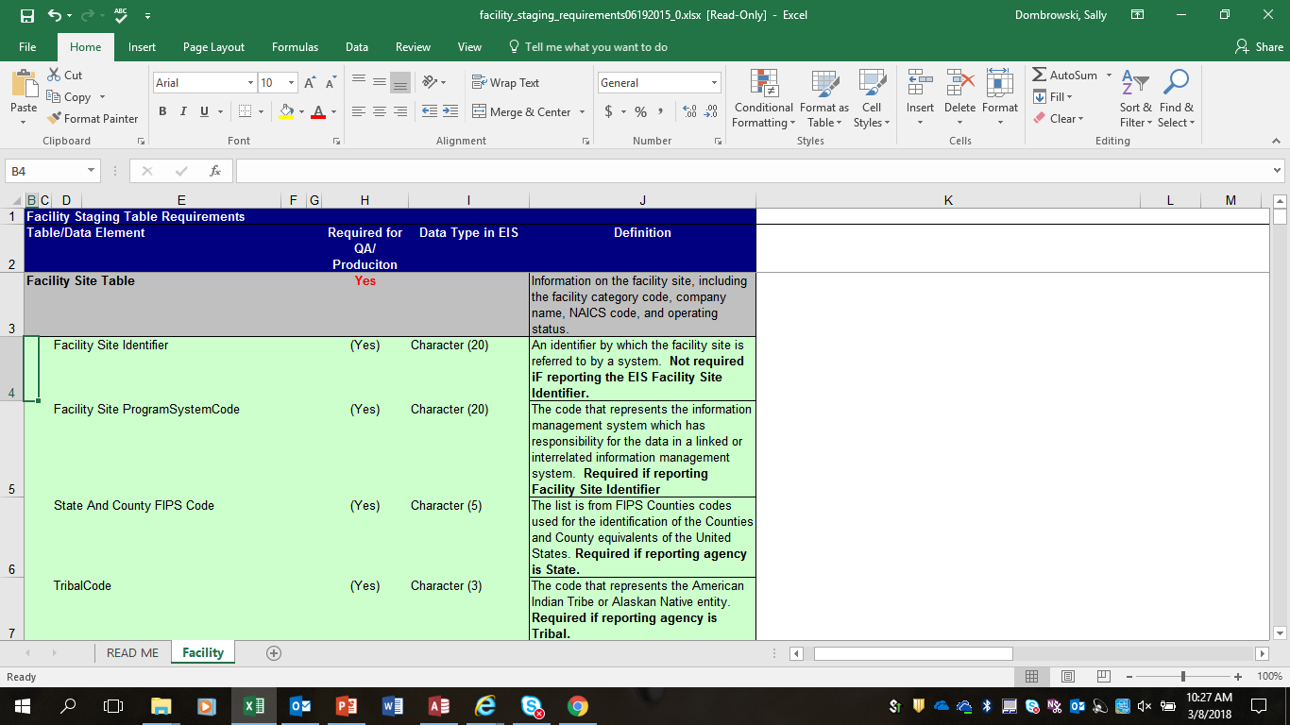
Requirements Spreadsheet
https://www.epa.gov/air-emissions-inventories/air-emissions-inventory-training
Notes:
As an added resource to help you with identifying which data fields are required and which are optional, a Facility and Point Staging Requirements spreadsheet can be found on our training website.

Slide 49
How do I create an XML file
Direct Export Feature in your SLT system
  Mainframes or desktop software packages
  or
Get your updated data into the EIS Bridge Tool
    https://www.epa.gov/air-emissions-inventories/air-emissions-inventory-tools
Notes:
There are several ways to submit your data to EIS. All of these ways require an XML file in the CERs schema format.
Many States have the ability to do a node-to-node transfer. Without getting too geeky, a node to node transfer is your server talks to our server and the magic happens.
If your agency does not have node to node capability, then a submission may be made using EPA’s Web Client. Your submission may be in the form of an export from the Bridge Tool or an export from your system that meets the CERs xml schema format.

Slide 50
Send XML to EPA CDX Node
  Node-to-node transfer
    or
  CDX web client
    https://nodewebrss.epa.gov/user/Login.aspx
    Use Gateway login and password
Notes:
Do not submit your POINT inventory directly after your facility inventory. If you have a problem in your facility inventory it will cause your POINT to fail as well.

Slide 51
The EIS Bridge Tool

Slide 52
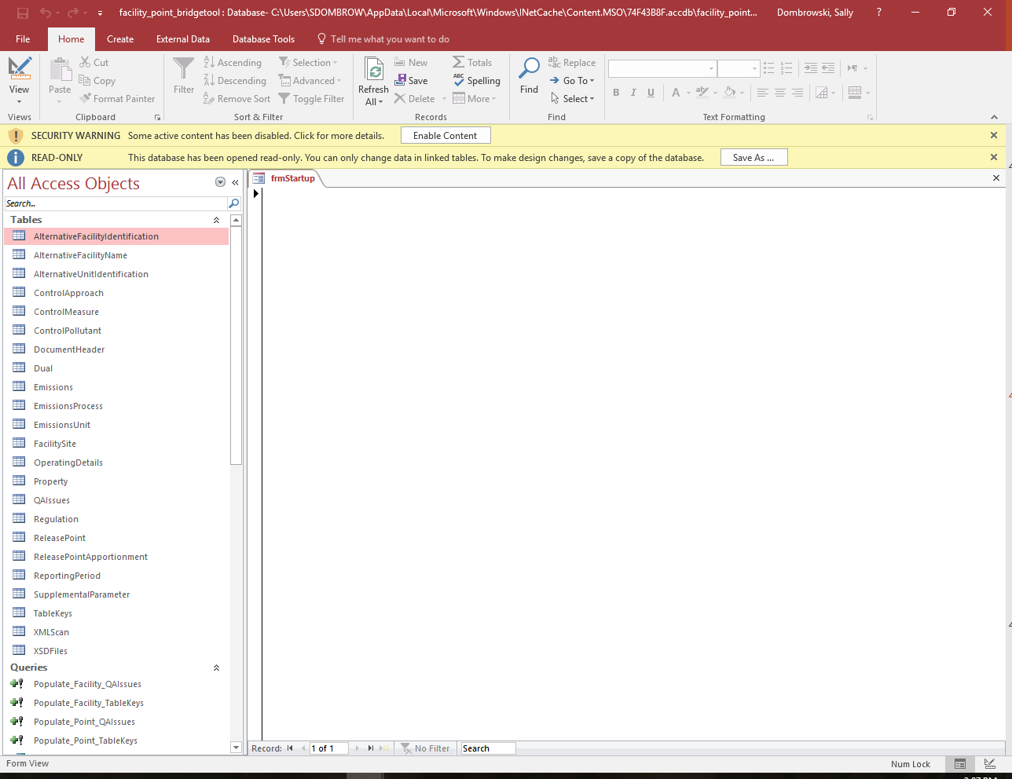
Notes:
When you first open the Facility/Point Bridge Tool you must first do two things before using the application:
Save As to your computer
Select “Enable Content”

Slide 53
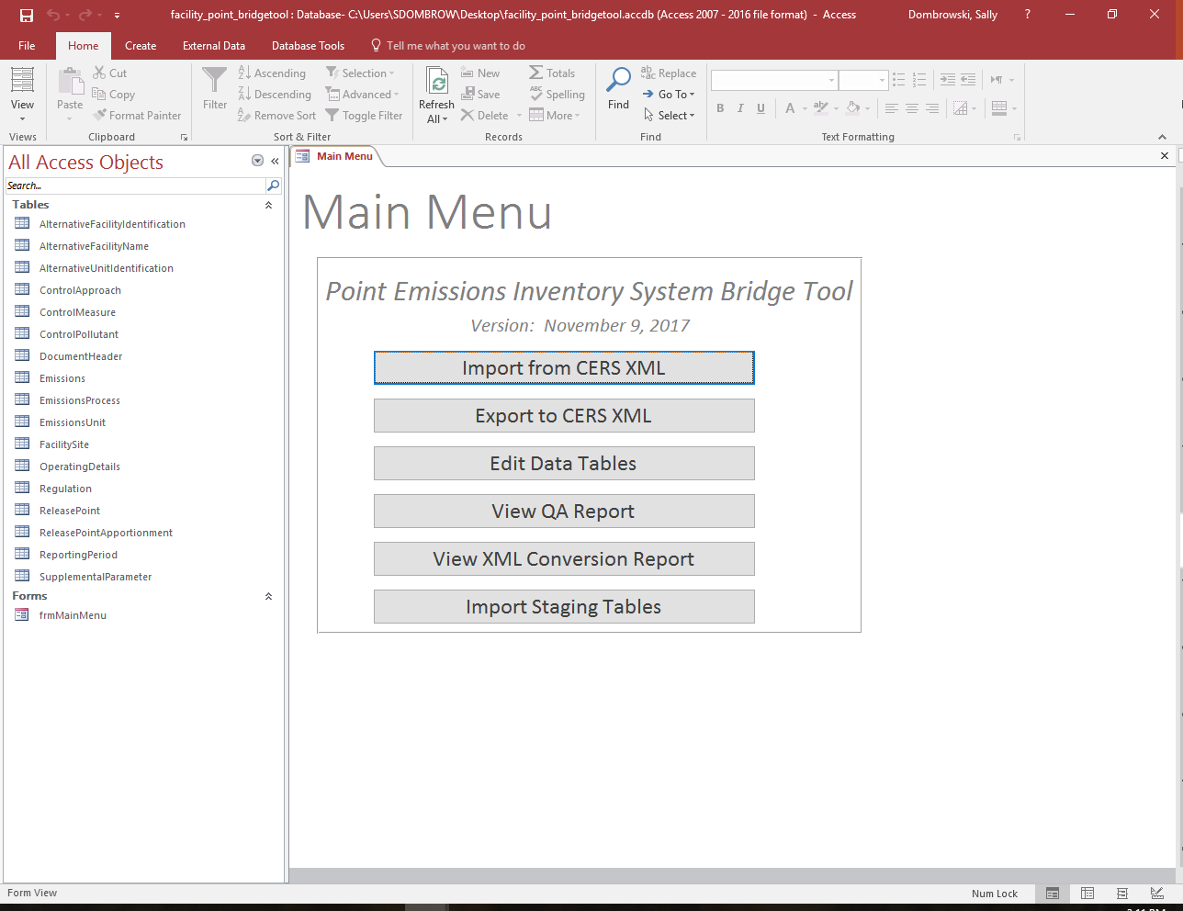
Notes:
Once the Bridge Tool is enabled the Main Menu is revealed.
Import from CERS XML function allows you to import the a facility or point emissions snapshot from EIS. The snapshot is the only report in EIS which is downloaded in CERS XML format.
Export to CERS XML function allows you to export the facility or point records in the Bridge Tool staging tables into a CERS XML file for submission to the EPA Web Client.
The third menu item is Edit Data Staging Tables. Allows you to Add or Edit a particular staging table. Personally I just open the tables from the left hand side of the tool.
View QA Report allows you to view a report which is created through export function and identifies any errors encountered. This report has links which brings you directly to the record in question.
View XML conversion report which tells you the number of records converted for each XML data component.
Last is the Import Staging Tables. This function allows you to import staging tables from another Bridge Tool file into your current file.

Slide 54
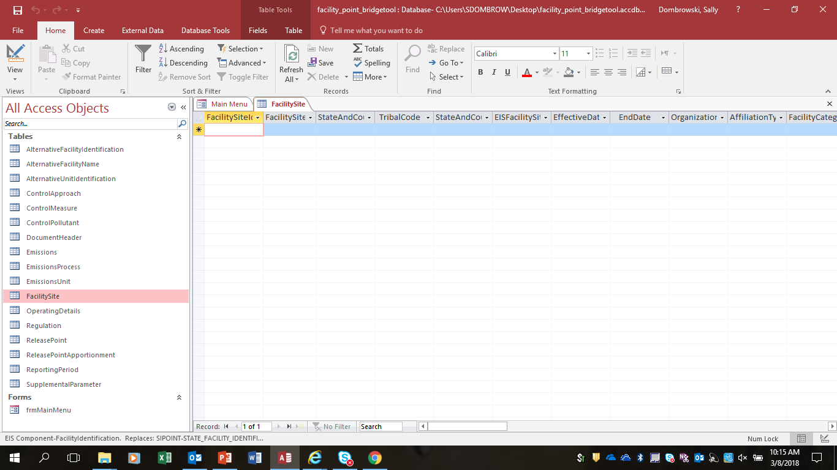
Notes:
On the left hand side of the Bridge Tool are the staging tables which represent each component of the Facility and Point Inventory.
If you open the Facility Site table a template opens which includes all of the required and optional fields in the Facility Site component.

Slide 55
Facility Inventory Tables
  Document Header
  Facility Site
    Unit Identifier
      Emissions Process
        Release Point Apportionment
    Release Point
  Optional – Control Approach (under unit or process)
    Control Measures
    Control Pollutant
  Optional – Regulations (under unit or process)

Slide 56
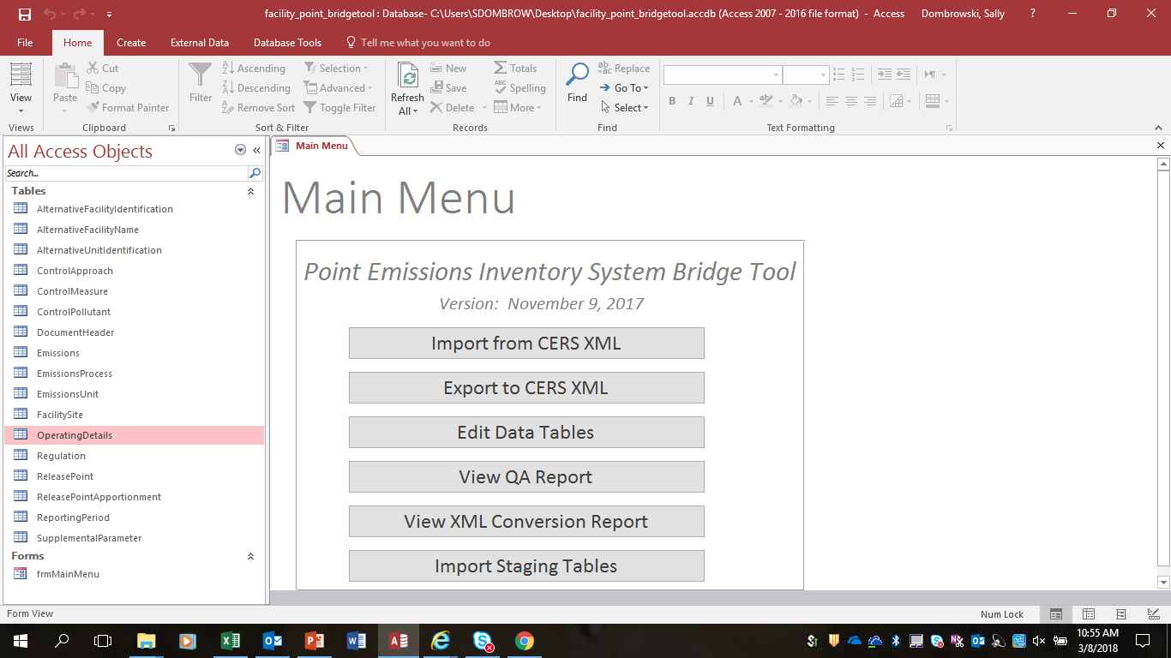
Notes:
Once your staging tables are complete, it is time to convert your files into a viable XML format for submission to EIS. Select Export to CERs XML.

Slide 57
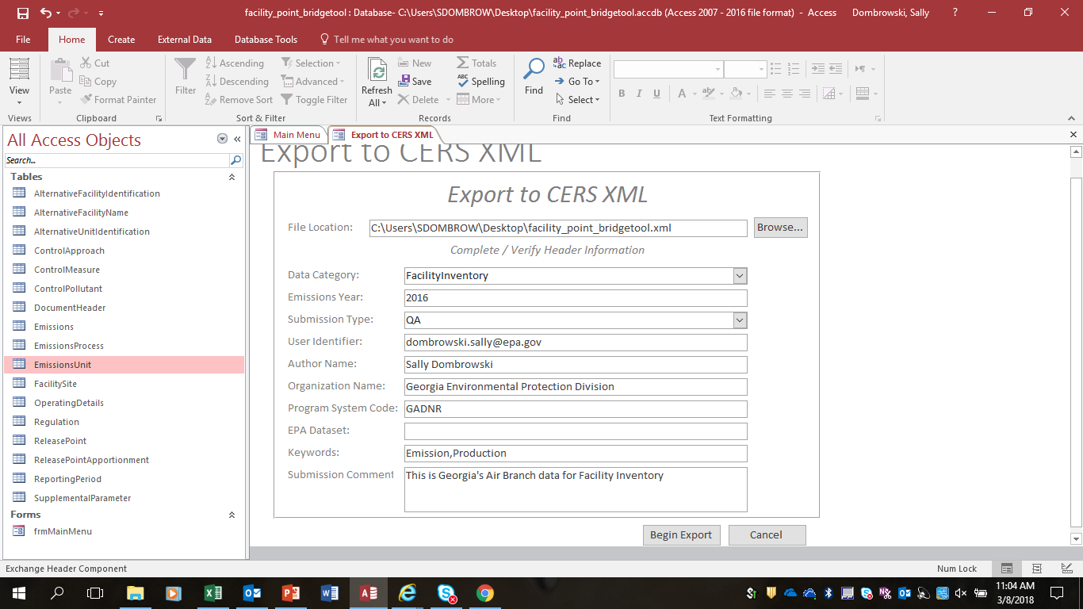
Notes:
The File Location is where your XML file will be saved. This defaults to the directory that you have saved your Bridge Tool in. You can changed this if you would want to save it elsewhere.
Data Category – This is a drop down with a selection for Facility and Point.
Emission Year – The inventory year for the data being submitted
Submission Type – This is a drop down with a selection for QA and Production
User Identifier – Your login. Usually your email address
Author Name – Your name
Organization Name – Your agency
Program System Code – This is a code which has been established in EIS and represents you agency.
EPA Dataset – For EPA use only
Keywords – Optional
Submission Comments – Optional
Then select “Begin Export”.

Slide 58
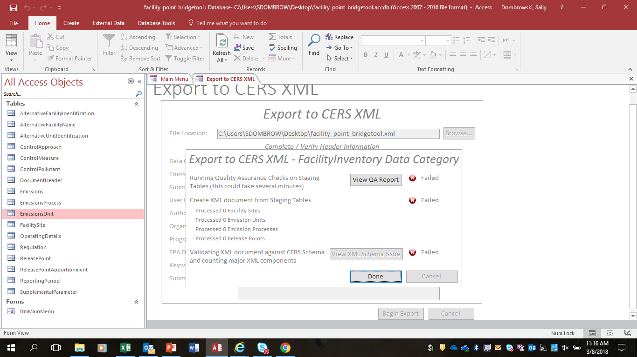
Notes:
While the export is being done, the Bridge Tool does some very basic QA for duplicates or referential integrity (a process record in the Emissions Process table but no corresponding Emissions Unit.)
If there is a problem, the Bridge Tool will produce a QA Report which identifies where the issues are that are preventing the file from completing the conversion.
Select View QA Report

Slide 59
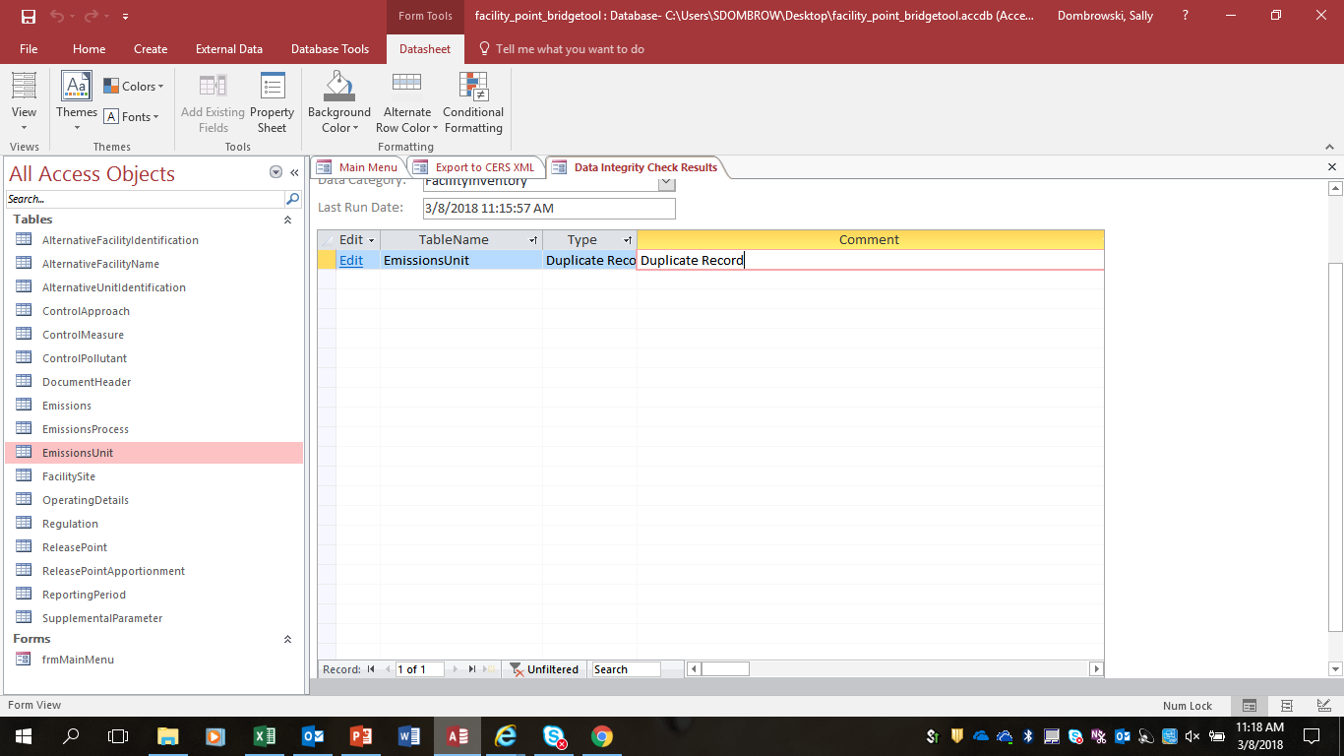
Notes:
This particular QA reports states that there is a duplicate record. Select the EDIT link.

Slide 60
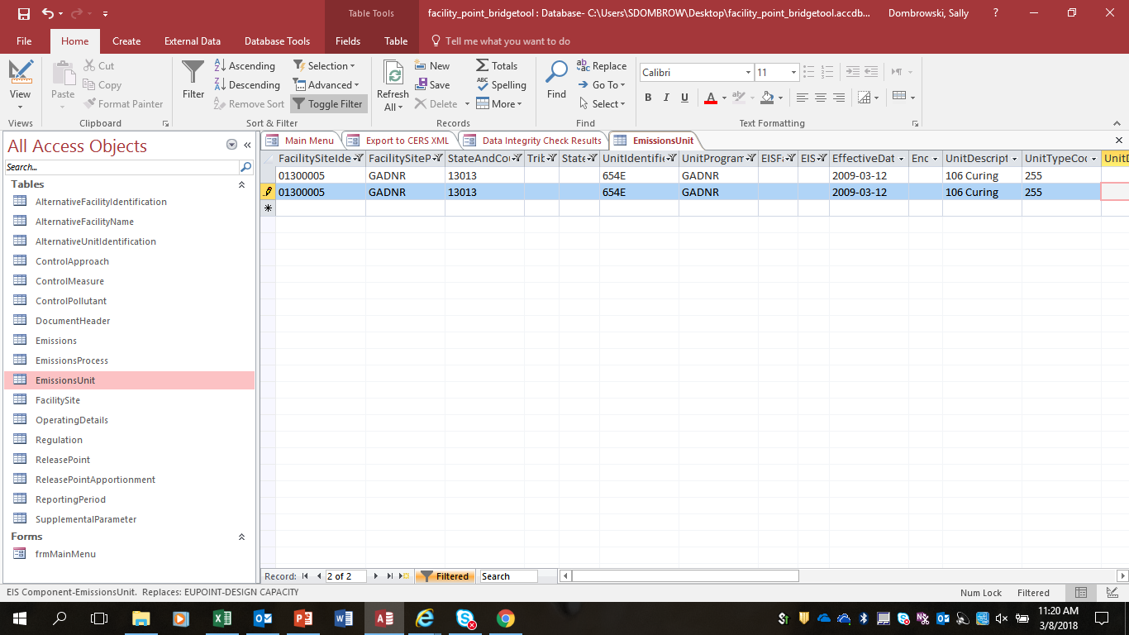
Notes:
The records which are duplicated are pulled up from the specific staging table which contains the error. You may correct the error from this table. In this particular case, you would simply delete the duplicate record and return to the main menu to Export your data again.

Slide 61
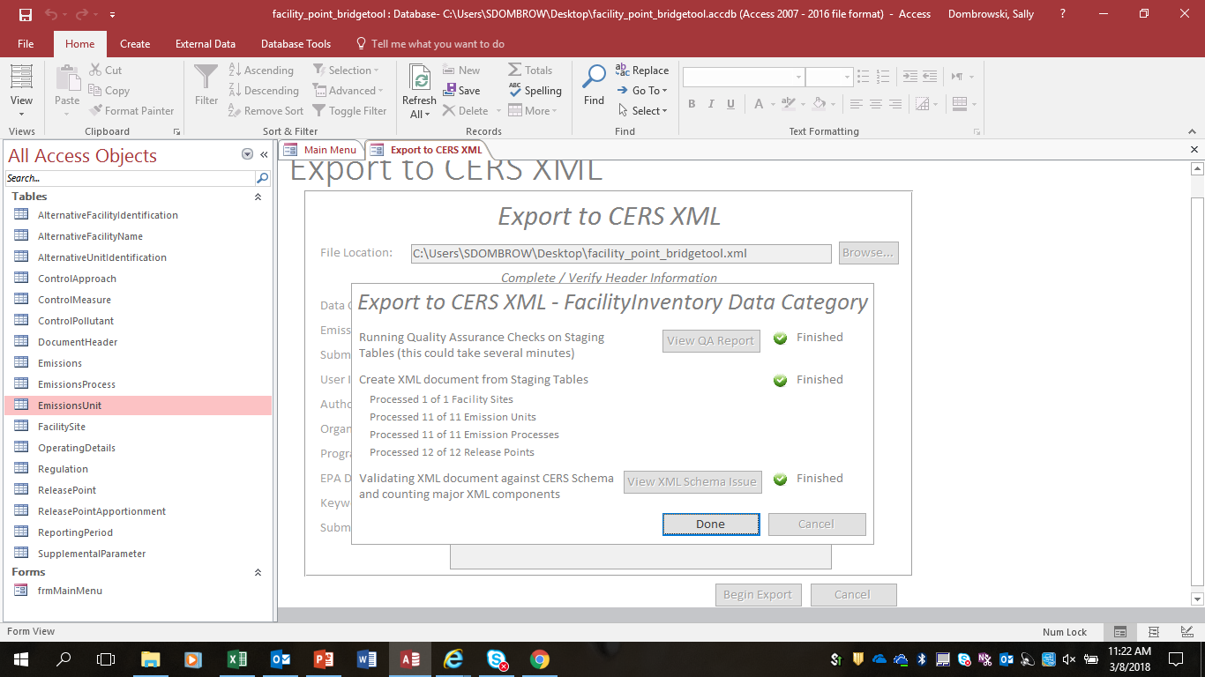
Notes:
When you have finally received all green lights as shown here, find your XML file in your directory and ZIP the file.

Slide 62


Slide 63
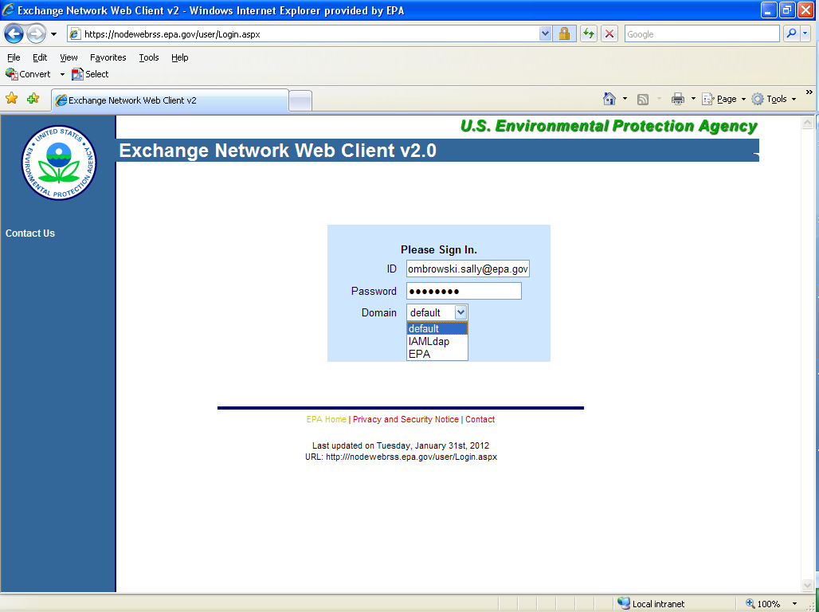
Notes:
You have to log into the Exchange network to submit your XML to EIS.
The URL for the web client is https://nodewebrss.epa.gov/user/Login.aspx
Enter your EIS account ID (the email address you registered in EIS) and password
Select Domain = IAMLdap (unless you are using a USEPA email address as your EIS account ID)

Slide 64
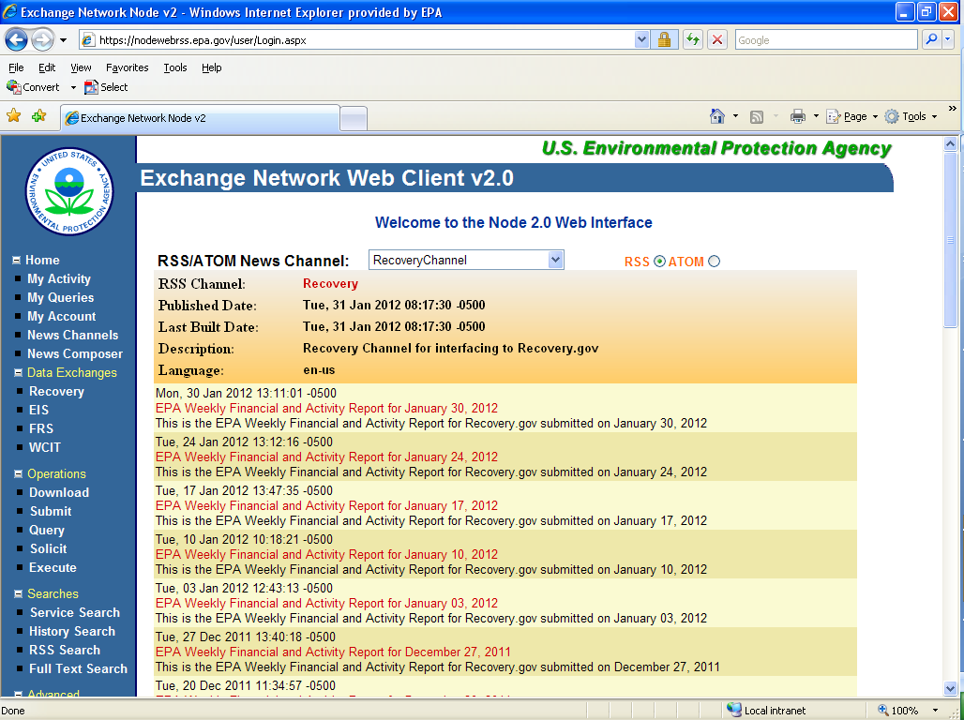
Select EIS from the left-hand side bar
Notes:
Select the “EIS” Data Exchange from the left hand navigation menu.

Slide 65
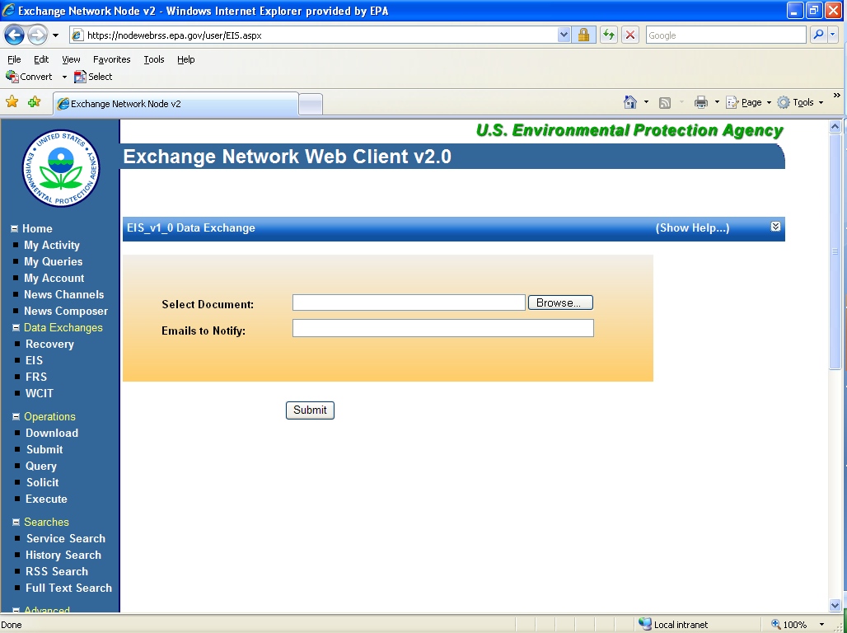
Browse for your ZIPPED XML submission file.
Add any emails besides the one given in the CERS table.
Then select “Submit”.
Notes:
Browse for your zipped XML file and click on “Submit”. Remember that you had to zip the xml file generated from the bridge tool.
Notifications go to the registered EIS user specified in the CERS table. Add any additional users you want to see the notifications.
Click Submit.

Slide 66
Email Notifications
First email, from “CDXNotification”, immediate
  – Transaction Status: Pending
Second email, also from “CDXNotification” , when EIS completes processing
  Transaction Status: Completed. Feedback report is available at EIS Gateway
Third email, from “noreply” (EIS Gateway) , on quarter hours
  Status : Completed or Failed
    Wrong file submission error – Usually a zipped Access file is submitted instead of the xml file
    Window closed error – “User, agency, submission year not authorized”
    Completed might be for an XML file containing no data
Go to EIS Gateway and read the Feedback Report and resolve any critical errors and Potential Duplicates
DO NOT SUBMIT A POINT EMISSIONS FILE IMMEDIATELY FOLLOWING A FACILITY SUBMISSION
Notes:
You will receive three notifications from CDX with regard to your submission.
- First notification - upon submittal to Node Client, you get an email within one minute from "CDXNotification", Subject = "CDX Data Submission Receipt", stating that CDX node has received a file from you, and that its status is "Pending".
- Second notification - also comes from "CDXNotification", Subject = "Transaction Status Notification", stating that your file has been processed and that a feedback report is available in the EIS Gateway. This notification will be sent as soon as the EIS has finished processing the file and has created and stored the feedback report in the EIS Gateway. This CDX-generated notification does NOT indicate if your file been processed successfully or if it has failed at EIS, only that EIS has completed reading it.
Third notification - this notification comes from "noreply", Subject="EIS Facility Inventory submission notification", also stating that your file has been processed and that a feedback report is available in the Gateway. This third notification comes from the EIS Gateway itself, and will not be sent until the next quarter hour after the file has completed processing. In addition to telling you the same "processing completed" message as the second CDX notification, this third notification (from EIS) also includes a STATUS line, which will say either COMPLETED or FAILED . This third notification will be sent to the submitter of the file, regardless of what is set as notification preferences in your EIS account. However, if you have selected notification preferences for your account in the EIS Gateway, you will also get this EIS-generated notification when anyone else in your Agency has a file which has completed processing. You would not have seen either of the first two notifications (from CDX) when someone else in your Agency has submitted or completed processing of a file.
It is important that you do not submit your point emissions file immediately following a facility submission. There may be changes needed in your facility submission to allow your point emissions to process completely. POTENTIAL DUPLICATES and CRITICAL errors in Facility feedback should be checked and resolved before submitting point emissions. Unresolved POTENTIAL DUPLICATES and any new process IDs that did not get created due to some critical error will give you critical errors on your point emission.

Slide 67
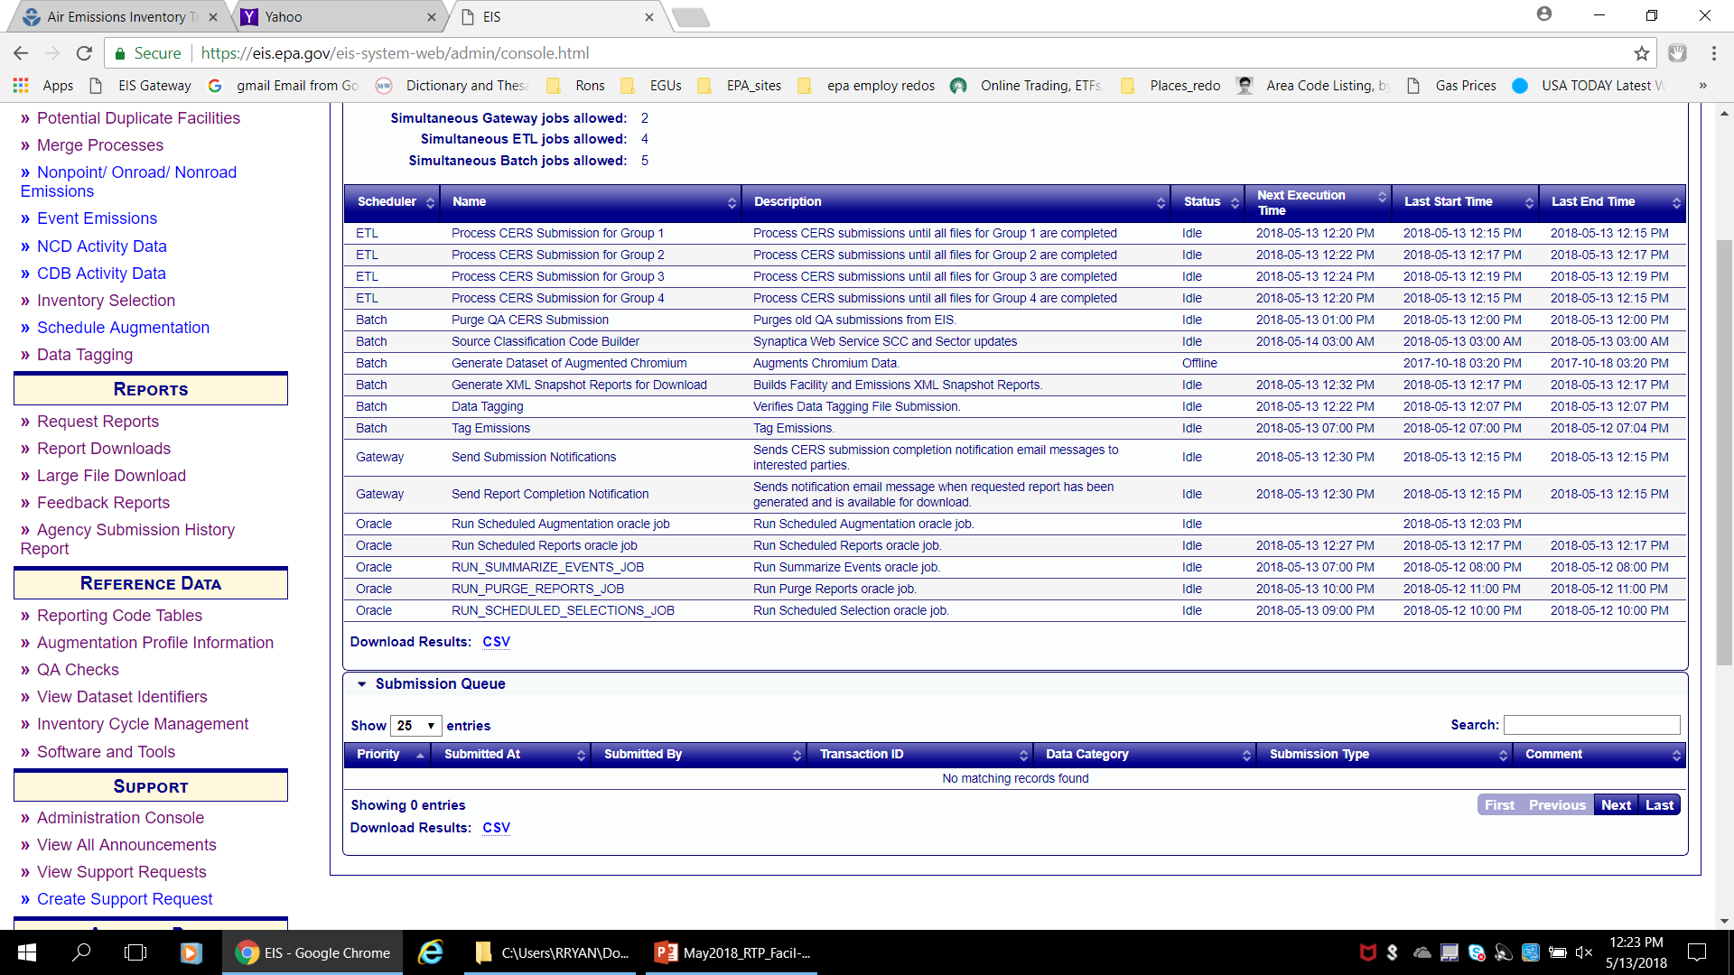
The Queue – Where is my submission?
Notes:
Under Support is the Administration Console. The console will display ALL submissions from any SLT that are currently in the queue and waiting to be processed through EIS. This comes in very handy when we get towards the end of a submission period and you wonder why your file is taking so long to process.
EIS now has multiple processing queues.

Slide 68
The Submittal Feedback Report
  compare the add and update counts in Statistics tab versus your staging tables
    Be wary of too many adds – you are mostly updating existing EIS facilities
  All critical errors (except protected lat-lon) should be addressed prior to your Production submission
    Except Error 1989 : release point ID in apportionment must exist
  Check and resolve the potential duplicates
  Review the warning messages too
Notes:
The first worksheet is the Summary page. This page gives you the submitters id, submission date and time; the status of the submission; a CDX tracking ID; data category; total system, critical and warning errors; total number of possible duplicates, program system code, and all of the facility IDs with the total number of errors per facility. The last column is called possible duplicates. If you receive a number other than “0” under Total Duplicates, this column will tell you the EIS facility identifier of the facility EIS believes is being duplicated. If you receive a possible duplicate, you need to go to the Gateway and look at the Potential Duplicate Facilities section under View/Add/Edit. This section will show you the full detail of the two (or more) facilities which may be duplicated. After your review, you may edit the incoming addition, delete the addition or request that the facility be added “as is”.
Critical errors must be addressed prior to sending your file to Production. The worksheet provides you with the FIPS code, Program System Code, agency identifiers, Reporting Period type; pollutant code, error identifier, type of error, error message, resolution message and information about the possible location of the error.
The easiest way of approach these errors is to sort on the critical error identifier. This will group all like errors into one section. Code and Present (required) errors are very obvious; you need a correct code or a required field is missing. Less obvious are cardinality errors. Cardinality errors are errors which identify missing links in the record. For instance, Error 1132, “A Process must be apportioned to at least one Release Point.” states that you are trying to add a new process which has not been apportioned to a release point. Another type of error is conditional. Conditional errors show where due to the data that you are submitting, other data elements are affected in an incorrect manner. For instance, Error 1031, “Emissions Unit status may not be changed if the Facility is Temporarily Shutdown (TS) or Permanently Shutdown (PS).” In other words, you can not change the status of an emission unit if the facility is already marked as TS or PS. You must first change the facility status to OP, then change the emission unit status; and then change the facility status back to TS or PS. It is assumed by the system that if a facility is TS or PS, then all units/processes and release points are also TS or PS.
Protected errors are caused by new data being submitted for a data field which EPA has locked. These will normally be seen with regard to facility or release point lat/lons. The worksheet gives you the FIPS, agency identifiers, error number, error type, error and resolution messages, and the location of the error.
Facility configuration report can show you the lat-lon and whether or not protected, for comparison to your system’s values.
Error 1989 exception: EIS is checking against release points already saved in EIS. If you are creating the release point ID in the same XML as apportionment, this error should disappear in Production feedback

Slide 69
Feedback Report
Statistics
Notes:
The statistics page tells you how many records in each of the components were added or updated. These numbers should correspond with the number of records in your file.
Note the unusual number of added vs updated release points in this summary compared to the one just linked to, even though not a lot of new sites or units were added. Suggests strongly that EIS is not recognizing the IDs you are using for the release points.

Slide 70
Protected Lat-Lon Coordinates
Have been verified using Google Earth for accuracy
Mostly from S/L/T responses to EPA review package in Summer 2011. Some due to later identified discrepancies
Cannot be overwritten or edited until unprotected by EPA
Does NOT prevent other data edits to the site or release point
Errors 1230 and 1231 “… geographic coordinates are protected, the data will not be stored…”
  Appear as a separate worksheet in the feedback report
  Use config reports or Gateway main site list to get coords
Notes:
Once a site lat/lon is confirmed to be accurate, the site geographic coordinate will be protected, or locked. This will prevent any accidental overwrites of these coordinates in the future. Contact EPA if you wish to have some of your coordinates protected, or if you find protected coordinates that you believe are not accurate. You do not have a mechanism to set or unset the protections, but we will be happy to help.
Critical Errors # 1230 and 1231 may be ignored unless you believe the EIS stored and protected lat/lon is not accurate. All other data for that record will be processed and stored if otherwise valid.
As part of summer 2011 revisions, EPA also removed some (not all) of the individual release point coordinates where they were equal to the site level coordinates. When we remove the release point coordinates, the “use site coordinates” flag that you see in the EIS Gateway is set. For these situations, the release point coordinates also inherit the protection status of the site coordinates. You do have the ability to set the “use site coordinates” flag in the EIS gateway, on individual release points. Please contact EPA if you are interested in setting a large batch to use site coordinates, since there is no mechanism for you to set those via a batch XML submittal.
Individual release point coordinates may also be protected.

Slide 71
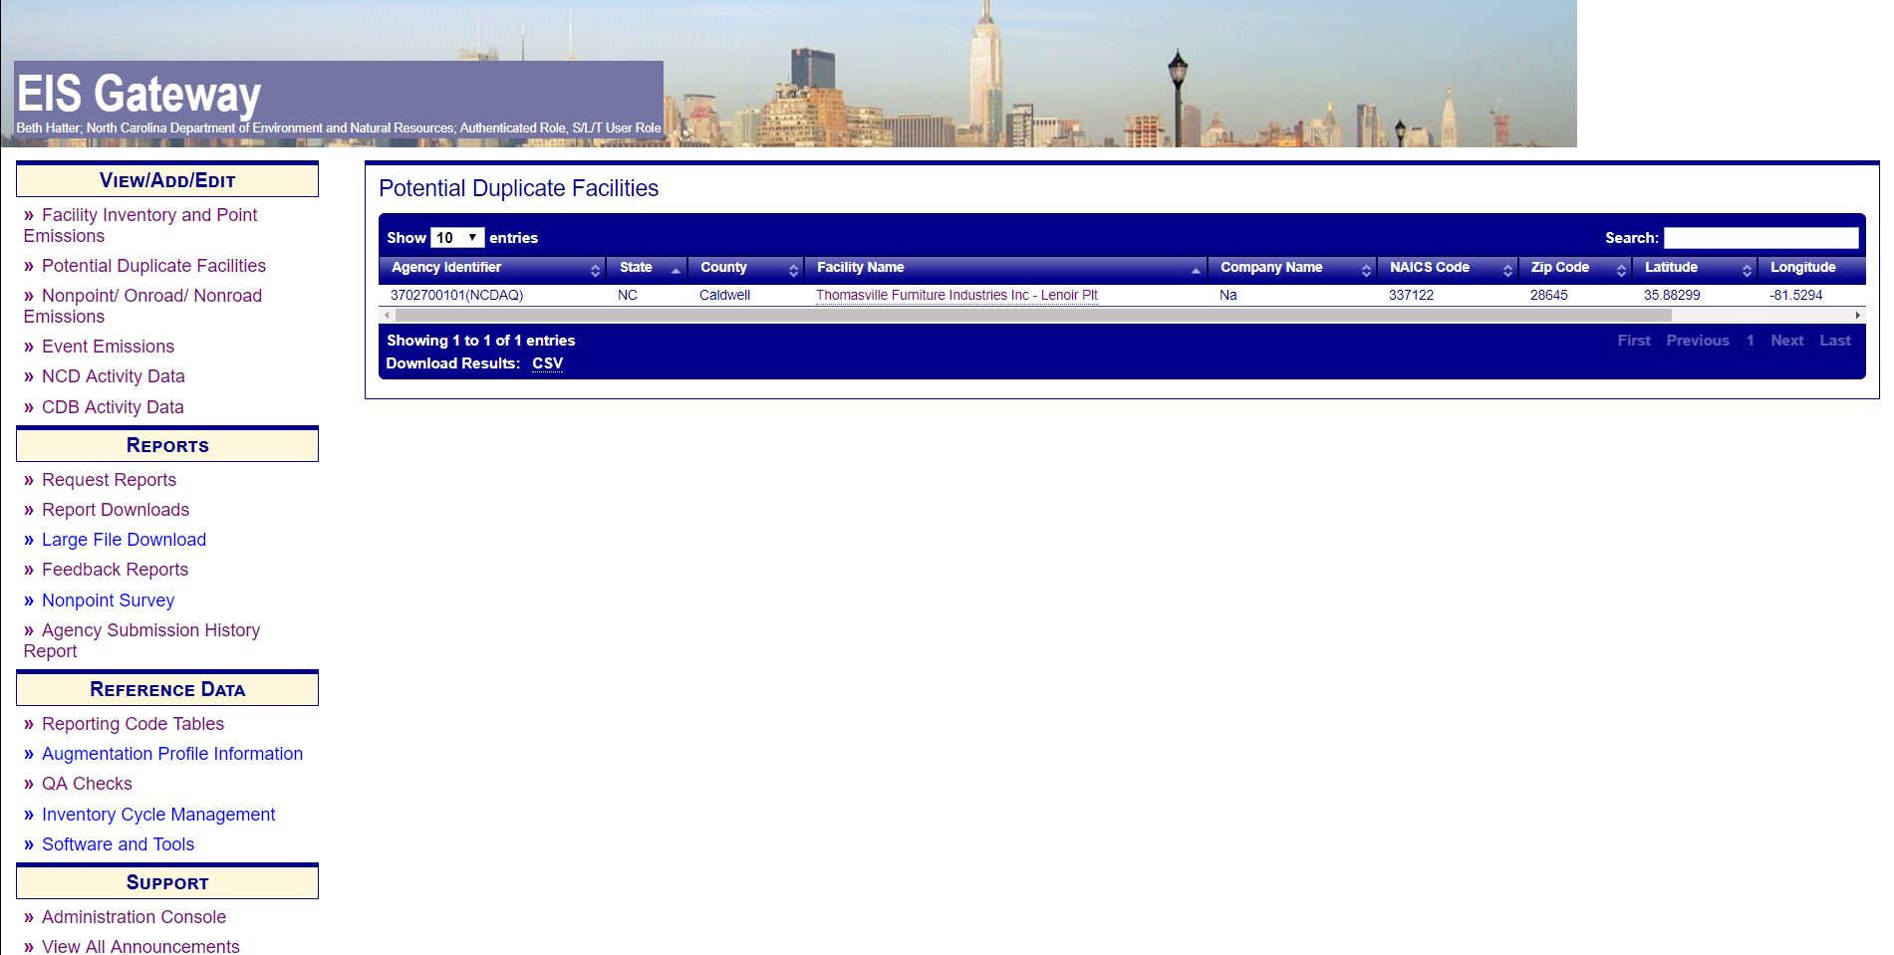
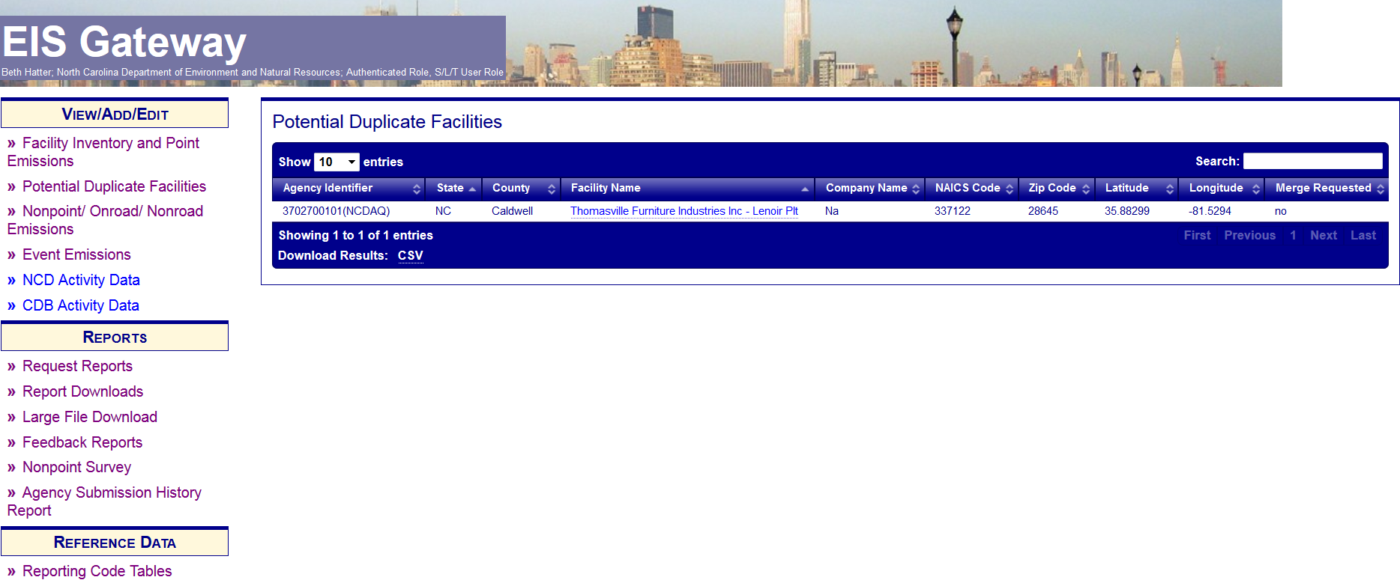
Notes:
Potential duplicate facilities are facilities that are being submitted with a different facility identifier but resembles a facility already existing in EIS. The algorithm looks at Facility Name, address, NAICs, and lat/lon. Each field is weighted differently. If a facility exceeds a set limit, the record is flagged. The record is not accepted into EIS until the issue is resolved.

Slide 72
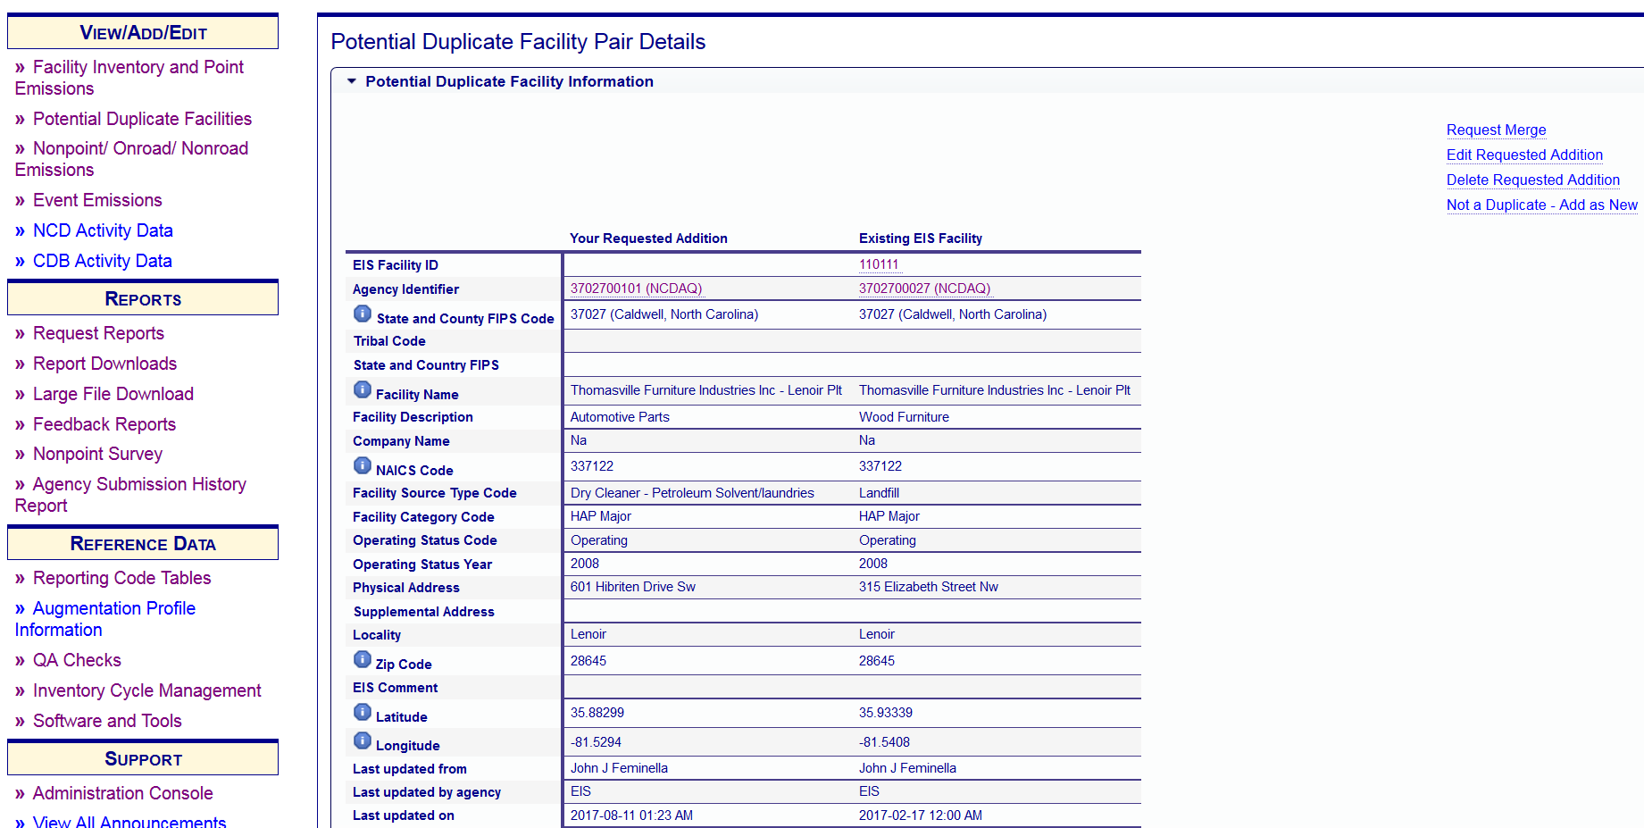
Notes:
This page will display the Potential Duplicate Facility pairs and allow you to request to merge the facility information with an already existing EIS facility; edit the submit facility, delete the submit facility, or tell us to that the submitted facility is really a new facility and should be added to EIS.

Slide 73
When will my data show up in EIS?
Immediately
  Facility Inventory data will show in the Gateway view screens and in the Facility Configuration Reports immediately
  Individual Emissions values at the process level will show in the Gateway screens and reports immediately
  Any Emissions Sums (Facility, Unit, RelPt sums on Gateway or Reports) immediately
  XML Snapshots – updated facility or point snapshots can be requested as reports immediately

Slide 74
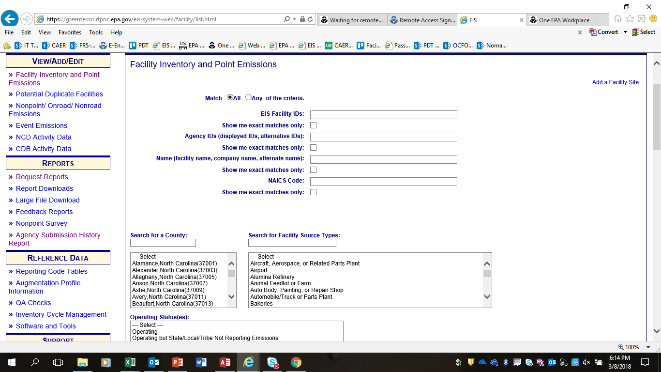
Correcting Data in EIS
Notes:
To correct Facility data within EIS select Facility Inventory and Point Emissions under the View/Add/Edit section on the left hand sidebar. From this point you can search for the facility by various filters such as Agency ID or Facility Name. Additional filters such as county, facility type or operating status can further reduce the number of records returned.

Slide 75
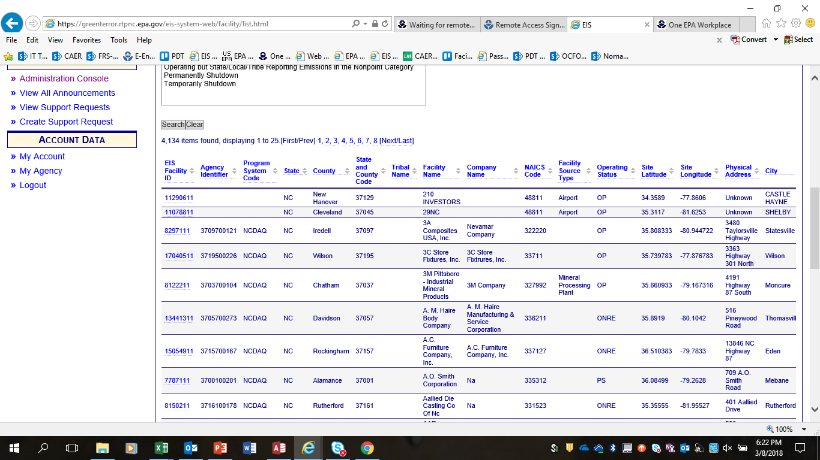
Notes:
Also at the bottom of the page is a list of the facilities in your jurisdiction. You can sort by the column headings as well. Select the link on a particular facility to get to the details.

Slide 76
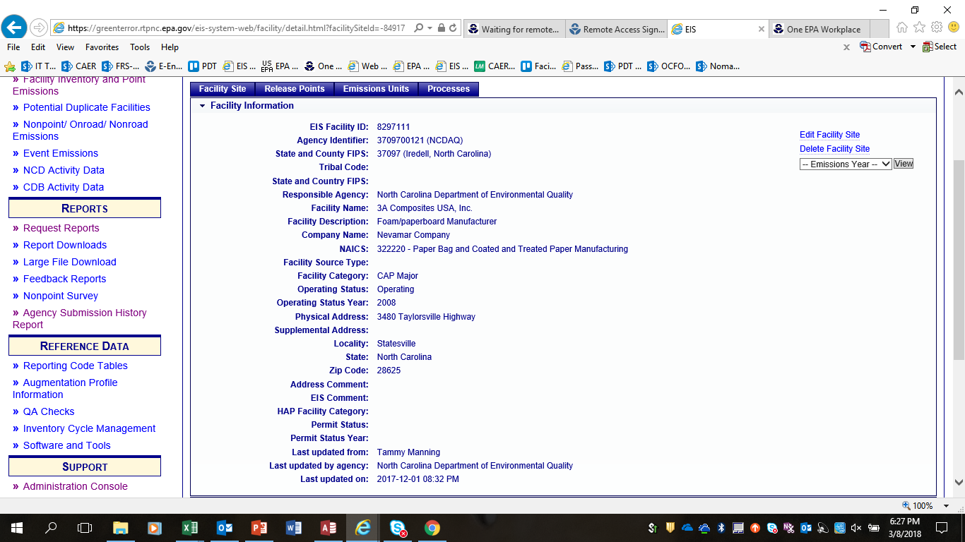
Notes:
At the top our tabs for each component of the facility configuration. For this example we will demonstrate how to change the status on the facility from operating to permanently shutdown.
First select Edit Facility Site.

Slide 77
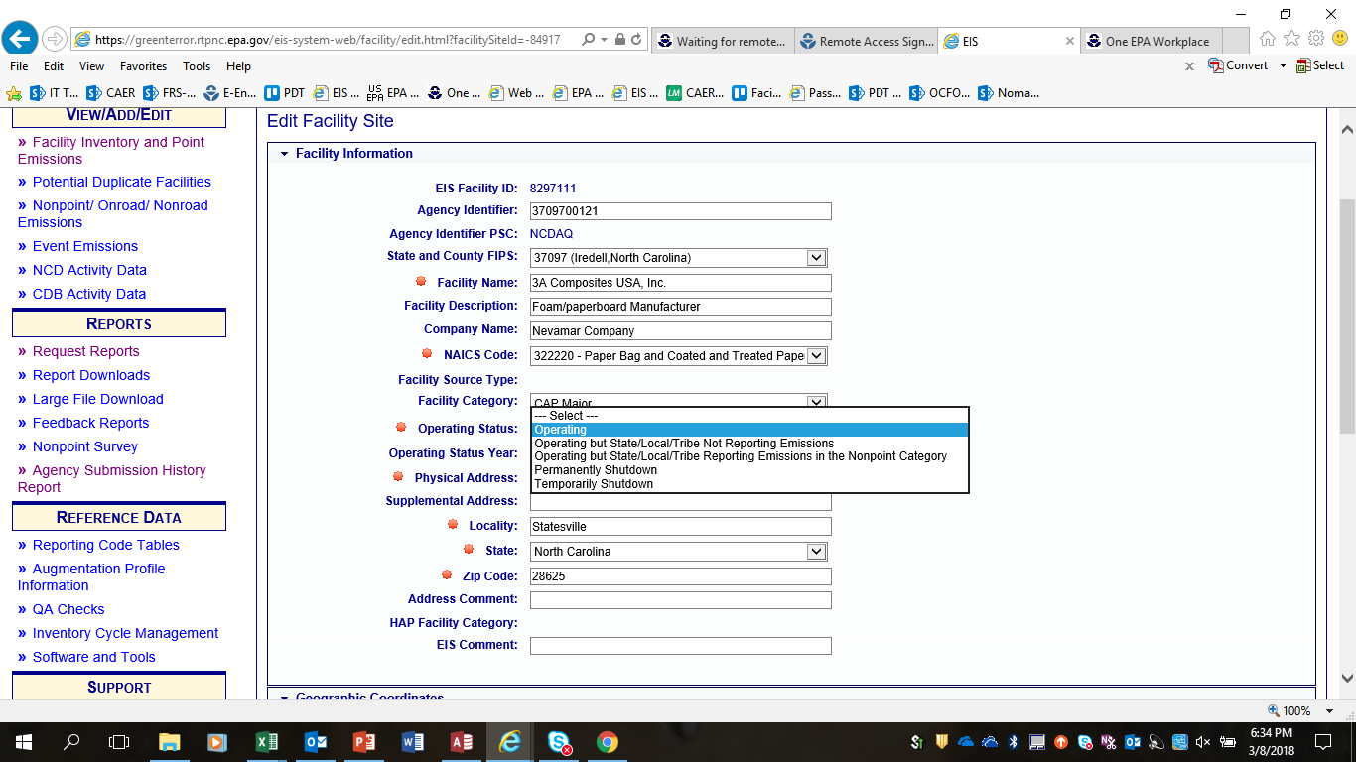
Notes:
The red sunbursts indicate fields which are required to be populated. To change the operating status select the drop down menu and change the status to permanently shutdown.
Then select Save at the bottom of the page.
This process is the same for each facility level.
There are some data fields which you will not be able to edit because they are owned by EPA. In this screenshot one of those fields is Facility Source Type.

Slide 78


Slide 79
What is the Point Inventory?
Emissions estimates for the facility inventory
  By pollutant
  By process
  By inventory year/reporting period (e.g., 2017 / annual)
In addition to emissions, point data may include
  Throughput (by process and inventory/year reporting period)
  Operating details
  Supplemental parameters
Notes:
The NEI Point data category contains emissions estimates for processes at facilities and other information related to emissions that is not static but rather is specific to an inventory year
Emissions are reported for each pollutant, by process and for a specific inventory year and reporting period, for example 2011, annual
The point inventory may also include other emissions-related data that depend on inventory year. These are: throughput which depends on the inventory year and reporting period, operating details like as hours per day, and seasonal percentages and supplemental parameters such as ash or sulfur content

Slide 80
Important Concepts (1)
Update your Facility inventory prior to submitting Point emissions
  Emissions may only be reported for an existing process
  Existing process cannot have a LastEmissionsYear less than the inventory year
  SCC code for process must still be valid and active
  Emission Unit and Facility must be OPerating for the inventory year (can’t be PS or TS Status with Status Year = inventory year)
Notes:
Before we get into the mechanics of reporting emissions I want to go over some important concepts – many of which stem from lessons learned during development of previous NEI.
First, it is very important that you complete the submission of any changes to your facility inventory prior to submitting your point submission.
Second, Emissions may only be reported for an existing process. Therefore you want to make sure that the processes you are submitting emissions to are already in EIS. If it is a new process you will need to submit it EIS as a Facility Inventory submission or add it to your facility through a gateway edit. If you are adding a process via a submittal, you should not submit a point file immediately after a Facility Inventory file, in case there are any critical errors or Potential Duplicate facilities in their facility inventory submittal. These will have to be resolved before emissions will have a place to be added.
Emissions cannot be reported for an existing process that has a process end year prior to the year you are submitting data for. EG you cannot submit 2011 emissions to a process that has a process end year of 2010.
If the unit is permanently shut down and the operating status year is equal to or prior to the year you are submitting emissions for, then you cannot submit emissions to it. For example if the operating status year is 2011 and the unit marked “PS” then you cannot submit 2011 emissions to it.
Also Do not add a process unless it is indeed new process. A problem we had with the 2008 NEI is that new processes were added not because they were new but because of id changes. The facility inventory webinar shows how to change Agency ids without adding a new unit or process.
All pollutants, CAPs and HAPs, must be reported together. Each submittal overwrites the last. In other words if your first submission had only CAPs and you decided later that you wanted to add HAPs, your second submission must include the previously submitted CAPs and the new HAPs. Just submitting the HAPs will overwrite your previous CAP submission.

Slide 81
Important Concepts (2)
Can use LB, TON or metric to submit emissions
  EIS reports show HAPs in LB and CAPs in TON
Report controlled emissions, not uncontrolled –even if you don’t report controls or %s
All pollutants for a given process must be reported together
  Each submittal overwrites the last for a given process
  You can submit different facilities or different processes at a facility in separate submittals
Notes:
Your emissions will not be adjusted or changed by EPA. If we see any outlier or problem, we will contact you to change your data. If the data is not changed, it may not be selected in the creation of the NEI. For example, for the 2008 NEI EPA developed a dataset called overwrite which was selected ahead of SLT data. The SLT data still resides in the EIS but the EPA overwrite dataset value was used ahead of the SLT data for the NEI.
EIS can support emissions values from multiple sources. This allows you to not only see your submitted value, but also the TRI, PM Aug, or other values EPA may have submitted for the process.
You may report in units of measure listed in the code table – which includes lbs, tons and several metric units. EIS will convert the values to tons and pounds for reporting purposes. EIS will always display the unit of measure “as reported” under the individual process on the Gateway. Modeling files (the ones that are fed to SMOKE for use in eventual AQ modeling) use only tons.
You should report emissions after controls – i.e., controlled emissions. The NEI intends to reflect ACTUAL emissions for a specific year, so your emissions should account for the impact of any controls on the unit or process. Since you are required to report controls if they exist, we can always use the information on the controls to generate uncontrolled emissions if we need them.

Slide 82
Important Concepts (3)
Report Process-level, not facility level
If you report any pollutants at the facility-level, emissions could cause potential double counting and other problems –
Notes:
Emissions are reported at the process, not facility level. Process level emissions should be integrated across CAPS and HAPs. While there is no current QA check in EIS for this, your VOC HAPs should sum to less than or equal to your VOC. That is because VOC can consist of both VOC HAPs (e.g., benzene, toluene, methanol, 1,3 butadiene, etc.) AND VOC that are not HAPs (e.g., pentane, ethanol, butanol, methyl ethyl ketone—this is no longer a HAP, etc). It is not possible to have more benzene than VOC at a process, though we saw this when doing outlier checks of HAPs. Generally, your PM HAPs should be less than or equal to your PM-10. While there are many semivolatile HAPs for which this check would be difficult to do, you can look at particular metal HAPs (such as chromium) and compare emissions to PM-10.
Facility level emissions could cause double counting. For example if EPA generates a dataset with process level emissions and there are facility level emissions at a facility-level process at the facility, then the EPA process level will be summed with the SLT facility-level causing a double count.

Slide 83
Point Emissions Tables – Bridge Tool
Document Header - Required
  DataFlowName – EIS_v1_0
  Property-SubmissionType - either QA or Production
  Property-DataCategory - Point
  UserIdentifier – your EIS registered acct ID (email)
  ProgramSystemCode – your Agency’s PSC
  EmissionsYear - 2017
Emissions - Required
Reporting Period - Optional
Operating Details - Optional
Supplemental Parameters - Optional
Notes:
you must fill in the user identifier fields and it must be a registered EIS account ID (email) and that user ID must reflect a user with CDX submittal privileges ---i.e., write access to EIS.
Also you much include the program system code that identifies your agency and the 4-digit emissions year.
Optional-your name, organization, a document title, keywords and comments –these are free flow text fields that don’t need to conform to particular values or format. Other fields in this table must be specified by particular names.

Slide 84
Emissions Table
Emissions – Required
  Site, Unit, and Process Identifiers
    EIS or your Agency’s IDs (w/PSC)
    State/County FIPS or Tribal Code if your Agency’s IDs
  Pollutant Code
  Total Emissions and UOM
  Reporting Period Type Code - “A” (annual) at minimum
  Emissions Operating Type Code - “R” (routine) at minimum
  Emission Calculation Method Code
Optional - but desired
  Emission Factor, EF Numerator and Denominator, Factor Text
  Emissions Comment
Notes:
all of your identifiers and state and county FIPS are included in the Emissions table, in addition to the Reporting Period Type Code and the Emissions Operating Code.
In addition to the above, you also need the Pollutant Code; Total Emissions and Unit of Measure; and the Emissions Calculation Method Code.
The Pollutant Code must be a valid code. Codes can be found on the EIS Gateway under Reference Data. Make sure that you filter on Active codes. If you receive an error message when submitting your data that the pollutant code is invalid, filter the pollutant code list on All. This will allow you to find your code and what this code as been mapped to. Whenever we retire a code; we try to give you a map to.
If you are reporting “0” as your emissions total, it must represent zero emissions. DO NOT report “0” as a placeholder.
The emissions calculation method code tells us how you calculated your emissions. The are codes for everything from use of CEM data to engineering judgment. Again these codes can be found on the EIS Gateway. Please fill this in as accurately as possible as we need it to learn more about the data you have reported.
The emission factor is an optional data field that we greatly desire to better understand the emissions being reported and being able to compare against alternative values. Since we are going to provide additional Efs it would be very useful to know if you used them, so if you do, please include them in the Emisison Factor field. Ideally you would report both the factor and the throughput.

Slide 85
Reporting Period Table
Required fields, IF you report this table
  Site, Unit, and Process Identifiers
    EIS or your Agency’s IDs (w/PSC)
    State/County FIPS or Tribal Code if your Agency’s IDs
  Reporting Period Type Code - “A” (annual) at minimum
  Emissions Operating Type Code - “R” (routine) at minimum
Optional additional fields
  Start Date / End Date for episodic reporting only
  Activity (e.g., throughput ) fields– if you provide, must have these all 4 together (1) Calculation parameter value, (2) Calculation Material Code, (3)Calculation Parameter Type Code, (4) Calculation UOM
  Optional Activity fields -- Data Year, Data Source
  Reporting Period Comment
Notes:
The Reporting period table contains your identifiers and the State and County FIPS with the additional of the Reporting Period Type Code and the Emissions Operating Type Code.
The Reporting Period Type Code tells us if the emissions being reported are Annual, Episodic, 5 month ozone, etc.
The second required code is the Emissions Operating Type Code. This code indicates whether the emissions being reported are routine, upset, start-up, or shutdown. At a minimum you must report Annual/Routine emissions.
The only time that you will use the Start Date/ End Date is when your emissions are for an episodic reporting period. Start Date / End Date is not to indicate the inventory period such as 1/1/xxxx to 12/31/xxxx.
Currently activity or throughputdata is not required in the point inventory. If this data is available and is not confidential business data, we want it. Never send CBI data to EPA. All data that we receive is available to the public.
If you provide activity data you must provide the 4 fields listed in the slide together. You can also provide either data year of the throughput and data source of the throughput.
A good QA check is you should have the same number of records in your Emissions Process table as you have in your Reporting Period table.

Slide 86
Operating Details Table
Required fields, IF you report this table
  Site, Unit, and Process Identifiers
    EIS or your Agency’s IDs (w/PSC)
    State/County FIPS or Tribal Code if your Agency’s IDs
  Reporting Period Type Code - “A” (annual) at minimum
  Emissions Operating Type Code - “R” (routine) at minimum
Optional additional fields
  Actual Hours Per Period, Average Days Per Week, Average Weeks Per Period
  Seasonal Throughputs – Must equal 100
Notes:
Operating Details is an optional table. It is important to note that on the Seasonal Throughput you must enter a value for all seasonal data fields (Fall, Winter, Spring and Summer), and those data fields must sum to 100.

Slide 87
Supplemental Parameters Table
Required fields, IF you report this table
  Site, Unit, and Process Identifiers
    EIS or your Agency’s IDs (w/PSC)
    State/County FIPS or Tribal Code if your Agency’s IDs
  Reporting Period Type Code - “A” (annual) at minimum
  Emissions Operating Type Code - R for routine
Optional additional fields
  Supplemental Calculation Parameter Type
    Heat Content, Percent Sulfur Content, or Percent Ash Content only
  Supplemental Calculation Parameter Value
  Supplemental Calculation Parameter Numerator and Denominator
    Heat Content must be BTU or E6BTU
  Supplemental Calculation Parameter Data year
  Supplemental Calculation Parameter Data Source
  Supplemental Calculation Parameter Comment
Notes:
Supplemental Parameters is also an optional table. The important item to remember when using the Supplemental Parameter table is that there is no CODE for the Supplemental Calculation Parameter Type. This value must be typed in as listed above. Also, when reporting for heat content you may only use BTU or E6BTU.

Slide 89
The Feedback Report
Summary Tab
Look here first
Submitter ID | Submission Date | Submission Status | CDX Submission ID | Submitted to | Data Category | Total System Errors | Total Critical Errors | Total Protected Errors | Total Warnings | Total Duplicates | Program System Code | Facility Site ID | System Errors per Facility | Critical Errors per Facility | Protected Errors per Facility | Warnings per Facility
brandon.porter@dep.state.fl.us | 2012-01-31 01:14 PM | COMPLETED | _4755be18-6c14-454a-b37a-f29e4c834fce | QA | Point | 0 | 37 | 0 | 29 | 0
 |  |  |  |  |  |  |  |  |  |  | FLDEP | 0010129 | 0 | 2 | 0 | 0
 |  |  |  |  |  |  |  |  |  |  | FLDEP | 1050422 | 0 | 0 | 0 | 1
Notes:
The first worksheet is the Summary page. This page give you the submitters id, submission date and time; the status of the submission; a CDX tracking ID; data category; total system, critical and warning errors; total number of possible duplicates, program system code, and all of the facility IDs with the total number of errors per facility.

Slide 90
Feedback Report
Statistics Tab
Nothing was really added for a QA submittal, but it is for a Production submittal
Component | Added | Updated
ReportingPeriod | 1157 | 0
OperatingDetails | 1157 | 0
SupplementalCalculationParameter | 437 | 0
Emissions | 4077 | 0
Total | 6828 | 0
If all went well, this should match the number of records in your emissions table. If it is less, then you had critical errors. Don’t correct just those errors and resubmit because whenever you submit emissions for a process, if you don’t submit all pollutants they will get wiped out.
Notes:
The statistics page tells you how many records in each of the components were added or updated. These numbers should correspond with the number of records in your file.

Slide 91
Feedback Report-Critical Errors
FIPS/Tribal Code | Facility Site ID | Emissions Unit ID | Release Point ID | Process ID | processid | Reporting Period Type | Pollutant Code | Critical Error | Critical Error Type | Critical Error Message | Resolution Message | Associated Data Component | Associated Data Component ID | Associated Data Element
06011 | EIS-76611 | EIS-51948213 |  | EIS-59563014 | 59563014 | A |  | 1930 | Cardinality | When reporting emissions, a pollutant may not reported multiple times under a single reporting period. |  | Reporting Period
06011 | EIS-76611 | EIS-51948313 |  | EIS-59562914 | 59562914 | A |  | 1930 | Cardinality | When reporting emissions, a pollutant may not reported multiple times under a single reporting period. |  | Reporting Period
06011 | EIS-76611 | EIS-51948613 |  | EIS-59562614 | 59562614 | A |  | 1930 | Cardinality | When reporting emissions, a pollutant may not reported multiple times under a single reporting period. |  | Reporting Period
Notes:
Critical errors must be addressed prior to sending your file to Production. The worksheet provides you with the FIPS code, Program System Code, agency identifiers, Reporting Period type; pollutant code, error identifier, type of error, error message, resolution message and information about the possible location of the error.
The easiest way of approach these errors is to sort on the critical error identifier. This will group all like errors into one section. elements are affected in an incorrect manner.

Slide 92
Common Critical Errors
Error 1770 - Process ID does not exist.
  Might be occurring if you submit your Point right after your facility inventory and you did not resolve critical errors or the Potential Duplicate Facilities error
Error 2319 – Emissions Year must not be greater than Last Inventory Year
Error 486 - Emission calculation method code is required

Slide 93
Checking Your Data
Completeness: Are there facilities that are operating but do not have emissions?
Emissions Values: Run an emissions summary report to compare what is in the system with your data
Notes:
Even though you’ve checked your feedback report it only provides record counts, not emissions totals. Therefore you should also to check the data in the system via reports
Remember to wait overnight. There were times that the refresh didn’t occur so if the numbers don’t check at first that is a possible explanation (call us or send support request and we can verify)
One important check is a completeness check. You can get a list of facilities with a status of operating but you have not reported emissions for them -
Another check is to run an emissions summary report to compare what is in EIS against what is in your data

Slide 94
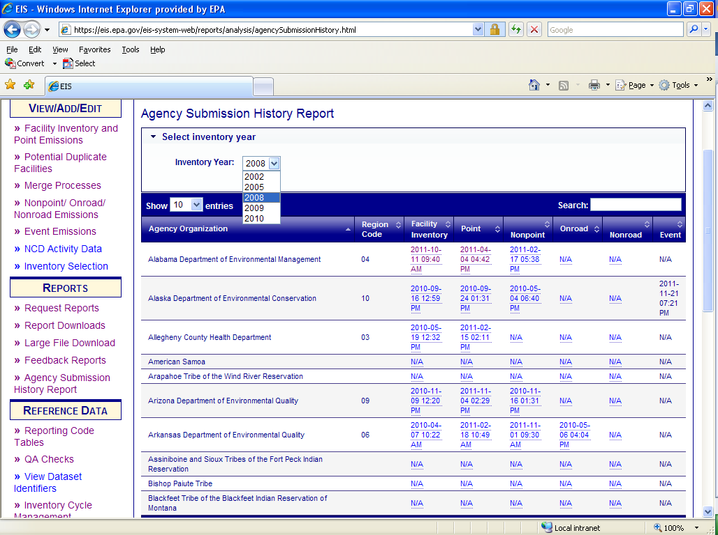
Agency Submission History Report
Select the inventory year of interest
Notes:
You can use the Agency submission history report to get a list of facilities for which you did and did not submit emissions
For you, this page will only have your agency submittals and any other agency for which you have READ rights.
The date and time of submittal is updated immediately. The date is the date of the last submittal of the data category
Manual Gateway edits in EIS will not be reflected in this report.
The data/times are links which will give more detail
Click on Agency submission history report, choose the inventory year and click on the date hyperlink under the Point report which provides the data of the last batch submittal for that year

Slide 95
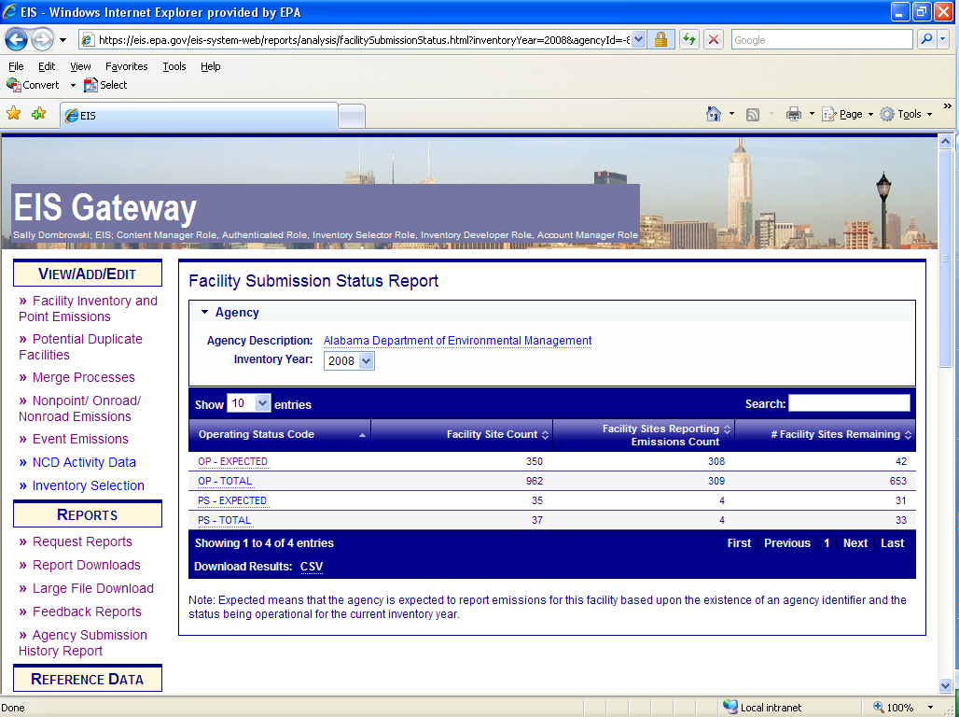
Agency Submission History Report
Notes:
You now see the count of facilities within each operating status code and the number of facilities with reported emissions
OP-Expected – Facilities in EIS in which there is any SLT identifier
OP-Total – All facilities in EIS for your agency plus those facilities which have EIS facilities identifiers only and belong to EPA.
PS – Expected – Facilities in EIS in which there is a SLT identifier and has a operating status of “Permanently Shutdown” or PS but the Status Code Year applies to a year later than the inventory reporting year.
PS – Total – All facilities in EIS for your agency plus those facilities which have EIS facilities identifiers only and belong to EPA. These facilities have an operating status of “Permanently Shutdown” or PS but the Status Code Year applies to a year later than the inventory reporting year.
click on OP-Expected to see if any facilities with an operating status of OP were missed

Slide 96
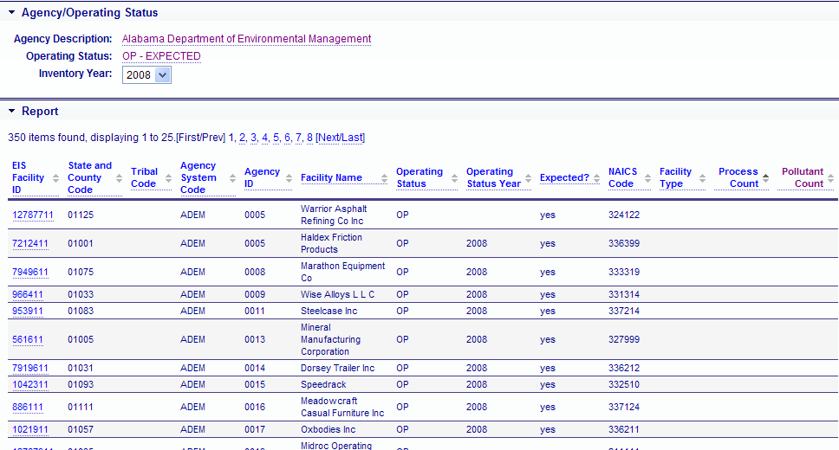
List of facilities for which emissions were expected but no emissions reported
Sort by Pollutant count
Notes:
Sort by pollutant count and the ones with null are brought to the top.
Where the pollutant count is null it means no emissions were reported.
These are expected since they have agency ids so it means either they are missing or the operating status may need to be changed

Slide 97
How do I edit an emissions value?
Edit emissions values by
  XML Batch (Staging Tables)
    Remember to include all pollutants previously reported, not just the pollutant to be changed
  Gateway
    Easiest and safest if you only have a few changes
Notes:
Editing previously submitted emissions may be done in one of two ways. The batch submission is basically a resubmission of your emissions but with the revised values. You would have to be extremely careful that you submitted all pollutants, including the one that was being edited. Remember that EIS does a complete replacement of pollutant/emissions for each process. In your batch submission you can include only the process that needs to be corrected – as long as you submit all pollutants for that process.
The second, and probably the easiest and safest if you only have a few corrections to make, is the Gateway. My rule of thumb is about 30 changes which will probably take an hour and a half – possibly the same time to develop a staging table, run the bridge to convert to xml and submit via CDX

Slide 98
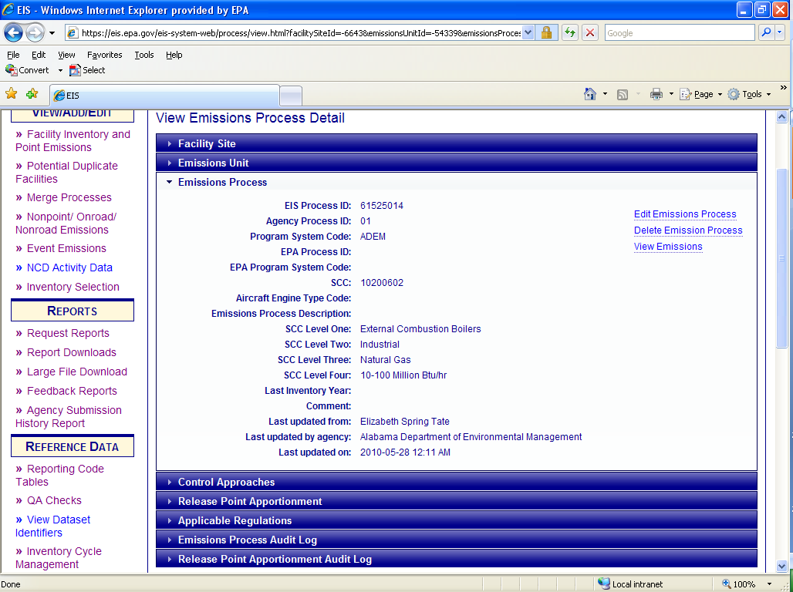
Editing Emissions on the Gateway (1)
Notes:
These next slides show the gateway editing method. Go to the Gateway and select the facility that you wish to edit emissions for. Next navigate down to the process and select view emissions.

Slide 99
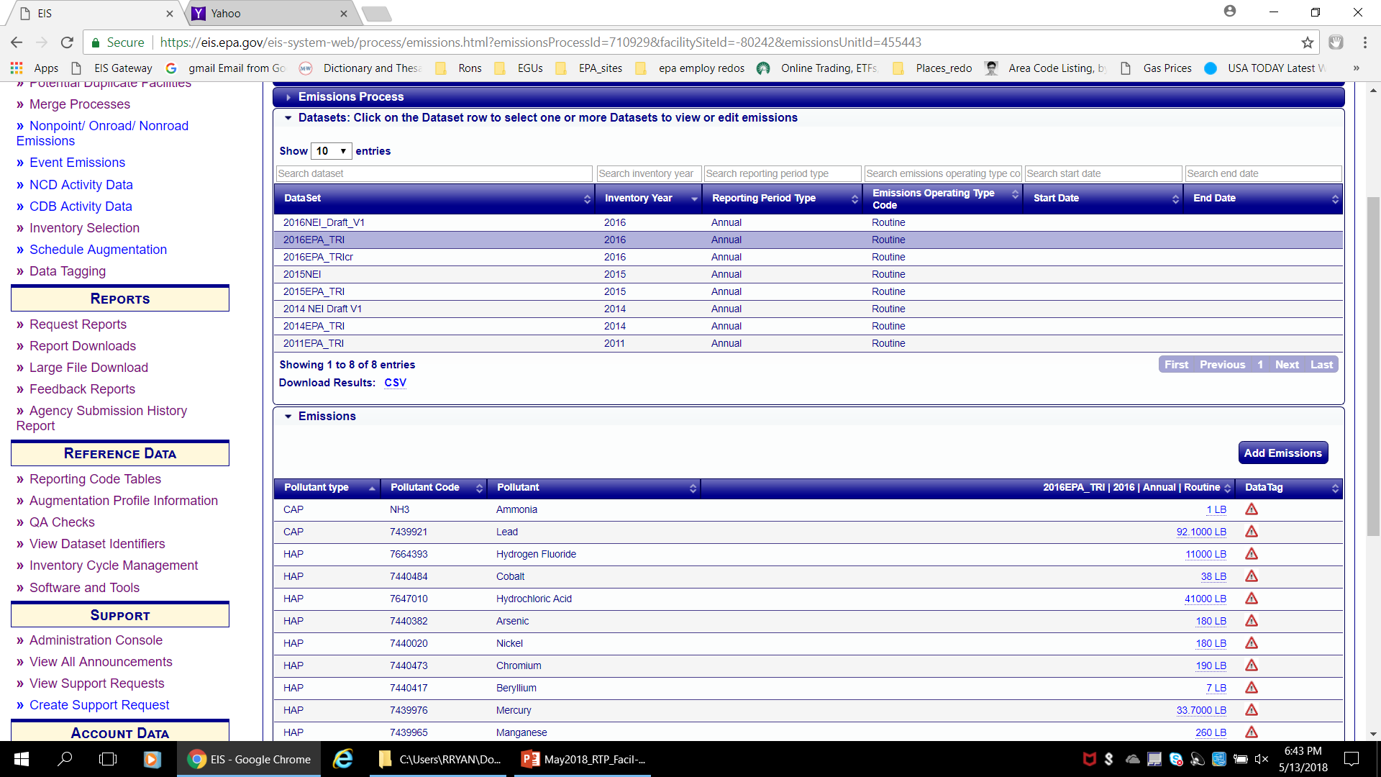
Editing Emissions on the Gateway (2)
Notes:
Select the dataset which needs to be edited. Note that agencies cannot edit EPA datasets and EPA cannot edit Agency datasets. Once the dataset is selected the emissions reported for the period are displayed at the bottom of the screen. The emissions total have an underscore to indicate a link. Select that link.
You can also add a pollutant on the gateway, as long as at least one pollutant from that process and dataset has already been reported.
If there are NO pollutants already reported for that reporting period you cannot add it via the gateway. You have to submit it via the batch method

Slide 100
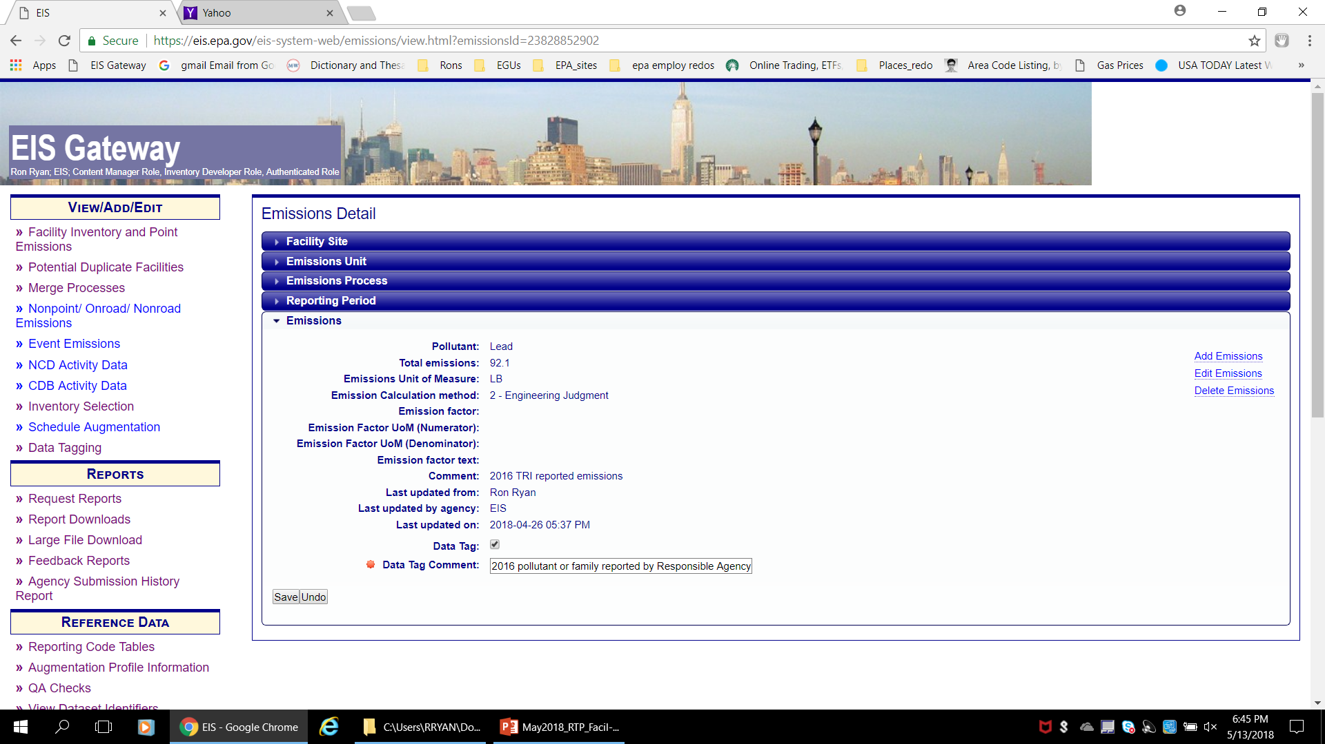
Editing Emissions on the Gateway(3)
Notes:
This screen gives you the detailed information on the reported emissions. The functionality to either edit or delete the emissions is available to you. This functionality will not be available if the submission window is closed. Also it won’t be available if you don’t have write permission for your Agency or if you are not in your Agency’s dataset.

Slide 101
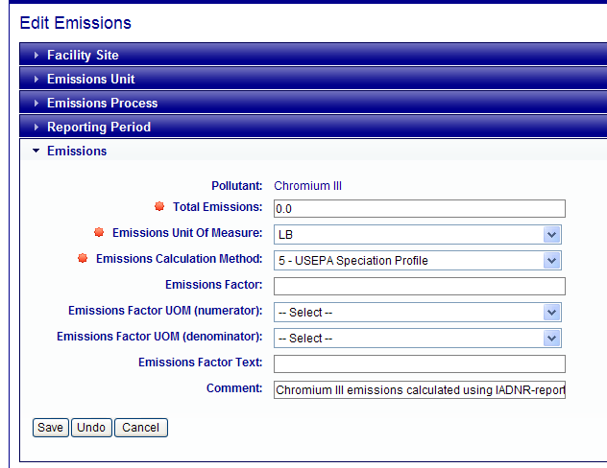
Editing Emissions on the Gateway (4)
Notes:
Once you click edit, You will be then be able to change the emissions value, emission factor, emission calculation method code and emissions comment.

Slide 102


Slide 103
Aircraft LTOs are Point Sources
Includes aircraft engines exhaust, auxiliary power units and ground support equipment (GSE). Excludes aviation gas distribution (nonpoint)
Although NONROAD model calculates GSE, those SCCs must be reported at the airport, and are not allowed in a nonroad submittal
Aircraft exhaust units are aircraft types by SCC (military, commercial, general aviation, etc). Processes are aircraft make and engine type, indicated by aircraftenginetype code
Submitters should not create new units and processes without first confirming you have SCC and aircraft-engine combinations that are not represented at the existing EIS airport. EIS will not accept new submittals that duplicate units or processes.
Notes:
Next few slides will review special types of facilities. First up is airports.
Must be reported as point sources
Includes aircraft engines exhaust, auxiliary power units and ground support equipment (GSE)
Aviation gas distribution is reported in nonpoint
Although NONROAD model calculates GSE, those SCCs must be reported at the airport, and are not allowed in a nonroad submittal
Aircraft exhaust units are aircraft types by SCC (military, commercial, general aviation, etc). Processes are aircraft make and engine type, indicated by aircraftenginetype code (now a required field).
Submitters should not create new units and processes without first confirming you have SCC and aircraft-engine combinations that are not represented at the existing EIS airport. EIS will not accept new submittals that duplicate units or processes.
EPA’s intent is for each tri-annual inventory year, to provide S/L/Ts with activity data and estimated emissions derived from the Emissions and Dispersion Modeling System (EDMS) for comment and updates. However, funding for this for 2011 NEI is uncertain. EPA will not post new LTO prior to window opening.
EIS capabilities are currently insufficient to collect this activity data without emissions. So any activity collection would be outside of EIS.
You should only submit airport data if it is collected locally and superior than EPA’s estimates. You might ask what are EPA’s estimates? Some possibilities, depending upon funding are: 2008 pulled forward, 2008 grown with National level LTO or full rerun of 2011 with updated LTO.

Slide 104
Rail Yards
EPA has developed facilities for 1240 large yards. Nonpoint yard emissions are also allowed, but submitters should first look for facility yards to avoid double counting, before reporting as nonpoint.
All yards are not yet in EIS, thus additional facilities are desired.
Rails lines are reported in nonpoint
Notes:
Unlike airports, EPA believes there are likely more rail yards than the approx 1240 that EPA developed facilities for. We encourage you to add railyard facilities and report emissions for them.
Note that, railyards can ALSO be reported in nonpoint. Submitters with rail yard emissions in nonpoint should make sure that the county doesn’t also have a point railyard facility. If it does, there may be double counting. Shapefiles are not needed for railyards for nonpoint.
the actual rail lines are reported as shapefiles in the nonpoint inventory. Explanation of the process will be discussed under the nonpoint category training.

Slide 105
EGUs
SLT responsible for reporting emissions
USEPA also estimates emissions for most units, based on facility reported heat inputs to CAMD (w/SO2 and NOx CEMS)
We use the SLT values in the NEI if available. Rare cases where we will use CAMD SO2 or NOx values if very different
The ORIS Facility and ORIS Unit IDs used for CEM reporting are stored in EIS as Alternate Unit IDs. If you re-arrange the way you report EGU Units, or need to change your Agency IDs, please let us know.

Slide 106
Species of PM
Filterable: PM10-FIL; PM25-FIL
Condensable: PM-CON
Primary: PM10-PRI; PM25-PRI
Please report FIL species and PM-CON. Report Primary species if you don’t have anything else.
Most important thing is to use the codes correctly – Don’t call it PRI if it only includes the FIL portion
If you don’t report all 5 flavors, EPA will gap fill based on the values of the PM species you do report – PM Augmentation
Notes:
There are 5 species of PM that are valid pollutants
Filterable PM - particulate matter that can be measured by being captured on a filter. By definition, not in the vapor state. Material in a vapor state will pass through a filter. Typical stack testing techniques will have either an in-stack filter or a filter located out of the stack but heated to near stack conditions. PM10-FIL is filterable PM where the particle sizes are less than 10 microns and PM5-FIL are filterable PM where the particle sizes are less than 5 microns
Condensible PM - particulate matter that exists in a vapor state at stack conditions and will condense immediately upon exiting the stack after being diluted and cooled to ambient temperatures.
Primary PM - the sum of filterable and condensible
Please report FIL and CON. EPA will sum the filterable and condensible in a step we call PM augmentation
Report Primary if you don’t have anything else. EPA will estimate condensable (where possible) using PM augmentation.
The PM augmentation procedures are documented in the 2008 v2 NEI documentation.
DO NOT REPORT TSP (total suspended particulates); there is NO pollutant code for that. PM-CON is NOT TSP so if you don’t have PM-CON then leave it null and EPA will gap fill.

Slide 107
QA Checks for PM
Critical Checks - ALL pollutants for emissions process will be rejected IF:
PM25-FIL > PM25-PRI
PM10-FIL > PM10-PRI
PM-CON > either PRI
PM25-FIL > PM10-FIL
PM25-PRI > PM10-PRI
Warning Check
Sum of FIL + CON not equal to PRI

Slide 108
The Types of HAPs
Listed HAPs reported as individual pollutants
Metals reported as a single pollutant code
Listed HAPs that can be reported as either individual pollutants or as a single aggregate pollutant
Special Cases
108
Notes:
108

Slide 109
HAPs Reported as Individual Pollutants
Easiest HAPs to report
One pollutant code per HAP: E.G.; benzene, 1,3 butadiene, hydrochloric acid, and about 160 others
Pollutant code is chemical abstract system # (no dashes)
Still need to be aware of synonyms
  Perchloroethylene = tetrachlorethylene
  Methylene chloride = dichloromethane
  1,2 –dibromoethane = ethylene dibromide
  1,2-dichloroethane = ethylene dichloride
109
Notes:
109

Slide 110
“Metal and compounds” reported as single aggregated Element
Includes:
  Antimony, Arsenic , Beryllium
  Cadmium, Cobalt, Lead
  Manganese, Mercury, Selenium
Can only use one code (CAS # of the metal)
Spreadsheet tool provides instructions for converting compounds into single aggregate pollutant: https://www.epa.gov/sites/production/files/2015-09/pollutant_code_conversion_spreadsheet05012012_0.xls
110
Notes:
For the metals listed here, there is only one valid pollutant code which is the CAS # of the metal.
We have a procedure to convert emissions from a specific metal compound such as cobalt oxide to the mass of the cobalt so that it could be reported under the cobalt pollutant code. This procedure is provided in the hyperlinked spreadsheet that we keep up to date.

Slide 111
HAPs that can be Reported as either Single species or aggregate group
  Cresols: p-cresol, m-cresol, o-cresol and cresols (Includes o,m &p)
  Fine Mineral Fibers: “Fine Mineral Fibers” and the following 4 specific ones: Ceramic Fibers (Man-Made Fibers), Glasswool (Man-Made Fibers), Slagwool (Man-Made Fibers), Rockwool (Man-Made Fibers)
  Glycol Ethers: Glycol Ethers and 52 specific glycol ether compounds
  PCBs: Polychlorinated Biphenyls and 10 specific PCBs
  POM/PAHs: “PAH, total”, “PAH/POM – Unspecified”, “coal tar” , EOM and 50 specific PAHs
  Xylenes: “Xylenes (Mixed Isomers)” and the 3 xylene isomers: o-xylene, m-xylene and p-xylene
  Radionuclides: “Radionuclides (Including Radon)” and 10 specific ones
  Dioxins/Furans: three aggregate pollutants (e.g. “dioxins/furans as 2,3,7,8-TCDD TEQs-I/98”) and 17 specific ones
  CRITICAL Error if the grouped pollutant and any of the specific members reported at same process. ALL pollutants for that process rejected.
111
Notes:
At the process level, report either individual pollutants or single aggregate pollutant, but not a combination of both.

Slide 112
Special Cases
Chromium
Nickel
Cyanide
112

Slide 113
Chromium
Allowable Pollutant Codes
Chromium VI (and chromium trioxide and chromic acid) are high risk HAPs.
Chromium (7440473) is not speciated, and could be a mix of chromium VI and non-high risk forms of chromium
Pollutant Code | Description
1333820 | Chromium Trioxide
16065831 | Chromium III
18540299 | Chromium (VI)
7440473 | Chromium
7738945 | Chromic Acid (VI)
If you have a chromium compound other than the ones listed, use the spreadsheet tool to convert to Chromium III or Chromium VI.
DO NOT REPORT CHROMIUM and hex or tri at the same process
CRITICAL QA check will reject all emissions for that process
In the 2008 NEI, EPA developed a speciated chromium dataset that contained hex and tri based on speciated SLT chromium. Documentation is on CHIEF
113
Notes:
The table shows allowable pollutant codes for chromium.
Chromium VI (and chromium trioxide and chromic acid) are high risk HAPs
Chromium, pollutant code 7440473, is not speciated, and could be a mix of chromium VI and non-high risk forms of chromium
While we allow aggregated chromium to be reported, we’d prefer to get only speciated data.
For the time being we are accepting aggregated chromium.
If you have a chromium compound other than the ones listed, use the spreadsheet tool to convert to Chromium III or Chromium VI.
DO NOT REPORT CHROMIUM and hex or tri at the same process
New QA check will reject all emissions for that process
In the 2008 NEI, EPA developed a speciated chromium dataset that contained hex and tri based on speciated SLT chromium. Documentation is on chief. Plan on using same approach for 2011

Slide 114
Nickel
Allowable Pollutant Codes
Pollutant Code
Pollutant Code | Description
12035722 | Nickel Subsulfide
1313991 | Nickel Oxide
604 | Nickel Refinery Dust
7440020 | Nickel
If you have a nickel compound other than the ones listed, use the spreadsheet tool to convert to nickel.
Ok to report nickel with any of the other flavors. Just know that any risk will be additive
114
Notes:
The table shows the allowable pollutant codes for nickel.
Where you have a nickel compound other than the ones listed, use the spreadsheet tool to convert to nickel.
It is ok to report more than one of these codes at the same process. Just know that any risk will be additive.

Slide 115
Cyanide
Allowable Pollutant Codes
Pollutant Code
Pollutant Code | Description
57125 | Cyanide
74908 | Hydrogen Cyanide
Can report cyanide or hydrogen cyanide
Spreadsheet tool provides instructions/data for converting other cyanide compounds (such as Potassium cyanide) to a valid pollutant.
115
Notes:
For cyanide you can report as cyanide or hydrogen cyanide. If you have other cyanides use the spreadsheet tool.
If you report cyanide and hydrogen cyanide at the same process, risk will be additive.

Slide 117
EPA Review, Augmentation, Selection

Slide 118
EPA Review of Your data
Completeness
Outliers
Comparison to Earlier Years and other data sets
  At Facility Level
  Filtered for largest % plus absolute deltas
  CAMD and TRI data sets used in addition to previous NEI
Notes:
EPA does a completeness check to look at those facilities which have an operating code of “OP” for which emissions were not reported. This can be easily seen by using the Agency History Submission Report and filtering by the processes reported. Ideally Agencies will do this and either add emissions where missing or change the operating code, if incorrect.
We will also look for outliers by doing comparisons between data sources.

Slide 119
Tagging and Augmentation
EPA will not change your emissions data
  But we may “tag out” outliers if not resolved
EPA will Augment to build a complete inventory
  Chrome speciation
  PM Augmentation
  TRI, CAMD-EGUs, Landfills, GHGRP
  HAP Augmentation
Notes:
Other than PM augmentation and the chromium speciation, SLT data has priority in the selection hierarchy. Additionally we will use other datasets, such as the TRI, HAP augmentation and Rule data to fill out the inventory where SLT data is missing.

Slide 120
Putting it all Together- the “Selection”
Preference is to use the S/L/T data first in the hierarchy
Other data sources used lower in hierarchy
  Chrome speciation
  PM Augmentation
  TRI, EGU
  HAP Augmentation
Data sources that may be used above S/L/T
  Some rule data
Draft release for SLT review

Slide 121
Timeline
S/L/T submittals for 2017 Inventory due Dec-31-2018
  Grace period for Facility Inventory - Jan 7, 2019
  Grace period for Point Emissions – Jan 15, 2019
EPA sends out comparison file (xls) – Feb 22, 2019
All EPA Augmentation datasets by April 1, 2019
S/L/Ts make edits to their data by May 15, 2019
Draft selection of NEI v1 Point Inventory in EIS for review June 15, 2019
Final NEI v1 Point Inventory in EIS July 1, 2019

Slide 122
Reports

Slide 123
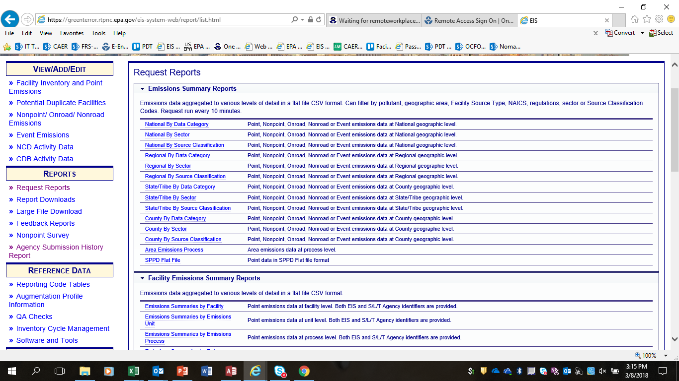
How do I get data out of EIS?
Notes:
Getting data back out of EIS is done through the Request Reports section of the Gateway.
There are several types of reports:
Emission Summary
Facility Emissions Summary
Facility Configuration
Event
Data Tagging
SMOKE Flat Files
Facility and Emission Snapshots – XML
Comparison Report
For the Facility Inventory, we will look at the Facility Configuration and Facility Snapshot reports.

Slide 124
Reports
Emissions Summaries – by Geography
  National, State/Tribe, or County
  Data Category, Sector, or SCC
Emissions Summaries – by Facility
  Facility, Unit, Process or Release Pt Level
Configuration Reports (CSV flat files)
Snapshots (XML files in CERS Schema)
SMOKE Flat Files (csv modeling format)
Comparison Reports (multiple data sets)
Data Tagging
Notes:
Emissions summaries can be done at either the facility level or geographical level such as national, state or county. A facility report will likely be useful for checking your point emissions. Geographic reports if you just want a sum by scc sector or across the whole data category or for data categories other than POINT.

Slide 125
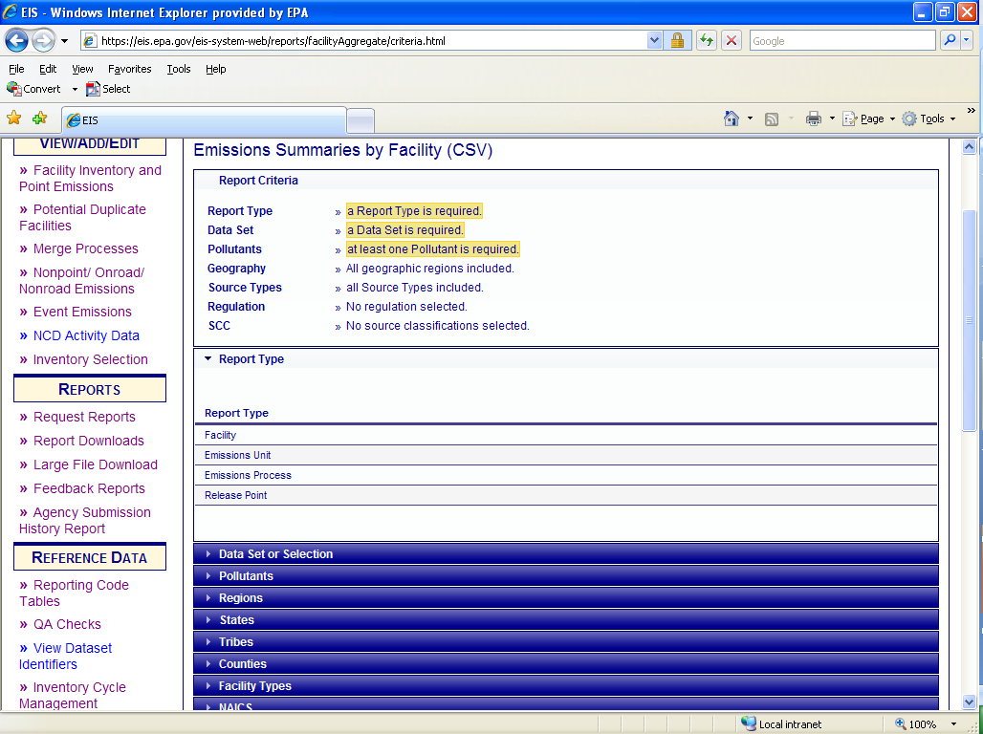
Emissions Summary by Facility (1)
Notes:
This is the screen you get when you select a facility summary report. At the top of the report selection are the highlighted sections which are required to run the report. In this case you must select a report type, a emissions dataset, and at least one pollutant.
For report type, you may select an emissions summary by facility, unit, process or release point level.

Slide 126
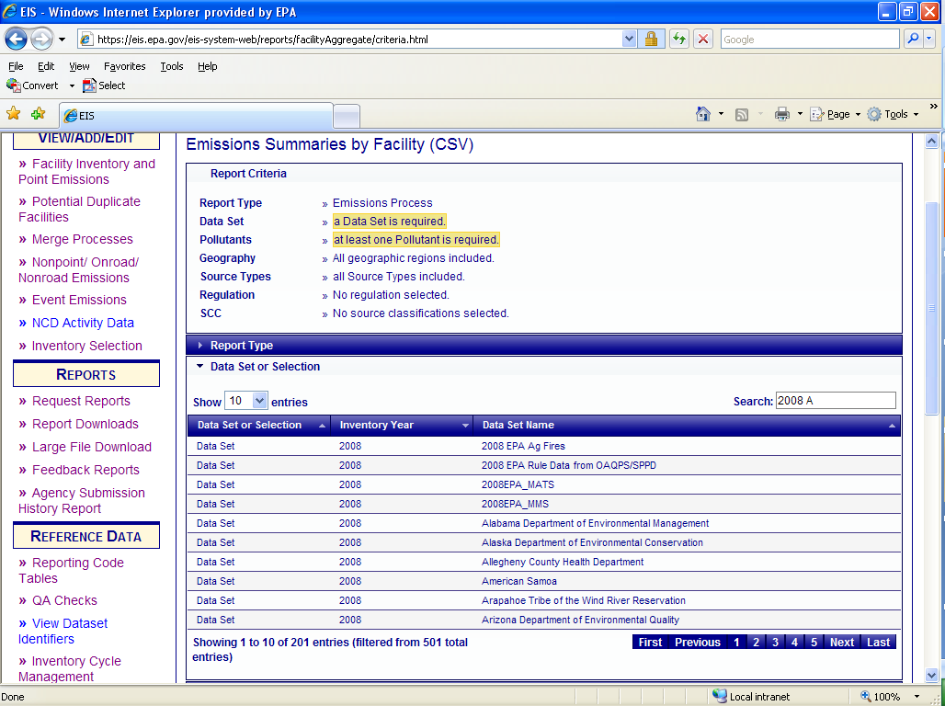
Emissions Summary by Facility (select a dataset)
Notes:
Select the data set by typing in the inventory year and agency name in the search box.

Slide 127
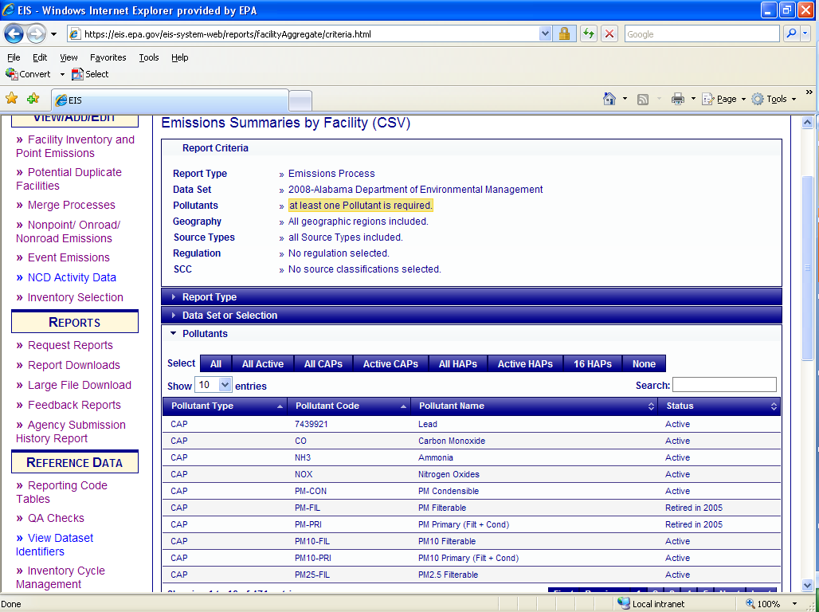
Emissions Summary by Facility (select pollutants)
Notes:
Select one or more pollutants. You may use the inclusive buttons for Active CAPs or Active HAPs. An “ALL” means that the report will include both active and retired pollutant codes. You may also select individual pollutants.

Slide 128
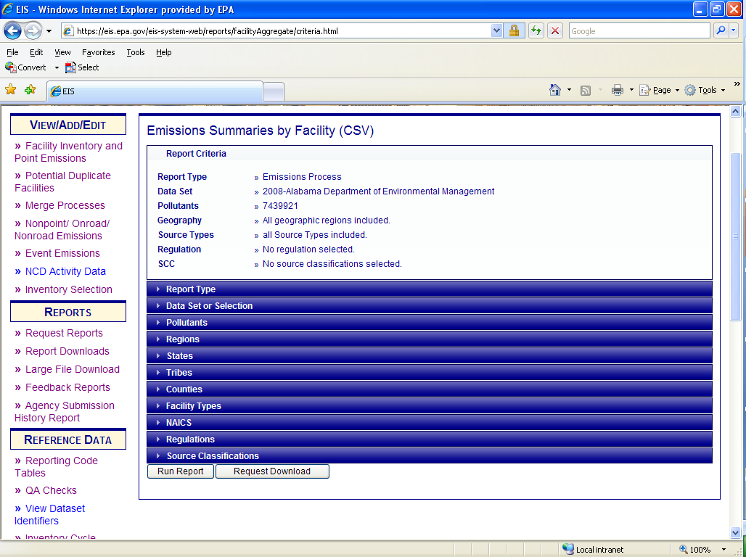
Emissions Summary by Facility (optional filters)
Notes:
You can now use the optional filters to filter by a particular county, facility type, NAICS code, regulation or SCC. Then select “Run Report”. You should receive results within a few minutes. These results can be downloaded using the “Download Results: CSV” link. If your report results in too many records for immediate display, you will receive a warning message. You can then select “Request Download” to receive the complete set of records. These reports will sometimes run in a half hour, a few hours or run overnight depending on how big the report is and how many other reports are ahead of you. To see the status and get the report go to “Report Downloads” If there is a very large report ahead of you or a problem with someone’s report getting stuck it may take longer than overnight.

Slide 129
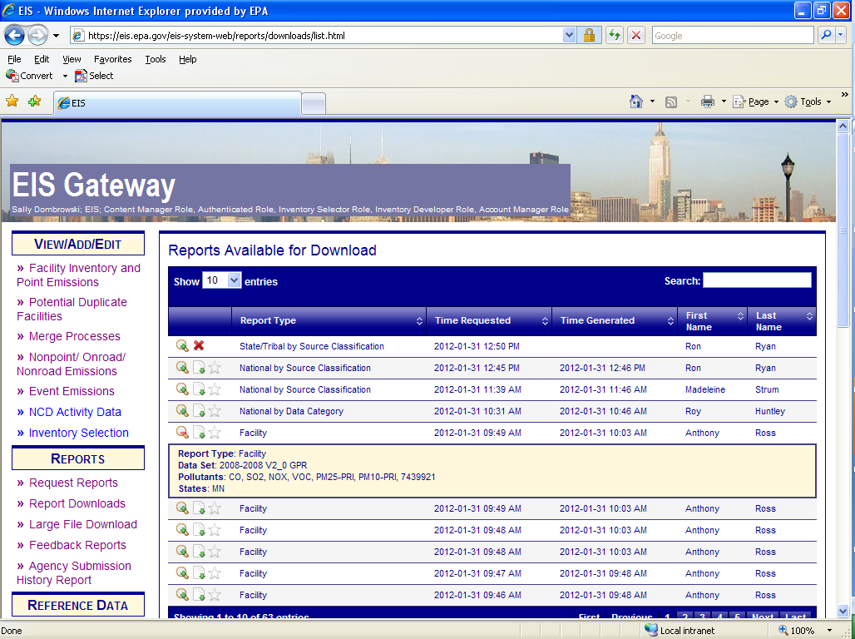
Report Downloads
Notes:
Once you have selected “Request Report” you will be able to download your report under “Report Downloads”
The report download sections shows all reports which have been requested by anyone in your agency. If you select the looking glass icon you can see the criteria for each report. This is helpful if someone else as already requested a report that you may need. The red “x” indicates that the report is not yet available. The file icon will replace the red “x” when your report is ready. These reports kick off every 15 minutes and are downloaded in .csv format except for the Facility Snapshot which is available in XML format.

Slide 130
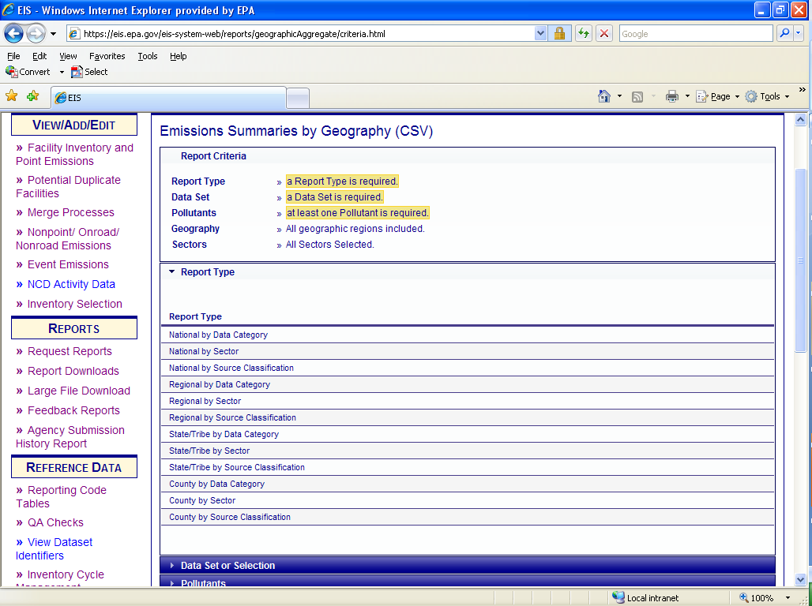
Emission Summary by Geography (1)
Notes:
The second report that is available is the Emissions Summary by Geography. This report will give you National, Regional, State/Tribal and County level reports by Data Category, Sector or SCC.
The three highlighted filters at the top of the report are required selections. First, you would select your report type. We will select County by data category.

Slide 131
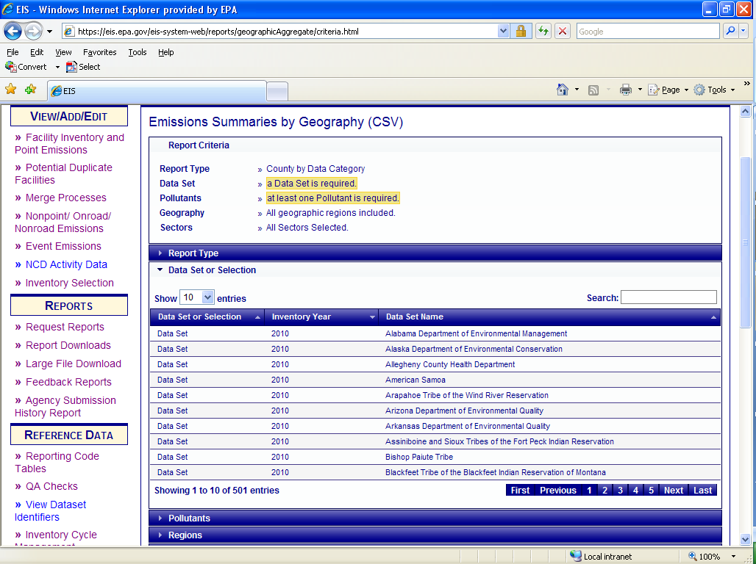
Emission Summary
by Geography (2)
Notes:
Next you would select your data set by typing in the inventory year of interest and agency name into the search box.

Slide 132
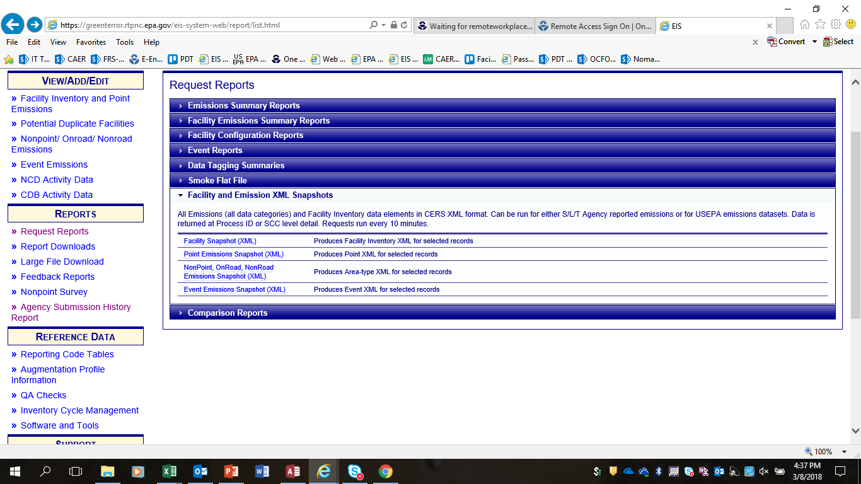
Reports - Snapshots
Notes:
Facility Snapshot. This report pulls your data in EIS in XML format which can be imported into the Bridge Tool staging tables. Some SLTs use this as a starting point, or resource, when developing their inventories.

Slide 133
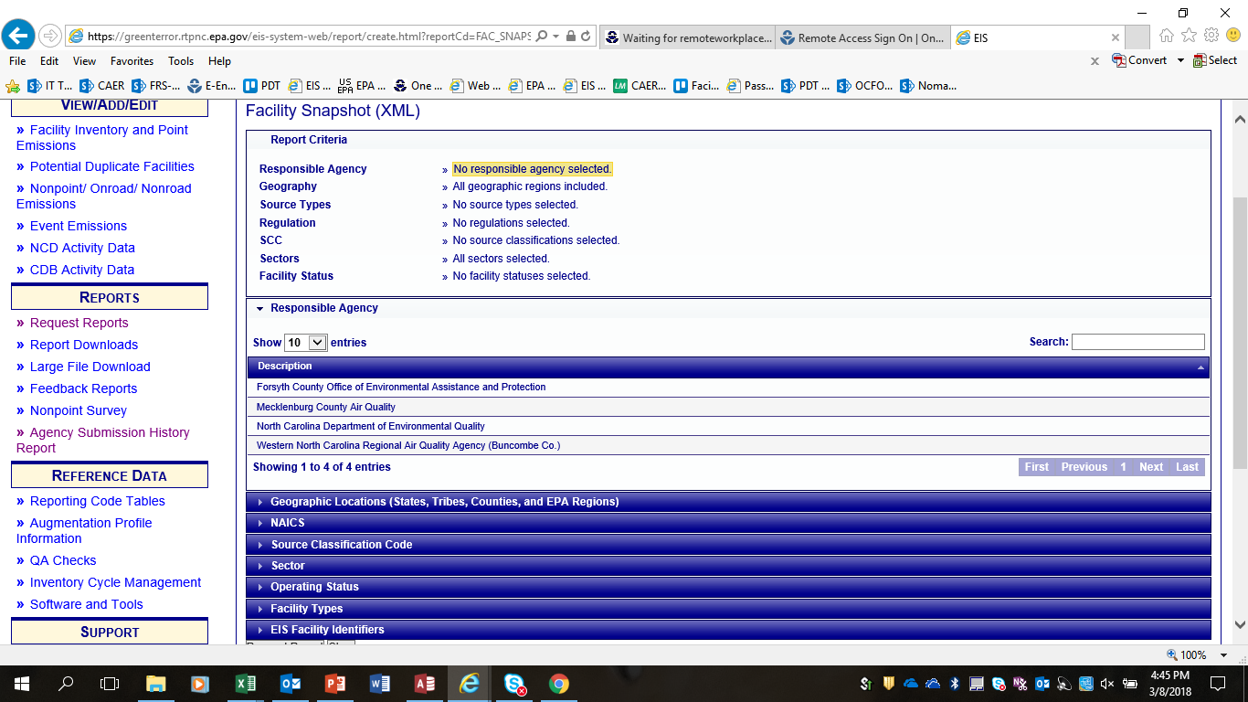
Reports - Snapshots
Notes:
The different filters are listed at the top. A highlighted filter is required. In this case, you must select a responsible agency.
The other filters allow you to narrow your report to specific NAICS, Operating Status or even by an EIS Facility Identifier. If you do not select any of these filters you will receive all the facilities under the selected jurisdiction.
Select “Request Report” on the bottom of the page.

Slide 134
Reports – of note
Process Level – Data Source column (selection reviews)
Comparison Reports (selection review, your QA, etc)
Custom Choice of Columns/Data Fields
Email now sent to you when report is ready
Geographic filters are not a drill-down – all levels chosen are “anded” together.

Slide 136
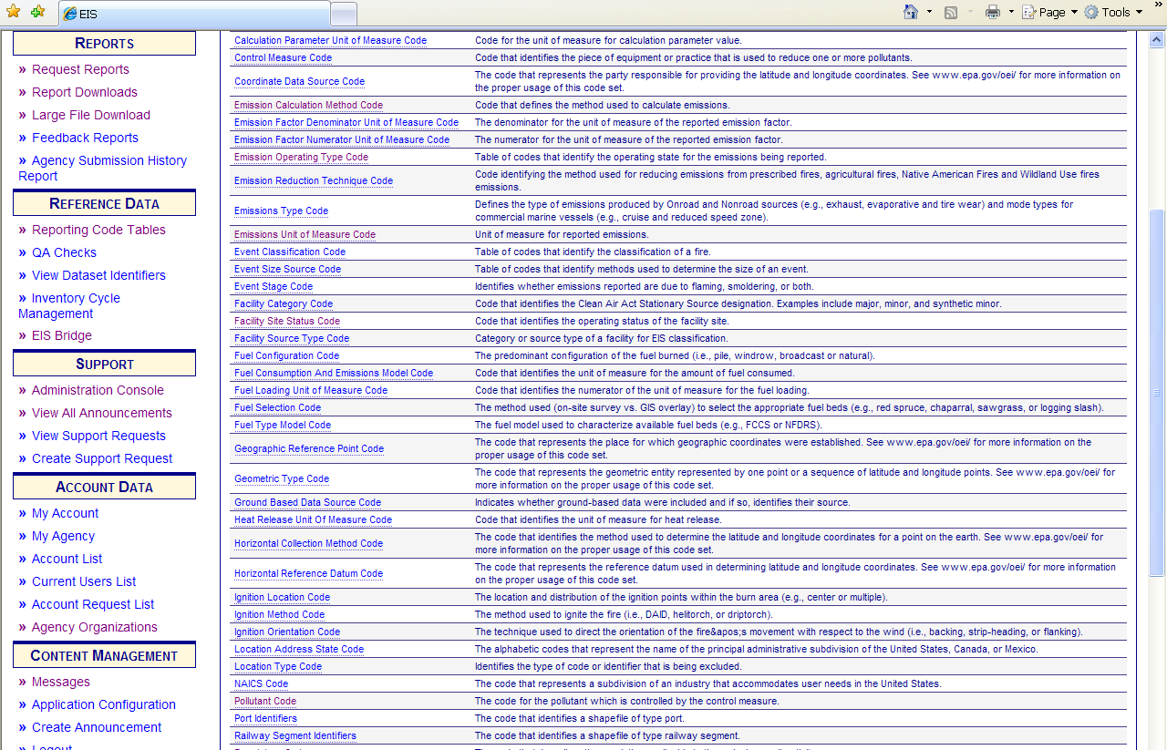
Where do I find Codes?
Notes:
Code tables are available on the gateway

Slide 137

Pollutant codes-example
See what is retired and what is not

Slide 138

Emissions QA Values – Warning Check # 474

Slide 139
Web Resources
One pagers
  How to gain access to the Gateway
  How to change your password
  How to submit data using the Web Client
http://www.epa.gov/ttn/chief/eis/index.html
2017 –specific information http://www.epa.gov/ttn/chief/net/2017inventory.html
2017 NEI/EIS Implementation Plan https://www.epa.gov/air-emissions-inventories/2017-national-emissions-inventory-nei-documentation
Notes:
The EIS User’s Manual is located on the CHIEF website and contains several helpful one pagers such as the ones listed on this slide.
Includes one pagers on how to change your password

Slide 140


Slide 141
Contacts
File Submittal Issues
  Sally Dombrowski – dombrowski.sally@epa.gov 919-541-3269
Most Data Issues
  Ron Ryan – ryan.ron@epa.gov
  919-541-4330
Aircraft and Rail Yard Issues
  Laurel Driver– driver.laurel@epa.gov
  919-541-2859

Slide 142

Help us Improve!
You will receive an email with a link to a survey to review the course(s) you attend at the Emissions Inventory Training Workshop.
Please take a few moments to let us know about your experience this week.
We welcome your feedback!

Slide 143


