Slide 1
Projecting Emissions Inventories for Air Quality Modeling of Future Years
May 17, 2018
Alison Eyth, Jeff Vukovich, Caroline Farkas
EPA Office of Air Quality Planning and Standards
Emission Inventory and Analysis Group

Slide 2
Future Year Projections
Course Outline and Schedule
8:30 Background Refresher
9:00 Introduction to projections
9:20 Control Strategy Tool overview
9:40 Agricultural and fugitive dust projections
10:00 Residential wood, commercial marine vessels, rail
10:15 Break
10:30 Oil and gas projections
10:55 NonEGU point, Aviation
11:10 EGU
11:30 Onroad mobile source projections
11:45 Wrap up and final questions
Notes:
Alison: Intro, EGU, Onroad
Caroline: CoST, nonEGU point, Ag, fugitive dust, Aviation
Jeff: O&G, RWC, CMV

Slide 3
Background: Purpose and
Contents of a Modeling Platform
Air quality modeling platforms are used to support air quality studies
  Use technically sound data and state-of-the-science tools
Major components of a modeling platform:
  Meteorological models (WRF) and met. data
  Boundary conditions (GEOS-Chem/Hemispheric CMAQ)
  Emissions: base year (NEI)+NonUS, future year projections
  Air quality models (CMAQ, CAMx)
  Other: ancillary data for emissions modeling, projections data, emissions modeling tools (SMOKE, etc) and scripts
US EPA OAQPS, Emission Inventory and Analysis Group

Slide 4
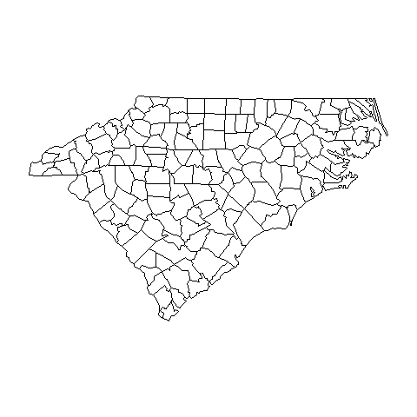
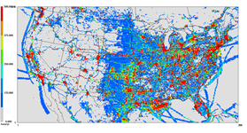
Air Quality Modeling Platform Components
Air Quality Model
Pollutant
Concentrations
Meteorological
Model: wind,
temperature,
precipitation,
radiation, …
Boundary Conditions
Concentrations of species
at boundaries
Emissions
Ground-level
and elevated

Slide 5
Why do Air Quality Modeling?
Regulatory Impact Assessments (RIAs)
  Model a base year focused on Criteria Air Pollutants (CAPs)
  Model a future year base case with on-the-books rules
  Model one or more cases that represent the rule
  Estimate costs and benefits of rule
National Air Toxics Assessment (NATA)
  Model a base year including as many
  Hazardous Air Pollutants (HAPs) as possible
  Compute risk based on CMAQ and AERMOD concentrations
Transport and Regional Haze Modeling
  Model a base year and a future year base case
  Perform source apportionment modeling to determine contribution of states and/or sectors to air quality issues
US EPA OAQPS, Emission Inventory and Analysis Group

Slide 6
Performing Emissions Modeling
We use the Sparse Matrix Operator Kernel Emissions (SMOKE) modeling system and associated tools to process our emissions into air quality model-ready files (http://www.cmascenter.org/smoke)
The input emission inventories (e.g., NEI) can be annual, monthly, daily, or hourly
“Ancillary” data files help process inventories into gridded hourly emissions of the chemical species (e.g., NO, NO₂, ISOP) used by the air quality model
Meteorological data such as temperature, precipitation, and radiation are needed to compute emissions and for some sectors temporalization (e.g., onroad mobile, biogenic, res. wood, agricultural)
Quality assurance steps and data summaries ensure data is properly transformed and mass is not lost
US EPA OAQPS, Emission Inventory and Analysis Group

Slide 7
Emissions Modeling Schematic
Hourly, speciated
point and gridded
emissions
Meteorological
Data: humidity,
temperature,
radiation, …
SMOKE
Ancillary Data
Speciation and Temporal
Profiles, Spatial Surrogates,
cross-references, etc.
Quality Assurance
Logs and Summaries
Emission
Inventories

Slide 8
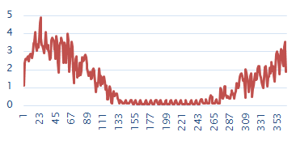

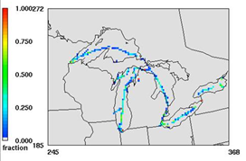
Emissions Modeling Process
Steps and data needed to convert emissions inventories into the resolution and formats needed by air quality models
Temporal Allocation
Temporal Profiles
Emission Inventories
(annual/
monthly/daily)
+
Meteorology
Speciation Profiles
Speciation
Spatial Allocation
Hourly, speciated, gridded emissions for air quality modeling
Spatial Surrogates
Note: Plume rise is typically
handled within the AQM
US EPA OAQPS, Emission Inventory and Analysis Group

Slide 9
Emissions Modeling Platforms
Contents:
  Starting point is a version of the National Emissions Inventory (e.g., 2014 NEI version 2)
  Related data sets needed for processing are also included
  Software and scripts that process inventories into AQM inputs
  Typically have a historic or “base” year and one or more future years
Historic platform development process:
  Base and future year inventories and met. data developed by EPA
  Data and software needed to process the inventories for AQM developed by EPA
  Platform released for public comment
  EPA incorporates comments into a new version of the platform
Now working on a more collaborative process
REPEAT

Slide 10
Recent and Upcoming Emissions Modeling Platforms
Multiple 2011 Platforms are available
Working on the 2014 NATA Platform
  Based on 2014NEIv2 (2014 only, no future years)
  Includes updated spatial surrogates, temporal profiles, and speciation profiles versus 2011 platforms
  Focus is hazardous air pollutants (HAPs)
Collaborative Effort for a new base year
  Not much ozone in the east in 2014
  The year 2016 was selected through a collaborative process between states, regional organizations and EPA
  States and MJOs wanted to be more involved in development of the next modeling platform
Notes:
HAP platform from NATA affects some inputs and scripts compared to CAP-platforms
Some files different than CAP-focused platforms

Slide 11
2016 Platform Schedule
Several versions of 2016 platform will be developed
  Alpha: preliminary version with 2016 emissions for some sectors and 2014 for the rest
  (February, 2018)
  Beta: improved version of 2016 emissions for most sectors and preliminary projected emissions to 2023 and 2028 (Summer-Fall, 2018)
    Timing of projections is uncertain
  V1.0: fully updated 2016 emissions and complete projected emissions for 2023 and 2028
  (Winter, 2019)

Slide 12
Recent Emission Modeling Platforms and Naming Convention
2011v6.3 platform is based on updated 2011NEIv2
2011v6.3
  Emission modeling platforms have base years and can have future years that go with them (e.g., 2017, 2023)
2014v7.0 is the initial 2014 NATA modeling platform based on 2014NEIv1
2016 Platform is currently under development and uses a different nomenclature (i.e., alpha, beta, v1.0)
Base year being modeled
Specific NEI year (e.g., 6 means 2011 NEI was used)
Iteration of platform
(e.g., 3 is the third platform for 2011)
US EPA OAQPS, Emission Inventory and Analysis Group

Slide 13
Emissions Modeling Case Abbreviations
A “case” is a specific set of AQM-ready emissions inputs and has an abbreviation or nickname
2011ek
Additional information can follow the main abbreviation and differs by case
  Speciation, control case, sensitivity adjustments, meteorological model configuration (e.g., 11g)
      Such as cb6, ctl, nox50 (e.g., 2011ek_cb6_11g)
Year being modeled
NEI base year
(e.g., e=2011 NEI, f=2014 NEI)
Configuration of emissions inputs
(e.g., k is the 11th version for 2011)
US EPA OAQPS, Emission Inventory and Analysis Group

Slide 14
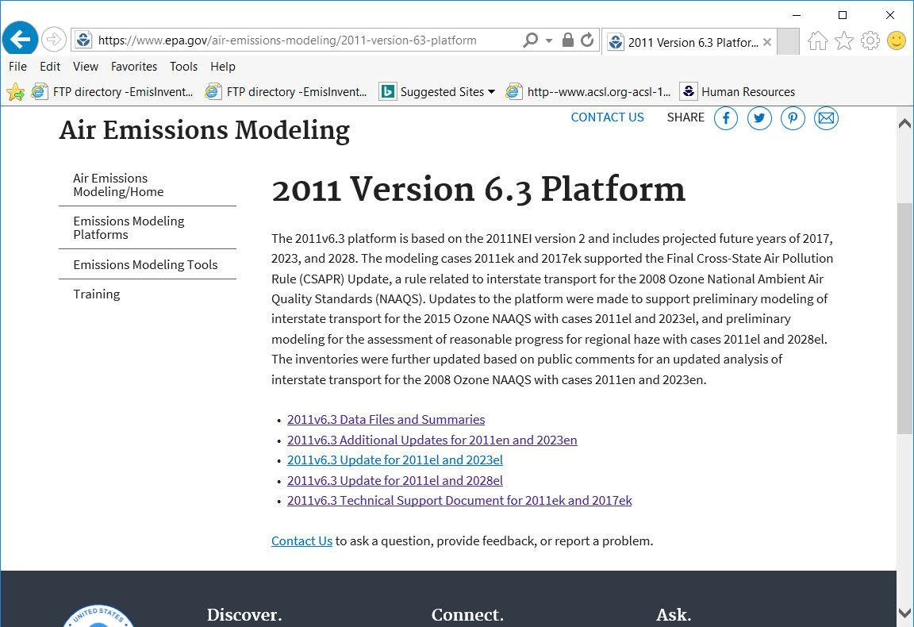
Case names appear on the web and FTP sites and in input file names

Slide 15
EPA US 12km Modeling Platform Domains
US domains / grids use consistent map projections (Lambert)
Other domains also exist (e.g., 36km, 4km, hemispheric)
Many US domains include parts of Canada and/or Mexico
US EPA OAQPS, Emission Inventory and Analysis Group
Notes:
Key point is to show that we also need to worry about future year emissions in Canada and Mexico

Slide 16
Non-US emissions in the emissions modeling platform
Canada emissions & ancillary data (e.g., surrogates)
  Courtesy Environment Canada
  Used 2010 until 2013 and 2025 data provided in April, 2017
  Fire emissions provided for summer 2011 and other years
Mexico 2008 emissions and projections of these
  Based on Inventario Nacional de Emisiones de Mexico, 2008
  MOVES-Mexico data was developed for key years
  Base year fire emissions for Mexico derived from
  Fire INventory from NCAR (FINN):
    A daily fire emissions product for atmospheric chemistry models [also used for winter in Canada]
Hemispheric Transport of Air Pollution (HTAP)
version 2 inventories used outside of North America in hemispheric runs
US EPA OAQPS, Emission Inventory and Analysis Group

Slide 17
Emissions Modeling Platform Sectors
Emission inventories are broken down into “sectors” used to prepare AQM-ready emissions for different parts of the inventory
Each sector has unique processing or inventory characteristics and names are lowercase (e.g., rwc)
Specific sectors vary by modeling platform but cover all sources in the inventory
Point source sectors keep their specific latitude-longitude locations throughout the process
Nonpoint sectors are allocated to grid cells using spatial surrogates
EPA processes emissions separately for each sector then merges the ground-level emissions for a case together to create final AQM-ready files

Slide 18
2016 Platform Sectors:
Point and Non-U.S.
Point and non-US Sectors | Sector Description
ptegu | Point sources that are Electric generating units (EGUs)
pt_oilgas | Point sources related to oil and gas production
ptnonipm | Point sources that are not EGUs nor related to oil and gas
ptagfire | Point source day-specific agricultural fires (was agfire)
ptfire | Point source day-specific wild and prescribed fires
ptfire_othna | Non-US point source day-specific fires in North America
cmv_c3 | Category 3 (large) Commercial Marine Vessels as points
othpt | Non-US point sources
othafdust_adj | Non-US area fugitive dust sources (Canada only)
othar | Non-US area (i.e., nonpoint) sources
onroad_can | Onroad mobile sources for Canada (was othon)
onroad_mex | Onroad mobile sources for Mexico (was othon)
US EPA OAQPS, Emission Inventory and Analysis Group

Slide 19
2016 Platform Sectors:
Ground-level
Nonpoint Sectors | Sector Description
afdust_adj | Met.-adjusted area fugitive dust emissions
ag | Agricultural ammonia sources
beis | Biogenic emissions based on the BEIS model
cmv_c1c2 | C1&C2 Commercial marine vessels (nonpoint)
nonpt | Nonpoint sources not in other sectors
nonroad | Mobile sources that do not drive on roads or railroads, including recreational pleasurecraft
np_oilgas | Nonpoint oil and gas production-related sources
onroad | On-land mobile sources that drive on roads
onroad_ca_adj | Onroad mobile sources in California
rail | Locomotive sources on railroads
rwc | Residential wood combustion sources
US EPA OAQPS, Emission Inventory and Analysis Group
Notes:
Our job as emissions modelers is to ensure there are quality inventories and ancillary data going into all of these sectors…

Slide 20

Questions?
Any questions on basic concepts of emissions modeling?
Notes:
Next: Jeff

Slide 21
Future Year Projections
Course Outline and Schedule
8:30 Background Refresher
9:00 Introduction to projections
9:20 Control Strategy Tool overview
9:40 Agricultural and fugitive dust projections
10:00 Residential wood, commercial marine vessel, rail
10:15 Break
10:30 Oil and gas projections
10:55 NonEGU point, Aviation
11:10 EGU
11:30 Onroad mobile source projections
11:45 Wrap up and final questions
Notes:
Alison: Intro, EGU, Onroad
Caroline: CoST, nonEGU point, Ag, fugitive dust, Aviation
Jeff: O&G, RWC, CMV

Slide 22
Goals of Class
To introduce you to the various tasks involved with preparing emissions inputs to air quality models for future years
  Focus is on the steps and data involved, not the details of running the scripts
Note: presentation is available for download: ftp://newftp.epa.gov/Air/nei/ei_training_may2018/projecting_ei/
US EPA OAQPS, Emission Inventory and Analysis Group

Slide 23
Future Year Projections
Overview
  Projections require inventories and ancillary data
  Strive for consistency in methods when there are multiple future years
Estimate changes between base and future years
  Activity changes
  Rules / technology changes in intervening years
  Facility and unit closures
  Interpolation / extrapolation often difficult
Projection techniques
  Replace the sector inventory or section thereof
  Have a set of sources that factors are applied to –
  to account for activity change and controls
  Model-based categories/sectors

Slide 24
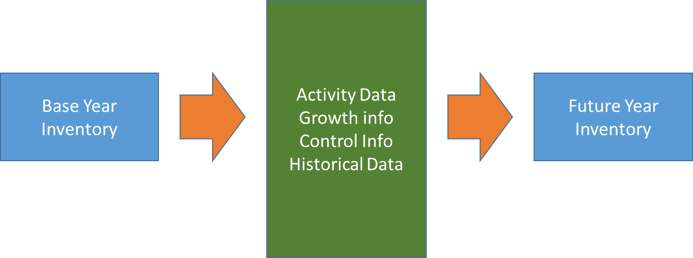
Future Year Projections
The future year inventory is then processed by SMOKE in a
similar way as if it were a base year inventory

Slide 25
Why Develop Projected Emission Inventories?
Near-term projections
  The full NEI is developed every three years (2011, 2014, 2017, …) but we often need to do air quality modeling for years other than NEI years (e.g., 2016)
Mid-term future projections (e.g., through 2028)
  We need to evaluate policy options and impacts of changing emissions and use the results in a relative sense
  EPA develops Regulatory Impact Analyses (RIAs) for regulations
    Describe the potential social benefits and social costs
  Interstate transport: The Clean Air Act’s "good neighbor" provision requires EPA and states to address interstate transport of air pollution that affects downwind states' ability to attain and maintain National Ambient Air Quality Standards (NAAQS)
  Other types of analyses

Slide 26
Developing Projections (1/2)
Future year emission inventories are developed starting with the base-year inventory and modeling platform
  Techniques vary by sector
For mid-term projections, base year-specific fires and biogenic emissions are typically also used in the future years

Slide 27
Developing Projections (2/2)
Factors to consider for each sector include:
  Confidence in base year inventory data
  Historical data available since base year
  What sources of information are available for each sector
    Databases (e.g. Annual Energy Outlook (AEO))
    Models (e.g. Integrated Planning Model (IPM) for EGUs)
  How can these sources of information be used for estimating emissions? (e.g., to update activity data)
  Spatial and temporal resolution of information
  Federal and state rules that go into effect in the intervening years are considered
  Point sources: consent decrees, planned shutdowns, etc.

Slide 28
Modeling Platforms with Projections
2011v6.3 platform
  https://www.epa.gov/air-emissions-modeling/2011-version-63-platform
  Based on 2011 NEI version 2 with updates (used 5+ years)
  Originally supported the Final Cross-State Air Pollution Rule (CSAPR) Update with cases 2011ek and 2017ek, and 2017ek_cntl
  Added 2011el and 2023el for a preliminary analysis of ozone transport with respect to the 2015 National Ambient Air Quality Standard (NAAQS) for ozone
    2011en and 2023en provided updates
  Added 2028el for regional haze
Working towards projections based on 2014 NEI
  Need short-term (historical) projections to year 2016
  Gathering data sources and information for mid-term

Slide 29
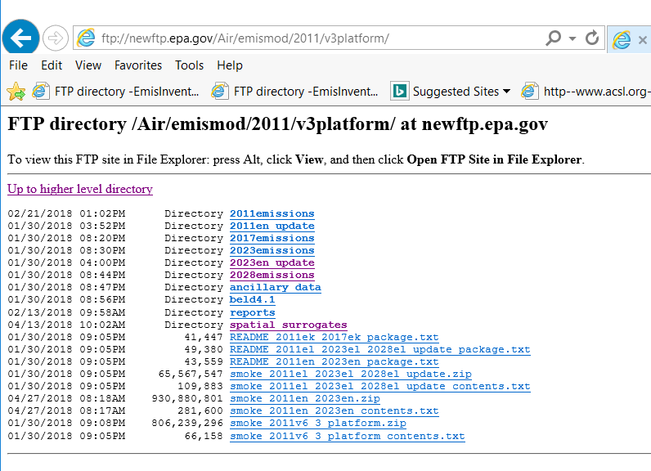
2011v6.3 Data on FTP site
2011v6.3 is the
latest with projections
See the README and
zip files for the case

Slide 30
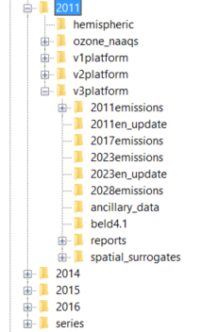
Emissions Modeling FTP site
Several versions of the 2011
platform and preliminary versions of 2014,2015, and 2016 are available on the FTP site:
ftp://newftp.epa.gov/air/emismod

Slide 31
Projection Techniques
Inventory projection techniques differ for different modeling platform sectors
  Some done using the Control Strategy Tool (CoST) within the Emissions Modeling Framework (EMF)
  Others are taken as outputs from models
Sparse Matrix Operator Kernel Emissions (SMOKE) modeling system is used to prepare the emissions for air quality models (e.g. CMAQ, CAMx)

Slide 32
Projections overview: Sectors projected based on NEI emissions
Sector(s) | Data sources and techniques used
Agricultural NH3 (ag) | USDA animal population growth estimates, livestock only.
Fugitive dust (afdust) | County-level VMT and population Annual Energy Outlook (AEO)-based projections to unpaved/paved roads. Note: Canadian fugitive dust (othafdust) not projected.
Residential Wood Combustion (rwc) | 2015 Wood heaters New Source Performance Standards (NSPS) with growth and appliance change-outs/retirement assumptions.
Class 1&2 CMV + trains (cmv, rail) | Locomotive and Marine (RIA-based) rule growth and controls; California data scaled from CARB inventories.
Class 3 CMV (cmv, othpt*) | Regional-based growth factors + ECA-IMO engine and fuel controls, extending from ports (state), to near-offshore (EEZ) to global; California scaled from CARB data.
Oil and Gas (pt_oilgas, np_oilgas) | AEO production, consumption fuel-based growth. Various NSPS impacts + local information.
Remaining non-EGUs (ptnonipm, nonpt) | AEO production, consumption fuel-based growth. Various NSPS impacts + local information. Numerous additional growth/control/closure information

Slide 33
Projections overview: Sectors not projected from NEI base year emissions
Sector(s) | Data sources and techniques used
EGUs (ptegu) | Engineering Approach or Integrated Planning Model
Onroad mobile (onroad) | MOVES 2014a w/ projected activity, fuels, inspection and maintenance, controls, speciation; California magnitude from CARB but temporalized based on SMOKE-MOVES
Nonroad mobile (nonroad) | MOVES projected inventories (previously NMIM/NONROAD), except for California data provided by CARB
Canada/Mexico (othar, othpt, othon) | Canada: hold constant or interpolate; sometimes adjust based on changes to U.S. inventories Mexico: Future-year inventories projected from 2008 base year inventory plus MOVES-Mexico
Biogenics & Fires (beis, agfire, ptfire) | No projections, same as base year in mid-term projections due to constant meteorology

Slide 34
Future-year Emissions Modeling Ancillary Data
Most ancillary (i.e., non-inventory) data stays the same in the base and future year modeling
Meteorology is held constant
Spatial surrogates are constant
Temporal profiles are constant for most sectors (except for EGUs)
Speciation profiles are constant for many sources
  Updated in future year for mobile sources

Slide 35
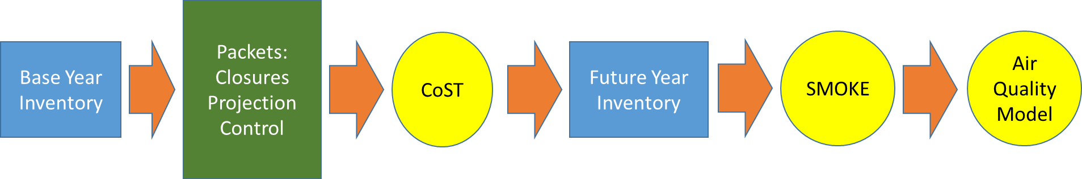
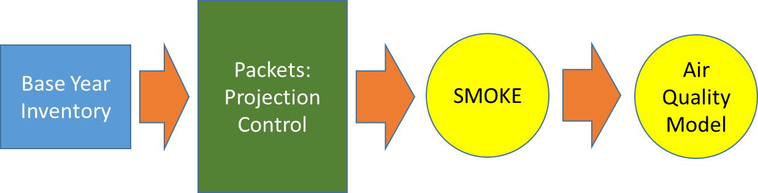
Available Tools for Projection of non-EGU Point/Nonpoint Projections
Control Strategy Tool (CoST) – a good organizational and reporting tool
SMOKE – traditional approach; good for simplified projection tasks

Slide 36
Control Strategy Tool (CoST)
Part of the Emissions Modeling Framework (EMF)
  https://www.cmascenter.org/cost/documentation/2.12/html/
Used to project most NEI non-EGU point and nonpoint inventories
  Exceptions include stand-alone future year inventories (e.g., biodiesel and cellulosic plants, new cement kilns)
Has a hierarchy for how “packets” are applied
Tracks the impact of each packet on the inventory
Used for projections, but also includes algorithms for other analyses like maximum emissions reduction and least-cost

Slide 37
Control Strategy Tool:
Packet Types
Plant CLOSURE
  Facility, unit, stack and/or process-level
  Effective date needed
  July 1 cut-off
PROJECTION
  Scalars (e.g., 0.3 = 70% reduction, 2.0=100% increase)
  All inventories: geographic (FIPS state / county), pollutant, source classification code (SCC)
  Point only: target a facility/sub-facility / or North American Industry Classification System (NAICS)
CONTROL
  Similar facility/geographic/SCC/pollutant applicability as PROJECTION packets
  Percent reductions (0-100), optional rule effectiveness and rule penetration
  Compliance date optional
  July 1 cut-off (before July 1 of year is applied, after is not applied)

Slide 38
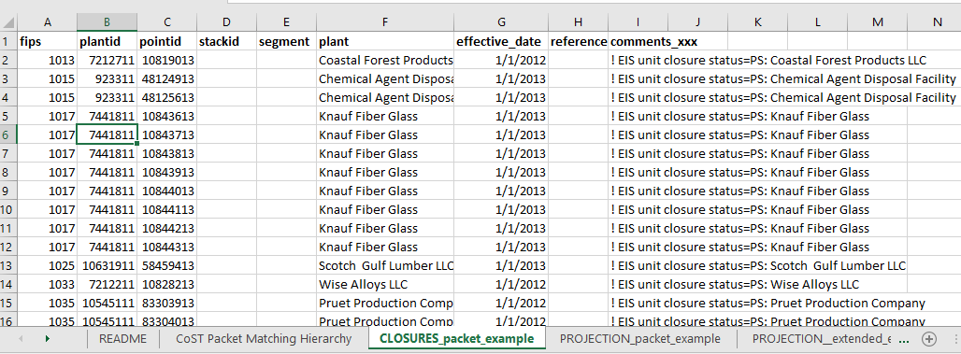
Closure Packet Example
Closures are applied for
a target year (e.g., 2020):
Records with effective
dates up to July 1 of target
year will be applied
Closures can be applied at multiple levels:
Region_cd = FIPS state & county
Facility = plant
Unit = point
Release point = stack
Process = segment
Notes:
Note that these use older terminology of plant/point/stack/segment instead of facility/unit/release point process and that we’re in the middle of updating this

Slide 39
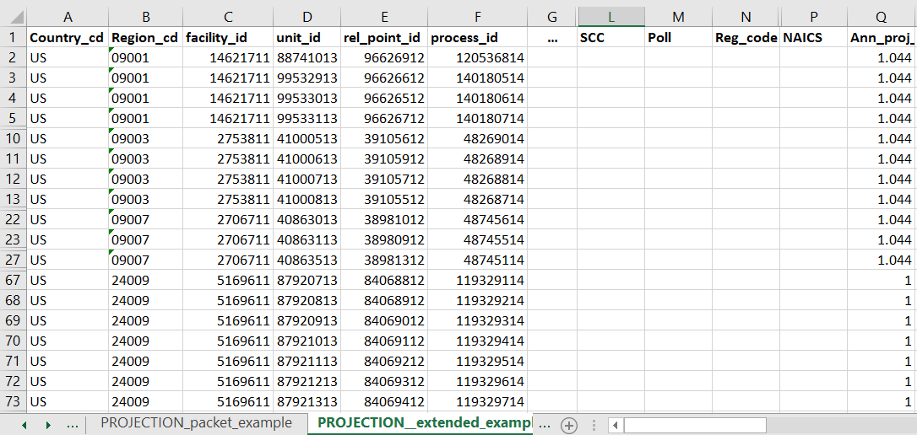
Projection Packet Example
Factors
to apply
are here
Projection entries can also be specified at multiple levels

Slide 40
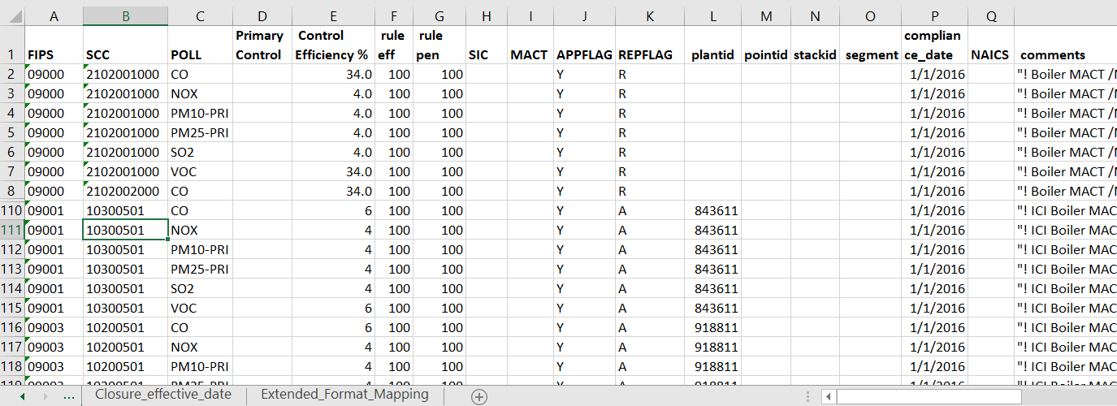
Control Packet Example
Ending FIPS with 000 applies to entire state
Rule effectiveness and penetration usually 100
APPFLAG of Y means to apply it
REPFLAG of R means replace existing controls, A means add on
Records applied if compliance_date before July 1 of target year
Notes:
Control efficiency is the key attribute, plus the setting of the attributes to specify what is controlled

Slide 41
Control Strategy Tool:
Hierarchy
CLOSURES, PROJECTION, CONTROL packet types applied separately in a run
All packets for each type concatenated and QA’d
Most-specific applicable row (compliance date, application flag) supersedes more general entries
Care needed when there are overlapping consent decrees, comments, broad control programs
  Need to be careful how you build packets
  QA very important to ensure output from strategy matches intended inputs – especially where the same sources are impacted by multiple packets

Slide 42
Entries in packets that are more specific have higher priority than the more general ones
General -> Specific
US EPA OAQPS, Emission Inventory and Analysis Group
Notes:
Talk about this at a general level but not in detail. That more specific controls are applied first

Slide 43
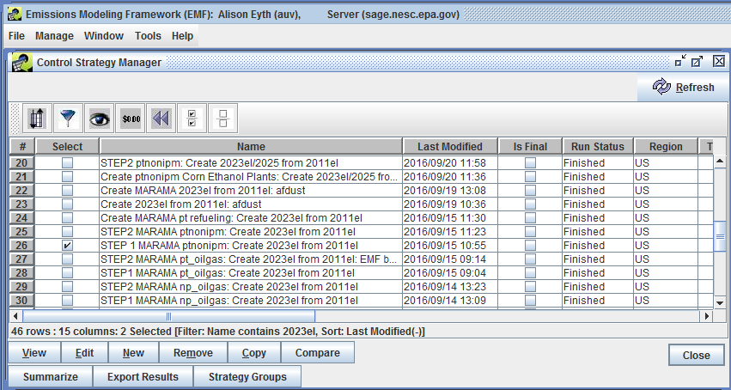
Control Strategies within the
Emissions Modeling Framework

Slide 44
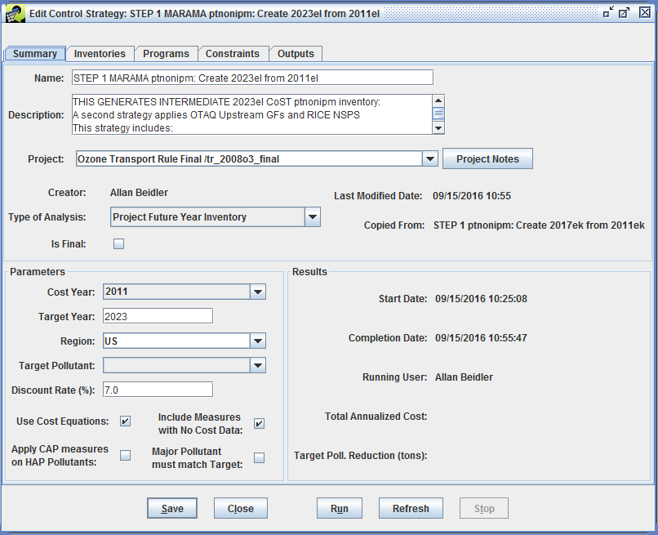
Editing a Control Strategy
Type of Analysis and Target Year are key parameters

Slide 45
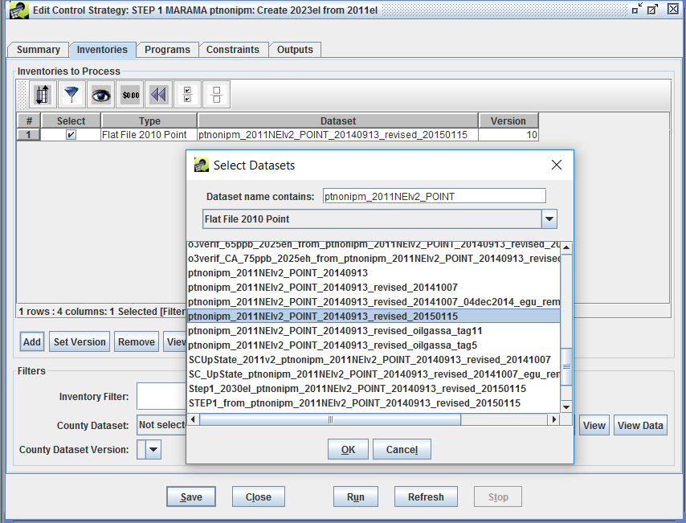
Select Inventories for Strategy
Select one
or more
inventories
to project

Slide 46
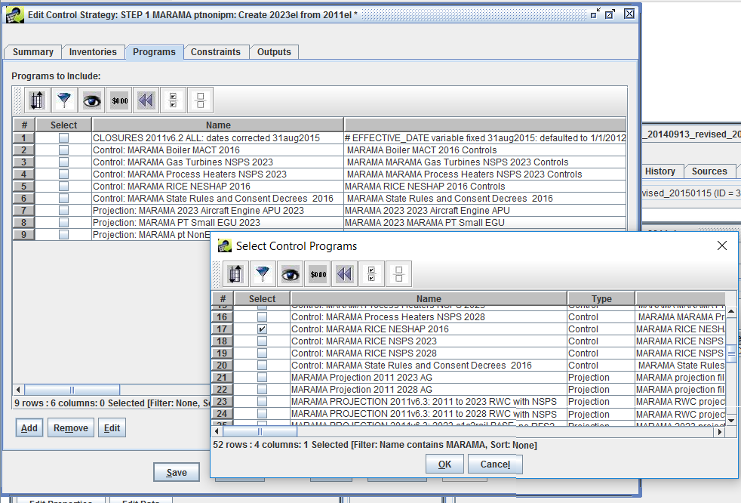
Select Control Programs to Apply
Select all
relevant
control
programs
for sector

Slide 47
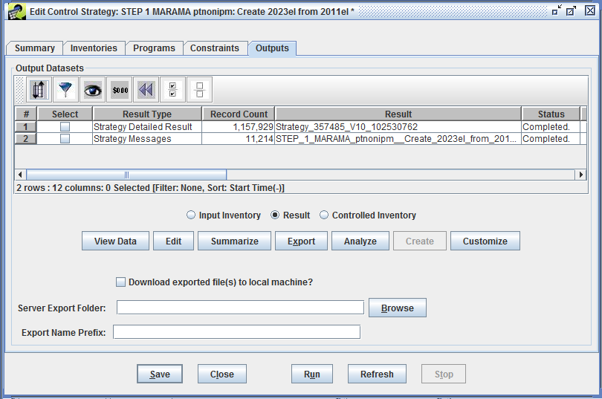
Control Strategy Tool: Outputs
After strategy
is run, outputs
will appear:
Detailed result
and Messages
It is important
To review these
outputs
Summaries of
detailed result
are also helpful
After QA, create
a controlled
inventory

Slide 48
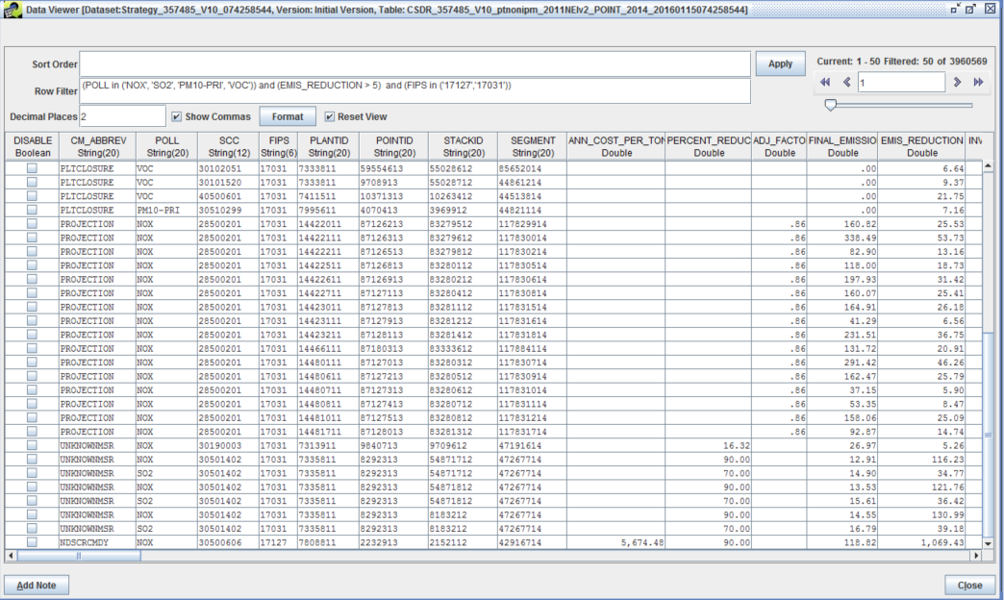
Example Detailed Result
(selected columns)

Slide 49
Control Strategy Tool:
Sectors/ Relative Complexity
Some packets shared over multiple sectors, some packets contain several sources of data/programs
Fugitive dust (afdust), ag NH3 (ag), RWC, CMV & trains (cmv, rail, othpt):
  1 projection packet for each sector
Oil & gas nonpoint (np_oilgas):
  4 packets
Remaining nonpoint (nonpt):
  10 packets
Oil & gas point (pt_oilgas):
  15 packets
Non-EGU point, not oil & gas (ptnonipm):
  22 packets

Slide 50
Projections:
Quality Assurance
CoST detailed summaries
Numerous template options in EMF for Structured Query Language (SQL)-based QA reports
  By control program
  Geography (e.g., state, county)
  Source classification code (SCC)
  Can limit pollutants in summary
  Option to show “unaffected” sources
Can also create custom reports and summaries
CoST filter/sorts, export to CSV

Slide 51
Questions?
Any questions on the Control Strategy Tool?

Slide 52
Nonpoint Projections

Slide 53
Data Sources for Nonpoint Projections
Energy Information Administration/Annual Energy Outlook
  Oil & gas, industrial sources, VMT
Data from multiple EPA offices
  Office of Research and Development: animal NH3
  Office of Air Quality Planning and Standards: RICE NESHAPs, regional haze, consent decrees, oil & gas, RWC, CISWI
  Office of Transportation and Air Quality: commercial marine vessels, trains, portable fuel containers (PFCs), upstream emissions
  Office of Atmospheric Programs: oil & gas
  Office of Enforcement and Compliance Assurance (OECA): consent decrees
Outside agencies
  State/local/regional: closures, projections, ICI boilers, fuel sulfur
  Federal Aviation Administration: aircraft
  Contractors: projections and controls for industrial sources including oil & gas, RWC
Collaboration needed to determine “most-appropriate” data for each source category

Slide 54

Nonpoint Projections:
Ag NH3
Animal-specific livestock only (no fertilizer approach; fertilizer future year = base year)
Based on national population estimates from the USDA and Food and Agriculture Policy and Research Institute (FAPRI)
Historical trends comparing number of animals vs production rates, net impact through 2027:
  Little/no change (growth) for dairy cows, turkey
  Very slight increase beef
  Increases in pork, broilers, layers
  and poultry

Slide 55
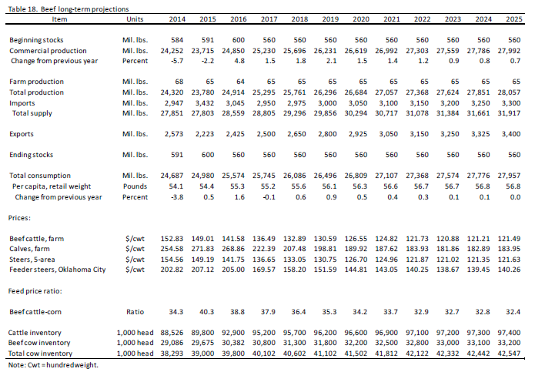

Nonpoint Projections:
Ag NH3 (continued)
  Projection Factor:
  $$1+\frac{Projection year value −Base year value}{Base year value}$$
  Example: 2014 projected to 2016
  $1+\frac{(30,382−29,086)}{29,086}$ = 1.04
~

Slide 56
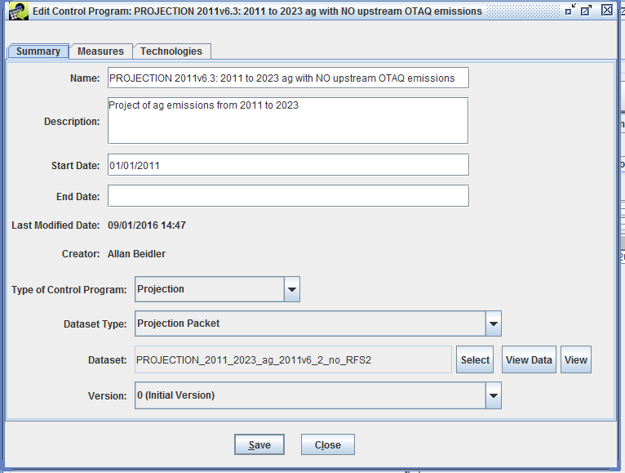
Ag Control Program
Select a dataset
for the control
program then
view the data…

Slide 57
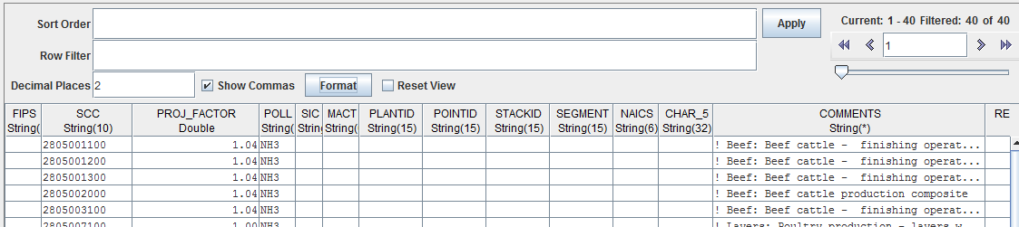

Nonpoint Projections:
Ag NH3 (continued)
  Emissions Example (projecting 2014 to 2016):
  By corresponding SCC:
  $$2014 {NH}_{3} Emissions x \text{PROJ}\text{_}\text{FACTOR}=2016 {NH}_{3} Emissions$$
  * If State or Regional data were available, this calculation would apply the corresponding projection factor based on FIPS and SCC

Slide 58
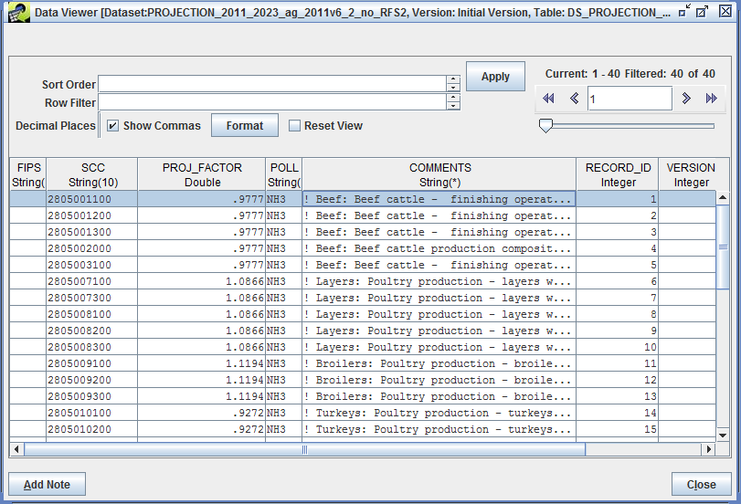
Example Ag Projection Packet
(selected columns)

Slide 59

Nonpoint Projections:
Fugitive Dust
  Impacts unpaved and paved road dust only
  Function of VMT on roads
  Onroad VMT projected to future year using AEO
  County projection factor equation
    PROJFAC = (Future-year total county VMT)
                (Base-year total county VMT)
  Future emis = PROJFAC * base emis

Slide 60
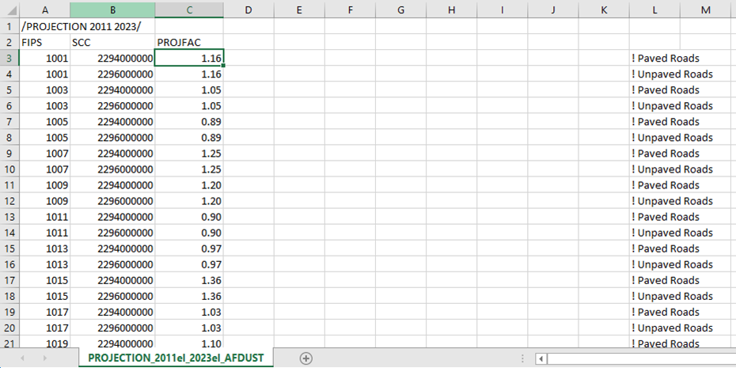
Example Fugitive Dust Packet

Slide 61
QA of ag/afdust Projections
Compare base and future year emissions to ensure that factors were properly applied
Create percent and absolute difference maps to make sure that results are as expected
Note: Future year fugitive dust inventories undergo meteorological and transport fraction reductions like the base year ones do

Slide 62
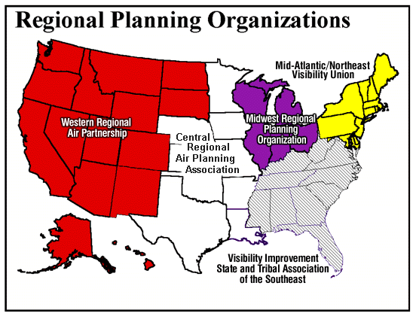
Regional Haze RPOs
Source: https://www.epa.gov/visibility/
visibility-regional-planning-organizations

Slide 63
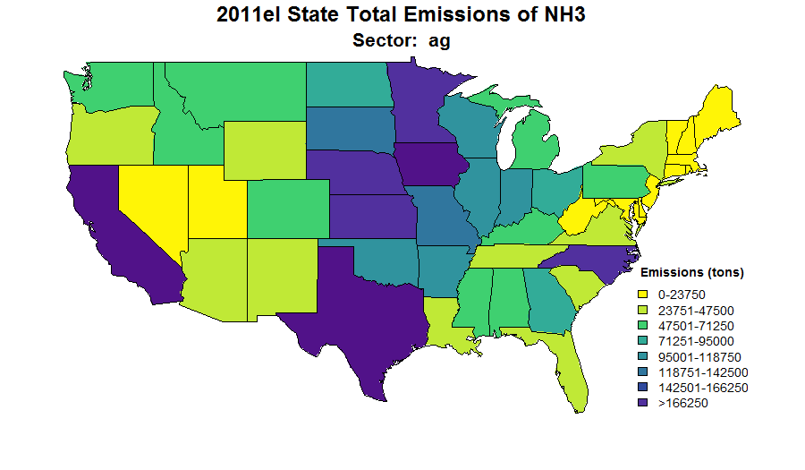
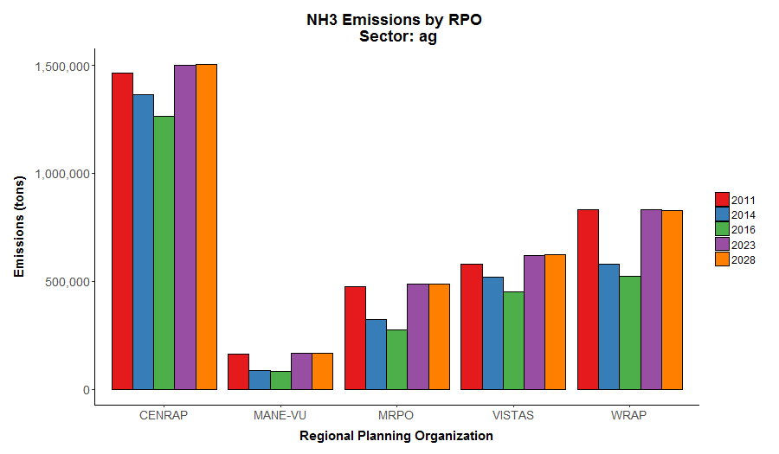
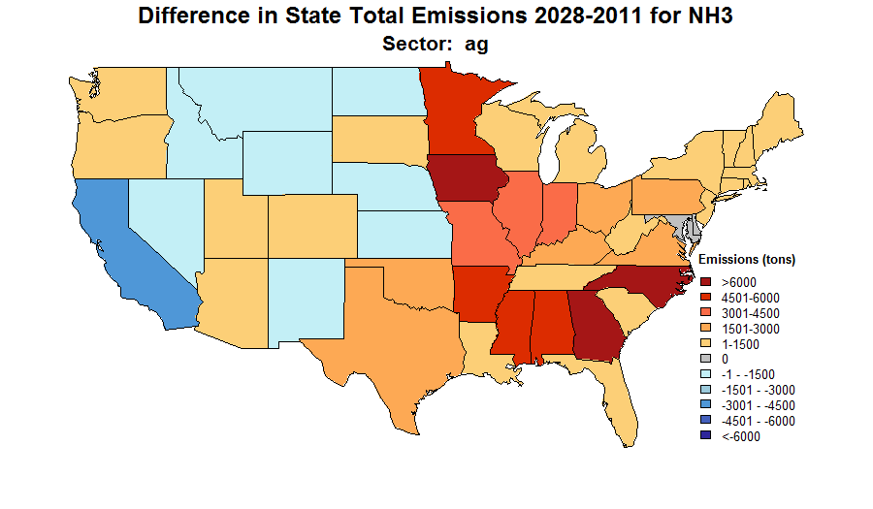
Changes in ag emissions 2011-2028
1,500,000
CENRAP MANE-VU MRPO VISTAS WRAP
Notes:
Mention negatives are blue and means emissions are decreasing, red increasing

Slide 64
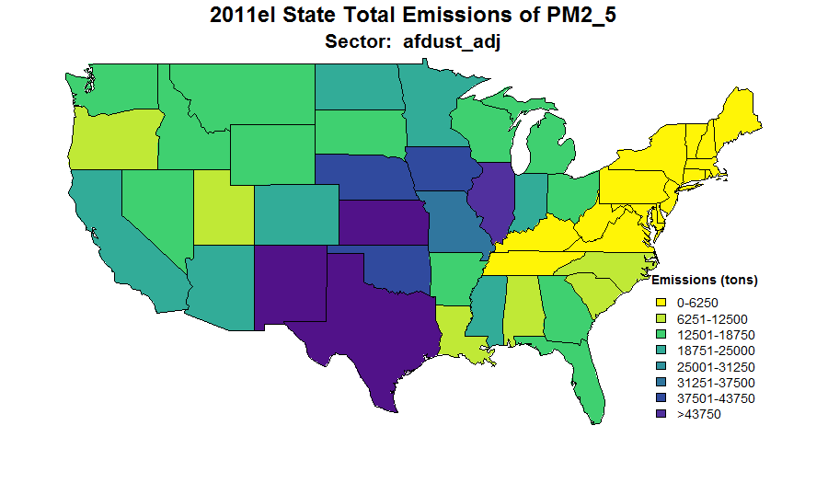
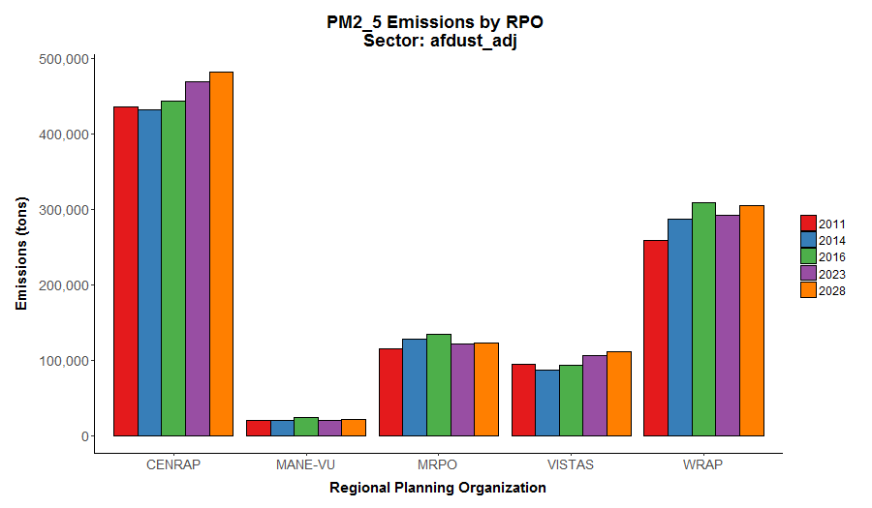
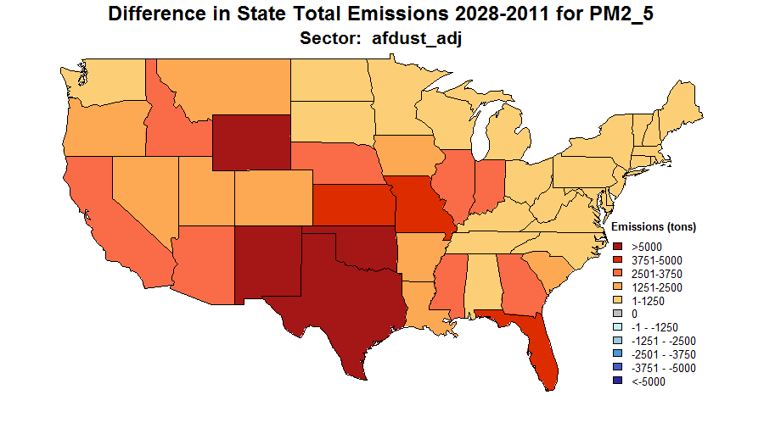
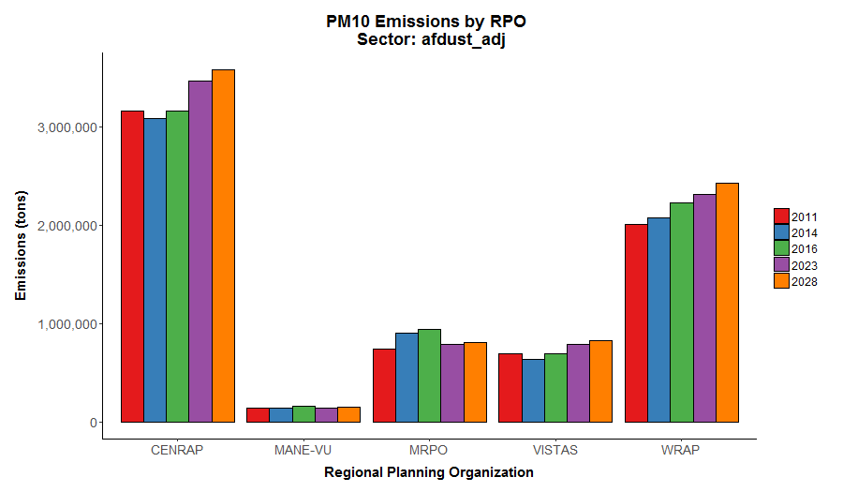
Changes in afdust emissions 2011-2028
500,000
CENRAP MANE-VU MRPO VISTAS WRAP
3,000,000

Slide 65
Questions?
Any questions on ag or fugitive dust projections?

Slide 66
Nonpoint Projections:
Residential Wood Combustion
Growth derived from year 2012 appliance shipments and forecast revenue forecasts (e.g. US Bureau of Economic Analysis)
Updated to include recently promulgated NSPS for ‘wood heaters’: http://www2.epa.gov/residential-wood-heaters/final-new-source-performance-standards-residential-wood-heaters
Net decrease rather than increase in RWC emissions vs business as usual approach in prior platform
Reflect year 2015 rulemaking and minor corrections
Appliance-specific retirement/replacement rates for most sources
“No-change” assumption used in western states: WA, OR, CA
Burn bans not addressed in 2011 platforms

Slide 67
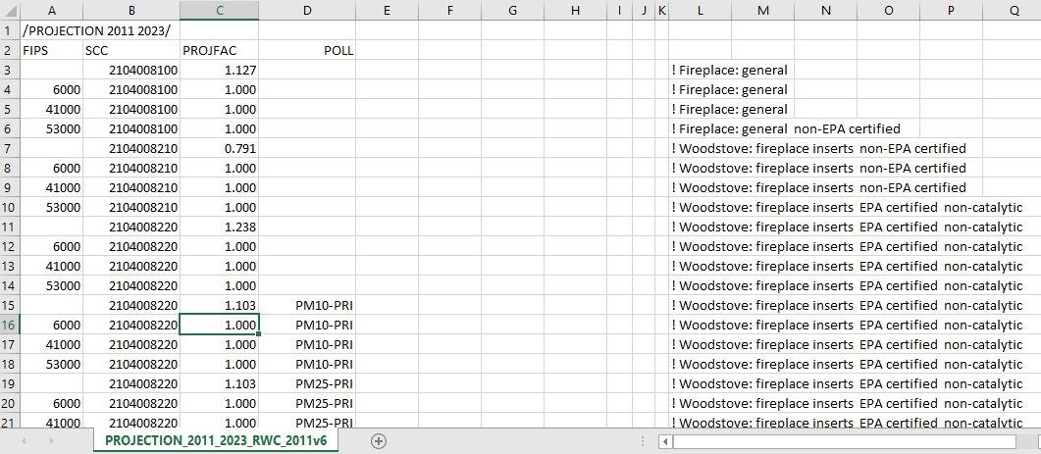
Packets for RWC projections
PROJECTION_2011_2023_RWC_2011v6_3_csv_02sep2016_v0.txt
BETA_Projections_RWC_2023_18apr2016_emf_csv_02sep2016_v0.txt
List the packets from our platform

Slide 68
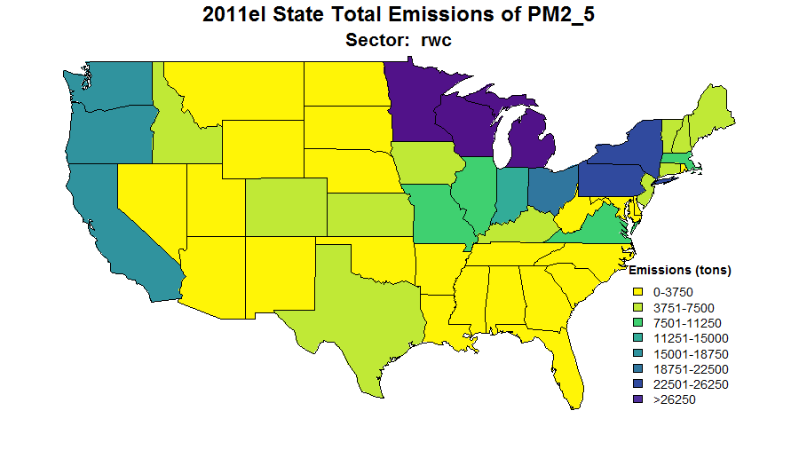
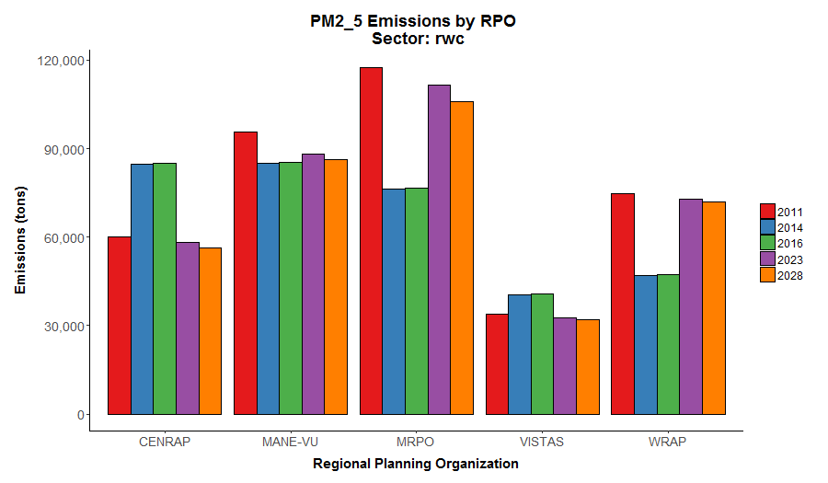
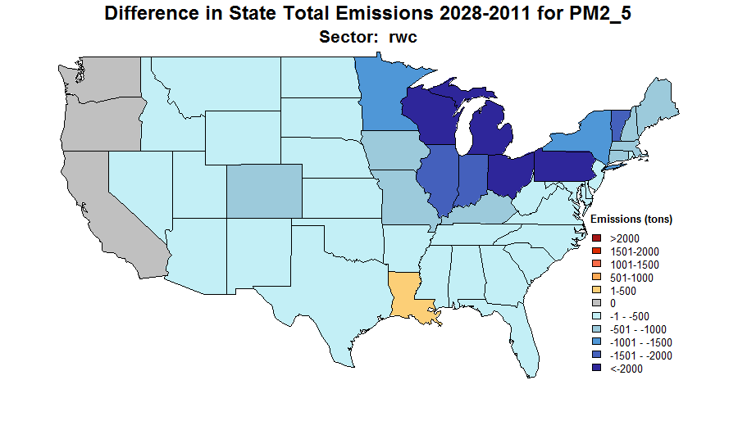
Changes in RWC Emissions 2011-2028
120,000
CENRAP MANE-VU MRPO VISTAS WRAP
Change in methodology
between 2011 and 2014 NEI
causes inconsistencies between
2014 and 2011-based projections

Slide 69
Non-EGU Projections:
CMV and rail
Rail includes on-rail line locomotives
  Yard Locomotives in point source inventory
The future year cmv and rail emissions account for increased fuel consumption based on Energy Information Administration (EIA) fuel consumption projections for freight
Regulatory programs:
  Final Locomotive-Marine rule for engines less than 30L/cylinder, Clean Air Nonroad Diesel Rule
  Category 3 marine diesel engines Clean Air Act and International Maritime Organization Standards
    CMV Exclusive Economic Zone (EEZ) reductions:
    SO2 reductions in EEZ 200 nautical miles from state waters by 2015, and implemented globally by 2020

Slide 70
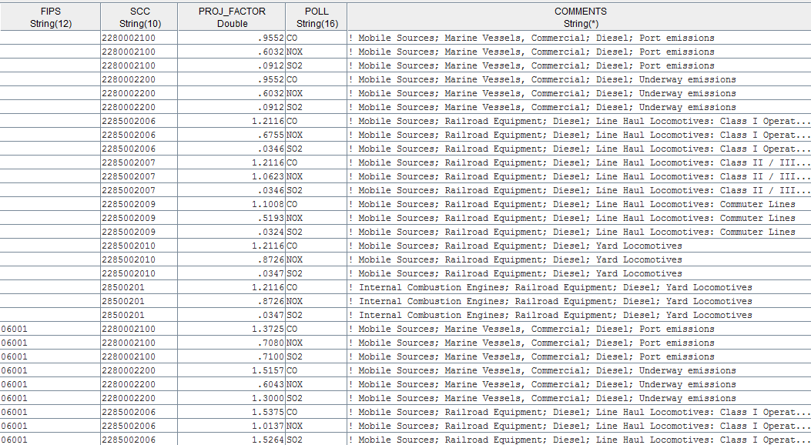
Example Projections for CMV/rail
Notes:
Note differences by pollutant and different factors for California

Slide 71
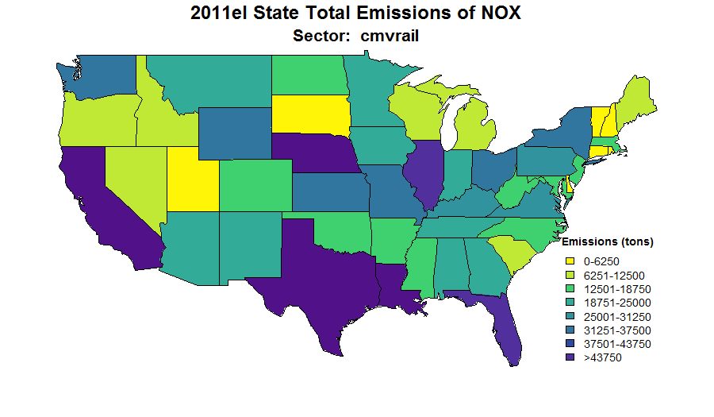
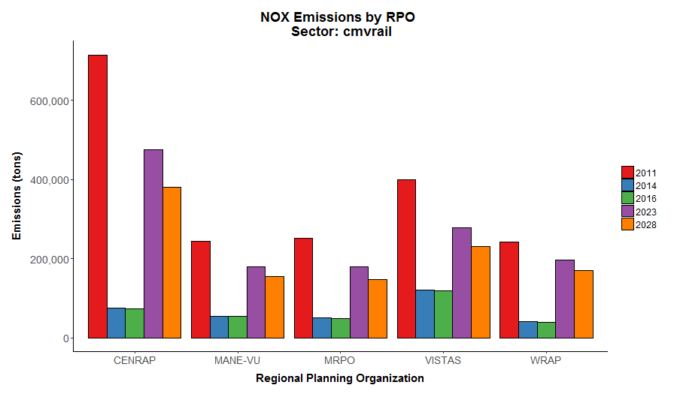
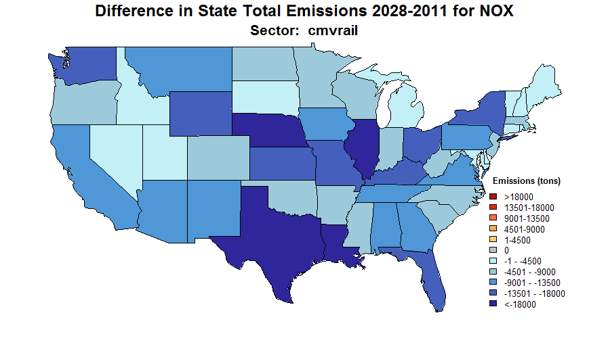
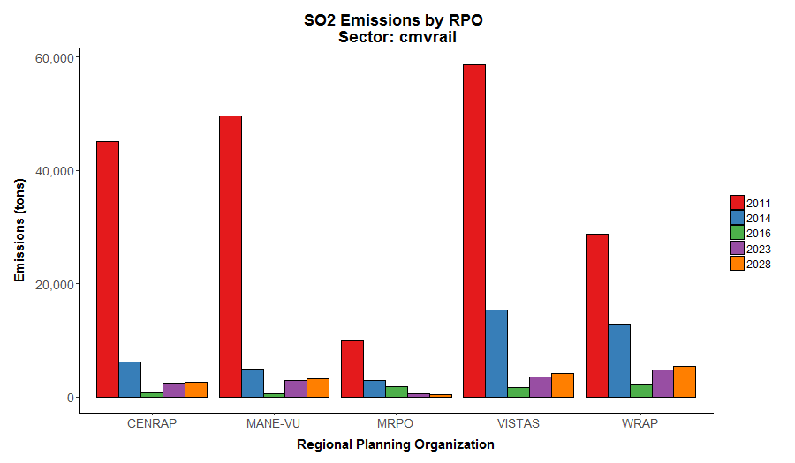
Changes in CMV/Rail NOx 2011-2028
700,000
CENRAP MANE-VU MRPO VISTAS WRAP
60,000

Slide 72
Questions?
Any questions on RWC, CMV, or rail projections?
Break

Slide 73
Oil and Gas Projections
Volatile sector; growth changing frequently
Various approaches
  Pros and cons of each
Various data sources
  State historical data
  AEO publicly available tables
  AEO internal tables (EIA)

Slide 74
Oil and Gas Projections Overview
Recent platforms use 2016/2017 AEO production data to estimate activity in future years
Use of state historical production data to capture growth from 2011 to 2015 or 2016
O&G VOC New Source Performance Standards (NSPS) application
NSPS (NOX) for Process Heaters, Internal Combustion (IC) Engines and Turbines
Includes both point and nonpoint sources
  Point: Production, Pipelines, other supporting activities
  Non-point: Production
Includes comments from states and regional planning organizations on the 2011 platform

Slide 75
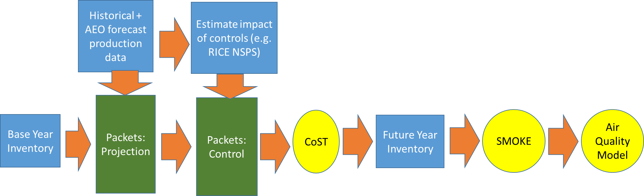
How growth factors are applied and emissions are then reduced

Slide 76
Oil and Gas Projections: Basin level production forecasts from 2011v6.2

Slide 77
Oil and Gas Projections: Basin-level
AEO table/data generated internally by EIA; not always readily available to public
Presents detailed information for some portions of the oil and gas sector
This approach can result in some “mass balance” issues when trying to match up with the total US production
  Some unrealistic changes outside of the basins
Used this approach using 2011v6.2 modeling platform

Slide 78
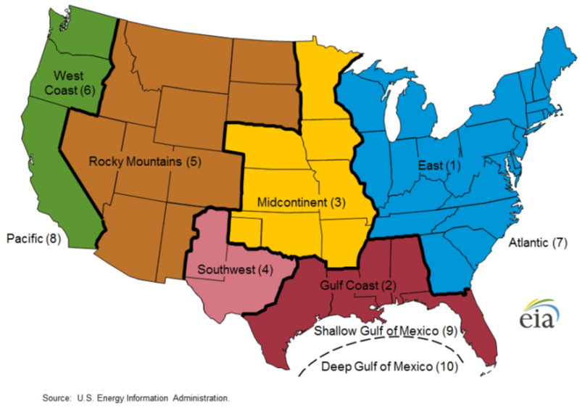
Oil and Gas Projections:
NEMS (or Supply) Regions

Slide 79
Oil and Gas Projections:
Supply Region-level (2011v6.3 2023)
AEO2016 Tables: Region production
  Table 60: Lower 48 Crude Oil Production
  Table 61: Lower 48 Natural Gas Production
AEO2016 Tables: National production
  Table 14: Oil and Gas Supply
    Coalbed Methane production
    Natural Gas Liquids production
    Offshore production: State-owned sources only
Develop SCC-oil/gas/both cross-reference to apply regional/national factors

Slide 80
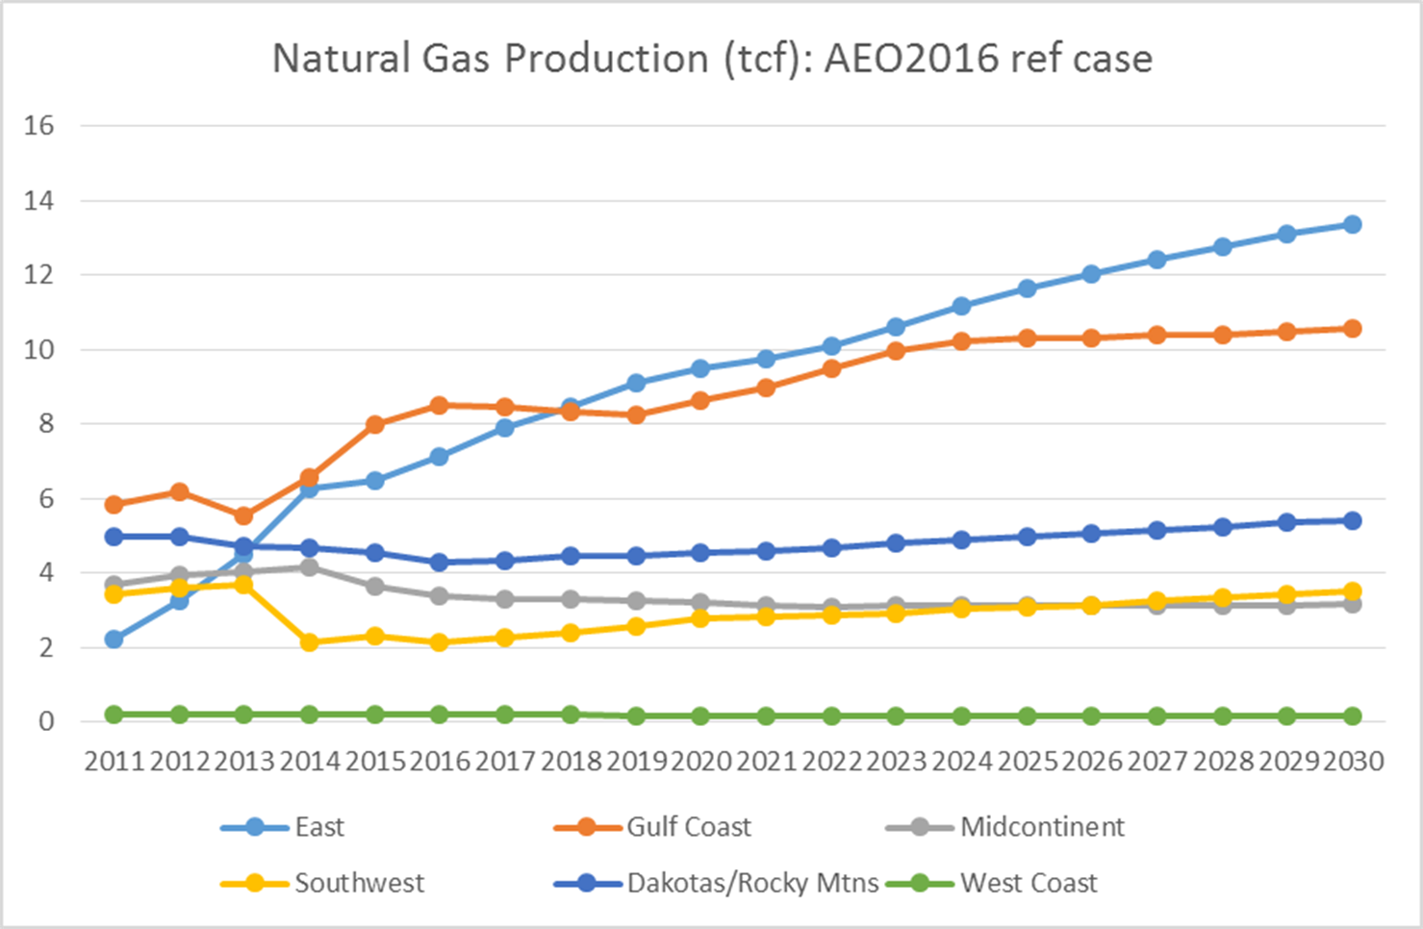
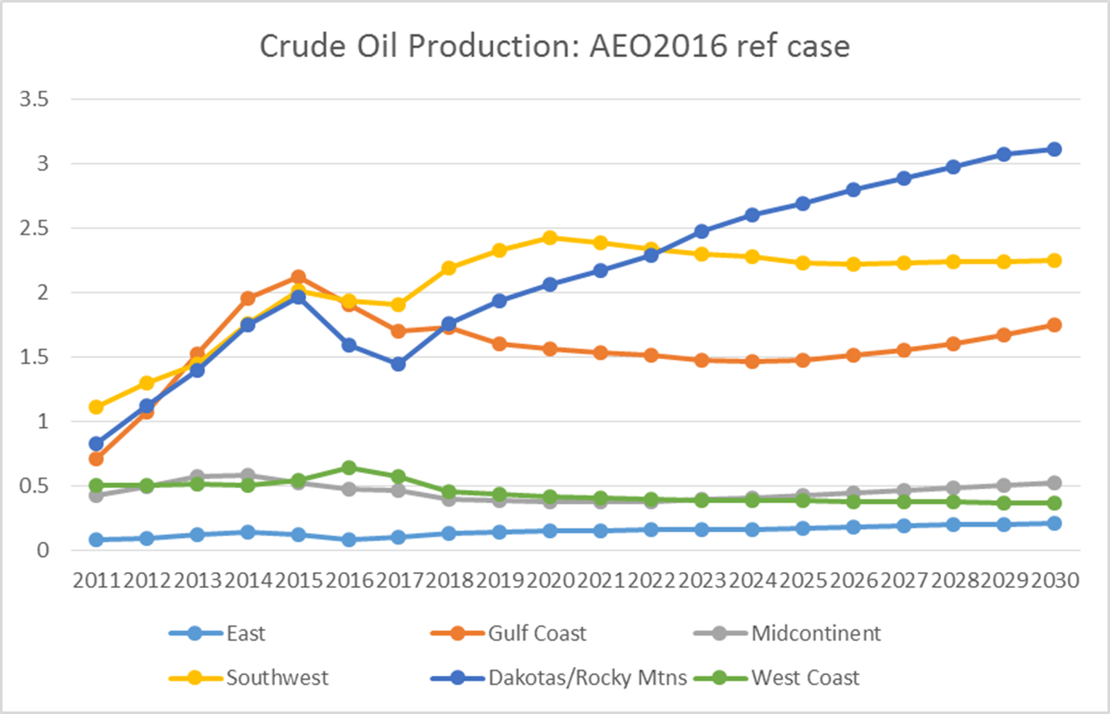
Oil and Gas Projections:
Supply Region-level
Applied this method for 2011v6.3 modeling platform along with state-specific factors supplied from MARAMA
Large regions where only 2-3 states make up the bulk of the production can cause issues with smaller-producing states in the region

Slide 81
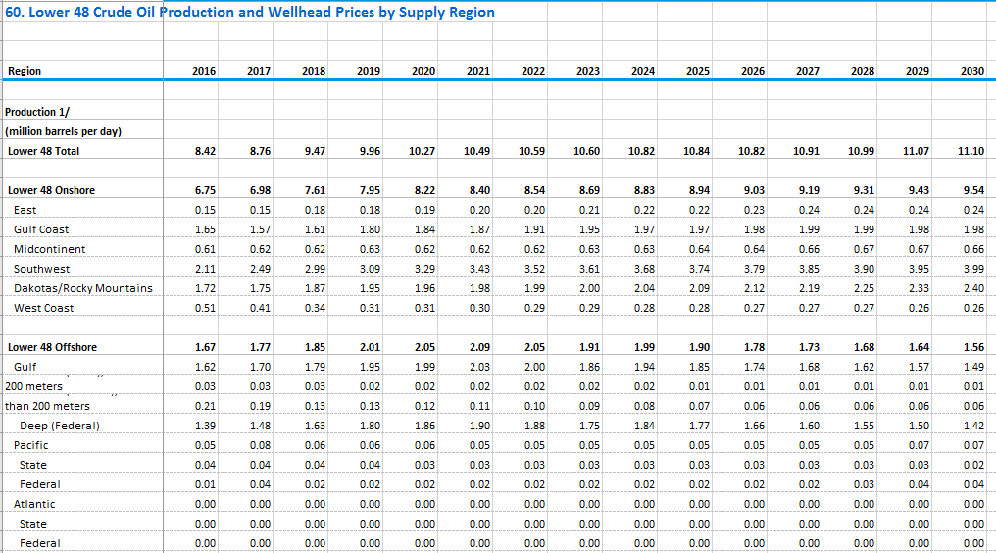
AEO Supply Region example

Slide 82
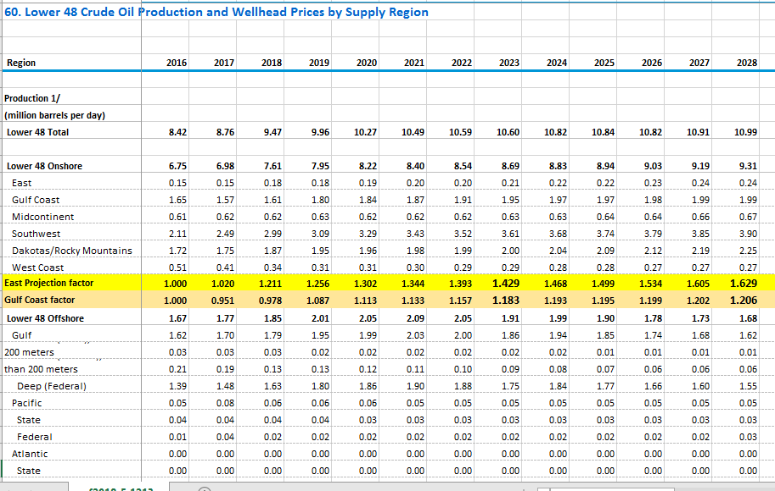
AEO Supply Region Example (2)

Slide 83
Oil and Gas Projections: Historical state data bridge to Supply Region-level forecast
Historical state production data publicly available on EIA website used to project sources from base year to a recent year (e.g. 2015 or 2016)
http://www.eia.gov/dnav/ng/ng_sum_lsum_a_epg0_r20_bcf_a.htm
http://www.eia.gov/dnav/pet/pet_crd_crpdn_adc_mbbl_a.htm
Can then use AEO Supply Region production forecasts to project from 2015 to desired future year
Some adjustments based on historical trends for “low production” states may be needed
Combine factors to get a state-specific projection factor from base year to desired future year
Use SCC-oil/gas/both cross-reference to apply state-specific factors

Slide 84
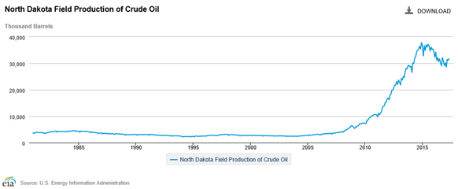
Oil and Gas Projections: Historical state data + AEO Supply Region
Historical state change
AEO Supply Region change
X
Combined Factors representing both historical state data and AEO supply region change for each state

Slide 85
Oil and Gas Projections:
NSPS Controls
For future-year NSPS controls (oil and gas, RICE, Natural Gas Turbines, and Process Heaters), we attempted to control only new sources/equipment
  Accounts for growth and retirement of existing sources and the differences between the new and existing source emission rates
Control_Efficiency (%) = 100 * (1- [(P_{f}-1)*Fn + (1-Ri)^{t} + (1-(1-Ri)^{t})*Fn]/ P_{f})
  P_{f} = growth rate expressed as ratio (e.g., 1.5=50% cumulative growth)
  t = number of years between base and future years
  Fn = emission factor ratio for new sources
  Ri = retirement rate, expressed as decimal (e.g., 3.3%=0.033)

Slide 86




Changes in Nonpoint Oil/Gas 2011-2028
400,000
CENRAP MANE-VU MRPO VISTAS WRAP
1,500,000

Slide 87




Changes in Point Oil/Gas 2011-2028
250,000
CENRAP MANE-VU MRPO VISTAS WRAP
100,000
Notes:
Note: RPO to state map is in ag/afdust section
Note: CENRAP includes some states going up and others going down

Slide 88
Possible Future work for Oil and Gas Projections
Examine methods to take basin-level information into account where possible
Include state historical data
Better incorporate state and any updated federal regulations on emissions
Improve SCC cross references to account variability in state-provided SCCs
  Some states submit with different SCCs than others

Slide 89
Questions on Oil and Gas Projections?

Slide 90
Non-EGU Point Projections:
Aviation
Aircraft emissions are in ptnonipm sector
Projected itinerant ITN (i.e., take off and landing) operations information available from the Federal Aviation Administration’s (FAA) Terminal Area Forecast (TAF) System:
https://www.faa.gov/data_research/aviation/taf/
Two sets of projections factors used:
  State-level for low traffic airports
  Airport specific factors for larger airports
Notes:
Review source data for background info

Slide 91

Example Projection Factors for Aviation

Slide 92
Non-EGU CoST Packets
Name
CLOSURES 2011v6.2 ALL: dates corrected 31aug2015
CONTROL 2011v6.2: 2014+ Fuel Sulfur Rules
CONTROL 2011v6.2: MARAMA-EPA Hybrid ICI Boiler MACT
CONTROL 2011v6.2: OilGas VOC NSPS for 2018
CONTROL 2011v6.2: POINT, 2011 to 2017 Consent decrees and (2018 docket) comments
CONTROL 2011v6.2: POINT, 2011 to 20XX AZ Regional Haze
CONTROL 2011v6.2: RICE NESHAP Final Amendments
CONTROL 2011v6.2: SCA Gas Turbines NSPS NOX for 2018
CONTROL 2011v6.2: SCA Process Heaters NSPS NOX for 2018
CONTROL 2011v6: CISWI
CONTROL: NCDAQ_CONTROL_2011v6_2_2017_BoilerMACT_POINT_v2_102315
PROJECTION 2011v6.2: 2011 to 2017 Aircraft BY AIRPORT and state-level
PROJECTION 2011v6.2: 2011 to 2018 LADCO POINT
PROJECTION 2011v6.2: 2011 to 2018 SCA NAICS/SCC-level CAPPED2.5
PROJECTION 2011v6.2: 2011 to 2018 SCA POINT SCC-level CAPPED
PROJECTION 2011v6.2: 2011 to 2018 SRA POINT CAPPED
PROJECTION 2011v6.3: 2011 to 2017 OK Source from NODA
PROJECTION 2011v6: 2011 to 2018 TCEQ ptnonipm NAICS
PROJECTION 2011v6: 2011 to 2018 state comments
PROJECTION by CENSUS DIVISION: 2011 v1 to 2018 ISIS cement policy

Slide 93
Non-EGU Control Packet:
ICI Boiler (MACT)
EPA-MJO “hybrid” method:
  Council of Industrial Boiler Owners (CIBO) data was collected and analyzed to determine how boiler emissions might change due to regulations and economics (i.e., replacements and conversions)
  Impacts nonpoint and specific point sources
  Includes NO_{X} cobenefits
  Set of fuel-based control assumptions (i.e., coal, distillate and residual)
Includes some state comments plus rules for NY, NJ

Slide 94
Non-EGU Projections:
Non-CoST
Some future-year sources do not exist in the NEI for the base year
  Biodiesel and cellulosic ethanol plants
  Other sources added based on comments
Take emissions for these sources as they are reported / provided
  These are put into separate inventory files
  Hard to project to additional future years

Slide 95



Non-EGU Projections:
Petroleum Refineries – NESHAP RTR
  Rule effective February 2016 – VOC reductions from controls at delayed coking units and storage vessels
  Across-the-board control factor for impacted units
    84% for delayed coking units; 49% for storage vessels

Slide 96

Non-EGU Projections:
CISWI Units – NSPS and Emission Guidelines
  Considers the MACT for incinerators, energy recovery units, waste-burning kilns, small, remote incinerators
  All impacted units are to have control devices in place by 2018
Existing control devices and baseline emissions based on a 2008-2009 Information Collection Request
Floor emissions represent all units’ emissions after employing least-cost controls to meet MACT standard

Slide 97




Changes in Non-EGU Point 2011-2028
300,000
CENRAP MANE-VU MRPO VISTAS WRAP
300,000

Slide 98
Projections High-level impacts: ptnonipm sector NO_{X}
CoST can isolate the impact of each control/projection packet

Slide 99
Non-EGU Projections:
Challenges/Limitations
Response to comments on prior platforms:
  Many different sources of data – need to correctly layer these so appropriate controls/projections apply
  Some data provided for a complete range of years, but other data provided for 2023 and 2025 and not for 2028
Promulgated vs proposed rules vs SIP inventories are confusing
Rapidly-changing world!
  2018 AEO recently out + 2014 NEI v2 just released

Slide 100
Questions on Non-EGU Point?

Slide 101
EGU Projection Methods
EPA historically used the Integrated Planning Model (IPM)
  IPM models sources that exist in the National Electric Energy Data System (NEEDS) database
  Versions upgraded over time to account for new AEO data and comments on units retiring and implementing controls
  Output emissions are “dropped in” to replace ptegu emissions that were used in the base year
For 2023en case, engineering analysis was used
  Incorporated historic 2016 emissions and other known upcoming changes to project to 2023
ERTAC EGU was developed by MJOs
  Used for planning purposes

Slide 102
EGU Projections with IPM
EGUs are identified in the NEI point inventory by filling in the IPM_YN column of the flat file
  Populated from a set of alternate IDs stored in EIS
  Sometimes there are not 1-1 matches between NEI and NEEDS database used by IPM
IPM reflects impacts of rules in intervening years
IPM 5.16 produces outputs for these years:
  2020, 2023, 2025, 2028, 2030, 2035, 2040, 2045
IPMv6 (coming soon) outputs for 2021-2050
  Updated inputs, assumptions, and features
More information on IPM is available here: https://www.epa.gov/airmarkets/clean-air-markets-power-sector-modeling

Slide 103

Future year EGU Processing with IPM
Parsing
happens
here

Slide 104

Map of IPM Output Regions – also used to create Non-CEMS profiles

Slide 105
Flat Files Created from IPM Outputs
IPM regional, seasonal outputs are converted to a Flat File format that can be input to SMOKE
  For a specific model output year, parse results to unit-level for each season (Pollutants = NO_{x}, SO₂, Hg, CO₂)
  SMOKE-ready Flat file is created from parsed file
    Cross reference from National Electric Energy Data System (NEEDS) to NEI units is used to assign NEI-compatible IDs, locations, stack parameters (improved with state review)
    PM emissions are created as a postprocess based on emission factors, fuel, and control information
The base year EGU inventory is fully replaced by the flat file inventory output from IPM
  IPM results not used in air quality modeling for municipal waste combustors, geothermal, nuclear, wind, solar, or hydro

Slide 106
EGU Temporal Allocation for Future Years
For sources with CEMS that exist in both base and future years, allocate seasonal emissions to base year (2011 or 2016) hourly temporal pattern of CEMS data by pollutant (i.e., NOx, SO2)
  Compute hourly ratio for each hour of season in base year and multiply that by the seasonal total to get the future year hourly emissions
Units not matched to CEMS data (aka “non-CEMS”) are temporalized using fuel- and pollutant-specific regional average profiles to allocate emissions to month, then day, then hour
  Method is also used for new units, units with no base year emissions, units that change fuels from base to future, and units with large predicted increases in emissions

Slide 107

Example Temporal Plots: base year, unit-specific, regional
Compute fraction
of emissions @ each
hour of the season
(winter/summer)
2. Future emissions @
each hour = seasonal
emissions * hourly factor
Seasonal emissions going down in
this example
CEMS-based profile (green) has service gaps
Regional average profile (red) does not include gaps

Slide 108
Adjust Emissions Below Historic Maximum
When emissions
are found to go above
the historic maximum,
allocate the excess
evenly to other hours

Slide 109
Regional Profile Applied that Exceeds Historic Maximum

Slide 110
Use Regional Profile when Cannot Adjust below Historic Maximum
See 2023en emissions modeling TSD for more details

Slide 111




Changes in EGU emissions 2011-2028
1,500,000
CENRAP MANE-VU MRPO VISTAS WRAP
500,000

Slide 112

Questions?
Any questions on EGU projections?

Slide 113
Onroad Emissions Modeling
Met. Data from WRF
Meteorological
Preprocessor
(Met4Moves)
MOVES
Temperature ranges,
rel. humidity
Run MOVES to get emission factors (EF) for representative counties for each temperature and speed needed
Gridded met
EF tables
Use representative EFs and county/ grid-specific activity data and meteorology to create emissions for all counties
Activity Data
SMOKE
AQ model-ready files

Slide 114

Representative Counties
3000+ counties are mapped to approx. 300 representative counties according to: state, fuels, light duty age distribution, ramp fraction, I/M programs, emissions standards
Notes:
Emphasize the county specific activity and the grid specific meteorology is used even if using rep counties.

Slide 115

Onroad Projections Overview

Slide 116
Onroad Projections Overview
MOVES2014a is used to develop emission factors for light-duty and heavy-duty vehicles
Main components adjusted for projections:
  Regulatory impacts (e.g., Tier-3, LD & HD GHG/CAFE standards, Modifications to Renewable Fuel Standard (RFS2), Mobile Source Air Toxics Rule (MSAT), California LEVIII)
  Fuel composition changes
  Inspection and Maintenance (I/M) programs
  Vehicle age distributions (in some cases)
  Vehicle Miles Traveled (VMT) and other activity data
  Most of these changes are included in the approximately 300 representative county databases from which emission factors are computed
  SMOKE combines activity data and emission factors
Notes:
CDB is where you update age distribution/fleet mix, I/M program. MOVES databases for LEV standards and regional fuel changes by year. Regulations are controlled by MOVES; NC provided separate speed data for 2011 vs 2017

Slide 117
Onroad Emission Processes and Inputs
On-roadway emissions
  Exhaust, evaporative, evaporative permeation, refueling, brake and tire wear
  Primary inputs: vehicle miles traveled (VMT), average speeds, speed profiles, and temperature (gridded, hourly)
  Known as rate-per-distance (RPD)
Off-network emissions (i.e. parked vehicles)
  Exhaust from starts, evaporative, evaporative permeation, refueling, hot soak (after a trip) [rate-per-vehicle (RPV)]
  Evaporative fuel vapor venting and diurnal (when vehicles are parked for a long period) [rate-per-profile (RPP)]
  Primary inputs: vehicle population (VPOP) and Temperature (gridded, hourly, daily min/max)
Hoteling:
  Extended idle and auxiliary power units (APU) for combination long-haul trucks
  Primary inputs: Hoteling hours and T (gridded, hourly) [rate-per-hour (RPH)]
Notes:
VMT and HOTELLING are temporalized, others aren’t

Slide 118
Onroad Projections Details
Constant between base year and future year
  Meteorology
  Representative counties
    If change representative counties, will create artificial spatial inconsistencies between base and future years
  Spatial surrogates for gridding
  Speeds (usually)
  Temporal profiles
Speciation is not constant
  Dependent on model year, fuel, etc.
Approaches differ for short-term vs mid-term
  MOVES CDBs updated and runs done for both
Notes:
CDB is where you update age distribution/fleet mix, I/M program. MOVES databases for LEV standards and regional fuel changes by year. Regulations are controlled by MOVES; NC provided separate speed data for 2011 vs 2017

Slide 119
Short-term Projection for 2016
FHWA provided urban / rural county-level VMT for 2016
  By road type: interstate, freeways, arterials, collectors, local
2016 VMT projected from 2014NEIv2 using state+urban and state+rural factors derived from FHWA VM-2 tables
  https://www.fhwa.dot.gov/policyinformation/statistics/2014/vm2.cfm
  https://www.fhwa.dot.gov/policyinformation/statistics/2016/vm2.cfm
  Use state overall factors when changes in urban/rural definitions between caused factors to be more different than they should be for two years of change
  State DOT web sites can sometimes have different trends than FHWA
Preserved 2014v2 ratio of VMT/hoteling hour for long-haul combination trucks in 2016
Preserved 2014v2 ratio of VMT/vehicle was in the 2016 vehicle Population (VPOP)
QA: Compare original and projected activity data

Slide 120




Onroad NOx: 2016 vs 2014NEIv2
Notes:
Numbers aren’t important, changes due to fleet turnover – newer vehicles more efficient; ND VMT is going down

Slide 121
Onroad Changes 2011 to 2016

Slide 122

Mid-term VMT projections 2011v6.3 Platform
Activity data for mid-term projections based on AEO2016
  Light-Duty gas, diesel and E-85
    Table 42: LD vehicle miles travelled by technology type
      Motorcycles, cars, light-duty trucks
  Heavy-Duty gas and diesel, Bus CNG
    Table 50: Freight Transportation Energy Use
      Heavy-Medium (Buses and Single Unit trucks)
      Heavy (Combo Unit Trucks)
  Geographic variation using projected
  human population data

Slide 123

AEO example

Slide 124

AEO example

Slide 125
VMT projections variation (1 of 2)
Use AEO2016 to get magnitude of change
Adjust light duty (LD) VMT projections geographically based on expected human population changes
Analysis indicated strong correlation between population and LD VMT
Correlation between population and medium and heavy duty (MD/HD) VMT is not as strong
  Use national factors for medium and heavy duty

Slide 126


VMT projections variation (2 of 2)
LD VMT projections for 2025
National projection
With county adjustment
Notes:
Point out that there is variation even in the national projection b/c of difference mix of vehicle/fuels by state/county

Slide 127
Onroad Projection Details
Vehicle Population (VPOP) uses same projection factors as VMT
Speciation
  Changes in model year and fuels impacts not only the emissions but the speciation
  Speciation internal to MOVES2014- makes it possible to consider detailed model year, regulatory class, and fuel information
Hoteling
  Calculate the total hoteling hours from future year combination long-haul restricted VMT
  Split between auxiliary power units (APUs) and extended idling (EXT) changes in future years due to greater penetration of APUs

Slide 128

Onroad Hoteling
Hoteling = Overnight truck idling: extended idle and APU
Temporal profile opposite of truck driving hours
Spatial surrogate is based on truck parking spaces
Notes:
Not idling at ports or bus stops, really about requirement to hotel for the long-haul trucks
Consider mentioning APU splits

Slide 129




Changes in Onroad emissions 2011-2028
1,500,000
CENRAP MANE-VU MRPO VISTAS WRAP
50,000

Slide 130
Nonroad Projections
Nonroad sector = Exhaust, evaporative, and refueling emissions from nonroad engines (not including CMV, aircraft and locomotives)
  Construction equipment, recreational marine, lawn & garden
Now within MOVES2014a, previously used National Mobile Inventory Model (NMIM)
Regulatory programs:
  Nonroad spark-ignition engines
  Locomotive & marine engines less than 30L/cylinder
  Clean Air Nonroad Diesel Final Rule
Same input county databases as base year
Run for future year with appropriate MET/fuels
  Meteorology is consistent with base year
  Fuels should be consistent with future year and ideally with onroad fuels
Use CARB data for California
Change VOC speciation to account for shift toward 10% ethanol fuels
MOVES2014b coming this summer has updated growth factors

Slide 131




Changes in Nonroad emissions 2011-2028
400,000
CENRAP MANE-VU MRPO VISTAS WRAP
40,000

Slide 132
Questions on onroad or nonroad projections?

Slide 133
International Projections
Canada
  Base year is 2013
  Projected 2025 Canadian inventory
  Interpolate to intervening years
Mexico
  Interpolate MOVES-Mexico as needed between 2014, 2017, 2020, 2023 and 2028
  Mexico point, nonpoint, nonroad inventories projected to years 2018, 2025 and 2030 and interpolate as needed

Slide 134
Ongoing work and New Directions
2016 modeling platform
  Workgroups underway
  Preparing emissions for 2016, 2023, 2028
  Alpha platform for 2016 only currently available
  Beta platform expected summer-fall
  V1.0 platform expected winter, 2019
Possible New Directions
    Projections of changes in land use/population
      Surrogates, New sources, Biogenics, Ag fertilizer
    Fires: Impact on biogenics, future year modeling treatment

Slide 135
Emissions Modeling Software and Data Downloads
The CMAS Center distributes many tools (https://www.cmascenter.org/)
  SMOKE, CMAQ, VERDI (visualization), the Surrogate Tool, Spatial Allocator, Speciation Tool, and the Control Strategy Tool which includes the Emissions Modeling Framework
SMOKE software and documentation is available from http://www.cmascenter.org/smoke
  A WIKI for SMOKE that answers common questions about emissions modeling is here: https://www.airqualitymodeling.org/index.php

Slide 136
Emissions Modeling Platform
Data Availability
EPA’s modeling platform data, documentation, scripts available from
  https://www.epa.gov/air-emissions-modeling
  Version 6 platforms include:
    2011v6.3: January 2017 NODA (2011el/2023el),
    Final Cross-State Air Pollution Rule (CSAPR) Update (2011ek/2017ek), hemispheric case
  Version 7.0 platform for NATA based on 2014NEIv1
  2016 alpha platform with compatible 2014 and 2015
  Spatial surrogates available for 4km, 12km, 36km
  Speciation data for CB05, CB6, SAPRC07TB
  Temporal profiles for all sectors

Slide 137

Questions?
Any final questions on the base year part of the training?
Please complete the course
evaluation at
www.tinyurl.com/EIAGsurvey
Contacts:
eyth.alison@epa.gov, Vukovich.jeffrey@epa.gov, farkas.caroline@epa.gov

