Slide 1
SPECIATE TRAINING
THURSDAY MAY 17, 1pm to 4:30pm
ROOM C111B

Slide 2

SPECIATE and Preparing VOC and PM chemical speciation profiles for air quality modeling
Madeleine Strum, EPA/OAQPS; Marc Menetrez, EPA/ORD

Slide 3
TRAINERS
Marc Menetrez, EPA ORD
Madeleine Strum, EPA OAQPS

Slide 4
COURSE OUTLINE
1:00 SPECIATE, SPECIATE 101
1:45 Speciation Concepts
2:30 Break
3:00 SPECIATE Data Gaps and Future Plan
3:45 Preparing Profiles for SMOKE
4:30 End of Class

Slide 5
CLASS OBJECTIVES
To introduce you to SPECIATE, its content and use
To introduce you to the SPECIATE Web Browser and its use
To provide an opportunity to ask questions about SPECIATE
To present the how the SPECIATE weight percent information gets converted to the speciation inputs used in SMOKE (GSPRO)

Slide 6
SPECIATE 101
What is Speciation?
What is SPECIATE?
The SPECIATE Data Browser

Slide 7

WHAT IS SPECIATION?
Speciation disaggregates inventory species (e.g. VOC, PM_{2.5}) into more detailed species
propane
ethylene
VOC
formaldehyde
acetaldehyde
ethanol
etc.
elemental carbon
organic carbon
nitrate
PM_{2.5}
sulfate
aluminum
silicon
iron
etc.

Slide 8
SPECIATION IN GENERAL (STEPS)
Emissions source for inventory pollutant, e.g. VOC, PM_{2.5}
Multiply inventory emissions by profile fraction to get emissions of specific chemical compounds
Assign Speciation Profile to source
100 tons of VOC
Solvent Utilization; Surface Coating; Architectural Coatings; Total: All Solvent Types in Autauga County, AL (SCC = 2401001000)
Profile Code: 8744
Composite Profile - Architectural Coatings: Solvent Borne and Waterborne
50 tons mineral spirits
9 tons texanol
9 tons propylene glycol
5 tons ethylene glycol
etc.

Slide 9
SPECIATION IN GENERAL (SPECIATE)
Assign Speciation Profile to source based on process (SCC)
SPECIATE is EPA’s repository of speciation profiles.
SPECIATE 4.5 is the current version.
Several hundred literature citations to SPECIATE have been found.

Slide 10
WHAT IS SPECIATE?
DATA SOURCES SPECIATE DATA USERS
Feedback on Data Gaps
Input to Air Quality Models
-- NEI Modeling Platform
NEI PM species (EC, OC, etc)
Source Apportionment/
Source Receptor Models
Black Carbon Report to Congress
Air Toxics Inventories
Peer-reviewed literature
Source testing of speciated emissions
Other

Slide 11
WHAT IS SPECIATE? (continued)
A repository for speciated emissions profiles
A searchable Microsoft Access database
Profiles for three air pollution emission types:
Particulate Matter (PM)
Total Organic Gases (TOG)
Other Gases [Hg, NO/NO₂/HONO, semivolatile organic compounds (SVOC)]
Available on EPA Website: https://www.epa.gov/air-emissions-modeling/speciate-version-45-through-40

Slide 12
WHAT IS SPECIATE? (continued)
Species include metals, ions, elements, organic and inorganic compounds
PM profiles are size-segregated (PM₁₀, PM_{2.5})
Lots of metadata (references, test methods, notes, geographic region…)
Profiles are rated for quality – judgement (J), vintage (V), number of data points (D)

Slide 13
KEY TABLES IN SPECIATE
PM_PROFILE
GAS_PROFILE
PM_SPECIES
GAS_SPECIES
SPECIES_PROPERTIES
REFERENCE
List of profiles
Weight percents by profile and species ID
Species ID, name, molecular weight, other IDs, formula, whether it is a HAP, non-VOC
Citation or source of data

Slide 14
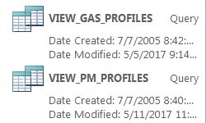
KEY SPECIATE QUERIES

Slide 15
EXAMPLES – USING MS ACCESS
1. How do I find a VOC profile that has “Oil and Gas” in the title? (106 of them, example: “95420 Oil and Gas Production - Composite Profile - Glycol Dehydrator, Uinta Basin”)
A. How do I find the latest profiles?
B. How would I know if a profile is for a specific geographic
region? (Look at Region field for where test was conducted)
C. How do I get out the weight percentages for any one
profile? (View gas profiles or view PM profiles, filter on profile ID)
2. How do I find a PM profile that has "Combustion" in the title? (There are 248 of them, example: 91105, Residential Wood Combustion -- Composite)

Slide 16
KEY METADATA COLUMNS
NOTES
REGION
T_METHOD (Test method for profile)
ANYLMETHOD (analytical method – specific to species in profile)
DOCUMENT (Reference)
TEST_YEAR
P_DATE (Profile date)
QUALITY
CONTROLS
ORIG_COMPO (original or composite)
MASTER_POL
LOWER_SIZE (PM only)
UPPER_SIZE (PM only)

Slide 17
QUESTIONS?
Are there any questions on what we've covered so far?

Slide 18
THE SPECIATE DATA BROWSER
Provides database access for the non-MS Access user
URL: https://cfpub.epa.gov/speciate/
On-Line demo
Key strength of the browser is the ability to search for profiles,
View them, and
Download them to MS Excel for further manipulation

Slide 19
SPECIATE DATA BROWSER QUERY
How do I find a VOC profile that has “Oil and Gas” in its title? [Use Keyword Search]
How would I know if a profile is for a specific geographic region? [View profile information. See 4th row.]
How do I download profiles to MS Excel? [Add to “Shopping Cart” (but note it’s free) from Search page. Download cart.]

Slide 20
SPECIATE 4.5 HIGHLIGHTS
New Profiles (September 2016)
182 new PM profiles for a total of 3,782
291 new TOG profiles for a total of 2,170
No new Other Gases profiles for a total of 249
2,602 unique species
Composite profiles for 85 source categories
SPECIATE4.5 Profiles being used in modeling:
Oil and Gas (TOG)
Prescribed/wildfires (TOG)
Brake & Tire (PM)
Nonroad gas & diesel (TOG)
Onroad CNG transit buses (PM)
Natural gas combustion (PM)

Slide 21
Profiles for SPECIATE5.0 (Spring 2019 release)
Gas combustion composite (already using)
Consumer Product and architectural coatings
More region-specific oil & gas profiles (WY)
Residential wood combustion profiles
Coal combustion
Midwest soil and road dust

Slide 22
QUESTIONS?
Are there any questions on what we've covered so far?

Slide 23
SPECIATION CONCEPTS
TOG (VOC) “Gas" Profiles” Terminology
PM Profiles and AE6
Assigning Inventory Sources to Profiles
VOC Integration
Composite Profiles
“Gap-Filling” Profiles
On-Road Speciation
Nonroad Speciation
Combination Profiles

Slide 24
VOC/TOG TERMINOLOGY
Gas Profiles in SPECIATE can be based on VOC or TOG (see MASTER_POL field)
Inventories have VOC (regulatory definition)
TOG is “Total Organic Gases”
TOG =VOC + exempt compounds (e.g., methane, ethane, various chlorinated fluorocarbons, acetone, perchloroethylene, volatile methyl siloxanes, etc.)
TOG profiles have a factor that allow you to convert VOC to TOG.
Methane, ethane, acetone
Numerous CFCs and HCFCs
Many other “exempt” compounds
VOC
TOG
Googled and got this from CARB fact sheet

Slide 25
Carbonates, Metal carbides, Carbon Monoxide
Carbon dioxide, Carbonic acid
Carbonates, Metal carbides, Carbon Monoxide
Carbon dioxide, Carbonic acid
Methane
Methane
Ethane
Ethane
TOG/TOC
ROG/VOC
Benzene
Toluene
Xylenes
Propane
Other hydrocarbons
Acetone
Perchloroethylene
Methylene Chloride
CFCs
HCFs
PFCs
Acetone
Perchloroethylene
Methylene Chloride
CFCs
HCFs
PFCs
Benzene
Toluene
Xylenes
Propane
Other hydrocarbons
Aldehydes
Aldehydes
Carbonates, Metal carbides, Carbon Monoxide
Carbon dioxide, Carbonic acid
Carbonates, Metal carbides, Carbon Monoxide
Carbon dioxide, Carbonic acid
Carbonates, Metal carbides, Carbon Monoxide
Carbon dioxide, Carbonic acid
Methane
Methane
Methane
Methane
Ethane
Ethane
Ethane
Ethane
Acetone
Perchloroethylene
Methylene Chloride
CFCs
HCFs
PFCs
Benzene
Toluene
Xylenes
Propane
Other hydrocarbons
Acetone
Perchloroethylene
Methylene Chloride
CFCs
HCFs
PFCs
NMOG/NMOC
Benzene
Toluene
Xylenes
Propane
Other hydrocarbons
THC/HC
Benzene
Toluene
Xylenes
Propane
Other hydrocarbons
NMHC
Acetone
Perchloroethylene
Methylene Chloride
CFCs
HCFs
PFCs
Aldehydes
Aldehydes
Aldehydes

Slide 26
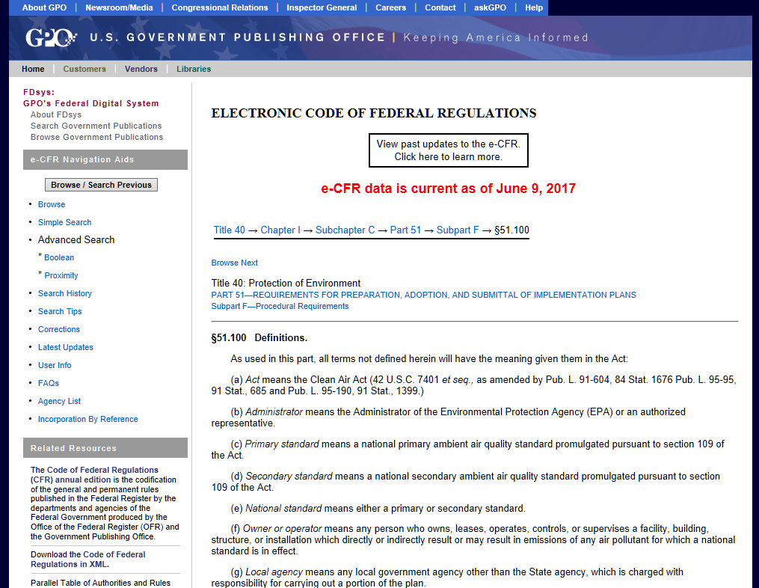
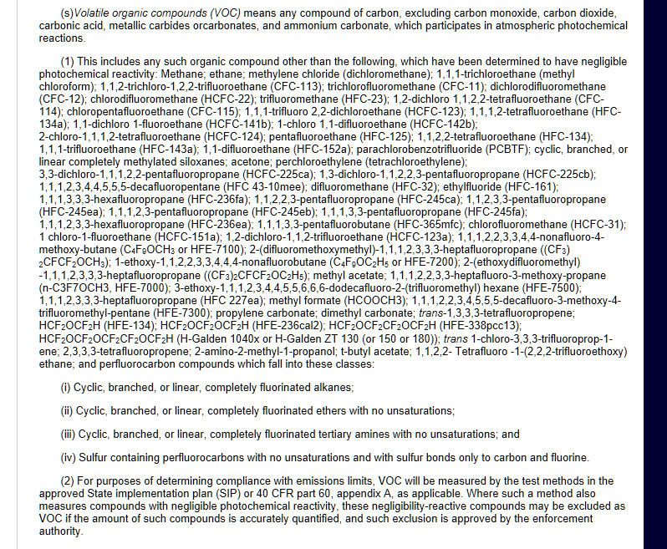
VOC EXEMPTION INFORMATION
EPA’s Regulatory Definition of VOC
VOC means any compound of carbon, excluding carbon monoxide, carbon dioxide, carbonic acid, metallic carbides or carbonates, and ammonium carbonate, which participates in atmospheric photochemical reactions.
This includes any such organic compound other than the following, which have been determined to have negligible photochemical reactivity: ……..
Electronic Code of Federal Register where the VOC information is available under Title 40 → Chapter I → Subchapter C → Part 51 → Subpart F → §51.100
http://www.ecfr.gov/cgi-bin/text-idx?SID=b77fd17146a534c225c8557b5ed4a469&node=40:2.0.1.1.2.3.8.1&rgn=div8

Slide 27
CURRENT STATUS OF VOC EXEMPTION
A VOC is exempt based on O₃ formation
List of Exempt VOC:
http://www.ecfr.gov/cgi-bin/text-idx?SID=b77fd17146a534c225c8557b5ed4a469&node=40:2.0.1.1.2.3.8.1&rgn=div8
Currently, we have about 70 exempt chemicals including methane and ethane.
More chemicals could be added to the list in future assessments.

Slide 28
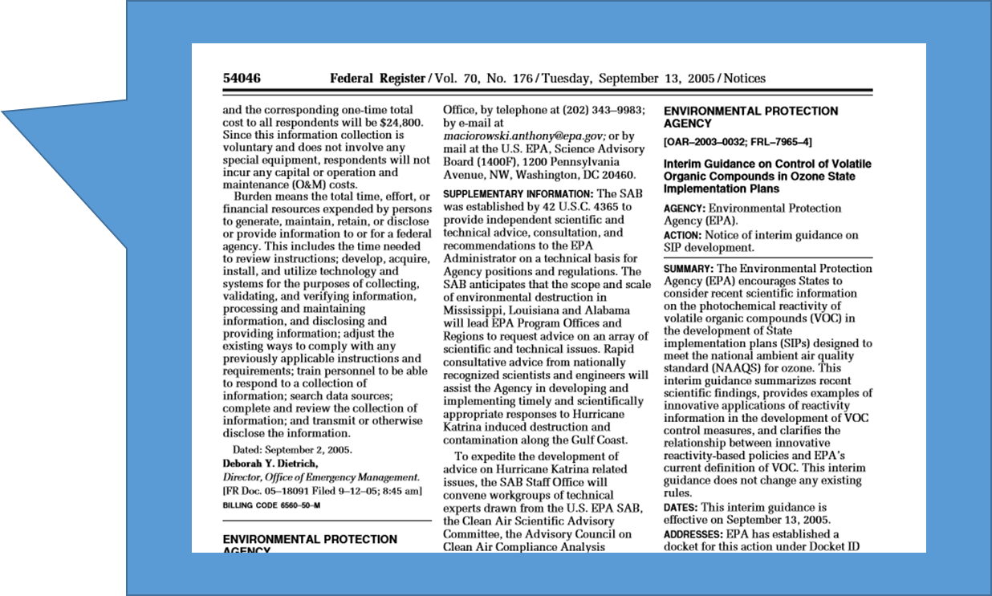
PROCESS OF VOC EXEMPTION
Interim Guidance of 2005 (70 FR 54046-54051) is the guiding process to assess the viability of a VOC exemption based on:
K_{OH}: Reactivity with OH
MIR: Maximum Incremental Reactivity to form O₃
Toxicity and environmental fate
GWP: Global Warming Potential
ODP: Ozone Depletion Potential
Viability as a better substitute for the same end-uses of other chemicals

Slide 29
CONVERTING VOC TO TOG
Ideally, when modeling you want TOG so you get all the species.
TOG profiles have a factor that allow you to convert VOC to TOG.
You can compute it
VOC-to-TOG = 100/(sum of VOC percent)
These factors are in the GSCNV SMOKE ancillary file.

Slide 30
EXAMPLE TOG SPECIATION PROFILE
(selected fields from the Query “View Gas Profiles”)
P_NUMBER | GAS_PROFILE.NAME | CONTROLS | P_DATE | TOTAL | VERSION | VOCtoTOG | SPECIES_ID | SPECIES_PROPERTIES.NAME | WEIGHT_PER | VOC
0051 | Flares - Natural Gas | Uncontrolled | 05-Jan-89 | 100 | 3.2 | 2 | 438 | Ethane | 30
0051 | Flares - Natural Gas | Uncontrolled | 05-Jan-89 | 100 | 3.2 | 2 | 465 | Formaldehyde | 20 | YES
0051 | Flares - Natural Gas | Uncontrolled | 05-Jan-89 | 100 | 3.2 | 2 | 529 | Methane | 20
0051 | Flares - Natural Gas | Uncontrolled | 05-Jan-89 | 100 | 3.2 | 2 | 671 | Propane | 30 | YES
Assume you have 100 lb VOC from Flare – How much propane?
Mass of Propane = 100 lb VOC x (30/100) [lb propane/lb TOG] x [2 lb TOG /1 lb VOC]
= 60 lb

Slide 31
QUESTIONS?
Are there any questions on what we've covered so far?

Slide 32

Profiles in SPECIATE are a part of what is needed for AQ modeling
Develop chemical-mechanism specific profiles from profiles in SPECIATE
Assign sources to profiles
Speciation profiles, species properties
Chemical mechanism mappings
Speciation Tool
Emission Inventories
Criteria Air Pollutants, Hazardous Air Pollutants
GSPRO: mechanism-specific profiles, GSCNV
SMOKE - Emissions Model
GSREF: SCC/FIPs-to-profile mapping
Model Species Emissions

Slide 33
PM_{2.5} SPECIATION- MODELING PROFILE EXAMPLE
Example modeling speciation profile – AE6
Model species definitions
species name | species description | AE5 | AE6
POC | organic carbon | Y | Y
PEC | elemental carbon | Y | Y
PSO4 | sulfate | Y | Y
PNO3 | nitrate | Y | Y
PMFINE | unspeciated PM2.5 | Y | N
PNH4 | ammonium | N | Y
PNCOM | non-carbon organic matter | N | Y
PFE | iron | N | Y
PAL | aluminum | N | Y
PSI | silica | N | Y
PTI | titanium | N | Y
PCA | calcium | N | Y
PMG | magnesium | N | Y
PK | potassium | N | Y
PMN | manganese | N | Y
PNA | sodium | N | Y
PCL | chloride | N | Y
PH2O | water | N | Y
PMOTHR | unspeciated PM2.5 | N | Y
Prescribed Burning – Composite (91109)
pollutant | species | massfrac
PM2_5 | POC | 0.5019
PM2_5 | PEC | 0.1093
PM2_5 | PSO4 | 0.0033
PM2_5 | PNO3 | 0.0107
PM2_5 | PNH4 | 0.0034
PM2_5 | PAL | 0.0005
PM2_5 | PCA | 0.0007
PM2_5 | PCL | 0.0024
PM2_5 | PFE | 0.0004
PM2_5 | PK | 0.0014
PM2_5 | PMN | 0.0001
PM2_5 | PMOTHR | 0.0125
PM2_5 | PNA | 0.0014
PM2_5 | PNCOM | 0.3513
PM2_5 | PSI | 0.0001
PM2_5 | PTI | 0.0007

Slide 34
HOW DO YOU KNOW THE PM_{2.5} PROFILE HAS WHAT YOU NEED?
Example1 – 95126 Gas-fired process heater exhaust
This one does NOT have what you need for AE6.
Example 2 – 95462 Composite - Brake Wear
This one does.
Hints
Composite profiles from “Emissions Inventory of PM2.5 Trace Elements across the United States, Environ. Sci. Technol., 43 (15), pp 5790–5796, 2009” will have what you need.
But, we did add more recent profiles as well (search for PNCOM or PH20).

Slide 35
SIMPLIFIED PROFILES – PM_{2.5} ONLY
These are legacy profiles.
They were used from AE5.
Their function was superceded by the Speciation Tool.

Slide 36
ASSIGNING SOURCES TO PROFILES – GSREF
Nonpoint (area) & Mobile (county level)
You can assign profiles based on SCC and/or country/state/county.
Provides no sub-county variation - If you want this, you need your source to be inventoried as a point source.
Point
You can assign based on SCC and/or country/state/county and/or facility, unit, process, release point.
You can assign a combination of multiple profiles to the same source (10% profile A, 35% profile B, 55% profile C).
NEW-SMOKE4.5

Slide 37
Examples of Profile Assignments
SCC 3999999 “Industrial Process, NEC”
Assigned to profile 0000 - Overall Average (the King of Defaults)
SCC 2811015001
Prescribed Forest Burning; Smoldering
County=Autauga, AL
Assigned to profile 95421 – Composite Profile - Prescribed fire southeast conifer forest
SCC 2811015001
Prescribed Forest Burning; Smoldering
County=Gila, AZ
Assigned to profile 95422 – Composite Profile - Prescribed fire southwest conifer forest

Slide 38
COMPOSITE PROFILES
Often, a single study may be too specific to apply to an inventory category or that study has multiple test scenarios or different operators.
A composite profile combines these data into something usable.
When creating a composite of different profiles, one can take the mean or median of each species from the various profiles being composited.
When compositing individual SPECIATE profiles, see NOTES for the P_NUMBERS used in the composite.

Slide 39
“GAP-FILLING” PROFILES
This is DIFFERENT from “Compositing” – It is adding missing species to a profile.
Why? ̶ Some profiles may be missing species that are expected. (Be aware of this when assigning profiles.)
We can create new profiles by filling in these species (gap-filling) from another profile.
Use “G” to indicate which profiles are gap-filled and the NOTES field to give details.
profile | pollutant | missing
95242 | Poultry Farm - Hen and Animal Waste | Methane Ethane
95241 | Swine Farm and Animal Waste
95240 | Beef Cattle Farm and Animal Waste
70% methane,
20% ethane
From profile 0203
(solid waste - animal waste decomposition)
+
Three new profiles for SPECIATE

Slide 40
QUESTIONS?
Are there any questions on what we've covered so far?

Slide 41
VOC INTEGRATION - CONCEPT
Integration
Process of taking select VOC HAPs from the HAP inventory and speciating the remaining VOC because it is generally believed that the HAP inventory is a better source of HAP emissions than the speciated VOC
Want to avoid double counting of HAPs
Want to speciate the remaining VOC taking into account HAPs that were removed
NBAFM chosen as “integration HAPs” in 2014 Modeling Platform
Naphthalene, Benzene, Acetaldehyde, Formaldehyde, Methanol
These are explicit VOC HAPs in the CB6-CMAQ chemical mechanism.
NONHAPVOC
Remaining VOC after removing explicit VOC HAPs
NONHAPVOC = VOC - NBAFM

Slide 42
Integration Steps
VOC+ NBAFM
SMOKE
Compute NONHAPVOC
INVTABLE
Convert to NONHAPTOG
GSCNV
SPECIATE NONHAPTOG and map NBAFM to model species
GSREF, GSPRO
Model species (e.g., ACET, ALD2, ALDX, BENZ, CH4, ETH, ETHA, ETHY, ETOH, KET, IOLE, ISOP, OLE, PAR, PRPA, TOL, XYLMN, SOAALK, NAPH, BENZ, ALD2, FORM, MEOH, SESQ, TERP)

Slide 43
EXAMPLE OF INTEGRATED PROFILE
No integrate/No use of HAP inventory
Integrate
pollutant | species | massfrac
TOG | ACET | 0.0393
TOG | ALD2 | 0.0895
TOG | ALDX | 0.12
TOG | BENZ | 0.0201
TOG | CH4 | 0.2163
TOG | ETH | 0.0588
TOG | ETHA | 0.0225
TOG | ETHY | 0.0369
TOG | FORM | 0.0612
TOG | IOLE | 0.014
TOG | ISOP | 0.002153
TOG | KET | 0.006088
TOG | NAPH | 0.0119
TOG | NVOL | 0.0115
TOG | OLE | 0.0331
TOG | PAR | 0.1041
TOG | PRPA | 0.008873
TOG | TOL | 0.0798
TOG | UNR | 0.0437
TOG | XYLMN | 0.0203
pollutant | species | massfrac
NONHAPTOG | ACET | 0.0481
NONHAPTOG | ALDX | 0.1468
NONHAPTOG | CH4 | 0.2647
NONHAPTOG | ETH | 0.0719
NONHAPTOG | ETHA | 0.0275
NONHAPTOG | ETHY | 0.0451
NONHAPTOG | IOLE | 0.0172
NONHAPTOG | ISOP | 0.002634
NONHAPTOG | KET | 0.007449
NONHAPTOG | NVOL | 0.0141
NONHAPTOG | OLE | 0.0405
NONHAPTOG | PAR | 0.1273
NONHAPTOG | PRPA | 0.0109
NONHAPTOG | TOL | 0.0977
NONHAPTOG | UNR | 0.0534
NONHAPTOG | XYLMN | 0.0248
Fireplace wood combustion - pine wood– 4642
Notes:
Total massfrac = 1 for both profiles
Still have FORM and ALD2 b/c of secondary formation, note much smaller
Note NONHAPTOG, i.e. need to go from NONHAPVOC -> NONHAPTOG
So have 2 sets of profiles: integrate and no integrate

Slide 44
WHY NOT INTEGRATE A SOURCE
Point sources –
The State reports HAPs at a different process level than where they reported VOCs. So HAP is at the facility but there is no VOC at that process level to do the subtraction.
There is misalignment of VOC and HAP even though both are reported.
Nonpoint sources –
There are no inventory NBAFM emissions at the source.
If there really shouldn’t be, then remove NBAFM from the profile.
NBAFM mass > VOC

Slide 45
TWO APPROACHES TO NO-INTEGRATE
1) Don’t use any HAPs from the HAP inventory.
Use the profile to generate all model species - HAPs and nonHAPs.
2) Assume HAP inventory is better than speciation:
Use the HAP inventory (NBAFM) for model species
Create TOG profiles that drop the mass of NBAFM.
TOG profiles will have less than 100% of mass if the profile has NBAFM.

Slide 46
VOC INTEGRATION BY SECTOR
Platform Sector * | Approach for Integrating
ptegu | No integration
ptnonipm | No integration
ptfire | No integration
othafdust | No integration
othar | No integration
othon | No integration
ag | N/A – sector contains no VOC
afdust | N/A – sector contains no VOC
biog | N/A – contains specific VOC model species
nonpt | Partial integration (NBAFM)
np_oilgas | Partial integration (NBAFM)
pt_oilgas | No integration
rwc | Partial integration (NBAFM)
nonroad | Full integration (calculated in MOVES)
c1c2rail | Partial integration (NBAFM)
othpt | Partial integration (NBAFM)
c3marine | Partial integration (NBAFM)
onroad | Full integration (calculated in the MOVES model)*
*See Modeling Platform technical support document for sector descriptions (https://www.epa.gov/air-emissions-modeling).
Notes:
Partial integration: means some sources are integrated and others aren’t
Biog – beis creates model species explicitly
Onroad: MOVES2014 doing integration within model (next slide)

Slide 47
ONROAD SPECIATION
MOVES2014 does speciation within MOVES for onroad sources
Uses outputs from the Speciation Tool
Different profiles for different vehicle model years, regulatory classes, fuel types, and emission processes
Previously used COMBO files or weighted profiles to approximate, but was a coarse approach
PM_{2.5}
AE6 species come directly from MOVES (in mass).
VOC
16 pollutants are explicit, i.e. integrated.
Model species (moles) and inventory pollutants (mass) come directly from MOVES.
Need to specify chemical mechanism in the MOVES run
Notes:
PM2.5: previous inventory polls from MOVES didn’t map cleanly to AE5 species

Slide 48
ONROAD SPECIATION IN MOVES

Slide 49
NONROAD SPECIATION
MOVES2014a provides nonroad emissions that are semi-speciated.
Also provides individual HAPs - benzene, toluene, etc.
And provides the remainder along with the profile code
e.g. NONHAPTOG95327 is the pollutant name
NONHAPTOG is the difference between TOG and the sum of the HAPs.
95327 is the profile code to use for NONHAPTOG.
Unlike onroad, the speciation is done in SMOKE.
Approach allows application of new chemical mechanisms in SMOKE without re-running MOVES.

Slide 50
COMBINATION PROFILES
SMOKE now has a method of combining two or more speciation profiles for a specific SCC/FIPS.
Examples:
Combine E0 and E10 fuel profiles
Combine flare profile with oil & gas process profile

Slide 51
COMBINATION PROFILES (cont.)
Combine flare profile with oil & gas process profile
Based on output from the Oil and Gas Tool (software & data that is used to develop EPA Oil and Gas estimates for the NEI)
SCC | PROFILE CODE | POLLUTANT | FIPS | FACTOR
2310021010 (Oil & Gas:On-Shore Gas Prod;Cond. Storage Tank) | SWFLA_R (Oil and Gas -SW Wyoming Basin Flash Gas Composition for Condensate Tanks) | NONHAPVOC | 56045 | 0.0456
2310021010 | FLR99 (Natural Gas Flare Profile with DRE >98%) | NONHAPVOC | 56045 | 0.9544

Slide 52
QUESTIONS?
Are there any questions on what we've covered so far?

Slide 53
BREAK

Slide 54
SPECIATE DATA GAPS AND FUTURE PLANS

Slide 55
DATA GAP ANALYSIS – AN ONGOING PROCESS
Goal: Every inventory source is assigned to a good profile that best fits its source category.
Are assignments appropriate?
How good are the available profiles?
What research is needed to meet the goal?
Past Efforts: Analyses leading toward 2011 NEI Modeling Platform improvements
Current Efforts: Gaps and needs analysis

Slide 56
PAST EFFORT: 2008 NEI (2013 VOLUNTEER)
Found low-hanging fruit in the 2008 NEI Platform
Reviewed VOC emission profiles applied to SCCs that are the largest sources of VOCs
Identified opportunities for Pulp & Paper
Over 200 source operations linked to generic profiles
Profile 1185: Coal Fired Boiler – Industrial linked to eight largest operations (43 of 144 kTpy)
The 2008 NEI had > 500 kTpy of TOG speciated with the default profile (0000).
Notes:
[Same idea as Reff, et.al. 2009 for PM profiles, but done superficially]
Reff et al., 2009: Reff, A., Bhave, P.V., Simon, H., Pace, T.G., Pouliot, G.A., Mobley, J.D., and Houyoux, M., Emissions Inventory of PM_{2.5} Trace Elements across the United States, Environmental Science and Technology, 43: 5790–5796, 2009.

Slide 57
IMPACT OF MISMATCHED PROFILES

Slide 58
PAST EFFORTS: 2011 NEI MODELING PLATFORM IMPROVEMENTS
EPA developed and applied appropriate composite source profiles for the Pulp & Paper and Chemical Manufacturing sectors from SPECIATE emissions profiles.
Pulp and Paper: 97 of 121 kTpy (80%) reassigned from profiles 0000 and 1185
Chemical Manufacturing: 20 of 90 kTpy (22%) reassigned from profile 0000
Composite profiles were added to SPECIATE 4.5.
Notes:
[Same idea as Reff, et.al. 2009 for PM profiles, but done superficially]
Reff et al., 2009: Reff, A., Bhave, P.V., Simon, H., Pace, T.G., Pouliot, G.A., Mobley, J.D., and Houyoux, M., Emissions Inventory of PM_{2.5} Trace Elements across the United States, Environmental Science and Technology, 43: 5790–5796, 2009.

Slide 59
Assessment of Important SPECIATE Profiles in EPA’s Emissions Modeling Platform and Current Data Gaps
Casey Bray, NC State & EPA/ORD Intern
Goals
Elucidate profiles/categories of most importance for air quality modeling purposes
Evaluate current profiles
Identify and articulate research needs

Slide 60
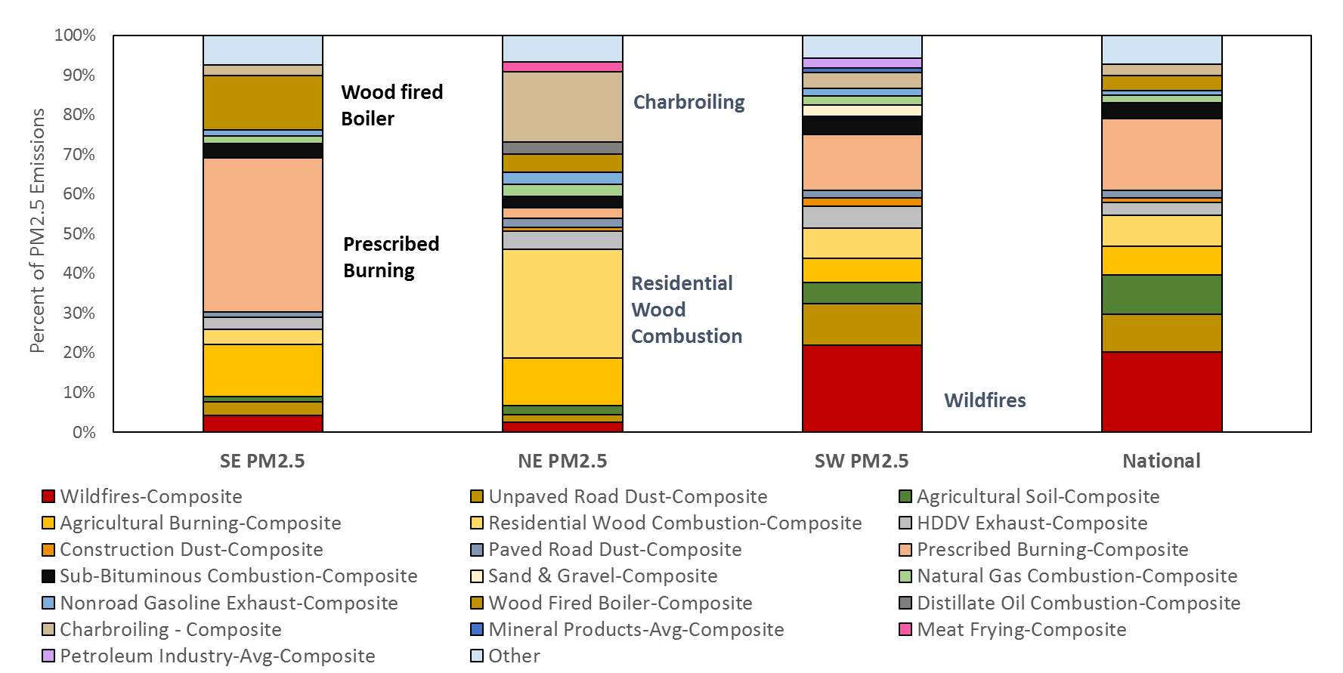
Major PM_{2.5} Profiles (% of mass assigned in 2014 EPA modeling platform)* - from Bray’s work
*excludes emissions from the onroad mobile sector

Slide 61
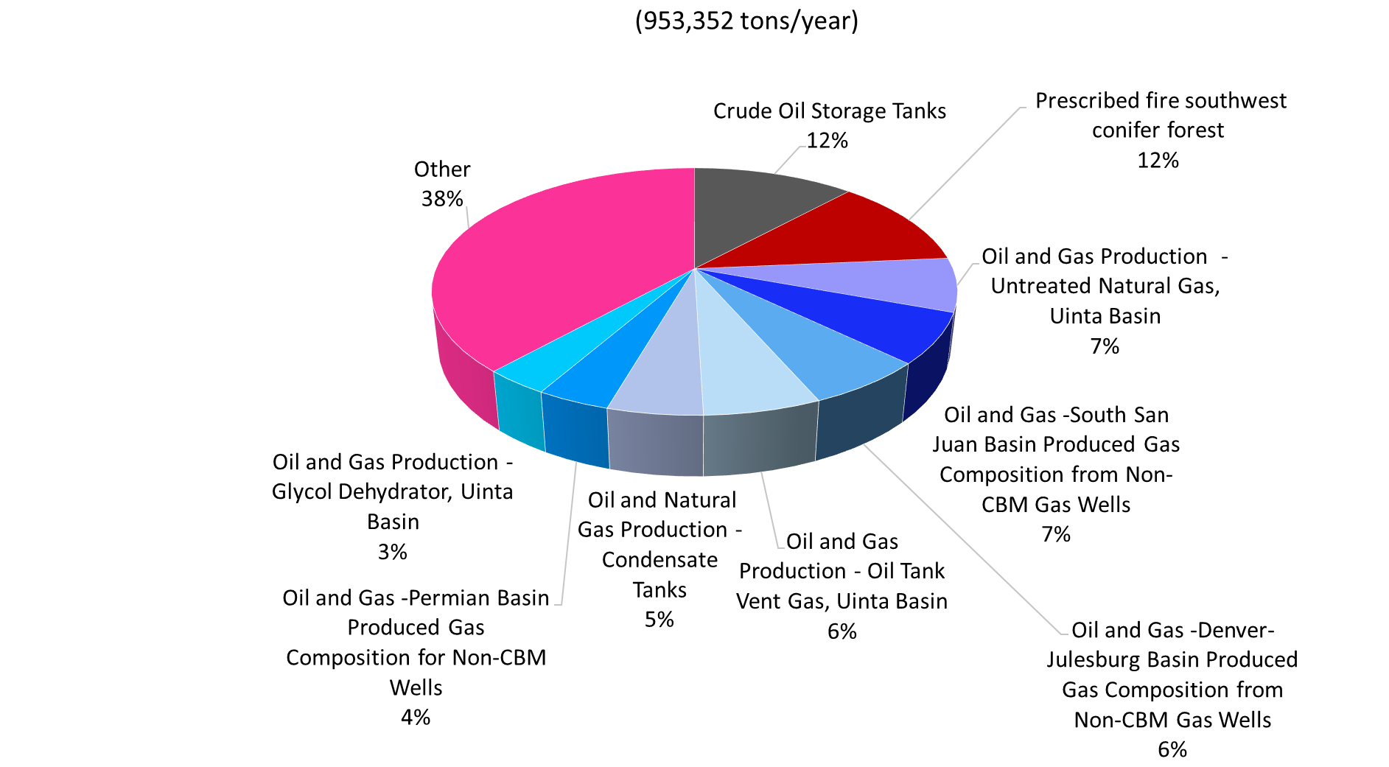
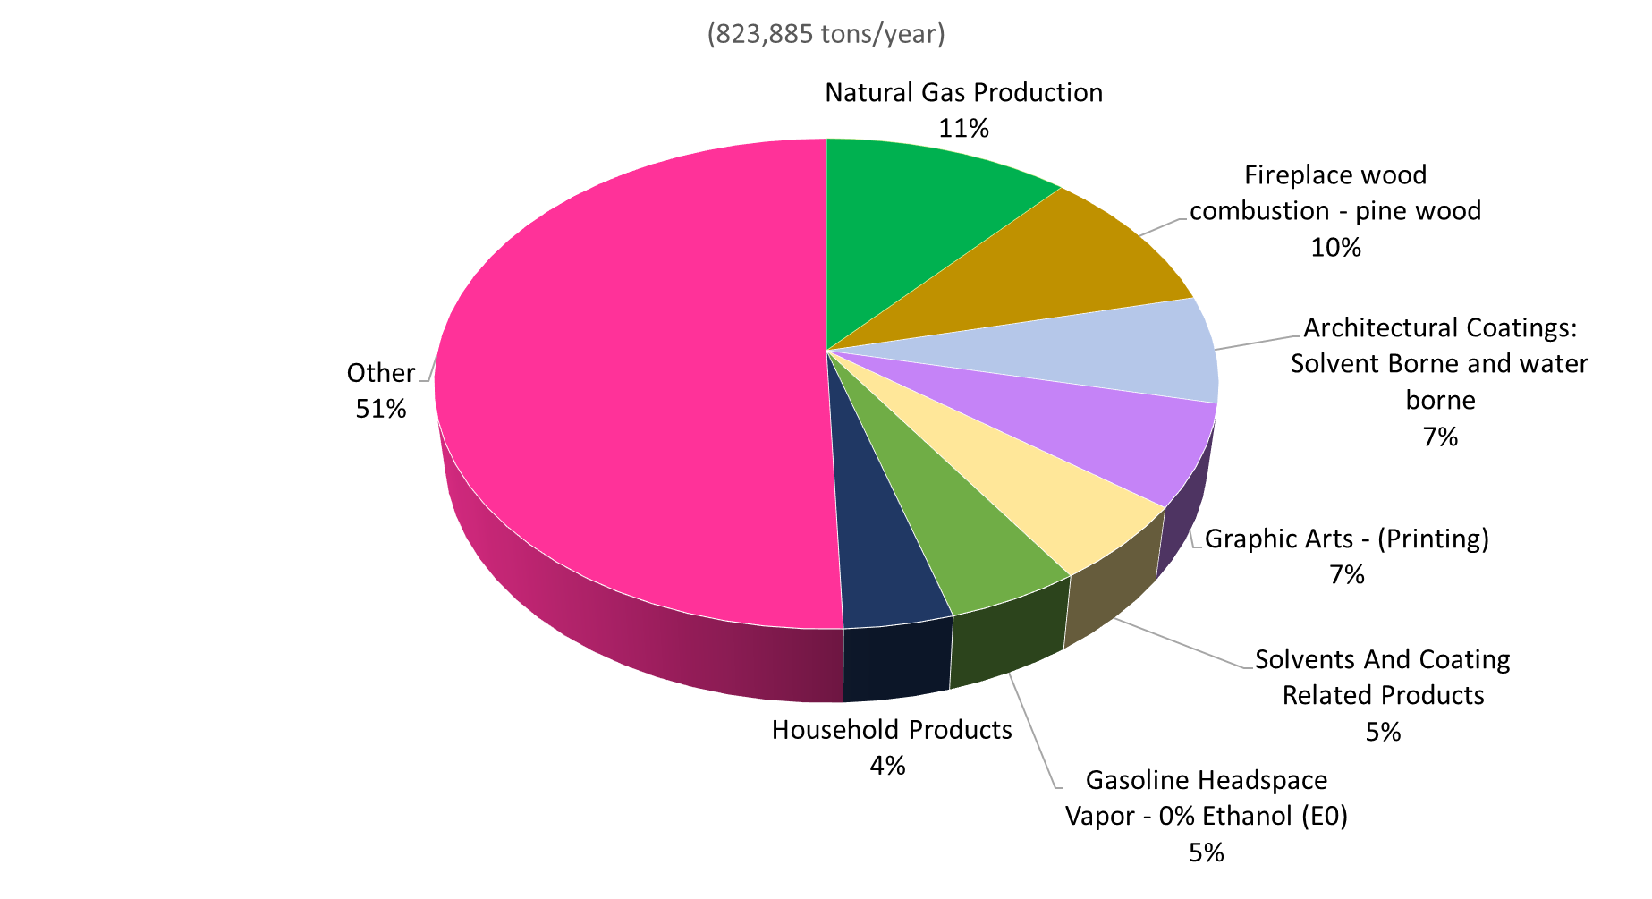
VOC PROFILES – REGIONAL DIFFERENCES*
(From Bray)
Southwest: UT, CO, AZ, NM
Northeast: ME, NH, VT, RI, CT, NY, NJ, DE, PA, MD
953,352 tons/year
823,885 tons/year
*excludes emissions from the onroad and nonroad mobile sectors

Slide 62
THE SPECIATE WORKGROUP AND FUTURE PLANS
EPA’s SPECIATE Workgroup
Modelers tell us what is important
Ongoing literature searches
Peer-reviewed journal articles preferred
The “Master List” of references
Needs Analysis Project - data gaps
Please let us know if you’ve got data that could be added!

Slide 63
FUTURE SPECIATE PLANS
Release SPECIATE5.0 – Spring 2019
Develop Standard Operating Procedure (SOP) for SPECIATE Profile Selection, Collection, and Entry
Allow In-House Processing of Profiles
Improve Documentation of Metrics and Processes
Identify Key Metrics for Quality Profiles
Formalize Prioritization Process
ACCESS database structure improvements (including use of forms to add to profiles)
Add new profiles

Slide 64
SPECIATION FOR AQ MODELING
SPECIATE profiles
Speciation Tool
Mechanism-Specific chemical mapping
ethane
ethene
propene
butane
pentane
….
ETHA
ETH
OLE
PAR
….
Source-to-Profile cross reference (GSREF)
Mechanism-Specific Speciation Profiles (GSPRO and GSCNV)
Emissions Source for Inventory Pollutant-e.g. VOC, PM2.5
Assign Chemical Mechanism-specific Speciation Profile(s) to source based on process (SCC), location (GSREF)
Multiply Inventory emissions by profile factor to get emissions of AQM species:
moles for gases, mass for particulates
SMOKE

Slide 65
SPECIATION STEPS IN MODELING TOOLS
Speciation Tool: creates SMOKE ancillary files GSPRO and GSCNV
Uses SPECIATE profiles
Uses mechanism-specific chemical mapping, e.g., CB6 different from CB05
SMOKE: Uses GSREF to assign profiles to sources and uses ancillary files GSPRO and GSCNV to compute AQM emission files
Emissions Modeling Framework: can be used as an interface for managing inventories and related data (profiles), and interface for running the Speciation Tool and SMOKE
International Emissions Inventory Conference Baltimore, MD, August 15, 2017

Slide 66
SPECIATION TOOL - SPTOOL
SPTOOL is a stand-alone tool that was developed to generate the GSPRO and GSCNV ancillary data SMOKE uses for speciation
SPTOOL implemented using open source PostgreSQL database and Perl interface
The latest SPTOOL install and User Guide can be downloaded from the EPA/CMAS website https://www.cmascenter.org/help/documentation.cfm?MODEL=speciation_tool&VERSION=4.0

Slide 67
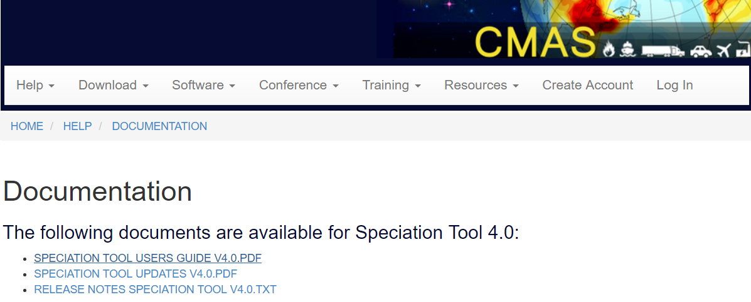
You can also look at slides from Baltimore Emission Inventory conference training which lists the steps to take to run it

Slide 68
DEFINITIONS
AQM – Air Quality Model
CMAQ, CAMx, etc.
Model Species - Model species are used in the AQM
e.g., OLE, PAR, etc. in CB mechanisms
Profile – list of mass fractions (or wt. %) of compounds
Organic Compounds – Organic compounds included in SPECIATE profiles
e.g., 1-Methylcyclopentene, isomers of hexane, etc.
SPECIATE – EPA’s SPECIATE database
SPTOOL – The stand-alone Speciation Tool

Slide 69
ATMOSPHERIC CHEMISTRY IN AQM
Atmospheric chemistry consists of millions of reactions among many thousands of chemical compounds
AQMs use a condensed chemical mechanism with a manageable number of reactions and model species
CB05, CB6
SAPRC99, SAPRC07, SAPRC11
RACM2
CRIv2r5
etc.

Slide 70
PREPARING EMISSIONS FOR MODELING
GSPRO contains factors to speciate
Split Factor: numerator for mole-based speciation
Divisor: denominator for the mole-based speciation
Split Factor/Divisor = moles of model species per mass of TOG
For PM, divisor = 1
GSCNV contains VOC-to-TOG conversion factors to convert inventory VOC (or ROG) to TOG to apply TOG-based speciation profiles

Slide 71
SMOKE GSPRO and GSCNV files
GSPRO sample profile
Speciation profile number | Pollutant ID (name) | Species ID (name) | Split factor | Divisor | Mass Fraction
0051 | TOG | CH4 | 0.2 | 16.042 | 0.2
0051 | TOG | ETHA | 0.3 | 30.069 | 0.3
0051 | TOG | FORM | 0.2 | 30.026 | 0.2
0051 | TOG | PRPA | 0.3 | 44.096 | 0.3
GSCNV sample profile
Name of pollutant converting from | Name of pollutant converting to | Speciation profile code | Conversion factor
VOC | TOG | 0051 | 2

Slide 72
Example GSPRO records
Poll is TOG
Poll is NONHAPTOG (remove formaldehyde)
GSPRO sample profile
Speciation profile number | Pollutant ID (name) | Species ID (name) | Split factor | Divisor | Mass Fraction
0051 | TOG | CH4 | 0.2 | 16.042 | 0.2
0051 | TOG | ETHA | 0.3 | 30.069 | 0.3
0051 | TOG | FORM | 0.2 | 30.026 | 0.2
0051 | TOG | PRPA | 0.3 | 44.096 | 0.3
Speciation profile number | Pollutant ID (name) | Species ID (name) | Split factor | Divisor | Mass Fraction
0051 | NONHAPTOG | CH4 | 0.25 | 16.042 | 0.25
0051 | NONHAPTOG | ETHA | 0.375 | 30.069 | 0.375
0051 | NONHAPTOG | PRPA | 0.375 | 44.096 | 0.375

Slide 73
Example GSPRO records using Inventory HAPs
Inventory HAP Maps to Explicit CB6 HAP
SMOKE converts from pollutant code to NAME
GSPRO sample records
Speciation profile number | Pollutant ID (SMOKE name) | Species ID (name) | Split factor | Divisor | Mass Fraction
0000 | ACETALD | ALD2 | 1 | 16.042 | 1
0000 | FORMALD | FORM | 1 | 30.026 | 1
0000 | BENZENE | BENZ | 1 | 78.1118 | 1
0000 | METHANOL | MEOH | 1 | 32.0419 | 1
0000 | NAPHTH | NAPH | 1 | 128.1705 | 1

Slide 74
Example GSPRO records using inventory HAPs
Inventory HAP Maps to Lumped CB6
SMOKE converts from pollutant code to NAME
GSPRO sample records
Speciation profile number | Pollutant ID (SMOKE name) | Species ID (name) | Split factor | Divisor | Mass Fraction
0000 | STYRENE | OLE | 0.125 | 26.0373 | 1
0000 | STYRENE | TOL | 0.875 | 91.1305 | 1
0000 | PROPIONAL | ALDX | 0.6667 | 38.7194 | 1
0000 | PROPIONAL | PAR | 0.3333 | 19.3597 | 1

Slide 75
Example GSPRO records using inventory HAPs
Inventory HAP maps to non CB6 HAP that is in CMAQ (version5.2)
SMOKE converts from pollutant code to NAME
GSPRO sample records
Speciation profile number | Pollutant ID (SMOKE name) | Species ID (name) | Split factor | Divisor | Mass Fraction
0000 | ACETALD | ALD2_PRIMARY | 1 | 30.069 | 1
0000 | FORMALD | FORM_PRIMARY | 1 | 30.026 | 1
0000 | ACROLEI | ACROLEIN | 1 | 56.0633 | 1
0000 | BUTADIE | BUTADIENE13 | 1 | 54.0904 | 1

Slide 76
GSPRO PM2.5 example
GSPRO sample records
Speciation profile number | Pollutant ID (SMOKE name) | Species ID (name) | Split factor | Divisor | Mass Fraction
95475 | PM2_5 | PAL | 0.0078 | 1 | 0.0078
95475 | PM2_5 | PCA | 0.0105 | 1 | 0.0105
95475 | PM2_5 | PCL | 0.0275 | 1 | 0.0275
95475 | PM2_5 | PEC | 0.0666 | 1 | 0.0666
95475 | PM2_5 | PFE | 0.0156 | 1 | 0.0156
95475 | PM2_5 | PK | 0.0037 | 1 | 0.0037
95475 | PM2_5 | PMOTHR | 0.0565 | 1 | 0.0565
95475 | PM2_5 | PNCOM | 0.1786 | 1 | 0.1786
95475 | PM2_5 | PNH4 | 0.0444 | 1 | 0.0444
95475 | PM2_5 | PNO3 | 0.0238 | 1 | 0.0238
95475 | PM2_5 | POC | 0.4465 | 1 | 0.4465
95475 | PM2_5 | PSI | 0.0243 | 1 | 0.0243
95475 | PM2_5 | PSO4 | 0.0943 | 1 | 0.0943

Slide 77
Calcs done by SPTOOL to go from SPECIATE profile to GSPRO profile Spreadsheet Tool: Sample_VOC_profile_calcs_speciate_training.xlsx

Slide 78
extras

Slide 79
SPTOOL SOFTWARE REQUIREMENTS
PostgreSQL can be downloaded from http://www.postgresql.org
Perl and the database drivers can be downloaded from http://www.perl.com
User must have database create privileges in PostgreSQL to run the Speciation Tool

Slide 80
RUN PARAMETERS
MECH_BASIS – select chemical mechanism to use
OUTPUT – select which output profiles to generate. Options are “VOC” for gas species and “PM” for particulates
RUN_TYPE - The RUN_TYPE options are: CRITERIA, INTEGRATE, NOINTEGRATE, HAPLIST, and VBS
AQM – this parameter selects model-correct species names for output files
TOLERANCE – specifies acceptable deviation from 100% for the sum of weight percentages (default is 5%)

Slide 81
SPTOOL FAQ
What happens when an organic compound used by a profile lacks a defined molecular weight?
Any detailed organic compound with an undefined molecular weight is dropped from the profile because a molecular weight is required to compute splits factors. Dropped mass fraction due to missing molecular weights may takes the profile sum outside the selected tolerance, causing the profile to be dropped. This problem should be resolved by specifying missing molecular weights in the species properties.

Slide 82
SPTOOL FAQ
What happens when an organic compound used by a profile lacks an assignment in the mechanism mapping?
SPTOOL issues a warning and the compound is assigned to UNK
When does SPTOOL renormalize a profile?
If the sum of mass fractions for a profile is not 100%, and nothing is done to correct the profile, subsequent SMOKE processing will not conserve mass. SPTOOL renormalizes all gas profiles whose sum is within the tolerance thereby preserving VOC mass. Profiles outside the tolerance are dropped and a warning is issued.
For the AE6 PM profiles, when sum of AE6 PM species is less than 100%, the remaining mass gets assigned to PMOTHR (=100% - sum of AE6). When the sum is greater than 100%, the profiles are dropped with a warning.

