Slide 1
Combined Air Emissions Reporting (CAER) for the Toxics Release Inventory (TRI), the National Emissions Inventory (NEI), and the States/Local Municipalities/Tribes (SLT) Emission Inventories
Phase 1 2017 “Program Crosswalk” Completed
Phase 2 2018 Preliminary findings presented here
Notes:
Good morning. I’m Madeleine Strum with the Emissions Inventory Group and I’m going to talk about an R&D team made up of folks from the TRI, NEI and SLT reporting programs. We are working on under the Product Design Team of Combined Air Emissions Reporting project or CAER. The goal of CAER is to create a system where facilities submit all air emissions data through one portal and interconnectivity across systems allows the common data to be shared.
The CAER goals include reducing burden to entities required to report, improving timeliness and transparency, consistency, and data quality.
The TRI-NEI-SLT team is doing research to help inform CAER. Phase I research was completed in 2017 and Phase 2 is underway.
Some of the Phase Islides were presented at the EI conference last August. I’ll be reviewing those and share some preliminary results on Phase 2.

Slide 2
TRI/NEI/SLT Project: Purpose and Scope
Purpose:
  Identify and evaluate consistencies and possible workflows for sharing emissions data between TRI, SLTs, and NEI.
Scope- Phase 1:
  Identify differences in terminology used to define reporting requirements in each program.
  Identify pollutants that are common between the TRI and NEI, and specify how they relate to each other if there is not a one-to-one match.
  Research how states use TRI data for their NEI submissions.
Team Members – Phase 1:
  States: MN, SC
  EPA: Office of Pollution Prevention & Toxics (OPPT), Office of Air Quality Planning & Standards (OAQPS), Office of Environmental Information (OEI)
  Environmental Council of the States (ECOS)
Notes:
Research how states use TRI data for their NEI submissions.
Identify pollutants that are common between the TRI and NEI, and specify how they relate to each other if there is not a one-to-one match.
Identify differences in terminology used to define reporting requirements in each program.

Slide 3
TRI/NEI/SLT Phase 1: Results and Findings
NEI and TRI terms and requirements comparison
 | TRI | NEI
Who reports the data to EPA | The facility itself | State, local, and tribal agencies as well as EPA
Frequency of Reporting | Annually | Annual for largest sources only, every three years for all sources
Industries covered | TRI-covered sectors (e.g., manufacturing, waste management, metal mining, electric utilities) | No restrictions based on industry sector
Pollutants covered | TRI-listed chemicals (generally chemicals that cause cancer or other chronic human health effects, acute human health effects, and/or environmental effects.) | Criteria air pollutants and precursors required. Hazardous air pollutants submitted voluntarily by SLT, and estimated by EPA.
Notes:
Our team documented comparisons of basic requirements and definitions like who reports, exemptions from reporting, activity/emissions thresholds, frequency of reporting, definition of facility.
Also industries and pollutants recovered.

Slide 4
TRI/NEI/SLT Phase 1: Results and Findings
Pollutant Crosswalk
  NEI:
    Criteria air pollutants & precursors (CAPs)
      Ammonia, Lead, VOC, PM2.5, PM10, NOx, CO, SO2
    187 hazardous air pollutants (HAPs)
  TRI:
    2 of the CAPs: lead (which is both a HAP and CAP) and ammonia
    Almost all (about 96%) of the 187 HAPs
    In all, 692 chemicals and chemical categories
TRI Chemicals and Chemical Categories
(692)
NEI Pollutants
(8 CAPs, 187 HAPs)
Notes:
While there is a large overlap between pollutants covered, there are also differences. We also found chemical categories where there is only partial overlap between the two programs. An example of this includes diisocyanates. There are 20 individually listed diisocyanates reportable to TRI as a category. Some of these 20 are NEI pollutants but not all of them, so the TRI category does not match up with NEI data collected.

Slide 5

TRI/NEI/SLT Phase 1: Results and Findings
Pollutant Crosswalk
  TRI pollutants to NEI pollutants and vice versa
  Identified overlap in categories of chemicals
  Discovered and corrected issue with NEI glycol ethers
Notes:
We created pollutant cross walks matching TRI chemicals to National Emissions Inventory (NEI) pollutants and NEI pollutants to TRI chemicals . During the process of matching, TRI found that the current list of glycol ethers reported to NEI was out of date. In August of 2000, OAQPS updated their CAA glycol ether HAP definition, making their definition match TRI’s – with the one exception of EGBE which meets the structural definition but is a listed exemption. Since then facilities have been allowed to report specific glycol ethers via the Emissions Inventory System (EIS) that do not meet the new definition. TRI alerted OAQPS to the issue, and OAQPS corrected their website and the EIS system.

Slide 6
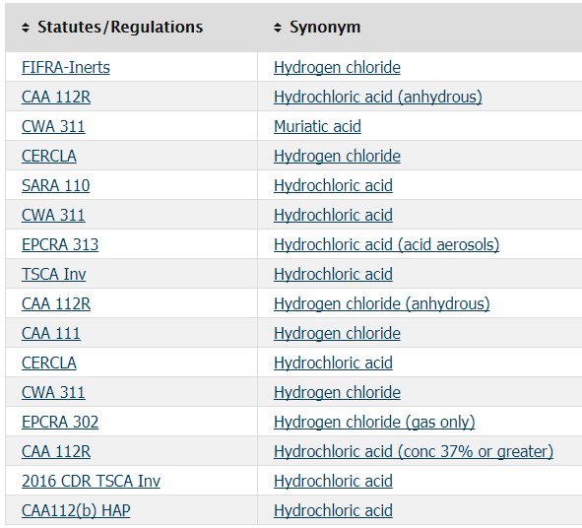
TRI/NEI/SLT Phase 1: Results and Findings
EPA’s Substance Registry Services (SRS)
Pollutant Crosswalk
  Original posted in Sept, update posted in April
  Use pollutant crosswalk to update EPA’s Substance Registry Services (SRS)
Notes:
SRS provides webservices for the chemicals that allows one to pull names, synonyms, and various properties of specific chemicals.

Slide 7
TRI/NEI/SLT Phase 1: Results and Findings
Survey
  Three states use TRI data for their EI submission: Illinois, Minnesota, and Indiana
    Illinois and Minnesota use similar approach and incorporate TRI data into EI submission.
    Indiana does not include TRI data in submission, but uses it to inform what they submit.
  EPA also answered survey on how TRI is incorporated into the NEI
    TRI data is incorporated by EPA after the Air Emissions Reporting Requirement (AERR) deadline
  States and EPA report TRI data using the engineering judgement calculation method code

Slide 8
Final report and pollutant crosswalk at https://www.epa.gov/e-enterprise/product-design-team
CAER webinar - https://www.youtube.com/watch?v=6r_elMUTMfY

Slide 9
TRI/NEI/SLT Project: Phase 2
Scope:
  Quantify differences in emissions (TRI and NEI data for 2014)
  Explore reasons for differences between reporting data
  Research cross-program data sharing and recommendations
  Develop comparisons and crosswalks for emission estimation method codes and control/treatment codes between NEI and TRI
Team Members:
  States: MN, SC, MI, GA
  EPA: Office of Pollution Prevention & Toxics (OPPT), Office of Air Quality Planning & Standards (OAQPS), Office of Environmental Information (OEI)
  Environmental Council of the States (ECOS)

Slide 10
Phase 2: Metrics- 2014 NEI & 2014 TRI
66,000 NEI stationary facilities; 20,000 TRI facilities
24,000 NEI stationary facilities with potential overlapping NAICS and at least one overlapping pollutant
At least 10,000 of these are in TRI (based on the EIS-to-TRI id matching)
Of the available TRI emissions that match NEI pollutants, ~97% are loaded into EIS
Emissions from 6,534 TRI facilities were used for gap-filling for at least one pollutant

Slide 11
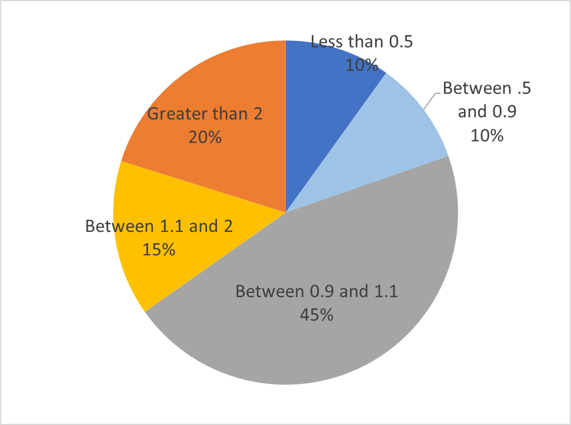
Phase 2: 2014 NEI compared to 2014 TRI
SLT Estimates Only
Most of the estimates (facility level) are within 10% of each other
TRI – to – NEI emissions ratio | Count of estimates
Less than 0.5 | 1,478
0.5 – <0.9 | 1,450
0.9 – <1.1 | 6,788
1.1 – 2 | 2,178
Greater than 2 | 3,003
Total Observations | 14,780
DRAFT -- PRELIMINARY FINDINGS. DO NOT QUOTE OR CITE.

Slide 12
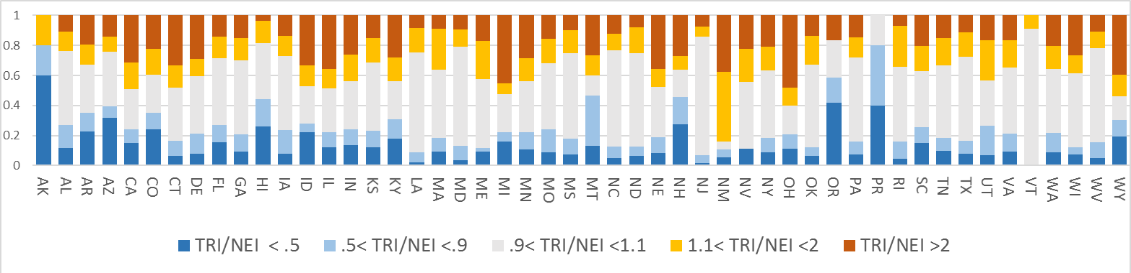
How do emissions compare by State
SLT Estimates Only
Distribution of TRI-to-NEI ratio bins by State
Number of data points compared shown above each bar
.
TRI~NEI
TRI>NEI
5 518 254 91 223 117 48 52 324 53 27 418 36 1113 524 275 480 1090 11 53 87 447 504 409 264 15 562 63 170 11 349 37 9 317 676 189 12 719 5 44 487 385 2150 30 179 11 137 519 309 89
TRI > NEI
TRI < NEI
TRI ~ NEI
TRI >NEI

Slide 13
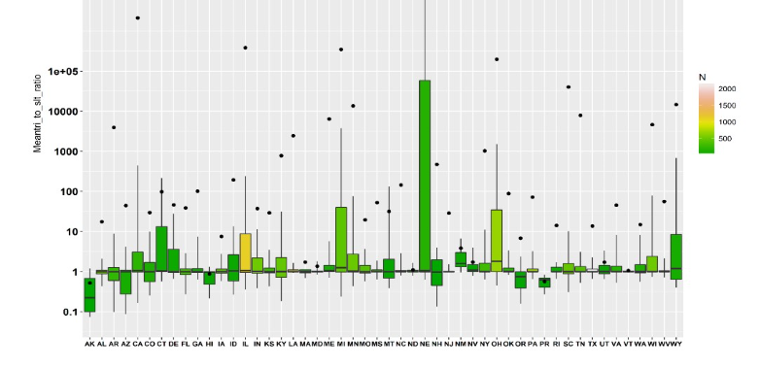
Magnitude of TRI/NEI ratios
SLT Estimates Only
For some facilities, TRI emissions may be 100 or more times greater than NEI
Number of data points (facility-pollutant combinations)
max
75th percentile
1e5
10,000
1000
100
10
1
0.1
90th percentile
2000
1500
1000
500
TRI/NEI Ratio

Slide 14
Why are TRI/NEI emissions different?
If SLT reports part of the facility’s emissions for a pollutant, but not all, then NEI doesn’t use TRI data and therefore NEI has incomplete emissions
Sometimes NEI has data TRI does not (e.g., facility/chemical does not meet TRI reporting requirement)
Additional explanations coming with case studies

Slide 15
Code cross-walks
TRI has some of the same basis of estimate codes as NEI calculation method codes
  Continuous emissions monitoring
  Source test
  Material balance
TRI has fewer codes (just one emission factor code “Published Emission Factor” compared to what is in the NEI)
  Developed ‘Best Fit’ code cross-walk
TRI treatment codes are generally broader than NEI control measure codes
  Scrubber, electrostatic precipitator
  TRI treatment codes are not just for air streams

Slide 16
Phase 2 next steps
Continue with reporting codes cross-walks
Complete case studies on why emissions are different
Complete document on the current sharing of data for QA
Recommendations for using and matching data in the combined form
If you have any experiences/thoughts on any aspects of this project please contact us! (strum.madeleine@epa.gov)

