Slide 1
Oil and Gas Production Emission Estimates in the NEI
Oil & Gas Emissions Summit
November 4, 2014
Roy Huntley, OAQPS, EPA

Slide 2
Today
NEI – brief description
Oil & Gas Estimation Tool
  Beginnings
  Features
  Results for 2011 NEI
Opportunities for improvements

Slide 3
National Emissions Inventory (NEI)
The full NEI is on a 3-yr cycle (e.g. 2008, 2011, 2014)
  Point sources (facility-process for ~100,000 facilities)
  Nonpoint and mobile sources (county-process)
  Fires (daily/point)
  Biogenic soil and vegetation (county)
States, locals, and tribes are required to submit CO, SO_{X}, NO_{X}, VOC, PM₁₀, PM_{2.5}, NH_{3,}and Lead.
  Basis is sections 110 and 172 of the Clean Air Act
  Use CAA-based emissions thresholds for “point.” States can go lower.
States can voluntarily submit Hazardous Air Pollutants (HAPs) and GHGs to the NEI
  EPA augments the data to make HAPs more complete
  GHGs are not published in the public release of the NEI
  Toxics Release Inventory helps

Slide 4
NEI Categories
All emissions to the atmosphere included, whether regulated or unregulated, all counties
  Electric power plants and industrial sources
  Universities, hospitals, landfills, other commercial sources
  Residential heating, gasoline fueling stations, dry cleaners, household solvent use
  Farm animal waste, fertilizer, and agricultural burning
  On-road vehicles – exhaust, evaporative, brake and tire wear, paved and unpaved road dust
  Non-road engines – e.g., farm equipment, mining equipment
  Aircraft, Ships, Railroads
  Wildfires and prescribed burning (forest management)
  Biogenics – soil and vegetation
Some not included, notably:
  Volcanoes and other natural geothermal (SO2, PM)
  Lightning NOx

Slide 5
Four Key NEI Goals
Complete
Represents the year of the inventory
Uses best available information
Transparent - includes the emissions origin
(who provided, factor, activity, method)

Slide 6
NEI Timeline – example 2014 NEI
Opportunities
to coordinate
QA, Feedback, & Augment
Release reporting code updates and point EFs
2015
2016
2017
Use and Review
QA
Use
EPA
Develop and release emissions tools/methods
2014 NEI v1
Corrections & improvements
2014 NEI v2
Emissions Year Ends
Prepare Emissions
SLT Submission Deadline
Review and Comment/Submit
States/Locals/
Tribes
Industry Reports to SLT
Review and Comment
Industry

Slide 7
Oil and Gas Tool: History and Status

Slide 8
ERTAC’s National Oil & Gas Committee
  ERTAC (Eastern Regional Technical Advisory Committee) recognized need for development of national EPA emissions of criteria and HAP estimates
    First established for 2008 NEI
    Purpose: Develop NEI methodologies for estimates
Established National Oil and Gas Committee, late 2011
  Members, OAQPS/EIAG (Roy Huntley & Jennifer Snyder) RPOs and MJOs (Westar/WRAP (Tom Moore), MARAMA (Julie McDill), CenSARA (Theresa Pella), Mark Janssen (LADCO)), and many state/county emission inventory experts
  Prepared white paper regarding need for national estimates
  EPA funding/resources became available to develop tool in early 2012

Slide 9
Tool Development
Based on estimation methodologies developed by CenSARA
  CenSARA states are TX, OK, KS, NE, LA, AR, IA, MO
  We wanted to leverage the progress CenSARA had already made on estimation methodologies
  Technical approaches were sound and based on new data
    Includes data and methodologies from operator surveys, permit reviews, literature reviews, the Climate Registry, and previous studies, such as one for the Haynesville Shale in NE Texas and the WRAP phase III study for the Rocky Mountain Region – Basin Factors
  Expanded coverage to all states (not just CenSARA states)

Slide 10
Overview of Tool
MS Access-based
  Creates county- and process-level detail for criteria and HAPs
  Needs to handle large amounts of data, inputs and outputs
  Ability to create front-end, user-friendly steps
  Portability/availability
  Transparent
  Combination of tables, queries, macros
  Logical grouping of tables and queries, use of message/instruction boxes
  Users can vary parameters by county or basin, as necessary
Emission process selection
  Can run the tool on one or more of the processes
    Processes coded with 34 Source Classification Codes (SCC)

Slide 11
Oil & Gas Processes Covered by Tool
Artificial lift engines
Associated gas venting
Condensate tanks
Crude oil tanks
Dehydrators
Drilling rigs
Flaring
Fugitive leaks
Gas-actuated pumps
Heaters
Hydraulic fracturing pumps
Lateral compressors
Liquids loading
Liquids unloading
Mud degassing
Pneumatic devices
Produced water tanks
Well completions
Wellhead compressors

Slide 12
Tool Data Sources
Basin-specific Inputs (or county level)
  Equipment profiles - e.g., number of dehydrators or lateral compressors per well
  Control profiles - e.g., fraction of well completion flared and control efficiency
  Whole gas composition profiles (percent VOC, benzene, toluene, etc.)
  Engine size, load, hours of operation
  Used state-provided factors where available, then EPA emission factors as defaults where available, then “CenSARA averages” when no better info available
Activity Data: from state oil and gas commissions, state inventory offices, Drillinginfo/HPDI,
trade associations, all at county level
  Well counts by type (oil, gas, CBM (coal bed methane))
  Oil and natural gas production
  Produced water from oil, gas, and CBM wells
  Well completion counts by type
  Fraction of gas wells that need compression
  Fraction of oil wells that need lift
  Spud information (aka drilling starts) - directional (horizontal, vertical) and feet drilled

Slide 13
Tool Data Sources (continued)
Emission factor data (i.e., drilling & compressor engines, well completions)
  EPA (EPA’s GHG Reporting Program, AP-42, FIRE, SPECIATE, Equipment Leaks Protocol)
  API (American Petroleum Institute)
  ANGA (America’s Natural Gas Alliance)
  NONROAD model
  Other sources (e.g., CenRAP (Central Region Air Planning Association), TCEQ (Texas Commission on Environmental Quality), Climate Registry)

Slide 14
Tool Outputs & Documentation
Data exported in EIS (Emission Inventory System) format
  County-process-pollutant
  Converting emission data to EIS format traditionally has been a hurdle for state inventory submitters
Point source subtraction
  User can subtract out point source contributions to prevent double counting
Summary queries
Basin factor and inputs activity glossaries
Master references table in tool identifies sources of all input data
Documentation of methodologies
Directions on how to use tool

Slide 15
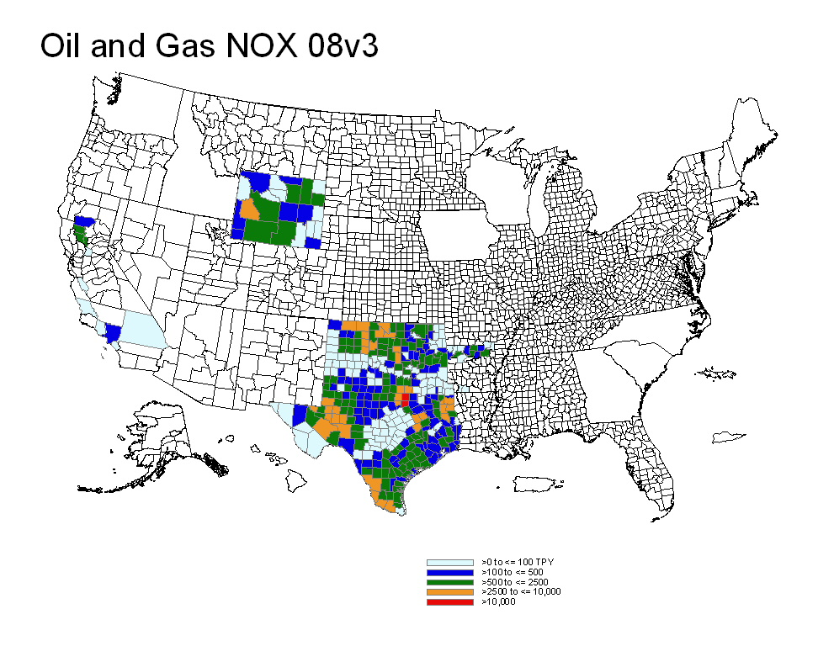
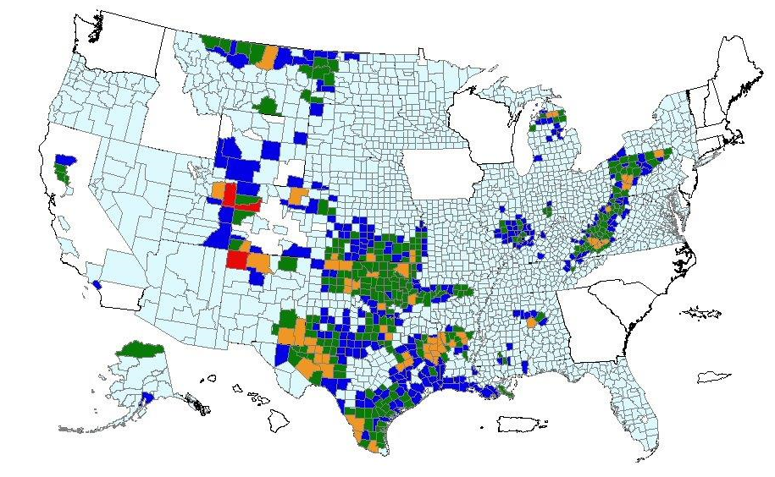
Oil and Gas NOx: 2008 versus 2011
2008 NEI
2011 NEI
>= 0 to <= 100 TPY
>100 to <= 500
>500 to <= 2,500
>2,500 to <= 10,000
>10,000

Slide 16
Oil and Gas NOx: 2008 versus 2011
2011 NEI
2008 NEI
>= 0 to <= 100 TPY
>100 to <= 500
>500 to <= 2,500
>2,500 to <= 10,000
>10,000

Slide 17
