Slide 1
Update:
2017/2018 Annual Multi-Pollutant Platforms
AQ Model Apps Meeting- 04/07/2021

Slide 2
Conceptual Plan to Incorporate Air Toxics into an Annual Multi-Pollutant Platform
Recall AQMG & EIAG FY21 Budget proposal of Annual MP Platform related to the OAQPS Air Toxics Strategy
Briefing for OAQPS Sr Mgmt Team - 9/16/2020

Slide 3
Purpose
Present a concept to develop an annual multi-pollutant Platform that incorporates air toxics
  Leverage ongoing O3 and PM2.5 annual platform development already done
  Similar to current emissions and modeling platform developed and applied for OTAQ rule RIAs that include mobile HAPs
  As done for criteria pollutants for decades, it would provide analytical foundation for air toxics assessments that can support the OAQPS air toxics strategy and associated programs
  More routine development on a recurring annual basis allows OAQPS to be more aware and expert in our nation's air toxics issues, similar to criteria pollutants
Mention the proposed development of an Air Toxics Scenario Tool to enable us to identify and understand emerging issues (not the focus here so can return at a later date with more details)
Consider placeholder funding in the FY21 budget request for this planned effort and/or other toxics needs related to the OAQPS Air Toxics Strategy

Slide 4
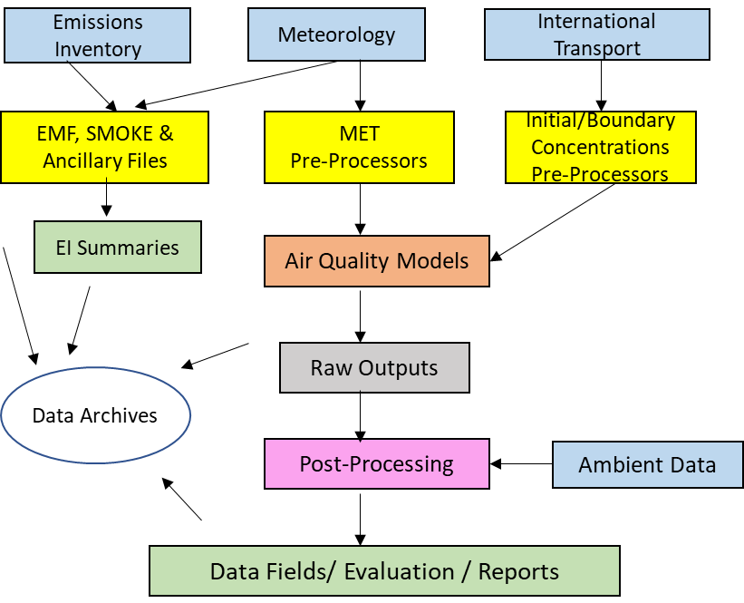
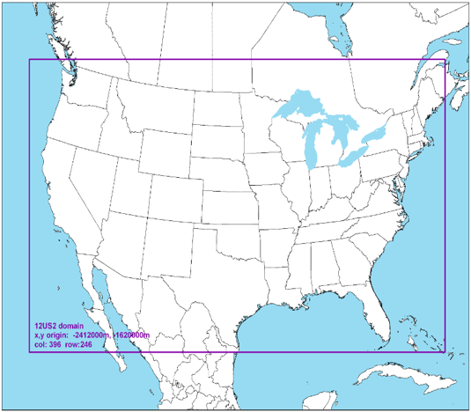
What is a Multi-Pollutant Platform?
Structured system of connected emissions, air quality modeling data and tools applied to a current year that provides a consistent and transparent basis for assessing the air quality response to changes in emissions and/or meteorology
Ultimate goal is a single, “harmonized” emissions and modeling platform for assessments of criteria pollutants (e.g., ozone and PM) and hazardous air pollutants (HAPs)

Slide 5
Adapting the Existing Annual Platform
  For over a decade, we have developed an annual platform to characterize O3 and PM2.5 in collaboration with CDC
  CDC platform completed about 2 ½ years after inventory year
    2017 CDC in May/June 2020; 2018 CDC in Summer 2021
  We can leverage CDC effort* and include air toxics for an annual HAP+CAP platform
    Include HAPs in the emissions and AQM CONUS runs
    Add AERMOD emissions/modeling and hybrid approach for HAPs
    Add Non-CONUS runs – AK, HI, PR/VI (separate model domains)
  Keep working to get even more efficient over time as we have done with CAP-only for CDC and for air toxics for NATA
* "leverage" pertains to internal technical operations & CDC resources only not providing toxics data to CDC

Slide 6
Overview: HAP+CAP modeling platform
CMAQ Multipollutant – 12 CMAQ runs (4 domains; 1 base and 2 zero outs)
  50 HAPs (including EtO), based on NEI
  All 50 states, PR/VI (4 total model domains: CONUS, AK, HI, PR/VI)
  Grid: 12-km CONUS, 9-km AK, 3-km HI & PR/VI
  Two sets of zero outs: biogenics and fires (source apportionment when available)
AERMOD – All anthropogenic sources
  185 HAPs + diesel PM, based on NEI
  All 50 states, PR/VI
  Gridded, block and monitoring site receptors
  Source attribution (about 30 source groups)
  Additional - point-only AERMOD run for point inventory QA
Hybrid approach: Combine CMAQ and AERMOD results to get finer scale annual average concentration for each HAP
Produce this every year, beginning 2017, and consider periodic updates for 1 or 2 historical years

Slide 7
Air Toxics in CMAQ: 9 HAPs added since 2011 NATA
Gas Phase – stationary & mobile
Gas Phase – stationary
Pollutant | Inhalation Health Impacts
BENZENE | Cancer, Noncancer
FORMALDEHDYE | Cancer, Noncancer
ACETALDEHYDE | Cancer, Noncancer
1,3 BUTADIENE | Cancer, Noncancer
NAPHTHALENE | Cancer, Noncancer
ACROLEIN | Noncancer
METHANOL | Noncancer
XYLENES (M, O, P) | Noncancer
TOLUENE | Noncancer
PAHs (9 Groups) | Cancer
Pollutant | Inhalation Health Impacts
ACRYLONITRILE | Cancer, Noncancer
Carbon tetrachloride | Cancer, Noncancer
CHLORINE | Noncancer
CHLOROFORM | Noncancer
1,4-DICHLOROBENZENE | Cancer, Noncancer
1,3-Dichloropropene | Cancer, Noncancer
ETHYLENE DIBROMIDE | Cancer, Noncancer
Ethylene dichloride | Cancer, Noncancer
ETHYLENE OXIDE | Cancer, Noncancer
Hexamethylene-1,6‑diisocyanate | Noncancer
HYDROCHLORIC ACID | Noncancer
HYDRAZINE | Cancer, Noncancer
MALEIC ANHYDRIDE | Noncancer
METHYLENE CHLORIDE | Cancer, Noncancer
PROPYLENE DICHLORIDE | Noncancer
Quinoline | Neither
1,1,2,2-Tetrachloroethane | Neither
2,4-Toluene diisocyanate | Cancer, Noncancer
Trichloroethylene | Cancer, Noncancer
Triethylamine | Noncancer
VINYL CHLORIDE | Cancer, Noncancer
Added for 2014/2017:
  chloroprene
  ethylbenzene
  acrylic acid
  acetonitrile
  methyl chloride
  styrene
  carbonyl sulfide
  hexane
  benzo(a)pyrene
Particle and multi-phase – stationary & mobile
Pollutant | Inhalation Health Impacts
NICKEL | Cancer, Noncancer
HEX CHROMIUM | Cancer, Noncancer
ARSENIC | Cancer, Noncancer
CADMIUM | Cancer, Noncancer
BERYLLIUM | Cancer, Noncancer
MANGANESE | Noncancer
LEAD | Noncancer
DIESEL PM | Noncancer
MERCURY | Noncancer

Slide 8
AQ Modeling 2017 HAP+CAP Platform
CMAQ – 3 CMAQ runs (12US2 CONUS base, fire and biogenic zero outs)
  CMAQ version 5.3.1 multipollutant (CAP+HAP)
    Config specs: cb6r3 chemical mechanism with AERO7; nonvolatile POA and without pcSOA, NO NH3 bi-di; NO Lightning NOx; M3DRY (dep mod)
  50 HAPs (including EtO), based on 2017 NEI
  Met: WRF v3.8; MCIP v4.3 - “17j”
  IC/BC: 2017 H-CMAQ; mix of NRT and 2014 monthly files for particular HAPs.
  Grid: 12US2 CONUS; 35-layer structure
  Two sets of zero outs: biogenics and fires
AERMOD – All anthropogenic sources
  AERMOD version 19191
  185 HAPs + diesel PM, based on NEI
  All 50 states, PR/VI
  Met: 2017 WRF v3.8; processed MMIF in AERMET (v. 19191)
  Gridded, block and monitoring site receptors
  Source attribution (about 30 source groups) from all source sectors
  Additional - point-only AERMOD run for point inventory QA
Hybrid calculation – Combine CMAQ and AERMOD results to get finer scale annual average concentration for each HAP in CONUS domain.
  Hybrid results at block level and at monitor locations (for model evaluations)

Slide 9
2017 Update & Tentative Next Steps
Conducted QA/analysis of 12US2 CMAQ runs as well as comparisons between 2017 CDC CMAQ (CAP only) run and 2017 HAPCAP run – update of speciation methodology
QA of Hybrid calculations
Model Evaluation – AQAG to provide updated 2017 HAP observational data (formatting) to conduct a robust HAP model evaluation for CMAQ/AERMOD/Hybrid.
For point, provided facility specific concentrations by pollutant and receptor at process/release point/unit ID level to HEID for assessment.
Provide 2017 Hybrid concentrations to HEID for risk calculations.
Analysis of trends in risk and air quality characterization (e.g., 2011/2014 and 2017).
Resource limitations to conduct the 2017 non-CONUS CMAQ domains and related zero-out runs.
Non-CONUS CMAQ runs are being considered for the 2018 Multipollutant platform (provided FY21 budget funding).

Slide 10
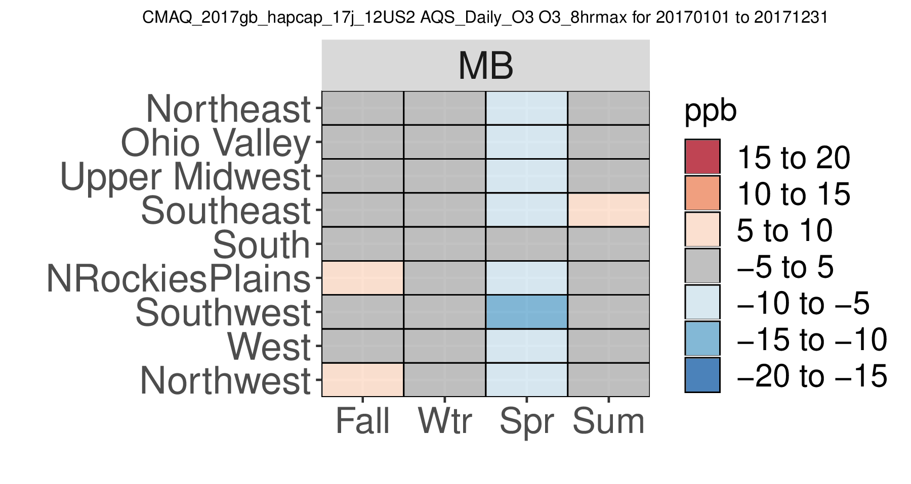
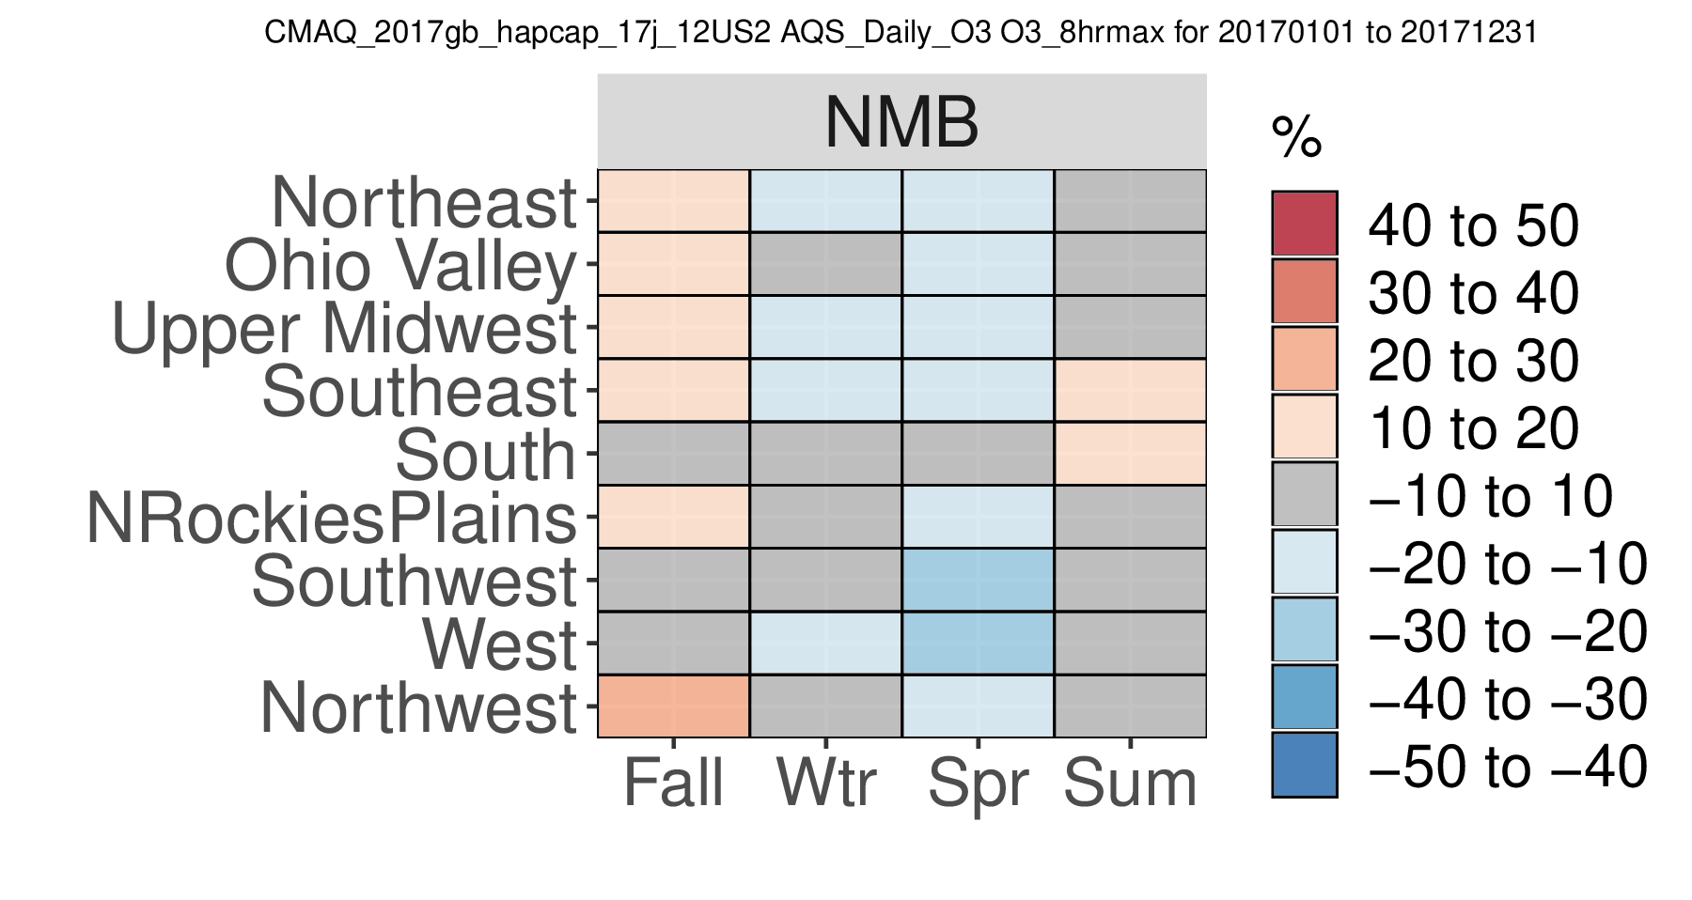
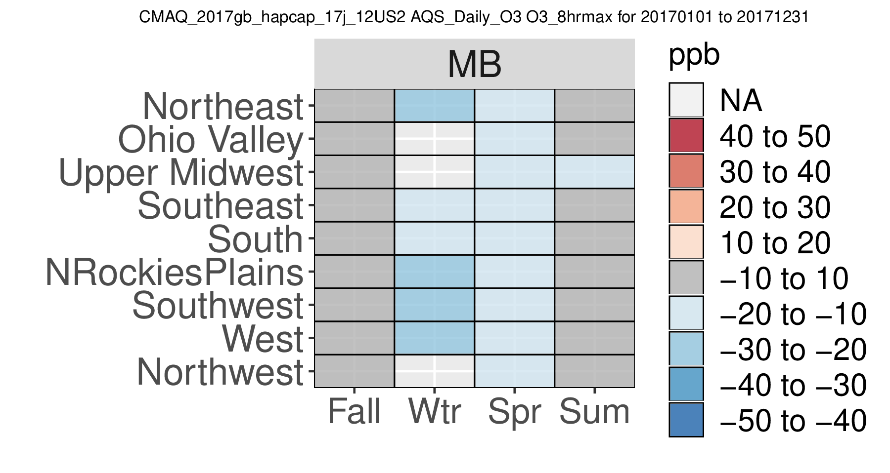
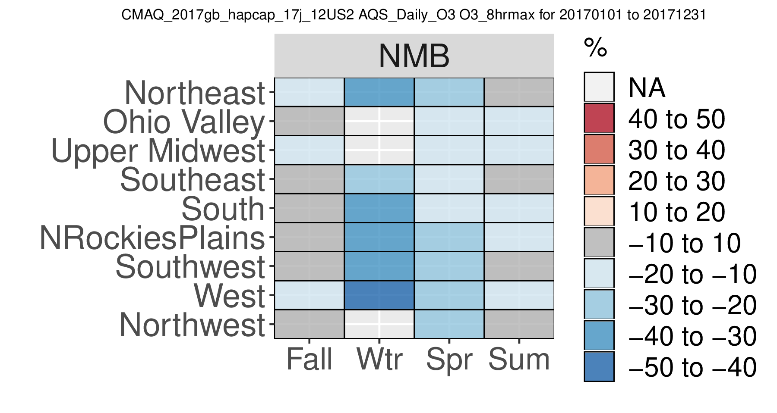
2017gb_hapcap_17j: 8hrmax Ozone
All Data
GE 60ppb

Slide 11
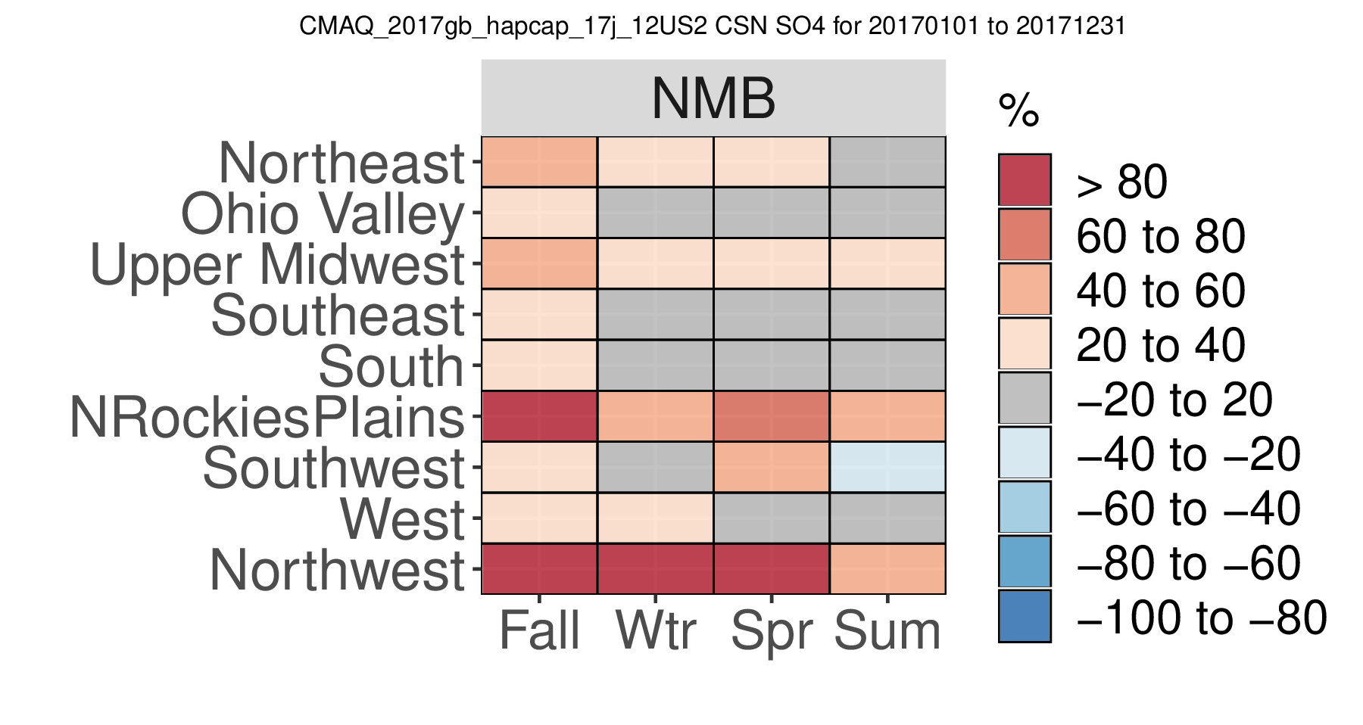
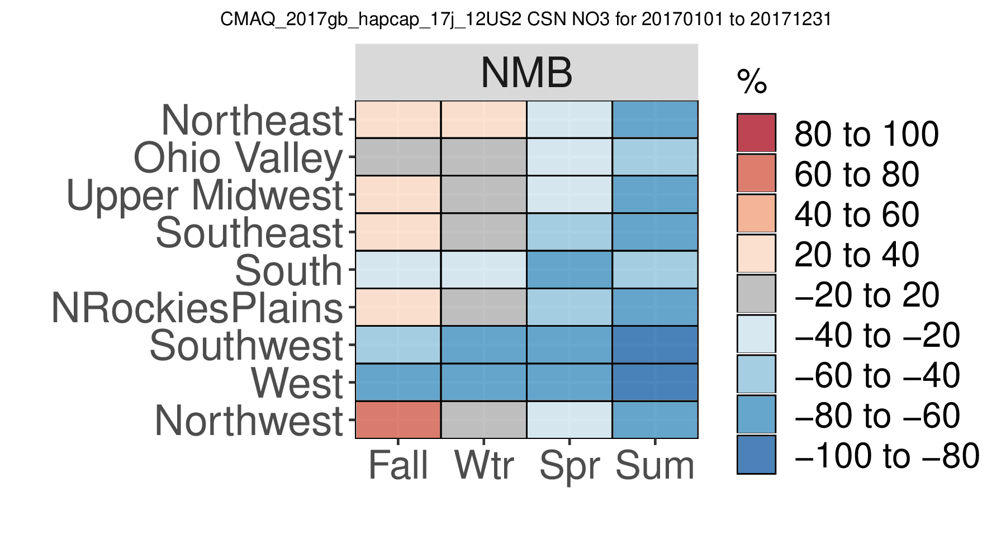
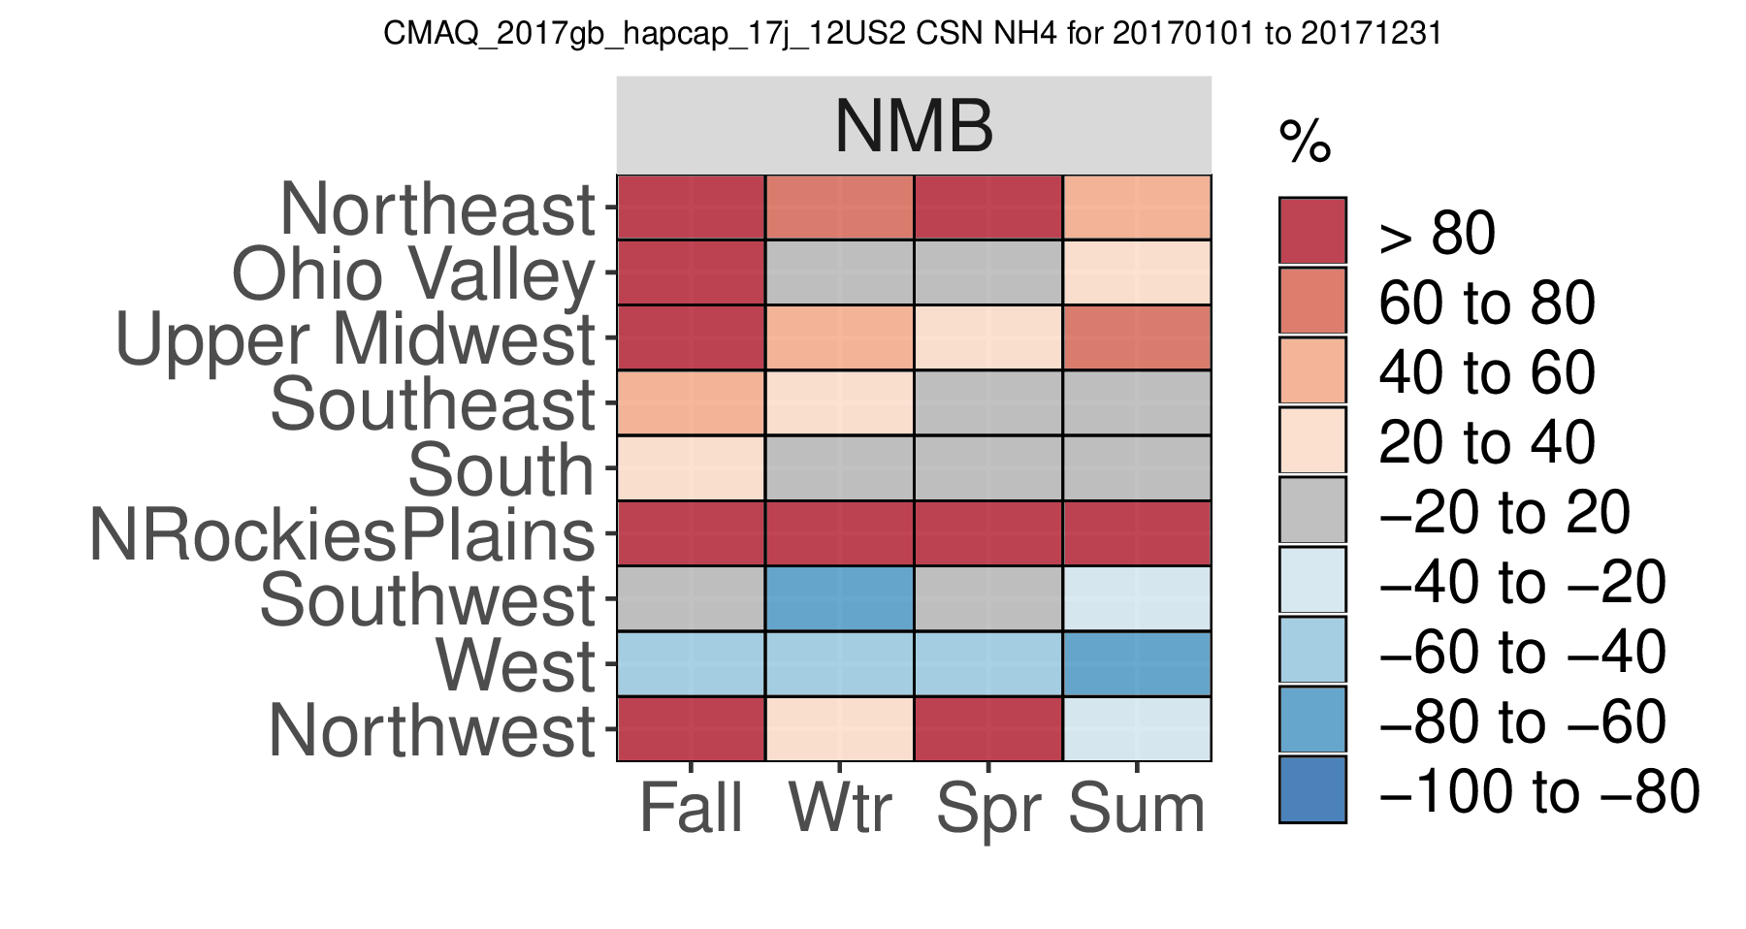
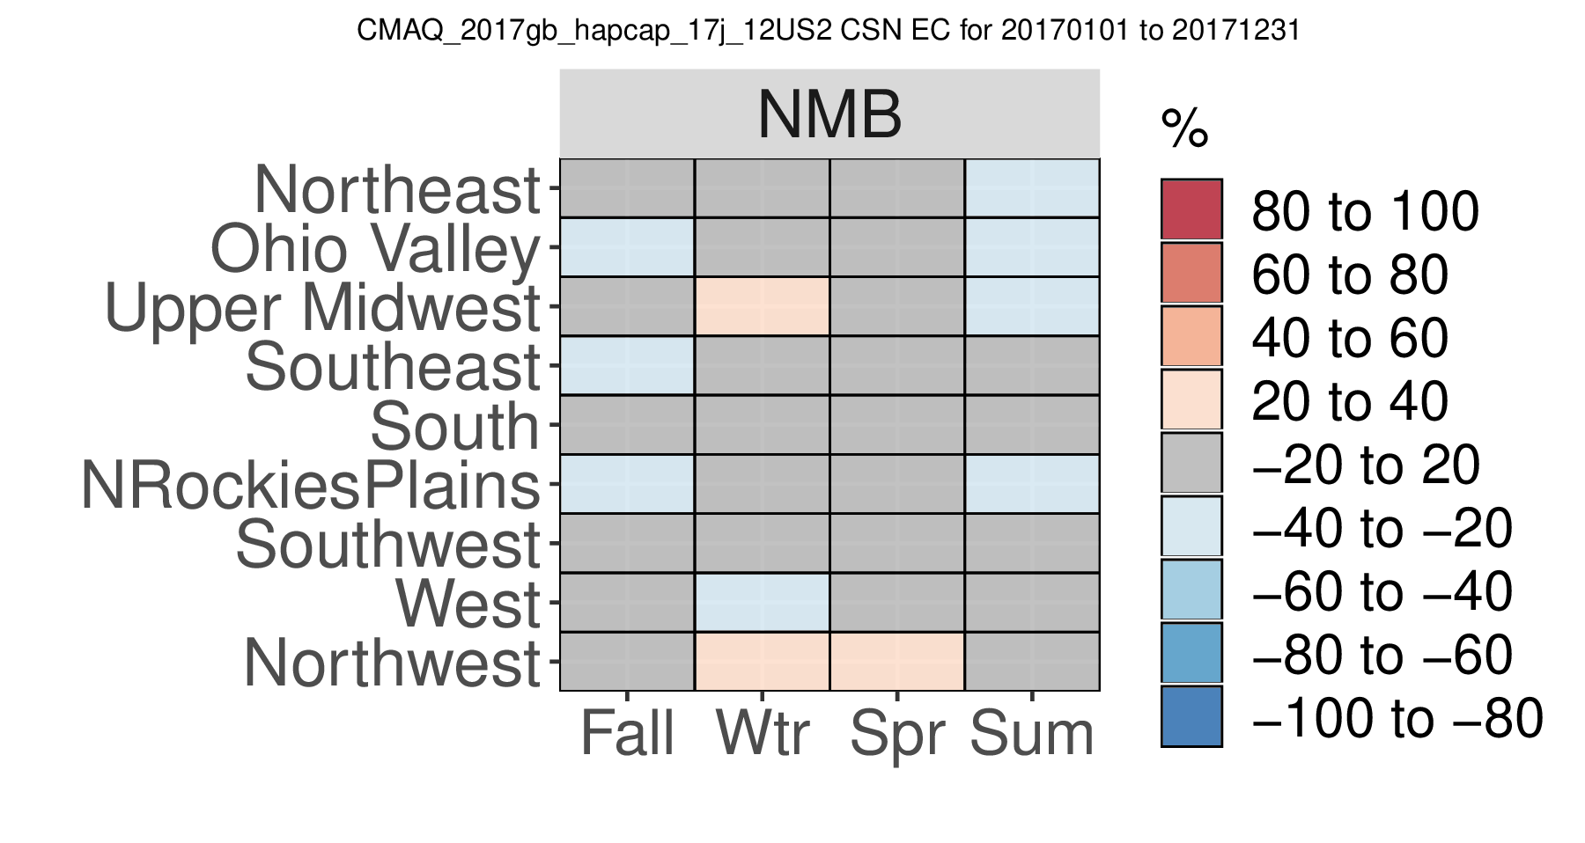
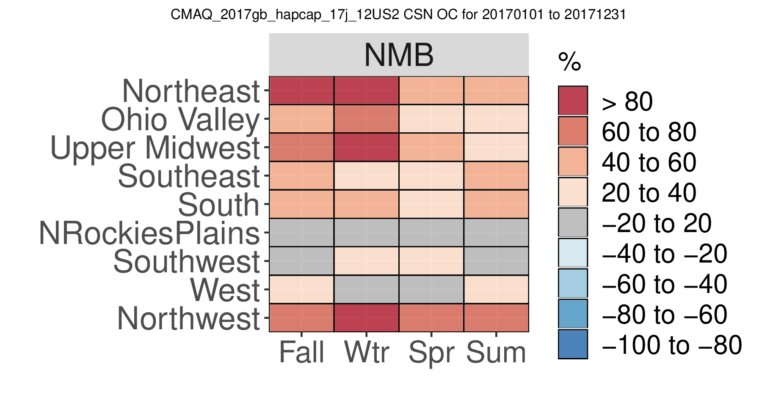
2017gb_hapcap_17j: PM2.5 Species at CSN sites
SO4
NO3
NH4
EC
OC

Slide 12
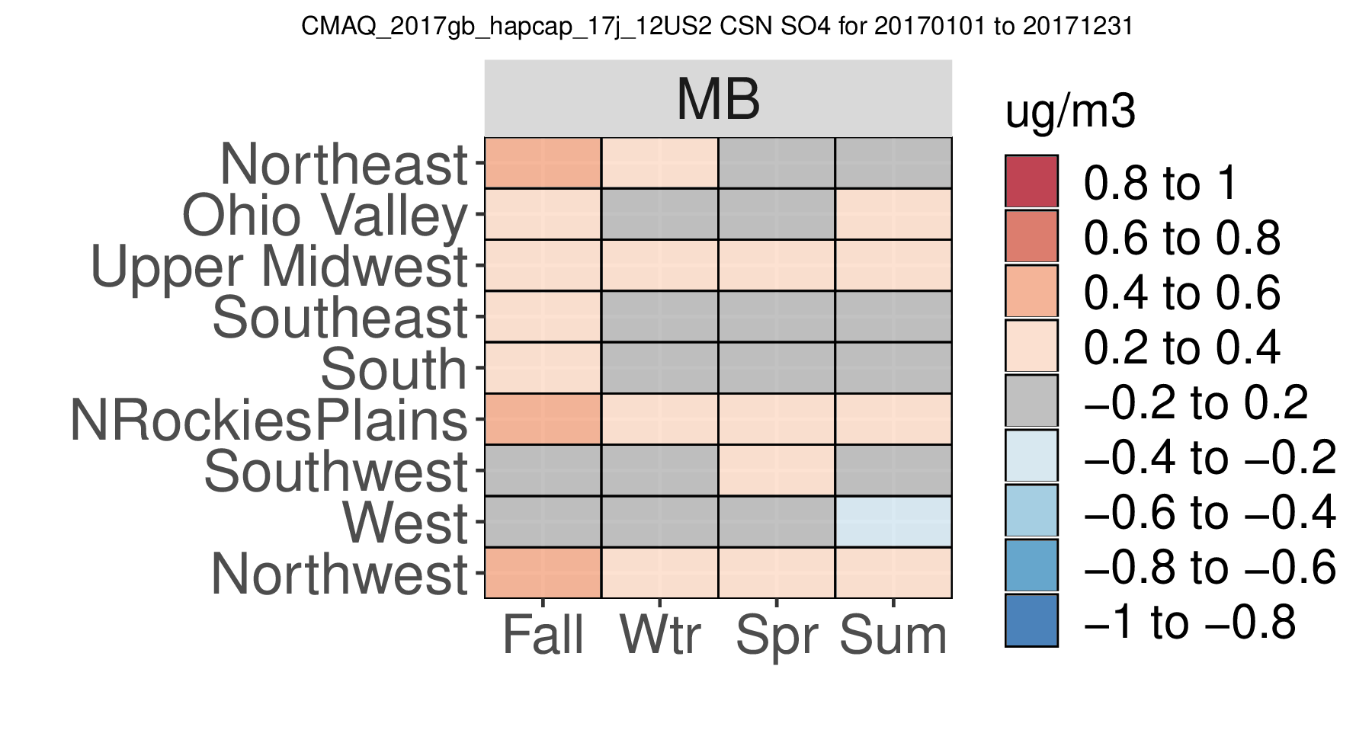
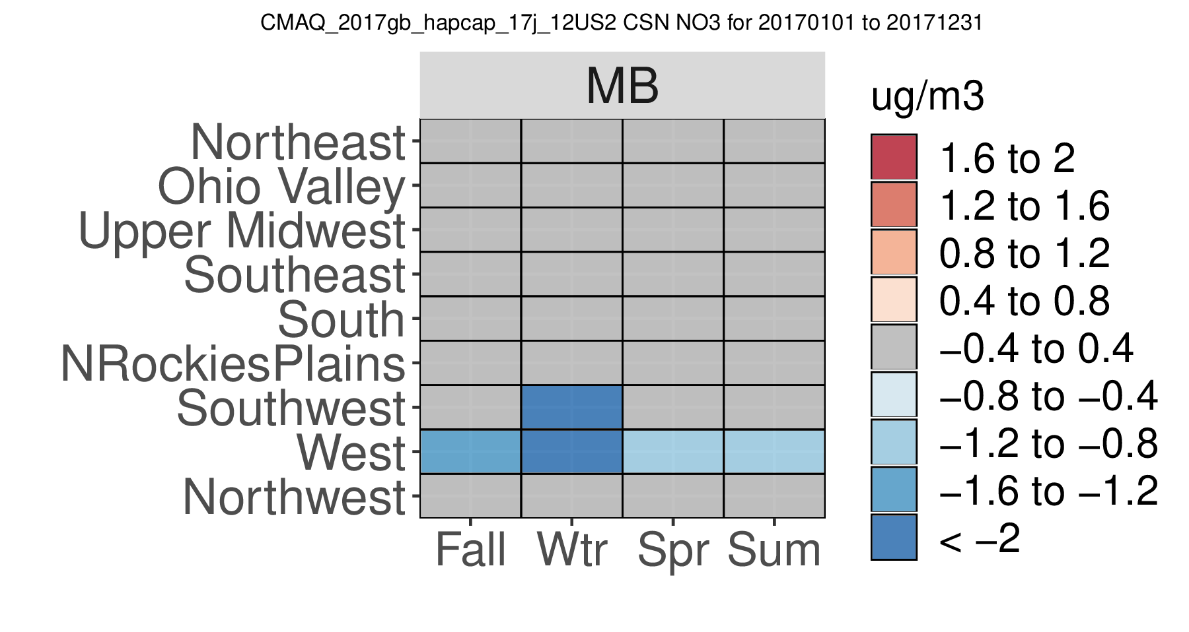
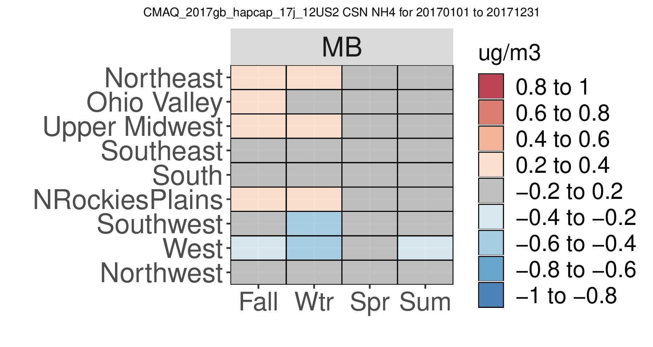
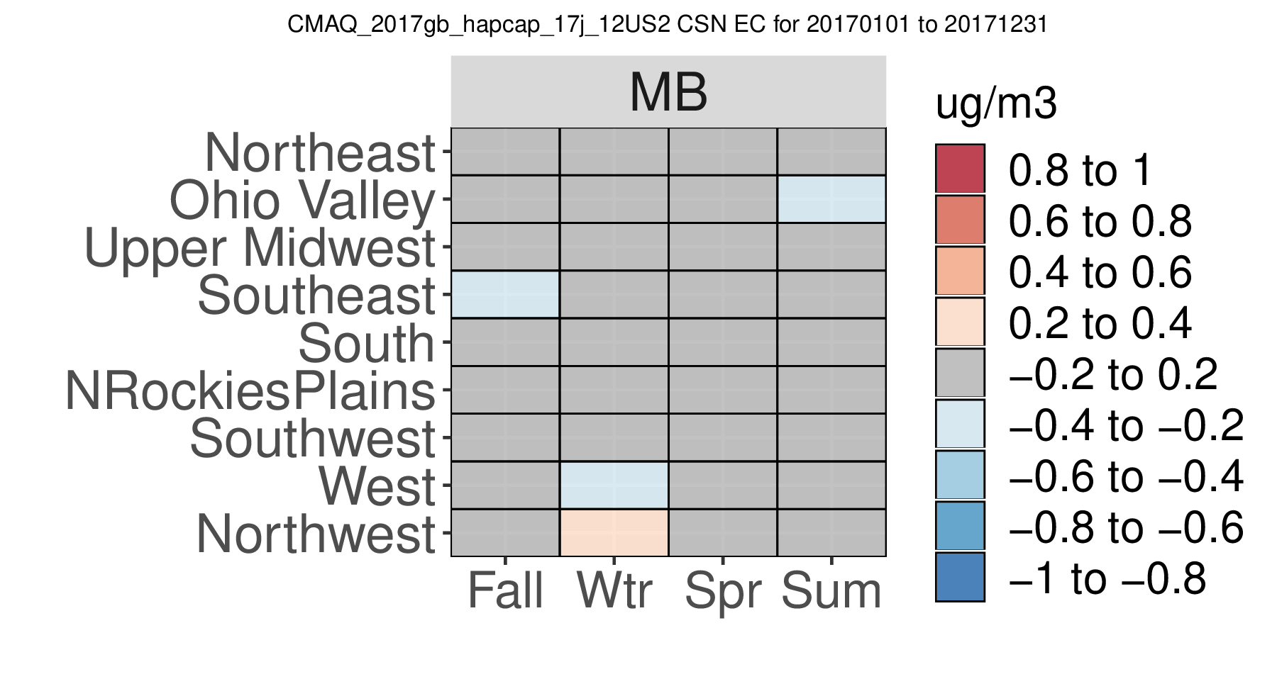
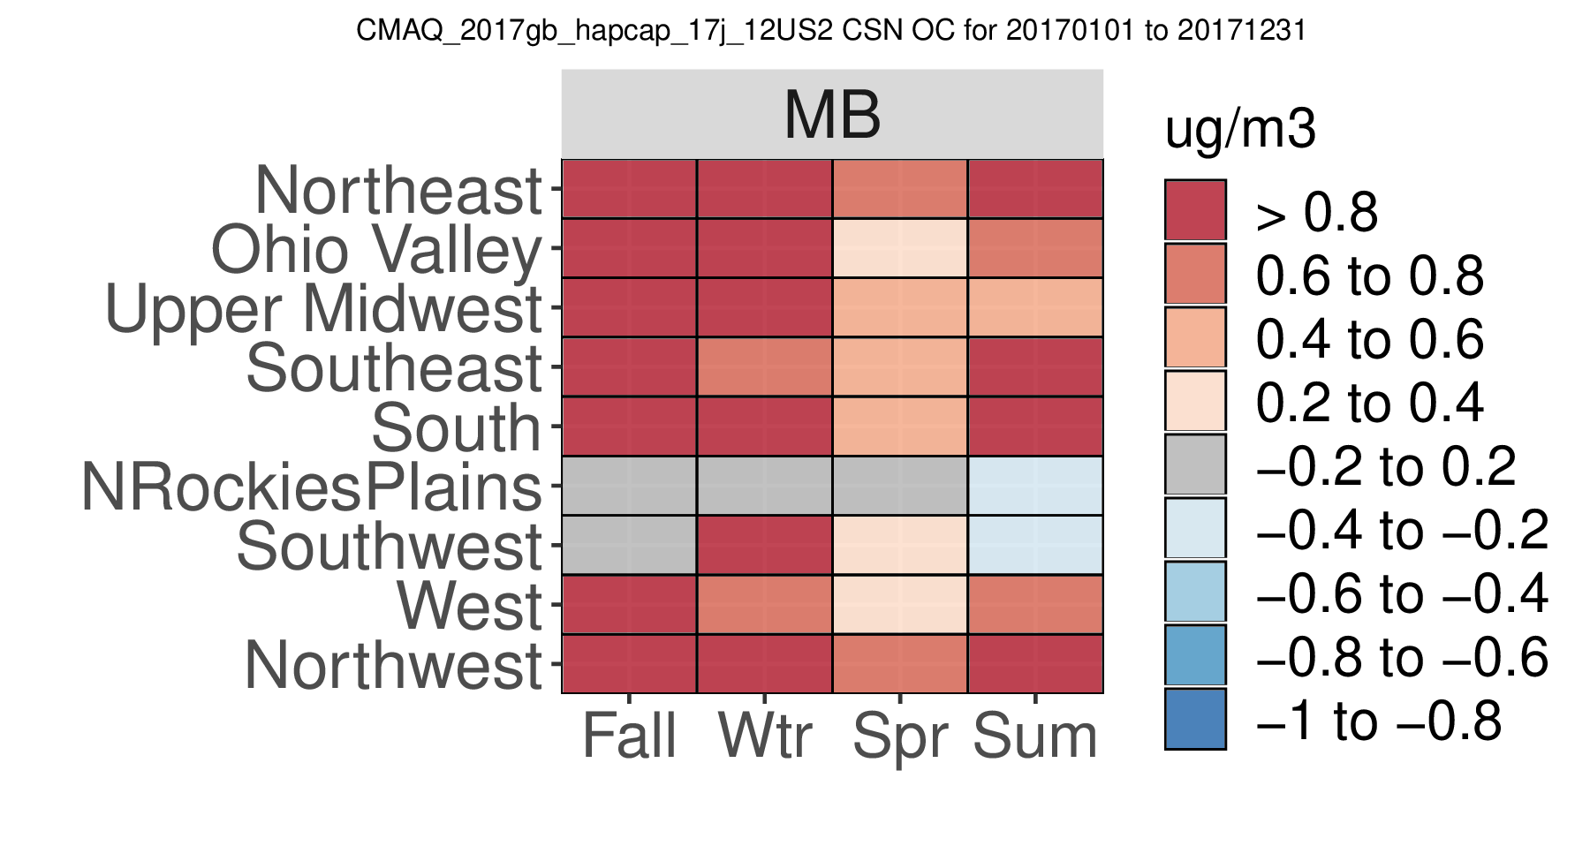
2017gb_hapcap_17j: PM2.5 Species at CSN sites
SO4
NO3
NH4
EC
OC

Slide 13
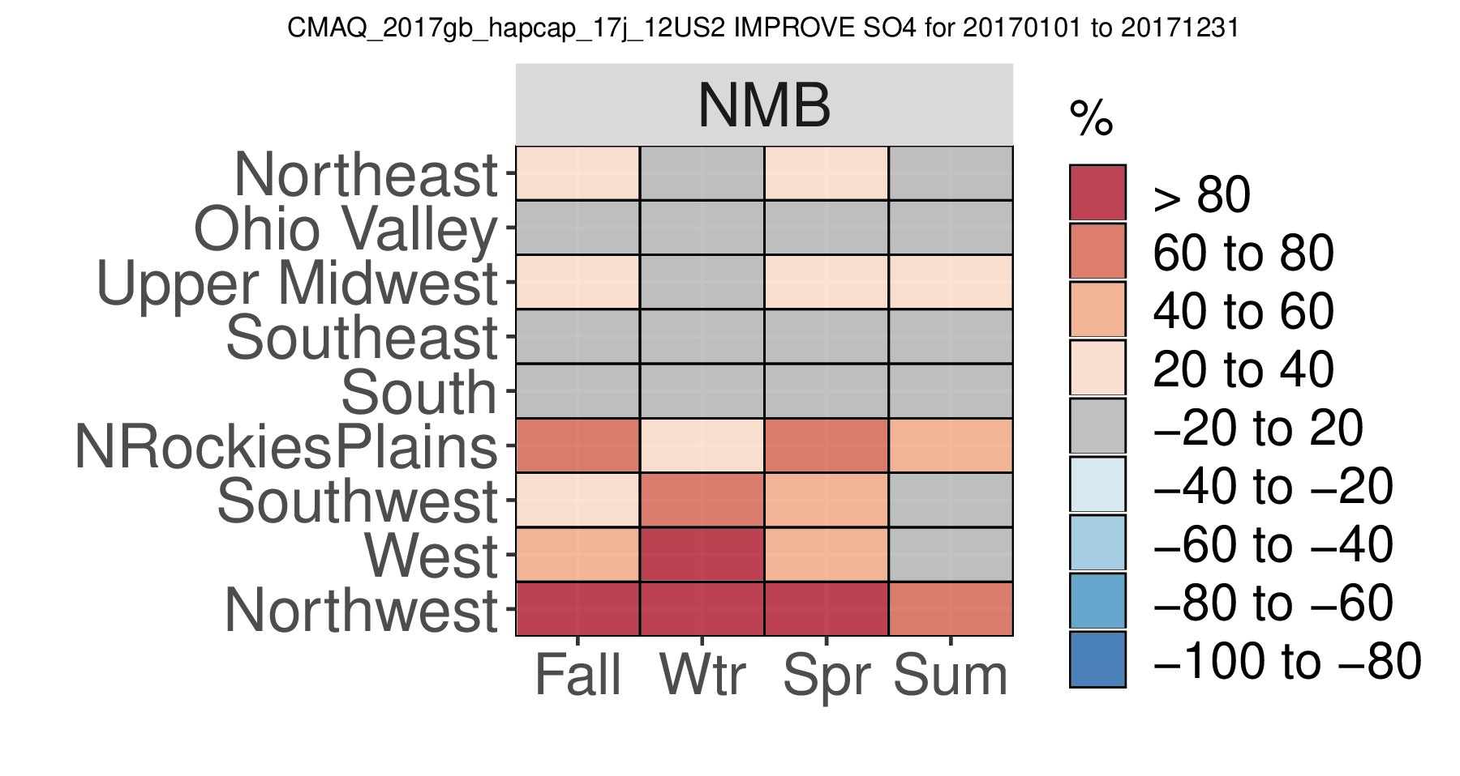
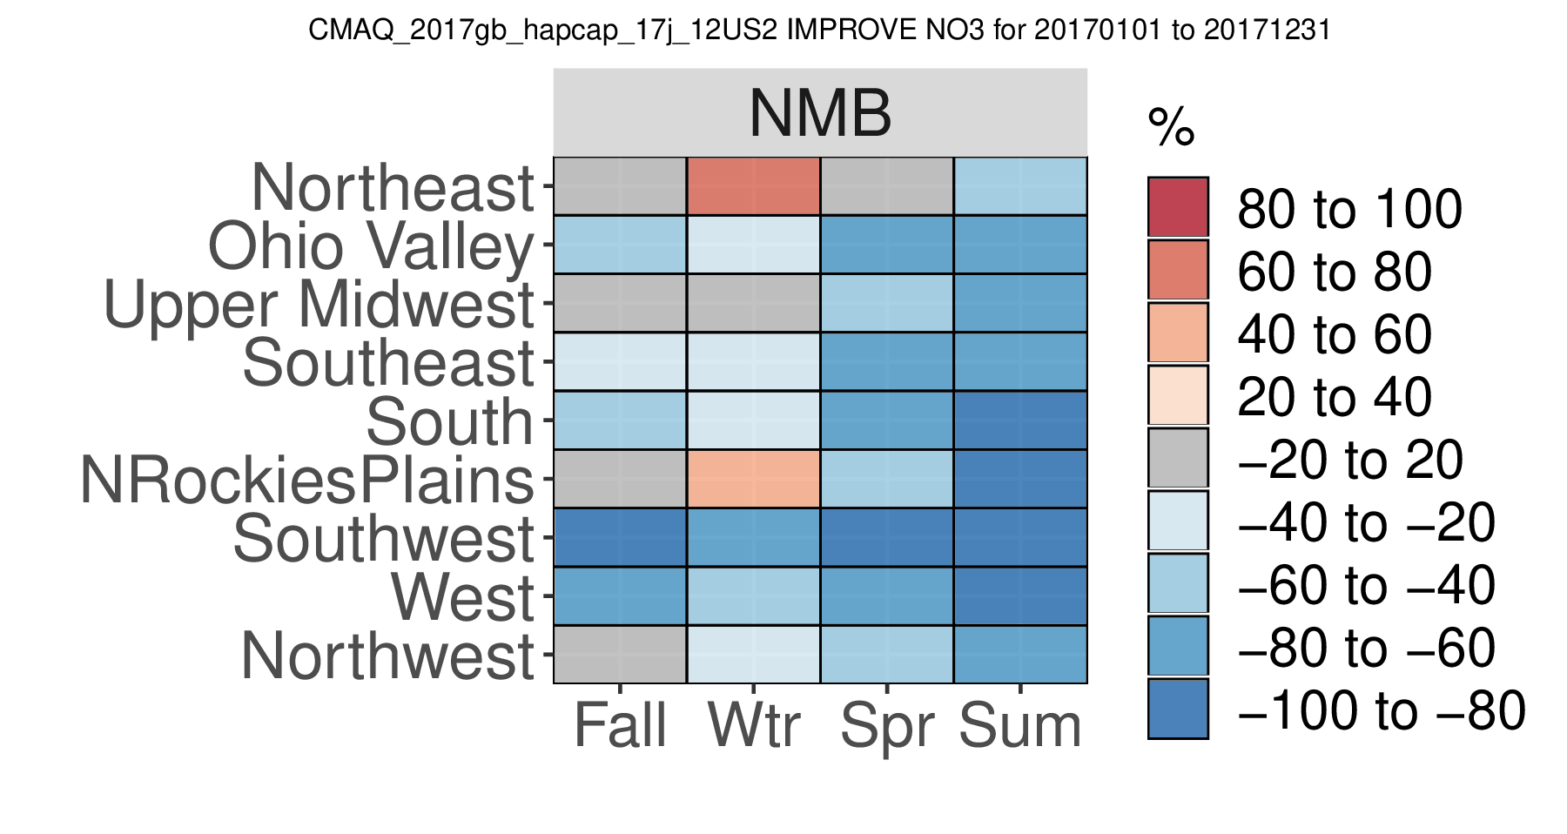
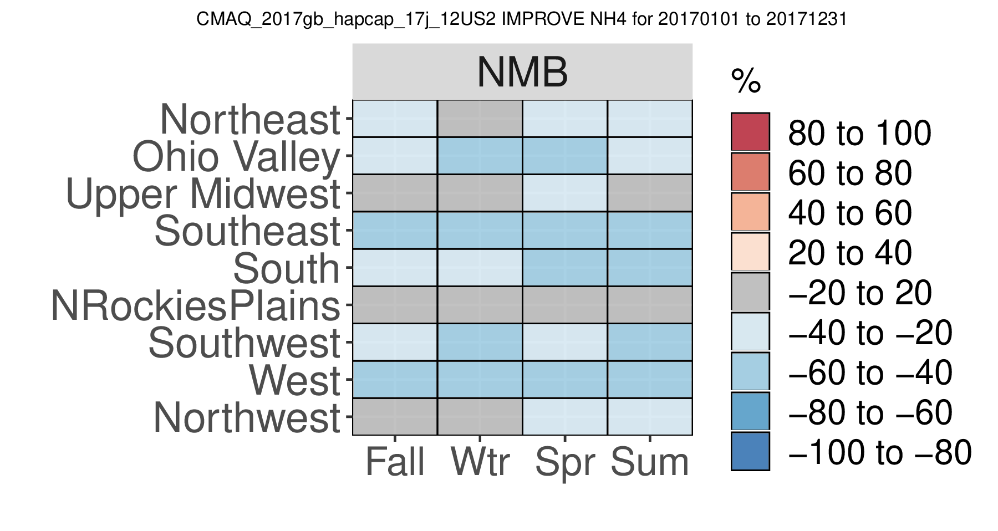
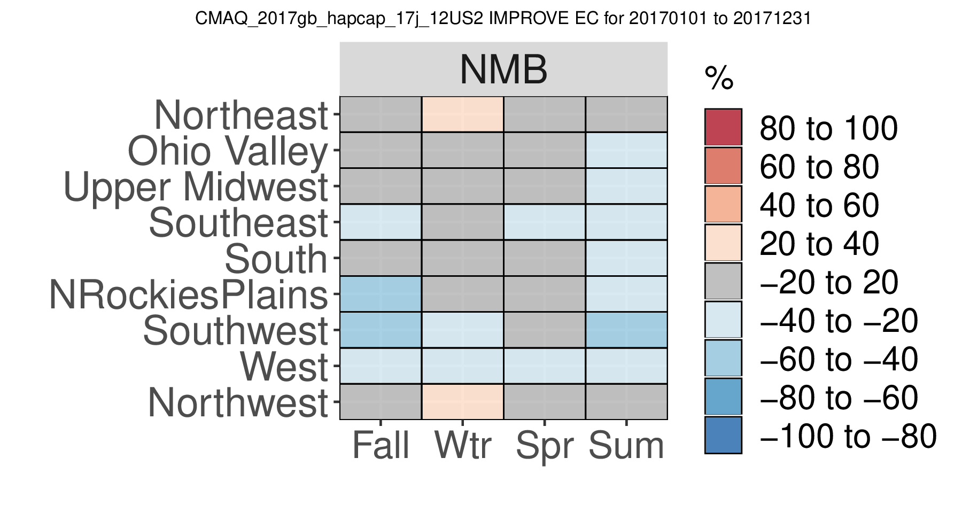
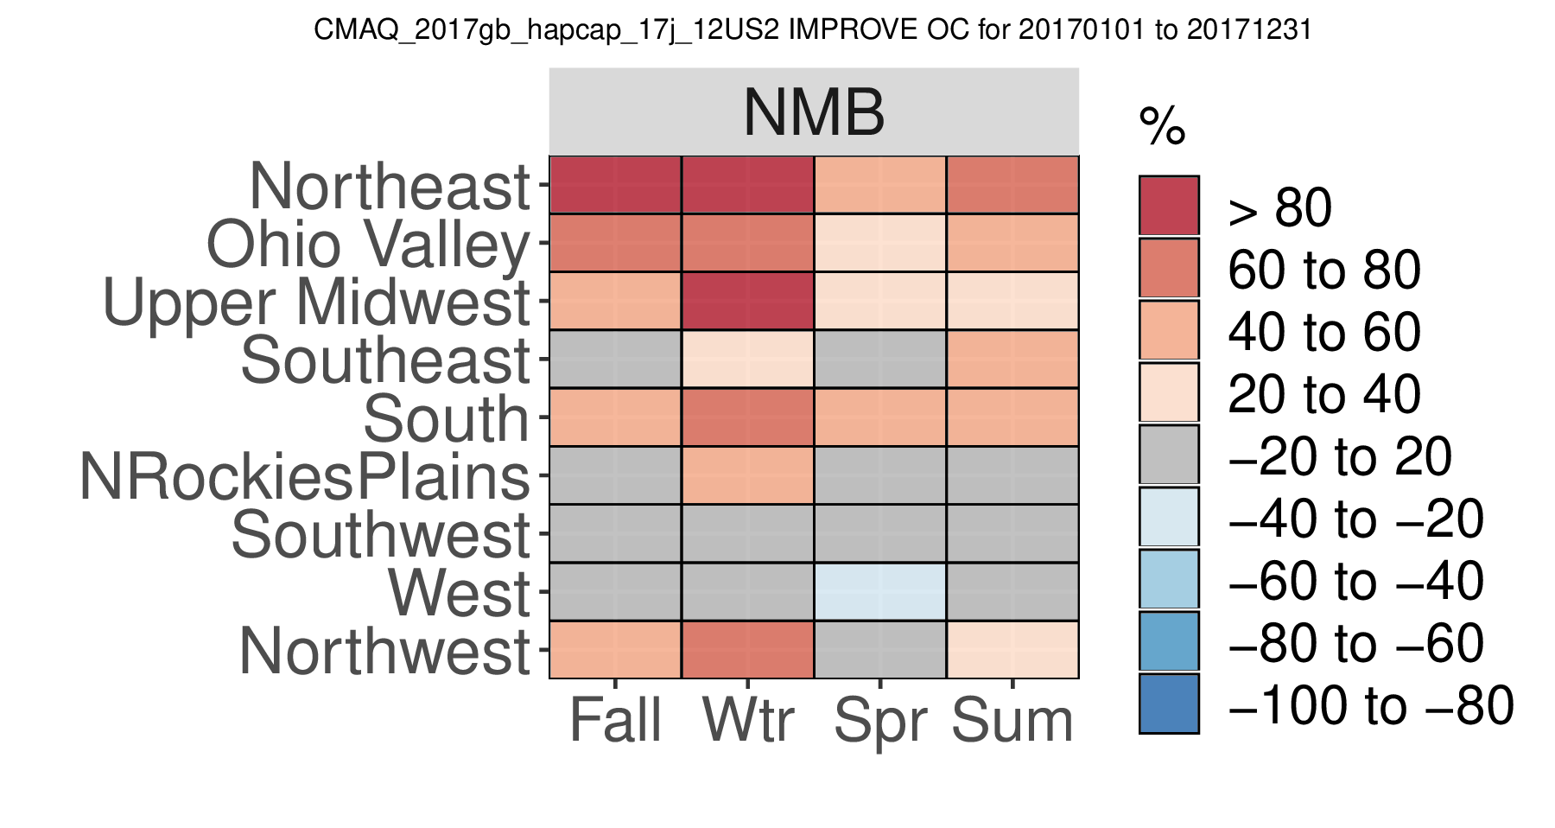
2017gb_hapcap_17j: PM2.5 Species at IMPROVE sites
SO4
NO3
NH4
EC
OC

Slide 14
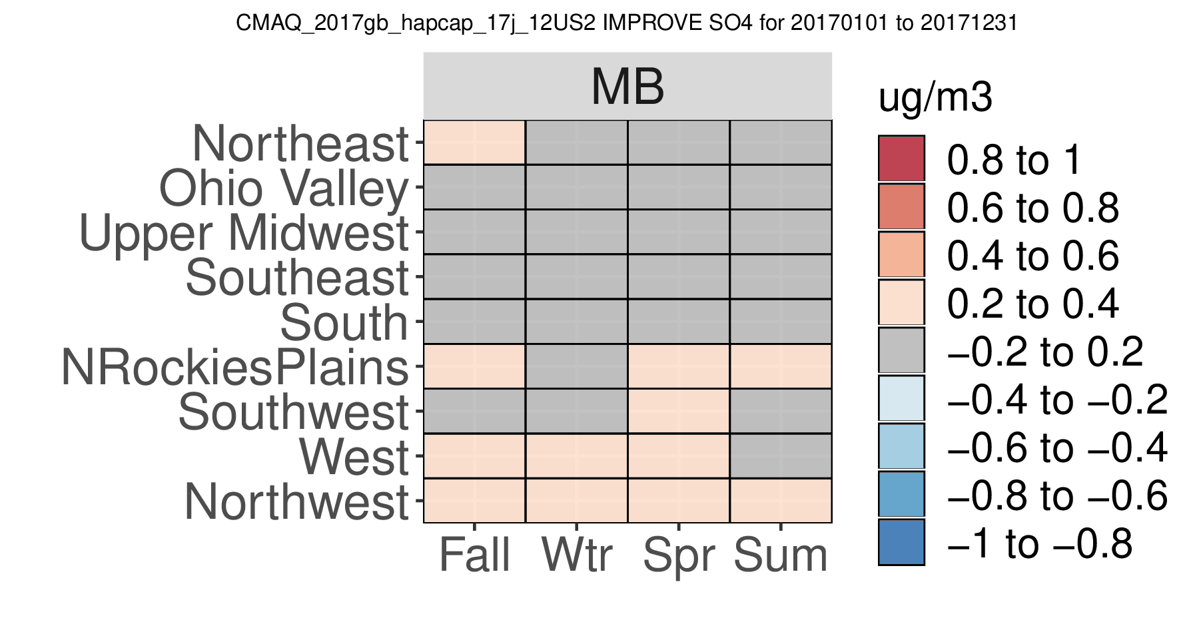
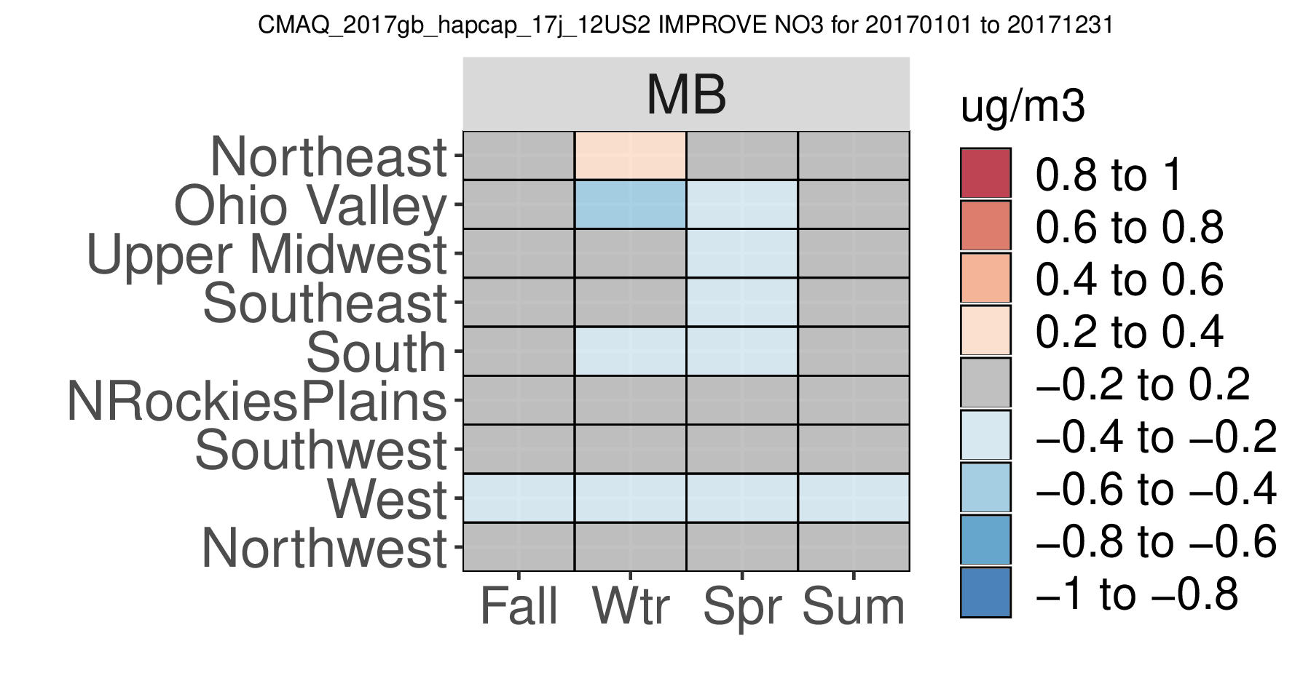
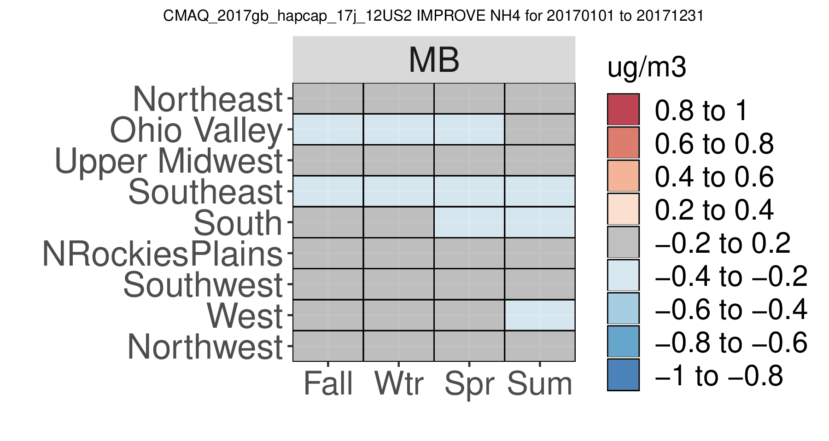
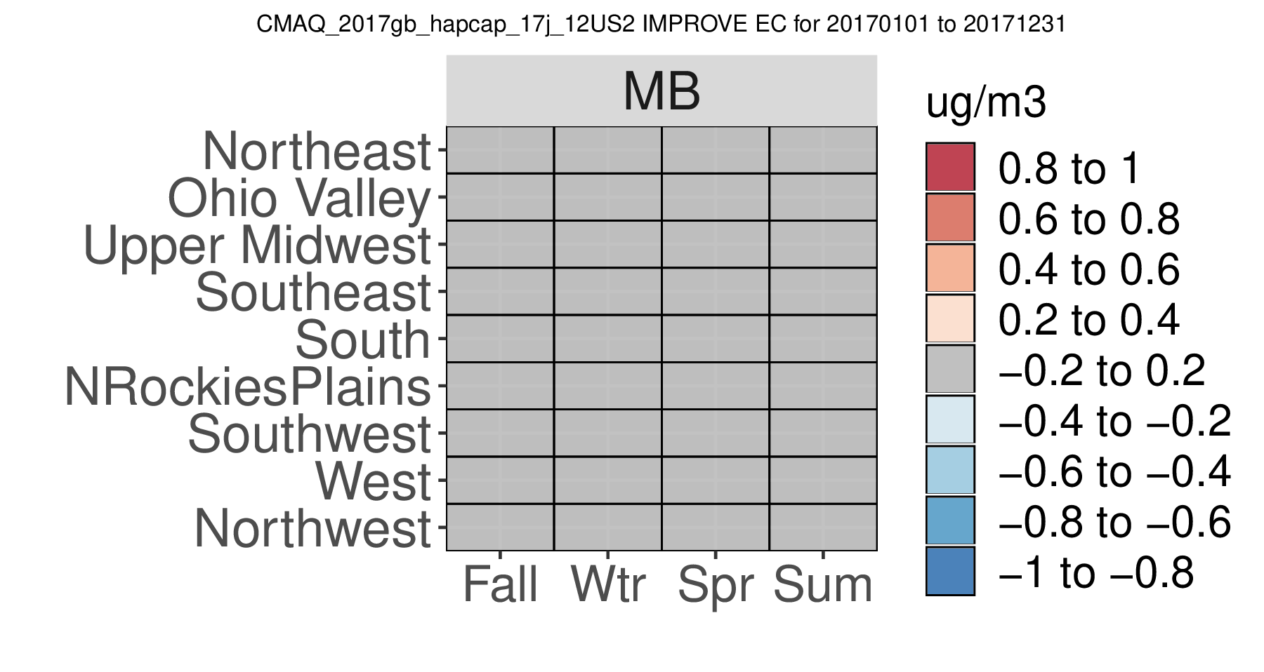
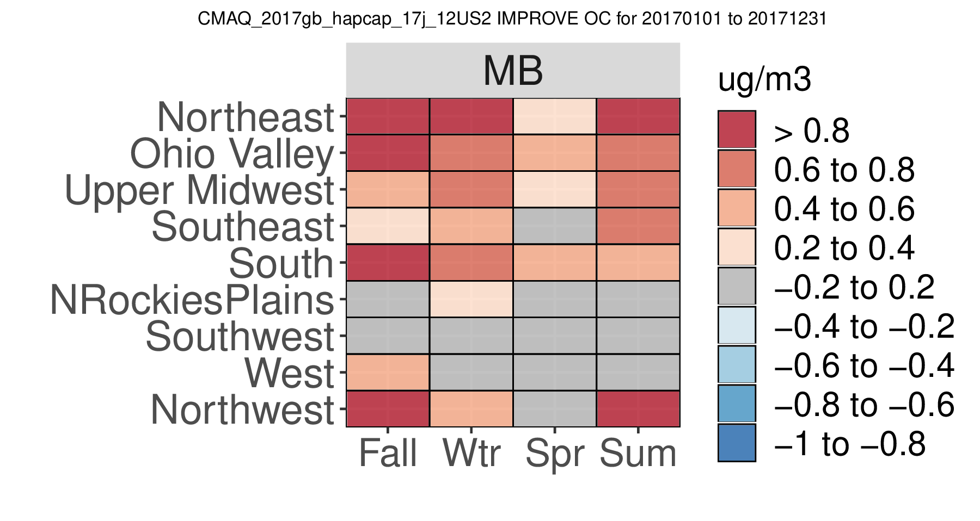
2017gb_hapcap_17j: PM2.5 Species at IMPROVE sites
SO4
NO3
NH4
EC
OC

Slide 15
2018 HAP+CAP Platform Planning

Slide 16
Photo-chemical Modeling Components for 2018 MP Platform
 | Details/Versions | Notes/Decisions?
Air Quality Model | CMAQ v5.3.2 Multi-Pollutant | Test new version with chemistry updates for fire HAPs via AESMD (Bill Hutzell)
Domain | 12-km CONUS 35 vertical layers | 12US1 vs 12US2 Non-CONUS (9AK1, 3HI1, 3PRVI1)??
Meteorology | 2018 WRF v3.8; MCIP v4.5 | Non-CONUS domains runs remaining (9AK1, 3HI1, 3PRVI1)
Emissions | 2018 (pivot off 2017 NEI for US - details on next slide); Canada new 2016 + adjusted mobile; Mexico new 2016; FINN (nonUS) | Include NH3 bi-di; Lightning NOx(?); M3DRY or STAGE for specific dry deposition velocities (NEI and EQUATES simulations have used STAGE)
Initial & Boundary Conditions | 2018 GEOS-Chem (4x5 degrees) + Annual remote HAP conc msmts (NOAA GMD and AGAGE) | More details to follow (Barron)
AQ Modeling Outputs | Ozone & PM2.5 species Nitrogen & Sulfur Deposition Air toxics for Hybrid Calculation | Ozone & PM2.5 – spatial surfaces for CDC and benefits?
Future Years | TBD | Regulatory needs?
Notes:
Annual remote conc msmts (NOAA GMD and AGAGE): chloroform, methyl chloride, benzene, carbon tetrachloride, dichloromethane, tetrachloroethylene
The Advanced Global Atmospheric Gases Experiment (AGAGE) has been measuring the composition of the global atmosphere continuously since 1978.→ chloroform for Trinidad Head (remote north coast of CA)
NOAA Global Monitoring Division (GMD): Cape Kumukahi, Hawaii; Mauna Loa Observatory (MLO); Niwot Ridge Observatory, Colorado (NWR); Barrow, Alaska Observatory (BRW); Alert Observatory, Canada (ALT)

Slide 17
2018 Emissions Development Methods by Sector
Sector | Method | Sector | Method
afdust | 2017 NEI + adjust paved roads to 2018 | onroad | 2018 MOVES3 EFs + activity projected from 2017 NEI to 2018 + CA
livestock | 2017 NEI adjusted to 2018 based on USDA data | ptnonipm | 2018 point with stack parameter corrections; projected rail yards
fertilizer | Computed based on bidi | pt_oilgas | 2018 point; 2017 data projected
airports | 2017 NEI adjusted to 2018 w/ factors from Terminal Area Forecast | ptegu | 2018 point with stack parameter corrections
beis | BELD5 w/ BEIS 3.7 run for 2018 | ptfire-rx & ptfire-wild | SMARTFIRE2 with national datasets + GA and FL activity & Flint Hills
cmv_c1c2 and c3 | 2017 NEI (hourly) adjusted to 2018 based on regional factors | ptagfire | Provide by George Pouliot
nonpt | 2017 NEI, but with VCP update | rail | 2017 NEI adjusted to 2018
nonroad | MOVES3 output for 2018 + Calif | rwc | 2017 NEI unchanged
np_oilgas | 2017 NEI projected to 2018 (EIA, etc.) | vcp | Karl Seltzer inventory for 2018

Slide 18
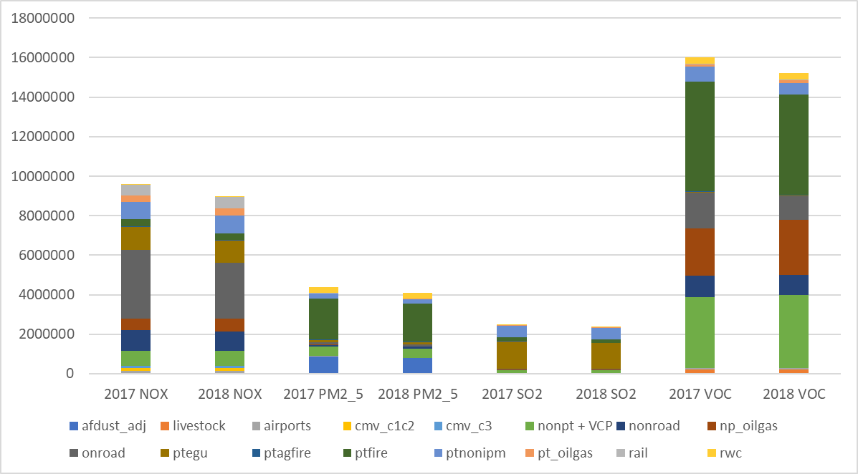
2017 vs 2018 Emission Summary

Slide 19
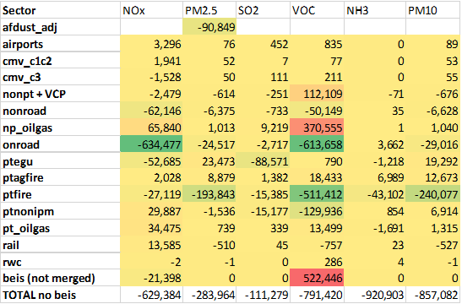
CAPs Difference: 2018 minus 2017

Slide 20
Tentative 2018 Platform Schedule & Next Steps
CDC 2018 CMAQ 12US2 CONUS – start late April-early May
  Analysis and model evaluation – start ASAP (June)
  O3/PM2.5 spatial surfaces – July
  Documentation – July/August
AERMOD runs – kick-off runs in Summer
Hybrid calculations – early Fall
Non-CONUS model runs - TBD

