Slide 1
179B Technical Demonstrations: San Antonio, TX and Northern Wasatch Front
Barron H. Henderson
2021-03-22
For Discussion and Deliberation

Slide 2
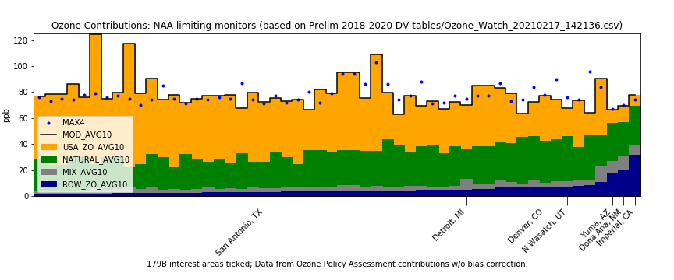
179B areas of interest
Six active areas with interest in 179B
Mexico border areas are clearly outliers with small US contribution and larger international.
Denver has decided not two submit and we don’t have anything from Detroit.
Focus of this presentation
Utah demonstration is in development and they want feedback. What can/should we say?
San Antonio has submitted and wants approval. Not supported by the data.
Figure data from: Ozone Policy Assessment modeling; consistent with CSAPR
Notes:
USA : 19.2-23.6 ppb (29-36%)
Nat : 31.0 - 34.8 ppb (47-53%)
Intl : 7.4 - 8.4 ppb (11-13%)

Slide 3
Outline
Attainment Status and Observations
Comparison to other areas
What is the range of international?
What sites or NAA are outliers?
Utah technical data
Utah DAQ
Ramboll photochemical modeling
EPA Policy Assessment
Guidance-based Review Summary
San Antonio technical data
TCEQ submitted demonstration
EPA Policy Assessment
Guidance-based Review Summary
Summary

Slide 4
Attainment and Monitor Data

Slide 5
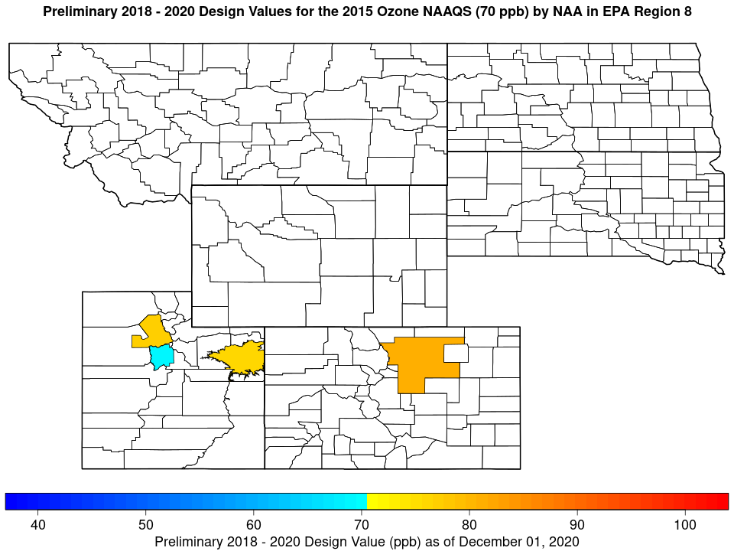
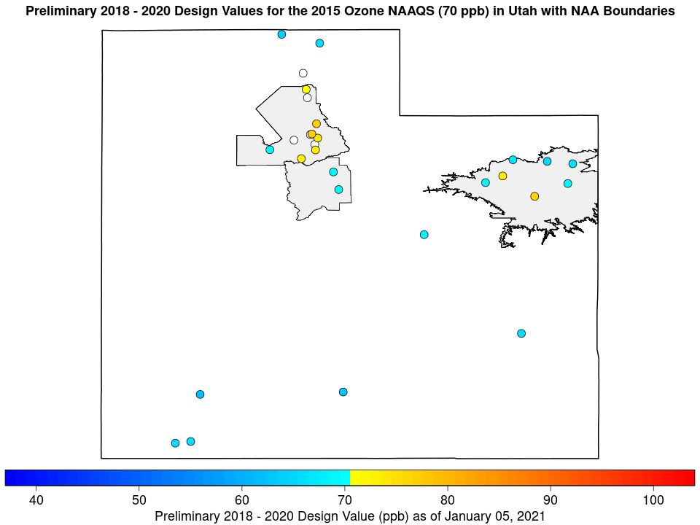
Utah Wasatch Front-s
Utah has three non-attainment areas
Northern Wasatch Front
Southern Wasatch Front
Uintah Basin has winter-time ozone and is not discussed further.
The Southern Wasatch Front is currently attaining the standard, though it is a close thing.
The Northern Wasatch Front, which include Salt Lake City is currently exceeding the standard
Exceeds Jun/Jul/Aug occasionally Sep
Period | Northern | Southern
2016-2018 | 78 | 72
2017-2019 | 77 | 70
2018-2020 | 77 | 69

Slide 6
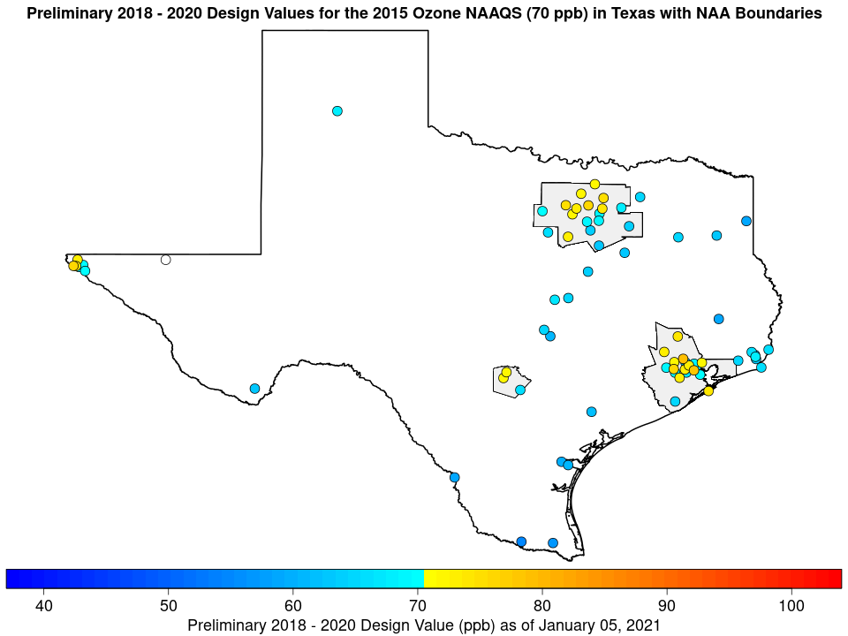
Texas Nonattainment Areas
Texas has three non-attainment areas
Houston-Galveston-Brazoria
Dallas-Fort Worth
San Antonio
Focus here is on San Antonio, but Houston and Dallas areas are “transport” sources for San Antonio.
San Antonio top 4 days a mix of months (preliminary data two controlling mon)
2017: Jun/Jun, Aug/Sep, May/Aug, Aug/Aug, May/May
2018: Aug/Aug, May/May, Apr/Apr, Jul/Jul, Jul/Apr
2019: Jun/Jul, Jul/Jun, Jun/Apr, Jul, Jul
2020: Aug/Apr, Oct/Oct, Oct/Oct, Apr/Oct, Aug/Apr
Period | HGB | DFW | San An
2016-2018 | 78 | 76 | 72
2017-2019 | 81 | 77 | 73
2018-2020 | 79 | 76 | 72

Slide 7
Intercomparison and Outlier Analysis

Slide 8
Top 10 average days across the country?
Selected Nonattainment Area controlling monitors
The ticks along the bottom show the areas that have expressed interest in 179B
Using Policy Assessment zero-out modeling
108km/36km/12km
No bias adjustment
There is a gradual increase across all sites until you reach the near border sites
The uptick at the end are the near border areas
So, visually you can see that near-border areas where there is a cross-border city are outliers.
Also performed a more formal analysis.
Notes:
No bias adjustment

Slide 9
Comparing NWF to other sites
Outlier analysis using standard threshold
Threshold = Q3 + 1.5 x (Q3 - Q1)
Comparing sites where Obs Max 4 is greater than 71
Outlier thresholds:
USA (13, 73 ppb)
Intl (-0.6, 7.89 ppb)
Nat (5.5, 43 ppb)
US-Anthro
International
Northern Wasatch Front
USA : 19.2-23.6 ppb (29-36%)
Nat : 31.0 - 34.8 ppb (47-53%)
Intl : 7.4 - 8.4 ppb (11-13%)
Outliers: 490353013, 490450004
Not outliers: 490353006, 490110004, 490570002, 490571003
Natural
Total
490110004 is the controlling monitor
Notes:
International

Slide 10
Comparing San Antonio to other sites
San Antonio, TX
USA : 34.7-46.2 ppb (54-64%)
Nat : 20.2 - 21.5 ppb (28-34%)
Intl : 3.0 - 4.4 ppb (4-7%)
Outliers: None
Not outliers: 480290032, 480290052, 480290059
Controlling monitors bold italics
US-Anthro
International
Natural
Total

Slide 11
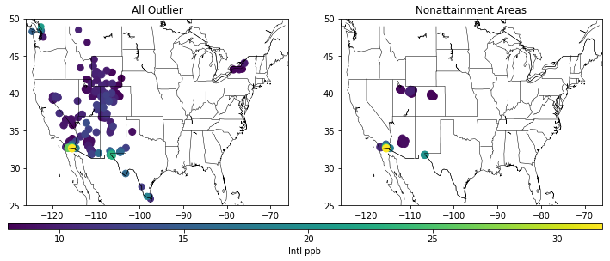
Where are all the other outlier monitors?
All sites that meet outlier threshold
Only those sites in Nonattainment Areas
Many sites that are outliers are in attainment
Notes:
All sites that meet outlier threshold

Slide 12
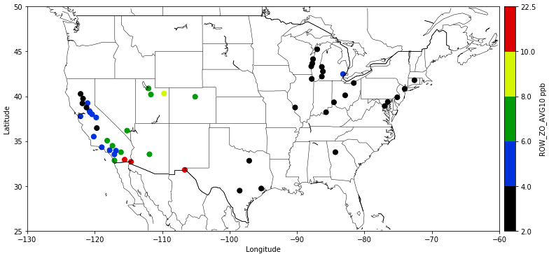
What about outlier Nonattainment areas?
Average monitors within NAA
Threshold = Q3 + 1.5 * IQR or Q1 – 1.5 * IQR
Intl (-2, 10.7 ppb)
Only border areas are outliers
Dona Ana, NM
Yuma, AZ
Imperial County, CA

Slide 13
Utah Technical Data
Utah DAQ letter
Ramboll photochemical modeling
EPA results

Slide 14
Utah State submission
HYSPLIT trajectories
Meteorological analysis
Received a letter from Director of Utah DAQ, asking for feedback with the following quote:
“UDAQ staff finds the HYSPLIT analysis to be consistent with those of the synoptic pattern analysis. Results from these two independent analyses suggest there was not a strong impact from international emission sources on local ozone concentrations on exceedance days. Peak ozone measurements did not coincide with strong frontal passages, which would be expected with the long-range transport of international emissions. There was no significant difference in transport patterns between exceedance and non-exceedance days. Finally, there appeared to be a larger contribution of air to the Wasatch Front from the US compared to urban regions outside the US.”

Slide 15
Utah State submission
Overall consistent findings between the synoptic patterns and HYSPLIT backward dispersion analyses
Results do not suggest a strong impact from international emission sources on local ozone concentrations:
Peak ozone measurements do not coincide with frontal passage, which would be expected with long range transport of international emissions.
No significant difference in transport patterns between exceedance and non-exceedance days
Increased particle count over the US compared to other urban regions
No significant difference in transport patterns between exceedance and non-exceedance days.
While the fraction of particles over Canada increased during exceedance days compared to non-exceedance days, this fraction is smaller than that over the US
Also, using "population count" as a proxy for urban emissions, significant emission contributions from outside the US are not expected.

Slide 16
Ramboll Analysis
Funded by:
Utah Petroleum Association
Utah Mining Association
With the following conclusion quote: “This preliminary modeling exercise suggests that Section 179B provisions are applicable for the Wasatch Front Ozone Nonattainment Areas. A more rigorous State-led modeling analysis employing higher resolution and area-specific meteorology and emission inventories is warranted to confirm…”
“In 2019, EPA used both sets of boundary conditions with the CMAQ Beta MP to run the BASE and ZROW scenarios on the finer-scale US domain but ran only the CAMx Beta MP for the BASE scenario. … We analyzed these products with a focus on the Wasatch Front, as described in Section 3.”
“we ran CAMx with its Ozone Source Apportionment Technology (OSAT)”
*I don’t see evidence that they used APCA
Notes:
EPA Platform in CMAQ and CAMx

Slide 17
Underestimated Domestic
Natural
International
“According to the DV scaling technique, modeled international contributions of 8.7 to 12.7 ppb are much greater than the 6.1 ppb exceedance at the most limiting monitoring site.”
“According to our analysis, both models tend to underpredict on high ozone days at Wasatch Front monitors, most likely from a lack of local ozone production rather than a lack of background ozone entering Utah. This underestimation may lead to a slight overestimate of the international contributions to local DVs, but we estimate that the related error is likely less than 2 ppb.”
Notes:
International

Slide 18
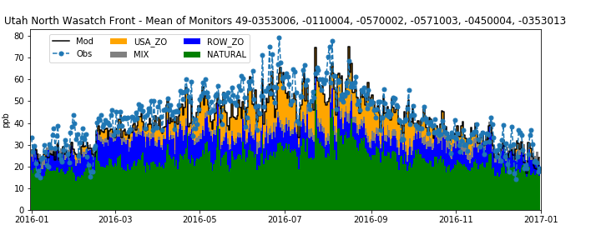
Model Performance and Attribution: 12km
Spring, which often has the maximum long-range transport (seen in blue) is well predicted. The summer, which often has the largest local contribution has underpredictions … particularly on the most relevant days.
* Our modeling may also underestimate local contributions on the 4-highest days. Even the top 10 days…
Notes:
Spring, which often has the maximum long range transport (seen in blue) is well predicted. The summer, which often has the largest local contribution has underpredictions … particularly on the really high days.

Slide 19
Model Performance and Attribution: 12km
* Observed high days (left) are underestimated.
* Our 2016 modeling likely also underestimates local contributions on the 4-highest days. Even the top 10 days…
* Modeled high days (right) are well simulated.
Notes:
Spring, which often has the maximum long range transport (seen in blue) is well predicted. The summer, which often has the largest local contribution has underpredictions … particularly on the really high days.

Slide 20
Summary: Utah’s Northern Wasatch Front
Above the standard 77-78 ppb; ~6-7 ppb higher than the Southern Wasatch Front
Has large USB (65-71%)
USB is mostly natural,
Also has high international
Among non-attainment monitors
Low-ish USA Total (~20 ppb; 30%; it’s in the West)
High-ish natural (~32 ppb; 51%; it’s high altitude)
High International (8 ppb; 12%; high altitude West)
Using standard Threshold = Median + 1.5 x IQR = 7.89
two are outliers; not the controlling monitor
Model biases to be aware of:
Underestimating local contribution (e.g., 5-10 ppb)
Ramboll showed background was well modeled
Data from: Ozone Policy Assessment
Notes:
USA : 19.2-23.6 ppb (29-36%)
Nat : 31.0 - 34.8 ppb (47-53%)
Intl : 7.4 - 8.4 ppb (11-13%)

Slide 21
Guidance-based review summary
Guidance Recommendation | Findings
Ambient Observations: “Relationship between high levels of pollution … and meteorological/air quality conditions characteristic of international transport.” | Not supportive. Exceedance day meteorology emphasizes local sources.
Backward Trajectory/Dispersion: “When a large majority of NPSC are from a source region (here Mexico), these results could be part of a weight of evidence that these days have international influence. When the fraction of NPSC is substantially larger on exceedance days than typical days, this strengthens the weight of evidence.” | Not supportive, trajectories agree with meteorology. Trajectories for Utah carry little weight because source is likely Asia.
Comprehensive Emissions Analysis: “When the emissions inventory shows large emissions in a nearby international metropolitan area (large both in total and relative to local emissions), this supports a weight of evidence that international emissions are contributing to exceedances.” | Not applicable, because not near an international source. Therefore, starts as not supportive.
Photochemical Modeling: “When results show that international contributions are larger on exceedance days and meaningfully larger than domestic contributions, the weight of evidence will be more compelling.” | Not supportive. Lower on days with exceedances (summer). Less than half of domestic contribution on exceedance days. Domestic likely underestimated.

Slide 22
San Antonio Technical Data
San Antonio Submission: trajectories, photochemical modeling
EPA photochemical modeling

Slide 23
Trajectory Analyses
9 years of trajectories for all days.
Analyzed for based on “pass through”
Mexico, but not Texas Metro
Texas Metro, but not Mexico

Slide 24
Trajectory Analysis Summary
More frequent air from Mexico and not Texas Metro, but only two years with an exceedance.
Less frequent area from Texas and not Mexico, but more and larger exceedances.
Every year, from Mexico max and mean are below from Texas
Not supportive.

Slide 25
Zero out at Global/Regional scales Source Apportionment at Regional scale
*With layer collapsing
Notes:
With layer collapsing

Slide 26
Source Apportionment and Zero-out
Conclusions drawn from zero-out
“The modeled 2020 DVF, including the international anthropogenic contribution, at Camp Bullis is 70 ppb.”
“The estimated modeled international anthropogenic contribution to Bexar County is in the 2 to 3 ppb range.”
“Source apportionment of the 2020 DVF showed that BC, which includes both natural and anthropogenic international emissions, is a large contributor to the 2020 DVF in Bexar County.”
“The most recent design value for the nonattainment area, based on certified monitoring data, is 72 ppb which, when combined with the estimated modeled international anthropogenic contribution of 2 to 3 ppb, is sufficient to bring Bexar County into attainment of the 2015 eight-hour ozone NAAQS.”
All Intl :
3.2 ppb
Canada/Mexico:
1.5 ppb
Notes:
3.2 ppb

Slide 27
San Antonio Submission Summary
Good summary of the analyses performed for a 179B demonstration, and good summary of the state of the science. The report provides multiple lines of evidence that are generally consistent with those to be recommended in our guidance.
The evidence, however, is not supportive of a 179B “but for” conclusion, i.e.,
International anthropogenic (3-4 ppb) ozone is small compared to Bexar county contributions (15 ppb), and very small compared to US anthropogenic (45 ppb).
High day air masses come from Texas metropolitan areas, and no exceedances occur on days where air masses come from Mexico after 2014 such that “background” and ambient trends are flat.
Consistent with EPA’s understanding
EPA’s contribution and zero out modeling shows similar results (~3-4 ppb O3 from all anthropogenic international emissions in San Antonio).
Higher int’l contributions in spring, but San Antonio has high days in summer.
Chinese NOx emissions have been decreasing over the last decade.
San Antonio has international contributions on high days similar to typical eastern US areas:
EPA’s modeling shows similar int’l contributions in most marginal nonattainment areas east of the Rockies such as Atlanta, St. Louis, Dallas, Boston, and Philadelphia.

Slide 28
Model Performance and Attribution: 12km
Spring, which often has the maximum long-range transport (seen in blue) is well predicted. The summer has mixed accuracy., which often has the largest local contribution has underpredictions … particularly on the most relevant days.
Notes:
Spring, which often has the maximum long range transport (seen in blue) is well predicted. The summer, which often has the largest local contribution has underpredictions … particularly on the really high days.

Slide 29
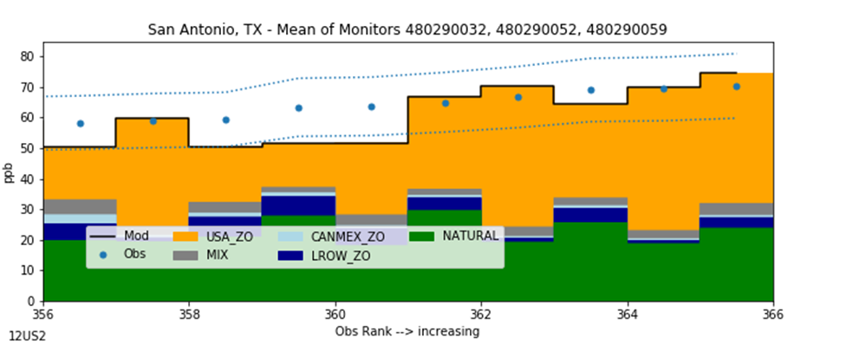
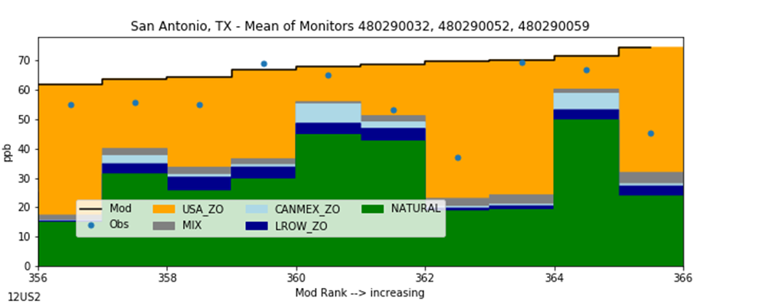
Model Performance and Attribution: 12km
* Top 5 days (left) are well simulated.
* Modeled high days (right) are mostly.
Notes:
Spring, which often has the maximum long range transport (seen in blue) is well predicted. The summer, which often has the largest local contribution has underpredictions … particularly on the really high days.

Slide 30
Summary: San Antonio, TX
Above the standard 72 ppb
Among non-attainment monitors
Typical USB (42%)
Typical USA (~40 ppb; 58%)
Typical natural (~21 ppb; 31%)
Typical international contribution (4 ppb; 6%)
Using standard Threshold = Median + 1.5 x IQR = 7.89
No monitors are outliers
Data from: Ozone Policy Assessment
Notes:
USA : 19.2-23.6 ppb (29-36%)
Nat : 31.0 - 34.8 ppb (47-53%)
Intl : 7.4 - 8.4 ppb (11-13%)

Slide 31
Guidance-based Review Summary
Guidance Recommendation | Findings
Ambient Observations: “Relationship between high levels of pollution … and meteorological/air quality conditions characteristic of international transport.” | Not supportive. Exceedance day meteorology emphasizes local sources.
Backward Trajectory/Dispersion: “When a large majority of NPSC are from a source region (here Mexico), these results could be part of a weight of evidence that these days have international influence. When the fraction of NPSC is substantially larger on exceedance days than typical days, this strengthens the weight of evidence.” | Not supportive, trajectories emphasize Texas Metro areas.
Comprehensive Emissions Analysis: “When the emissions inventory shows large emissions in a nearby international metropolitan area (large both in total and relative to local emissions), this supports a weight of evidence that international emissions are contributing to exceedances.” | Not applicable, because too far from Mexico. Therefore, starts as not supportive.
Photochemical Modeling: “When results show that international contributions are larger on exceedance days and meaningfully larger than domestic contributions, the weight of evidence will be more compelling.” | Not supportive. International (1) lower on days with exceedances (summer); (2) approximately 1/10 of domestic.

Slide 32
Summary
San Antonio, TX is a typical area and none of the evidence provided or internally supports 179B relief.
Northern Wasatch Front, UT is a high background site with high international, but also high domestic contribution.
Evidence is not supportive according to guidance metrics.
Harder to categorically reject.

Slide 34
Dona Ana, NM
Note: Juarez emissions may be a little overestimated.

