Slide 1
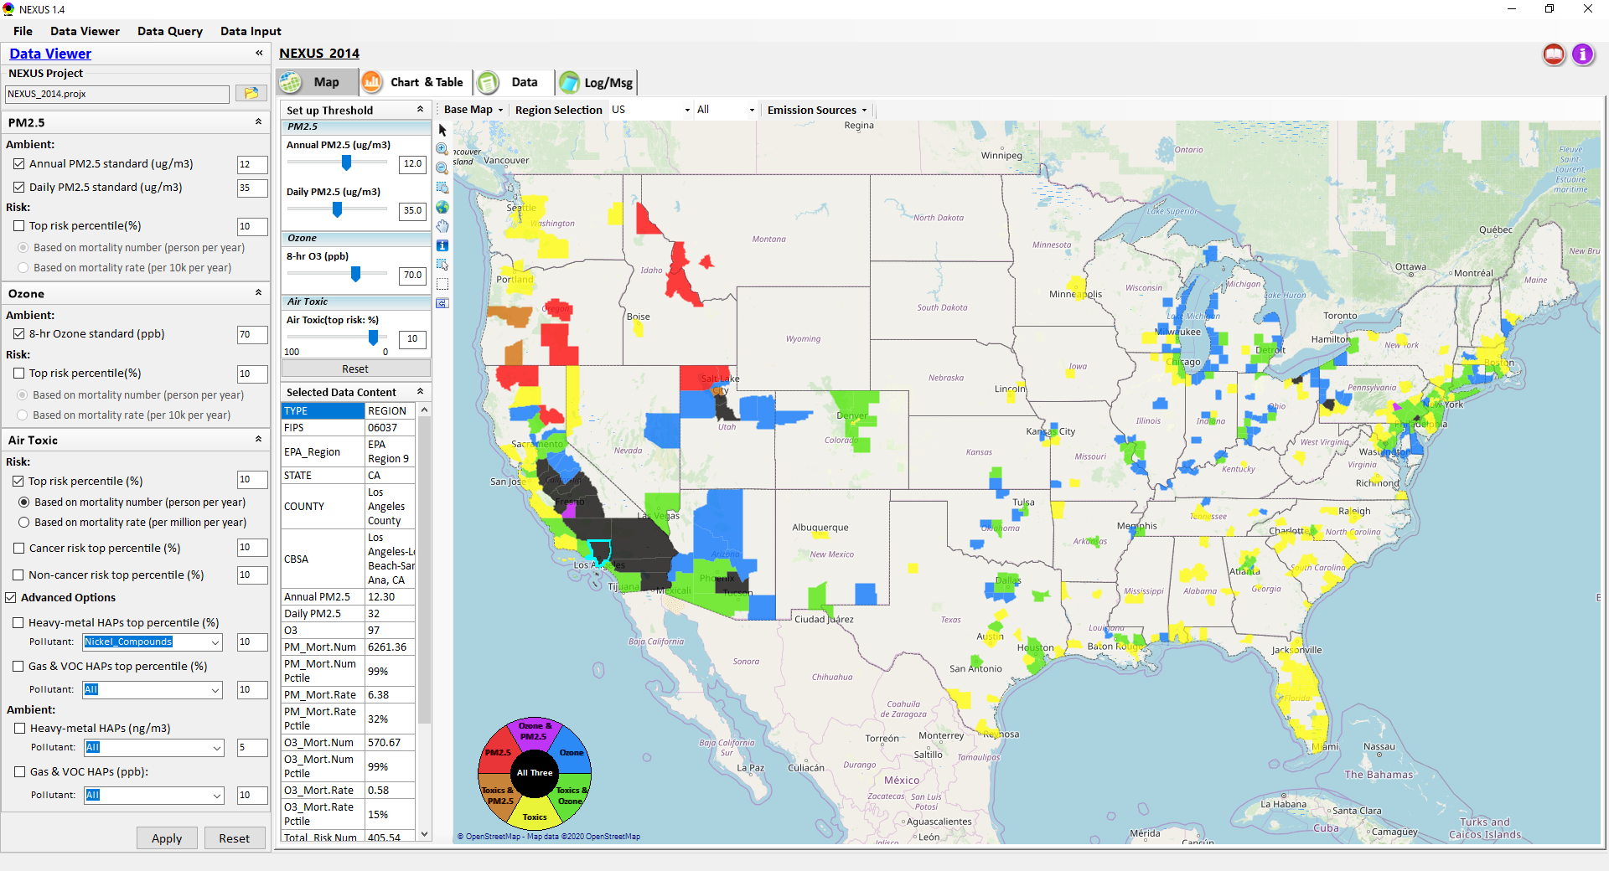
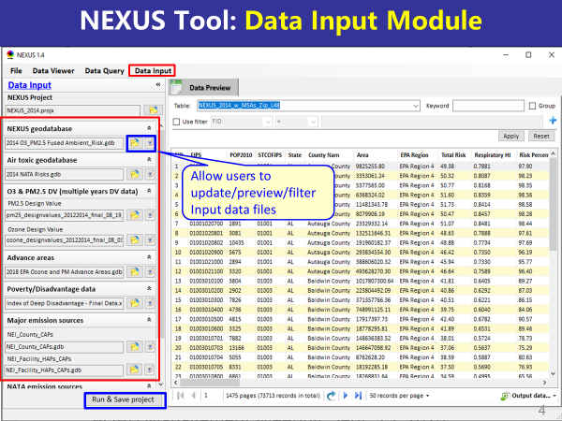
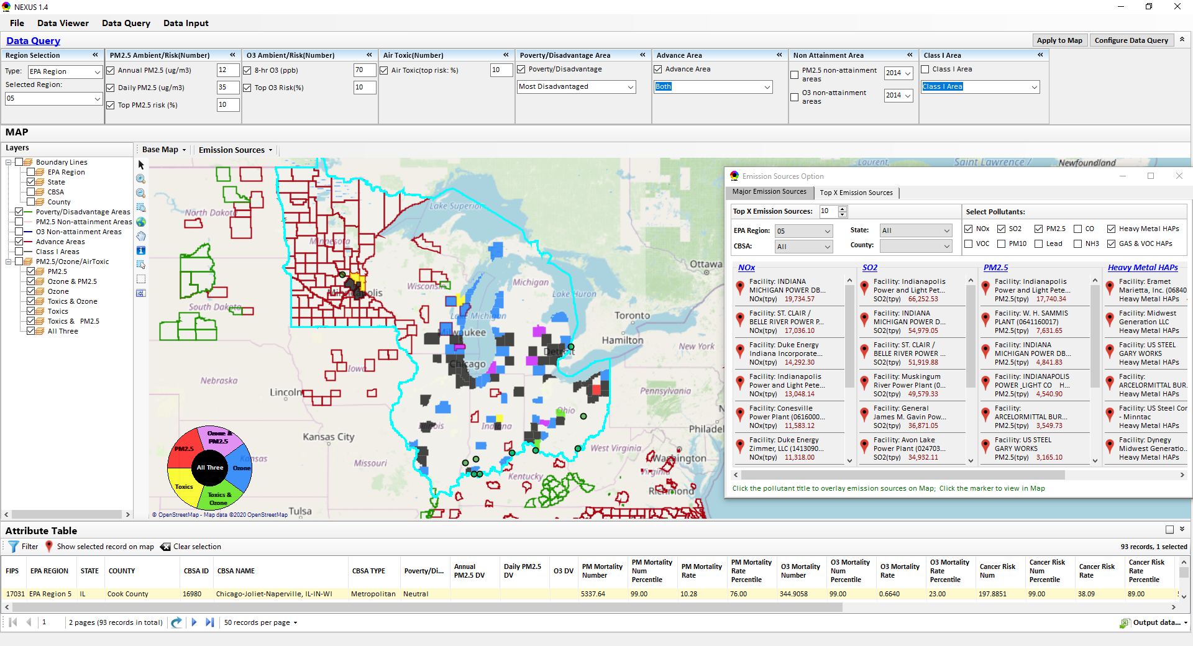
“NEXUS” Multi-Pollutant Analysis Tool
Development: Status Update
Data Viewer Module
Data Input Module
Data Query Module
“NEXUS 1.5” available on OAQPS’s Shared Drive at: “G:\SHARE\NEXUS\NEXUS 1.5\”
or at EPA’s new FTP site: ftp://newftp.epa.gov/aqmg/cjang/NEXUS/NEXUS 1.5/
HEID/AQAD Briefing
April 12, 2021
Carey Jang & Beth Landis

Slide 2
Overview
Feedback from OAQPS/SMT Briefing
NEXUS Updates
  Metrics (Toxics)
  2017 Data
Ranking of Highest Risk Areas
Examples: NEXUS use for MP & EJ purposes within areas
  Region 5 – Chicago
  Region 6 – Houston
  Region 3 - Pittsburgh
  NAA – Atlanta
  Advance Area – Louisville
Developing a Multi-pollutant Proximity Based Module
Next Steps / Issues for Discussion
2

Slide 3
Feedback from OAQPS & SMT Briefing
Improve the national screening metrics for air toxics to reduce possible ‘false-negatives’
Augment current “area” orientation of tool to provide national and area-specific screening capabilities for sectors in multi-pollutant context
Within high-risk areas, provide multi-pollutant proximity-based screening capabilities for sources/sectors so accounts for both criteria and toxic pollutants
Incorporate Economic information?
3

Slide 4
NEXUS 1.7 (Under Development)
Near-term Priorities for 2021 NEXUS development:
Upgrade NEXUS (metrics/EJ indicators) for EPA beta testing
  Revising national air toxic (AT) metrics based on AT team’s suggestions
  Include EJ/demographic index from EJSCREEN & Tribal areas
2017 emissions data update (including GHG & Sector mapping)
2017 AQ concentrations (PM_{2.5}, O₃, AT) & risk data update (note: separate discussion on air toxics risk effort with SMT)
Draft design for new Multi-pollutant based “Proximity analysis” module for EJ and related considerations (at census tract and block level)
Ongoing
Planned
4

Slide 5
Need to Improve Air Toxics Metrics
MP Team engaged with Air Toxics Team to improve upon current national screening metrics for air toxics
Current risk metrics were based on county-level population weighted averages (not appropriately accounting for local nature of risks) so false negatives could influence the areas ranking
ATAG provided input on improving these metrics
  New metrics now reflect more local risk estimates (at census-tract level) and expressed in “X in a million”
  Update use of percentiles based on risk value
5

Slide 6
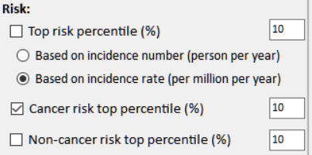
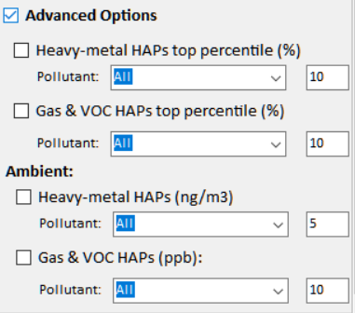
NEXUS Updates: New Air Toxics Metrics
Current
New
Risk:
□ Cancer Risk (max tract-level risk in the county): (default checked)
o Top risk Percentile (higher than x%) 90 (Note: default checked)
o Risk value (x-in-1 million) ? (Note: use 90 %tile risk value)
□ Non-cancer Hazard (max tract-level HI in the county):
o Top risk Percentile (higher than x%) 90 (default if above box checked)
o Hazard Index (HI) ? (Note: use 90 %tile value, find a reasonable range)
(Note: Add up all “HI” in “NATA_2014_Tract_HIs_FINAL” file.
“HI” > 1 means likely adverse non-cancer hazard; <1 means unlikely
Cancer Risk (max tract-level risk in the county):
□ PM & Metal HAPs
Pollutant: All
○ Top risk percentile (higher > %) 90
○ Risk value (x-in-1 million) ?
□ Gas & VOC HAPs
Pollutant: All
○ Top risk Percentile (higher > %) 90
○ Risk value (x-in-1 million) ?
[ ] Advanced Options:
6

Slide 7
Regional Engagement: Highest MP Risk Areas
 | EPA_REGION | STATE | CBSA_NAME | Overall Rank
1 | EPA Region 5 | IL-IN-WI | Chicago-Joliet-Naperville, IL-IN-WI | 1
2 | EPA Region 3 | PA | Pittsburgh, PA | 1
3 | EPA Region 6 | TX | Houston-Sugar Land-Baytown, TX | 1
4 | EPA Region 9 | CA | Los Angeles-Long Beach-Santa Ana, CA | 2
5 | EPA Region 6 | TX | Dallas-Fort Worth-Arlington, TX | 2
6 | EPA Region 4 | GA | Atlanta-Sandy Springs-Marietta, GA | 3
7 | EPA Region 4 | FL | Tampa-St. Petersburg-Clearwater, FL | 3
8 | EPA Region 4 | AL | Birmingham-Hoover, AL | 3
9 | EPA Region 9 | AZ | Phoenix-Mesa-Glendale, AZ | 3
10 | EPA Region 9 | CA | Fresno, CA | 3
11 | EPA Region 2 | NY-NJ-PA | New York-Northern New Jersey-Long Island, NY-NJ-PA | 3
12 | EPA Region 5 | OH | Cleveland-Elyria-Mentor, OH | 3
13 | EPA Region 9 | CA | Sacramento--Arden-Arcade--Roseville, CA | 4
14 | EPA Region 9 | NV | Las Vegas-Paradise, NV | 4
15 | EPA Region 4 | NC-SC | Charlotte-Gastonia-Rock Hill, NC-SC | 5
16 | EPA Region 9 | CA | San Diego-Carlsbad-San Marcos, CA | 5
17 | EPA Region 5 | MI | Detroit-Warren-Livonia, MI | 5
18 | EPA Regions 5 & 7 | MO-IL | St. Louis, MO-IL | 5
 | EPA_REGION | STATE | CBSA_NAME | Overall Rank
19 | EPA Region 5 | MI | Grand Rapids-Wyoming, MI | 6
20 | EPA Region 4 | TN | Nashville-Davidson--Murfreesboro--Franklin, TN | 6
21 | EPA Region 9 | CA | Bakersfield-Delano, CA | 6
22 | EPA Regions 2 & 3 | PA-NJ-DE-MD | Philadelphia-Camden-Wilmington, PA-NJ-DE-MD | 6
23 | EPA Region 9 | CA | Riverside-San Bernardino-Ontario, CA | 6
24 | EPA Region 4 | FL | Miami-Fort Lauderdale-Pompano Beach, FL | 6
25 | EPA Region 6 | LA | Baton Rouge, LA | 7
26 | EPA Region 6 | TX | El Paso, TX | 7
27 | EPA Region 10 | WA | Seattle-Tacoma-Bellevue, WA | 7
28 | EPA Region 4 & 5 | KY-IN | Louisville-Jefferson County, KY-IN | 7
29 | EPA Region 8 | CO | Denver-Aurora-Broomfield, CO | 8
30 | EPA Region 3 | PA | Reading, PA | 8
31 | EPA Region 9 | CA | Visalia-Porterville, CA | 8
32 | EPA Region 1 | CT | Bridgeport-Stamford-Norwalk, CT | 8
33 | EPA Region 4 & 6 | TN-MS-AR | Memphis, TN-MS-AR | 8
34 | EPA Regions 2 & 3 | PA-NJ | Allentown-Bethlehem-Easton, PA-NJ | 9
35 | EPA Region 6 | LA | New Orleans-Metairie-Kenner, LA | 9
NEXUS can be used to identify highest risk areas across O₃, PM_{2.5}, and Air Toxics. OAQPS could provide area profile packets to Regions to discuss nature of MP issues and possible avenues to address or conduct more refined analyses.
The information above was generated in NEXUS & exported into Excel where rankings were applied.
These CBSAs include at least one county that meets ALL the following criteria:
PM Mortality Number Percentile >= 90
O₃ Mortality Number Percentile >= 90
Cancer Risk Rate Max Percentile >= 90 (max census tract-level in a county)
7

Slide 8
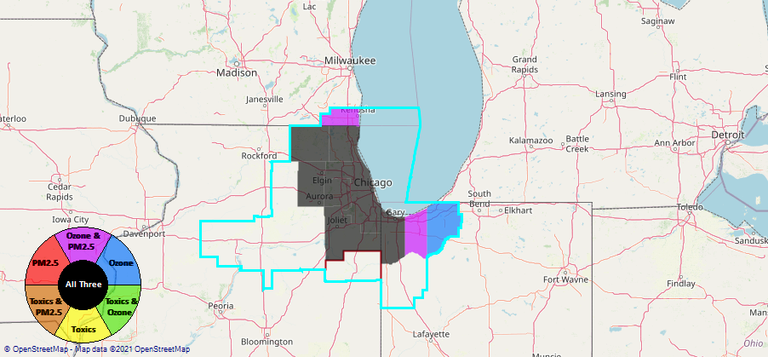
Region 5 Example—Chicago CBSA
Generated in NEXUS
8

Slide 9
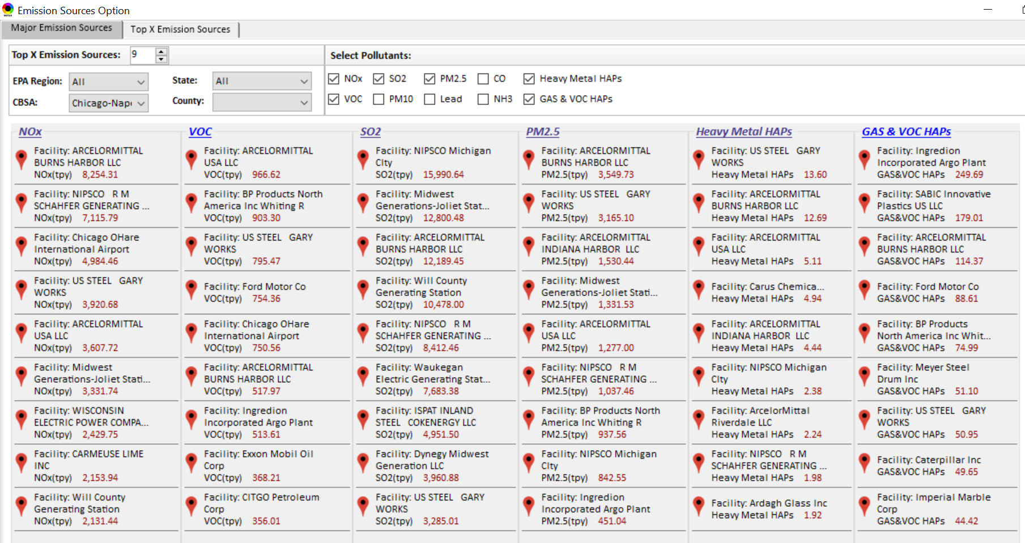
Chicago CBSA: Top Emission Sources
Generated in NEXUS
9

Slide 10
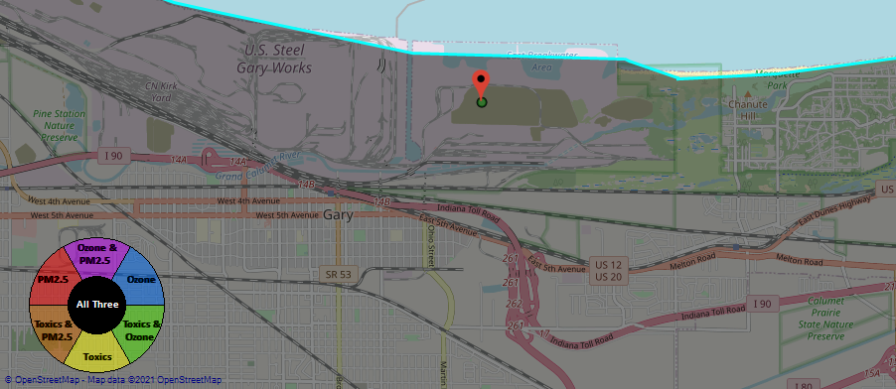
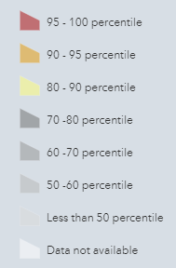
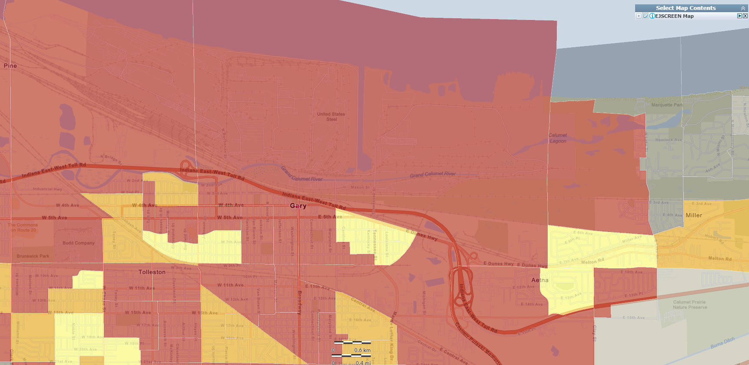
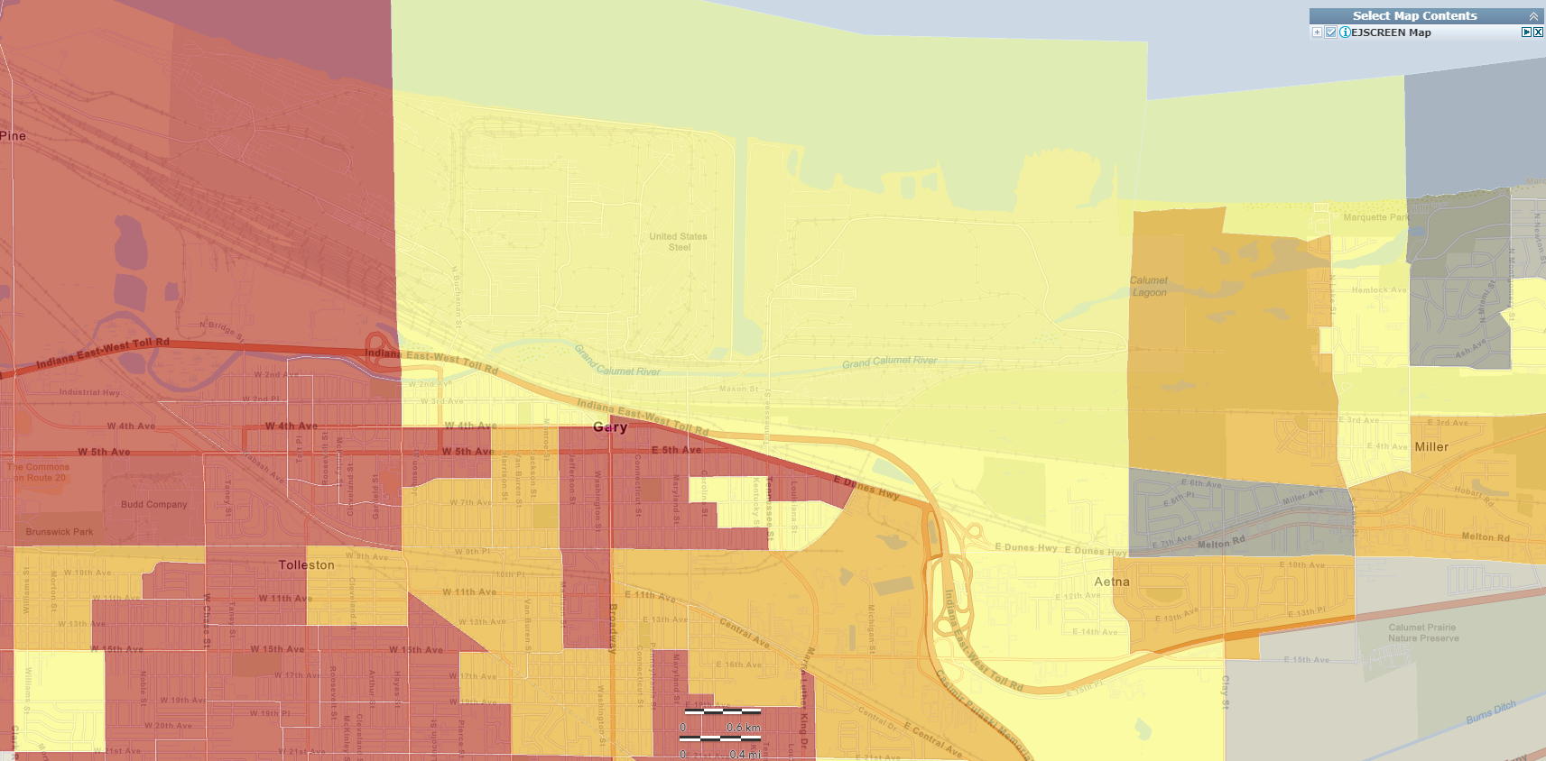
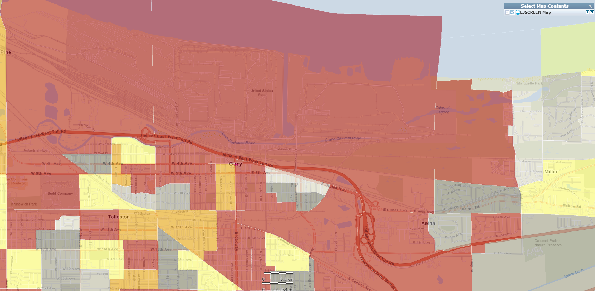
Chicago CBSA: US Steel Gary Works & EJ Screening
Generated in NEXUS
National Percentiles
Generated in EJSCREEN
Generated in EJSCREEN
Generated in EJSCREEN
Demographic Index
People of Color Population
10
Low Income

Slide 11
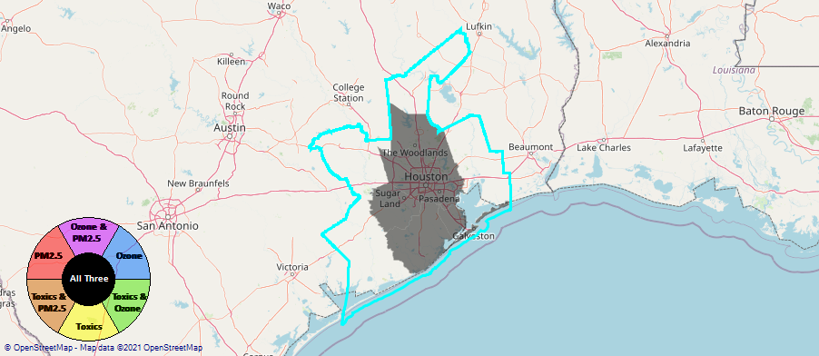
Region 6 Example – Houston CBSA
Generated in NEXUS
11

Slide 12
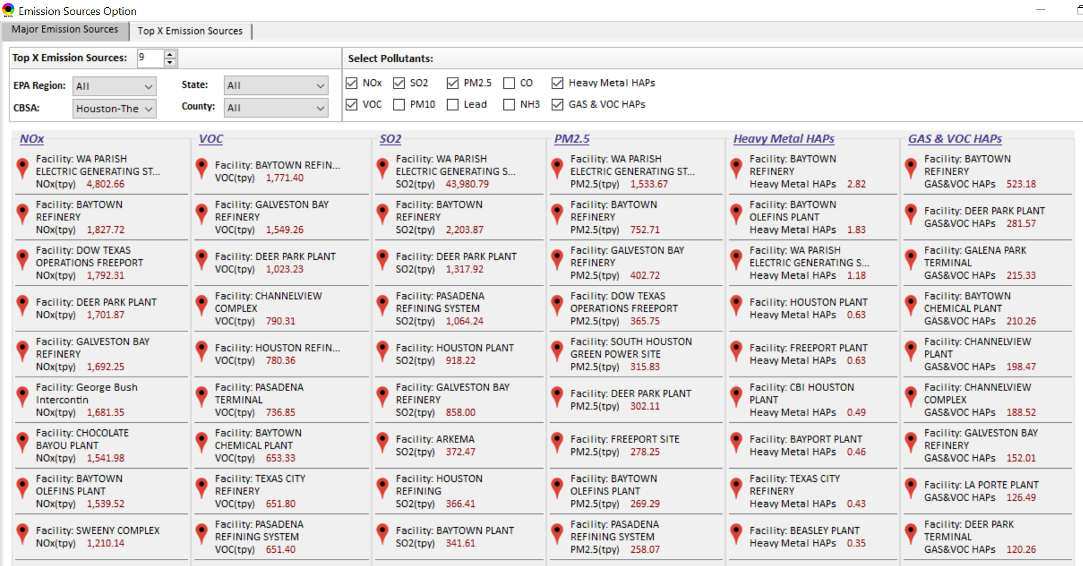
Houston CBSA: Top Emission Sources
Generated in NEXUS
12

Slide 13
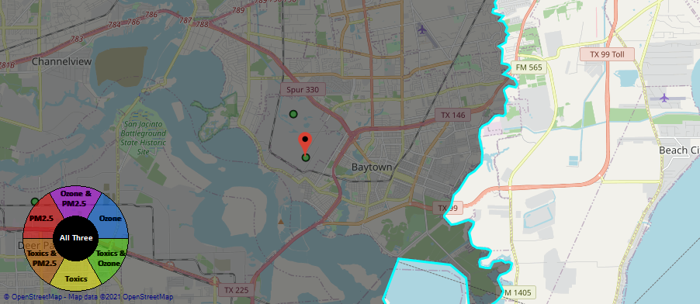
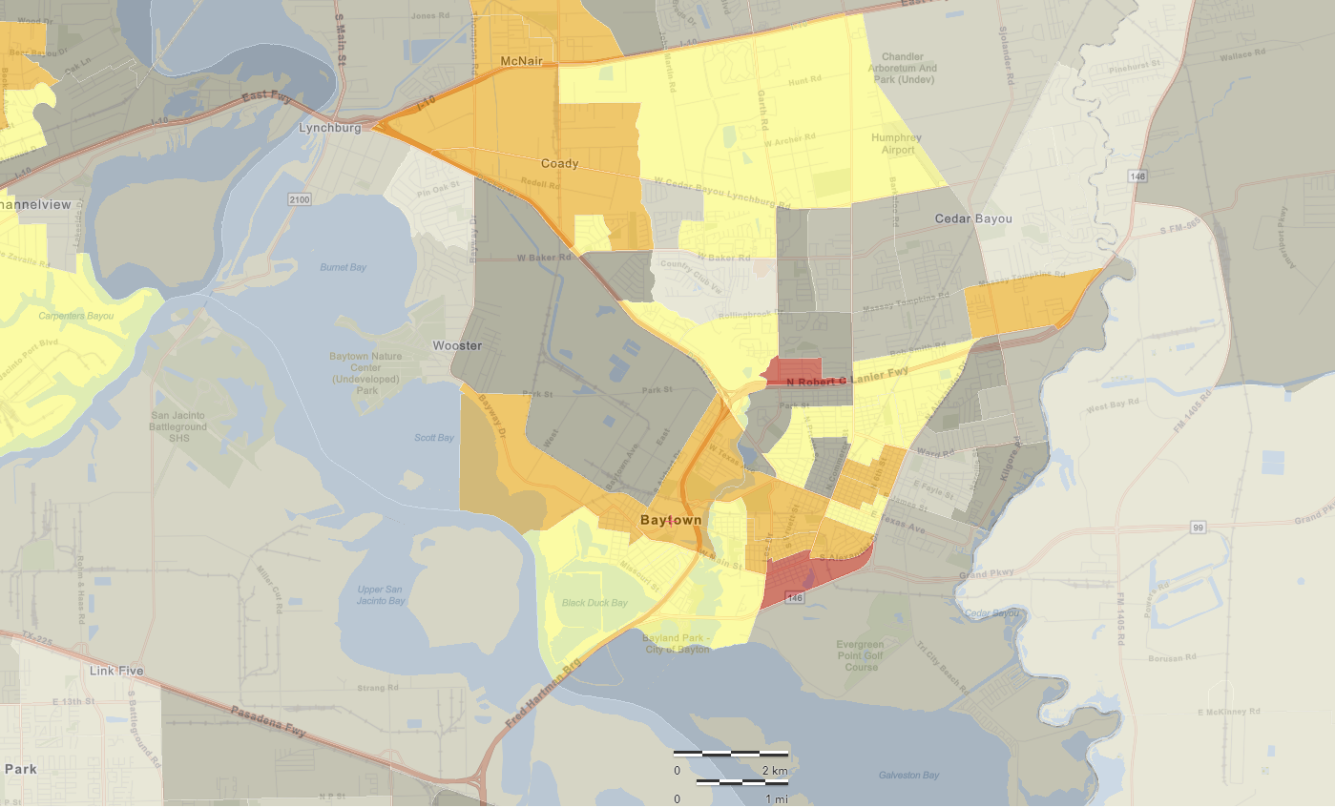
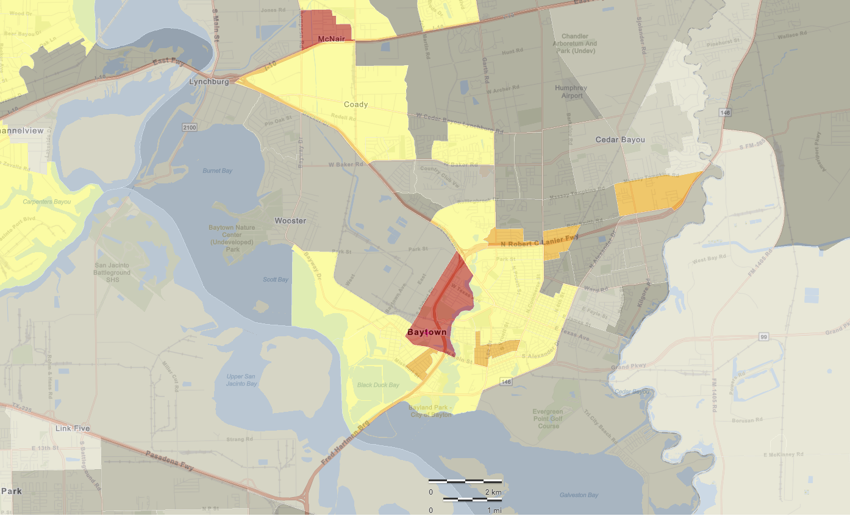
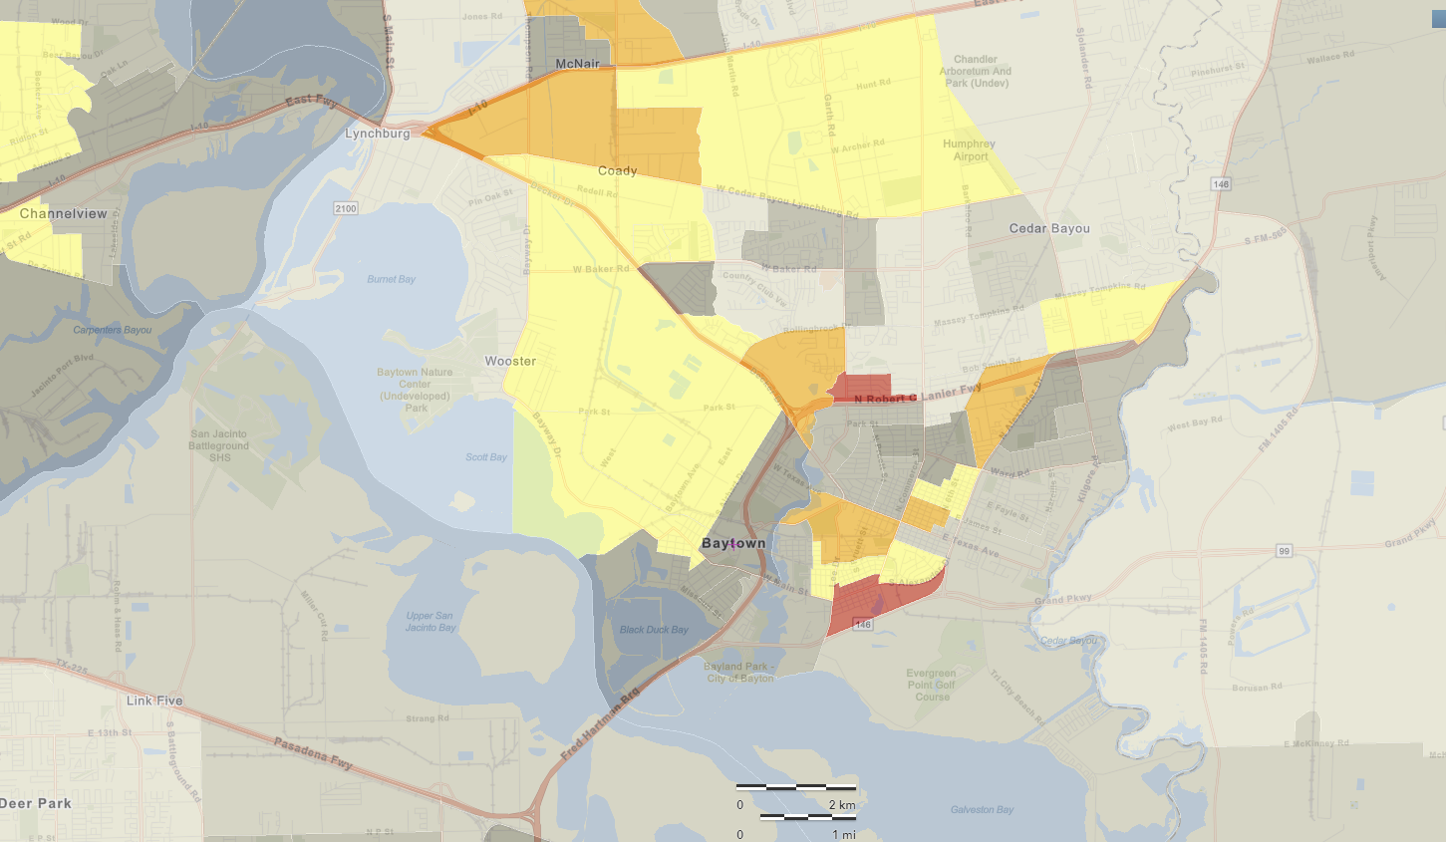
Houston CBSA: Baytown Chemical Plant & Refinery
Generated in NEXUS
National Percentiles
Baytown Olefins Plant (Chemical Plant)
Baytown Refinery (Petroleum)
Generated in EJSCREEN
Generated in EJSCREEN
Generated in EJSCREEN
Demographic Index
People of Color Population
13
Low Income

Slide 14
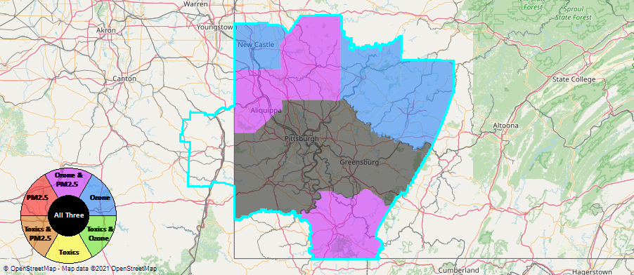
Region 3 Example - Pittsburgh CBSA
Generated in NEXUS
14

Slide 15
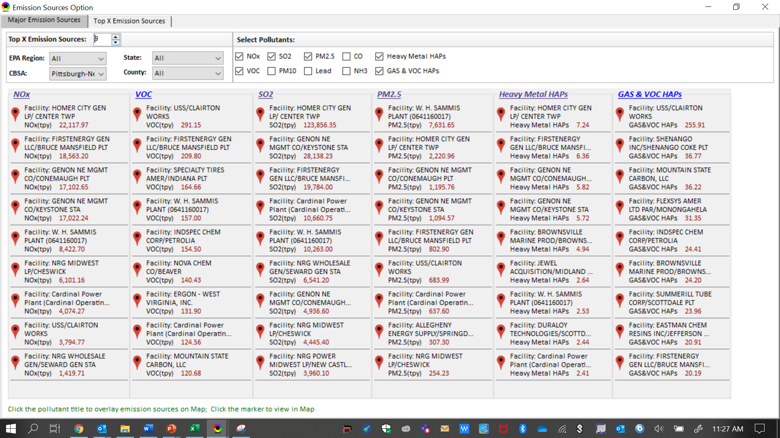
Pittsburgh CBSA: Top Emission Sources
Generated in NEXUS
EGUs
15

Slide 16
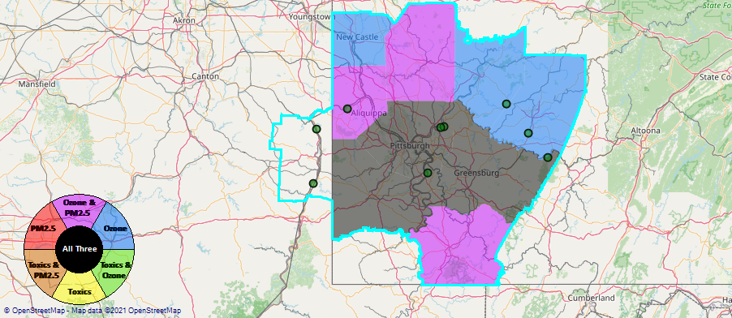
Pittsburgh CBSA: Dominated by EGUs
Generated in NEXUS
16

Slide 17
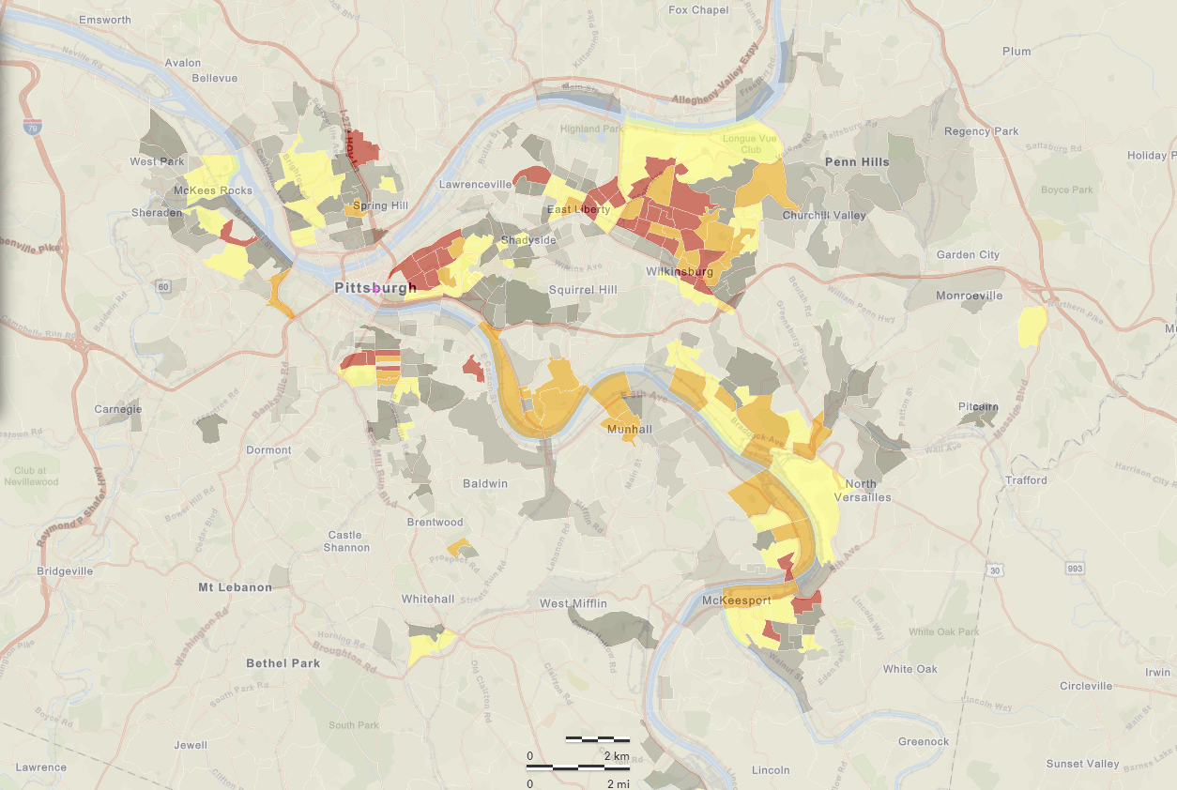
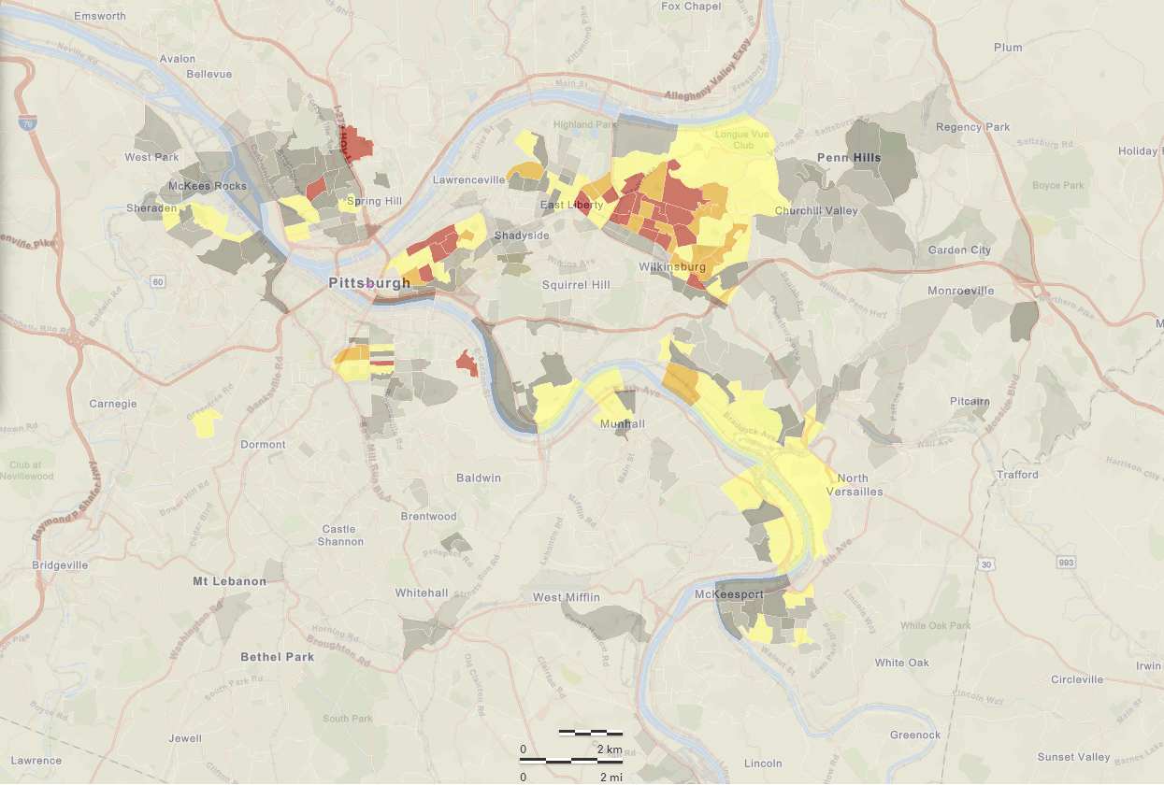
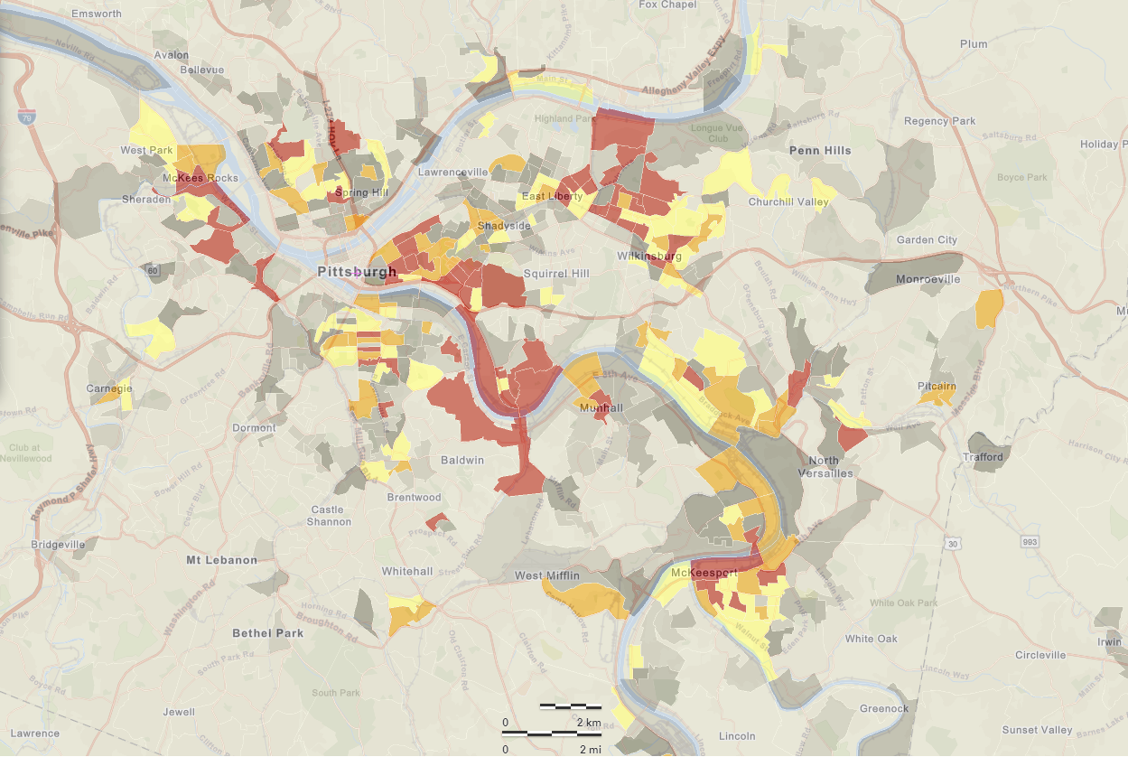
Pittsburgh CBSA: EJ Concerns
National Percentiles
Generated in NEXUS
No major sources in the downtown area where EJ indicators are highest. Could transport play a role??
Generated in EJSCREEN
Generated in EJSCREEN
Generated in EJSCREEN
Demographic Index
People of Color Population
Low Income

Slide 18
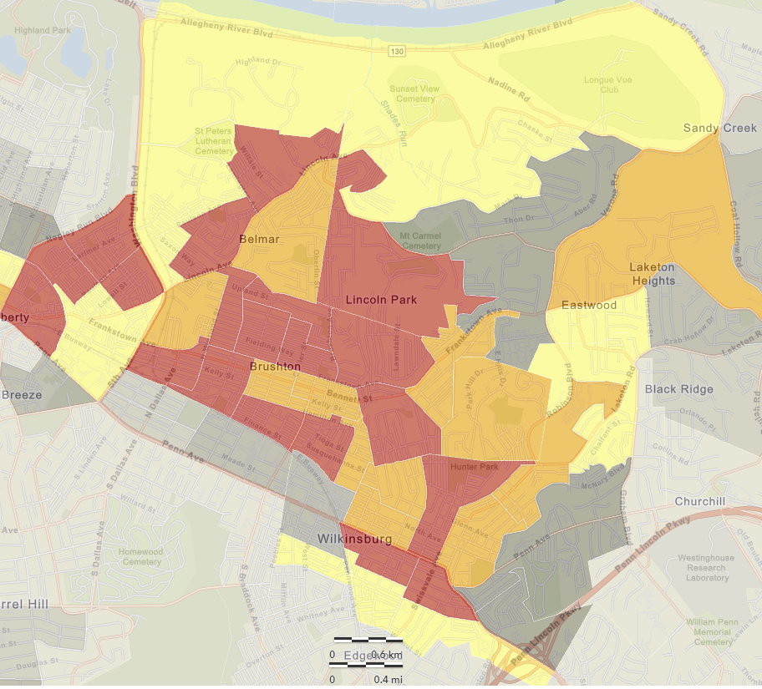
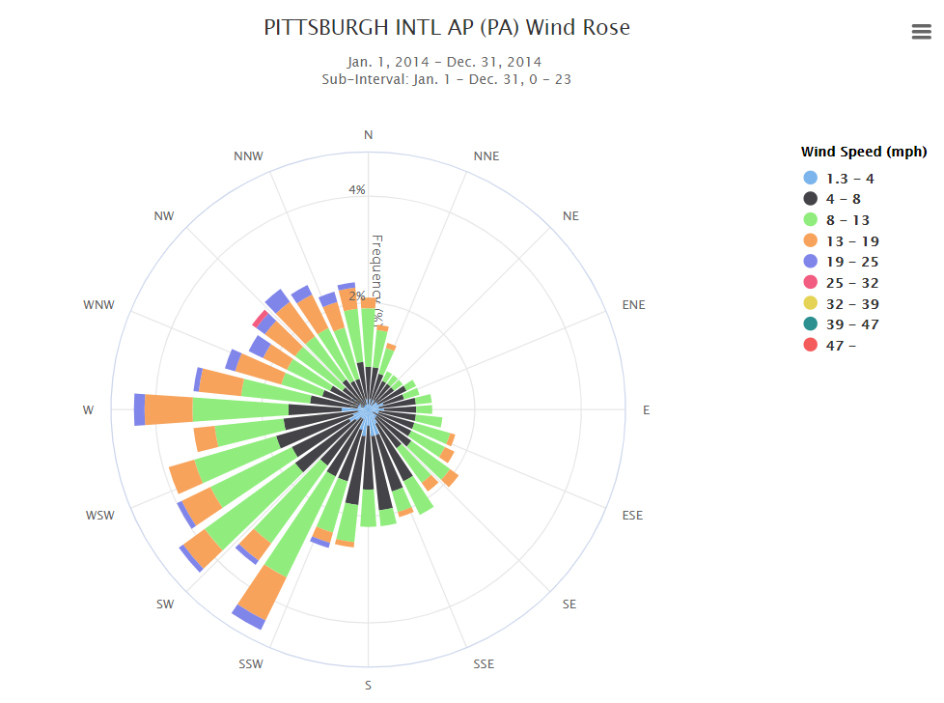
Pittsburgh CBSA: EJ Concerns
Generated in EJSCREEN
Generated in EJSCREEN
Lincoln Park community top 95-100% for demographic index, people of color & low income. Could they be impacted by transport? Predominate winds from NW/W/SW. There are facilities upwind…
Generated in NEXUS
Generated in MRCC’s Application Tools Environment (cli-MATE)

Slide 19
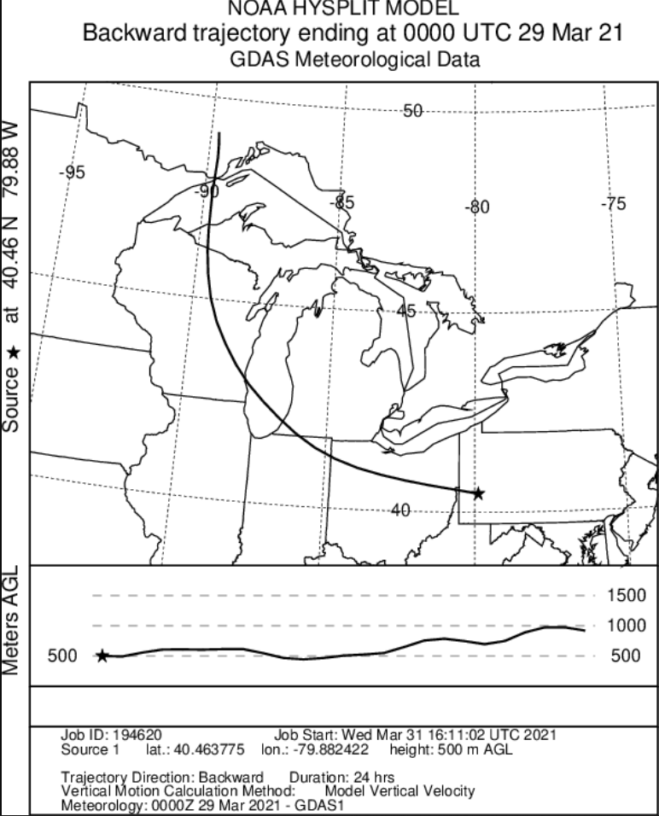
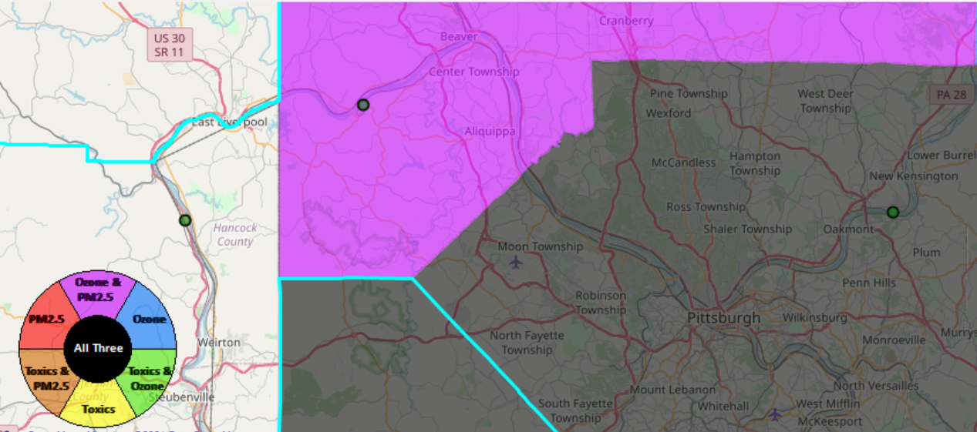
Pittsburgh CBSA: Potential Impacts to Lincoln Park Community
Generated in NEXUS
Generated in NOAA’s HYSPLIT
Lincoln Park
Backtrajectory passes right over W.H. Sammis Plant (EGU) in Ohio..

Slide 20
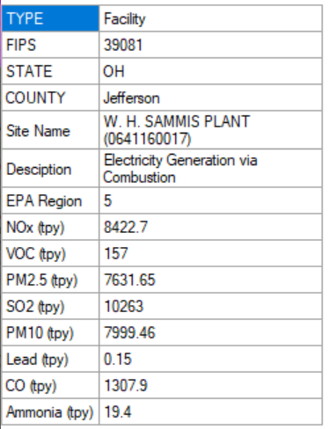
Pittsburgh CBSA: W.H. Sammis Plant EGU
Sammis Plant (EGU) is a top NOx & VOC emitter for the area. Could it lead to higher concentrations of O₃ downwind in the Lincoln Park Community?

Slide 21
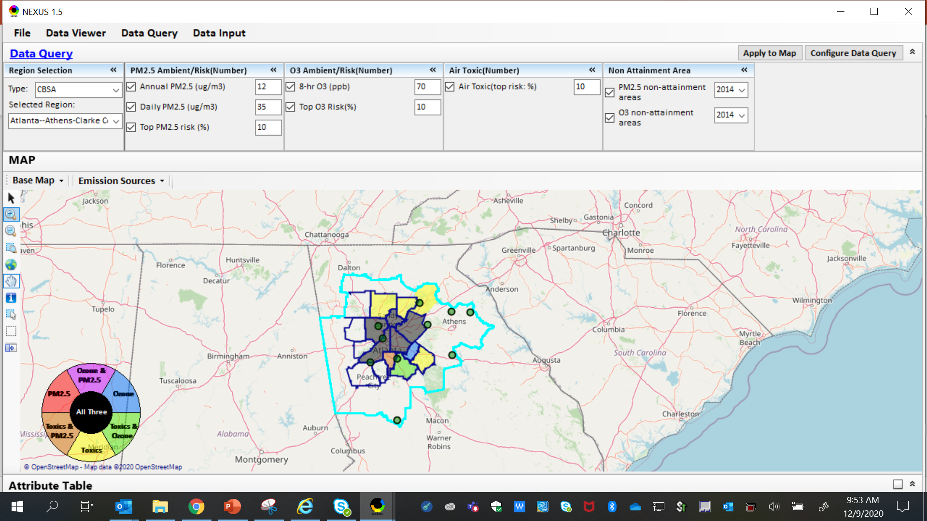
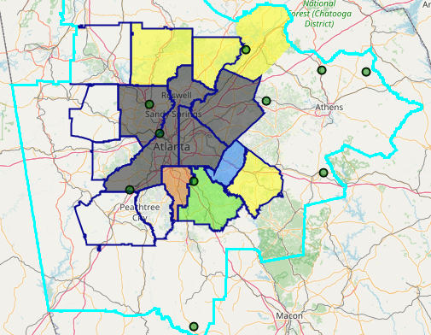
NAA Example - Atlanta
The maps above were generated for the Atlanta CBSA (2014 O₃ NAA), using the data query module. The top 10 Gas & VOC HAPS emission sources are plotted.
21

Slide 22
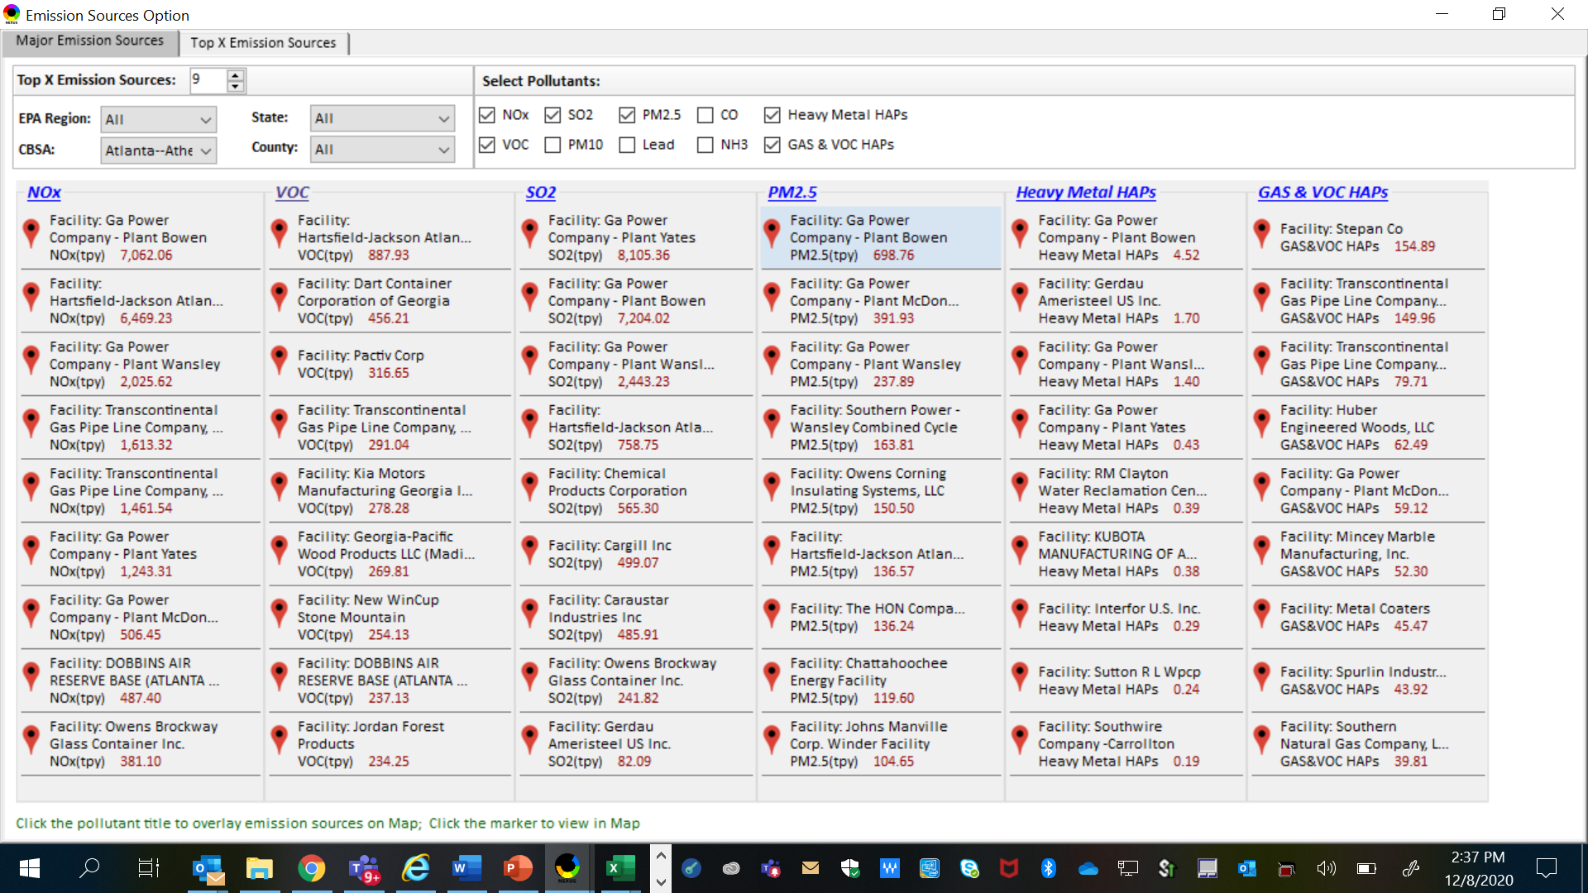
NAA Example - Atlanta
NEXUS can be used to identify top emission sources. Information above was generated in Data Query for the Atlanta CBSA. This can help identify the potential co-benefits of controls.
22

Slide 23
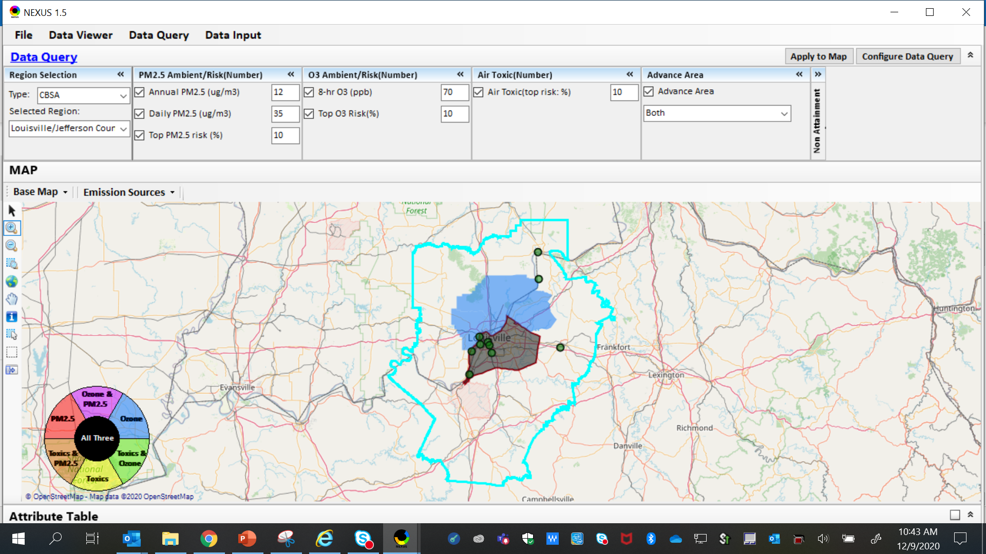
ADVANCE Example - Louisville
The map above was generated for the Louisville/Jefferson County - Elizabethtown - Madison, KY-IN CBSA (2014 O₃ NAA), using the data query module. The top 10 Gas & VOC HAPS emission sources are identified.
23

Slide 24
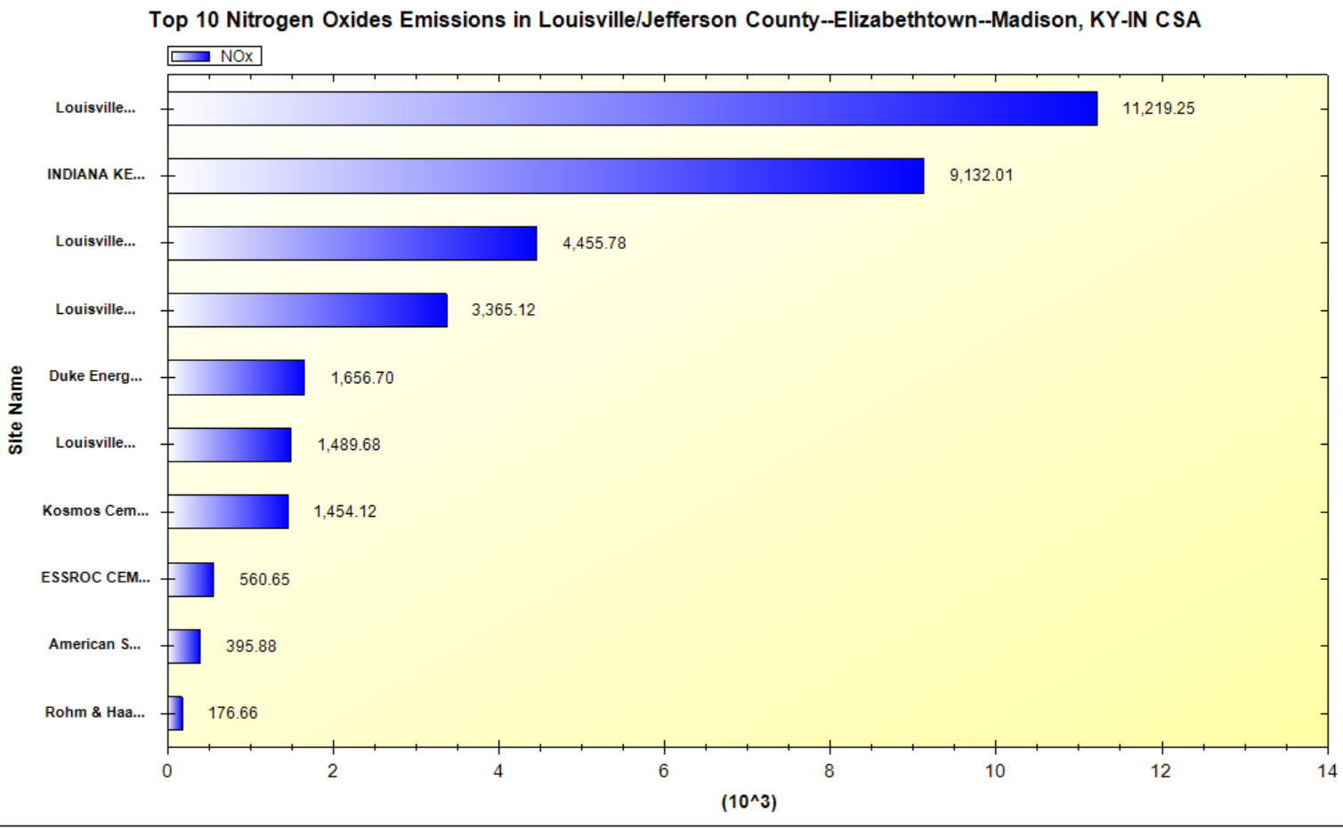
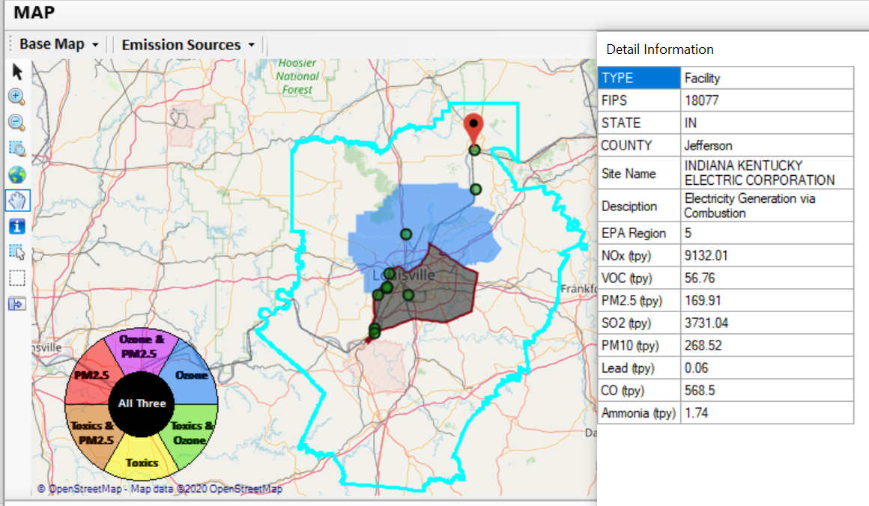
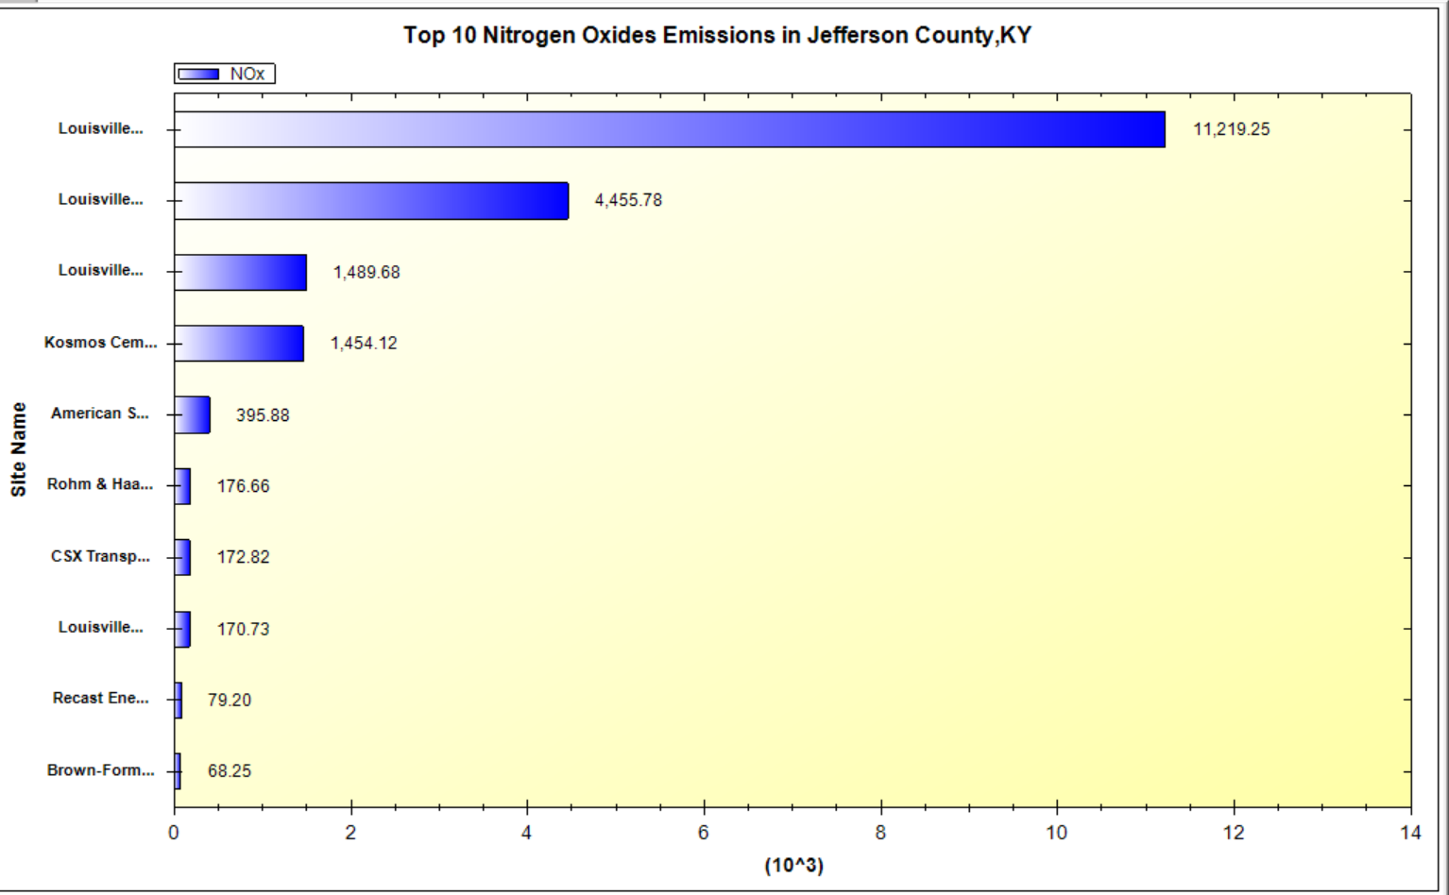
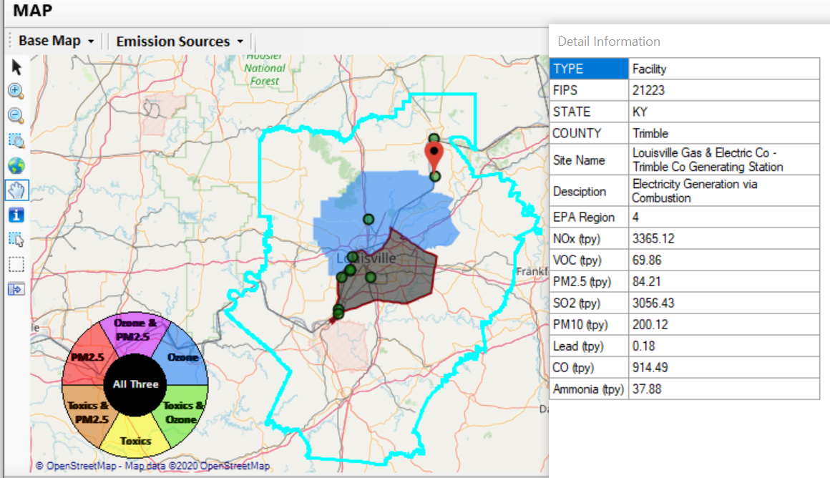
ADVANCE Example - Louisville
2 of the top 4 NOx emission sources outside Jefferson County, KY (Jefferson County, IN & Tremble, KY)
24

Slide 25
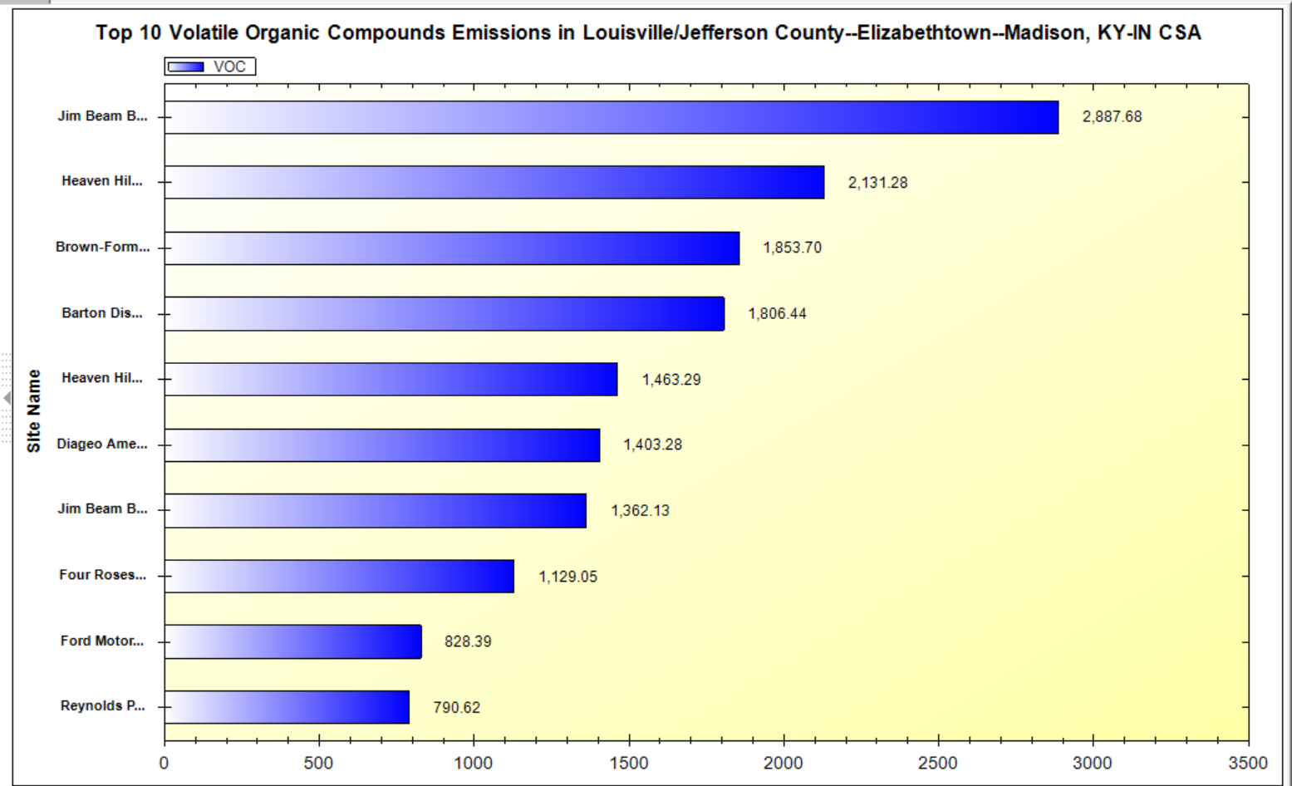
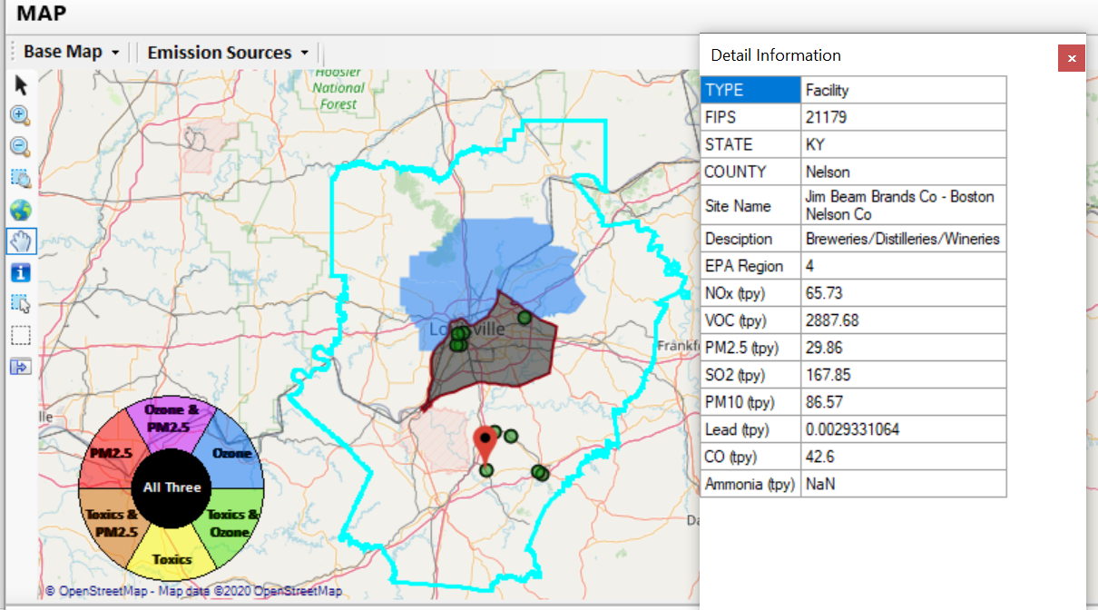
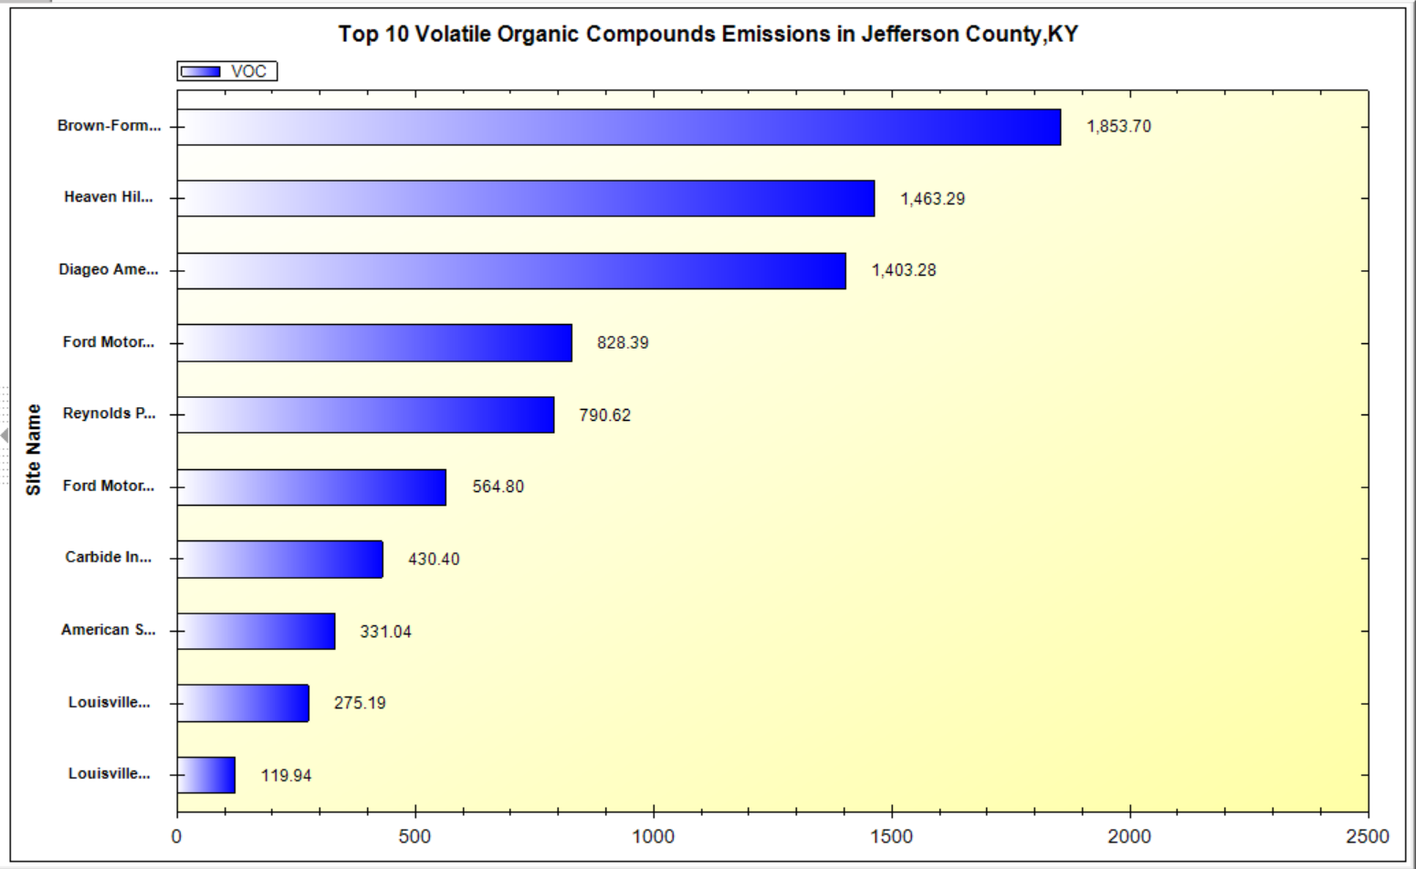
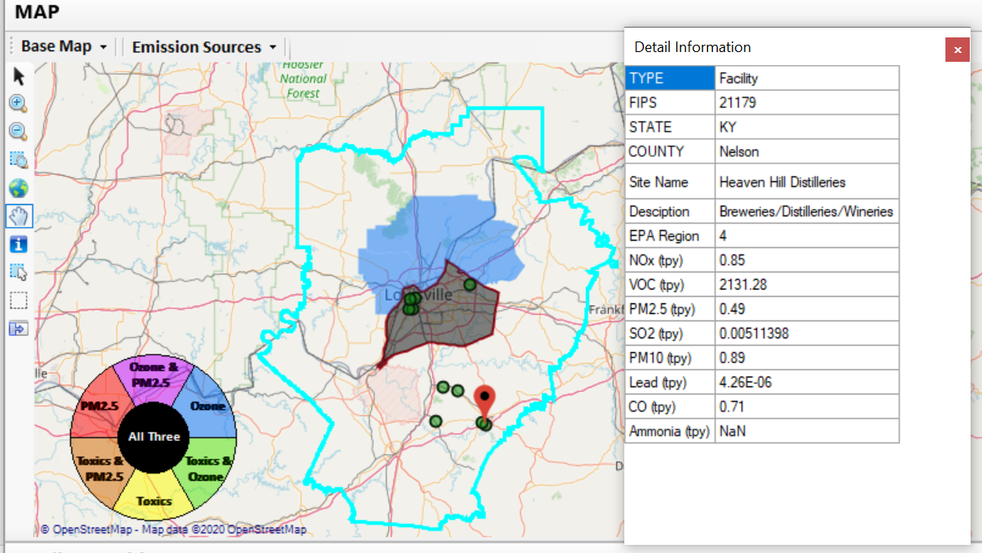
ADVANCE Example - Louisville
Top 2 VOC emission sources are in Nelson County, KY
25

Slide 26
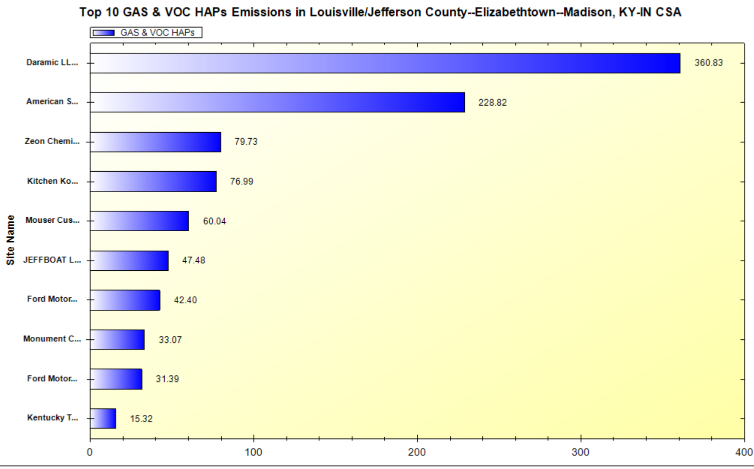
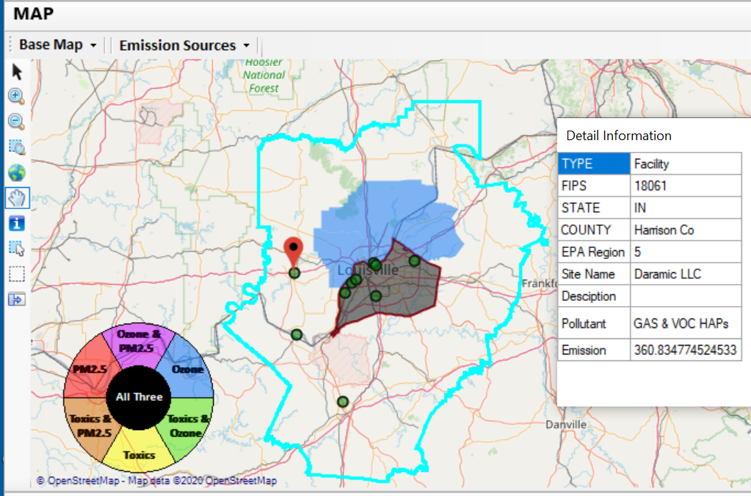
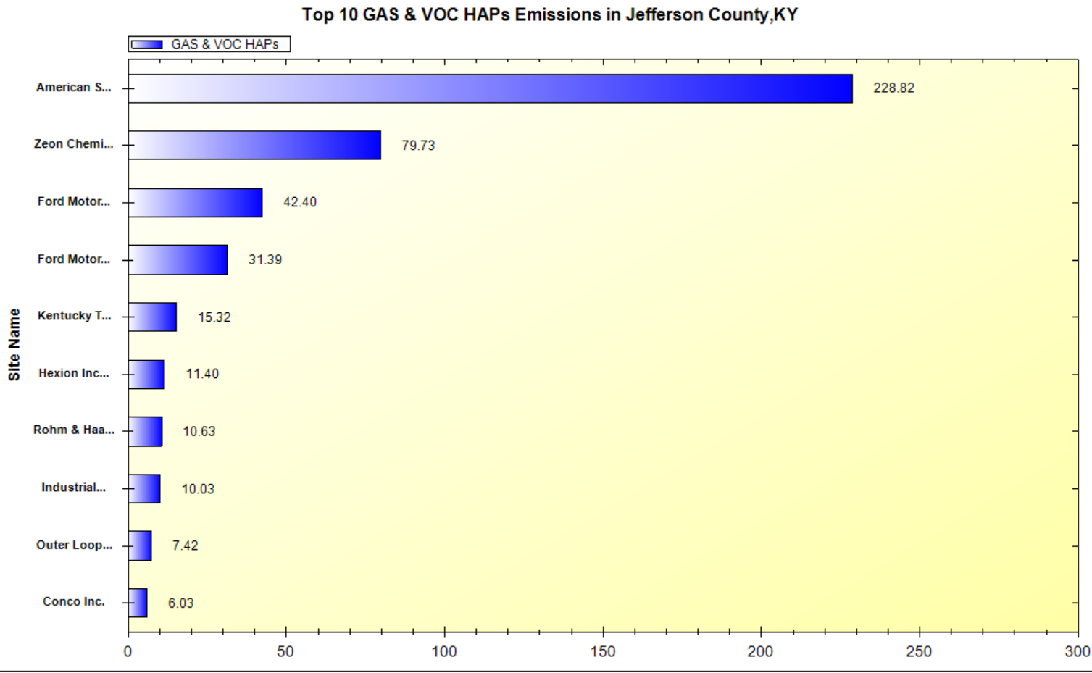
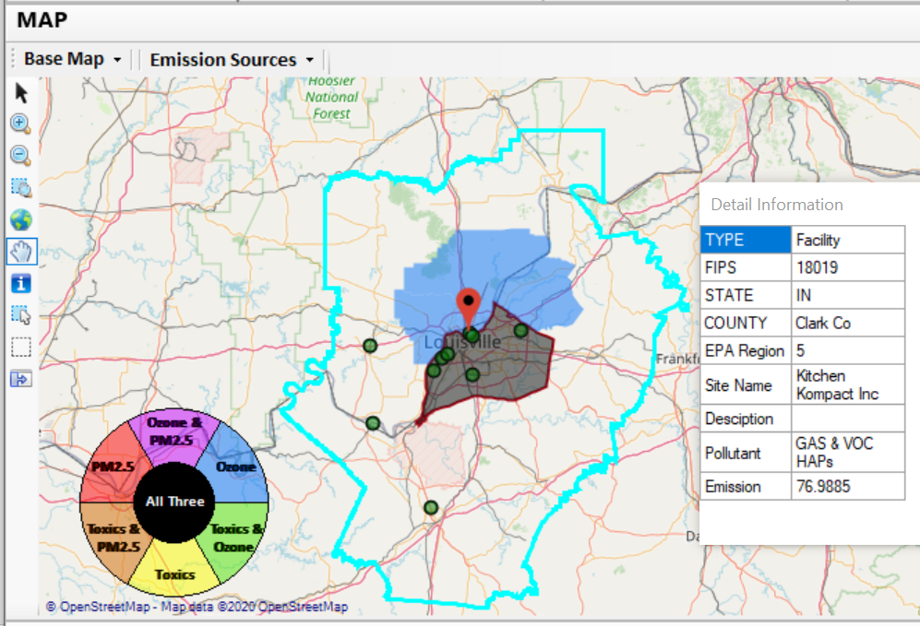
ADVANCE Example - Louisville
26
2 of the top 4 gas & VOC HAPs emission sources in Indiana (Harrison & Clark County)

Slide 27
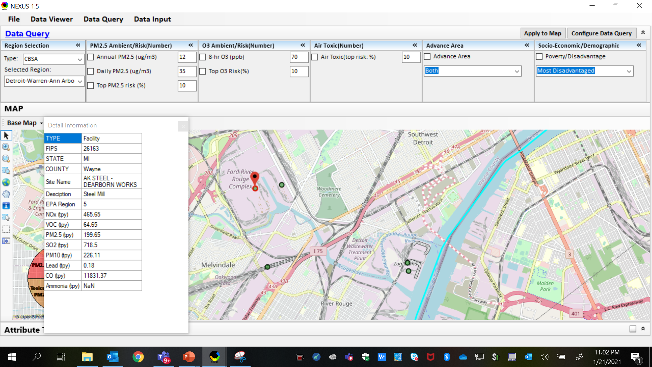
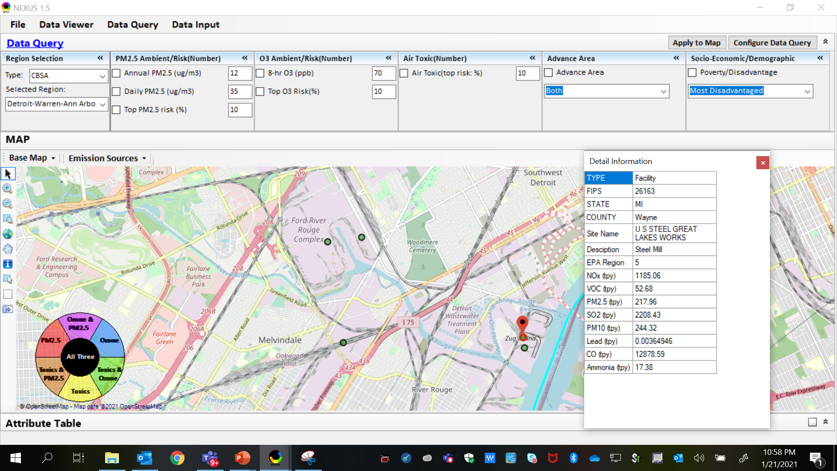
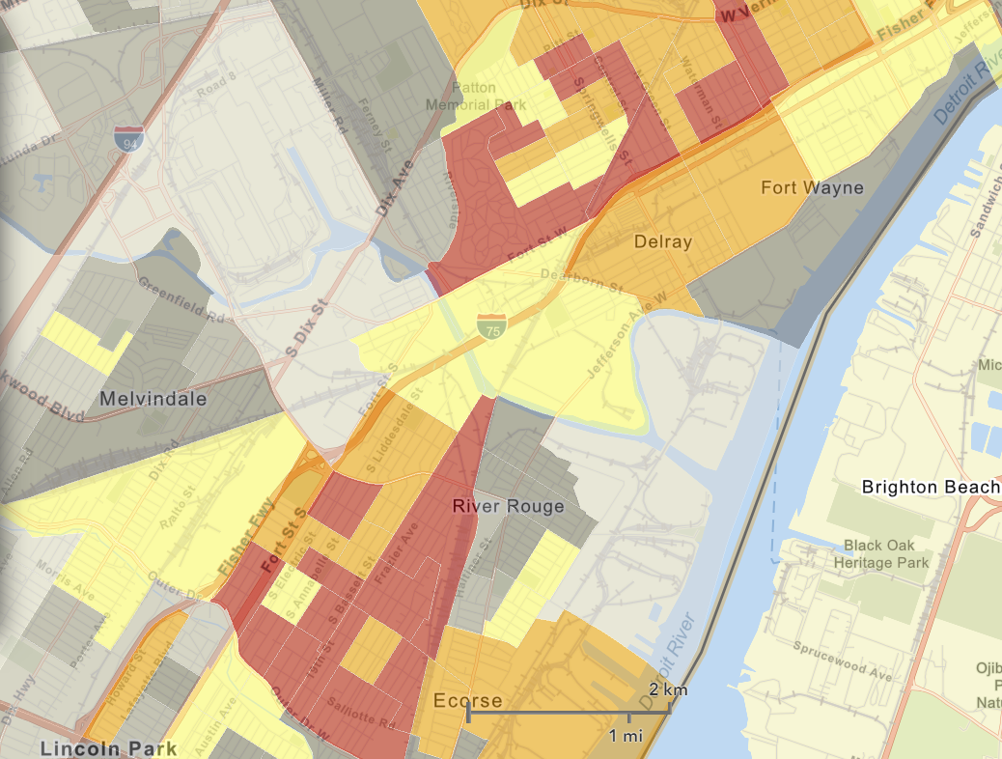
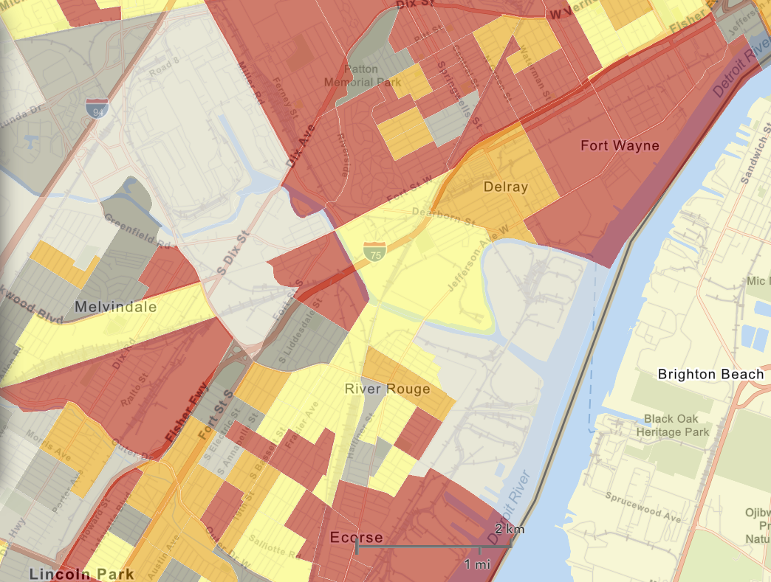
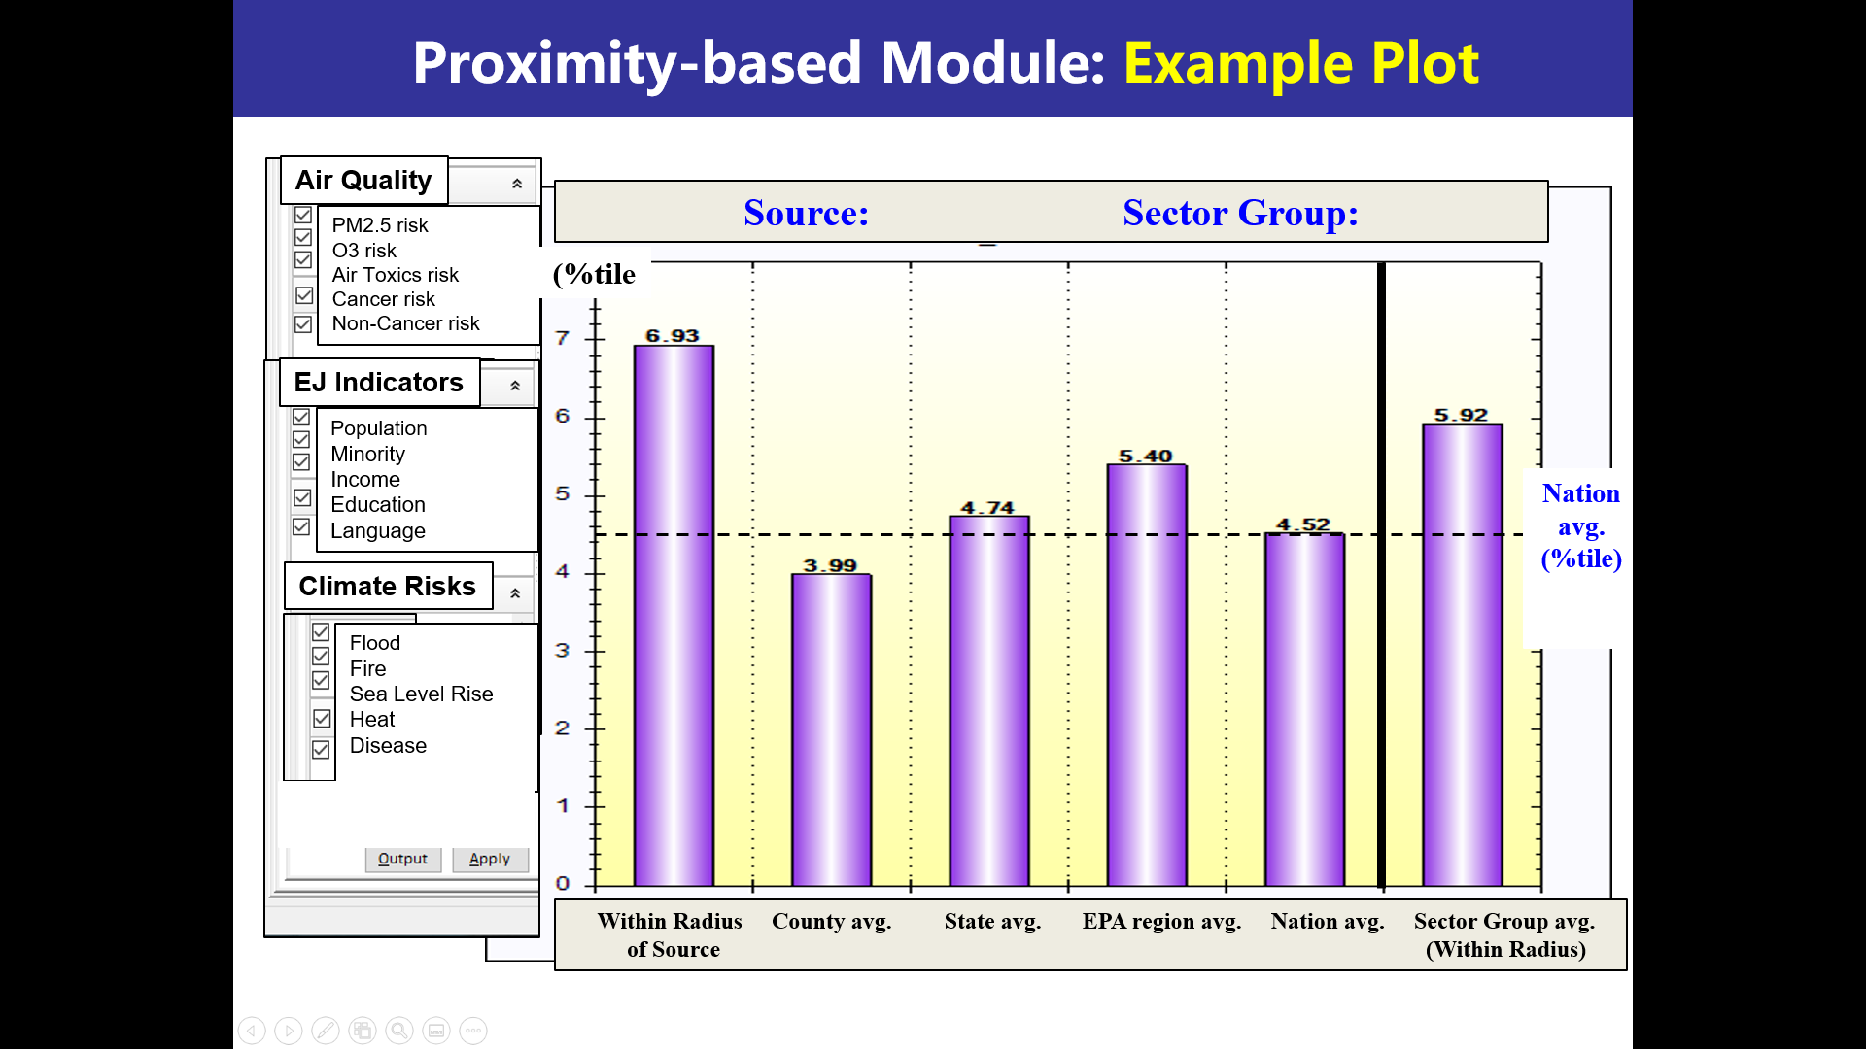


MP Proximity Analysis Example – Developing Capabilities
AK Steel
US Steel
AK Steel
NEXUS is used to quickly identify top emitters of NOx, SO₂, PM_{2.5}, and heavy-metal HAPs near elevated demographic index and has developing proximity capability
US Steel
EJSCREEN Demographic Index
EJSCREEN Low Income Population

Slide 28


MP Proximity Analysis Example – Developing Capabilities

Slide 29
Next Steps / Issues for Discussion
Next Steps
  Updating existing data to 2017
    Emissions, O₃/PM_{2.5}/Toxics concentration, O₃ and PM_{2.5} risk
  Add new information
    Tribal areas, Advance areas, GHG emissions, monitoring data
  Develop MP proximity analysis module for areas
    MP risk in context of EJ (and can incorporate climate considerations)
  Follow up with additional EJ discussions/connection with EJSCREEN?
  Meeting with economics group
Issues for Discussion
  2017 Air Toxics Risk Data (to be topic of AT-DAT meeting with ATC)
  OAQPS review/prioritization of analytical tools
  Funding mechanism
29

Slide 30
Questions?
30

Slide 31
Appendix A
NEXUS Sector Ranking within Highest Risk Areas
31

Slide 32
MP Ranking: CBSAs w/ Top-Ranked MP Risks
Method: Identify CBSAs with top MP risk ranking: Major CBSAs are selected.
 | EPA_REGION | STATE | CBSA_NAME | Overall Rank
1 | EPA Region 5 | IL-IN-WI | Chicago-Joliet-Naperville, IL-IN-WI | 1
2 | EPA Region 3 | PA | Pittsburgh, PA | 1
3 | EPA Region 6 | TX | Houston-Sugar Land-Baytown, TX | 1
4 | EPA Region 9 | CA | Los Angeles-Long Beach-Santa Ana, CA | 2
5 | EPA Region 6 | TX | Dallas-Fort Worth-Arlington, TX | 2
6 | EPA Region 4 | GA | Atlanta-Sandy Springs-Marietta, GA | 3
7 | EPA Region 4 | FL | Tampa-St. Petersburg-Clearwater, FL | 3
8 | EPA Region 4 | AL | Birmingham-Hoover, AL | 3
9 | EPA Region 9 | AZ | Phoenix-Mesa-Glendale, AZ | 3
10 | EPA Region 9 | CA | Fresno, CA | 3
11 | EPA Region 2 | NY-NJ-PA | New York-Northern New Jersey-Long Island, NY-NJ-PA | 3
12 | EPA Region 5 | OH | Cleveland-Elyria-Mentor, OH | 3
13 | EPA Region 9 | CA | Sacramento--Arden-Arcade--Roseville, CA | 4
14 | EPA Region 9 | NV | Las Vegas-Paradise, NV | 4
15 | EPA Region 4 | NC-SC | Charlotte-Gastonia-Rock Hill, NC-SC | 5
16 | EPA Region 9 | CA | San Diego-Carlsbad-San Marcos, CA | 5
17 | EPA Region 5 | MI | Detroit-Warren-Livonia, MI | 5
18 | EPA Regions 5 & 7 | MO-IL | St. Louis, MO-IL | 5
19 | EPA Region 5 | MI | Grand Rapids-Wyoming, MI | 6
20 | EPA Region 4 | TN | Nashville-Davidson--Murfreesboro--Franklin, TN | 6
21 | EPA Region 9 | CA | Bakersfield-Delano, CA | 6
22 | EPA Regions 2 & 3 | PA-NJ-DE-MD | Philadelphia-Camden-Wilmington, PA-NJ-DE-MD | 6
23 | EPA Region 9 | CA | Riverside-San Bernardino-Ontario, CA | 6
24 | EPA Region 4 | FL | Miami-Fort Lauderdale-Pompano Beach, FL | 6
25 | EPA Region 6 | LA | Baton Rouge, LA | 7
26 | EPA Region 6 | TX | El Paso, TX | 7
27 | EPA Region 10 | WA | Seattle-Tacoma-Bellevue, WA | 7
28 | EPA Region 4 & 5 | KY-IN | Louisville-Jefferson County, KY-IN | 7
 | EPA_REGION | STATE | CBSA_NAME | Overall Rank
29 | EPA Region 8 | CO | Denver-Aurora-Broomfield, CO | 8
30 | EPA Region 3 | PA | Reading, PA | 8
31 | EPA Region 9 | CA | Visalia-Porterville, CA | 8
32 | EPA Region 1 | CT | Bridgeport-Stamford-Norwalk, CT | 8
33 | EPA Region 4 & 6 | TN-MS-AR | Memphis, TN-MS-AR | 8
34 | EPA Regions 2 & 3 | PA-NJ | Allentown-Bethlehem-Easton, PA-NJ | 9
35 | EPA Region 6 | LA | New Orleans-Metairie-Kenner, LA | 9
36 | EPA Region 4 | NC | Greensboro-High Point, NC | 10
37 | EPA Region 4 | AL | Mobile, AL | 10
38 | EPA Region 4 | TN-GA | Chattanooga, TN-GA | 11
39 | EPA Region 4 | TN | Knoxville, TN | 11
40 | EPA Region 3 | DC-VA-MD-WV | Washington-Arlington-Alexandria, DC-VA-MD-WV | 11
41 | EPA Region 6 | OK | Tulsa, OK | 11
42 | EPA Region 9 | AZ | Tucson, AZ | 11
43 | EPA Region 4 | SC | Charleston-North Charleston-Summerville, SC | 12
44 | EPA Region 4 | SC | Greenville-Mauldin-Easley, SC | 12
45 | EPA Region 3 | WV | Charleston, WV | 13
46 | EPA Region 4 | SC | Spartanburg, SC | 13
47 | EPA Region 4 | NC | Winston-Salem, NC | 13
48 | EPA Region 4 | FL | Lakeland-Winter Haven, FL | 13
49 | EPA Region 5 | OH | Akron, OH | 13
50 | EPA Region 6 | TX | Beaumont-Port Arthur, TX | 14
51 | EPA Region 5 | MI | Lansing-East Lansing, MI | 14
52 | EPA Region 4 | FL | Orlando-Kissimmee-Sanford, FL | 14
53 | EPA Region 10 | OR | Eugene-Springfield, OR | 14
54 | EPA Region 9 | NV | Reno-Sparks, NV | 14
55 | EPA Regions 4 & 5 | OH-KY-IN | Cincinnati-Middletown, OH-KY-IN | 14
56 | EPA Region 3 | PA | Lancaster, PA | 14
32

Slide 33
Sectors Most Prevalent in Highest Risk Areas
Method: Highest emitting sectors within top ranked 50 CBSAs (Note: Facilities are grouped based on “Sector definition” spreadsheet created by Marc H. & SPPD)*
“Sector group” emissions combined for all 50 Highest Risk Ranked CBSAs Total Population: 134,940,816
Sector Group | SO2 (TON) | NOx (TON) | PM2.5 (TON) | Gas_VOC_HAPs (LB) | Heavy_Metal_HAPs (LB) | CO2e (TON) | SO2 Score (freq. & rank)
Electric Utilities | 276526 | 195865 | 25828 | 6432707 | 127030 | 485754073 | 2014
Petroleum Refining | 52943 | 40169 | 12438 | 10295621 | 99736 | 95097998 | 574
Coke Ovens | 22405 | 15473 | 5158 | 1787622 | 29716 | 14570119 | 132
Pesticides and Agricultural Chemical Manufacturing | 17644 | 5861 | 1292 | 1627958 | 1788 | 18233480 | 153
Inorganic Chemical Manufacturing | 14522 | 7273 | 1405 | 1073205 | 48966 | 5231826 | 190
Mineral Processing | 13714 | 12628 | 1659 | 886251 | 33740 | 8364046 | 256
Iron and Steel Production | 10679 | 13345 | 5691 | 858984 | 110757 | 33030868 | 375
Cement Manufacturing | 10566 | 44083 | 5007 | 1472498 | 25010 | 27859268 | 444
Air Transportation | 8127 | 63035 | 2685 | 10417526 | 122777 | 18485627 | 1380
Pulp and Paper Industry | 7413 | 9791 | 2779 | 7227413 | 23704 | 10517197 | 251
Organic Chemical Manufacturing | 6240 | 38070 | 6254 | 10280694 | 20059 | 82521408 | 299
Landfills | 2952 | 9872 | 2356 | 2799470 | 1880 | 28651639 | 563
Consumer Products (Cleaning, Photographic, etc.) | 2815 | 1980 | 486 | 1363144 | 1724 | 1389978 | 66
Oil and Gas Production and Distribution | 2717 | 28271 | 2259 | 4467061 | 1804 | 12342771 | 466
Food Products Manufacturing | 2705 | 6197 | 3085 | 4110212 | 2496 | 3408089 | 327
Non-Ferrous Metals Production | 2694 | 3511 | 1695 | 3663067 | 91643 | 2165692 | 212
Glass Manufacturing | 2355 | 5832 | 953 | 92289 | 9990 | 1174855 | 210
Clay Products Manufacturing | 1349 | 685 | 602 | 650323 | 1631 | 200293 | 311
Waste Incineration | 1024 | 11872 | 483 | 679918 | 1801 | 9825913 | 189
*Appendix contains graphics with sector ranking by pollutants
33

Slide 34
SO₂ & NOx: Sector Group emissions
Summed up top 20 facility emissions over 50 major CBSAs
over
34

Slide 35
Primary PM_{2.5}: Sector Group emissions
Summed up top 20 facility emissions over 50 major CBSAs
Primary PM2.5 emissions (ton/yr) from top Sector groups
over
35

Slide 36
Gas & VOC HAPs: Sector Group emissions
Summed up top 20 facility emissions over 50 major CBSAs
Gas & VOC HAPs emissions (lb/yr) from top Sector groups
36

Slide 37
Heavy Metal HAPs: Sector Group emissions
Summed up top 20 facility emissions over 50 major CBSAs
Heavy HAPs emissions (lb/yr) from top Sector groups
37

Slide 38
CO2e: Sector Group emissions
Summed up top 20 facility emissions over 50 major CBSAs
over
38

