Slide 1
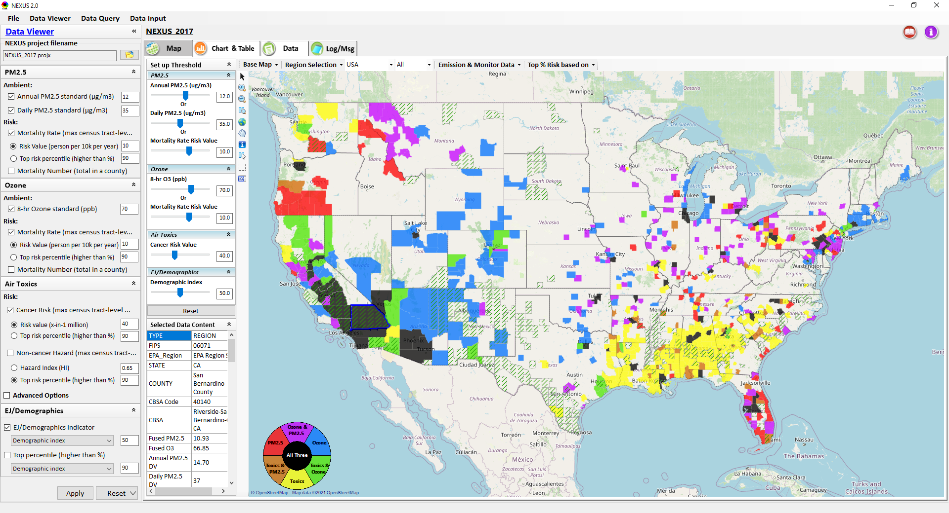
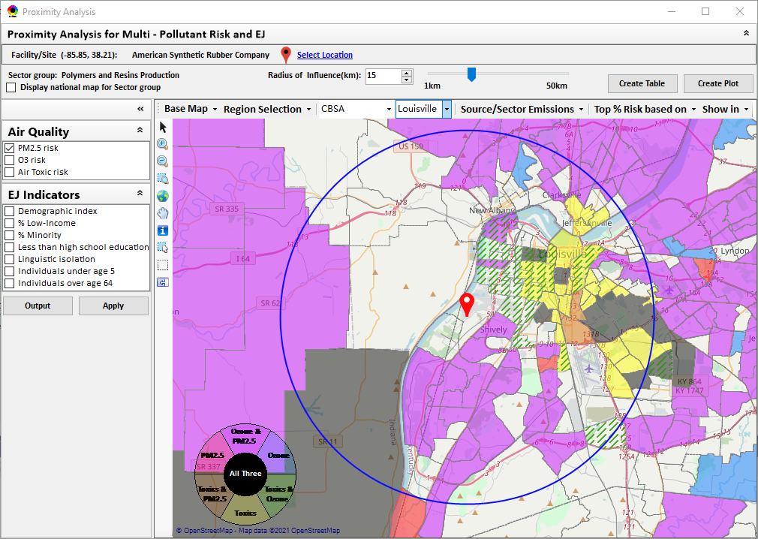
“NEXUS” Multi-Pollutant Advanced Screening Tool Title VI Briefing for OGC/ECRCO
Data Viewer: National/Regional Level
Proximity Analysis: Community Level
Beth Landis, HEID/Climate, International, & Multi-Media Group
Carey Jang, AQAD/Air Quality Modeling Group
8/15/22
1

Slide 2
Multi-Pollutant Team Members
HEID
Beth Landis / Kimber Scavo
Matt Woody / Kelly Rimer
Robin Langdon / Darryl Weatherhead
Sara Terry
Carrie Wheeler
Rob Pinder
Chris Davis
Conor Mulderrig
Kayla McCauley
OID
Amanda Kaufman
James Payne
Loren Fox
AQAD
Carey Jang / Tyler Fox
Jim Kelly
Shannon Koplitz
Joe Mangino
Jeanette Reyes
AQPD
Rich Damberg / Megan Brachtl
Mia South
SPPD
Lisa Conner
2

Slide 3
Overview
Background
Data Inputs and Major Functions
Briefings & Demos
Feedback
NEXUS & EJSCREEN
Example OAQPS Use for Monitoring
Live Demo
3

Slide 4
Multi-Pollutant Background
Support a comprehensive, MP treatment of air quality problems to effectively improve air quality and make the most efficient use of available resources
Primary Goal - identify & evaluate local control strategies targeting emissions of O₃ & PM_{2.5} and their precursors while at the same time reducing Air Toxics of concern for communities to maximize both health benefits and air quality improvements
MP planning has the potential to reduce the costs and increase benefits associated with air quality management (AQM)
Supports S/L/T air agencies in developing MP, risk-based AQM plans and implementing strategies that reduce air pollution emissions & improve public health
Success has been demonstrated in Detroit and SC; another project is currently underway in Louisville, KY
Tools needed to analyze MP data are either available currently or being developed in OAQPS (e.g., NEXUS)
4

Slide 5
NEXUS: Background
“NEXUS” is an advanced screening tool for multi-pollutant (MP) risks and EJ/Demographic analysis developed by OAQPS’s MP team
“NEXUS” integrates a suite of MP data, including emissions, monitoring, modeling, fused AQ data and health risk data for PM_{2.5}, O₃ & air toxics as well as EJ/demographic data, into one single platform to allow national and areal overlay mapping & analysis of MP ambient & risk data
“NEXUS” provides MP analysis across from national level “Phase 1” to regional (EPA region/State/CBSA) level “Phase 2”, and now down to community level “Phase 3” (Proximity analysis” in census tract-level)
We expect to use this tool in conjunction with Regions and identify areas that would potentially benefit most from MP approaches to reduce emissions (including current NA areas)
We also expect that it can have additional value-added uses across the Office for Air Toxics, Environmental Justice and other programs
The NEXUS tool will essentially provide a ‘conceptual model’ of an area’s MP issues to facilitate engagement with state/local/tribal agencies & community stakeholder groups
5

Slide 6
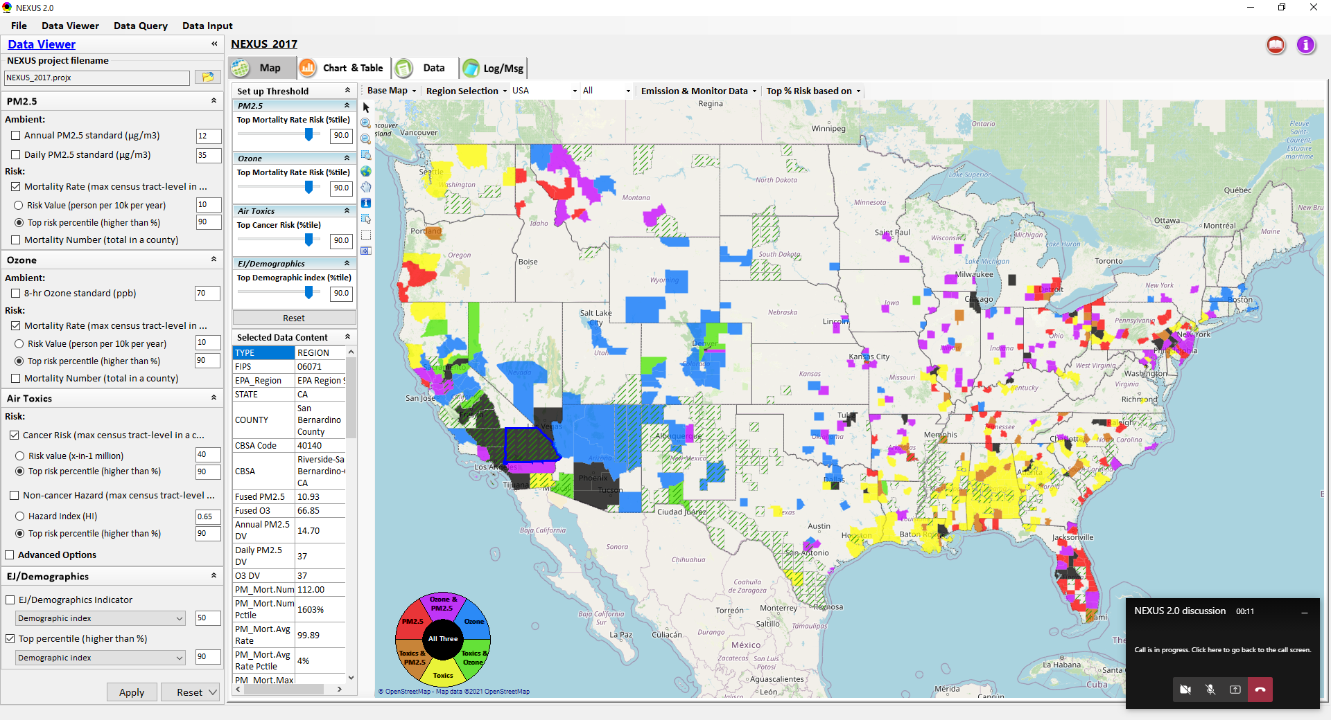
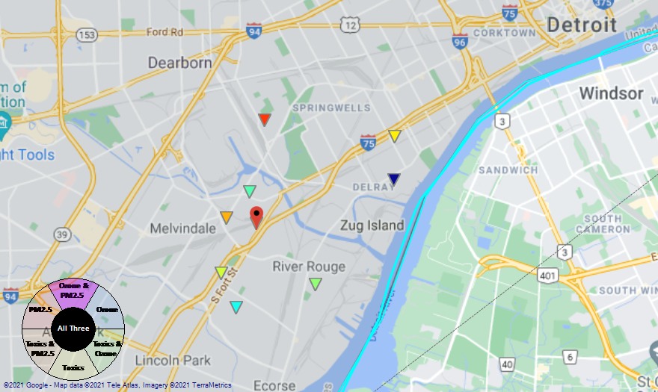
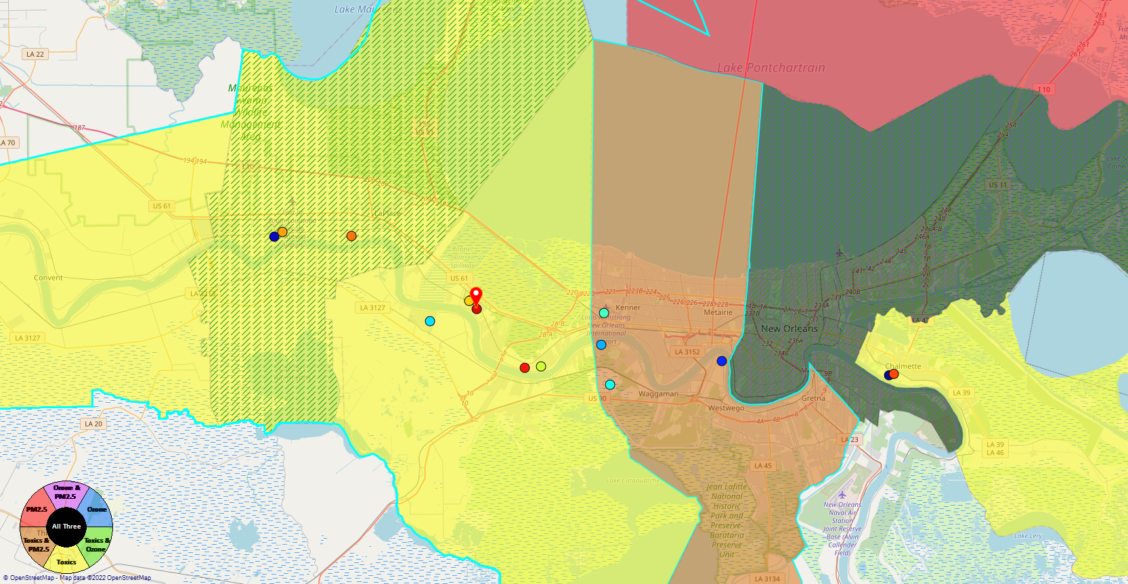
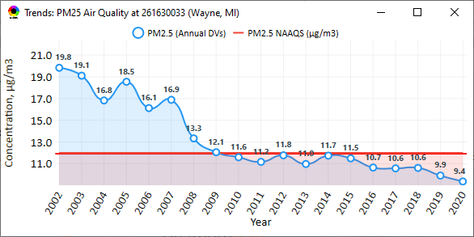
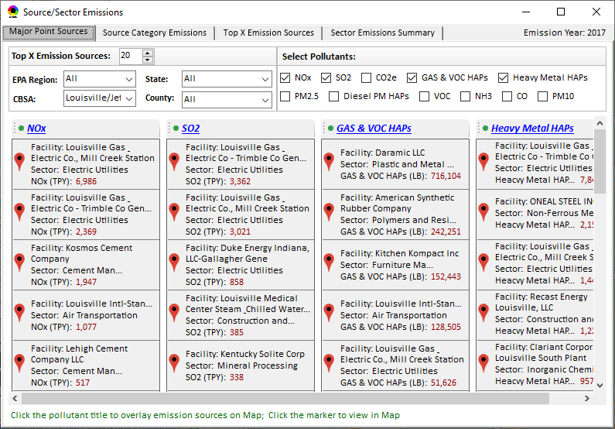
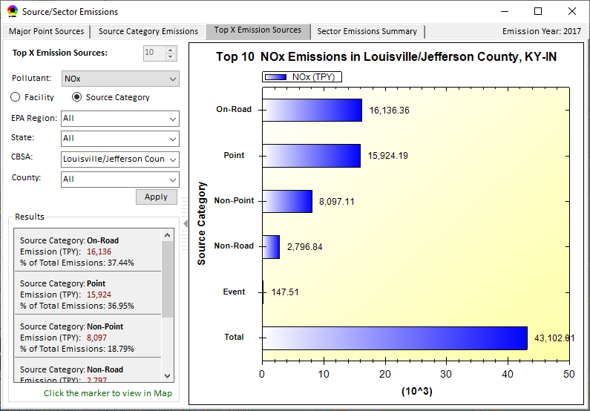
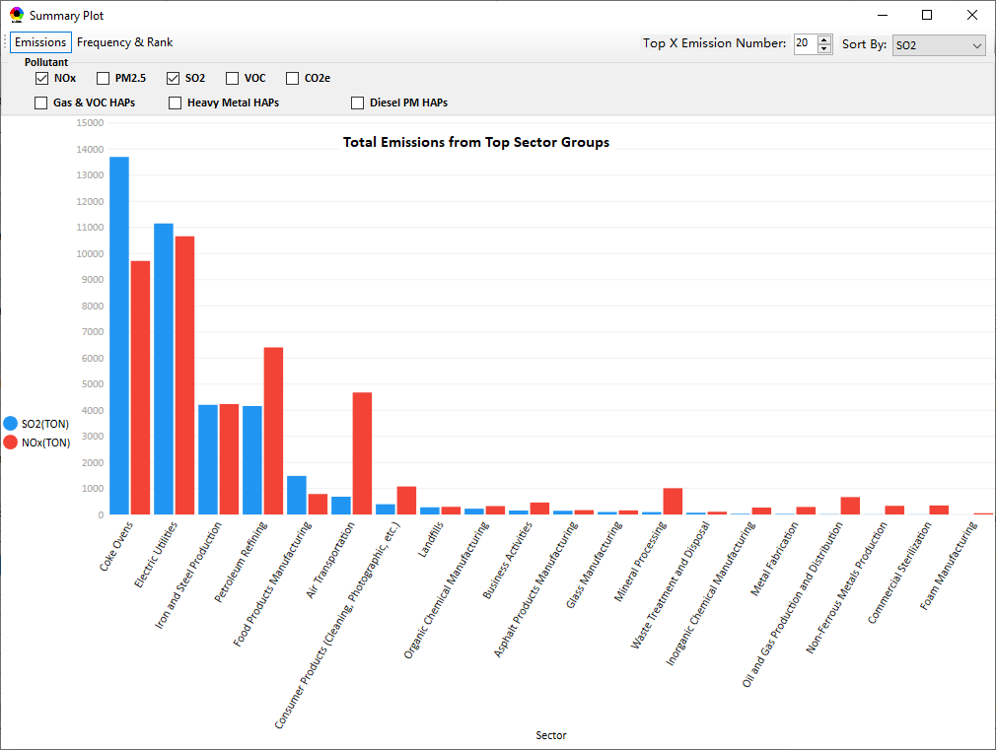
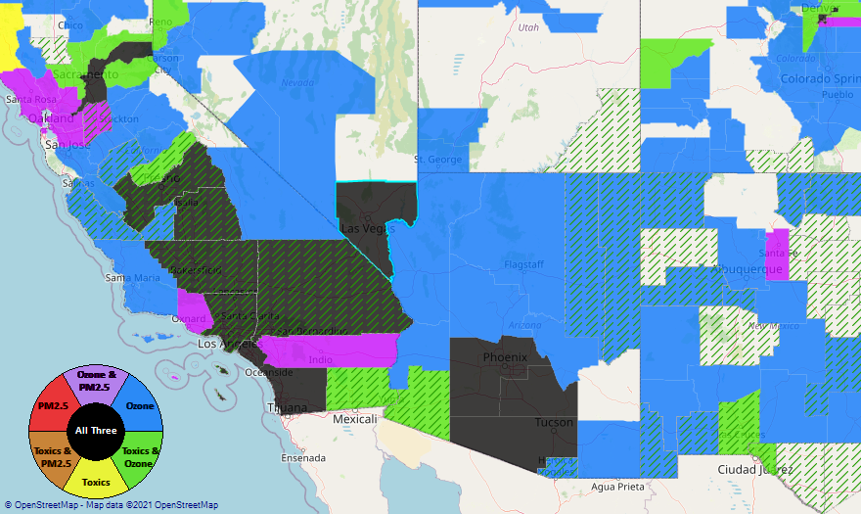
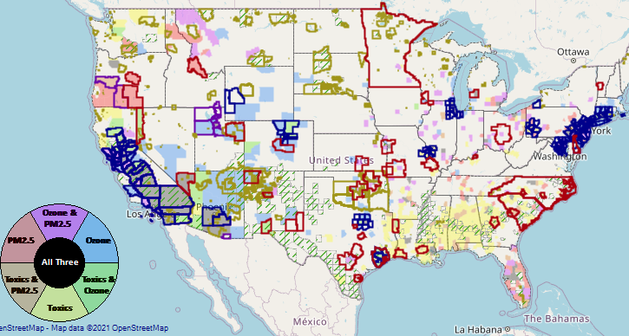
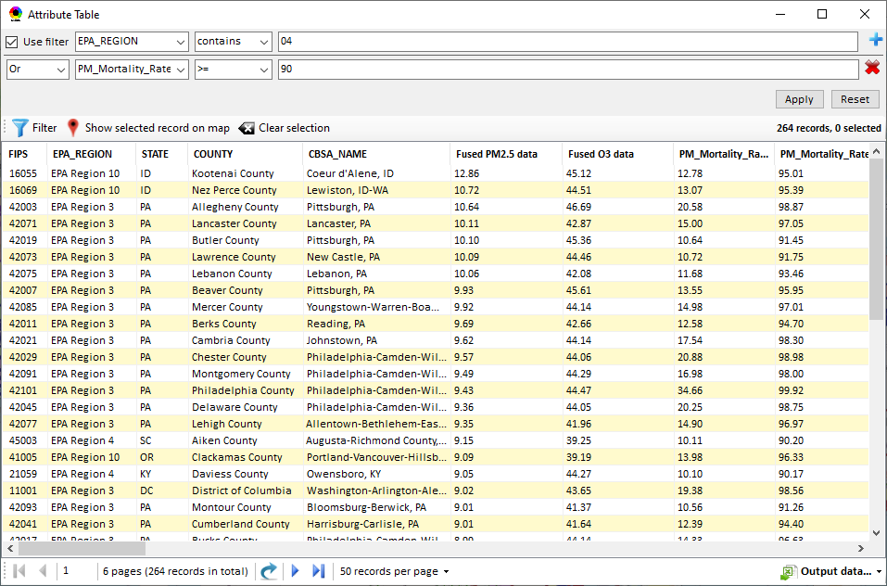
NEXUS: Data Inputs and Major Functions
O₃ & PM_{2.5}
Ambient/Design Value
(2012-2020)
(County-level)
Multi-Pollutant
Ambient and/or Risk National & Areal Mapping
Display Monitoring Sites & Trend Data
O₃, PM_{2.5} & Air Toxics Risk Data &
Conc. (fused AQ) Data
(2017 & 2014)
(Census tract-level)
Display Major Point Emissions Sites/Data
Provide Source Category Emissions
NEXUS
O₃, PM_{2.5} & Air Toxics Monitoring Data
(2002-2020 & -2018)
Provide Sector Emissions Summary
NEI County &
Facility Emissions
(2017 & 2014)
Include EJ/Demographic Indicators
Map Overlay with NAA, Advance Area, Class-I Area, or Tribal Area
Environmental Justice & Demographic Data
(from EJSCREEN)
Data Query, Search, Filter & Export
Advance Area
Class-I Area
Tribal Area
Proximity Screening Analysis
6

Slide 7
NEXUS: Briefings and Demos
9/25/2020– AQAD & HEID
11/3/2020 – MP Team
11/4/2020 – Air Toxics Group
12/10/2020 – AQPD
1/25/2021 – OID
1/28/2021 – SPPD
2/1/2021 – Peter/SMT
4/12/2021 – HEID & AQAD
5/17/2021 – Peter/SMT
5/24/2021 – MP Team
6/29/2021 – ORD
7/12/2021– HEID & AQAD
7/19/2021 – OID
8/10/2021– OAP
8/26/2021 – OAR
8/27/2021 - OP
8/30/2021 – OEJ
8/30/2021 - Region 4/Louisville
9/7/2021 – RO ADDs
9/20/2021 – OAR Demo
10/14/2021 – OP/NCEE
11/2/2021 – RO APMs
11/8/2021- RO APMs Demo
11/16/2021 – R1 (RARE) Project
11/28/2021 – AQAD All-Hands
11/23/2021 – R3 NEXUS Beta Testers
2/15/22 – AQPD (NSRG, OPG & SLPG)
2/17/22 – AT Strategy Mgmt & Mitigation Team
3/15/22 – OID (CTPG)
4/26/22 – EPA NEXUS Beta Testing Team
4/28/22 – AQAD (AAMG)
5/3/22 – HEID & AQAD
5/4/22 – Air Toxics Data Analysis Team
5/10/22 – ADVANCE Workgroup
5/26/22 - OAP/CCD
6/15/22 – Regional Ambient Air Monitoring
6/23/22 – SPPD All-Hands
7/21/22 – EJ in Rulemaking Comm. Of Practice
8/15/22 – OGC & ECRCO – Title VI
8/16/22 – Pre-brief for HEID & AQAD
8/17/22 – Peter
8/22/22 – OID/CTPG – Liz
9/6/22 – RO APMs
TBD –MJOs
7

Slide 8
NEXUS: Feedback from Briefings & Demos
“Fascinating… phenomenal… I’m blown away!”
- Caroline Freeman (R4 ADD)
“The R3 air program has evaluated 18 web tools … NEXUS overall has been the most useful to our air program”
- Cynthia Stahl, PhD
(R3 Integrated Assessment Analyst)
“Your presentation of the NEXUS tool was absolutely awesome!!! … The NEXUS tool looks very promising”
- Osmond Lindo (OAPPS Lead Economist)
“Breathtaking… incredibly powerful… I feel like we discovered nuclear fusion!”
- Joe Goffman
(OAR Acting AA)
“The tool is well designed and provides a wealth of information that is useful for evaluating air quality impacts in local communities”
- Rick Gillam
(R4 Air Modeling Team Lead)
“Dr. Nance [R6 RA] will be thrilled with the NEXUS tool and excited with its capabilities.”
- Fran Verhalen
(recently retired R6 Monitoring Section Chief)
8

Slide 9
NEXUS & EJSCREEN
EJ Layers
Hazardous waste
EJ Grants
Water features
Places
Schools & Parks
Transportation
Boundaries
Prisons
Public Housing
Subsidized Housing
Climate
Sites reporting to the EPA
Superfund (NPL)
RSEI
Environmental Indicators
Wastewater Discharge Indicator
Hazardous Waste Proximity
Superfund Proximity
Lead Paint Indicator
Traffic Proximity
RMP Proximity
EJ Layers
Tribal Areas
Nonattainment Areas
Environmental Indicators*
NATA Respiratory HI
NATA Cancer Risk
NATA Diesel PM
Ozone Model Concentrations
PM_{2.5} Model Concentrations
Demographic Indicators
People of Color Population
Less Than HS Educated
Low Income Population
Linguistically Isolated
Demographic Index
Under Age 5
Over Age 64
Ozone and PM_{2.5}
Emissions and source data
Risk data
Monitoring data
Air Toxics
Emissions and source data
Modeled concentration data
Risk data
Monitoring data
GHG emissions
*Provided to OEJ by OAQPS (AQAD & HEID)
9

Slide 10
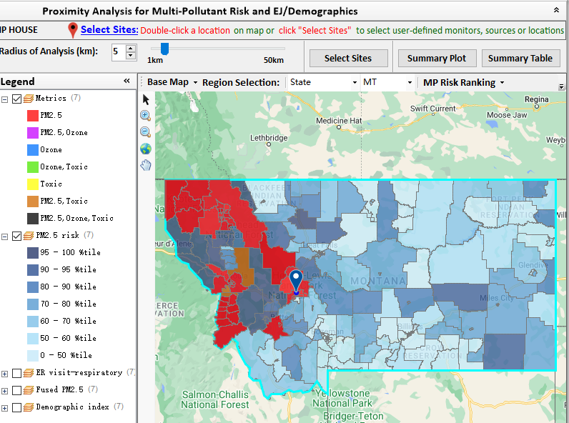
NEXUS: Example OAQPS Use for Monitoring
AQAD/AAMG summer intern (Tom Agger) used NEXUS to provide Justice40 criteria recommendations for the National PM_{2.5} Monitoring Network
Goal: Determine if at least 40% of the current PM_{2.5} monitoring network serves EJ/At-Risk communities
Process: Used NEXUS proximity analysis tool to analyze geographic areas around monitors or pollutions sources to determine demographics and pollutant risk in those areas
Outcome:
Examined numerous combinations of demographic index, low income, minority, and PM_{2.5} risk criteria
Preliminary findings suggest that the current National PM_{2.5} Network meets the Justice 40 goals
AAMG will share the findings with the Regions
This analysis can be used for future monitor siting purposes, but must be combined with other considerations
10

Slide 11
“NEXUS 3.0” Live Demo
11

Slide 12
“NEXUS 3.2”Beta Release Version: Quick Tutorial
OAQPS Multi-Pollutant team, 5/25/2022
12

Slide 13
NEXUS Tool: Installation
To download NEXUS, a request must be submitted with EISD via ServiceNow (even if you have PowerBroker/Administrative privileges)
Access ServiceNow by clicking on the URL: https://usepa.servicenowservices.com/
Click on the ‘Service Catalog’ box on the left-hand side
Scroll down and click on the ‘Software Request’ box. Click ‘Software Request’ again when the screen refreshes.
Since NEXUS will not be listed under the ‘ *Please select the name of the software application needed:’, click the box for ‘Software Application Not Found.’
The page will refresh. User will need to fill out the form includes filling in the following fields outside of what is already pre-filled:
*Supervisor/Approver.
*Machine Name (Instructions provided on where to find)
*Describe the business need & justification for this software license - “NEXUS is a multi-pollutant screening analysis tool for providing multi-pollutant risks and EJ analysis developed by EPA and contractors under a GSA contract with UNC-CH. This tool is needed to complete my work duties”
*Software Company - “EPA”
*Software Title - “NEXUS Tool”
*Software Version - “3.2”
*Software URL - If you have Power Broker privilege, type “Self-install with Power Broker privilege”… if you do not have Power Broker privilege, type “https://gaftp.epa.gov/aqmg/cjang/NEXUS/NEXUS-3.0 – please install NEXUS_3.0_Data.exe and NEXUS_3.2_Setup.exe”
*What type of license will this likely be? (Dropdown: Licensed, Freeware/Shareware, Unknown) – “Unknown”
Approximate price – “Free”
Click on Submit.
EISD will contact you once your form has been approved to install NEXUS. Repeat these steps with installation of new versions of NEXUS.
13

Slide 14
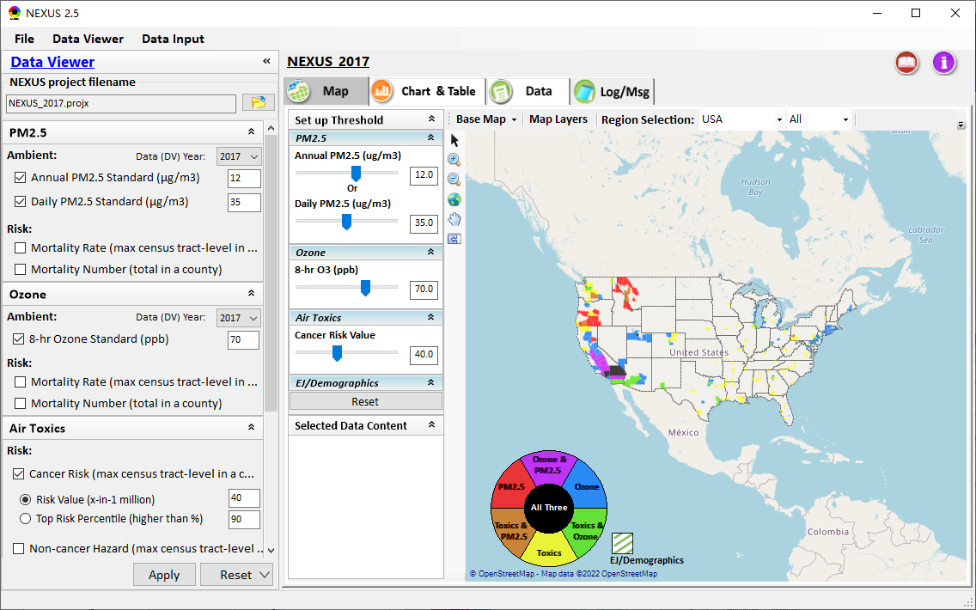
NEXUS Tool: On-line User’s Manual
Click “book” icon to launch “User’s manual”
Hot link to User’s manual’s “Data Viewer” chapter (same for “Data Input” module)
14

Slide 15
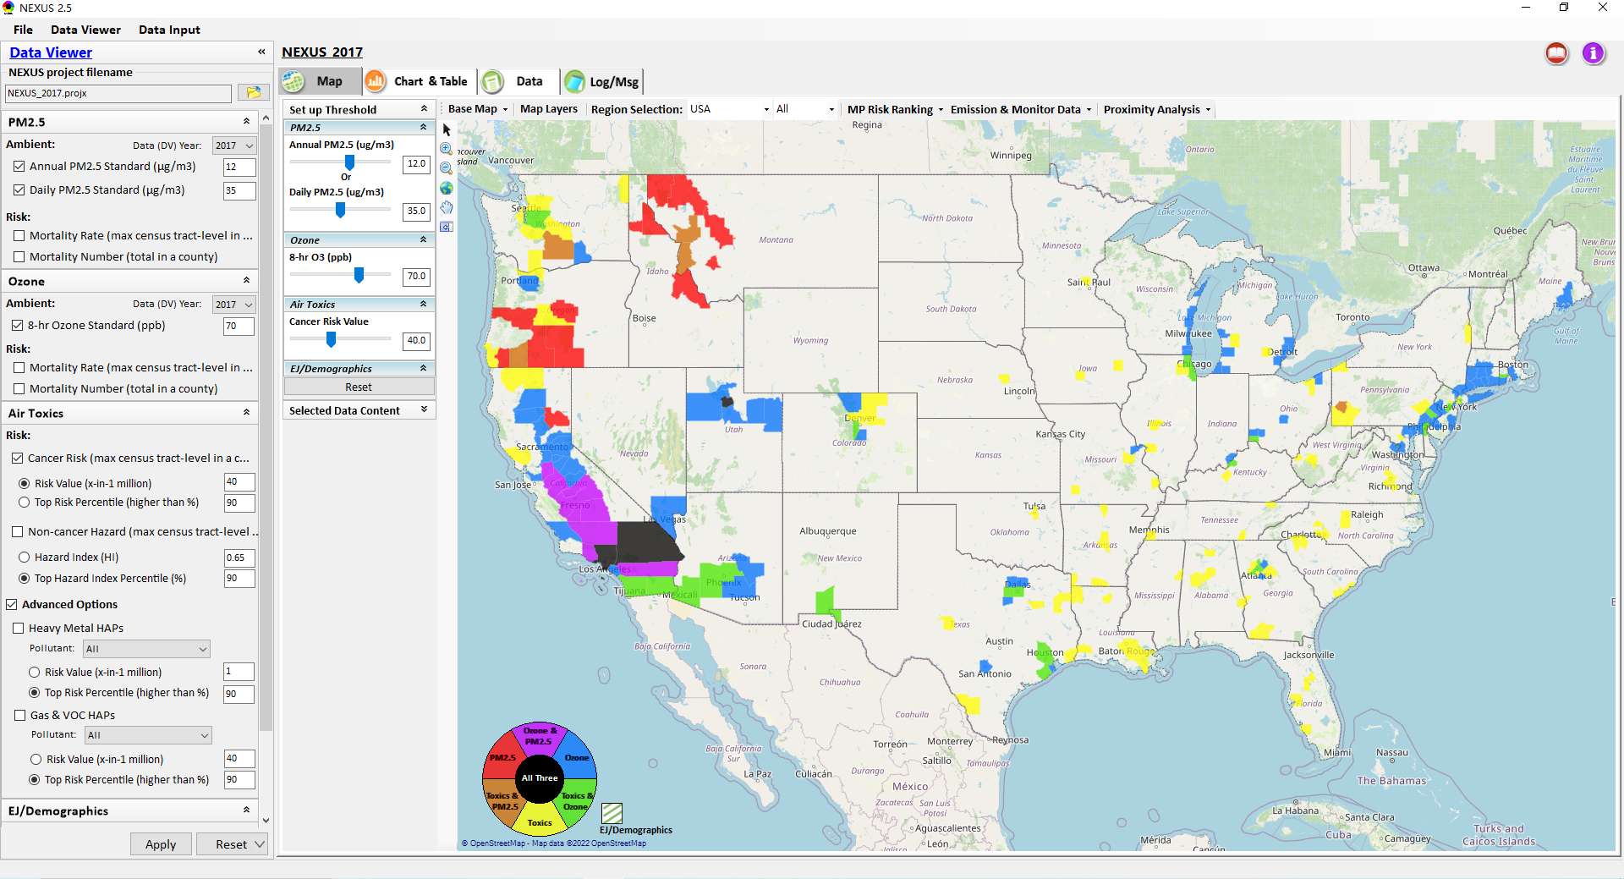
NEXUS Tool: Data Viewer Module
Click “File” to open or save a project
Switch between 2 key modules
NEXUS project file name
Select desired ambient data (DV) year (2013-2020)
Select & adjust “Ambient” or “Risk” levels
“Advanced Option”: provide HAPs & species selections
15

Slide 16
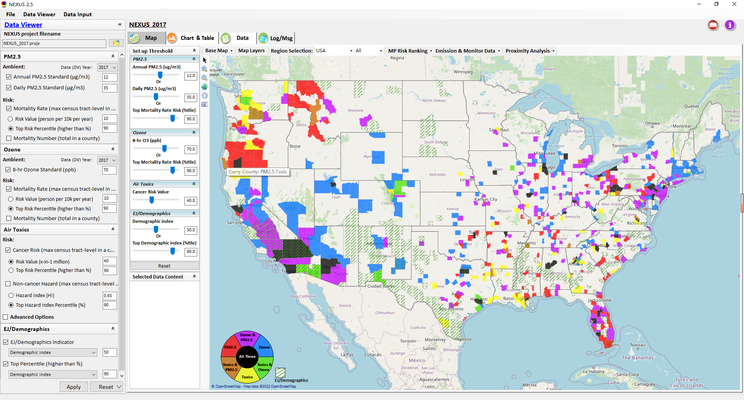
Data Viewer: “Apply” New Selections
“Check” boxes to add or remove “Ambient” and/or “Risk” selections
New selections will appear in “Slider bars” panel and map display
“Slider bars” allow to select & adjust “Ambient” and/or “Risk” threshold levels to display corresponding color map
“Apply” new selections
16

Slide 17
NEXUS Update: EJ/Demographics Metric and Data
EJ/Demographic metric is displayed with “green dash” for counties exceeding selected threshold
17

Slide 18
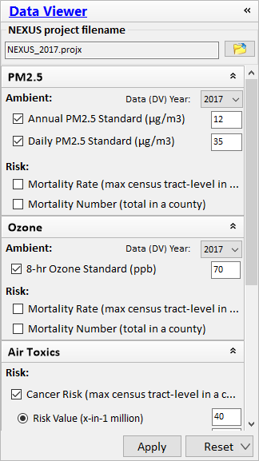
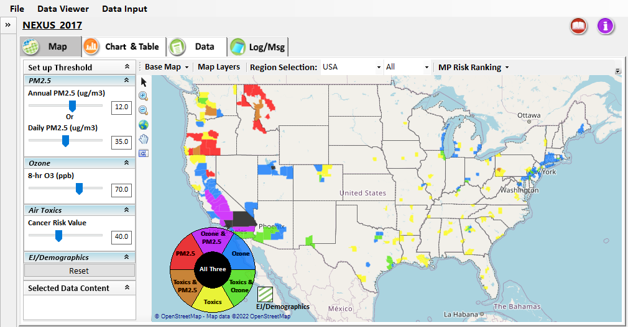
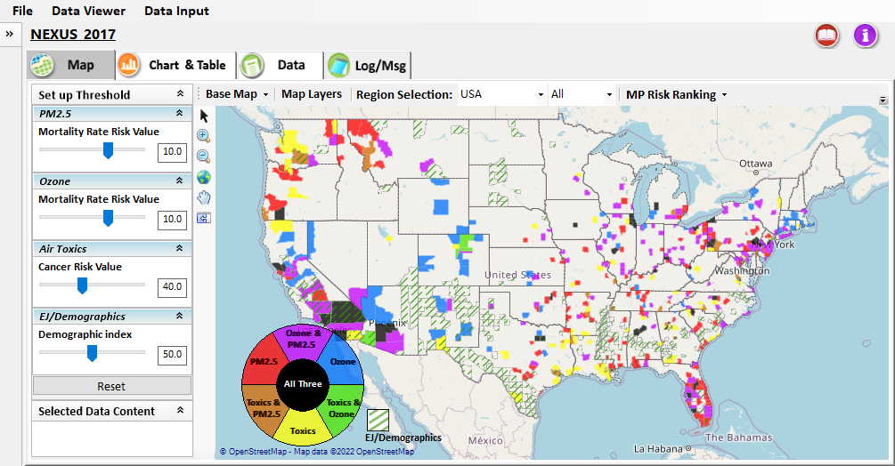
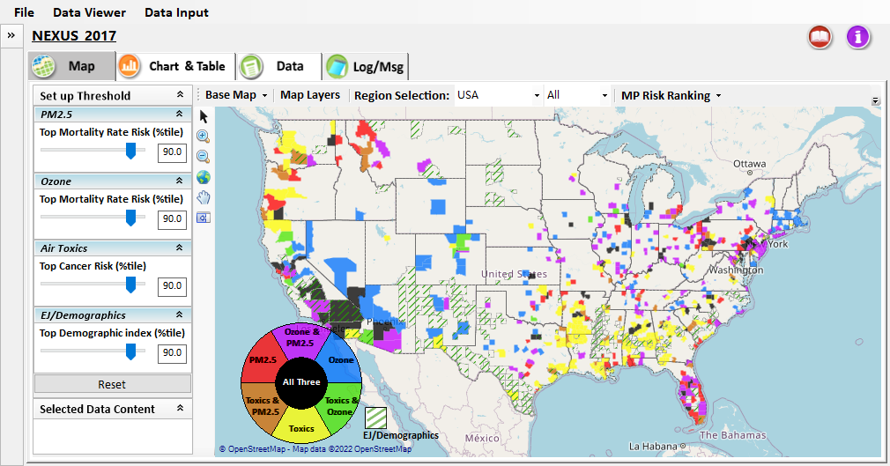
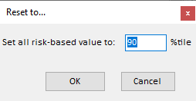

Data Viewer: “Reset” New Selections
default configuration
risk-based value
risk-based in %tile
“Reset” new selections
risk-based in desired %tile
18

Slide 19
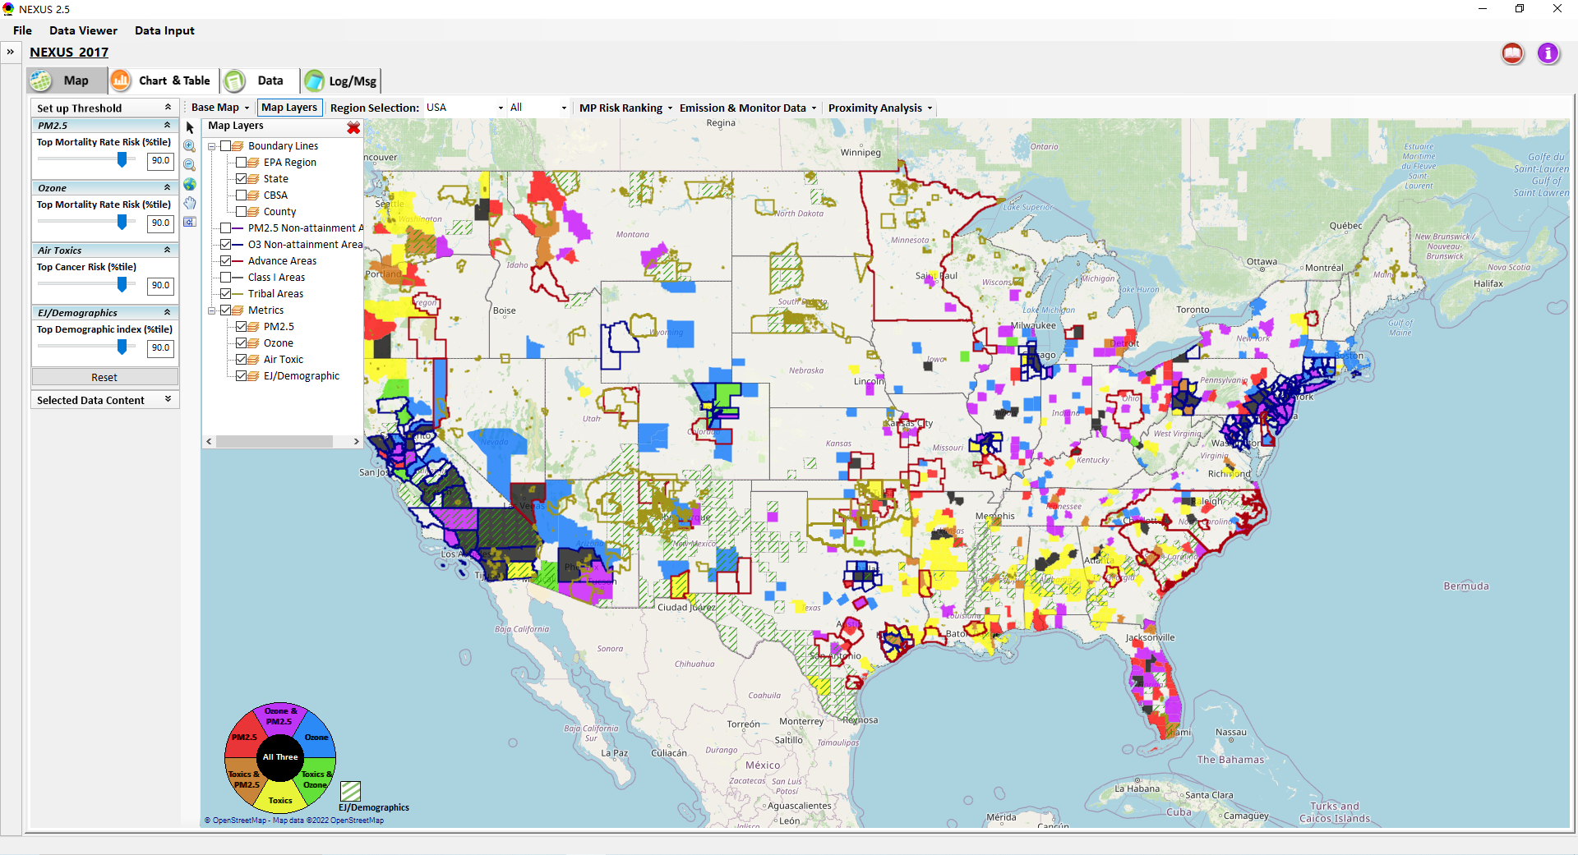
Data Viewer Module: Map Layers menu
Click “X” to close “Map Layers” menu
“Map Layers” menu: Provide (show/hide) map overlaps of various areas, AQ metrics and boundary lines
19

Slide 20
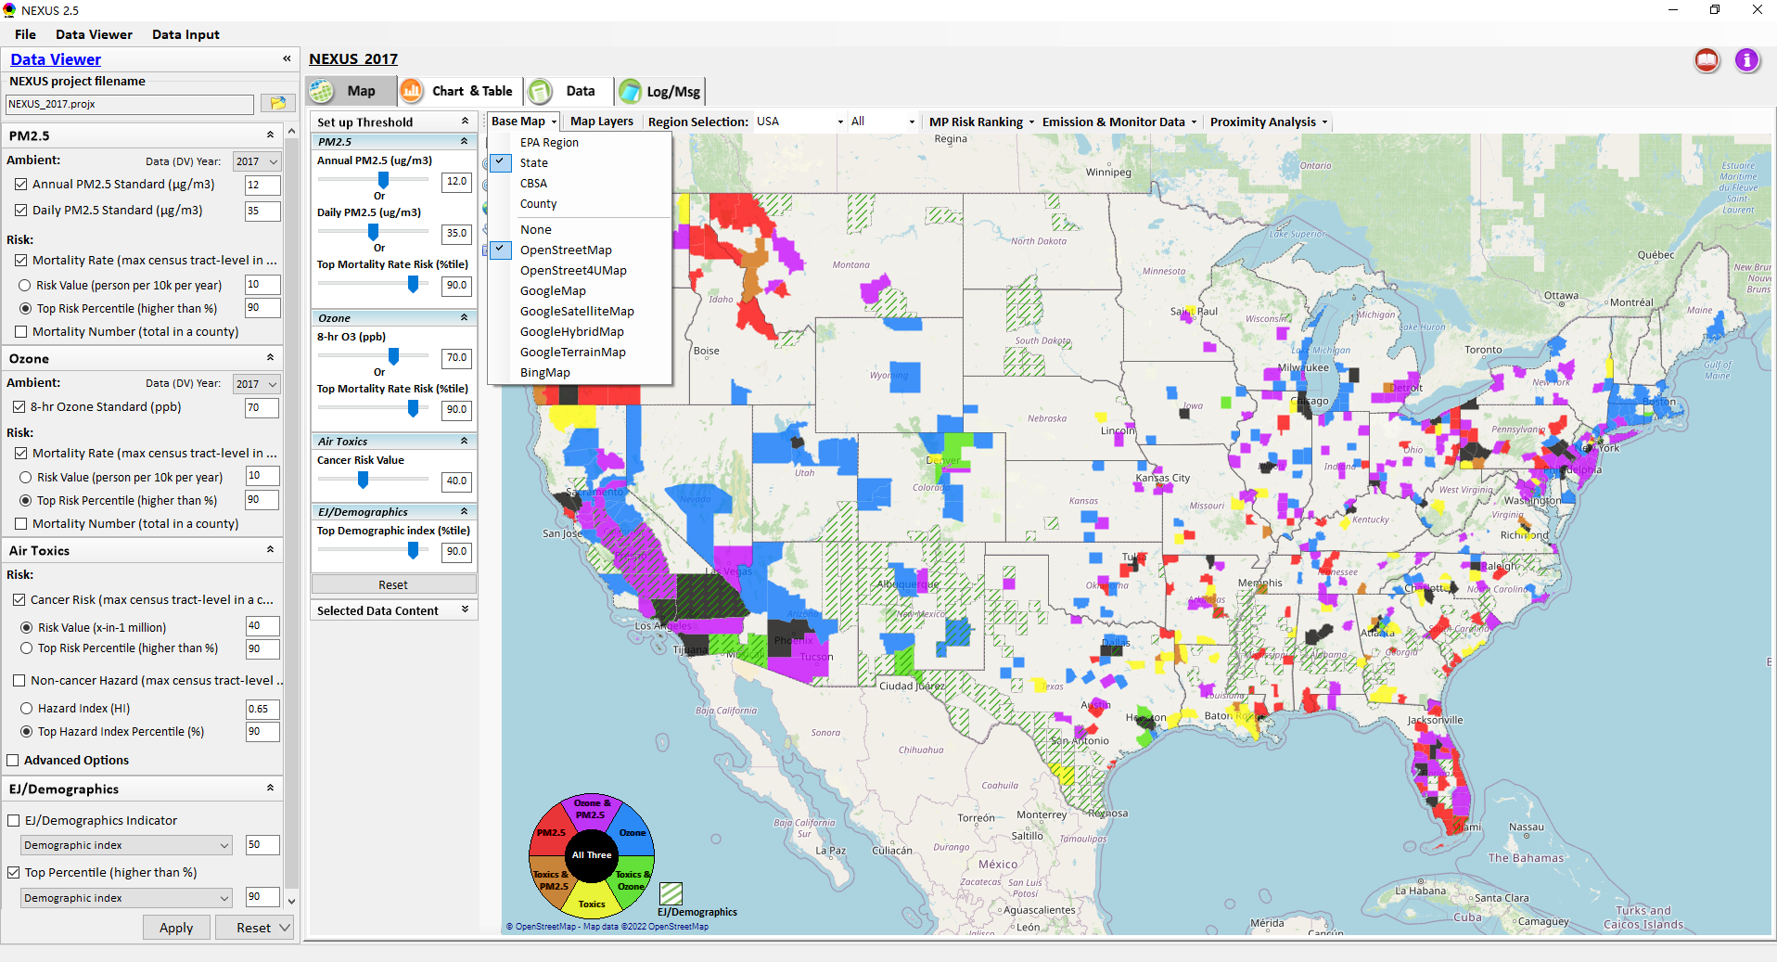
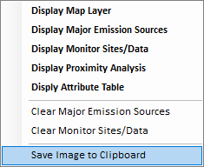
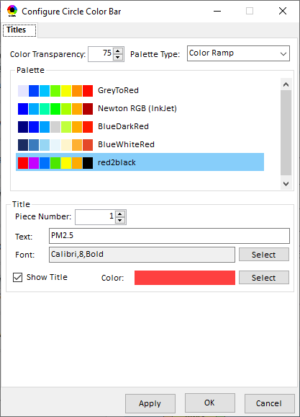
Data Viewer Module: Configure Base Map & Color
“Base Map” menu: Change boundary lines and background map (e.g., “Google Map”)
“Right-click” map to save map image
Click “color map” to change color & transparency
20

Slide 21
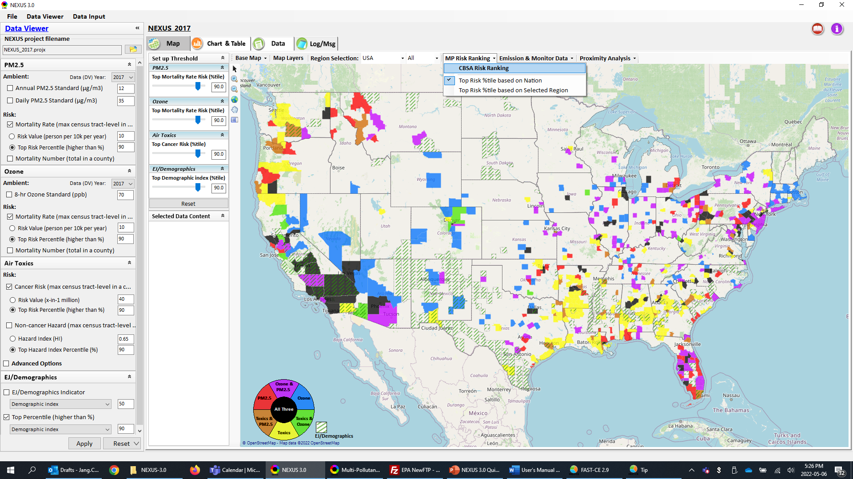
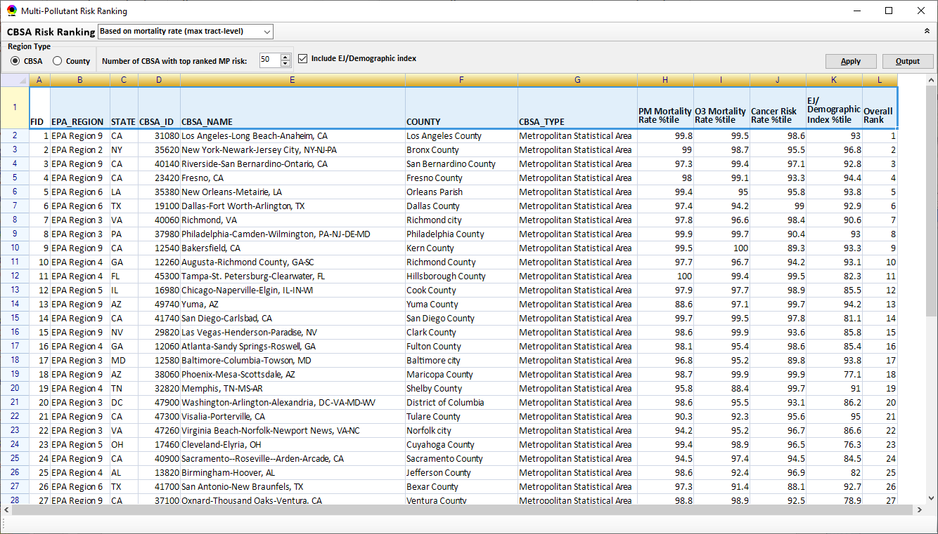
Data Viewer Module: MP Risk Ranking
Check box to include EJ/demographic index as part of CBSA ranking
Click “CBSA Risk Ranking” to provide MP risk ranking by CBSA or County
21

Slide 22
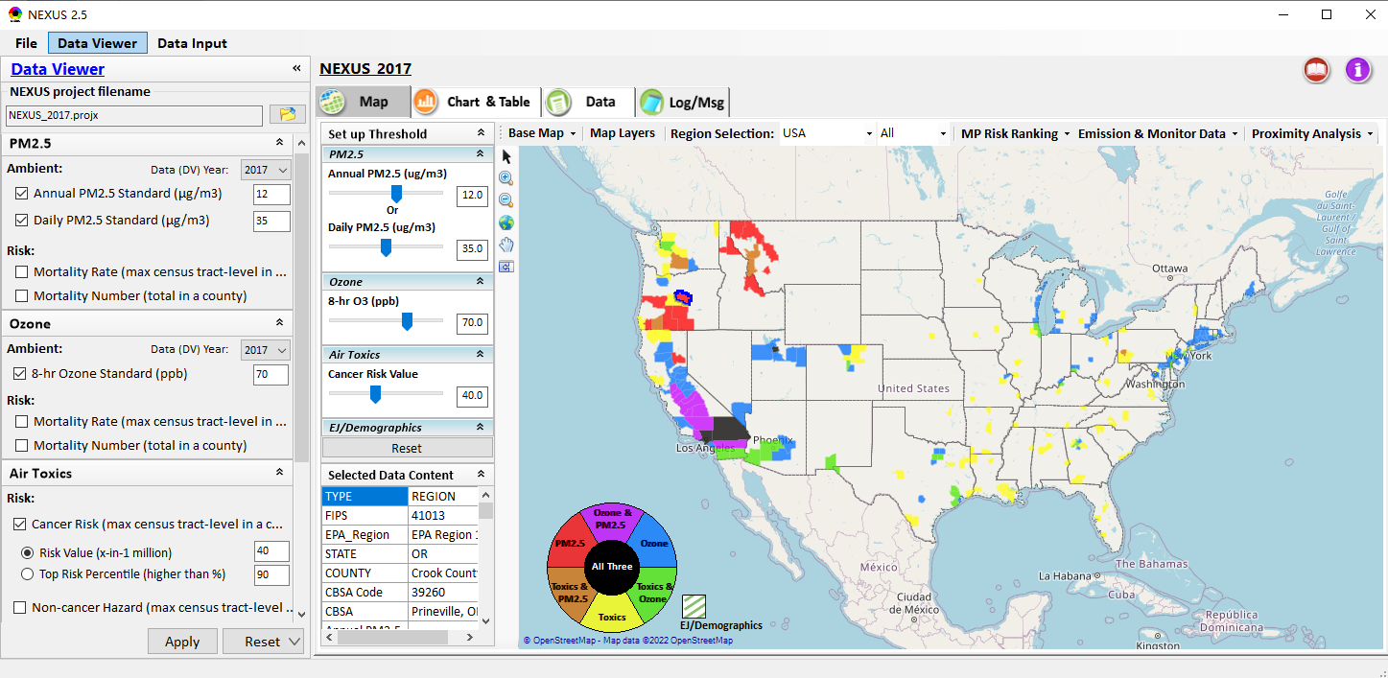
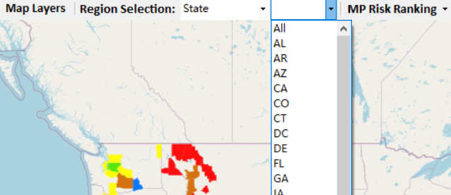
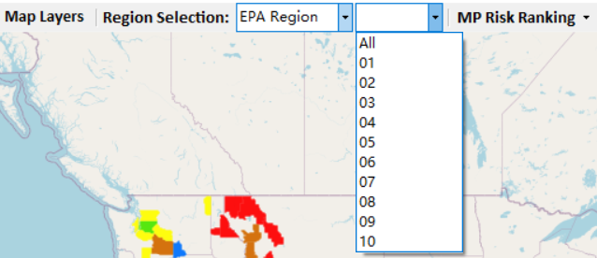
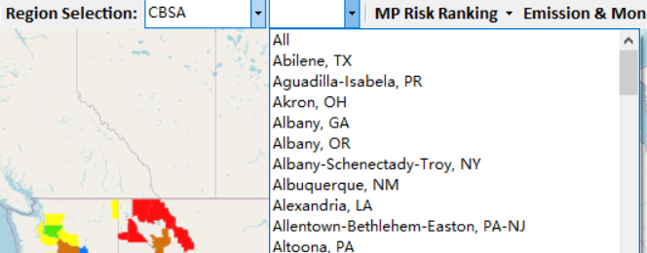
Data Viewer: “Region Selection”
Allow to select “EPA regions”, “States”, or “CBSA”
22

Slide 23
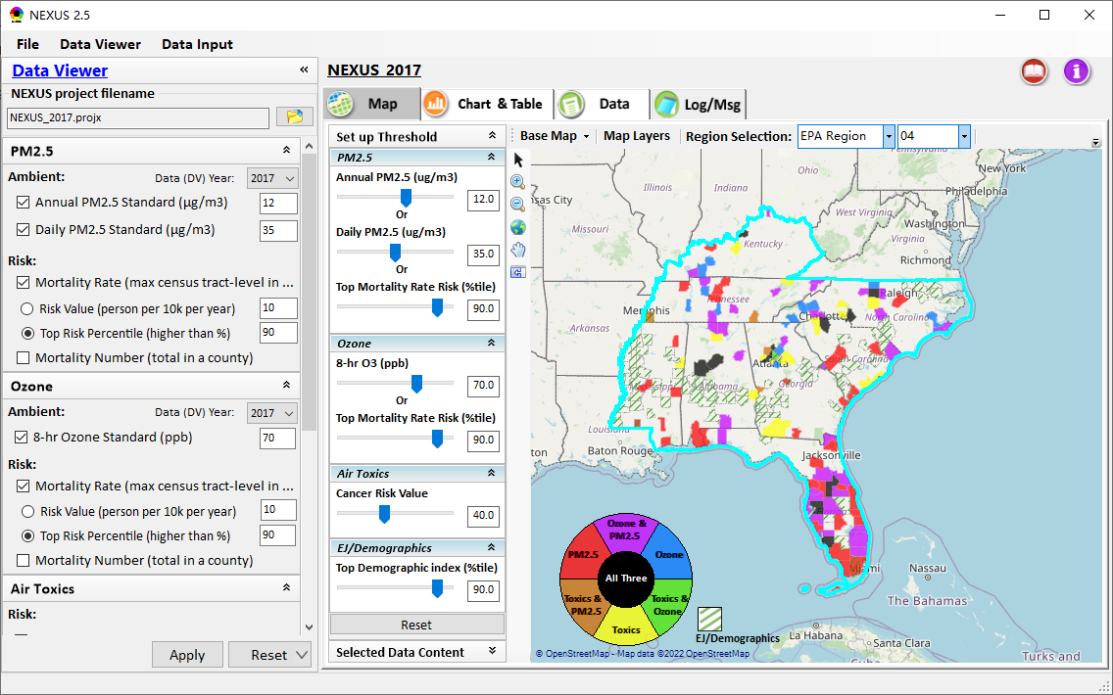
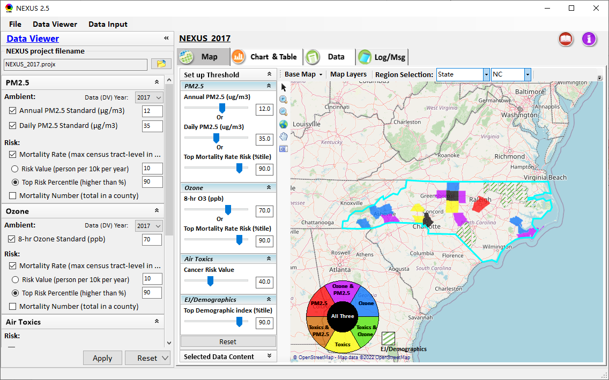
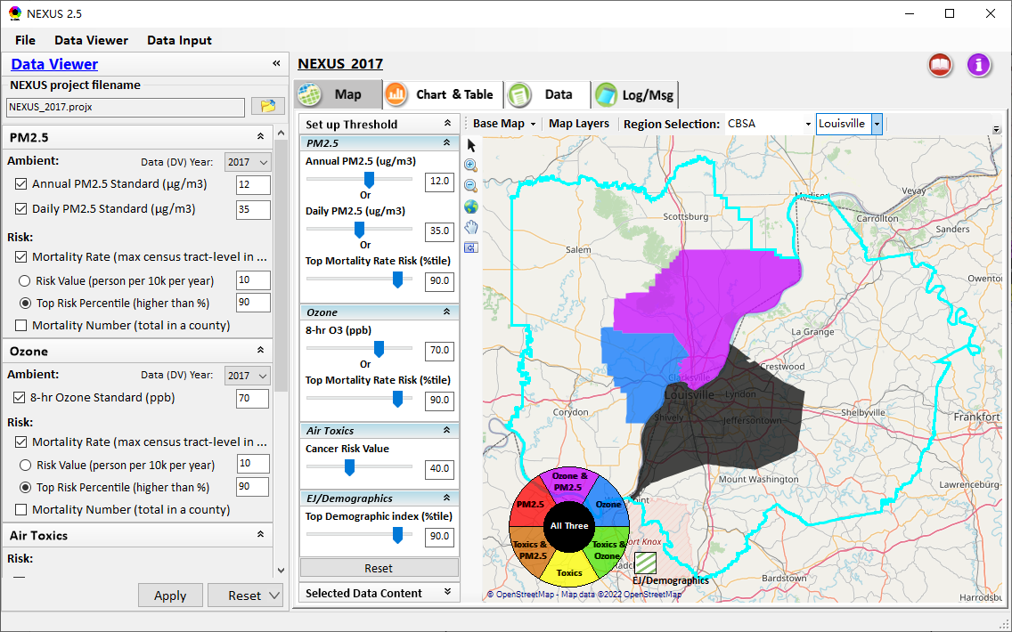
Data Viewer: Select EPA Region/State/CBSA
Examples:
EPA Region 4
State: NC
Louisville CBSA (KY/IN)
23

Slide 24
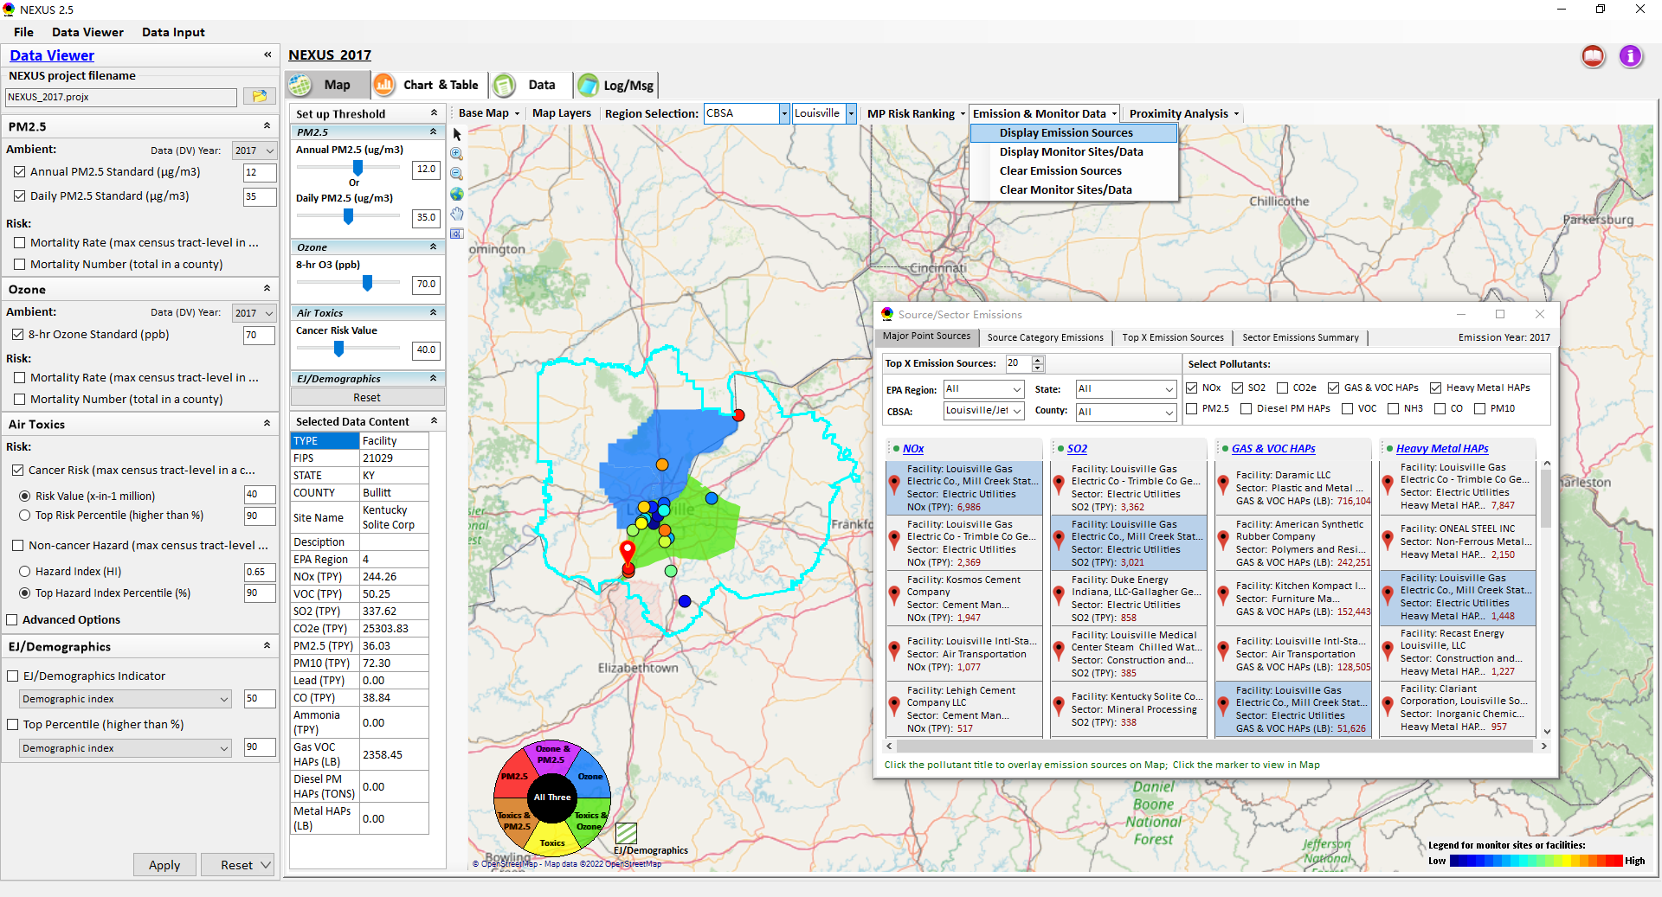
Data Viewer: Major Emission Sources
Click “Display Emission Sources” tab (or “right-click”) to display emission sources and launch new window
Click any “facility” to link & display source location and emitted pollutants information. Same facility emitting various pollutants can be identified with the same highlighted color.
24

Slide 25
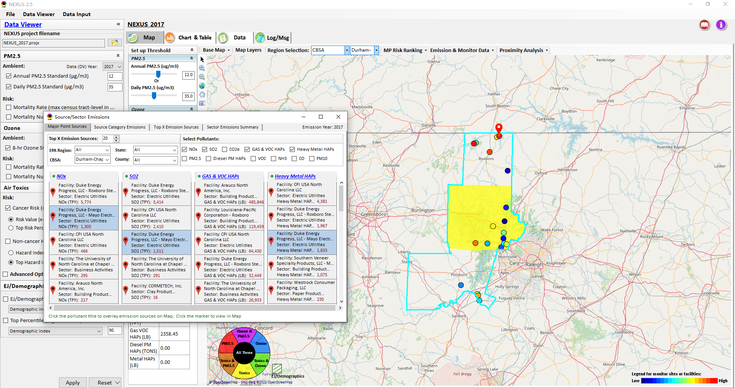
Data Viewer: Major Emission Sources
Allow to scroll down to CBSA-level (e.g., Durham CH CBSA ) or County-level
Durham CH CBSA
Emissions ranking by “color” of circles from red (higher) to blue (lower)
Color Legend for facilities emissions
25

Slide 26
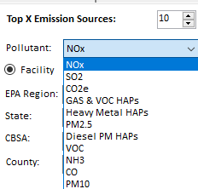
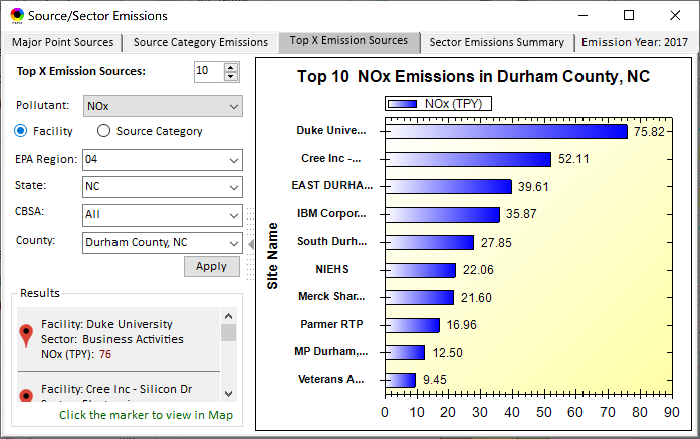
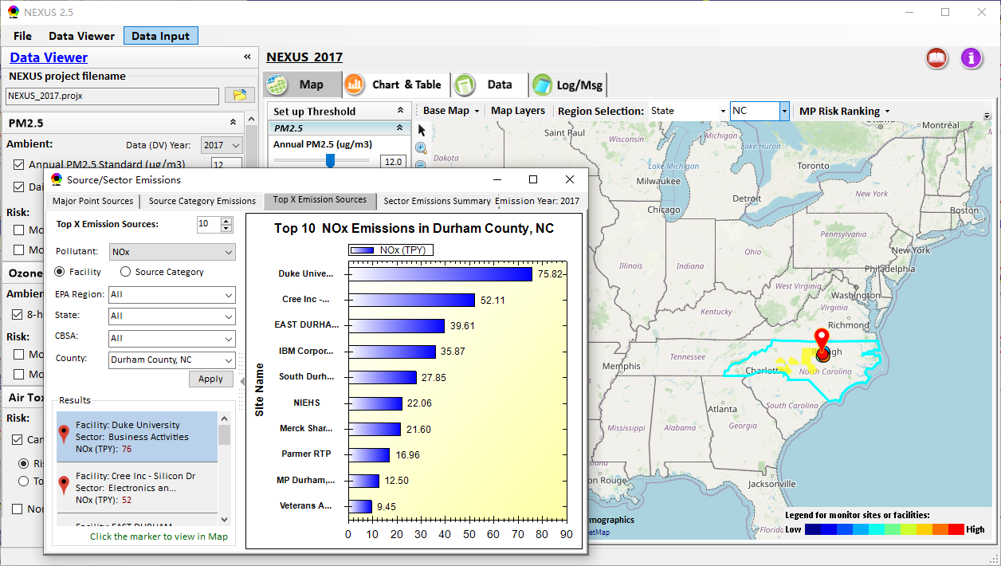
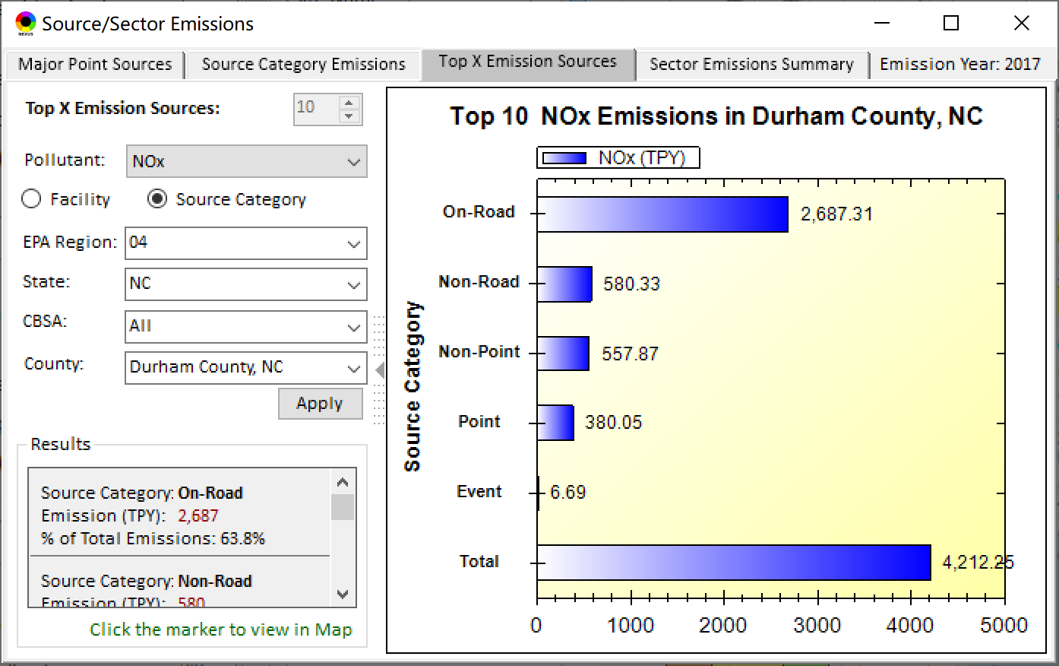
Data Viewer: Top “x” Emission Sources
Provide selection of Facility & Source Category
Provide selection of Facility or Source Category
Durham county, NC
26

Slide 27
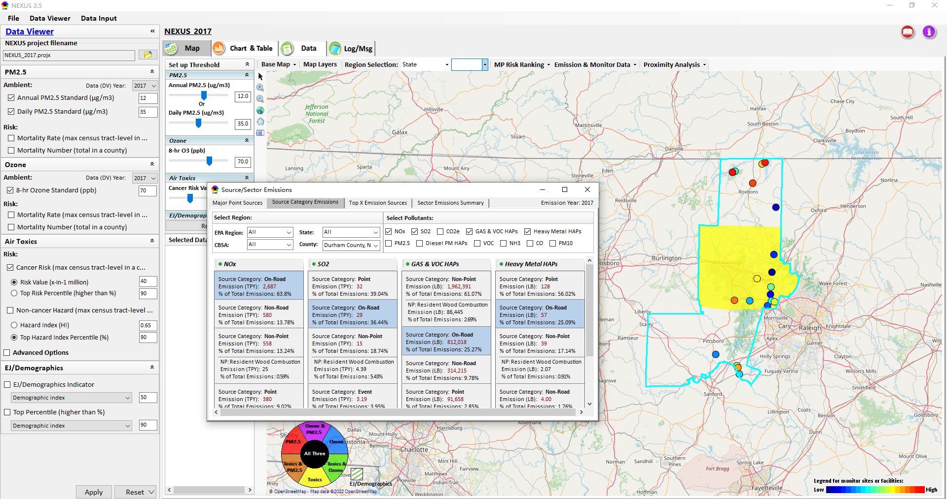
Data Viewer: “Source Category Emissions”
“Source Category Emissions” module provide five source categories, including “Point”, “Non-Point”, “On-Road”, “Non-Road”, and “Event” emissions for the selected region, CBSA, or county.
For “Non-Point”, including Resident Wood Combustion (RWC) emissions.
27

Slide 28
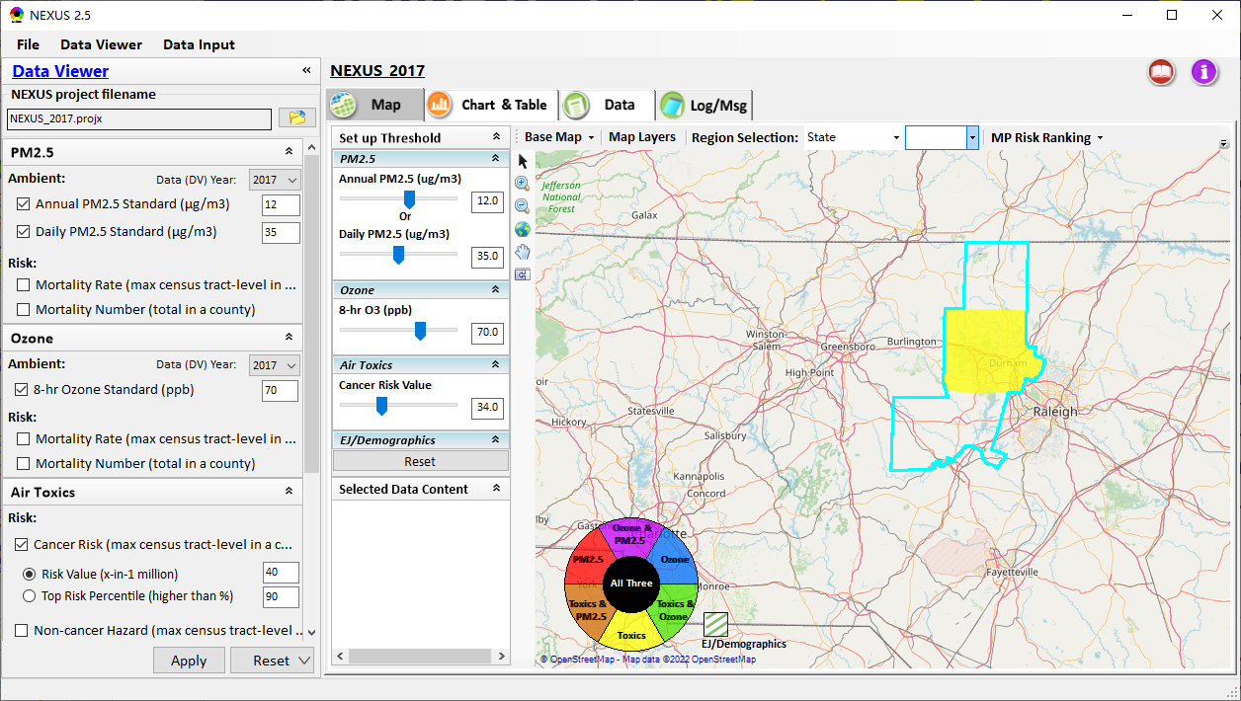
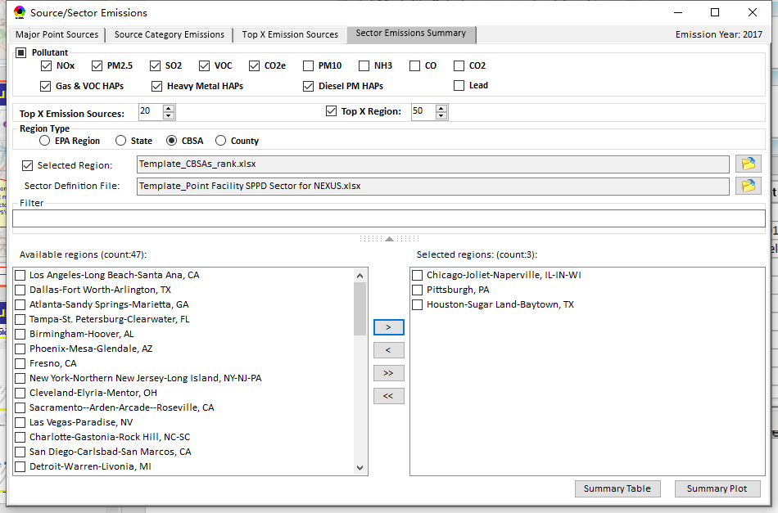
Data Viewer: “Sector Emissions Summary”
“Sector Emission Summary” function allow to select major CBSAs and provides source and sector emissions summary to support “Sector Prioritization” effort
28

Slide 29
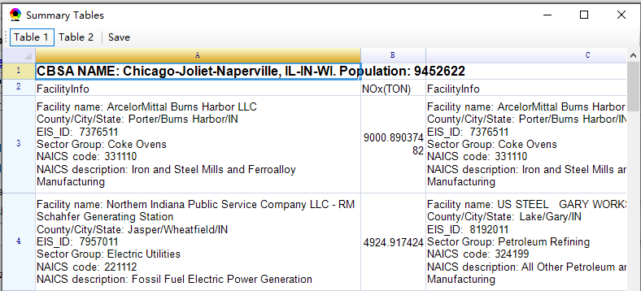
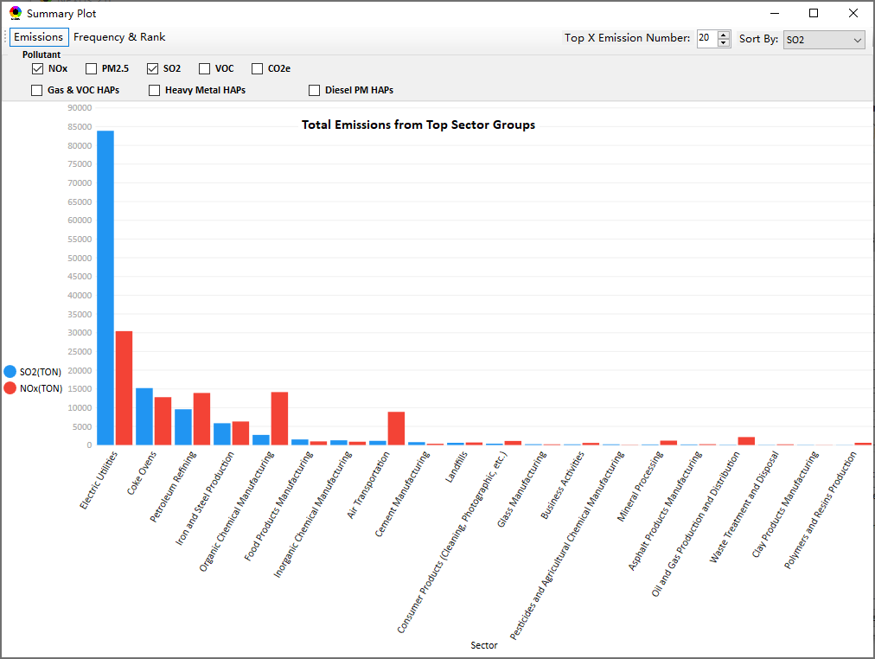
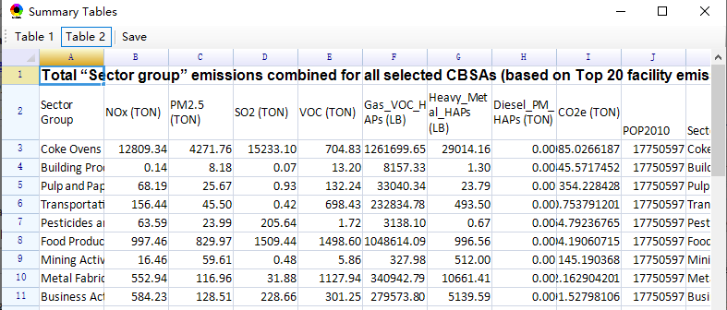
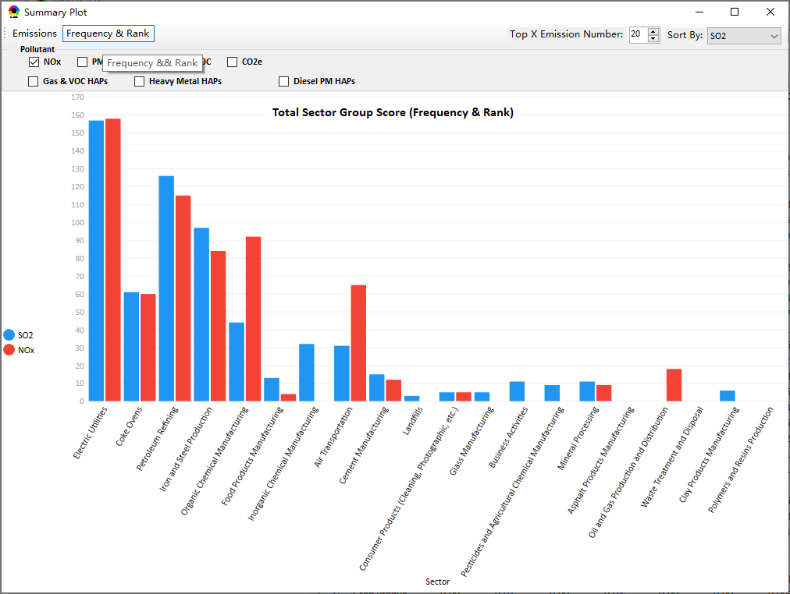
Data Viewer: “Sector Emissions Summary”
Summary table
Summary plot
Emissions
Frequency & Rank
29

Slide 30
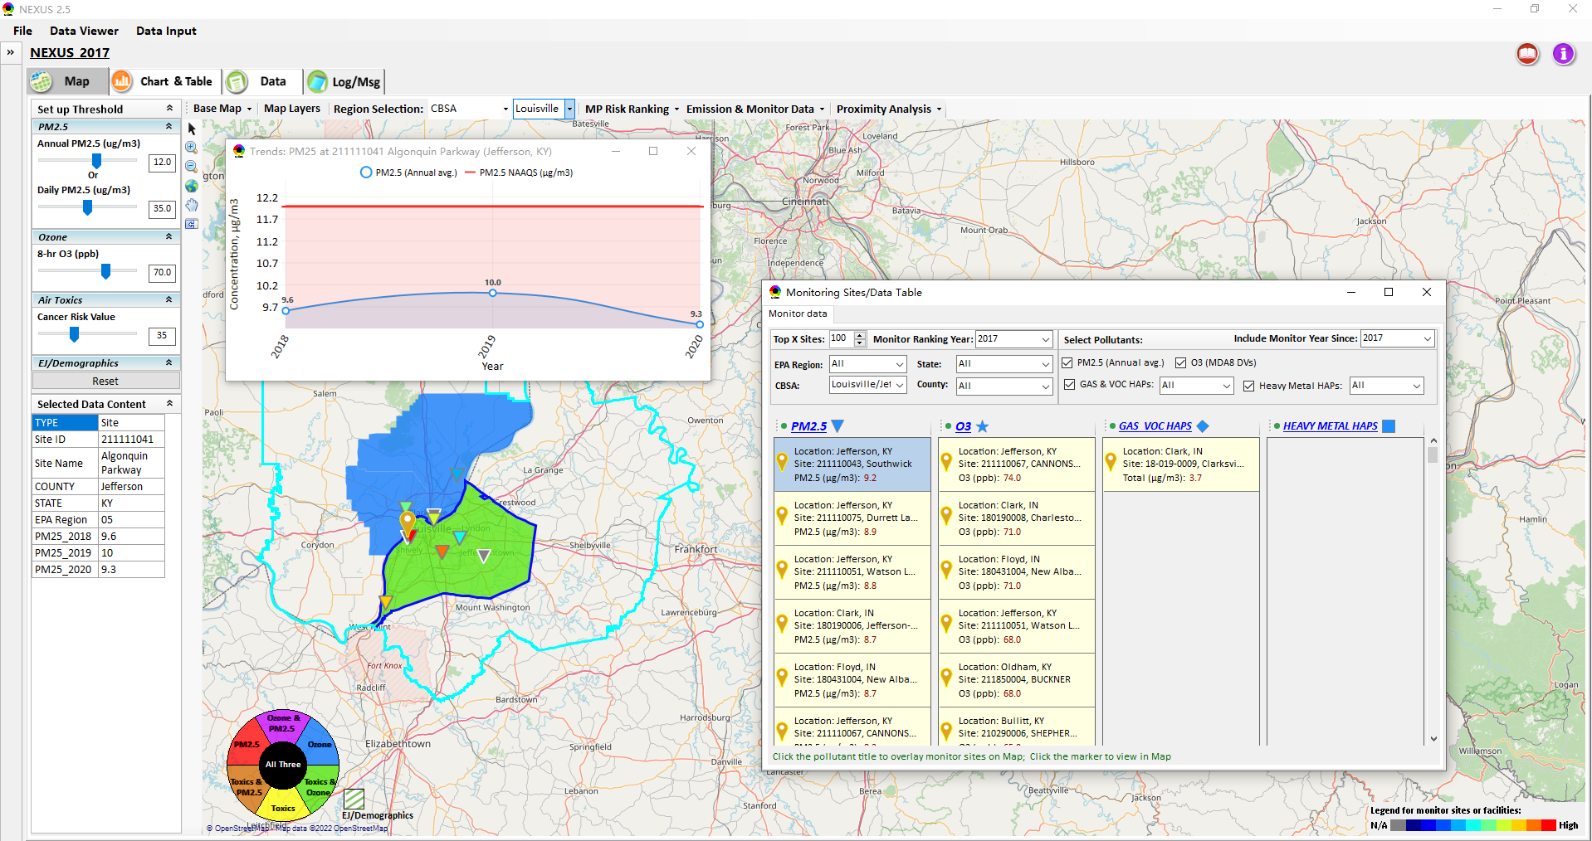
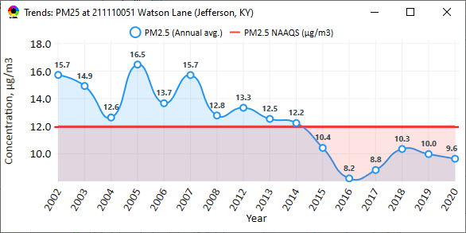
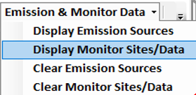
NEXUS Update: “Monitoring Data/Sites”
Click menu (or right-click) to display “Monitor Sites/Data”
List the monitor sites by ranking the data based on selected year
AQ trend
Include only those monitor sites with data since selected year
Monitor Site/Data
Click to display
AQ trend at monitor site
Use different symbol to display each pollutant’s “monitoring sites” e.g., PM_{2.5} (triangle), O₃ (star), etc.
Click to select monitor site & pollutant
Color Legend for monitor sites
30

Slide 31


NEXUS Update: “Attribute Table” (1)
“Attribute Table” provides information of “counties” displayed. This table will display “census tract” information under “Proximity analysis” module.
“Right-click” map to select “Display Attribute Table ” to launch “Attribute Table”
31

Slide 32

NEXUS Update: “Attribute Table” (2)
Provide “filter/search/export functions
Click “+” to add filters; Click “x” to remove current filter;
Click to show/hide Filter settings
Click to show selected record on map
Click a “record” to link and display its location & info.
Click “Reset” to clear all filter criteria
Show specified records per page.
Click to output data as Excel file
32

Slide 33

Data Viewer: EPA Region Table Generator
“EPA Region Table Generator” provides attainment status of O3 and PM2.5 and their DVs; also allows to select any EPA region based on data updated to 2020.
33

Slide 34

Data Viewer: Data Search & Filter
Click “+” to add filters; Click “x” to remove current filter;
Click the “Select by map” to get the information of counties which are displayed on “Map” module
Show specified records per page.
Click “Output data…” to output current page records or all records
34

Slide 35

Data Input Module: Data Preview
“Transparency” & “Open-Source”:
All NEXUS input/output data files are available under:
“This PC\Documents\My NEXUS files\Data (\Result)”
Check to use filter to query data
Select a table to view if there are multiple tables in the selected data source file
Click to change input data file
Click to view data
Click to run & save project
35

Slide 36
NEXUS update:
Proximity Analysis
Module
(Census tract-level)
36

Slide 37


Two ways navigate to Proximity Analysis Module
Click any monitor site, facility or county, and then “right-click” to select “Display Proximity Analysis”.
Or double click any monitor site or facility to launch “Proximity Analysis” module.
37

Slide 38

Proximity Analysis Module: Overlaying Map
“Set up Threshold” panel (similar to Data Viewer module) allows to identity those geographic areas exceeding the selected thresholds.
Check/un-check to display/hide overlaying map of selected metrics
Allow to select AQ mortality or morbidity risks, AQ concentration and EJ/demographic indicators and display overlaying map.
38

Slide 39
Proximity Analysis Module: Overlaying Map
Click “Reset” button to reset all values to default (or to a specified %tile if all indicators are selected in %tile)
Provide a “toggle” choice to select “Risk %tile” or “Risk value”
39

Slide 40


Proximity Analysis Module: Configure Color & Transparency
Move “Slider bar” to select desired “Radius of analysis”
Click any “color tile” to configure color legend & transparency
40

Slide 41


Proximity Analysis Module: Summary Plot & Summary Table (1)
Create “Summary Plot” and “Summary Table” for a selected census tract, monitor site or emitting facility
Summary Plot
Summary Table
41

Slide 42


Proximity Analysis Module: Summary Plot & Summary Table (2)
Summary table
Summary plot
Set “Radius of analysis” and threshold of air toxics to show summary results for selected site(s) within radius
Click to select the desired scale of highlighted numbers
Click “Output” button to export summary table to an Excel file (*.xlsx)
List top 3 risk drivers within radius of sites
Select one or more indicators to plot summary results for selected site(s) within radius, county/CBSA/State/EPA Region and Nation avg.
42

Slide 43





Proximity Analysis Module: “Select Sites” Functions (1)
Click “Select Sites” to select one or a group of monitor sites, facilities, census tracts, or user-defined locations under “Select Sites” pop-up window
43

Slide 44




Proximity Analysis Module: “Select Sites” Functions (2)
Click the “Output” button to export to an Excel file.
Include only census tracts falling within the area of specified radius, with an area ratio larger than x% (10% by default)
Select all
Click the “Create individual Sites” or “Create National Sites Table” to provide proximity analysis for individual sites
National & State avg. table
National table for all selected individual sites
44

Slide 45


Proximity Analysis Module: “Select Sites” Functions (3)
Configure
color legend:
1. Click to select the desired scale of highlighted numbers
2. Set max. & min. values and then click the “Rebuild” button to rebuild the color legend
3. Customize the numerical range for each color legend
Check/uncheck to display/ hide highlighted colors
4. Click “Apply” or “OK” button to apply new setting
45

Slide 46




Proximity Analysis Module: “Group” Summary Plot & Table
Summary plot & table for a group of census tracts, monitor sites, facilities or locations (latitude/longitude)
Summary table
①Click “Select Sites”
④Click “Summary Table” or “Summary Plot”
Select sites
② Select a group of sites
③Click “Apply”
Summary Plot
46

Slide 47


Proximity Analysis Module: Display Site information
Click a facility or monitoring site or a census tract to show the detail information
47

Slide 48
NEXUS 3.0
Quick Tutorial Slides
End
48

