Slide 1
“NEXUS” Multi-Pollutant Analysis Tool
EPA Regional APM Briefing and Live Demo
OAQPS’s Multi-Pollutant Team
November 8th, 2021

Slide 2
Overview
NEXUS Background
  Tool Development
  Expected Use
  Key Modules
  Data Inputs
  Recent and Ongoing Development
Feedback Process
NEXUS 2.0 Live Demo
2

Slide 3
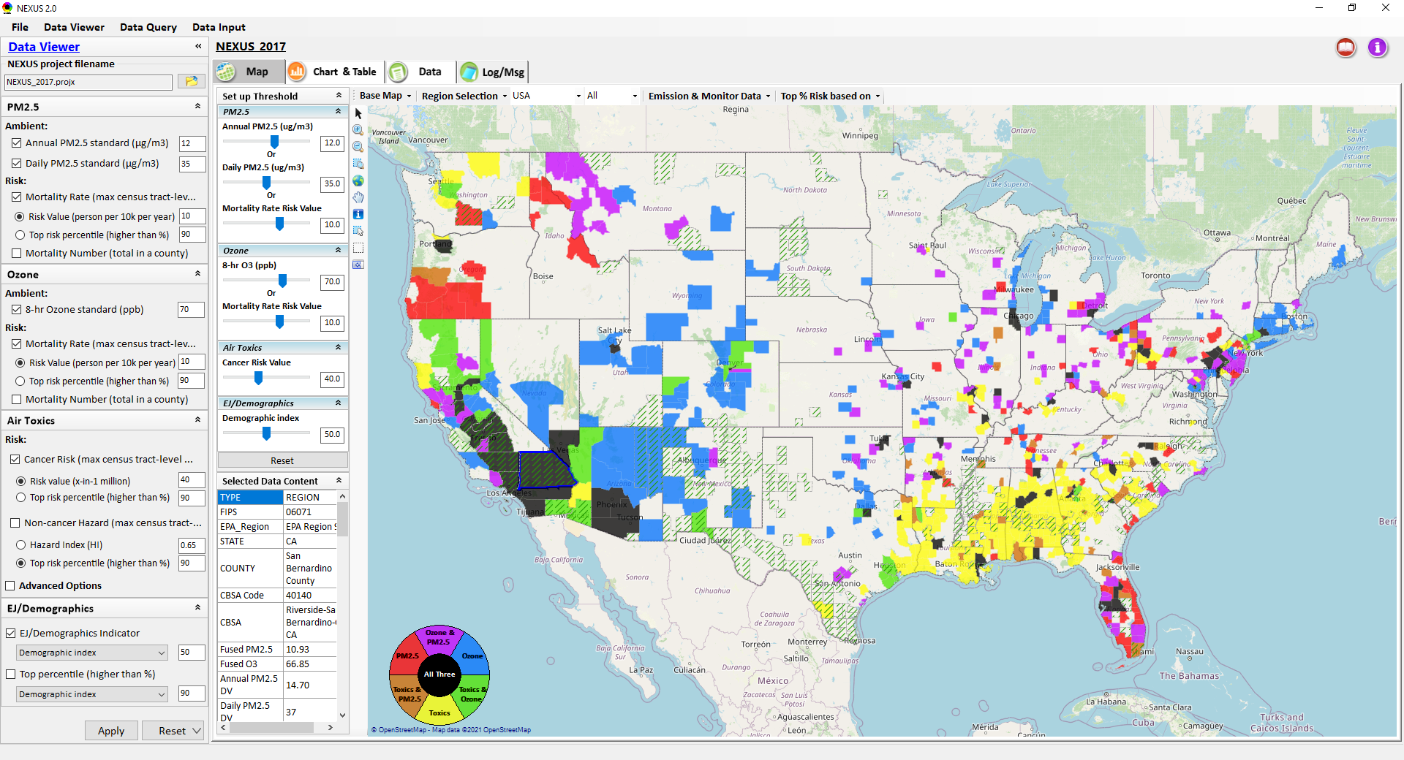
NEXUS: Tool Development
A new Multi-Pollutant (MP) Advanced Screening Tool (NEXUS) is being developed to:
Identify geographic areas where health risks related to O₃, PM_{2.5} and air toxics overlap
Characterize the nature of MP AQ issues for specific areas to consider MP AQ planning
3

Slide 4
NEXUS: Expected Use
The NEXUS tool will allow users to do the following:
  National screening to identify areas with MP issues: Phase 1 development provides ability to quickly screen areas across nation that have combination of high air quality and/or risk levels for O₃, PM_{2.5} and Air Toxics.
  Area screening to understand nature of MP problem: Phase 2 development provides ability to ‘dial-into’ specific areas to determine extent to which common emissions sources are causing the MP issues.
We expect to use this tool in conjunction with Regions and identify areas that would potentially benefit most from MP approaches to reduce emissions (including current NA areas).
The NEXUS tool will essentially provide a ‘conceptual model’ of an area’s MP issues to facilitate engagement with state/local/tribal agencies and community stakeholder groups.
We also expect that it can have additional value-added uses across the Office for Air Toxics, Environmental Justice and other programs.
4

Slide 5
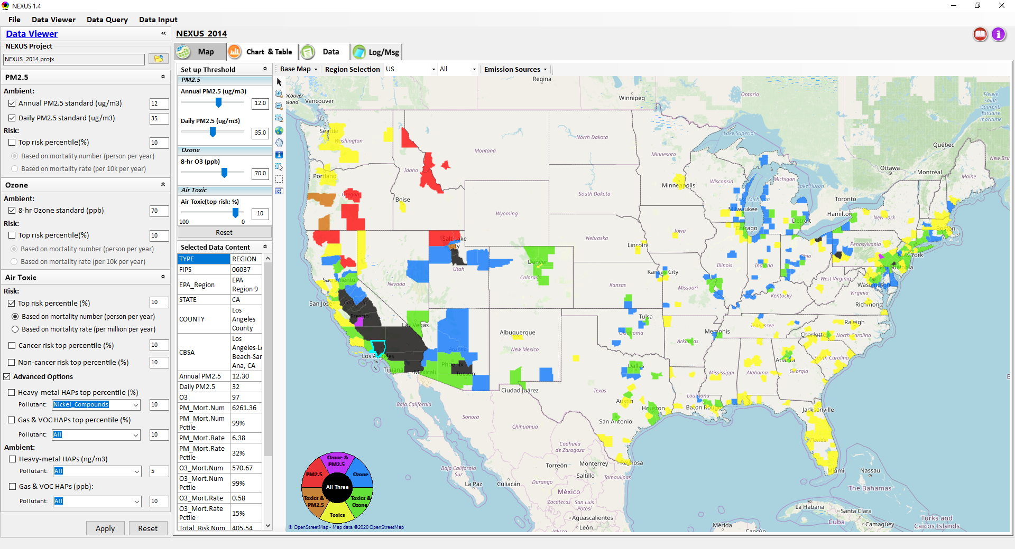
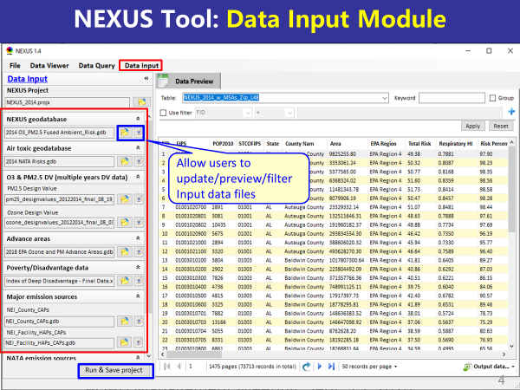
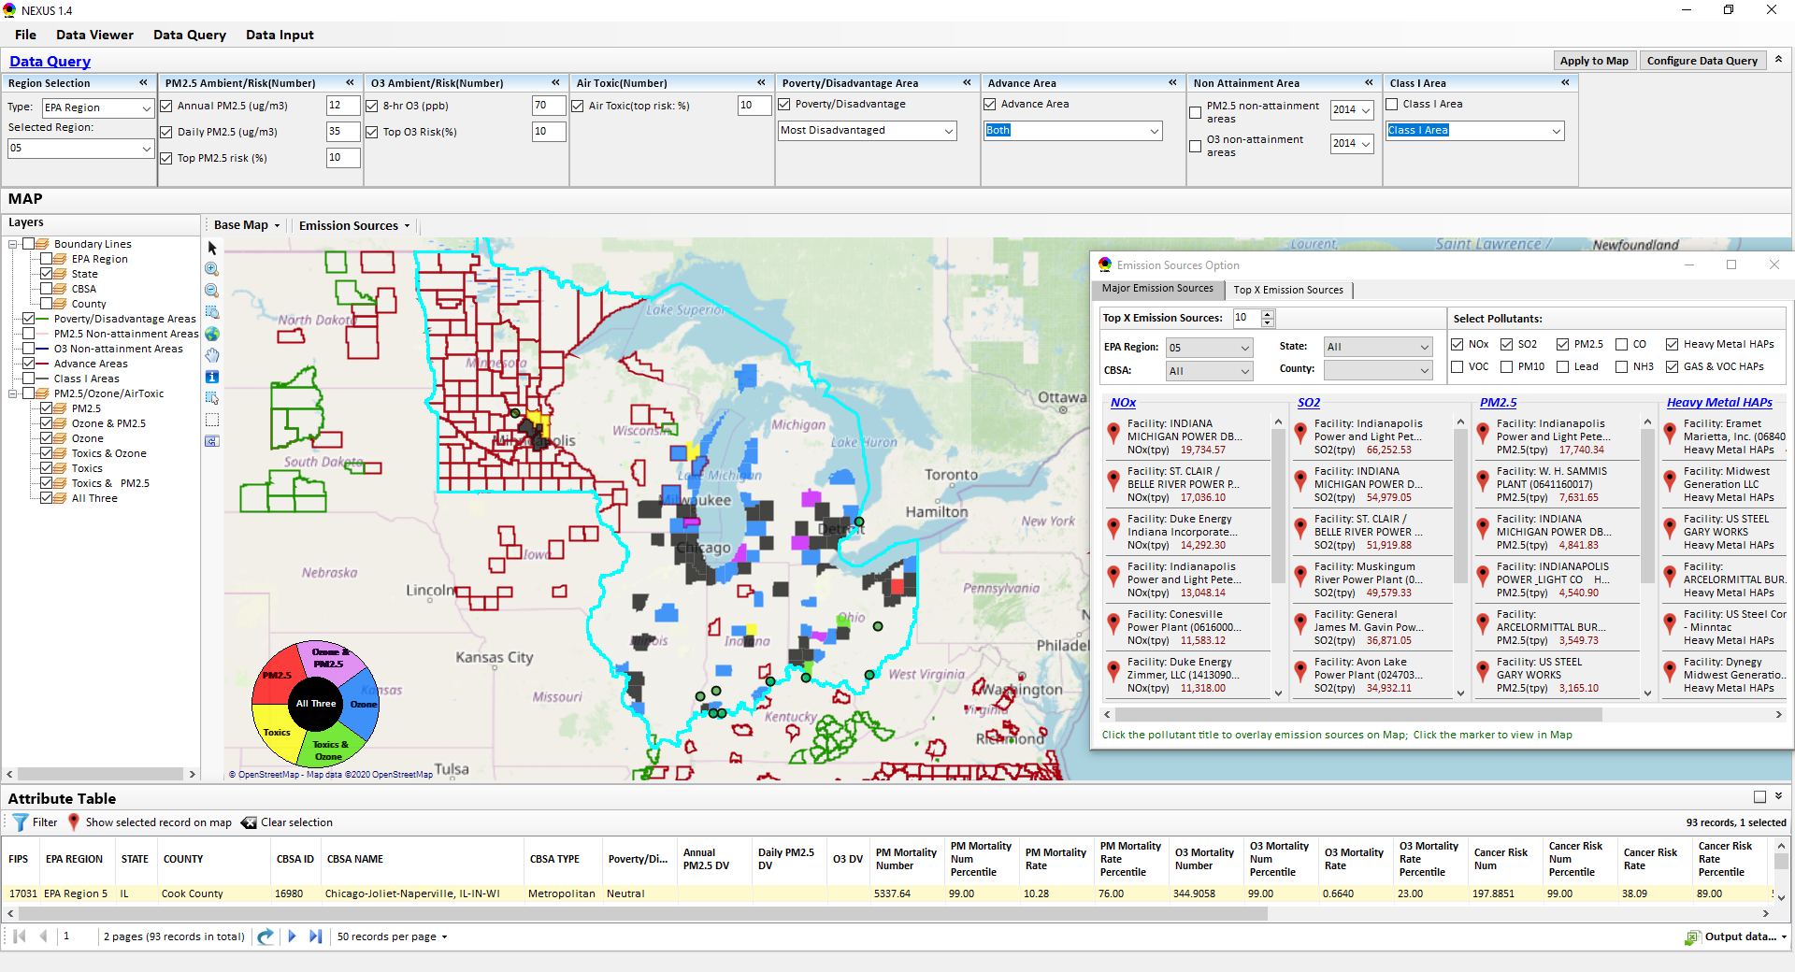
NEXUS: Three Key Modules
Data Viewer Module
Data Input Module
Data Query Module
View and create interactive Map/Data/Chart/Table
Provide flexible selections & mapping of “Ambient” and/or “Risk” levels of PM_{2.5}, O₃ and Air Toxics
Provide regional analysis for “EPA region”, “States”, “CBSA”, and “County”
Display major point emission locations and monitoring sites/data by pollutants
Integrate all MP data - emissions, monitoring, modeling, health risk, and EJ/demographic data into a single platform
Currently use10 publicly available input datasets
Provide data preview, search, filter and output functions
Allow to update/change input data files and then run/save to a new “project”
Expand data field selections and flexibility for exploratory & advanced users
Provide map overlaying and summary table for data query results
Current data query based on selected data fields: “Ambient & Risk for PM, O3 & Air toxics”, “EJ/demographic indicator”, “Advance area”, “NA Area”, “Tribal area”, Class I area”
5

Slide 6
NEXUS 2.0: Input Data Files and Sources
Input Data Files | Data Format | Data Description | Data Source | Data Period
“O₃ & PM_{2.5} Ambient and Risk” | Excel | O₃/PM_{2.5} fused ambient conc & risk data at county/census tract level | from OAQPS MP & BenMAP team | 2017
“Air Toxic Ambient and Risk” | Geodataset | Air toxics fused ambient conc & risk data at county/census tract level | from OAQPS MP & Air Toxic team | 2014*
“O₃ & PM_{2.5} Design Values” | Excel | O₃ & PM_{2.5} design values at county level | From EPA public website: https://www.epa.gov/air-trends/air-quality-design-values | 2012 to 2020
“NEI County Emissions” “NEI Facility Emissions” | Excel | County-level and facility source emissions of CAPs, HAPs & GHGs | From OAQPS public website: https://www.epa.gov/air-emissions-inventories/2017-national-emissions-inventory-nei-data | 2017
“O₃ & PM_{2.5} monitoring data | Excel | O₃ & PM_{2.5} monitoring data (DVs) | From OAQPS public website: https://gispub.epa.gov/arcgis/rest/services/OAR_OAQPS | 2002 to 2020
“Air Toxic monitoring data” | Excel | Air toxics monitoring data (22 HAPs) | From OAQPS public website: https://www.epa.gov/amtic/amtic-air-toxics-data-ambient-monitoring-archive | 2003 to 2018
EJ/Demographics data | Geodataset | Demographic indicators (7) from EJSCREEN | from EJSCREEN: https://www.epa.gov/ejscreen/download-ejscreen-data | 2020
“Advance areas“ | Geodataset | O₃ & PM_{2.5} Advance Areas | from OAQPS MP team | 2021
“Class 1_Areas” | Geodataset | EPA Class 1 Federal Areas | From EPA Class 1 Federal Areas Website: https://edg.epa.gov/data/public/OAR/OAQPS/Class1/Class1Areas.zip | 2016
“Tribal Areas” | Geodataset | EPA Tribal Areas | From EPA public website: https://edg.epa.gov/data/Public/OEI/OIAA/Tribes/EPAtribes.zip | 2018
* Will be updated to 2017 by end of 2021
6

Slide 7
NEXUS: Recent & Ongoing Development
NEXUS “1.5” (Jan. 2021) → NEXUS “2.0” (Sep. 2021)
  New/revised Metrics (PM_{2.5}, O₃, Air Toxics + EJ/Demographics as 4th metric)
  New/updated data inputs and functions:
    EJ/Demographic data (from EJSCREEN)
    Tribal areas, Advance areas, Attainment/DVs data, etc.
    2017 emissions data (including GHG & Sector mapping) (updated from 2014)
    “Sector Emissions Summary” module to support “Sector prioritization” effort
    “Source Category Emissions” module (point, non-point, on-road, non-road, event)
    Monitoring sites/data (PM_{2.5}, O₃ and Air Toxics)
Near-term (Ongoing) Updates/Improvements
  Updating to 2017 fused PM_{2.5} & O₃ and health risk data (Nov.) and fused air toxics and risk data (Dec.) from current 2014 data
  Developing “Proximity analysis for MP risks and EJ” module (Dec.)
7
Notes:
Carey and his team have a lot of updates they have recently completed or that are in the queue for the near future
In general, we have been working to update fused surfaces, emissions, and risk data from 2014 to 2017
We have added in new data inputs and functions, including EJ/demographic data, GHG emissions, and monitoring site information
And in the coming months, development of a proximity analysis module will be completed, and I have an example of what that may look like on the next slide

Slide 8
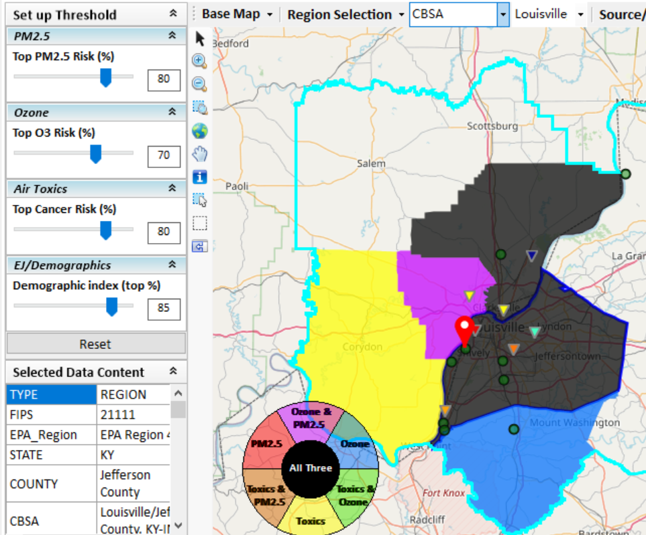
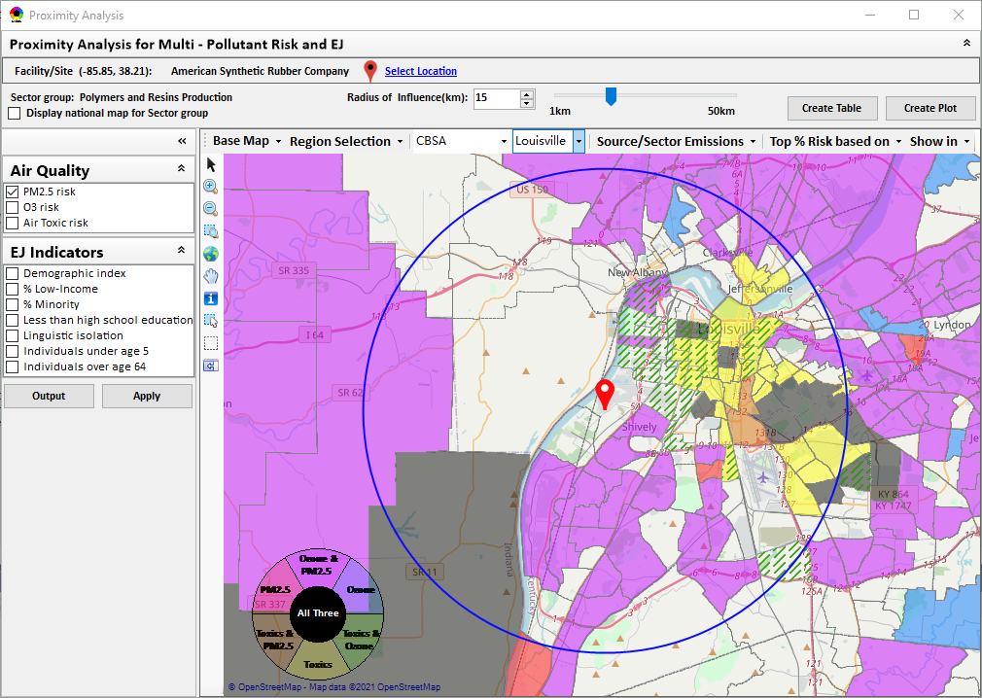
New “Proximity Analysis” Module (under development)
Currently in NEXUS
Proximity Analysis for MP Risks and EJ
County – level (current)
Community (Census Tract) - level
8

Slide 9
Regional Office Feedback Process
Feedback Process
Feedback Requested
Download, install and explore NEXUS 2.0 https://gaftp.epa.gov/Air/aqmg/cjang/NEXUS/NEXUS 2.0/
Provide feedback / questions / concerns to Beth Landis (landis.elizabeth@epa.gov) and Carey Jang (jang.carey@epa.gov) by January 21, 2022
Suitability for air quality planning efforts and engagement with SLTs
Interest in a region-specific discussion regarding NEXUS use
Suggested improvements in NEXUS regarding data, visualization, screening capabilities, etc.
Any errors/bugs/concerns
9

Slide 10
“NEXUS 2.0” Demo
Download “NEXUS” tool at: https://gaftp.epa.gov/aqmg/cjang/NEXUS/NEXUS 2.0/*
Carey Jang
OAR/OAQPS/AQAD/Air Quality Modeling Group, November 2021
10

Slide 11
“NEXUS 2.0”:
Quick Tutorial
Appendix
Download “NEXUS” tool: The “NEXUS 2.0” package (“NEXUS 2.0 Setup.exe” & “NEXUS 2.0 Data.exe”: run both “*.exe” files to install) can be downloaded at EPA’s new FTP site:
https://gaftp.epa.gov/aqmg/cjang/NEXUS/NEXUS 2.0/*
Note: Require software installation privilege or “Power Broker” (limited elevated privilege) to install “NEXUS tool” at EPA’s PC; Check “This PC\Documents\My NEXUS files\data\* (\tool\*, \result\*)” to see if NEXUS program & input dataset are installed successfully
11

Slide 12
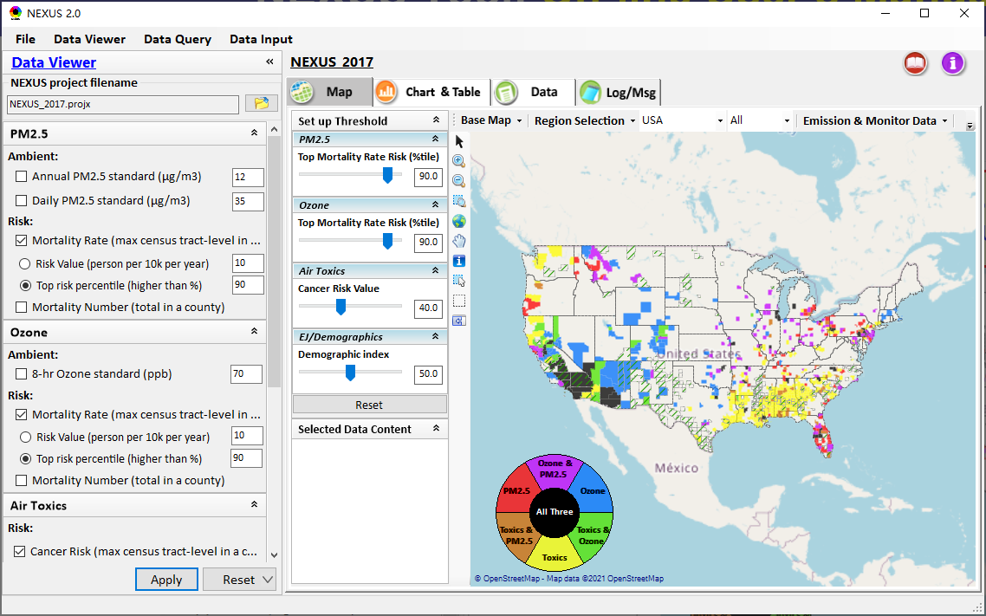
NEXUS Tool: On-line User’s Manual
Click “book” icon to launch “User’s manual”
Hot link to User’s manual’s “Data Viewer” chapter (same for “Data Input” module & “Data Query” model)
12

Slide 13
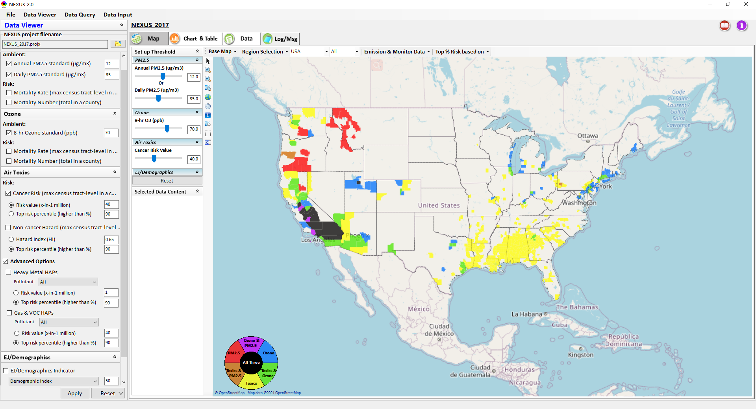
NEXUS Tool: Data Viewer Module
Click “File” to open or save a project
Switch between 3 key modules
NEXUS project file name
Select & adjust “Ambient” or “Risk” levels
“Advanced Option”: provide HAPs & species selections
13

Slide 14
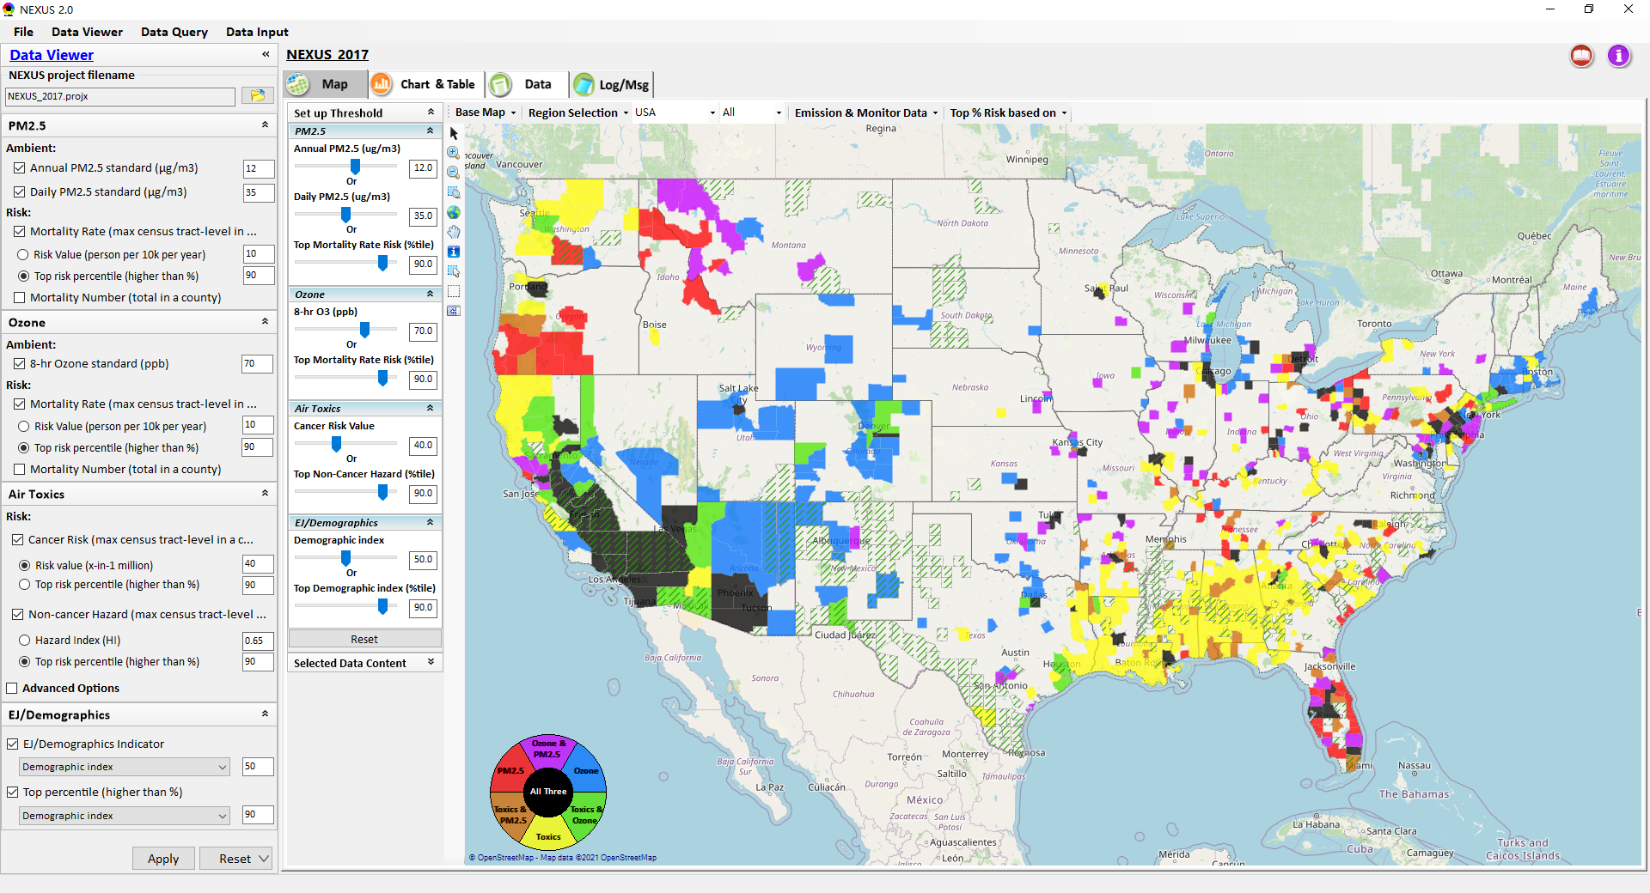
Data Viewer: “Apply” New Selections
“Check” boxes to change/add selections
New selections will appear in “Slider bars” panel and map display
“Slider bars” allow to select & adjust “Ambient” and/or “Risk” threshold levels and displaying color map
“Apply” new selections
14

Slide 15
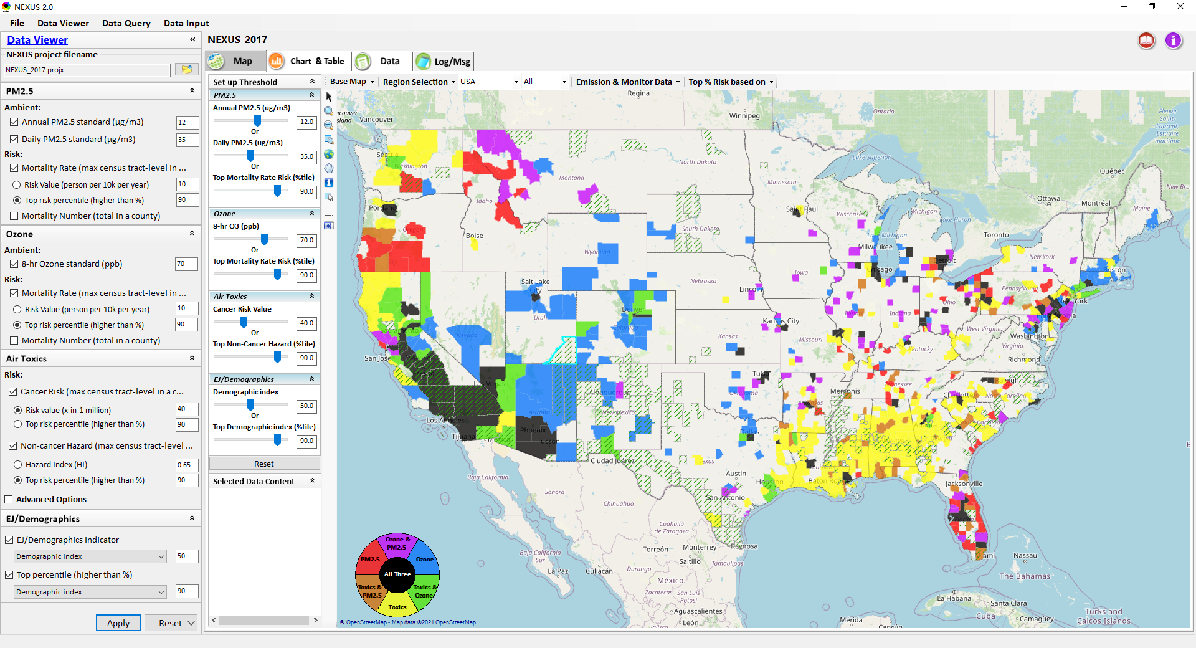
NEXUS Update: New EJ Metric and Data
New EJ/Demographic metric is added to display in “Green dash” for counties exceeding selected threshold
15

Slide 16
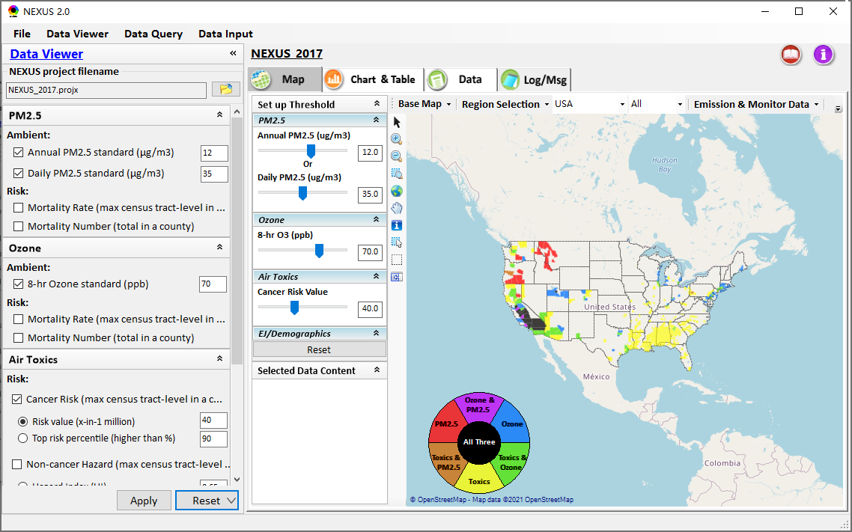
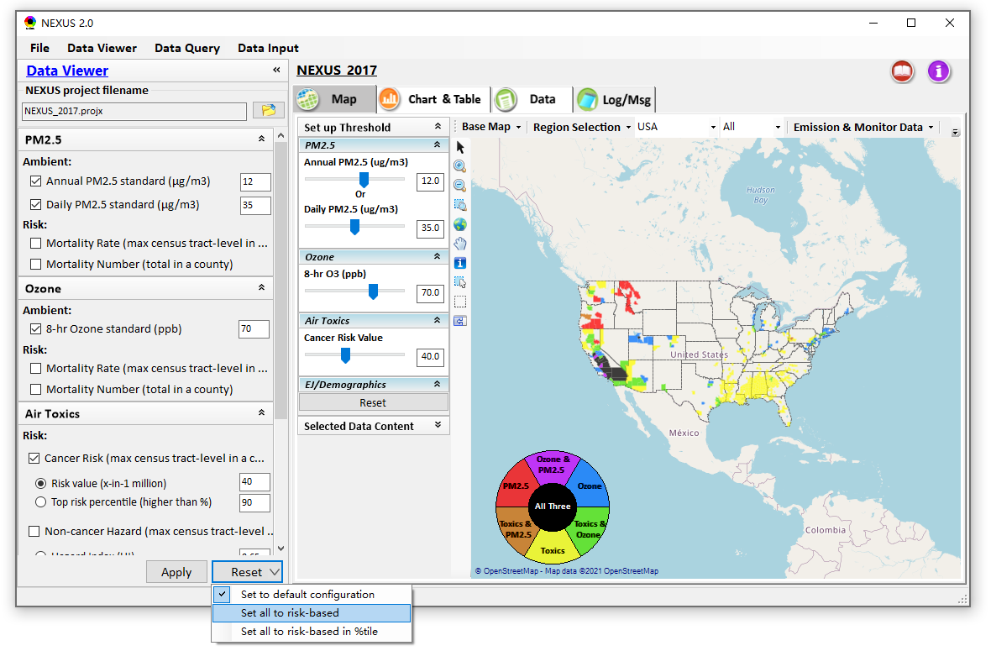
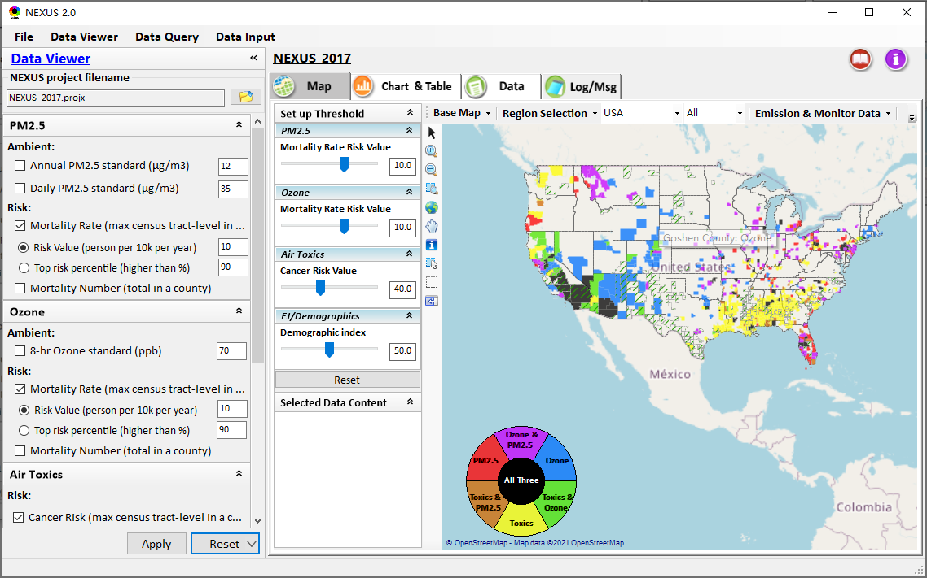
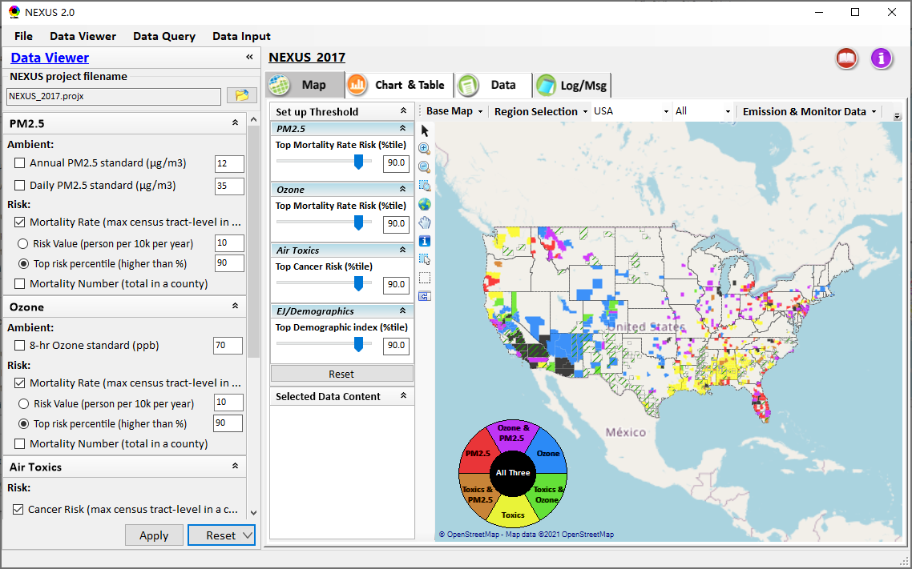
Data Viewer: “Reset” New Selections
default configuration
risk-based
“Reset” new selections
risk-based in %tile
16

Slide 17
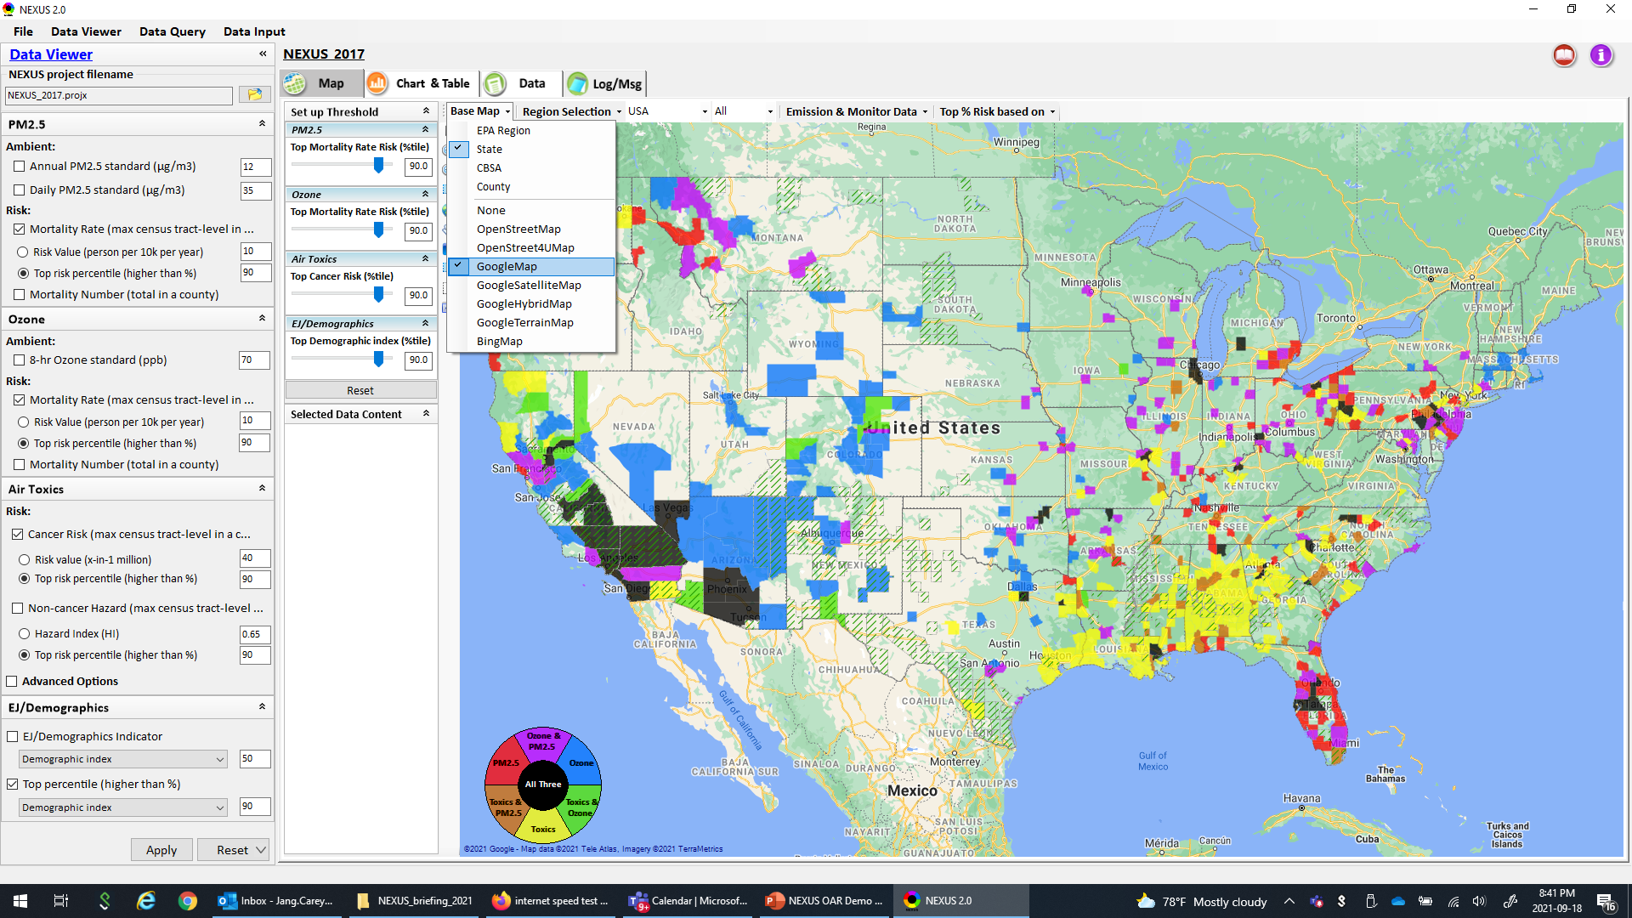
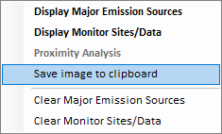
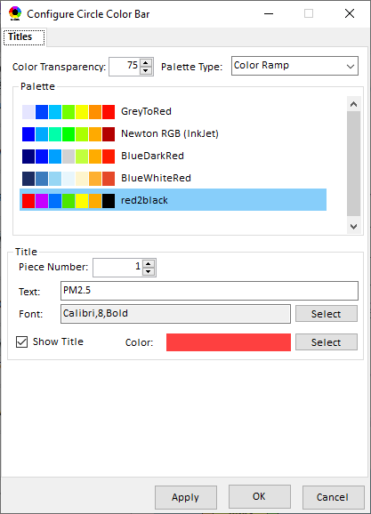
Data Viewer Module: Configure Base Map & Color
“Base Map”: Change boundary lines and background map (e.g., “Google Map”)
“Right-click” map to save map image
Click “color map” to change color & transparency
17

Slide 18
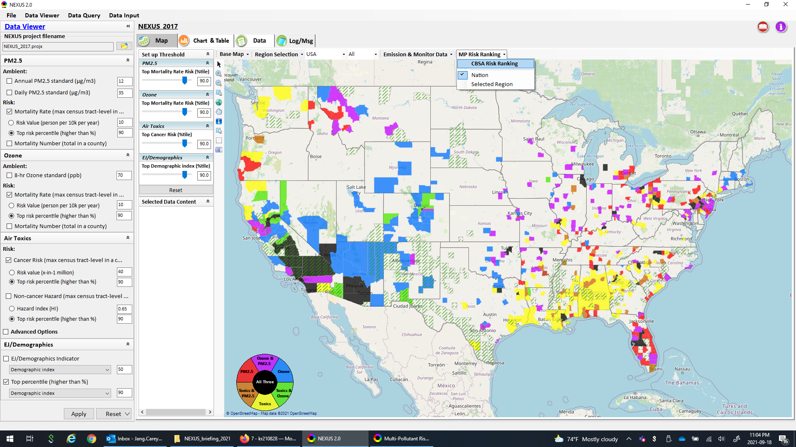
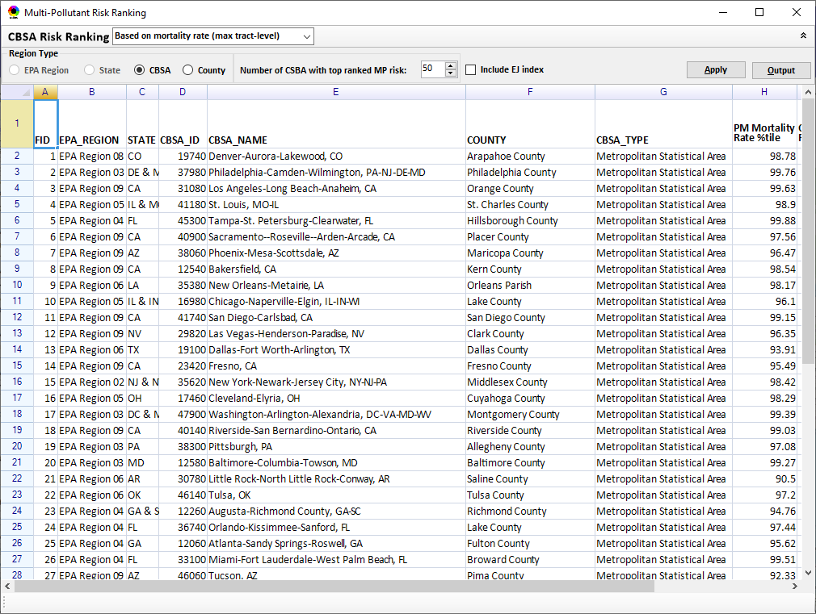
Data Viewer Module: MP Risk Ranking
“CBSA Risk Ranking”: provide MP risk ranking by CBSA or County
18

Slide 19
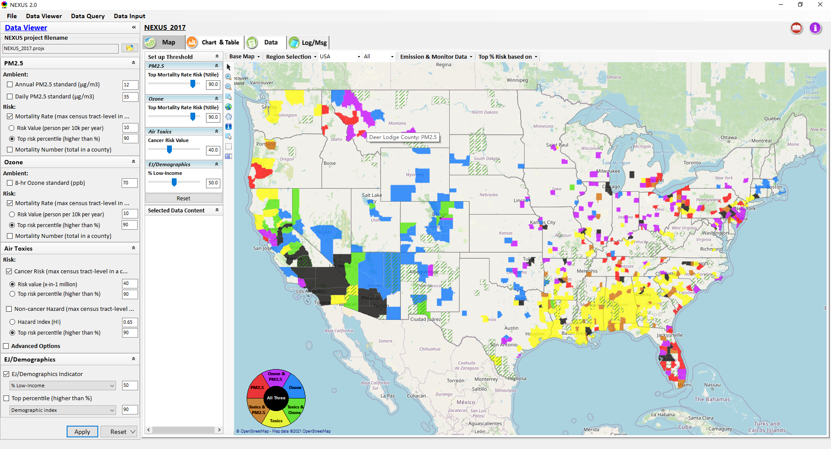
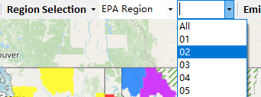
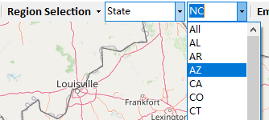
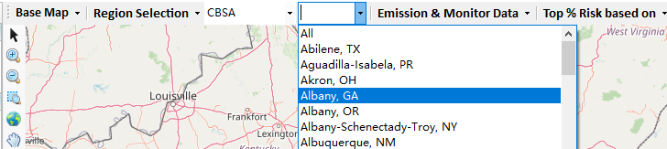
Data Viewer: “Region Selection”
Allow to select “EPA regions”, “States”, or “CBSA”
19

Slide 20
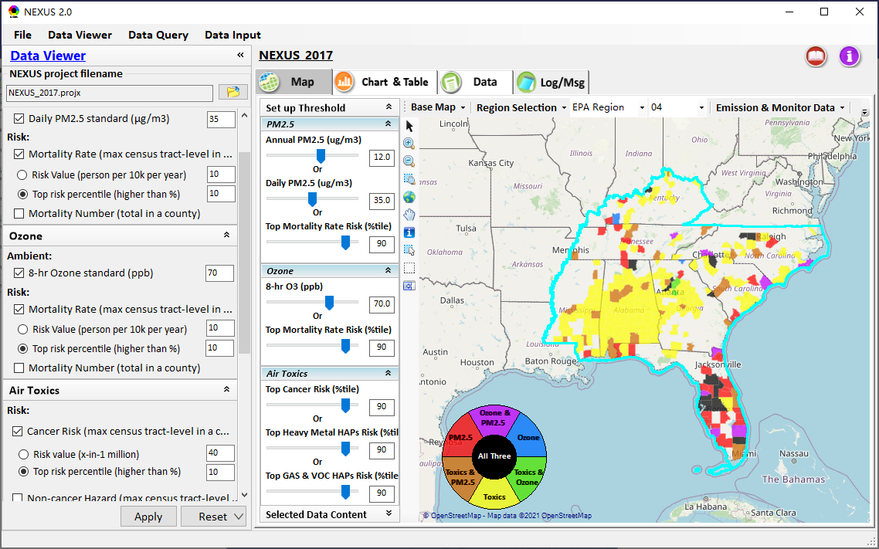
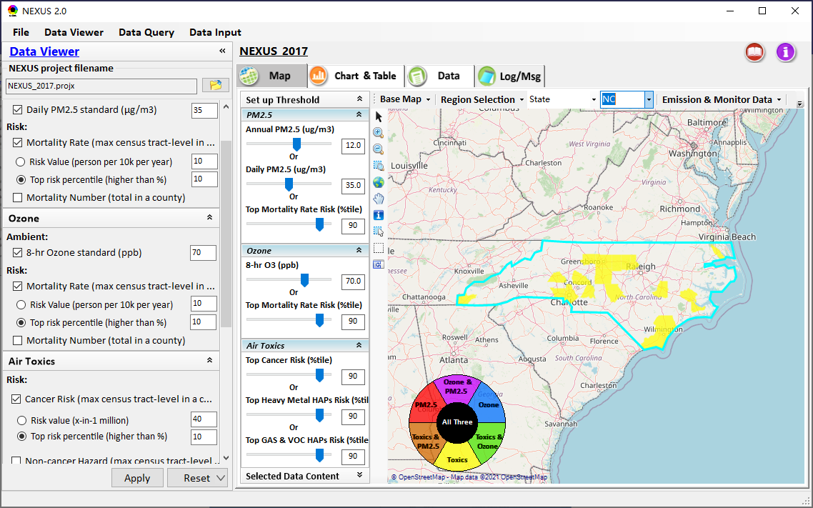
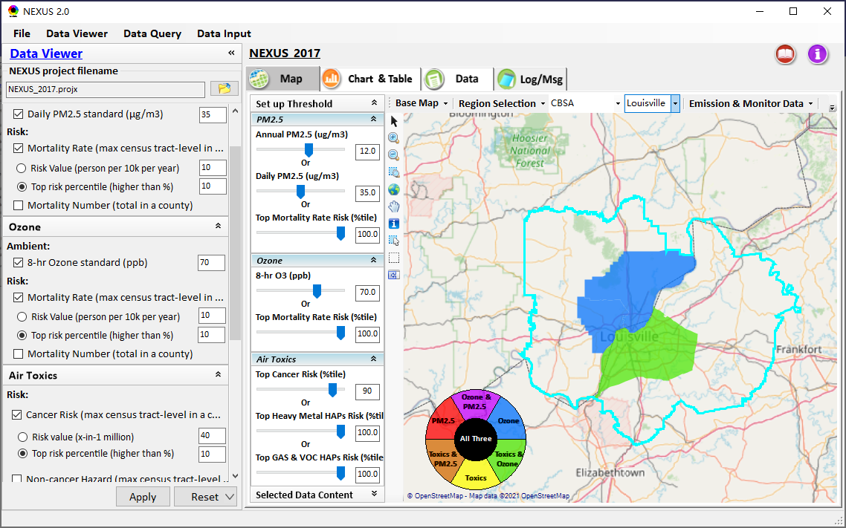
Data Viewer: Select EPA Region/State/CBSA
Examples:
EPA Region 4
NC State
Louisville CBSA
20

Slide 21
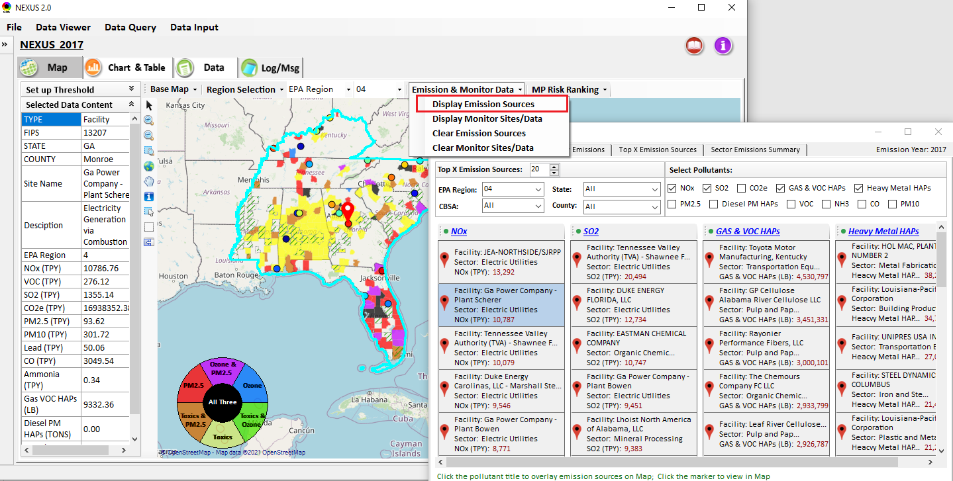
Data Viewer: Major Emission Sources
Click “Display Emission Sources” tab to display emission sources and launch new window
Click any “facility” to link & display source location and emission information. Same facility emitting various pollutants can be easily identified with the highlighted color
21

Slide 22
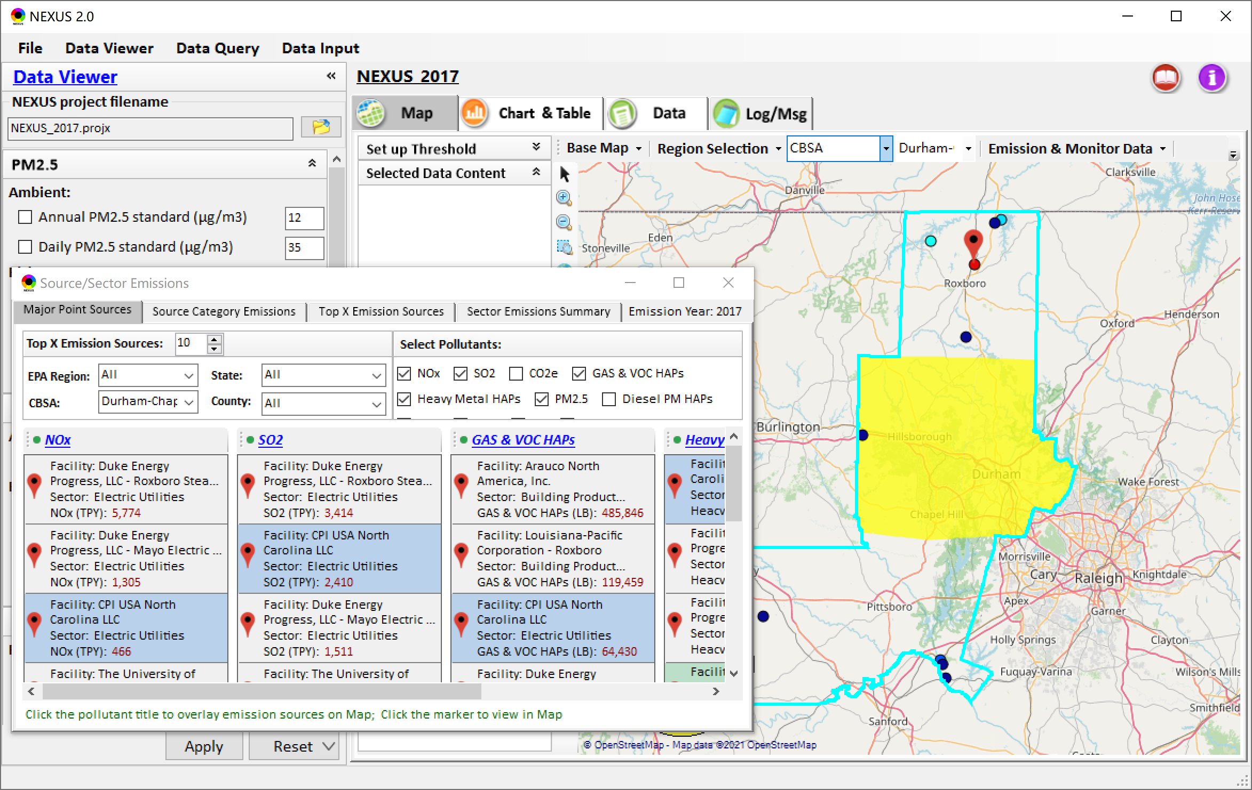
Data Viewer: Major Emission Sources
Allow to scroll down to CBSA-level (e.g., Durham CH CBSA ) or County-level
Durham CH CBSA
22

Slide 23
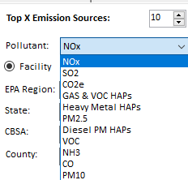
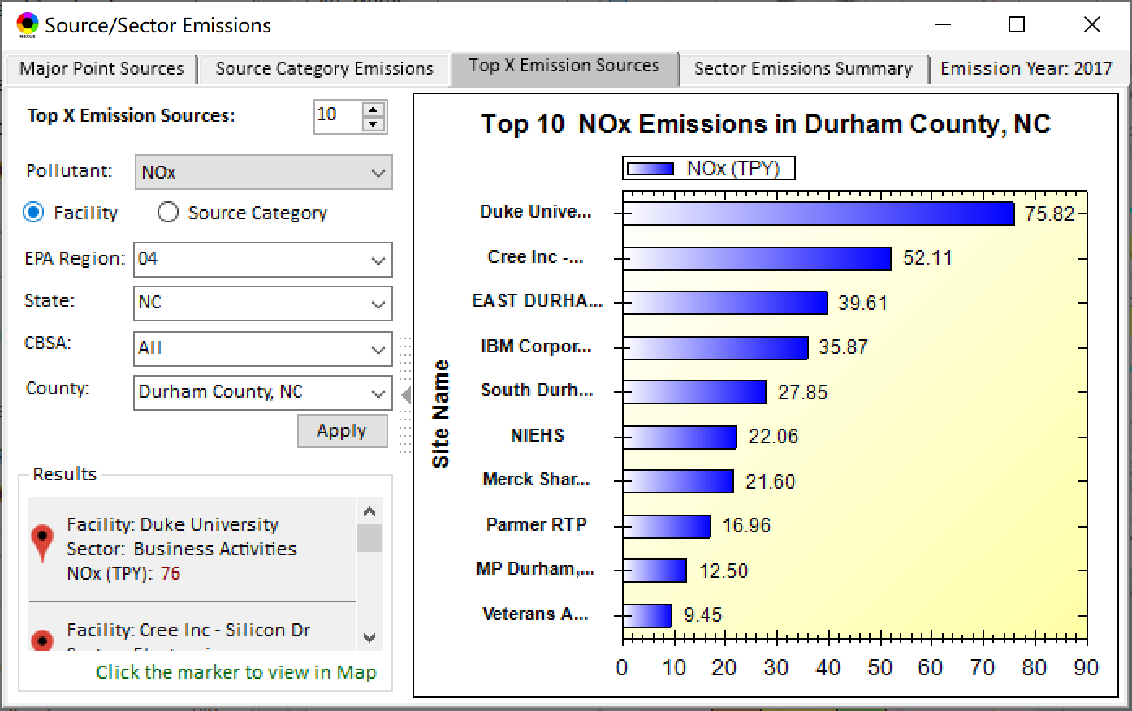
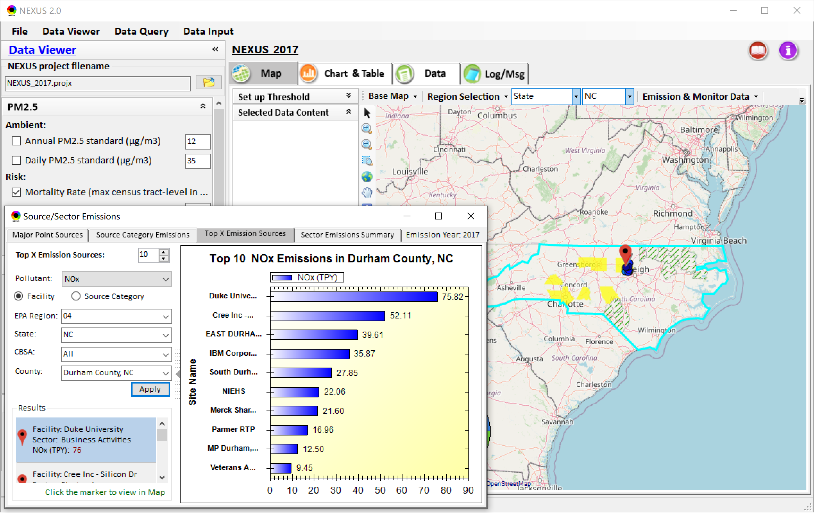
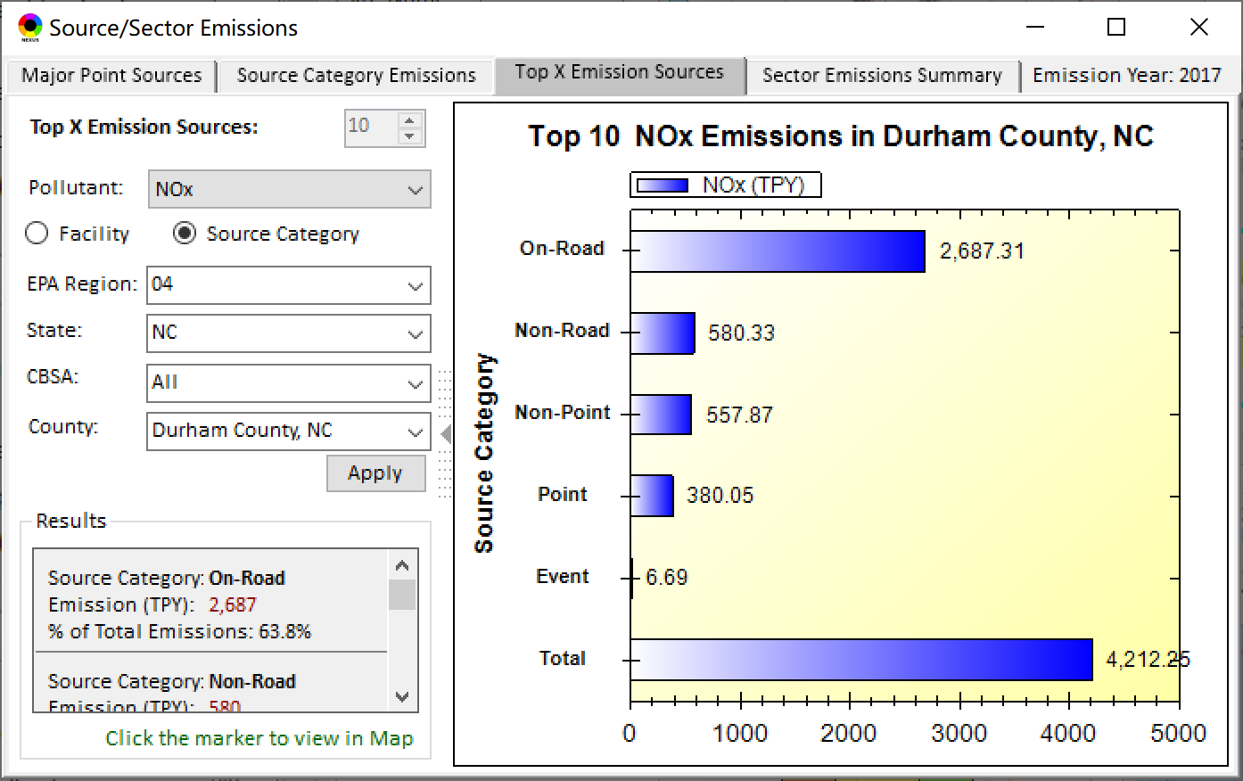
Data Viewer: Top “x” Emission Sources
Provide selection of Facility & Source Category
Provide selection of Facility & Source Category
Durham county, NC
23

Slide 24
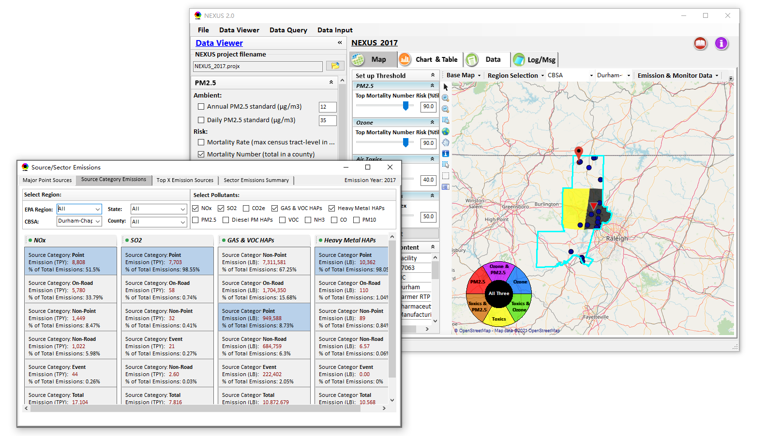
NEXUS Update: “Source Category Emissions”
“Source Category Emissions” module provide five source categories, including “point”, “non-point”, “on-road”, “non-road”, and “event” emissions for the selected region, CBSA, or county.
24

Slide 25
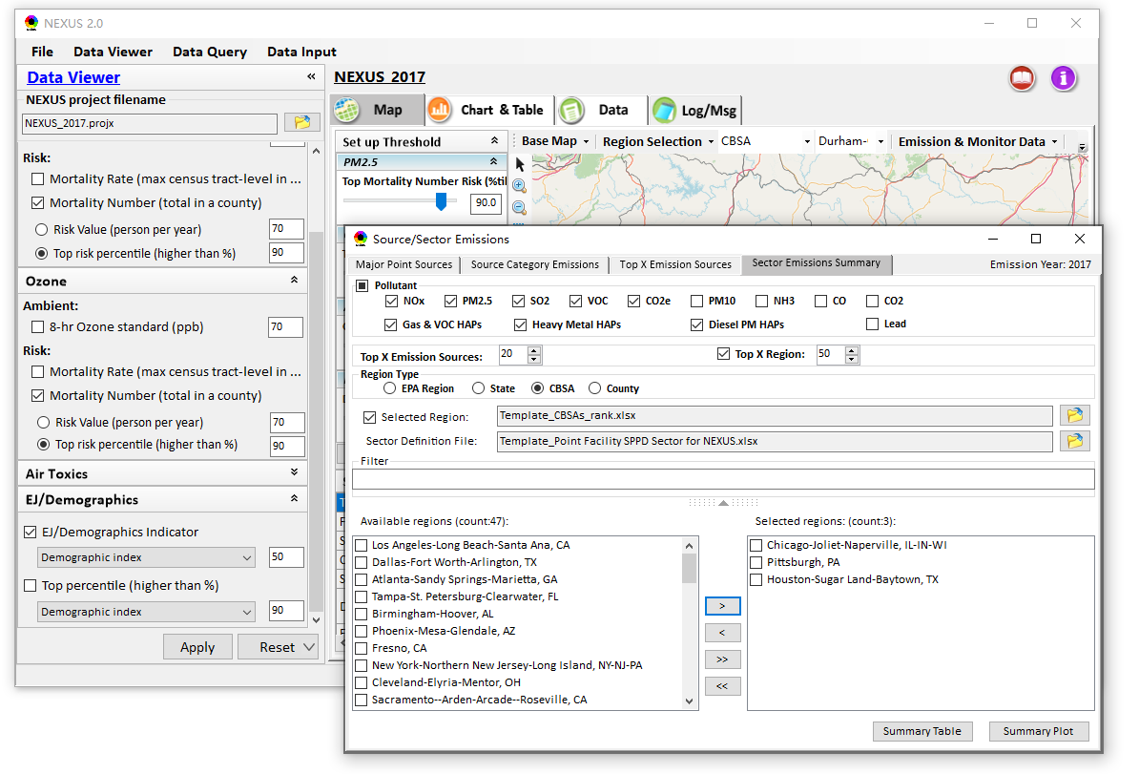
NEXUS Update: “Sector Emissions Summary”
“Sector Emission Summary” function allow to select major CBSAs and provides source and sector emissions summary to support OAQPS’s “Sector Prioritization” project effort
25

Slide 26
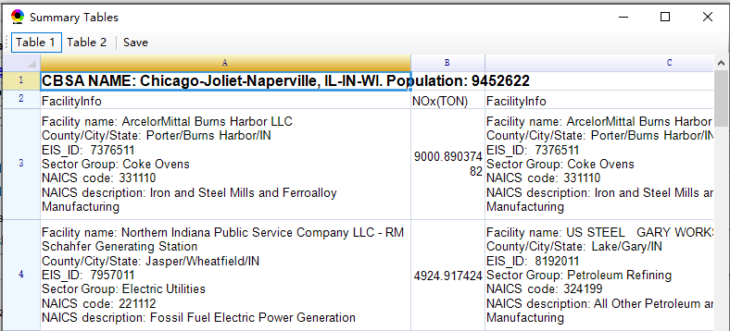
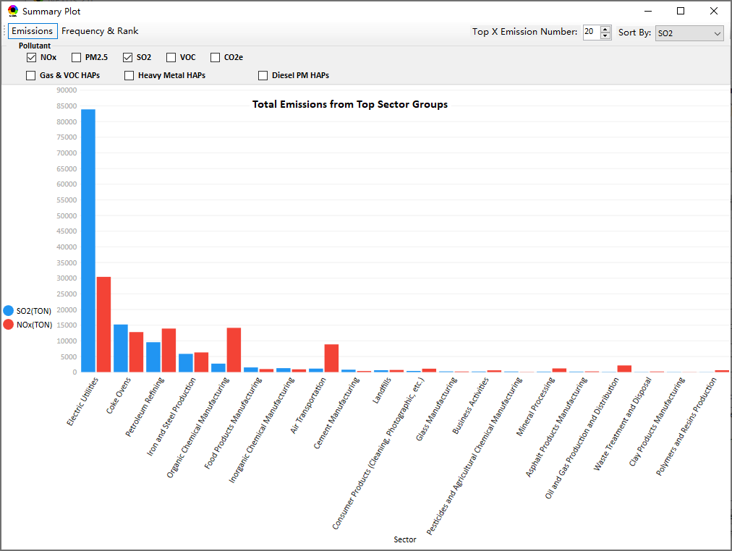
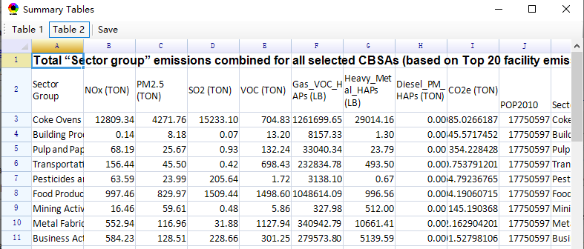
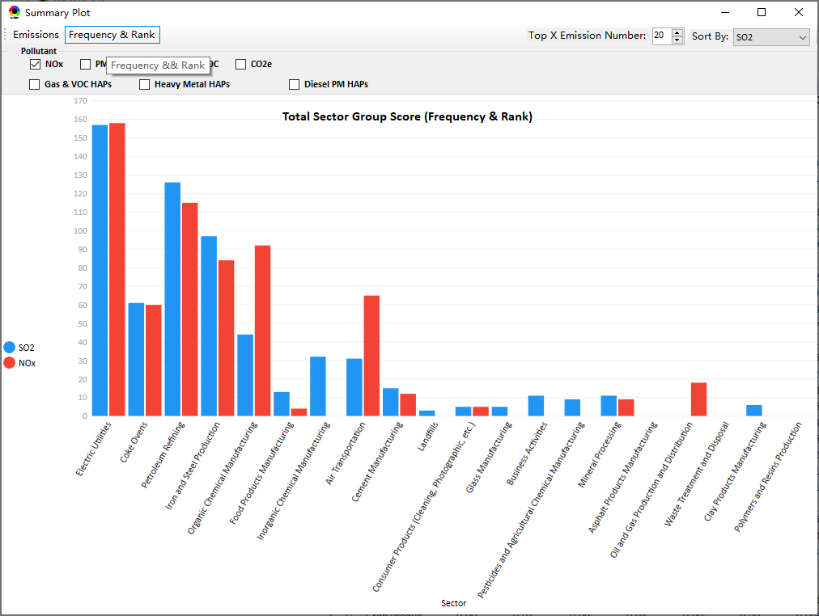
NEXUS Update: “Sector Emissions Summary”
Summary table
Summary plot
Emissions
Frequency & Rank
26

Slide 27
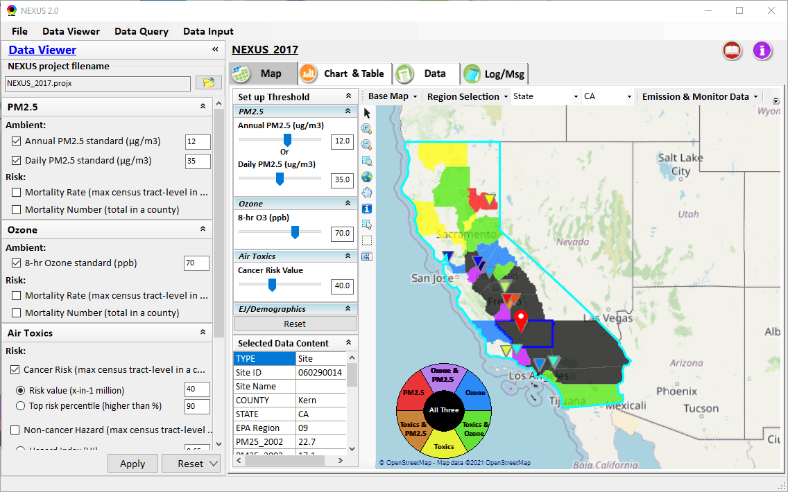
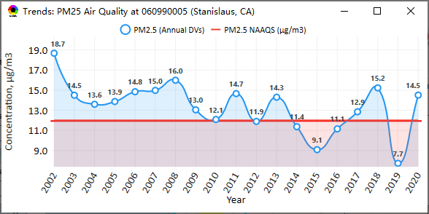
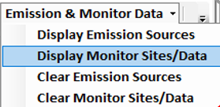
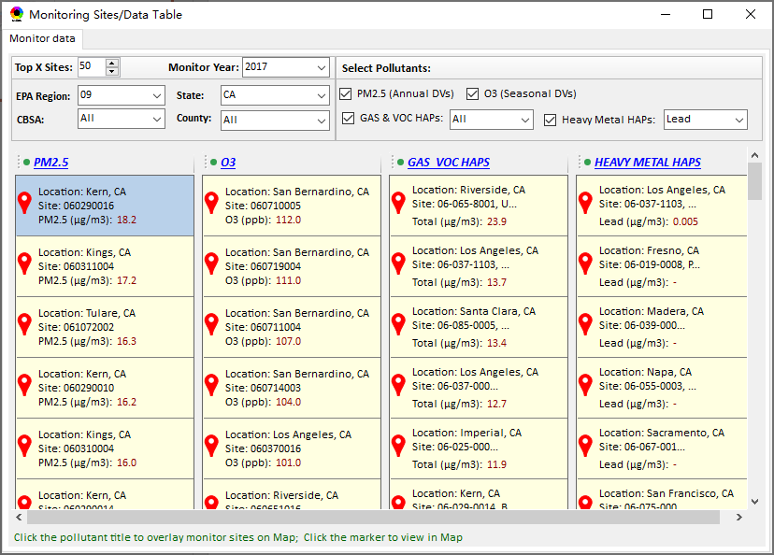
NEXUS Update: “Monitoring Data/Site” Module
AQ trend
Right-click to invoke
Click to display
AQ trend at monitor site
Monitor Site/Data
Click to select monitor site
& pollutant
27

Slide 28
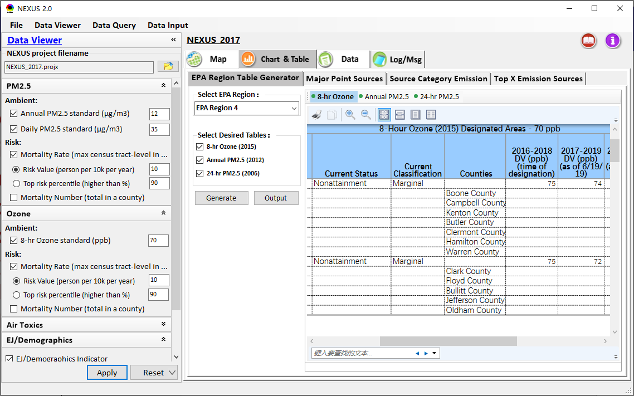
Data Viewer: EPA Region Table Generator
“EPA Region Table Generator” provides attainment status of O3 and PM2.5 and their DVs; also allows to select any EPA region based on data updated to 2020.
28

Slide 29
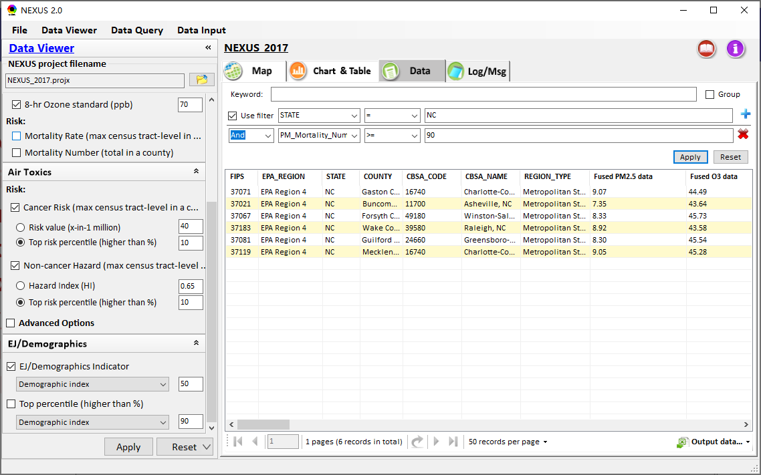
Data Viewer: Data Search & Filter
Click “+” to add filters; Click “x” to remove current filter;
Click “Output data…” to output current page records or all records
Show specified records per page.
29

Slide 30
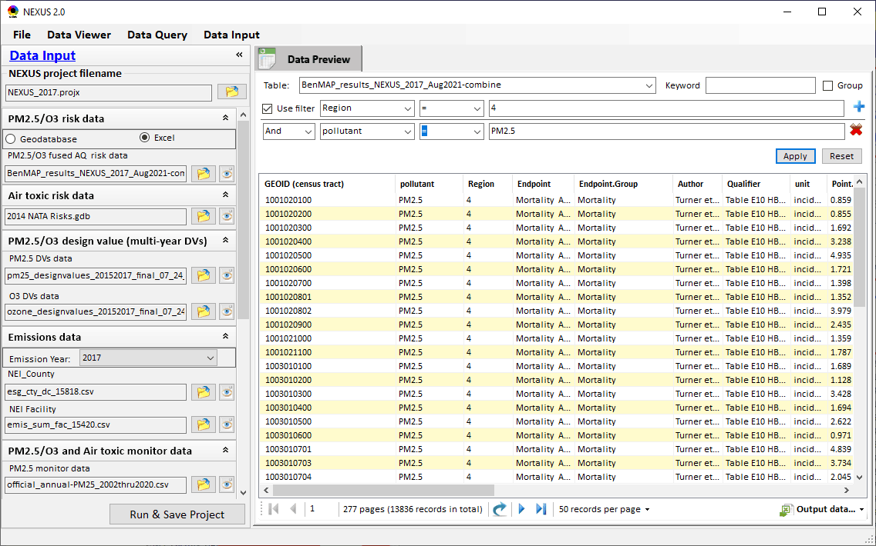
Data Input Module: Data Preview
“Transparency” & “Open-Source”:
All NEXUS input/output data files are available under:
“This PC\Documents\My NEXUS files\Data (\Result)”
Check to use filter to query data
Select a table to view if there are multiple tables in the selected data source file
Click to change input data file
Click to view data
Click to run & save project
30

Slide 31
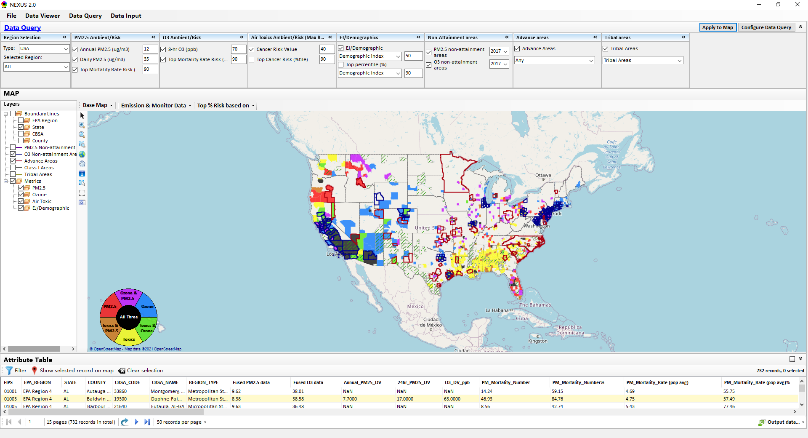
Data Query Module: Overlaying Map
Region Selection
Data Query Configuration
Data Query qualifier selection
Overlaying Map selection
31

Slide 32
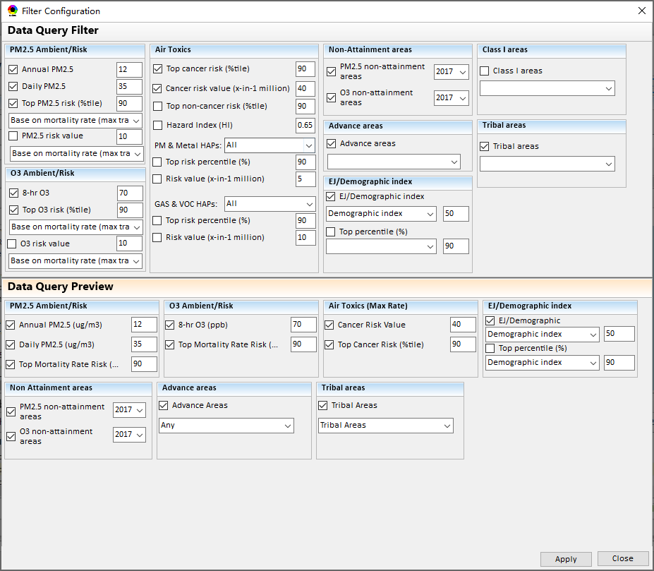
Data Query Module: Configure Data Query
“Data Query Filter” allows to select “qualifiers” for query
“Data Query Preview” displays the selected “qualifiers” at the same time
32

Slide 33
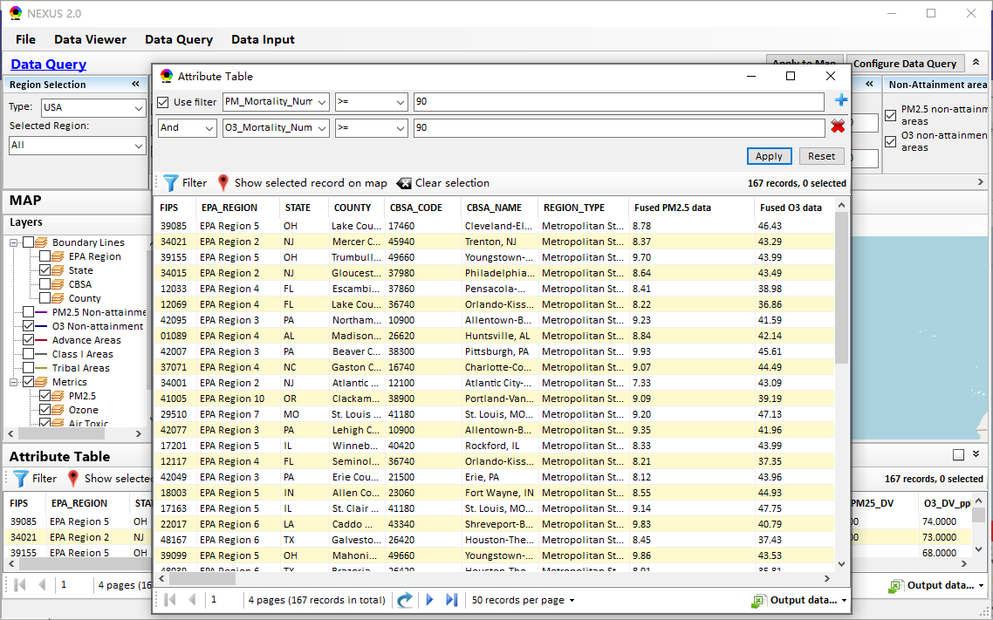
Data Query Module: Attribute Table
Filter/search/export functions
Detachable “Attribute Table”
33

Slide 34
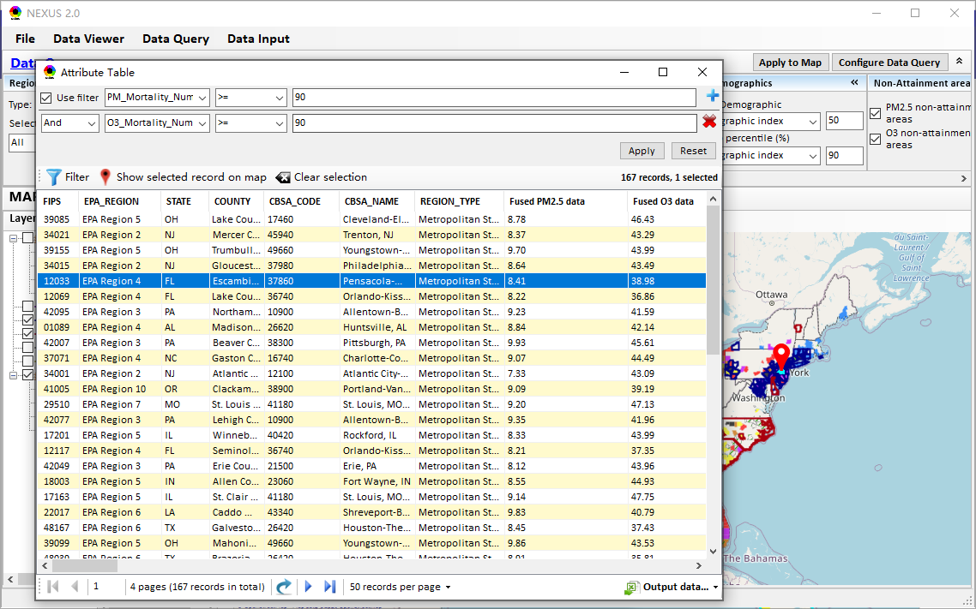
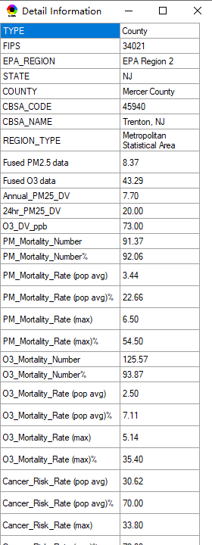
Data Query Module: Attribute Table
Click a “record” to link and display its location & info.
34

Slide 35
Quick Tutorial Slides
End
35

