Slide 1
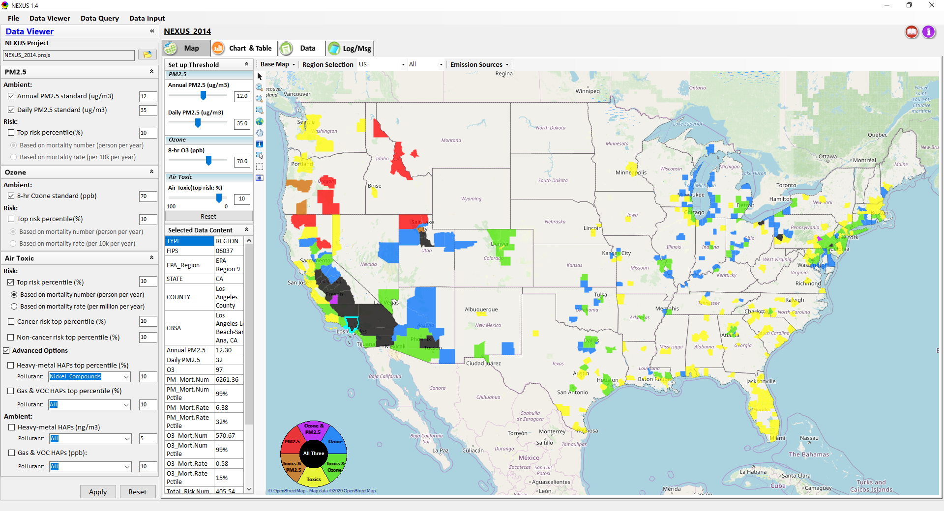
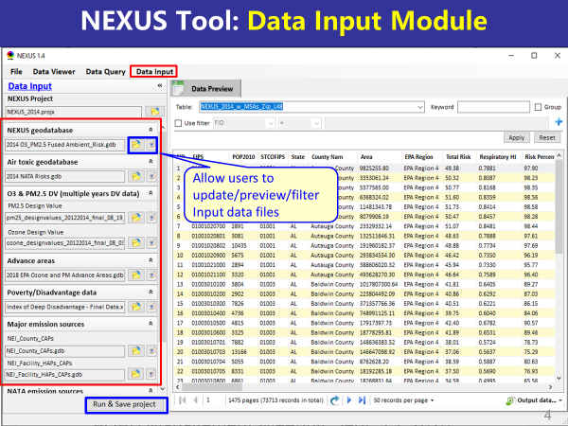
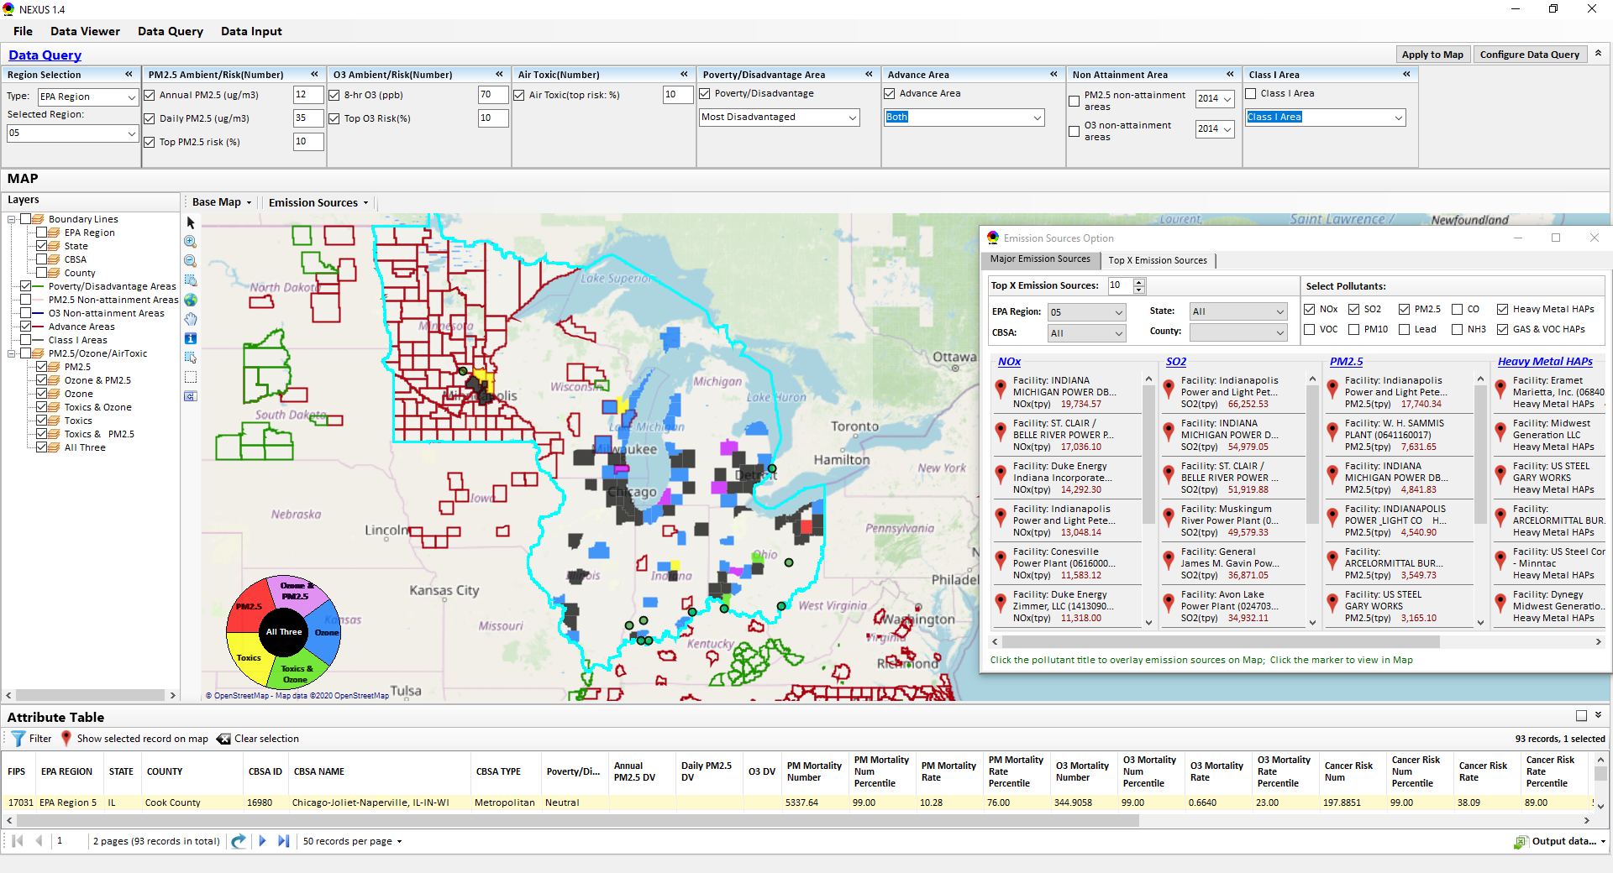
“NEXUS” Multi-Pollutant Analysis Tool
Development: Status and Progress
Data Viewer Module
Data Input Module
Data Query Module
“NEXUS 1.5” available on OAQPS’s Shared Drive at: “G:\SHARE\NEXUS\NEXUS 1.5\”
OAQPS/AQAD/Air Quality Modeling Group
AQAD Management Team Meeting, Sept. 25, 2020

Slide 2
NEXUS Tool Development
Motivation: Develop a new multi-pollutant analysis tool to identify and assess areas with high ambient levels and/or health risks associated with PM2.5, O3, and air toxics
Phase-1: Develop a GIS-based NEXUS prototype with a user-friendly graphical interface to provide analysis and visualization functions of potential multi-pollutant AQ issues at national level (continental US)
Phase-2: Expand the NEXUS tool to allow users to dail into an EPA region, State, or metropolitan area and provide data query and V/A functions for “AQ and emissions” information over the selected region of interest
2

Slide 3
Expected Use of NEXUS Tool
The NEXUS tool will allow users to do the following:
  National screening for areas with MP issues: Phase 1 development will provide ability to quickly screen areas across nation that have combination of high air quality and/or risk levels for O3, PM2.5 and air toxics.
  Area screening to understand nature of MP problem: Phase 2 development will provide ability to ‘dial-into’ specific areas to determine extent to which common emissions sources are causing the MP issues.
OAQPS expects to use this tool to engage with Regions and identify areas that would potentially benefit most from MP approaches to reduce emissions (including current NAs and Advance areas).
The NEXUS tool will essentially provide a ‘conceptual model’ of MP issues within an area to facilitate engagement with state/local/tribal agencies and community stakeholder groups.
3

Slide 4
NEXUS Tool : Schedule & Installation
Work Plan | Date
Developed NEXUS tool prototype and Phase-1 functions | Dec. 2019 ~ April 2020
Developed Phase-2 functions and deliver first working (interim) NEXUS tool | May ~ July 2020
Developing a fully functional NEXUS tool for beta-testing and on-line User’s Manual | Aug. ~ Oct. 2020
Download “NEXUS” tool: The “NEXUS 1.5” package (“NEXUS v1.5 setup.exe” & “NEXUS 1.5 Data.exe”: run both to install) is available at OAQPS’s Shared Drive at: G:\SHARE\NEXUS\NEXUS 1.5\
Or Google Drive link below (or EPA’s ScienceFTP2 site upon request):
https://drive.google.com/open?id=1Xl3VqtlRXeBt_FrfHpuCZYumxjqMR9hL
(Note: Require software installation privilege to install “NEXUS tool” at EPA’s PCs; Older EPA PCs may be less efficient in running “NEXUS” tool)
4

Slide 5
NEXUS Tool: Three Key Modules
Data Viewer module
Data Input module
Data Query module
View and create interactive Map/Data/Chart/Table
Provide flexible selections & mapping of “Ambient” and/or “Risk” levels of PM2.5, O3 and air toxics
Provide regional analysis for “EPA region”, “States”. CBSA”, and “County”
Link and display major emission sources locations & emitted pollutants info.
Allow to update & change input data files
Provide data preview and filter functions
Extend to use 10 input data files now (publicly available, ~4 GB)
Quick turnaround to run & save to a new “project” using new input data files
Expand data field selections and flexibility for exploratory/advanced users
Provide overlaying map and summary table for data query results
Current data query based on selected data fields: “Ambient/Risk, Advance area, Socio-demographic (EJ) area, NA Area, Class I area”

Slide 6
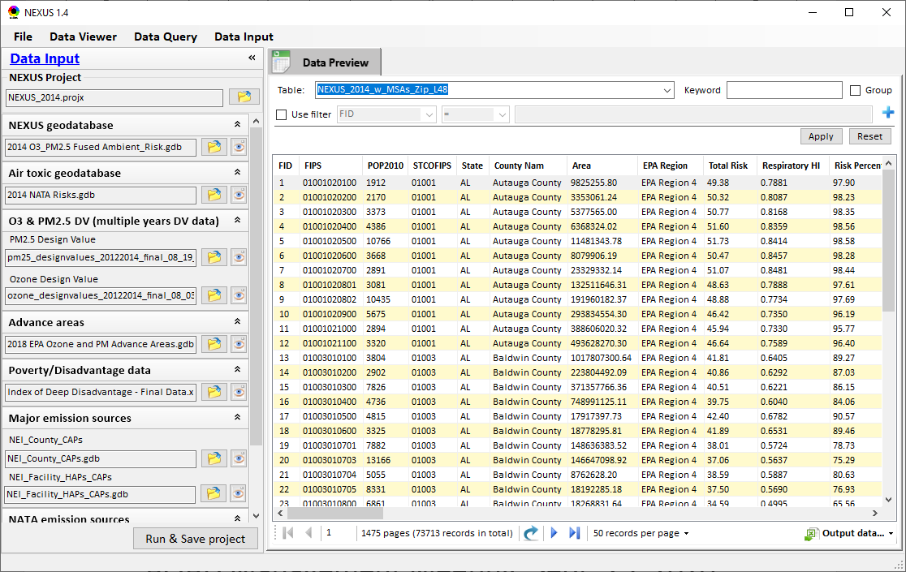
NEXUS Tool: Data Input Module
Allow users to update/preview/filter Input data files
Currently, there are 10 input data files used (publicly available)
Total files size ~4 GB
Run and Save to a new project after loading new input data files
6

Slide 7
Data Input File Names | Data Format | Data Description | Data Source | Data Period
“2014 O3 & PM2.5 Ambient & Risk” | Geodataset | O3/PM2.5 ambient & risk data at county/census tract level | from OAQPS MP team | 2014
“2014 NATA Risk” | Geodataset | Air toxics ambient & risk data at county/census tract level | from OAQPS MP team | 2014
“O3_DV_2009_2018” | Excel | O3 design values at county level | From EPA public website: https://www.epa.gov/air-trends/air-quality-design-values | 2009 to 2018
“PM_DV_2009_2018” | Excel | PM2.5 design values at county level | From EPA public website: https://www.epa.gov/air-trends/air-quality-design-values | 2009 to 2018
“Advance areas O3_PM” | Geodataset | O3 & PM2.5 Advance Areas | from OAQPS MP team | 2018
“Index of Poverty_ Disadvantage” | Excel | Index of poverty/disadvantage at county level | from Univ. of Michigan website: https://poverty.umich.edu/projects/understanding-communities-of-deep-disadvantage/ | 2017
“NEI_Country_CAPs” “NEI_Facility_HAPs_ CAPs” | Geodataset | Major emission sources and facility info. of CAPs & HAPs at county level | From OAQPS public website: ftp://newftp.epa.gov/EPADataCommons/OAR/OAQPS/NEI/NEI_Facility_HAPs_CAPs.zip ftp://newftp.epa.gov/EPADataCommons/OAR/OAQPS/NEI/NEI_County_CAP.zip | 2008, 2011, 2014
“2014 NEI_NATA Emissions” | Access Database (*. accdb) | NATA emissions data from 2014 NEI database, including various source groups | From EPA public website: https://www.epa.gov/national-air-toxics-assessment/2014-nata-assessment-results#emissions | 2014
“Class1_FederalAreas” | Geodataset | Mandatory Class 1 Federal Areas | From Mandatory Class 1 Federal Areas Web Service: https://edg.epa.gov/data/public/OAR/OAQPS/Class1/Class1Areas.zip | —
Data Input Module: Input Files & Attributes
7

Slide 8
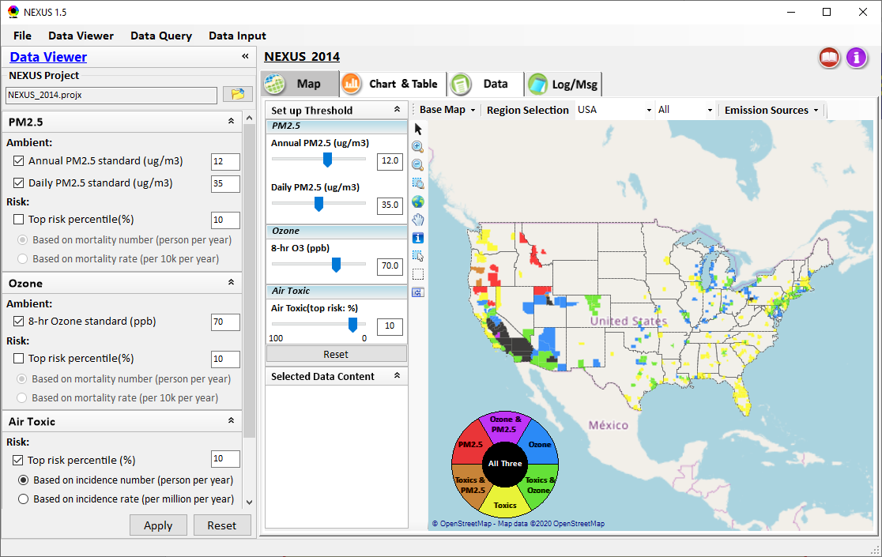
NEXUS Tool Demo: 2014 NEXUS Case
Launching Page
Roadmap for Demo:
(Use example cases)
National View: Use “NEXUS” across pollutants to provide an initial “SCREEN” at the national level by providing an indicator where there may be a common set of sources contributing to Multi-pollutant issues.
Regional View: Dial into a region or area of interest to understand the pollutant/source connections, and potential for more effective and efficient multi-pollutant solution.
8

Slide 9
RoadMap for NEXUS Tool Demo (1)
National Screening (2014 Data)
Replicate 2008 NEXUS map with O3/PM2.5 concentrations above NAAQS and NATA risk estimates above selected percentile of top 10%
  What happens to areas at lower O3/PM2.5 NAAQS levels?
  What happens to areas current over O3/PM2.5 NAAQS if change HAP risk percentile?
Provide NEXUS map on risk basis: O3/PM2.5 BenMAP mortality risk based on fused surfaces and NATA risk estimates above selected percentile of top 10% for all pollutants
  What happens to MP areas as one changes percentile to top 20% or others?
  What is relationship between Heavy Metal HAPs risk (top 10%) and PM2.5 risk to identify potential co-pollutant issues?
  What is relationship between Gas/VOC HAPs risk (top 10%) and O3 risk to identify potential co-pollutant issues?
9

Slide 10
RoadMap for NEXUS Tool Demo (2)
Regional/State/CBSA/County Screening
EPA Region 4 Example
  Areas with MP risk in top 10% across O3, PM2.5 and HAPs
  Louisville CBSA: General view and then dial into “Jefferson County” with transparent map color
    What are the top 10 emissions sources in county by pollutant?
    What specific sources are common across pollutants that may indicate co-control potential?
    Can view these sources on the map with summary data available.
10

Slide 11
RoadMap for NEXUS Tool Demo (3)
Data Query: State/CBSA/County Views
Advance Areas
  Initial view of national level information using the Advance Area definition to show overlay with MP areas
  Region 5 => Minneapolis Example: General view and then dial into “Dakota County” with transparent map color
    What are the top 10 emissions sources in county by pollutant?
    What specific sources are common across pollutants that may indicate co-control potential?
    Can view these sources on the map with summary data available.
11

Slide 12
RoadMap for NEXUS Tool Demo (4)
Data Query: State/CBSA/County Views
Socio-Economic/Demographic (EJ) Areas
  Initial view of national level information using the Poverty/Disadvantaged indicator to show overlay with MP areas
  Region 5 => Detroit Example: General view and then dial into “Wayne County” with transparent map color
    What are the top 10 emissions sources in county by pollutant?
    What specific sources are common across pollutants that may indicate co-control potential?
    Can view these sources on the map with summary data available.
12

Slide 13
Discussion and Next Steps
    Short-term:
    Develop a fully functional version and continue to improve NEXUS based on MP team’s suggestions
    Develop NEXUS User’s Manual
    Long-term:
    Upgrade and prepare NEXUS for Beta test with EPA Regions followed by public release & training
    Update with 2017 fused AQ & air toxic data; Consider addition of screening-level analysis & assessment capabilities (e.g., EJ indicators) based on ours & user needs
    Support OAQPS’s Air Toxic Strategy programs
    Potential Issue:
    UNC EMAQ contract ends in Sept., currently no funding to support NEXUS under new GSA contract starting Oct. 1st
13

Slide 14
“NEXUS 1.5”: Tutorial
Carey Jang, 9/25/2020
14

Slide 15

NEXUS Tool: On-line User’s Manual
Click “book” icon to launch “User’s manual”
Hot link to User’s manual’s “Data Viewer” chapter (same for “Data Input” & “Data Query”
15

Slide 16
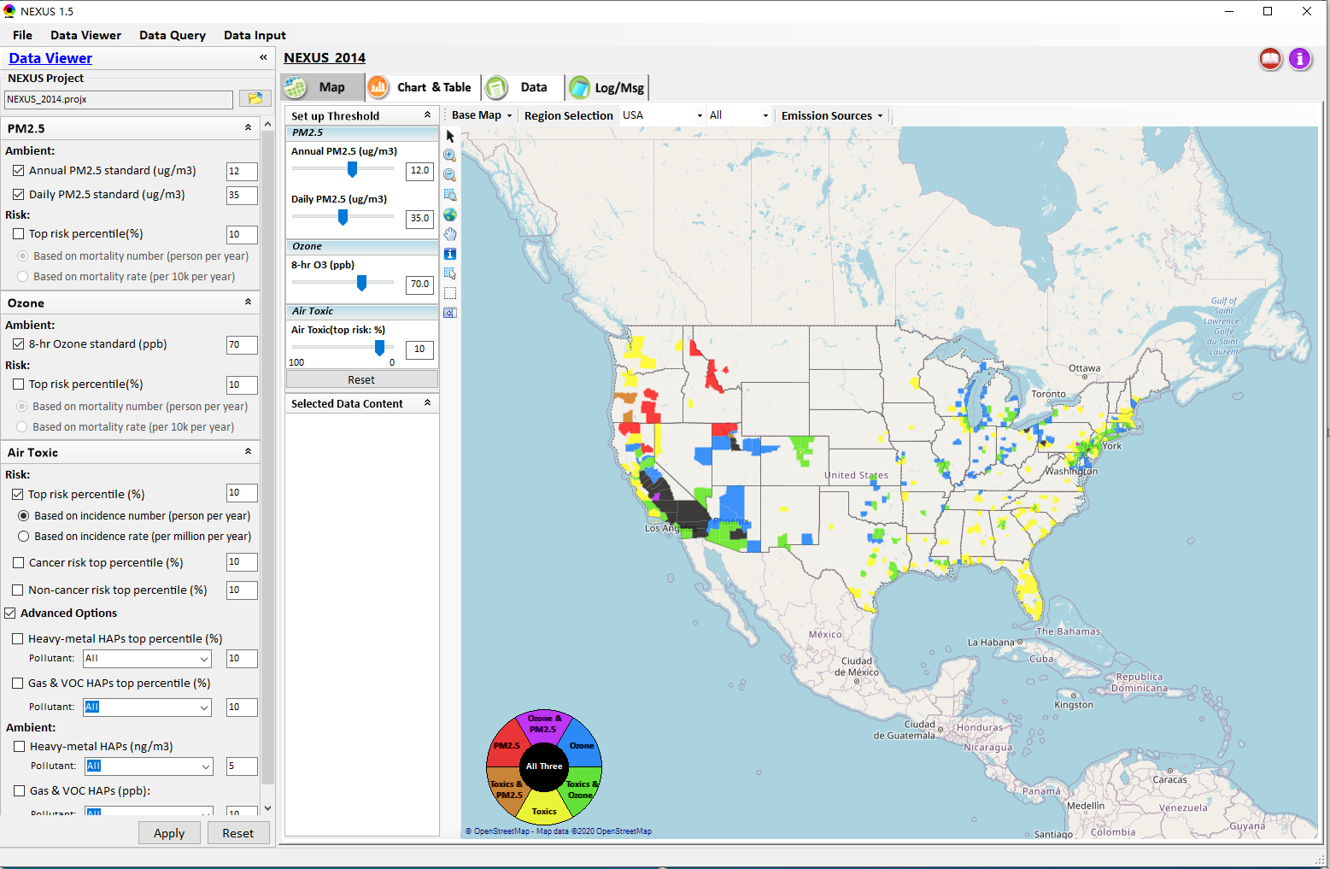

NEXUS Tool: Data Viewer Module
Click “File” to open or save a project
Switch between 3 key modules
Loaded NEXUS project file name
Select & adjust “Ambient” & “Risk” levels
“Advanced Option”: provide HAPs & species selections
16

Slide 17
Data Viewer Module: Selections & Map Display
Select & adjust “Ambient” & “Risk” threshold levels for color map display
“Apply” new selections to “Radio button” panel
17

Slide 18
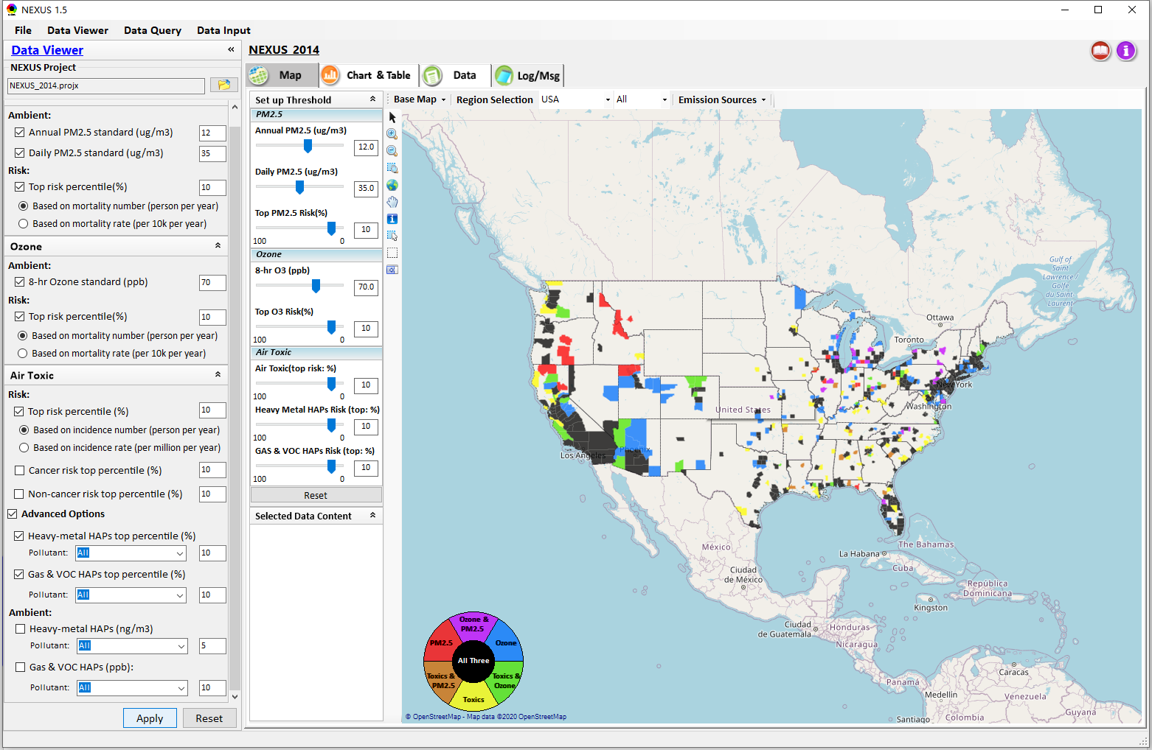
Data Viewer: “Apply” New Selections
“Check” new selections
New selections will appear on-the-fly in “radio button” panel and map display
“Apply” new selections
18

Slide 19
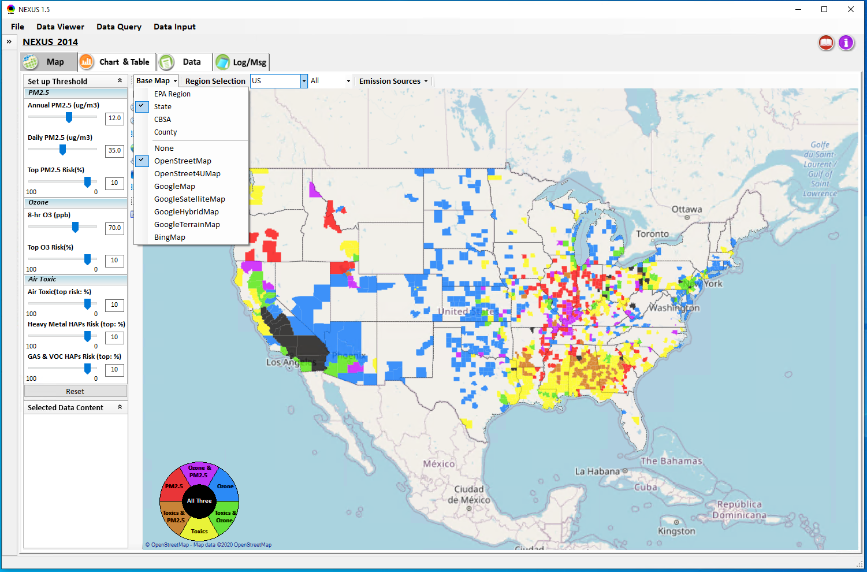
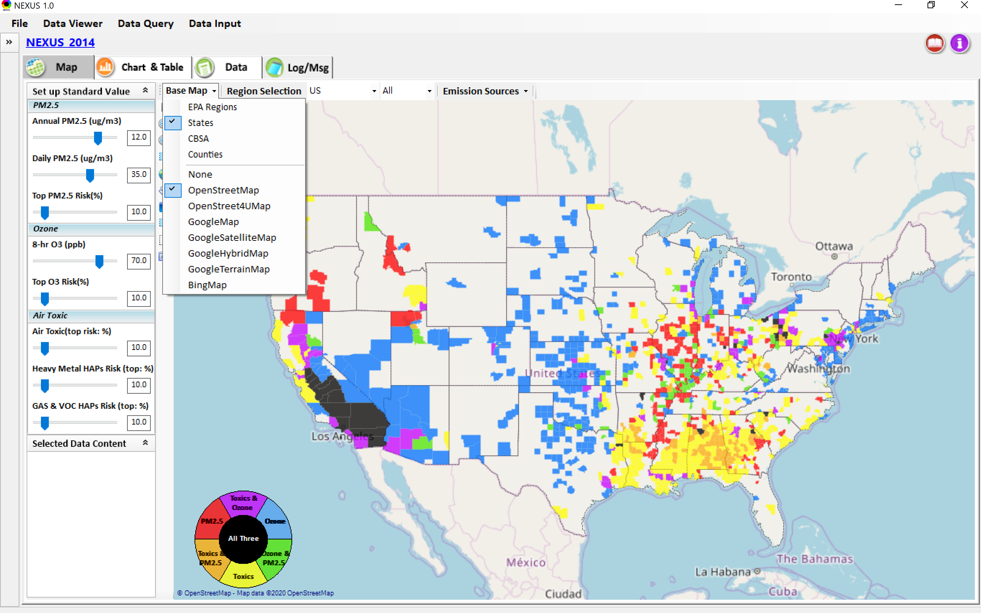
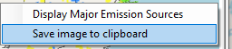
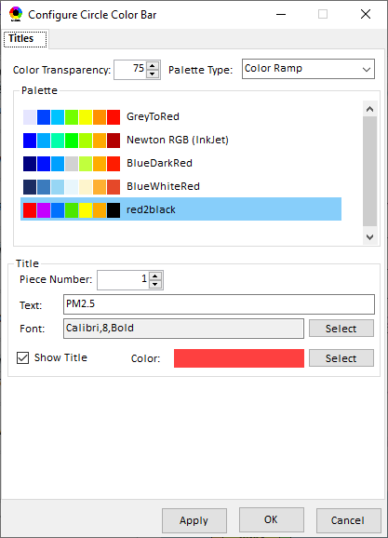
Data Viewer Module: Base Map & Color
“Base Map”: Change boundary lines and background map
“Right-click” map to save image
Click to change color & transparency
19

Slide 20
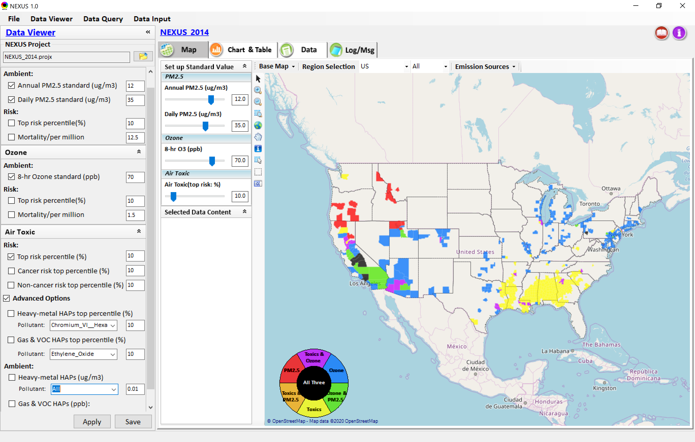

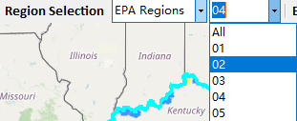
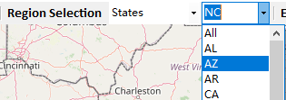
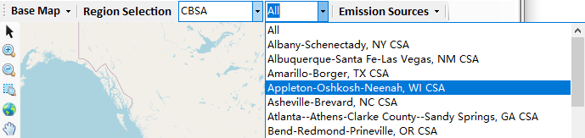
Data Viewer: “Region Selection”
Allow to select “EPA regions”, “States”, or “CBSA”
20

Slide 21
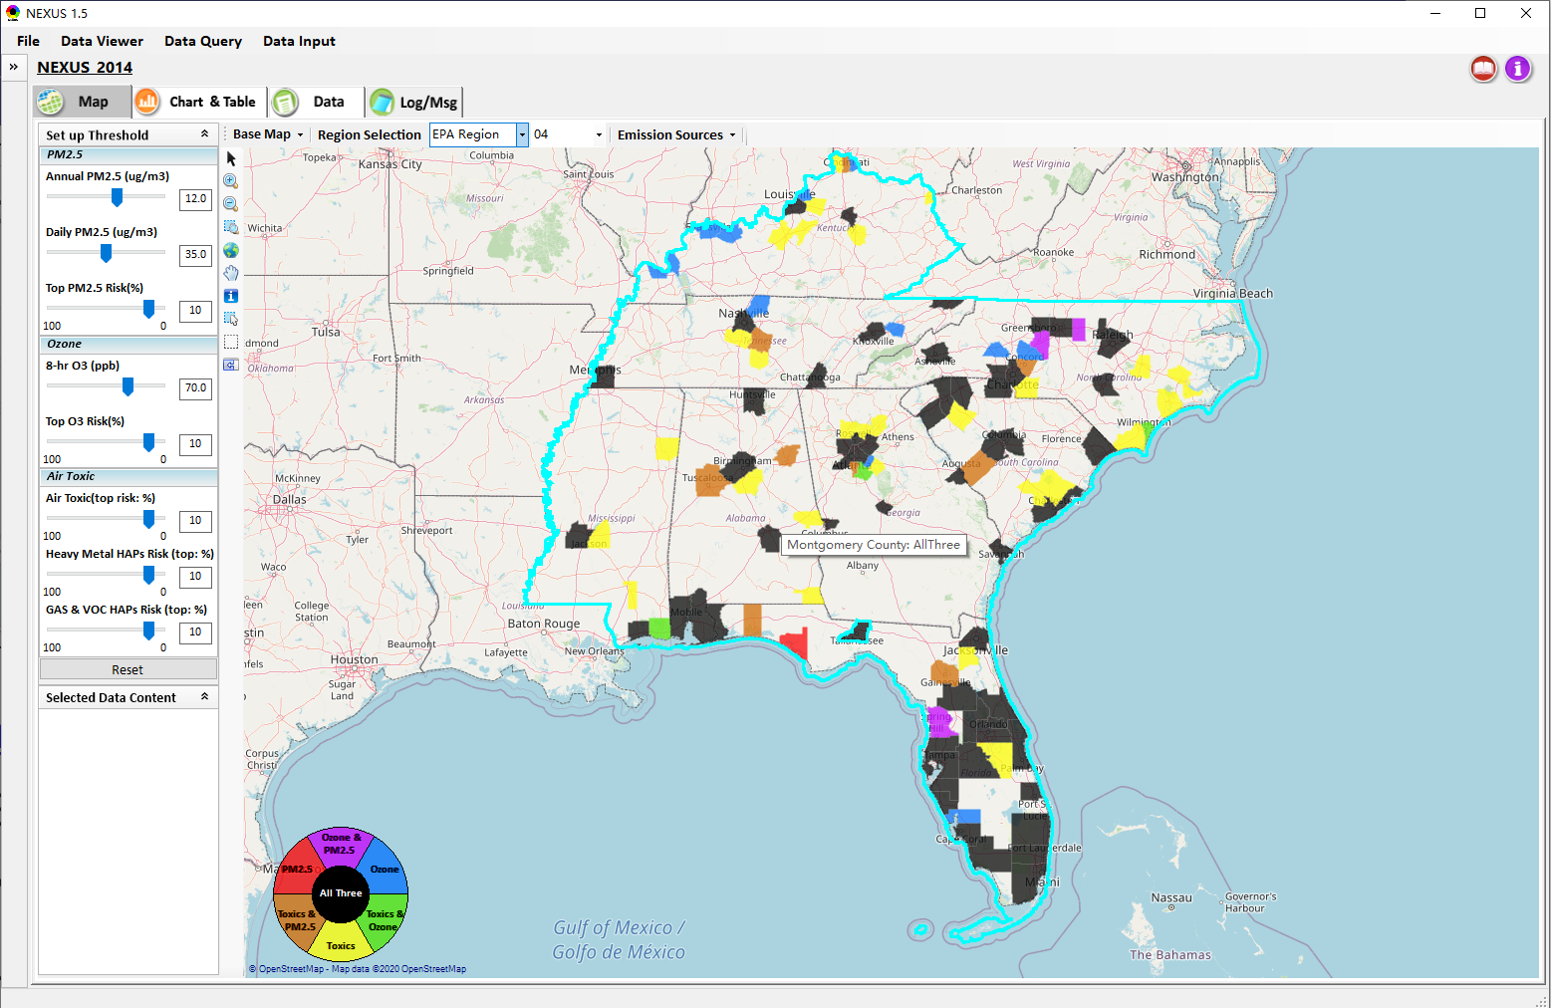
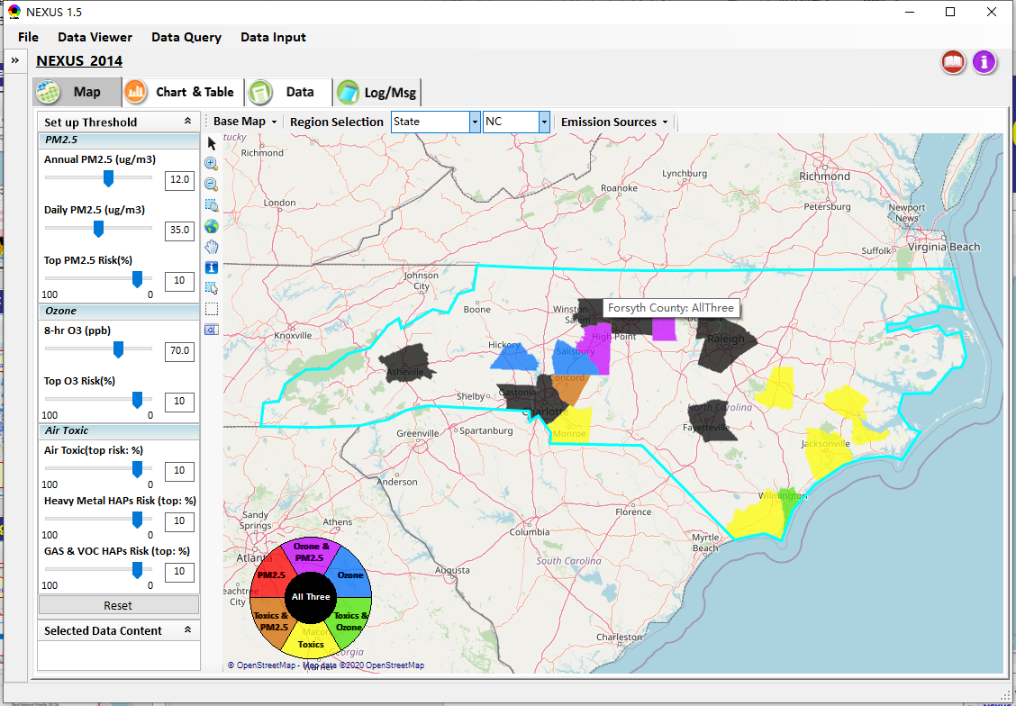
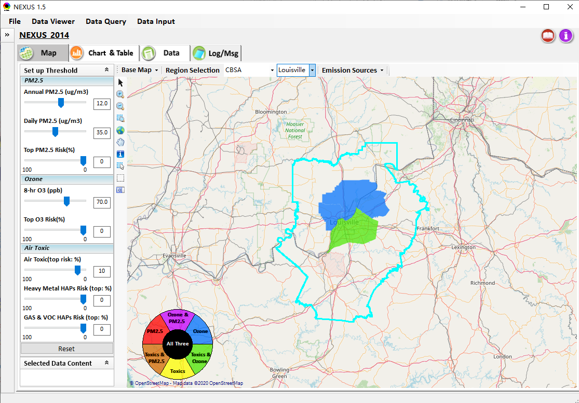
Data Viewer: Select EPA Region/State/CBSA
Examples:
EPA Region 4
NC
Louisville CBSA
21

Slide 22
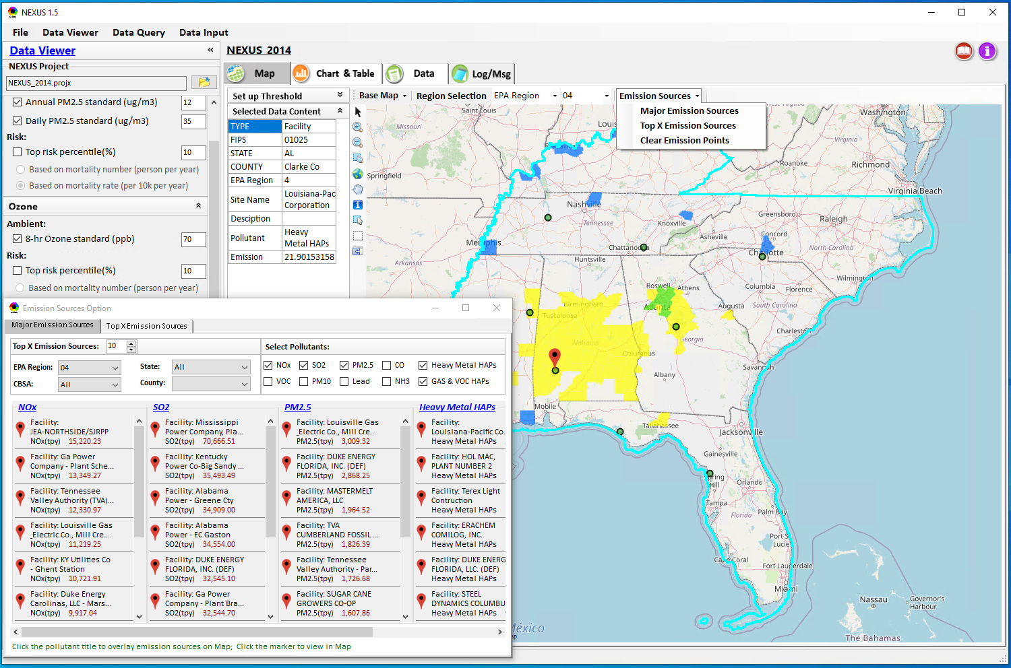
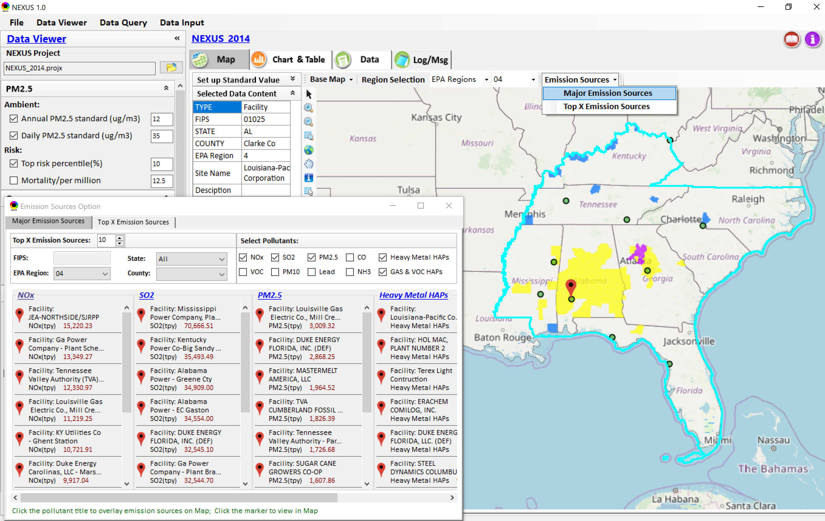
Data Viewer: Major Emission Sources
Click “Emission Sources” tab to display emission sources (green dots) and launch new window
Click any “facility” to link & display source location and emission information
22

Slide 23
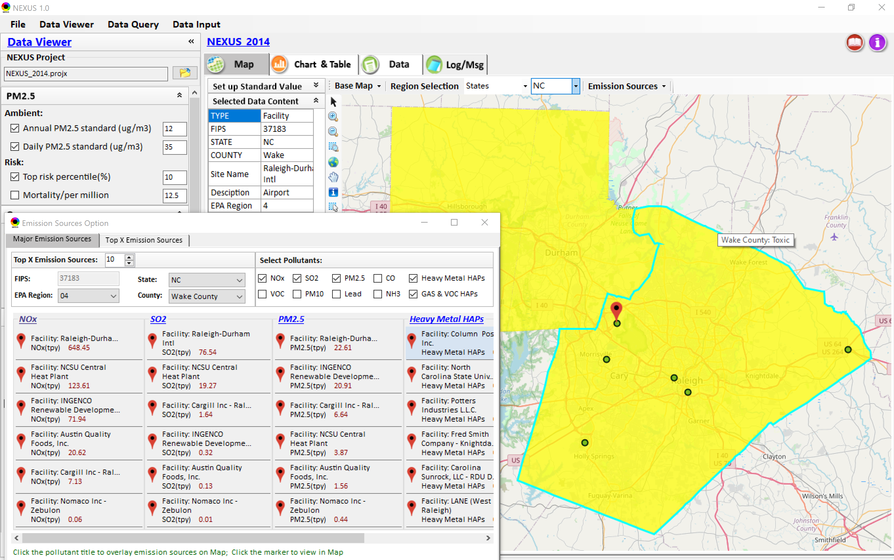
Data Viewer: Major Emission Sources
Allow to scroll down to county-level (e.g., Wake County, NC)
Wake county, NC
23

Slide 24
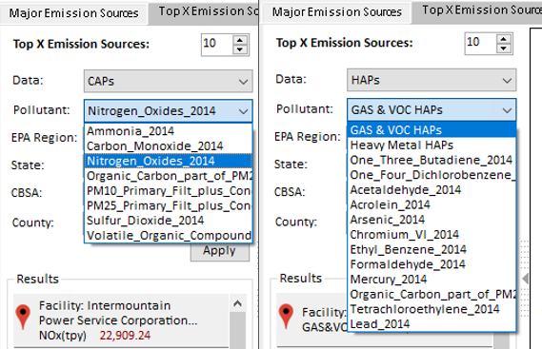
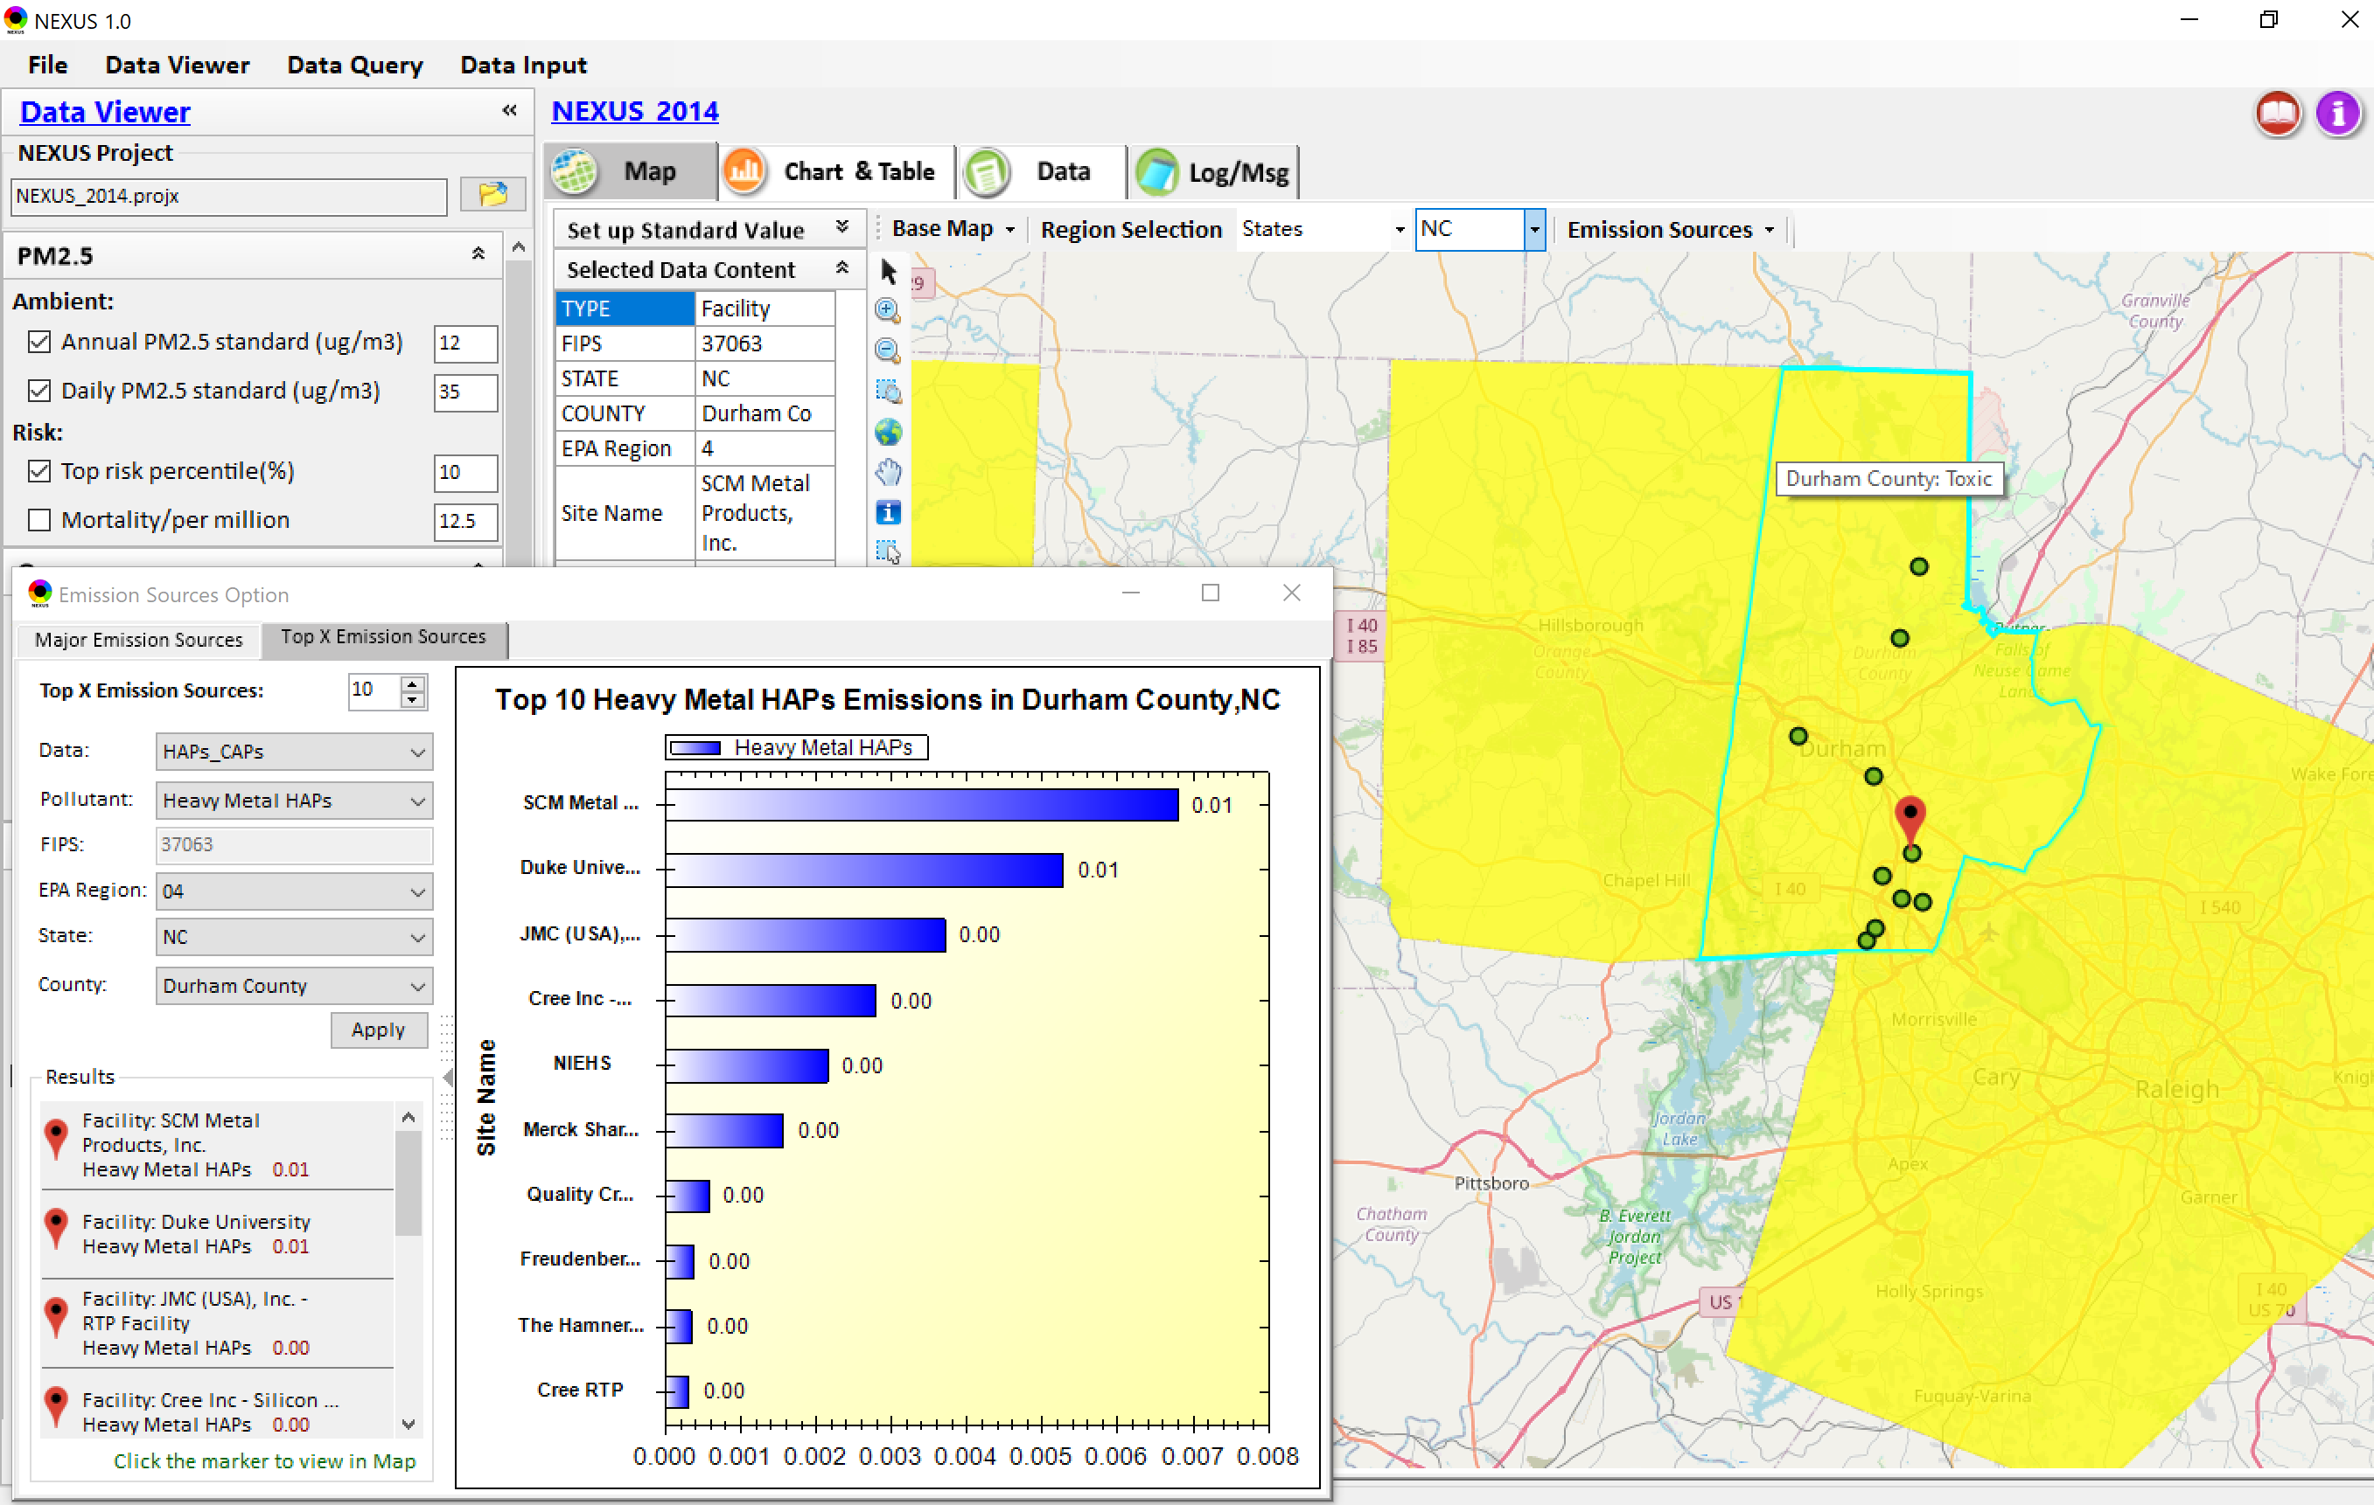
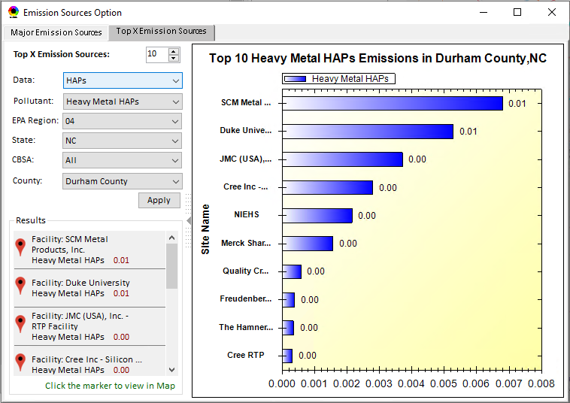
Data Viewer: Top “x” Emission Sources
Provide selection of CAPs precursors & HAPs species
Durham county, NC
24

Slide 25
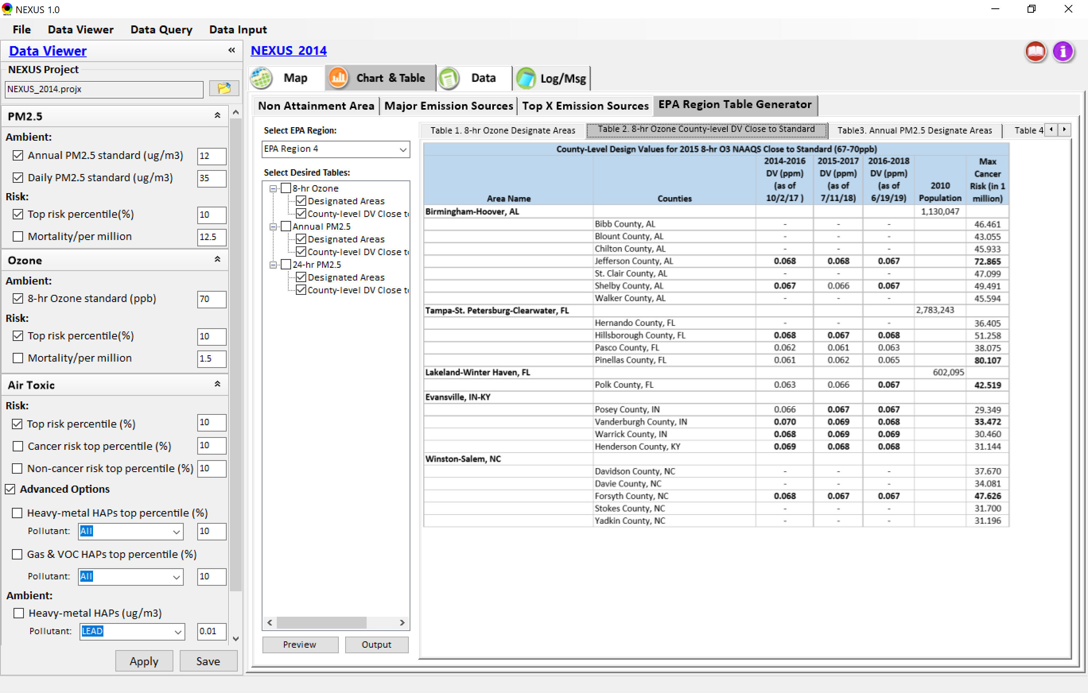
Data Viewer: EPA Region Table Generator
“EPA Region Table Generator” is still under development, but a preview of example “EPA Region 4” tables can be provided
25

Slide 26
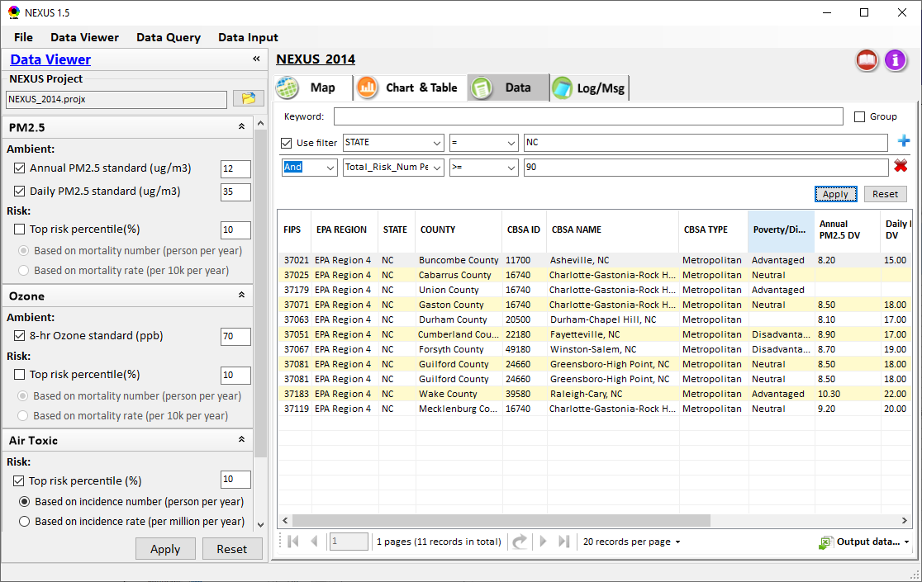
Data Viewer: Data Search & Filter
Click “+” to add filters; Click “x” to remove current filter;
Show specified records per page.
Click “Output data…” to output current page records or all records

Slide 27
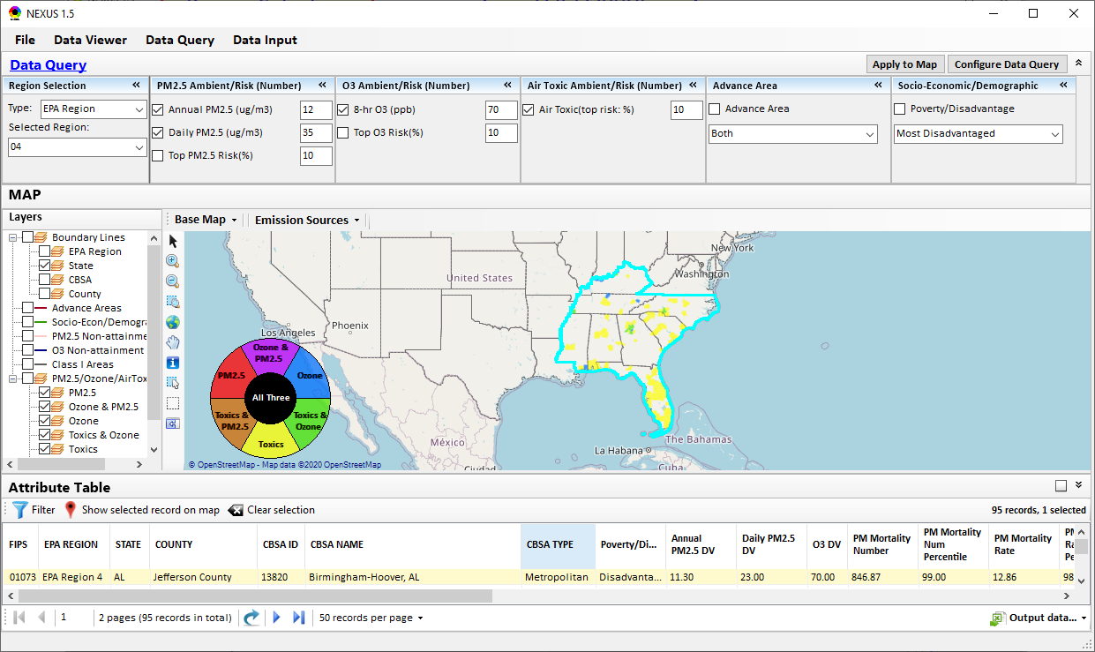
Data Query Module: Main Page
Region Selection
Data Query qualifier selection
Data Query Configuration
Map Overlaying selection
Detachable “Attribute Table”
11111111
27

Slide 28
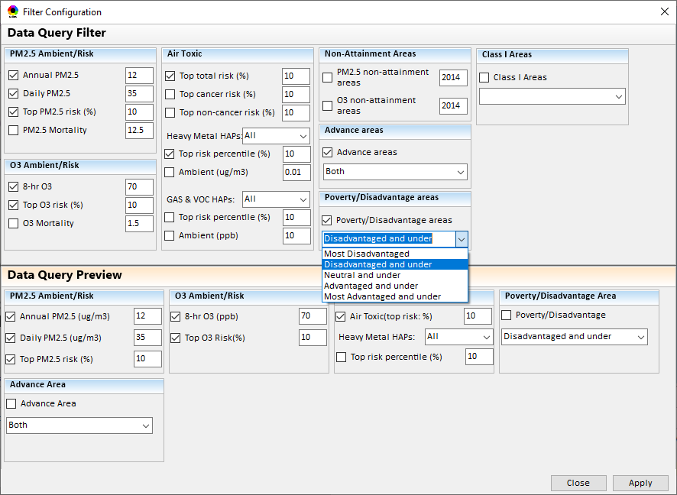
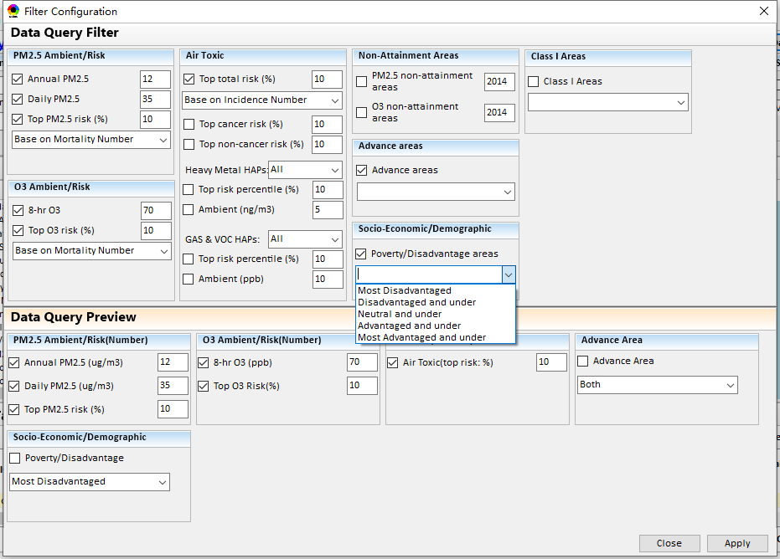
Data Query Module: Configure Data Query
“Data Query Filter” allows to select “qualifiers” for query
“Data Query Preview” displays the selected “qualifiers” at the same time
28

Slide 29
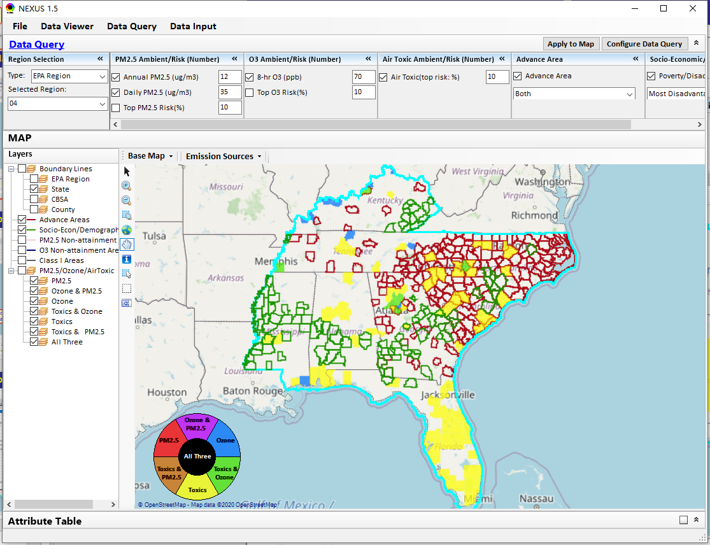
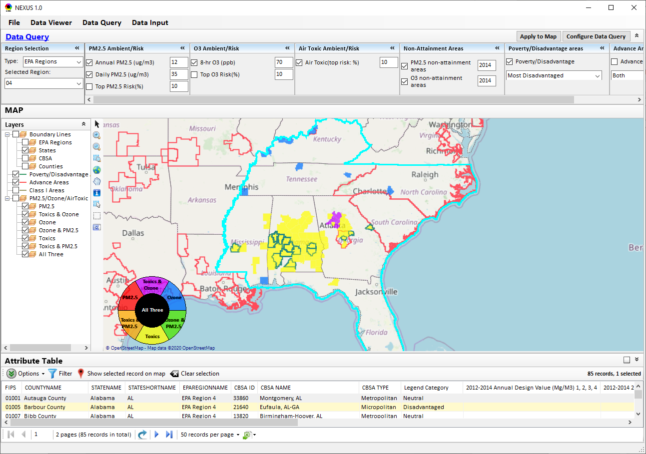
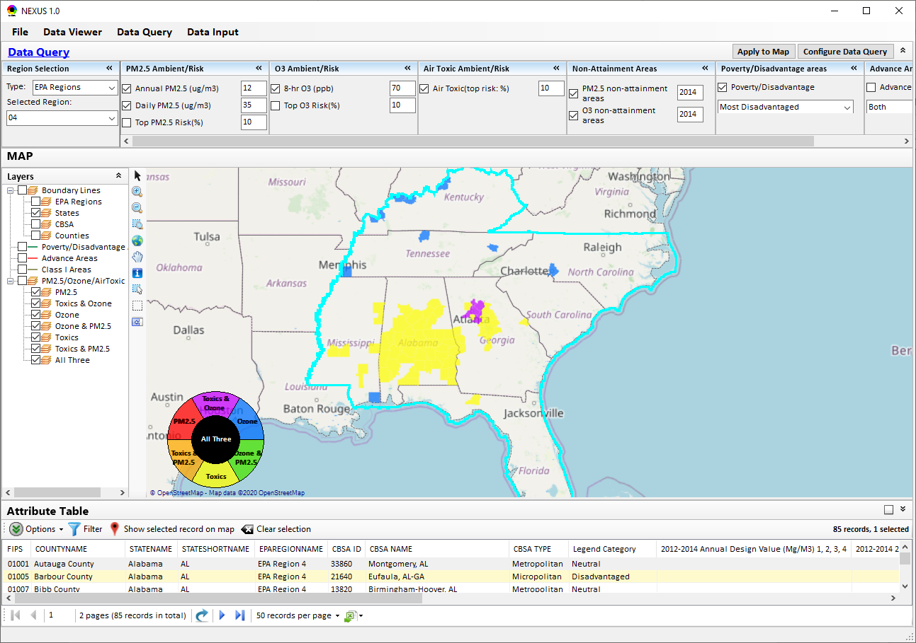
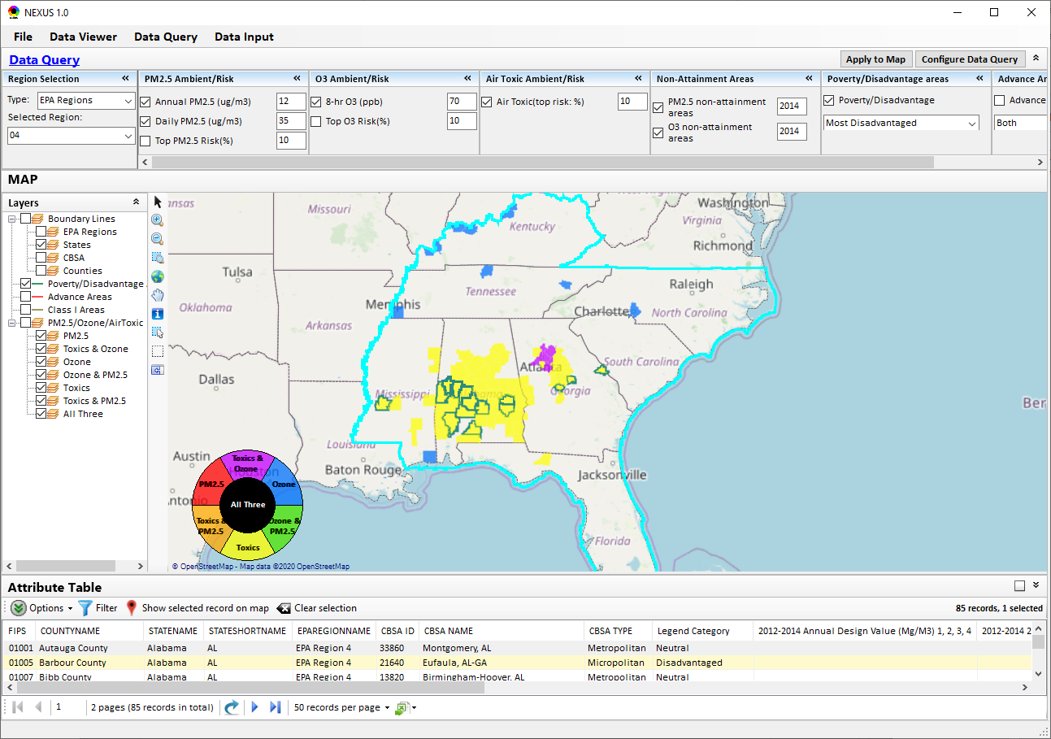
Data Query Module: Overlaying Map
Overlaying Map selection
29

Slide 30
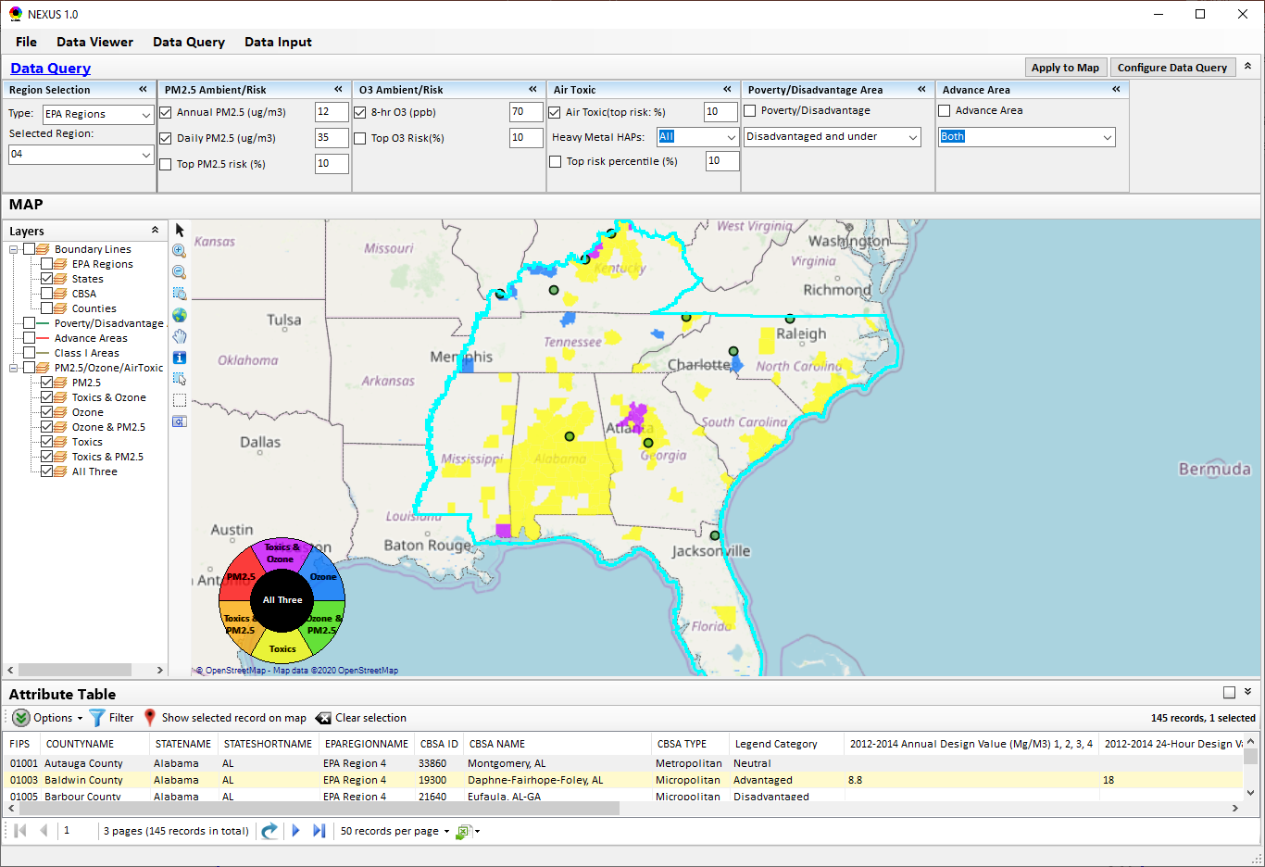
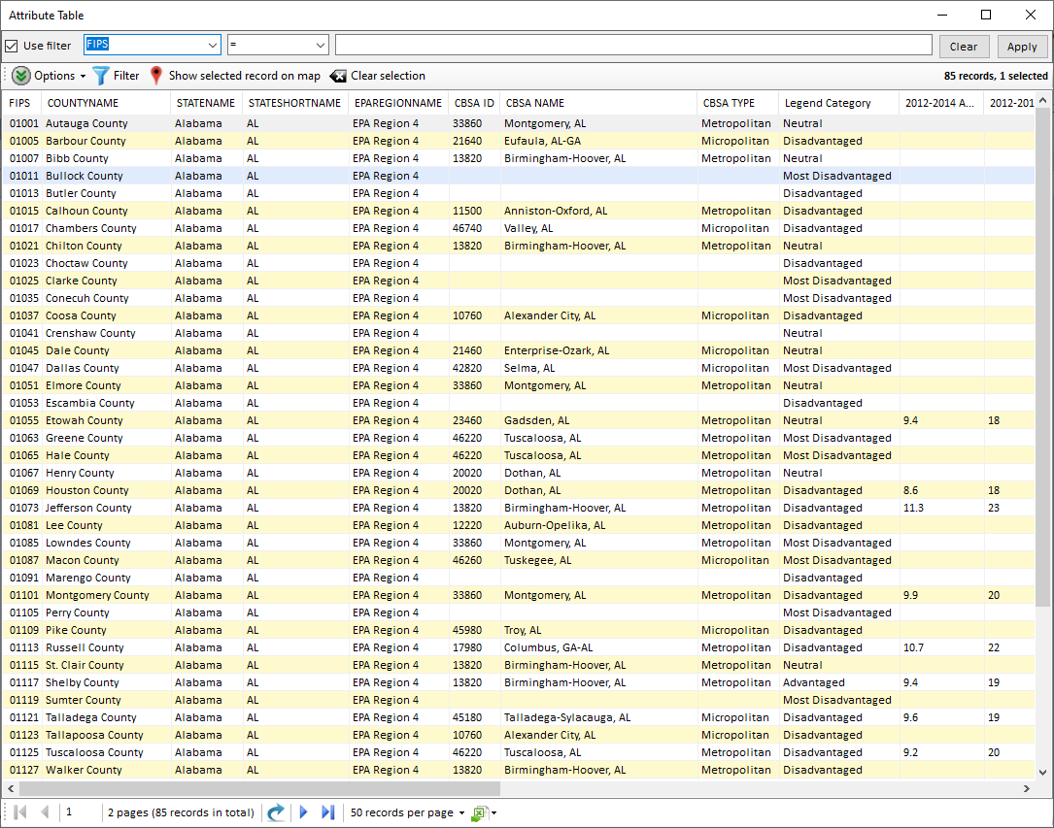
Data Query Module: Attribute Table
Filter/link/export functions (to be completed)
Detachable “Attribute Table”
30

Slide 31
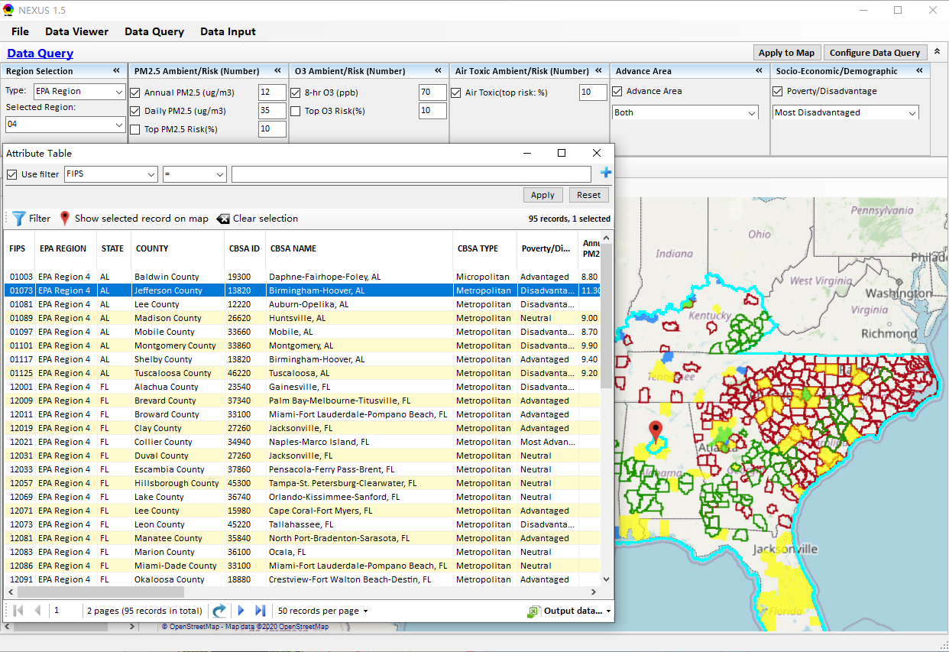
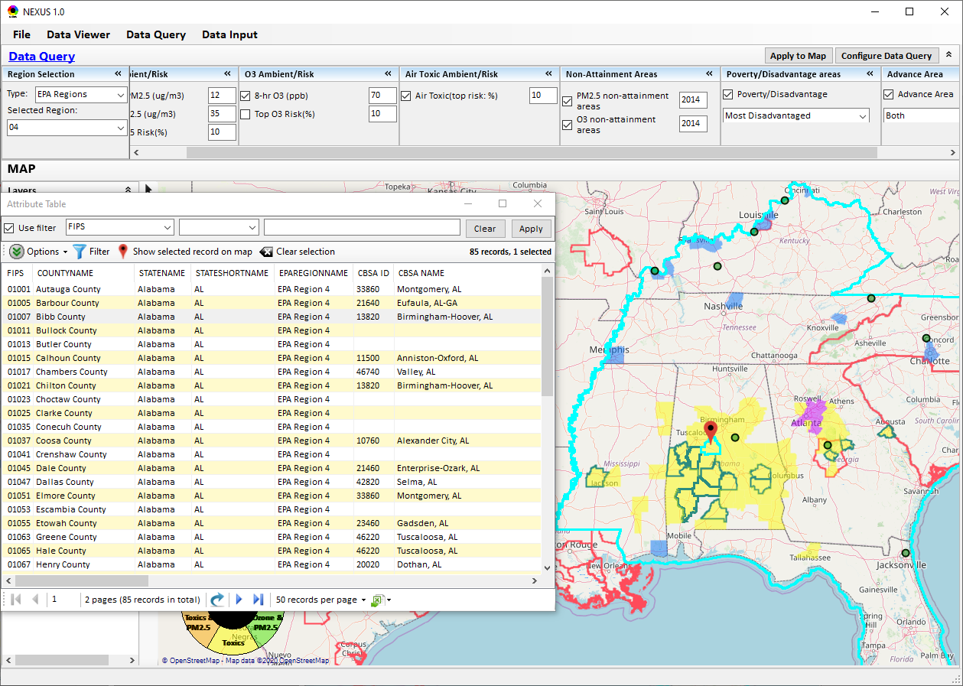
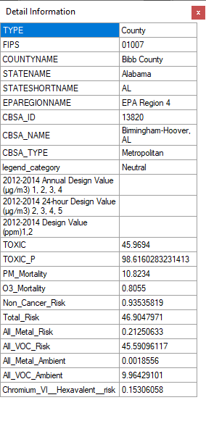
Data Query Module: Attribute Table
Click a “record” to link and display its location & info.
31

Slide 32
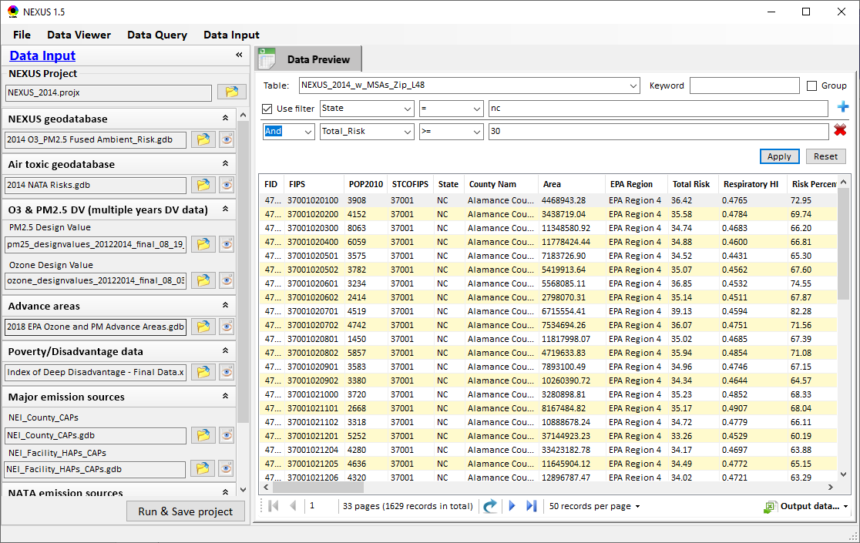
Data Input Module: Data Preview
Click to view data
Click to change input data file
Click to view data
Select a table to view if there are multiple tables in the selected data source file
Check to use filter to query data
Click to run & save project

Slide 33
End
33

