Slide 1
DeepRSM Training and Source Attribution Evaluation Report
04/27/2023, SCUT Team

Slide 2
DeepRSM Training and Source Attribution Evaluation Report
1. What is DeepRSM?
2. DeepRSM Training Report of Entire US domain 2018 Case
Contents
3. DeepRSM Training Report of US Climate-Region July 2018
4. O₃ Source Attribution Evaluation in US Cases
5. PM_{2.5} Source Attribution Evaluation in US Cases

Slide 3

1.1 “DeepRSM, Deep-learning-based RSM”
Air pollutant 1
Air pollutant 1
Air pollutant
Air pollutant
Further reduce the number of air quality simulation cases required to build the RSM model.
Air pollutant 2
Air pollutant 2
Specific 3D mode control scenario
High dimensional Kriging interpolation
High dimensional Kriging interpolation
Polynomial equation
Source emission in region A
$$∆Conc=\sum_{i=1}^{n}{X_{i}∙{\left(E_{NOx}\right)}^{a_{i}}∙{\left(E_{SO2}\right)}^{b_{i}}∙{\left(E_{NH3}\right)}^{c_{i}}∙{\left(E_{VOCs}\right)}^{d_{i}}∙{\left(E_{POA}\right)}^{e_{i}}}$$
Source emission in region B
POA
NO_{x}
NH₃
Source emission
Source emission
Source emission in region C
VOC
CTM
RSM
ERSM
pf-RSM
DeepRSM
SO₂
2009-2011
2015-2016
2018-2019
2019-2020
Xing et al., ACP, 2011
Zhao et al., GMD, 2015
Xing et al., ACP, 2018
Xing et al., ESorT, 2020
Wang et al., ESorT, 2011
Zhao et al., ACP, 2017
Xing et al., ESorT, 2017

Slide 4
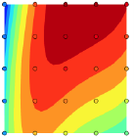
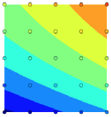
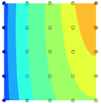
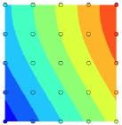
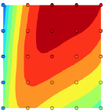
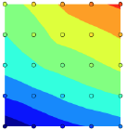
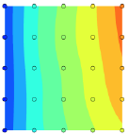
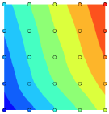
1.2 The Advantages of DeepRSM
Only 2 cases needed (1 base case and 1 clean boundary conditions), the response relationship can be established.
VOCs
NH₃
VOCs
NH₃
Traditional fitting
Deep Learning
NH3
VOCs
NH3
VOCs
NOx
SO₂
NOx
SO₂
January
July
Mean standard error <5%;
90th maximum standard error <10%

Slide 5
DeepRSM Training Report and Source Apportionment
1. What is DeepRSM?
2. DeepRSM Training Report of Entire US domain 2018 Case
Contents
3. DeepRSM Training Report of US Climate-Region July 2018
4. O₃ Source Attribution Evaluation in US Cases
5. PM_{2.5} Source Attribution Evaluation in US Cases

Slide 6
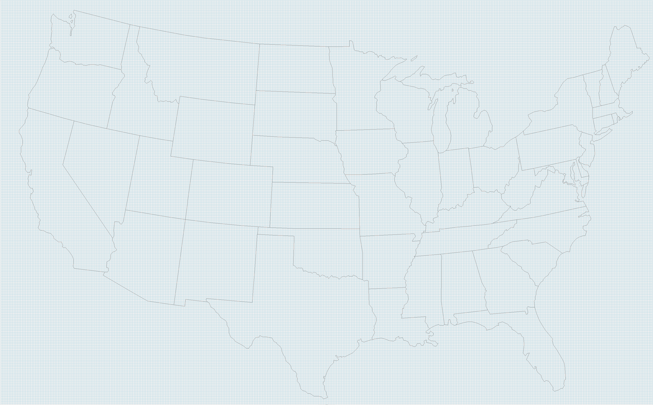
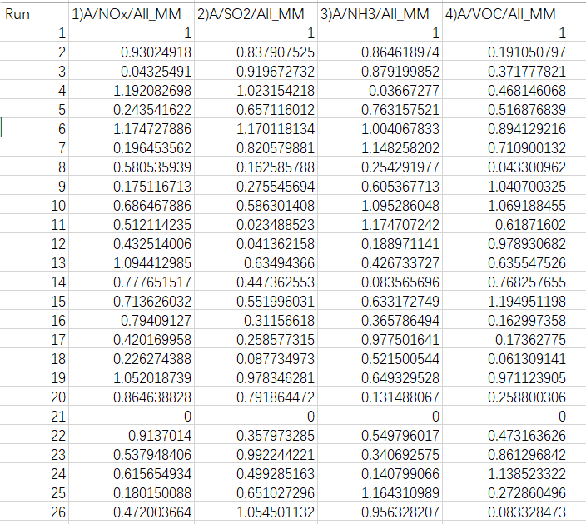
2.1 Model configuration and control matrix design of Entire US domain
2.1.1 CMAQ Configuration
2.1.2 Control Matrix Design for Entire US domain 2018
CMAQ Version: CMAQ5.3.2
Model domain grids: 396 * 246
Grid resolution：12km * 12km
Chemical mechanism: cb6r3_ae7_aq
Simulation Period: The whole year of 2018
1 Region: USA
4 Pollutants: NOx, SO₂, NH₃, VOCs
1 Sector: All manmade(ALL_MM)
4 factors = 4 pollutants * 1 region * 1 sector
26 CMAQ simulation cases: 1 base case, 19 cases created by HSS method (0-1.2) for non-linear factors, 1 clean boundary conditions, 5 cases for out of sample (OOS)
2.1.3 Data set of DeepRSM
Training cases: 21 US 2018 daily cases from January to December of 2018
（#1 - #21：21 cases * 12 months = 252 monthly runs）
OOS cases: 5 US 2018 daily cases from January to December of 2018
（#22 - #26：5 cases *12 months = 60 monthly runs）
1-21： training cases
Model domain: Entire US domain
22-26： Out of sample validation
Control Matrix

Slide 7
2.2 Validation of Entire US domain 2018 DeepRSM
2.2.1 Validation ( DeepRSM vs Opf-RSM )
As shown in the figures below, both DeepRSM and Opf-RSM have a good performance for US 2018 case in PM_{2.5} and O₃ , but the performance of DeepRSM is still worse than that of the Opf-RSM. Besides, the prediction of O₃ exhibits better performance than PM_{2.5} in both DeepRSM and Opf-RSM. To demonstrate the performance of DeepRSM in US 2018 case, the good, typical and poor cases for PM_{2.5} and O₃ will be selected to compare (Table 1) in the following slides based on the relative mean deviation (RMD).
Table 1. Selected cases for demonstration in the following slides
Item | O₃ | PM_{2.5}
Good case | May | May、January
Typical case | July | September
Poor case | January | December、July
DeepRSM
Opf-RSM

Slide 8
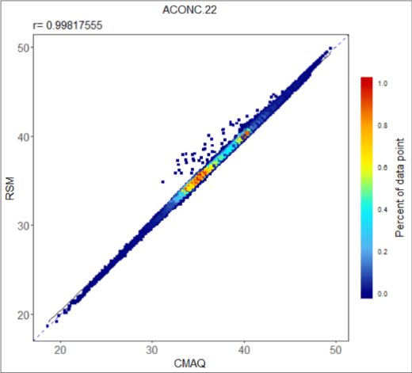
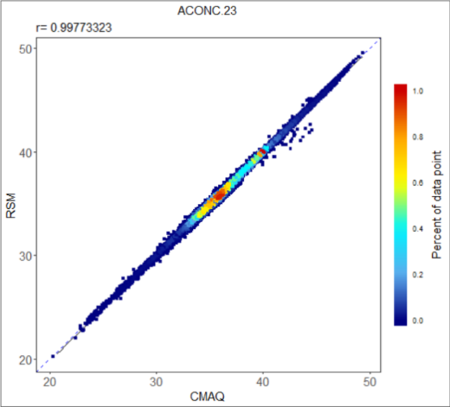
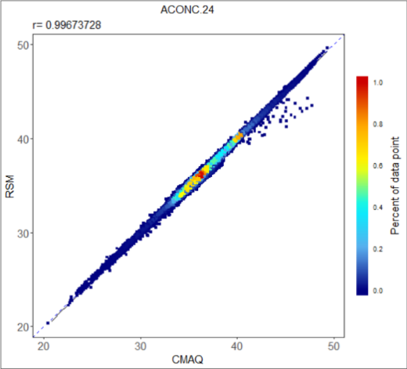
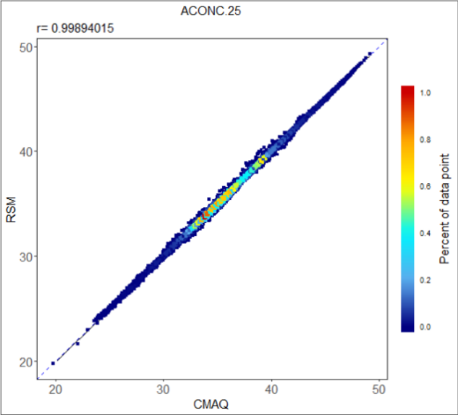
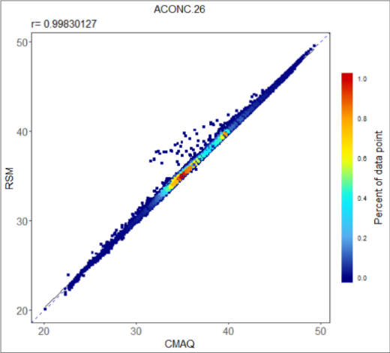
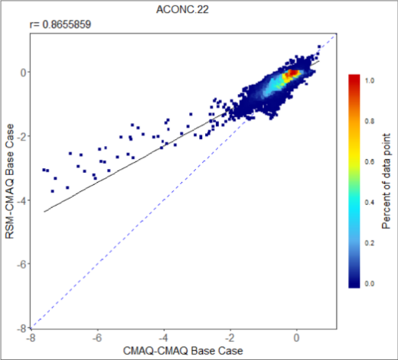
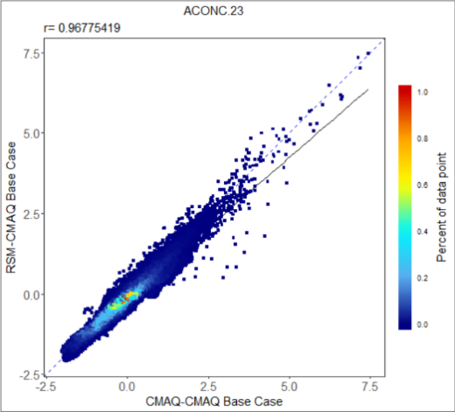
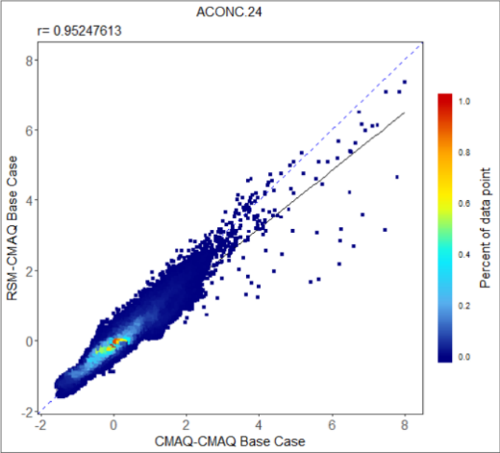
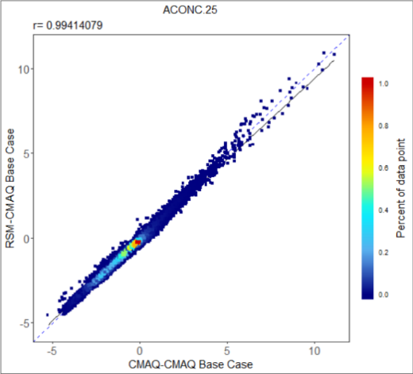
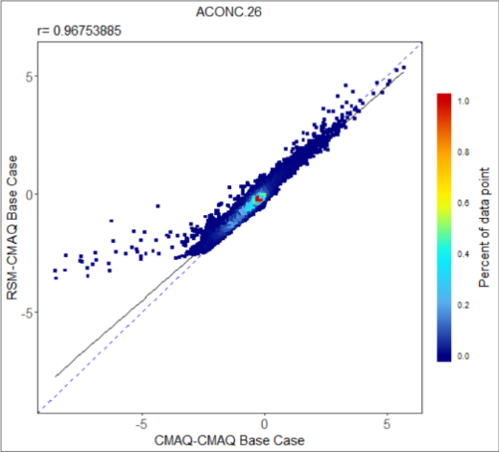
2.2 Validation of Entire US domain 2018 DeepRSM
Poor case (January) for monthly average MDA8 O₃ in Scatter plot with color density
RSM VS CMAQ:
RSM VS CMAQ (Base Response):

Slide 9
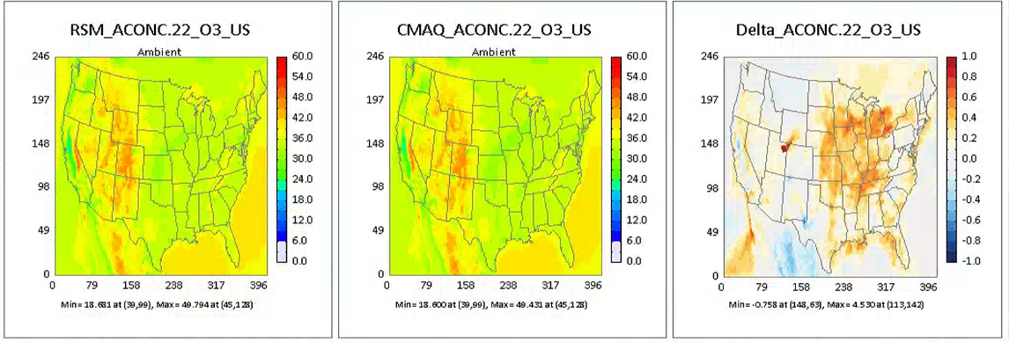
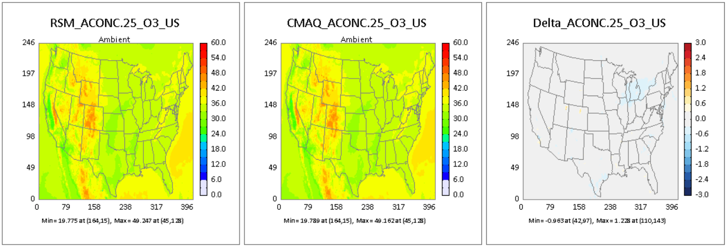
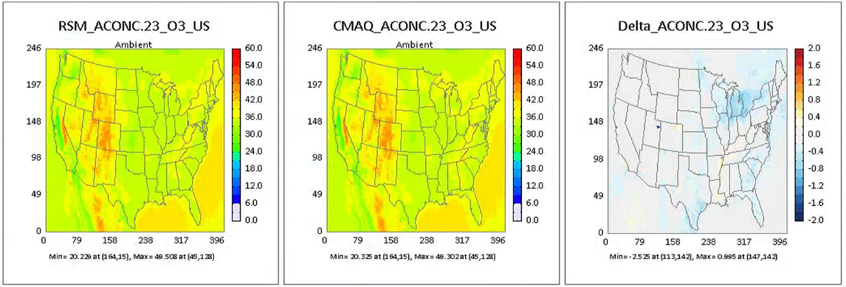
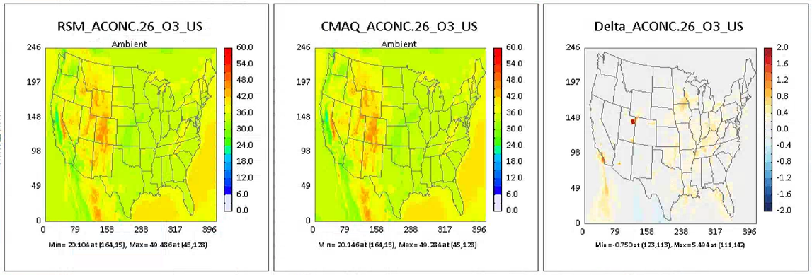
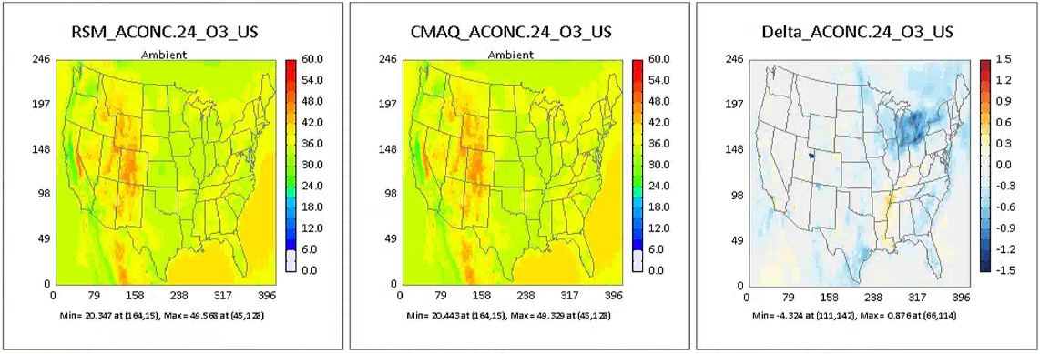
2.2 Validation of Entire US domain 2018 DeepRSM
Poor case (January) for monthly average MDA8 O₃ in concentration map
ACONC.22
ACONC.25
ACONC.23
ACONC.26
ACONC.24
Notes:
Ambient： Spatial distribution of pollutant concentration in control scenario

Slide 10
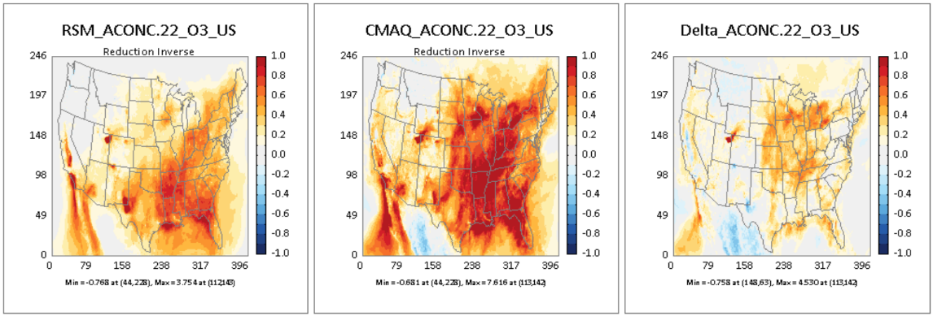
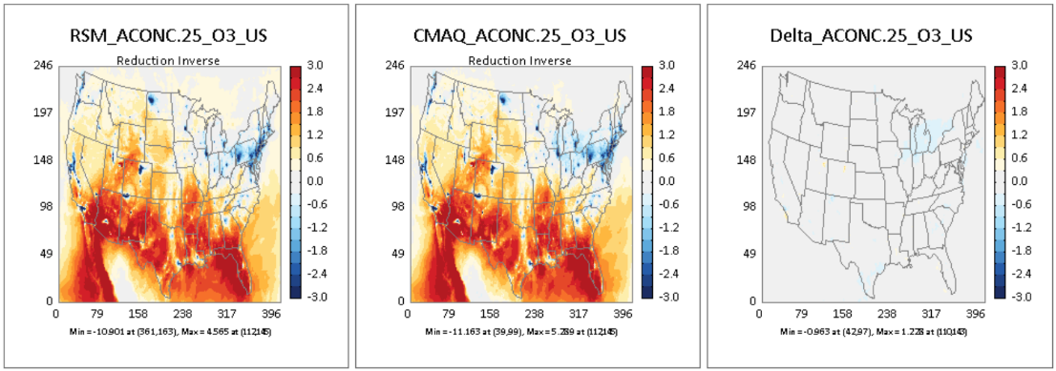
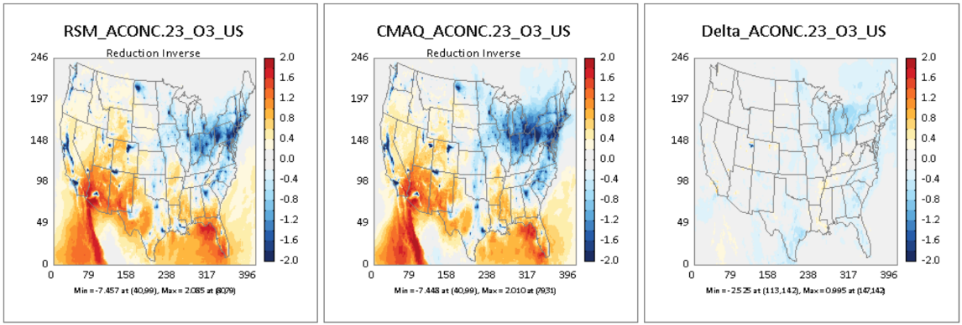
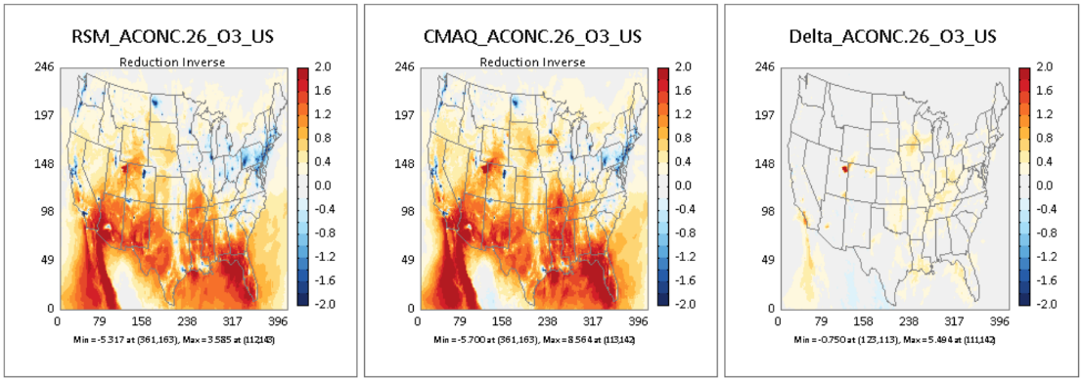
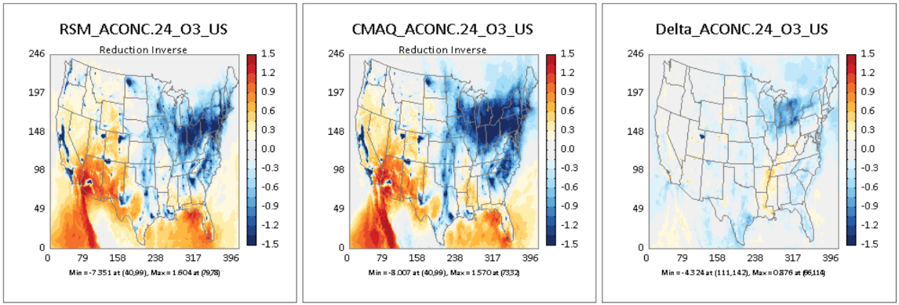
2.2 Validation of Entire US domain 2018 DeepRSM
Poor case (January) for monthly average MDA8 O₃ in concentration response map
ACONC.22
ACONC.25
ACONC.23
ACONC.26
ACONC.24
Notes:
Response： The difference between the baseline scenario and the control scenario

Slide 11
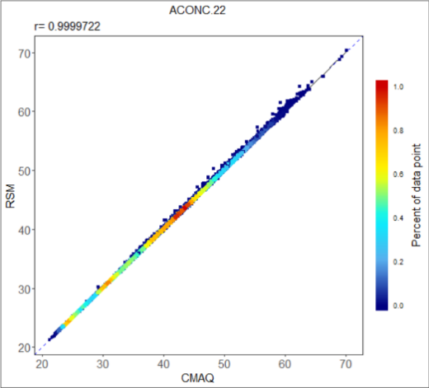
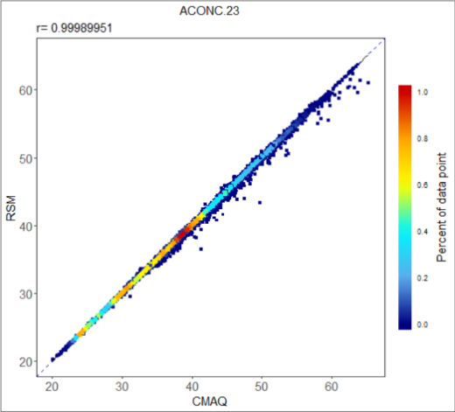
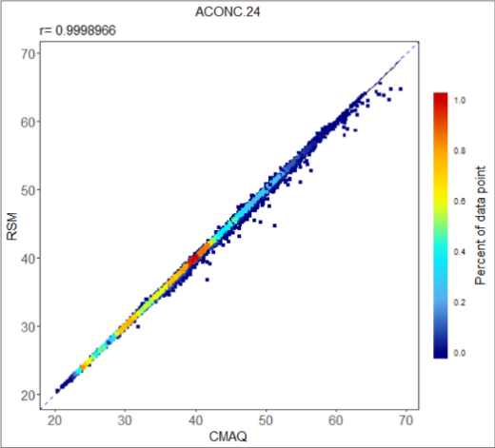
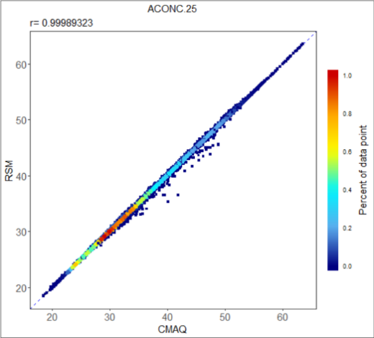
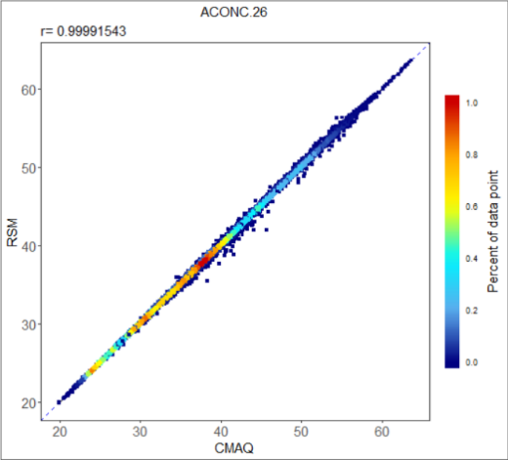
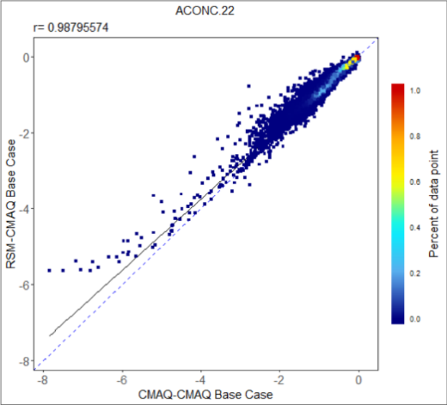
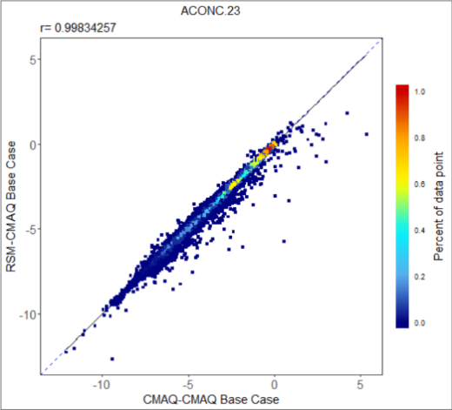
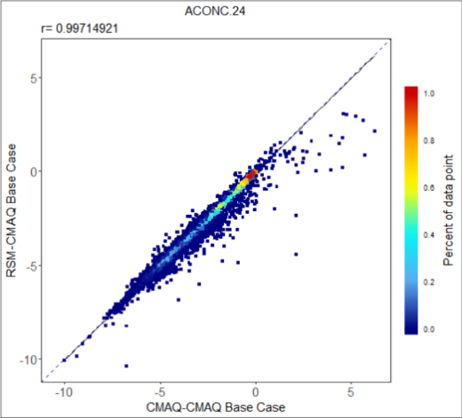
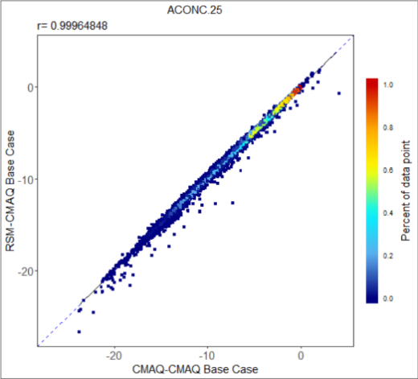
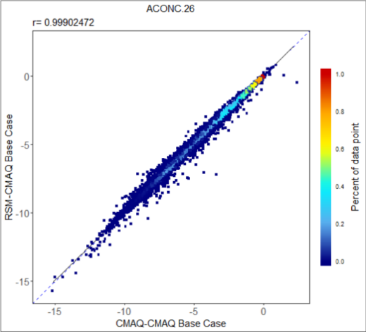
2.2 Validation of Entire US domain 2018 DeepRSM
Typical case (July) for monthly average MDA8 O₃ in Scatter plot with color density
RSM VS CMAQ:
RSM VS CMAQ(Base Response):

Slide 12
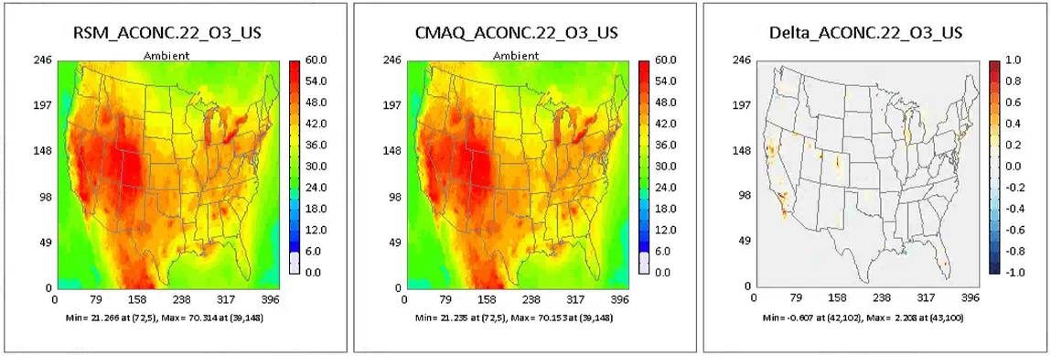
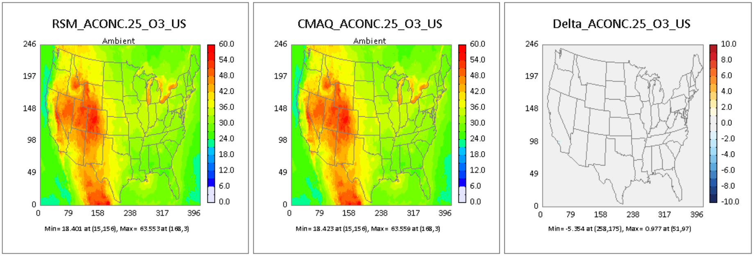
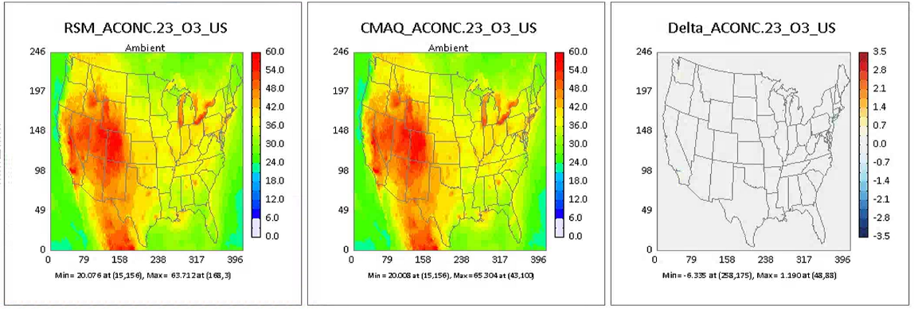
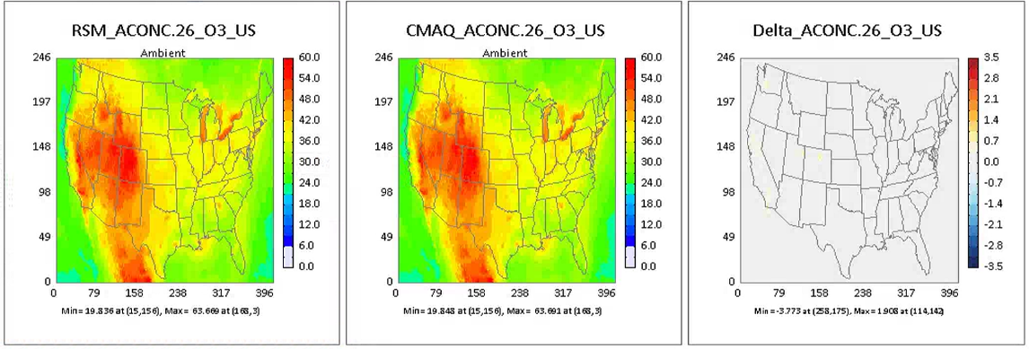
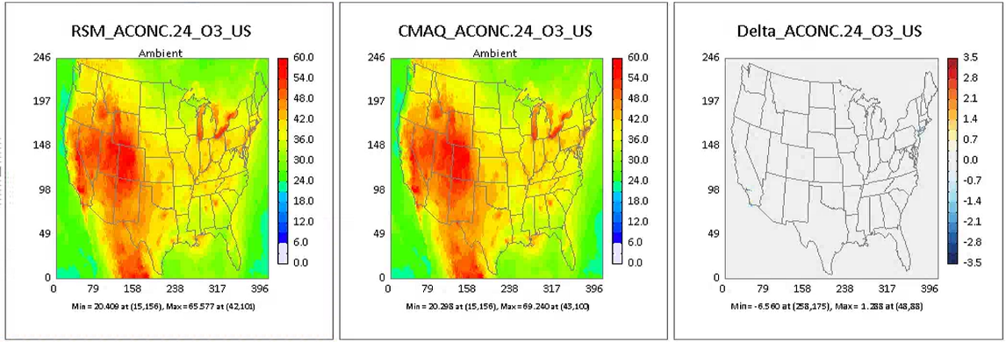
2.2 Validation of Entire US domain 2018 DeepRSM
Typical case (July) for monthly average MDA8 O₃ in concentration map
ACONC.22
ACONC.25
ACONC.23
ACONC.26
ACONC.24
Notes:
Ambient： Spatial distribution of pollutant concentration in control scenario

Slide 13
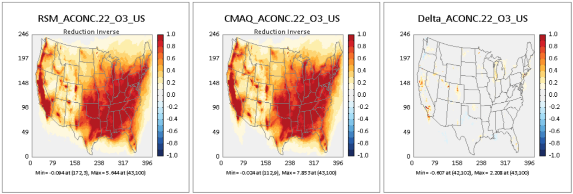
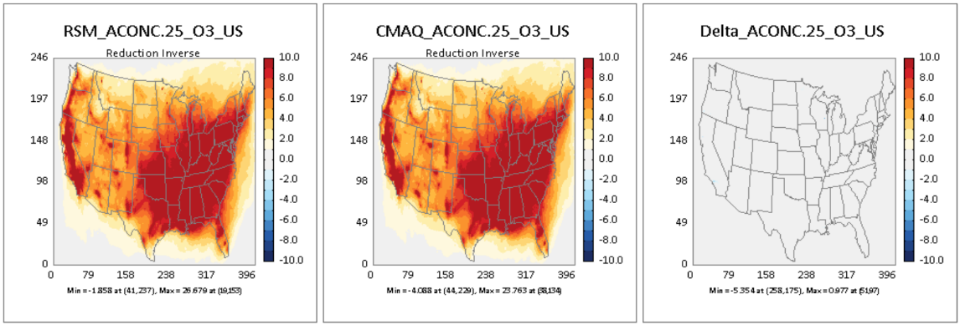
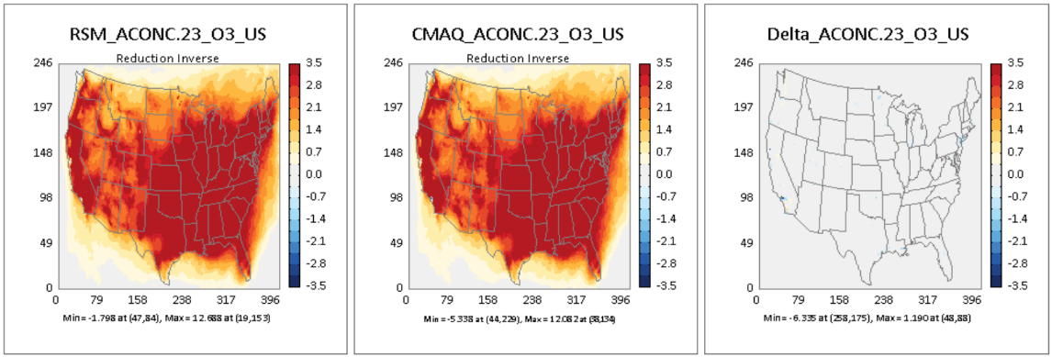
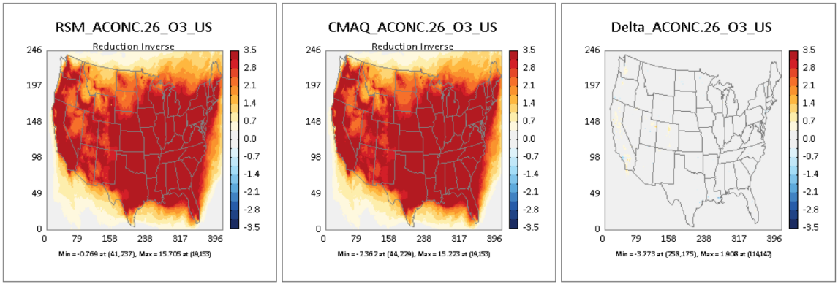
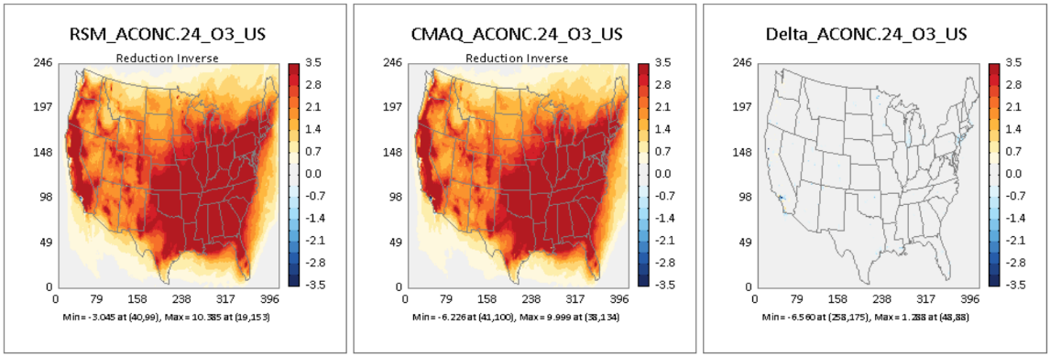
2.2 Validation of Entire US domain 2018 DeepRSM
Typical case (July) for monthly average MDA8 O₃ in concentration response map
ACONC.22
ACONC.25
ACONC.23
ACONC.26
ACONC.24
Notes:
Response： The difference between the baseline scenario and the control scenario

Slide 14










2.2 Validation of Entire US domain 2018 DeepRSM
Good case (May) for monthly average MDA8 O₃ in Scatter plot with color density
RSM VS CMAQ:
RSM VS CMAQ(Base Response):

Slide 15





2.2 Validation of Entire US domain 2018 DeepRSM
Good case (May) for monthly average MDA8 O₃ in concentration map
ACONC.22
ACONC.25
ACONC.23
ACONC.26
ACONC.24
Notes:
Ambient： Spatial distribution of pollutant concentration in control scenario

Slide 16





2.2 Validation of Entire US domain 2018 DeepRSM
Good case (May) for monthly average MDA8 O₃ in concentration response map
ACONC.22
ACONC.25
ACONC.23
ACONC.26
ACONC.24
Notes:
Response： The difference between the baseline scenario and the control scenario

Slide 17










2.2 Validation of Entire US domain 2018 DeepRSM
Poor case (January) for monthly average PM_{2.5} in Scatter plot with color density
RSM VS CMAQ:
RSM VS CMAQ(Base Response):

Slide 18





2.2 Validation of Entire US domain 2018 DeepRSM
Poor case (January) for monthly average PM_{2.5} in concentration map
ACONC.22
ACONC.25
ACONC.23
ACONC.26
ACONC.24
Notes:
Ambient： Spatial distribution of pollutant concentration in control scenario

Slide 19





2.2 Validation of Entire US domain 2018 DeepRSM
Poor case (January) for monthly average PM_{2.5} in concentration response map
ACONC.22
ACONC.25
ACONC.23
ACONC.26
ACONC.24
Notes:
Response： The difference between the baseline scenario and the control scenario

Slide 20










2.2 Validation of Entire US domain 2018 DeepRSM
Poor case (December) for monthly average PM_{2.5} in Scatter plot with color density
RSM VS CMAQ:
RSM VS CMAQ(Base Response):

Slide 21





2.2 Validation of Entire US domain 2018 DeepRSM
Poor case (December) for monthly average PM_{2.5} in concentration map
ACONC.22
ACONC.25
ACONC.23
ACONC.26
ACONC.24
Notes:
Ambient： Spatial distribution of pollutant concentration in control scenario

Slide 22





2.2 Validation of Entire US domain 2018 DeepRSM
Poor case (December) for monthly average PM_{2.5} in concentration response map
ACONC.22
ACONC.25
ACONC.23
ACONC.26
ACONC.24
Notes:
Response： The difference between the baseline scenario and the control scenario

Slide 23










2.2 Validation of Entire US domain 2018 DeepRSM
Typical case (September) for monthly average PM_{2.5} in Scatter plot with color density
RSM VS CMAQ:
RSM VS CMAQ(Base Response):

Slide 24





2.2 Validation of Entire US domain 2018 DeepRSM
Typical case (September) for monthly average PM_{2.5} in concentration map
ACONC.22
ACONC.25
ACONC.23
ACONC.26
ACONC.24
Notes:
Ambient： Spatial distribution of pollutant concentration in control scenario

Slide 25





2.2 Validation of Entire US domain 2018 DeepRSM
Typical case (September) for monthly average PM_{2.5} in concentration response map
ACONC.22
ACONC.25
ACONC.23
ACONC.26
ACONC.24
Notes:
Response： The difference between the baseline scenario and the control scenario

Slide 26










2.2 Validation of Entire US domain 2018 DeepRSM
Good case (May) for monthly average PM_{2.5} in Scatter plot with color density
RSM VS CMAQ:
RSM VS CMAQ(Base Response):

Slide 27





2.2 Validation of Entire US domain 2018 DeepRSM
Good case (May) for monthly average PM_{2.5} in concentration map
ACONC.22
ACONC.25
ACONC.23
ACONC.26
ACONC.24
Notes:
Ambient： Spatial distribution of pollutant concentration in control scenario

Slide 28





2.2 Validation of Entire US domain 2018 DeepRSM
Good case (May) for monthly average PM_{2.5} in concentration response map
ACONC.22
ACONC.25
ACONC.23
ACONC.26
ACONC.24
Notes:
Response： The difference between the baseline scenario and the control scenario

Slide 29










2.2 Validation of Entire US domain 2018 DeepRSM
Good case (July) for monthly average PM_{2.5} in Scatter plot with color density
RSM VS CMAQ:
RSM VS CMAQ(Base Response):

Slide 30





2.2 Validation of Entire US domain 2018 DeepRSM
Good case (July) for monthly average PM_{2.5} in concentration map
ACONC.22
ACONC.25
ACONC.23
ACONC.26
ACONC.24
Notes:
Ambient： Spatial distribution of pollutant concentration in control scenario

Slide 31





2.2 Validation of Entire US domain 2018 DeepRSM
Good case (July) for monthly average PM_{2.5} in concentration response map
ACONC.22
ACONC.25
ACONC.23
ACONC.26
ACONC.24
Notes:
Response： The difference between the baseline scenario and the control scenario

Slide 32
DeepRSM Training Report and Source Apportionment
1. What is DeepRSM?
2. DeepRSM Training Report of Entire US domain 2018 Case
Contents
3. DeepRSM Training Report of US Climate-Region July 2018
4. O₃ Source Attribution Evaluation in US Cases
5. PM_{2.5} Source Attribution Evaluation in US Cases

Slide 33


3.1 Model configuration and Data set of Climate-Region
3.1.1 CMAQ Configuration
3.1.3 Data set of building climate-region RSM
CMAQ Version: CMAQ5.3.2
Model domain grids: 396 * 246
Grid resolution：12km * 12km
Chemical mechanism: cb6r3_ae7_aq
Simulation Period: July 2018
DeepRSM Model: obtained from US 2018 daily cases training (January to December, not divided into regions, treating the entire United States as a single region)
Building multi-region RSM cases: 11 daily cases in July(1 base case, 1 clean boundary conditions per region)
OOS cases: 5 daily cases in July
3.1.2 Climate-Region division
The continental United States was divided into 10 regions based on climate zones:
10 Regions: CEN_CR, NE_CR, NPR_CR, NW_CR, S_CR, SE_CR, SW_CR, UPMW_CR, W_CR, OTHER
NW_CR
NPR_CR
1,222-231: used to build climate-region RSM
UPMW_CR
NE_CR
W_CR
CEN_CR
SW_CR
S_CR
SE_CR
OTHER
287-291: Out of sample validation
Control Matrix
Model domain: 10 regions

Slide 34
3.2 Validation of US Climate-Region July 2018 DeepRSM
3.2.1 Validation (Single-Region VS Climate-Region)
As shown in the figures below, both relative mean deviation (RMD) of O₃ and PM_{2.5} have an increase compared with RMD of Single-Region since the entire United States was divided into 10 regions according to climate zone. This result is similar to PRD training (i.e. the RMD of multi-region will be larger than that of single-region), but the RMD after rise is within an acceptable range. To demonstrate the performance of DeepRSM in US multi-region July 2018 case, scatter plot with color density and concentration response map for PM_{2.5} and O₃ will be exhibited in following slides based on the relative mean deviation (RMD). In addition, RMD of each region were also counted, the result will be displayed in next slide.
Single-Region
Climate-Region
O₃ (MDA8 average)
PM_{2.5} (Monthly average)
Fig.1 Daily RMD of O₃
Fig.2 Daily RMD of PM_{2.5}
Fig.3 Monthly Average RMD (July)
Notes:
Single-Region: Treat the entire United States as a region
Climate-Region: The entire model domain is divided into 10 regions

Slide 35
3.2 Validation of US Climate-Region July 2018 DeepRSM
3.2.2 Validation of each region
As shown in the figures below, relative mean deviation (RMD) varies by different region. RMD of O₃ in NE_CR、SE_CR、W_CR are restively higher than other regions. Besides, the RMD of PM_{2.5} in SW_CR is the highest compared with other regions, followed by W_CR、NW_CR、NRP_CR.
Per Region
Average
RMD of per region (O₃ MDA8 average PM_{2.5} monthly average)

Slide 36










3.2 Validation of US Climate-Region July 2018 DeepRSM
Case (July) for monthly average MDA8 O₃ in Scatter plot with color density
RSM VS CMAQ:
RSM VS CMAQ (Base Response):

Slide 37





3.2 Validation of US Climate-Region July 2018 DeepRSM
Case (July) for monthly average MDA8 O₃ in concentration map
ACONC.287
ACONC.290
ACONC.288
ACONC.291
ACONC.289
Notes:
Ambient： Spatial distribution of pollutant concentration in control scenario

Slide 38





3.2 Validation of US Climate-Region July 2018 DeepRSM
Case (July) for monthly average MDA8 O₃ in concentration response map
ACONC.287
ACONC.290
ACONC.288
ACONC.291
ACONC.289
Notes:
Response： The difference between the baseline scenario and the control scenario

Slide 39










3.2 Validation of US Climate-Region July 2018 DeepRSM
Case (July) for monthly average PM_{2.5} in Scatter plot with color density
RSM VS CMAQ:
RSM VS CMAQ(Base Response):

Slide 40





3.2 Validation of US Climate-Region July 2018 DeepRSM
Case (July) for monthly average PM_{2.5} in concentration map
ACONC.287
ACONC.290
ACONC.288
ACONC.291
ACONC.289
Notes:
Ambient： Spatial distribution of pollutant concentration in control scenario

Slide 41





3.2 Validation of US Climate-Region July 2018 DeepRSM
Case (July) for monthly average PM_{2.5} in concentration response map
ACONC.287
ACONC.290
ACONC.288
ACONC.291
ACONC.289
Notes:
Response： The difference between the baseline scenario and the control scenario

Slide 42
DeepRSM Training Report and Source Apportionment
1. What is DeepRSM?
2. DeepRSM Training Report of Entire US domain 2018 Case
Contents
3. DeepRSM Training Report of US Climate-Region July 2018
4. O₃ Source Attribution Evaluation in US Cases
5. PM_{2.5} Source Attribution Evaluation in US Cases

Slide 43
4.1 Configuration of source attribution evaluation method
4.1.1 Configuration of DDM and HDDM
4.1.2 Configuration of ISAM
CMAQ Version: CMAQ5.3.2
Model domain grids: 396 * 246
Grid resolution：12km * 12km
Chemical mechanism: cb6r3_ae7_aq
Simulation Period: July in 2018
Model domain: the entire of US
CMAQ Version: CMAQ5.3.2
Model domain grids: 396 * 246
Grid resolution：12km * 12km
Chemical mechanism: cb6r3_ae7_aq
Simulation Period: July in 2018
Model domain: the entire of US
1 Sector: All manmade(ALL_MM)
1 Sector: All manmade(ALL_MM)
2 Pollutants: NOx, VOCs
Species:
NOx : NO, NO₂
VOCs : TOL, XYLMN, BENZENE, NAPH, PAR, PRPA, MEOH, ETH, ETOH, OLE, ACET, FORM, GLY, KET, ETHY, ALD2, ETHA, IOLE, ALDX, ISOP, TERP, APIN
The 12 built-in sources were merged into three. For NOx (VOCs), set all species to zero except those belonging to NOx (VOCs):
 | EGGNOx | EPTNOx | ECMVNOx
NOx | GR_EMIS_N, GR_FIRE_N | PT_EGU_N, PT_NEGU_N, PT_OILG_N, PT_RXF_N, PT_F_N, PT_OTHF_N, PT_AGF_N, PT_OTH_N | PT_C1C2_N, PT_C3_N
 | EGGVOC | EPTVOC | ECMVVOC
VOCs | GR_EMIS_V, GR_FIRE_V | PT_EGU_V, PT_NEGU_V, PT_OILG_V, PT_RXF_V, PT_F_V, PT_OTHF_V, PT_AGF_V, PT_OTH_V | PT_C1C2_V, PT_C3_V
The results of HDDM and DDM will be compared with the results of Opf-RSM and DeepRSM, and the specific comparison chart will be shown on the next slides.

Slide 44


4.2 Comparison of source attribution evaluation method results
4.2.1 The result of NO_{x} or VOC reduction with different method in July
NOx or VOC each reduction in Jul 2018
The total amount of DeepRSM and Opf-RSM source contribution is generally consistent with “Total”, demonstrating the accuracy of their simulations, but both their VOCs exhibit a slight negative contribution, indicating that there are still problems with the algorithms.
CMAQ BF: NOx or VOC
Opf-RSM BF: NOx or VOC
DeepRSM BF: NOx or VOC
Opf-RSM
DeepRSM
HDDM
DDM
CMAQ BF: Total
CMAQ BF: NOx or VOC
Opf-RSM BF: NOx or VOC
DeepRSM BF: NOx or VOC
Opf-RSM
DeepRSM
HDDM
DDM
CMAQ BF: Total
CMAQ BF: NOx or VOC
Opf-RSM BF: NOx or VOC
DeepRSM BF: NOx or VOC
Opf-RSM
DeepRSM
HDDM
DDM
CMAQ BF: Total
ISAM
CMAQ BF: NOx or VOC
Opf-RSM BF: NOx or VOC
DeepRSM BF: NOx or VOC
Opf-RSM
DeepRSM
HDDM
DDM
CMAQ BF: Total
Note: “Total” means the difference between the base case and the control case (100%, 75%, 50% and 25% reduction of NO_{x}, VOC, NH₃ and SO₂).
O₃ MDA8 Jul Avg (ppbv)
Note: All source attribution results in section 4 are for the entire US domain.

Slide 45
4.2 Comparison of source attribution evaluation method results
4.2.2 The result of NO_{x} or VOC reduction with different method in August
NOx or VOC each reduction in Aug 2018
Opf-RSM BF: NOx or VOC
DeepRSM BF: NOx or VOC
Opf-RSM
DeepRSM
Opf-RSM BF: NOx or VOC
DeepRSM BF: NOx or VOC
Opf-RSM
DeepRSM
Opf-RSM BF: NOx or VOC
DeepRSM BF: NOx or VOC
Opf-RSM
DeepRSM
Opf-RSM BF: NOx or VOC
DeepRSM BF: NOx or VOC
Opf-RSM
DeepRSM
O₃ MDA8 Aug Avg (ppbv)

Slide 46

4.2 Comparison of source attribution evaluation method results
4.2.3 The result of NO_{x} or VOC reduction with different method in September
NOx or VOC each reduction in Sep 2018
Opf-RSM BF: NOx or VOC
DeepRSM BF: NOx or VOC
Opf-RSM
DeepRSM
Opf-RSM BF: NOx or VOC
DeepRSM BF: NOx or VOC
Opf-RSM
DeepRSM
Opf-RSM BF: NOx or VOC
DeepRSM BF: NOx or VOC
Opf-RSM
DeepRSM
Opf-RSM BF: NOx or VOC
DeepRSM BF: NOx or VOC
Opf-RSM
DeepRSM
O₃ MDA8 Sep Avg (ppbv)

Slide 47

4.2 Comparison of source attribution evaluation method results
4.2.4 The result of NO_{x} or VOC reduction with different method in October
NOx or VOC each reduction in Oct 2018
Opf-RSM BF: NOx or VOC
DeepRSM BF: NOx or VOC
Opf-RSM
DeepRSM
Opf-RSM BF: NOx or VOC
DeepRSM BF: NOx or VOC
Opf-RSM
DeepRSM
Opf-RSM BF: NOx or VOC
DeepRSM BF: NOx or VOC
Opf-RSM
DeepRSM
Opf-RSM BF: NOx or VOC
DeepRSM BF: NOx or VOC
Opf-RSM
DeepRSM
O₃ MDA8 Oct Avg (ppbv)

Slide 48



4.3 Contour maps of NO_{x}-VOC-O₃
As shown in Figure 1 and 2, the O₃ contour plots for DeepRSM and Opf-RSM are almost identical and show a predominant contribution of NO_{x} to O₃ and little contribution of VOC to O₃.
O₃ MDA8 Jul Avg
O₃ MDA8 Jul Avg
VOC
ppbv
VOC
ppbv
NO_{x}
NO_{x}
Fig. 1. DeepRSM's O₃ MDA8 Monthly Average Contour Plot (Jul)
Fig. 2. Opf-RSM's O₃ MDA8 Monthly Average Contour Plot (Jul)

Slide 49



4.3 Contour maps of NO_{x}-VOC-O₃
O₃ MDA8 Aug Avg
O₃ MDA8 Aug Avg
VOC
ppbv
VOC
ppbv
NO_{x}
NO_{x}
Fig. 3. DeepRSM's O₃ MDA8 Monthly Average Contour Plot (Aug)
Fig. 4. Opf-RSM's O₃ MDA8 Monthly Average Contour Plot (Aug)

Slide 50



4.3 Contour maps of NO_{x}-VOC-O₃
O₃ MDA8 Sep Avg
O₃ MDA8 Sep Avg
VOC
ppbv
VOC
ppbv
NO_{x}
NO_{x}
Fig. 5. DeepRSM's O₃ MDA8 Monthly Average Contour Plot (Sep)
Fig. 6. Opf-RSM's O₃ MDA8 Monthly Average Contour Plot (Sep)

Slide 51



4.3 Contour maps of NO_{x}-VOC-O₃
O₃ MDA8 Oct Avg
O₃ MDA8 Oct Avg
VOC
ppbv
VOC
ppbv
NO_{x}
NO_{x}
Fig. 7. DeepRSM's O₃ MDA8 Monthly Average Contour Plot (Oct)
Fig. 8. Opf-RSM's O₃ MDA8 Monthly Average Contour Plot (Oct)

Slide 52
DeepRSM Training Report and Source Apportionment
1. What is DeepRSM?
2. DeepRSM Training Report of Entire US domain 2018 Case
Contents
3. DeepRSM Training Report of US Climate-Region July 2018
4. O₃ Source Attribution Evaluation in US Cases
5. PM_{2.5} Source Attribution Evaluation in US Cases

Slide 53
5.1 PM_{2.5} Source Attribution Evaluation in US Cases
As shown in the figure below, the results of DeepRSM and Opf-RSM source contribution analysis are almost similar.
Opf-RSM BF
DeepRSM BF
Opf-RSM
DeepRSM
Opf-RSM BF
DeepRSM BF
Opf-RSM
DeepRSM
Opf-RSM BF
DeepRSM BF
Opf-RSM
DeepRSM
Opf-RSM BF
DeepRSM BF
Opf-RSM
DeepRSM
Note: “BF” means controlling NO_{x}, VOC, NH₃ , SO₂ or PM_{2.5} in turn.

Slide 54


5.2 Contour maps of NO_{x}-NH₃-PM_{2.5}
As shown in Figure 10 and 11, the PM_{2.5} contour plots for DeepRSM and Opf-RSM are almost identical and show a predominant contribution of NH₃ to PM_{2.5} and little contribution of NO_{x} to PM_{2.5} .
PM_{2.5} Jul Avg
PM_{2.5} Jul Avg
NH₃
ppbv
NH₃
ppbv
NO_{x}
NO_{x}
Fig. 10. DeepRSM’s PM_{2.5} Monthly Average Contour Plot (Jul)
Fig. 11. Opf-RSM's PM_{2.5} Monthly Average Contour Plot (Jul)

Slide 55


5.3 Contour maps of NO_{x}-SO₂-PM_{2.5}
As shown in Figures 12 and 13, the PM_{2.5} contour plots of DeepRSM and Opf-RSM have similar trends, and the contribution levels of NO_{x} and SO₂ to PM_{2.5} are similar.
PM_{2.5} Jul Avg
PM_{2.5} Jul Avg
SO₂
ppbv
SO₂
ppbv
NO_{x}
NO_{x}
Fig. 12. DeepRSM’s PM_{2.5} Monthly Average Contour Plot (Jul)
Fig. 13. Opf-RSM's PM_{2.5} Monthly Average Contour Plot (Jul)

