Slide 1
Multipollutant Planning for Louisville, KY
OAQPS – Research Triangle Park, NC
February 2018

Slide 2
Evaluating Multipollutant AQ at Local Level
Understand
First develop a conceptual model for the area of interest: What extent does this area have a multipollutant issue?
Consult
Meet with the locals and local air districts to focus on community concerns (visit 9/21-22): What are the concerns? Are they multipollutant in nature?
Engage
Determine roles and responsibilities with respective EPA Region: How to coordinate and collaborate with the state/local air district?
Partner
Partner to develop a comprehensive plan to address multipollutant AQ issues: Can it be combined with NAAQS implementation or “advance” programs?

Slide 3
Pollutant Concerns: Louisville, KY
Ozone NAAQS
  Clean for 1997 NAAQS, ozone advance for 2008 NAAQS, "marginal" nonattainment for 2015 NAAQS
    Attainment deadline is August 3, 2021
  Is the area VOC or NOx limited?
    LMAPCD recently released Request for Proposal (RFP)
Odors from VOCs
  Community complaints about odors in Rubbertown (industrial chemical area)
    EJ concerns as well
  Ethanol – 9.5 million pounds annually from distilleries
    Contribution to O₃ levels?
  Ongoing research
    Sensor study; an odor wheel app; gas chromatograph (oVET)
Air Toxics Risk
  1,3d butadiene spikes in area
    LMAPCD investigating

Slide 4
Louisville Multipollutant Highlights
Focused on developing an O₃ control strategy to address nonattainment—how to design an effective program that may also address other concerns such as odor, ethanol, etc?
Not all VOCs are HAPs – from a multipollutant view, what HAP reductions could assist on ozone strategies?
  RFP on O₃ formation to inform ozone reactivity
Is there a link between ethanol emissions and local ozone formation?
  Ethanol is not one of the listed 187 HAPs
Are there sources to control for O₃ purposes that also emit direct PM_{2.5} or precursors (NOx or SO₂)?

Slide 5
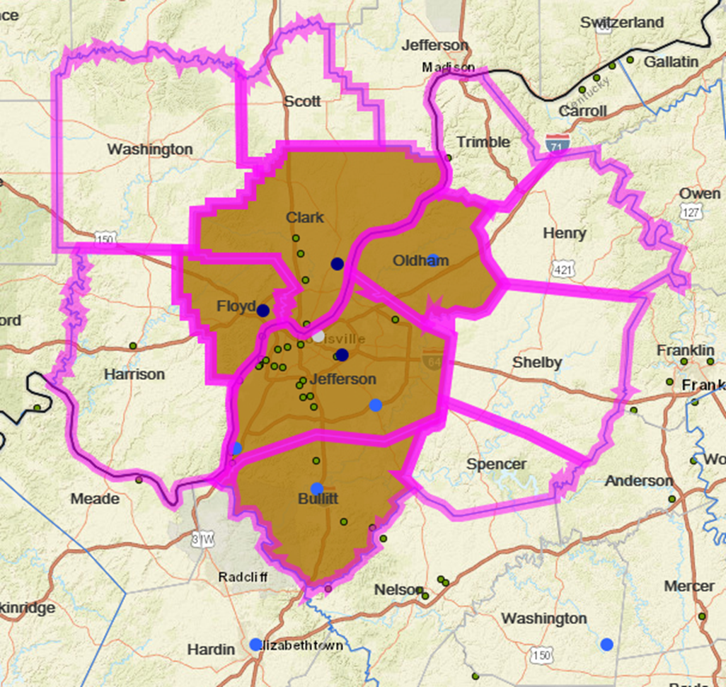
Ozone Ambient Air Characterization
Multistate O₃ nonattainment area - KY/IN
12 county CBSA, 5 counties are NAA for 2015 NAAQS
Violating monitors (dark blue) with most recent DV of 75, while monitors in light blue are below NAAQS and in white with no value
  Clark, IN – 71 ppb
  Floyd, IN – 72 ppb
  Jefferson, KY – 75 ppb

Slide 6
Ozone Trends: Jefferson County, KY
2014-2016 = 74 ppb, 2015-2017 = 75 ppb, 2016-2018 = 75 ppb* (preliminary)
Investigating seasonality of high ozone, i.e., months with ozone exceedances. LMAPCD indicated that they occur May – end of summer.

Slide 7
2023 Ozone Design Value Projections (Released 6/18)
Site | 2009-2013 Avg | 2009-2013 Max | 2016-2018* | 2023 Max
211110051 – Watson Lane | 78.5 | 79 | 68 | 64.8
211110067 – Canons Lane | 85.0 | 85 | 75 | 70.1
Attainment deadline is in 2021
Existing Federal measures like Tier 3 will impact the monitors and we expect reductions in ozone concentrations such that the area will attain the NAAQS.

Slide 8
EPA Modeled Ozone Contributions:
CSAPR Update
The total pollution in any area forms from the combination of local and upwind sources.
States – anthropogenic NOx and VOC emissions from the contiguous 48 states and DC
Biogenics – biogenic NOx and VOC emissions domain-wide
Global boundary – concentrations transported into the modeling domain from the lateral boundaries
Other – could include offshore, tribal and fires emissions

Slide 9
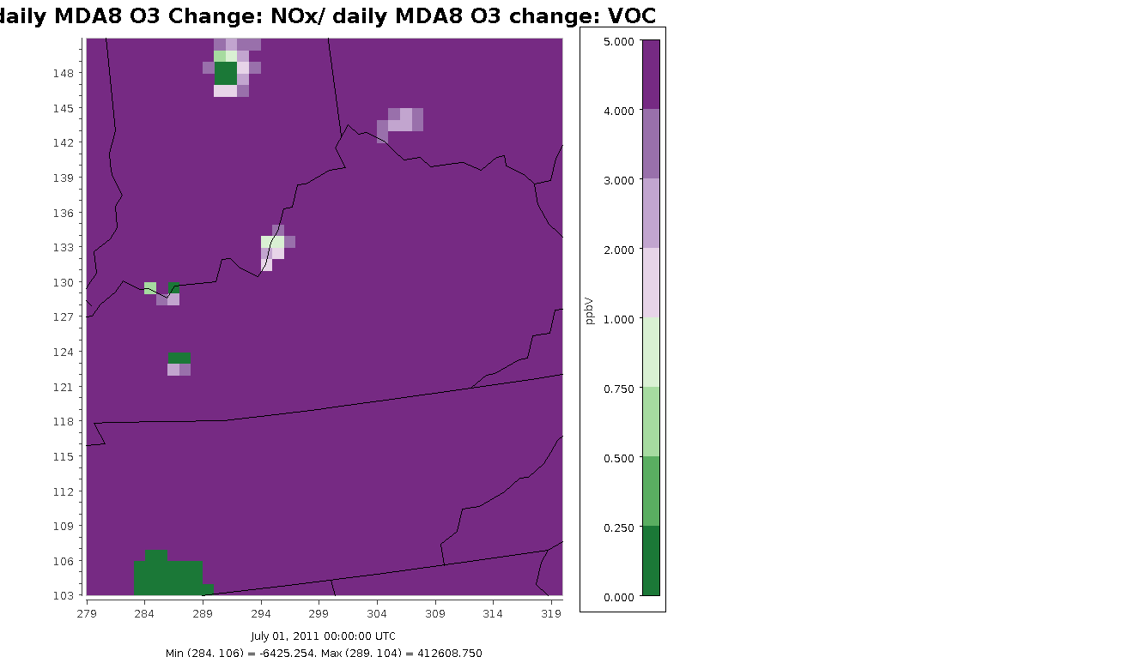
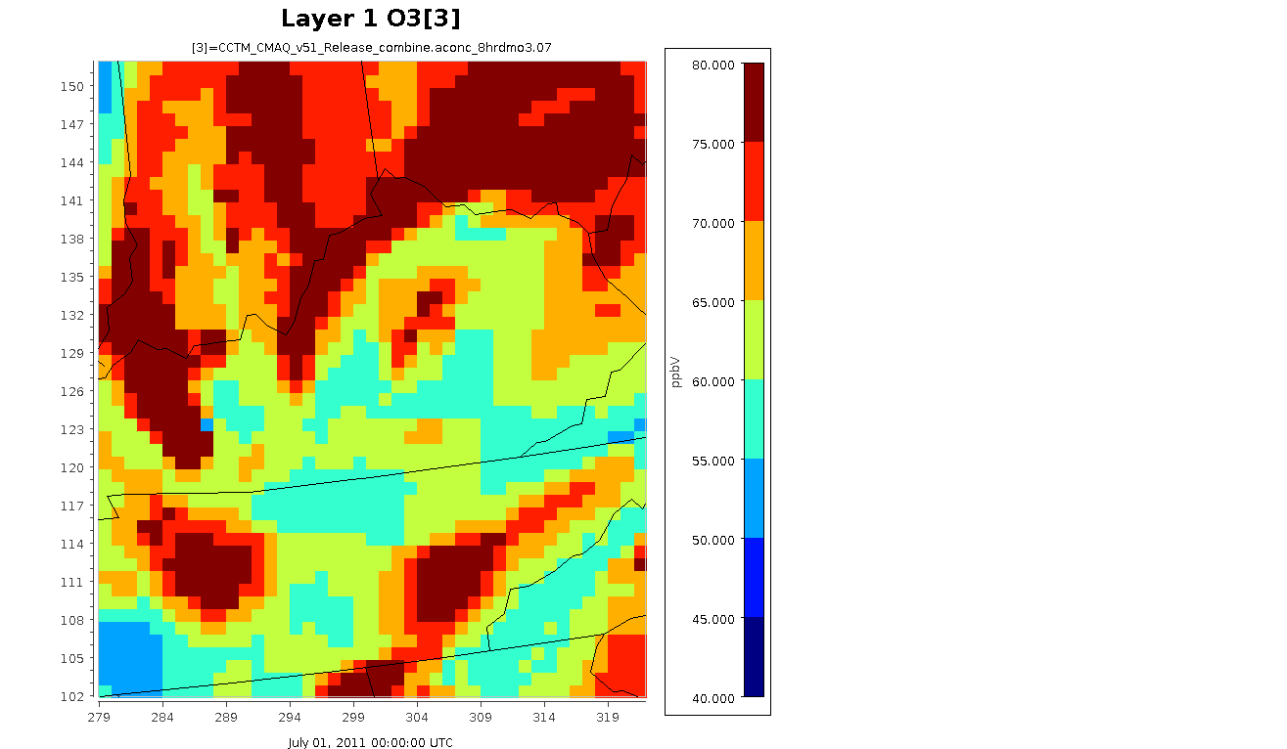
This modeling was performed for a single summer month in the peak of an ozone season (July 2011). This type of analysis does not give any information about how effective local VOC or NOx emissions reductions would necessarily be, but can be informative in identifying which areas would see a benefit in terms of lower ozone concentrations from additional reductions in VOC or NOx emissions.
Ozone Formation - VOC or NOx Limited?
LMAPCD has released an RFP to fund research to inform them whether area is NOx or VOC limited
and, thus better able to identify effective control measures.
EPA conducted modeling for O₃ Advance program that indicates area is NOx limited
Video on the left displays the NOx/VOC sensitivity. Ratios greater than one (shown in purple) indicate that ozone was reduced more effectively by similar percentage reductions in NOx emissions. Video on the right displays ozone concentrations for the corresponding days.

Slide 10
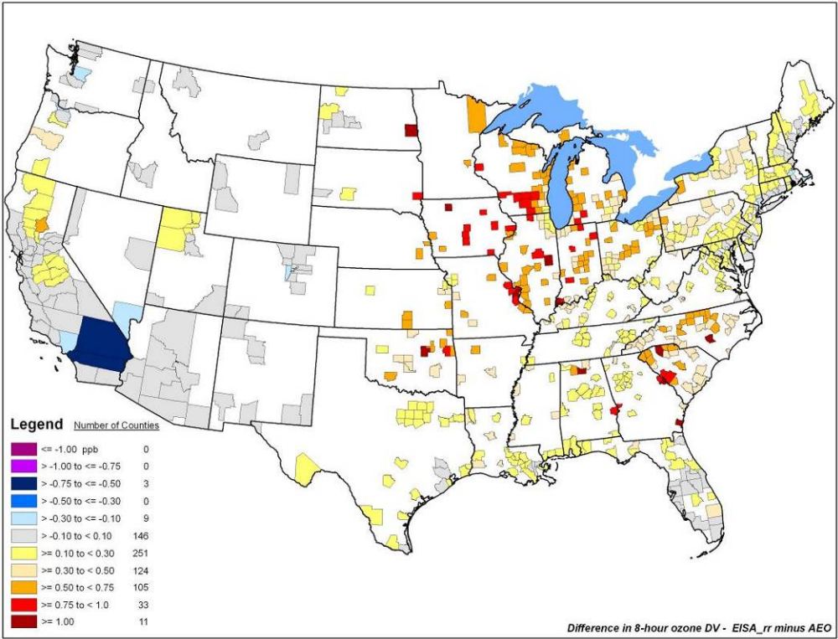
ETHANOL – RFS2 Rule
Will Ethanol reductions help reduce O₃ levels in Louisville?
EPA modeling for RFS rule shows some potential for reductions.
OTAQ RFS modeling shows ethanol has some ozone impacts

Slide 11
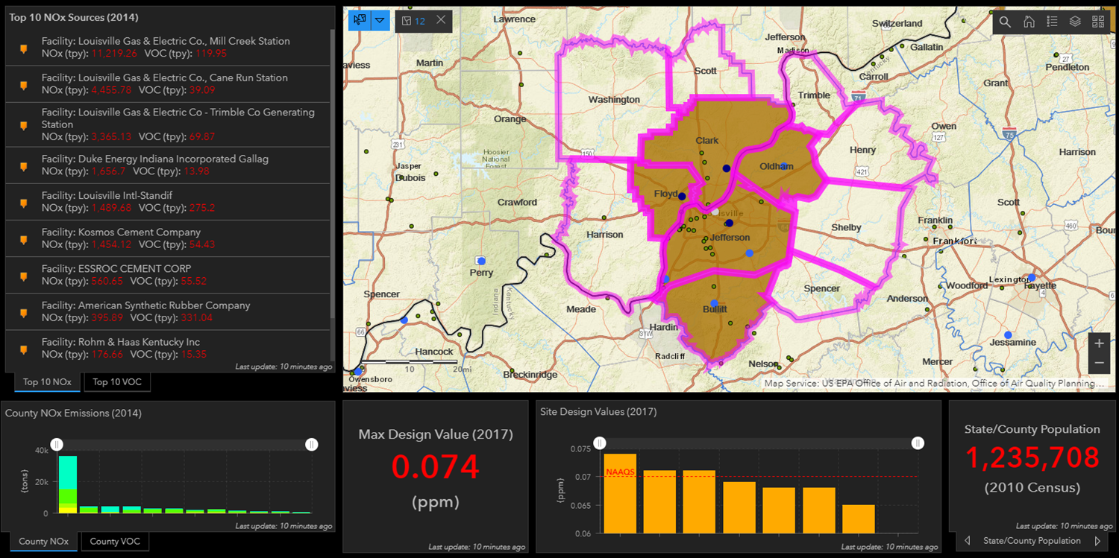
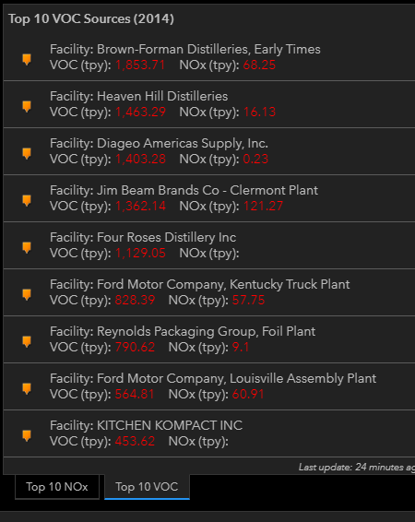
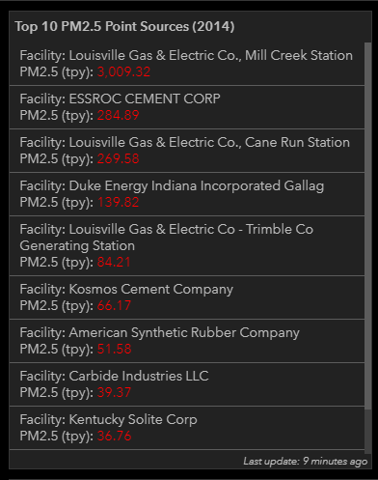
Top 10 Pollutant Sources in Jefferson County, KY
Source: NAAQS Dashboard based on 2014 NEI

Slide 12
Source Summary
Local NOx Emissions Changes
  Louisville Gas & Electric Co. Mill Creek – Recent upgrades to comply with MATS
  Louisville Gas & Electric Co. Cane Run – Coal to gas conversion in 2015
  Kosmos Cement – subject to SO₂ monitoring per LMAPCD agreement with source
Top 5 VOC emitters are alcohol distilleries
  Co-control of NOx?
  Would reductions also address odor and ethanol concerns?
These same sources also emit direct PM_{2.5} providing co-control opportunities with associated local public health benefits?
  Potential to address EJ concerns depending upon the proximity of source to sensitive populations?
Year | Cane Run | Mill Creek | Trimble | Gallagher
2014 | 4,448 | 11,213 | 3,365 | 1,657
2015 | 1,640 | 8,504 | 2,935 | 940
2016 | 427 | 6,886 | 2,906 | 649
2017 | 317 | 6,983 | 2,367 | 393

Slide 13
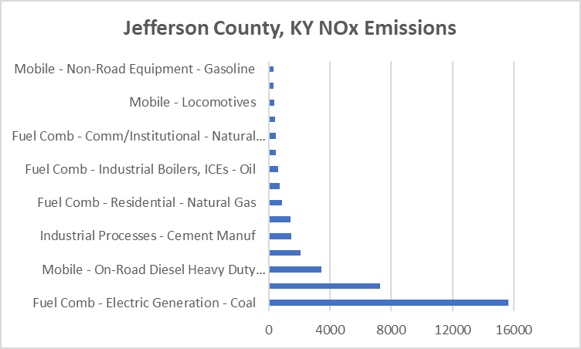

Slide 15
Developing Multipollutant Risk Based Control Strategy?
Louisville wants an ozone control strategy with following considerations:
  NOx or VOC emissions reductions to most effectively reduce O₃ (depending on outcome of study below)
  Potential VOC emission reductions to address air toxic concerns
  Potential co-control of PM_{2.5} at sources evaluated for NOx/VOC reductions
How can EPA help?
  Consult/provide insights on RFP project regarding O₃ formation that will inform focus on NOx or VOC emissions to most effectively reduce O₃
  Provide any VOC/ethanol data analyses to determine if joint control possible
  Provide control and cost data for sources of interest
  Provide BenMAP data to illustrate health benefits of O₃ concentration reductions and co-benefits for PM_{2.5} reductions
  Provide NATA risk based analysis to illustrate air toxic risk reduction opportunities
  Provide information to inform EJ assessment of control strategies
Develop a plan to define and coordinate activities across EPA OAQPS, EPA Region 4, state and LMAPCD

