Slide 1
Multi-Pollutant Update 3-Division Meeting
Beth Landis
May 4, 2020

Slide 2
PLEASE INSERT A GENERAL INTRO SLIDE THAT PROVIDES SOME STRUCTURE TO WHAT IS PROVIDED HERE

Slide 3
PLEASE INSERT AN INTRO SLIDE THAT PROVIDES SOME STRUCTURE SPECIFIC TO LOUISVILLE EFFORT

Slide 4
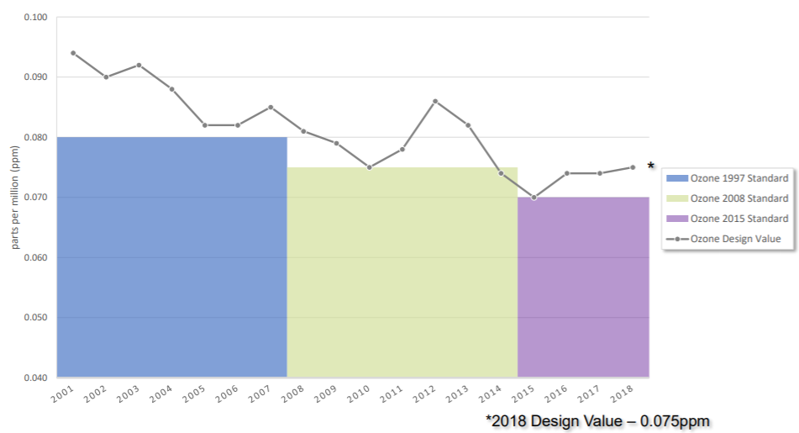
Louisville - Pollutant Concerns
Ozone
Clean for 1997 NAAQS
Advance for 2008 NAAQS
Marginal nonattainment for 2015 NAAQS
Attainment deadline August 3, 2021
Odors from VOCs
Community complaints about odors in Rubbertown (industrial chemical area)
EJ concerns as well

Slide 5
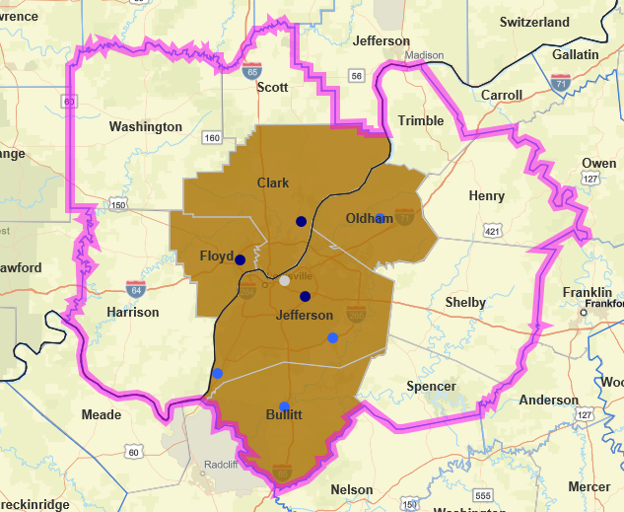
O₃ Ambient Air Characterization*
Graphic Created Using EPA NAAQS Dashboard
Multistate marginal O₃ NAA - KY/IN
12 county CBSA -- 5 counties marginal NAA for 2015 NAAQS
2015-2017 DVs:
Jefferson, KY – 74 ppb
Clark, IN – 71 ppb
Floyd, IN – 71 ppb
2018 Preliminary DV of 75 ppb
Dark Blue – violating monitor
Light Blue – below NAAQS
White – no value
*Adapted from Conceptual Model created by Gobeail McKinley

Slide 6
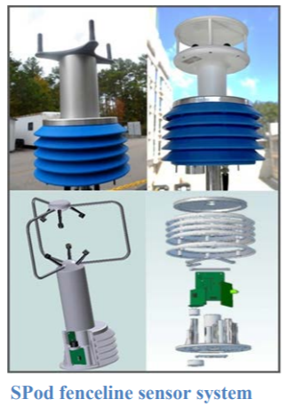
ORD Projects in Louisville
Rubbertown Next Generation Emission Measurement (NGEM) Demonstration Project¹
R4 RARE Project
SPod fenceline sensors evaluation
Citizen Science Regional Sustainability and Environmental Sciences (RECES) Project²
Phone app for citizens to report odors
Regional State Innovation Projects³
Odor VOC Emissions Tracker (oVET) combines fenceline VOC sensor, automated GC, & canister sampling to detect & locate fugitive odor causing air toxic VOC emission sources
¹ https://louisvilleky.gov/sites/default/files/air_pollution_control_district/documents/allother/2017/rubbertown_ngem_external_science_in_action_final_draft_090517.pdf
² https://louisvilleky.gov/sites/default/files/air_pollution_control_district/documents/allother/2018/community-leader-meeting-8-20-18-epa-citizen-science-project-odor-app.pdf
³ https://www.epa.gov/innovation/multi-component-voc-sensor-system-fugitive-emissions-and-odor-identification

Slide 7
BenMAP Results: Jefferson County, KY
Retrospective Analysis
Determined health benefits from PM_{2.5} reductions from 2014 to 2018
73-165 avoided premature adult deaths/year (value of $635M - $1,440M, 2018$)
Rollback Analysis using Ramboll Results
Total estimated health benefits from across-the-board reductions of VOCs and NOx by 25% (in 2018$)
Sensitivity 1 NOx: $74 – 152 Million
Sensitivity 2 VOC: $16 – 27 Million
Analysis completed by Ali Kamal / Chris Davis
Notes:
Slides 10-12 have more detailed results

Slide 8
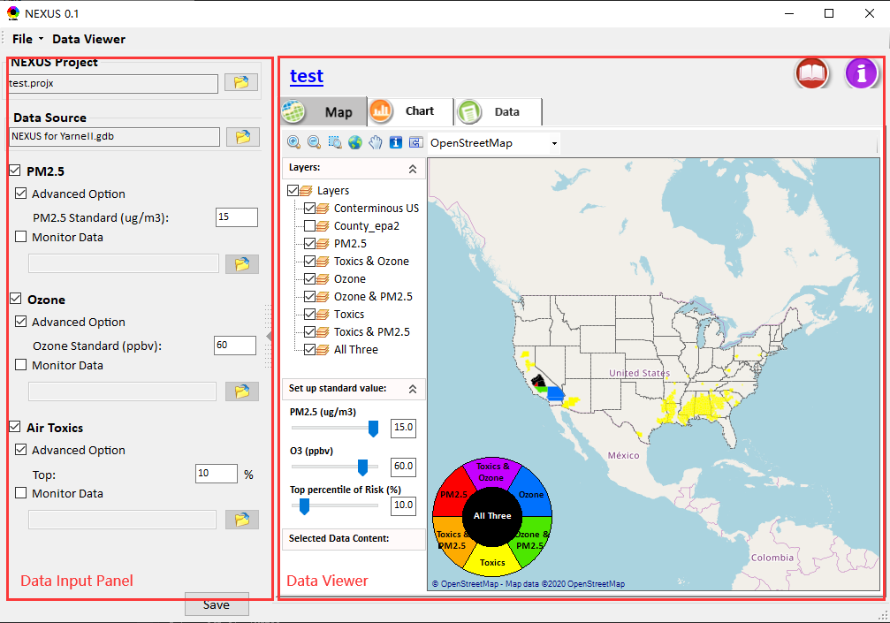
NEXUS Tool Development
NEXUS tool is being developed to identify geographic areas where health risks related to O₃, PM_{2.5} and air toxics overlap and will be used to identify additional areas for Multi-P collaboration
Notes:
The broader goal for NEXUS is to create a user-friendly screening tool such that regions, states, local agencies, and other institutions can conduct their own multi-pollutant, risk-based screening analyses
The screening tool should have different data presentations for understanding and communicating an area’s potential multi-pollutant risk, including (i) characterizing the air quality issues in terms of pollutant concentrations and risks and (ii) identifying source(s) that may contribute to the air quality issues and related risks.
2014 Version NEXUS Created in HEID - 2020 Version NEXUS Created in AQAD (Carey Jang)

Slide 9
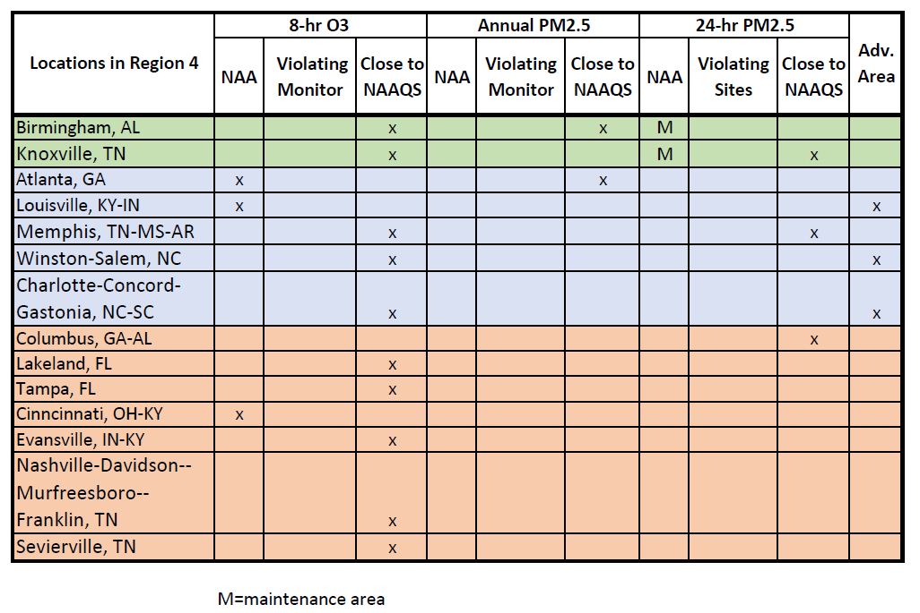
Initial MP Info for Region 4

Slide 10
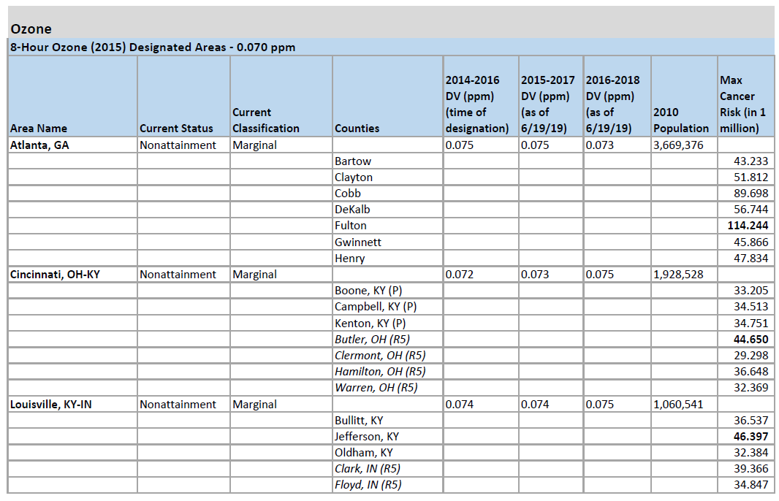
Initial MP Info for Region 4

Slide 11
Multi-Pollutant Team
MP Team Members
HEID
Beth Landis / Kimber Scavo
Robin Langdon / Darryl Weatherhead
Ben Gibson (Binational MP projects)
Rob Pinder
Chris Davis (BenMAP)
Carrie Wheeler
AQPD
Rich Damberg / Megan Brachtl (Advance)
AQAD
Carey Jang / Tyler Fox (NEXUS)
Region 4
Jane Spann / Lynorae Benjamin
Scott Davis
Gobeail McKinley, Ali Kamal & Laura Bunte also provided substantial contributions to the MP Team but are no longer members due to duty changes

Slide 12
Additional Slides

Slide 13
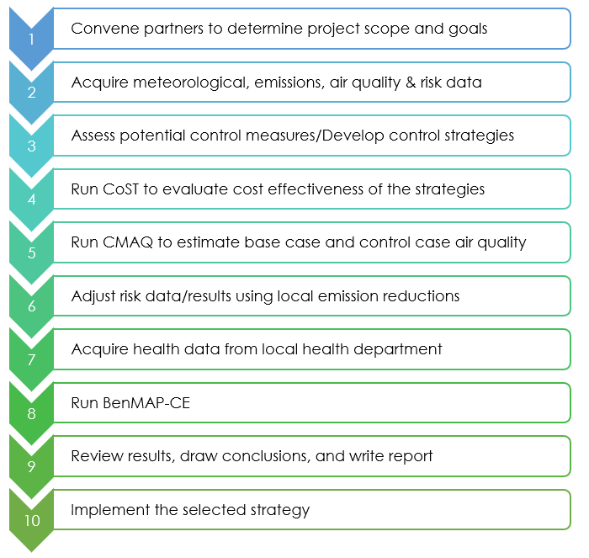
MP Assessment Process
Adapted from the SC Report (pages 23-24) - https://www.epa.gov/sites/production/files/2016-05/documents/usepa-south_carolina_final_report_may_26_16_2.pdf

Slide 14
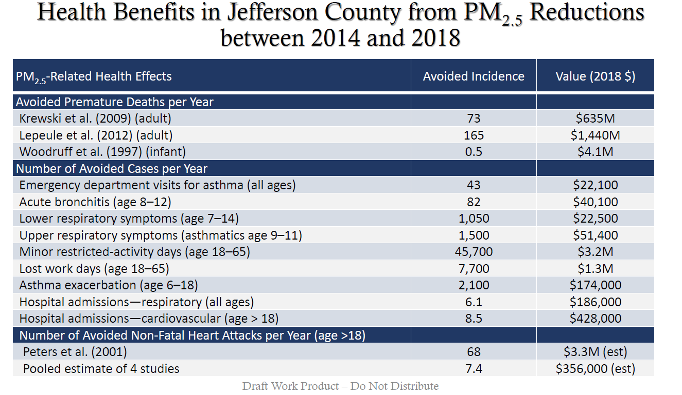

Slide 15
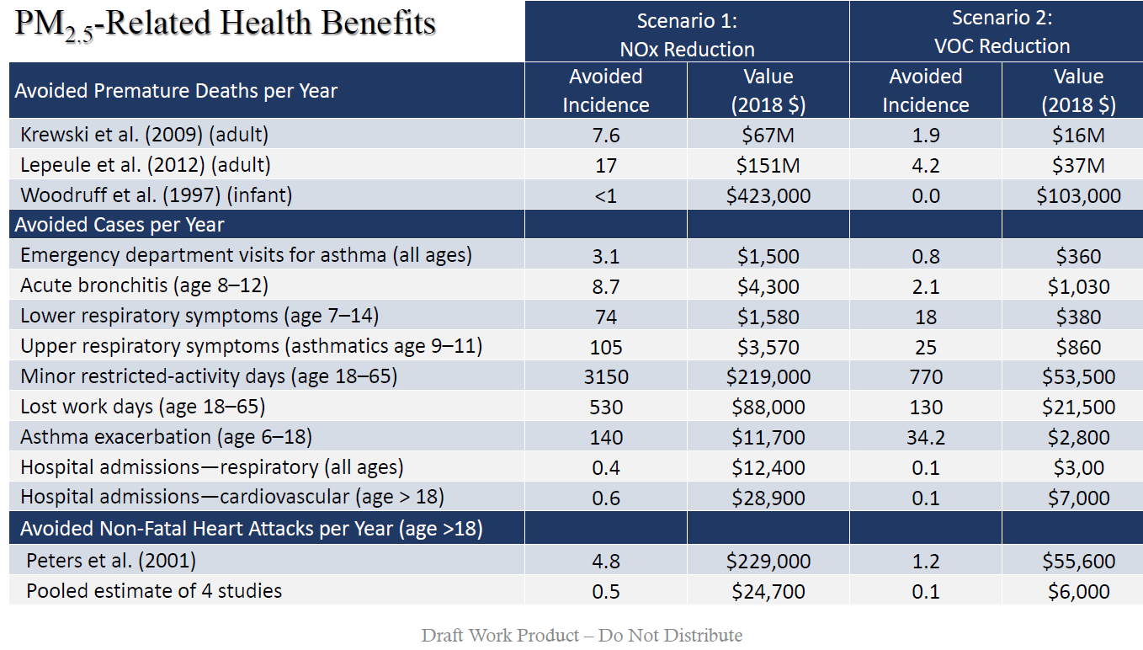

Slide 16
