Slide 1
Multi-Pollutant Update 3-Division Meeting
Beth Landis
May 4, 2020

Slide 2
Outline
Louisville MP Project Background
Pollutant Concerns
ORD Projects
O₃ Ambient Air Characterization
NEXUS Tool Development
Ozone Formation Study
BenMAP Results
MP Info in Region 4

Slide 3
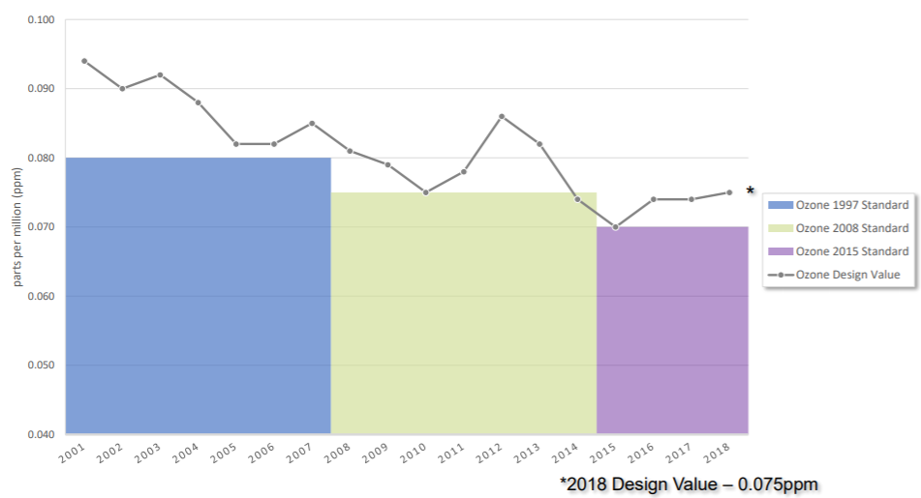
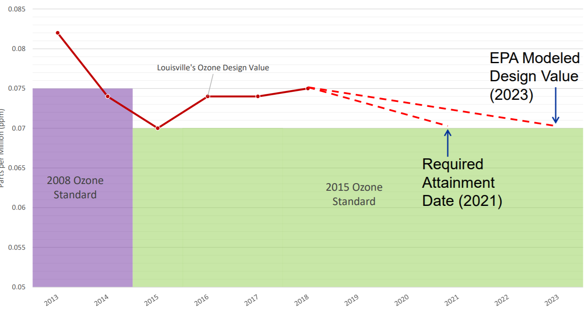
Louisville - Pollutant Concerns
Ozone
Clean for 1997 NAAQS
Advance for 2008 NAAQS
Marginal nonattainment for 2015 NAAQS
Attainment deadline August 3, 2021
Odors from VOCs
Community complaints about odors in Rubbertown (industrial chemical area)
EJ concerns as well
https://louisvilleky.gov/sites/default/files/air_pollution_control_district/documents/allother/2019/mpsg_mtg_20191106.pdf

Slide 4
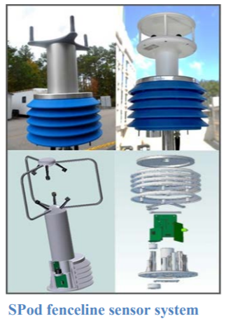
ORD Projects in Louisville
Rubbertown Next Generation Emission Measurement (NGEM) Demonstration Project¹
R4 RARE Project
SPod fenceline sensors evaluation
Citizen Science Regional Sustainability and Environmental Sciences (RECES) Project²
Phone app for citizens to report odors
Regional State Innovation Projects³
Odor VOC Emissions Tracker (oVET) combines fenceline VOC sensor, automated GC, & canister sampling to detect & locate fugitive odor causing air toxic VOC emission sources
¹ https://louisvilleky.gov/sites/default/files/air_pollution_control_district/documents/allother/2017/rubbertown_ngem_external_science_in_action_final_draft_090517.pdf
² https://louisvilleky.gov/sites/default/files/air_pollution_control_district/documents/allother/2018/community-leader-meeting-8-20-18-epa-citizen-science-project-odor-app.pdf
³ https://www.epa.gov/innovation/multi-component-voc-sensor-system-fugitive-emissions-and-odor-identification

Slide 5
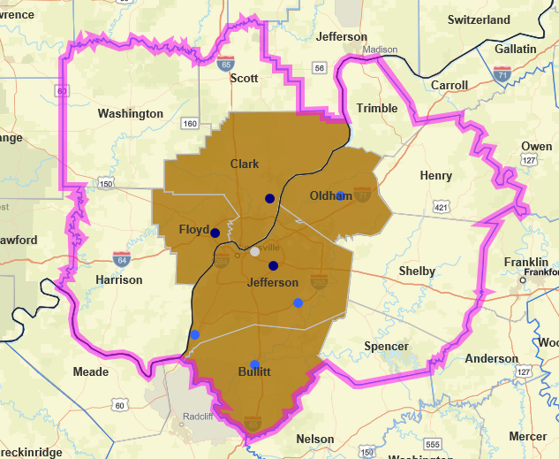
O₃ Ambient Air Characterization*
Graphic Created Using EPA NAAQS Dashboard
Multistate marginal O₃ NAA - KY/IN
12 county CBSA -- 5 counties marginal NAA for 2015 NAAQS
2015-2017 DVs:
Jefferson, KY – 74 ppb
Clark, IN – 71 ppb
Floyd, IN – 71 ppb
2018 Preliminary DV of 75 ppb
Dark Blue – violating monitor
Light Blue – below NAAQS
White – no value
*Adapted from Conceptual Model created by Gobeail McKinley
Notes:
Transport issues – recent CSAPR Update modeling shows ~30 percent from home state and ~30% from upwind states

Slide 6
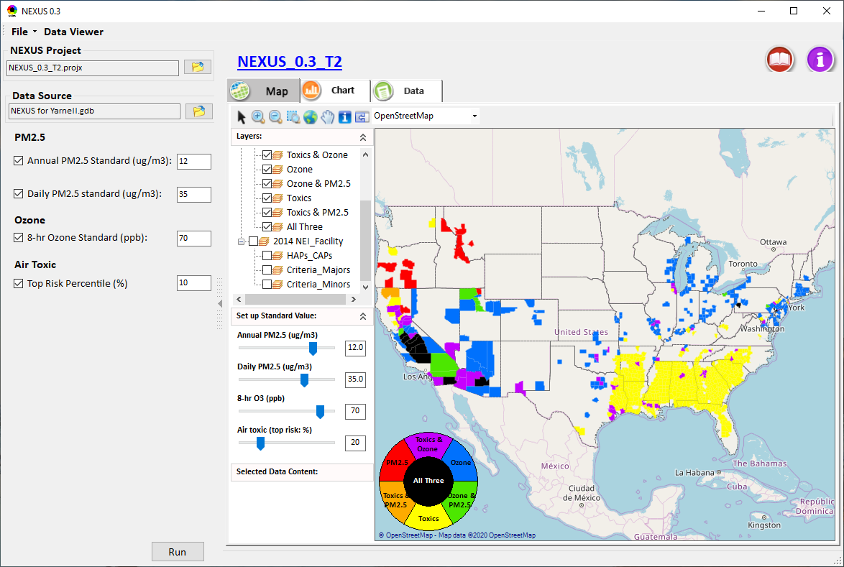
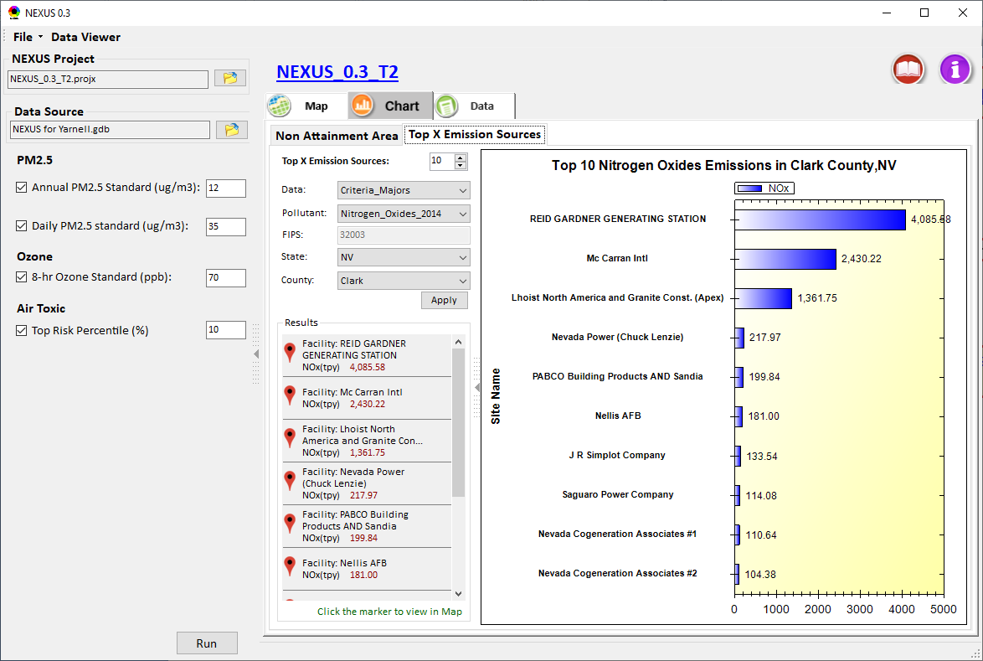
NEXUS Tool Development
A new NEXUS tool is being developed to identify geographic areas where health risks related to O₃, PM_{2.5} and air toxics overlap and will be used to identify additional areas for MP collaboration
Data Input
Data Viewer
Data Query
Notes:
The broader goal for NEXUS is to create a user-friendly screening tool such that regions, states, local agencies, and other institutions can conduct their own multi-pollutant, risk-based screening analyses
The screening tool should have different data presentations for understanding and communicating an area’s potential multi-pollutant risk, including (i) characterizing the air quality issues in terms of pollutant concentrations and risks and (ii) identifying source(s) that may contribute to the air quality issues and related risks.
2014 Version NEXUS Created in HEID - 2020 Version NEXUS Created in AQAD (Carey Jang)
New Nexus tool – Phase 1 prototype developed; Currently work on improving Phase 1 prototype based on MP team’s feedback and developing Phase 2 functions for regional analysis and data query; Anticipate to have a functional tool for demo in July.

Slide 7
LMAPCD Ozone Formation Study (OFS)
LMAPCD funded the OFS conducted by Ramboll
Goal: refine understanding of O₃ formation in Louisville / Jefferson Co. O₃ NAA to inform strategic policy decisions
Objectives:
Develop comprehensive EI suitable for modeling O₃ formation
Develop modeling tool useful for analyzing ozone formation processes
Understand the sensitivity of Louisville O₃ to emissions precursors
Findings:
Model-ready EI developed using data available to LMAPCD
Model has acceptable performance for ozone
When regional emissions reduced, Louisville/Jefferson County ozone is more NOx sensitive than VOC sensitive
NOx emissions reductions decrease modeled ozone by 3.8 ppb in Jefferson County vs. 1.3 ppb for VOC emissions reductions¹
On select days, ozone within Jefferson County has similar response to NOx and VOC emissions reductions
¹ Based on average of Top 10 days
² https://louisvilleky.gov/sites/default/files/air_pollution_control_district/documents/allother/2019/ramboll_mpsm_20191120_final.pdf

Slide 8
BenMAP Results: Jefferson County, KY*
Retrospective Analysis
Determined health benefits from PM_{2.5} reductions from 2014 to 2018
1.67 µg/m³ change in Average Annual PM_{2.5} across Jefferson County
73-165 avoided premature adult deaths/year (value of $635M - $1,440M, 2018$)
Rollback Analysis using Ramboll Results
Total estimated health benefits from across-the-board reductions of VOCs and NOx by 25% (in 2018$)
Sensitivity 1 NOx: $74 – 152 Million
0.18 µg/m³ PM_{2.5} and 0.76 ppb O₃ reductions
Sensitivity 2 VOC: $16 – 27 Million
0.042 µg/m³ PM_{2.5} and 0.30 ppb O₃ reductions
Analysis completed by Ali Kamal / Chris Davis
*Additional details in Appendix Slides 16-18

Slide 9
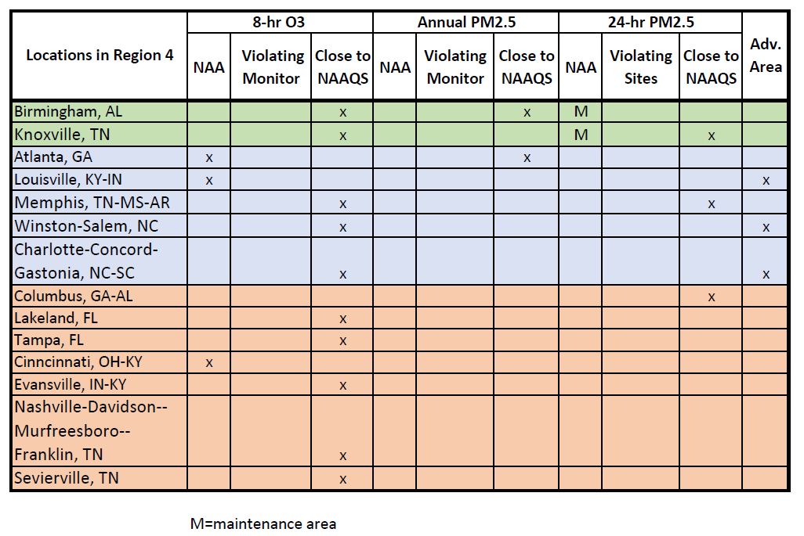
Preliminary MP Info for Region 4

Slide 10
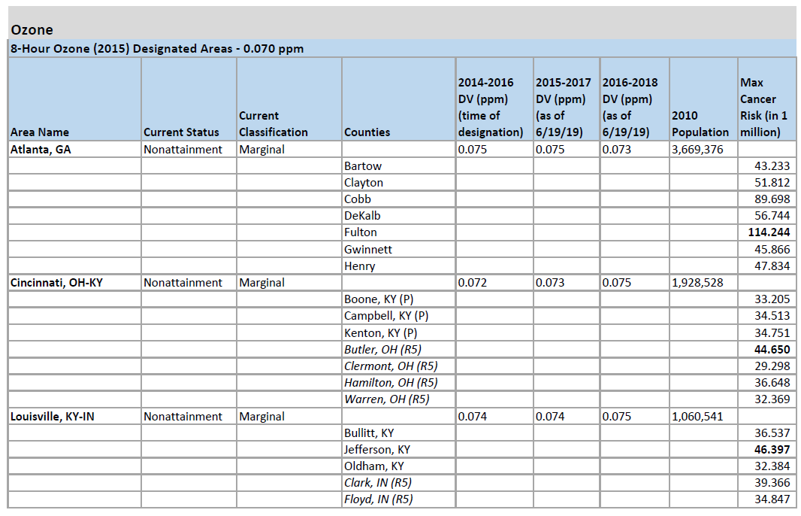
Preliminary MP Info for Region 4

Slide 11
Multi-Pollutant Team
MP Team Members
HEID
Beth Landis / Kimber Scavo
Robin Langdon / Darryl Weatherhead
Ben Gibson (Binational MP projects)
Rob Pinder
Chris Davis (BenMAP)
Carrie Wheeler
AQPD
Rich Damberg / Megan Brachtl (Advance)
AQAD
Carey Jang / Tyler Fox (NEXUS)
Region 4
Jane Spann / Lynorae Benjamin
Scott Davis
Gobeail McKinley, Ali Kamal & Laura Bunte also provided substantial contributions to the MP Team but are no longer members due to duty changes

Slide 12
Appendix Slides

Slide 13
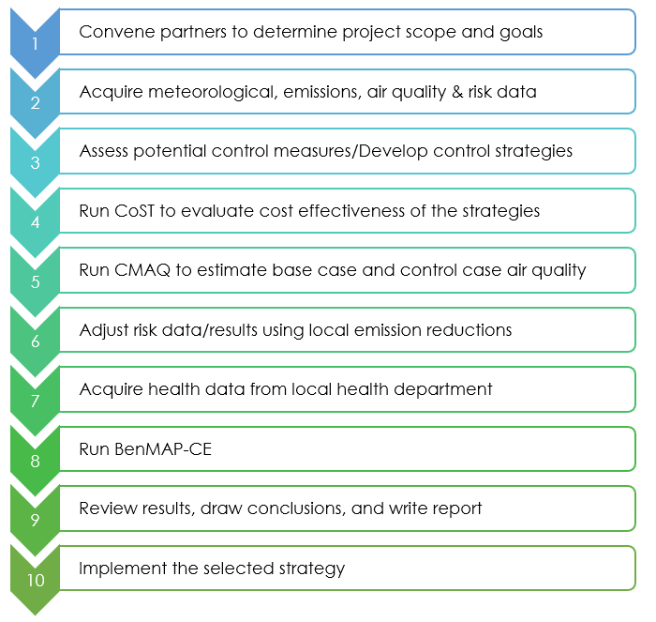
MP Assessment Process
Adapted from the SC Report (pages 23-24) - https://www.epa.gov/sites/production/files/2016-05/documents/usepa-south_carolina_final_report_may_26_16_2.pdf

Slide 14
Evaluating Multipollutant AQ at Local Level
Understand
First characterize the air quality (develop a conceptual model) for the area of interest: What extent does this area have a multipollutant issue?
Consult
Meet with the locals and local air districts to focus on community concerns What are the concerns? Are they multipollutant in nature?
Engage
Determine roles and responsibilities with respective EPA Region: How to coordinate and collaborate with the state/local air district?
Partner
Partner to develop a comprehensive plan to address multipollutant AQ issues: Can it be combined with NAAQS implementation or Advance programs?

Slide 15
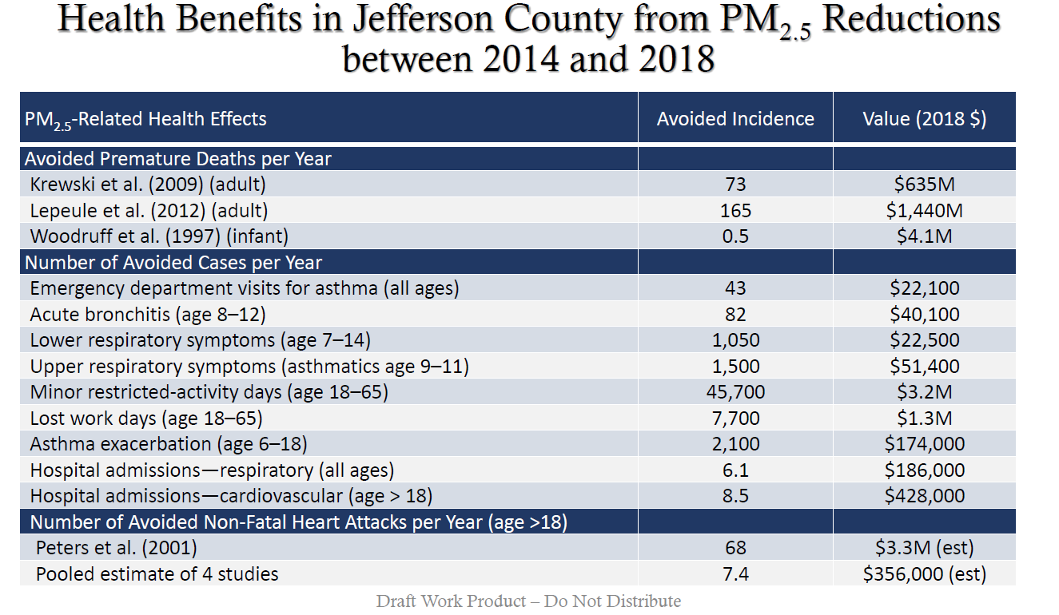

Slide 16
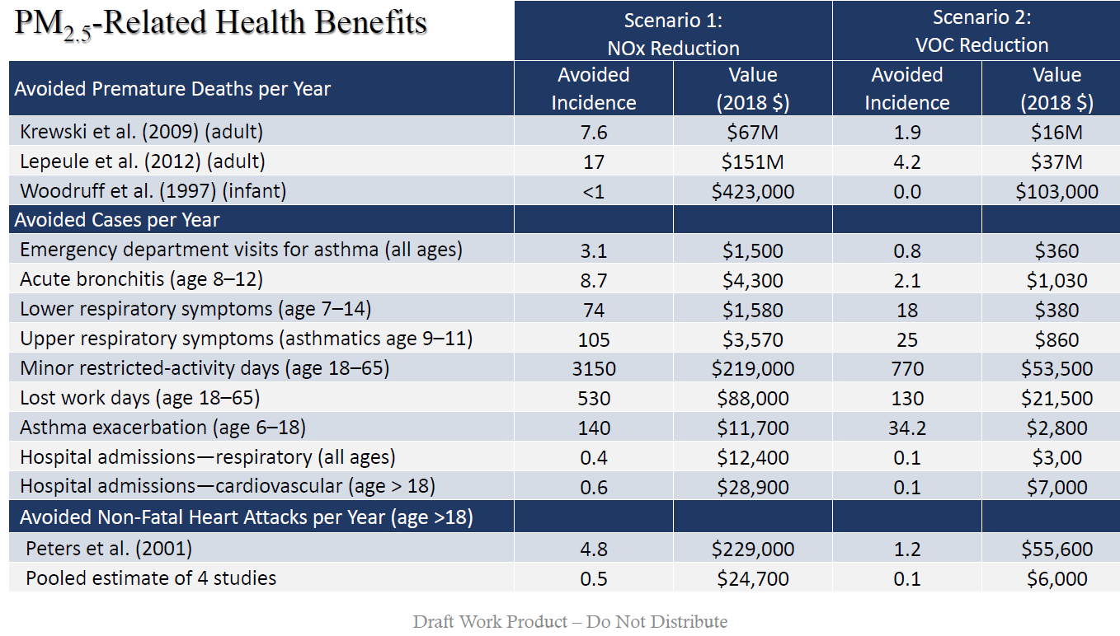

Slide 17
