Slide 1
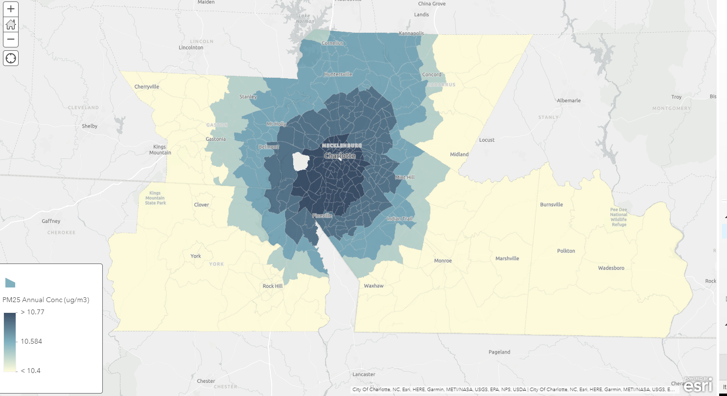
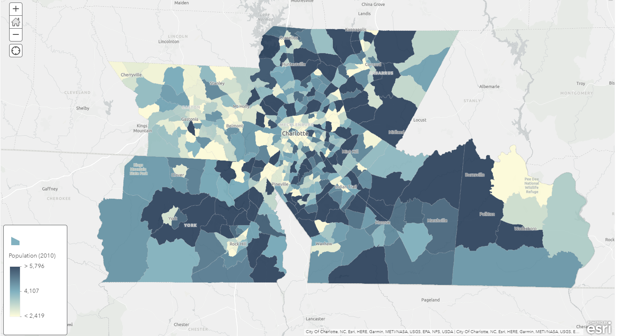
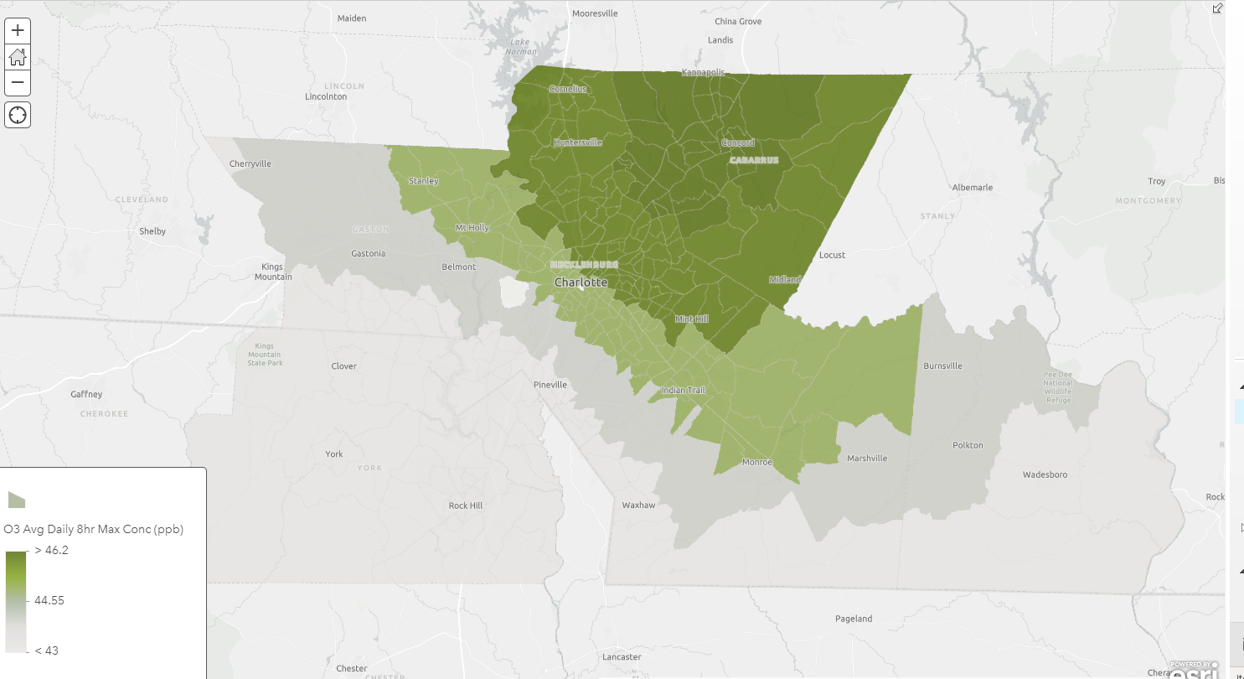
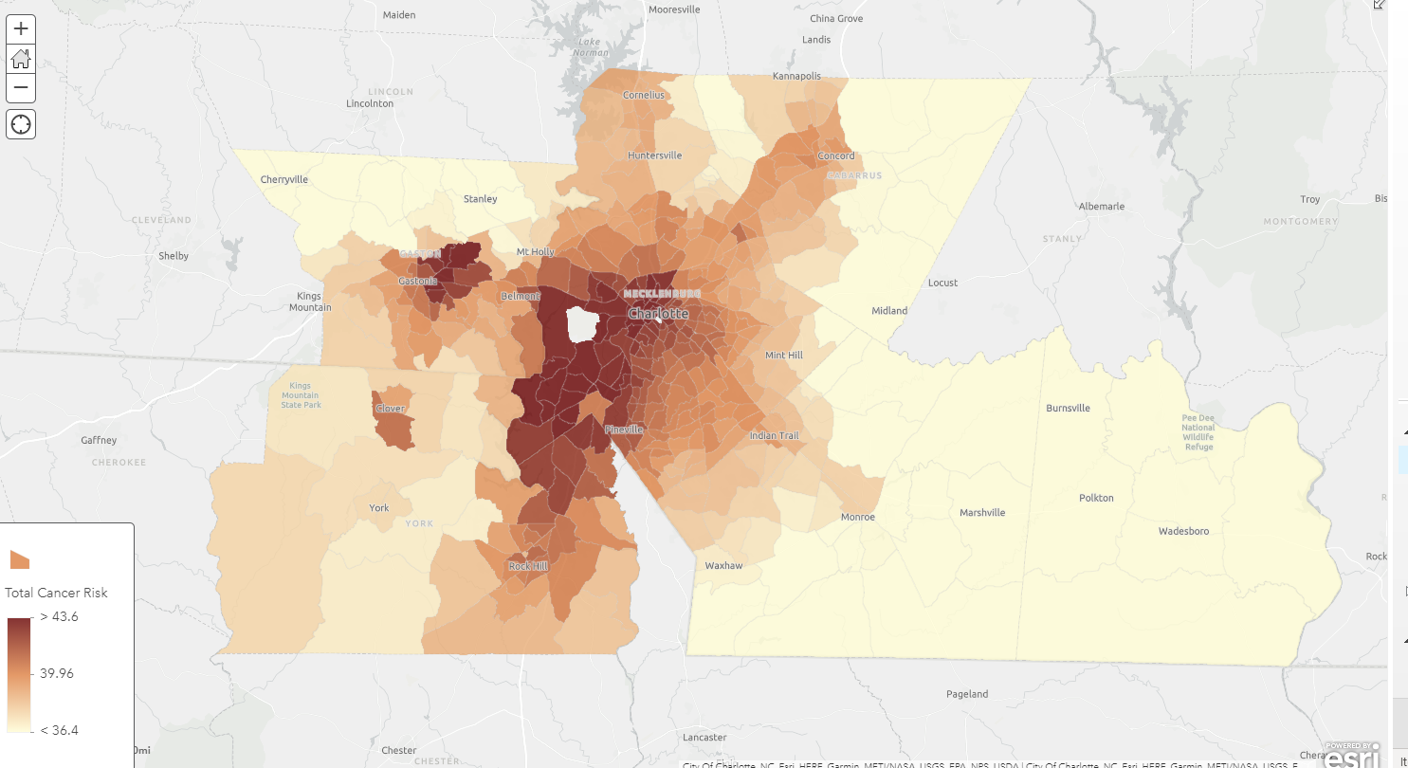
Charlotte CBSA
Population:1.76 Million (2010) 428 Census Tracts
PM2.5 Annual Concentration
9.8-10.8 ug/m3 (52-74 %ile)
Ozone 8-Hour Max Concentration
42-47 ppb (40-84 %ile)
Cancer Risk
33.6-84.7 in a Million (62-99.8 %ile)
Draft Work Product – Do Not Distribute
Notes:
Each of these 4 maps are data from Nexus. The top left is simply the 2010 population of the Charlotte CBSA…
After selecting the CBSA in Nexus, you can view the underlying data for just the area selected, so annual PM2.5 has a distribution of 9.8-10.8; Ozone annual average (of the 8-hour max) is 42-47ppb, and the cancer risk, although below the upper limit of acceptable risk (100:Million).
What is interesting to note is how these areas fall in line with the rest of the country, and that is why the percentile is helpful to gauge where the CBSA falls in comparison with other areas.

Slide 2
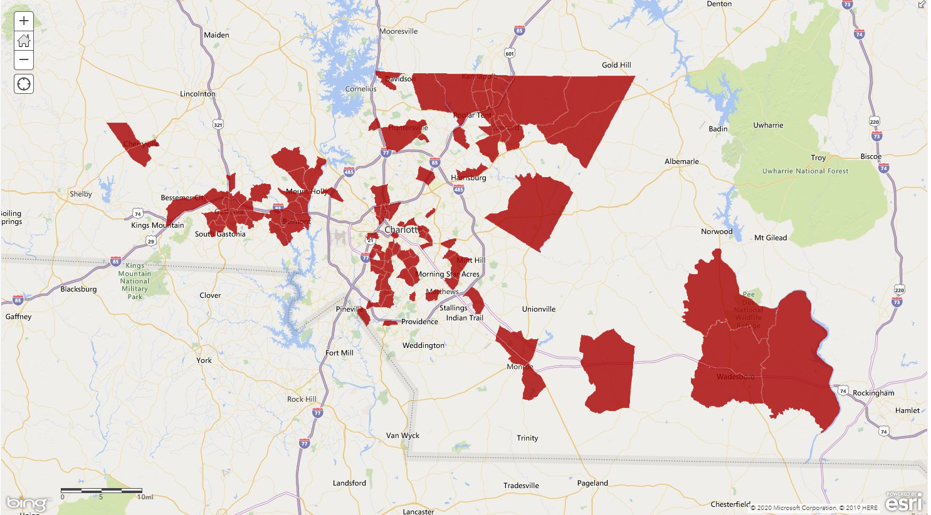
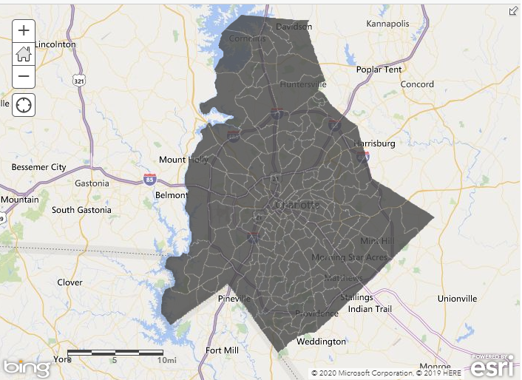
Selecting the 50th Percentile within the Charlotte CBSA
Ozone Respiratory Hospital Admissions: 10-15 per 10,000
PM_{2.5} All Cause Mortality: 7-22 per 10,000
Cancer Risk: 34-64 in a Million
Charlotte CBSA
Population:1.76 Million (2010) 428 Census Tracts
O3 DV >70ppb
112 Overlapping Tracts
427,000 Individuals
Only 41 of the 112 Tracts (181,300) Fall within the
Tracts with a DV >70 ppb
Draft Work Product – Do Not Distribute
Notes:
Now the metric show previously for ozone is the annual average of the daily 8-hour maximum concentrations because that is the ozone metric used to calculate the health impacts in our regulatory impact analyses. In the map shown here, the areas where the design value exceeds 70ppb is highlighted in grey. Nexus can IDENTIFY AREAS OF OVERLAPPING concern by selecting any criteria defined by the user. On the map to the right, the 50%ile was set for the health outcomes shown and Nexus identified 112 census tracts that met that criteria, 41 of which are within the area where the DV was >70ppb.

Slide 3
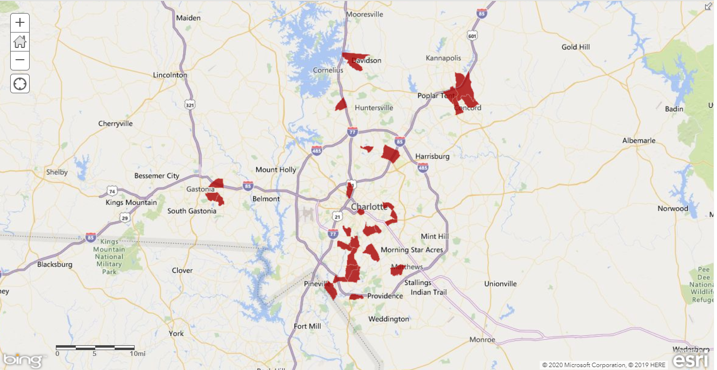
Selecting the 75th Percentile within the Charlotte CBSA
Ozone Respiratory Hospital Admissions: 12-15 per 10,000
PM_{2.5} All Cause Mortality: 10-22 per 10,000
Cancer Risk: 38-64 in a Million
Charlotte CBSA
Population:1.76 Million (2010) 428 Census Tracts
O3 DV >70ppb
25 Overlapping Tracts
96,300 Individuals
16 of the 25 Tracts (68,.600) fall within a DV >70 ppb
Draft Work Product – Do Not Distribute
Notes:
This map goes even further: the 75%ile was set and Nexus identified 25 tracts, 16 of which fell within the area where the DV was >70ppb. In this example, the tool is demonstrating the areas of highest overlapping risks to help air quality regulators make better informed decisions on areas of highest concern, not just by the ambient concentrations of multiple pollutants, but by the impact of multiple polluton the public.

