Slide 1
Draft Design of NEXUS and FAST-CE

Slide 2
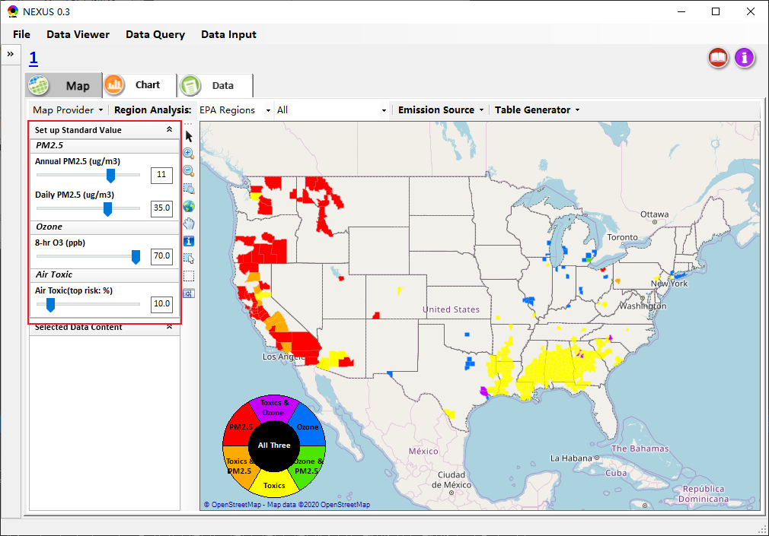
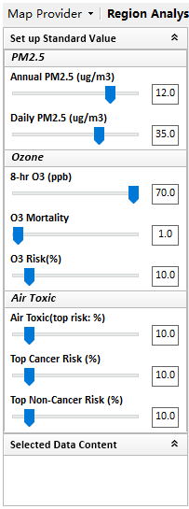
Data Viewer
Group the slide bars into “PM2.5”, “Ozone” and “Air Toxic”

Slide 3
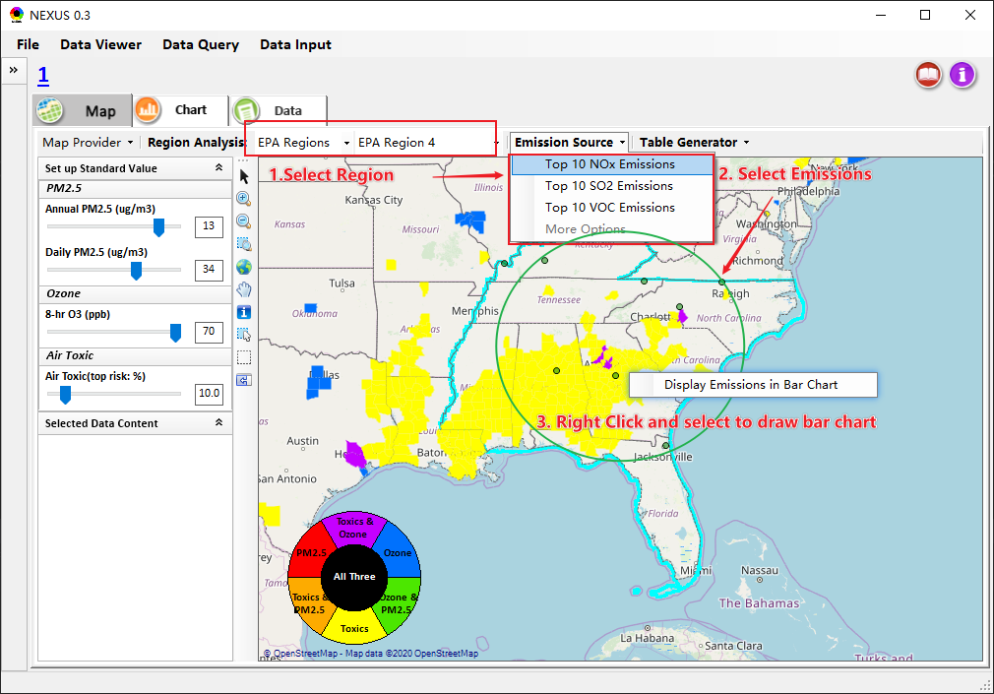
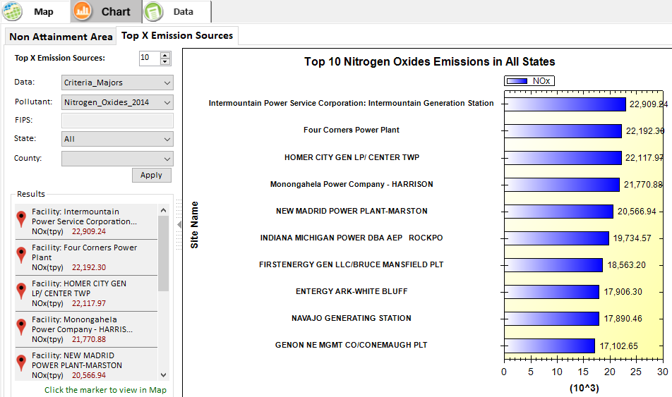
Data Viewer
Overlay Emission Source and create bar chart

Slide 4
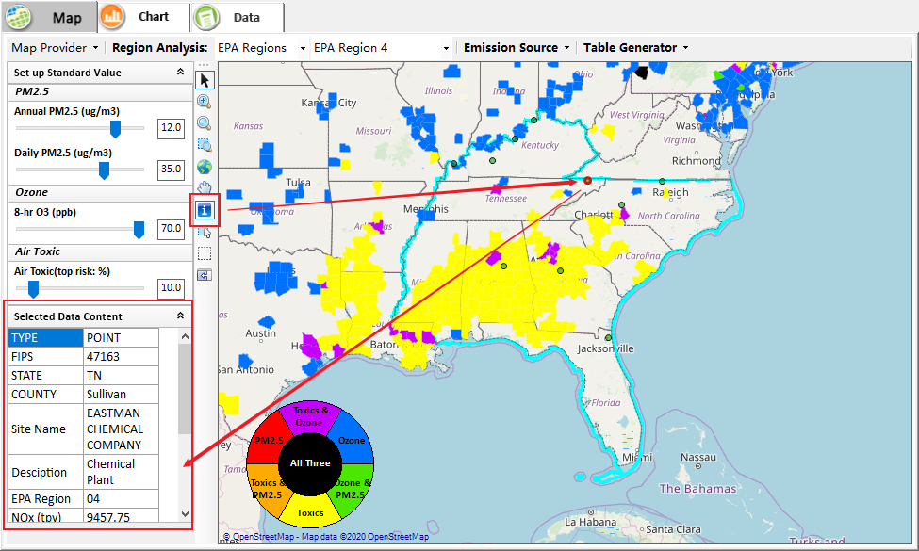
Use identify tool to view emission point details

Slide 5
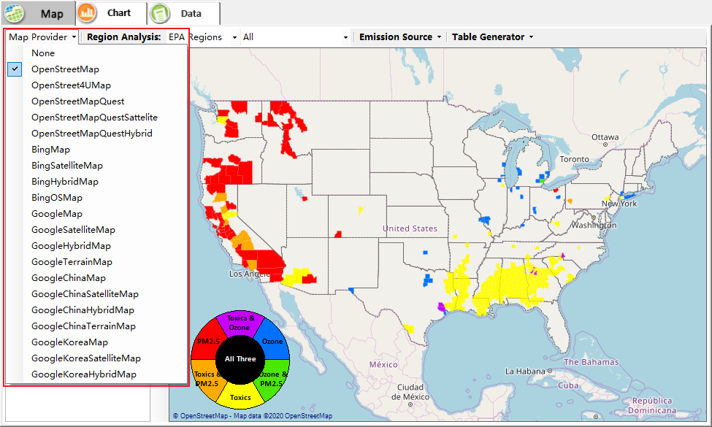
Data Viewer
Change Map Provider

Slide 6
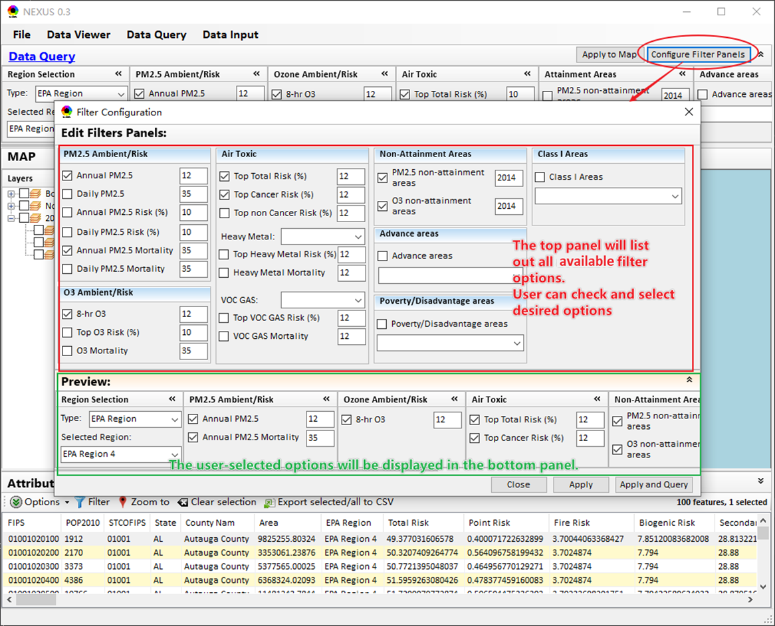
Data Query
New Design for Filter Configuration
Notes:
available

Slide 7
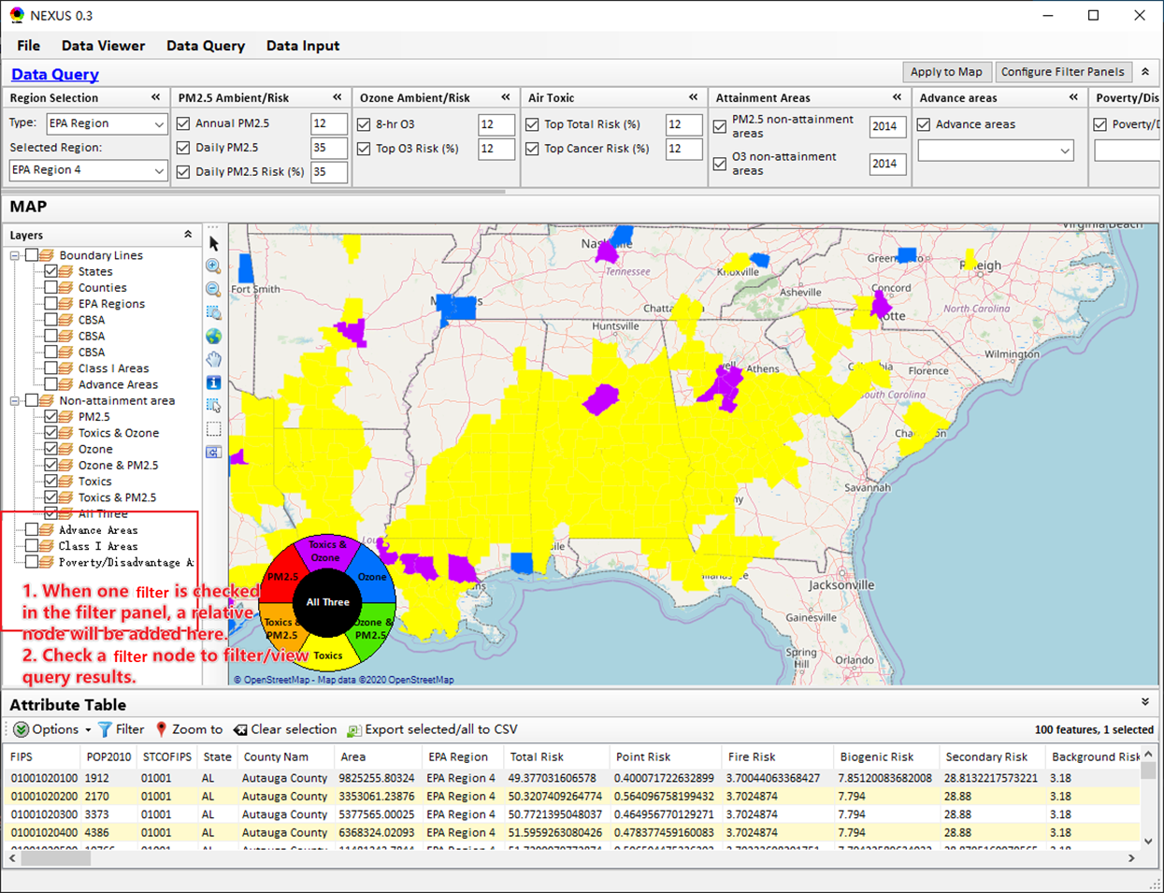
Data Query

Slide 8
FAST-CE Developments

Slide 9
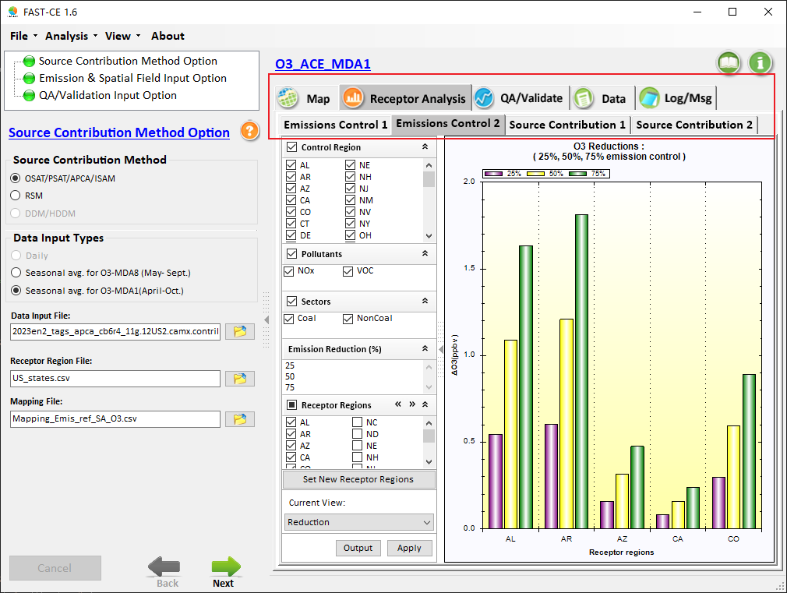
FAST-CE
Make all selected“tabs”in the same style and keep the same font for all “tabs”

Slide 10
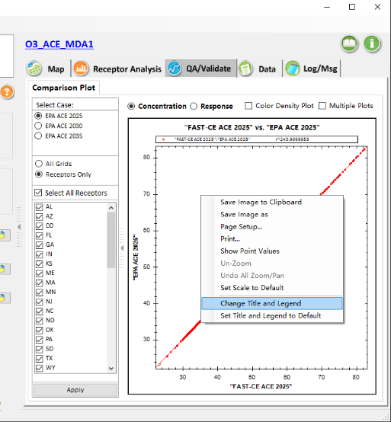
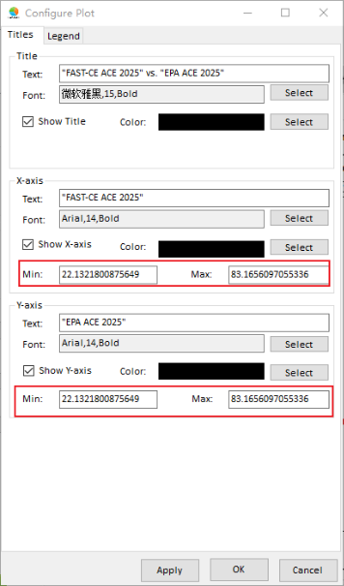
FAST-CE
Allow user to change the scale of X, Y axis

Slide 11
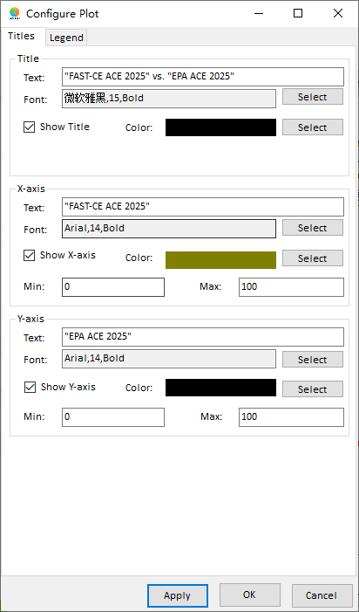
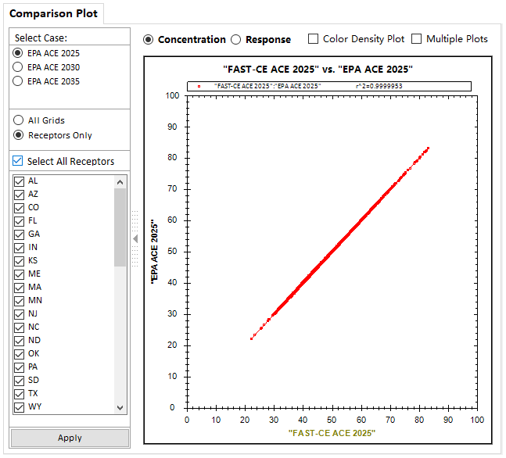
FAST-CE

