Slide 1
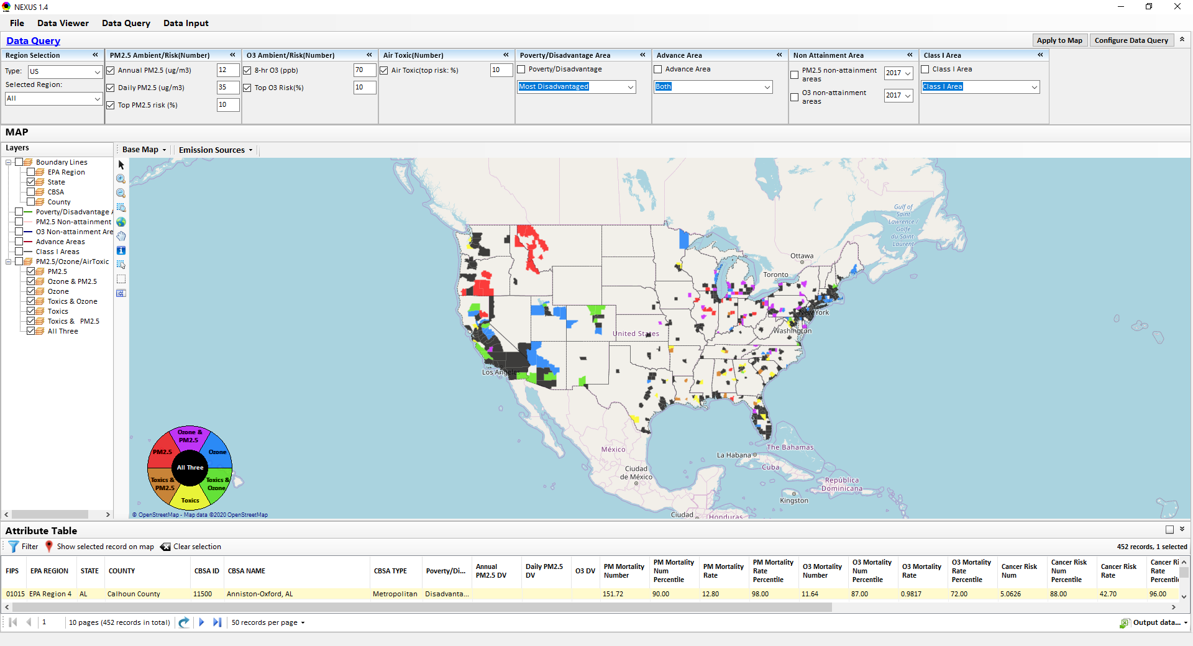
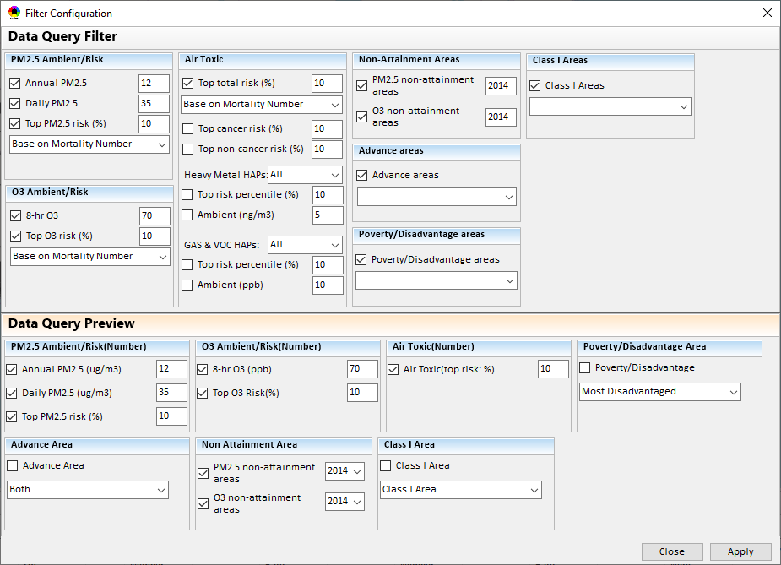
NEXUS Tool: Data Query Module
Change “Poverty/Disadvantage” to “Socio-Economic/Demographic” (only the title bar, not below)
Change “Poverty/Disadvantage” to “Socio-Econ/Demographic”
1

Slide 2
NEXUS 1.4: List of Improvements
Carey Jang, 9/17/2020
These suggestions are minor improvements. Please continue to finish the “to-do-list” before early October
Please send me a new/updated version and updated PPT slides (Tutorial slides starting #8) by 9/21 (Mon) if feasible

Slide 3
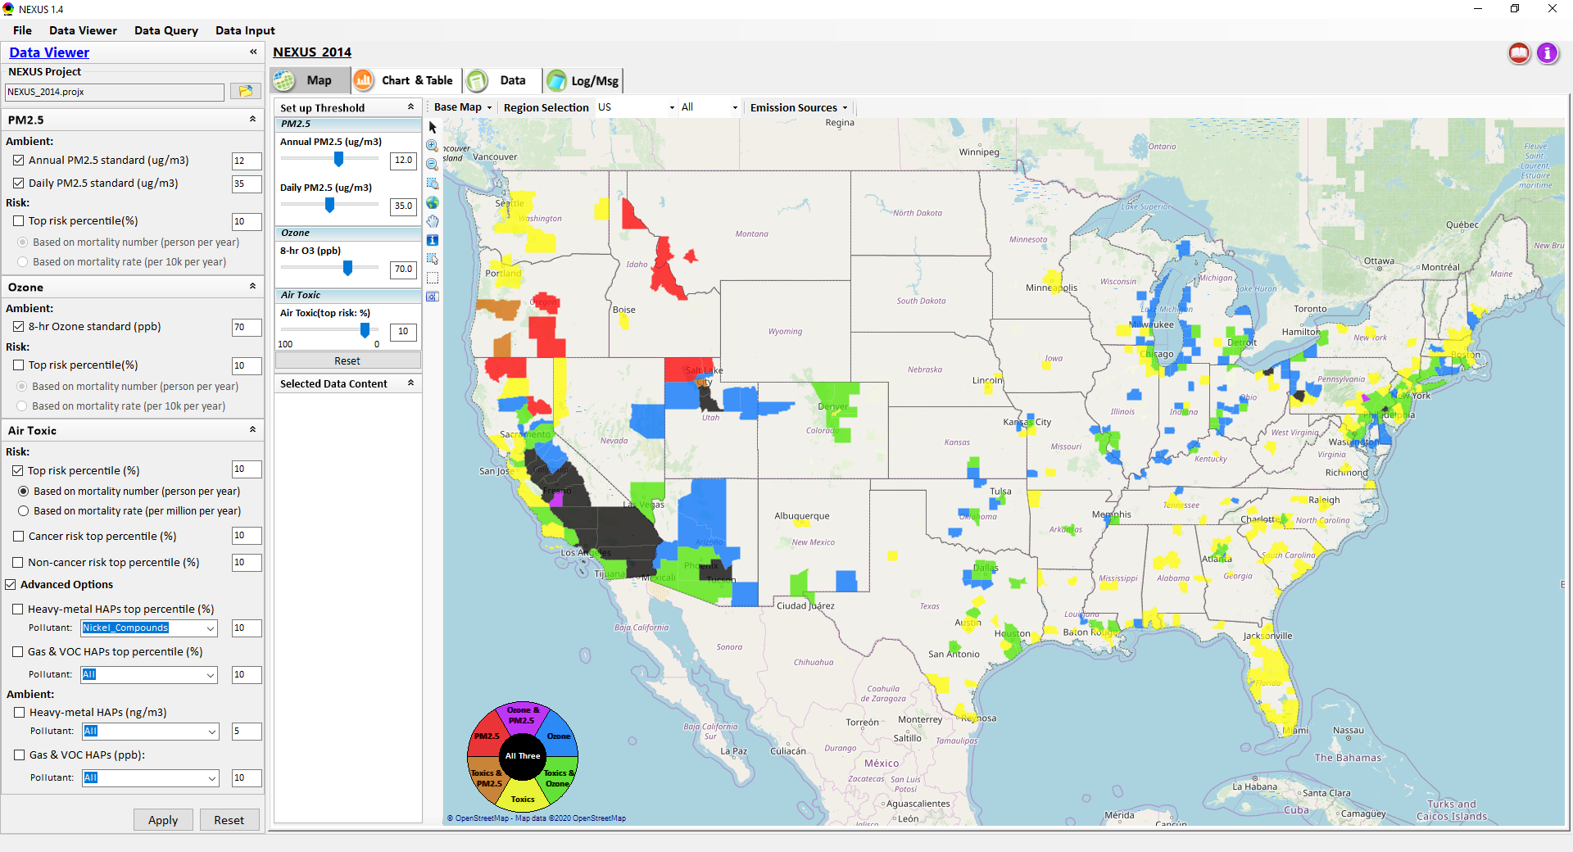
NEXUS Tool: Data Viewer Module
Change default to “User’s Manual” size to smaller size partial window (expanded to entire window now)
Right-click in “Map” to “Save image to clipboard” (may put it under “Display major sources”)
Bug: Change default to “All”
3

Slide 4
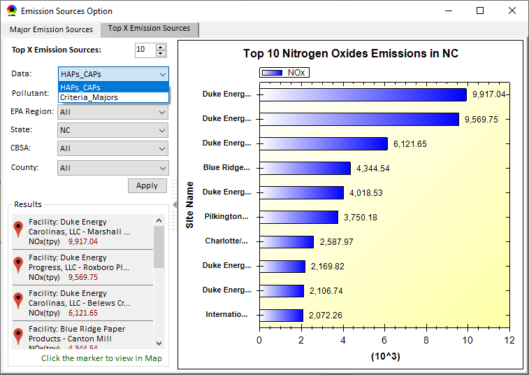
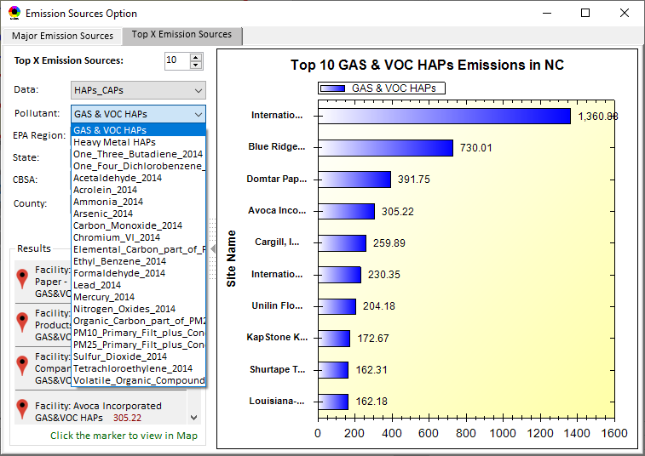
NEXUS Tool: Data Viewer Module
Under “HAPs”, list only “HAPs” pollutants. Remove all “CAPs” pollutants
There are duplicated emission sources. Change “Data” to include “CAPs” and “HAPs”. Under “CAPs”, list only “Pollutants” under current “Criteria_Major”
4

Slide 5
NEXUS Tool: Data Query Module
List “Advance Area” first before “Poverty/Disadvantage” Area
List in order:
Advance”
Poverty
PM2.5 NA
O3 NA
Class 1 area
5

Slide 6
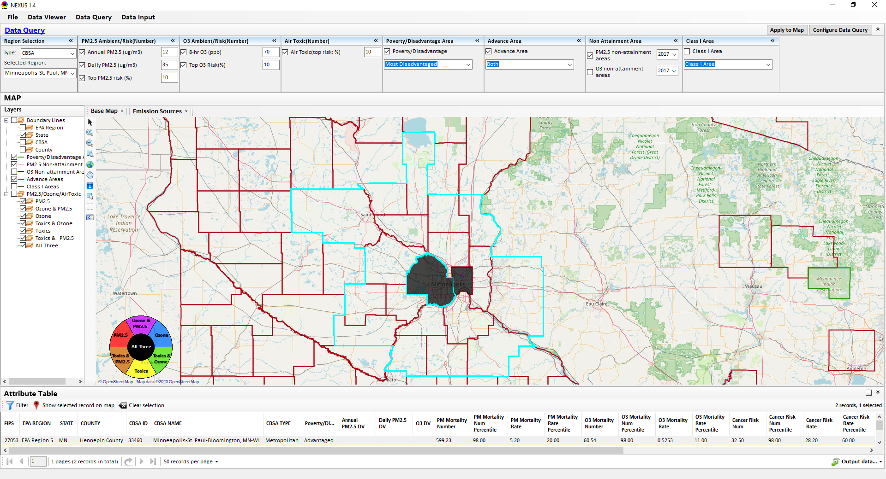
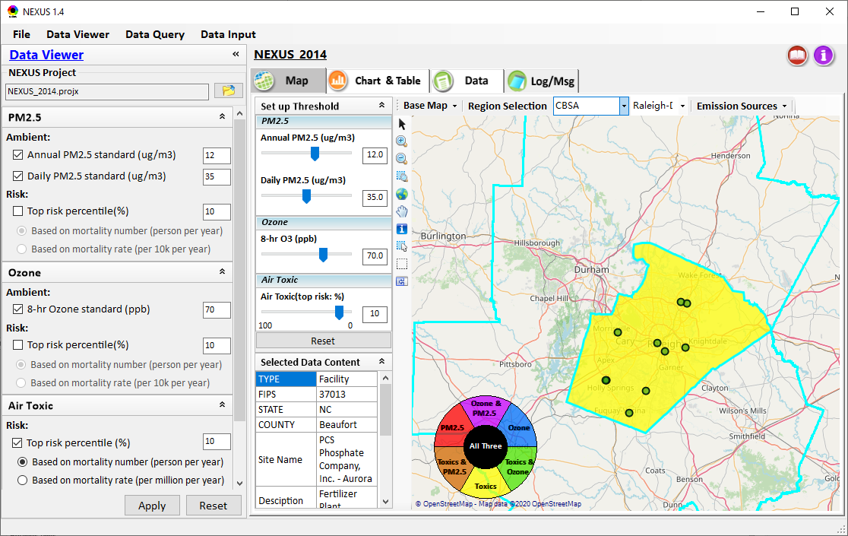
NEXUS Tool: Data Query Module
Use slightly “deeper blue” for the “selected county boundary lines” to avoid confusion
Same here in “Data Viewer” module: Use slightly “deeper blue” for the “selected county boundary lines” to avoid confusion
Remove “boundary lines” outside of the selected region for “Advance”, “Poverty” areas, etc. (to avoid confusion)
6

Slide 7
NEXUS Tool: Data Viewer Module
To Do List (by early October):
Include an updated Online-User’s manual
Under Data Query Module, remove those layers which locate outside the selected region.
Complete the Table Generator module (at least one working EPA region) by early October.
Under the Data Module, display the checked data only.
7

Slide 8
“NEXUS 1.5”: Tutorial
Update the following slides (based on “NEXUS 1.0”) to “NEXUS 1.5”
Add new slides or functions as appropriate (will be great!)
8

Slide 9
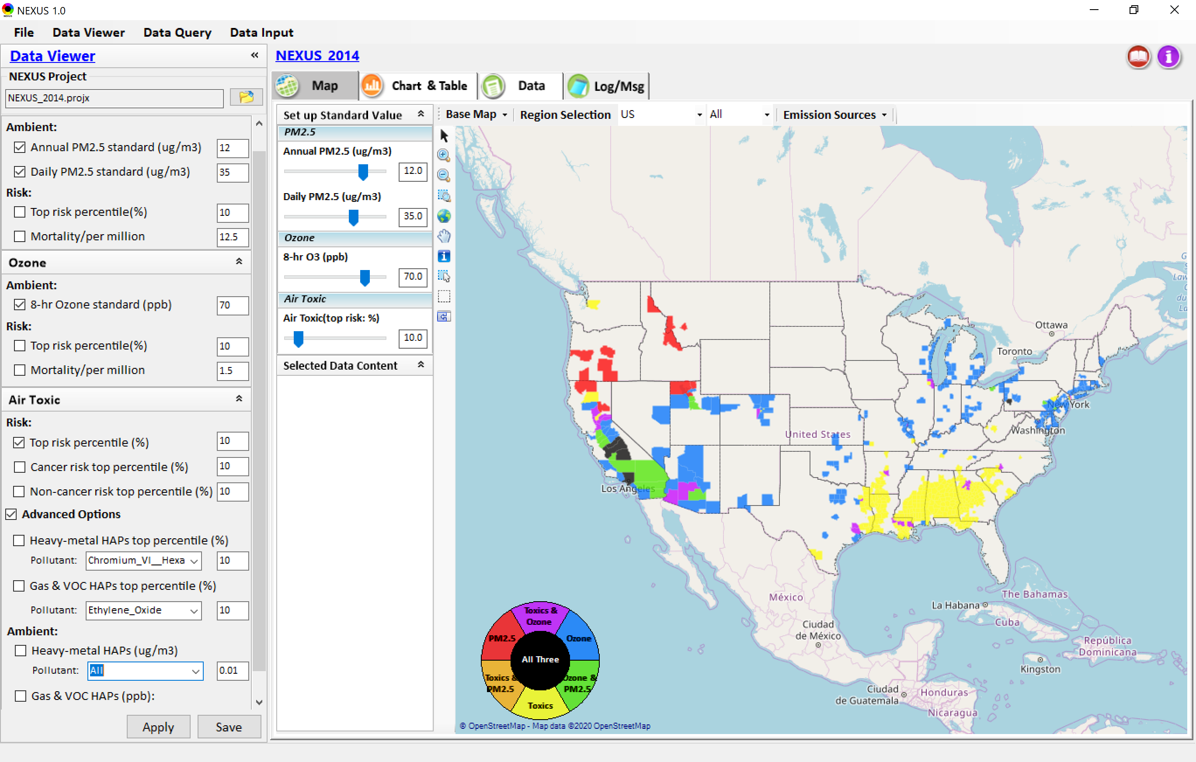
NEXUS Tool: Data Viewer Module
Click “File” to open or save a project
Switch between 3 key modules
Loaded NEXUS project file name & project file loading icon
Select & adjust “Ambient” & “Risk” levels
“Advanced Option”: provide HAPs & species selections
9

Slide 10
Data Viewer Module: Selections & Map Display
Select & adjust “Ambient” & “Risk” levels for color map display
“Apply” new selections to “Radio button” panel
10

Slide 11
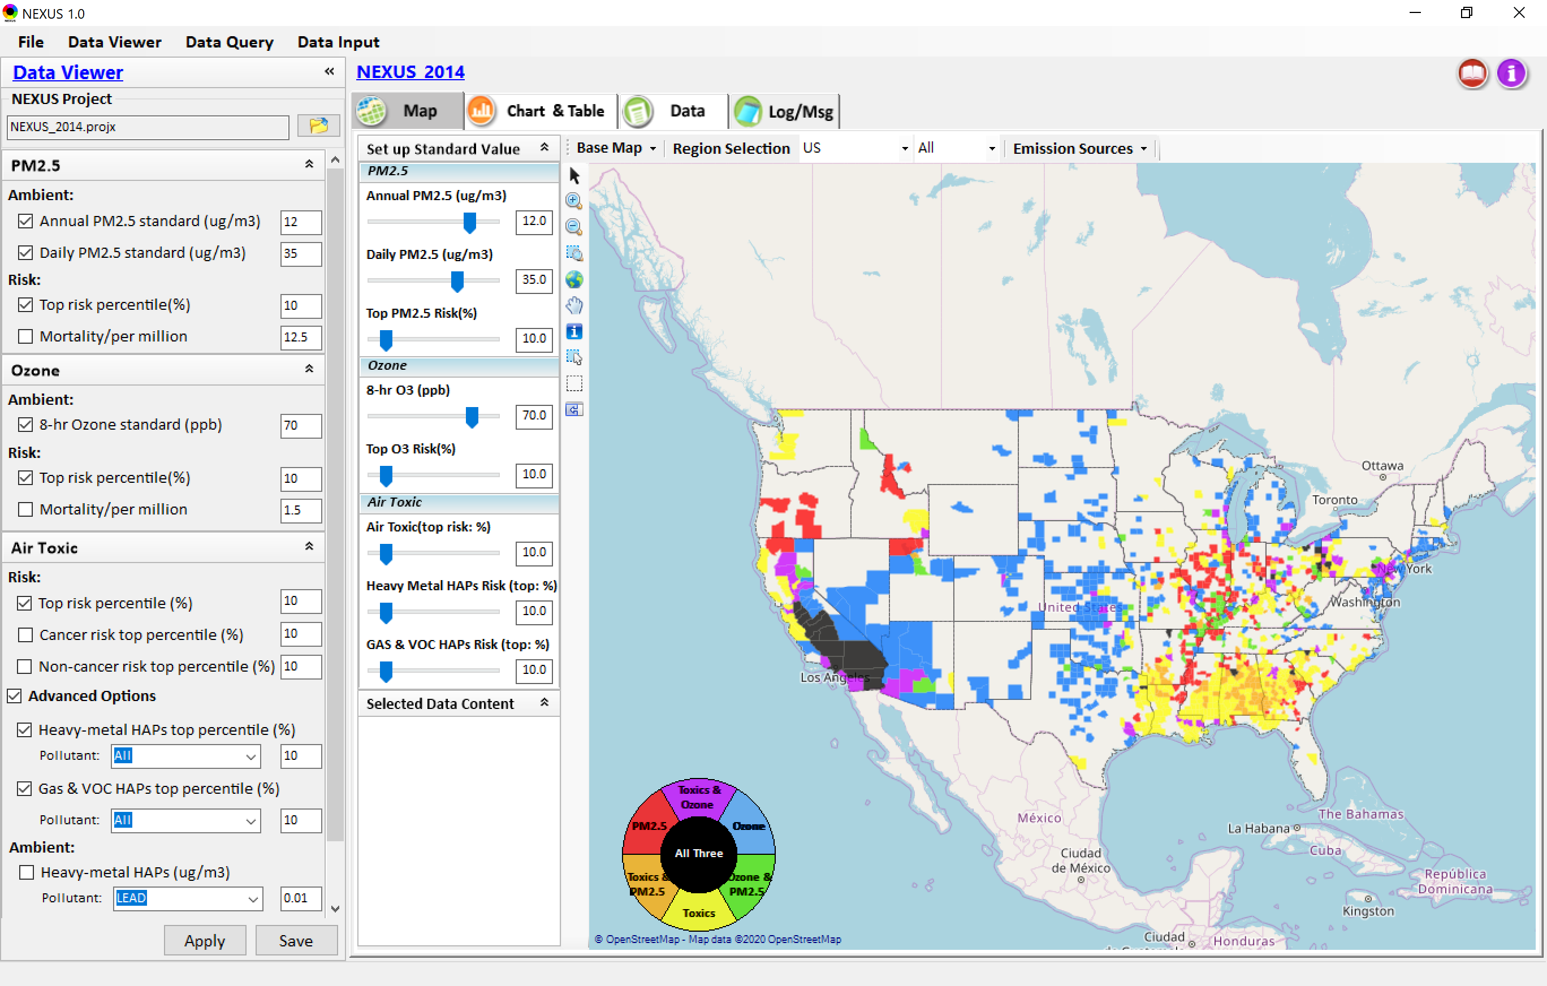
Data Viewer: “Apply” New Selections
“Check” new selections
New selections will appear on-the-fly in “radio button” panel and map display
“Apply” new selections
11

Slide 12
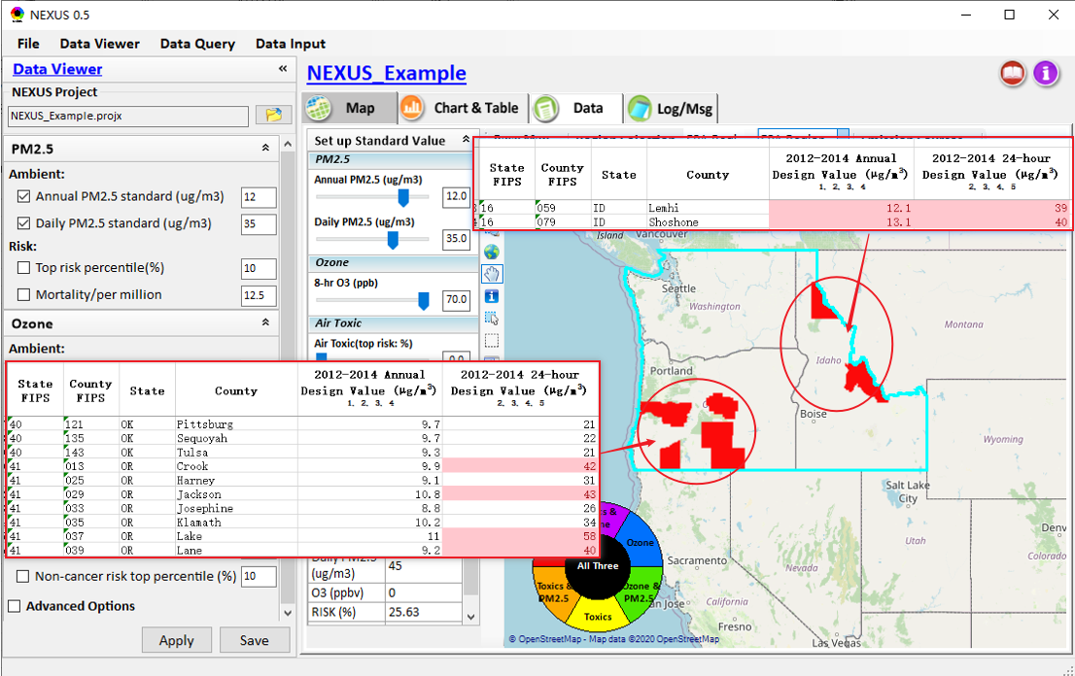
Data Viewer Module: Map & Data QA
High PM2.5 DVs real?
Questionable high PM2.5 DVs in Oregon (daily PM) and Idaho (annual & daily PM) appear to be “real”
12
12

Slide 13
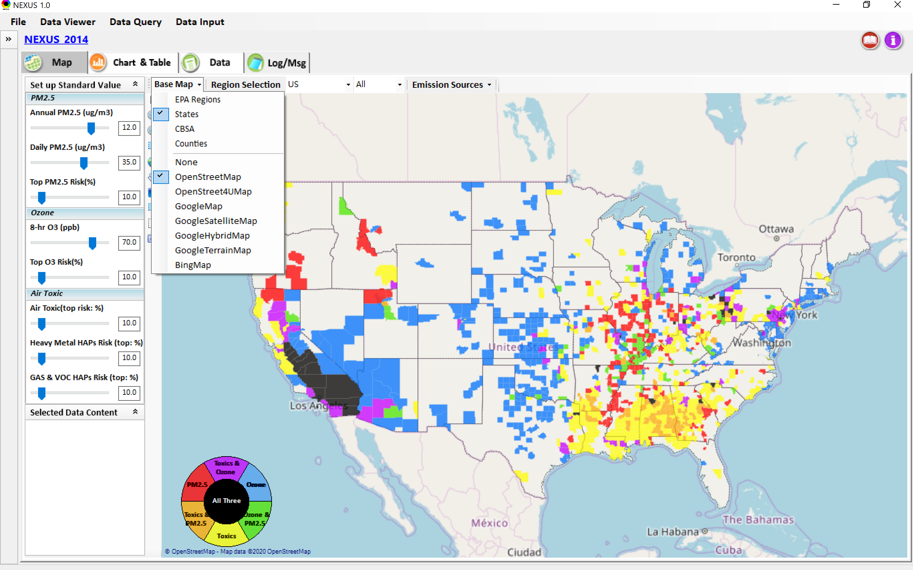
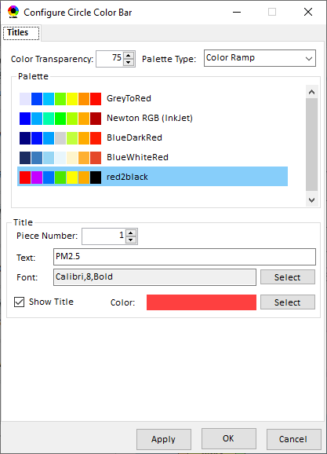
Data Viewer Module: Base Map & Color
“Base Map”: Change boundary lines and background map
Click to change color & transparency
13

Slide 14
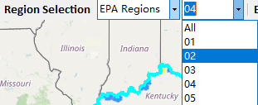
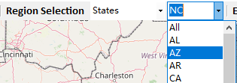
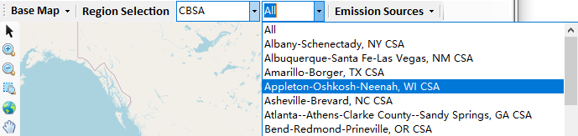
Data Viewer: “Region Selection”
Allow to select “EPA regions”, “States”, or “CBSA”
14

Slide 15
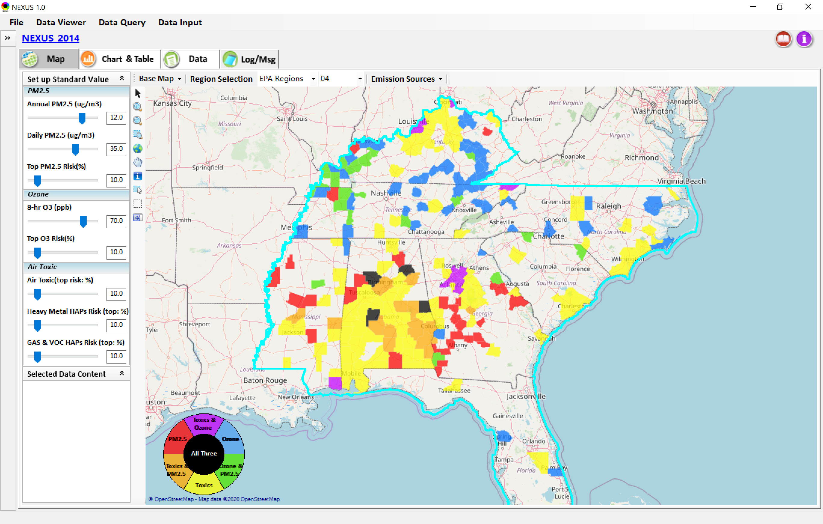
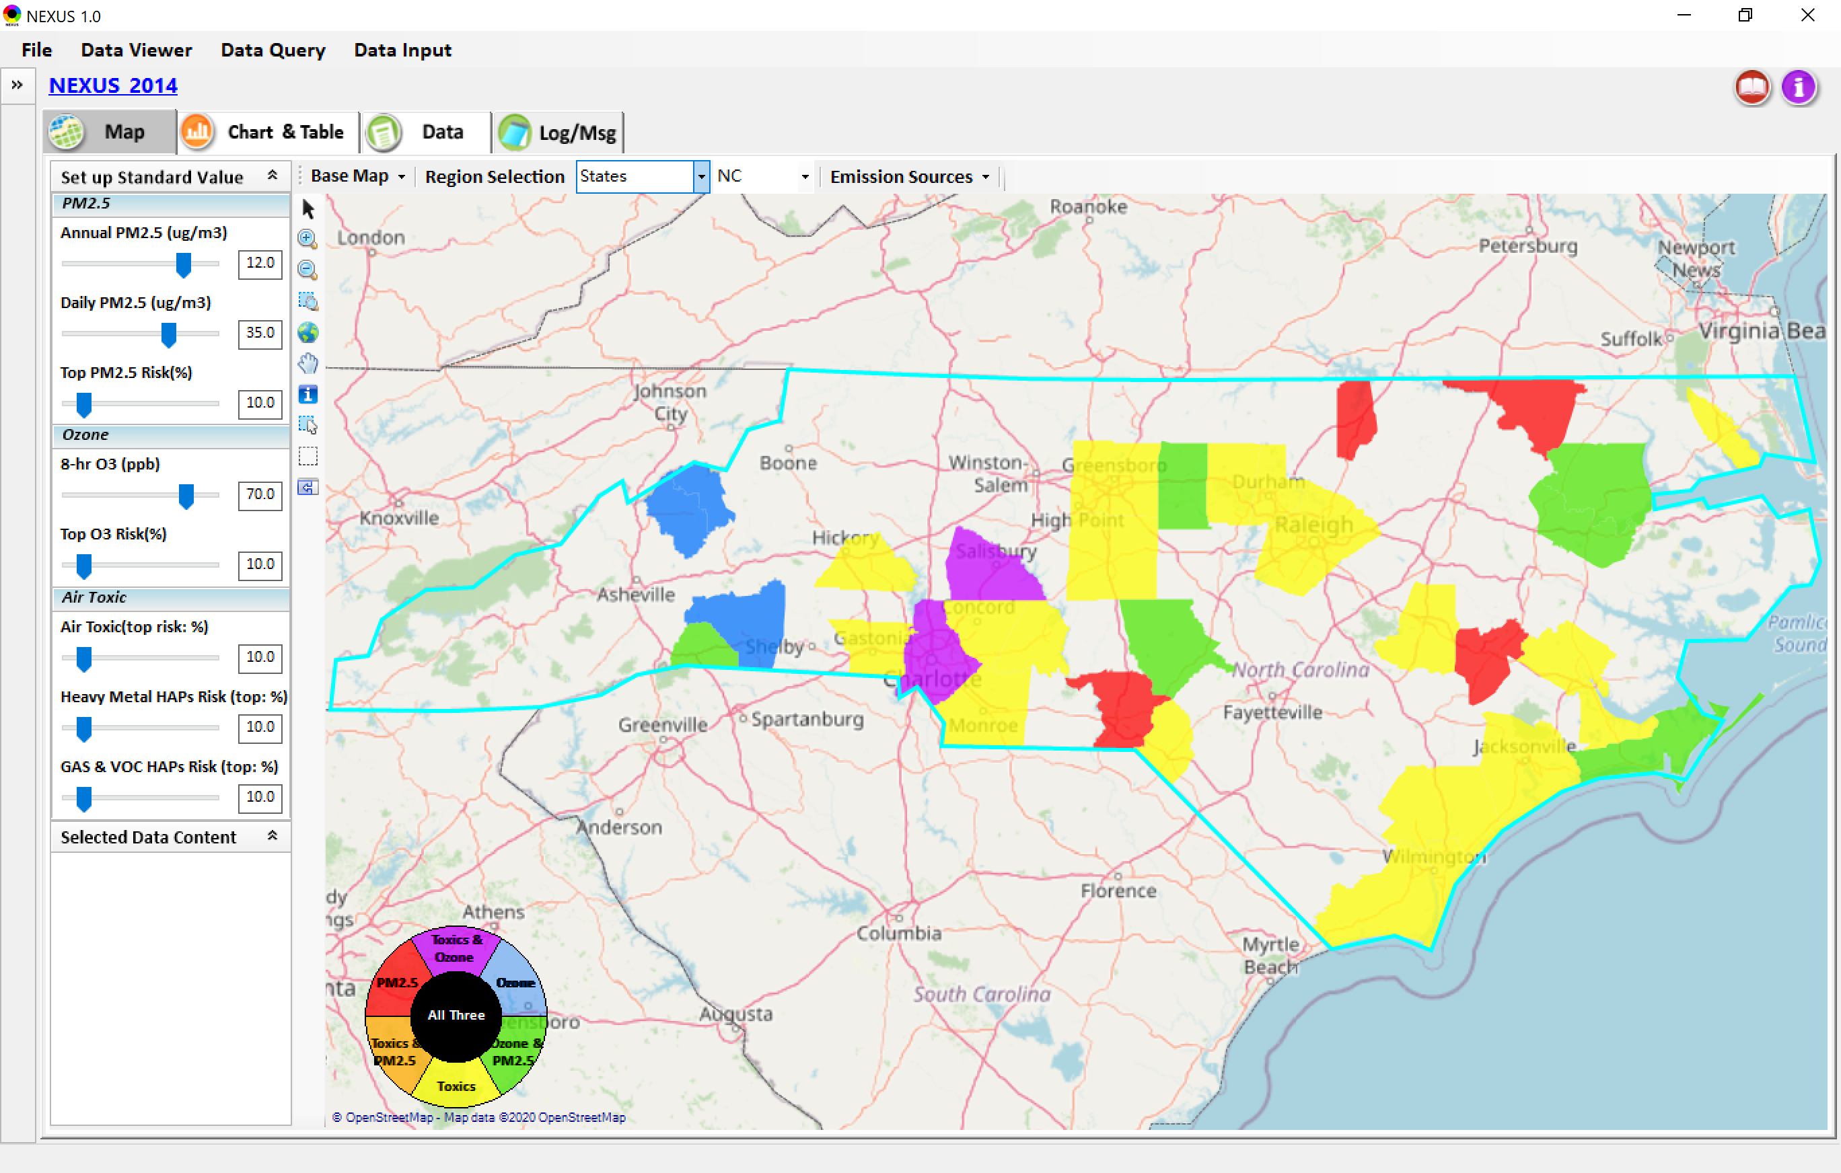
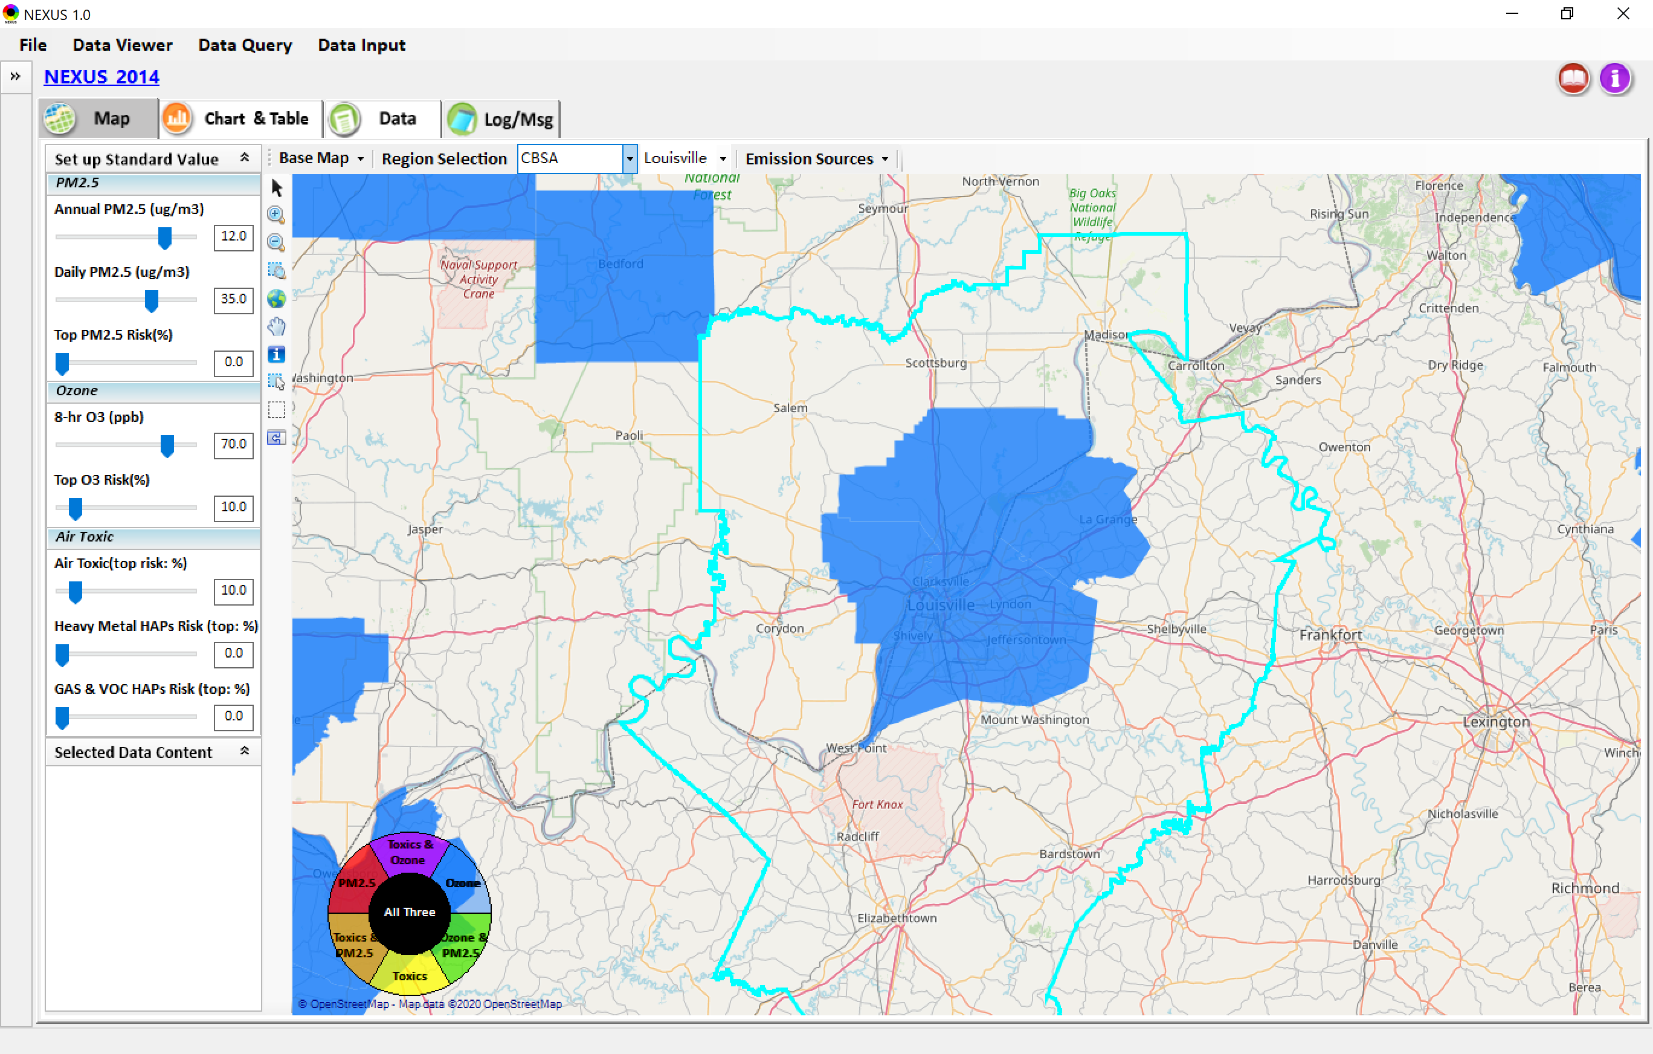
Data Viewer: Select EPA Region/State/CBSA
Examples:
EPA Region 4
NC
Louisville CBSA
15

Slide 16
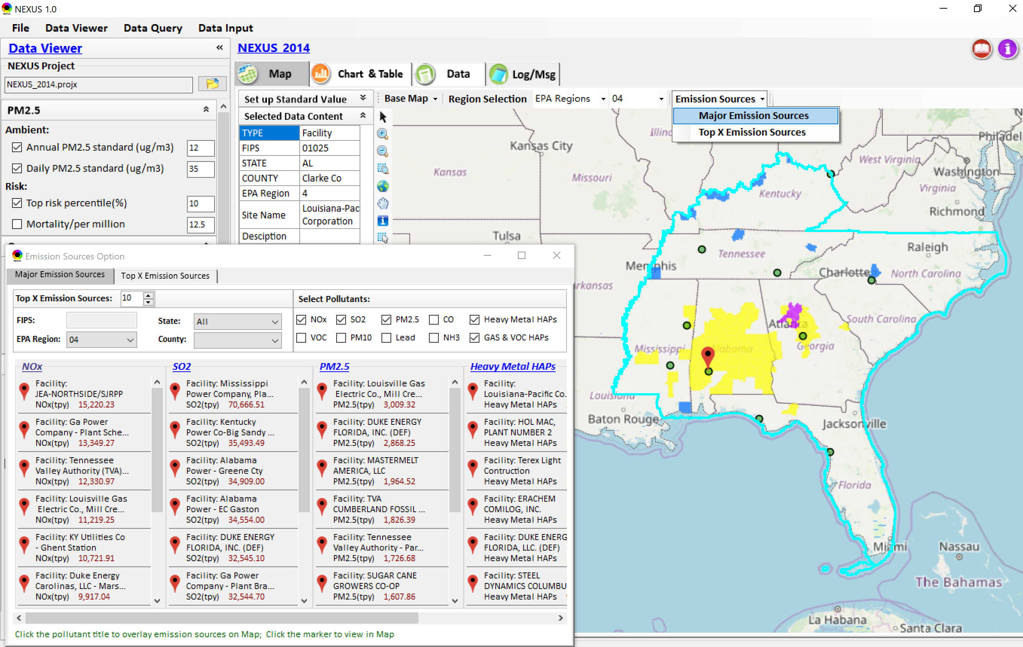
Data Viewer: Major Emission Sources
Click “Emission Sources” tab to display emission sources (green dots) and launch new window
Click any “facility” to link & display source location and emission information
16

Slide 17
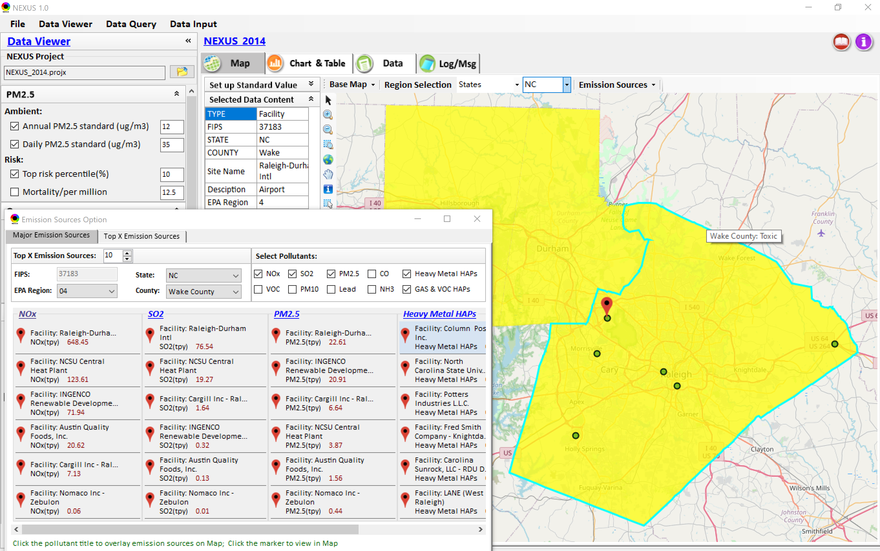
Data Viewer: Major Emission Sources
Allow to scroll down to county-level (e.g., Wake County, NC)
Wake county, NC
17

Slide 18
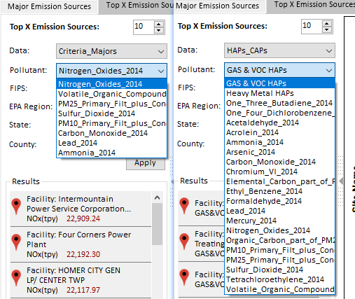
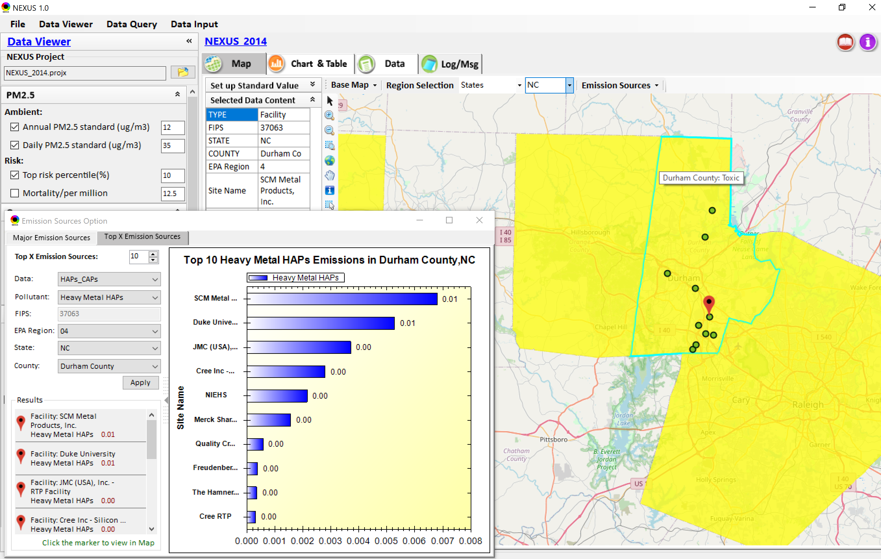
Data Viewer: Top “x” Emission Sources
Provide selection of CAPs precursors & HAPs species
Durham county, NC
18

Slide 19
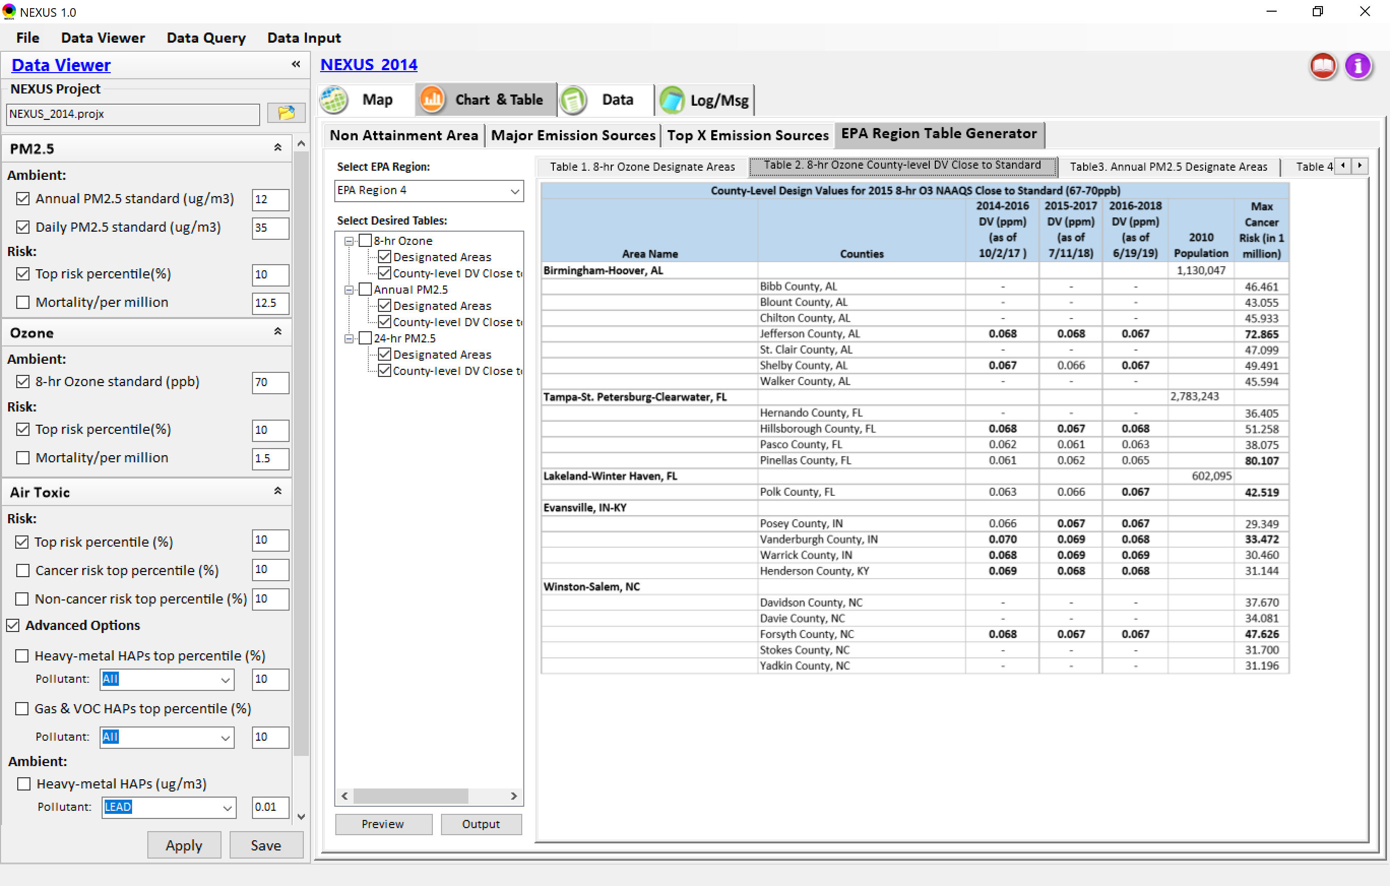
Data Viewer: EPA Region Table Generator
“EPA Region Table Generator” is still under development; the output format & info. needs the MP team’s suggestion (e.g., how the HAPs info. to be added or provided).
19

Slide 20
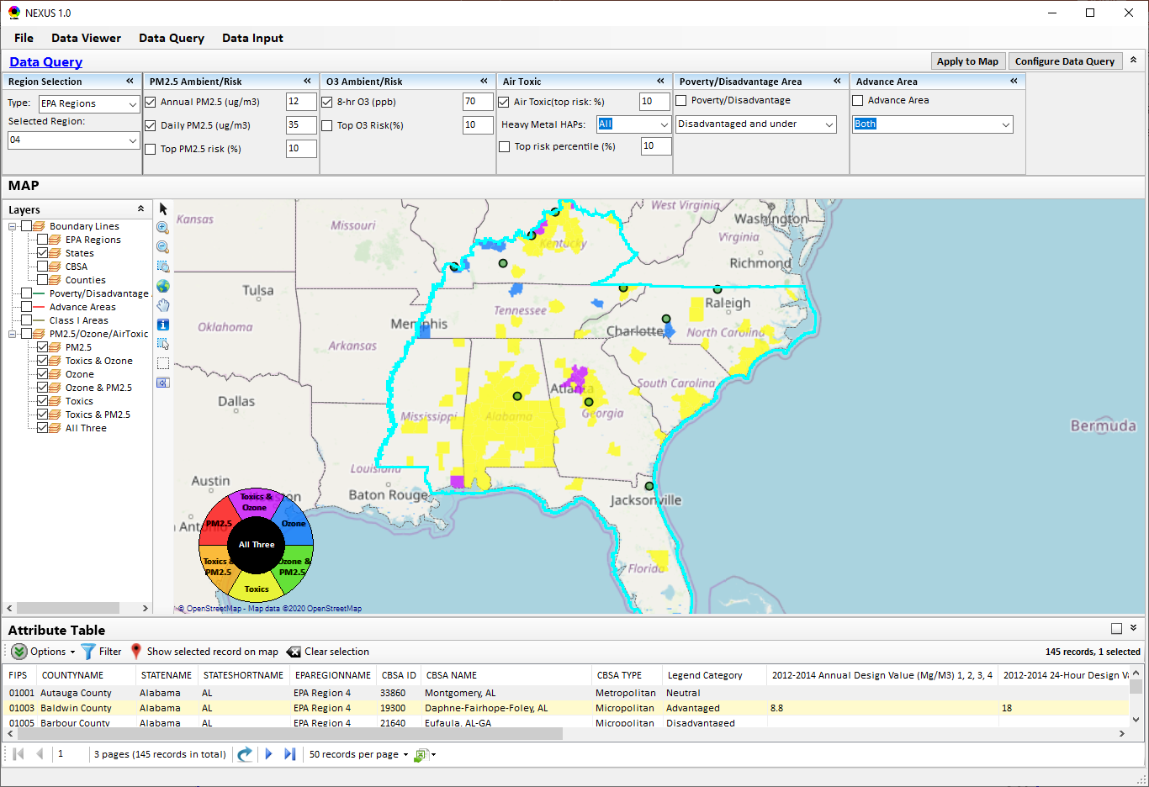
Data Query Module: Main Page
Region Selection
Data Query qualifier selection
Data Query Configuration
Map Overlaying selection
Detachable “Attribute Table”
20

Slide 21
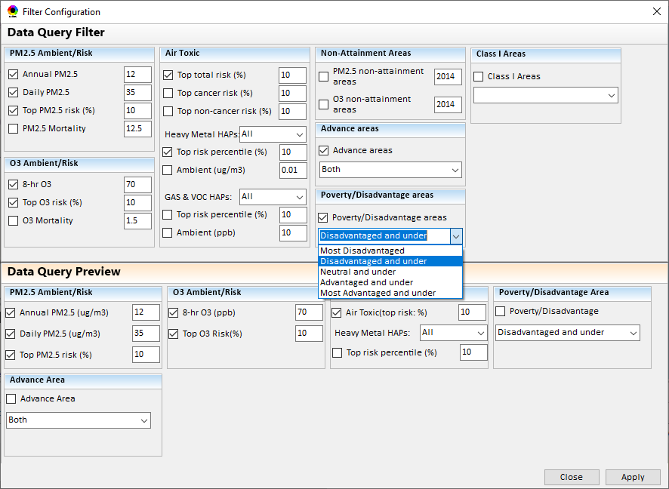
Data Query Module: Configure Data Query
“Data Query Filter” allows to select “qualifiers” for query
“Data Query Preview” displays the selected “qualifiers” at the same time
21

Slide 22
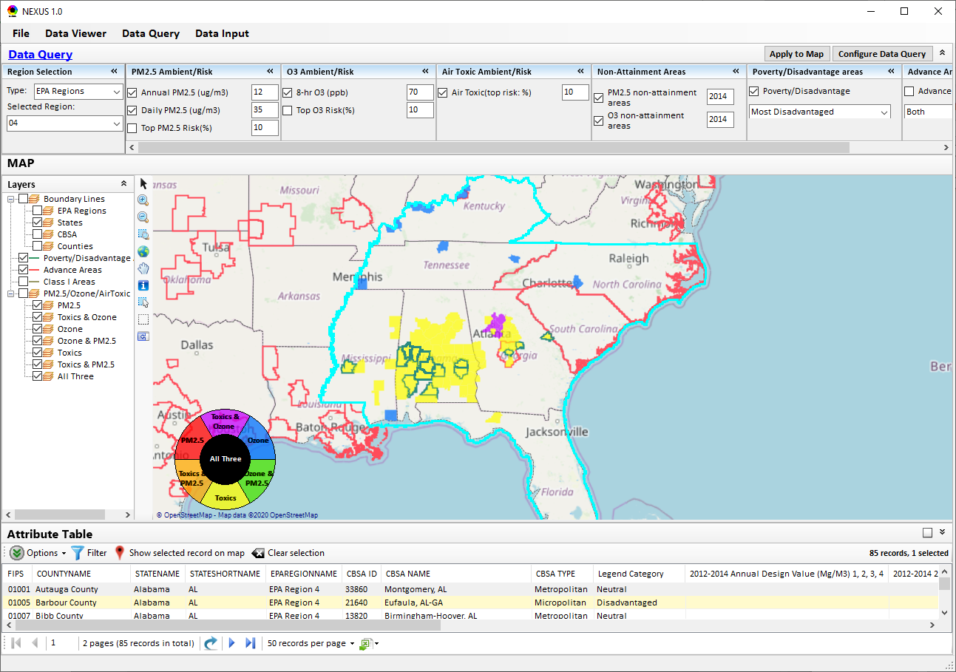
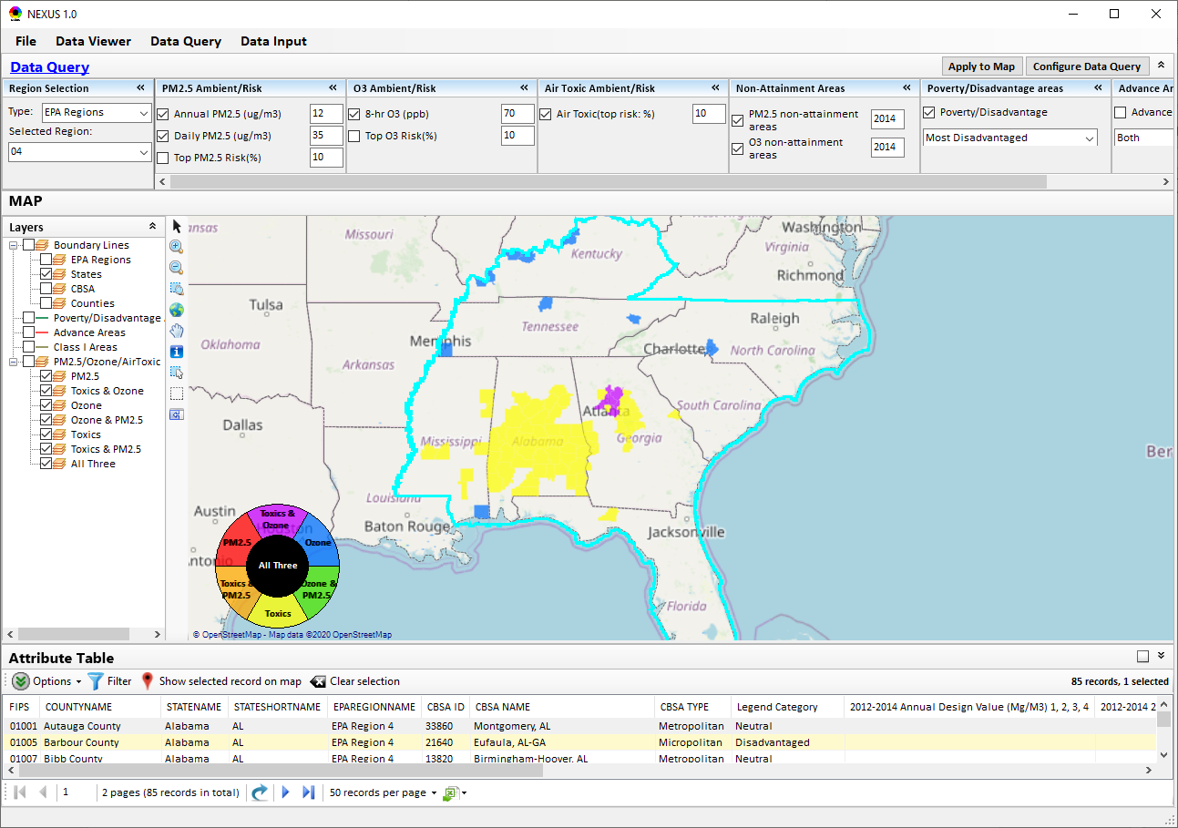
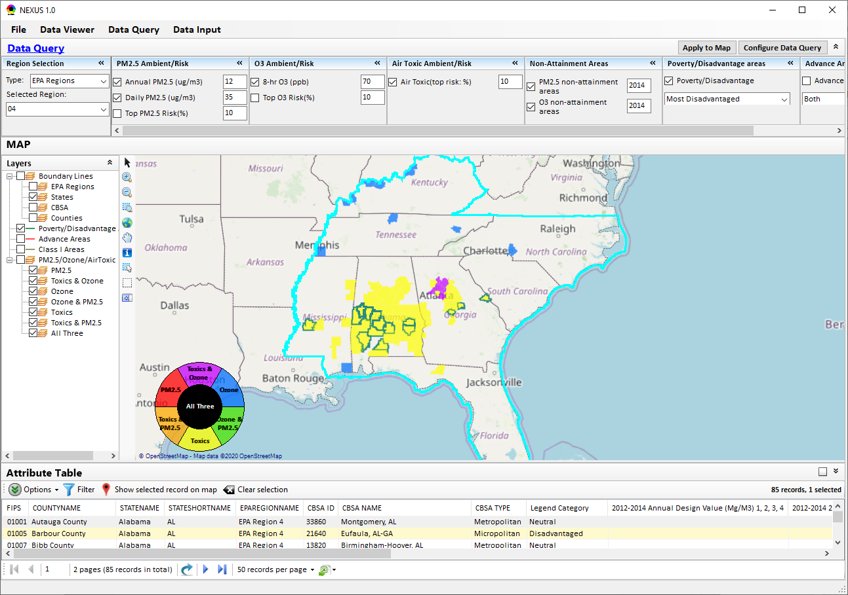
Data Query Module: Overlaying Map
Overlaying Map selection
22

Slide 23
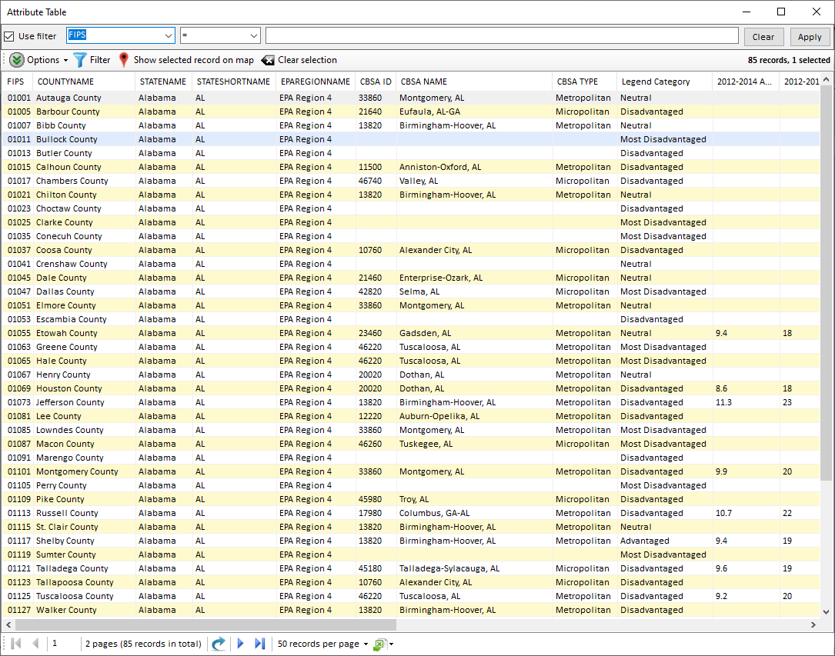
Data Query Module: Attribute Table
Filter/link/export functions (to be completed)
Detachable “Attribute Table”
23

Slide 24
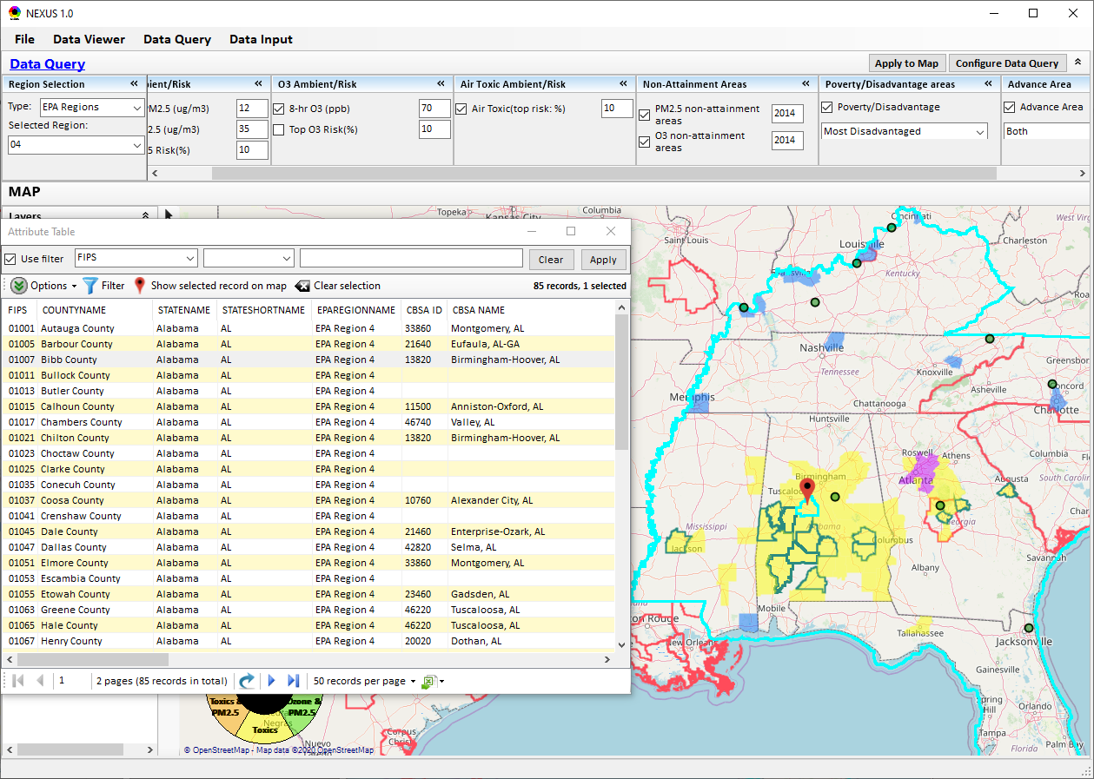
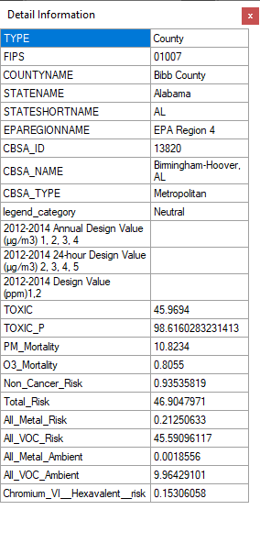
Data Query Module: Attribute Table
Click a “record” to link and display its location & info.
24

Slide 25
End
25

