Slide 1
Upgrade to NEXUS 1.7.1: List of Improvements
Near-term Priorities for 2021 NEXUS development:
Upgrade NEXUS (GUI/module/metrics/EJ) for public beta release
2017 emissions data update (including GHG & Sector)
2017 fused AQ (PM2.5, O3 & Air Toxics) & risk data update
New “Proximity-based risk & EJ analysis” module (census block group level of resolution)
Carey Jang, April 11, 2021

Slide 2
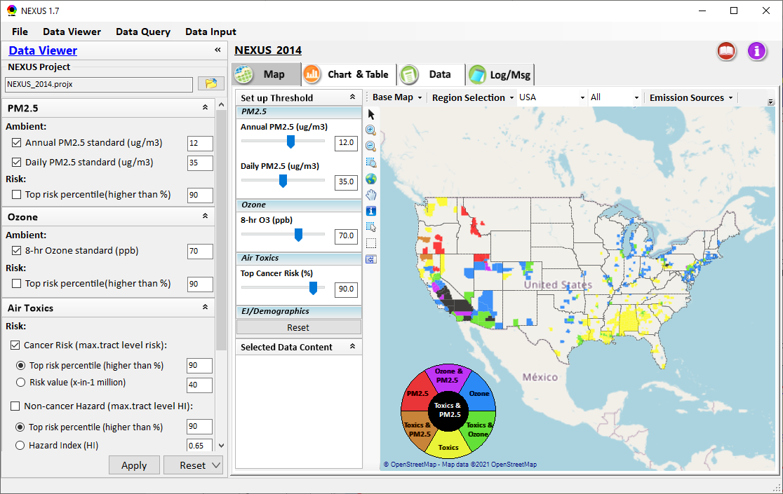
NEXUS 1.7 : Data Viewer Module
Change to “Cancer Risk (max tract-level risk in a county)”
(Note: only add “in a county” here to save space; if not
enough space within one line, can remove “risk”)
Remove all “.” in “max.” & “avg.” to just “max” & “avg”
Add all “-” between “tract” & “level” (ie., “tract-level”)
Change default to “Cancer Risk Value (x-in-1 million)”
(Note: default select “Risk value”)
Switch these two (default select “Risk value”)
(x) Risk value (x-in-1 million)
( ) Top risk %tile ……….
(Note: Also switch “Hazard Index” & Advanced options below)
2

Slide 3
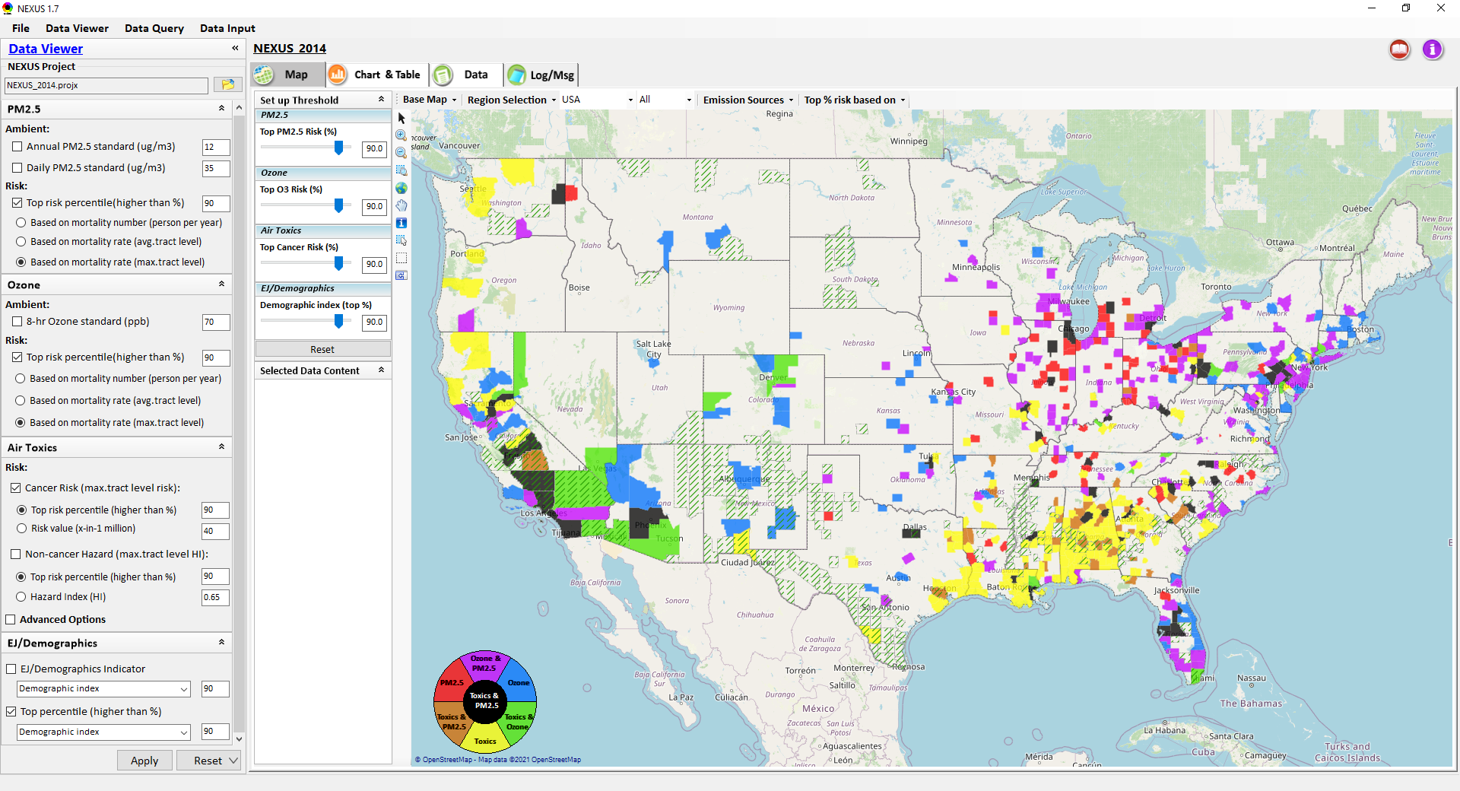
NEXUS 1.7 : Data Viewer Module
Change default selection to “Based on mortality number”
Remove all “.” in “max.” & “avg.” to just “max” & “avg”
Add all “-” between “tract” & “level” (ie., “tract-level”)
Change default to “50” from “90”
(“50” is about 90%tile)
3

Slide 4
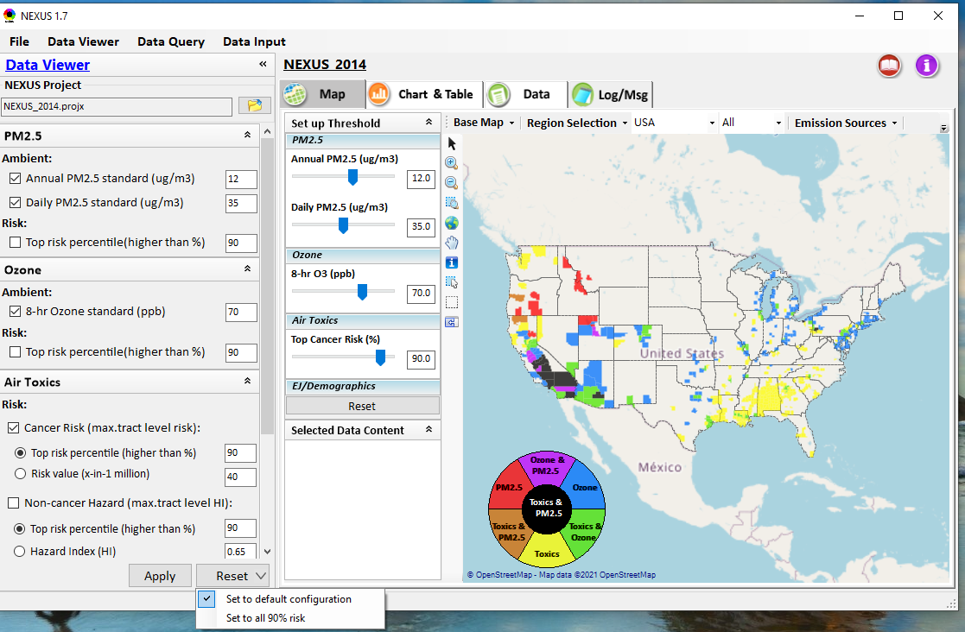
NEXUS 1.7 : Data Viewer Module
Change to
(x) Set to default configuration
(Note: select air toxic “Risk value (x-in-1 million)” to “40”)
( ) Set all to risk-based
(Note: select PM2.5 & O3 in mortality number “90 %tile”,
select air toxic “Risk value (x-in-1 million)” to “40”,
select EJ/Demographic indicator to “50”
( ) Set all to risk-based in %tile
(Note: select PM2.5 & O3 in mortality number “90 %tile”,
select air toxic “risk %tile to “90 %tile”,
select EJ/Demographic indicator to “90 %tile”,
4

Slide 5
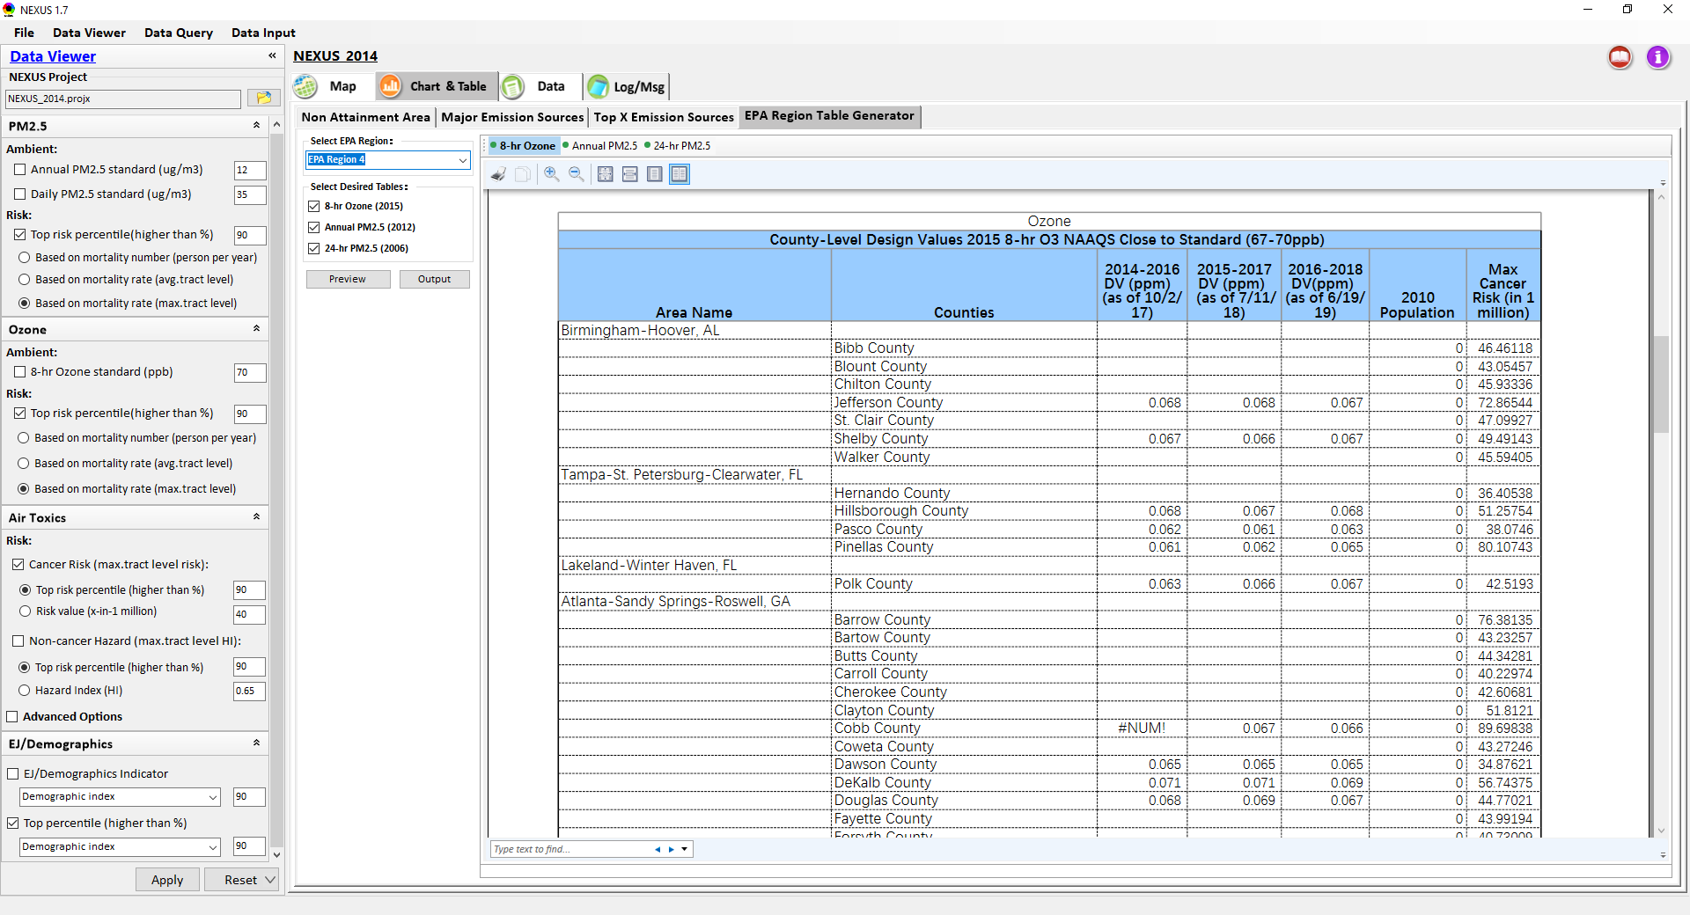
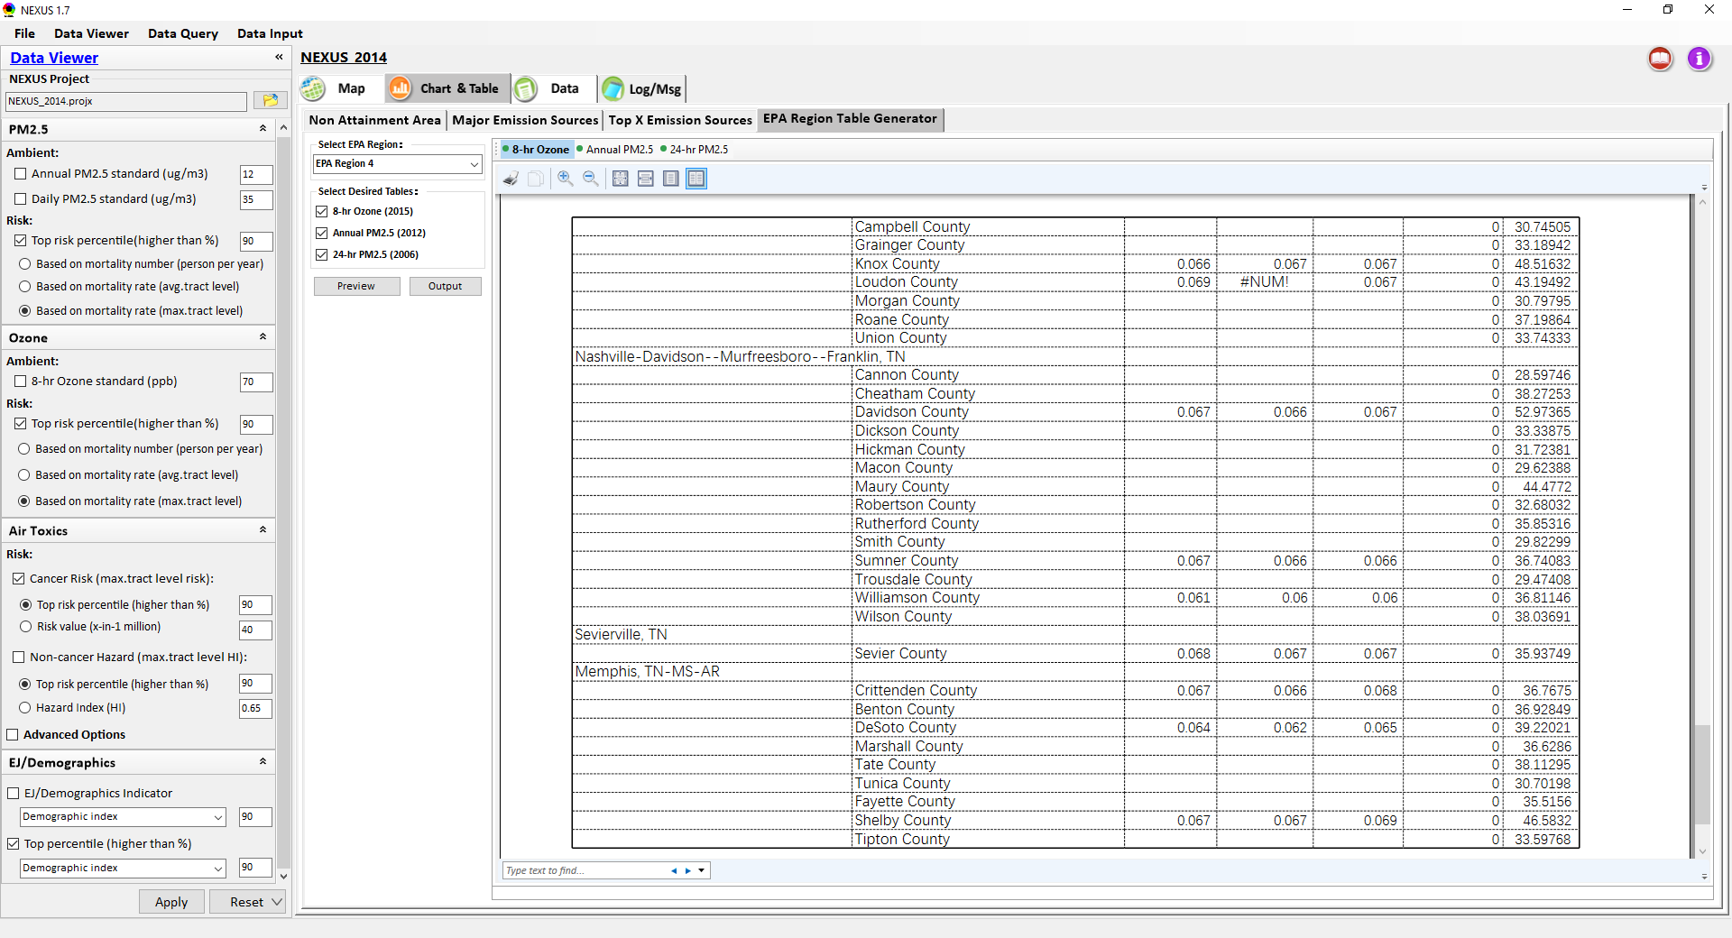
NEXUS 1.7 : Data Viewer Module
Move “EPA Region Table Generator” to first tab before “Non-attainment Area”
Can output a file, but can not open the file in “Excel”
Fix all the “Num!” bugs
(check all tables with this bug)
5

Slide 6
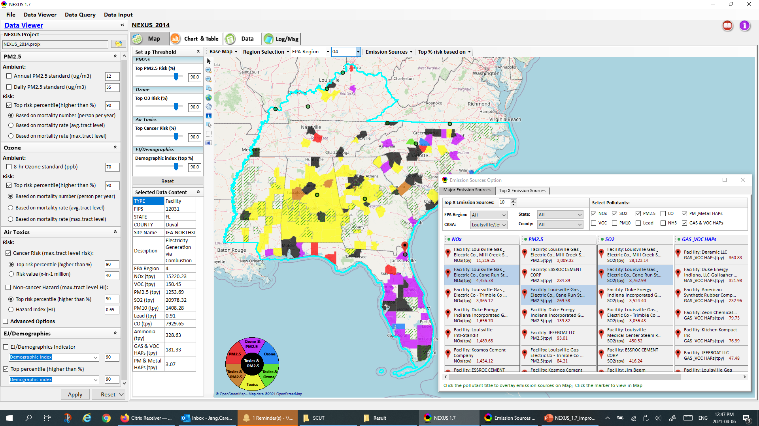
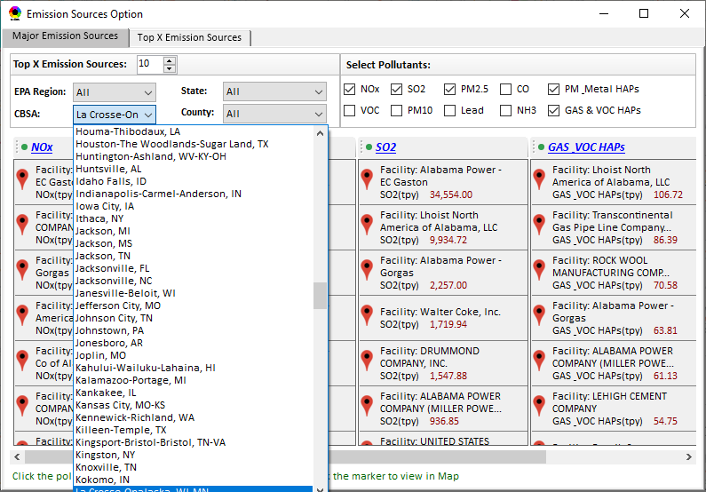
NEXUS 1.7 : Data Viewer Module
Change “Emission Sources” to “Source/Sector Emissions
Under, change the Tab
“Output Summary Table” to “Sector Emission Summary”
Change to “Top Risk based on”
When enter a letter (e.g, “L”), move the first “L” starting CBSA to the top, not the bottom (currently have to roll the cursor down in order to find the CBSA of interest
When selecting a CBSA here, the map display doesn’t reflect the selection
6

Slide 7
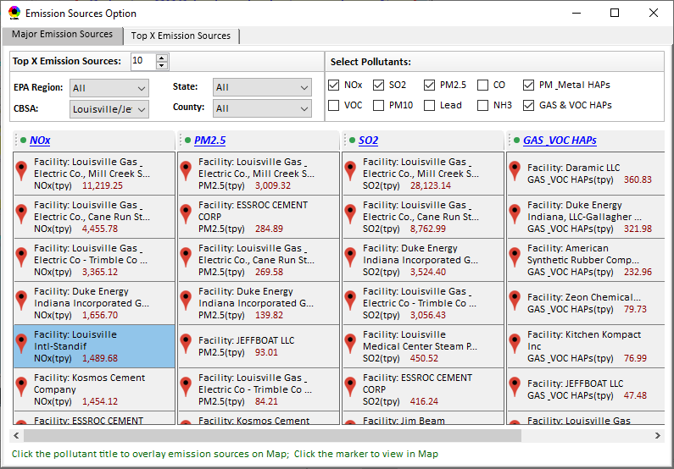
NEXUS 1.7 : Data Viewer Module
Add two new tabs:
Source Category Emissions
Sector Emissions Summary
(see next two slides)
Change to “Source/Sector Emissions Option”
1.Change the default Selections to:
NOx, SO2, CO2e (new add), Gas & VOC HAPs,
Heavy Metal PM HAPs
2. Separate “PM & Metal HAPs” to “Heavy Metal
PM HAPs” & “Diesel PM HAPs”
3. If no enough space, can remove “PM10”, “Lead”,
“CO”
Add a new selection here:
(X) CBSA (default selection)
( ) Tribal
(Note: allow to zoom-in to “Tribal areas too)
For every facility listed, add sector name:
Facility:
Sector:
NOx (tpy):
7

Slide 8
NEXUS 1.7 : Data Viewer Module
New tab: “Source Category Emissions”
Under “Source Category Emissions”, provide a similar table, but instead of listing facility, listing “Source Categories” (see example below):
----------------
Point
NOx (tpy):
----------------
Non-Point
NOx (tpy):
----------------
Road
NOx (tpy):
----------------
Non-Road
NOx (tpy):
----------------
Event
NOx (tpy):
----------------
8

Slide 9
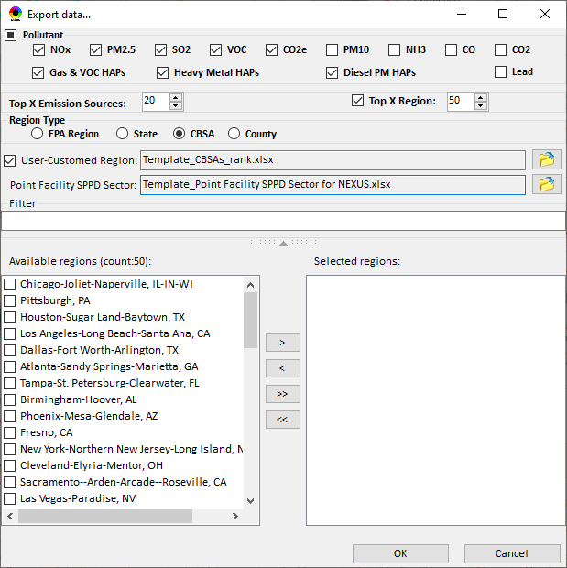
NEXUS 1.7 : Sector Emissions Summary
Change to “Output Sector Emissions Summary Tables”
Change “User-customed Region” to “Selected Region”
(Note: should be customized, not customed”)
Change “Point Facility SPPD Sector” to “Sector Definition File:
Add two new tabs to replace “OK”
Summary Table
(Note: Display tables first, and then provide a function to output tables)
Summary Plot
(Note: Display plotting window for Table-2. See example plot in next slide)
9

Slide 10
Sector Emission Summary: Example Plot
over
Default selections:
“NOx” & “CO2e”
Allow to adjust Y-axis scale;
(Note: some emission such as EGUs can be large, so may need to re-scale)
X-axis uses top 20 sectors
Top Sector Groups Score (Frequency & Rank)
10

Slide 11
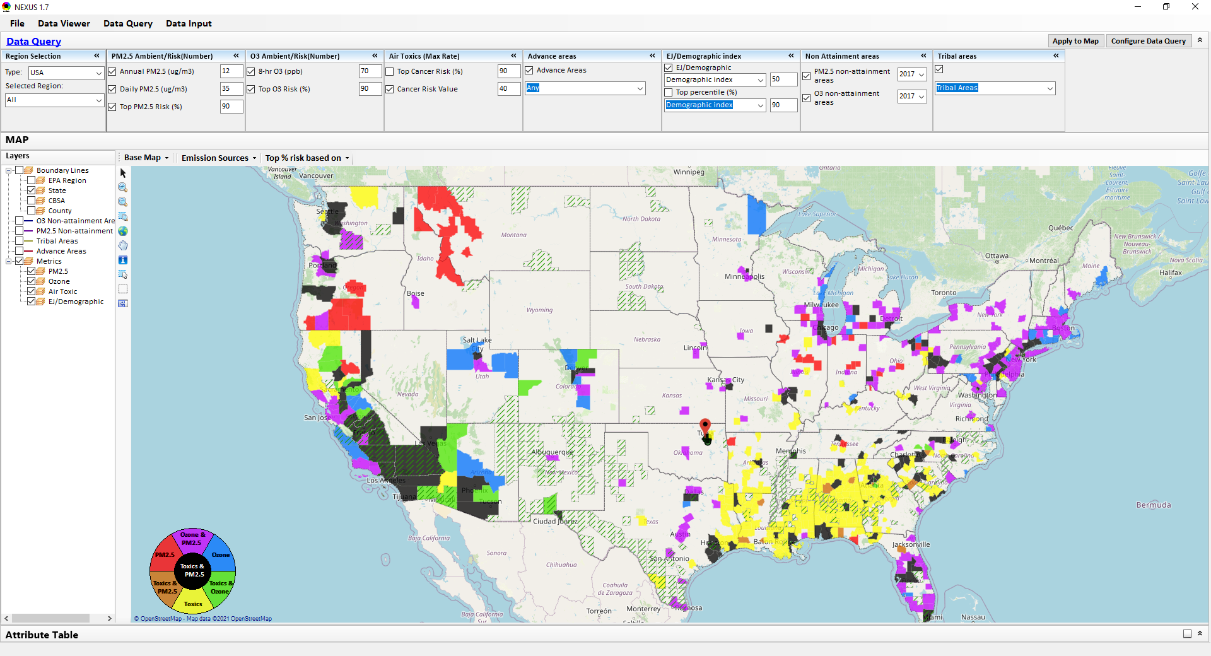
NEXUS 1.7 : Data Query Module
Switch These two:
(x) Cancer risk value
( ) Top cancer risk
Use these selections as default Data Query module starting window. Please check carefully on the “selected boxes and numbers”. These default selections are also used in “Configure Data Query”
Default display “unchecked” for these 4 options of map overlaying
11

Slide 12
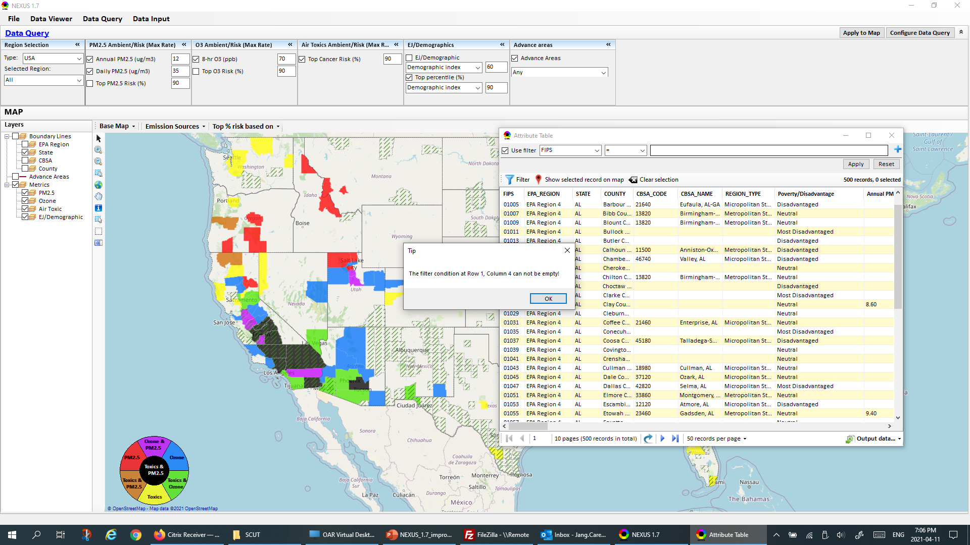
NEXUS 1.7 : Data Query Module
This bug still exists! This window pops up when trying to click “Output data” to export a CSV file from the attributes table. Please make sure to fix this bug!
“Data Query”
12

Slide 13
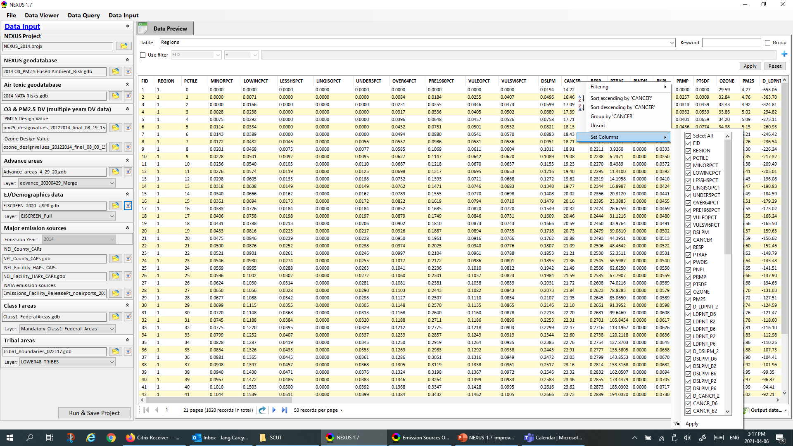
NEXUS 1.7 : Data Viewer Module
Does EJSCREEN data include “Climate risk” layer data? We may need to include “Climate risk” metrics similar to “EJ/Demographics” metrics. The 2020 version of EJSCREEN does have the “Climate risk” layer so the climate data should be available too.
Update to 2017 emissions data for both “County” and “Facility” files
13

Slide 14
End
14

Slide 15
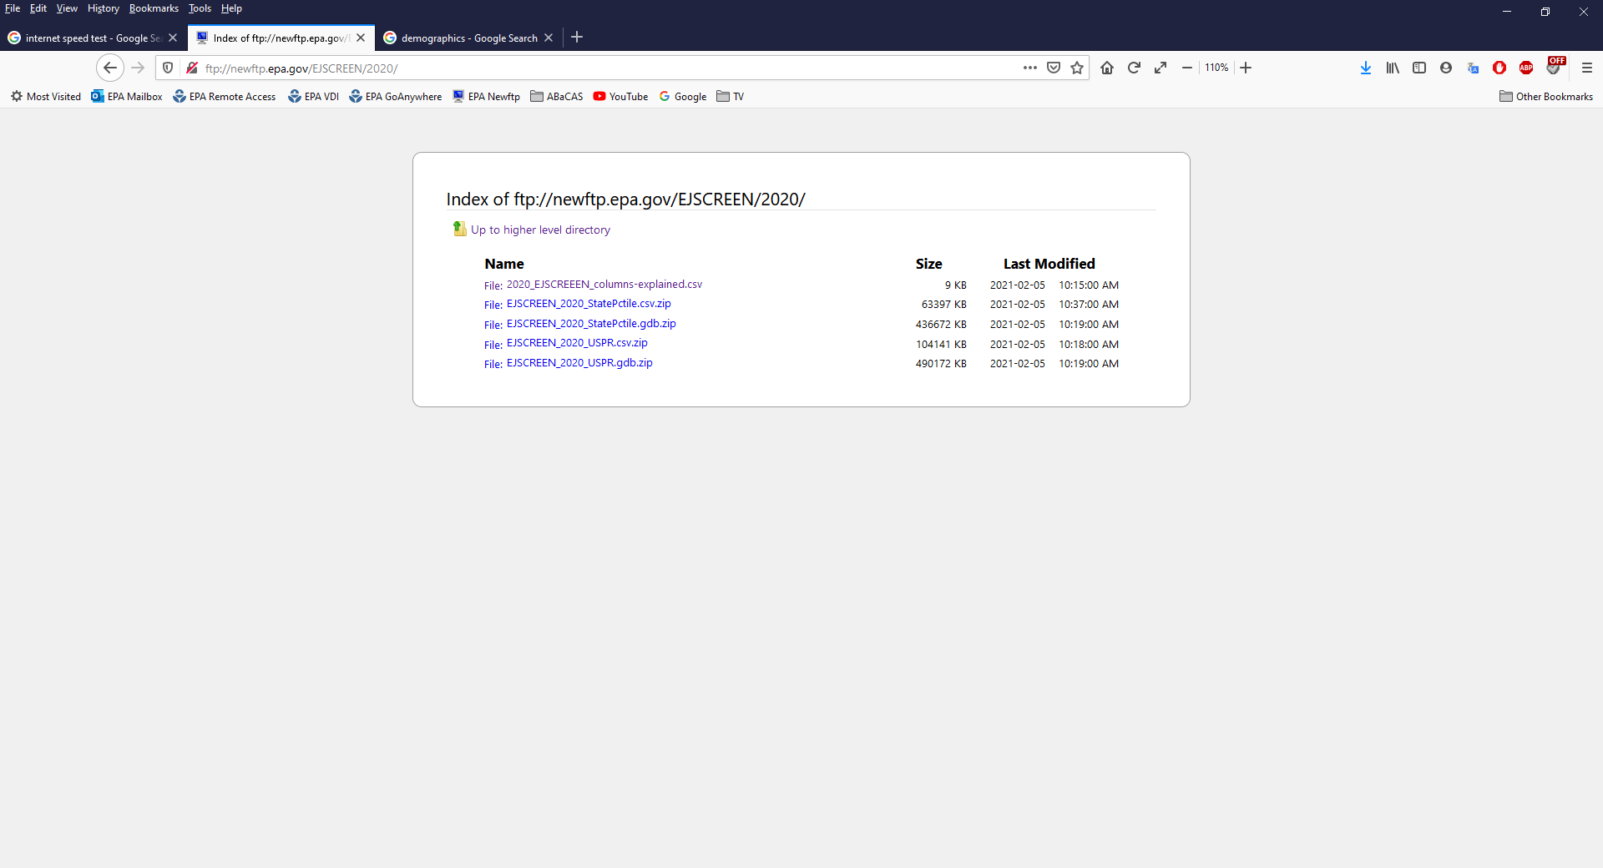
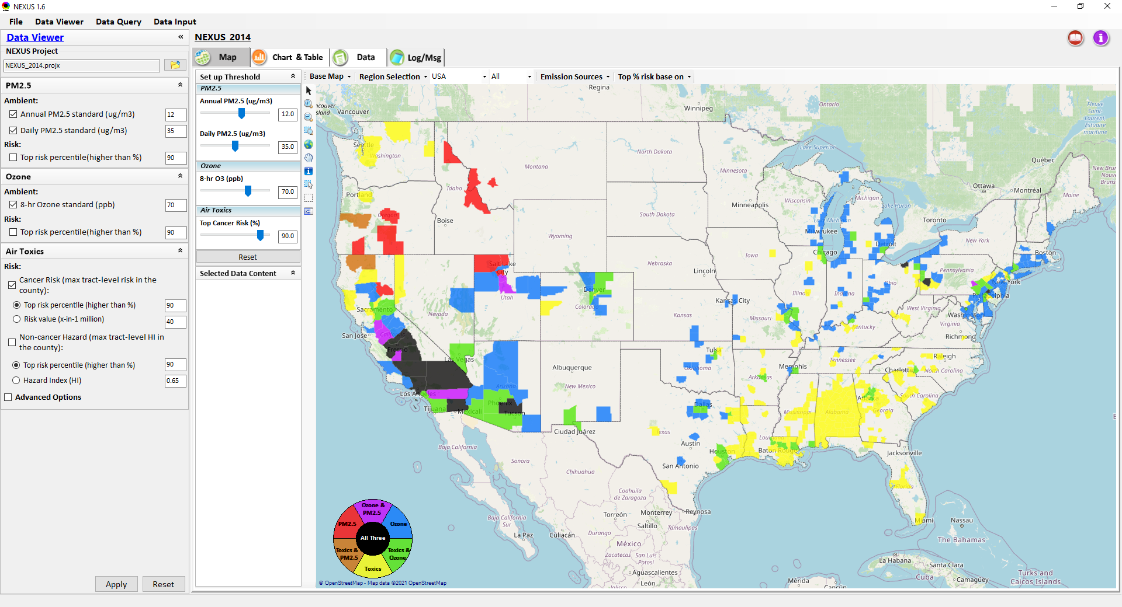

1st Priority: Add EJ/Demographics data as a new metric
Download from EJSCREEN (use 2020 data, see left). Include “Demographic Index” (default) and 6 demographic indicators as options:
Percent Low-Income:
​The percent of a block group's population in households where the household income is less than or equal to twice the federal "poverty level."
Percent Minority:
The percent of individuals in a block group who list their racial status as a race other than white alone and/or list their ethnicity as Hispanic or Latino. That is, all people other than non-Hispanic white-alone individuals.
Less than high school education:
Percent of people age 25 or older in a block group whose education is short of a high school diploma.
Linguistic isolation:
Percent of people in a block group living in linguistically isolated households. A household in which all members age 14 years and over speak a non-English language (or have difficulty with English) is linguistically isolated.
Individuals under age 5:
Percent of people in a block group under the age of 5.
Individuals over age 64:
Percent of people in a block group over the age of 64.
EJSCREEN includes A Demographic Index is based on the average of two demographic indicators; Percent Low-Income and Percent Minority.
When “EJ/Demographics” is checked (default unchecked), display “dark green” outlines for counties > x% (similar to Data Query’s map overlapping)
EJ/Demographics
EJ Indicator (based on max trarct-level)
Demographic index
This is a new 4th metric “EJ/Demographics”:
Include “Demographic index” (default) and the 6 indicators listed above as options (Note: this is only a suggestion how it should look like. Please give it a more professional design
15

Slide 16
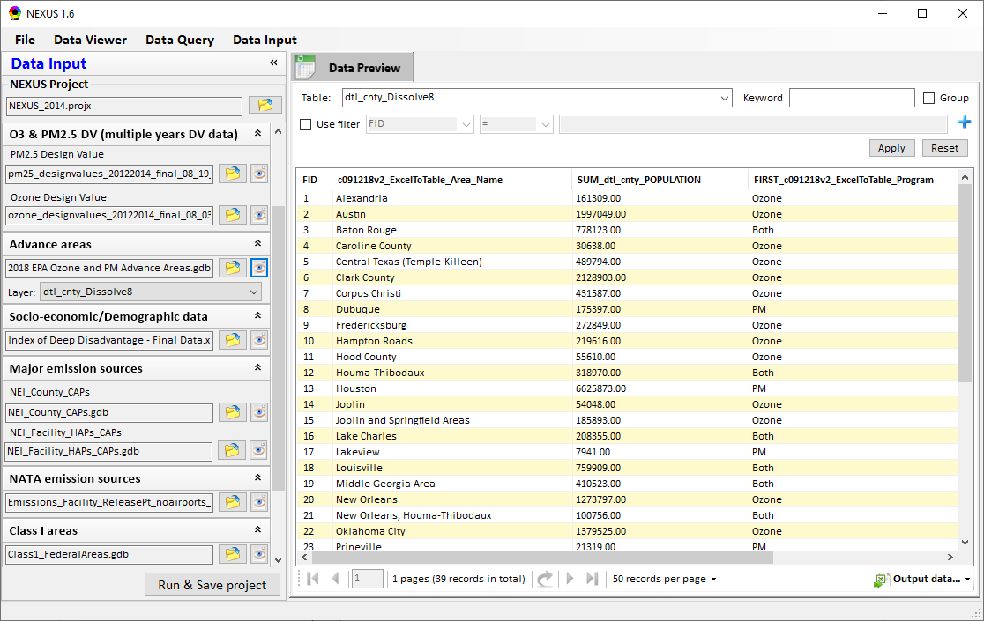
NEXUS 1.7 : Data Input Module
Make sure to use new “2020” Advance areas data (Advance_areas_4_29_20.mpk), not the old “2018” data.
Don’t use “2018” as part of file name here.
Change to “EJ/Demographics data”
Replace with “EJSCREEN data (“census block group” level)
Data View module’s “EJ indicator” will be based on “max census tract-level” %tile, but the EJSCREEN data is based on “census block group” %tile,
So first calculate the averaged “population-weighted block group %tile” to each “census tract level %tile”,
and then use/select “max census tract level %tile” in the county (Note: this is important so make sure the calculation is correct)
Remove “Layer” below if not needed (to save space)
16

Slide 17
Part 3.1 (for NEXUS 1.6.2)
“Part 3.1” slides are updated for “NEXUS 1.6.2” (stop at NEXUS 1.7 for now)
1st priority: Add “EJ/Demographics” as one of the four key metrics (PM, O3, AT & EJ) in main GUI page (see next slide). Each task’s priority is based on the order of PPT slides (if all tasks can not be finished together, follow the slide# order)
File names need to be consistent (e.g., “v1.6” vs. “1.6”); In next version,
if dataset no change , use “NEXUS_1.6.1_setup.exe” & “NEXUS_1.6_data.exe”
If dataset updated, use “NEXUS_1.7_setup.exe” & “NEXUS_1.7_data.exe” (only advancing version number when dataset is updated)

Slide 18
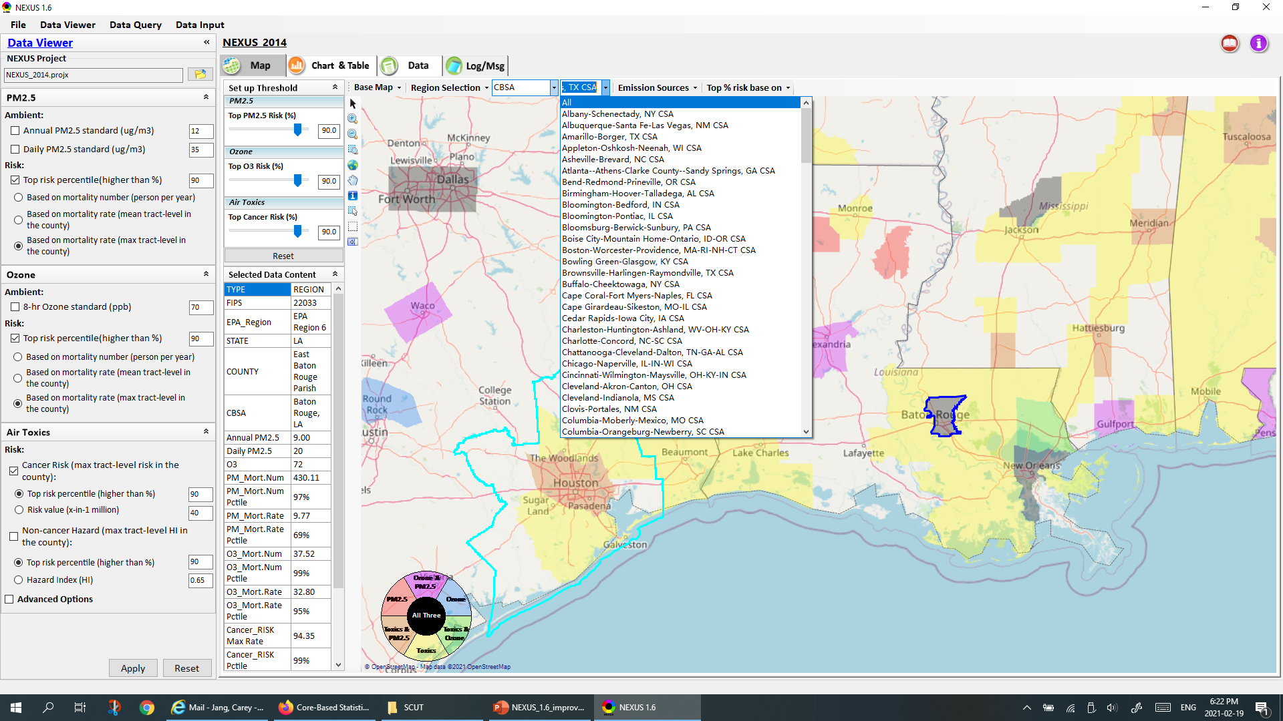
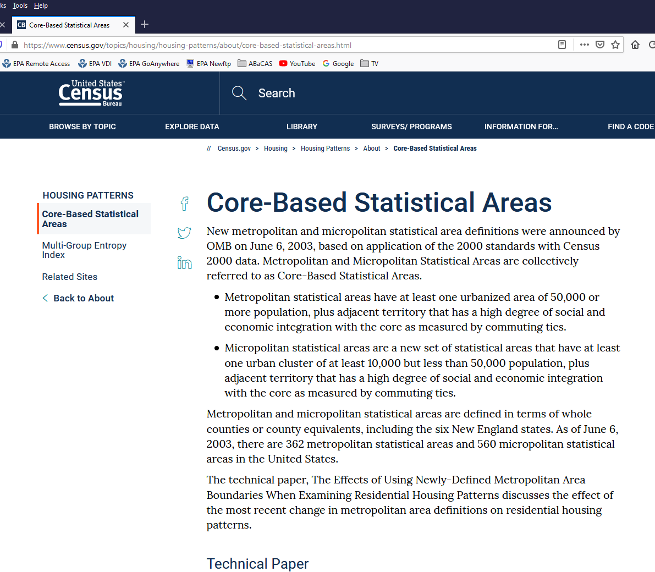
NEXUS 1.6.2 : Data Viewer Module
Why some of CBSAs (metropolitan areas, see left) are not included in the list? For example, no “Phoenix CSA” & “Baton Rouge CSA”. Is it possible to include all the major metropolitan/CSA areas (362 areas)?
18

Slide 19
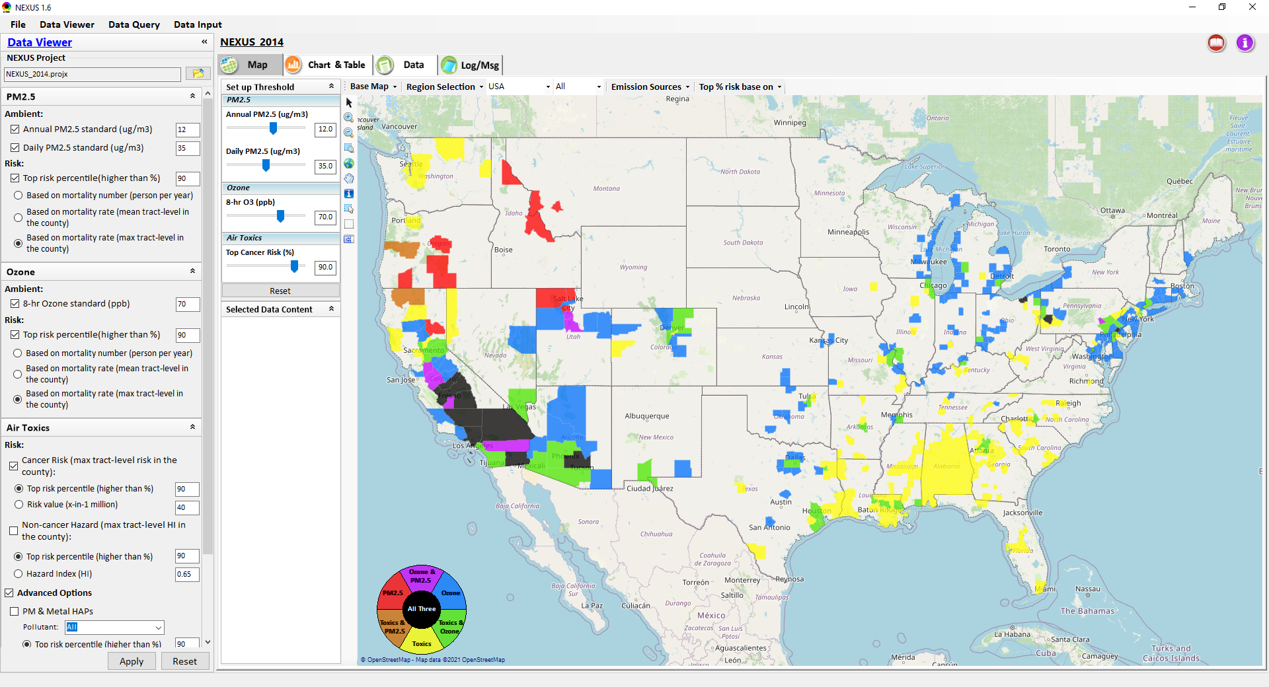
NEXUS 1.6.2 : Data Viewer Module
Change “(mean tract level in the county)” to “(avg. tract level)” (Note: to save space)
Typo: Top % risk “based” on
Bug in “based on “selected region”, when selected, some counties disappeared (should have more counties showing up)
Change to “(avg. tract level)”
Remove all “in the county” below (don’t need to repeat “in the county” as above to save space)
Click “Reset” once to reset; Create a “toggle” reset function to
click “Reset” again (twice) to set all 90%tile risk (PM, O3, Air Toxics)
(Note: current “Reset” has a bug (not working correctly in “Air Toxics”)
19

Slide 20
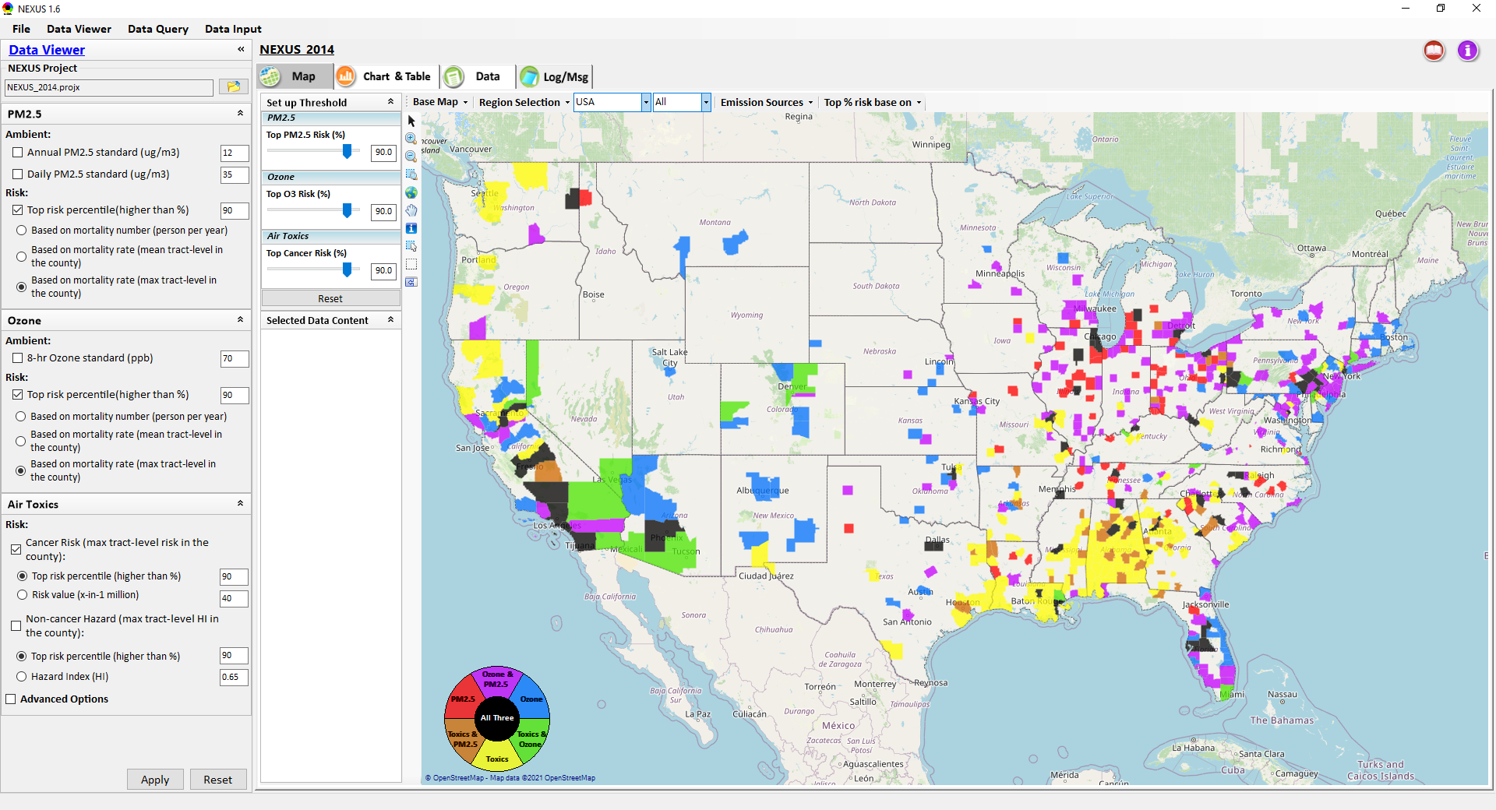
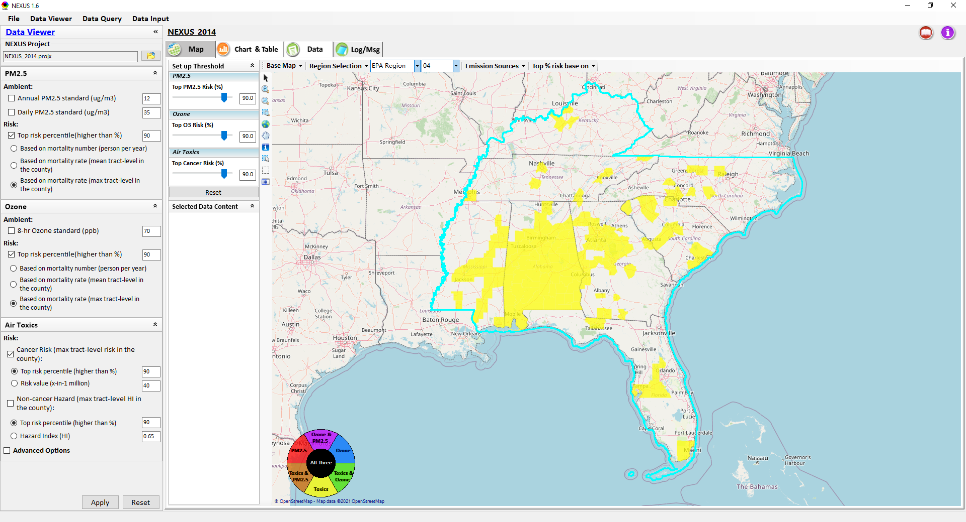
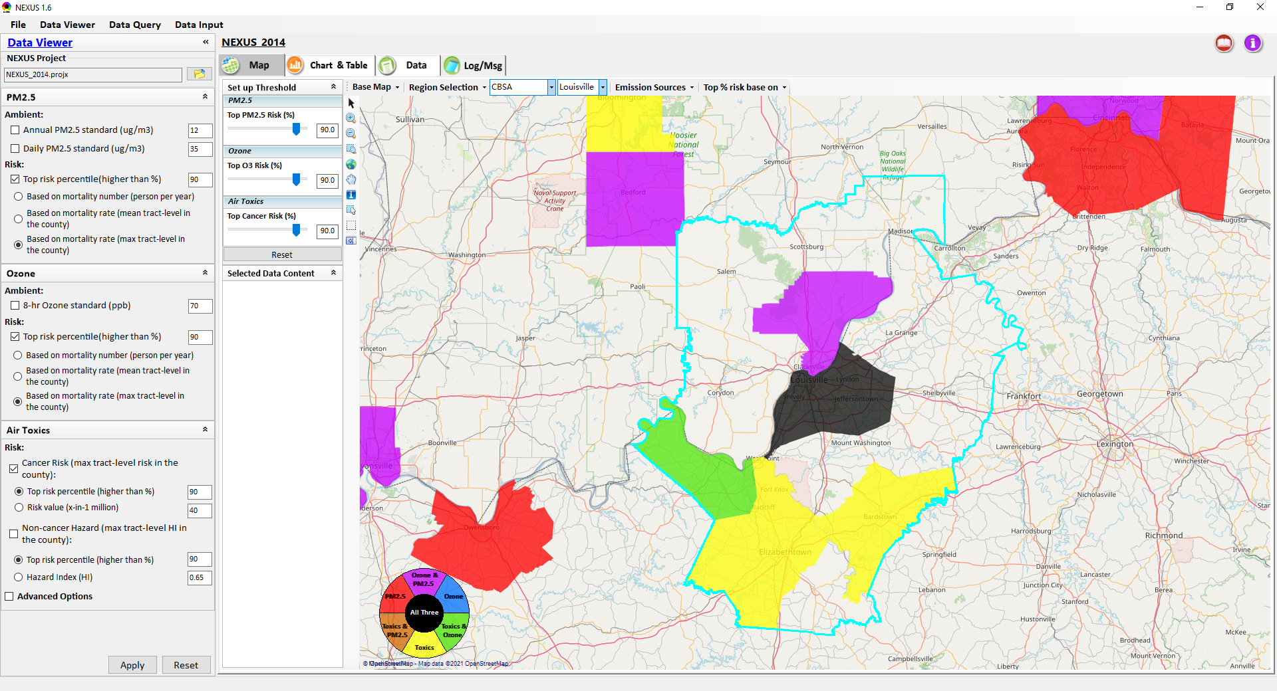
NEXUS 1.6.2 : Data Viewer Module
A major bug in “zoom-in” & displaying “Region/State/CBSA”
Another bug in “zoom-in” & displaying “CBSA”
Display not stable (sometimes blank, e.g., Louisville CBSA)
Areas outside of selected CBSA also displayed (should not be displayed)
20

Slide 21
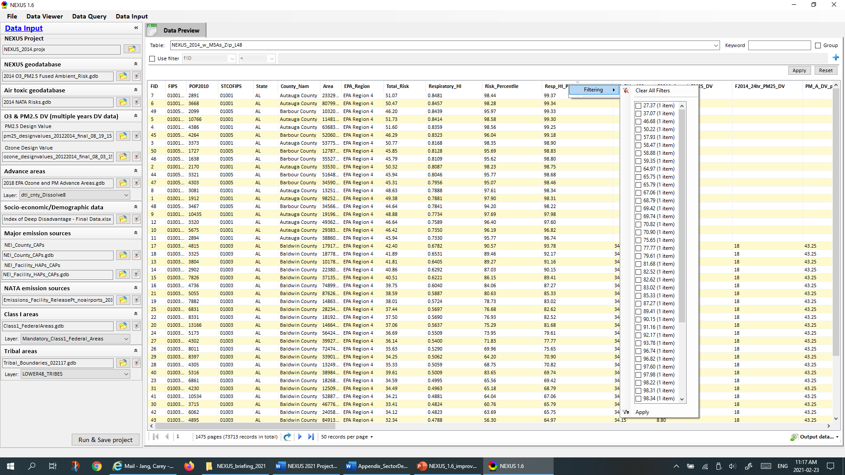
NEXUS 1.6.2 : Data Input Module
Data field selection is not working
21

Slide 22
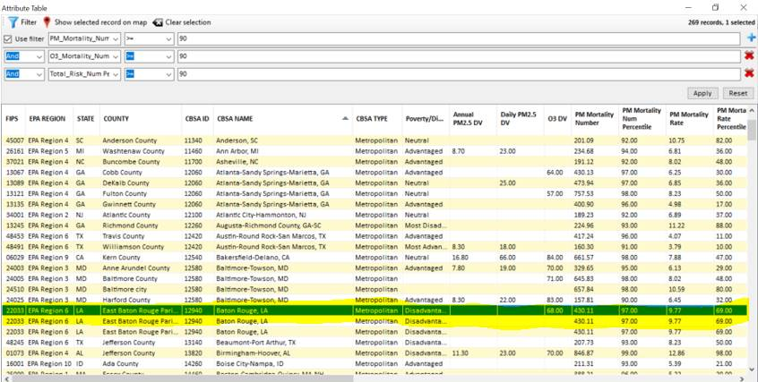
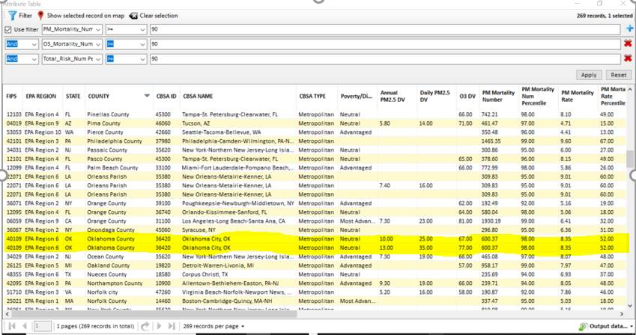
NEXUS 1.6.2 : Data Query Module
At least the other following counties also have duplicate records:
Lexington County, SC
Virginia Beach City, VA
Horry County, SC
Clackamas County, OR
Orleans Parish, LA
Guilford County, NC
Please check why some duplicate counties but have different data
Also a bug in NEXUS in trying to export a CSV file from the attributes table, can not export when selecting“Save All Records to CSV. An error window pop out (1 row, 4 column……). Also please make sure the error msg is grammatically correct (should be Row 1, Colum 4)
Please check why some duplicate counties but have different data
22

Slide 23
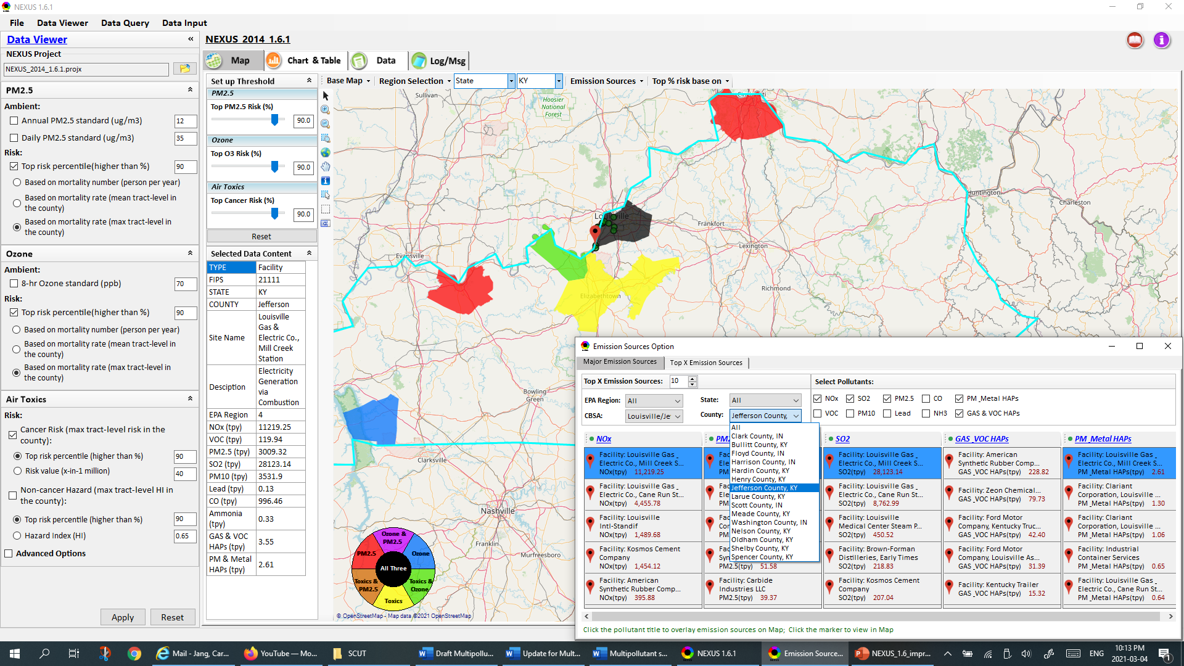
NEXUS 1.6.2 : Data Viewer Module
Bug: When selecting a county, wrongfully jump to State (KY)
There should be two “Jefferson County” in Louisville. One is “Jefferson co., KY”, the other one is “Jefferson co., IN” (this IN one disappears in this version, was in previous version)
The default table size is too big now. Change back to previous table size
Change to lighter blue (easier to see facility info.)
23

Slide 24
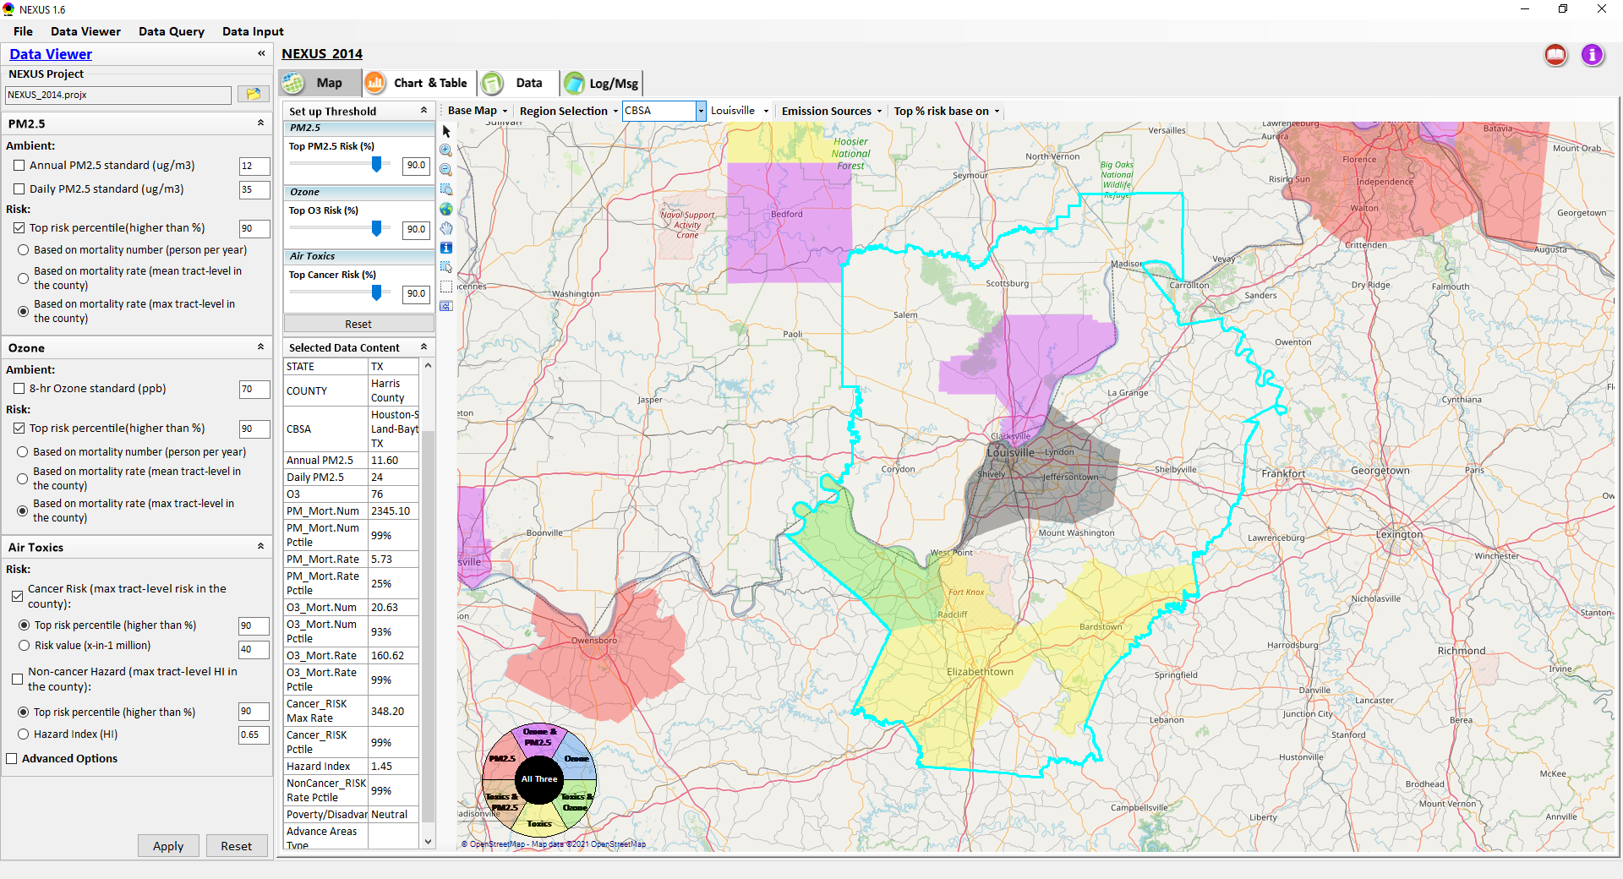
NEXUS 1.6.2 : Data Viewer Module
PM & O3 “Mort_Rate” & “%tile” need to be updated based on “max tract-level” %tile” (similar to air toxics risk)
24

Slide 25
NEXUS 1.7 (with new EJ & other input data)
1st priority: Add “EJ/Demographics” as one of the four key metrics (PM, O3, AT & EJ) in main GUI page (see next slide). Each task’s priority is based on the order of PPT slides (if all tasks can not be finished together, follow the slide# order)
File names need to be consistent (e.g., “v1.6” vs. “1.6”); In next version,
if dataset no change , use “NEXUS_1.6.1_setup.exe” & “NEXUS_1.6_data.exe”
If dataset updated, use “NEXUS_1.7_setup.exe” & “NEXUS_1.7_data.exe” (only advancing version number when dataset is updated)

Slide 26
End
26

Slide 27
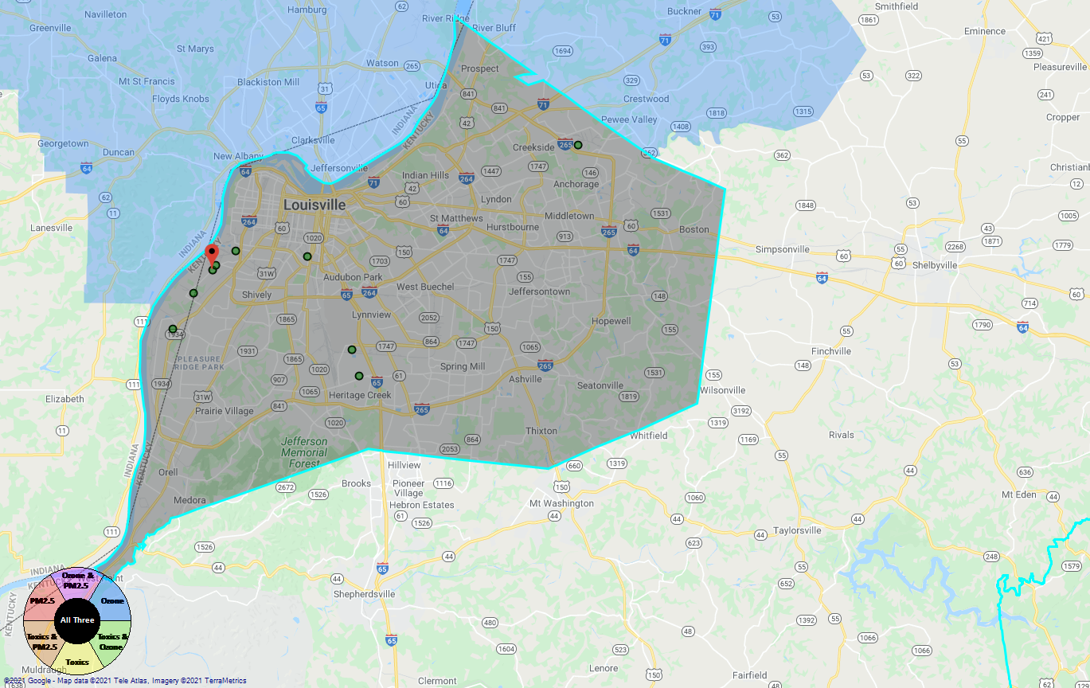
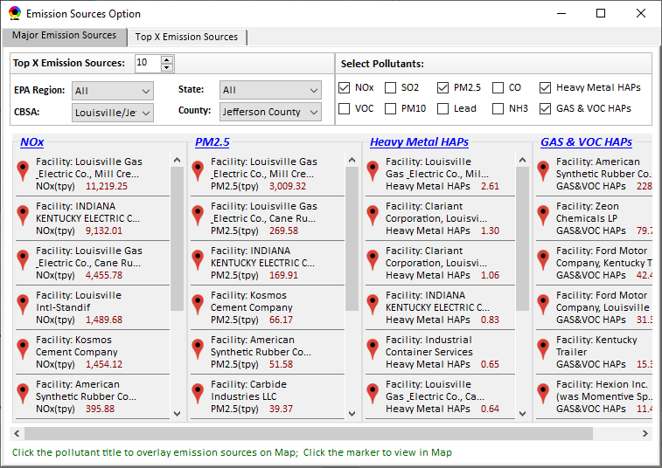
Proximity-based Risk & EJ Analysis Module
Allow to set a flexible “Radius of Impact” for selected source/facility
Add “Tribal” for listing tribal areas (All & individual)
Proximity-based Source/Sector Multi-Pollutant Risk & EJ Analysis
Source/Sector Analysis
Spatial Analysis
Source: American Synthesis Rubber Co., KY Sector group: Organic Chemical Manufacturing
[ x Display national map for Sector group
Radius of Impact
1
50km
Create Table
Create Plot
27

Slide 28
Proximity-based Module: Example Table
Source Name: American Synthesis Rubber Co., Louisville, KY Sector Group Name: Organic Chemical Manufacturing
 | Within Radius of Source | County Avg. | State Avg. | EPA Region Avg. | Nation Avg. | Sector Group (within radius) National avg.
Population total | x,xxx | xx,xxx | xxx,xxx | xxx,xxx | 317,xxx,xxx | xxx,xxx
PM2.5 risk (%tile) | x% | x% | x% | x% | x% | x%
Ozone risk (%tile) | x% | x% | x% | x% | x% | x%
Air Toxics risk: Cancer risk (%tile) | x% | x% | x% | x% | x% | x%
Cancer risk value (x in-million lifetime) | x.x | x.x | x.x | x.x | x.x | x.x
Non-cancer risk (%tile) | x% | x% | x% | x% | x% | x%
Non-cancer risk (Hazard Index) | x.x | x.x | x.x | x.x | x.x | x.x
Climate risk: Flood (%tile) | x% | x% | x% | x% | x% | x%
Sea level rise (%tile) | x% | x% | x% | x% | x% | x%
Fire (%tile) | x% | x% | x% | x% | x% | x%
Disease (%tile) | x% | x% | x% | x% | x% | x%
EJ Indicators: Minority group (%tile) | x% | x% | x% | x% | x% | x%
Low-income group (%tile) | x% | x% | x% | x% | x% | x%
Demographic Index (%tile) | x% | x% | x% | x% | x% | x%
Linguistic Isolation (%tile) | x% | x% | x% | x% | x% | x%
28

Slide 29
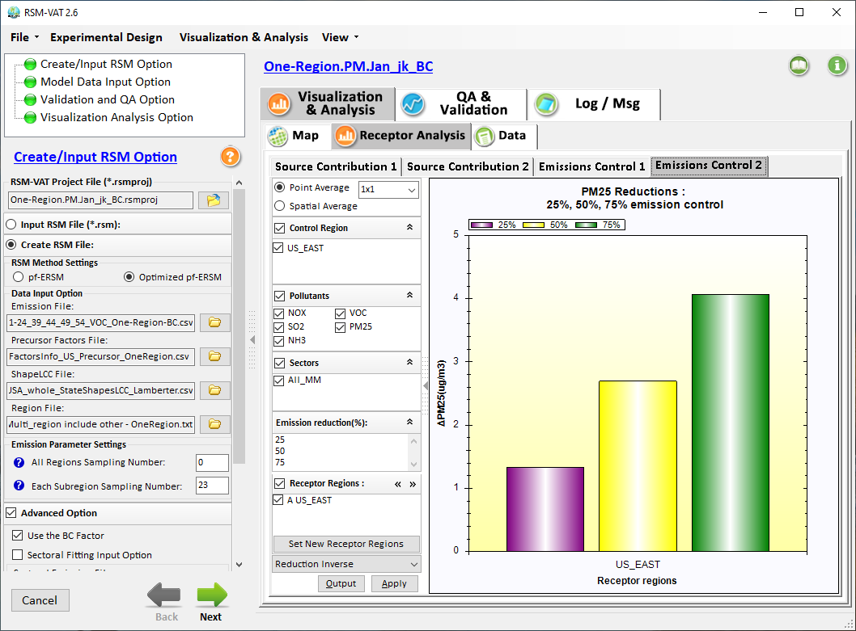
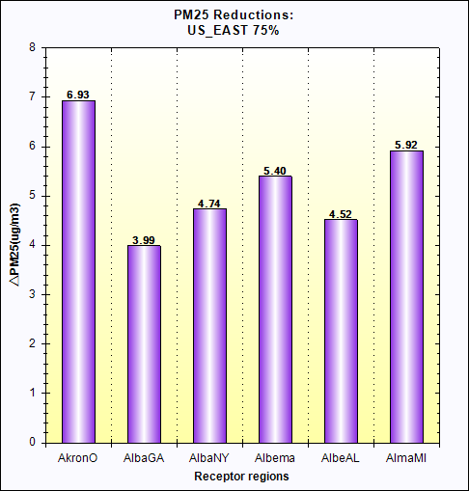
Proximity-based Module: Example Chart
Air Quality
Source: Sector Group:
PM2.5 risk
O3 risk
Air Toxics risk
Cancer risk
Non-Cancer risk
(%tile
EJ Indicators
Climate Risks
Population
Minority
Income
Education
Language
Flood
Fire
Sea Level Rise
Heat
Disease
Nation
avg. (%tile)
Climate Risks
Flood
Fire
Sea Level Rise
Heat
Disease
Within Radius County avg. State avg. EPA region avg. Nation avg. Sector Group avg.
of Source (Within Radius)
29

Slide 30
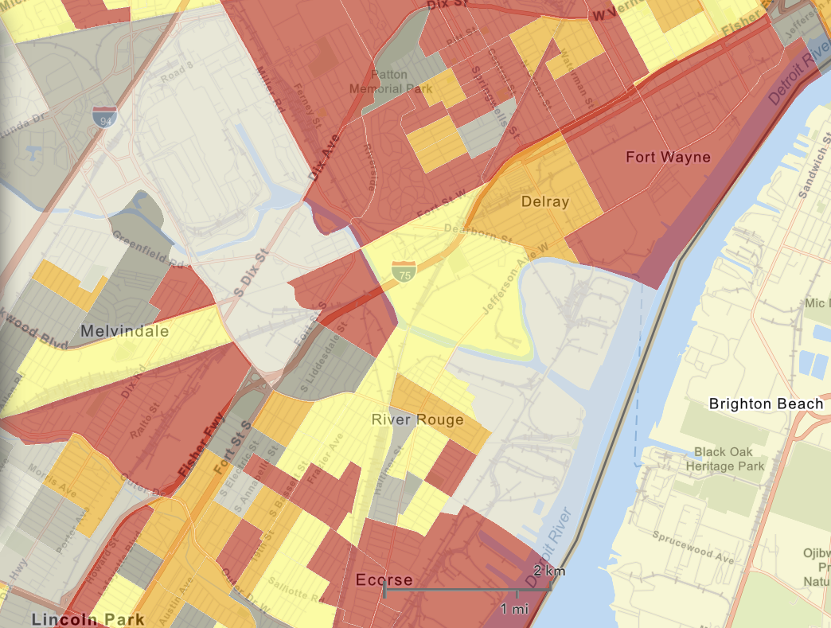
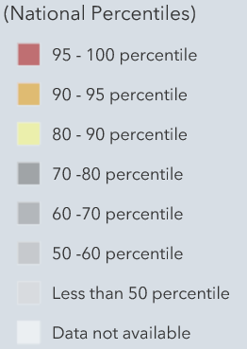

Proximity Analysis Module: Spatial Analysis
EJ Indicators
Demographic Index
Minority
Income
Education
Language
Climate Risks
Flood
Fire
Sea Level Rise
Heat
Disease
Proximity-based Source/Sector Multi-Pollutant Risk & EJ Analysis
Source/Sector Analysis
Spatial Analysis
EJ
Indicators
Minority
Climate
Risk
Fire
30

Slide 31
Proximity-based Risk & EJ Analysis Module
Proximity-base Source/Sector Multi-Pollutant Risk & EJ Analysis
Source/Sector Analysis
EJ Analysis
Climate Analysis
Tribal Analysis
Radius of Analysis
1
75km
Source: American Synthesis Rubber Co., KY
Sector Group: Organic Chemical Manufacturing
[ x ] Display sector group’s national map
Create Table
Create Plot
31

Slide 32
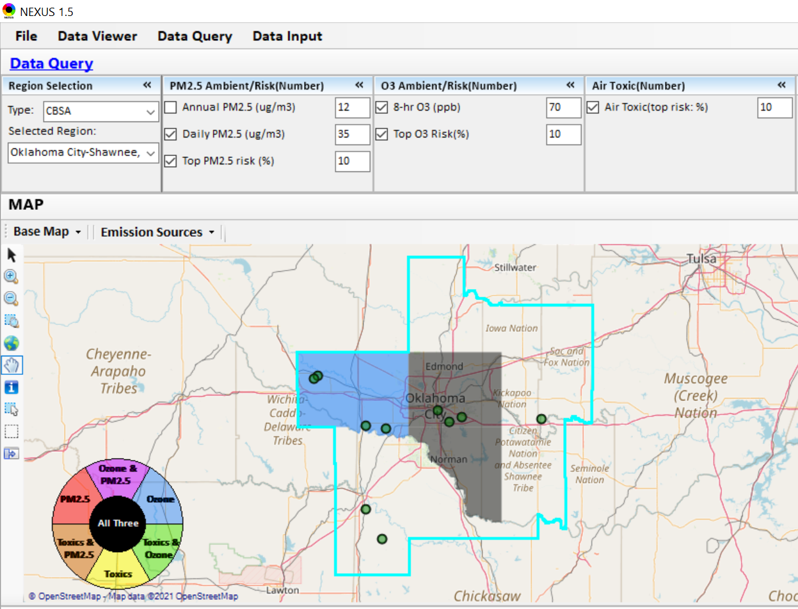
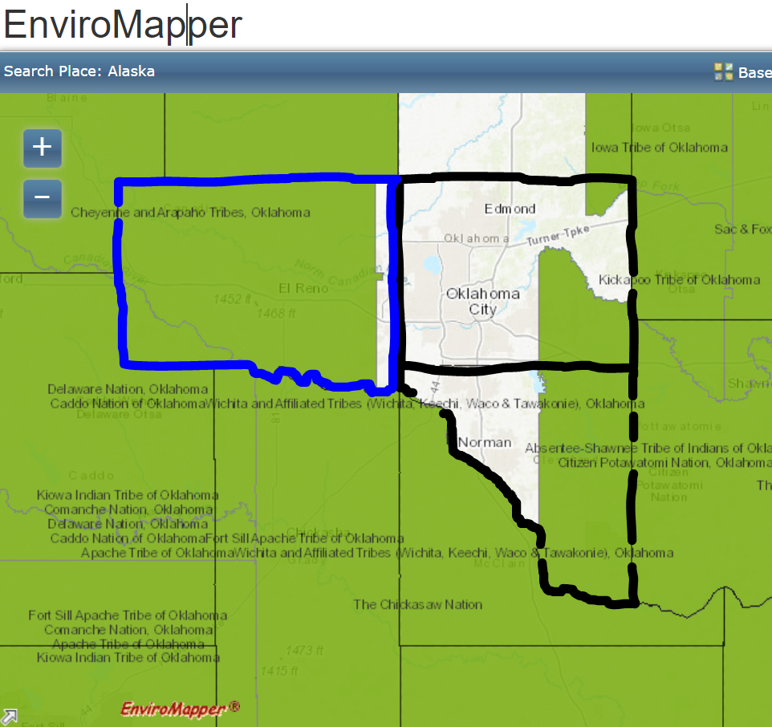
“Tribal Areas” Example: OKC-Shawnee CBSA
Cheyenne & Arapaho Tribes, OK
Iowa Tribe of OK
Add “Tribal” for listing Tribal areas (All & individual)
Kickapoo Tribe of OK
Citizen Potawatomi Nation, OK
The Chickasaw Nation
The maps above were generated for the Oklahoma City-Shawnee CBSA using the NEXUS data query module & EnviroMapper to demonstrate the benefit of adding a Tribal Boundary layer. The top 10 Gas & VOC HAPs emission sources are plotted in NEXUS.
32

Slide 33
Part 2

Slide 34
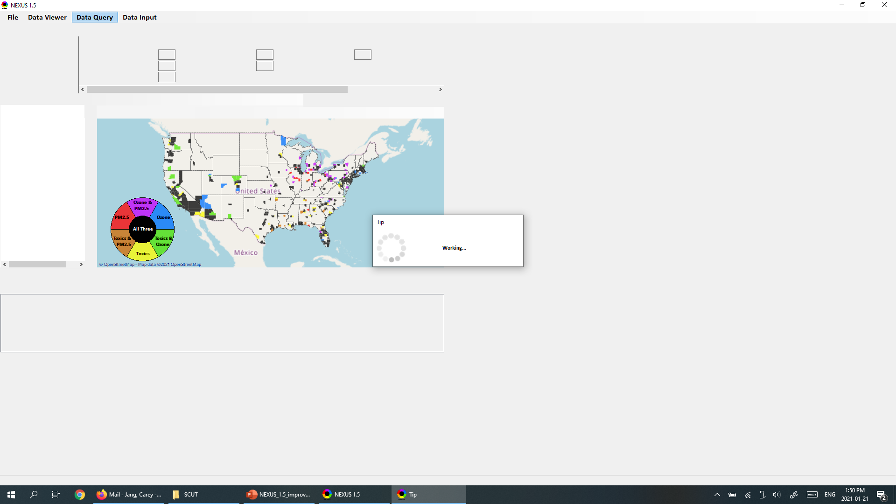
NEXUS 1.6 : Data Query Module
“Data Query” screen (map, table, etc.) flashing & sometimes with some black screen when the module starts and refreshes. Need to avoid the “black screen” and make NEXUS look more professional; for example, keep the current “working” tip window, and then display just one clean window snapshot without flashing if possible. Also try to avoid the “Table” flashing with each column displayed one by one.
34

Slide 35
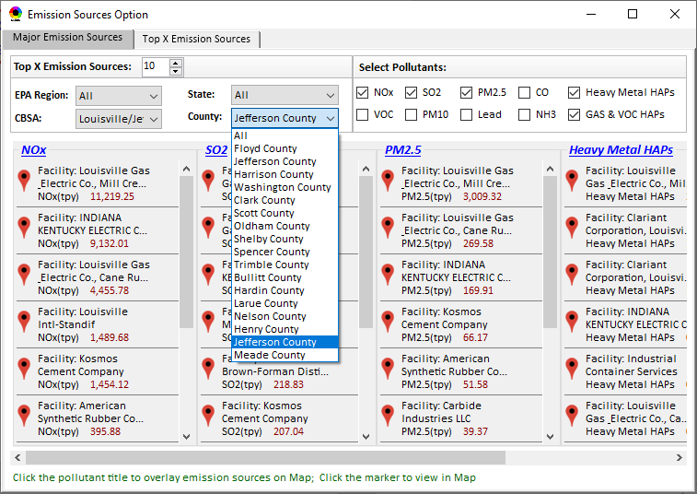
NEXUS 1.6 : Data Query Module
List a alphabetic order (so the selected county can be found easier) under both in “Data Viewer” & “Data Query”
35

Slide 36
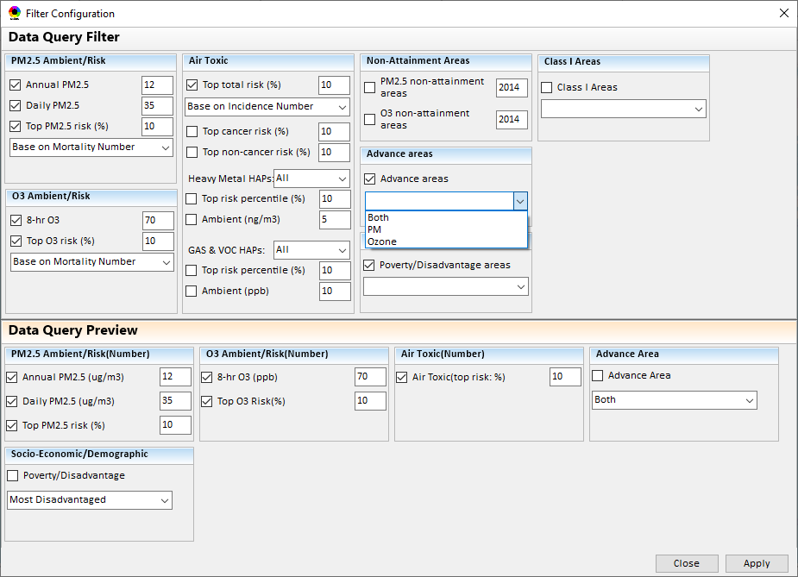
NEXUS 1.6 : Data Query Module
Advance areas: Need to add an option “Any” with any Advance areas displayed (i.e., “either PM or Ozone”). Use “Any” as default (Current “Both” option misses “PM only” or “Ozone only” areas);
Change “PM” to “PM only” and “Ozone” to “Ozone only”
36

Slide 37
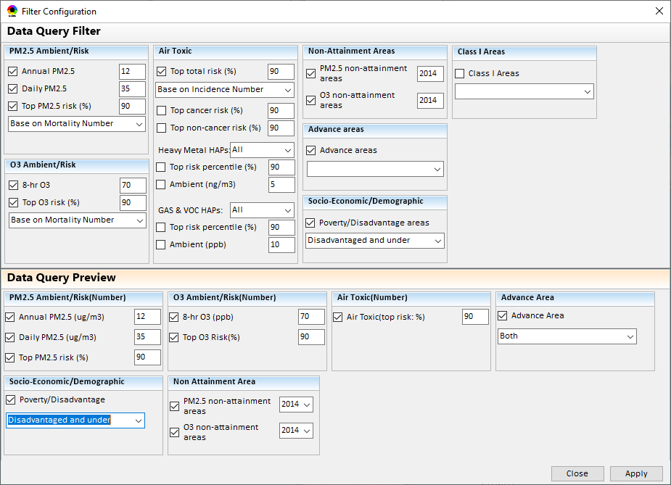
NEXUS 1.6 : Data Query Module
Use this Configuration window selections as the default options, also reflecting new “metrics” changes in “Data Viewer”
Any
In these two windows, Make all “Air Toxic” to “Air Toxics”,
All “Areas” & “Area” to “areas”
(consistency is the key!)
areas
List under:
Based on mortality number
Based on mortality rate (max tract-level)
Based on mortality rate (mean tract-level)
Any
areas
Switch: “Apply” first
37

Slide 38
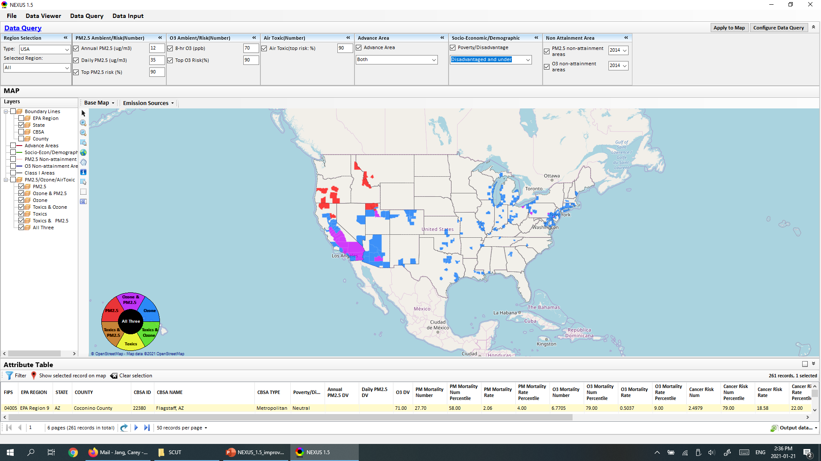
NEXUS 1.6 : Data Query Module
This is the default window how the look like
Any
Although these 3 options default “checked”, but don’t display in the “Map overlapping” boundaries” as a start (Note: please make sure they work and boundary lines appear when the box is checked. Also when a new box “checked”, the option’s boundary lines should cover/overlap the previously checked option if they overlap)
38

Slide 39
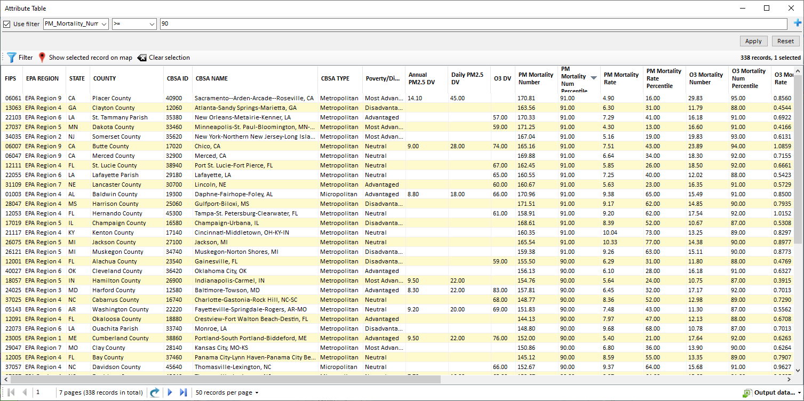
NEXUS 1.6 : Data Query Module
There must be a bug in the Filter function in Attribute table (and other tables). Please see below. There are many “PM_Mort_Number_%tile” >92, but they are not listed (only 91 & 90 listed here). Also the same problem with other metrics. Either something wrong with the sorting or pages display (e.g., not all pages sorted at the same time). Please check.
39

Slide 40
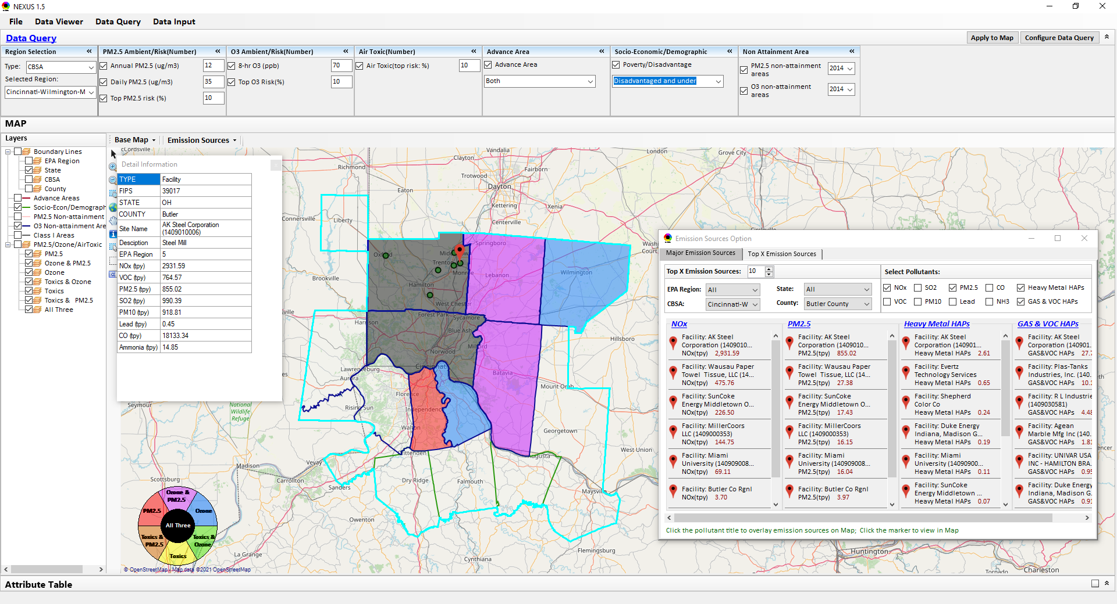
NEXUS 1.6 : Data Query Module
When a “facility” is clicked, display both CAPs & HAPs emissions data together in the pop-up emission table (now they are displayed separately). Same for the information table under the “Slider bars” in Data Viewer module.
Now users need to click/find the “small green circle” in order to display “pop-up” facility emission table. If feasible, make it easier to click the “Target sign” to display the facility emissions table. Same for the Data Viewer module and its information table under the “Slider bars”.
40

Slide 41
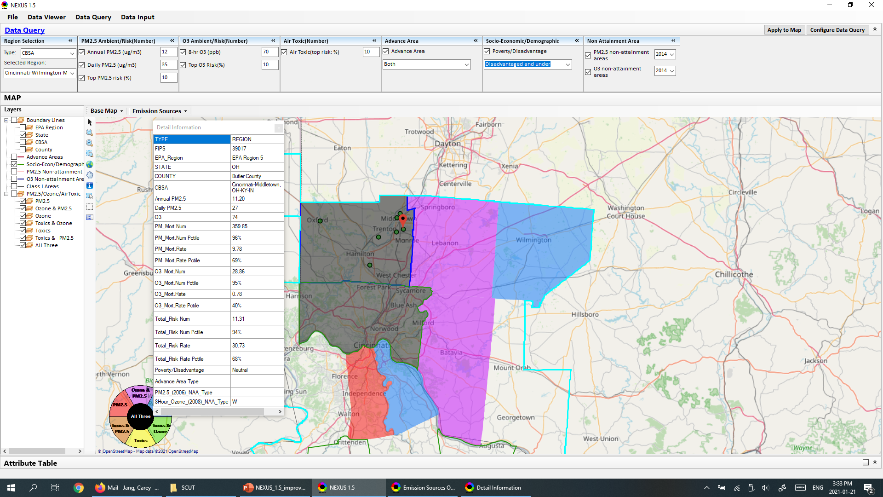
NEXUS 1.6 : Data Query Module
This county level information table is very helpful and will also need to be updated with the new metrics (particularly new Air Toxics metrics, current has no specific air toxics info.) in both “Data Query” module and “Data Viewer” module (under the Slider bars).
41

Slide 42
Part 1

Slide 43
“NEXUS 1.6”
To Do List for Updated “NEXUS 1.6”
(before Chinese New Year):
Complete the Table Generator module
Upgrade “Data Query” module & “Data Input” module to make their functions and graphic displays more stable (Note: “Data Query” screen flashing when the module starts and refreshes. So is “Data Input” module when larger dataset is displayed or refreshed. Try to make it look more professional; for example, send a “working” pop-up “hint” (if taking some time to display, and then display just one snapshot without flashing)
Update Online-User’s manual and Quick tutorial PPT slides
43

Slide 44
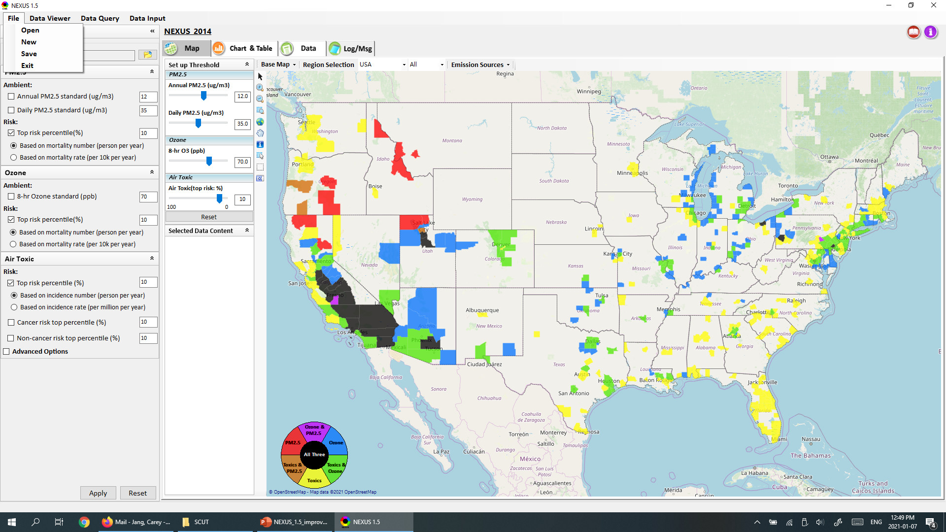
NEXUS 1.6 : Data Viewer Module
Change to: (similar to FAST-CE)
Open Project (*.proj)
New Project
Save Project
Change to:
O Based on mortality rate (mean tract-level in the county)
(note: “Air Toxics” also changed, given next)
Also add a new option for both PM & O3 risk:
O Based on mortality rate (max tract-level in the county)
44

Slide 45
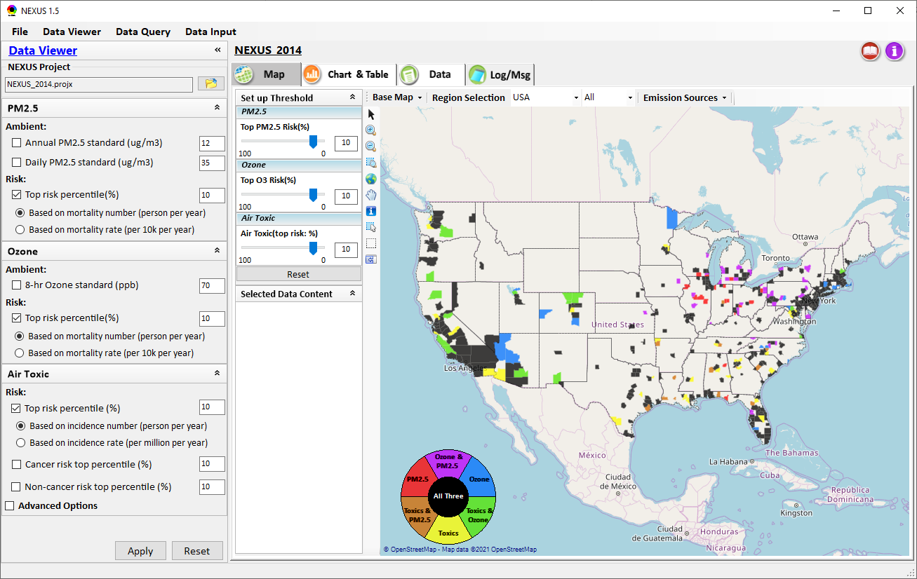
NEXUS 1.6 : Data Viewer Module
Change to:
□ Top risk percentile (higher than x%)
All default: 90%
[Note: reverse scale “100-0” now to “0-100”)
Allow to select top risk %tile based on either “nation” or selected region. Suggest to add an icon/menu here to provide a toggle option:
“Top risk % based on (x) Nation ( ) Selected region”
(default: “Nation”) (also the same in “Data Query”
Change to (PM, O3 & Air Toxics):
Top PM2.5 Risk (%)
Top O3 Risk (%)
Top Air Toxics Risk (%)
[Note: “Air Toxics (risk value)” should be displayed if “Risk value” is selected, see next slide]
All default: 90%
[Note: Reverse scale now to “0 - 100”]
Change all “Air Toxic” to “Air Toxics”)
45

Slide 46
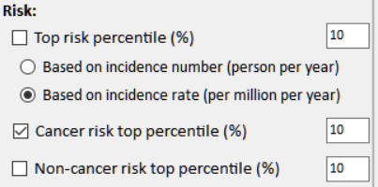
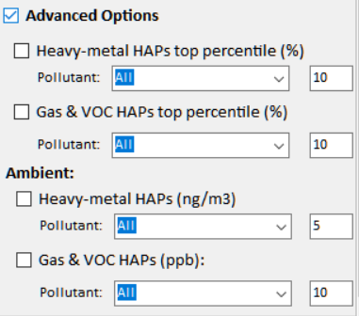
NEXUS 1.6 : Air Toxics
Current
New
Risk:
□ Cancer Risk (max tract-level risk in the county): (default checked)
o Top risk Percentile (higher than x%) 90 (Note: default checked)
o Risk value (x-in-1 million) ? (Note: use 90 %tile risk value)
□ Non-cancer Hazard (max tract-level HI in the county):
o Top risk Percentile (higher than x%) 90 (default if above box checked)
o Hazard Index (HI) ? (Note: use 90 %tile value, find a reasonable range)
(Note: Add up all “HI” in “NATA_2014_Tract_HIs_FINAL” file.
“HI” > 1 means likely adverse non-cancer hazard; <1 means unlikely
Cancer Risk (max tract-level risk in the county):
□ PM & Metal HAPs
Pollutant: All
○ Top risk percentile (higher > %) 90
○ Risk value (x-in-1 million) ?
□ Gas & VOC HAPs
Pollutant: All
○ Top risk Percentile (higher > %) 90
○ Risk value (x-in-1 million) ?
[ ] Advanced Options:
46

Slide 47
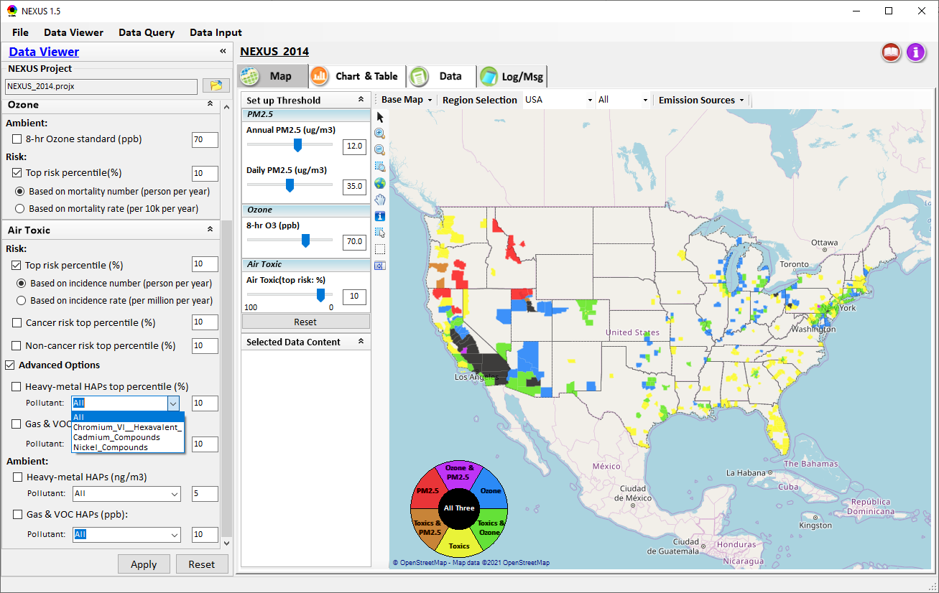
NEXUS 1.6 : Data Viewer Module
List of “PM & Metal HAPs”
CAS No. | Metal HAP
7440-36-0 | Antimony
7440-38-2 | Arsenic
7440-41-7 | Beryllium
7440-43-9 | Cadmium
7440-47-3 | Chromium
7440-48-4 | Cobalt
7439-92-1 | Lead
7439-96-5 | Manganese
7439-97-6 | Mercury
7440-02-0 | Nickel
7782-49-2 | Selenium
1854-02-99 | Chromium-VI
Change to “PM & Metal HAPs”
(also change in every elsewhere here & “Major Emissions Source” tables & “Data Query”)
Add “Arsenic” & “Beryllium” to “PM & Metal HAPs”
(delete “_Compounds” & “_Hexvalent” here)
Also remove ““Arsenic” & “Beryllium” in “Gas & VOC HAPs”
Remove “Ambient” from Air Toxics (see previous slides)
47

Slide 48
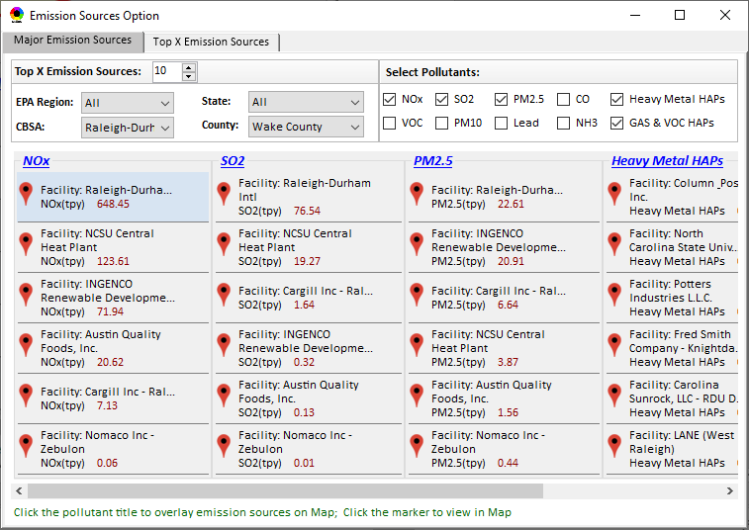
NEXUS 1.6 : Data Viewer Module
When a “Facility” is selected/clicked , “highlight” all the same facility displayed in this table (now w/ a light blue background, please make it a little more obvious; for example, a darker background color or an outline)
48

Slide 49
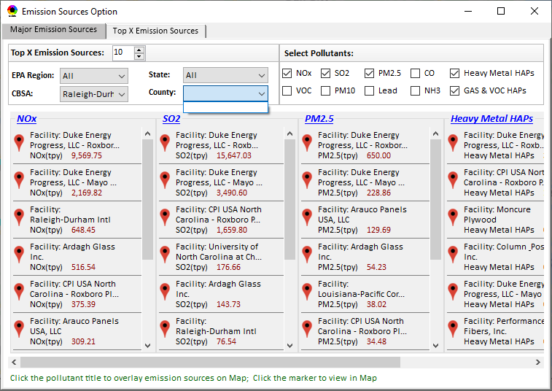
NEXUS 1.6 : Data Viewer Module
Countries should be automatically provided (now need to select/click CBSA again in order to show county names)
Make the table size “re-sizable” (allow to change table size)
49

Slide 50
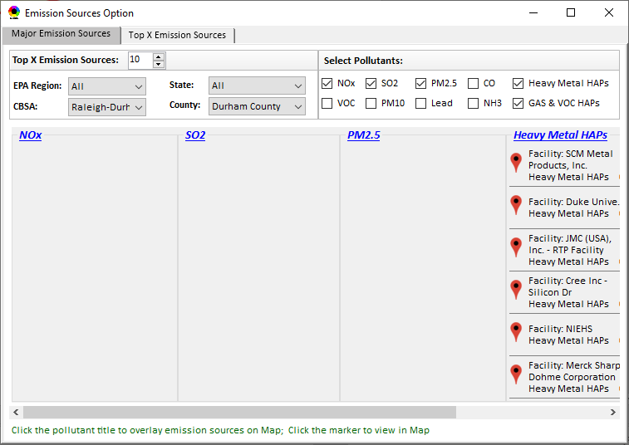
NEXUS 1.6 : Data Viewer Module
Please check again why “Durham Country” does not have any CAPs facility emissions (but HAPs have emissions). EPA (my office) is in Durham county is it is important to make this correct!
50

Slide 51

NEXUS 1.6 : Data Viewer Module
When switching from “Major Emission Sources” to “Top X Emission Sources”, default to give the same selected region/CBSA/county
Same problem here. Countries should be automatically provided (now need to select CBSA again to show county names)
51

Slide 52

NEXUS 1.6 : Data Viewer Module
Use “left justified” for title to show at least first part of title (now important part is missing)
Shorten these CAPs names (e.g., NH3, CO, POC, PM10, PM2.5, SO2, VOCs)
(Note: Under “HAPs”. also remember to change “Heavy metal HAPs” to “PM & Metal HAPs”)
52

Slide 53
NEXUS 1.6 : Data Viewer Module
Major Sector Emissions
Add a “Major Sector Emissions” to display/rank sector emissions (Point, NonPoint, Road, NonRoad, Total)
(Note: now only has CAPs sector, but expect to include HAPs sector in the future)
Display/rank CAPs’ sector emissions
53

Slide 54

NEXUS 1.6 : Data Viewer Module
There are two duplicated “Jefferson County”. Need to check FIPs code or add State name. There is one “Jefferson County” in KY state and another in IN state. Louisville CBSA is an important example case we will use for demo
This emission source in the (IN) State should not appear when Louisville CBSA (KY) Jefferson county is selected
(there are two “Jefferson county” in this CBSA)
54

Slide 55

NEXUS 1.6 : Data Input Module
Add these two HAPs to “PM & Metal HAPs” list in “Data Viewer”
“Advanced areas” input data file:
Use updated “Advance_areas_9_12_18.mpk”
Sent to you previously already, also under EPA’s newftp “/aqmg/cjang/NEXUS/Input_Data”
Change to:
“Socio-economic/Demographic data
Add “Tribal areas” input data file:
Use ”Tribal_Boundaries_022117.gdb”
under EPA’s newftp at: “/aqmg/cjang/NEXUS/Input_Data”, similar to “Class I areas”, include “Tribal areas” into “Data Query” module as part of “map overlaying” menu selection
55

Slide 56
End
56

