Slide 1
2024 Final EGU Rules RIA Air Quality Analyses
2024/02/20 AQAD All Hands Meeting

Slide 2
AQMG Approach to Meet Multiple EGU Rules
Consistent with OMB guidance, EPA routinely estimates the anticipated impacts of regulatory actions
Changes in emissions
Changes in air quality (change in pollutant concentrations across impacted domain)
Costs and benefits of changes, including the number and value of air pollution-attributable health impacts
Whenever possible, EPA estimates these impacts using a s “full-form” approach in which photochemical modeling is applied to future year baseline and policy scenarios
When the regulatory timeline does not allow for full-form photochemical modeling of the final rule scenario, EPA/OAR has used “reduced-form” approaches, which employ simpler methods to approximate the more complex analyses
Recently, OAQPS developed a reduced form approach (“SABAQS”) used in RIAs for multiple EGU and Oil and Gas rules that provides flexibility to quickly approximate final rule air quality impacts based on previously developed model-based source-receptor relationships
Once air quality surfaces are developed, they are used as inputs to quantitative benefits (BenMAP) and EJ analyses

Slide 3
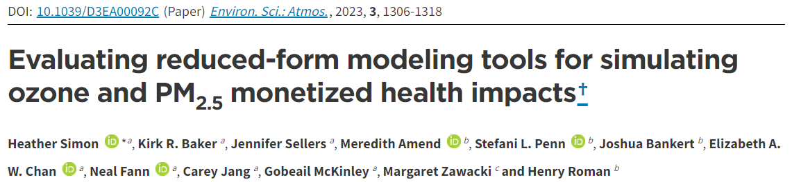
Source Apportionment Based Air Quality Surfaces (SABAQS)
First developed and applied to estimate AQ benefits for the 2020 Affordable Clean Energy (ACE) rule which needed a flexible and scientifically credible approach for benefits due to schedule constraints
SABAQS was later used to support other rulemakings related to the EGU sector: MATS coal refuse rule, Office of Water’ Effluent Limit Guidelines (ELG), and CSAPR update remand proposal
SABAQS Approach
Photochemical model source apportionment used to track emissions from pre-defined groups (by states) of EGUs
Modeled air quality surfaces relate state specific EGU emissions to gridded ozone and PM_{2.5} impacts
State/EGU/pollutant specific impacts are then modulated to reflect emissions levels associated by different policy options provided by the IPM model
SABAQS has been integrated into the FAST-CE tool along with other data so we can similarly inform rules related to other sectors

Slide 4
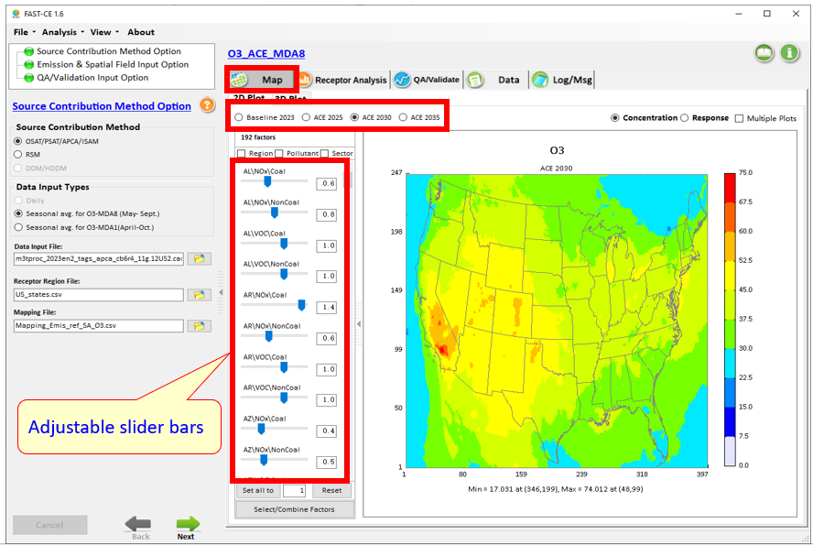
“FAST-CE” (FAST-CE: Flexible Air Quality Scenario Tool – Community Edition)
For Ozone and PM_{2.5}
Base emissions and scenarios’ emissions
Source appointment ioapi netcdf
A baseline AQ data: usually from SMAT
Factor mapping file
The FAST-CE 3.8 package (“FAST-CE 3.8.exe” & “FAST-CE 3.5 Data.exe”: run both to install) is available at EPA’s NewFTP site under:
https://gaftp.epa.gov/aqmg/jhuang/FAST-CE/

Slide 5
Ongoing EGU rulemaking RIAs
AQMG’S EGU modeling approach designed to meet multiple EGU rules
MATS
In April 2023, EPA proposed to strengthen and update the Mercury and Air Toxics Standards (MATS) for power plants, to reflect recent developments in control technologies and the performance of these plants
Rule uses direct PM as a surrogate for particle-bound toxics emitted from EGUs
Updated direct PM emission standards are being finalized
Impacts on ozone and total PM_{2.5} concentrations are small
Rule Signature expected mid-April 2024
111b/d EGU GHG rules
In May 2023, EPA proposed Clean Air Act emission limits and guidelines for carbon dioxide (CO2) from fossil fuel-fired power plants based on cost-effective and available control technologies.
This rule will affect existing coal EGUs and new natural gas EGUs
The new requirements will impact the composition of the EGU fleet and the dispatch of units within that fleet leading to changes in NO_{x}, SO₂ and direct PM emissions in addition to CO₂ emissions
In all years, national NO_{X} emissions decrease, but NO_{X} and ozone increase in some locations due to utilization of (Carbon capture and storage) CCS and load shifting among EGU facilities
Most PM impacts result of SO₂ emissions changes
PM decreases over broad regions in all years with some localized PM increases
Rule Signature expected late April 2024
Office of Water, Effluent Limit Guidelines Rule also expected to be signed in late April 2024

Slide 6
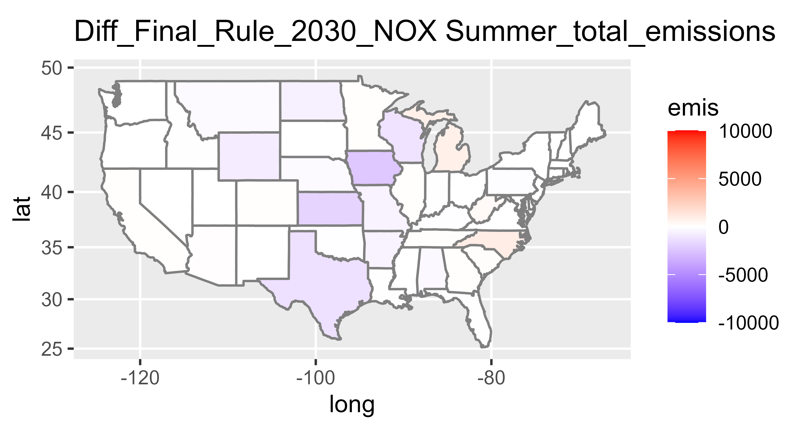
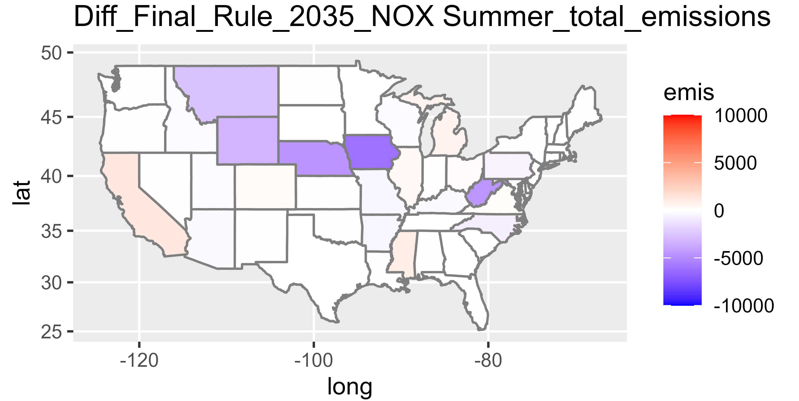
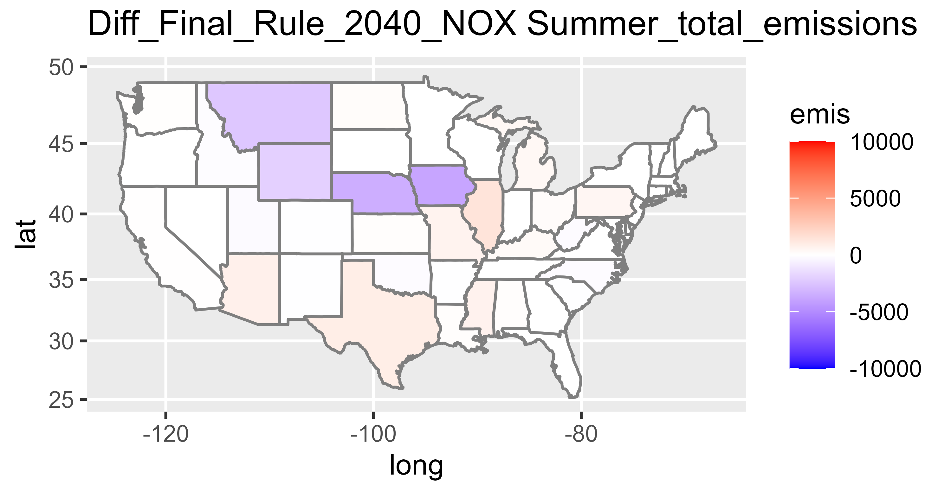
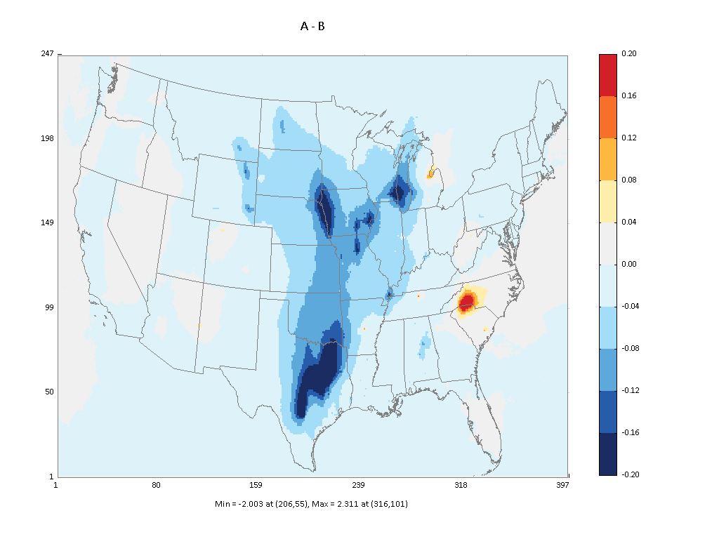
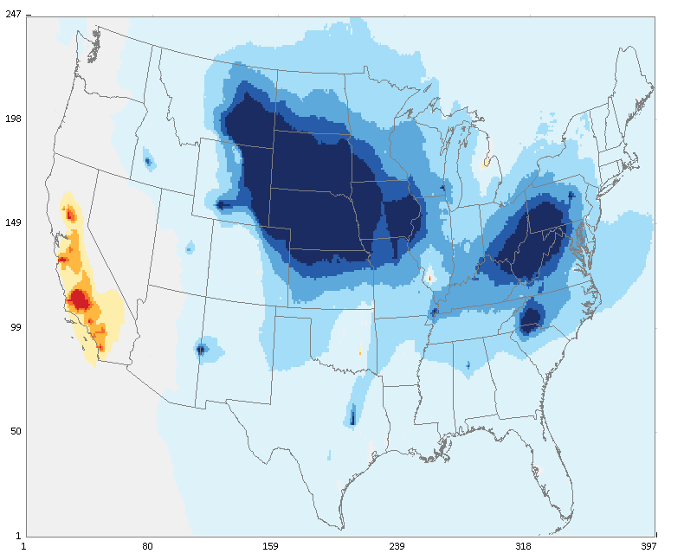
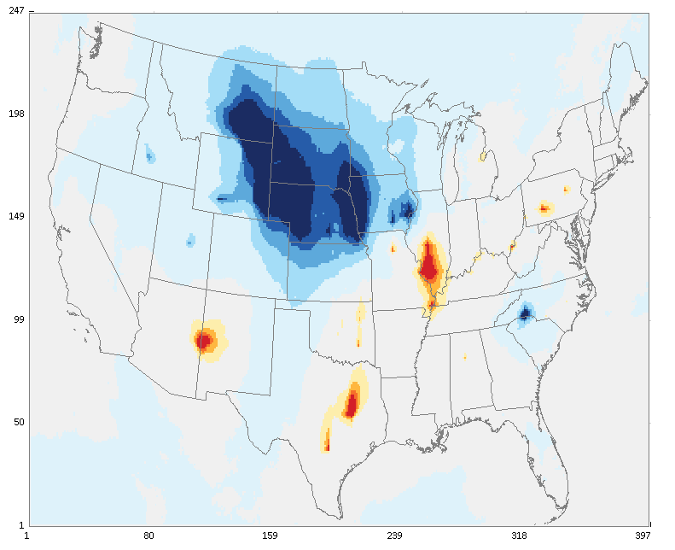
111b/d Ozone results: 2030, 2035, 2040
2030 Summer Season NOx Emissions: policy - baseline
2035 Summer Season NOx Emissions: policy - baseline
2040 Summer Season NOx Emissions: policy - baseline
2030 Ozone Results: policy - baseline
2035 Ozone Results: policy - baseline
2040 Ozone Results: policy - baseline

Slide 7
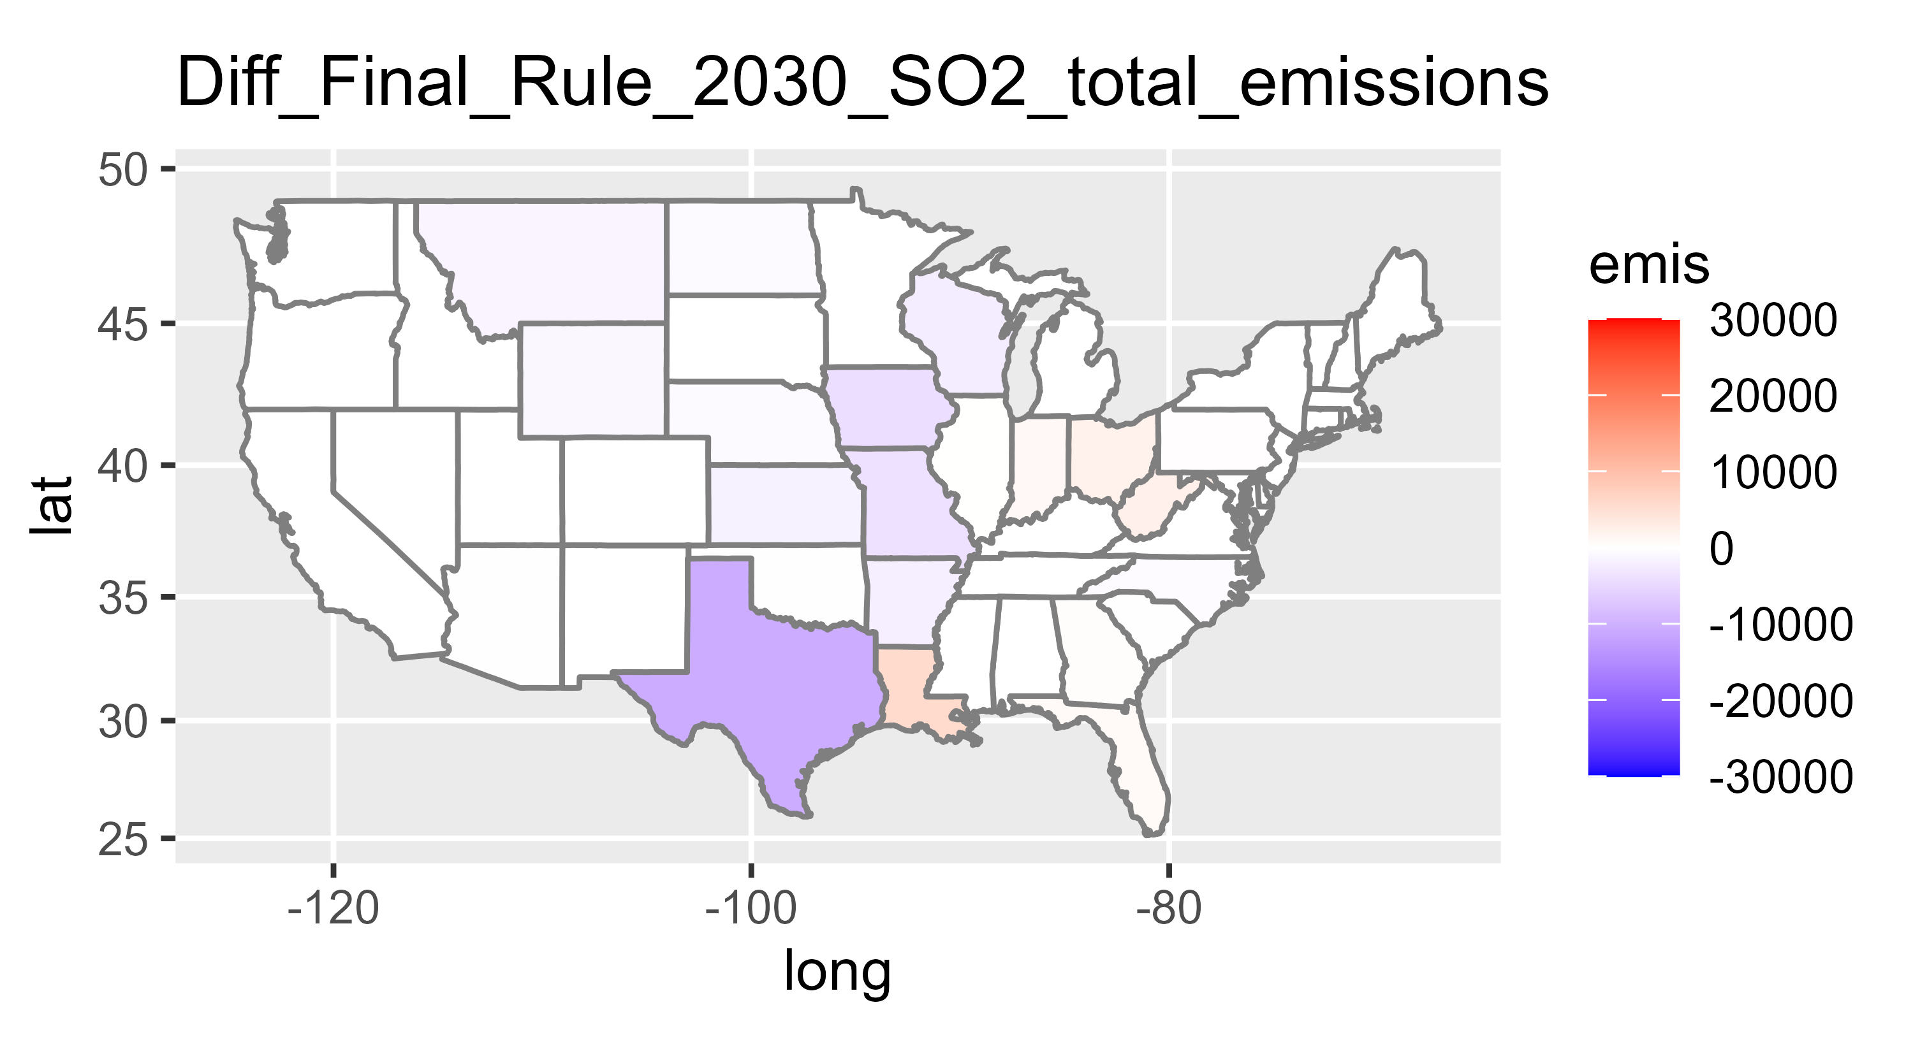
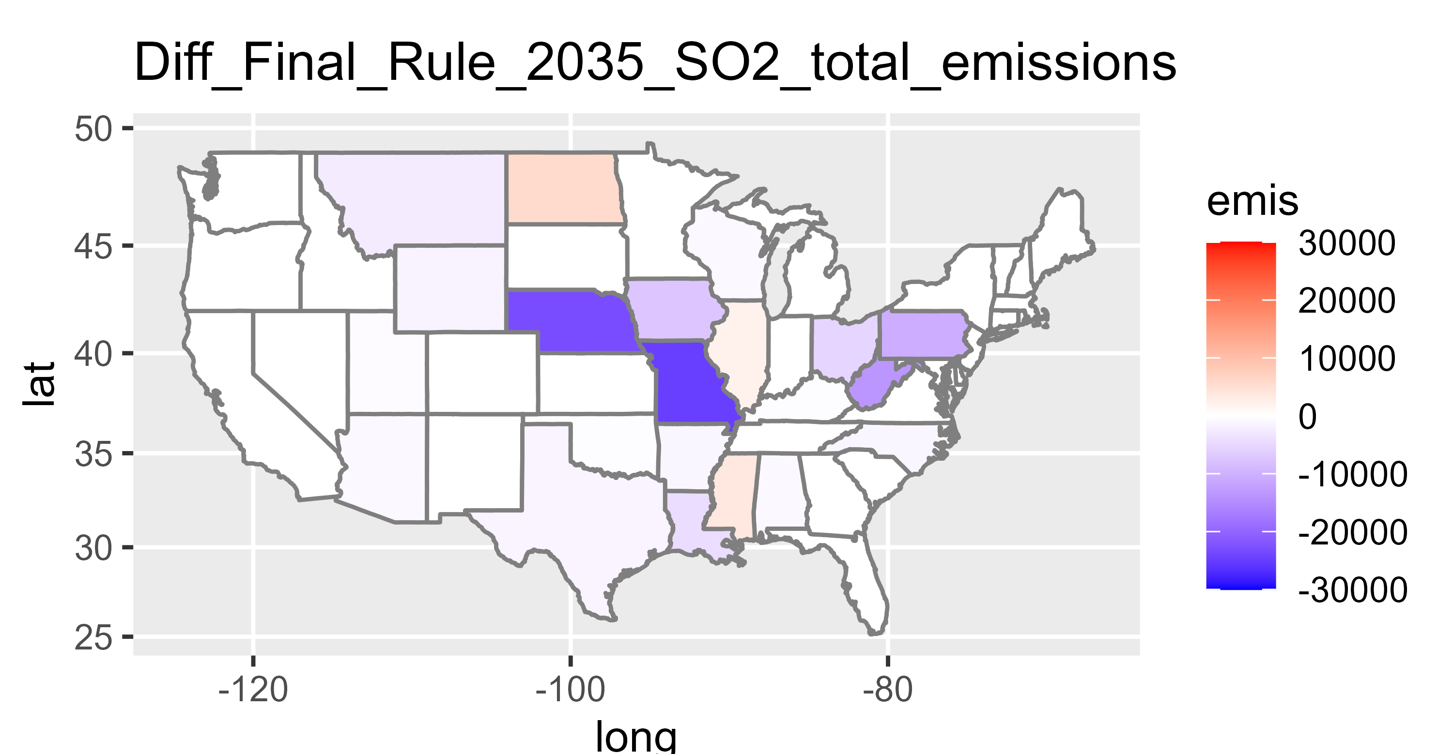
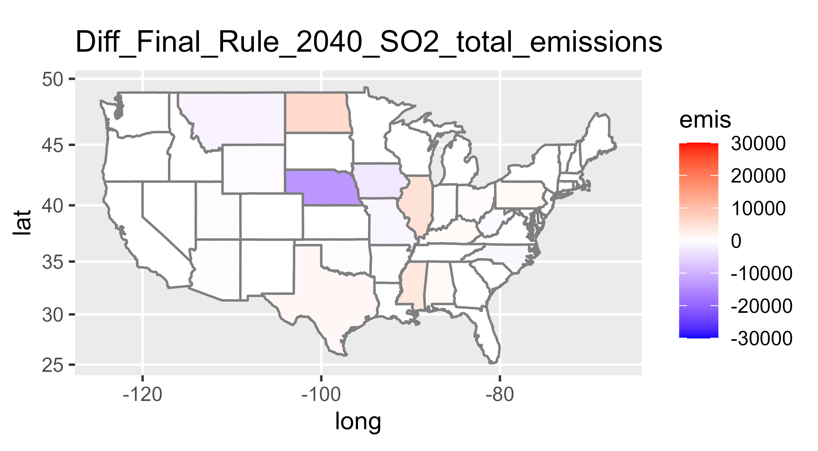
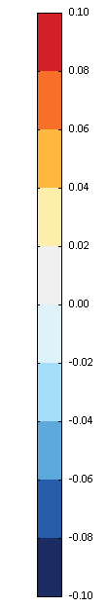
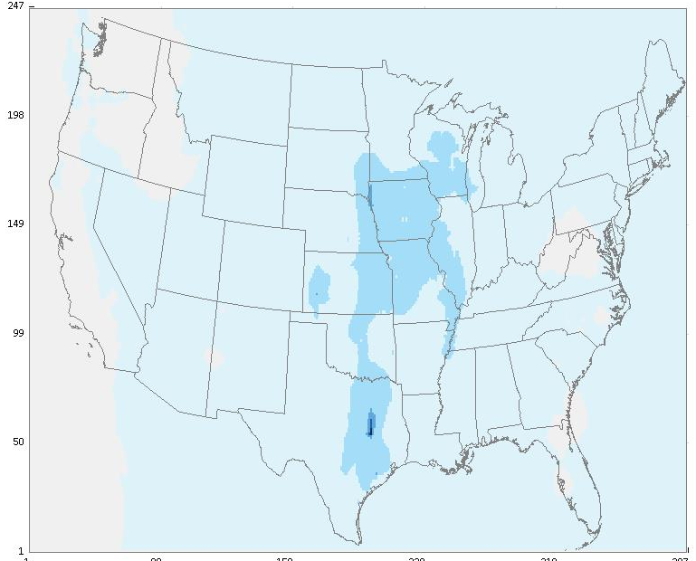
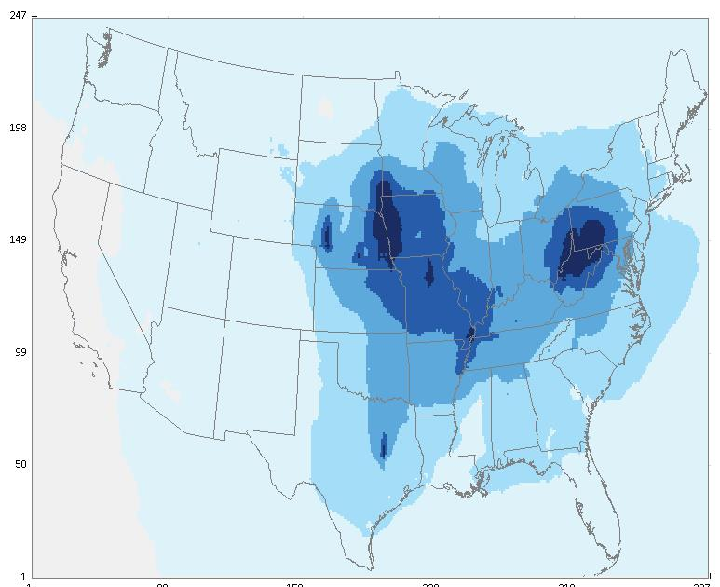

111b/d PM2.5 results: 2030, 2035, 2040
2030 Annual SO₂
Emissions: policy - baseline
2035 Annual SO₂
Emissions: policy - baseline
2040 Annual SO₂
Emissions: policy - baseline
2030 PM_{2.5} Results: policy - baseline
2035 PM_{2.5} Results: policy - baseline
2040 PM_{2.5} Results: policy - baseline
Notes:
Plants in IL, AL in 2040

