Slide 1
Procedure for Quality-Assuring PM2.5 and Ozone Health Impacts Estimated for the NEXUS Tool
Jennifer Sellers
2024-08-06

Slide 2
Purpose/Background: This document describes the procedure we followed to quality-assure the estimated counts of PM_{2.5} and O₃ related mortality and morbidity quantified using the BenMAP-CE program. These results are to be imported into the NEXUS tool. The NEXUS tool is an advanced multi-pollutant screening tool currently internal to EPA.
Each BenMAP-CE scenario used a consistent set of input parameters (i.e. population counts, baseline rates of death and disease and concentration-response parameters) with the exception of the air quality input files as noted below. The two key components to quality assure as follows: first we confirmed that BenMAP loaded the air quality surfaces correctly and second, we confirmed that the magnitude and distribution of the change in deaths/incidences per 10k agreed with the magnitude and distribution of the pollutant concentrations.
Log: May 2024 – Updates to this process include: USALEEP tract level mortality rates, and the addition of updated long-term mortality study (Wu et. al.).
ER visit issues. Pre/Post BenMAP AQ issues. Differences between GUI exports and CL exports.
Solution: Rerun in Benmap version 1.5.8.31
Moved Rabinovitch to the morbidity file, as it was incorrectly in the mortality file in past versions.

Slide 3
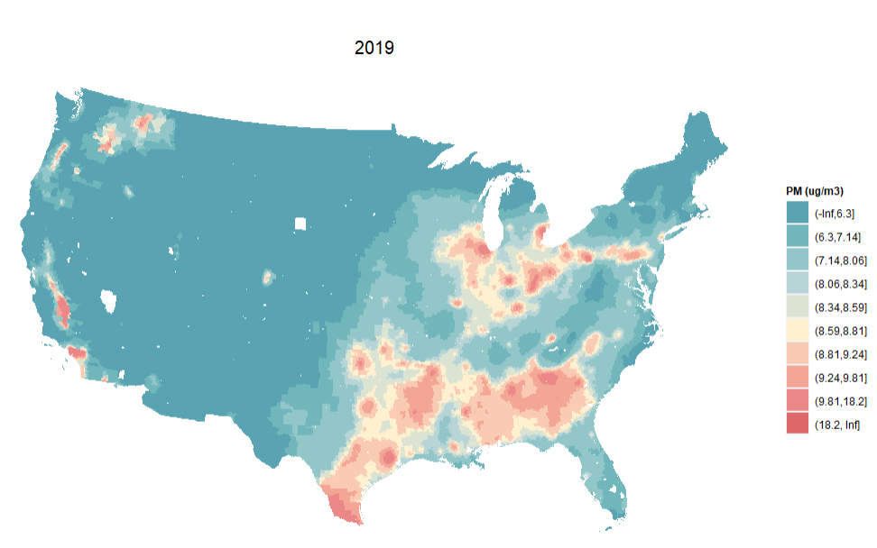
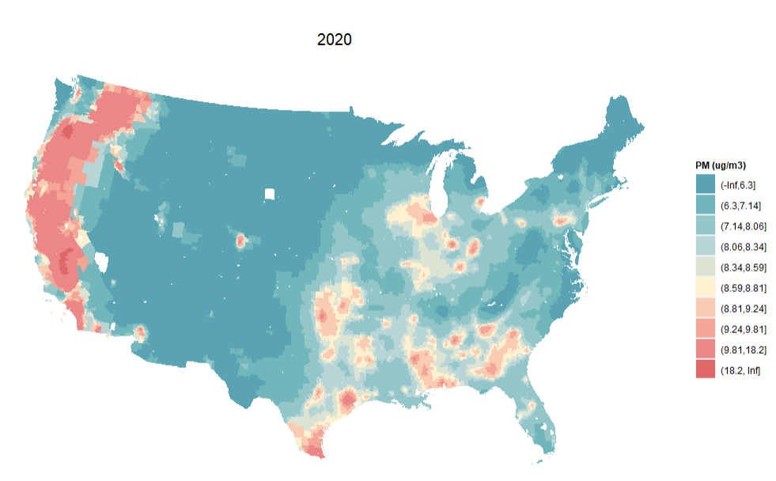
Air Quality Comparison – PM_{2.5}
Notes:
The 2020 map matches patterns in the 2017-2019 maps. That includes the missing tracts which are due to no/low population in those tracts.

Slide 4
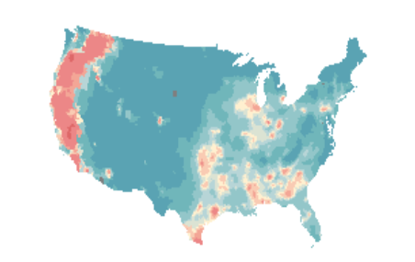
Air Quality Comparison – PM_{2.5} – Part 2
Pre-BenMAP AQ
Post-BenMAP AQ

Slide 5
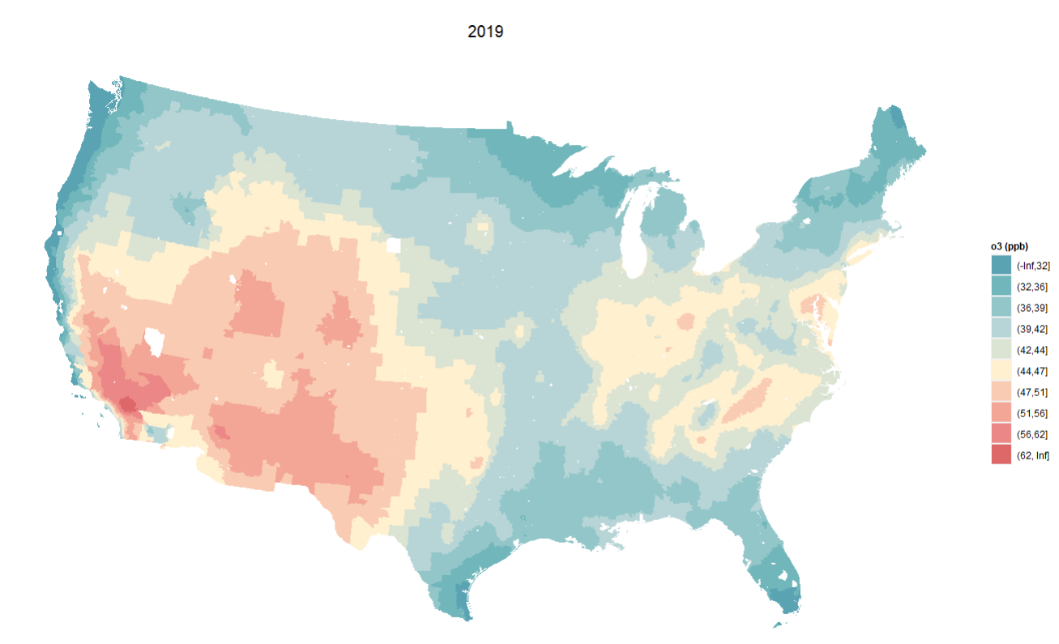
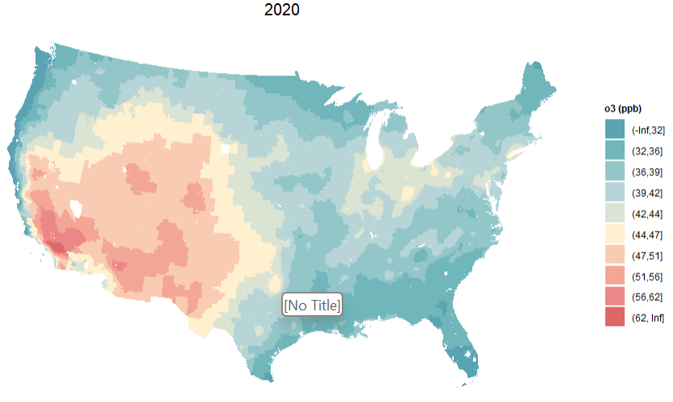
Air Quality Comparison – O₃

Slide 6
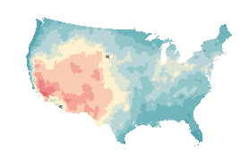

Air Quality Comparison – O₃ Part 2
Pre-BenMAP
Notes:
Updated the BenMAP version to correct for issues related to the AQ - Post-BenMAP Ozone AQ from BenMAP version 1.5.8.31

Slide 7
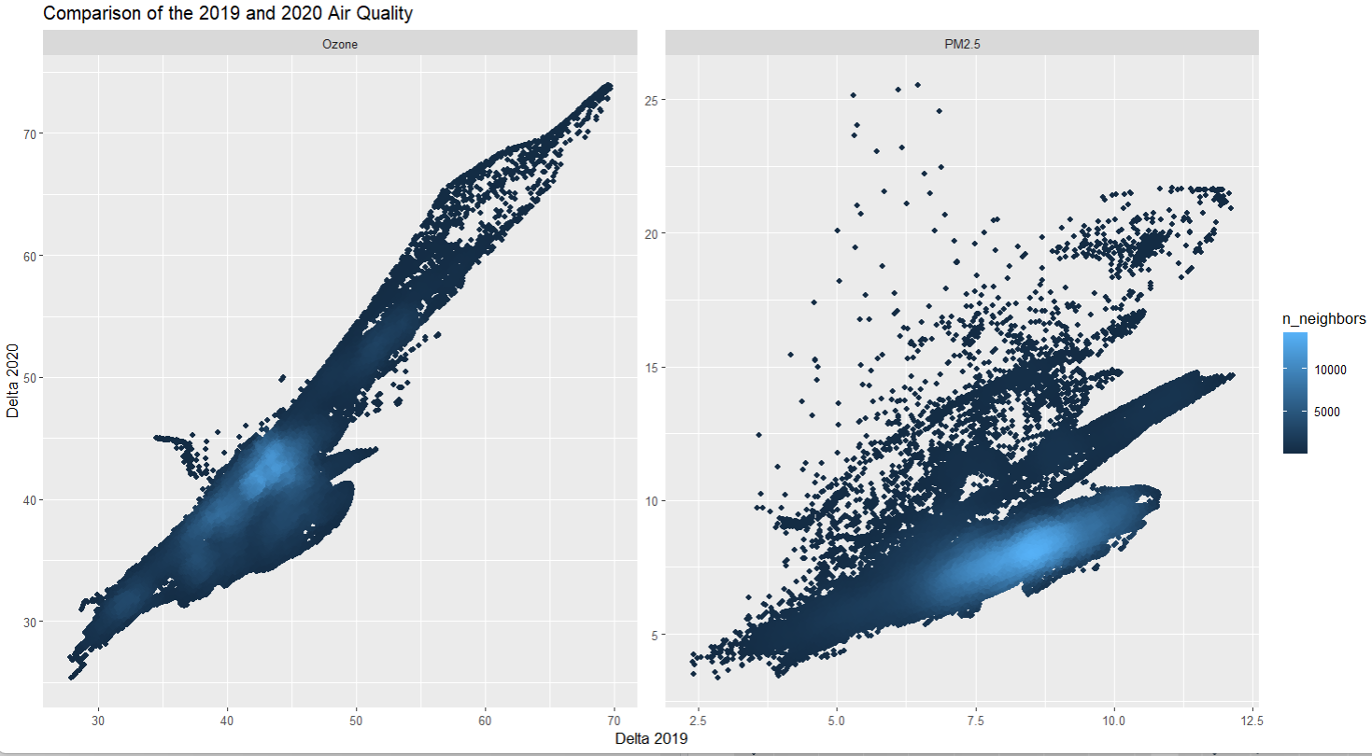

Slide 8
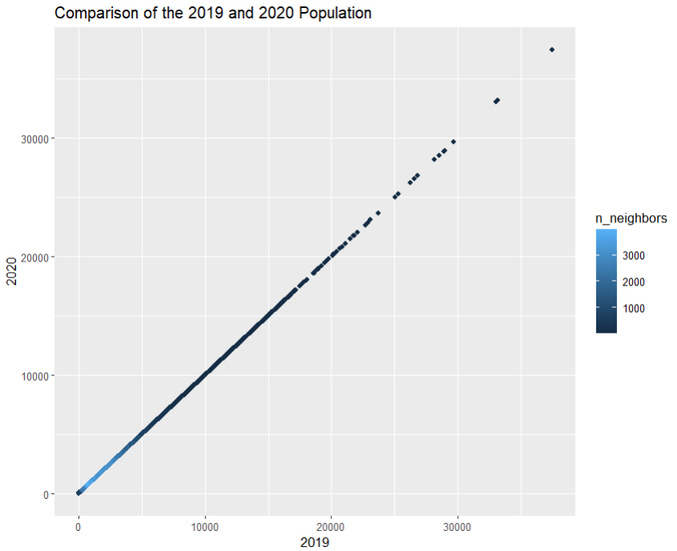

Slide 9
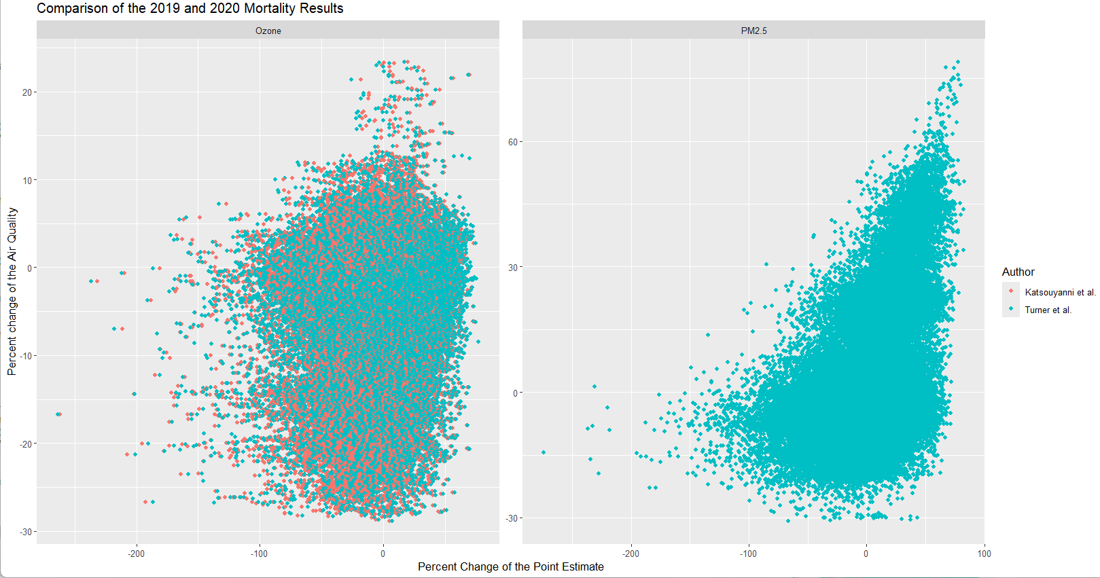
Notes:
Changes due to USALEEP data.

Slide 10
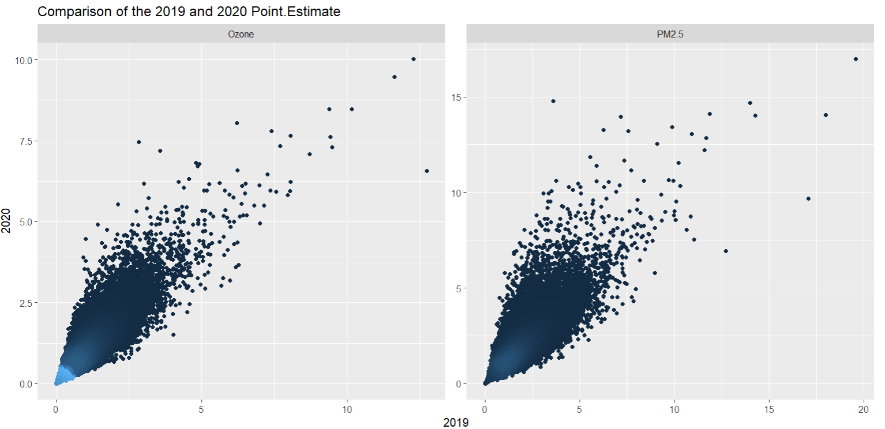
Notes:
AQ and USALEEP causing differences between 2020/2019

Slide 11
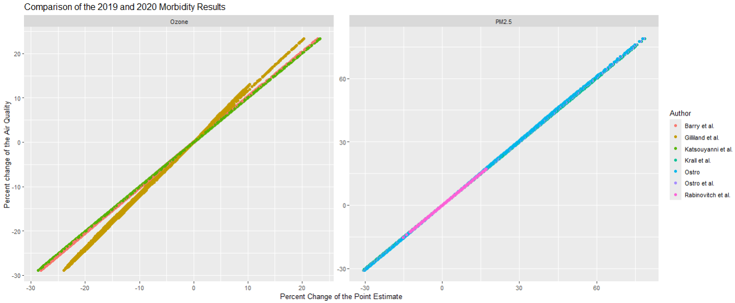

Slide 12
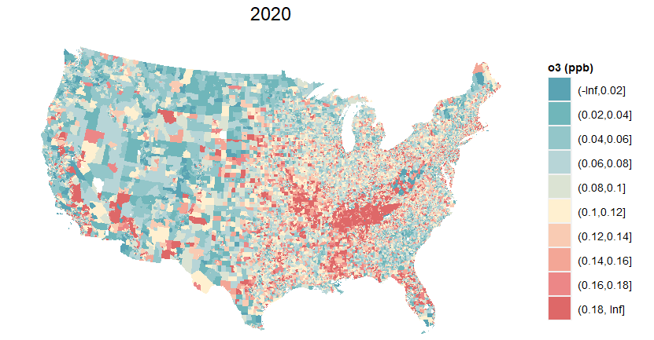
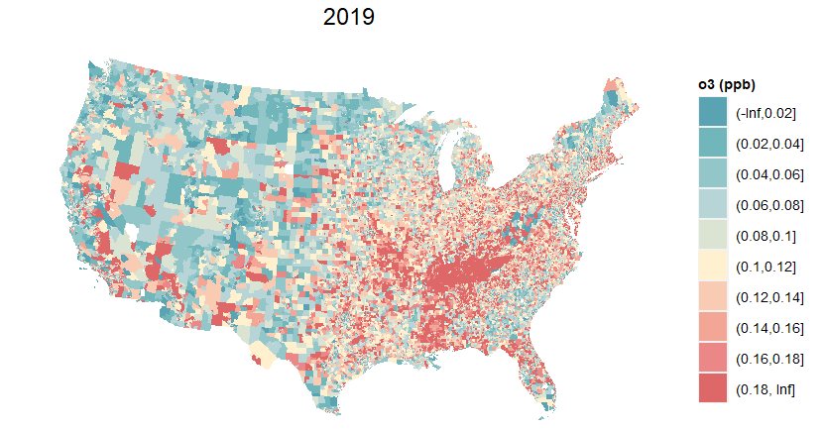
Incidence
Incidence
Notes:
Katsouyanni et al. – Hospital Admissions – Similar

Slide 13
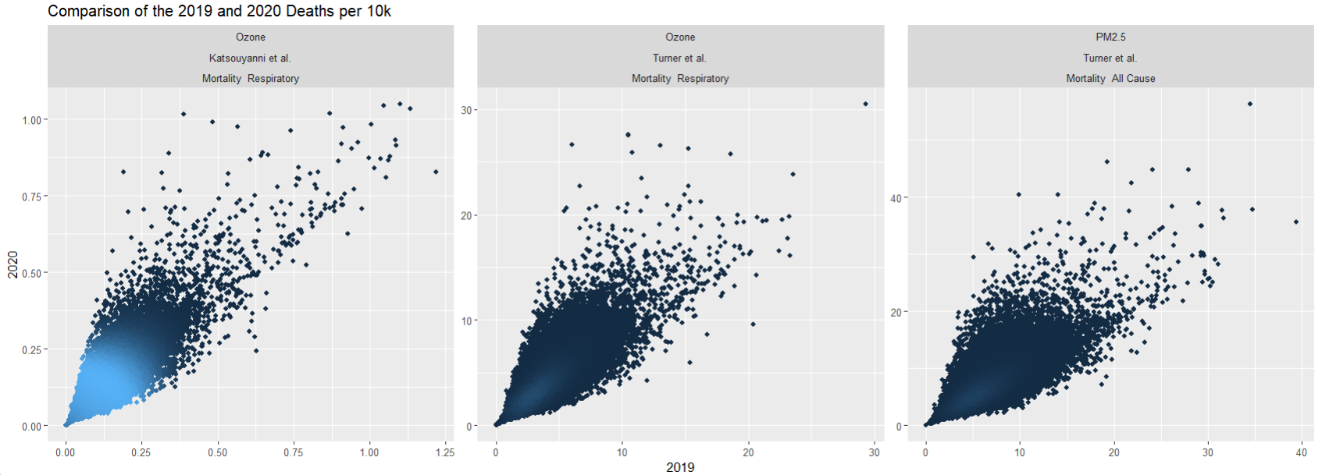
Notes:
Changes due to USALEEP data.

Slide 14
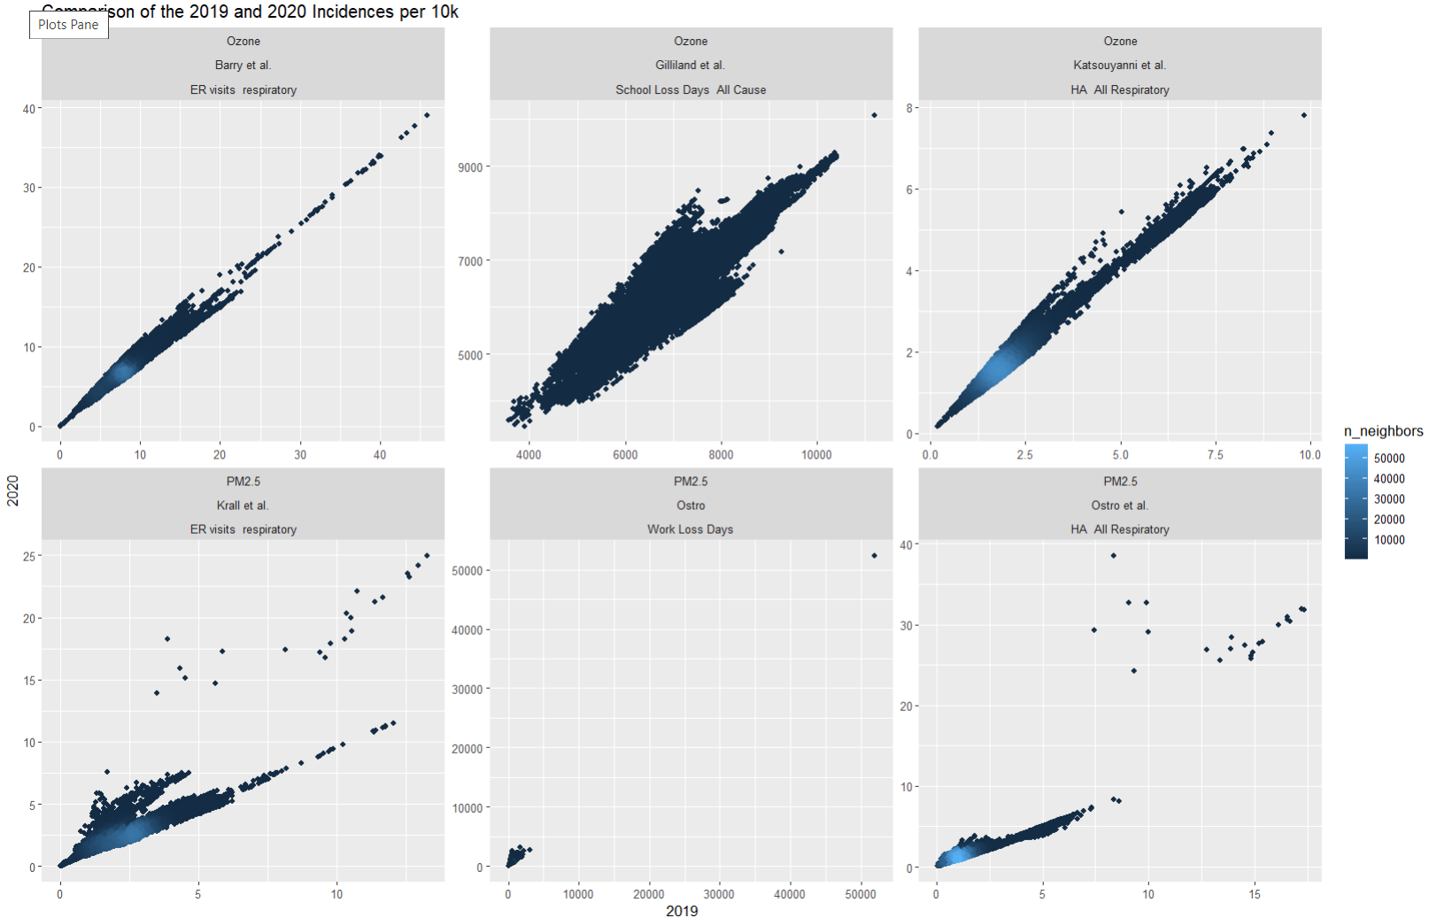
Notes:
Matches previous year comparisons

Slide 15
