Slide 1
Development of 2016 Alpha
Onroad Mobile Emissions
February 15, 2018
Alison Eyth and Jeff Vukovich
EPA Office of Air Quality Planning and Standards

Slide 2
Onroad Emissions Preparation
Hourly Met. Data
from WRF*
Meteorological
Preprocessor
(Met4Moves)
MOVES
Temperature ranges;
rel. humidity by county,
season, temperature
Run MOVES to get emission factors (EFs) for representative counties for each temperature and speed needed
Gridded met
EF tables
Use representative EFs with county/ grid-specific activity data and hourly meteorology to create emissions for all counties
Activity Data
SMOKE
* WRF = Weather
Research and
Forecasting model
AQ model-ready files

Slide 3
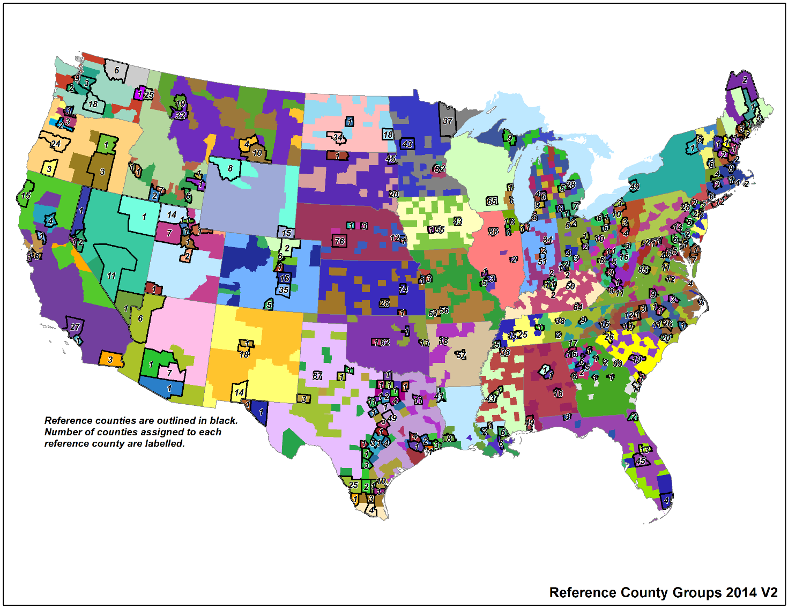
2014v2 Representative Counties
3000+ US counties are mapped to 303 representative counties according to: state, fuels, age distribution, ramp fraction, inspection & maintenance (I/M) programs, and emissions standards
The criteria for
selecting rep.
counties was
discussed on
MJO in June, 2017
The selection
spreadsheet
will be available
with the v2
documentation
Notes:
Emphasize the county specific activity and the grid specific meteorology is used even if using rep counties.

Slide 4
Onroad Emission Processes and Inputs
On-roadway emissions
  Exhaust, evaporative, evaporative permeation, refueling, brake and tire wear
  Primary inputs: vehicle miles traveled (VMT), average speeds, speed profiles, and temperature (gridded, hourly)
Off-network emissions (i.e. parked vehicles)
  Exhaust from starts, evaporative, evaporative permeation, refueling, hot soak (immediately after a trip)
  Evaporative fuel vapor venting and diurnal (when vehicles are parked for a long period)
  Primary inputs: vehicle population (VPOP) and Temperature (gridded, hourly, daily min/max)
Hoteling:
  Extended idle and auxiliary power units (APU) for combination long-haul trucks
  Primary inputs: Hoteling hours and T (gridded, hourly)
Notes:
VMT and HOTELLING are temporalized, others aren’t

Slide 5
2016 Alpha Activity Data Preparation
VMT was projected from 2014v2 using state+urban and state+rural factors derived from FHWA VM-2 tables
  https://www.fhwa.dot.gov/policyinformation/statistics/2014/vm2.cfm
  https://www.fhwa.dot.gov/policyinformation/statistics/2016/vm2.cfm
  For some states, changes in urban/rural definitions between the two years caused factors to be more different than they should be for two years of change
    State-overall growth factors used for these states: AK, GA, IN, ME, Mass, NE, NM, NY, ND
  For Texas and NM, state-wide factors from state DOT web sites used
    7.8% (TX) and 11.6% (NM) were more conservative growth factors than VM-2
2014v2 ratio of VMT/hoteling hour for long-haul combination trucks was preserved in 2016
2014v2 ratio of VMT/vehicle was preserved in the 2016 vehicle Population (VPOP)
See 2016v2 onroad activity versus 2014v2.xlsx for more

Slide 6
2016 MOVES Table Contents
Note: Tables not listed on this or next slide are empty by default
See 2014v2 Plans for CDB input data spreadsheet for state-specific info
CDB Table | Default content for 2014 NEI v2
avft | 2014 IHS data
avgspeeddistribution | CRC A-100 study
dayvmtfraction | CRC A-100 study
fuelformulation | Based on EPA estimates for each county for 2016 – updated with 2014 refinery data
fuelsupply | Based on EPA estimates for each county for 2016 – updated with 2014 refinery data
fuelusagefraction | MOVES2014a default E85 usage
hotellingactivitydistribution | MOVES2014a default APU vs. Main Engine fractions
hotellinghours | 2016 estimates of hoteling hours based on long-haul combination truck VMT
hourvmtfraction | CRC A-100 study

Slide 7
2016 MOVES Table Contents
See 2014v2 Plans for CDB input data spreadsheet for state-specific info
CDB Table | Default content for 2014 NEI v2
imcoverage | 2014 NEI v1 adjusted to 2016
monthvmtfraction | 2014 NEI v1
roadtype | 2014 NEI v1 (ramp fraction of 0.08 is default)
roadtypedistribution | EPA estimates based on FHWA
sourcetypeagedistribution | 2014 IHS data – unchanged for 2016
sourcetypeyear | 2016 vehicle population data
sourcetypeyearvmt | 2016 VMT based on 2014v2 state submissions, growth factors and 2014 IHS data for LD splits
zonemonthhour | 2016 meteorology data averaged by county
emissionratebyage | The `emissionratebyage` tables for some counties were populated using appropriate data described in the guidance for states adopting California emission standards

Slide 8
2011, 2014v2, 2016 by Pollutant
Pollutant | 2011el/en | Con. U.S. 2014NEIv2 | 2016 alpha | 2016-2014 % change
CO | 25,981,557 | 24,141,986 | 20,445,327 | -15%
NH3 | 120,859 | 107,684 | 101,230 | -6%
NOX | 5,707,939 | 4,835,396 | 4,045,836 | -16%
PM10 | 336,423 | 301,467 | 272,855 | -9%
PM2_5 | 188,925 | 161,732 | 130,263 | -19%
SO2 | 28,195 | 28,094 | 27,356 | -3%
VOC | 2,713,181 | 2,346,620 | 1,961,995 | -16%
*These numbers do not include AK, HI, PR, VI, or Tribal submissions

Slide 9
Onroad from 2011 to 2016

Slide 10
2011, 2014v2, 2016 by Mode
Pollutant | 2011el/en | Con. U.S. 2014NEIv2 | 2016 alpha | 2016-2014 % change
RPD NOx | 4,630,787 | 3,949,368 | 3,215,154 | -19%
RPH NOx | 287,139 | 181,202 | 184,705 | 2%
RPV NOx | 790,013 | 704,827 | 645,977 | -8%
RPD VOC | 1,098,917 | 895,718 | 714,769 | -20%
RPH VOC | 68,756 | 36,953 | 34,050 | -8%
RPP VOC | 197,376 | 160,156 | 154,232 | -4%
RPV VOC | 1,348,132 | 1,253,793 | 1,058,943 | -16%
*These numbers do not include AK, HI, PR, VI, or Tribal submissions

Slide 11
Onroad by Mode 2011 to 2016

Slide 12
2016 Onroad NOx by State, Mode

Slide 13
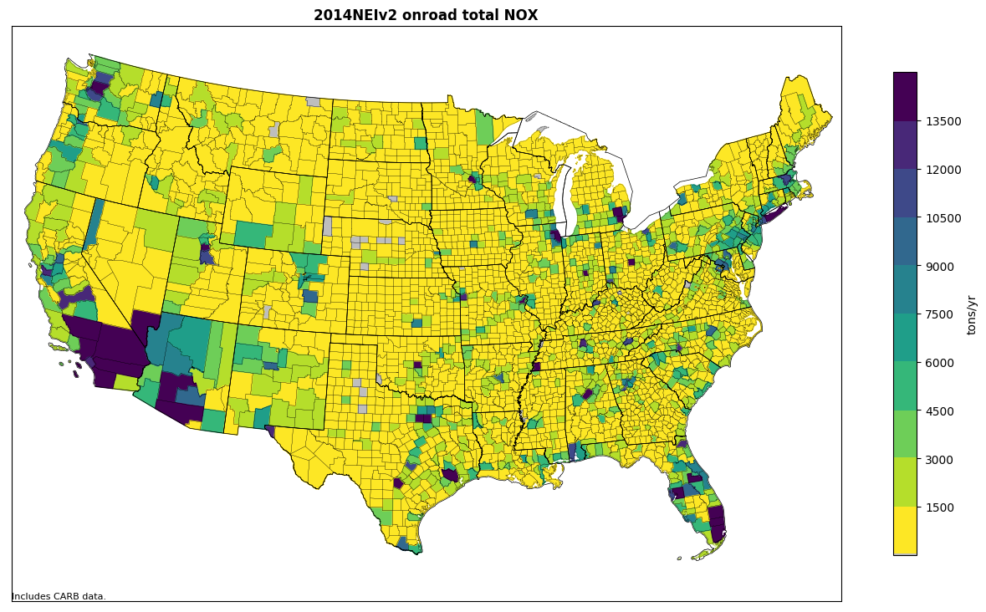
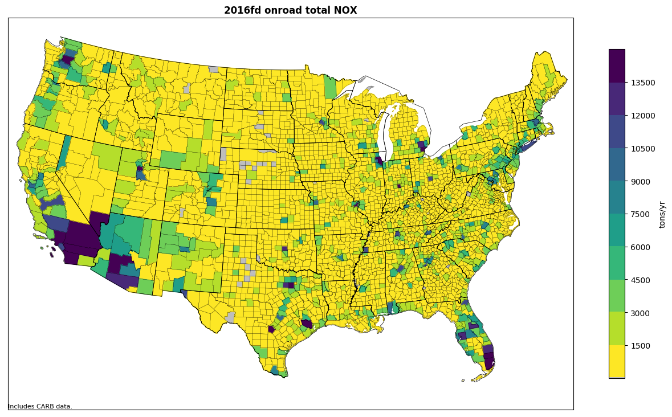
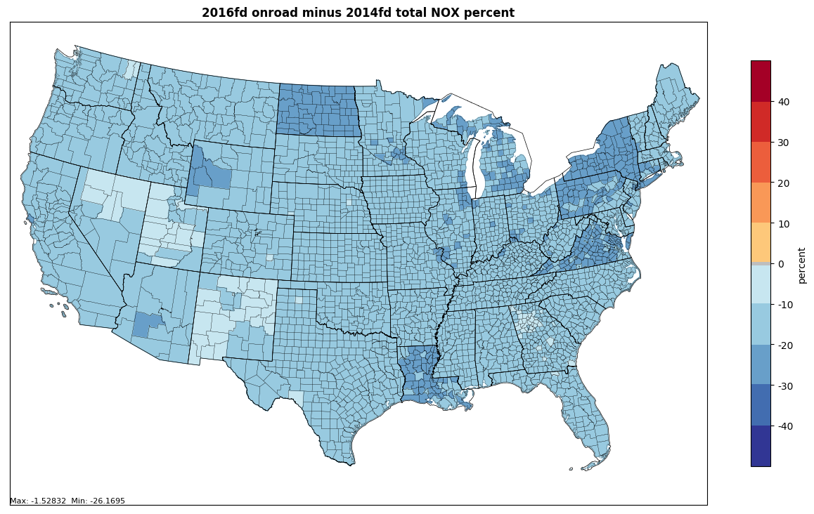
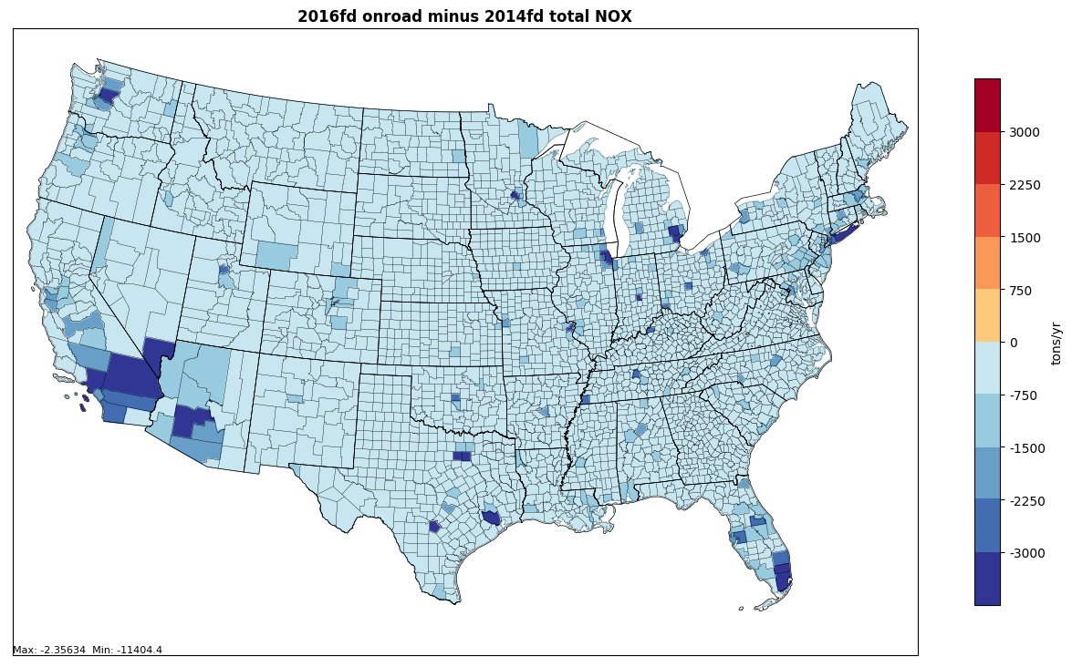
Onroad NOx total changes

Slide 14

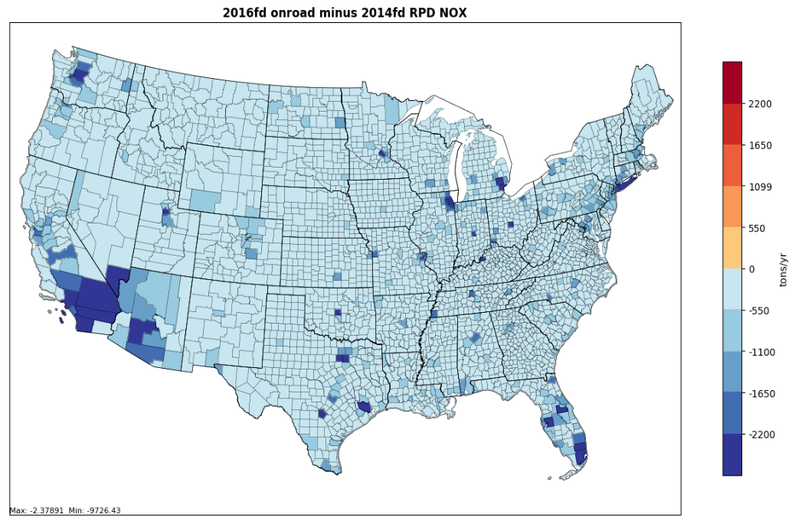
Rate per Distance NOx and changes 2014 to 2016
RPD is the largest onroad NOx
contributor and is on roadways
VOC changes look similar

Slide 15
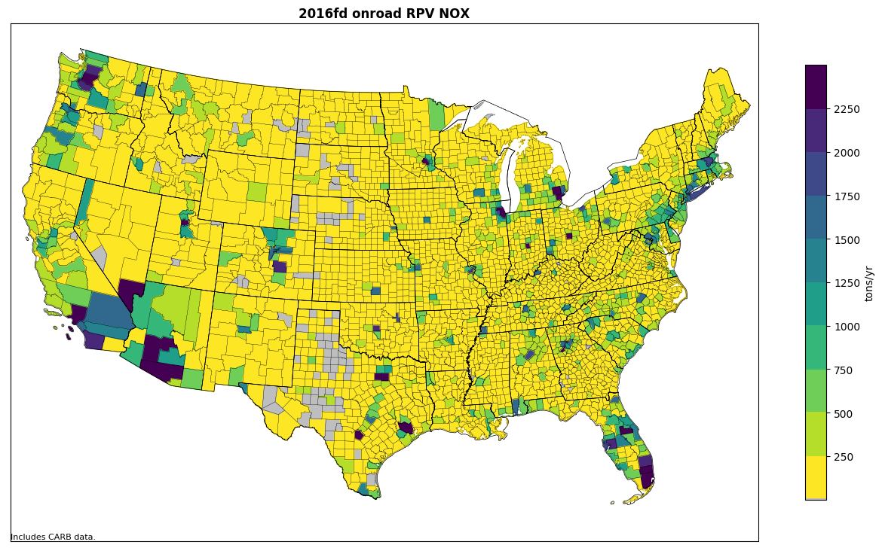
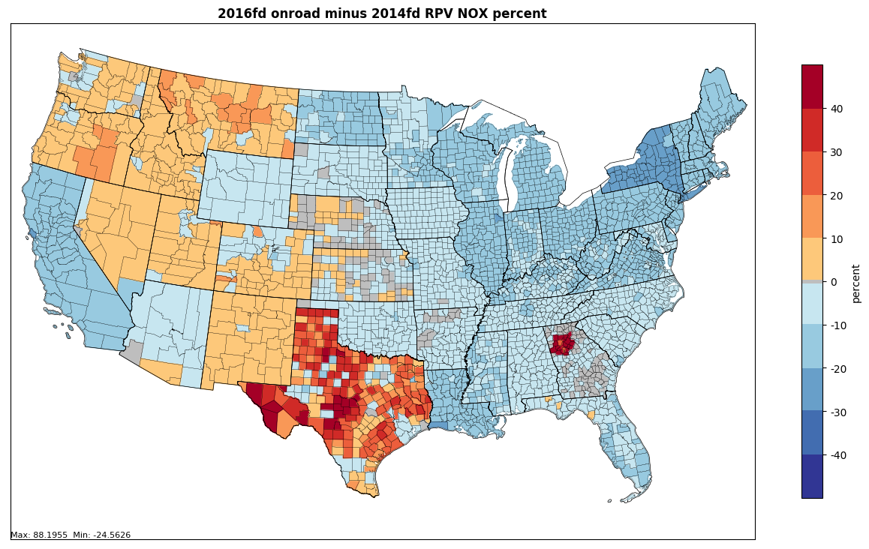
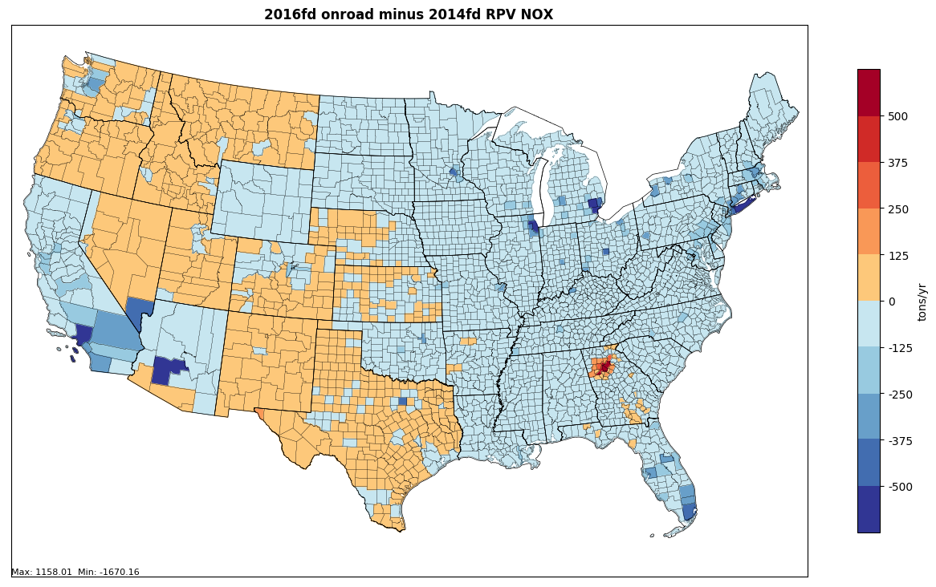
Rate per Vehicle NOx and changes
This category of modest
emissions (746K of 4.8M tons in
2014) is concentrated in higher
vehicle population areas
Changes vary by state based on
activity changes – Atlanta and Texas
stand out due to Starts per day

Slide 16
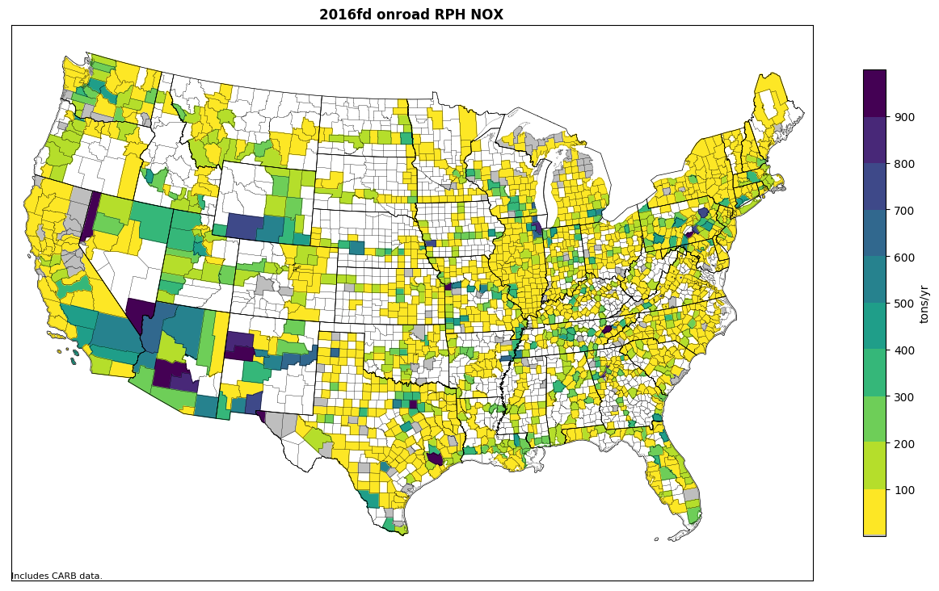
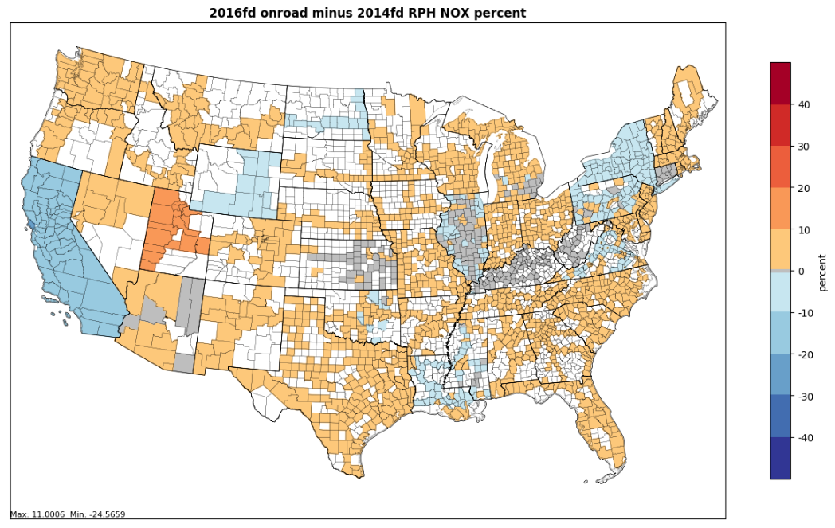
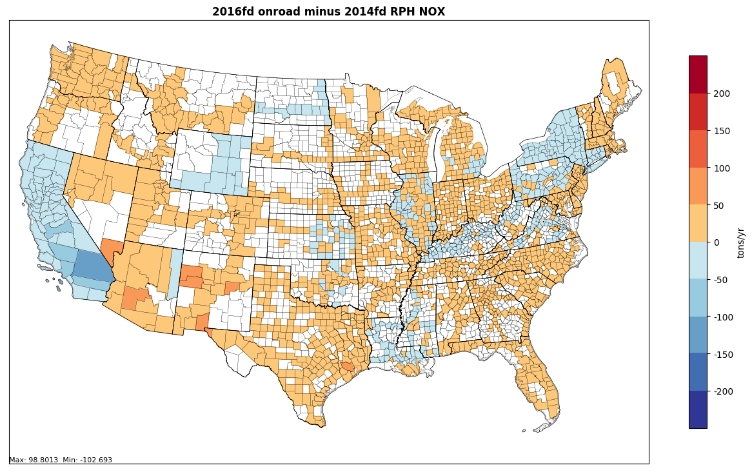
2016 Hoteling NOx and changes
Small emissions compared to other modes
187K tons of 4.8M tons in 2014

Slide 17
2016 Onroad VOC by State, Mode

Slide 18

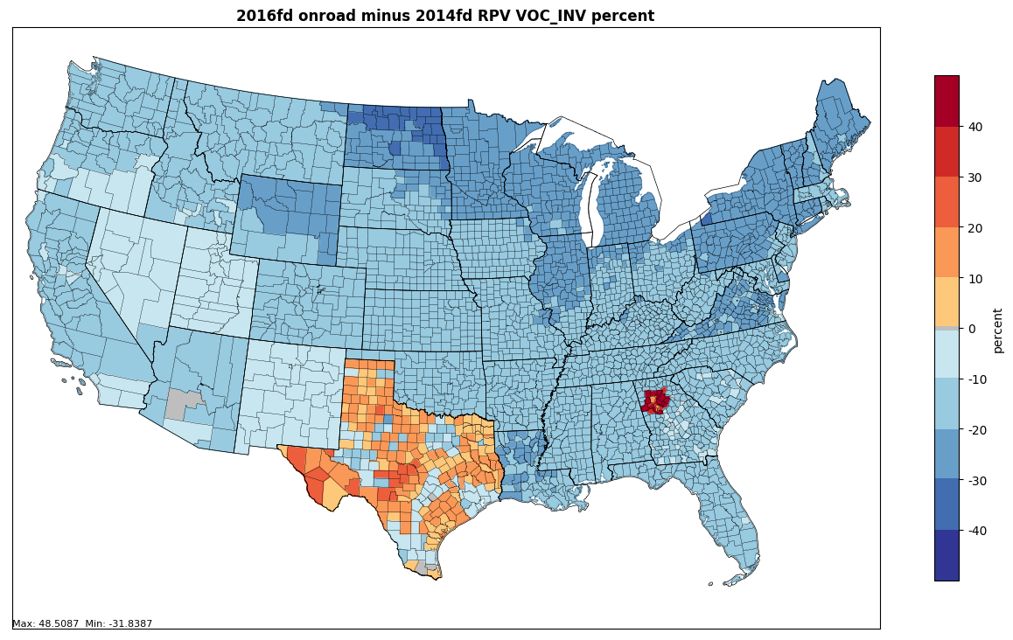
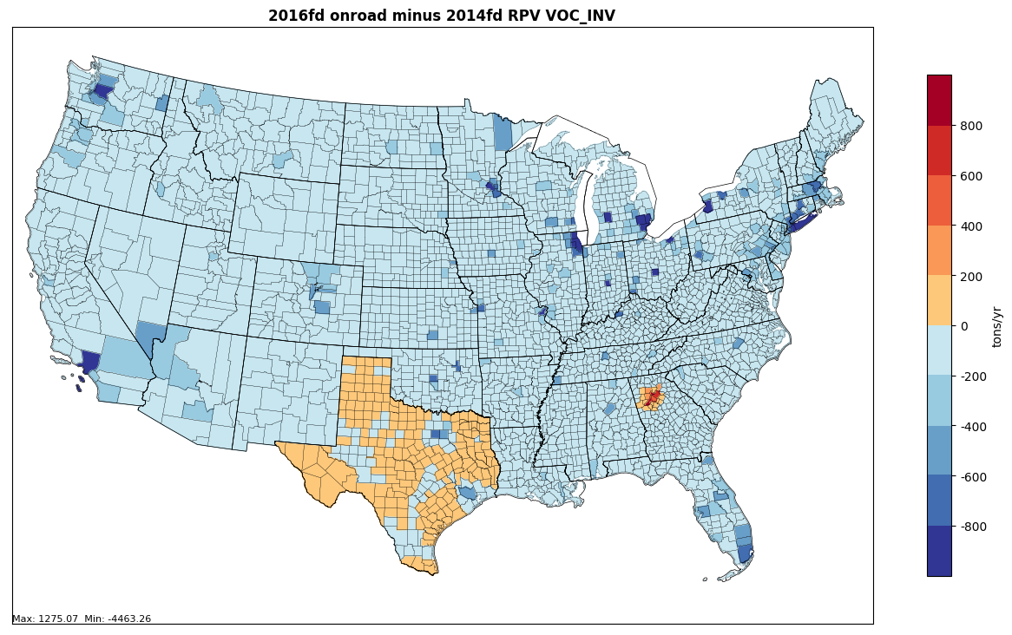
Rate per Vehicle VOC and changes
RPV is an important
contributor for VOCs
1.3M of 2.4M tons im 2014

Slide 19
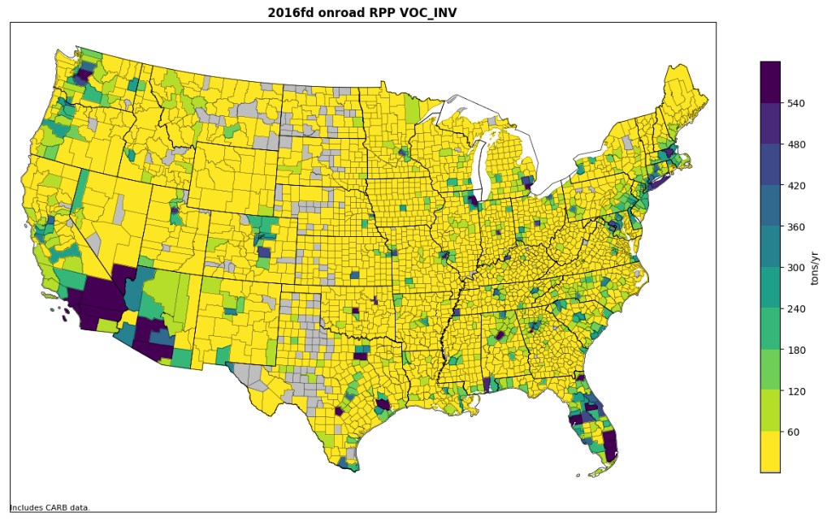
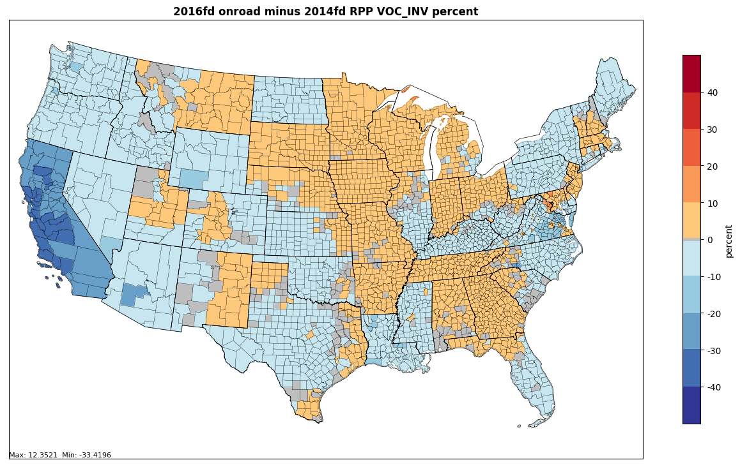
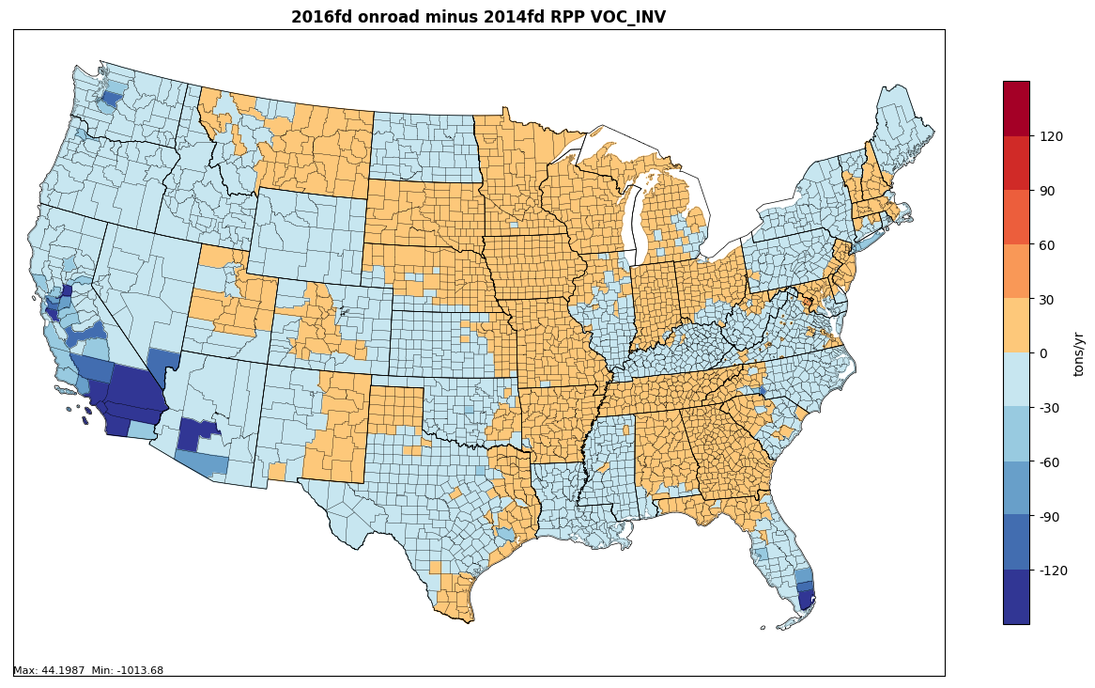
Rate per Profile VOC and changes
This is a small category
focused on population
centers
200K of 2.4M tons VOC in 2014

Slide 20
Data to be Posted for Download
See ftp://newftp.epa.gov/Air/emismod/2016/alpha/2016fd/
2016 Activity data in SMOKE FF10 format (VPOP, VMT, hoteling)
Spreadsheet summarizing 2016 vs 2014 activity data
Spreadsheet showing how 2014NEIv2 tables were filled with state vs default data
Spreadsheets comparing 2014v2 to 2016 alpha onroad emissions at various resolutions
County maps of 2016 and 2014 onroad emissions
2014v2 rep. counties spreadsheet and map
2016 Rep. County CDBs
2016 Emission factors (likely on same site as 14/15)

Slide 21
Planned Improvements for Beta Version
The beta version will incorporate state-submitted activity data for states wishing to provide these data
Any provided data for 2016, (and if desired, 2023, and 2028) should be in SMOKE FF10 formats
  This is the same format in which data are posted for 2014 and 2016
States that do not provide updated data will be projected to 2016 using a default approach such as we show here
Default projections to 2023 and 2028 will probably be based on AEO 2018 (discussion needed)
Question: are there other parameters besides activity data that states may want to update? E.g., see list of MOVES tables on slides 6-7
Disclaimer: FY18 budget allocations for 2016 platform support have not yet been determined
  Levels will impact how much we can do to support beta and v1

Slide 22
References
Improvements to Default Data for the On-road Sector of the 2014 NEI (ERG)
  https://www.epa.gov/sites/production/files/2017-10/documents/denbleyker.pdf
CRC A-100
  https://crcao.org/reports/recentstudies2017/A-100/ERG_FinalReport_CRCA100_28Feb2017.pdf
WA 5-08 Task 1 memo (ERG, July 2017)
2014NEIv2 EPA Default Onroad Activity Data Documentation (January, 2018)

Slide 23
Sources of Additional NEI and Modeling Information
Air Emissions Inventory Website
  https://www.epa.gov/air-emissions-inventories
  2017 NEI Plan
  2014 NEI Documentation and Data
  2011 NEI Documentation and Data
Air Emissions Modeling Website
  https://www.epa.gov/air-emissions-modeling
  2011 Emissions Modeling Platforms
  2014, 2015, and 2016 Emissions Modeling Platform(s)
  Includes Technical Support Documents (TSDs), inventory data, scripts, summary report spreadsheets

