Slide 1
The impact of biofuel on fuel prices and the environment: a multiproduct noncompetitive set-up
Gal Hochman, Ella Segev, Geoff Barrow, and David Zilberman

Slide 2
Motivation
Regulation of biofuels is based on estimates of the impact of biofuel on greenhouse gas emission, using lifecycle analysis.
Most of the literature conducting such assessments assumes perfectly competitive fuel markets and ignores the fact that fossil fuels are a result of a multiproduct process, whereby gasoline and diesel are derived from crude oil together with other petroleum products.

Slide 3
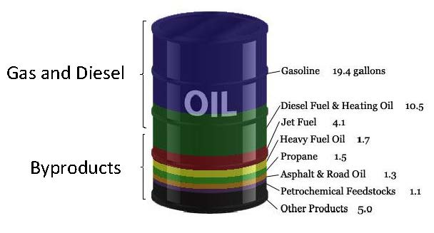
But …
crude oil is used to produce gasoline and diesel, as well as other petroleum products such as liquid-petroleum-gas and asphalt.
Notes:
----- Meeting Notes (6/3/12 09:53) -----
while gasoline and diesel account for about 70% of the barrel, other products account for the rest and include asphalt, LPG, and heating oil.

Slide 4
Putty-clay structure
The petroleum refining process is a capital-intensive process, whereby once a refinery is configured and the capital investment made short-term decisions are constrained by existing technologies.
This is an industry whose response to market fundamentals is limited in the short-run but becomes much more flexible in the long run.

Slide 5
Not a competitive environment
The refining industry is an oligopolistic industry
The petroleum refineries respond to the introduction of biofuels, and this effect is different than what is implied under competition.
This leads to differences in
Environmental side effects
Dynamics of the introduction and adoption of alternatives energy sources
Pricing of various petroleum products
Distributional implications

Slide 6
A simple numerical model

Slide 7
The indirect co-product effect
The indirect co-product effect is defined as the change in GHG emissions associated with changes in petroleum co-product supply resulting from increased biofuel use.
Production system

Slide 9
Indirect co-product effect
Without including ILUC, the EPA calculates the annual emission of corn-based ethanol to be 39 gCO2e/MJ, compared to 92 gCO2e/MJ annual emissions for gasoline (first two columns of Figure 1).

Slide 11
Indirect co-product effect
Without including ILUC, the EPA calculates the annual emission of corn-based ethanol to be 39 gCO2e/MJ, compared to 92 gCO2e/MJ annual emissions for gasoline (first two columns of Figure 1).
When the EPA includes ILUC, it calculates corn-based ethanol emits 74 gCO2e/MJ per year, which represents 21% less GHG emissions than traditional gasoline (column 3 of Figure 1).

Slide 13
Indirect co-product effect
Without including ILUC, the EPA calculates the annual emission of corn-based ethanol to be 39 gCO2e/MJ, compared to 92 gCO2e/MJ annual emissions for gasoline (first two columns of Figure 1).
When the EPA includes ILUC, it calculates corn-based ethanol emits 74 gCO2e/MJ per year, which represents 21% less GHG emissions than traditional gasoline (column 3 of Figure 1).
By contrast, including indirect co-product effect in the EPA's LCA (with ILUC), we find in columns 4 that corn-based ethanol emits between 28 and 50 gCO2e/MJ, which represents between 46% and 70% less GHG emissions than traditional gasoline, depending on the assumption about adjustment.

Slide 15
Indirect co-product effect
Without including ILUC, the EPA calculates the annual emission of corn-based ethanol to be 39 gCO2e/MJ, compared to 92 gCO2e/MJ annual emissions for gasoline (first two columns of Figure 1).
When the EPA includes ILUC, it calculates corn-based ethanol emits 74 gCO2e/MJ per year, which represents 21% less GHG emissions than traditional gasoline (column 3 of Figure 1).
By contrast, including indirect co-product effect in the EPA's LCA (with ILUC), we find in columns 4 that corn-based ethanol emits between 28 and 50 gCO2e/MJ, which represents between 46% and 70% less GHG emissions than traditional gasoline, depending on the assumption about adjustment.
Using the Searchinger et al. estimates, without including indirect co-product effect, corn-based ethanol emits 143 gCO2e/MJ, or 54% more GHGs than gasoline (column 5). Including the IBBE estimate under fixed proportion assumption, corn-based ethanol emits 97 gCO2e/MJ (column 6).

Slide 17
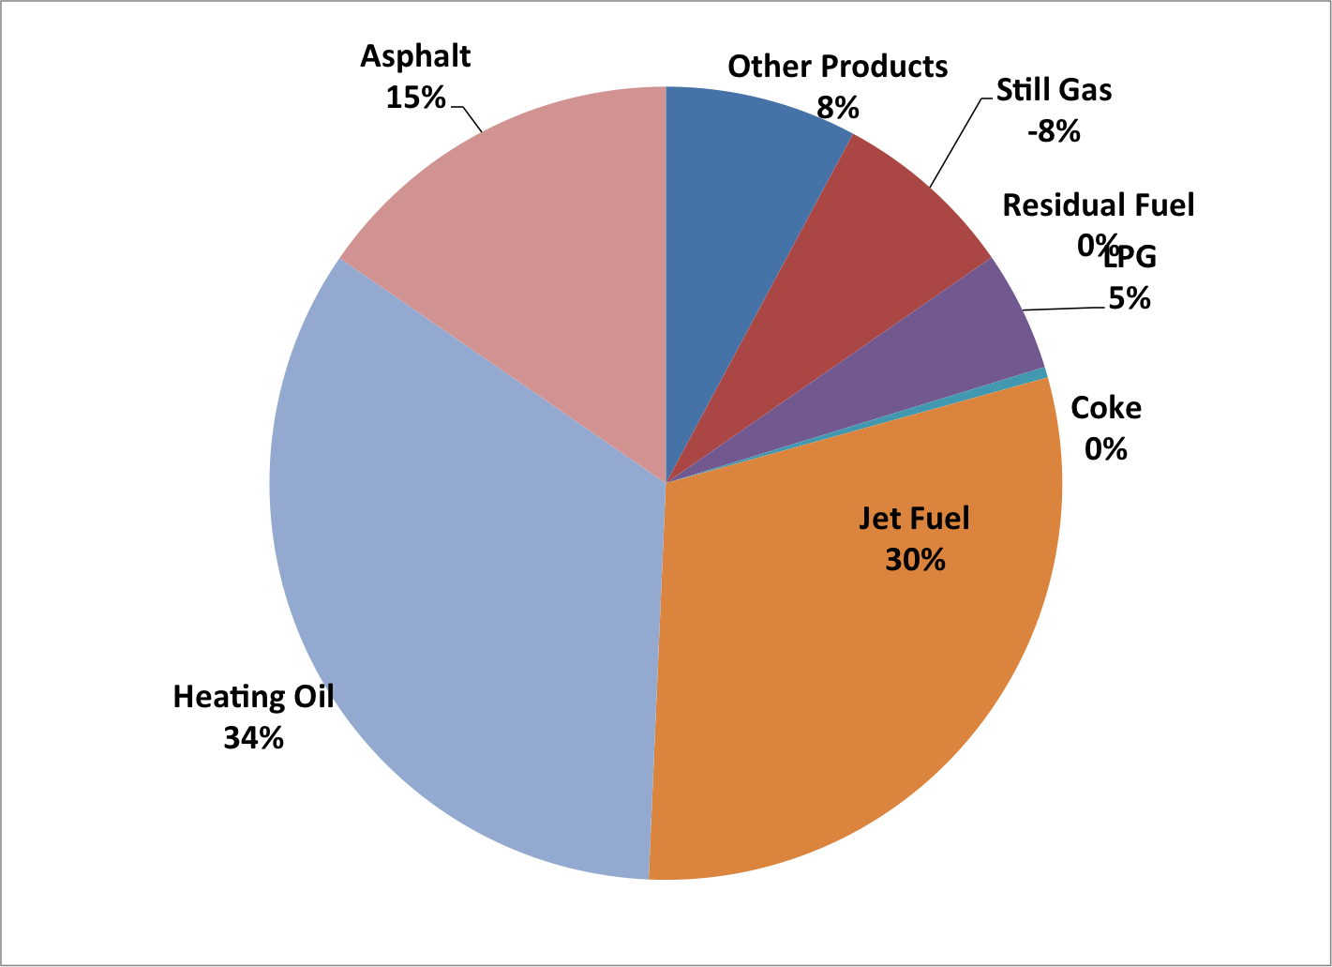
Co-product contributions to GHG savings under full replacement

Slide 18
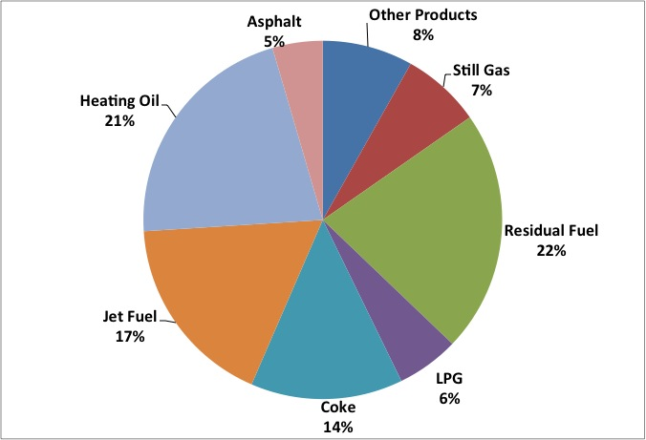
Co-product contributions to GHG savings under no replacement

Slide 19
Comparing the two outcomes
The reason for the more even distribution under the assumption of no replacement, is that the emissions differentials are all on the same order of magnitude, unlike in the full replacement case, in which we assume the emissions differential from jet fuel and heating oil to be much larger than the differentials associated with the remaining co-products.

Slide 20
Reintroducing non-competitive behavior

Slide 21
The short run: With the introduction of the non-petroleum sector
Amount of gasoline supplied to the market declines, but so does the amount of asphalt.
The price of gasoline declines (the rebound effect) but the price of asphalt increases.
The petroleum refinery response results in a larger decline in amount of gasoline supplied to the market, and thus a lower decline in prices, than in competition.
Assuming non-competitive behavior results in a larger indirect fuel and co-product effect, than in competition.

Slide 22
The long run: Intensive and extensive margins
The introduction of alternative to gasoline results in inefficient refineries exiting the industry, and active refineries adjusting the technology and producing more of the petroleum co-products, relative to the short-run.
But the introduction of an alternative results in less petroleum co-products produced, both in the short-run and in the long run.

Slide 23
concluding remarks: The implications to greenhouse gas accounting
The fall in supply of fossil fuels affects production of other petroleum products resulting in an indirect effect, namely, the indirect co-product effect, where under plausible scenarios may be larger than the biofuel indirect land use effect.
The rebound effect is substantially smaller than in previous studies that assumed competitive behavior.

Slide 24
Implications to advance biofuels
The feedstock for advance biofuels offer significantly higher yields and do not compete with the food supply, which means the indirect effects on land-use change will be much smaller. However, the indirect co-product and fuel effects on GHG reductions is the same regardless of the biofuel technology replacing gasoline and diesel, which suggests that advance biofuels may carry even larger environmental benefits than are currently believed.

