Slide 1
Our Location on Wednesday, May 16th at 1 pm (1st floor EPA Building) is Room C111-C

Slide 2

Help us Improve!
You will receive an email with a link to a survey to review the course(s) you attend at the Emissions Inventory Training Workshop.
Please take a few moments to let us know about your experience this week.
We welcome your feedback!

Slide 3
Background on Ammonia and EPA methods for key Ammonia (NH3) sectors in the NEI
Tesh Rao, Jesse Bash
OAQPS/ORD
May 16, 2018

Slide 4
General Information
Trainers
Logistics
Tesh Rao, EPA, OAQPS
Rao.Venkatesh@epa.gov
919-541-1173
Jesse Bash, EPA, ORD
Bash.Jesse@epa.gov
919-541-0862
This training runs from 1 pm to 5 pm
We will try to have a couple of small breaks
Questions always welcome, but if we are falling behind, we may ask for you to see us at a later time or during a break. Feel free to email us after this course is over as well.

Slide 5
Course Outline
1:00-1:15 pm Introductions: Trainers and Attendees
1:15-1:50 pm General background on NH3 air quality and emissions
1:50-2:05 pm Short Break
2:05-2:55 pm CMU (Carnegie Mellon University) FEM (Farm Emissions Model) for estimating Livestock Emissions (EPA methods)
2:55-3:15 pm 2014 NEI (National Emissions Inventory) v2, 2017 NEI plans for Livestock
3:15-3:30 pm Short Break
3:30-4:25 pm EPA methods for estimating Fertilizer Emissions
4:25-4:40 pm 2014 NEI v2, 2017 NEI Plans for Fertilizer
4:40-5:00 pm Last set of questions/comments/suggestions, end of class

Slide 6
Course Objectives
To introduce you to some background on NH3 and key sectors in the inventory
To introduce you to CMU’s FEM for estimating livestock NH3 emissions which was used as the basis for EPA estimates for the 2014 NEI
To introduce you to EPA/ORD’s methods for estimating fertilizer NH3 emissions, which was used as the basis for EPA estimates in the 2014 NEI
Outline 2014 results and plans for the 2017 NEI for both sectors
To provide you an opportunity to ask questions about all of the above
To offer collaboration on these important sectors, and listen to any suggestions/comments you may have moving forward

Slide 7
Background on NH3

Slide 8
NH3 is a significant air pollutant b/c of its impacts to land, water, and human health
Eutrophication, Deposition, and Fine PM formation are all important issues when you have excess NH3

Slide 9
Some Background on NH3
Brief look at NH3 and atmospheric chemistry
Policy relevance of NH3
Precursor insignificance demonstrations
SIP development examples
Standard-setting and regional haze
Model-measurement comparisons
Suggest that NH3 emissions are too low
Deposition issues
Emission inventories
Sectors of importance as we move to the 2017 NEI focus
Resource-sensitive projects that need to be completed to address perceived shortcomings in inventories, measurements, and modeling of ammonia
The emissions inventory is one of those key projects that need to be completed

Slide 10
NH3 and atmospheric chemistry
NH3 is the primary basic gaseous compound in the atmosphere
NH3 is directly emitted (it’s not formed by photochemical reactions)
NH3 combines with gaseous acids (e.g., sulfuric acid and nitric acid) to form corresponding PM constituents (e.g., ammonium sulfate and ammonium nitrate)
Favorable meteorological conditions for ammonium nitrate formation are low temperature and high relative humidity, which often occur in winter or at night
PM formation can be limited by the availability of NH3 or the availability of acids (e.g, nitric acid formed from NOx emissions)
Understanding which PM precursor limits PM formation is often critical for AQ management

Slide 11
Policy Relevance: Precursor Demonstrations, SIP Development, Regional Haze, Standard Setting

Slide 12
Precursor Insignificance Demonstrations
NH₃ is a PM_{2.5} precursor under Clean Air Act subpart 4 nonattainment area provisions (January 2013 ruling)
Precursor insignificance demonstrations based on AQ modeling can be used to remove NH₃ as a precursor for attainment plans and nonattainment New Source Review (NH₃ is not a Prevention of Significant Deterioration precursor)
Precursor insignificance demonstrations are attractive because they can potentially avoid consideration of RACT(Reasonably Available Control Technology)/RACM (Reasonably Available Control Measures) controls
CARB will likely submit a demonstration for the San Joaquin Valley (SJV) where results will depend on the percent reductions in NH₃ selected for modeling
The SJV demonstration (and demos for Cache Valley Utah and other areas) could depend on the accuracy of the modeling inventories

Slide 13
SIP Development
South Coast Air Basin
Projects funded by the Coordinating Research Council found that NOx emission reductions cause PM_{2.5} disbenefits, whereas NH₃ reductions produce PM_{2.5} benefits
Authors conclude that South Coast is pursuing the wrong control strategy by targeting NOx emission sources
EPA modeling for 2010 indicates that NH₃ reductions produce PM_{2.5} benefits under current conditions, but we have found issues with our NH₃ modeling in South Coast (discussed below) and have not examined responsiveness for future years
Salt Lake, Cache, and Utah Valleys
The limiting precursor (NH₃ or NOx) for PM_{2.5} nitrate formation is uncertain
Utah has been adding non-inventory NH₃ emissions into model grid cells domain-wide to improve model performance
Recently, the model-added NH₃ has been found to have a large impact on sulfate formation in clouds and has raised questions about the reliability of the approach
New data have recently become available from a 2017 field campaign, but these data have yet to be analyzed or compared with model predictions

Slide 14
Standard Setting and Regional Haze
Standard Setting
Secondary NOx/SOx/PM NAAQS: Ecosystem effects of PM ammonium deposition are included in the review, and CASAC (Clean Air Scientific Advisory Committee) has highlighted the importance of NH₃:
August 2017 letter: “Ammonia emissions are increasing in many regions of the U.S. and the CASAC recommends that EPA consider the need for developing National Ambient Air Quality Standards for reduced forms of nitrogen during the Risk and Exposure Assessment and Policy Analysis phases of this NAAQS review”
PM NAAQS: Will likely be asked to consider NH₃ emission controls in Risk/Exposure/Impact analyses
Regional Haze (RH) Planning
Under-predictions of nitrate in the southwest in regional photochemical models, possibly related to under-predictions of NH₃, present challenges to developing RH SIPs for the 2nd implementation period (2018-2028)
Modeling to address BART (Best Available Retrofit Technology) provisions of the RH program can be sensitive to assumptions about background levels of NH₃, which are uncertain

Slide 15
Comparisons of AQ Model Predictions of NH₃ with Measurements/Monitoring

Slide 16
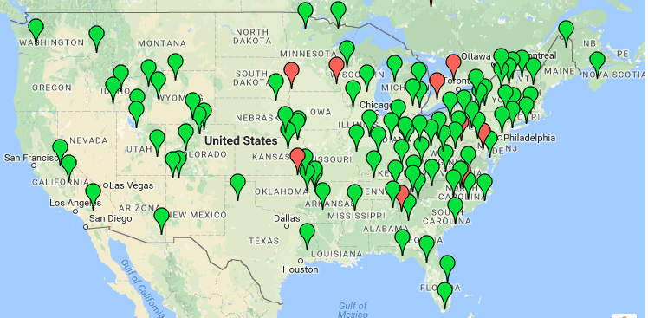
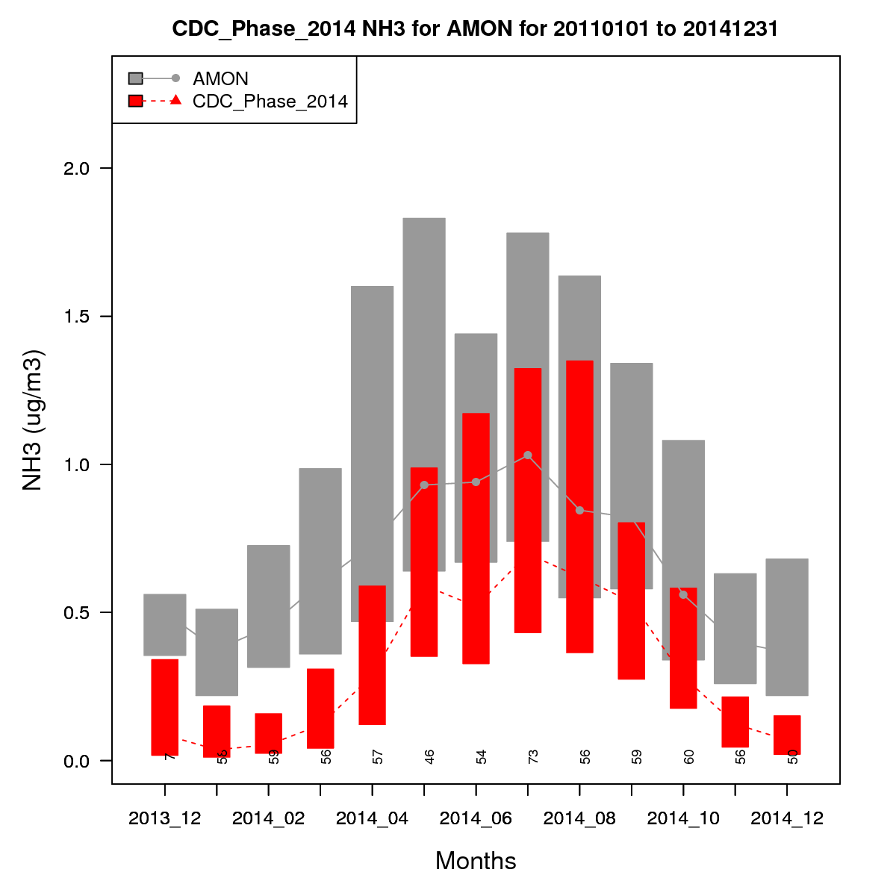
Ammonia Monitoring Network (AMoN)
AMoN provides a national picture of two-week average NH₃ concentration at mostly rural sites
2014 CMAQ NH₃ predictions are compared with AMoN measurements (figure, left)
Seasonal profiles of the observations are generally captured by the model
However, the model underestimates observed concentrations
Source: Jesse Bash

Slide 17
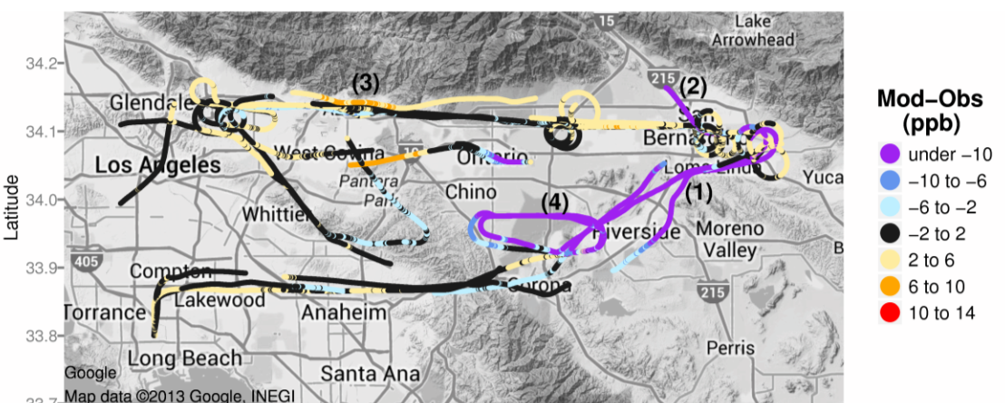
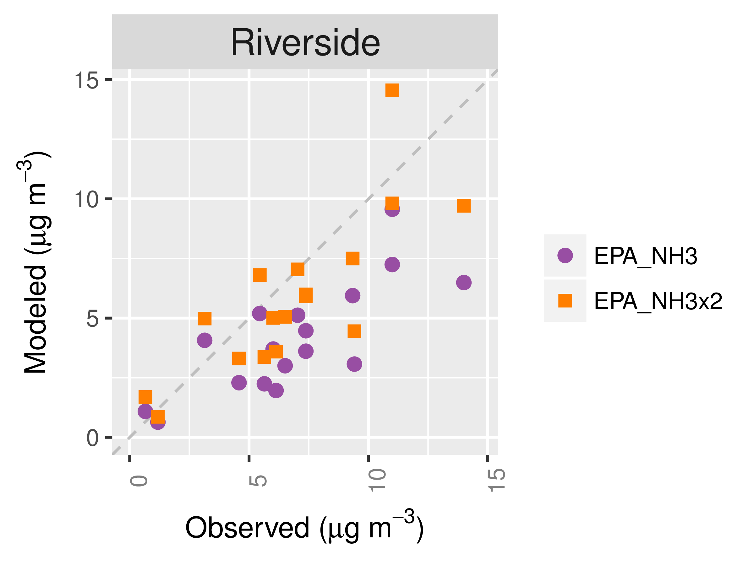
Aircraft Measurements in South Coast Air Basin (CalNex-2010)
NH₃, Modeled - Observed
Nitrate
NH₃ is under-predicted for aircraft transects near Riverside downwind of Chino dairy facilities (e.g., markers (1) and (4), above left)
NH₃ is over-predicted for transects along San Gabriel Mountains near Pasadena, e.g., (3)
Nitrate predictions in Riverside are sensitive to NH₃ emissions (above, right), and increased NH₃ emissions lead to better model performance in Riverside
Source: Kelly et al. (2014) Fine-scale simulation of ammonium and nitrate over the South Coast Air Basin and San Joaquin Valley of California during CalNex-2010. Journal of Geophysical Research-Atmospheres 119(6): 3600-3614.

Slide 18
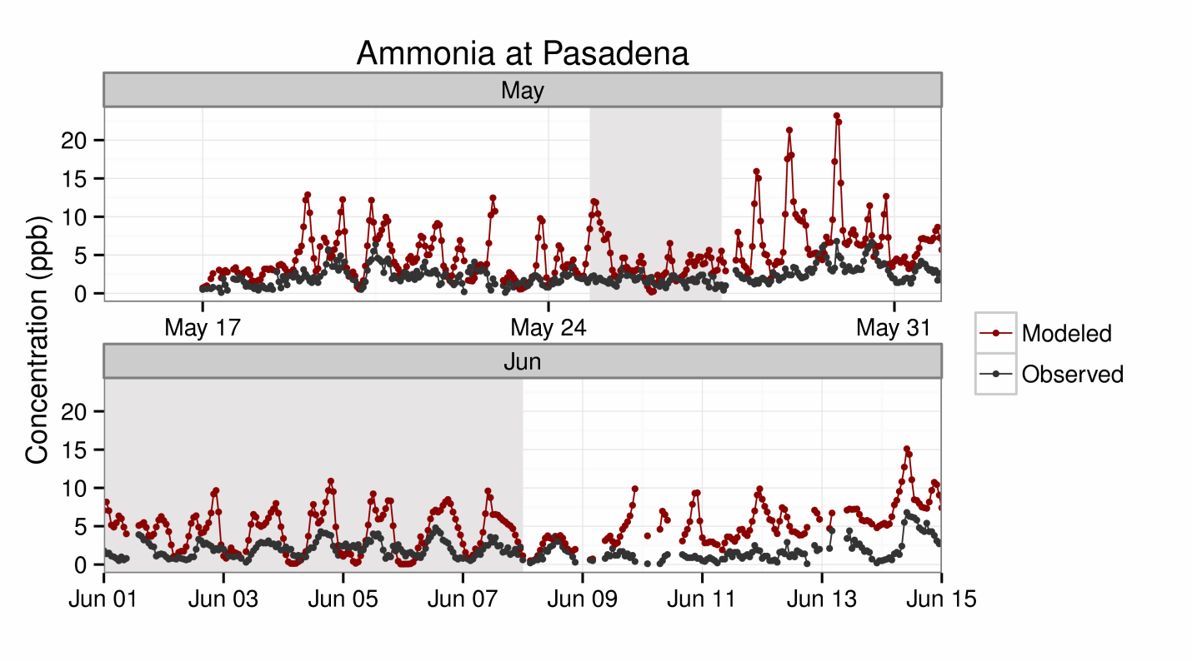
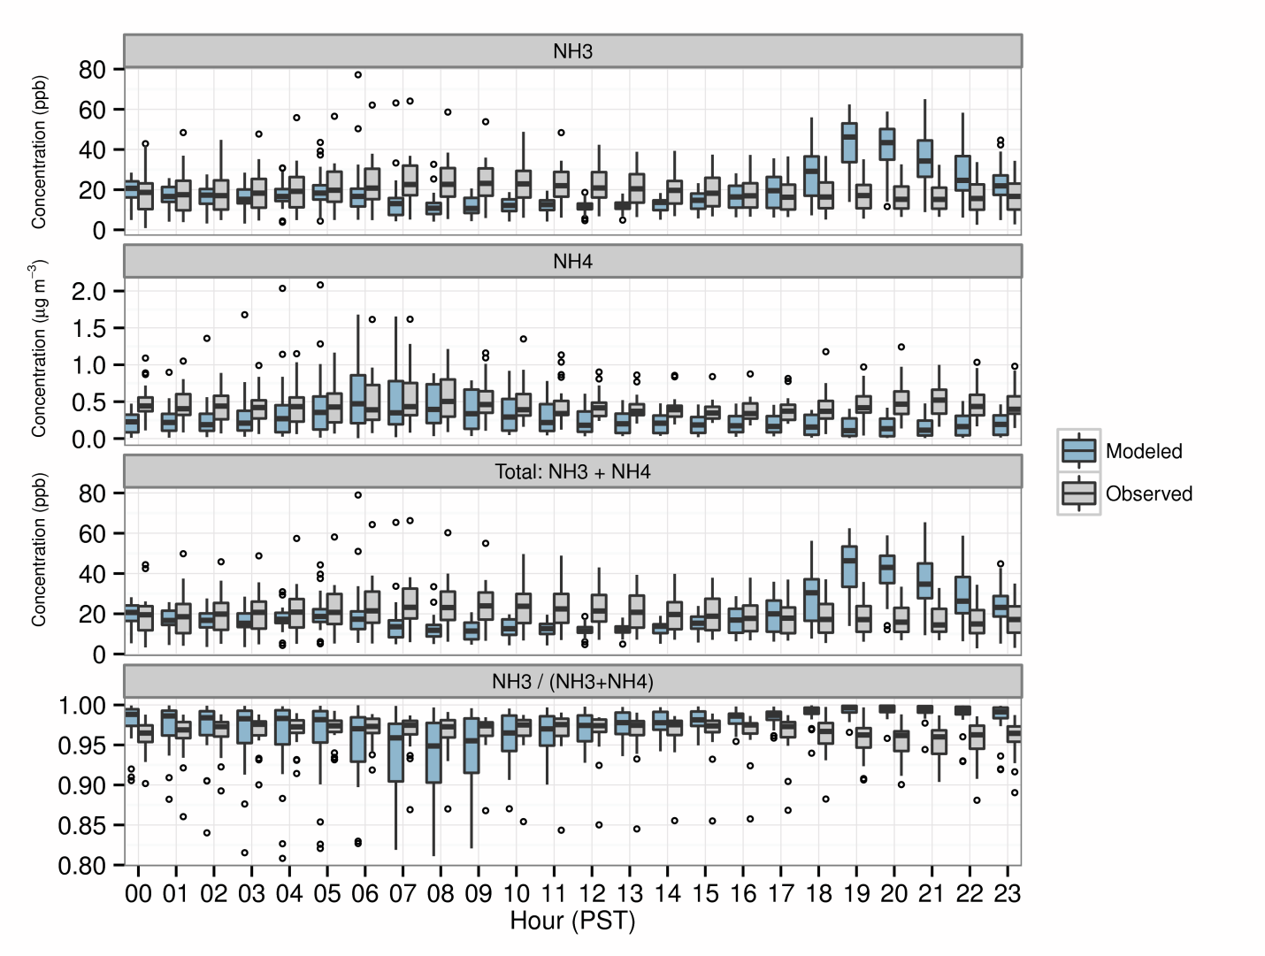
Pasadena and Bakersfield Ground Sites (CalNex-2010)
In Pasadena, NH₃ tends to be over-predicted especially at night, consistent with aircraft transects in this region on previous slide
Some overpredictions occur overnight and could be related to underestimated vertical mixing in the model
In Bakersfield, NH₃ is underestimated during the day when emissions are highest but is overestimated in the evening, possibly due to issues with nighttime mixing in the model
Bakersfield, 22 May – 28 June 2010
Source: Kelly et al. (2014) Fine-scale simulation of ammonium and nitrate over the South Coast Air Basin and San Joaquin Valley of California during CalNex-2010. Journal of Geophysical Research-Atmospheres 119(6): 3600-3614.

Slide 19
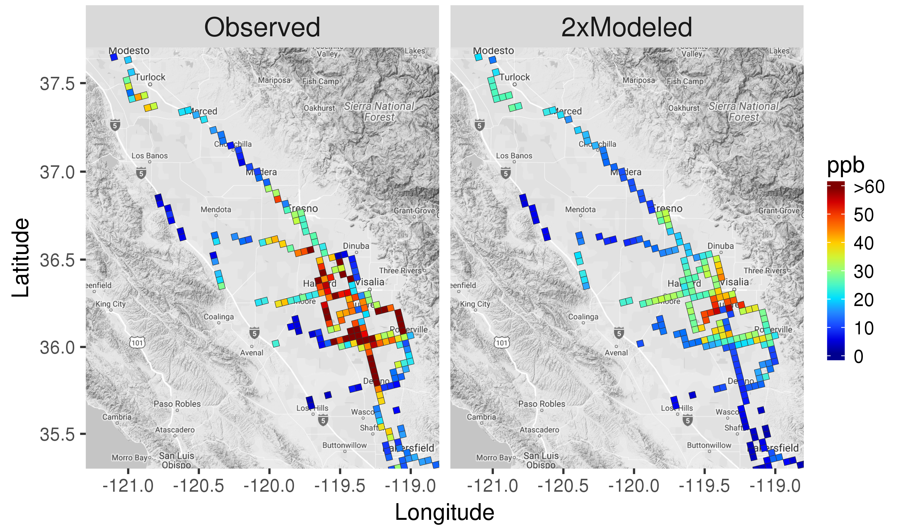
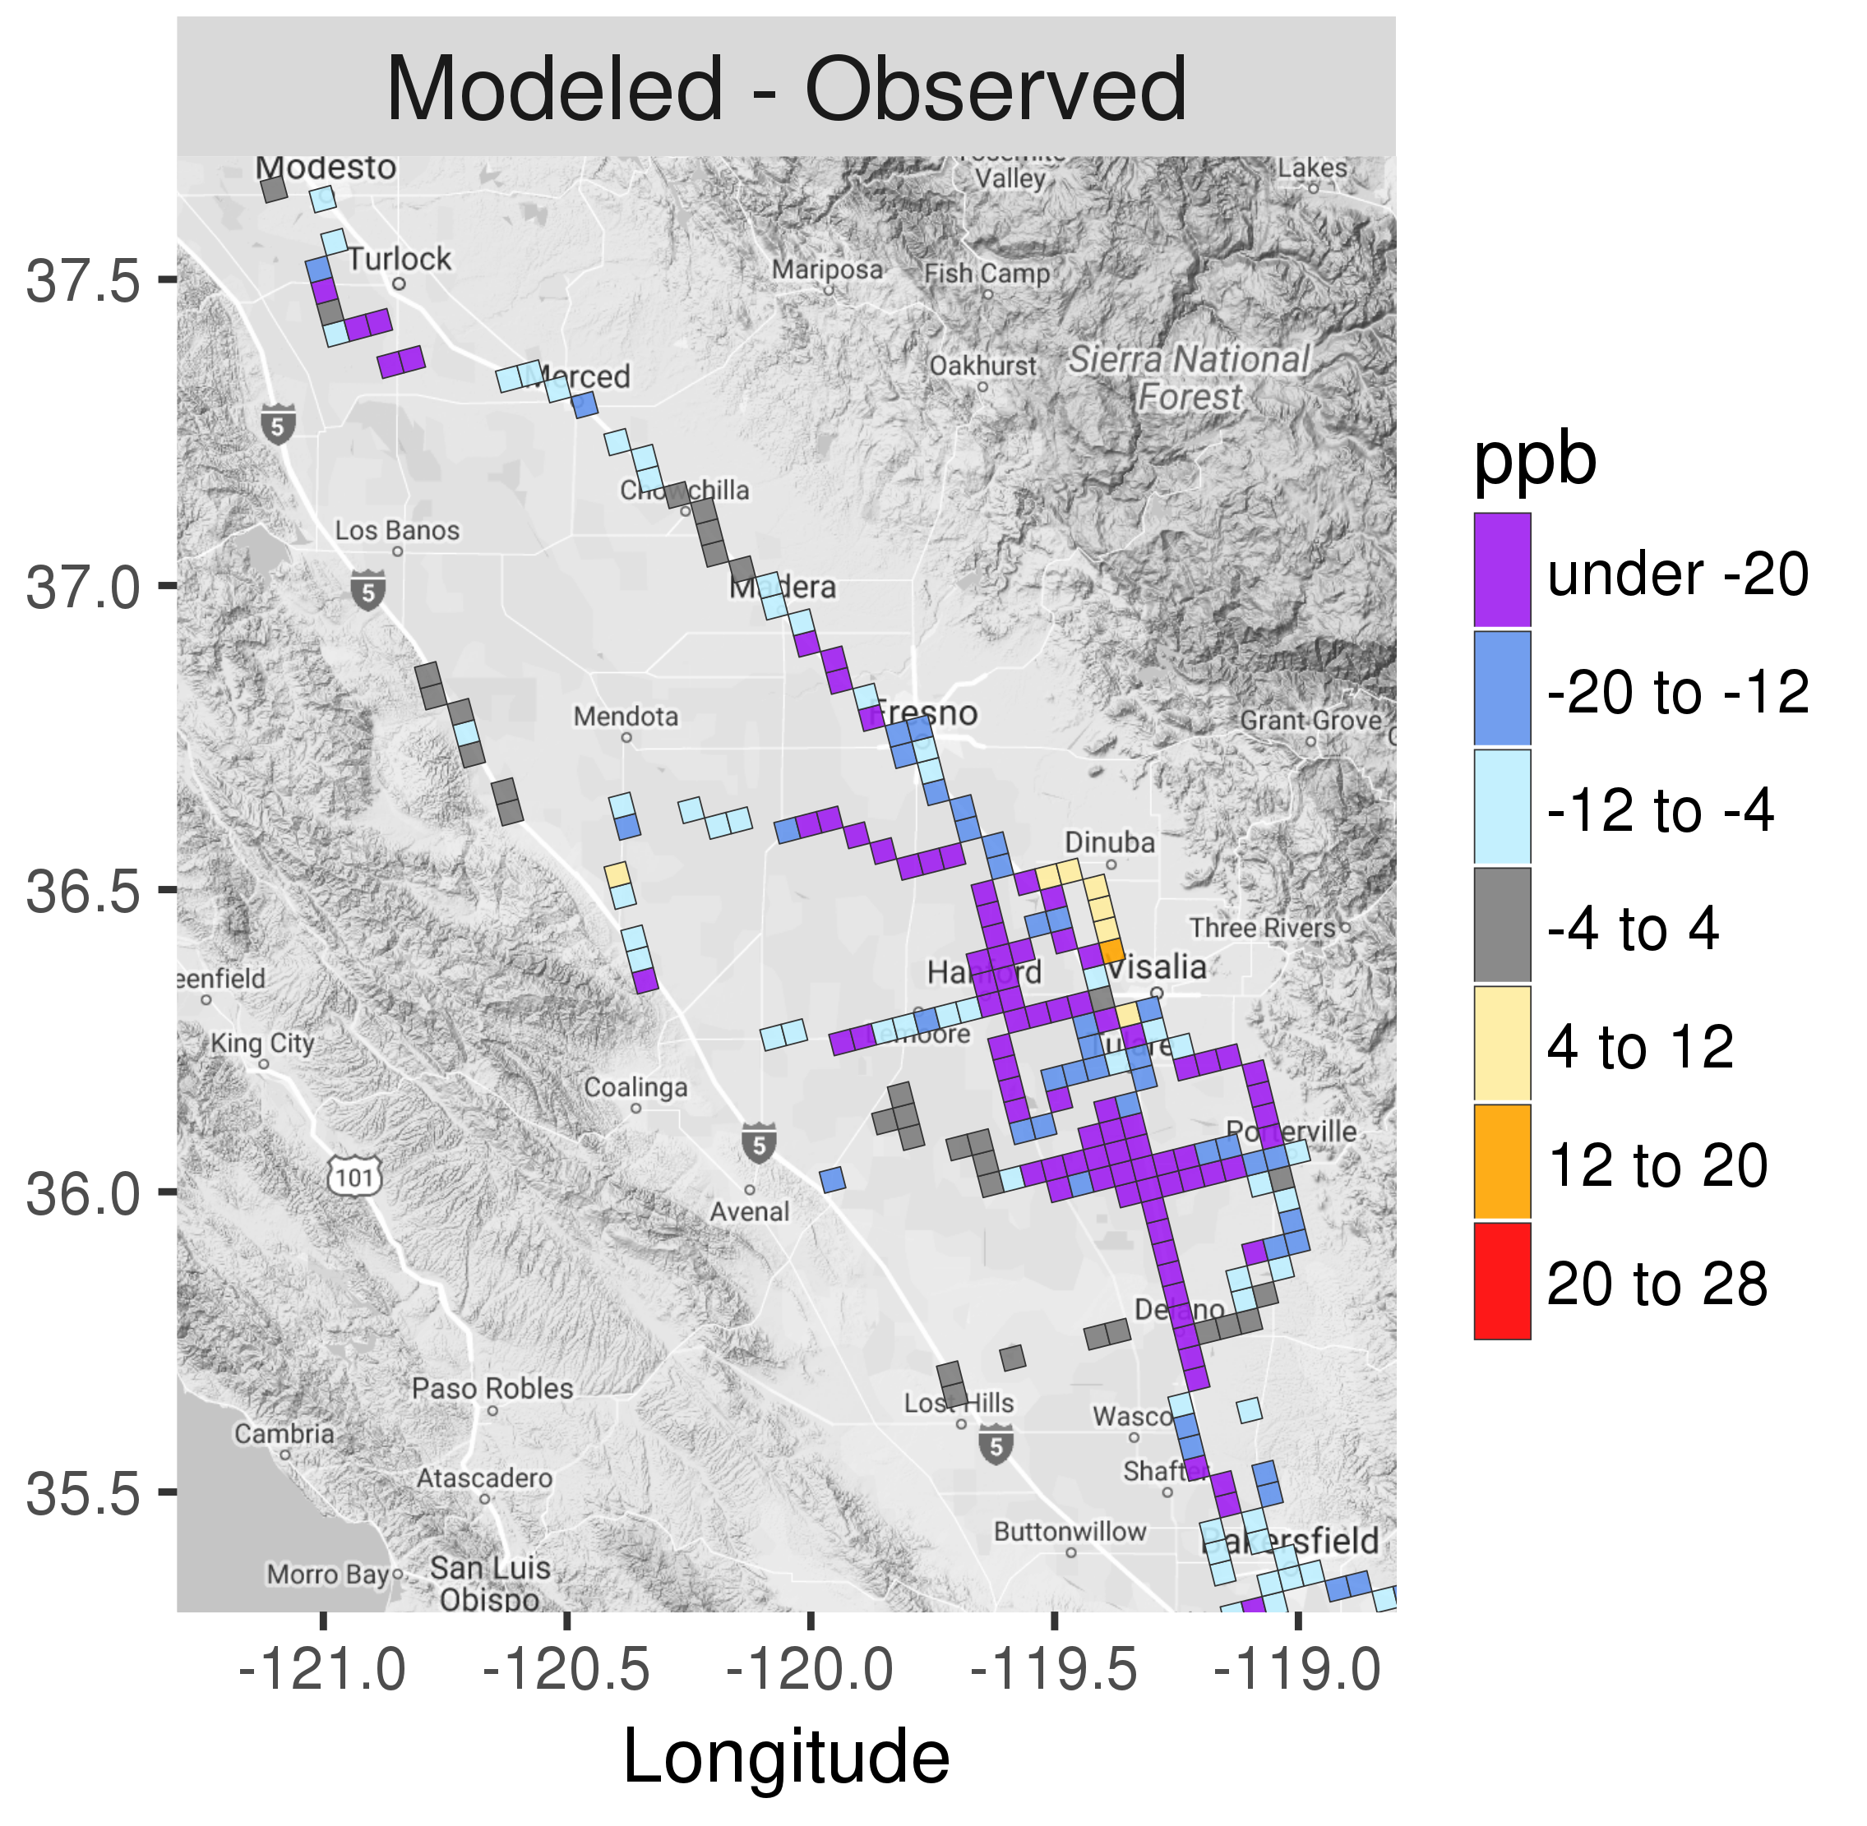
2013 San Joaquin Valley DISCOVER-AQ
Turlock
Turlock
Turlock
Fresno
Fresno
Fresno
Hanford
Hanford
Hanford
Bakersfield
Bakersfield
Bakersfield
Some consistency in observed and modeled spatial patterns of NH₃ in SJV, but concentrations are underestimated significantly in source regions
However, in contrast to South Coast, model predictions of nitrate are not very sensitive to NH₃ emissions in SJV (i.e., NH₃ is not the limiting precursor) (not shown)
Source: Kelly et al. (2017) Modeling NH₄NO₃ during the 2013 San Joaquin Valley DISCOVER-AQ campaign [in prep]

Slide 20
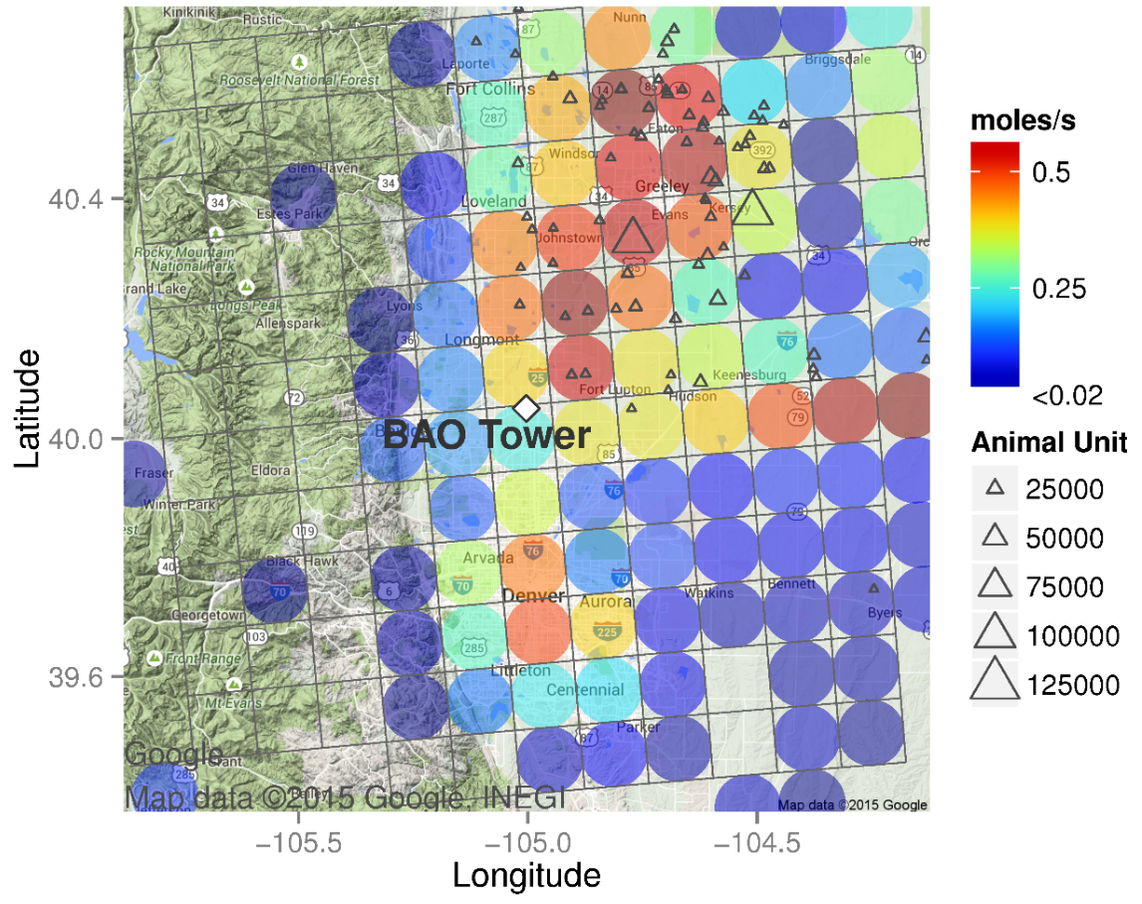
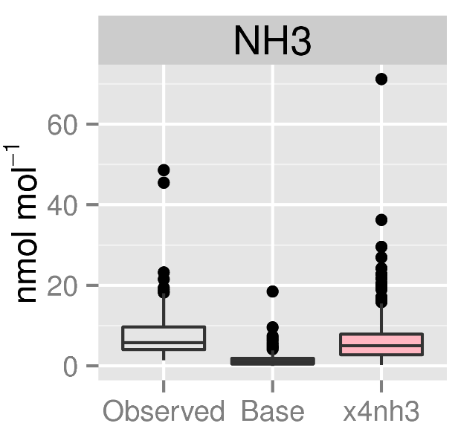
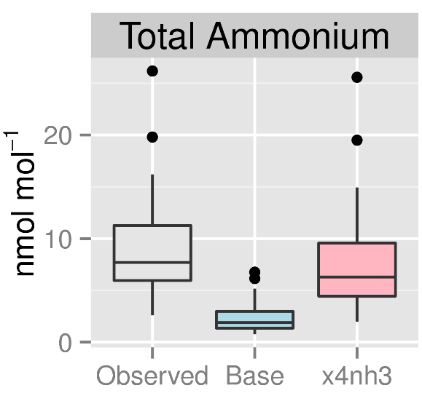
NE Colorado: Boulder Atmospheric Observatory
NHx
RMNP
Greeley
~33 km
Denver
NH₃ and NHx (NH₃ + NH₄⁺) are underestimated in the base simulation at the Boulder Atmospheric Observatory (BAO) southwest of the Greeley high-emission region
Closer agreement between model and measurements when NH₃ emissions are increased by a factor of four
Colors indicate average NH₃ emissions in model cells
BAO: Boulder Atmospheric Observatory
RMNP: Rocky Mountain National Park
Source: Kelly et al. (2016) Simulating the phase partitioning of NH₃, HNO₃, and HCl with size-resolved particles over northern Colorado in winter. Atmospheric Environment 131:67-77.

Slide 21
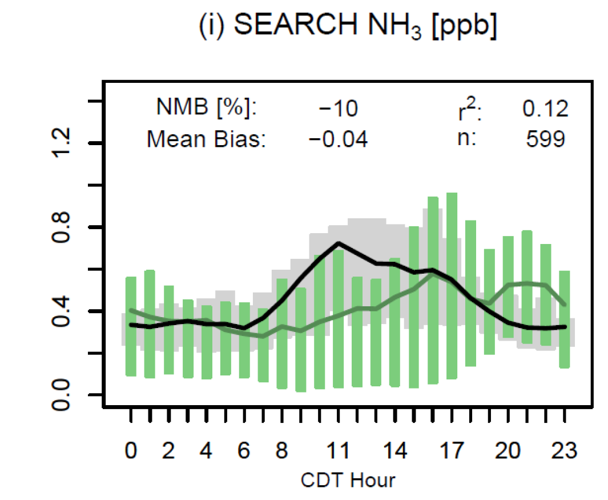
Southeastern Aerosol Research and Characterization (SEARCH) Study
At the SEARCH site in Centreville, AL, model predictions are of similar magnitude as observations during summer of 2013
Some differences in diurnal profiles
Our modeling seems to show that the match between model-predicted NH3 and observations is better in the SE US
Source: Pye et al. (2015) Modeling the current and future roles of particulate organic nitrates in the southeastern United States, Environmental Science Technology

Slide 22
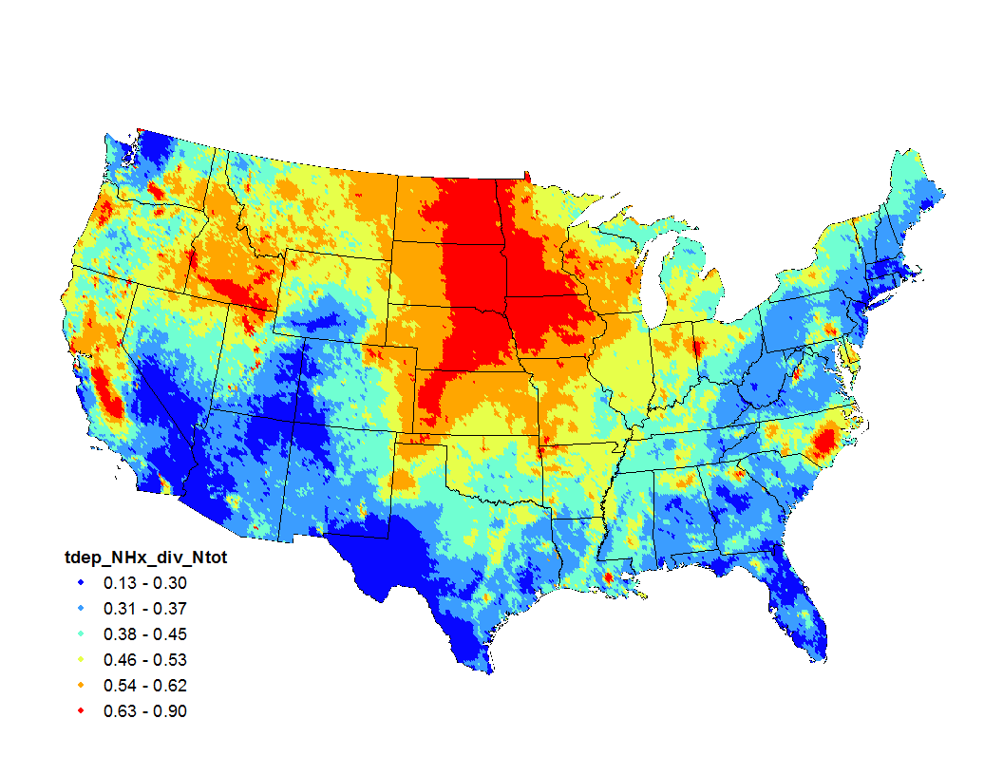
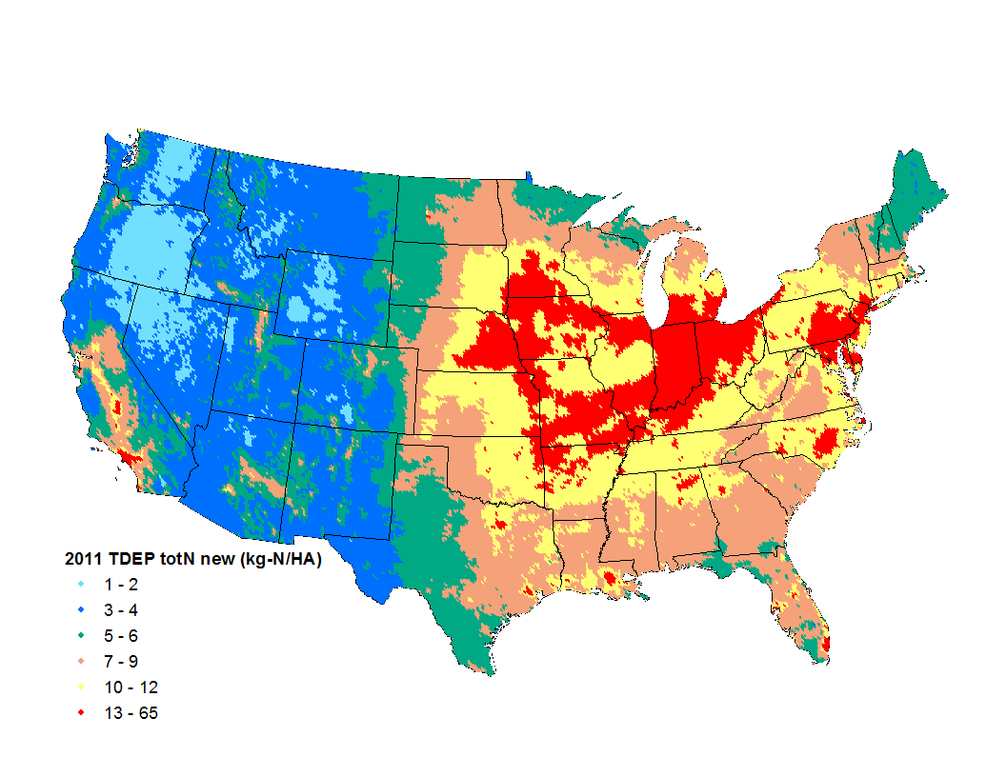
Deposition of NHx relative to total N
NH₄ + NH₃ = NHx, which nationally makes up nearly half of all nitrogen deposition
Based on NADP TDEP (fused CMAQ and CASTNET) data
2011 Ratio of NHx to total N deposition
2011 total N deposition
Source: NADP TDEP

Slide 23
Summary of NH3 Model Evaluations
National evaluations with AMoN data suggest the model is biased low but has a reasonable representation of seasonal patterns
Evaluations for regions with large livestock operations indicate that the model has significant under-predictions in these areas, although modeled emissions are elevated in these regions compared to surrounding areas
For some areas/periods (e.g., SEARCH and Pasadena), model predictions are in reasonable agreement with measurements or are biased high
Overall, model evaluations suggest that emissions are too low in many areas; however,
NH₃ is highly variable in space/time, so we need to use caution in interpreting short snapshots from field campaigns or sparse monitoring
Issues with modeling the fate and transport of NH₃ likely explain a portion of the model-measurement differences
Issues with the spatial allocation of emissions could explain a portion of the differences

Slide 24
General Emissions Inventory Issues related to NH3 emissions

Slide 25
What is the issue?
Many papers have suggested that NH3 emissions may be too low in certain key sectors in the NEI based on modeling results and other analysis
EPA’s modeling is also showing an under-prediction between model output and monitored NH3 values
It remains unclear which sources may be underestimated—but Ag sources have been implicated, since they contribute most NH3 totals in the NEI

Slide 26
NH3 in the 2014 NEI v2, ~ 3.6 millions tons total

Slide 27
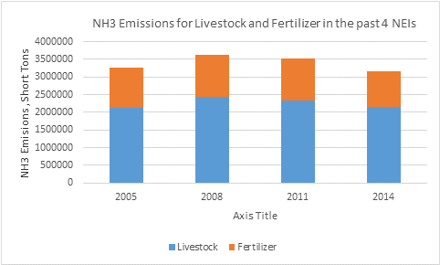
NH3 in the 2014 NEI v2, continued…
Top 15 EIS Sectors for NH3 in the 2014 NEI, Emissions shown in Short Tons (Total NH3 = 3.6 Million Tons)
Ag Livestock emissions have been fairly constant over time in the NEI. Fertilizer is actually seen going down from 2011 to 2014

Slide 28
Emissions changes over time show NH3 to be stagnant

Slide 29
Inventory-Related Issues
Ag Livestock
Sector with most NH3 emissions in inventory
For the 2014 NEI, used a revised CMU model that was run by a graduate student working for Peter Adams
We have the source code, but more work needed to use for other emissions years
EPA also working on analysis of NAEMS data and Emissions Estimation Models
For NEI work, collaboration between OAQPS and ORD on-going. Considering additional university collaboration (only for NEI efforts)
Ag Fertilizer
ORD provides emissions estimates based on their bidirectional (bidi) approach
Research and model revisions continue (much more on this later)
Mobile Sources
NH3 emissions have not been investigated by EPA for some time. Not currently an agency priority for mobile sources.
Fires
OAQPS/ORD testing project is expected to give updated emission factors (EFs) for possible future use in EPA fire emissions approaches

Slide 30
Short Break: Be back in 15 minutes please!

Slide 31
CMU’s Farm Animal Ammonia emissions model (FEM)
Model developed by Carnegie Mellon University 2016

Slide 32
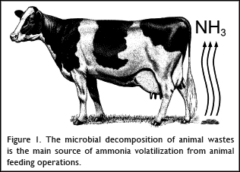
Ammonia is a common by-product of animal waste due to the often inefficient conversion of feed nitrogen into animal manure (urine + feces). Livestock and poultry are often fed high-protein feed, which contains surplus nitrogen, to ensure that the animals' nutritional requirements are met. Nitrogen that is not metabolized into animal protein (i.e., milk, meat, or eggs) is excreted in the urine and feces of livestock and poultry where further microbial action (conversion of urinary urea to ammonia…the enzyme Urease, released in feces, reacts with urinary urea to form NH3) releases ammonia into the air during manure decomposition.

Slide 33
2014 NEI Efforts for Livestock Waste Ammonia Emissions
EPA was able to leverage work done via EPA’s Science to Achieve Results (STAR) grant to CMU, which enabled EPA to use an updated version of the CMU model to estimate livestock NH3 emissions in the 2014 NEI. Alyssa McQuilling (graduate student of Dr. Peter Adams at CMU) ran the model for v1 of the 2014 NEI.
We could not control deliverables nor understand the intricacies of the model as well as we wanted due to the structure of the grant and timing issues
We do have gaps in our current methods, and we are trying to improve these for the 2017 NEI
I am not an expert on the intricacies of the CMU model, and if there are questions that I (or others here) cannot answer, I will get you an answer as we begin to work on the 2017 NEI

Slide 34
Sources of information
Alyssa McQuilling Thesis, February 2016
"Ammonia Emissions from Livestock in the United States: From Farm-Level Models to a New National Inventory" (2016).
http://repository.cmu.edu/cgi/viewcontent.cgi?article=1704&context=dissertations
Alyssa McQuilling and Peter Adams, publication, September 2015
“Semi-empirical process-based models for ammonia emissions from beef, swine, and poultry operations in the United States,” Atmospheric Environment 120:127 - 136 · September 2015
Various presentations made by CMU professor Peter Adams on this subject
2014 v2 TSD, available currently on this FTP site: ftp://newftp.epa.gov/Air/nei/2014/doc

Slide 35
General Overview of Semi-Empirical Process-Based Models for NH3 from Livestock
Farm-level emission factors in the literature vary by an order of magnitude due to the variations in manure management practices and meteorology
It is essential to capture this variability in emission inventories used, for example, for atmospheric modeling
Here (as the details will highlight), through a nitrogen mass balance with losses controlled by mass transfer resistance parameters, which vary with meteorological conditions, are tuned to match literature-reported and NAEMS-based (National Air Emissions Monitoring Study) EFs
Variations due to management practices are captured by having tuned factors that are specific to each set of practices
The resulting farm emissions models (FEMs) explain between 20 and 70% of the published EFs and typically estimate EFs within a factor of 2

Slide 36
Ammonia Emissions Variability
Emissions depend on a variety of factors including
Meteorology
Management Practices
Manure Characteristics
Lots of variability, how to build an inventory??
The approach here with the “updated” CMU FEM Model: emissions model instead of use of emission factors

Slide 37
Scatter plot of fraction of input nitrogen volatilized as
ammonia, comparing application sub-model predictions
and experimental data showing range of measured data
(Pinder, et al., 2004) ---shows the variability that can be encountered

Slide 38
Primary Meteorological Factors Affecting Ammonia Emissions, in general…
Temperature – temperature, emissions
Higher temperature increases volatility of ammoniacal nitrogen
Wind speed – wind speed, emissions
Higher wind speed decreases surface resistance
Precipitation – precipitation, emissions
Precipitation allows for greater ground infiltration
pH also very important factor, will address later in presentation

Slide 39
Process-based Models
Emissions ~ Nitrogen/Resistance (Wind, Temp)
Volatilization
Volatilization
Volatilization
Feed
Housing/grazing/
feedlot
Storage
Application
Animal
Excreta
Losses to soil, groundwater and biota
Track Nitrogen through manure management process
Includes mass balances and mass transfer laws
Goal is that such a model can capture the variability seen in measurements

Slide 40
Overall objectives and goals
We want to build a national emissions inventory. We would like the data to also be applicable to air quality models
Therefore, the model’s focus should be on:
Unbiased emission factors
Seasonal cycle (daily variation would be even better)
Regional scale variability in EFs
Computational efficiency
Scalability (do we have national inputs to drive model)
For Livestock, this leads to the following compromises
Tune model to measurements rather than using “First Principles”
Omit “details” when we don’t have national data (ventilation rates, for example) or no systematic regional variation
Predicting results for an “average” farm, rather than a specific farm

Slide 41
Approaches
MORE PROCESS ORIENTED
MORE EMPIRICAL
Constant Emission Factors, Emissions = g/animal/day
x
# of Animals
Empirical Emission Factors, Emissions = F(temp, wind, etc.)
Semi-Empirical Process Model
First Principle Process Models

Slide 42
This approach versus earlier CMU work
Early 2000s, Rob Pinder did…
process-based model for dairy only
completed inventory using surrogate seasonal cycles for other livestock types
This work, Alyssa McQuilling…
applied same process-based model framework to beef, swine, poultry
first national inventory completely based on process-based modeling
used NAEMS data
various other updates

Slide 43
Emissions Measurements (of NH3)
Historical Measurement Campaigns
National Air Emissions Monitoring Study
Short-term monitoring deployments
Many researchers, many farms
Limited monitoring reporting of farm and measurement conditions
Spread of measurements poor (by season for example)
At the time of this work, 1-3 years of data collection (long-term measurements of seasonal cycles)
Consistent measurement techniques
Extensive monitoring of meteorological and farm management conditions

Slide 44
NAEMS Measurements
National Air Emissions Monitoring Study
~ 2 year measurement campaign
Dairy, swine, and chicken farms
Better contextual data
Long-term measurements, 2007-2010 … evaluate seasonal and daily variability
https://www.epa.gov/sites/production/files/2017-09/documents/_epaoig_20170919-17-p-0396.pdf

Slide 45
Objectives
Build process-based FEMs for all livestock types
Dairy cows (basically carried forward from previous work), Beef Cattle, Swine, Layer Chickens, Broiler Chickens
Evaluate the model(s), especially for seasonal and daily variability (using NAEMS data, for example)
Build National Inventory (the 2014 NEI in our case)
See if results help improve air quality modeling evaluations

Slide 46
Methods: Details
Emissions ~ N/Resistance (Wind, Temp)
Volatilization
Volatilization
Volatilization
Feed
Housing/grazing/
feedlot
Storage
Application
Animal
Excreta
Losses to soil, groundwater and biota
Each farm has a manure management train with mass balances on: 1) ammoniacal nitrogen, 2) urea, and 3) manure volume
Each component (e.g., housing, storage, …) has NH3 volatilizations and thus ammonia emissions

Slide 47
Methods: Details
Volatilization
Volatilization
Volatilization
Housing/grazing/
feedlot
Storage
Application
Animal
Excreta
Emissions Computed:
EF = {A * [TAN] * H*}/r
Losses to soil, groundwater and biota
EF: Emissions Factor ------------------→ Key Output
A: Surface Area Fouled by Manure ----------→ Model Parameter
H*: Henry’s Law Equilibrium Constant ---------→ Model Parameter
[TAN]: Total Ammoniacal Nitrogen Concentration --------→ Mass Balance
r: Mass Transfer Resistance Parameter--→ TUNED TO OBSERVATIONS

Slide 48
FEM Submodel Flow
Data flows through each submodel:
Inputs
Outputs
Submodel
(e.g. swine storage)
Nitrogen and water
From literature or previous submodel
Daily Average Emission Factor
Adjusted parameters
Nitrogen and water balance
(goes to next submodel)
Meteorological data
From National Climate Data Center (NCDC)
Mass balances on each sub-model
What isn’t emitted remains in the same sub-model
Transfers between sub-models only occur when “Scheduled” based on farming practices.
For example, housing manure may be cleaned out daily and take to storage for dairy cows but less often for poultry
Similarly, manure is taken out of storage and applied at various points in the year

Slide 49
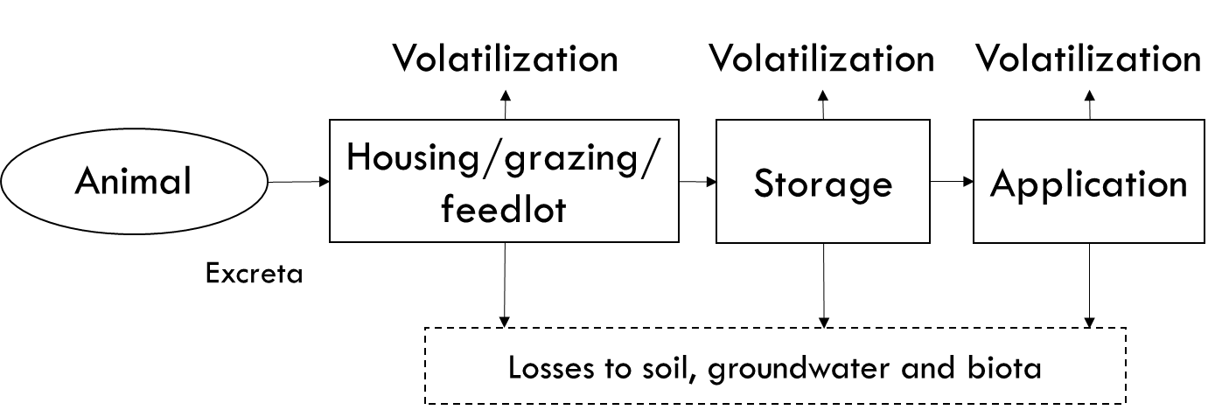
Methods: Details
Emissions Computed:
EF = {A * [TAN] * H*}/r
SURFACE RESISTANCE:
Tuned to match measured EFs!!
r_{s} = function (Meteorology and Practices)
e.g. for Beef Feedlots
r_{s}=H₁T + H₂u + C
Where H₁ and H₂ are constants and tuned to capture variability due to temperature and windspeed
r = r_{a} +r_{b}+ r_{s}
Aerodynamic and quasi-laminar resistances: standard atmospheric theory

Slide 50
The “r” resistance term is very important!!
Each box has its own equation for r. E.g. storage has its own equation and housing has a different one. Moreover, each practice type has its own r equation, e.g. tie stall dairy housing has a different equation than free-stall dairy housing. In general, the r equations are also functions of meteorology. This approach to specifying the r is how the model makes the emissions depend on practices and meteorology.
Volatilization
Volatilization
Volatilization
Housing/grazing/
feedlot
Storage
Application
Animal
Excreta
Losses to soil, groundwater and biota

Slide 51
Methods: Summary
How does the model get seasonal (daily) variability?
Resistance depends on meteorological variables
How does the model get variability due to practices?
Separate resistance sub-model for each
Livestock type
Manure management stage: housing, storage and application
Major practice: e.g. deep-pit and shallow-pit swine housing
Other differences (e.g. frequency of house clean-out)
Regional variation is a combination of meteorology and practices
The met data pulled from NCDC is actually according to their “climate zones”. There are ~200 of them. So EFs for different counties in the same climate zone will be the same for the same farming practices. Note, however, that this is not really an inherent limitation of the CMU model – just the structure of the input data used.

Slide 52
Model evaluation
Since the tuning is done to have no bias versus observations, the fact that the model predicts the right magnitude is not evidence that the model is working as it would be if it were a purely untuned first-principles model
Evaluation of the model is done against the same data used for tuning. This is a documented weakness since everything is not totally independent.
Ideally we would want to tune based on some data and test based on other, but there simply isn’t that much data
However, the evaluation does provide an useful quantification of how well a relatively simple mass balance model (there are much more complex farm models out there) can explain “variability” in emissions factors in a complex system.
Model performance evaluated primarily in terms of R value and mean fractional error between observed and modeled EFs

Slide 53
FEM: Tuning and Evaluation
Unbiased (because the models have been tuned, and the error between model predictions and measured EFs are minimized)
R2 values ranges from 0.2 for Beef to 0.7 for layers
Modeled EFs are generally within a factor of 2 of measured…at farm scale
Beef Feedlots
Broiler Housing
Layer Housing
Swine Housing

Slide 54
Role of “Contextual Information”
Versus all studies
Vs studies reporting N
Not all studies report all required input parameters (e.g. feed or manure nitrogen)
Measurements need to report feed N, other practices, and meteorological conditions to put results in context and be useful to process-based models and inventories
Notes:
A-B:
Figure 2a shows the model evaluation for the beef feedlot submodel of the beef cattle farm emission model. The figure shows that the model has some skill in reproducing the literature reported emissions for feedlot beef production. Figure 2b shows the model evaluation for beef feedlots where information about the nitrogen content of feed and/or excreta is presented with the emission factor. This figure highlights the importance of reporting dietary nitrogen and nitrogen excretion rates in the literature, because with this extra information we were better able to simulate ammonia emission factors for beef feedlots than when we did not have this information, increasing the r² value of the data from 0.21 to 0.36.

Slide 55
Open vs Enclosed Sources
Swine Housing: Enclosed
Swine Storage: Open
Open (outdoor) sources are more difficult to measure … need to infer emissions rate from downwind concentrations….must make dispersion assumptions
Notes:
Here is a side-by-side comparison of all four animal types for which a farm emission model has been developed. I’ve displayed the evaluation of each animal’s housing submodel.
You can see from the figure the variation in both the amount of literature data available for each animal type as well as the ranges of emission factors that each animal type spans, just for the housing portion of manure management.
You’ve seen the beef and swine results in previous slides, so focusing on the lower row:
Broiler chickens have a short life cycle and, as a result, we have chosen to report emission factors in terms of grams of ammonia volatilized per animal unit per day, where 1 animal unit (AU) is 500 kg. This avoids dealing with the complicated task of separating the effects of differences in temperature and other meteorological conditions and difference in bird weight, which changes rapidly. Unfortunately this is not a perfect solution as there is some evidence that emission factor per bird weight changes over the course of the production cycle, though there is no consensus on how the emission factor changes. Model results in Figure 2e show an R² value of 0.29 with the data reported from the literature from farms in the United States. It is important to know the outdoor temperature even at enclosed facilities because the outdoor temperatures often drive ventilation rates and affect how much ammonia is volatilized within the barn. Model results in Figure 2f show an R² value of 0.65 with the data reported from the literature from farms in the United States.

Slide 56
Further (seasonal) evaluation examples using NAEMS Farms
These graphs show seasonal cycle of emission factors compared to that predicted by the corresponding FEM
Typically, Dairy and Swine Farms have peaks in the summer while layers and broilers typically have winter peaks
FEMs seem to capture the NAEMS data well (R2 values range from 0.6 to 0.9)
Free Stall Dairy Barn, NY
Shallow Pit Swine Housing, NC
Litter-based Broiler Housing, CA

Slide 57
Evaluation: Daily Variability
Free-Stall Dairy House in Indiana
Dairy Lagoon in Indiana
Daily variability in housing emissions tends to be better characterized by the model than storage emissions

Slide 58
Development of a National Emissions Inventory
National Climate Data Center (NCDC)
Temperature, Precipitation, and Wind Speed
Daily Time Resolution, Climate Division Spatial Resolution
Meteorology
National Animal Health Monitoring Survey
Housing type, Storage type, Application methods
Multi-state regional spatial resolution
Management Practices
USDA Agricultural Census
County level animal numbers from 2012
Animal Population

Slide 59
Regional Farming Practices: An Example
Regional variation in housing, storage and application practices
Swine shown as an example here
The MW includes ID, IA, MN, MT, ND, NE, SD, WI, and WY
The Eastern states include CT, DE, IL, IN, ME, MD, MA, MI, NH, NJ, NY, OH, PA, RI, and VT
All other states in Southern Region

Slide 60
Inventory Calculations
Run FEM for county-specific meteorology to produce daily emission factors
Repeat for all farm practices
Compute a county composite EF as a weighted average across all manure management practices in that county
Repeat for all animal types
County-based Emissions = (Emissions Factor) x (Animal Population)
Resulting data has structure of emissions = f(county, day, livestock type, “practice”) where “practice” is shorthand for the different housing/storage/application configurations that prevail in a county
Result is ammonia emissions with:
Daily temporal resolution
County spatial resolution
…by livestock type, management stage, practice

Slide 61
2011 Results: National Totals
Seasonal and daily variability apparent
Summer emissions dominated by swine
Beef and broilers more important during wintertime (relative to swine)
Layers have reverse seasonal emission pattern

Slide 62
Spatial Distribution
Iowa, Beef and Swine Production
NC Coastal Plain, Broiler and Swine Production
San Joaquin Valley, Poultry and Cattle Production

Slide 63
Regional Emission Factors
NC Swine EF about double that of IA (annual)
Higher EFs in warmer places
Differences in practices less significant than Temperature differences
Note also different EFs within a given state

Slide 64
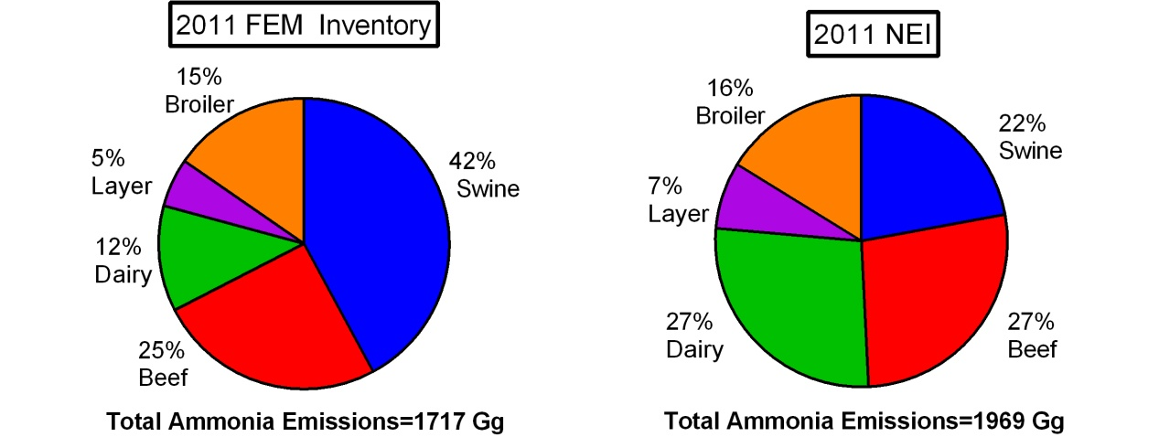
Animal Contributions vs 2011 NEI
Similar magnitude of emissions in 2011 FEM inventory and 2011 NEI
Much greater swine emissions in FEM inventory (swine storage emissions higher in NAEMS compared to prior literature)
Much smaller contribution from dairy

Slide 65
Conclusions, observations, caveats
Framework: process-based model tuned to observed emissions factors
Captures regional and seasonal variability
Unbiased overall compared to EFs used in tuning
FEM captures seasonal cycle and practice differences; limited on daily variability
The general approach: Measurements -> process model -> prediction EFs everywhere
…whereas a more traditional approach skips the middle step and just tries to take the measured EF that most closely matches the situation at hand. In the process-model approach, hopefully, the model learns something important, e.g. about T-dependence, and uses that to interpolate (and extrapolate) to other conditions that don’t exactly match those measured.
First national inventory based on process based modeling was 2011
similar total emissions as NEI 2011
swine ↑ but dairy ↓
stronger seasonal cycle

Slide 66
Conclusions, observations, caveats
EF measurements more useful if they also report “context”
meteorology, pH, manure N, etc.
Manure management / farm practice data is as much of a limiting factor as EF measurements
pH is a very important parameter for governing NH3 emissions
With the current FEM, the Henry’s law constant takes pH into account
Many sensitivity studies show pH to be very important
Challenge for inventory building because there is no national database of manure pH
So, when building the inventory, the model uses a “typical value” for pH.
When we tune or otherwise evaluate the models against specific measurements, we use the actual manure pH value – if it was measured and reported. Frequently, it’s not. When it’s not reported, we’re forced to use a “typical value” again.
This same methodology was used to develop the 2014 NEI v2, the next section will outline how that was done

Slide 67
Extra Slides for Livestock Portion of Course

Slide 68
Submodel Calculations
Each submodel relies on 3 mass balance equations to track changes in:
Manure volume
Increases due to deposits and precipitation
Decreases due to emission and infiltration
Urea concentration
Decreases due to hydrolysis and infiltration
Total ammoniacal nitrogen (TAN) concentration
Increases due to urea breakdown
Decreases due to volatilization and infiltration

Slide 69
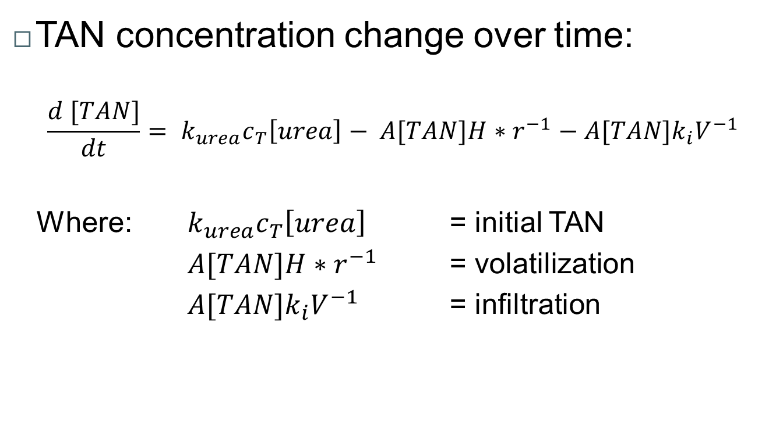
Submodel Mass Balance Equations

Slide 70
National Inventory Contruction (cont.) - Composite EF Diagram
Daily EF _{a,b,c,d1}
x
Fraction _{c,d1}
Daily EF _{a,b,c,d2}
x
Fraction _{c,d2}
Composite EF_{a,b,c}
Daily EF _{a,b,c,dx}
x
Fraction _{c,dx}
Where: a = animal type
b = day
c = county
d = management practice

Slide 71
Regional Manure Management Practices
Used data from most recent USDA National Animal Health Monitoring Surveys (NAHMS)
Informs on type of animal housing, manure storage and manure application methods
Data available by U.S. region

Slide 72
Animal Populations
2012 USDA Animal census
County-level, grown to 2014 levels using available survey data at the time of v1 inventory development
Includes dairy cows, beef cows, feedlot beef cows, swine, layer chicken, and broiler chickens
Data was reviewed for missing parameter data and filled in with reasonable values
Notes:
Data was reviewed for missing parameter data and filled in with reasonable values
Counties without data assumed to have average “missing county” population
(State animal population – animal population attributed to counties)/ number of counties with missing animal population
Counties in states with unknown total population were assumed to have a population of zero
This occurred in 1 state for swine and 4 states for beef feedlots

Slide 73
FEM Results
Found ammonia emissions depend strongly on temperature and nitrogen and less on wind speed and precipitation
Emission factors recommendations from earlier EPA guidelines fall within the range of emissions factors produced by the FEM
Model performance evaluated primarily in terms of R value and mean fractional error between observed and modeled EFs

Slide 74
2014 NEI v2 Livestock Emissions

Slide 75
U.S. Ammonia Emissions Sources, 2014 NEI v2
Figure A – U.S. ammonia emissions sources (3.6 million tons)
Figure B – U.S. livestock ammonia sources (2.1 million tons)
A)
B)

Slide 76
Livestock waste emissions in the NEI
These are the only five SCCs that EPA reports their data into for the 2014 NEI (there are others that SLTs can choose to report into):
EPA estimates NH3 and VOC emissions for these SCCs
Livestock is inventoried in NonPoint (annual/county totals)
SCC | SCC Level 1 | SCC Level 2 | SCC Level 3 | SCC Level 4
2805002000 | Miscellaneous Area Sources | Agriculture Production - Livestock | Beef cattle production composite | Not Elsewhere Classified
2805018000 | Miscellaneous Area Sources | Agriculture Production - Livestock | Dairy cattle composite | Not Elsewhere Classified
2805025000 | Miscellaneous Area Sources | Agriculture Production - Livestock | Swine production composite | Not Elsewhere Classified
2805007100 | Miscellaneous Area Sources | Agriculture Production - Livestock | Poultry production - layers with dry manure management systems | Confinement
2805030004 | Miscellaneous Area Sources | Agriculture Production - Livestock | Poultry Waste Emissions | Broilers

Slide 77
General methods for going to 2014 NEI v2
After reviewing the v1 estimates based on the methods outlined previously, we:
Found errors in allocations of emissions to counties
Had several states ask us to use more up-to-date animal population data
In going to the v2 inventory:
We corrected the county allocation errors
We estimated revised 2014 county-level animal populations using USDA 2014 Survey and 2012 Census data. Then constructed the v2 inventory using EFs from CMU’s v1 model.
We did not alter the FEM model in going from v1 to v2, so used the same 2011 meteorology
We added VOC emissions to this sector

Slide 78
2014 NEI v2 – Animal Population Revisions
Animal population data were obtained primarily from the 2014 USDA National Agricultural Statistics Service (NASS) Quick Stats program
As many counties as possible across the United States
Single farm counties/types not reported (NR) for confidentiality
Not as complete as the USDA Census
USDA 2012 Census used to augment the 2014 Survey for NR
Unclear if NR is 0 or grouped
If 2014 county/type = NR and 2012 reported, 2014 pop = 2012 pop x state 2014pop / 2012 pop
County/types with NR in 2012 and 2014
Diff = 2014 state – Σ 2014 counties
NR counties = Diff / (Number of NR counties)

Slide 79
Details – Animal Populations
Animal Type | Source
Chicken Broilers | The inventory reflects the 2012 state level totals, because no 2014 data is available in the Survey at either the county or state level. The NR county gap fill described in previous slide used as needed.
Chicken Layers | The inventory is based primarily on the 2012 Census. There were 30 states with 2014 state level population data, and the 2012 county level populations for those states were adjusted to reflect the change in population between 2012 and 2014 state level totals.

Slide 80
Details – Animal Populations
Animal Type | Source
Swine | The NEI 2014 v1 inventory had four states with 2014 county level data (MT, NC, ND, OK). These states were not changed for v2. The other 46 states were updated to reflect the 2014 state-level total. The county populations were adjusted to reflect the change in population between 2012 and 2014 state level totals.

Slide 81
Details – Animal Populations
Animal Type | Source
Dairy Cattle | Counts are based on 2014 Survey data where available, and counties with missing data are “gap filled” using the algorithm described earlier.
Beef Cattle | Counts are based on 2014 Survey data where available, and counties with missing data are “gap filled” using the algorithm described earlier.

Slide 82
Details – Population Gap Filling
 | Beef Cattle | Dairy Cattle | Swine | Chicken Layers | Chicken Broilers
Number of counties with gap filling (3,071 counties in database) | 776 (25%) | 973 (32%) | 643 (21%) | 433 (14%) | 621 (20%)
Number of states with no gap filling | 5 | 4 | 9 | 6 | 3

Slide 83
VOC Emissions
Prior to 2014 NEI, VOC emissions had not been estimated by EPA for the livestock waste
Calculated VOC emissions using the ratio of VOC to NH₃ emissions from livestock waste.
Calculated an average VOC/NH₃ ratio of 0.08 using data at the county level where both VOC and NH₃ were reported in 2014 NEI v1 by SLTs (from 3 states, total of about 110 counties)
Applied this ratio to the 2014 NEI v2 NH₃ livestock inventory to develop the county and animal type specific VOC inventory
About 150,000 tons of VOC nationally estimated using this approach

Slide 84
Comparisons between EPA’s estimates and SLT submissions
Animal Type | States Submitting NH₃ Emissions | 2014 State NH₃ (tons/year) | 2014 v2 EPA NH₃ in these States (tons/year)
Beef Cattle | CA, GA, ID, IL | 110,107 | 102,717
Dairy Cattle | GA, ID, IL | 38,400 | 14,116
Swine | CA, GA, ID, IL | 35,154 | 50,227
Chicken Layers | CA, GA, ID | 12,424 | 8,804
Chicken Broilers | CA, GA, ID | 56,240 | 45,559
We used the states’ submissions in the NEI when they were submitted over EPAs
The NEI is thus a combination of EPA data and SLT-submitted data
When a SLT submits emissions, they are not required to submit the accompanying activity data
Reasonably good agreement when aggregated across SLTs (EPA estimates low for dairy cattle and chicken categories)

Slide 85
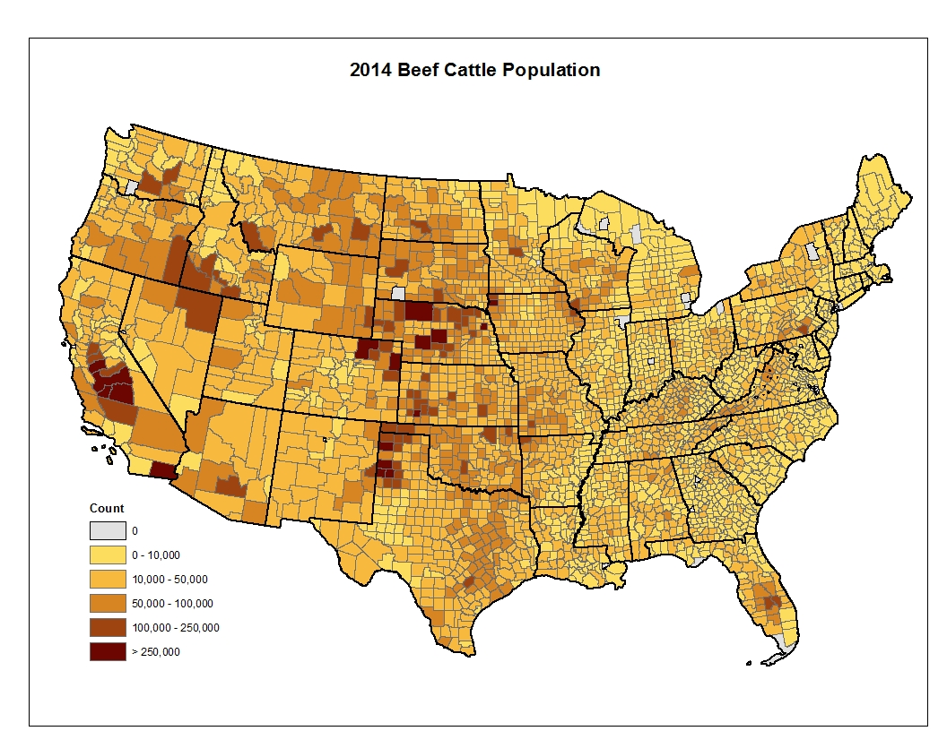
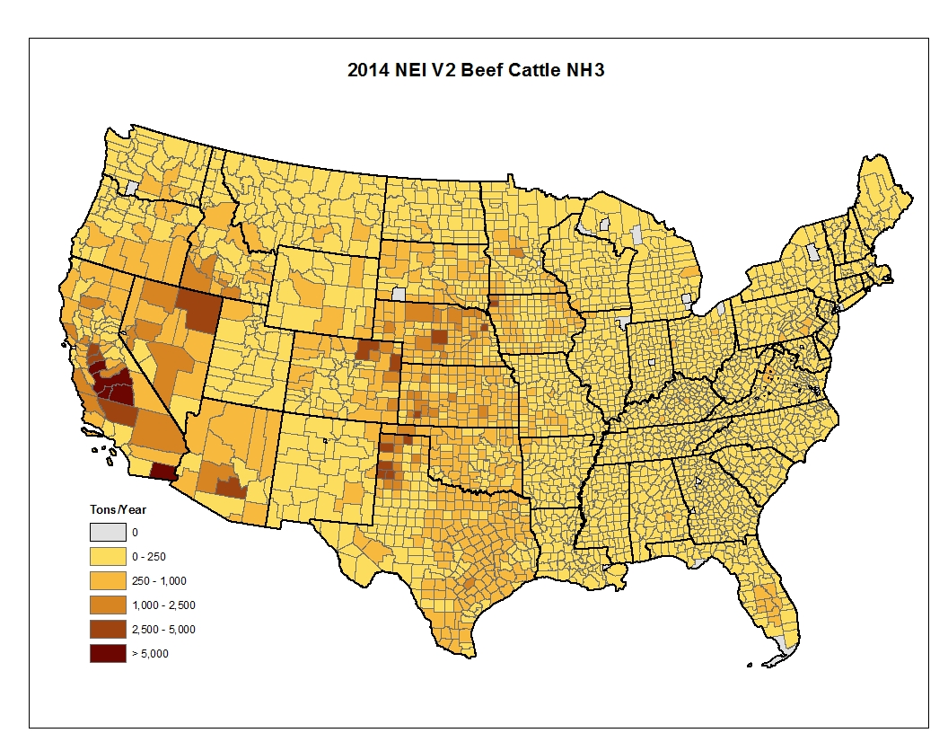
Beef Cattle: Population and NH3 Emissions– 2014 NEI V2

Slide 86
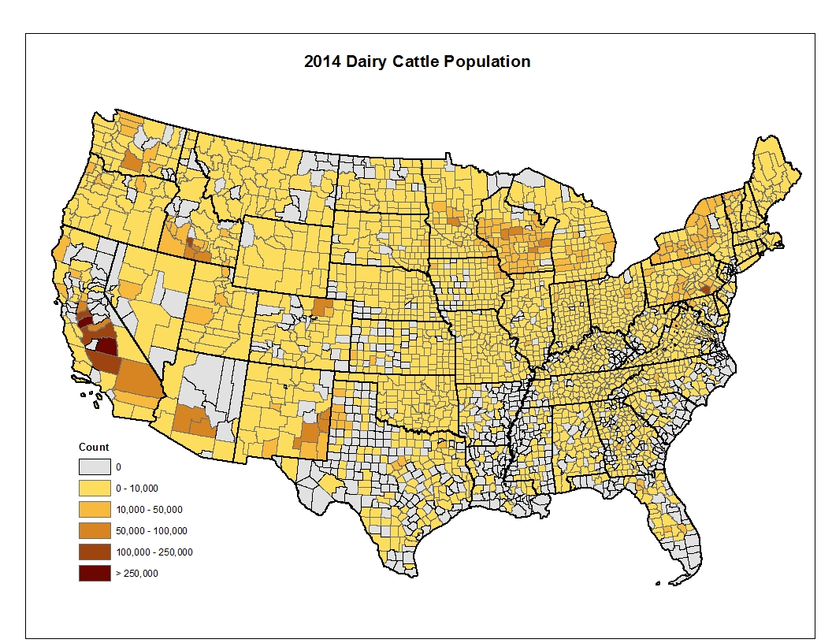
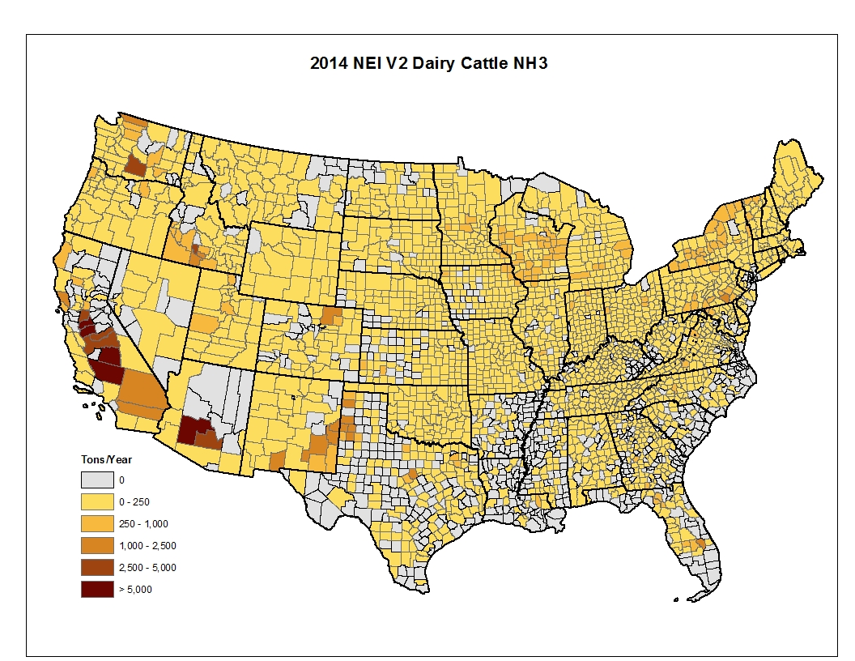
Dairy Cattle: Population and NH3 Emissions– 2014 NEI V2

Slide 87
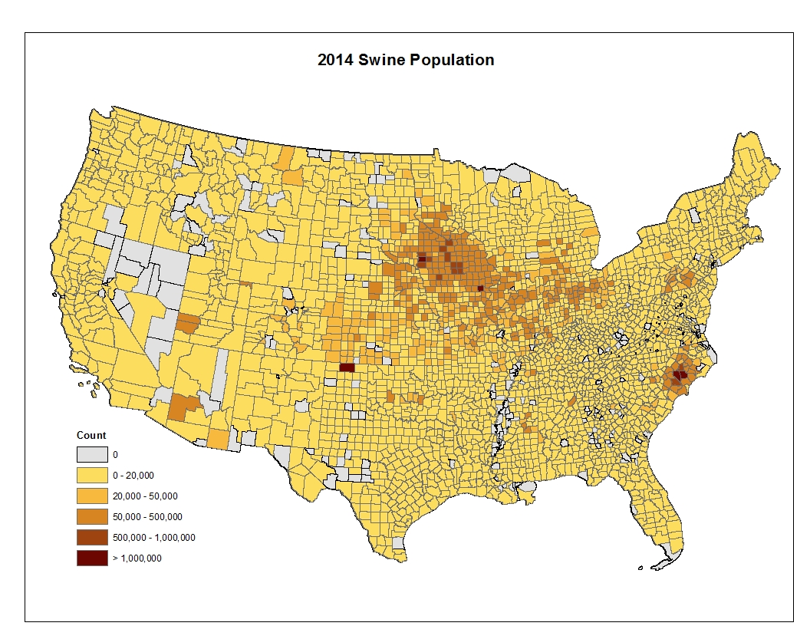
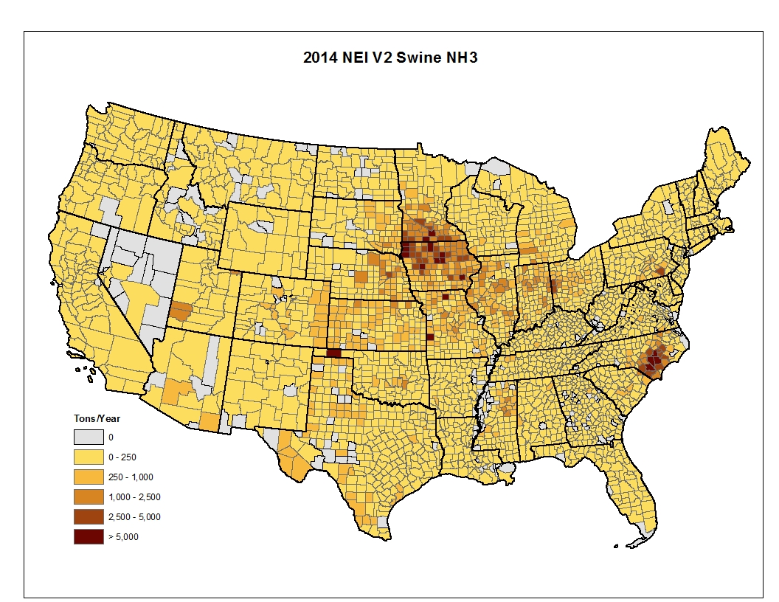
Swine: Population and NH3 Emissions– 2014 NEI V2

Slide 88
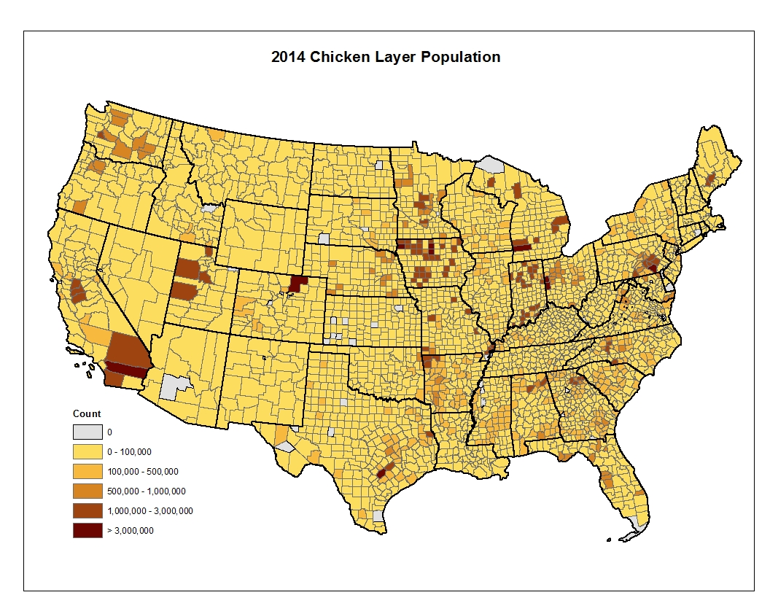
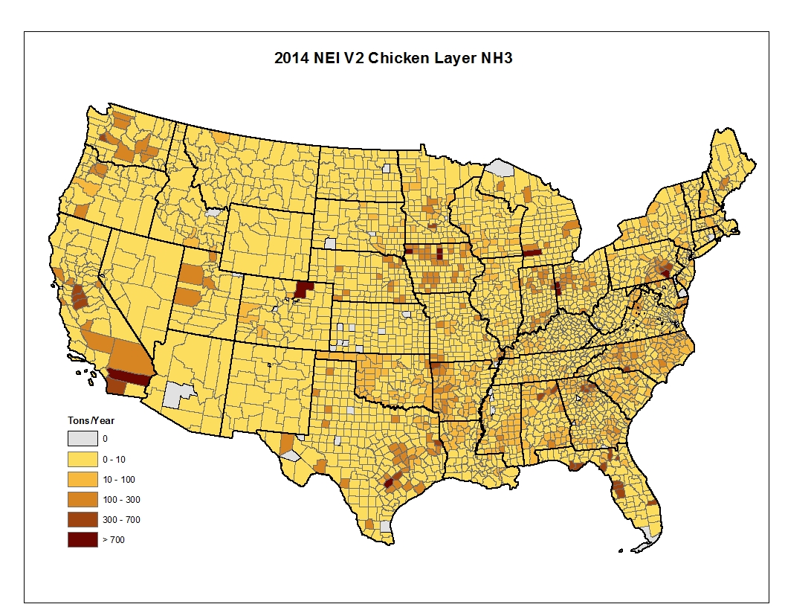
Chicken Layers: Population and NH3 Emissions– 2014 NEI V2

Slide 89
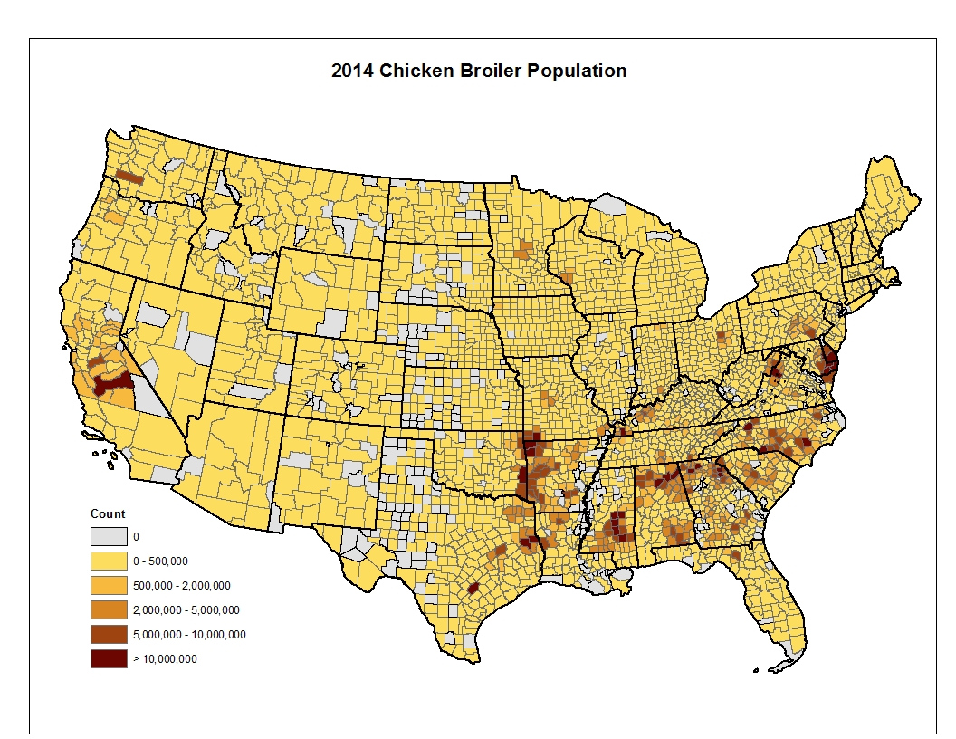
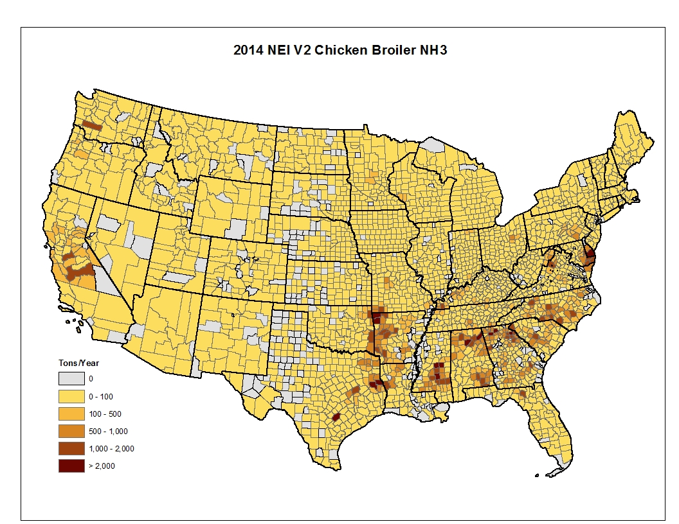
Chicken Broilers: Population and NH3 Emissions– 2014 NEI V2

Slide 90
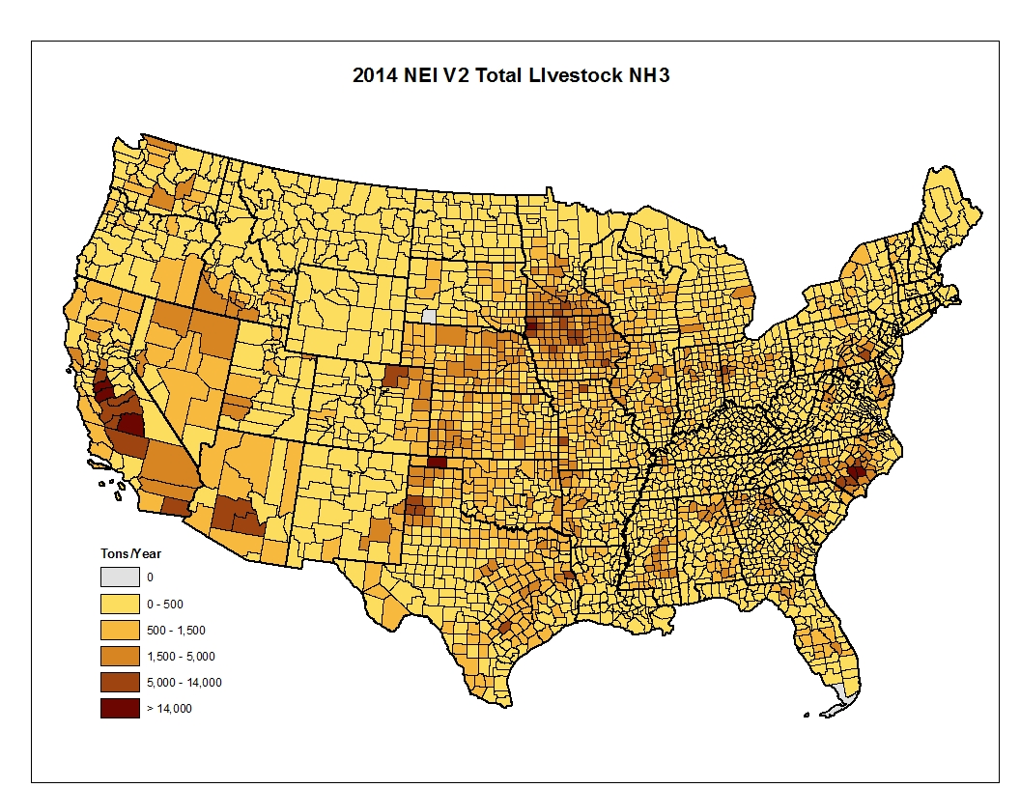
NH3 Emissions from all Livestock – 2014 NEI V2

Slide 91
Looking forward to the 2017 Process
Apply CMU model code, after testing and revising/updating as needed, as possible, for the final inventory (resource dependent)
Consider options for developing a draft inventory sooner using 2017 census data (collected and compiled by OAP) for animal populations and EFs from the 2014 CMU model
Increase collaboration and science for this sector
Rethink and revise methods for VOC estimates (resources permitting)
Include silage VOC emissions on dairy farms as a source (dependent on resources, data availability and methods development)
Develop methods for AK, HI, PR and VI
Ask SLTs to submit animal count data for their states, after review of draft estimates…

Slide 92
Short Break: Be back in 15 minutes please!!

Slide 93
Fertilizer NH3 Emissions in the 2014 NEI

Slide 94
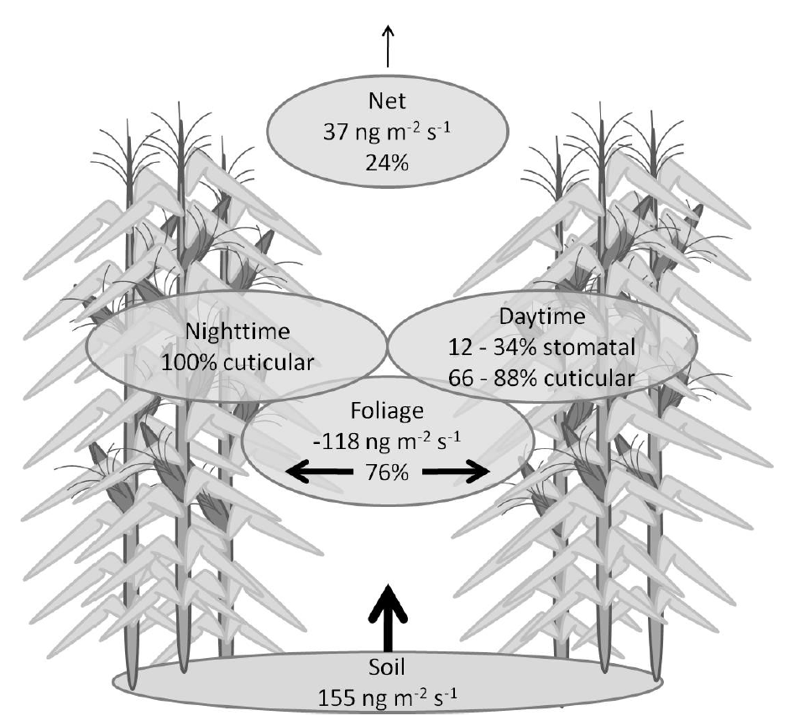
NH₃ Bidirectional Exchange
Measurements show that NH₃ can deposit or emit
Depending on meteorology and soil, plant nitrogen status, and ambient NH₃ concentration
Traditionally emissions and deposition have been modeled separately
NH₃ bidirectional exchange has been incorporated into the Community Multiscale Air Quality (CMAQ) Modeling system
Consistent representation of NH₃ emissions and deposition
Walker et al 2013

Slide 95
NH₃ Fertilizer Emissions
SCC Code 2801700099
EPA was able to leverage work done in an EPA/ORD and USDA Agriculture Research Service (ARS) collaboration
Develop the methodology to run the USDA’s Environmental Policy Integrated Climate (EPIC) field scale model on a continental domain
EPIC output is used by US EPA’s CMAQ model to estimate NH₃ emissions from fertilizer considering bidirectional exchange

Slide 96
Modeling of NH₃ Emissions in CMAQ
Meteorology (WRF)
Agricultural Modeling (EPIC)
Air Quality Modeling (CMAQ)
Diagnostic Emission Estiamtes

Slide 97
Primary Meteorological Factors Affecting Fertilizer Ammonia Emissions
Temperature – temperature, emissions
Higher temperature reduces the soil equilibrium ammonium concentration
Wind speed – wind speed, emissions
Higher wind speed decreases surface resistance
Precipitation – precipitation, emissions
Precipitation dilutes the ammonium available for evasion in the soil
Soil pH – pH, emissions
Higher soil pH favors reduces the soil equilibrium ammonium concentration

Slide 98
USDA’s Environmental Policy Integrated Climate (EPIC) Simulations for CMAQ

Slide 99
USDA EPIC Model
Environmental Policy Integrated Climate (EPIC) Model
Assess the effect of soil erosion on productivity.
Predict the effects of management decisions on:
Soil, water, nutrient, and pesticide movements
Impact on soil loss, water quality, and crop yields for areas with homogeneous soils and management
We have developed an interface to run EPIC for CMAQ applications
Fertilizer Emission Scenario Tool for CMAQ (FEST-C)
Available at https://www.cmascenter.org/fest-c/
Includes EPIC and data needed to run for the contiguous US

Slide 100
EPIC Inputs
Soil hydrological properties, type and pH
USDA National Resources Inventory agricultural soil survey data
Crop area
BELD 4 land use data
Crop Type
2012 census of agriculture survey data
Crop management
USDA Farm Production Regions based on census of agriculture data
Meteorological data
Weather Research and Forecast (WRF) precipitation, wind speed, min and max daily temperature

Slide 101
EPIC Crops Modeled for CMAQ Applications
Fertilizer Emission Scenario Tool for CMAQ (FEST-C)
Interface to run EPIC on the contiguous US domain and formats EPIC output for CMAQ
Includes USDA survey data for farm practices and crops grown
Mapped to CMAQ domain
Set up to models 21 crops
Hay, Alfalfa, Grass, Barley, Beans Edible, Corn Grain, Corn Silage, Cotton, Oats, Peanuts, Potatoes, Rice, Rye, Sorghum Grain, Sorghum Silage, Soybean, Spring Wheat, Winter Wheat, Canola, Beans, Other Crops
Other crops modeled as corn
Crop rotation is modeled
Biogenic nitrogen fixation and mineralization of organic material are modeled

Slide 102
NH₃ in the Nitrogen Cycle
Cooter et al 2012
Processes considered in CMAQ coupled to the USDA Environmental Policy Integrated Climate (EPIC) model

Slide 103
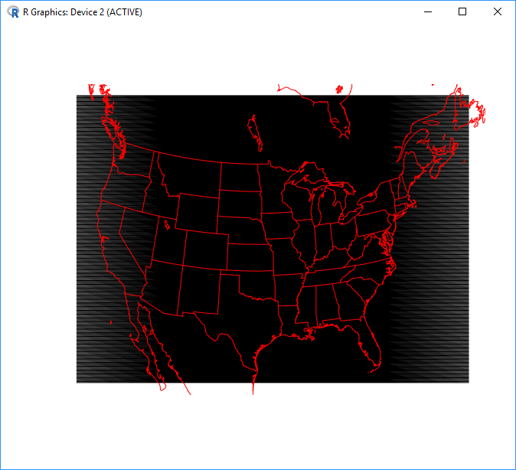
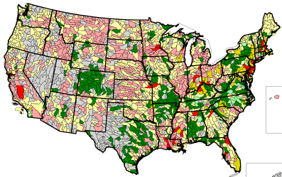
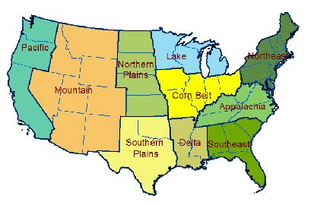
Scale of input data
Model Grid Resolution
Meteorology
Land use
Hydrologic Unit Code 8
Subbasin level soil properties
County (census of agriculture data)
Crop and associated fertilizer types
Cropping system practices (e.g. injected versus broadcast)
Irrigation
USDA Production Regions
Similar cropping methods
Cooter et al 2012

Slide 104
Running EPIC with FEST-C for CMAQ
What input data do I need?
Simulation cell size, domain extent and projection
MCIP formatted meteorological data on same domain as you will run CMAQ
MODIS and NLCD data layers
What data are provided/generated
Land use coverage (location of agricultural land)
Soils (pH, texture, nutrient status)
Agricultural management
What do I get out?
Land use file required for bidirectional CMAQ
Daily agricultural depth of fertilizer application and fertilizer amount
Initial soil chemistry status
Fertilizers application rates and estimated crop yields
Available at https://www.cmascenter.org/fest-c/

Slide 105
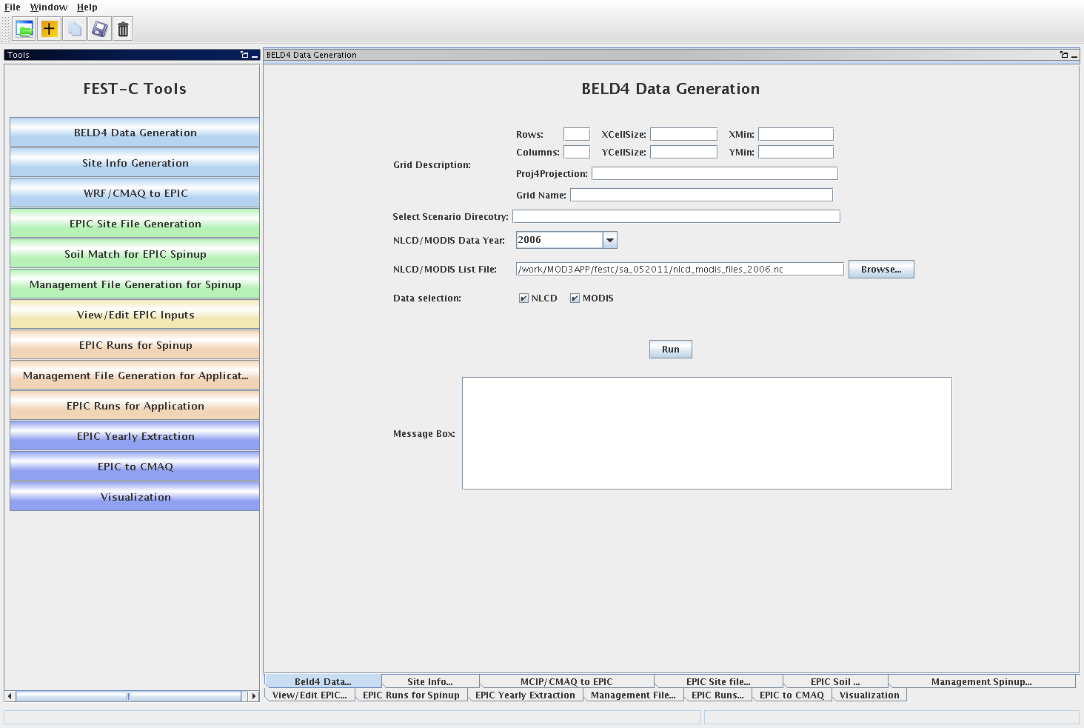
The FEST-C User Interface – facilitates user-generated CMAQ-ready fertilizer input for any gridded domain, grid cell resolution and weather year by creating and submitting executable scripts.

Slide 106
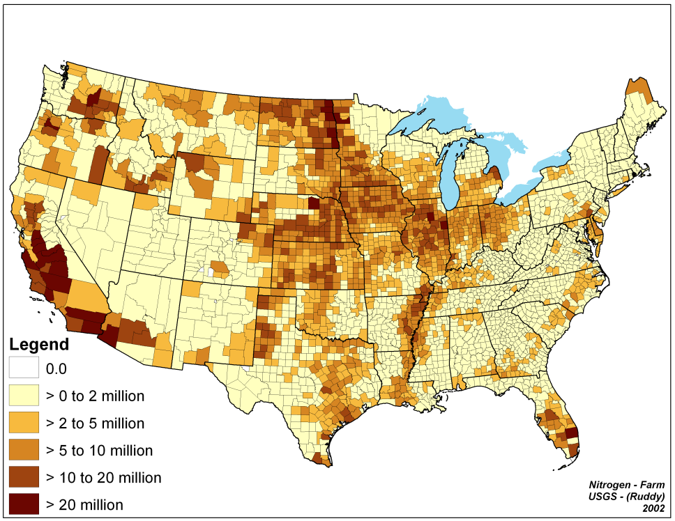
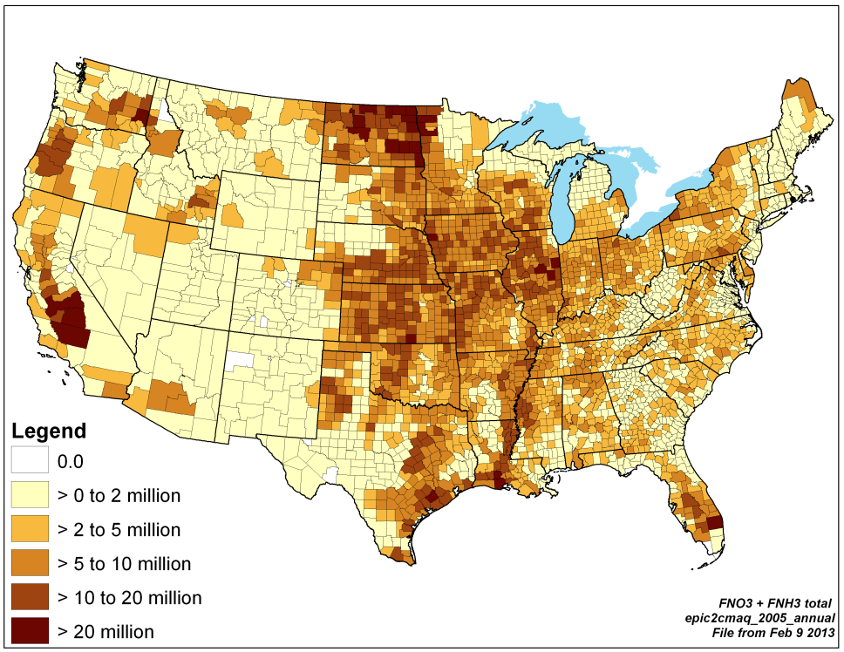
Running EPIC for CMAQ
Fertilizer Sales
EPIC Application
Gronberg and Spahr (2012)
The system does a reasonable job reproducing regional patterns of reported agricultural fertilizer purchases and use

Slide 107
CMAQ Bidirectional NH₃ Simulations

Slide 108
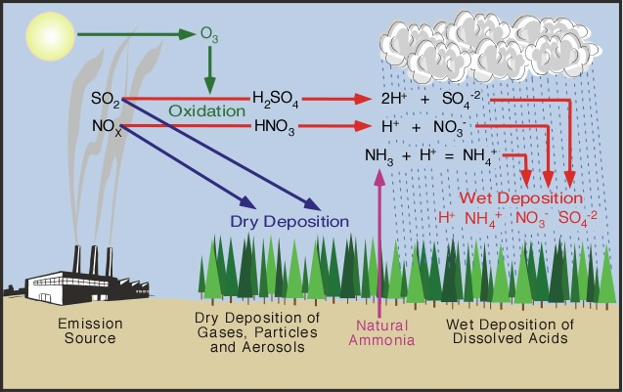
Modeling NH₃ exchange
CMAQ with bidirectional exchange connects the emission and deposition of NH3 from cropping systems to ambient concentrations
Important for emissions and deposition weeks to months following fertilization
Captures the impact that vegetation coverage has on emissions

Slide 109
CMAQ with Bidirectional NH₃ Exchange
Ammonium, pH, and
application method
Modeled
EPIC
Data
Fertilizer Applied?
CMAQ Modeled
Atmospheric NH₃
Yes
Modeled
WRF
Data
Soil Moisture
& Temperature
CMAQ Modeled Soil NH₄
Atm NH₃ > soil NH₃?
Emissions
No
NH₄→NO₃
Yes
Nitrification
Deposition

Slide 110
CMAQ with Bidirectional NH₃ Exchange
Requires setting a few environmental variables
Setting the soil N file, EPIC outputs, and flags to run the model
Currently works only with WRF in a retrospective simulation mode, the Pleim-Xu land surface scheme
CMAQ v5.3 will have options to work with WRF land surface schemes capable of forecasting
Emissions, NH3_Emis in kg ha hour, are output in the CMAQ Dry Deposition file
Currently estimates agricultural and natural emissions
Emissions are removed from the soil pool in the model
Ensures emissions cannot exceed nitrogen input

Slide 111
NEI V2 Fertilizer NH₃ Emissions

Slide 112
2014 NEI V2 estimates
Ran EPIC with updates to fertilizer application to pasture and hay
Reduced application in the Southeast US
Emission estimates from a 2014 CMAQ v5.1 simulation
Tabulated monthly and annual emission estimates
Emissions reduced in Southeast and TX, increases in parts of CA and Upper Midwest
Cooler spring temperatures in 2014 accounted for some emission reductions

Slide 113
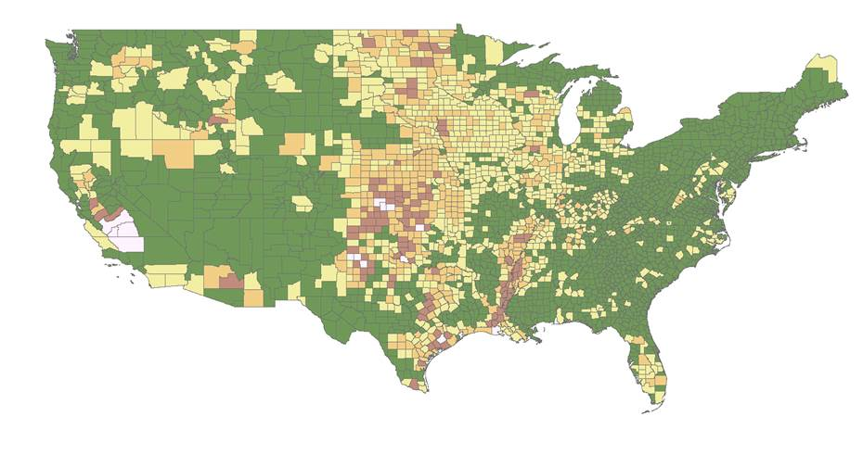
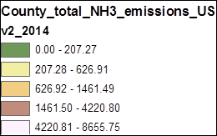
2014 NEI V1 estimates
(Ton per County)

Slide 114
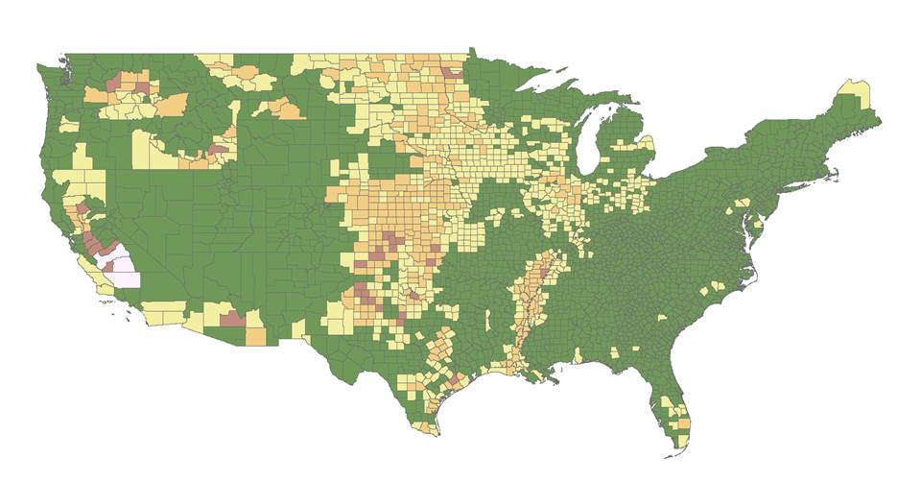
2014 NEI V2 estimates
(Ton per County)

Slide 115
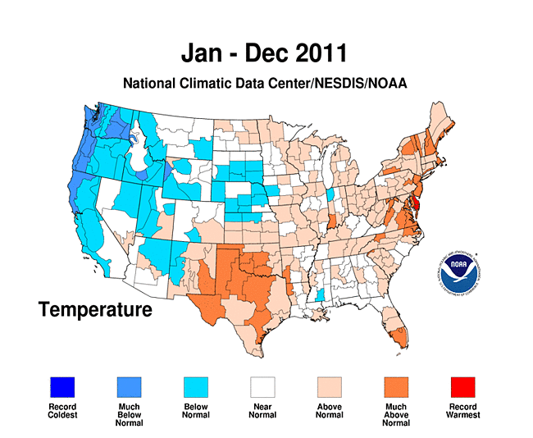
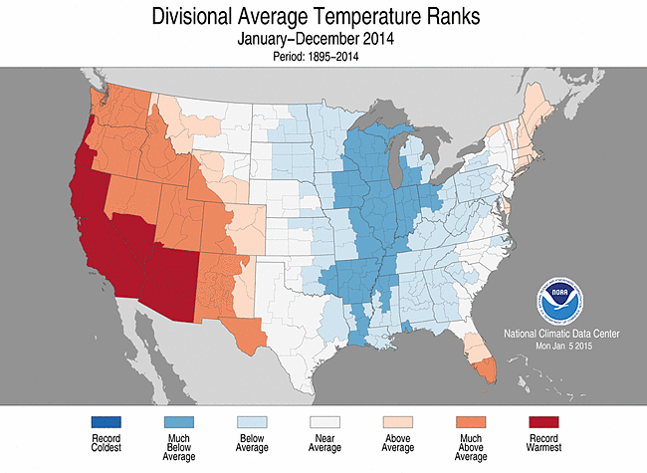
2011 versus 2014 Meteorology
Differences in emissions are due to meteorological dependence on emission factor and improvements to EPIC pasture and hay management

Slide 116
Looking forward to 2017 NEI
Similar as 2014 NEIv2
NH₃ emission model is being made more consistent with representation of fluxes in the Comprehensive Air Quality Model with Extensions (CAMx) and for other pollutant species in CMAQ
Higher emissions in some agricultural regions due to more explicit modeling of agriculture and updated algorithms
Additional evaluation of technique against observations to give more credibility to 2017 NEI, if successful
Agricultural and non-agricultural field observations
Biogenic and agricultural NH₃ emissions output explicitly
Updating FEST-C to use 2016 Census of agriculture activity data to better represent current farm management practices

Slide 117
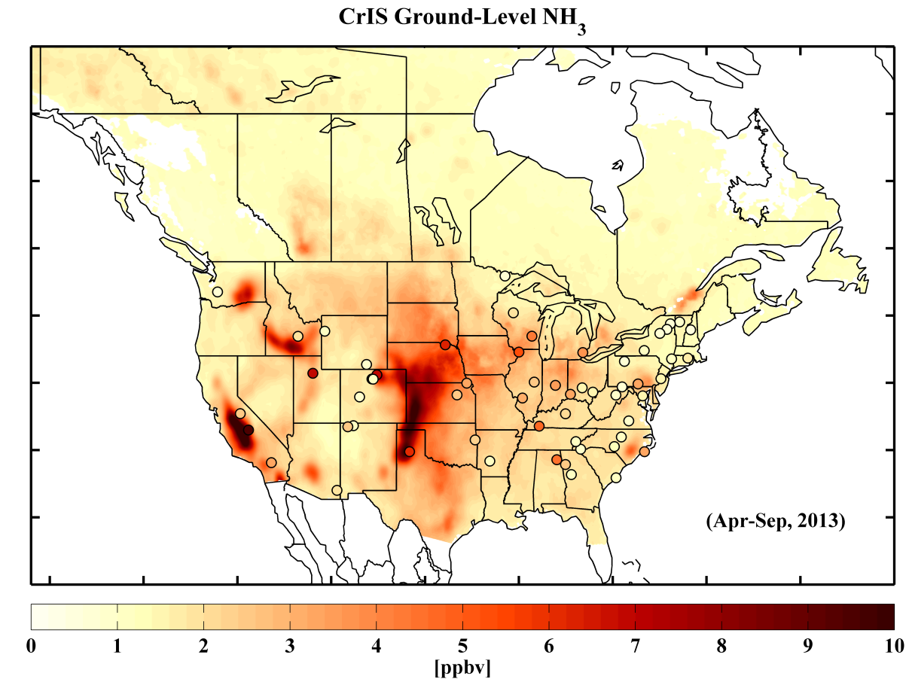
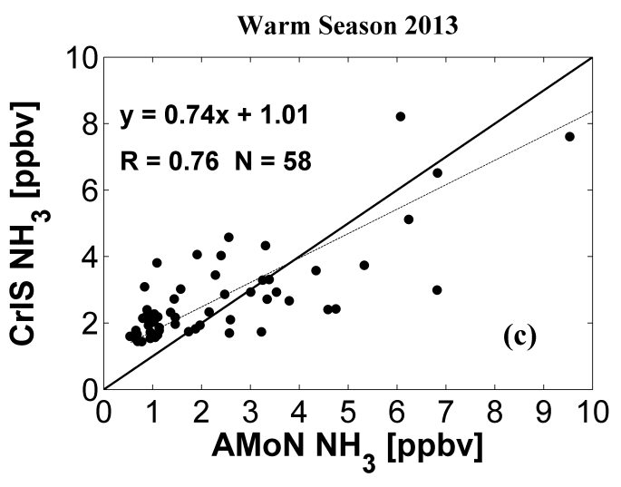
Data that could help 2017 NEI development
EPIC activity data
Fertilization rates, types and application depths, planting and harvesting dates, crop types
Cross Infrared Sounder (CrIS) NH₃ retrieval
Daily satellite NH₃ data, ~1 ppb detection limit, 15-8 km grid resolution
Retrieval algorithm delivered to NASA
This data will help in identifying source areas and seasonality of NH₃ emissions
Spatial and temporal allocation of animal sectors
Identify areas where more detail may be necessary to improve fertilizer emissions
What you can do to help
Crop activity data, farm nutrient management
Shailesh Kharol et al. In prep. 2018

Slide 118
Appendix

Slide 119
References
Walker, J.T., Jones, M.R., Bash, J.O., Myles, L., Luke, W., Meyers, T.P., Schwede, D., Herrick, J., Nemitz, E., Robarge, W., 2013, Processes of ammonia air-surface exchange in a fertilized Zea Mays canopy, Biogeosciences, 10, 981-998
Cooter, E.J., Bash, J.O., Benson V., Ran, L.-M., 2012, Linking agricultural management and air-quality models for regional to national-scale nitrogen deposition assessments, Biogeosciences, 9, 4023-4035
Bash, J.O., Cooter, E.J., Dennis. R.W., Walker, J.T., Pleim. J.E., 2013, Evaluation of a regional air-quality model with bi-directional NH₃ exchange coupled to an agro-ecosystem model, Biogeosciences, 10, 1635-1645
Pleim, J.E., Bash, J.O., Walker, J.T., Cooter, E.J., 2013, Development and testing of an ammonia bi-directional flux model for air-quality models, J. Geophys. Res. 118, doi:10.1002/jgrd.50262

Slide 120
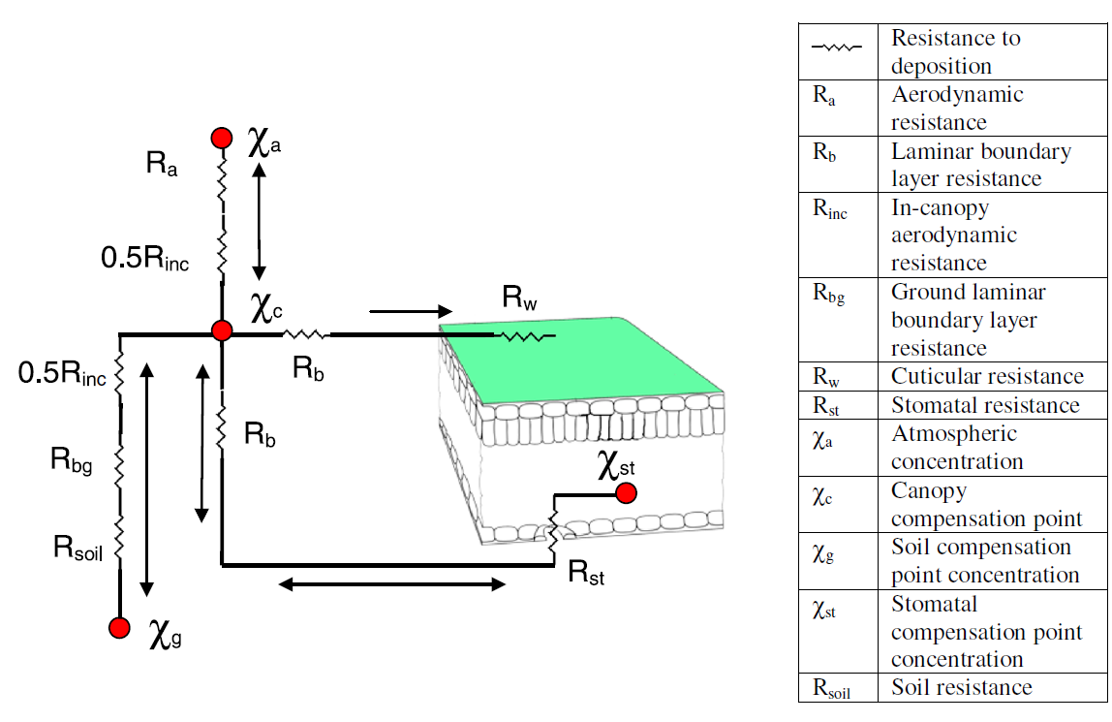




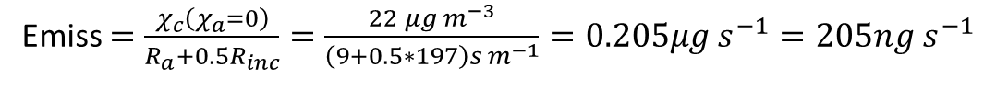
Modeled NH₃ exchange example
$F_{t}=\frac{\left(χ_{c}−χ_{a}\right)}{R_{a}+0.5R_{inc}}$=$F_{g}$+$F_{st}$+$F_{cut}$
9 s m⁻¹
7 s m⁻¹
$$F_{g}=\frac{\left(χ_{g}−χ_{c}\right)}{0.5R_{inc}+R_{gb}+R_{soil}}$$
197 s m⁻¹
182 s m⁻¹
$$F_{st}=\frac{\left(χ_{s}−χ_{c}\right)}{R_{b}+R_{st}}$$
1200 s m⁻¹
48 s m⁻¹
6 µg m⁻³
24 µg m⁻³
$$F_{cut}=\frac{χ_{c}}{R_{b}+R_{w}}$$
422 µg m⁻³
2 µg m⁻³
400 s m⁻¹
From Pleim et al. 2013 with observed data from Walker et al. 2013
$F_{t}=\frac{\left(χ_{c}−χ_{a}\right)}{R_{a}+0.5R_{inc}}$ = $\frac{\left(24−6\right)μg m^{−3}}{\left(9+0.5∗197\right)s{ m}^{−1}}=0.167μg s^{−1}=167ng s^{−1}$
From Bash et al. 2013 to estimate just the emission component
Emiss $=\frac{χ_{c}\left(χ_{a}=0\right)}{R_{a}+0.5R_{inc}}=\frac{22 μg m^{−3}}{\left(9+0.5∗197\right)s{ m}^{−1}}=0.205μg s^{−1}=205ng s^{−1}$

Slide 121
NEI V1 Fertilizer NH₃ Emissions

Slide 122
2014 NEI V1 estimates
Data available at the time
Recent 2011 simulation with bidirectional exchange
2014 and 2011 EPIC simulations
Estimated monthly emission factors from the latest 2011 CMAQ simulation and applied to 2014 EPIC output
Annual fertilizer estimates were similar
Emission factors estimated are a function of meteorology
County level emissions include biogenic and fertilizer NH₃

Slide 123
2014 NEI V1 estimates

