Slide 1
Help us Improve!
You will receive an email with a link to a survey to review the course(s) you attend at the Emissions Inventory Training Workshop.
Please take a few moments to let us know about your experience this week.
We welcome your feedback!

Slide 2
TRI Training
for Emission Inventory Specialists
Instructors: Steve Witkin
Velu Senthil
USEPA
Office of Chemical Safety and Pollution Prevention
Toxics Release Inventory Program
Madeleine Strum, EPA OAQPS

Slide 3
Agenda for Today TRI Training
TRI Overview
  TRI 101 enhanced with implied and unstated information
Data Quality
Combined Air Emissions Reporting (CAER) for
TRI / NEI / SLT
Break
Data Access Overview
Data Access Examples
Q & A
Slides with gold star and bar contain supplemental information

Slide 4
TRI Overview

Slide 5

Why was the Toxics Release Inventory created?
Bhopal, India December 1984
Methyl isocyanate gas released at a Union Carbide chemical plant
Thousands died the first night
Thousands more have died due to long-term health effects
Survivors continue to suffer with permanent disabilities
Institute, West Virginia August 1985
Chemical release at a similar facility in the U.S.
Over 100 people hospitalized
Bhopal memorial for those killed and disabled by the 1984 toxic gas release
Increased concern in the U.S. about chemical accident preparedness and availability of information on toxic chemical releases from industrial facilities
5

Slide 6
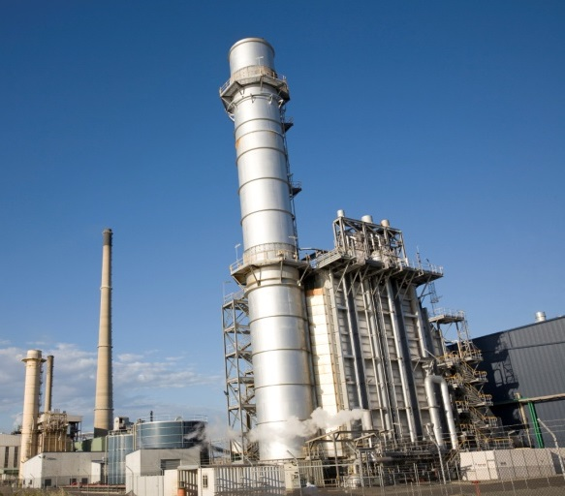
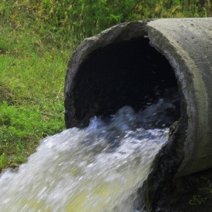
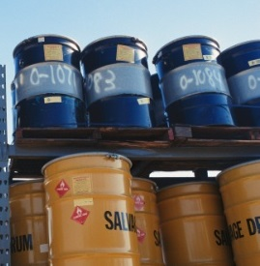


What is the Toxics Release Inventory (TRI)?
Reporting program tracking the waste management of certain toxic chemicals that pose a threat to human health and the environment.
Facilities to States / Tribes and to EPA
TRI includes information on:
And much more!
Releases
Waste
transfers
Recycling
Pollution prevention
6

Slide 7


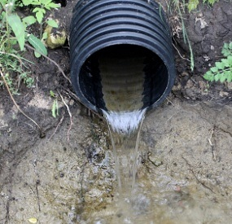
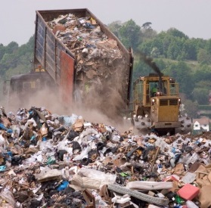
What is a “release”?
A "release" refers to different ways that toxic chemicals from industrial facilities enter the:
  Air Water Land
The likelihood of residents coming into contact with toxic chemicals depends on the type of release and other factors
For more information, see “Factors to Consider When Using TRI Data” at: https://www.epa.gov/toxics-release-inventory-tri-program/factors-consider-when-using-toxics-release-inventory-data
7

Slide 8
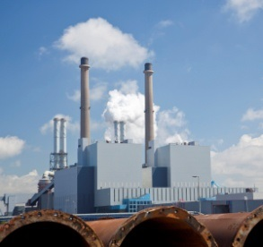



Which facilities must report to TRI?
Facility must be in a TRI-covered industry sector or category, including:
Facility must have the equivalent of at least 10 full-time employees
Facility must manufacture, process or use more than a certain amount of a TRI toxic chemical per year
Manufacturing
Coal/Oil electricity generation
Certain Mining Facilities
Hazardous Waste Management
Federal Facilities

Slide 9
TRI-covered industries
Identified by NAICS
  212 Mining
  221 Utilities
  31 - 33 Manufacturing
  All Other Miscellaneous Manufacturing (includes 1119, 1131, 2111, 4883, 5417, 8114)
  424 Merchant Wholesalers, Non-durable Goods
  425 Wholesale Electronic Markets and Agents Brokers
  511, 512, 519 Publishing
  562 Hazardous Waste
  Federal Facilities
Exceptions / conditions exist across all industries !
Full list available from most secondary web pages off of www.epa.gov/tri, in left hand side bar is a link to “Covered Industries

Slide 10
Industries NOT covered Under TRI
Partial list of industries who do not report to TRI
Oil & Gas Extraction (NAICS 211xxx)
Other Services (NAICS 81xxxx)
example - Dry Cleaner 812320
Retail Trades (NAICS 44xxxx)
example - Gas Stations 447190
Most Wholesale Trades (NAICS 42xxxx)
except Chemical 424690
Bulk Petroleum Stations and Terminals 424710
Transportation (NAICS 48xxxx)
  Airports
  Rail
  Marine (w/1 niche exception)

Slide 11
Good to Know
The facility’s NAICS are based on the facility’s primary economic activities, which can change from year to year.
Example – Soy bean production and Biofuel production
TRI now follows the Census updates cycle of 5 years.
Awkward situation where the same facility performing the same operations may report under a different NAICS. (typically only at the 6 digit level)
TRI facility attributes (including NAICS and Name) are based on the most recent TRI submission from the facility.

Slide 12
Ten full-time employees equivalents
20,000 Total employments hours per year
Includes paid holidays, vacations and sick leave
Includes full time, part time and contract staff

Slide 13
TRI Listed Chemical
692 Chemicals and chemical categories
  595 individually-listed chemicals and
  32 chemical categories
    Five categories containing 70 specifically-listed chemicals).
  13 chemical / chemical categories have qualifiers
Full list available from most secondary web pages off of www.epa.gov/tri, in left hand side

Slide 14
Chemical / chemical categories with qualifiers
Qualifiers based on form
  Aluminum 7429-90-5
  Aluminum oxide 1344-28-1
  Ammonia 7664-41-7
  Asbestos 1332-21-4
  Hydrochloric acid 7647-01-0
  Nitrate compounds NA
  Phosphorus 7723-14-0
  Sulfuric acid 7664-93-9
  Vanadium 7440-62-2
  Zinc 7440-66-6
Qualifiers based on activity
  Dioxin and dioxin-like compounds
  Isopropyl alcohol 67-63-0
  Saccharin 81-07-2

Slide 15
Chemical Groups
Most are not part of TRI reporting regulations
Groups created to support user needs
  PBT (includes 21 chemical or chemical compound)
  OSHA Carcinogens
  HAP
  Metal and metal Compounds
  CERCLA Hazardous Substances

Slide 16
Persistent Bioaccumulative, and Toxic (PBT) Chemical Group
ALDRIN METHOXYCHLOR
BENZO(G,H,I)PERYLENE OCTACHLOROSTYRENE
CHLORDANE PENDIMETHALIN
DIOXIN AND DIOXIN-LIKE COMPOUNDS PENTACHLOROBENZENE
HEPTACHLOR POLYCHLORINATED BIPHENYLS
HEXACHLOROBENZENE POLYCYCLIC AROMATIC COMPOUNDS
ISODRIN TETRABROMOBISPHENOL A
LEAD TOXAPHENE
LEAD COMPOUNDS TRIFLURALIN
MERCURY
MERCURY COMPOUNDS
HEXABROMOCYCLODODECANE (HBCD) Category- Added starting with reporting year 2017

Slide 17
Chemical Activity Threshold
(This determines if facility must report. It is unrelated to quantities which must be reported)
For toxic chemicals that are NOT PBT chemicals the threshold amounts are:
  25,000 pounds for manufacture or
  25,000 pounds for process or
  10,000 pounds for otherwise use
PBT thresholds do not vary by activity, but do vary by specific chemical
  100 lbs, 10 lbs, 0.1 grams (Dioxins)

Slide 18



What information do facilities report to TRI?
On-site releases of TRI chemicals to:
  Air
  Water
  Land
Transfers of chemical waste to off-site locations
Other waste management:
  Recycling
  Treatment
  Energy Recovery
Pollution prevention activities (www.epa.gov/tri/p2)
18

Slide 19
What information do facilities report to TRI?
Quantity of release – Available in all tools
Media released to - Available in all tools
Method of Estimation – only available in EZ or Customized queries, or from reporting forms (available in most tools)
Method of Treatment – only available in EZ or Customized queries, or from reporting forms (available in most tools)
19

Slide 20
What information do facilities report to TRI?
42 U.S.C., Chapter 16, Section 11023 (g)(2)
Use of available data
In order to provide the information required under this section, the owner or operator of a facility may use readily available data (including monitoring data) collected pursuant to other provisions of law, or, where such data are not readily available, reasonable estimates of the amounts involved. Nothing in this section requires the monitoring or measurement of the quantities, concentration, or frequency of any toxic chemical released into the environment beyond that monitoring and measurement required under other provisions of law or regulation. In order to assure consistency, the Administrator shall require that data be expressed in common units.
https://www.gpo.gov/fdsys/pkg/USCODE-2011-title42/html/USCODE-2011-title42-chap116.htm
20

Slide 21
Considerations When Using TRI
TRI doesn't cover all chemicals or facilities
Data reflect annual totals.
Quantities reflect chemicals released into air, water, and land and managed through recycling, energy recovery, treatment and disposal
Toxicity level varies among the chemicals on the TRI list
TRI doesn't include information about public exposure to chemicals
TRI facility operations and releases are regulated under other EPA programs with requirements designed to limit human and environmental harm
For more information, see “Factors to Consider When Using TRI Data” at: https://www.epa.gov/toxics-release-inventory-tri-program/factors-consider-when-using-toxics-release-inventory-data

Slide 22
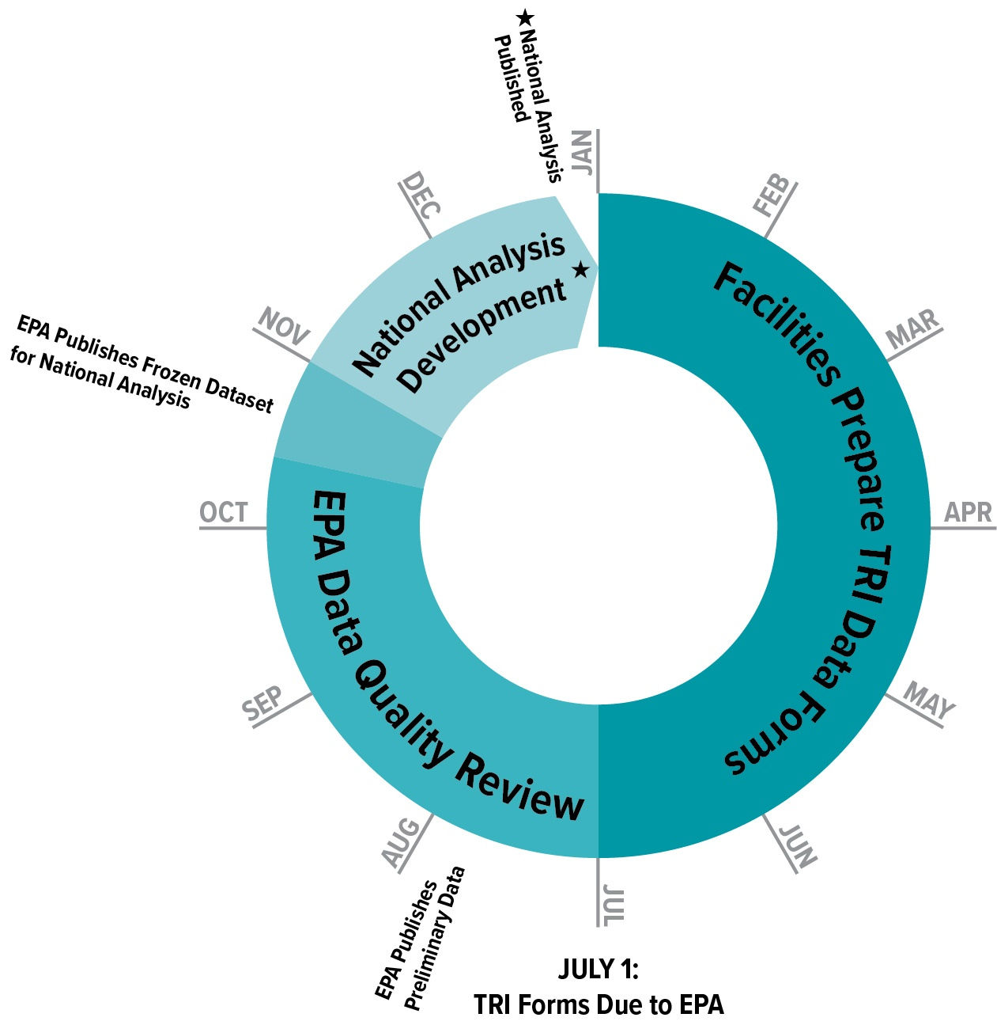
Annual TRI Data Cycle
TRI forms due every July 1 for the previous year’s data
Preliminary dataset available in July
Ongoing data quality checks and compliance assistance
TRI National Analysis (EPA’s annual TRI report) is published in January
Note that previous years’ data are retained and periodically “refreshed”
22

Slide 23
TRI Datasets
Preliminary Dataset
  First release in July
  Only in Envirofacts and downloadable data files
  Dataset ~ 95% complete in July
  Dataset updated several times during summer and fall
National Analysis Data Set
  Typically releases in October
  Complete dataset
‘Spring’ Update
  Typically released in March
  Incorporates any revisions since NA dataset
23

Slide 24
Recent TRI Developments
1-Bromopropane
  First year of data was RY 2016
Hexabromocyclododecane (HBCD) category
  First year of data will be RY 2017
Natural gas processing plants
  Proposed rule currently listed as inactive in the Unified Agenda

Slide 25

Contact Information
Steve Witkin
  witkin.steve@epa.gov
  202-566-0638
Velu Senthil
  sinthil.velu@epa.gov
  202-566-0749
tri.help@epa.gov

Slide 26
Resources
Toxics Release Inventory Program: http://epa.gov/tri/
Using TRI Data and Tools: http://www.epa.gov/tri/tridata/index.html
TRI-Listed Chemicals Home Page:
  2016 TRI Chemical List (pdf)
  2016 TRI Chemical List (Excel)
  2017 TRI Chemical List (Excel)
TRI Industry List
TRI GuideME – Searchable TRI guidance document, Q & As, and Reporting Forms and Instructions (RFI)

Slide 27
Help us Improve!
You will receive an email with a link to a survey to review the course(s) you attend at the Emissions Inventory Training Workshop.
Please take a few moments to let us know about your experience this week.
We welcome your feedback!

