Slide 1

Applying Bioinformatics to Chemical Risk Assessment: Assays, Databases, Models
Richard Judson
U.S. EPA, National Center for Computational Toxicology
Office of Research and Development
3rd Danish Bioinformatics Conference
24 August2017
The views expressed in this presentation are those of the author and do not necessarily reflect the views or policies of the U.S. EPA

Slide 2
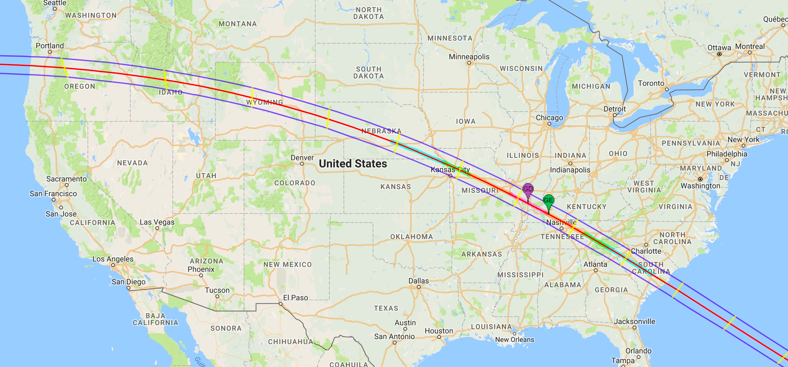
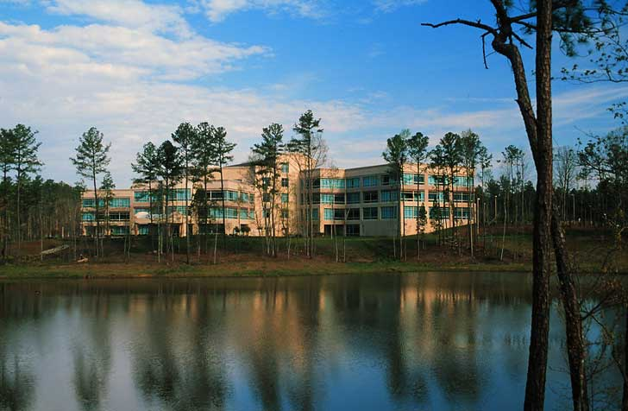
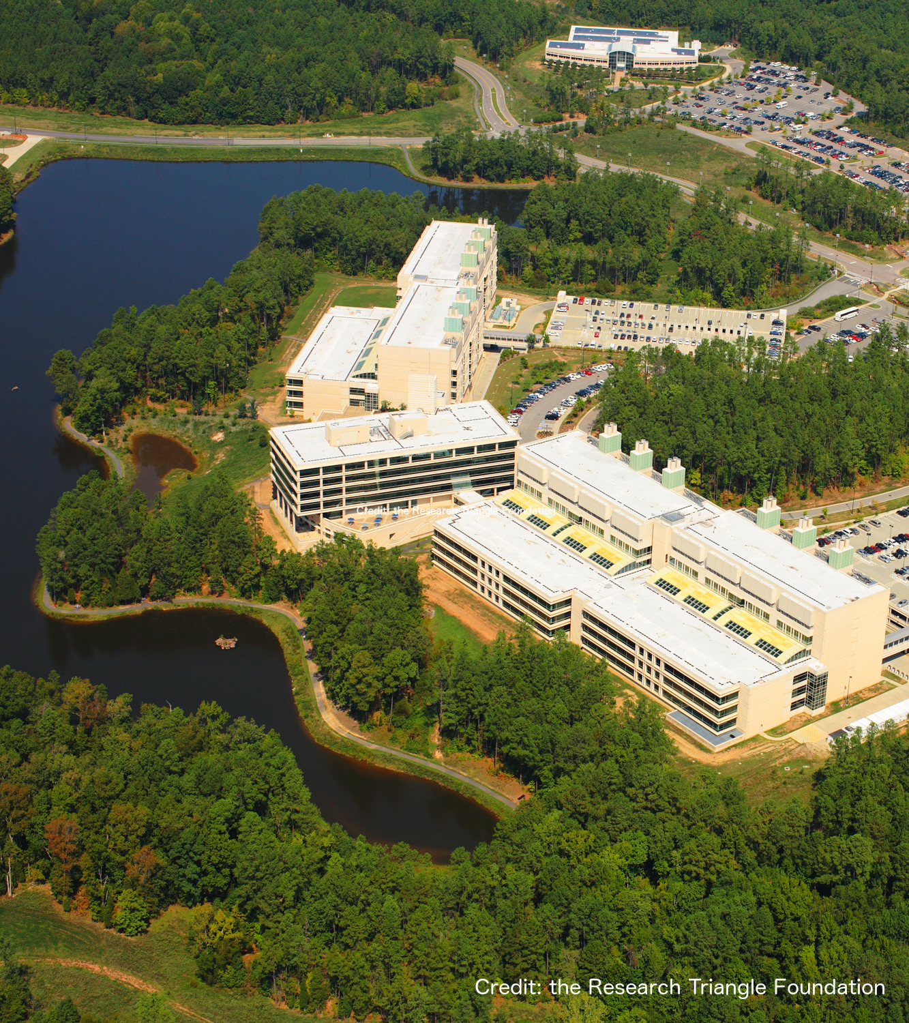
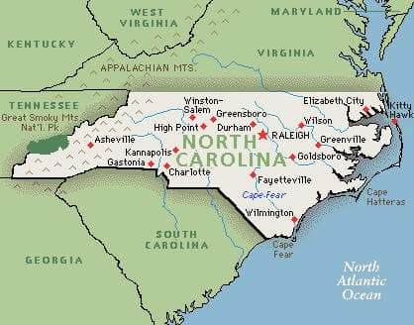
National Center for Computational Toxicology
National Center for Computational Toxicology established in 2005 to integrate:
High-throughput and high-content technologies
Modeling and data mining
Modern molecular biology
Computational biology and chemistry
Currently staffed by ~60 employees
PIs, Postdocs, grad students, support staff
EPA’s Office of R&D

Slide 3
Bioinformatics: From Society to Sequences
Society puts T tons of chemical X into the environment
Person P is exposed to Y amount
Can we predict T, Y?
Can we predict the effect on P at the level of molecules, cells, tissues, organs?
Need to model biology that is multiscale, complex, non-linear
Multiple and often unknown sources of:
Noise
Variation
Goal: use data, models, algorithms to make predictions
Predictions are statistical, probabilistic

Slide 4
How far can we go with modeling biology?
Biology and computer science (e.g. bioinformatics) tell us that we are just algorithms embedded in flesh, soon to be replaced by silicon and metal.
We will worship Information and our hearts will belong to Data
Paraphrase of Steven Shapin, on the coming cyborg future
We’re all just cyborgs, random clanking assemblages inserted in circuits way beyond our understanding
Jenny Turner, commenting on Steven Shapin

Slide 5
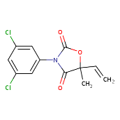
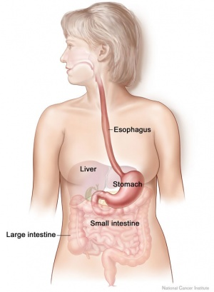
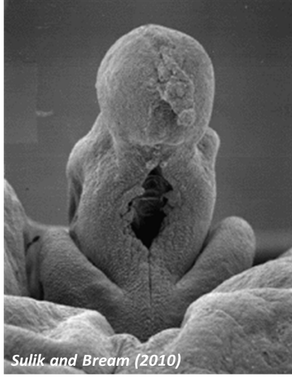
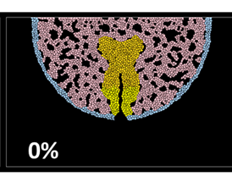
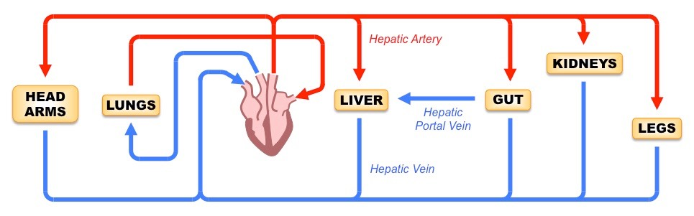
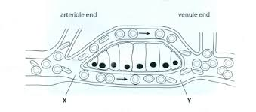
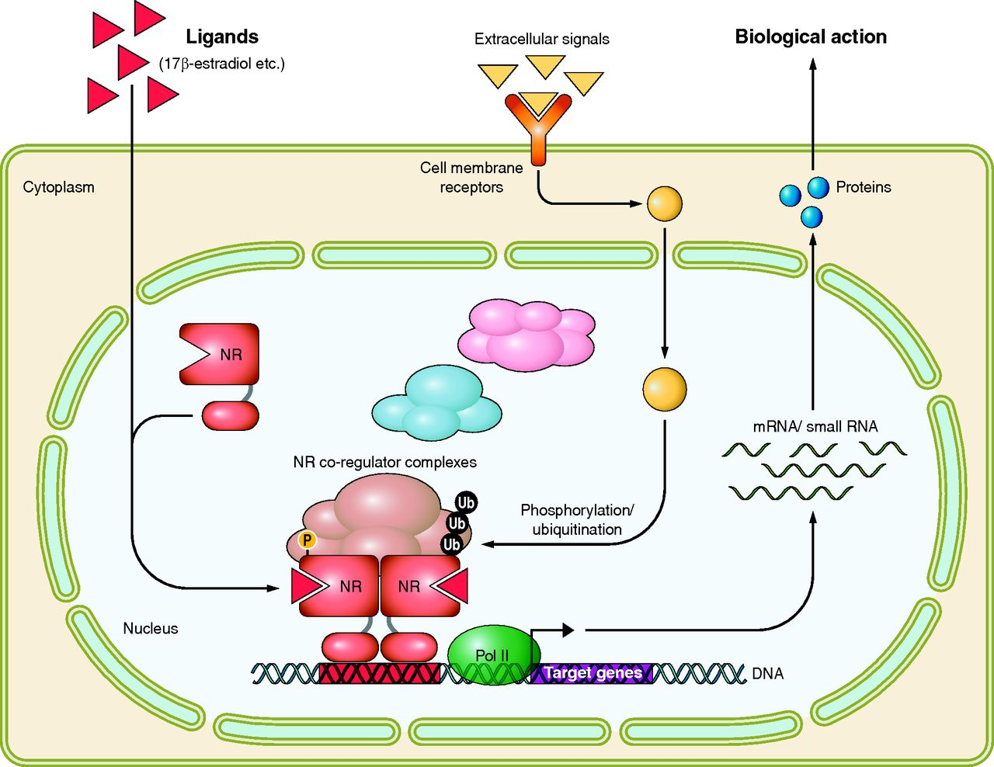
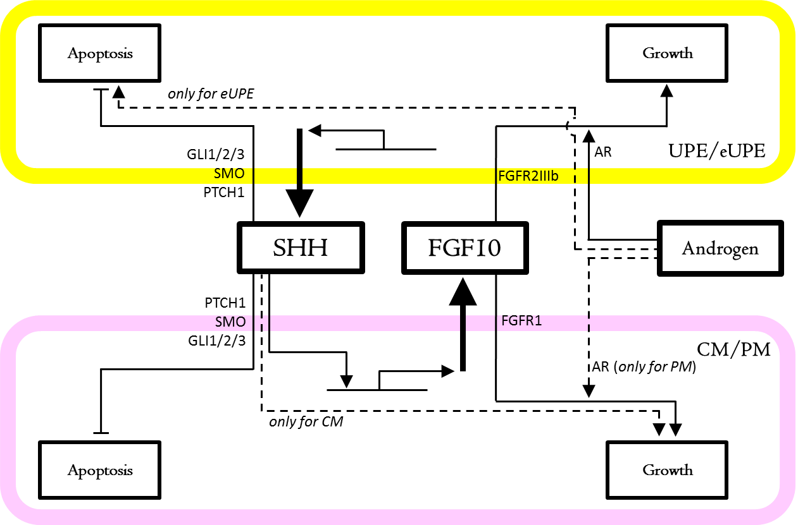
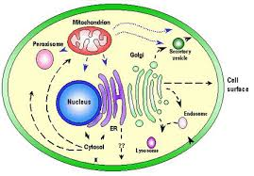
Multiscale
Chemical
Mouth
GI Tract
Blood
Liver
Tissues
Cells
Proteins/DNA
Molecular Circuits
Cells
Tissue
Organ
Organism

Slide 6
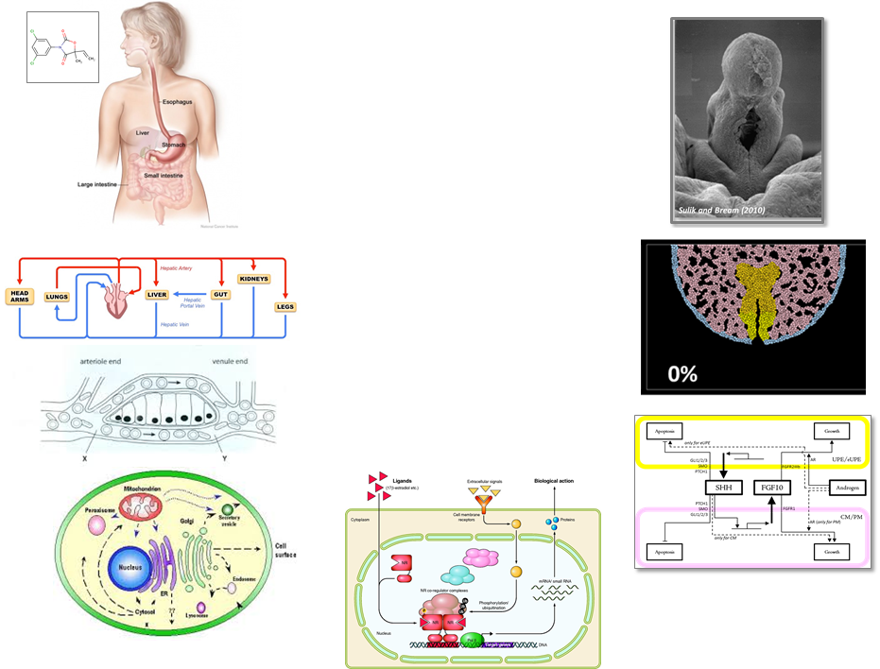

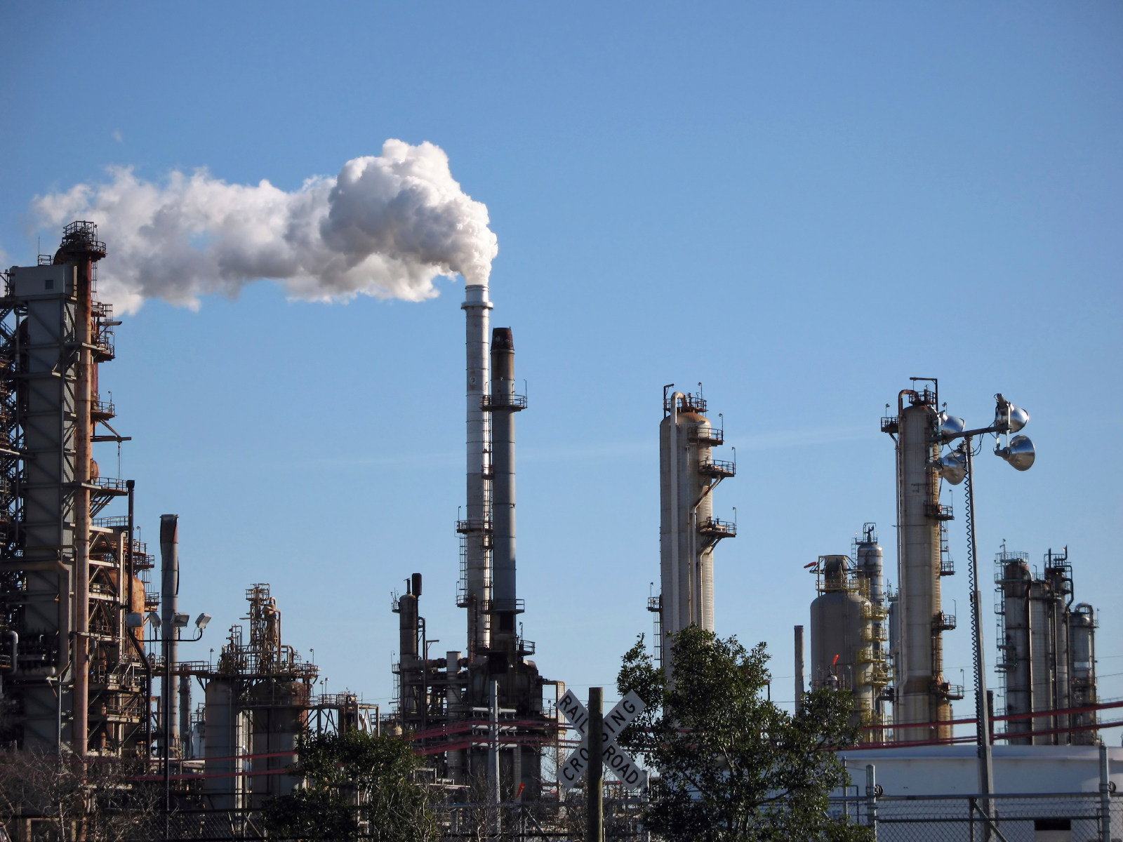

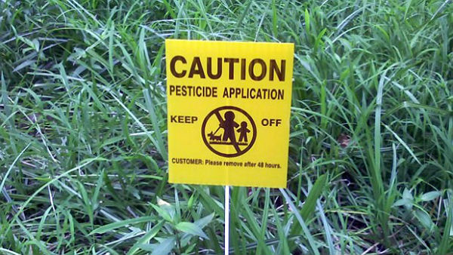
Risk-based Approach Hazard + Exposure (+ uncertainty)
mg/kg BW/day
Kinetics
Dynamics
Hazard:
Kinetics
+
Dynamics
Exposure
Low
Priority
Medium
Priority
High
Priority

Slide 7
Computational Toxicology
Identify biological pathways of toxicity (AOPs)
Develop high-throughput in vitro assays
Test “Human Exposure Universe” chemicals in the assays
Develop models that link in vitro to in vivo hazard
Develop exposure models
Add uncertainty estimates
Dynamics
Kinetics

Slide 8
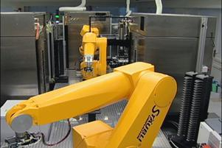
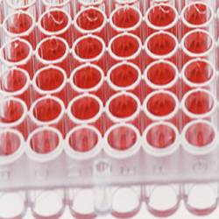
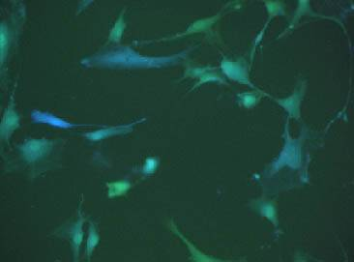
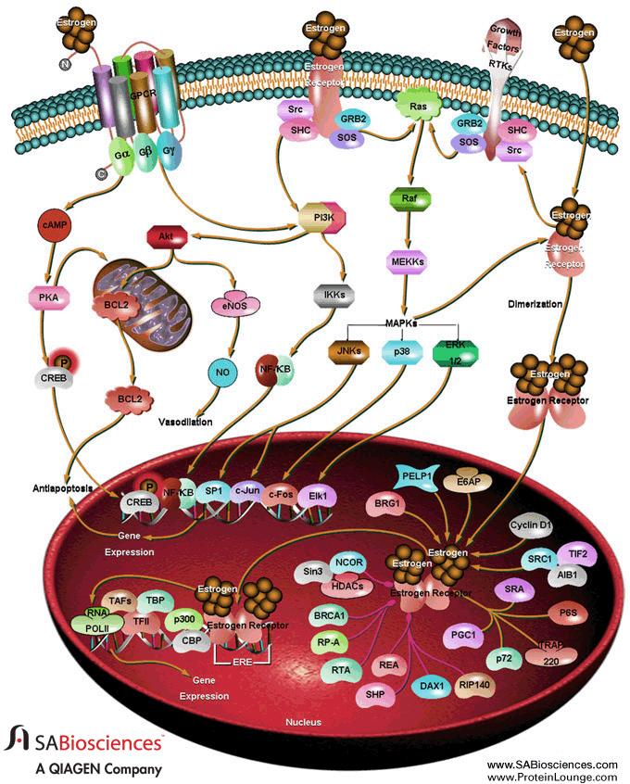
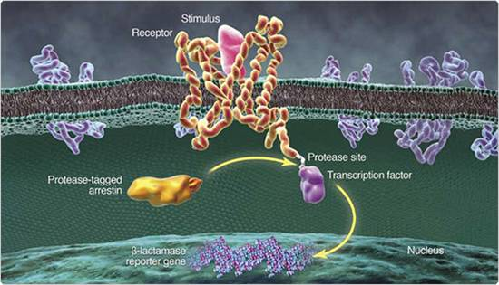
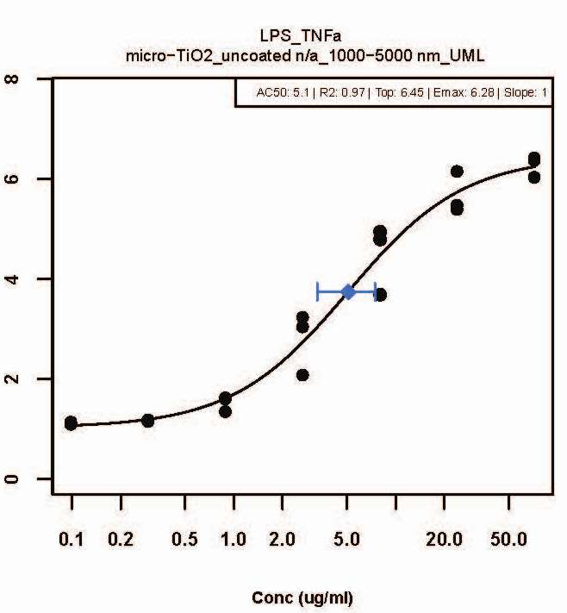
High-Throughput Screening 101 (HTS)
Chemical Exposure
Robots
96-, 384-, 1536 Well Plates
Cell Population
Pathway
Emax
Target Biology (e.g., Estrogen Receptor)
Response
LEC
AC50
8
Conc (uM)

Slide 9
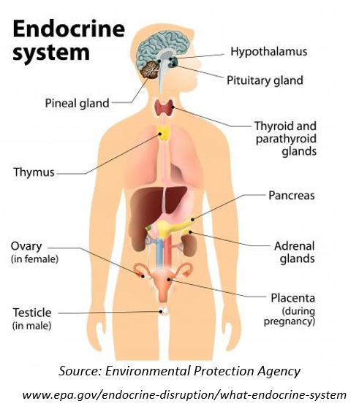

Typical Risk Assessment Problem: Identifying Endocrine Disruptors
Chemicals that mimic natural sex hormones can have significant effects years to decades after exposure (e.g. DES)
There are 10,000s of chemicals to be evaluated
Can we screen for these in an efficient way?
Can we understand the uncertainty of our results?

Slide 10
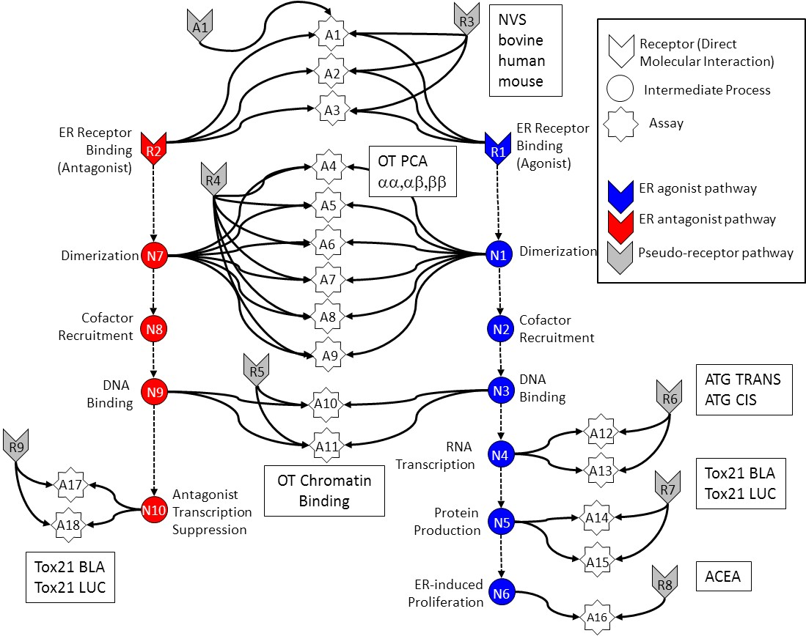
In Vitro Estrogen Receptor Model
No in vitro assay is perfect
Assay Interference
Noise
Use multiple assays per pathway
Different technologies
Different points in pathway
Use model to integrate assays
Evaluate model against reference chemicals
Judson et al: “Integrated Model of Chemical Perturbations of a Biological Pathway
Using 18 In Vitro High Throughput Screening Assays for the Estrogen Receptor” (EHP 2015)

Slide 11
A1
R3
NVS
bovine
human
mouse
A1
Receptor (Direct Molecular Interaction)
A2
Intermediate Process
A3
Assay
ER Receptor Binding
(Antagonist)
ER Receptor Binding
(Agonist)
R2
OT PCA
αα,αβ,ββ
R1
A4
R4
ER agonist pathway
A5
ER antagonist pathway
Dimerization
N7
A6
N1
Dimerization
Pseudo-receptor pathway
A7
Cofactor
Recruitment
N8
A8
N2
Cofactor
Recruitment
A9
DNA
Binding
R5
DNA
Binding
ATG TRANS
ATG CIS
N9
A10
N3
R6
RNA
Transcription
A12
R9
A11
N4
OT Chromatin
Binding
A13
Tox21 BLA
Tox21 LUC
A17
Antagonist
Transcription
Suppression
R7
N10
Protein
Production
N5
A14
A18
Tox21 BLA
Tox21 LUC
A15
ER-induced
Proliferation
R8
ACEA
N6
A16

Slide 12
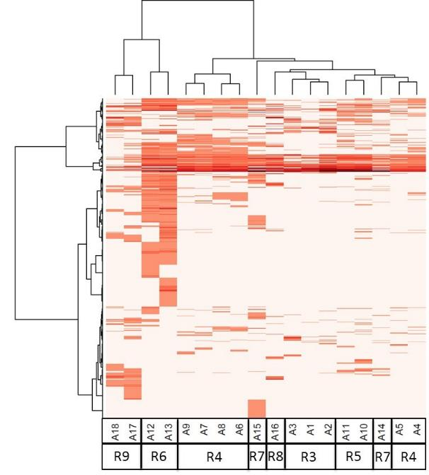
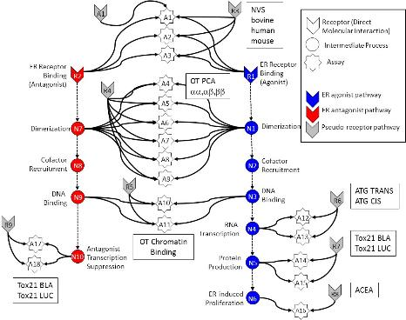
All In vitro assays have false positives and negatives
Much of this “noise” is reproducible
“assay interference”
Result of interaction of chemical
with complex biology in the assay
Chemical universe is structurally diverse
Solvents
Surfactants
Intentionally cytotoxic compounds
Metals
Inorganics
Pesticides
Drugs
Assays cluster by technology,
suggesting technology-specific
non-ER bioactivity
Chemicals
Assays
Judson et al: ToxSci (2015)

Slide 13
Schematic explanation of non-specific activity
Specific
Non-specific
Oxidative Stress
DNA Reactivity
Protein Reactivity
Mitochondrial stress
ER stress
Cell membrane disruption
Specific apoptosis
…

Slide 14
A1
R3
NVS
bovine
human
mouse
A1
Receptor (Direct Molecular Interaction)
A2
Intermediate Process
A3
Assay
ER Receptor Binding
(Antagonist)
ER Receptor Binding
(Agonist)
R2
OT PCA
αα,αβ,ββ
R1
A4
R4
ER agonist pathway
A5
ER antagonist pathway
Dimerization
N7
A6
N1
Dimerization
Pseudo-receptor pathway
A7
Cofactor
Recruitment
N8
A8
N2
Cofactor
Recruitment
A9
DNA
Binding
R5
DNA
Binding
ATG TRANS
ATG CIS
N9
A10
N3
R6
RNA
Transcription
A12
R9
A11
N4
OT Chromatin
Binding
A13
Tox21 BLA
Tox21 LUC
A17
Antagonist
Transcription
Suppression
R7
N10
Protein
Production
N5
A14
A18
Tox21 BLA
Tox21 LUC
A15
ER-induced
Proliferation
R8
ACEA
N6
A16

Slide 15
A1
A1
R3
Receptor (Direct Molecular Interaction)
A2
Intermediate Process
A3
Assay
ER Receptor Binding
(Antagonist)
ER Receptor Binding
(Agonist)
R2
R1
A4
R4
ER agonist pathway
A5
ER antagonist pathway
Dimerization
N7
A6
N1
Dimerization
Pseudo-receptor pathway
A7
Cofactor
Recruitment
N8
A8
N2
Cofactor
Recruitment
A9
DNA
Binding
R5
DNA
Binding
N9
A10
N3
R6
RNA
Transcription
A12
R9
A11
N4
A13
A17
Antagonist
Transcription
Suppression
R7
N10
Protein
Production
N5
A14
A18
A15
ER-induced
Proliferation
N6
R8
A16

Slide 16
A1
A1
R3
Receptor (Direct Molecular Interaction)
A2
Intermediate Process
A3
Assay
ER Receptor Binding
(Antagonist)
ER Receptor Binding
(Agonist)
R2
R1
A4
R4
ER agonist pathway
A5
ER antagonist pathway
Dimerization
N7
A6
N1
Dimerization
Pseudo-receptor pathway
A7
Cofactor
Recruitment
N8
A8
N2
Cofactor
Recruitment
A9
DNA
Binding
R5
DNA
Binding
N9
A10
N3
R6
RNA
Transcription
A12
R9
A11
N4
A13
A17
Antagonist
Transcription
Suppression
R7
N10
Protein
Production
N5
A14
A18
A15
ER-induced
Proliferation
N6
R8
A16

Slide 17
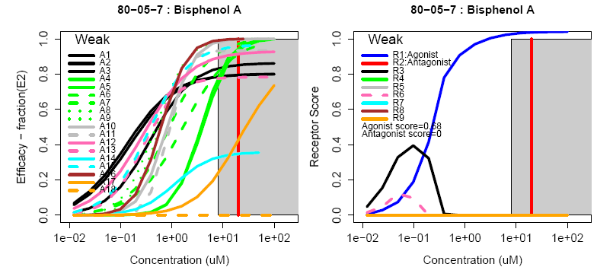
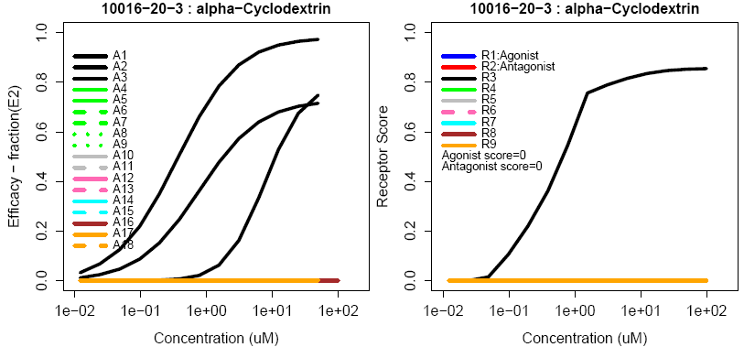
Example chemicals: Observe quantitative uncertainty
True Agonist
Assay Interference Example “R3”

Slide 18
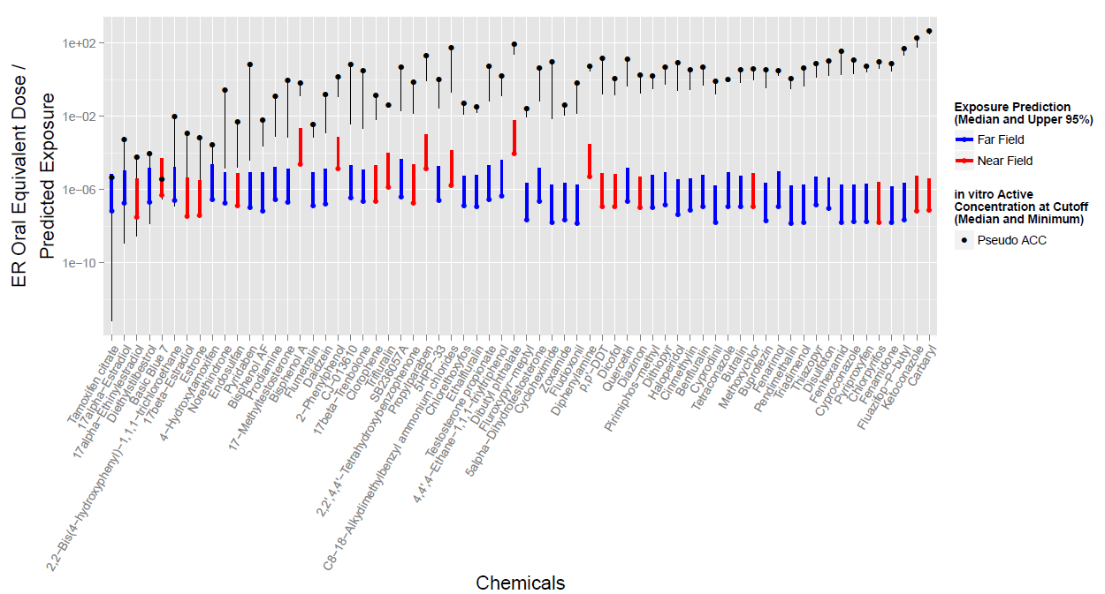
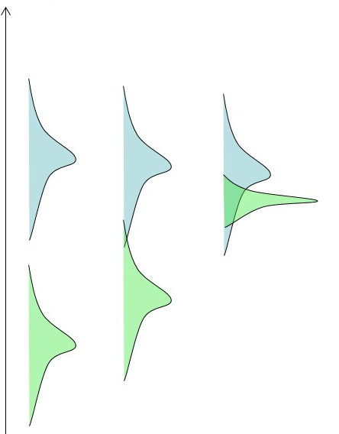
Compare predicted exposure and ER hazard
Hazard
Exposure

Slide 19

Cell-level Modeling: The ‘Virtual Embryo’
Heart
NVU/BBB
Somite
Vasculature
Neural Tube
Limb-bud
Palate
Liver / GI
Testis / BTB
Genital Tubercle
Renal
Delivered
Underway
Future
Hester et al. (2011) PLoS Comp Bio; Dias et al (2014) Science
Kleinstreuer et al. (2013) PLoS Comp Bio.
Ahir et al. (MS in preparation).
Hutson et al. (2017) Chem Res Toxicol.
Leung et al. (2016) Reprod Toxicol.
Zurlinden/Saili et al. (FY17 product).
Hunter et al. (FY18 product).
Your name here.
Tom Knudsen Group, EPA NCCT

Slide 20
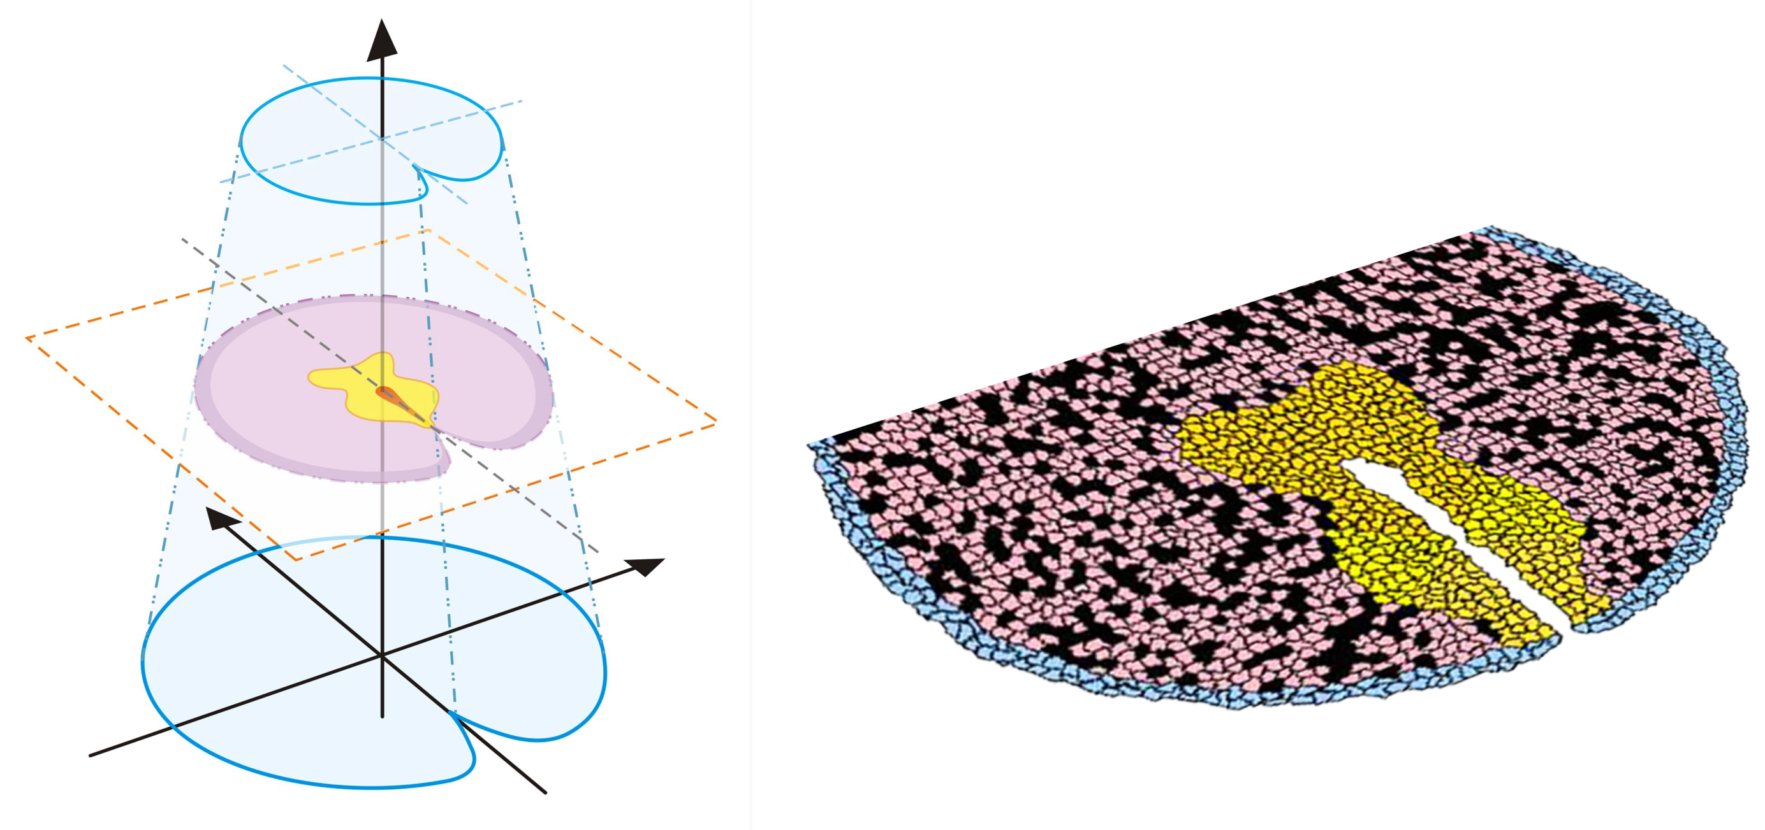
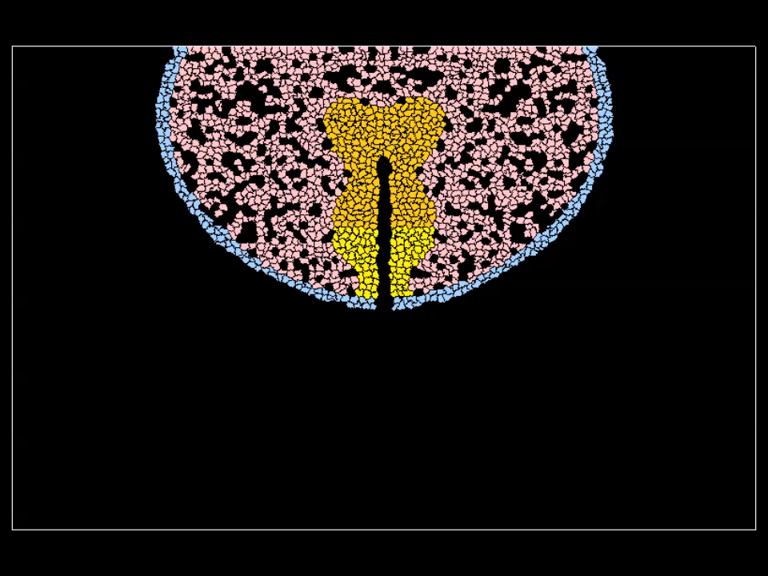
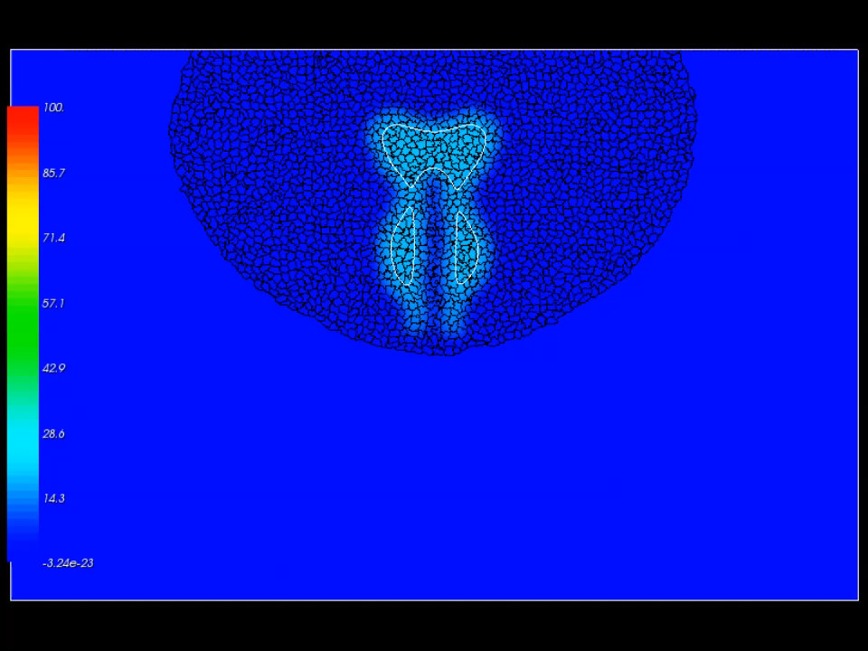
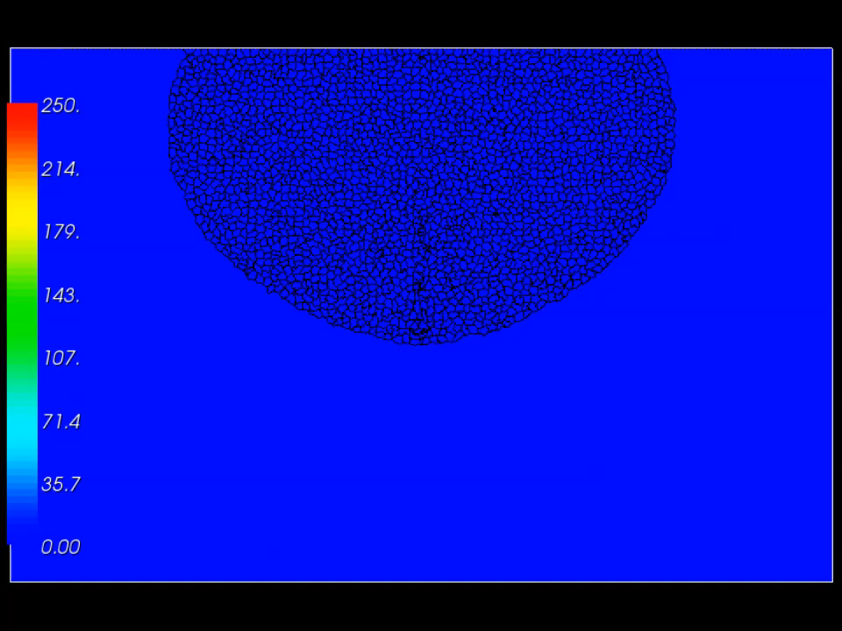
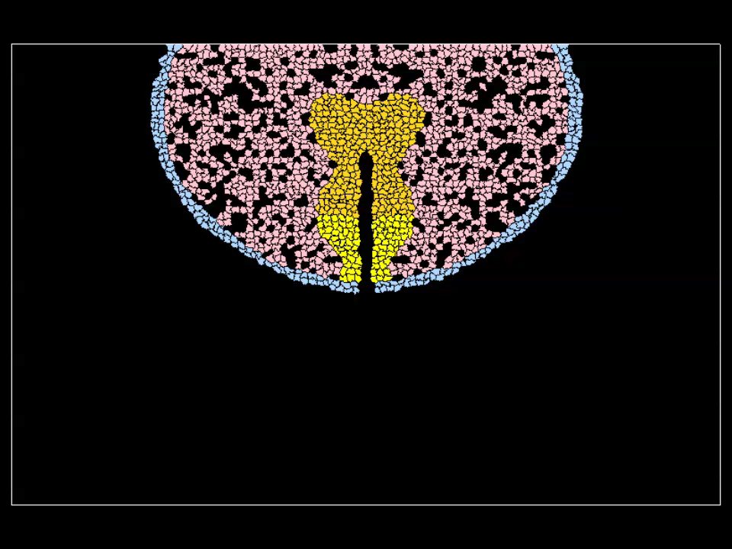

Model Genital Differentiation
Agent-based models: CompuCell3D
Agent=Cell with internal control network
Genital tubercle (GT) Control Network (mouse)
ABM simulation for sexual dimorphism (mouse GD13.5 – 17.5)
androgen
SHH field
FGF10 field
no androgen
20
SOURCE: Leung et al. (2016) Reprod Tox
Common Pathway for Fusion: Hypospadias, Cleft Palette, Spina Bifida

Slide 21
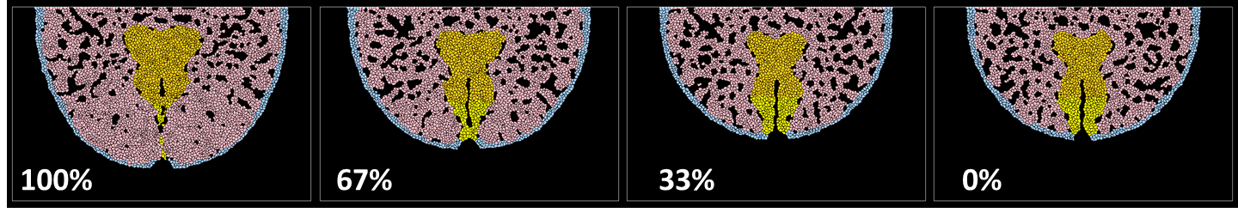
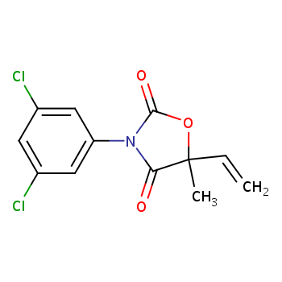
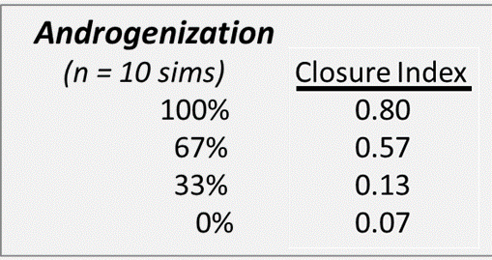
Apply model to chemical insult: Vinclozolin and Hypospadias
Driven by urethral endoderm (contact, fusion apoptosis) and androgen-dependent effects on preputial mesenchyme (proliferation, condensation, migration) via FGFR2-IIIb.
androgen
vinclozolin
SHH
FGF
Common Pathway for Fusion: Hypospadias, Cleft Palette, Spina Bifida

Slide 22
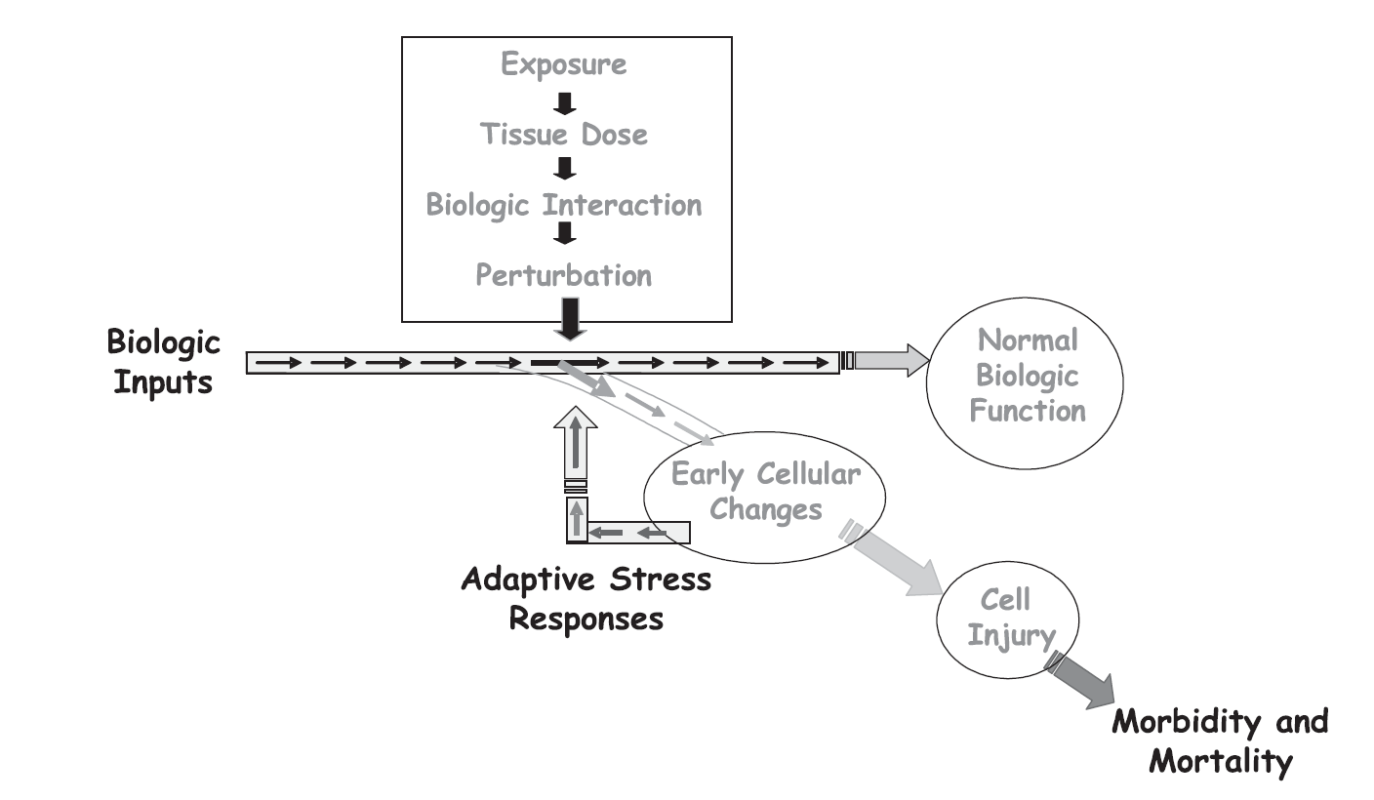
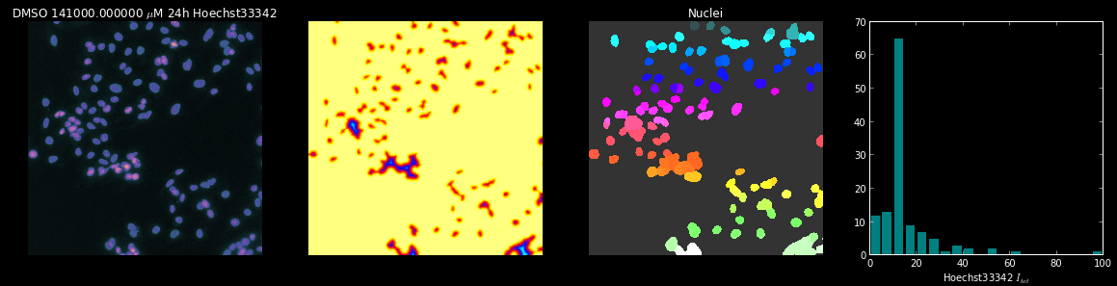
What is Adverse?
Discriminating between compensatory changes and changes that will lead to adverse outcomes
Tipping Point: Threshold between adaptation and adversity
Use ToxCast High Content Imaging (HCI) data to identify Tipping Points
967 chemicals (ToxCast)
HepG2 cells culture
10 concentrations
3 Time points
10 HCI Assays
400 plates
100,000 wells
2,400,000 images
Imran Shah group, EPA NCCT

Slide 23
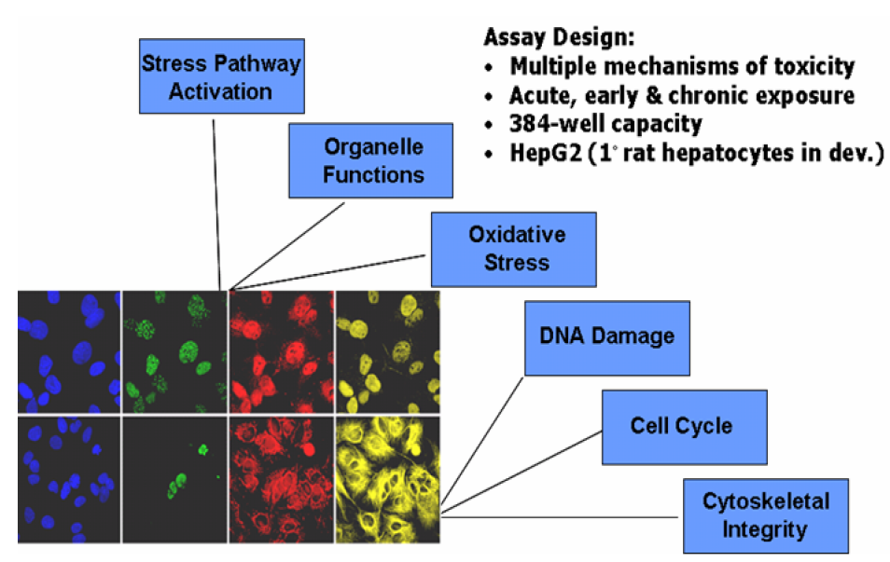
High Content Imaging (HCI)
Study
HepG2 cell culture
967 chemicals (ToxCast)
10 conc
HCI Assays
Health
Stress
Cellular perturbations
Dynamic phenotypic response of cells to chemicals
Large-scale data
~400 plates
~100,000 wells
~2,400,000 images
High-Content Imaging (HCI): multiplexed measurements on cell populations
HCI Conducted by Cyprotex, Inc.

Slide 24
Cell-State Data from Images
Raw Image
(Hoechst)
Intensity
Analysis
Object
Identification
Nuclear intensity
distribution
Image analysis and cell level feature feature extraction conducting by Cyprotex Inc. (proprietary software)
Notes:
24

Slide 25
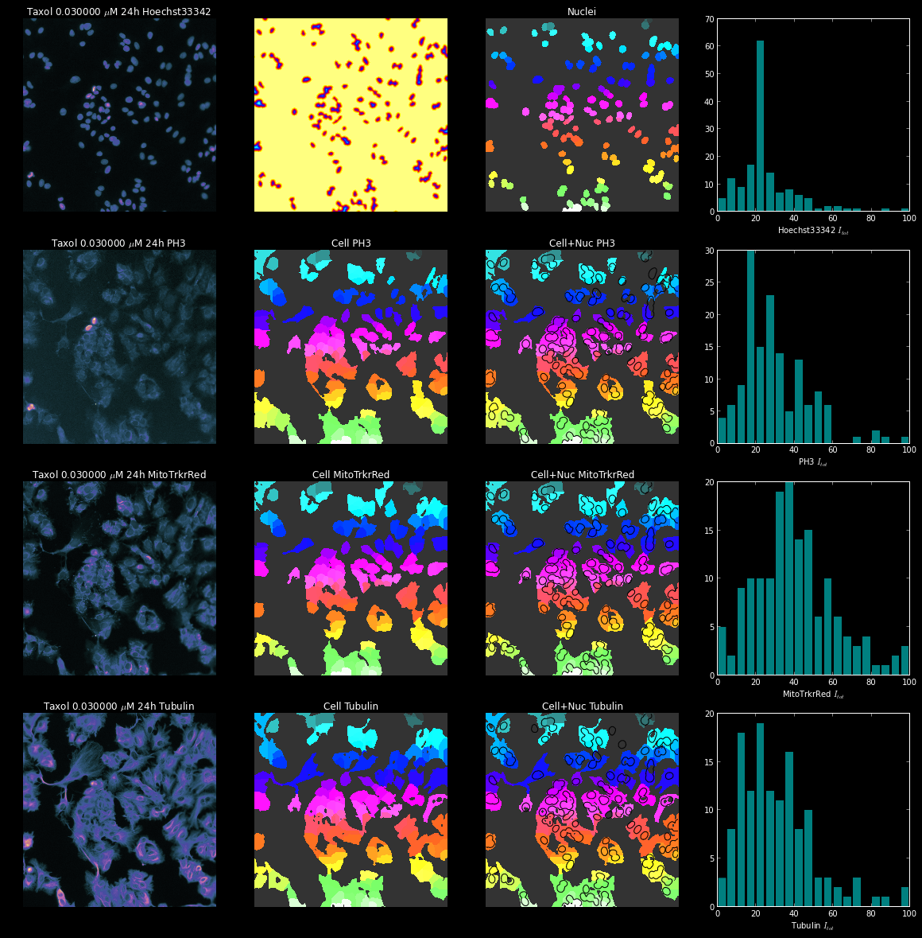
Data for Taxol 0.03uM
nuclear size (NS)
cell cycle arrest (CCA)
cell number (CN)
Hoechst33342
Phospho-Histone3
mitotic arrest (MA)
Mitochondrial mass
(MM)
Mitochondrial membrane
potential (MMP)
MitoTracker Red
Phospho-Tubulin
microtubules (Mt)

Slide 26
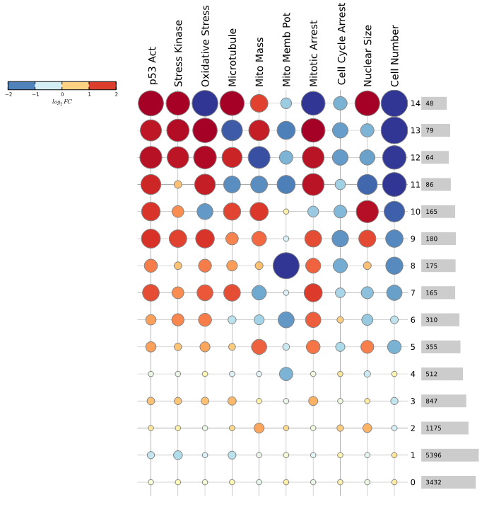
HCI to Phenotypic States
Derive “phenotypic “states” of HepG2 cells across all chemicals and concentrations
Phenotypic states approximate canonical behaviors of cells
State transitions indicate dynamic responses to chemicals
More adverse
“States” of HepG2 Cells
Less
adverse

Slide 27
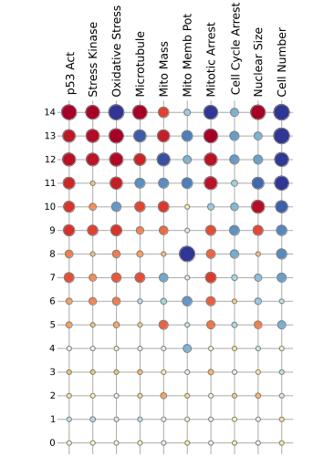
System trajectories
“Normal” State
Fluazinam 0.78 uM
0h

Slide 28
System trajectories
State Transition
Fluazinam 0.78 uM
1h
0h

Slide 29
System trajectories
System trajectory
Fluazinam 0.78 uM
1h
24h
24h
0h

Slide 30
System trajectories
System trajectory
Fluazinam 0.78 uM
Trajectory=Sequence of states
1h
24h
24h
0h
72h

Slide 31
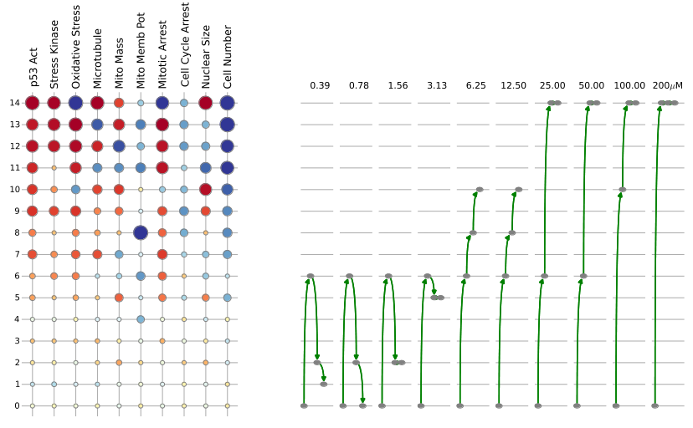
Fluazinam “Trajectories”
Tipping Point
Cell State
Increasing Dose

Slide 32
Select Modeling Approach to Suit the Problem
Estrogen receptor model:
Perturbing a single receptor is the first key step in adversity
Statistical, pathway-based, accounting for assay noise
Cell-agent-based Virtual Embryo Model
Development is driven by complex cell-cell signaling
Agent-based model integrates time, dose, cell internals and signaling
Tipping Point Model
Not all doses are adverse
Statistical model integrates multiple signals to find point of no return

Slide 33
Summary: Modeling Complex Biological Systems
Our first goal is prediction
Predictions are based on models
“All models are wrong”
All models are based on data, which is always subject to noise, variability
Therefore, all predictions are uncertain
“You have a big approximation and a small approximation. The big approximation is your approximation to the problem you want to solve. The small approximation is involved in getting the solution to the approximate problem.”
Origin Unknown: Maybe Douglas Bates. Though he attributed it to George Box, Box denied it.

Slide 34
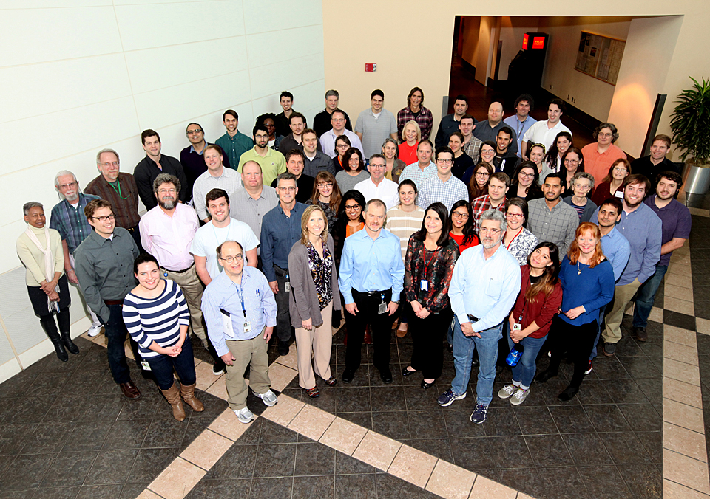
National Center for Computational Toxicology
NCCT Staff
Rusty Thomas
Kevin Crofton
Keith Houck
Ann Richard
Richard Judson
Tom Knudsen
Matt Martin*
Grace Patlewicz
Woody Setzer
John Wambaugh
Tony Williams
Steve Simmons
Chris Grulke
Katie Paul-Friedman
Jeff Edwards
Chad Deisenroth
Joshua Harrill
Rebecca Jolley
Jeremy Dunne
NCCT Postdocs
Todor Antonijevic
Audrey Bone
Swapnil Chavan
Kristin Connors*
Danica DeGroot
Jeremy Fitzpatrick
Dustin Kapraun*
Agnes Karmaus*
Max Leung*
Kamel Mansouri*
Andrew McEachran
LyLy Pham
Prachi Pradeep
Caroline Ring*
Kate Saili
Eric Watt*
Todd Zurlinden
NCCT
Nancy Baker
Dayne Filer*
Parth Kothiya*
Sean Watford
Indira Thillainadarajah
Robert Pearce
Danielle Suarez
Doris Smith
Jamey Vail
Risa Sayre
Nathan Rush
NTP Collaborators
Warren Casey
Nicole Kleinstreuer
Mike Devito
Dan Zang
Rick Paules
Nisha Sipes
NIH/NCATS Collaborators
Menghang Xia
Ruili Huang
Anton Simeonov
* Graduates

