Slide 1

Applying Bioinformatics to Chemical Risk Assessment: Assays, Databases, Models
Richard Judson
U.S. EPA, National Center for Computational Toxicology
Office of Research and Development
3rd Danish Bioinformatics Conference
24 August2017
The views expressed in this presentation are those of the author and do not necessarily reflect the views or policies of the U.S. EPA

Slide 2
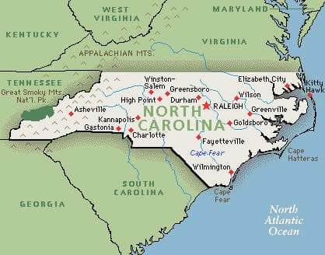
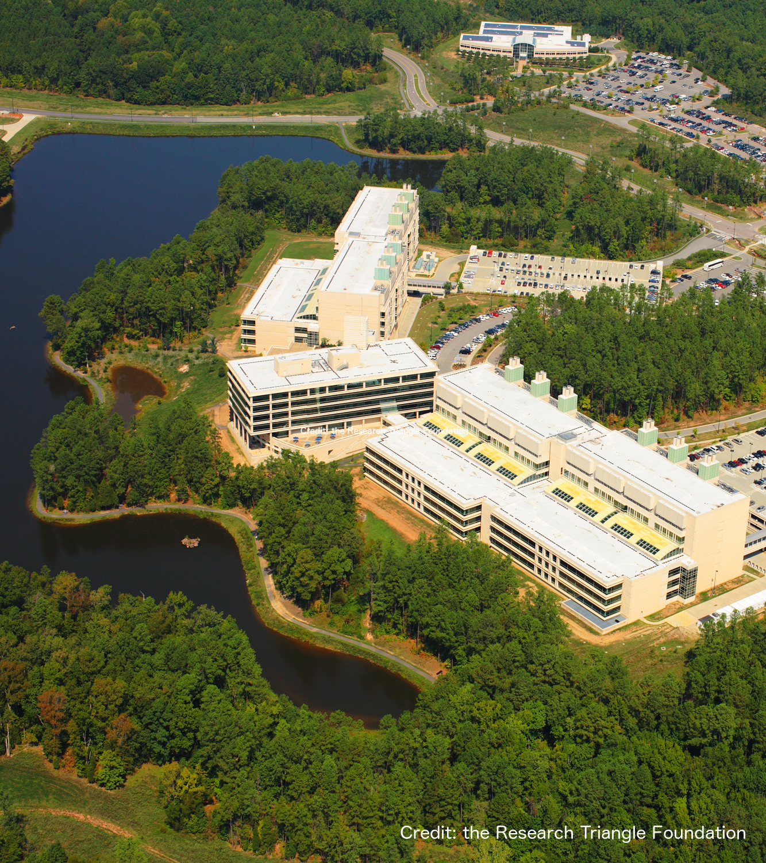
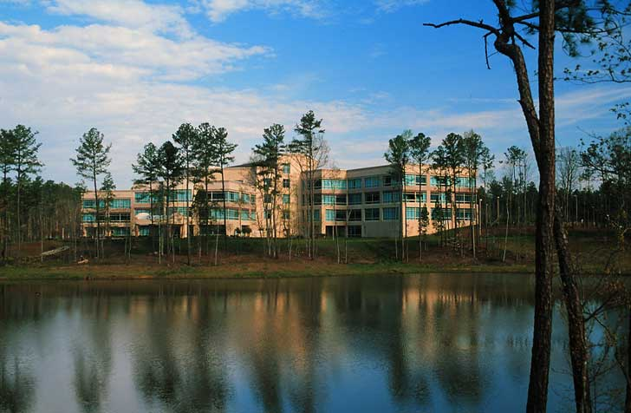
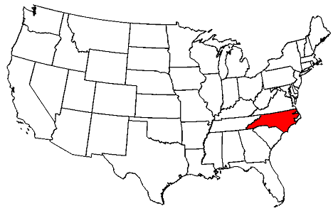
National Center for Computational Toxicology
National Center for Computational Toxicology established in 2005 to integrate
  High-throughput and high-content technologies
  Modeling and data mining
  Modern molecular biology
  Computational biology and chemistry
Currently staffed by ~60 employees
  PIs, Postdocs, grad students, support staff
EPA’s Office of Research and Development

Slide 3
How far can we go with Bioinformatics?
Biology and computer science tell us that we are just algorithms embedded in flesh, soon to be replaced by silicon and metal
Paraphrase of Steven Shapin, on the coming cyborg future
We’re all just cyborgs, random clanking assemblages inserted in circuits way beyond our understanding
Jenny Turner, commenting on Steven Shapin

Slide 4
A Big Bioinformatics Question
What is the effect of dosing person P with X amount of chemical Y?
Need to model biology that is multiscale, complex, non-linear
Multiple and often unknown sources of:
  Noise
  Variation
Goal: use data, models, algorithms to make predictions
  Predictions are statistical, probabilistic

Slide 5
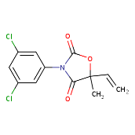
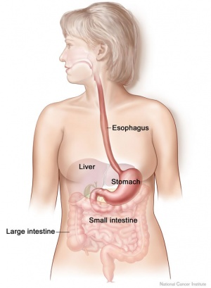
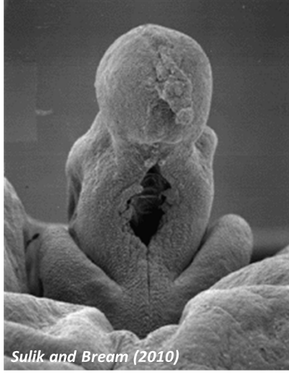
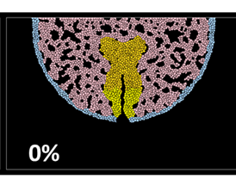
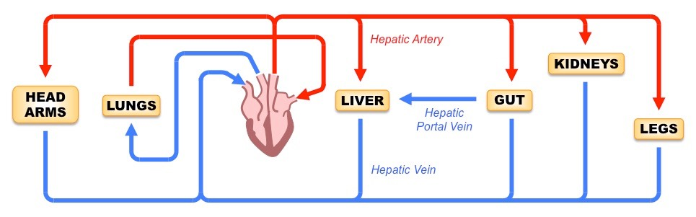
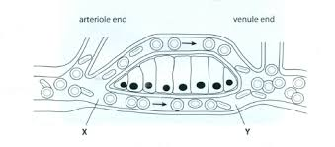
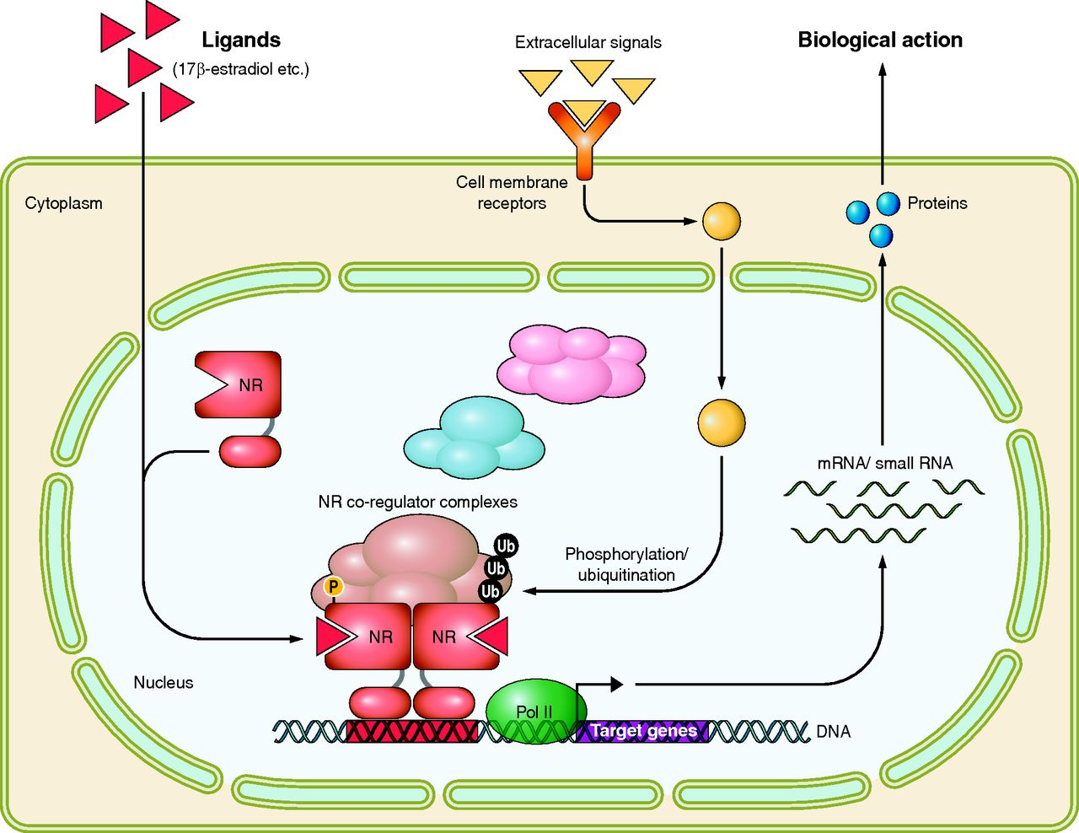
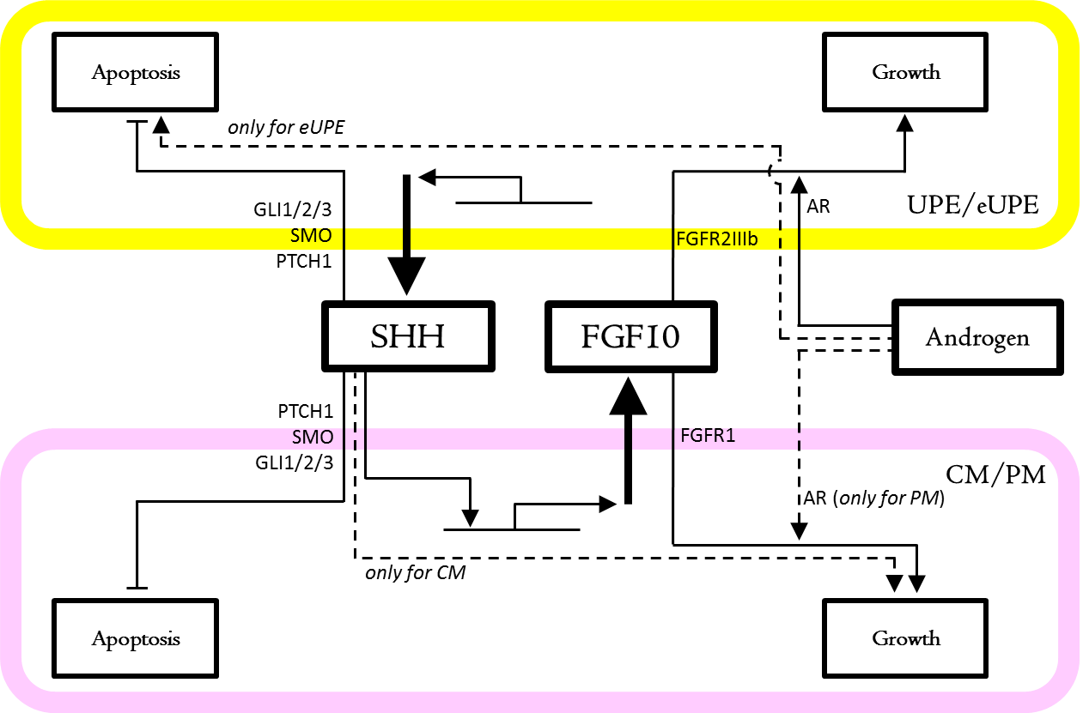
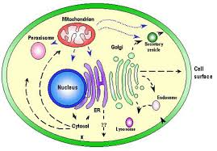
Multiscale
Chemical
Mouth
GI Tract
Liver
Blood
Tissue
Cells
Proteins
Molecular Circuits
Cells
Tissue
Organ
Organism

Slide 6
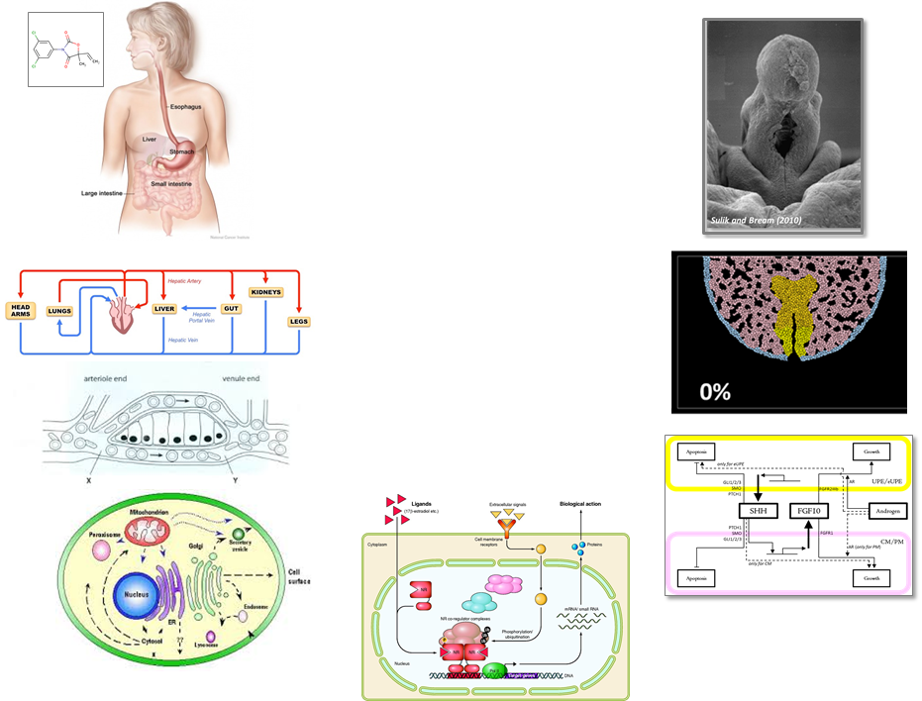

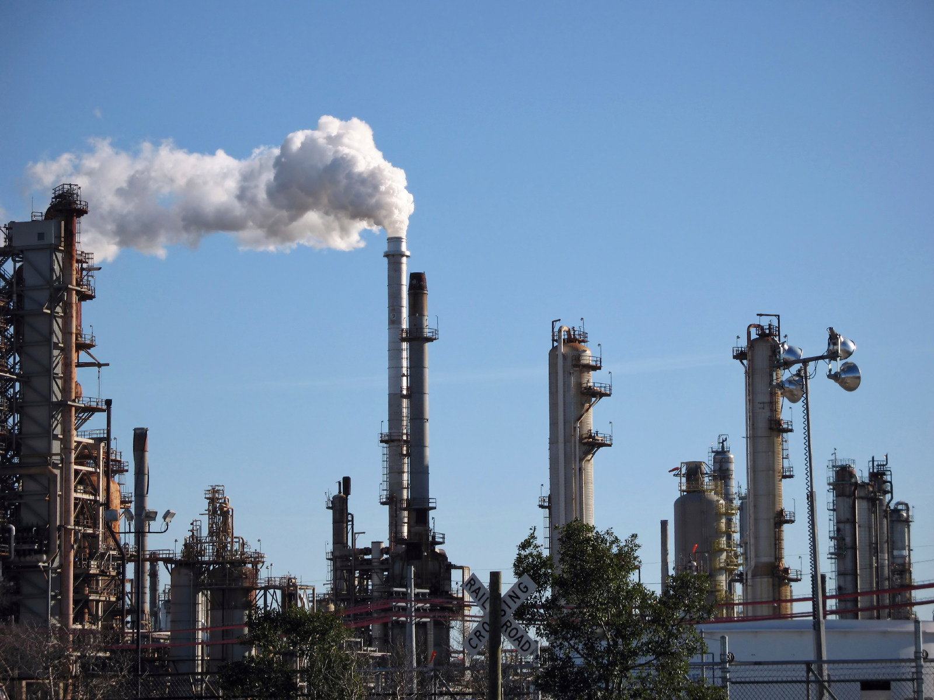

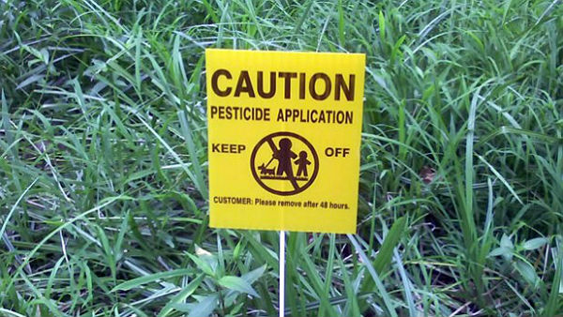
Risk-based Approach
Hazard + Exposure (+ uncertainty)
mg/kg BW/day
Kinetics
Dynamics
Hazard:
Kinetics + Dynamics
Exposure
Low
Priority
Medium
Priority
High
Priority

Slide 7
Computational Toxicology
Identify biological pathways of toxicity (AOPs)
Develop high-throughput in vitro assays
  Test “Human Exposure Universe” chemicals in the assays
Develop models that link in vitro to in vivo hazard
  Use kinetic models to predict activating doses
Develop exposure models
Add uncertainty estimates
Dynamics
Kinetics

Slide 8
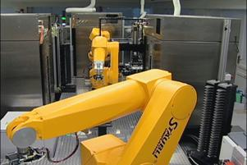
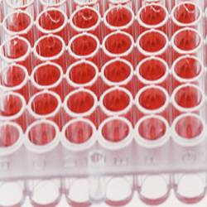
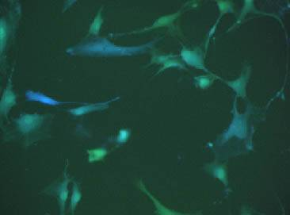
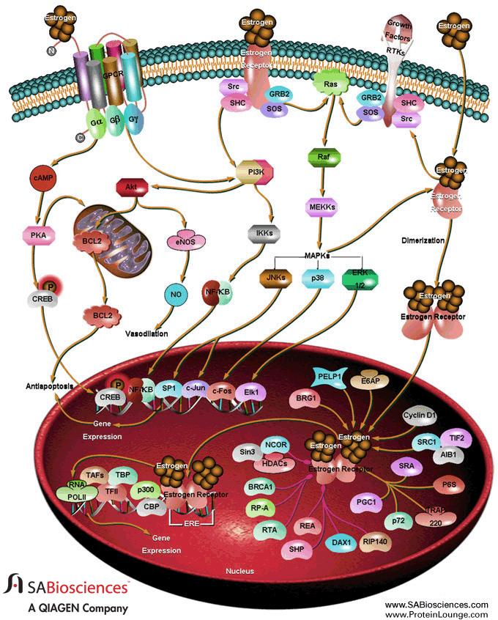
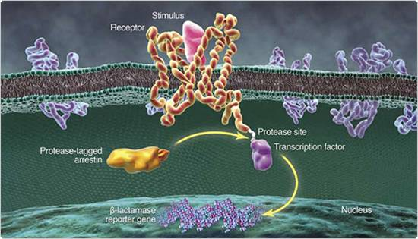
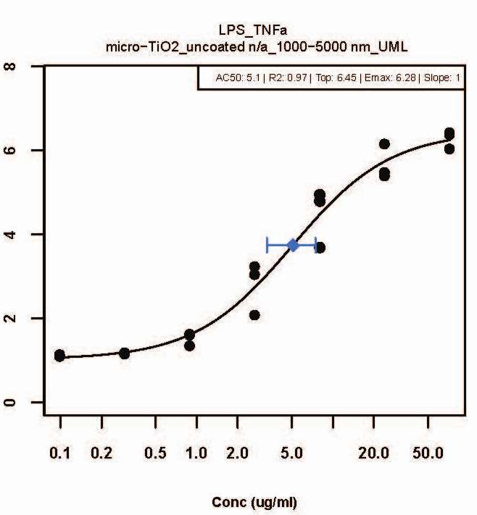
High-Throughput Screening 101 (HTS)
Chemical Exposure
Robots
96-, 384-, 1536 Well Plates
Cell Population
Pathway
Emax
Target Biology (e.g., Estrogen Receptor)
Response
LEC
AC50
8
Conc (uM)

Slide 9
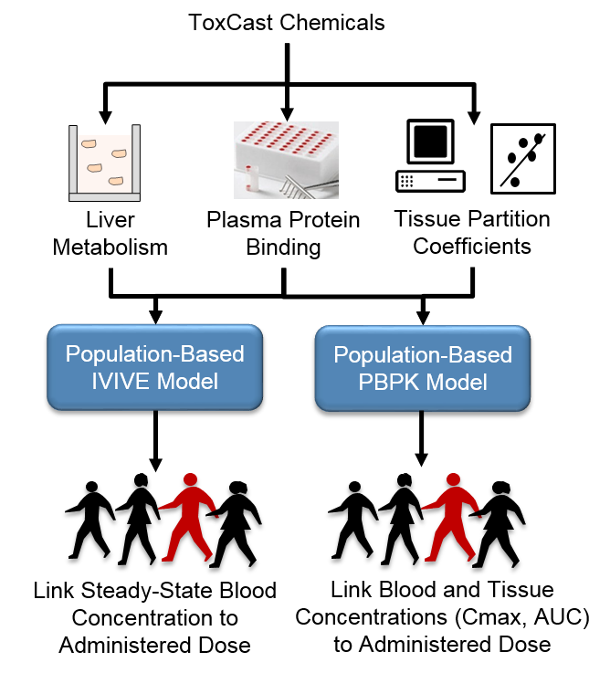
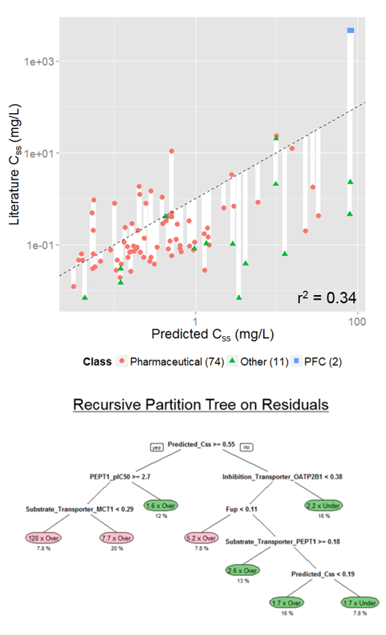
Kinetics Modeling
Incorporating Dosimetry and Uncertainty into In Vitro Screening
Wetmore et al.
Wambaugh et al., 2015
Notes:
I think we have heard yesterday, how important TK is in interpreting the results from NAMs. This includes both read across and the in vitro testing. However, first, we need to have an in vitro and in silico approach to generate the TK data that we need and we need to be rigorous in characterizing the uncertainty around whatever approach we develop.

Slide 10
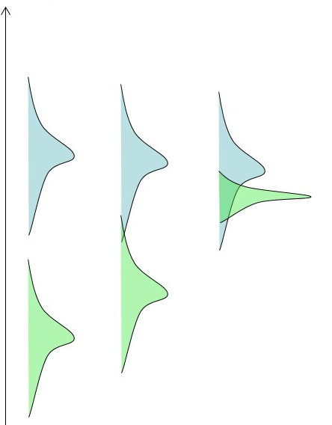
Simple Question:
Can we predict the dose that harms a rat?
Spanned 38 In Vivo Endpoints across Multiple Tissues, Organ Systems, and Study Types (Repro, Chronic, and Dev)
Start with battery of in vitro assays
Convert to dose with HT kinetics
94% of chemicals have a health-protective prediction of toxic dose
But: How golden is the gold-standard?
5.7% below line
Wetmore et al., Tox Sci., 2013

Slide 11
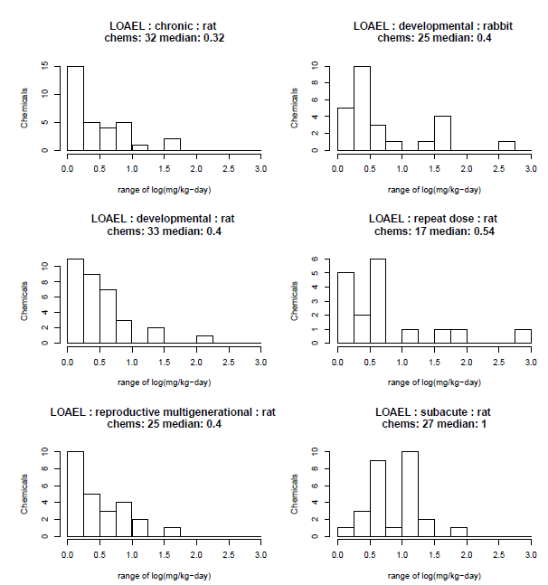
Essences and Accidents:
Data, Variability and Noise
Toxic doses vary significantly from one lab to the next
Median span from lowest to highest is 0.3 to 1 log unit
Evaluate using ToxValDB, a large database of public animal toxicology data

Slide 12
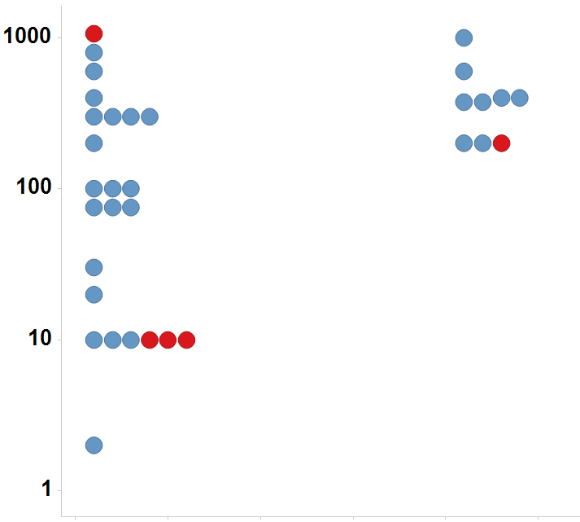
Uterotrophic guideline study uncertainty
Simplest endocrine effect to measure in vivo
26% of chemicals tested multiple times in the uterotrophic assay gave discrepant results
Immature Rat: BPA
LEL or MTD (mg/kg/day)
Uterotrophic
Active
Inactive
Injection
Oral
Kleinstreuer et al: “A Curated Database of Rodent Uterotrophic Bioactivity” EHP (2015)

Slide 13
Anemia concordance results
Quantitative In Vivo Measurement
Species / study 1 | Species / study 2 | Concordant | Not Concordant | Fraction Concordant
rat SUB | rat CHR | 18 | 2 | 0.90
rat CHR | dog CHR | 13 | 2 | 0.87
rat CHR | rat SUB | 18 | 4 | 0.82
rat SUB | rat SUB | 16 | 4 | 0.80
rat SUB | dog CHR | 11 | 4 | 0.73
mouse CHR | rat CHR | 11 | 4 | 0.73
mouse CHR | rat SUB | 13 | 7 | 0.65
dog CHR | rat SUB | 11 | 6 | 0.65
dog CHR | rat CHR | 13 | 8 | 0.62
rat CHR | mouse CHR | 11 | 11 | 0.50
mouse CHR | dog CHR | 6 | 6 | 0.50
rat SUB | mouse CHR | 13 | 14 | 0.48
dog CHR | mouse CHR | 6 | 8 | 0.43
mouse CHR | mouse CHR | 2 | 3 | 0.40
Judson et al. Reg. Tox. Pharm (2017) “Retrospective Mining of Toxicology Data to Discover Multispecies and Chemical Class Effects: Anemia as a Case Study”.

Slide 14
Sources of Uncertainty / Variability In Vivo
Experimental variability
  Species, strain, dose range, dose spacing
Statistical power issues
  Too few animals to see weak or rare effect
Reporting bias
  Was an effect negative or not looked for?
Observer bias
  Less severe phenotypes not reported when more severe ones are present
Diagnostic terminology drift
Data assimilation and analysis
  Typos, incomplete transcription
Always question the data!

Slide 15
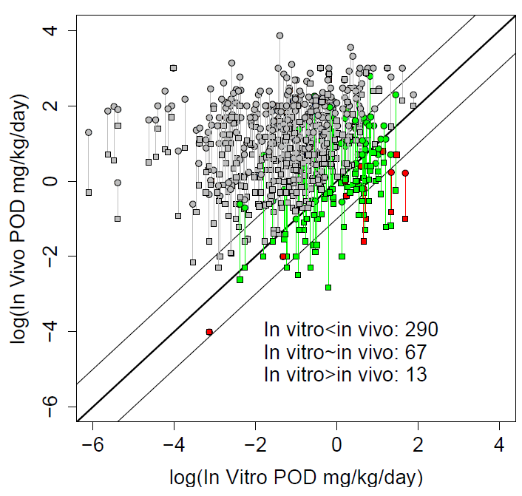
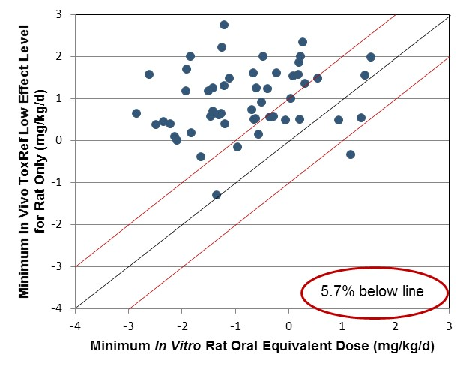
Updated IVIVE, accounting for uncertainty
Larger set of chemicals with in vivo, in vitro, TK
~4% have in vitro POD consistently greater than in vivo values
Issue: what is the correct in vitro POD assay?
- Bioactivity vs. adversity
Unpublished

Slide 16
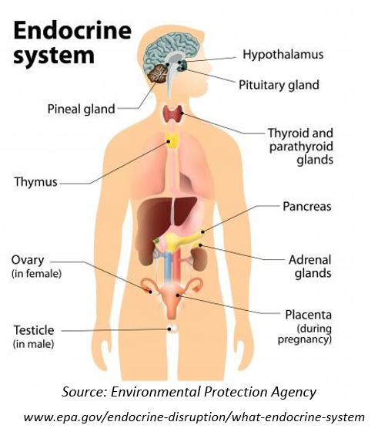

More Complex Risk Assessment Problem:
Identifying Endocrine Disruptors
Chemicals that mimic natural sex hormones can have significant effects years to decades after exposure (e.g. DES)
There are 10,000s of chemicals to be evaluated
Can we screen for these in an efficient way?
Can we understand the uncertainty of our results?

Slide 17
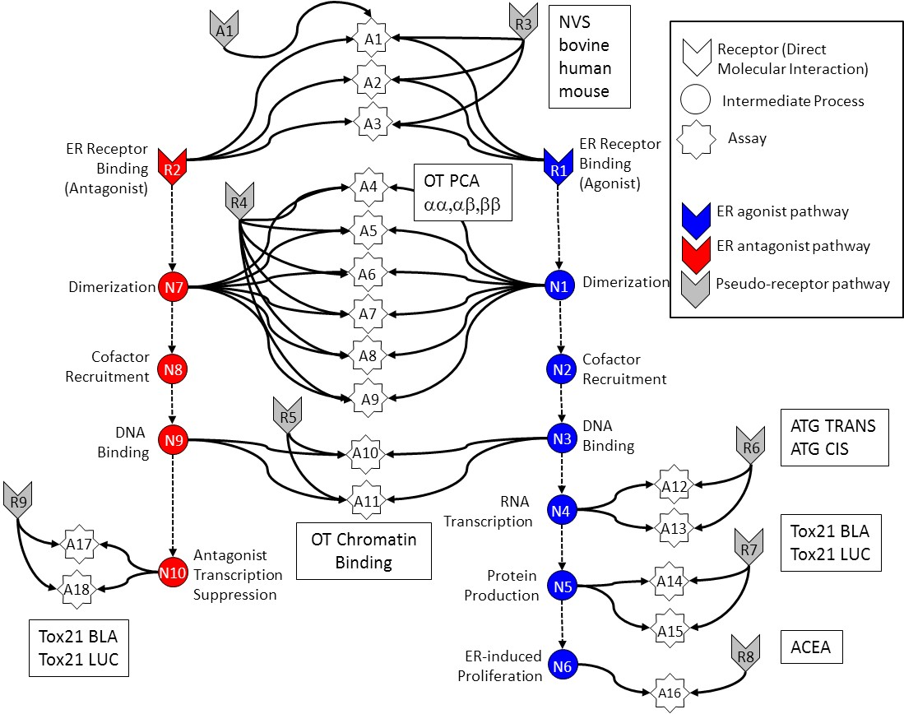
In Vitro Estrogen Receptor Model
No assay is perfect
  Assay Interference
  Noise
Use multiple assays per pathway
  Different technologies
  Different points in pathway
Use model to integrate assays
Evaluate model against reference chemicals
Judson et al: “Integrated Model of Chemical Perturbations of a Biological Pathway
Using 18 In Vitro High Throughput Screening Assays for the Estrogen Receptor” (EHP 2015)

Slide 18
A1
R3
NVS
bovine
human
mouse
A1
Receptor (Direct Molecular Interaction)
A2
Intermediate Process
A3
Assay
ER Receptor Binding
(Antagonist)
ER Receptor Binding
(Agonist)
R2
OT PCA
αα,αβ,ββ
R1
A4
R4
ER agonist pathway
A5
ER antagonist pathway
Dimerization
N7
A6
N1
Dimerization
Pseudo-receptor pathway
A7
Cofactor
Recruitment
N8
A8
N2
Cofactor
Recruitment
A9
DNA
Binding
R5
DNA
Binding
ATG TRANS
ATG CIS
N9
A10
N3
R6
RNA
Transcription
A12
R9
A11
N4
OT Chromatin
Binding
A13
Tox21 BLA
Tox21 LUC
A17
Antagonist
Transcription
Suppression
R7
N10
Protein
Production
N5
A14
A18
Tox21 BLA
Tox21 LUC
A15
ER-induced
Proliferation
R8
ACEA
N6
A16

Slide 19
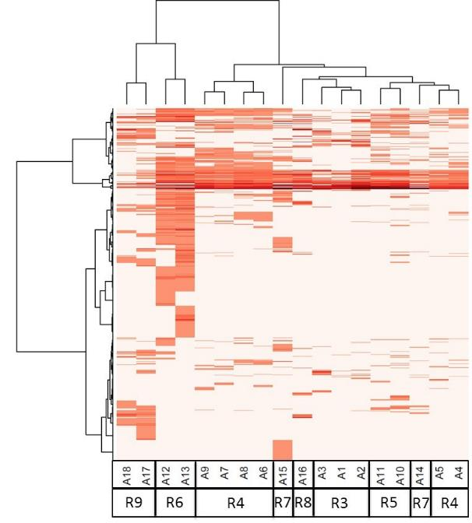
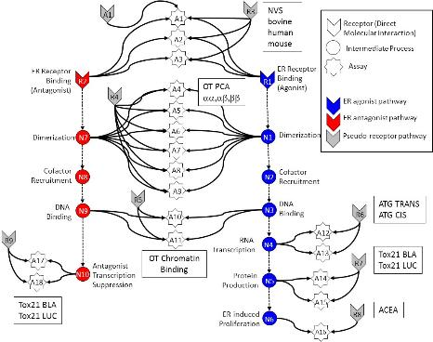
In vitro assays also have false positives and negatives
Much of this “noise” is reproducible
“assay interference”
Result of interaction of chemical
with complex biology in the assay
Chemical universe is structurally diverse
Solvents
Surfactants
Intentionally cytotoxic compounds
Metals
Inorganics
Pesticides
Drugs
Assays cluster by technology,
suggesting technology-specific
non-ER bioactivity
Chemicals
Assays
Judson et al: ToxSci (2015)

Slide 20
Most chemicals display a “burst” of potentially non-selective bioactivity near cytotoxity concentration
Concentration Space
Z- Space
Tested Concentration Range
Cytotoxicity
Range
3 MAD
Burst
Region
Cytotoxicity
Range
3 MAD
Burst
Region
Number of Hits
Number of Hits
0.1
1
10
100
1000
21 18 15 12 9 6 3 0 -3 -6 -9
AC50 (μM)
Bioactivity inferred
Z
Judson et al. Tox.Sci. (2016)

Slide 21
Schematic explanation of the burst
Specific
Non-specific
Oxidative Stress
DNA Reactivity
Protein Reactivity
Mitochondrial stress
ER stress
Cell membrane disruption
Specific apoptosis
…

Slide 22
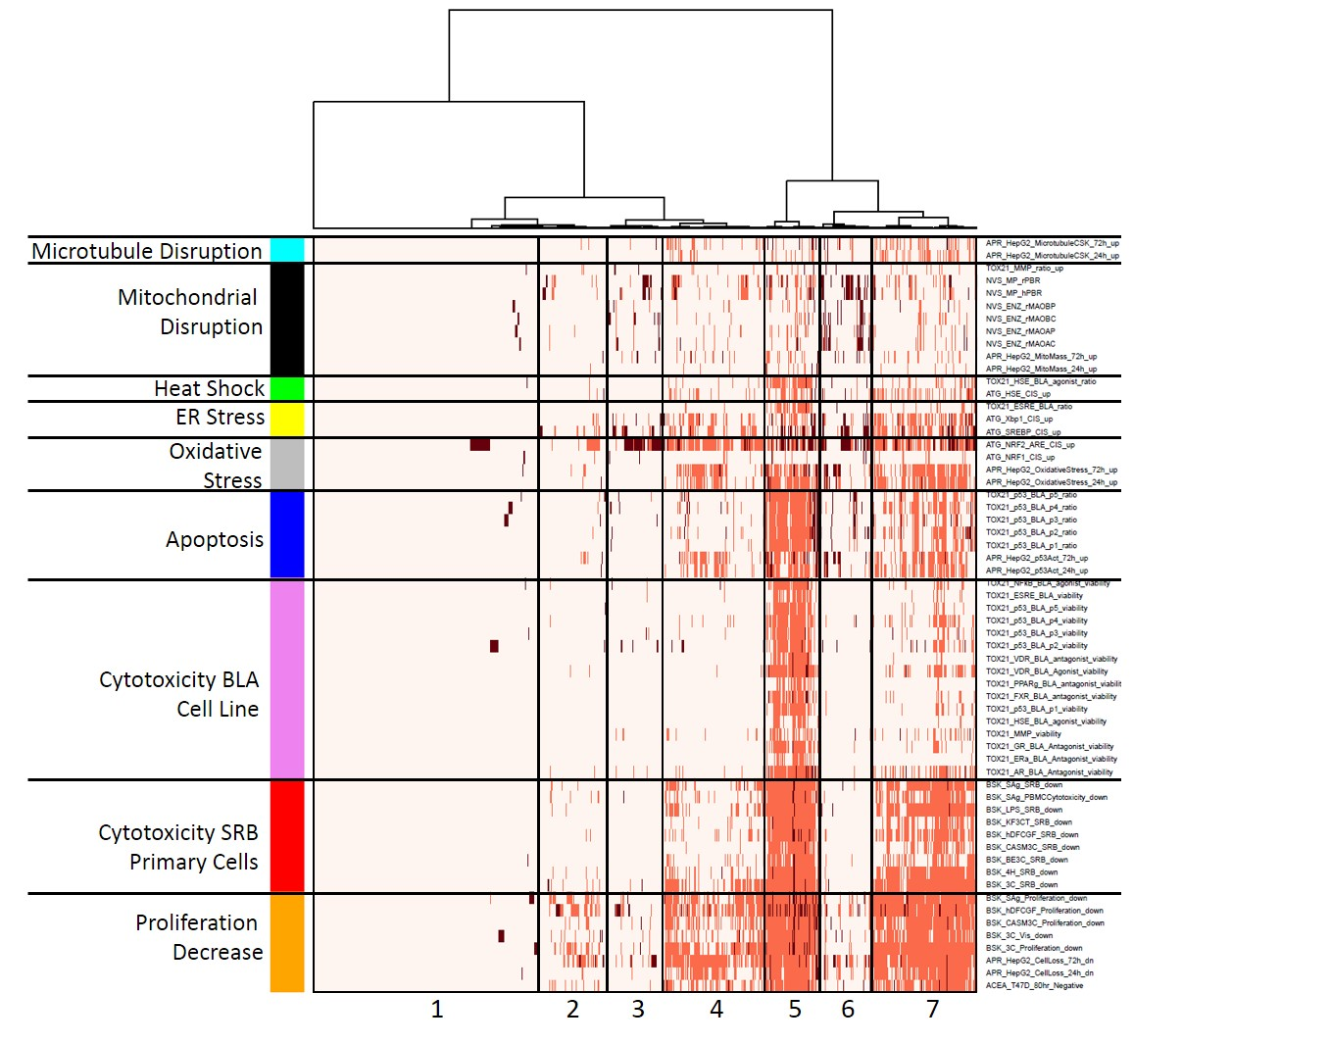
Heatmap of stress and cytotoxicity assays in 1000 chemicals
Chemicals
Judson et al. ToxSci (2016)

Slide 23
A1
R3
NVS
bovine
human
mouse
A1
Receptor (Direct Molecular Interaction)
A2
Intermediate Process
A3
Assay
ER Receptor Binding
(Antagonist)
ER Receptor Binding
(Agonist)
R2
OT PCA
αα,αβ,ββ
R1
A4
R4
ER agonist pathway
A5
ER antagonist pathway
Dimerization
N7
A6
N1
Dimerization
Pseudo-receptor pathway
A7
Cofactor
Recruitment
N8
A8
N2
Cofactor
Recruitment
A9
DNA
Binding
R5
DNA
Binding
ATG TRANS
ATG CIS
N9
A10
N3
R6
RNA
Transcription
A12
R9
A11
N4
OT Chromatin
Binding
A13
Tox21 BLA
Tox21 LUC
A17
Antagonist
Transcription
Suppression
R7
N10
Protein
Production
N5
A14
A18
Tox21 BLA
Tox21 LUC
A15
ER-induced
Proliferation
R8
ACEA
N6
A16

Slide 24
A1
A1
R3
Receptor (Direct Molecular Interaction)
A2
Intermediate Process
A3
Assay
ER Receptor Binding
(Antagonist)
ER Receptor Binding
(Agonist)
R2
R1
A4
R4
ER agonist pathway
A5
ER antagonist pathway
Dimerization
N7
A6
N1
Dimerization
Pseudo-receptor pathway
A7
Cofactor
Recruitment
N8
A8
N2
Cofactor
Recruitment
A9
DNA
Binding
R5
DNA
Binding
N9
A10
N3
R6
RNA
Transcription
A12
R9
A11
N4
A13
A17
Antagonist
Transcription
Suppression
R7
N10
Protein
Production
N5
A14
A18
A15
ER-induced
Proliferation
N6
R8
A16

Slide 25
A1
A1
R3
Receptor (Direct Molecular Interaction)
A2
Intermediate Process
A3
Assay
ER Receptor Binding
(Antagonist)
ER Receptor Binding
(Agonist)
R2
R1
A4
R4
ER agonist pathway
A5
ER antagonist pathway
Dimerization
N7
A6
N1
Dimerization
Pseudo-receptor pathway
A7
Cofactor
Recruitment
N8
A8
N2
Cofactor
Recruitment
A9
DNA
Binding
R5
DNA
Binding
N9
A10
N3
R6
RNA
Transcription
A12
R9
A11
N4
A13
A17
Antagonist
Transcription
Suppression
R7
N10
Protein
Production
N5
A14
A18
A15
ER-induced
Proliferation
N6
R8
A16

Slide 26
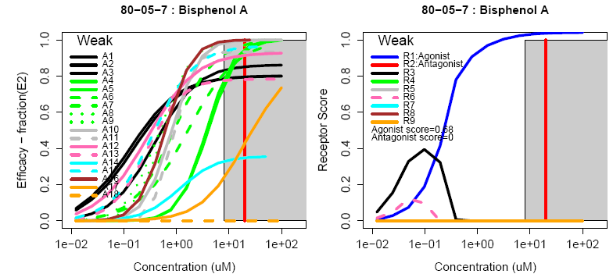
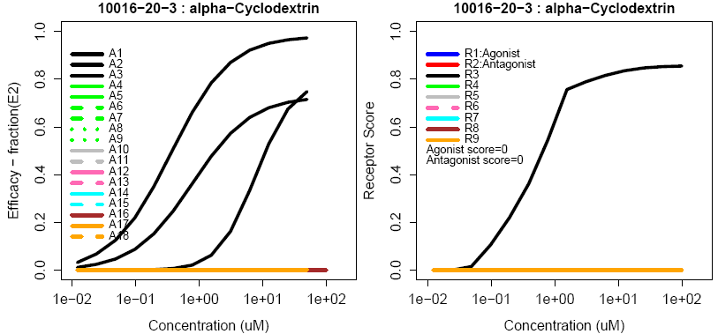
Example chemicals:
Observe quantitative uncertainty
True Agonist
Assay Interference Example “R3”

Slide 27
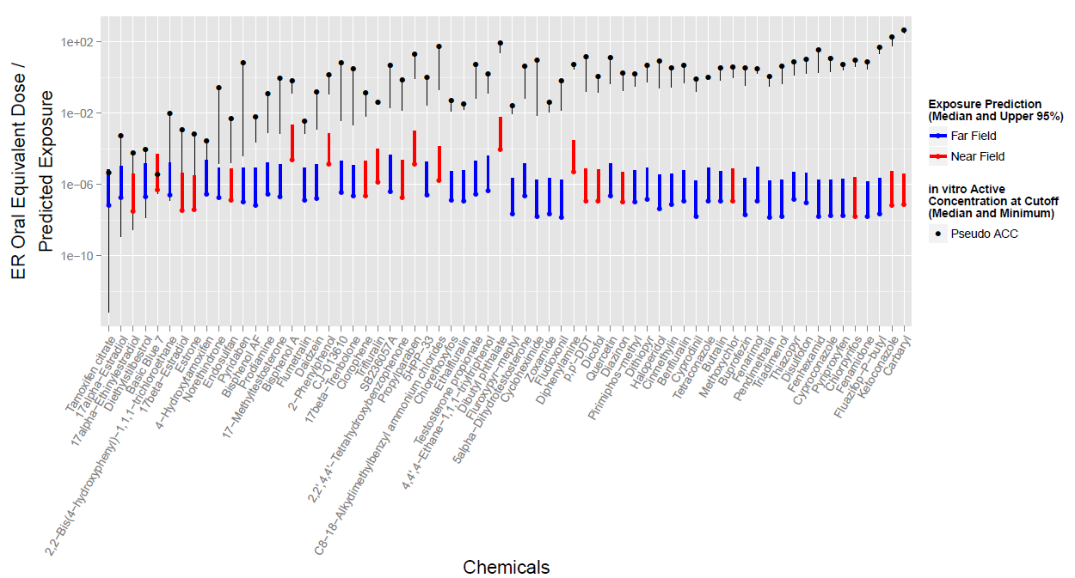
Prioritization (Replacement) Example
Compare predicted exposure and hazard POD
Compare estrogen receptor assay battery and exposure model

Slide 28

Toward a ‘Virtual Embryo’
Heart
NVU/BBB
Somite
Vasculature
Neural Tube
Limb-bud
Palate
Liver / GI
Testis / BTB
Genital Tubercle
Renal
Delivered
Underway
Future
Hester et al. (2011) PLoS Comp Bio; Dias et al (2014) Science
Kleinstreuer et al. (2013) PLoS Comp Bio.
Ahir et al. (MS in preparation).
Hutson et al. (2017) Chem Res Toxicol.
Leung et al. (2016) Reprod Toxicol.
Zurlinden/Saili et al. (FY17 product).
Hunter et al. (FY18 product).
Your name here.
Tom Knudsen Group, EPA NCCT

Slide 29
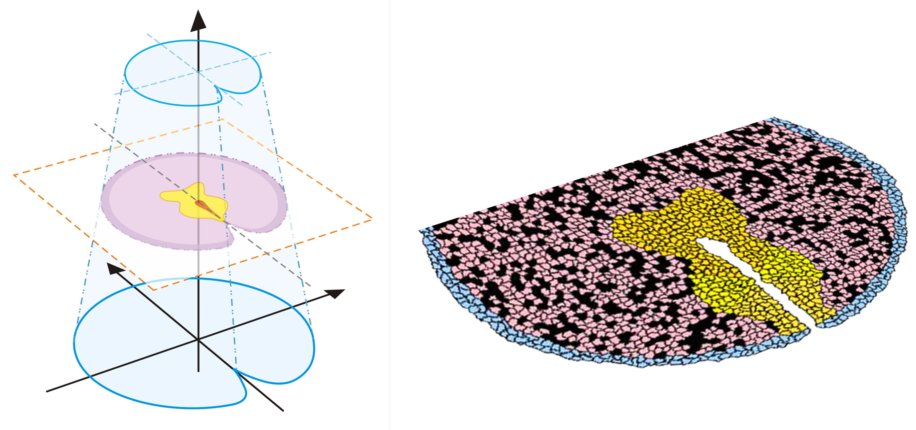
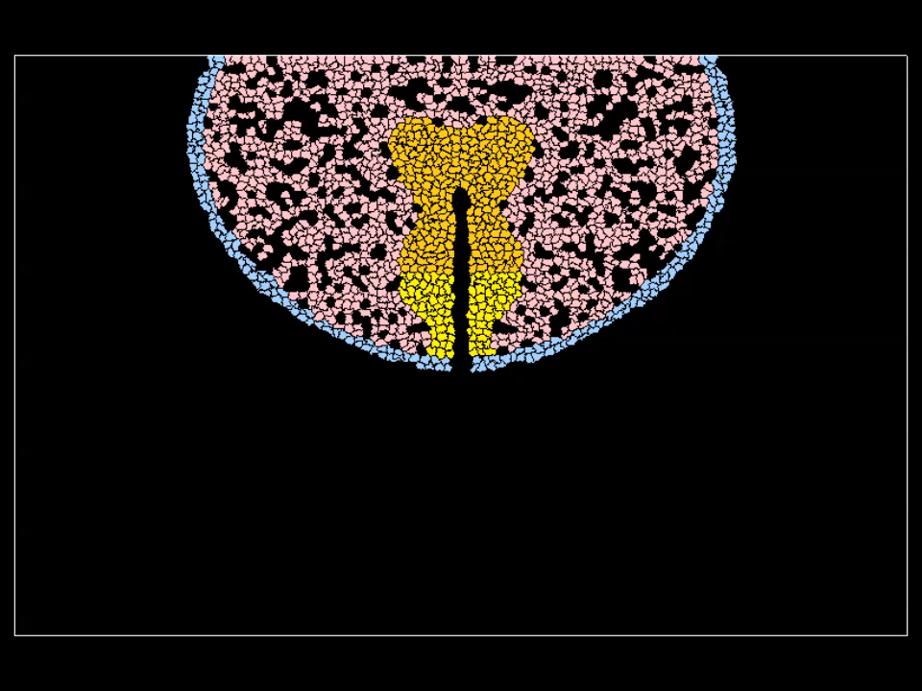
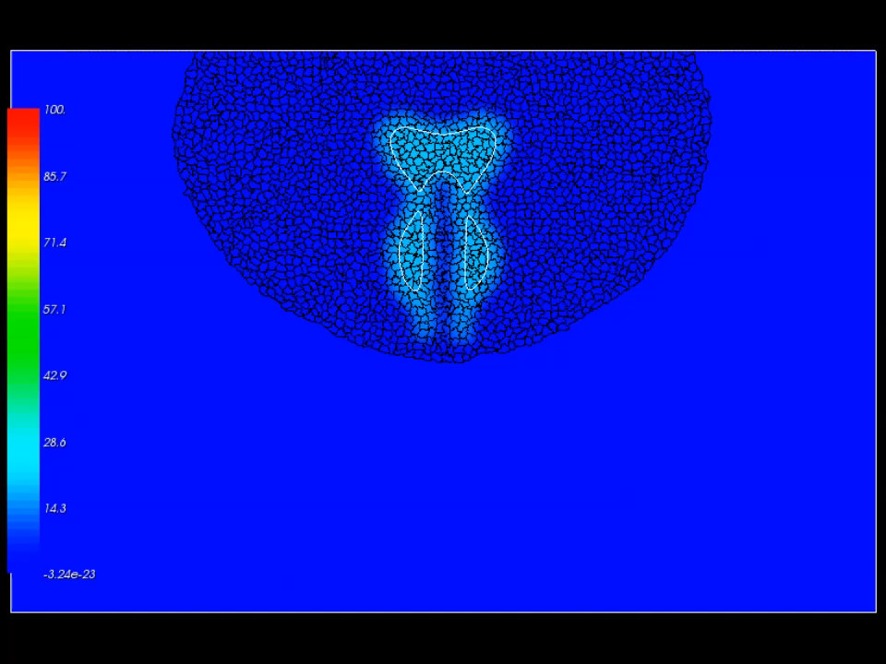
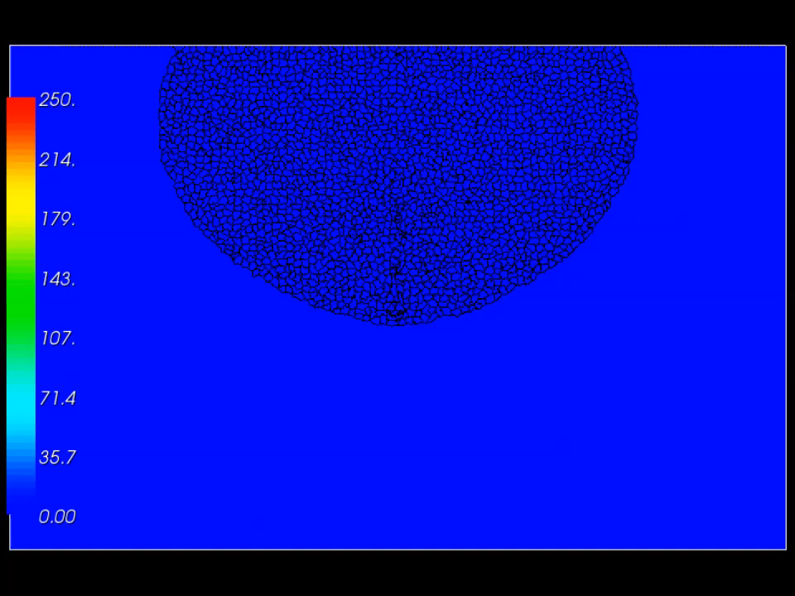
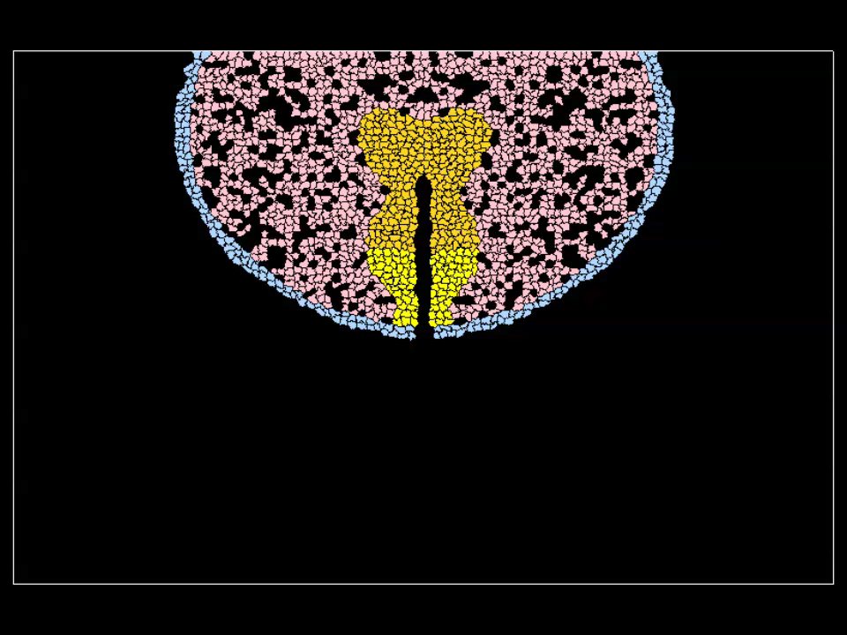

Model Genital Differentiation
Agent-based models, CompuCell3D
Genital tubercle (GT) Control Network (mouse)
ABM simulation for sexual dimorphism (mouse GD13.5 – 17.5)
androgen
SHH field
FGF10 field
no androgen
29
SOURCE: Leung et al. (2016) Reprod Tox

Slide 30
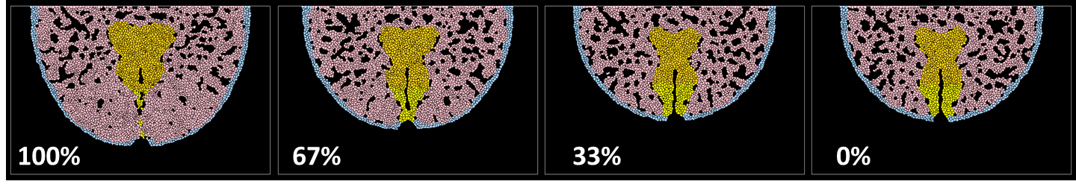
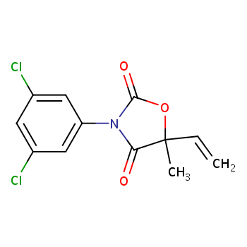
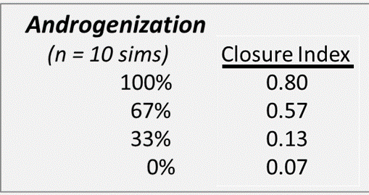
Hypospadias
Driven by urethral endoderm (contact, fusion apoptosis) and androgen-dependent effects on preputial mesenchyme (proliferation, condensation, migration) via FGFR2-IIIb.
androgen
vinclozolin
SHH
FGF

Slide 31
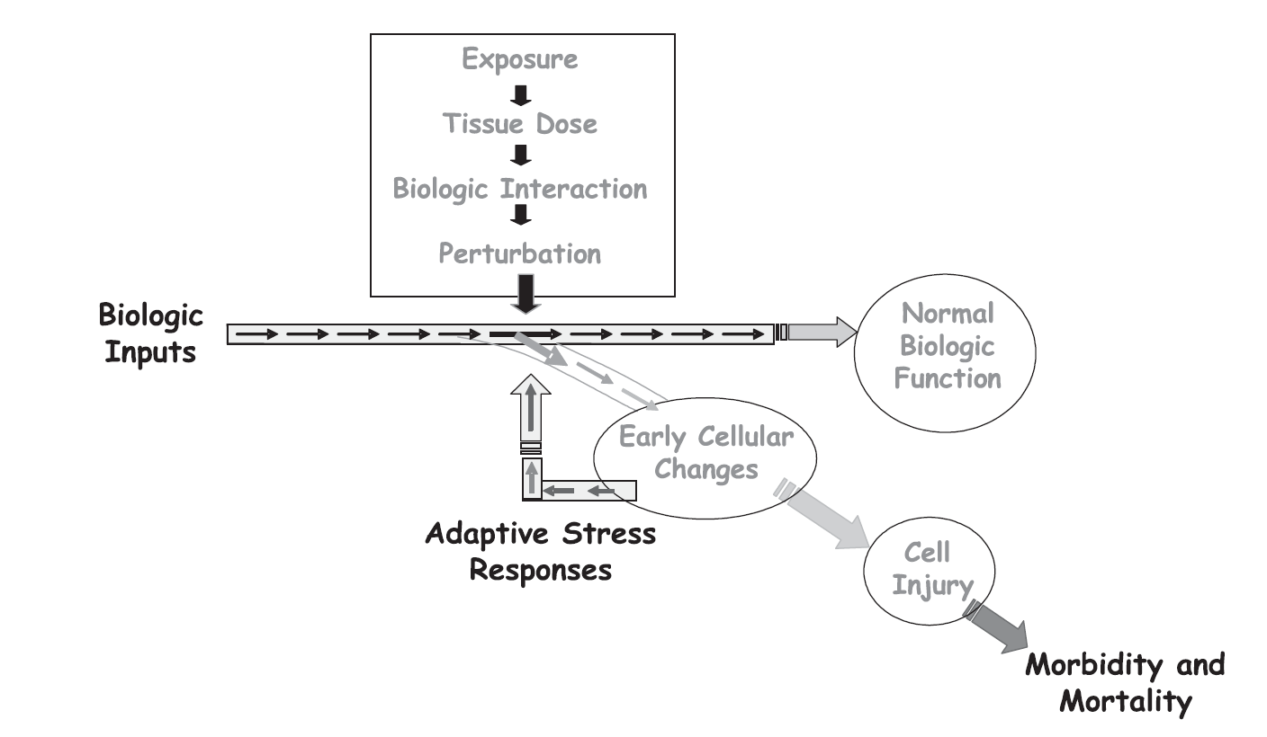
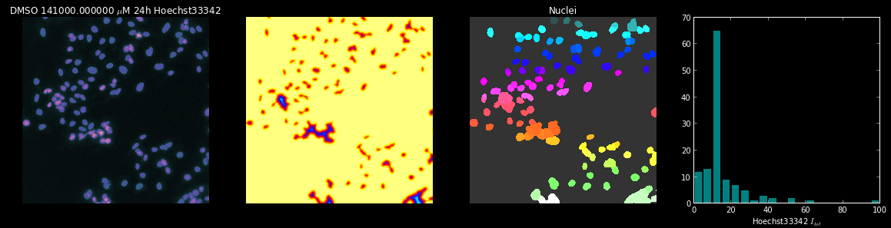
What is Adverse?
Discriminating between compensatory changes and changes that will lead to adverse outcomes
Tipping Point: Threshold between adaptation and adversity
Use ToxCast High Content Imaging (HCI) data to identify Tipping Points
967 chemicals (ToxCast)
HepG2 cells culture
10 concentrations
3 Time points
10 HCI Assays
400 plates
100,000 wells
2,400,000 images
Imran Shah Group, EPA NCCT

Slide 32
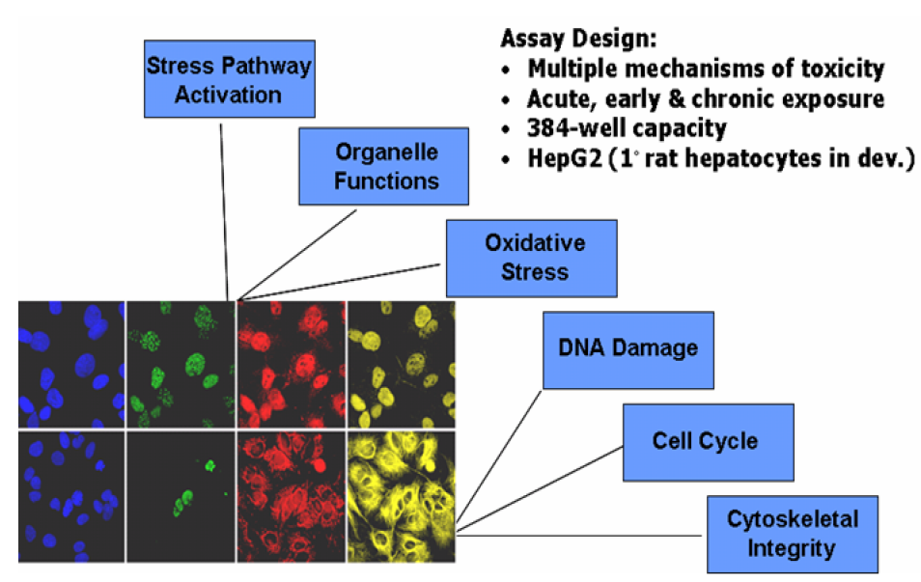
High Content Imaging (HCI)
Study
HepG2 cell culture
967 chemicals (ToxCast)
10 conc
HCI Assays
Health
Stress
Cellular perturbations
Dynamic phenotypic response of cells to chemicals
Large-scale data
~400 plates
~100,000 wells
~2,400,000 images
High-Content Imaging (HCI): multiplexed measurements on cell populations
HCI Conducted by Cyprotex, Inc.

Slide 33
Cell-State Data from Images
Raw Image
(Hoechst)
Intensity
Analysis
Object
Identification
Nuclear intensity
distribution
Image analysis and cell level feature feature extraction conducting by Cyprotex Inc. (proprietary software)
Notes:
33

Slide 34
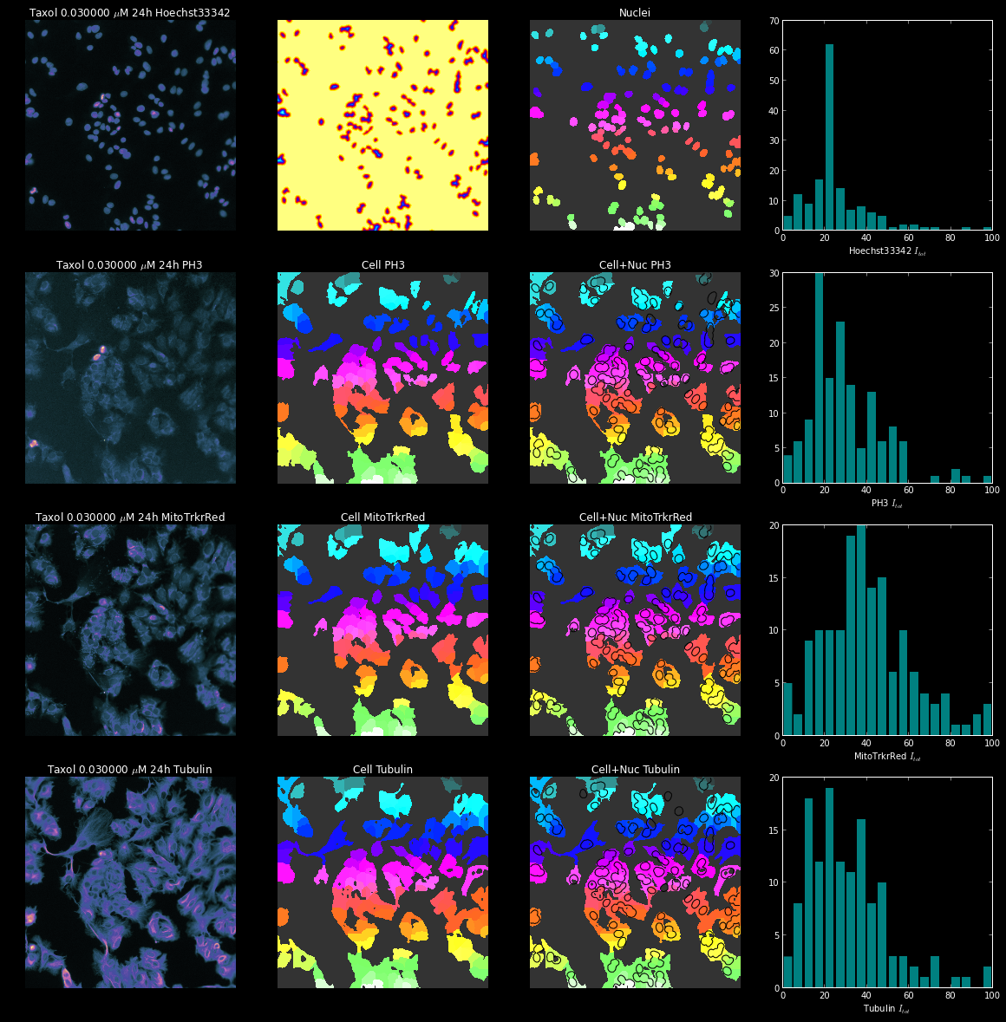
Data for Taxol 0.03uM
  nuclear size (NS)
  cell cycle arrest (CCA)
  cell number (CN)
Hoechst33342
Phospho-Histone3
  mitotic arrest (MA)
  Mitochondrial mass
  (MM)
  Mitochondrial membrane
  potential (MMP)
MitoTracker Red
Phospho-Tubulin
  microtubules (Mt)

Slide 35
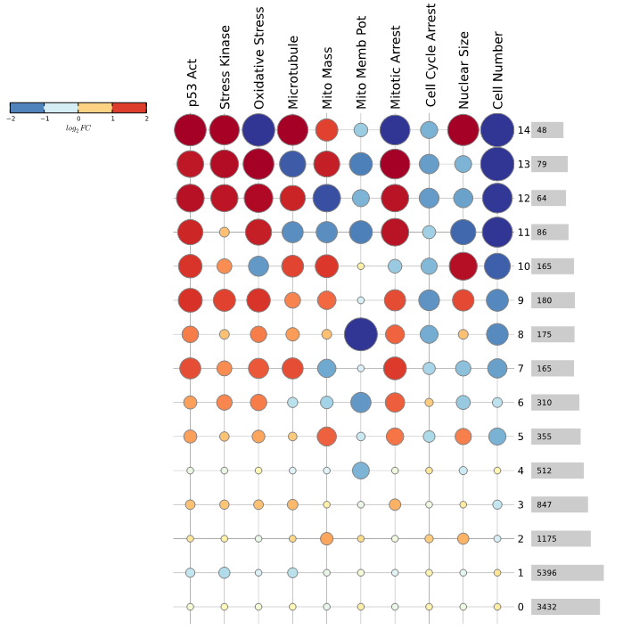
HCI to Phenotypic States
Derive “phenotypic “states” of HepG2 cells across all chemicals and concentrations
Phenotypic states could represent canonical behaviors of cells
Sate transitions indicate dynamic responses to chemicals
More adverse
“States” of HepG2 Cells
Less
adverse

Slide 36

System trajectories
“Normal” State
Fluazinam 0.78 uM
0h

Slide 37
System trajectories
State Transition
Fluazinam 0.78 uM
1h
0h

Slide 38
System trajectories
System trajectory
Fluazinam 0.78 uM
1h
24h
24h
0h

Slide 39
System trajectories
System trajectory
Fluazinam 0.78 uM
Trajectory=Sequence of states
1h
24h
24h
0h
72h

Slide 40

Fluazinam “Trajectories”
Tipping Point
Cell State
Increasing Dose

Slide 41







Next Big Thing – High-throughput Transcriptomics
From Design to Counts
Generate Cryopreserved
Cell Stocks
Cell Expansion
Targeted RNA-Seq
Cell Plating
Generating Cell Lysates
TempO-Seq WT:
Measure Gene Expression
Design – On Plate:
Standards
Positive controls
DMSO Controls
Test chemicals: 8 half-log spaced concentrations, 3 replicate plates
Complete design replicated for 3 times (6,12,24 hours) and 2 media.
Cell Dosing
wells
LabCyte Echo® 550 Liquid Handler
…
21,111 probes
…
randomization
Notes:
Cryovial: http://www.labmart.com/index.php?main_page=product_info&products_id=20937
Culture Flask: https://www.thermofisher.com/us/en/home/life-science/cell-culture/cell-culture-plastics/cell-culture-flasks.html
STR Profile: https://www.mti-globalstem.com/str-analysis
BioTek Multflo FX:
LabCyte Echo 550: http://www.selectscience.net/products/echo-550-liquid-handler/?prodID=13658
Cellomics: http://www.labotal.co.il/products/1359/4784.aspx

Slide 42
Data: Trust But Verify
We will worship Information
and our hearts will belong to Data
Steven Shapin (mystic)
You don’t believe data—you test data. If I could put my finger on the moment we genuinely screwed ourselves, it was the moment we decided that data was something you could use words like believe or disbelieve around.
Paolo Bacigalupi (scientist)

Slide 43
Models: Know your limits
“You have a big approximation and a small approximation. The big approximation is your approximation to the problem you want to solve. The small approximation is involved in getting the solution to the approximate problem.”
Origin Unknown: Maybe Douglas Bates. Though he attributed it to George Box, Box denied it.
Our first goal is prediction
Predictions are based on models
“All model are wrong”
All models are based on data, which is always subject to noise, variability
Therefore, all predictions are uncertain

Slide 44

National Center for Computational Toxicology
NCCT Staff
Rusty Thomas
Kevin Crofton
Keith Houck
Ann Richard
Richard Judson
Tom Knudsen
Matt Martin*
Grace Patlewicz
Woody Setzer
John Wambaugh
Tony Williams
Steve Simmons
Chris Grulke
Katie Paul-Friedman
Jeff Edwards
Chad Deisenroth
Joshua Harrill
Rebecca Jolley
Jeremy Dunne
NCCT Postdocs
Todor Antonijevic
Audrey Bone
Swapnil Chavan
Kristin Connors*
Danica DeGroot
Jeremy Fitzpatrick
Dustin Kapraun*
Agnes Karmaus*
Max Leung*
Kamel Mansouri*
Andrew McEachran
LyLy Pham
Prachi Pradeep
Caroline Ring*
Kate Saili
Eric Watt*
Todd Zurlinden
NCCT
Nancy Baker
Dayne Filer*
Parth Kothiya*
Sean Watford
Indira Thillainadarajah
Robert Pearce
Danielle Suarez
Doris Smith
Jamey Vail
Risa Sayre
Nathan Rush
NTP Collaborators
Warren Casey
Nicole Kleinstreuer
Mike Devito
Dan Zang
Rick Paules
Nisha Sipes
NIH/NCATS Collaborators
Menghang Xia
Ruili Huang
Anton Simeonov
* Graduates

