Slide 1
OECD IATA Case Studies for Fourth Review Cycle:
Screening Chemicals for Estrogen Receptor Bioactivity Using a Computational Model
U.S. Environmental Protection Agency
Office of Research and Development
Research Triangle Park, NC
Notes:
Authors – include Richard and Rusty? Others?
Title – need something shorter?

Slide 2
Introduction
The US Environmental Protection Agency’s (EPA) Endocrine Disrupting Screening Program (EDSP)
  established in response to Congressional mandates in the Federal Food Quality Protection and Safe Water Drinking Acts
  evaluating potential risk of endocrine disruption in humans and wildlife from exposure to pesticide chemicals and drinking water contaminants
  included a battery of five in vitro and six in vivo Tier 1 screening assays
Notes:
Too basic? Felt like this needed a bit of bkgd on EDSP before getting into the point of case study.

Slide 3
Introduction
EDSP has a mismatch between resources needed for Tier 1 and number of chemicals to be tested
  ~10,000 chemicals in EDSP Universe
  ~$1M per chemical for Tier 1, 50-100 year backlog
In 2012, EPA began a multiyear transition to prioritize and screen thousands of EDSP chemicals using computational and high-throughput assays.
Notes:
Can I say the mismatch bit? Or is that a sensitive point?

Slide 4
Proposed IATA Case Study
Proposed Case Study: Screening Chemicals for Estrogen Receptor Bioactivity Using a Computational Model
Purpose of Case Study:
  Demonstrate performance-based approach for measuring estrogen bioactivity using multiple high-throughput in vitro assays
  Model would be used to prioritize chemicals and replace selected EDSP Tier 1 assays
Notes:
I’m assuming the purpose of this is in part to demonstrate the approach as it will be used beyond ER. But if the purpose is specific to ER I can alter that.

Slide 5
Overall Approach
Integrate multiple high-throughput screening assays for key ER pathway events using a mathematical model that:
  considers biological and technological interference, and
  incorporates uncertainty
Apply performance based validation to ER pathway model by comparison of ToxCast ER model scores with:
  sets of reference chemicals with independently confirmed ER bioactivity in a validated test method
  results of EDSP Tier 1 guideline assays currently used to screen chemicals for endocrine bioactivity

Slide 6
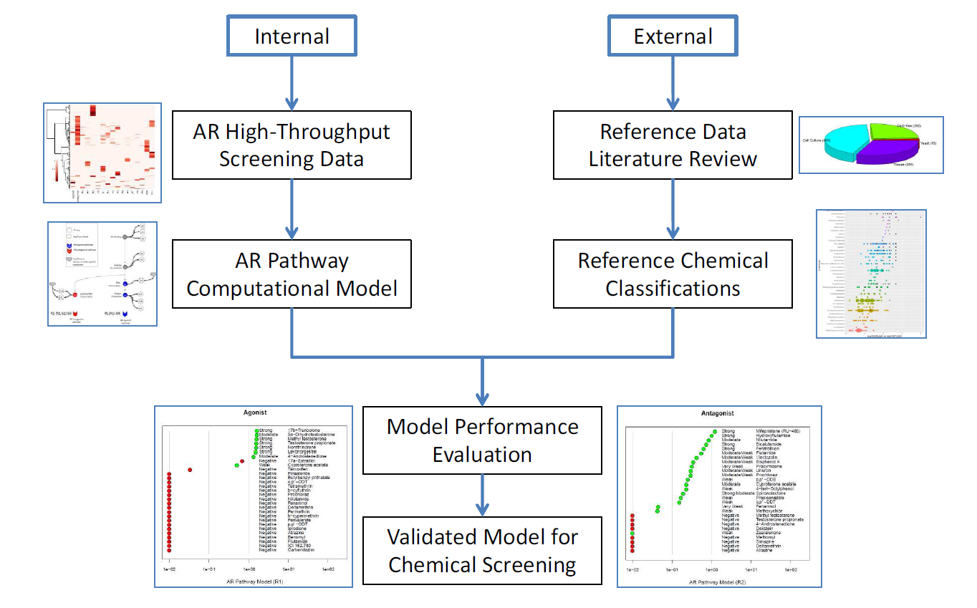
Overall Approach
Notes:
Need to change AR to ER -

Slide 7
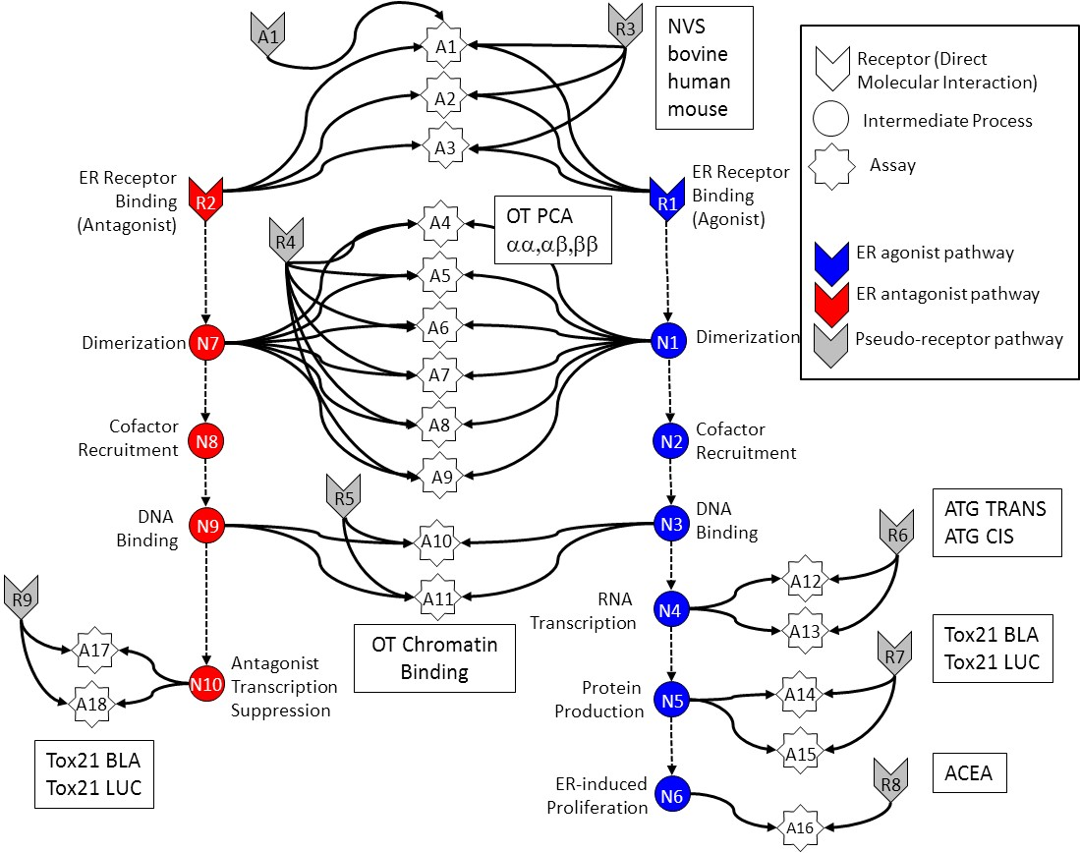
In Vitro Estrogen Receptor Model
Use multiple assays per pathway
  Different technologies
  Different points in pathway
No assay is perfect
  Assay Interference
  Noise
Use model to integrate assays
Evaluate model against reference chemicals
Methodology being applied to other pathways
Judson et al: “Integrated Model of Chemical Perturbations of a Biological Pathway
Using 18 In Vitro High Throughput Screening Assays for the Estrogen Receptor” (EHP 2015)
7
Notes:
Review manuscript to work up correct talking points for figure.

Slide 8
Key Points of the Model
Goal of the model is to distinguish true ER activity from false activity
Mathematically / statistically test multiple sources of activity:
  True agonist, true antagonist, several interference modes
  Quantify each mode by AUC value (area under the dose-response curve)
  Mode with highest AUC is assigned
8
Notes:
Beginning Question: If any one ER assay is active, is the chemical an ER ligand?
No: there can be false positive (and negative) activity
AUC is not potency, but potency values are provided

Slide 9
Proposed IATA Case Study
Proposed IATA case study:
  will include description of the development of a method to prioritize chemicals for further analysis based on potential for ER activity (agonist and antagonist)
    Integrate multiple HTS assays for key ER pathway events using a mathematical model that:
    Apply performance based validation to ER pathway model
  is intended to address how ER computational model can be applied to screening and prioritization of endocrine disrupting chemicals
9
Notes:
Do we need a slide at the end like this that shows what the case study will include?
Should it include the lit search used for reference chems for validation?
Somewhat redundant with earlier slides but thought having something like this at the end to tee up discussion made sense.

