Slide 1

Applications of National Center for Computational Toxicology (NCCT) Dashboards and Computational Toxicology Approaches
Richard Judson
U.S. EPA, National Center for Computational Toxicology
Office of Research and Development
ISES 2017
15 October 2017
The views expressed in this presentation are those of the author and do not necessarily reflect the views or policies of the U.S. EPA

Slide 2
Computational Toxicology: From Society to Sequences
Society puts T tons of chemical X into the environment
Person P is exposed to Y amount
Can we predict T, Y?
Can we predict the effect on P at the level of molecules, cells, tissues, organs?
Need to model biology that is multiscale, complex, non-linear
Multiple and often unknown sources of:
  Noise
  Variation
Goal: use data, models, algorithms to make predictions
Predictions are statistical, probabilistic

Slide 3
How far can we go with modeling biology?
Biology and computer science (e.g. bioinformatics) tell us that we are just algorithms embedded in flesh, soon to be replaced by silicon and metal.
We will worship Information and our hearts will belong to Data
Paraphrase of Steven Shapin, on the coming cyborg future
We’re all just cyborgs, random clanking assemblages inserted in circuits way beyond our understanding
Jenny Turner, commenting on Steven Shapin

Slide 4

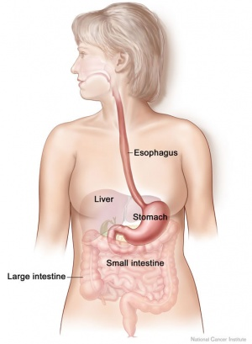
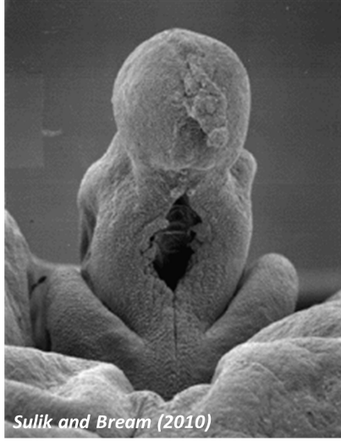
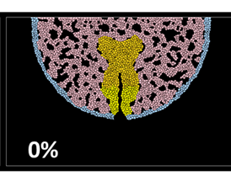
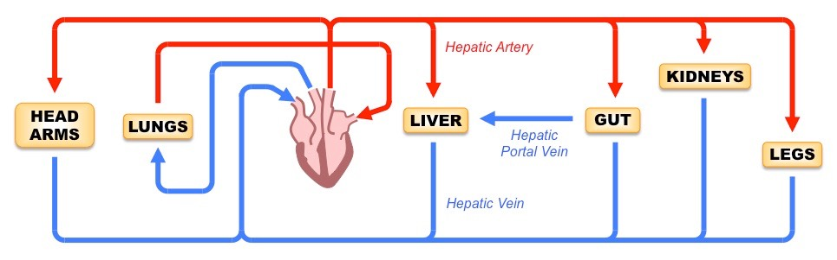
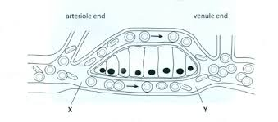
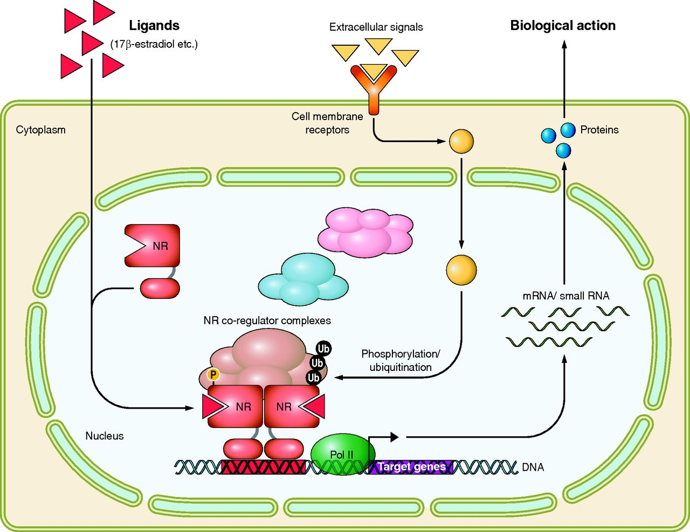
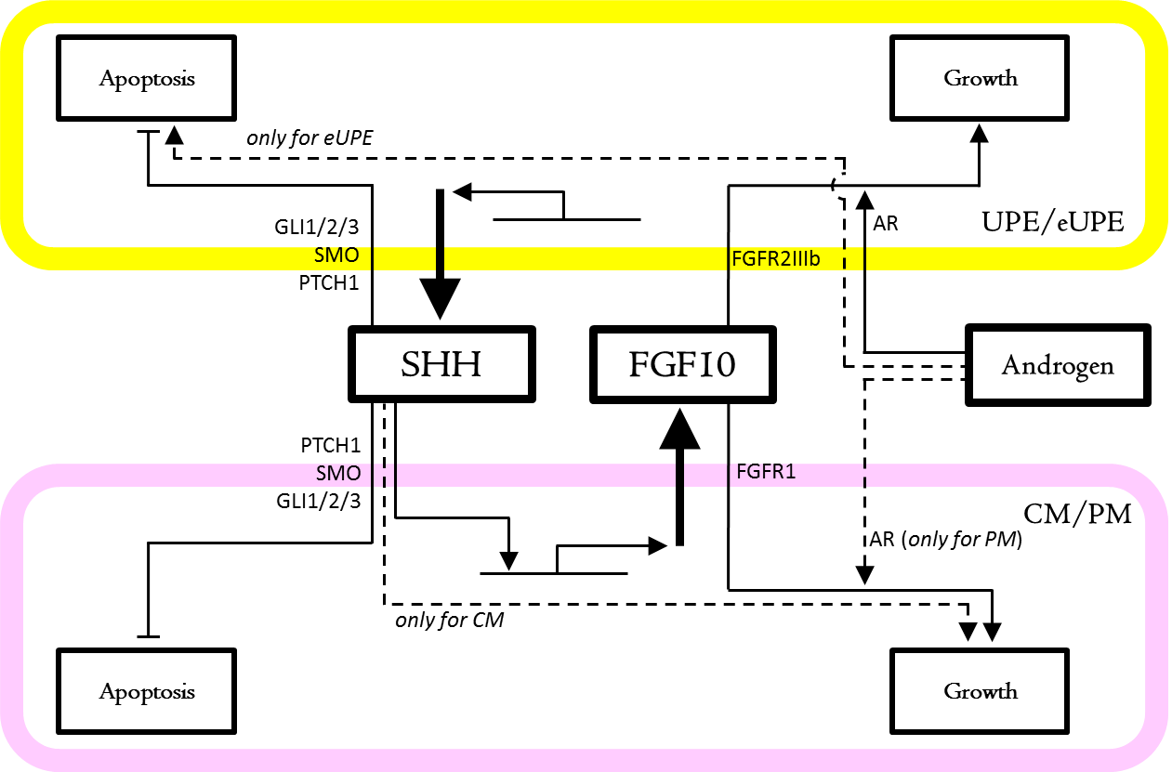
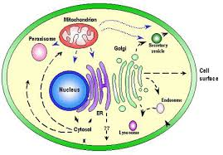
Multiscale
Chemical
Mouth
GI Tract
Blood
Liver
Tissues
Cells
Proteins/DNA
Molecular Circuits
Cells
Tissue
Organ
Organism

Slide 5
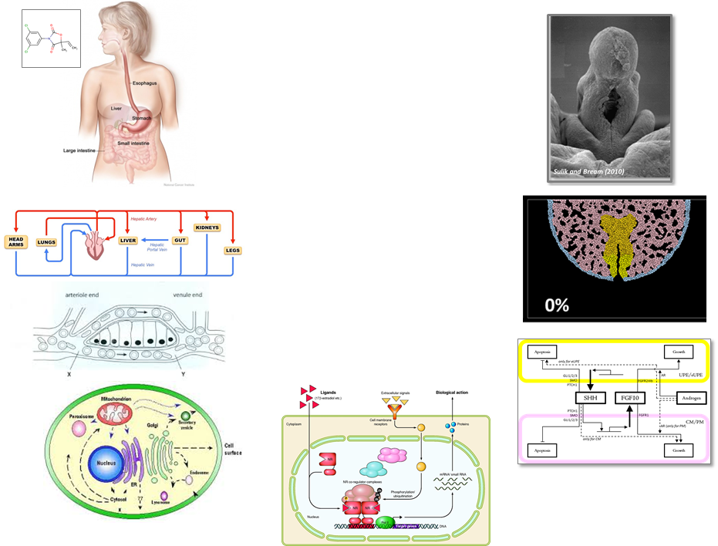




Risk-based Approach
Hazard + Exposure (+ uncertainty)
mg/kg BW/day
Kinetics
Dynamics
Hazard:
Kinetics
+
Dynamics
Exposure
Low
Priority
Medium
Priority
High
Priority

Slide 6
Computational Toxicology
Identify biological pathways of toxicity (AOPs)
Develop high-throughput in vitro assays
  Test “Human Exposure Universe” chemicals in the assays
Develop models that link in vitro to in vivo hazard
Develop exposure models
Add uncertainty estimates
Dynamics
Kinetics

Slide 7
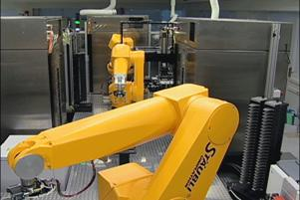

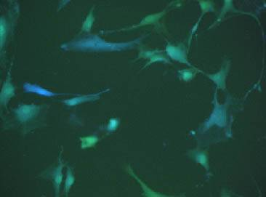
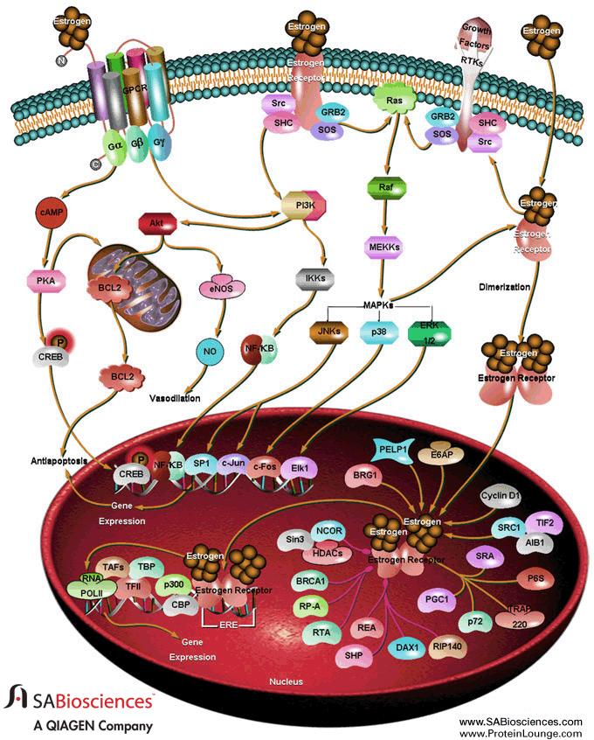
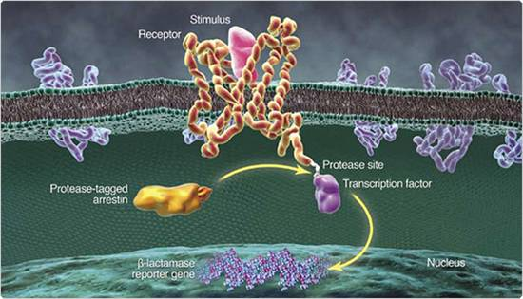
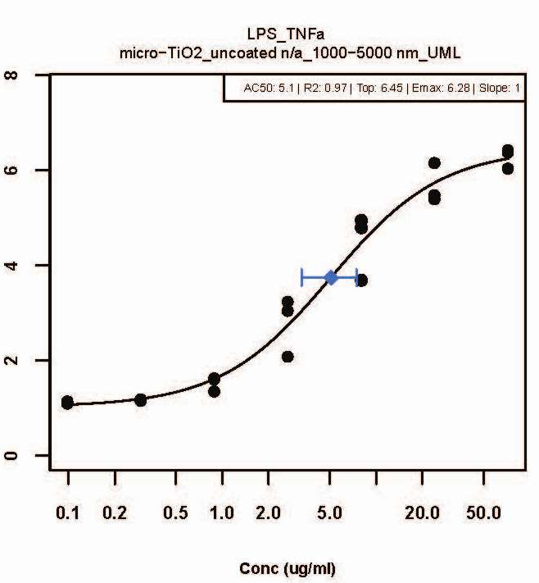
High-Throughput Screening 101 (HTS)
Chemical Exposure
Robots
96-, 384-, 1536 Well Plates
Cell Population
Pathway
Emax
Target Biology (e.g., Estrogen Receptor)
Response
LEC
AC50
7
Conc (uM)

Slide 8
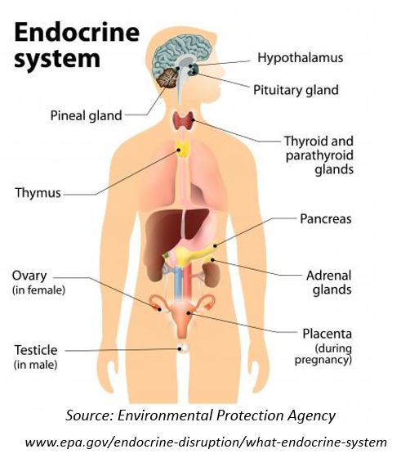

Typical Risk Assessment Problem:
Identifying Endocrine Disruptors
Chemicals that mimic natural sex hormones can have significant effects years to decades after exposure (e.g. DES)
There are 10,000s of chemicals to be evaluated
Can we screen for these in an efficient way?
Can we understand the uncertainty of our results?

Slide 9
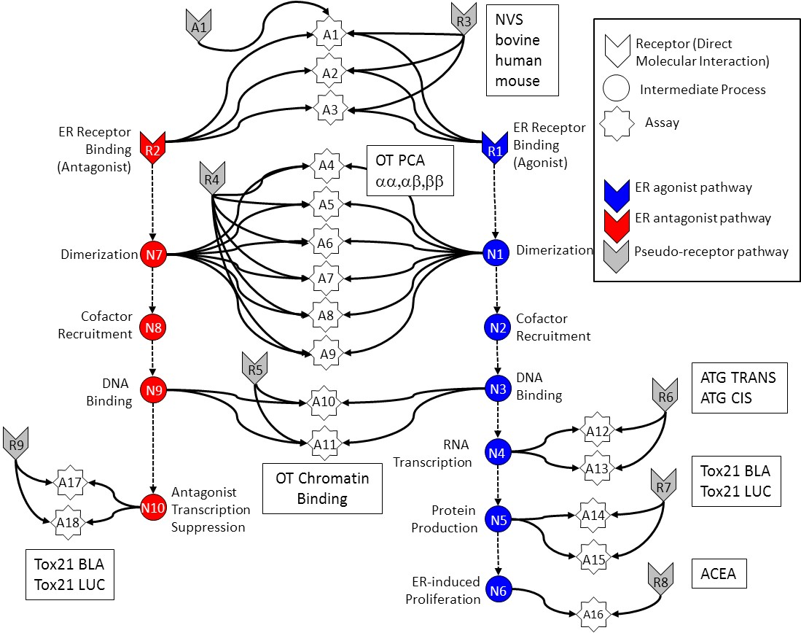
In Vitro Estrogen Receptor Model
No in vitro assay is perfect
  Assay Interference
  Noise
Use multiple assays per pathway
  Different technologies
  Different points in pathway
Use model to integrate assays
Evaluate model against reference chemicals
Judson et al: “Integrated Model of Chemical Perturbations of a Biological Pathway
Using 18 In Vitro High Throughput Screening Assays for the Estrogen Receptor” (EHP 2015)

Slide 10
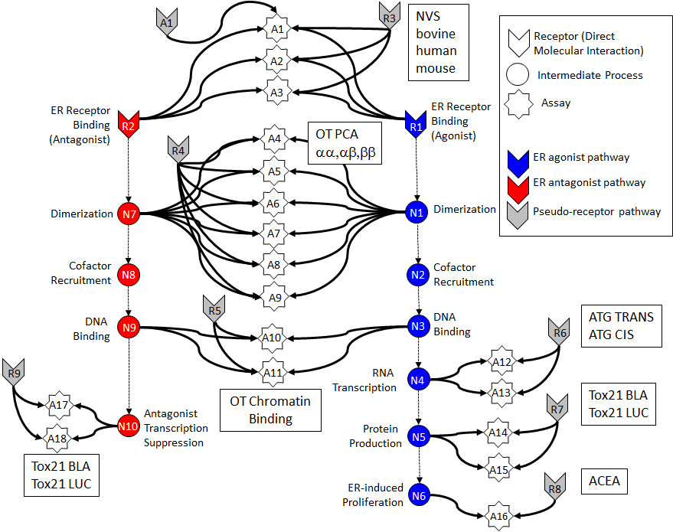

Slide 11
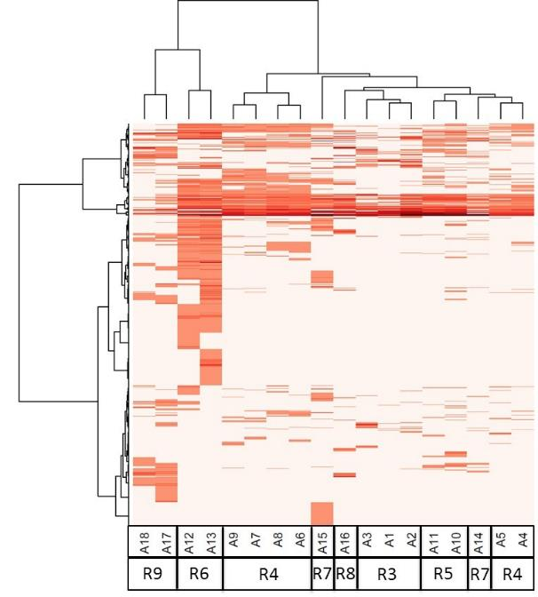
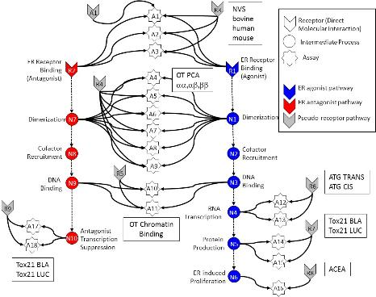
All In vitro assays have false positives and negatives
Much of this “noise” is reproducible
“assay interference”
Result of interaction of chemical
with complex biology in the assay
Chemical universe is structurally diverse
Solvents
Surfactants
Intentionally cytotoxic compounds
Metals
Inorganics
Pesticides
Drugs
Assays cluster by technology,
suggesting technology-specific
non-ER bioactivity
Chemicals
Assays
Judson et al: ToxSci (2015)

Slide 12
Schematic explanation of non-specific activity
Specific
Non-specific
Oxidative Stress
DNA Reactivity
Protein Reactivity
Mitochondrial stress
ER stress
Cell membrane disruption
Specific apoptosis
…

Slide 14
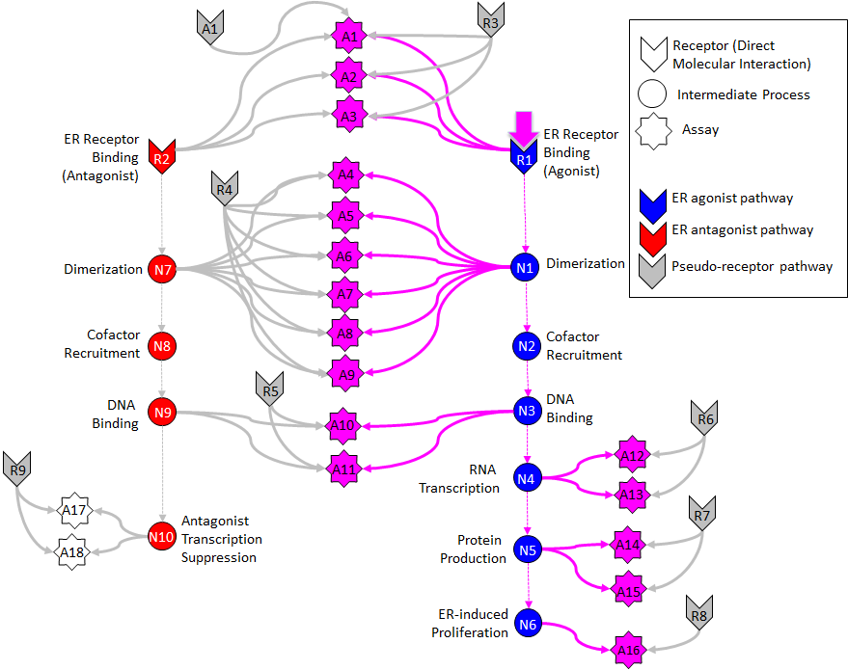

Slide 15
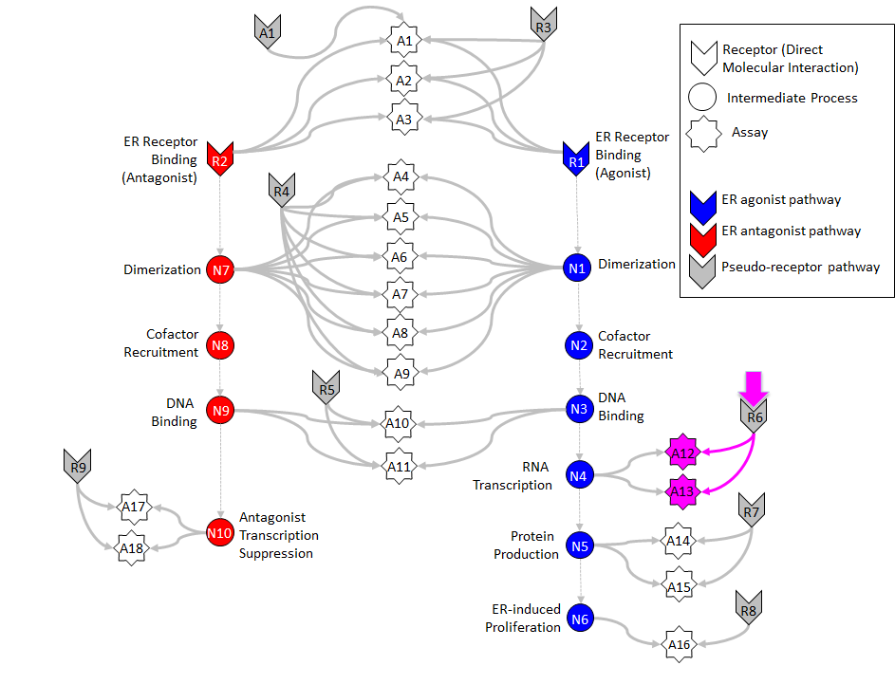

Slide 16
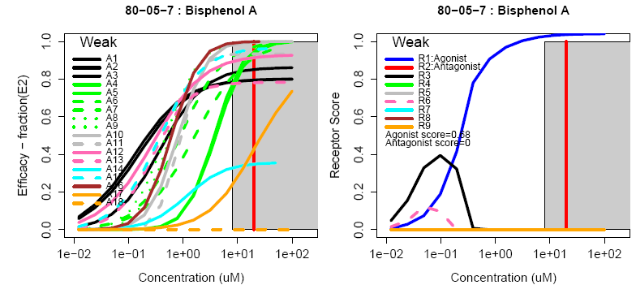
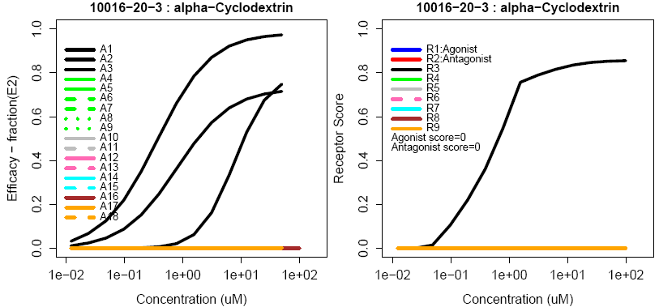
Example chemicals:
Observe quantitative uncertainty
True Agonist
Assay Interference Example “R3”

Slide 17
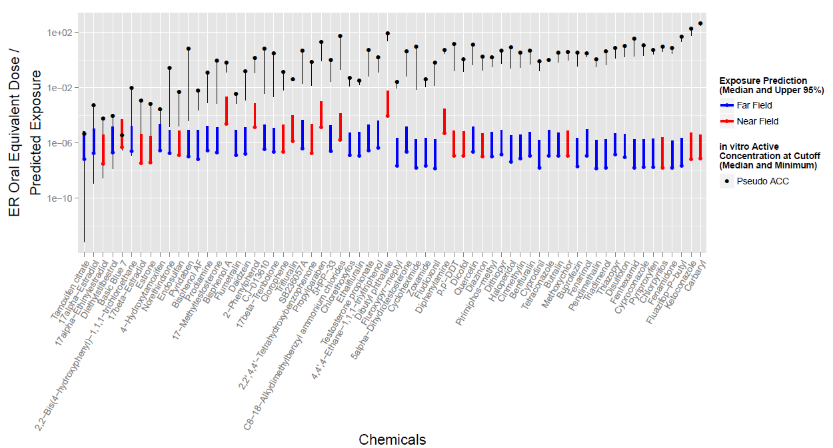
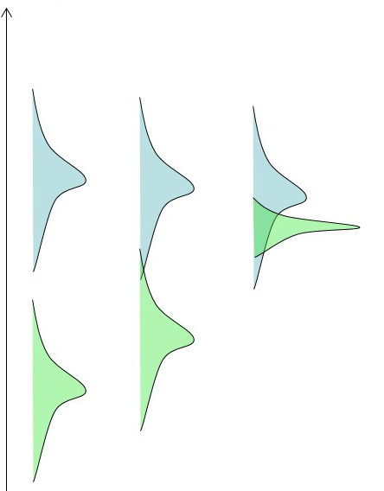
Compare predicted exposure and ER hazard
Hazard
Exposure

Slide 18
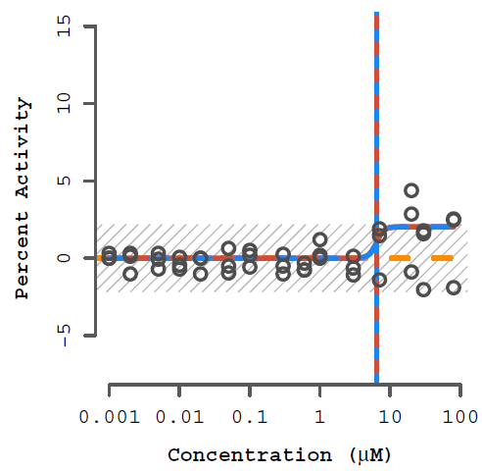
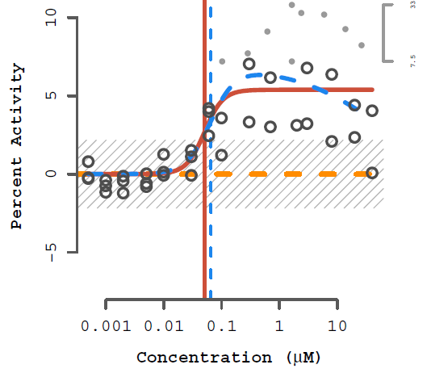
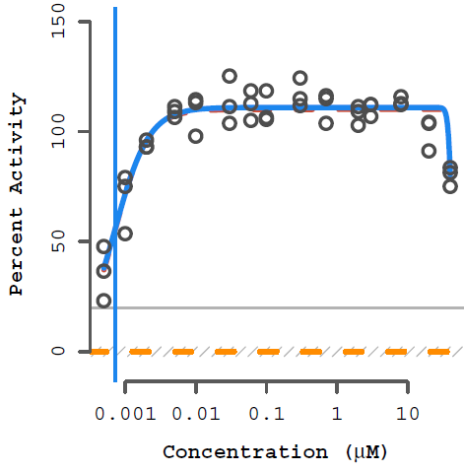
What does the in vitro data look like?
Data is run in concentration response
Multiple replicates
May require background subtraction, normalization, outlier removal
Processing at NCCT uses tcpl (ToxCast Pipeline), an R-language package on CRAN

Slide 19
Now, Where is the data?
ToxCast Dashboard
https://actor.epa.gov/dashboard
EDSP21 Dashboard
https://actor.epa.gov/edsp21

