Slide 1

RapidTox / CompTox Dashboard Supporting Screening-Level Risk Assessments
Richard Judson
U.S. EPA, National Center for Computational Toxicology
Office of Research and Development
August 7, 2017
The views expressed in this presentation are those of the author and do not necessarily reflect the views or policies of the U.S. EPA

Slide 2
RapidTox Project Goals
Provide easy access to high-quality (high-tier) data as inputs to risk assessments, when available
Provide lower tier data when higher-tier is not available
Develop and provide modeled inputs when even lower-tier data in not available
All data and models will be made available through the CompTox Dashboard
Types of data / models to be provided is client-dependent

Slide 3
Superfund / OLEM Use Case
A site contains 500 chemicals
To evaluate, you need (for instance)
Screening levels
Other hazard information (carcinogenicity, corrosivity, etc.)
Fate and transport information
Ecotoxicology information
What happens when data is not readily available?
CompTox system aim allow easy access to high-tier data, and to provide usable estimates to fill data gaps

Slide 4
Specific Example: Screening Levels
Tier 1,2 RfD
(IRIS/PPRTV)
Missing Tier 1,2 RfD
Use “Tier 3+” RfDs
Use “Tier 3+” NOAELs with conservative UF
Use modeled NOAELs with conservative UF
Fate&Transport
RSL Formulas
Database contains many chemicals with Tier 3+ PODs
POD models (IVIVE or QSAR) are being developed
RSL values
“Not-RSL” values

Slide 5
OLEM Project
1505 “data-poor” chemicals of interest to OLEM and Regions
Data Priorities
In vivo hazard data
PODs (especially RfDs to RSLs)
target class (chronic, cancer, repro, dev)
Read-across hazard predictions
QSAR hazard models
ToxCast-based hazard models
ADME / Pharmacokinetics
Physchem properties / environmental fate and transport / bioavailability
Use Information
Literature summary
Analytical chemistry methods for detection in environmental media
Uncertainty analyses

Slide 6
RapidTox Data, Model domains
Human hazard:
Acute
Chronic
DevTox
ReproTox
Mutagenicity, genotoxicity
Eco hazard
Exposure
Use
Physchem, Fate and Transport
GHS classifications

Slide 7
Hazard Data Sources
Data is contained in the ToxVal database
~3000 chemicals with repeat-dose studies
ToxRefDB (OPP actives, literature, NTP)
EPA IRIS
EPA PPRTV
EPA RSL
ACToR (collection)
COSMOS (FDA and Cosmetics Europe)
ECHA
EFSA
Health Canada
EPA HEAST
HESS (Japan)
EPA HPVIS
IARC
Pennsylvania DEP
RAIS
RIVM
RSEI
Wignall
ToxCast

Slide 8
Exposure Data Sources
NHANES-derived quantitative screening-level exposure models (SEEM2 and SEEM3)
Detailed exposure models (SHEDS-HT)
Data on chemical use and formulations (CPCat and CPDat)
EPA IUR and TRI production volume and release
OSHA and USGS sampling data
Pharmacokinetics
Used to convert ToxCast in vitro potency to oral equivalent dose

Slide 9
Physchem Data Sources
DSSTox (720,000 chemicals)
Details chemical identity and structure
NCCT PhysChem Database
Experimental properties
Models
OPERA – NCCT open source physchem models
EPA EPISuite
EPA T.E.S.T.
Other open source and commercial models

Slide 10
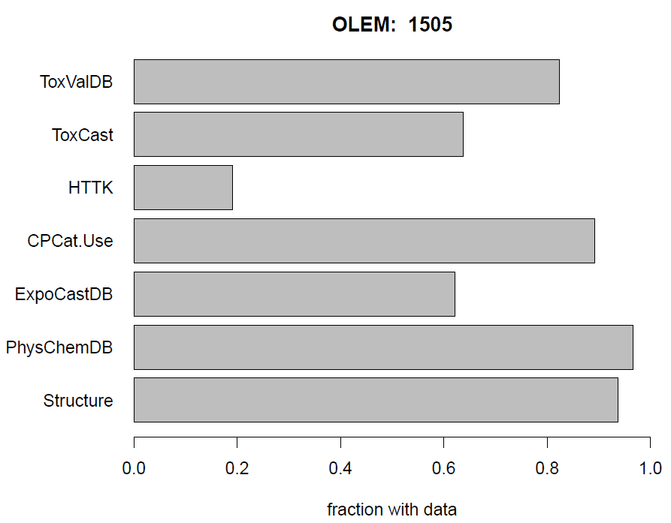
Data coverage for the OLEM chemical Set
In vivo POD

Slide 11
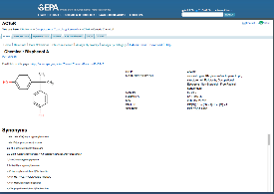
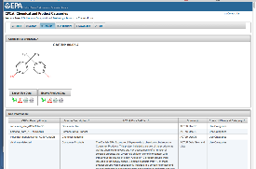
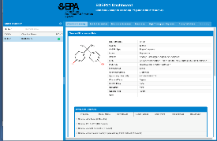
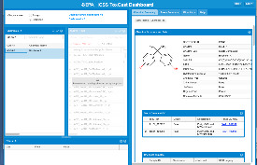
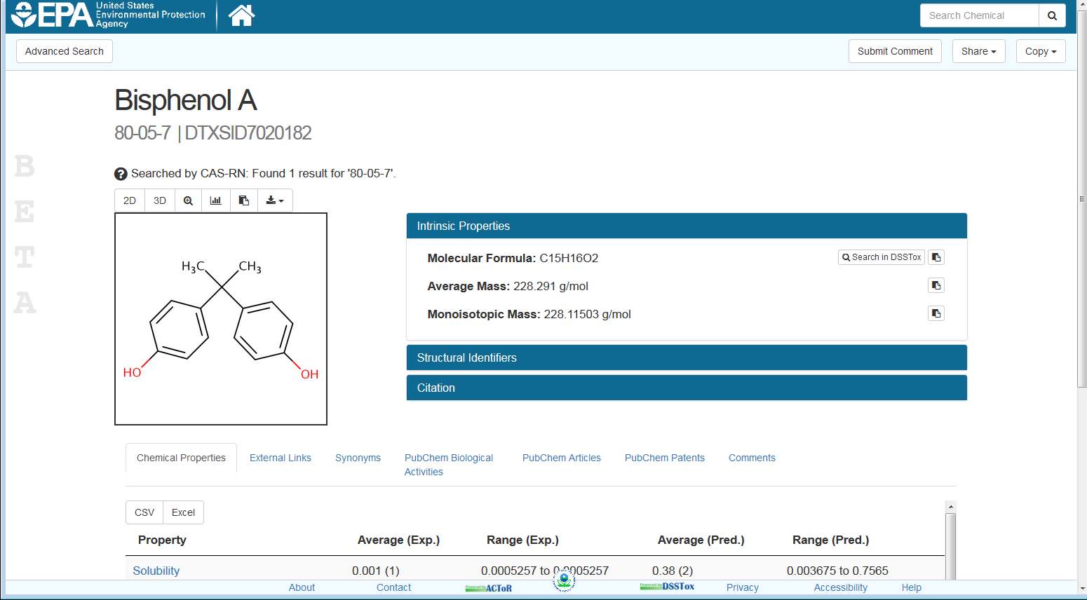
NCCT Software Architecture
Dashboards
Databases
DSSTox: Chemistry
PhysChemDB
ToxRefDB: Hazard Details
ToxValDB: Hazard Summary
InVitroDB: ToxCast
ExpoCastDB: Exposure
CPCat: Chemical Use
ACToR: Multiple Types
PKDB: Toxicokinetics
LitDB: Open Literature
ACToR
Web Services
CPCat
Models
EDSP21
ToxCast
CompTox

Slide 12
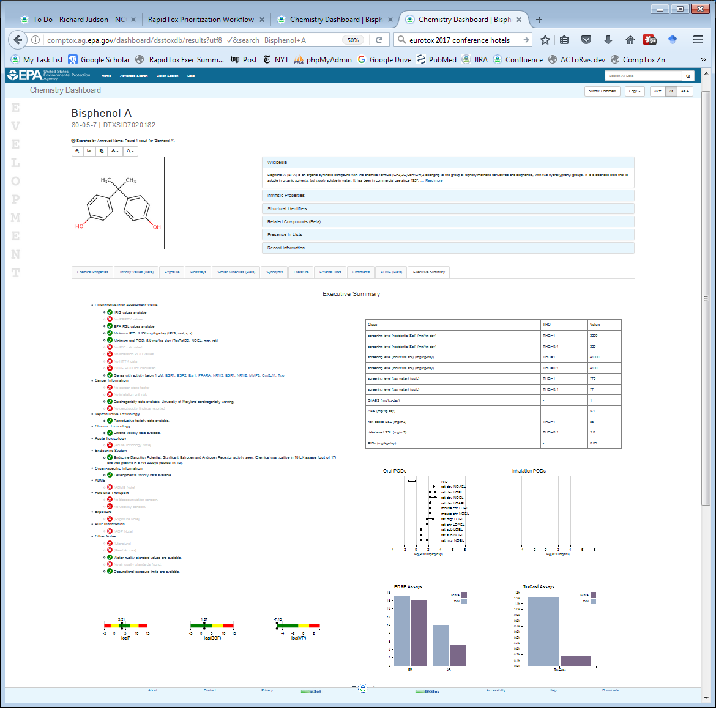
RapidTox Executive Summary Page
Summary
Chemical Information
RSL
Table
Summary Text
POD charts
Fate and Transport Indicators

Slide 13
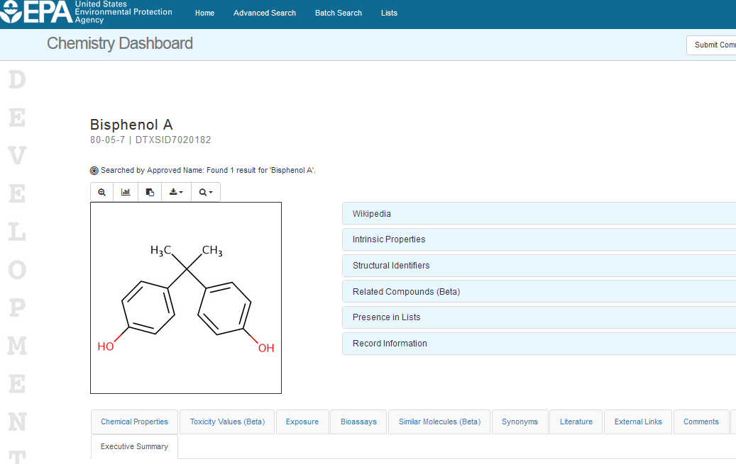

Slide 14
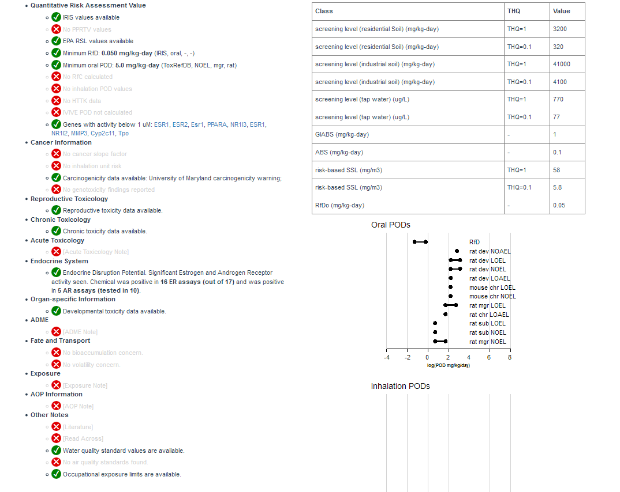

Slide 15
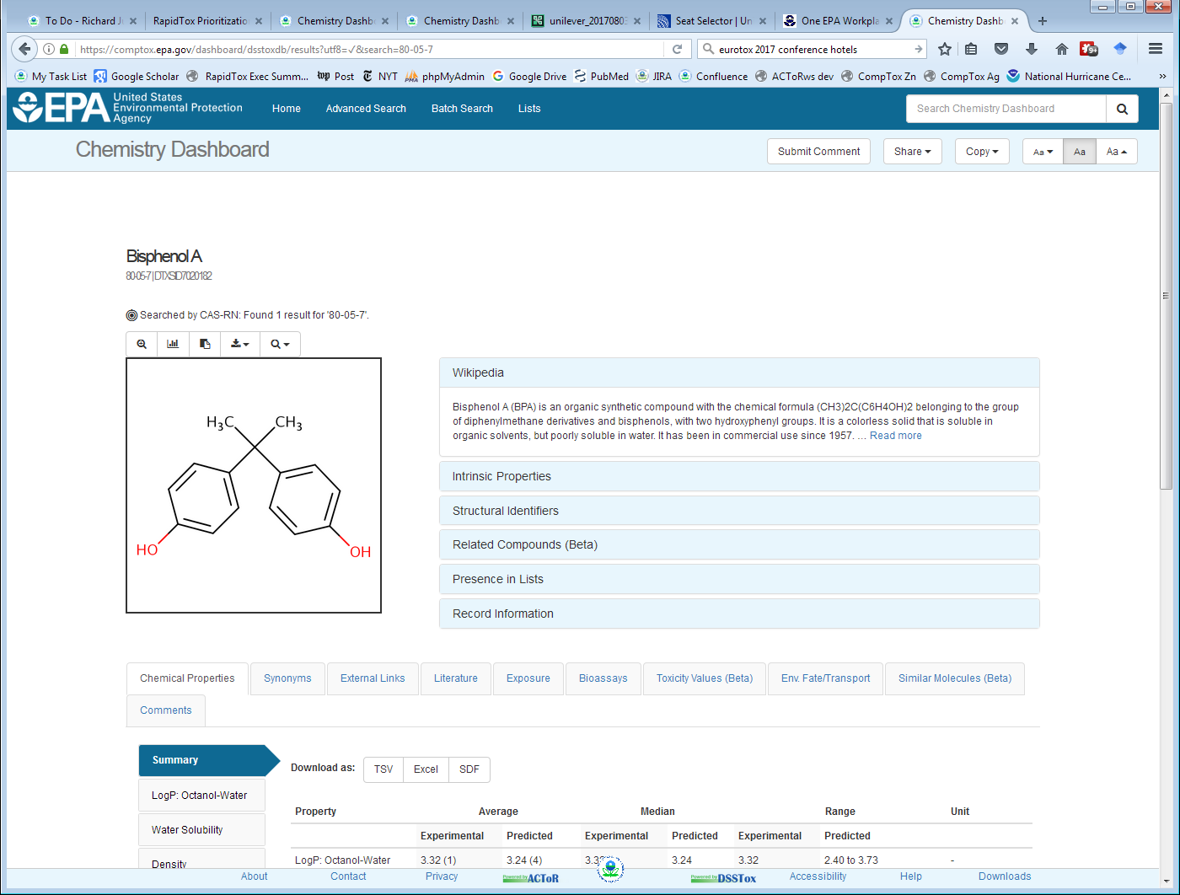
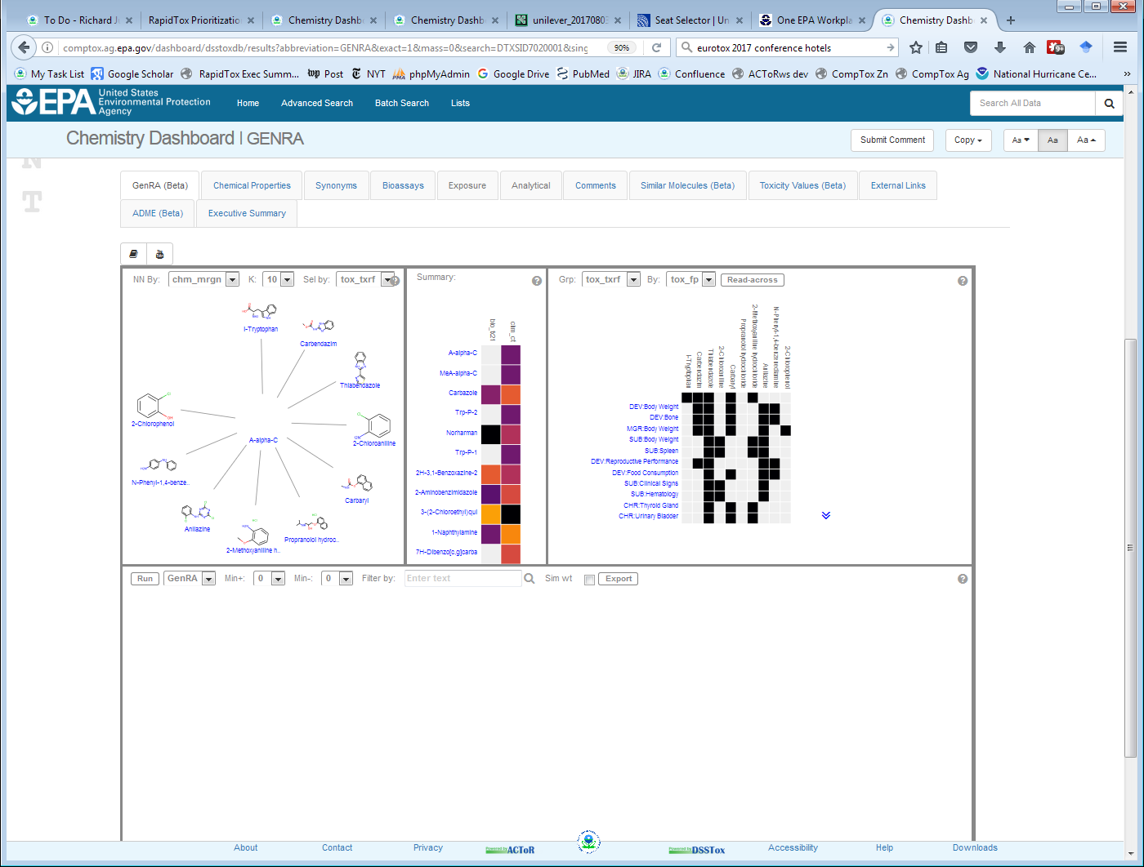
Demo of Dashboard
CompTox Dashboard
GenRA tool
Development: https://comptox.ag.epa.gov
Production / Public: https://comptox.epa.gov

Slide 17
Demo of Dashboard
http://comptox.ag.epa.gov/dashboard/chemical_lists/genra
CompTox Dashboard
GenRA tool
http://comptox.ag.epa.gov/dashboard/dsstoxdb/results?utf8=%E2%9C%93&search=Bisphenol+A

Slide 18
Prioritization Project (OPP, OPPT)
Develop databases and tools to help in screening-level prioritization efforts
Hazard
Exposure
Physchem (e.g. persistence, bioaccumulation)
Applications to TSCA “pre-prioritization”, OPP inerts prioritization plan and others

Slide 19
Hazard Scoring
Quantitative hazard information: score 1, 2, 3 in each domain based on toxvalue (LOEL, NOEL, RfD, LD50, etc.)
Acute, subchronic, chronic, cancer, devtox, reprotox, neurotox, genetox
Cutoffs for categories 1 (low concern) to 3 (high concern) depend on route (oral, inhalation, dermal)
If no in vivo data is available, use models (ToxCast + HTTK and QSAR)
Qualitative hazard information: score 1,2,3 based on model predictions of specific organ effects (GenRA model)
Endocrine disruption potential (ER and AR)

Slide 20
Exposure scoring
Add points 1 to 3 for
IUR production volume
TRI release levels
Industrial use
Commercial use
Presences in children’s products
Biomonitoring in various media (blood, food, environment)
Quantitative exposure estimated (SEEM3, SHEDS-HT)

Slide 21
Physchem Score
Add points 1 to 3 for:
Bioaccumulation
Persistence
Calculated from OPERA models
Limited to single organic molecules
No mixtures
No inorganics, organometallics

Slide 22
Overall prioritization
Method 1: TSCA 2012
Add up maximum score from each domain (hazard, exposure, physchem)
Total scores from 3 to 9
Method 2: Add up total scores
E.g. in hazard, could get 3 points each for chronic, subchronic and cancer
Total scores from 13 to 64 for TSCA chemicals
Problem: Over-weights well-studied chemicals
Method 3: Predicted “Hazard Exposure Ratio” (HER)
Like margin of exposure
Minimum oral POD / maximum predicted quantitative exposure
HER from 2.2 (concern) to 10¹⁴ (no concern)

Slide 23
Results for the TSCA list
Top 10 chemicals from each scoring scheme
Method 1 (TSCA 2012)
Method 2 (Total score)
Octamethylcyclotetrasiloxane
BDE-209
1,2,5,6,9,10-Hexabromocyclododecane
Dibenz(a,h)anthracene
Benz(a)anthracene
Benzo(a)pyrene
1-Hexadecanol
3,3',5,5'-Tetrabromobisphenol A
2,4,6-Tris(tert-butyl)phenol
Hexachloro-1,3-butadiene
Bisphenol A
Styrene
Ethylbenzene
4-(1,1,3,3-Tetramethylbutyl)phenol
Di(2-ethylhexyl) phthalate
Trichloroethylene
Formaldehyde
Naphthalene
Benzyl butyl phthalate
Tetrachloroethylene
Method 3 (HER)
Red text indicates chemicals are in top 10 for more than one method
N-Nitrosodimethylamine
1,2-Dichloropropane
Aniline
Trichloroethylene
Formaldehyde
Naphthalene
Dioctyl phthalate
Carbon tetrachloride
Di(2-ethylhexyl) phthalate
4-Chloro-2-methylaniline

Slide 24
Chemical Name | OPPT score | difference | RapidTox score
Hexabromocyclododecane (HBCD) | 9 | 0 | 9
Decabromodiphenyl ethers (DecaBDE) | 9 | 0 | 9
Phenol, isopropylated, phosphate (3:1) (iPTPP) | 9 | 3 | 6
Trichloroethylene (TCE) | 8 | 1 | 7
Tetrachloroethylene (PERC) | 8 | 1 | 7
p-Dichlorobenzene | 8 | 1 | 7
1,1,2-Trichloroethane | 8 | 1 | 7
Tribromomethane (Bromoform) | 8 | 1 | 7
Hexachlorobutadiene | 8 | 0 | 8
4-tert-Octylphenol; 4-(1,1,3,3-Tetramethylbutyl)-phenol | 8 | 1 | 7
Phosphoric acid, triphenyl ester (TPP) | 8 | 1 | 7
Pigment Yellow 83 | 8 | 3 | 5
2,4,6-Tris(-tert-butyl)phenol | 8 | 0 | 8
Vinyl chloride | 8 | 1 | 7
Octamethylcyclotetra-siloxane (D4) | 8 | -1 | 9
Creosotes | 8 | 1 | 7
1,2-Dichloropropane | 7 | 0 | 7
Benzenamine | 7 | 0 | 7
Formaldehyde | 7 | 0 | 7
Naphthalene | 7 | 0 | 7
Carbon tetrachloride | 7 | 0 | 7
Di-ethylhexyl phthalate (DEHP) | 7 | 0 | 7
1,2-Dichloroethane | 7 | 0 | 7
Acrylonitrile | 7 | 0 | 7
Methylene chloride | 7 | 0 | 7
Tris(2-chloroethyl) phosphate (TCEP) | 7 | 0 | 7
Acetaldehyde | 7 | 0 | 7
o-Dichlorobenzene | 7 | 0 | 7
Benzene | 7 | 0 | 7
Ethylene dibromide | 7 | 0 | 7
Ethylbenzene | 7 | 0 | 7
trans-1,2-Dichloroethylene | 7 | 0 | 7
1,4-Dioxane | 7 | 0 | 7
N-Nitroso-diphenylamine | 7 | 0 | 7
2,5-Furandione | 7 | 0 | 7
4,4'-Methylene bis(2-chloroaniline) | 7 | 0 | 7
Dibutyl phthalate (DBP) | 7 | 0 | 7
Butyl benzyl phthalate (BBP) | 7 | 0 | 7
bis(2-Ethylhexyl) adipate | 7 | 0 | 7
1,1-Dichloroethane | 7 | 0 | 7
1-Bromopropane | 7 | 0 | 7
1,3-Butadiene | 7 | 0 | 7
Styrene | 7 | 0 | 7
Phthalic anhydride | 7 | 0 | 7
p-Xylene | 7 | 0 | 7
m-Xylene | 7 | 0 | 7
Bisphenol A (BPA) | 7 | 0 | 7
1,2-Dimethoxyethane (Monoglyme) | 7 | 0 | 7
N-Methyl-2-pyrrolidone (NMP) | 7 | 0 | 7
tert-Amyl methyl ether | 7 | 0 | 7
4,4'-(1-Methylethylidene)bis[2,6-dibromophenol] (TBBPA) | 7 | -1 | 8
3,3'-Dichlorobenzidine | 7 | 0 | 7
1-Hexadecanol | 7 | -1 | 8
Triglycidyl isocyanurate | 7 | 0 | 7
p,p'-Oxybis(benzenesulfonylhydrazide) | 7 | 0 | 7
Dicyclohexyl phthalate | 7 | 0 | 7
3,3'-Dichlorobenzidine dihydrochloride | 7 | 0 | 7
bis(2-Ethylhexyl) -3,4,5,6-tetrabromophthalate (TBPH) | 7 | 1 | 6
o-Xylene | 7 | 0 | 7
2-Hydroxy-4-(octyloxy) benzophenone | 7 | 0 | 7
1,3,4,6,7,8-Hexahydro-4,6,6,7,8,8-hexamethylcyclopenta [g]-2-benzopyran (HHCB) | 7 | 0 | 7
4-sec-Butyl-2,6-di-tert-butylphenol | 7 | 1 | 6
2-Dimethylaminoethanol | 7 | 0 | 7
Barium Carbonate | 7 | 0 | 7
Di-isodecyl phthalate (DIDP) | 7 | 0 | 7
Di-n-octyl phthalate (DnOP) | 6 | -1 | 7
Di-isononyl phthalate (DINP) | 6 | -1 | 7
Di-isobutyl phthalate (DIBP) | 4 | -3 | 7
Comparing TSCA 2014 Update with RapidTox scores
Exclude mixtures, “Data Gap” chemicals
Most scores are within 1 point

Slide 25
What is RapidTox?
Goal: Provide tools to allow risk assessors to perform first-order (rapid, screening level ,…) risk assessments on one or many chemicals relatively rapidly
Tools:
Data, models, workflows, dashboards
Models can be used to:
Fill data gaps
Integrate different kinds of models (e.g. prioritization)

