Slide 1
Enhancing Control of Childhood Asthma in AI/AN Communities
Indian Health Service Yakama Medical Clinic
And Northwest Portland Area Indian Health Board
Managing Asthma through Medicine and Healthy Living Environments
A grant from the National Institutes of Health

Slide 2



Common Indoor Air Quality Pollutants
Radon
Mold
Particulate Matter
Volatile Organic Compounds (VOCs)
Secondhand Smoke
Biological Pollutants
Pests and pesticides

Slide 3
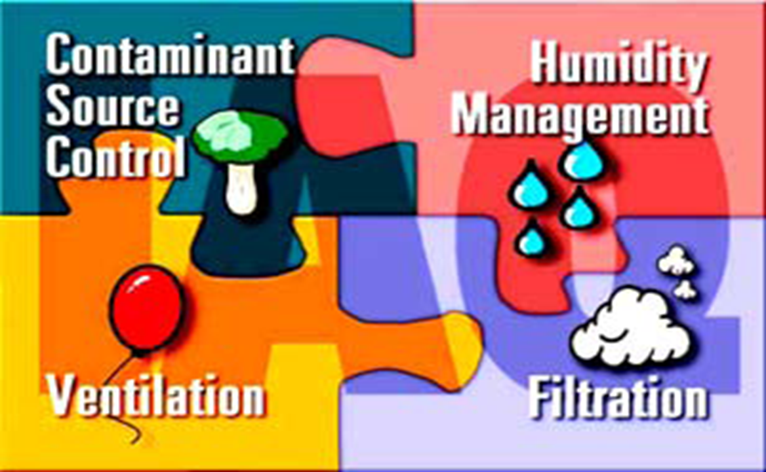

Indoor Air Quality (IAQ) and Health
Immediate Effects
Irritation to eyes, nose, throat
Headache, dizziness, fatigue
Long-Term Effects
Respiratory Disease
Heart Disease
Cancer
Death

Slide 4
Asthma
Washington Department of Health reports that American Indians/Alaska Natives have a higher prevalence of asthma than the general population in the State of Washington.
The asthma education and management grant is designed to improve self-management and to reduce use of emergency rooms for management.

Slide 5
Summary of 2018 IHS Pilot Program
66.6% of referrals from IHS clinic elected to allow at least one asthma management home assessment.
77.7% of the asthma home assessments resulted in an environmental modification or habit modification (i.e. no pets in the bedroom, etc.).
47% reported a decrease usage in rescue medication usage.
90% of patients with improved control – initial diagnosis with asthma symptoms not well-controlled; later self-reported or were diagnosed with asthma symptoms as well-controlled.
Notes:
Program targeted all asthma patients at the Yakama IHS clinic; both children and adults. NIH grant focused on childhood asthma in 3 tribes.

Slide 6
Summary Urgent Care 2018
52.9% of total enrolled patients had one or more Urgent Care (UC) visits to either the IHS Ambulatory Clinic or other outside clinic with asthma as the Purpose of Visit (POV) before the first home asthma assessment.
11.7% of total enrolled patients had UC visits as POV up to one year after the first home assessment.

Slide 7
Summary of Hospital Visits 2018
47% of participating patients were seen at Emergency Room for asthma symptoms eval. chart 1 year before asthma home assessment program enrollment.
17.6% of patients seen at Emergency Room for asthma symptoms after first asthma home assessment within 3 month time period, evaluated at 2nd home visit.
14 total ER visits decreased to 3 total at the end of a year’s participation; 78.5% reduction.

Slide 8
Highlights 2018
Good response from Yakama Nation Housing Authority in addressing deficiencies in YN owned homes.
3 family relocations to better housing.
1 removal of all carpeting and cleaning of ductwork by Yakama Nation Housing Authority.
Replacement of old woodburning stoves for EPA certified cleaner burning models through YN EMP

Slide 9
Identification of unique insect asthma trigger.
1 hospital admission prevented.
Increased integration between clinical staff & environmental health program.
Partnership with EPA.
Increased participation by word-of-mouth.
YN Housing Authority addressing home deficiencies in general.

Slide 10
Northwest Portland Area Indian Health Board
Yakama Ambulatory Medical Clinic
Child patients w/ moderate to severe asthma.
Three tribes participating in the study.
Three visit model; tracks implementation of recommendations and asthma control diagnosis.
IHS pharmacy sets up appointment for home assessment; pharmacy is the hub for information flow.
Home assessment includes intervention materials: bedding encapsulation, low VOC cleaning supplies, HEPA vacuum cleaner, and patient education- triggers mitigation and med. usage.
Report of findings to IHS clinical provider, report is placed into patient’s EHR by pharmacy.
Liaison with Tribal Programs for remediation or correction of deficiencies; i.e. leaking roof, pipes, bad ventilation, etc.; if the home qualifies for assistance.
Modified to a virtual process because of pandemic; loan patient tablet and mobile hot spot.

Slide 11
Current NIH Study
33 patients enrolled for Yakama
51 home visits completed to date, including 2nd and 3rd visits.
Higher participation level since going virtual
Study will be ending
2 other tribes in the study
Preliminary results show decrease in asthma rescue medication usage and the majority of homes made lasting environmental or habit modifications to their residences for Yakama

Slide 12
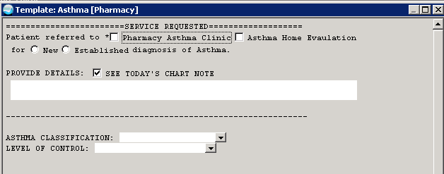
EHR Template for Home Visits

Slide 13


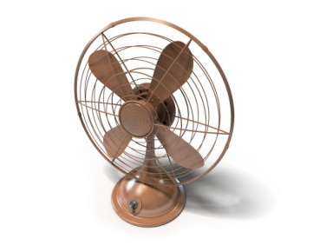



Health-Environment-Housing Referral Network
Review or Monitor Medical Records
Healthcare Provider Assesses Patient
Provider Refers Patient to Specialist
Environmental Specialist Conducts Home Assessment
Specialist Makes Recommendations & Conducts Health Education; findings entered into patient’s EHR
Occupant Changes Behavior &/or Housing Is Improved
Goal: Reduce Patient Asthma Exacerbations & Asthma Rates in Tribal Communities

Slide 14
Resources
https://cdn.indiancountryecho.org/wp-content/uploads/2022/04/1.4-Asthma-Need-to-Know-Mature-Audience.pdf
https://cdn.indiancountryecho.org/wp-content/uploads/2022/04/1.2-Childrens-Inhaler-Comparison.pdf
https://cdn.indiancountryecho.org/wp-content/uploads/2022/04/1.3-peak-flow-meter-handout.pdf

Slide 15
Asthma Toolkit
https://cdn.indiancountryecho.org/wp-content/uploads/2022/04/Asthma_Toolkit.pdf

