Slide 1
Quinault Diesel Emission Reduction Act
Jonathan Law, Jim Darmiento, Aaron Evich
EPA Biennial Meeting 11/10/2022

Slide 2
DERA
How to Reduce Emissions
  Using Technologies like
    Idle reduction,
    Engine replacement
  Eligible vehicles, engines and equipment
    Marine vessels
    School busses
  Grant Types
    National
    Tribal
Notes:
Techologies available- Verified Retrofit, Verified idle rection, verified aerodynamic, verified low rolling resistance tires, cerified engine replacemnets and conversion and certified vehicle or equipment replacement. Noting why these are important to the tribe and how they may help improve air quality
Eligible veicles Marine Engines on fishing and other vessels, Nonroad engines, equipment , School buses, Electrified parking spaces, Heavy duty highway vehicles, Locomtive engines
Grants National, Tribal, School bus and State

Slide 3
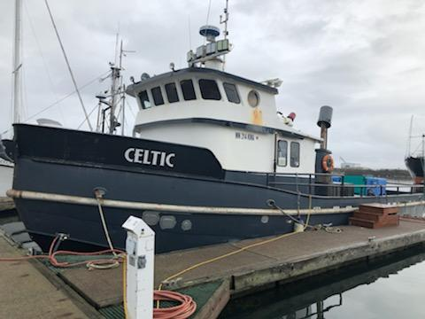
Phase 1 FY 18/19
F/V Celtic
Replaced 2 propulsion engines and 1 auxiliary
  Proposed reductions by 42% Nitrogen Oxides (Nox), Particulate Matter (PM) 2.5 by 83% and Hydrocarbon (HC) by 73.2%
$223,543

Slide 4
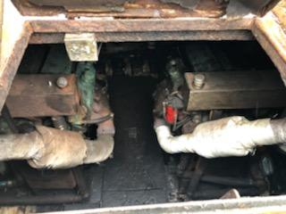
Phase 1 FY 18/19 F/V Celtic
Success
  Phased approach
  Out of Scope of DERA
  Communication
Challenges
  Wastage
  Hydraulics
This project is completed
Notes:
Phase 1 FY 18/19
First DERA applicant to replace marine engines. We replaced engines on the Celtic. It was a learning project because it was the first, but for the most part it was successful. Our DERA team worked with the vessel Owner to come up with a phased approach to complete the project. In this way the vessel owner got an opportunity to work on projects out of the scope of DERA ei, plumbing, blasting the engine room, and other projects. There were not too many challenges to this project, but when replacing some things there was wastage which was not accounted for. However, this wastage did not delay the project. Another challenge was figuring out how the hydraulics would move when everything was replaced and back into the water.

Slide 5
Phase 2 FY 20
Fishing Vessel Lady Debbie
Replacement of main engine and auxiliary engine
  Proposed reduction of Nox 32%, PM2.5 by 76.4% and HC 55.6%
$200,000

Slide 6
Phase 2 FY 20 Lady Debbie
Challenges-
  Didn’t account for out of scope work, left on island, last minute,
  Trouble with Vendor- weren’t timely, ordered wrong part, lost certified techs- delaying,
  CoVid
Success
  Completed
Learning for next time
  Explain expepted ideals for the project
Completed
Notes:
Phase 2 FY 20
The lady Debbie. The Lady Debbie had the main engine and an auxiliary engine replaced. This project did not go as smooth as the previous years. Challenges started with communication with vessel owner and our DERA team, out of scope work was not accounted for and were last minute. The vendor we were using had miscues on their part as well, not timely, ordered wrong part, and had lost workers. And the big one CoVid hit. The success in this project was that with the challenges it was still completed.

Slide 7
Lady Debbie

Slide 8
Phase 3 FY21
Lady Nancy and KaiKoa
Lady Nancy 1 engine and KaiKoa main Engine and Auxiliary Engine
  Proposed reduction of Nox by 41%, PM 2.5 by 75% and HC by 59%
$510,508

Slide 9
Phase 3 FY21 Lady Nancy and KaiKoa
Challenges
  Global supply chains
Successes
  Auxiliary engine
  Some parts delivered
In Progress
Notes:
Phase 3 FY 21
Lady Nance replaced main engine and KaiKoa replaced main engine and an auxiliary. Application with 2 vessels. The biggest challenge right now is the global supply chain, there are small parts that are need to move forward with this project but have been delayed. We have been able to replace one of the engines before the tribal crabbing season started and are slowly getting parts in.

Slide 10
Phase 4 FY22
Largest Vessel the Fierce Leader
Application Submitted
Notes:
What you are hoping to see for the future with this vessel

Slide 11
Summary
4 vessels with engine replacement
  5 propulsion engines and 3 auxiliary engines Replaced
  Estimated 18 tons/NOx reduced, 1.4 tons/PM2.5, 1.2 tons/ HC reduced over these engine lifetime
$934,051

Slide 12
Questions
Contact information
  Jonathan Law, Jonathan.Law@Quinault.org
  Jim Darmiento, Project Coordinator injundot5@gmail.com
  Aaron Evich, Marine Consultant ae4waypointmarine@hotmail.com

