Slide 1
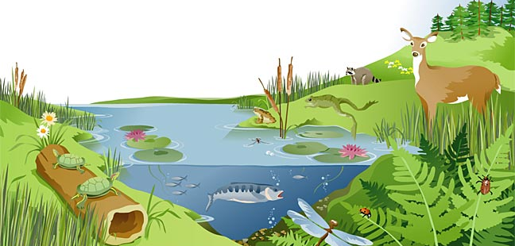

Preschool:
Ecosystems and the Food Chain
Ecosystems are important to human lives and provide what humans need.
US EPA
Region 10
EcoLearn
Notes:
Source: https://www.thinglink.com/scene/373893887053266944

Slide 2
Today you will learn…
Notes:
Source: http://cashmancuneo.net/pictures/fc/chain2.jpg
Today you will learn…. The importance of the food chain!

Slide 3
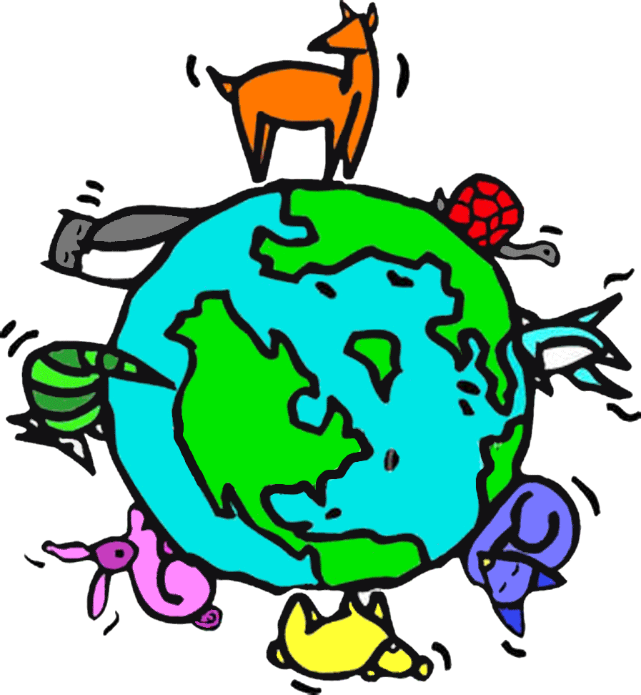
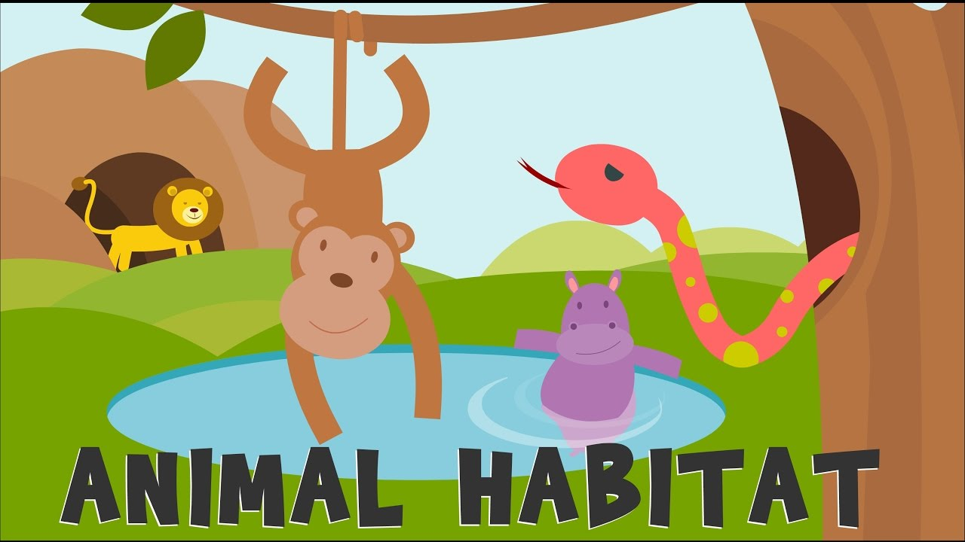


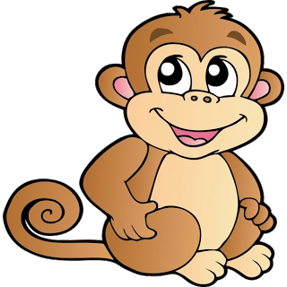
Keywords
Click for audio.
Notes:
Ecosystems: http://worldartsme.com/ecosystem-clipart.html#gal_post_33206_ecosystem-clipart-1.jpg
Key Words:
1) Ecosystem
2) Habitat
3) Living and Non-Living things
4) Food chain

Slide 4
Do Now
Click for audio.
Notes:
Source: http://www.sparklebox.co.uk/previews/10301-10325/_wp_generated/pp642c1a3c_02.jpg
Identify all of the animal cutouts on the table!

Slide 5
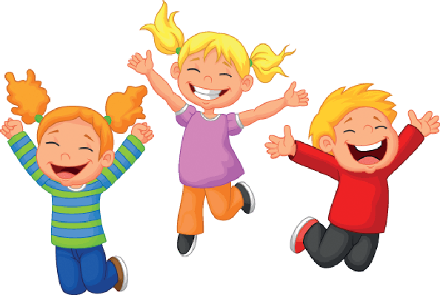

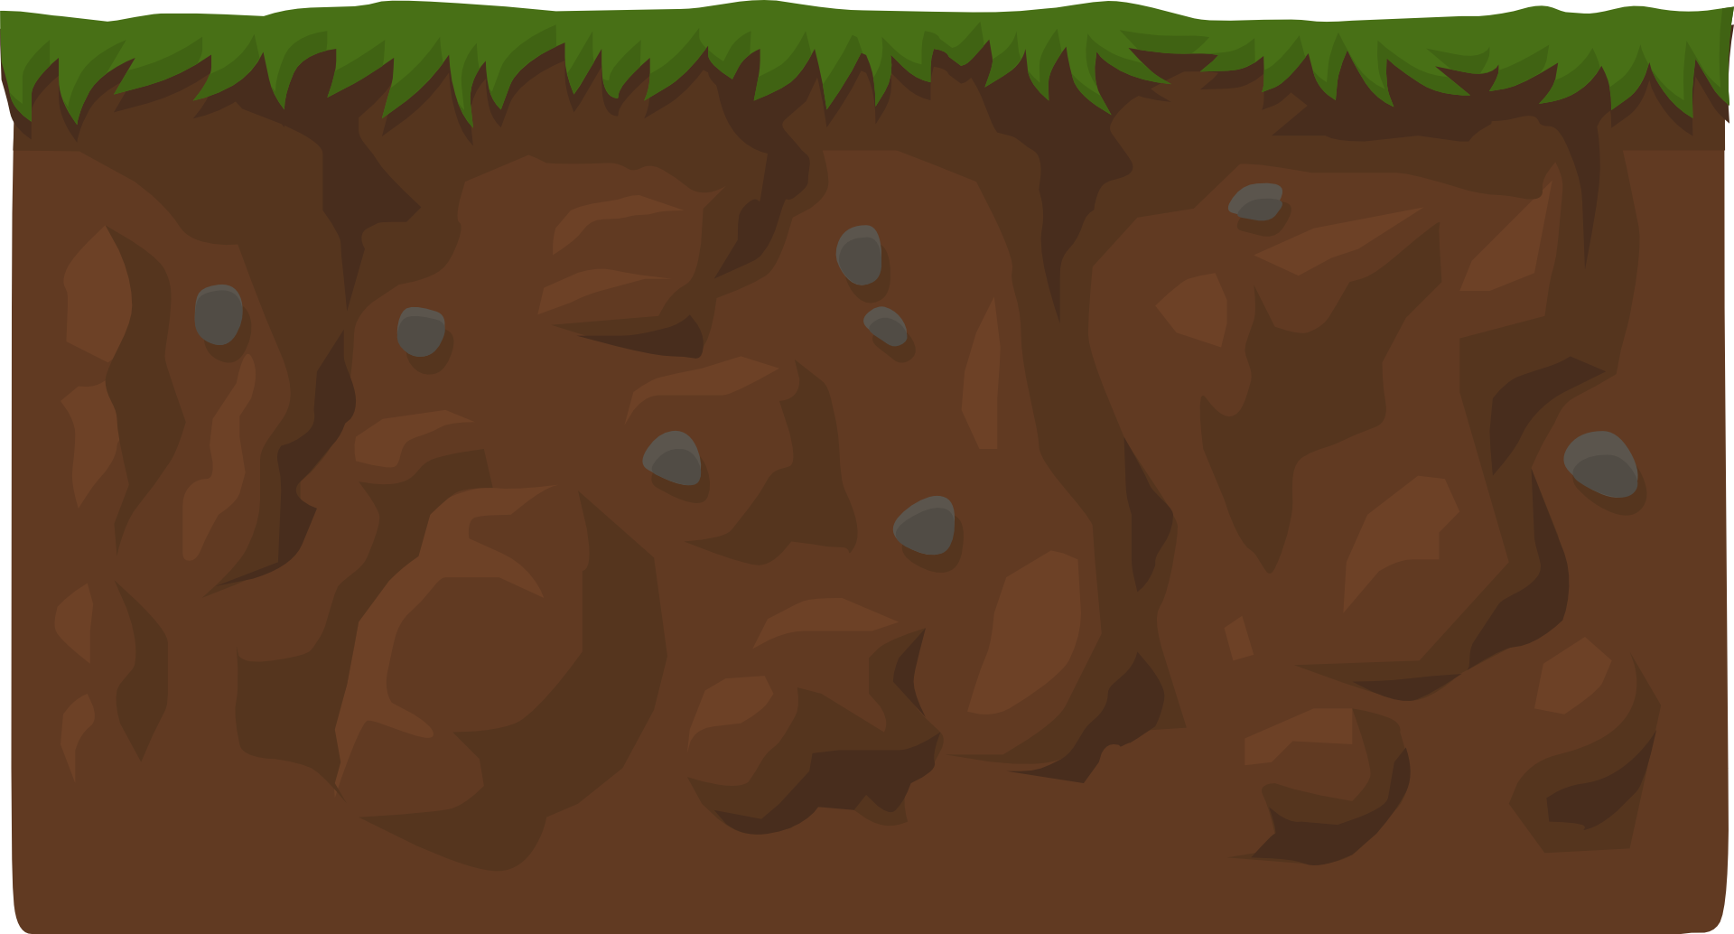
What is an ecosystem?
Notes:
Sources:
Plant - https://gallery.yopriceville.com/Free-Clipart-Pictures/Decorative-Elements-PNG/Green_Plant_Decoration_PNG_Clipart_Image
Giraffe - http://stjohnsweldonspring.org/wp-content/uploads/2015/06/Giraffe.png
Sun - https://gallery.yopriceville.com/Free-Clipart-Pictures/Sun-and-Moon-PNG/Sun_Clipart#.XAF4P6OZORs
Kids - https://www.pinterest.com/pin/142426406948402072/
An ecosystem includes all of the living things like plants, animals, and people in a given area. It also includes non-living things like weather, earth, water, sun, soil, and air. In an ecosystem, all of these living and non-living things interact with each other and depend on each other. For example, soil is not technically alive, but the plants rely on the soil to grow, and all life depends on the existence of plants. Another word for an ecosystem is a “habitat,” which is the natural environment in which something lives, including us! There are many kinds of ecosystems and habitats, all of which are unique. But today, we’ll focus on one major characteristic of all ecosystems: the food chain.

Slide 6
Food Chain
Click for audio.
Notes:
Source: https://userscontent2.emaze.com/images/166f4411-fd19-41be-9bbe-bfd2bb2c7ec4/4fd177fa-7b43-448d-a680-5893df50a833.jpg
Introduce the project: An important part of ecosystem is the food chain. Animals have to eat to survive, just like we do. The food chain shows us which animals eat what things inside their habitats. Provide an example: Let’s look at a lion, for example. The lion lives in the grasslands, which have flat, grassy spaces. In his ecosystem, the lion is at the top of the food chain, which means nothing eats him. But he eats the antelope, so the antelope is next down on the food chain. The antelope eats the grass, which makes the grass at the bottom of the food chain. Explain the project: I’m going to give each table an ecosystem, and I want you to paste your animals in their food chain order. The animals on your table are all numbered. The highest number is the highest animal on the food chain. The lower the number, the lower it is on the chain. Find the animal labeled with the number one and put that farthest to the left. Then build your numbers up and to the right. Give the kids about 10 minutes to complete this task with assistance.
This example: For example, look at the killer whale. The killer whale lives in the ocean which has open spaces. In his ecosystem, the killer whale is at the top of the food chain which means nothing eats them. But he can eat the blue whale or the leopard seal. Next on the food chain are animals like the leopard seal which eats penguins, the penguins eat the fish, the fish eat the krill, and krill eats algae which makes algae the bottom of the food chain.

Slide 7
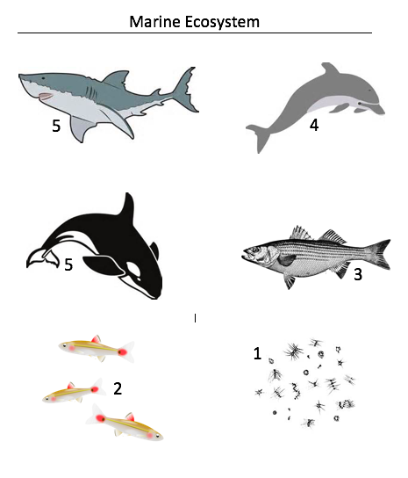
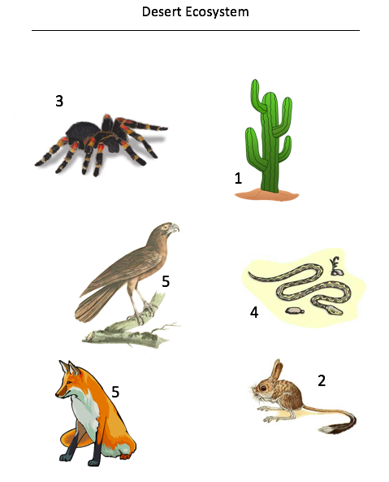
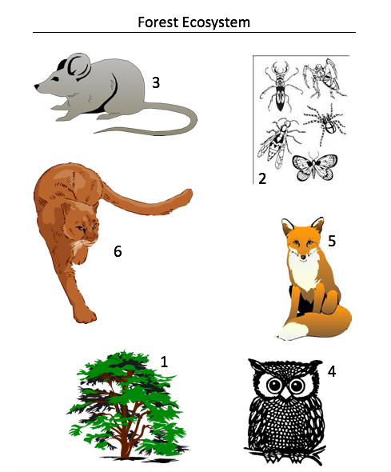
Food Chain Project
Click for audio.
Notes:
Instructions:
I’m going to give each table an ecosystem, and I want you to paste your animals in their food chain order.
The animals on your table are all numbered. The highest number is the highest animal on the food chain. The lower the number, the lower it is on the chain.
Find the animal labeled with the number one and put that farthest to the left. Then build your numbers up and to the right.

Slide 8
Review and Display…
Notes:
Source: http://proprofs-cdn.s3.amazonaws.com/images/QM/user_images/1452023/1430982767.jpg
Instructions: For each ecosystem, point to the animal at the top of the food chain and ask the students to identify it. Do this for all of the animals in all of the ecosystems. This repetition should allow students to better grasp the idea that animals all have specific ecosystems.
Next, take all strips off the board and tape them into a chain by creating a circle with one ecosystem. Then loop the next strip through the circle and tape that strip into a circle. Continue until you have a chain of all the ecosystems. The students can help with this.
Not only are all of the animals and plants inside an ecosystem important to one another, but all of the ecosystems are also important to one another, just like links in a chain. When our ecosystems are healthy, our animals are healthy, our plants are healthy, and we are healthy!

Slide 9
What do you think would happen if…
We took all the snakes out of the desert ecosystem?
Click for audio.
Notes:
Source; http://www.buzzle.com/articles/desert-ecosystem.html
The key lesson from the critical thinking task: Protecting the animals and their ecosystems is important because all animals play a role in helping other animals survive! As humans, we also rely on ecosystems for things like clean air and water, food, and materials.

Slide 10
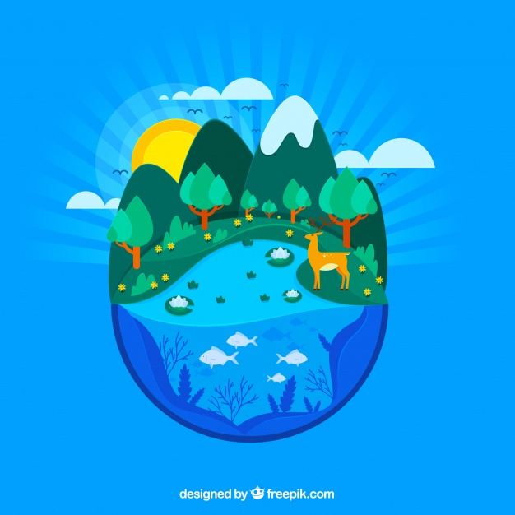
Closure
Click for audio.
Notes:
Ask Students:
What is an ecosystem?
Why are ecosystems important?
Which ecosystem does your favorite animal live in?
Source: https://www.freepik.com/free-vector/nature-and-ecosystem-concept_2739731.htm#term=ecosystem&page=1&position=19

Slide 11
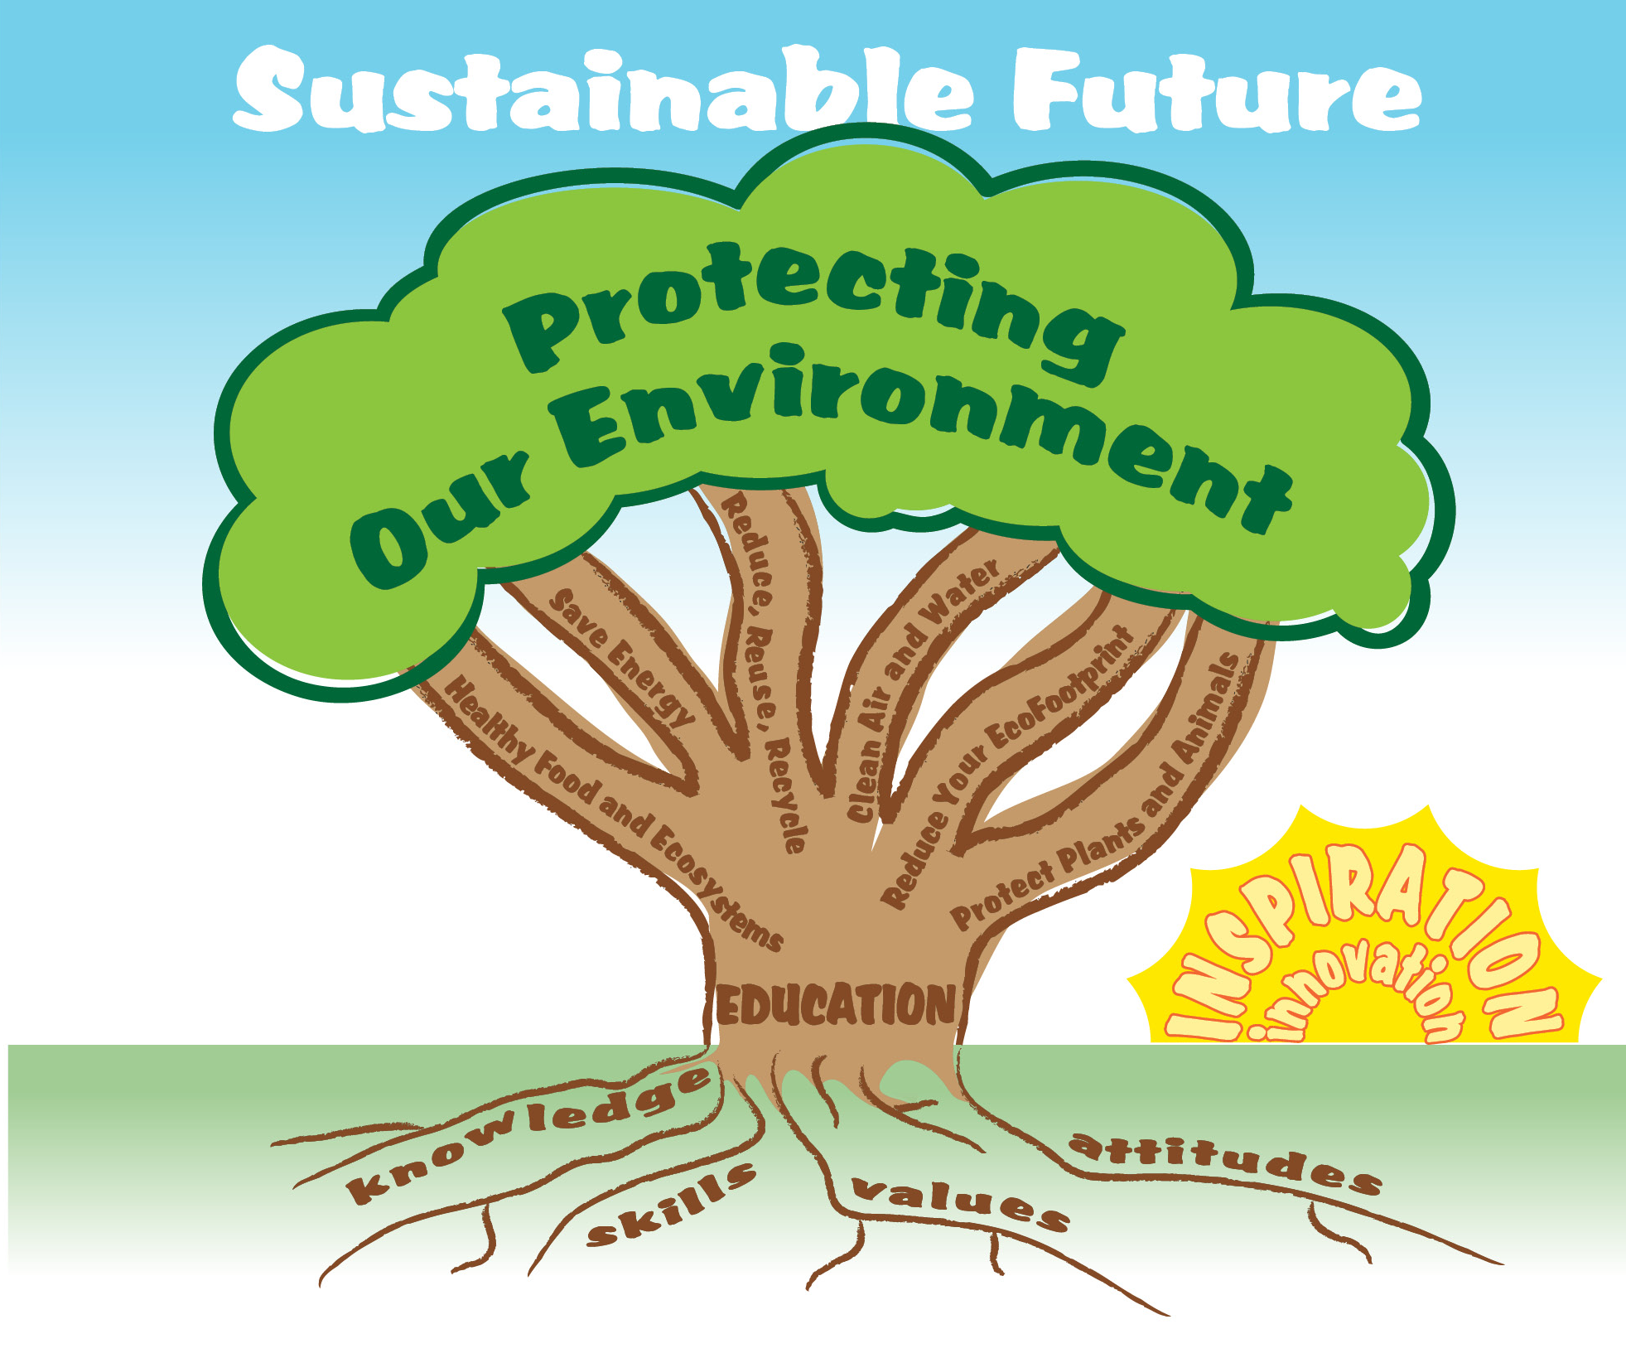
EcoLearn
For more information:
hanft.sally@epa.gov or
salazar.viccy@epa.gov
Developed by the Environmental Protection Agency
With support from Department of State
Virtual Students of Foreign Service Interns
https://www.epa.gov/education
US EPA
Region 10
EcoLearn

