Slide 1
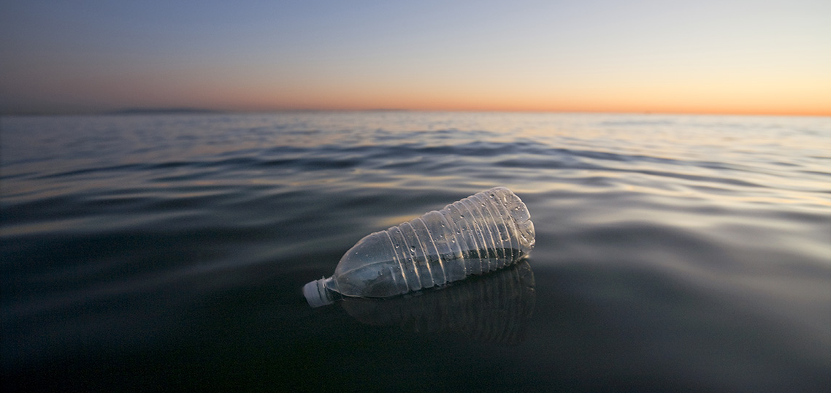

Kindergarten
Marine Debris
Learn what we can do to keep our oceans clean.
US EPA
Region 10
EcoLearn

Slide 2
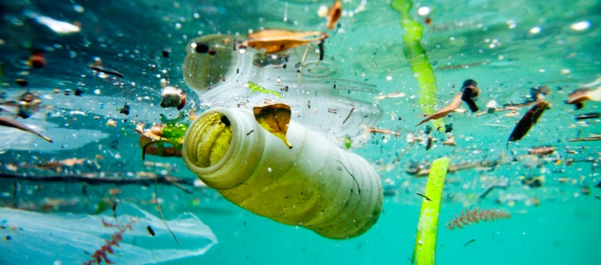
Today you will learn…
Notes:
Today, we will learn about aquatic trash, also called marine debris. Marine debris is any kind of trash that has made its way to the ocean, such as plastic bags, bottles, or other kinds of litter.
Source: http://www.infrastructurene.ws/2018/03/22/plastic-biggest-ocean-waste-offender-report/

Slide 3
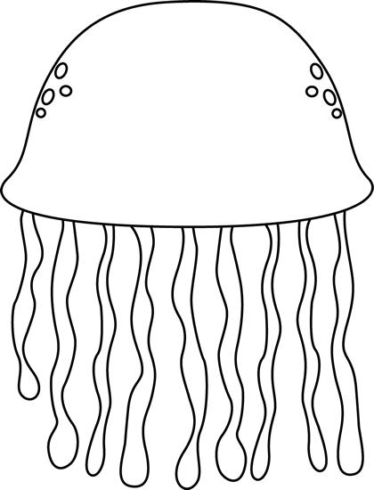



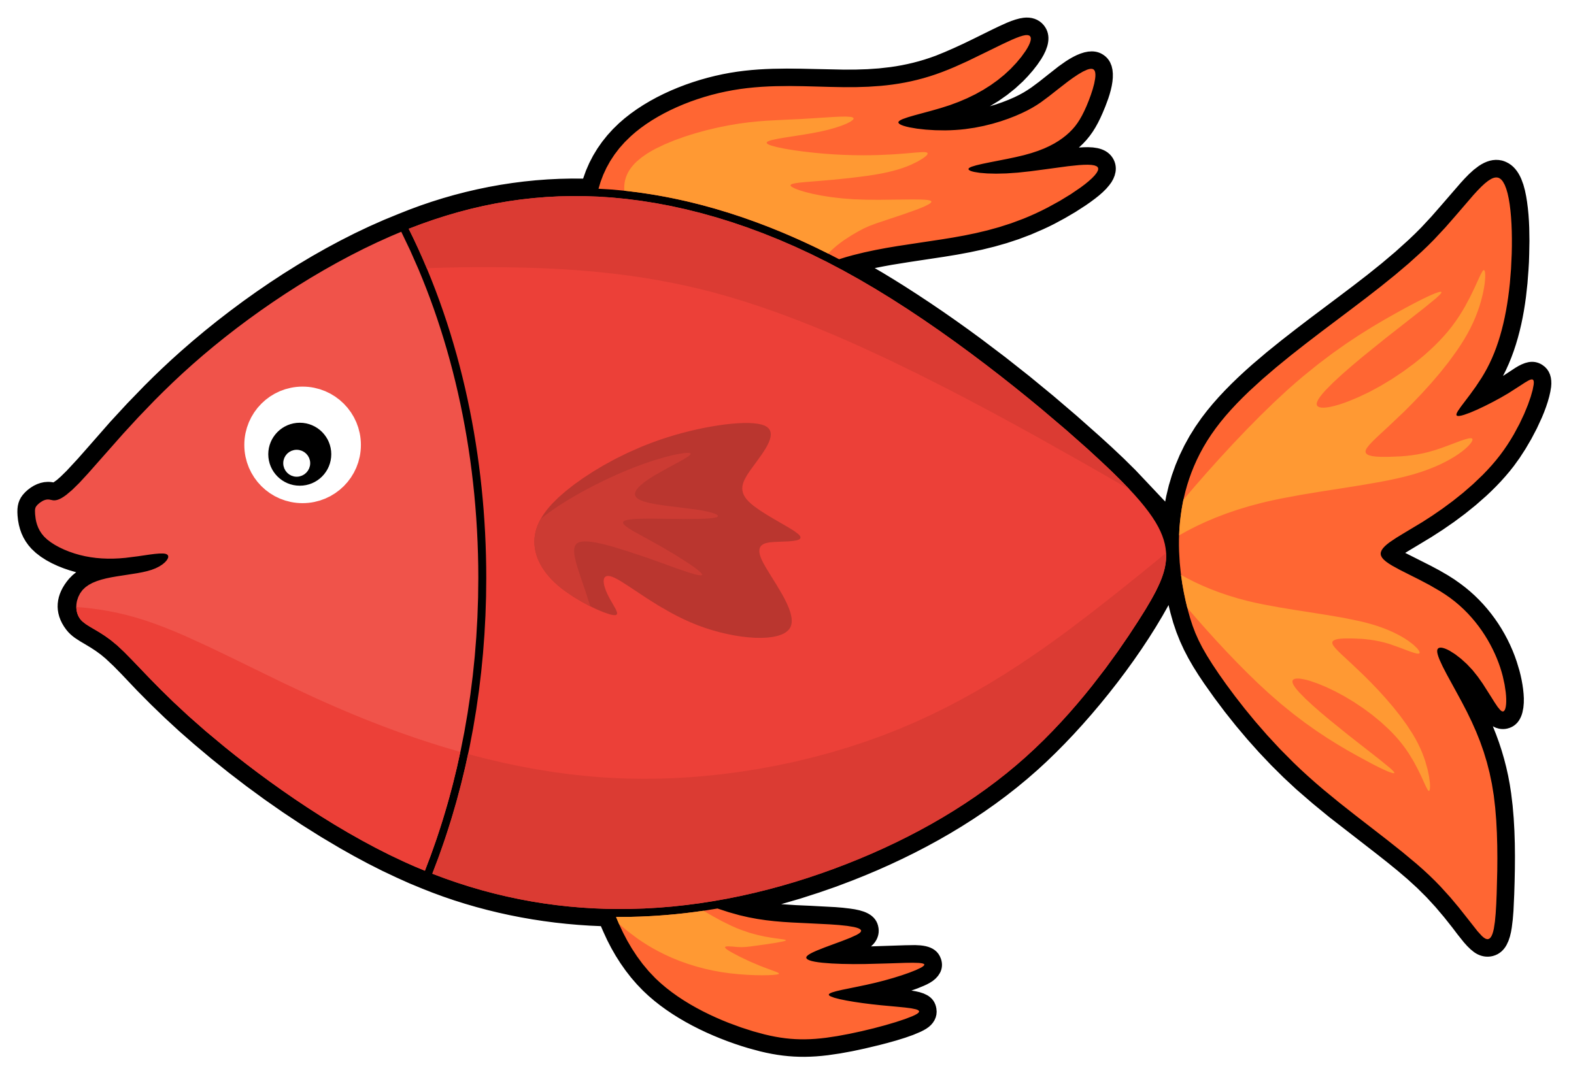
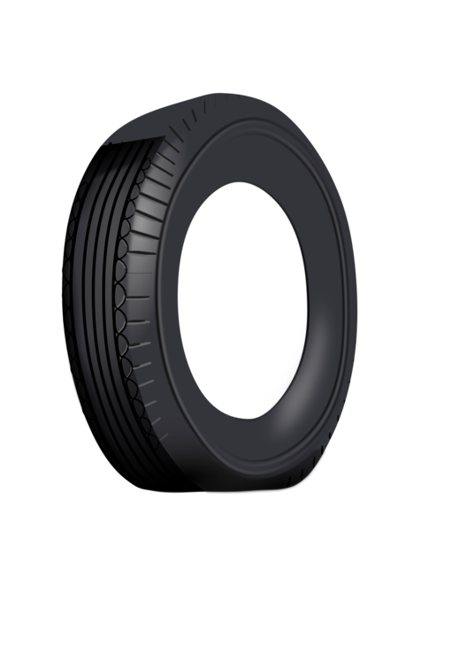
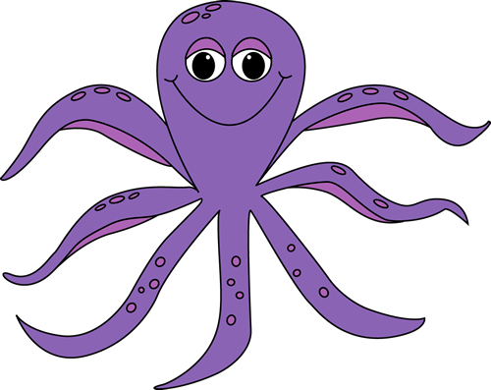


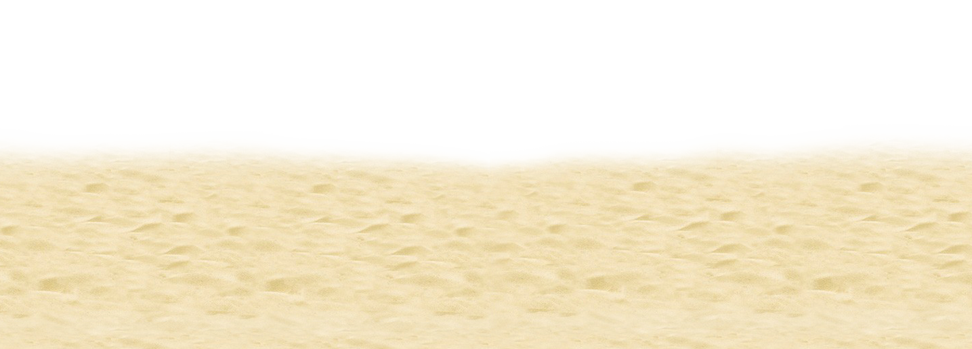
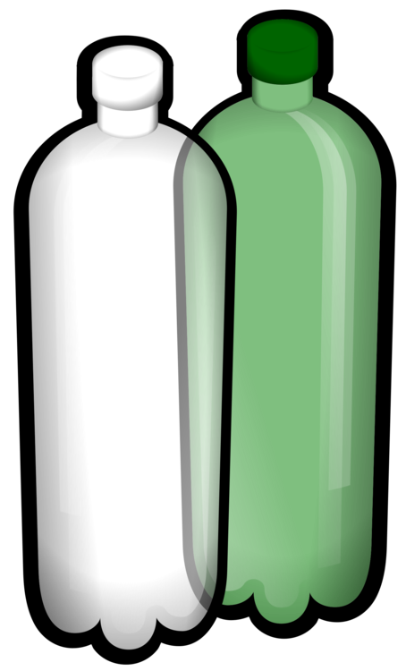

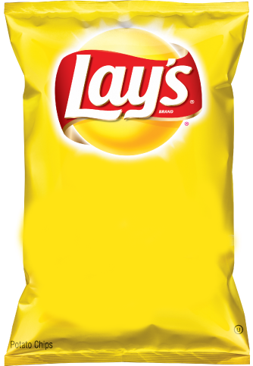
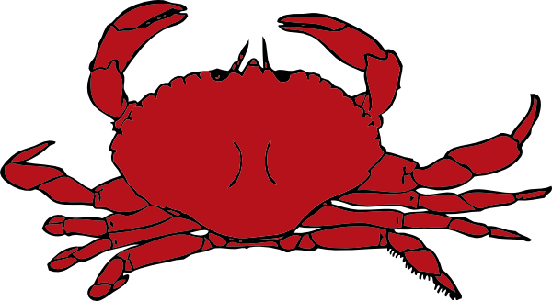
Notes:
DO NOW:
Can you tell me what belongs in the ocean? What lives in the ocean and what doesn’t? What grows in the ocean and what doesn’t? What in this picture doesn’t belong?
Fish: https://requestreduce.org/categories/images-of-fish-clipart.html
Octopus: https://www.mycutegraphics.com/graphics/letter/octopus.html
Starfish: https://clipartpng.com/?1439,starfish-png-clip-art
Shell: https://gallery.yopriceville.com/Free-Clipart-Pictures/Summer-Vacation-PNG/Sea_Shell_PNG_Clip_Art_Image
Crab: http://www.clipartpanda.com/categories/crab-clip-art-cartoon
Coral: http://worldartsme.com/coral-free-clipart.html#gal_post_52417_coral-free-clipart-1.jpg
Seaweed: http://clipart-library.com/seaweed-cliparts.html
Plastic Bottle: https://www.kisscc0.com/clipart/plastic-bag-fizzy-drinks-plastic-bottle-water-bott-3v81ct/
Plastic Bag: https://openclipart.org/detail/303136/plastic-shopping-bag
Tire: https://www.kisscc0.com/clipart/car-a-rubber-tire-download-duesi-tire-12zmst/
Fishing Net: https://clipart.wpblink.com/wallpaper-4864769
Jellyfish: https://www.pinterest.com/pin/119626933828969334/
Sand: http://clipart-library.com/beach-sand-cliparts.html

Slide 4
Notes:
DO NOW:
Answers.
Fish: https://requestreduce.org/categories/images-of-fish-clipart.html
Octopus: https://www.mycutegraphics.com/graphics/letter/octopus.html
Starfish: https://clipartpng.com/?1439,starfish-png-clip-art
Shell: https://gallery.yopriceville.com/Free-Clipart-Pictures/Summer-Vacation-PNG/Sea_Shell_PNG_Clip_Art_Image
Crab: http://www.clipartpanda.com/categories/crab-clip-art-cartoon
Coral: http://worldartsme.com/coral-free-clipart.html#gal_post_52417_coral-free-clipart-1.jpg
Seaweed: http://clipart-library.com/seaweed-cliparts.html
Plastic Bottle: https://www.kisscc0.com/clipart/plastic-bag-fizzy-drinks-plastic-bottle-water-bott-3v81ct/
Plastic Bag: https://openclipart.org/detail/303136/plastic-shopping-bag
Tire: https://www.kisscc0.com/clipart/car-a-rubber-tire-download-duesi-tire-12zmst/
Fishing Net: https://clipart.wpblink.com/wallpaper-4864769
Jellyfish: https://www.pinterest.com/pin/119626933828969334/
Sand: http://clipart-library.com/beach-sand-cliparts.html

Slide 5
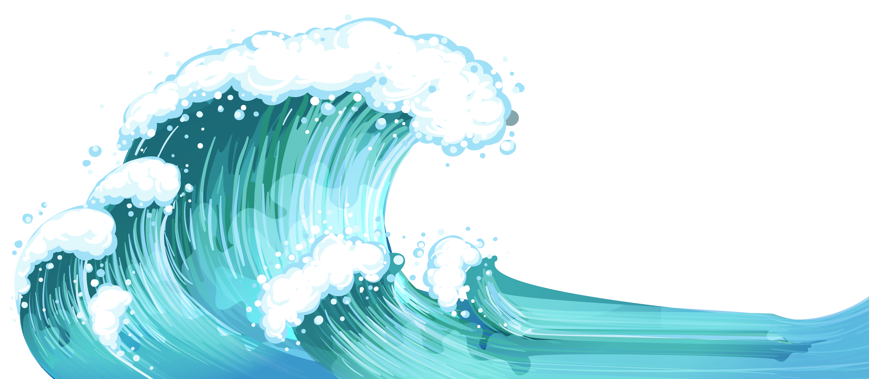

Discuss
Click for audio.
Notes:
Discussion Questions:
What is marine debris?
How does this impact our water and beaches?
Sources:
Ocean: http://clipart-library.com/waves-cliparts-transparent.html

Slide 6

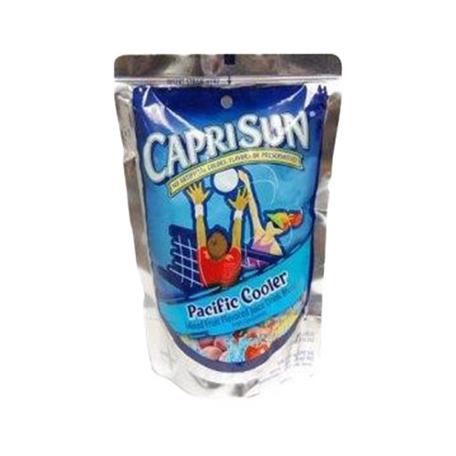
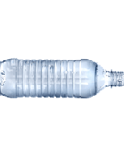
Discuss
Click for audio.
Notes:
Answer: Plastic and other garbage can enter our water ways and pollute our ocean!
Sources:
Ocean: http://clipart-library.com/waves-cliparts-transparent.html
https://etownpubliclibrary.org/event/wild-wednesday-copy-copy-copy/
http://pluspng.com/plastic-bottles-png-170.html
https://yocartdelivery.com/products/capri-sun-pacific-cooler-6oz

Slide 7
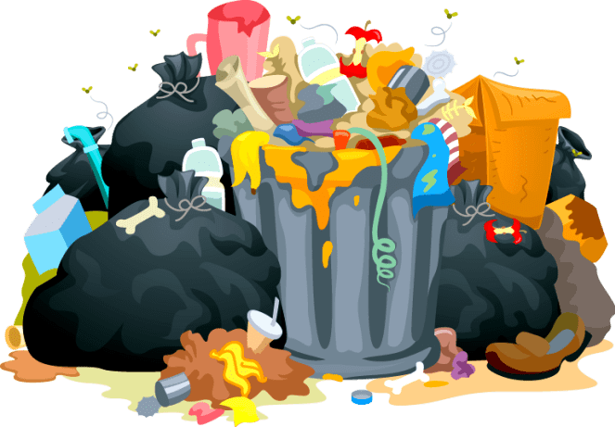
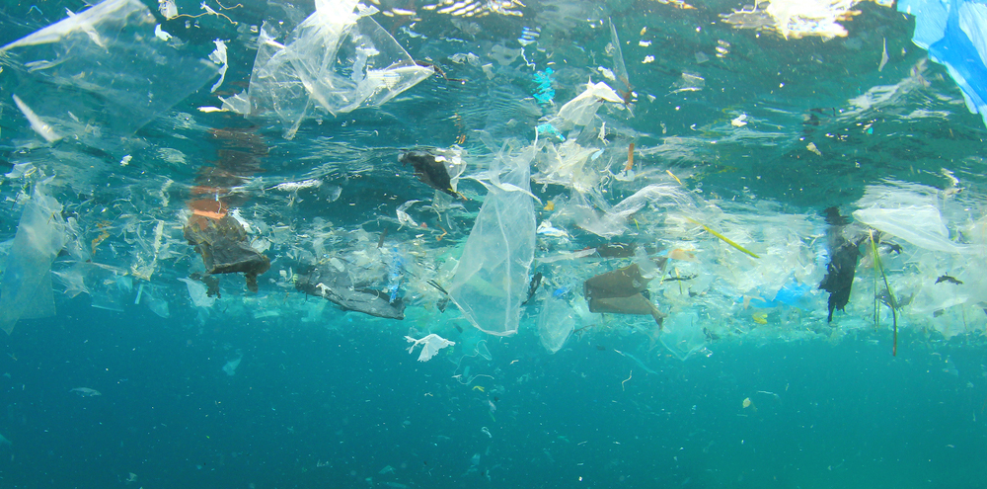

Keywords
Notes:
Waste
Trash in our water
Reduce
Reuse
Recycle
For today’s lesson, we will learn the following key words. Accumulate: to build up over time. Marine Debris: any piece of solid trash that enters the marine environment. Pollution: contamination to air, water, or soil by things that are harmful to living things. It can happen in nature, like by a volcanic eruption, or by humans, like smoke from factories.
Source: https://www2.padi.com/blog/2016/09/27/truth-about-great-pacific-garbage-patch/

Slide 8
The 4 R’s
R
R
R
R
Notes:
The 4 Rs: Today, we are going to learn about plastics, trash, and our big waste problem. Have you ever seen trash that isn’t in trash cans? Where? Trash can accidentally flow into our streams, rivers, and oceans, which upsets our animal friends. Soemtimes, trash can leak nasty chemicals into the soil. It’s important to follow the four Rs – refuse, reduce, reuse, and recycle – as much as we can.
Refuse means that you can choose not to use or buy something in the first place!
Reduce means using less stuff in general.
Reuse means trying to use something until it can’t be used any more.
Recylce means properly disposing of plastics, metals, and other recyclable materials so they can be made into other things.
8 million metric tons of garbage end up in the ocean every year. This is the same as a garbage truck dumping its trash into the ocean every minute of every day for a whole year! Almost all of this trash, 88%, is plastic. Plastics don’t break down, or biodegrade, like apples or other products, but instead break into tinier and tinier pieces that can stick around for thousands of years! Litter is ugly, can hurt animals, and costs people billions of dollars every year. Let’s play a game called “how long til it’s gone?”

Slide 9
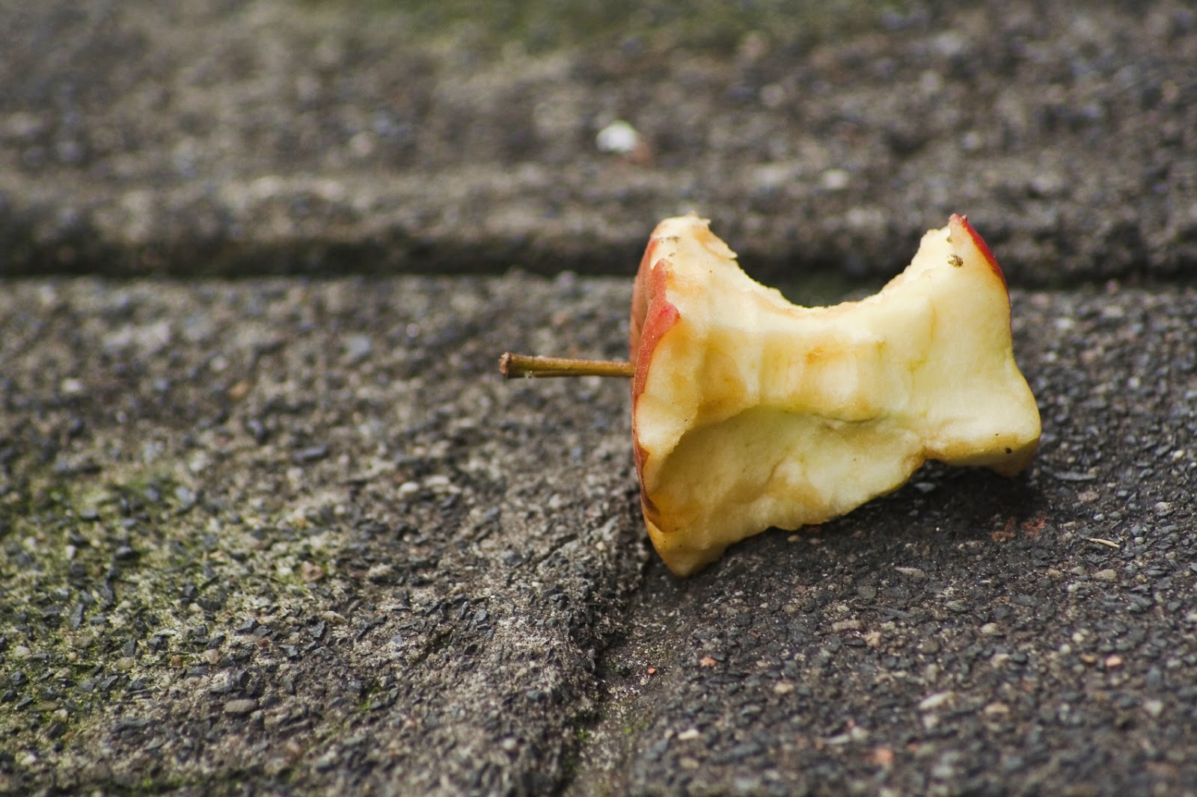
How long ‘til its gone?
Notes:
Today, we’re going to learn about plastics, trash, and our big waste problem. Have you seen trash that isn’t in trash cans? Where? Trash can accidentally flow into our streams, rivers, and oceans, which upsets our animal friends. Sometimes, trash can leak nasty chemicals into the soil. It’s important to Refuse, Reduce, Reuse and Recycle as much as we can.
“Refuse” means that you can choose not to use or buy something in the first place!
“Reduce” means using less stuff in general.
“Reuse” means trying to use something until it can’t be used any more.
“Recycle” means properly disposing of plastics, metals, and other recyclable materials so they can be made into other things.
Use PowerPoint.
8 million metric tons of garbage enter the world’s oceans each year. This is the equivalent to a garbage truck unloading its contents into the ocean every minute of every day for the entire year. 88% of this garbage entering the ocean is made up of plastic. Plastics are especially frightening because they do not biodegrade like apples and other products but instead break into smaller and smaller pieces persisting in the environment for thousands of years. Litter on land is ugly, harmful to animals and their habitats, and cost humans billions of dollars annually.
Let’s play a game called “how long ‘til it’s gone!” (On PowerPoint)
How long until an apple is gone? An apple is gone in 2 Months!

Slide 10

How long ‘til its gone?
Months
Notes:
How long until an apple is gone? An apple is gone in 2 Months!
Source: http://clipart-library.com/birthday-cliparts-number-2.html

Slide 11
How long ‘til its gone?
Notes:
How long ‘till a plastic bag breaks down? We think it takes about 20 years for a plastic bag to break down.

Slide 12
How long ‘til its gone?
0+
Years
Notes:
How long ‘till a plastic bag breaks down? It takes 20-1000 years for a plastic bag to break down.

Slide 13
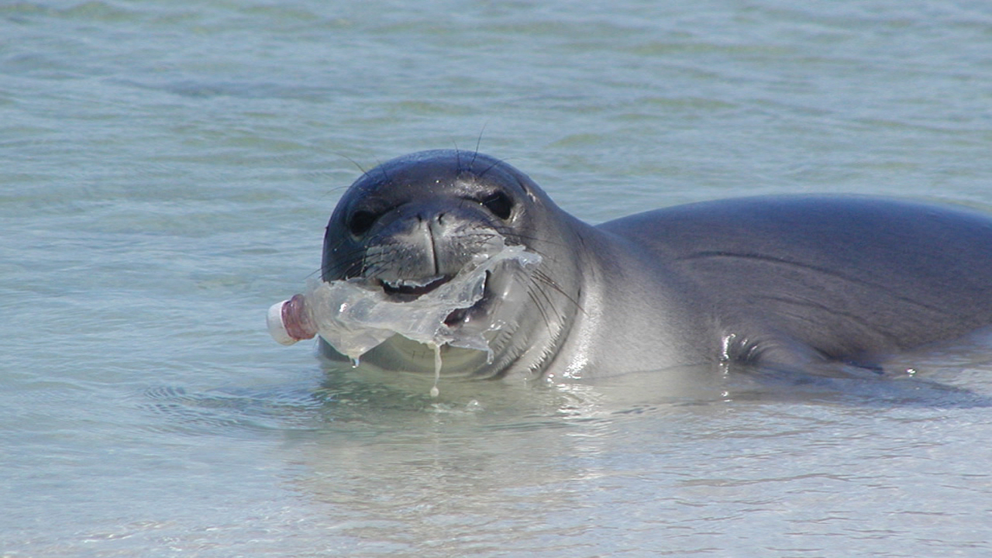
How long ‘til its gone?
Notes:
How long ‘till a plastic bottle is gone? It takes 450 years for a plastic bottle to break down!

Slide 14
How long ‘til its gone?
450
Years
Notes:
How long ‘till a plastic bottle is gone? It takes 450 years for a plastic bottle to break down!

Slide 15
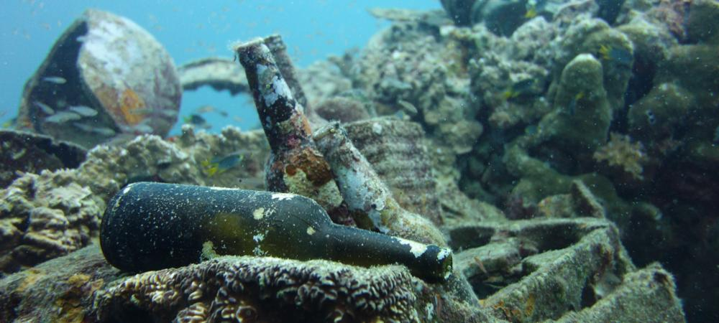
How long ‘til its gone?
Notes:
How long ‘till a glass bottle is gone? It takes one *million* years for a glass bottle to break down!

Slide 16
How long ‘til its gone?
1,000,000
Years
Notes:
How long ‘till a glass bottle is gone? It takes one *million* years for a glass bottle to break down!

Slide 17
What in this picture doesn’t belong?
Notes:
Lets play another game! This time around, show the preschoolers pictures of our waterways with items that don’t belong in the ocean. This will touch on the first lesson practiced, which was “what lives in the ocean.” Facilitate the “What in this picture doesn’t belong” activity. Pass out the worksheet with pictures of marine environments littered with trash and have them circle the marine debris aka “what doesn’t belong.” This activity is meant to reinforce some of the basic concepts learned in class. Kindergarteners should be able to identify what does and does not belong in the ocean, and pick out the foreign objects in the pictures. Once they have had time to circle the images that you passed out, go over the correct answers on the powerpoint slides.
What in this picture doesn’t belong? The plastic bag!
Source: https://washedashore.org/marine-debris/

Slide 18
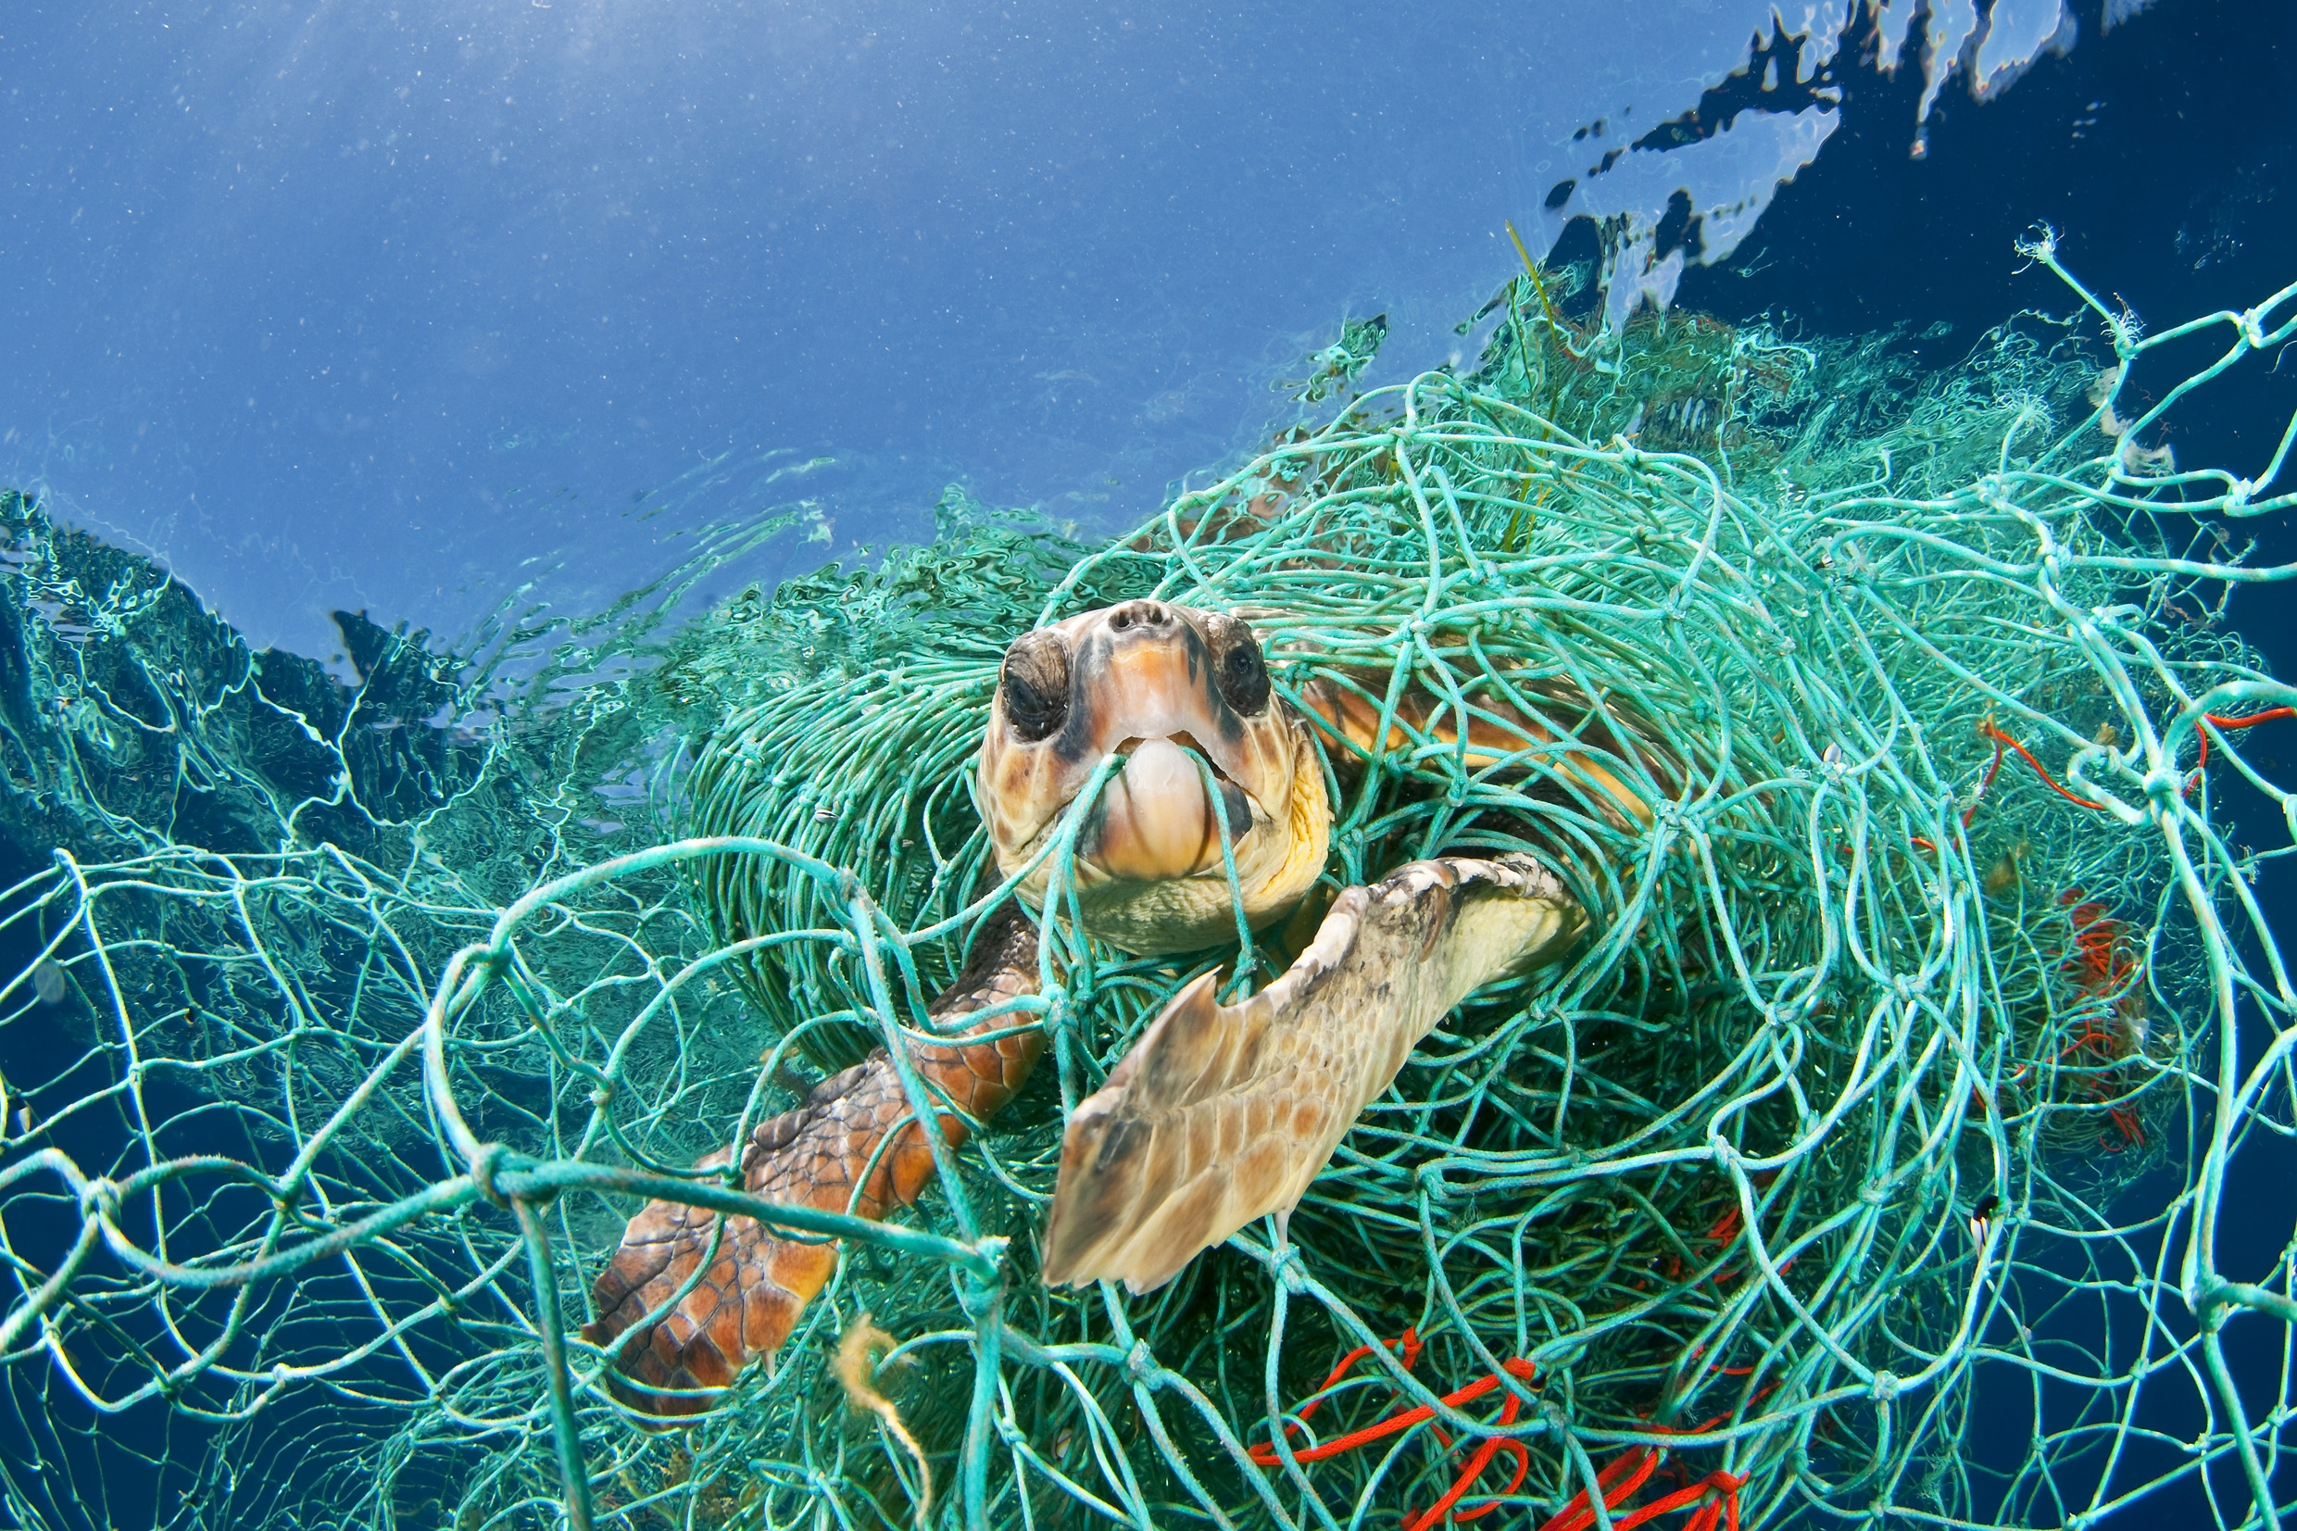
What in this picture doesn’t belong?
Notes:
What in this picture doesn’t belong?
Answer: The fishing net!
Source: https://us.whales.org/issues/man-made-marine-debris

Slide 19
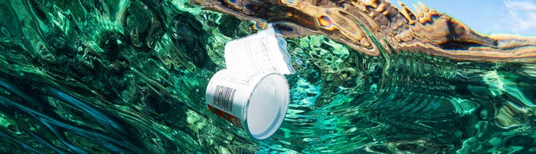
What in this picture doesn’t belong?
Notes:
What in this picture doesn’t belong?
Answer: The yogurt cup!
Source: https://www.pacificwhale.org/conservation/marine-debris/

Slide 20
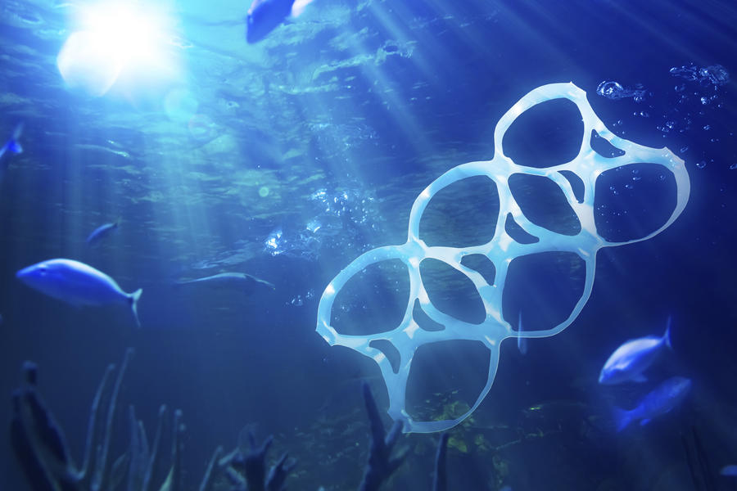
What in this picture doesn’t belong?
Notes:
What in this picture doesn’t belong?
Answer: Can holder!
https://www.packworld.com/article/sustainability/waste-reduction/chinese-plastics-associations-join-effort-reduce-marine

Slide 21
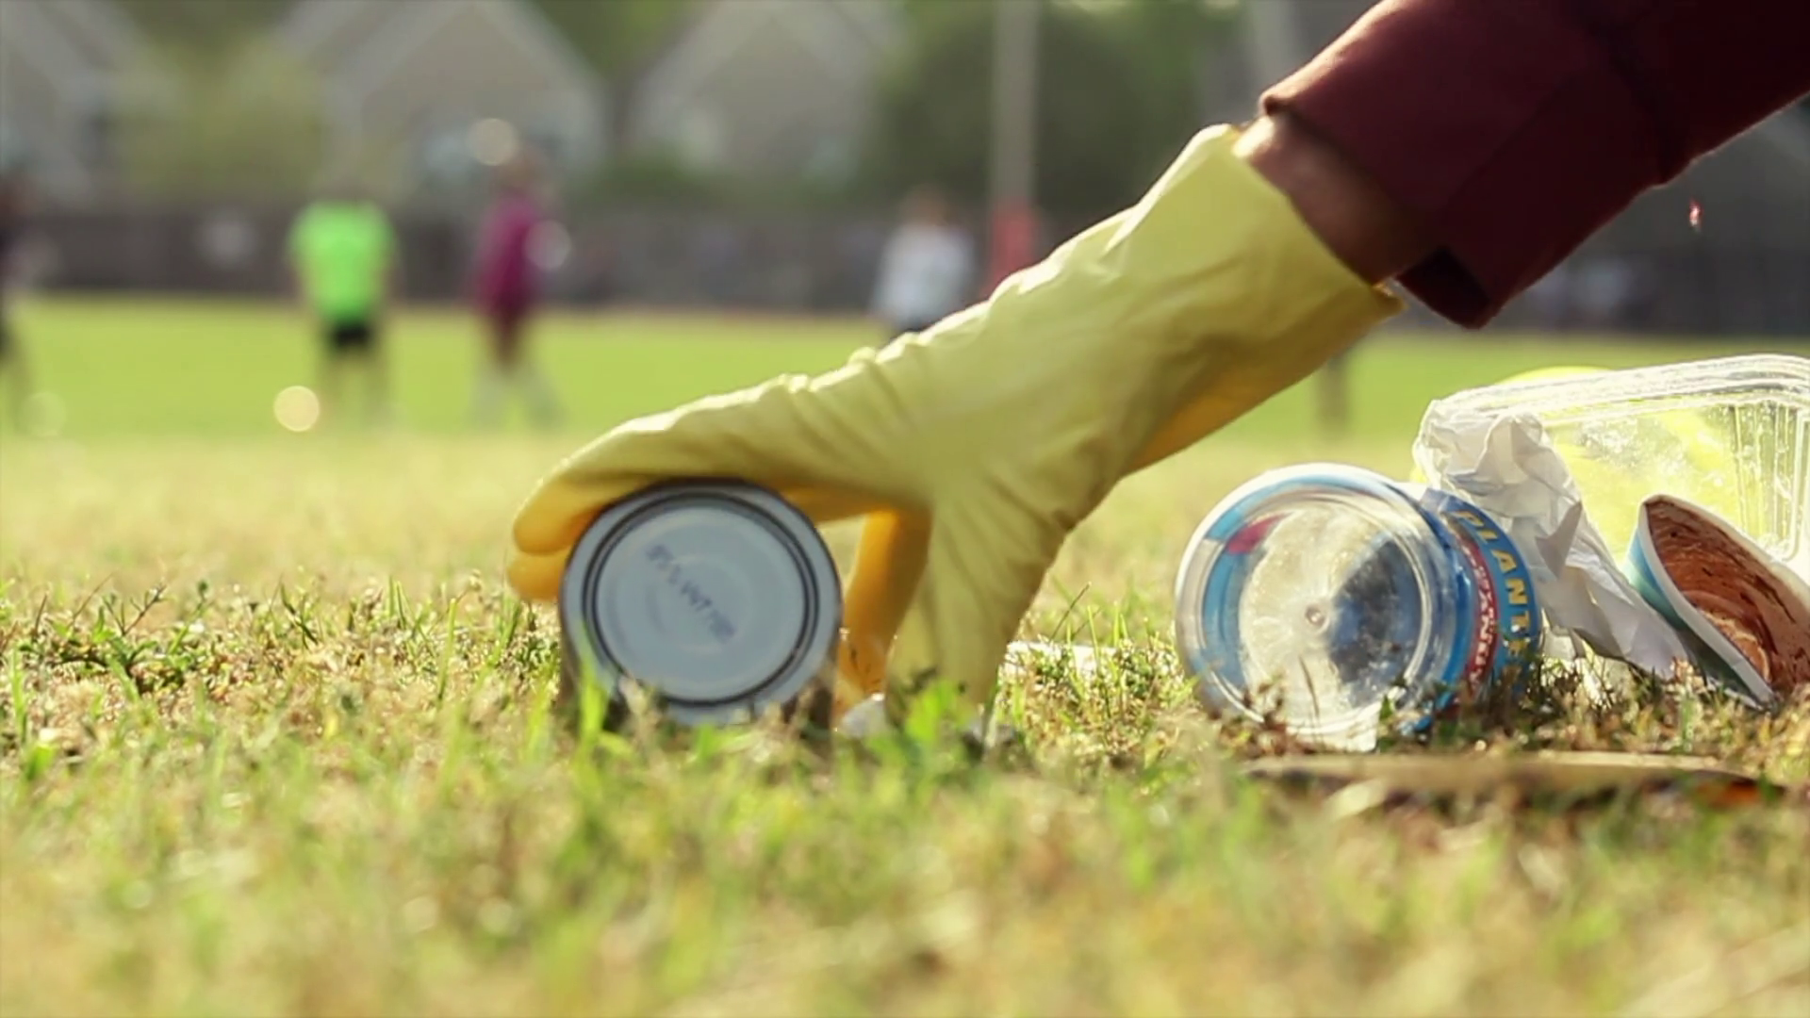
How Can we Help?
Notes:
How can we help? These issues may seem huge and scary, but there are things all of us can do to help keep our oceans clean and our animals safe. Let’s brainstorm ways we can help. Why is there trash in the water? Why does it keep happening? What are steps you can take at school or at home to help?
Consider the 4 R’s. Refuse, Reduce, Reuse Recycle.
Source: https://www.videoblocks.com/video/picking-up-trash-in-park-r7cd_w9nxix15ycz5

Slide 22
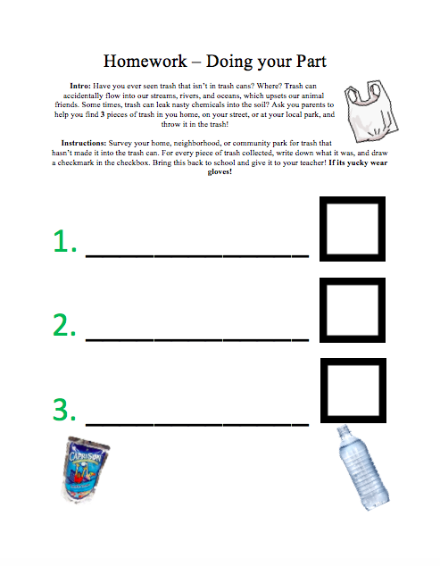
Homework

Slide 23
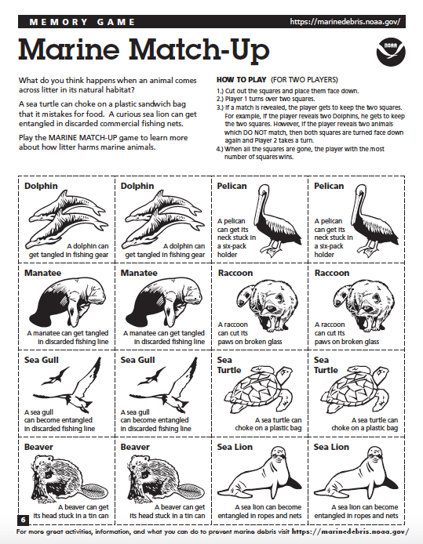
Marine Match Up
Notes:
If the students haven’t completely lost interest at this point, you can either facilitate this matching game, or give the kids copies to take home to do with their parents! Facilitate the Marine Match Up game. It is just a memorization matching game. The words underneath will go over the younger grades’ heads, so focus solely on the matching activity. The next few slides will have pictures of animals coming in contact with trash as suggested in activity.
HOW TO PLAY (FOR TWO PLAYERS)
1.) Cut out the squares and place them face down.
2.) Player 1 turns over two squares.
3.) If a match is revealed, the player gets to keep the two squares. For example, if the player reveals two Dolphins, he gets to keep the two squares. However, if the player reveals two animals which DO NOT match, then both squares are turned face down again and Player 2 takes a turn.
4.) When all the squares are gone, the player with the most number of squares wins.

Slide 24
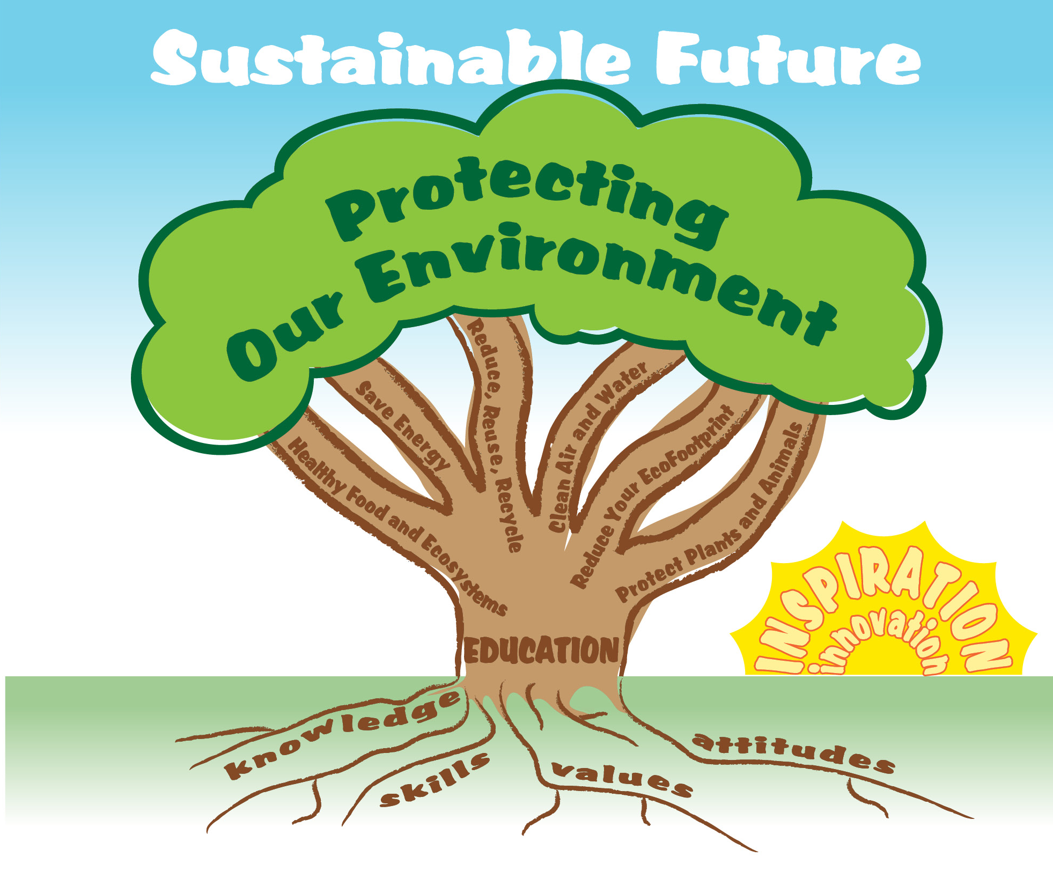
EcoLearn
Developed by the Environmental Protection Agency
With support from Department of State
Virtual Students of Federal Service Interns
https://www.epa.gov/education
US EPA
Region 10
EcoLearn
For more information: hanft.sally@epa.gov or salazar.viccy@epa.gov

