Slide 1
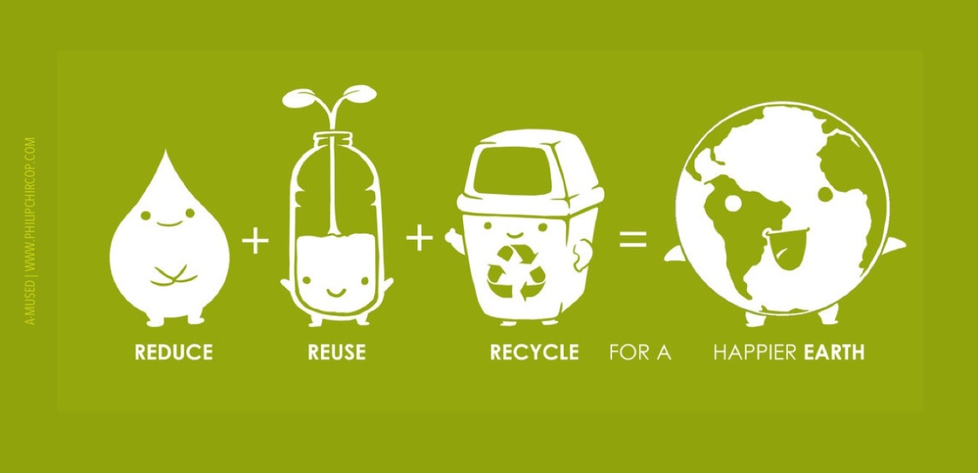


Waste
USA EPA,
Region 10
EcoLearn
1st Grade: Waste and the 4 R’s
Notes:
http://www.philipchircop.com/post/117077877097/reduce-reuse-recycle-today-the-22nd-of-april

Slide 2

Today:
Today you will…
Learn how you can help the Earth by remembering to the Four R’s: Reduce, Reuse, Recycle and Refuse!
Key Words:
Waste
Landfill
Reduce
Reuse
Recycle
Refuse

Slide 3
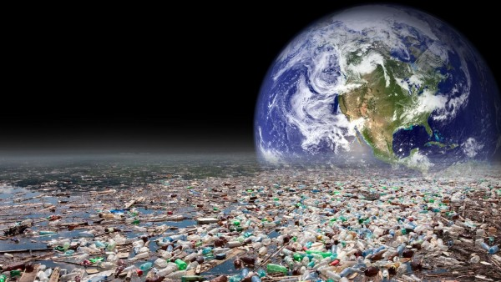
Understanding alternatives to producing landfill waste will encourage students to reduce their overall consumption and environmental footprint.
Notes:
http://www.ecologistnews.com/global-warming/plastic-waste-facts.html

Slide 4
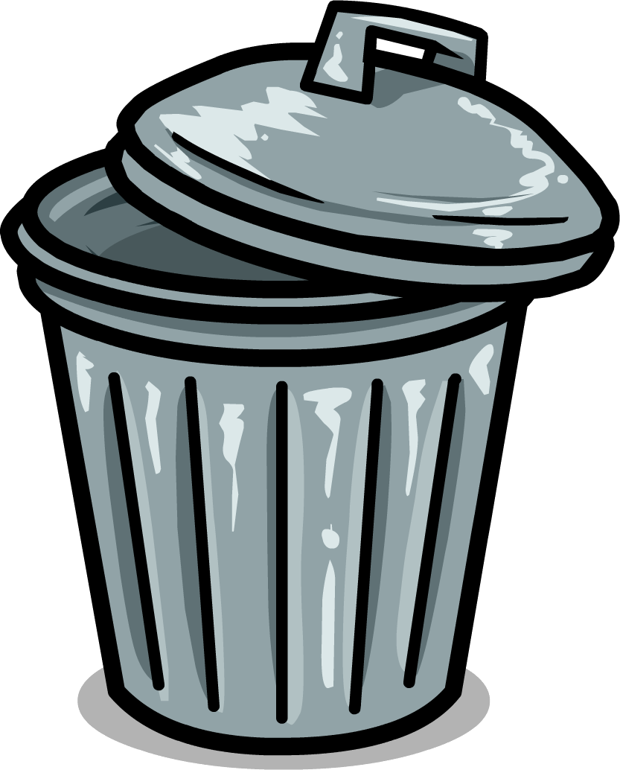
Opening Questions:
What does “waste” mean to you?
Waste is stuff that no one wants. It typically gets thrown in the trash, and then is taken to a landfill

Slide 5
The First “R”
REDUCE
To reduce something means to make it smaller.
Notes:
Visual representations can help make this point.
Different examples include:
A multi-pack of water bottles compared to a 1-gallon jug of water.
Snack packs of crackers compared to a whole box of crackers (not individually wrapped)

Slide 6
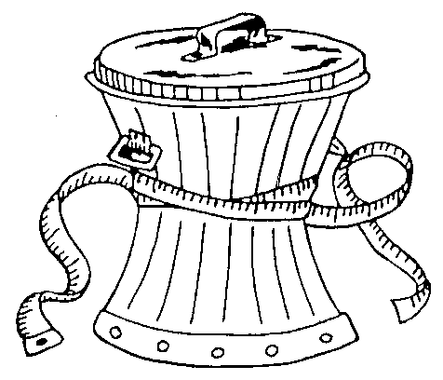
“How do I reduce waste if I…”
Drink a reusable water bottle instead of buying plastic water bottles?
Write on both sides of my paper instead of only one side?

Slide 7
The Second “R”
REUSE
Reusing means to use again.
Notes:
Show the students different items and ask them how each item can be reused for something else.
If possible bring these types of items to class for a visual presentation:
An empty can - Ex: Reuse as a pencil holder.
An empty water bottle - Ex: Reuse for other liquids including more water!
A shoe box - Ex: Reuse as a yarn organizer.
A glass bottle - Ex: Reuse as a flower vase.

Slide 8
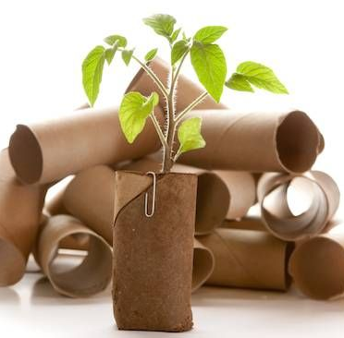
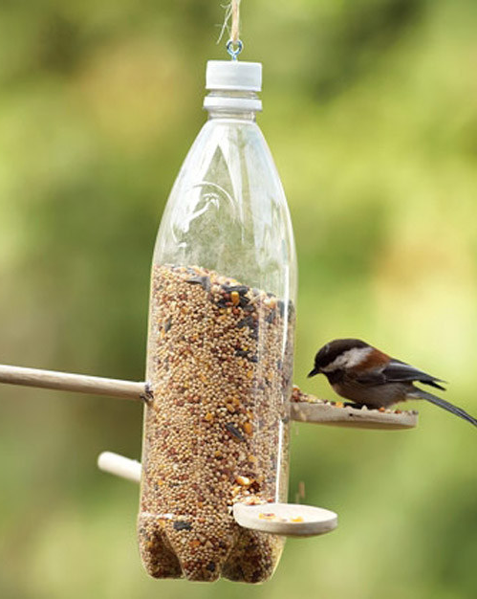
What kinds of things have you seen be reused? What do you reuse?
Notes:
Picture Sources: http://www.mnn.com/money/personal-finance/stories/50-ways-to-reuse-your-garbage

Slide 9
The Third “R”
RECYCLE
Recycling means making new things out of old things.

Slide 10
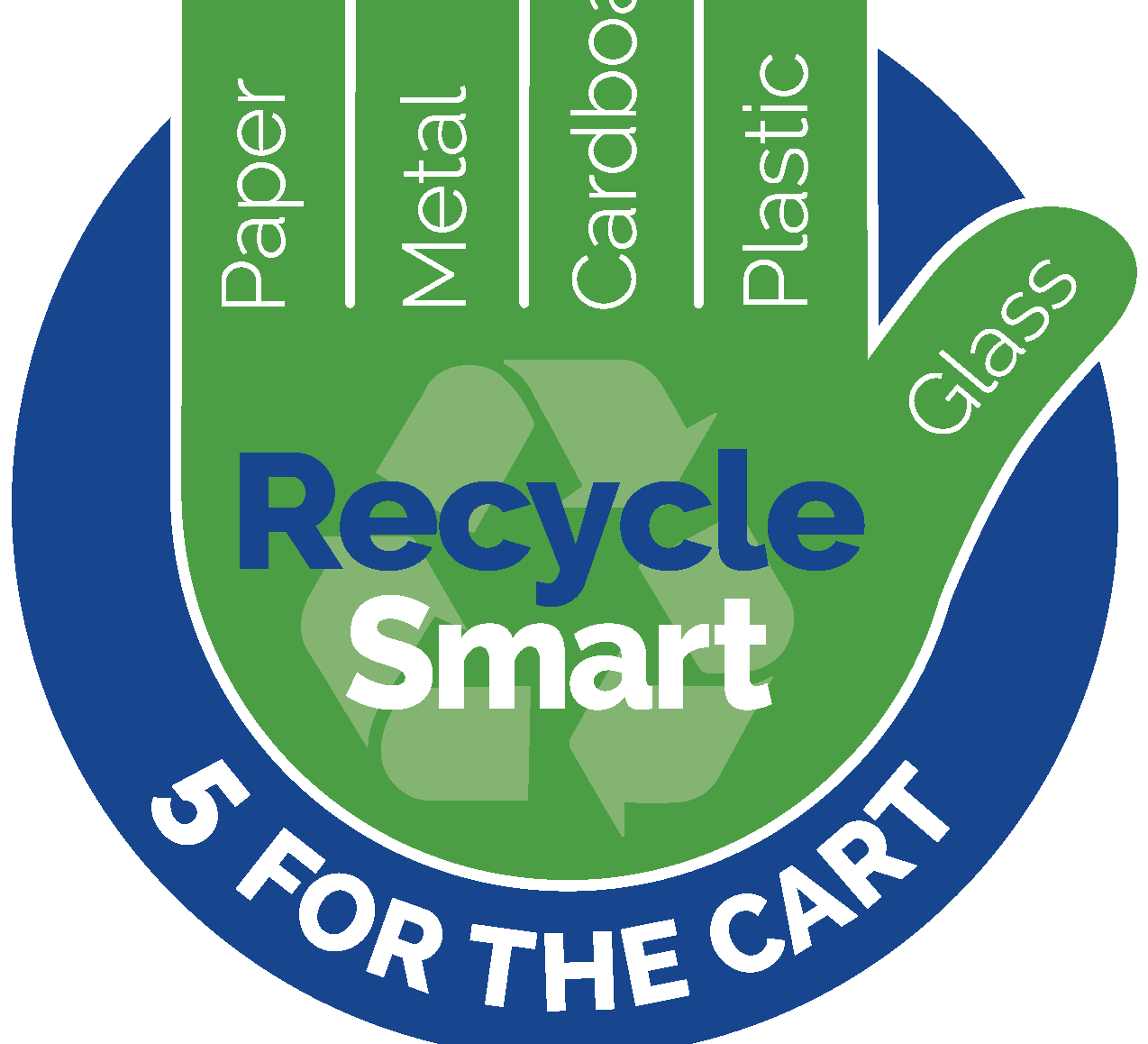
What do we know about recycling?
Notes:
http://www.leegov.com/solidwaste/residential/recycling

Slide 11
The Fourth “R”
REFUSE
To refuse something means to turn it away or not accept it.
Notes:
Pass around the 4-pound weight, 4-pound object, or 4-pound bag of trash (previously collected by the teacher) to the students. Have each student take a turn holding the weight so they know what 4 pounds feels like. This activity is most compelling if done with the bag of trash, which will make more of a difference to a student than simply holding a dense weight.

Slide 12
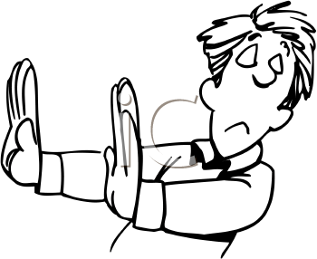
What kinds of things can we refuse?
Notes:
Picture Source: http://www.clipartpanda.com/categories/refuse-clipart

Slide 13


Slide 15

Write a Story about Waste!
This story can be about why waste is a problem, how waste can be reduced, how something can be reused, or anything else you can think of!

Slide 16
The 3 R’s Song – Jack Johnson

Slide 17
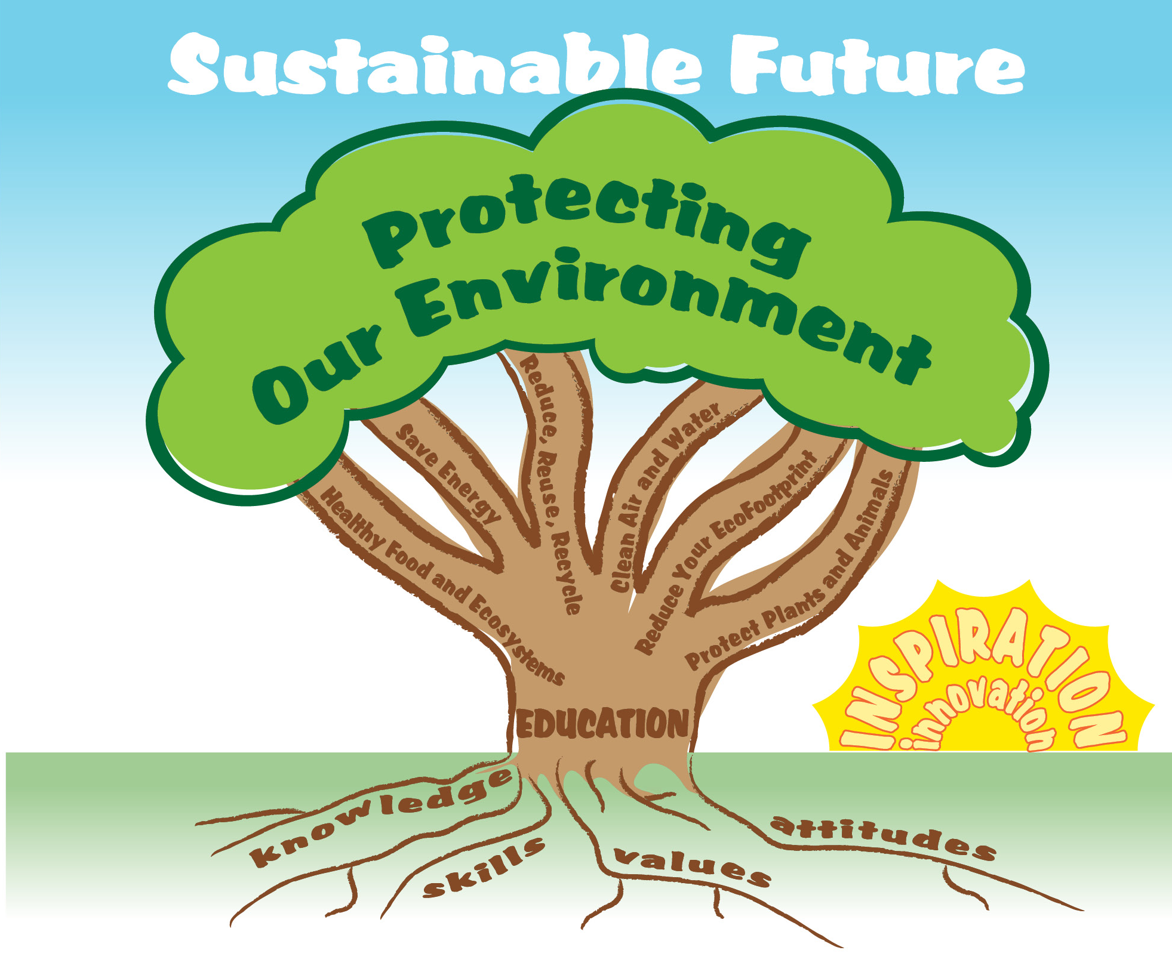

EcoLearn
Developed by the Environmental Protection Agency
With support from Department of State
Virtual Students of Foreign Service Interns
https://www.epa.gov/education
US EPA
Region 10
EcoLearn
For more information: hanft.sally@epa.gov or salazar.viccy@epa.gov

